Slide 1


PBIS School-Wide Team Training
Year 3
Trainers
Created from content from the National Technical Assistance Center on Positive Behavioral Interventions and Supports
U.S. Department of Education, Office of Special Education Programs and Office of Elementary and Secondary Education
with support from NEPBIS Network, May Institute, & Broad Reach Consulting

Slide 2
Coach Tasks
Review and share In Person Training Days with Team
Register for September Convening
Identify your Google drive
Complete the Team Communication Survey
Share PBIS Conference Information
Review and share Learning Opportunities with your entire school or district
Review Website https://sebacademy.edc.org/
Agenda
Academy 3 Year Structure
Meeting Dates and SEB Coach Trainers
Google Drive for Submitting Docs
Communication Survey
Other Learning Opportunities
PBIS Conference

Slide 3
2024-2025 SEB Academy PBIS Training Format
Years
01
02
03
Attendees
Team Training (Minimum):
        Administrator
        Grade-Level Representatives
        Support Staff
        Coaches
Coaches Training:
2-3 Coaches
  Technical Assistance:
  Administrator
  Coach
  Data Entry Staff
  Faculty/Staff
Support
5 – 1.5 hr. Monthly Coach Meetings (Virtual)
3 Full Day - Team Trainings (Years 1 & 2) (In Person)
2 Full Day - Team Trainings (Year 3) (In Person)
8 hours Individualized Technical Assistance per school
SWIS Data System & Training
Tiered Fidelity Inventory Evaluation in Spring
Notes:
Trainer note: Review support options for this year. Please let folks that future trainings will include a mixture of in person and online (hybrid) approaches (e.g., in person team trainings, but virtual coaches meetings). Regardless of support delivery, the categories of the support will be listed and developed based on DESE recommendations.

Slide 4
Cohort 9 Training Dates
If you can’t make one of your training dates and would like to attend with the other cohort, please let your trainer know and they will arrange for your invite to the other day.
Cohort 9A – Erik Maki & Chelsea Salvatore
Cohort 9B – Michelle Pratt & Christine Downs

Slide 5
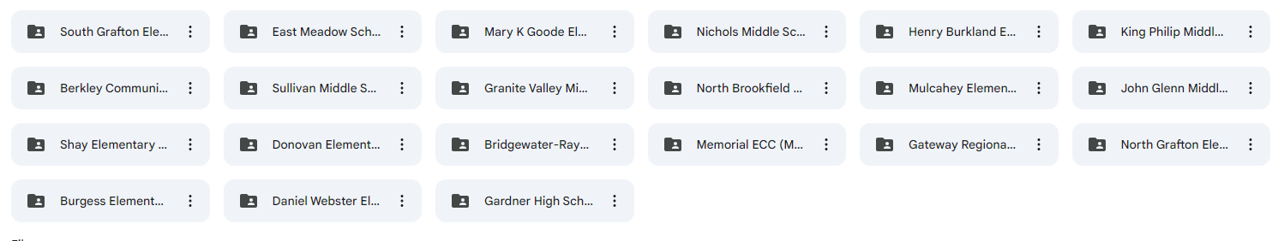
Google Drive – For Submitting Documents
All schools will be connected to their Google Folder.
Add documents here for review by your PBIS Trainer
Coaches will be linked to the school Google folder and can share with team

Slide 6
Cohort 9A Google Folders
Nichols MS - https://drive.google.com/drive/u/0/folders/1MecvAHzZMsaBzkl6zavACn21NTasjC2X
Berkland ES - https://drive.google.com/drive/u/0/folders/17WuSfGdwiaMX-gr9jN6jkUl9A9D-l4Rq
Memorial ECC - https://drive.google.com/drive/u/0/folders/1mBTD21oMO2KhPsrsF0-FCitKlu_sjuyh
Goode ES - https://drive.google.com/drive/u/0/folders/1b8rKfr1DNPvGA3hP1_UW4PDrrMBHslI_
Gardner HS – https://drive.google.com/drive/u/0/folders/1rhDaS70sLaB9tGXUOCPLe0QKZScSJnJT
John Glen MS - https://drive.google.com/drive/u/0/folders/1JzhMJVSgJX8YJaHiiRYrI9GT9458W-pX
Bridgewater-Raynham HS -https://drive.google.com/drive/u/0/folders/1EDLprCiebaGYHvRNU9Tn6nahLgynUGVk
Shay ES - https://drive.google.com/drive/u/0/folders/1svOPA5KiXY6SEh13CQttKf5IOKtHnM2r

Slide 7
Cohort 9B Google Folders
Daniel Webster- https://drive.google.com/drive/u/0/folders/1SSYC7btmjvYGULUXW7B4KyvlmUJSgKQ0
North Grafton - https://drive.google.com/drive/u/0/folders/1S0382zmqwPDWv3zy0mud0IZQ4fapGScn
South Grafton - https://drive.google.com/drive/u/0/folders/1vLX2lo5cstAx79VIRDnKjW4cAFurBse5
King Phillip -
https://drive.google.com/drive/u/0/folders/1xl3bbqH54xu7-z7YkOaKbIW4JUNCG9Nv
East Meadow - https://drive.google.com/drive/u/0/folders/1uw4RjcK1izwpflEI7ycXtdhAXa1segvX
Burgess - https://drive.google.com/drive/u/0/folders/1tPpdq2SUMJaJ722_9Gwv_PfMg01onwOX

Slide 8
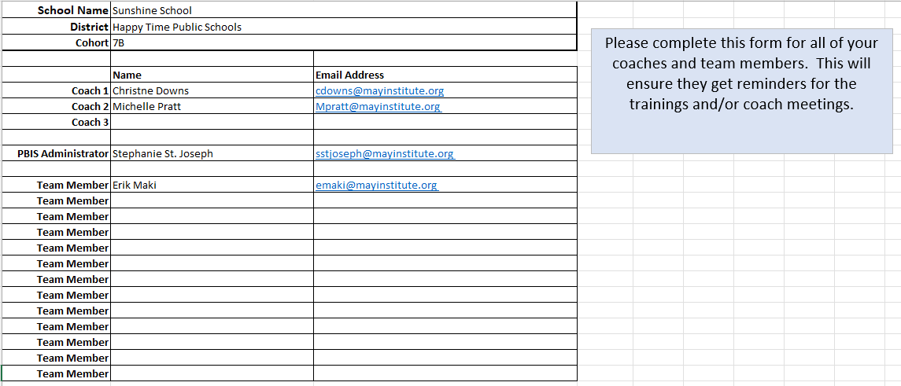
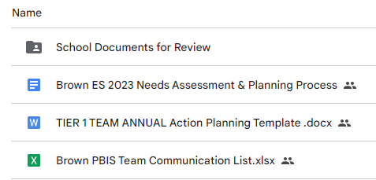
Communication Survey & Mail Chimp
Please add all your team’s contact information into the Communication Excel Sheet.
Move to School Documents for Review folder in your school’s Google Folder when completed
TEAM Communications List

Slide 9
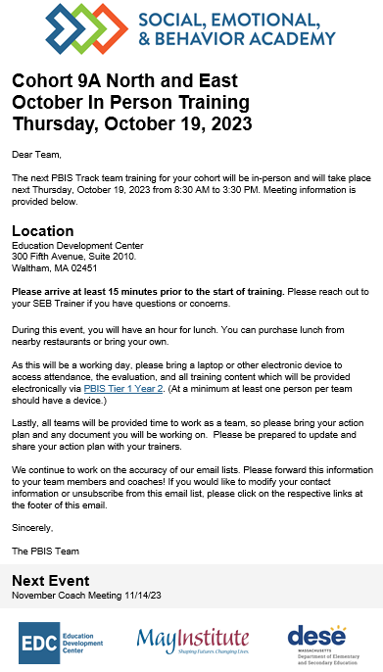
Communication Reminders
Email Reminders will be sent to all coaches, administrators and team members for our PBIS Events. The email will come from SEB Academy sebacademy@edc.org
Please review invitation for Date, Time, Location/Zoom Link, and any other important information included.
The next training or coach meeting will be displayed at the bottom
Share with other Coaches or Team Members

Slide 10
Year 3 Page SEBAcademy.edc.org

Slide 11
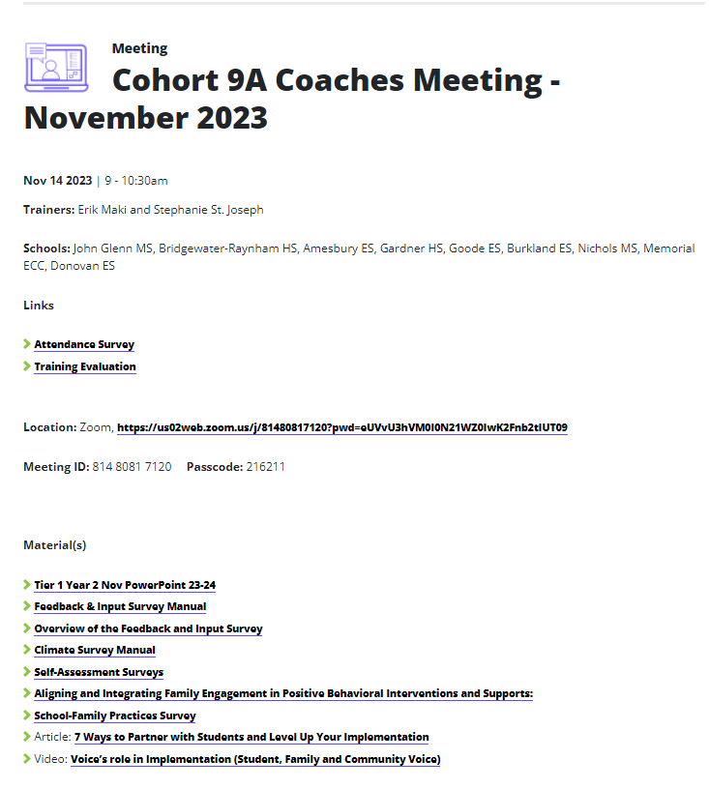
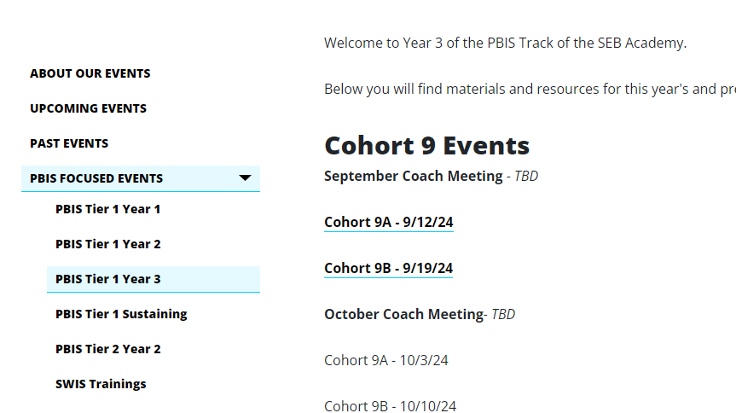
Training Pages
Trainers and Teams
Attendance and Evaluation Links
Zoom Link
Under Construction
Materials/Resources

Slide 12

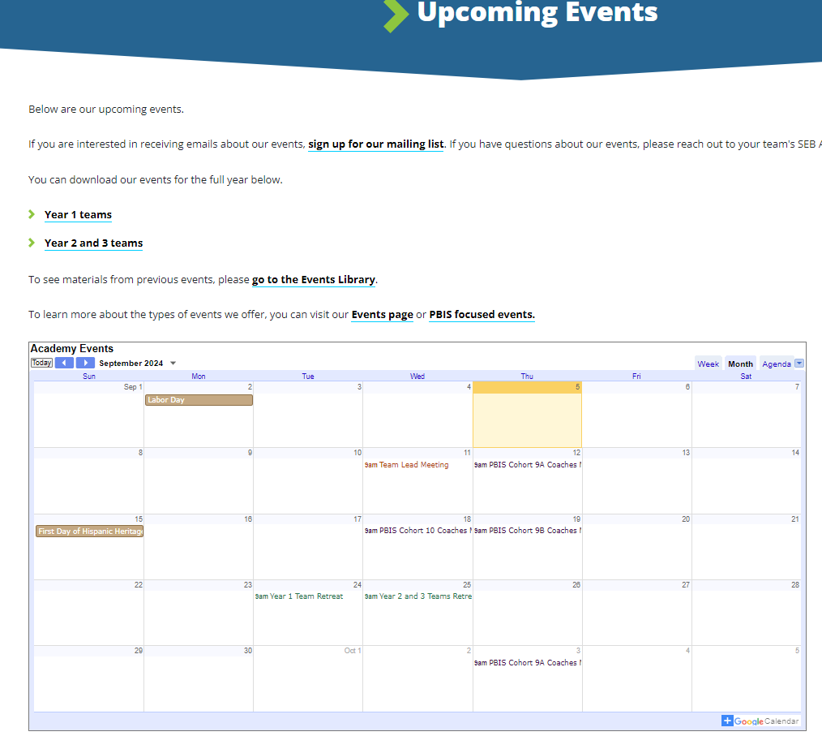
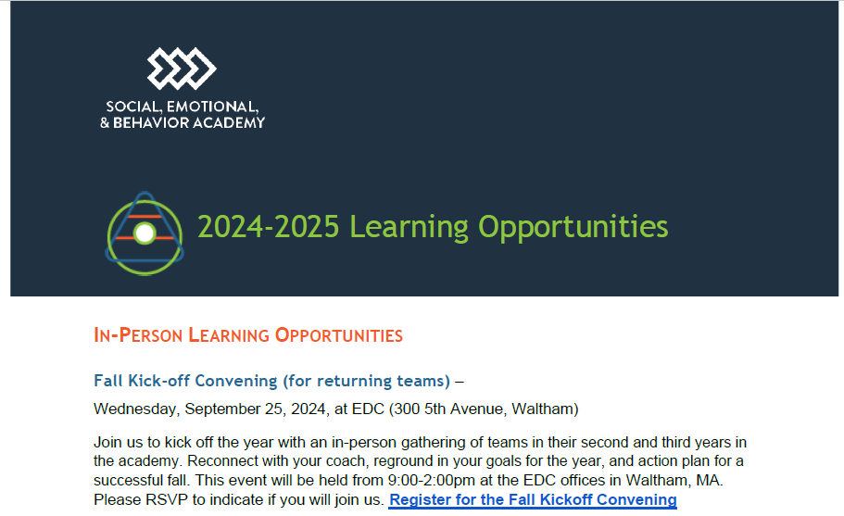
Other Upcoming Events
https://sebacademy.edc.org/upcoming-events
Notes:
https://sebacademy.edc.org/upcoming-events
Put the 24-25 Learning opportunities doc in the Chat or send by email. All of the PBIS dates for the cohort plus extra learning opportunities are in that doc.

Slide 13
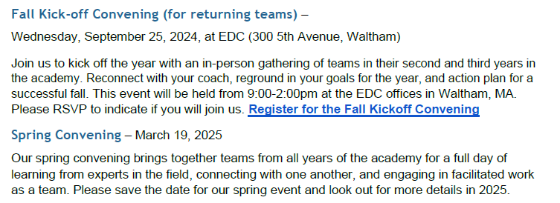
In Person Convening - Sept 25
Fall Kick Off Convening Registration
https://docs.google.com/forms/d/e/1FAIpQLSfDfUYTSujO9rFbKaWVWz1hfHGOkcxmJDLDiJSit1g324y7HQ/viewform

Slide 14
VIRTUAL LEARNING OPPORTUNITIES
Virtual Workshops
Below is a list of dates and topics for our 2024-2025 virtual workshops.
Virtual workshops are open to any educator in your school or district.
Please share these dates with anyone who might be interested in attending.
More information about our virtual workshops can be found on our About Our Events page.
+ Surveys and Screeners to inform MTSS for SEB - Tuesday, October 8 from 9:30-11:00 AM
+ MTSS Through an Equity Lens - Tuesday, October 15 from 9:30-11:00 AM
+ Supporting Educator Wellbeing - Tuesday, October 22 from 9:30-11:00 AM
+ Centering Belonging - Tuesday, October 29 from 9:30-11:00 AM
+ Strengthening Family-School Partnerships - Tuesday, November 19 from 9:30-11:00 AM
+ Integrating SEL and Mental Health Supports - Wednesday, December 4 from 9:30-11:00 AM
+ Setting Positive Behavior Norms & Expectations - Wednesday, January 22 from 9:30-11:00 AM
+ Equitable Data Use in MTSS for SEB - Tuesday, January 28 from 9:30-11:00 AM
+ Sustainability: Going from Good to Great - Wednesday, February 12 from 9:30-11:00 AM

Slide 15
VIRTUAL LEARNING OPPORTUNITIES
Peer Sharing Call Series
Peer sharing calls bring together members of the academy around a shared topic area or goal for three sessions of facilitated conversation around successes and challenges. These calls are facilitated by members of the SEB Academy team and may contain short presentations of content related to the topic area of focus. Peer sharing calls are open to any educator in your school or district. Winter sessions will run in December, January, and February, and Spring sessions will run in March, April, and May. Please share these dates with anyone who might be interested in attending. More information about our peer sharing calls can be found on our About Our Events page.
+ Supporting Adult Belonging - Winter
+ Creating Strong Relationships and Community with Tier 1 Supports - Winter
+ Effective Data Use in MTSS for SEB - Winter
+ Supporting Students of Immigrant and Refugee Origins - Winter
+ Enhancing the Identification, Matching, & Monitoring Process for Advanced Tiers - Winter
+ Supporting LGBTQIA+ Students - Spring
+ Sustaining Progress - Spring
+ Strengthening Family-School Partnerships - Spring
+ Supporting ELL Students - Spring
+ Increasing Buy-In Through Strategic Communication - Spring

Slide 16
School Technical Assistance
Each school gets 8 hours of Technical Assistance (TA)
Possible Uses
  Prep for Meetings
  Team meeting Support
  Staff Presentations
  Data Analysis
  Deeper Team Training
  Parent Presentations
  Coach Support
  SWIS Support
Teams will also have access to other SEB coaches to help on topics such as:
Equity
Mental Health
SEL
Belonging

Slide 17
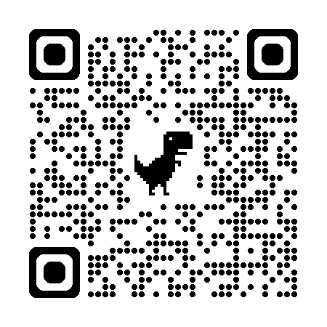
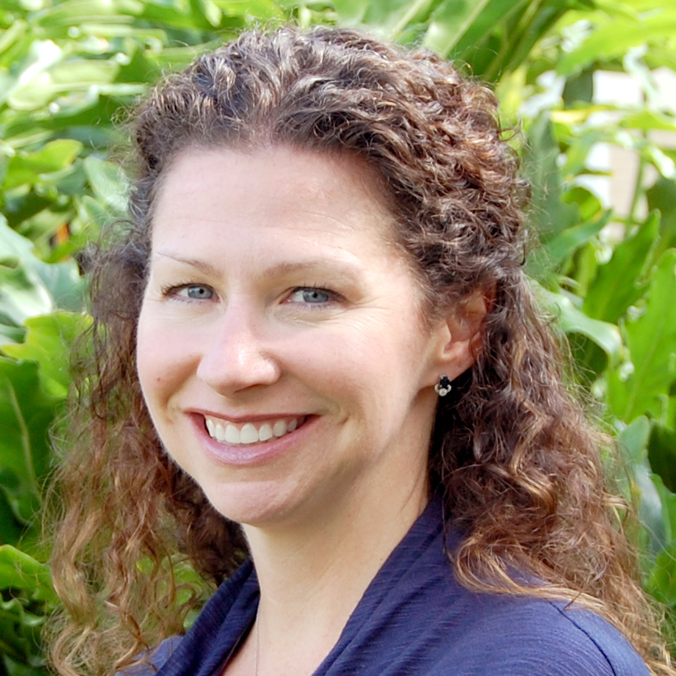
May Institute’s’20th Annual New England Positive Behavioral Support Forum
Friday, November 15, 2024 - Norwood, Mass.
Morning Keynote
STRANDS TO INCLUDE:
PBIS Foundations
PBIS and Families
Mental Health / Wellness
Classrooms
Equity
IDD and PBS
Heather George: Co-Director National Technical Assistance Center on Positive Behavioral Interventions and Supports
Registration Opens 5/30/24 – https://www.mayinstitute.org/services-for-schools/pbis/forum.html

Slide 18
Coach Tasks
Review and share In Person Training Days with Team
Register for September Convening
Identify your Google drive
Complete the Team Communication List
Share PBIS Conference Information
Review and share Learning Opportunities with your entire school or district
Review Website https://sebacademy.edc.org/

Slide 19

Questions?

