Slide 1


PBIS School-Wide Team Training
Year 1: October 2024
Trainer Names Here
Created from content from the National Technical Assistance Center on Positive Behavioral Interventions and Supports
U.S. Department of Education, Office of Special Education Programs and Office of Elementary and Secondary Education
with support from NEPBIS Network, May Institute, & Broad Reach Consulting

Slide 2

EXPECTATIONS
Self
Others
Environment
Self-monitor
Listen while others are speaking​
Have your computer charged and ready to go​
If you have questions or comments:
Work as a team:
Keep necessary materials at hand
Are you participating?
Engaged as a learner?
Stretch, break, stand as needed​
Raise hand
Room for every voice
Reinforce participation
action plan
relevant docs
water/snacks
Minimize distractions if possible​

Slide 3
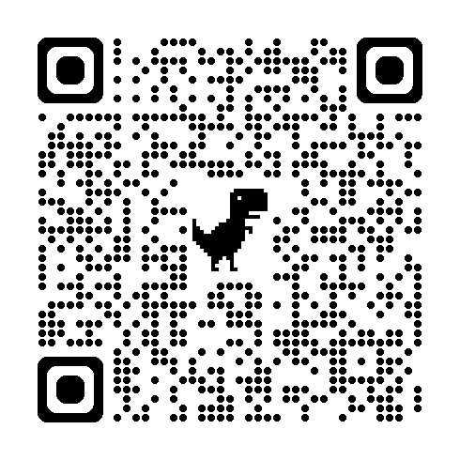
ACTIVITY: ATTENDANCE
Scan QR code on the left or follow the URL posted in the chat to access the online attendance survey
Follow prompts to enter attendance information
Notify trainers if you require assistance (e.g., identifying your cohort or cohort group)
Certificates of Attendance will be sent in January and June. Attendance records will be use as verification
1 minute
Notes:
ATTENDANCE: https://docs.google.com/forms/d/e/1FAIpQLSf-la8kZA-l6ZXIR48DsDhimdXqFAX2d8Cw6xIXio0UxScqvw/viewform

Slide 4
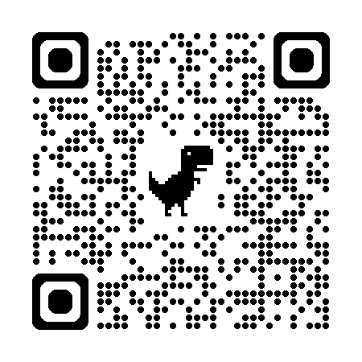
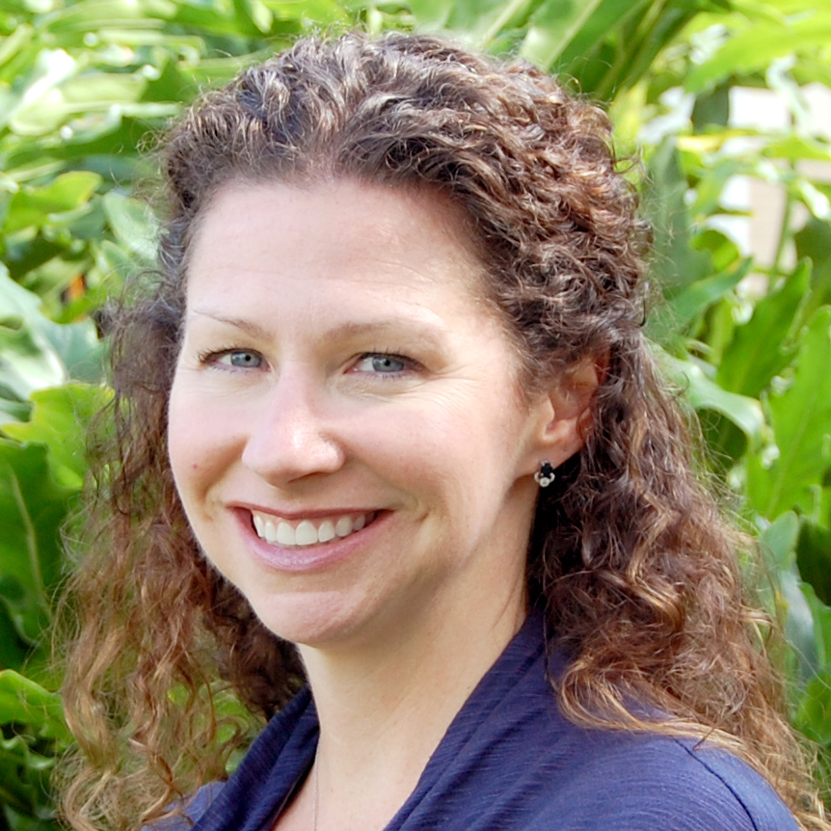
May Institute’s’20th Annual New England Positive Behavioral Support Forum
Friday, November 15, 2024 - Norwood, Mass.
Morning Keynote
STRANDS TO INCLUDE:
PBIS Foundations
PBIS and Families
Mental Health / Wellness
Classrooms
Equity
IDD and PBS
Heather George: Co-Director National Technical Assistance Center on Positive Behavioral Interventions and Supports
Registration Opens 5/30/24 – https://www.mayinstitute.org/services-for-schools/pbis/forum.html

Slide 5
Agenda & Coaches' Tasks
Coaches’ Tasks:
Submit updated Action Plan with Goals
Presentation Content:
Academy Overview
Why PBIS / PBIS Overview
PBIS Teaming
Statement of Purpose and Goal Setting
PBIS Expectations and Matrix
Teaching Expectations – Lesson Plans
Complete Team Comminution List

Slide 6

HELPFUL RSOURCES
RESOURCES:
Team Roles Worksheet
Sample Meeting Norms
Action Plan Template
Behavioral Expectations Teaching Matrix Template
Personal Matrix Activity (students)
PBIS Cultural Responsiveness Field Guide
Lesson Plan Activity and Template
EDC – PBIS Resources (Matrix and Lesson Samples)
Northeast Exemplar Repository
Notes:
Team Roles Worksheet https://sebacademy.edc.org/pbis-team-roles-worksheet
Action Plan Template https://sebacademy.edc.org/action-plan-template-1-year-1-teams-team-meetings
Sample Meeting Norms - https://sebacademy.edc.org/sample-team-noms-expectation-matrix
Behavioral Expectations Teaching Matrix Template https://sebacademy.edc.org/behavior-teaching-matrix
Expectation Matrix Samples https://sebacademy.edc.org/list-of-pbis-resources?keyword=Sample+matrix&pbis_resource_type=All&pbis_resource_topic=All&sort_by=field_date_value&sort_order=DESC
Personal Matrix Activity (students) https://sebacademy.edc.org/personal-matrix-activity-students
PBIS Cultural Responsiveness Field Guide https://sebacademy.edc.org/pbis-cultural-responsiveness-field-guide
Lesson Plan Activity and Template https://sebacademy.edc.org/behavioral-lesson-plan-activity
Lesson Plan Samples https://sebacademy.edc.org/list-of-pbis-resources?keyword=Lesson+Plan+Sample&pbis_resource_type=All&pbis_resource_topic=All&sort_by=field_date_value&sort_order=DESC
Northeast Exemplar Repository https://sebacademy.edc.org/northeast-pbis-exemplar-resources

Slide 7

WELCOME!
Share:
Your name
Your role at your school
Your experience with PBIS
A favorite childhood toy, game, or activity

Slide 8
PBIS Academy Support Structure

Slide 9
2024-2025 SEB Academy PBIS Training Format
Years
01
02
03
Attendees
Team Training (Minimum):
        Administrator
        Grade-Level Representatives
        Support Staff
        Coaches
Coaches Training:
2-3 Coaches
  Technical Assistance:
  Administrator
  Coach
  Data Entry Staff
  Faculty/Staff
Support
5 – 1.5 hr. Monthly Team Lead Meetings (Virtual)
3 Full Day - Team Trainings (Years 1 & 2) (In Person)
2 Full Day - Team Trainings (Year 3) (In Person)
15 hours Individualized Technical Assistance per school
Tiered Fidelity Inventory Evaluation in Spring
Notes:
Trainer note: Review support options for this year. Please let folks that future trainings will include a mixture of in person and online (hybrid) approaches (e.g., in person team trainings, but virtual coaches meetings). Regardless of support delivery, the categories of the support will be listed and developed based on DESE recommendations.

Slide 10
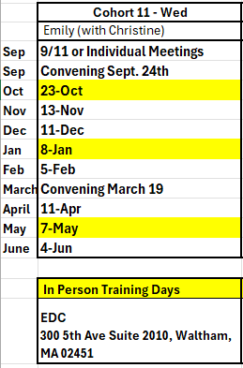
Cohort 11 Training Dates
Cohort 11
Emily Baton ebaton@mayinstitute.org
Christine Downs cdowns@mayinstitute.org
Virtual Team Lead Meetings- 9:00-10:30
In Person Team Training - 8:30-3:00
Notes:
Let Holyoke know they can get individualized team training day if travel to EDC it too far.

Slide 11
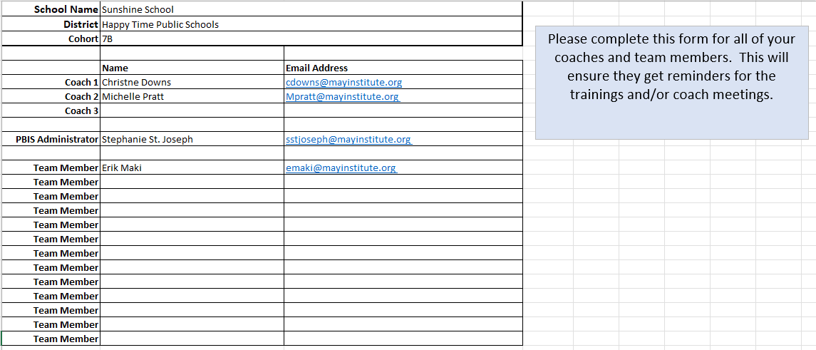
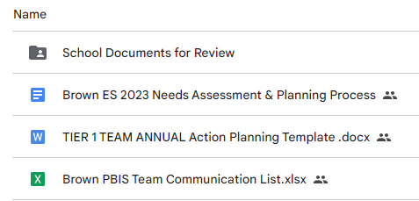
Communication Survey & Mail Chimp
Please add all your team’s contact information into the Communication Excel Sheet.
Move to School Documents for Review folder in your school’s Google Folder when completed
TEAM Communications List

Slide 12
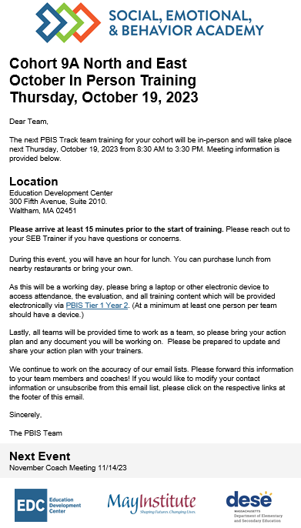
Communication Reminders
Email Reminders will be sent to all coaches, administrators and team members for our PBIS Events. The email will come from SEB Academy sebacademy@edc.org
Please review invitation for Date, Time, Location/Zoom Link, and any other important information included.
The next training or coach meeting will be displayed at the bottom
Share with other Coaches or Team Members

Slide 13
Cohort 11 Google Folders
Shoemaker ES https://drive.google.com/drive/folders/1_xg8umHGg4R2jqpsh2O4_NU_pY4Pf6tZ
Connery ES - https://drive.google.com/drive/u/0/folders/1ePb_LLCt9VUc1Iog92ISpNwroC5OUAkJ
Ford ES - https://drive.google.com/drive/u/0/folders/11hvZ8ysLieWmWH-6L5Goo_SnsYwf0IwY
Tracey ES - https://drive.google.com/drive/u/0/folders/1bgeO6XXr7Mv5PrYW9EeoaQxT0nG077QC
Holyoke Community CS- https://drive.google.com/drive/u/0/folders/1rcwmZ2aHeEmhMqTGVFVwI0d9oFmHVfoe

Slide 14
Year 1 Page SEBAcademy.edc.org

Slide 15
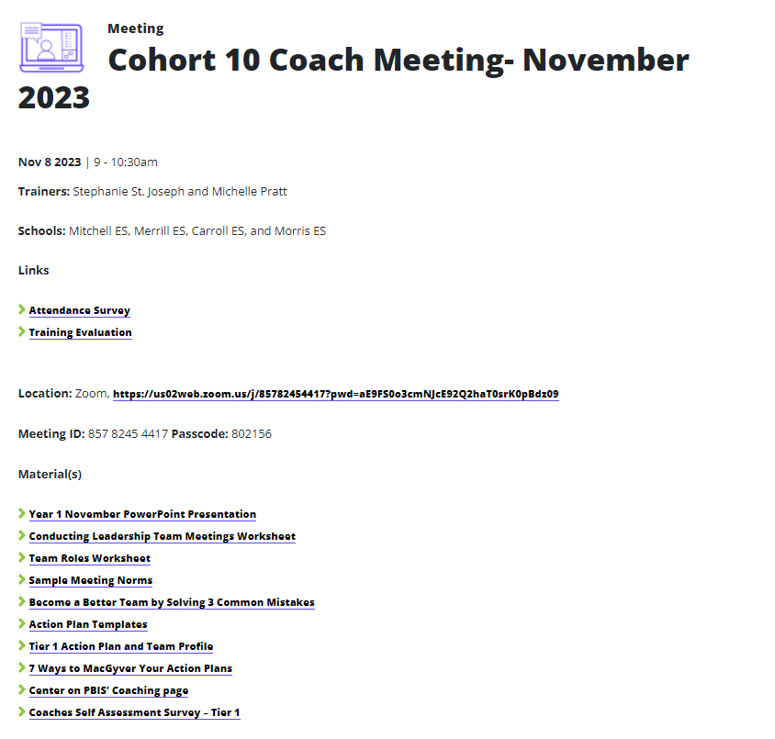
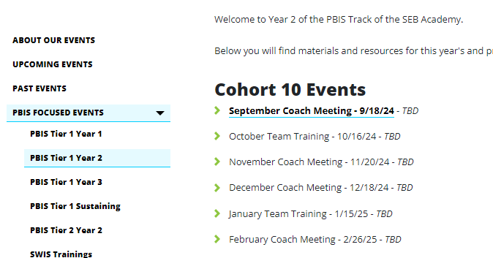
Training Pages
Trainers and Teams
Attendance and Evaluation Links
Zoom Link
Cohort 11 pages are Under Construction
Materials/Resources

Slide 16
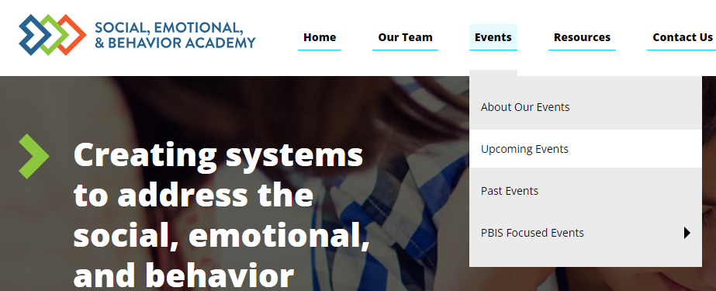
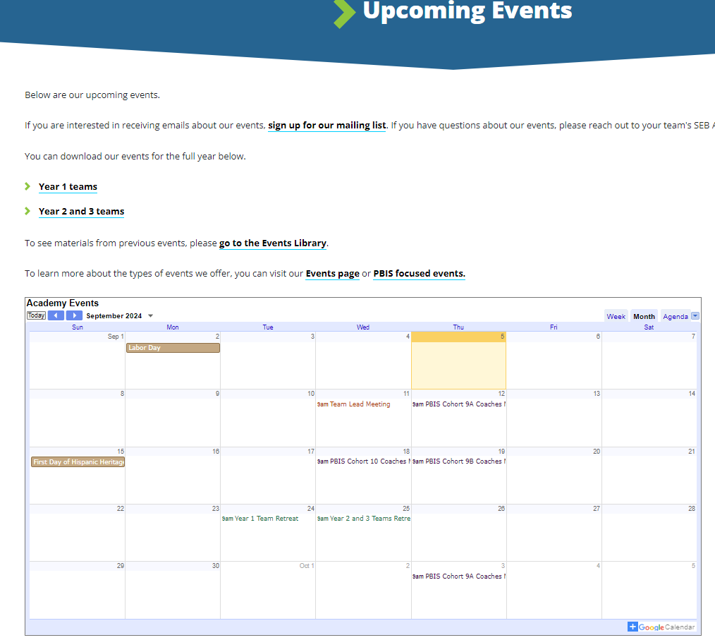
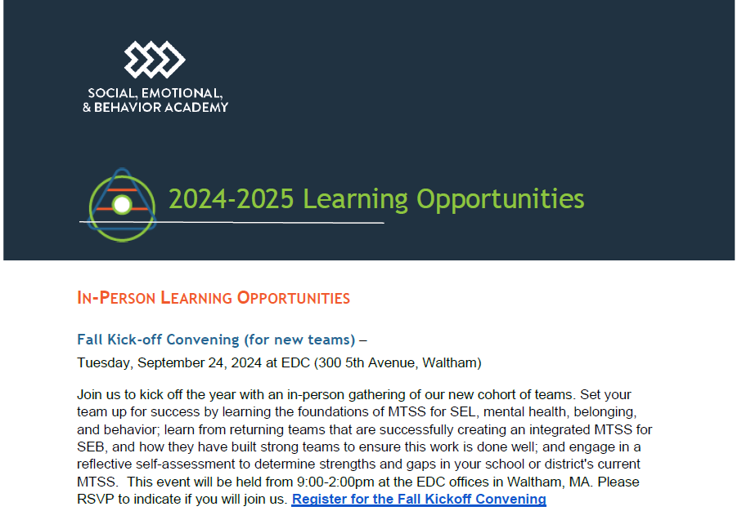
Other Upcoming Events
https://sebacademy.edc.org/upcoming-events
Notes:
https://sebacademy.edc.org/upcoming-events
Put the 24-25 Learning opportunities doc in the Chat or send by email. All of the PBIS dates for the cohort plus extra learning opportunities are in that doc.

Slide 17

VIRTUAL LEARNING OPPORTUNITIES
Virtual Workshops
Below is a list of dates and topics for our 2024-2025 virtual workshops.
Virtual workshops are open to any educator in your school or district.
Please share these dates with anyone who might be interested in attending.
More information about our virtual workshops can be found on our About Our Events page.
+ Surveys and Screeners to inform MTSS for SEB - Tuesday, October 8 from 9:30-11:00 AM
+ MTSS Through an Equity Lens - Tuesday, October 15 from 9:30-11:00 AM
+ Supporting Educator Wellbeing - Tuesday, October 22 from 9:30-11:00 AM
+ Centering Belonging - Tuesday, October 29 from 9:30-11:00 AM
+ Strengthening Family-School Partnerships - Tuesday, November 19 from 9:30-11:00 AM
+ Integrating SEL and Mental Health Supports - Wednesday, December 4 from 9:30-11:00 AM
+ Setting Positive Behavior Norms & Expectations - Wednesday, January 22 from 9:30-11:00 AM
+ Equitable Data Use in MTSS for SEB - Tuesday, January 28 from 9:30-11:00 AM
+ Sustainability: Going from Good to Great - Wednesday, February 12 from 9:30-11:00 AM

Slide 18
VIRTUAL LEARNING OPPORTUNITIES
Peer Sharing Call Series
Peer sharing calls bring together members of the academy around a shared topic area or goal for three sessions of facilitated conversation around successes and challenges. These calls are facilitated by members of the SEB Academy team and may contain short presentations of content related to the topic area of focus. Peer sharing calls are open to any educator in your school or district. Winter sessions will run in December, January, and February, and Spring sessions will run in March, April, and May. Please share these dates with anyone who might be interested in attending. More information about our peer sharing calls can be found on our About Our Events page.
+ Supporting Adult Belonging - Winter
+ Creating Strong Relationships and Community with Tier 1 Supports - Winter
+ Effective Data Use in MTSS for SEB - Winter
+ Supporting Students of Immigrant and Refugee Origins - Winter
+ Enhancing the Identification, Matching, & Monitoring Process for Advanced Tiers - Winter
+ Supporting LGBTQIA+ Students - Spring
+ Sustaining Progress - Spring
+ Strengthening Family-School Partnerships - Spring
+ Supporting ELL Students - Spring
+ Increasing Buy-In Through Strategic Communication - Spring

Slide 19
Questions? Review
The Academy Structure and resources will be reviewed in more depth with the coaches in November.
Take a minute to locate your google folder and explore the website
Whole Group
5 minutes

Slide 20
Why PBIS?

Slide 21
WHY PBIS?
“Getting tough” doesn’t work
Context matters
Schools asked to do more with less
PBIS works
Provides a framework to promote equity
PBIS supports mental health

Slide 22
Immediate & seductive solution...“Get Tough!”
Behavior escalates in intensity, frequency, and duration to levels that interfere with teaching and learning
Increase intensity, frequency, and duration of “aversive” consequences
Give additional and more “aversive” consequences
Give initial “aversive” consequence
  Zero tolerance policies
  Increased monitoring and security
  Physically assist or intervene
  Give out of school suspension

Slide 23

“Get Tough” gives a false sense of
safety and security!
Fosters environments of control
Triggers & reinforces antisocial behavior
Shifts accountability away from school
Devalues child-adult relationship
Weakens relationship between academic & social behavior programming
Increase intensity, frequency, and duration of “aversive” consequences
Give additional and more “aversive” consequences
Give initial “aversive” consequence

Slide 24
Science of Behavior has Taught Us, Students...
Erroneous Assumptions...
student is inherently "bad" and must prove they deserve to be part of class
aversive consequences teach
some kids improve (even temporarily), so all will
are NOT born with “bad behaviors”
do NOT learn when presented contingent aversive consequences
do learn better ways of behaving by being taught directly & receiving positive feedback
The power of PBIS is not in the rewards,
it is in the teaching!

Slide 25
WHY PBIS?
“Getting tough” doesn’t work
Context matters
Schools asked to do more with less
PBIS works
Provides a framework to promote equity
PBIS supports mental health

Slide 26

PBIS Message!
Successful individual student behavior support is linked to host environments or school climates that are effective, efficient, relevant, & durable.
(Zins & Ponti, 1990)
Notes:
Individual student success is linked to effective environments. We can expect improvement in student behavior if they are in a chaotic environment. We must ensure the environment is supportive and that support can be sustained.

Slide 27
WHY PBIS?
“Getting tough” doesn’t work
Context matters
Schools asked to do more with less
PBIS works
Provides a framework to promote equity
PBIS supports mental health

Slide 28

Competing Goals with Limited Time
Teach standards
Improve academic skills
Eliminate bullying
Prevent drug use
Support social-emotional learning
Promote college & career readiness
Reduce at-risk, antisocial behavior
Create positive learning environment
…and more

Slide 29





PBIS provides an evidence-based framework for addressing ongoing needs
Returning to School During and After Crisis
Improving Attendance and Chronic Absenteeism
Supporting College and Career Readiness
Discussing Race, Racism and Important Current Events
Building a Culture of
Staff Wellness

Slide 30
WHY PBIS?
“Getting tough” doesn’t work
Context matters
Schools asked to do more with less
PBIS works
Provides a framework to promote equity
PBIS supports mental health

Slide 31

PBIS is a Mental Health Initiative
"Mental health includes our emotional, psychological, and social well-being.
It affects how we think, feel, and act.
It also helps determine how we handle stress, relate to others, and make healthy choices.
Mental health is important at every stage of life, from childhood and adolescence through adulthood."

Slide 32



Mental Health is….
How we connect
Social
How we feel
Emotional
How we act
Behavioral
SEB described by Dr. Sandy Chafouleas
https://www.psychologytoday.com/us/blog/promoting-student-well-being/202008/4-questions-ask-now-in-preparing-your-child-school
Notes:
Chafouleas, S. (August 2020). Four questions to ask now in preparing your child for school. Psychology Today. https://www.psychologytoday.com/us/blog/promoting-student-well-being/202008/4-questions-ask-now-in-preparing-your-child-school

Slide 33
WHY PBIS?
“Getting tough” doesn’t work
Context matters
Schools asked to do more with less
PBIS works
Provides a framework to promote equity
PBIS supports mental health

Slide 34

PBIS centers equity in all decisions...
Throughout your training and implementation,
  Access
  Representation
  Meaningful Participation
  Positive Outcomes
will be highlighted as well as the systems needed to promote and sustain equity for each and every individual.
Notes:
https://www.pbis.org/topics/equity

Slide 35
Significant Predictors of Equitable Outcomes
Data-based decision making
Classroom PBIS Systems
Formal reward systems
Tobin & Vincent (2011)
Tobin & Vincent (2011)
Barclay (2017),
Tobin & Vincent (2011)

Slide 36
WHY PBIS?
“Getting tough” doesn’t work
Context matters
Schools asked to do more with less
PBIS works
Provides a framework to promote equity
PBIS supports mental health

Slide 37
Decades of evidence shows PBIS leads to a positive outcomes when implemented with fidelity...
Improved Student Outcomes
academic performance^{6,8,13}
decreased rates of student-reported drug and alcohol abuse^{1,5}
Reduced Exclusionary Discipline
Improved Teacher Outcomes
school organizational health and school climate ^{2,3}
social-emotional competence^{5,8,13}
reduced bullying behavior ^{11, 14}
perception of teacher efficacy^{7,11}
perception of school safety⁶
office discipline referrals^{4,5,6}
suspensions⁴
restraint and seclusion^{9,12}
¹Bastable, Kittelman, McIntosh, & Hoselton, 2015  ²Bradshaw, Koth, Bevans, Ialongo, & Leaf, 2008  ³Bradshaw, Koth, Thornton, & Leaf, 2009  ⁴Bradshaw, Mitchell, & Leaf, 2010  ⁵Bradshaw, Waasdorp, & Leaf, 2012  ⁶Horner et al., 2009  ⁷Kelm & McIntosh, 2012  ⁸Lewis, 2017  ⁹Reynolds et al., 2016  ¹⁰Ross & Horner, 2009  ¹¹Ross, Romer, & Horner, 2012  ¹²Simonsen, Britton, & Young, 2010  ¹³Tobin, Horner, Vincent, & Swain-Bradway, 2012  ¹⁴Waasdorp, Bradshaw, & Leaf, 2012
Notes:
¹Bastable, Kittelman, McIntosh, & Hoselton, 2015  ²Bradshaw, Koth, Bevans, Ialongo, & Leaf, 2008  ³Bradshaw, Koth, Thornton, & Leaf, 2009  ⁴Bradshaw, Mitchell, & Leaf, 2010  ⁵Bradshaw, Waasdorp, & Leaf, 2012  ⁶Horner et al., 2009  ⁷Kelm & McIntosh, 2012  ⁸Lewis, 2017  ⁹Reynolds et al., 2016  ¹⁰Ross & Horner, 2009  ¹¹Ross, Romer, & Horner, 2012  ¹²Simonsen, Britton, & Young, 2010  ¹³Tobin, Horner, Vincent, & Swain-Bradway, 2012  ¹⁴Waasdorp, Bradshaw, & Leaf, 2012

Slide 38


TEAM DISCUSSION: Why PBIS at your school?
“Getting tough” doesn’t work
Context matters
Schools asked to do more with less
PBIS works
Provides a framework to promote equity
PBIS supports mental health
"Which of these reasons do you think will resonate or be most meaningful in your school?"
Discuss as a team and share out to the group
5 minutes

Slide 39
TEAM Introductions and Share Out
“Getting tough” doesn’t work
Context matters
Schools asked to do more with less
PBIS works
Provides a framework to promote equity
PBIS supports mental health
Have one person introduce your team and share one reason your team is excited to bring PBIS To your school.
15 minutes

Slide 40
What is PBIS?

Slide 41
School-wide PBIS is a...
Framework for enhancing adoption & implementation of
Continuum of evidence-based interventions to achieve
Academically & behaviorally important outcomes for
All students
Notes:
Quick review of PBIS main Core Components – We will dig deeper into the overview in October at the team training

Slide 42
PBIS Core Features
-Problem Solving Model
Support Educators
through Equity-focused PD
Systems
Practices
Data
Equity
Disaggregate
All Data by
Student Group
Adapt Practices
to Meet
Needs and Values
Outcomes
High Expectations for Each Student

Slide 43

Continuum of School-Wide Instructional
& Positive Behavior Support
What do we do for the FEW needing intensive support?
Tertiary Prevention:
Specialized
Individualized
Systems for Students with High-Risk Behavior
What do we do for ALL?
Primary Prevention:
School-/Classroom-
Wide Systems for
All Students,
Staff, & Settings
~5%
~15%
What do we do for the SOME needing more support?
Secondary Prevention:
Specialized Group
Systems for Students with
At-Risk Behavior
~80% of Students

Slide 44

GETTING STARTED WITH PBIS
1
Establish an effective leadership team
6
Develop a continuum to strengthen demonstrations of expectations
2
Develop a brief statement of purpose & define outcomes
7
Develop a continuum to discourage violations of expectations
3
Identify positive school-wide behavior expectations
8
Develop data-based procedures for monitoring
4
Develop procedures to teach school-wide expectations
9
Develop systems to support staff
5
Develop procedures to teach class-wide expectations
10
Build routines to ensure ongoing implementation
Notes:
(Add to TRAINER Workbook)...
TRAINER NOTES- for this section- Create tension for teams without shutting them down- goal is that they walk away understanding they need to prioritize time and resources to get this done

Slide 45
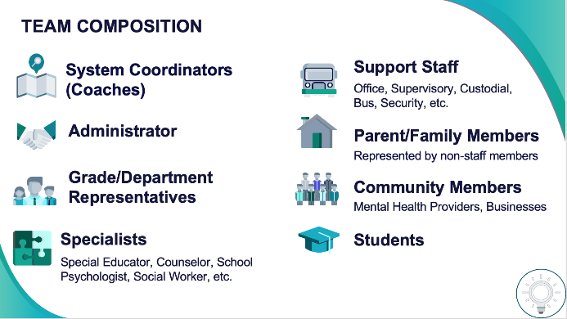
1
Establish an effective leadership team
Systems
Supports Relevance & Equity
Improves student outcomes
Promotes Engagement
Notes:
Your first step is to create a representative team to lead your school’s PBIS efforts.

Slide 46

2
Develop a brief statement of purpose & define outcomes
Practices
What do we hope to achieve by implementing PBIS?
"Our mission is to provide a positive, safe, healthy, nurturing and respectful environment in which all students have the opportunity to become productive members of society."
Purpose
“As a result of implementing PBIS during the 20XX-20XY school year, student reports of school climate will improve by 20%.”
Outcome
Notes:
You’ll then focus your school’s PBIS efforts by creating a statement of purpose to identify your hopes and goals for PBIS implementation.

Slide 47



3
Identify positive school-wide behavior expectations
Practices
Notes:
Your team will work with your school community to uncover what you value and use those values to identify your schoolwide expectations

Slide 48
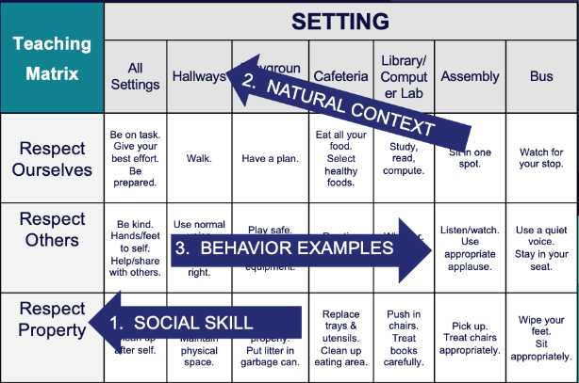
4
Develop procedures to teach school-wide expectations
Practices
Define
Teach
Prompt
Monitor
Evaluate
Notes:
Using those identified expectations, you’ll define what those expectations look and sound like in key routines/settings throughout your school. This is organized through a behavioral matrix. Using the schoolwide matrix, your team will develop lessons that will be explicitly taught to students at the beginning of the year (and boosted throughout the year) so that they know how to be successful within each context (like the hallway, cafeteria, assemblies, etc.)

Slide 49
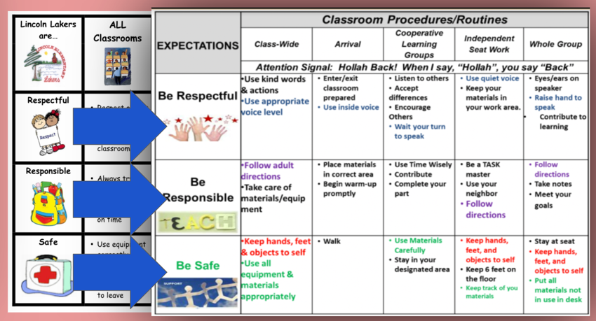
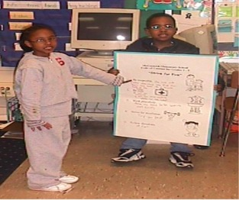
5
Develop procedures to teach class-wide expectations
Practices
Notes:
Once the schoolwide expectations have been determined, classroom educators will apply the behavior matrix format to the routines and settings within their classrooms. They will also explicitly teach the expectations to their students throughout the year.

Slide 50
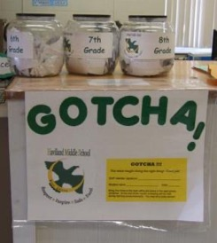
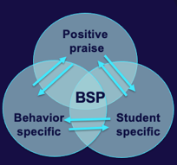
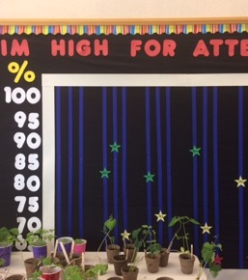
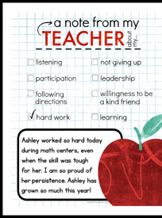
6
Develop a continuum to strengthen
demonstrations of expectations
Practices
Notes:
To encourage contextually appropriate behaviors to occur, you'll support educators to provide frequent specific feedback and praise. To promote this critical practice, you’ll develop recognition/acknowledgement systems for both students and staff.

Slide 51
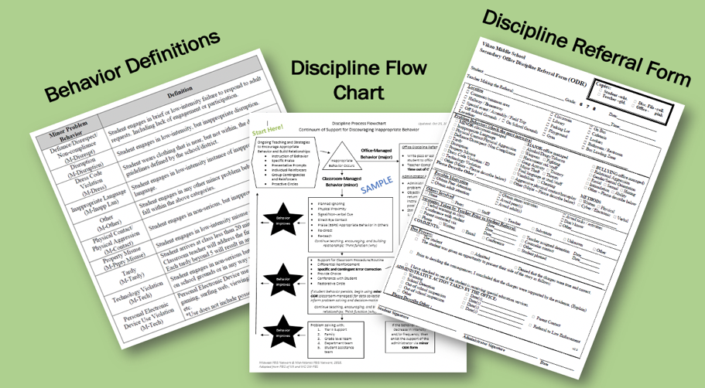
7
Develop a continuum to discourage
violations of expectations
Practices
Notes:
You will also clarify how staff should respond when contextually inappropriate behaviors occur by clearly defining, determining who’s responsible for responding, identifying clear responses, and recording the behaviors.

Slide 52
8
Develop data-based procedures for monitoring
Data
Collect Data!
Present the data in a user-friendly fashion
(i.e., graph)
Use the data to make decisions
Notes:
All the while you’ll be gathering data:
-to identify solutions to contextually inappropriate behavior
-to evaluate the fidelity to which you’re implementing PBIS
-to evaluate whether you’re getting your desired outcomes (such as increased attendance, fewer ODRs, and improved state test scores)

Slide 53
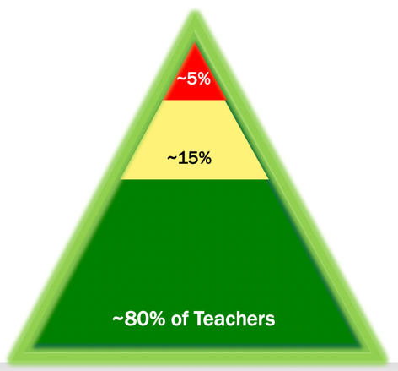


9
Develop systems to support staff
Systems
Notes:
PBIS is ineffective if it isn’t living and breathing within your entire school staff. Your team will spend time and effort on building and sustaining staff buy-in and building their capacities to use positive behavioral practices. Just like our students, our staff may need different levels of support to buy-in and implement PBIS.

Slide 54


10
Build routines to ensure ongoing implementation
Systems
Notes:
Finally, your team will work towards building systems and routines to ensure that the PBIS framework continuously improves and sustains over time.

Slide 55
GETTING STARTED WITH SWPBIS
1
Establish an effective leadership team
6
Develop a continuum to strengthen appropriate behaviors
2
Develop a brief statement of purpose
7
Develop a continuum to discourage violations of expectations
3
Identify positive school-wide behavior expectations
8
Develop data-based procedures for monitoring
4
Develop procedures to teach school-wide expectations
9
Develop systems to support staff
5
Develop procedures to teach class-wide expectations
10
Build routines to ensure ongoing implementation

Slide 56
ACTIVITY: PBIS Overview to Staff Presentation
Staff will need explicit training in The PBIS Framework:
What is PBIS?
Why PBIS?
Core Features
Discuss and BEGIN to plan a presentation to your school as a team:
What big ideas of SWPBIS do you need to cover?
Who will present what?
Given your school context and goals, what should be highlighted?
Teams
15 minutes
Notes:
TRAINER NOTE:
Please explain to teams that time for tasks today are to get them started but they are not expected to complete the task during today’s training
Discuss and BEGIN to plan as a team:
What big ideas of SWPBIS do you need to cover?
Who will present what?
Given your school context, what should be highlighted?

Slide 57

15-minute break

Slide 58
Team Composition

Slide 59
TEAM COMPOSITION
Support Staff
Parent/Family Members
Administrator
Grade/Department Representatives
Community Members
Specialists
System Coordinators
(Coaches)
Represented by non-staff members
Students
Special Educator, Counselor, School Psychologist, Social Worker, etc.

Slide 60
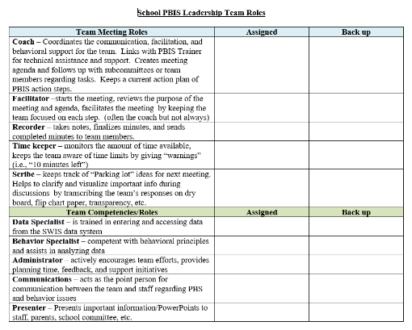
Team Roles
Facilitator
Note Taker
Timekeeper
Scribe
Norm Keeper
“Friendly Reminder”
Faculty Presenter
(Parent/Student Voice)
Notes:
Team Roles Worksheet https://sebacademy.edc.org/pbis-team-roles-worksheet
In Resources

Slide 61
Team
Operating Procedures & Agreements

Slide 62
Effective Teaming Operating Procedures
regular meeting format/agenda that prompts the regular review of tier 1 practices, systems, and data
minutes available to all staff for review
established and regularly used team norms
defined meeting roles
current action plan accessible to all team members
regular (e.g., quarterly) two-way data sharing and communication with advanced tiers teams to inform decision making

Slide 63
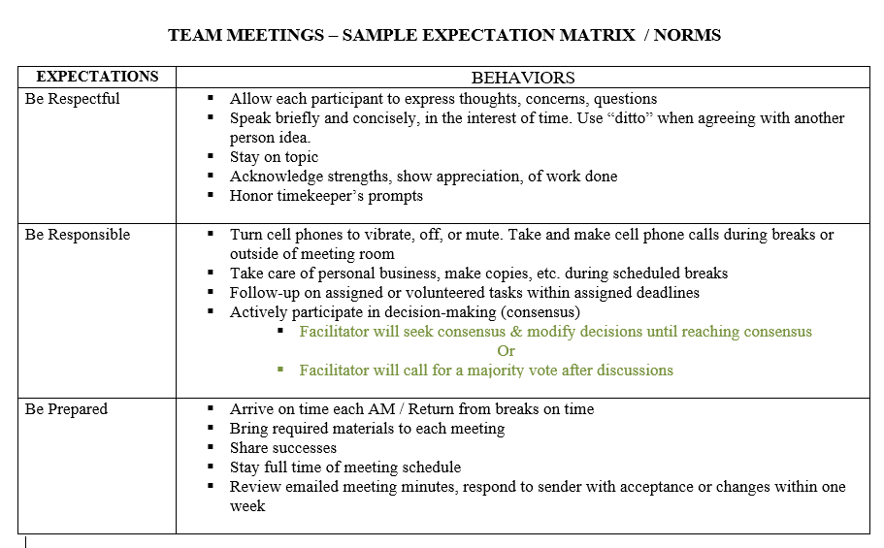
Meeting Structure
Notes:
Sample Meeting Norms
https://sebacademy.edc.org/sample-team-noms-expectation-matrix

Slide 64
Action
Planning

Slide 65
ACTION PLANNING
Foundation for all you do as a team
Action Plan
Vital for achieving goals
Specifies three features:
1
2
3
Who
What
When
Who is responsible…
…for doing what…
…by when?

Slide 66
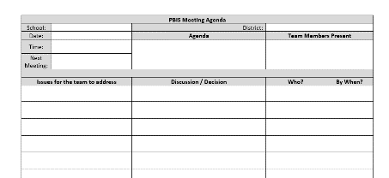
ACTION PLANNING CHECK IN
The process of organizing resources to enable individuals to engage in activities designed to achieve specific and important outcomes.
Has a shared action plan document been started?
Do you know how to access it?
Do action steps include who? What? By when?
Consider adding “action plan manager” as a team role.
What routine will the team use to keep it updated?
Notes:
.

Slide 67
ACTIVITY: Developing an Effective Leadership Team
Collaborate with your team to identify the following team procedures and agreements:
Composition
Meeting format/agenda
Roles
Meeting schedule
Norms
Action Plan Form (choose one link in notes and resources)
Accessible location for materials
15 minutes
Notes:
Team Roles Worksheet https://sebacademy.edc.org/pbis-team-roles-worksheet
Action Plan Templates https://sebacademy.edc.org/list-of-pbis-resources?keyword=action+plan&pbis_resource_type=113&pbis_resource_topic=All&sort_by=field_date_value&sort_order=DESC
Sample Meeting Norms - https://sebacademy.edc.org/sample-team-noms-expectation-matrix

Slide 68
Statement of Purpose / Goal Setting

Slide 69
Why are we doing this?

Slide 70
PBIS PURPOSE STATEMENT
What would it look like if all students developed the SEB skills needed to be effective learners?
Example:
Ensure all students develop the social-emotional-behavioral (SEB) skills needed to be effective learners through the implementation of evidence-based interventions and use of data to inform decisions.
behavior referrals and exclusionary discipline would decrease
disproportionate discipline would decrease
students would be in class consistently
all students would meet academic standards

Slide 71
Purpose Statement Considerations
Purpose Statement
Action Plan Outcome Goals
School/District Improvement Plans
Working Smarter Matrix (e.g. resource allocation)
Notes:
SIP = School Improvement Plan

Slide 72




Purpose statement identifies WHY you are implementing PBIS at your school
Positively stated
2 to 3 sentences in length
Supportive of academic achievement and social-emotional-behavioral (SEB) health
Comprehensive in scope (relevant to all students, staff & settings)
We will have a positive climate.
Ensure all students develop the social-emotional-behavioral (SEB) skills needed to be effective learners through the implementation of evidence-based interventions and use of data to inform decisions.
To develop and implement universal systems and interventions supporting the academic and social success of each student.

Slide 73
ACTIVITY: DEFINING PURPOSE
As a team, begin to draft your team’s purpose statement for PBIS implementation in your school.
Identify how your purpose statement and outcomes can be shared with stakeholders and used to support rollout
Remember the Why PBIS section. What is your reason for implementing PBIS?
15 minutes

Slide 74
How will we get there?

Slide 75
Critical Features of PBIS
Systems
Practices
Data
Equity
Make student growth and benefit central to all decisions. Student outcomes that reflect equitable learning opportunities must be the ultimate criteria for all decisions.
Outcomes

Slide 76
Outcomes tell us if we achieve our purpose and guide framework implementation
As a result of implementing PBIS during the
20XX-20XY school year, behavior incident data will decrease by __% relative to that same period the prior year.
Based on data
Locally important and meaningful
Applicable to all (culturally equitable)
  Students’ social competence and academic achievement
  Staff implementation of critical skills
Observable and measurable
Written as a goal

Slide 77
Outcomes are our GOALS for implementation
As a result of implementing PBIS during the 20XX-20XY school year, student reports of school climate will improve by 20%
Based on data
Locally important and meaningful
Applicable to all (culturally equitable)
  Students’ social competence and academic achievement
  Staff implementation of critical skills
Observable and measurable
Written as a goal
As a result of
implementing PBIS,
student behavior will improve, and the school will feel better.
By spring break, staff, students, and families will provide input into creation of School Wide PBIS Matrix as demonstrated by responses to questionnaires, class focus groups, and faculty meetings
By the end of the year support for implementing PBIS will be rated “Highly Important” by at least 80% of staff as measured by PBIS staff survey.

Slide 78
Identifying Outcomes/Goals
What outcomes are you hoping to achieve this year?
(Consider BOTH implementation fidelity and student outcomes)
Step 1: Develop evaluation questions.
Step 2: Identify indicators or measures.
Step 3: Develop methods for collecting & analyzing indicators.
What do you want to know?
What information can be collected?
How/when should information be gathered?
Step 4: Make decisions and action plan from analysis of indicators.
How will the question be answered & what should be done next?

Slide 79
ACTIVITY: DISCUSSION
What is our primary goal for PBIS implementation in our school?
How will we gain input from others on our goals?
Do our goals align with district/school strategic plans?
Identify your draft primary goal, record it on your action plan and submit your action plan to your trainer in Canvas.
Teams
15 minutes
Notes:
TRAINER NOTE: This is a hope / goal statement. They probably aren’t ready and don’t have the data for a full data driven goal yet.
Team Discussion:
What is our primary goal for PBIS implementation in our school?
How will we gain input from others on our goals?
Do our goals align with district/school strategic plans?
Identify your draft primary goal, record it on your action plan and submit your action plan to your trainer in Canvas.

Slide 80

LUNCH
Notes:
I tried to make lunch 11:30-12:30 Adapt as needed.

Slide 81
DEVELOP
SCHOOL-WIDE EXPECTATIONS / CORE VALUES

Slide 82
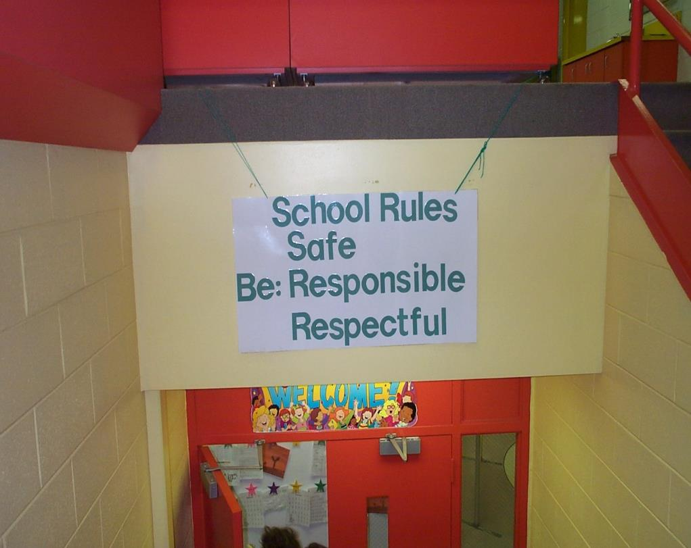
REDESIGN LEARNING & TEACHING ENVIRONMENTS
School Rules
NO Food
NO Weapons
NO Backpacks
NO Drugs/Smoking
NO Bullying
School Rules
BE RESPECTFUL
BE SAFE
BE RESPONSIBLE

Slide 83

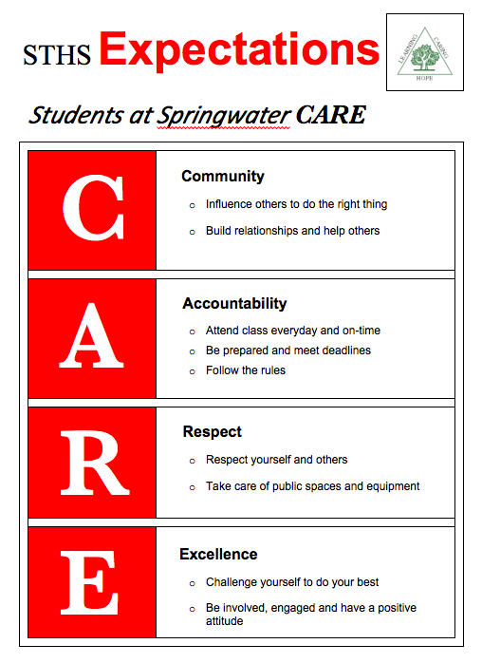

Slide 84


Slide 85
GUIDELINES FOR EXPECTATIONS
Linked to social culture of school
Appropriate cultural and contextual fit
Considerate of social skills that already exist
3-5 in number
1-3 words per expectation
Positively Stated
Supportive of academic achievement
Comprehensive in scope
Mutually exclusive (minimal overlap)

Slide 86
ACTIVITY: DISCUSSION
Do you already have Expectations / Core Values you can use or adapt?
If creating new Expectations, how will you include staff and students?
Teams
10 minutes
Notes:
Team Discussion:
What is our primary goal for PBIS implementation in our school?
How will we gain input from others on our goals?
Do our goals align with district/school strategic plans?
Identify your draft primary goal, record it on your action plan and submit your action plan to your trainer in Canvas.

Slide 87
DEFINING CORE VALUES AND CREATING EXPECTATIONS

Slide 88
Define
Teach
Prompt
Monitor
Evaluate
KEY STEPS

Slide 89
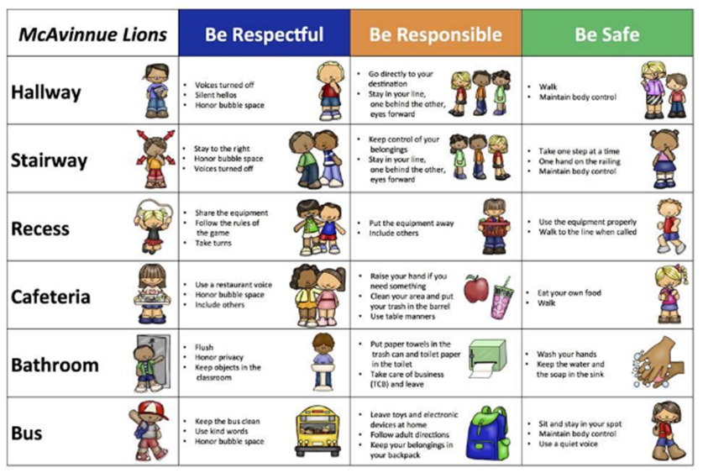
Behavioral Expectations
Define
Operationally define what expectations look like across all the routines and settings in your school.
One way to do this is in a matrix format.

Slide 90
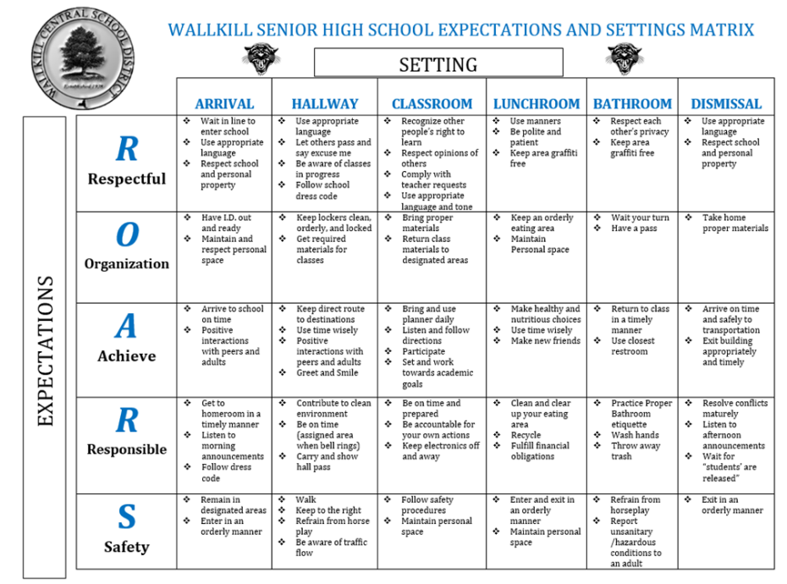
Wallkill SHS ROARS
Notes:
Behavioral Expectations Teaching Matrix Template https://sebacademy.edc.org/behavior-teaching-matrix
Expectation Matrix Samples https://sebacademy.edc.org/list-of-pbis-resources?keyword=Sample+matrix&pbis_resource_type=All&pbis_resource_topic=All&sort_by=field_date_value&sort_order=DESC

Slide 91
Teaching Matrix |  | SETTING
 |  | All Settings | Hallways | Playgrounds | Cafeteria | Library/ Computer Lab | Assembly | Bus
EXPECTATIONS | Respect Ourselves | Be on task. Give your best effort. Be prepared. | Walk. | Have a plan. | Eat all your food. Select healthy foods. | Study, read, compute. | Sit in one spot. | Watch for your stop.
 | Respect Others | Be kind. Hands/feet to self. Help/share with others. | Use normal voice volume. Walk to right. | Play safe. Include others. Share equipment. | Practice good table manners | Whisper. Return books. | Listen/ watch. Use appropriate applause. | Use a quiet voice. Stay in your seat.
 | Respect Property | Recycle. Clean up after self. | Pick up litter. Maintain physical space. | Use equipment properly. Put litter in garbage can. | Replace trays & utensils. Clean up eating area. | Push in chairs. Treat books carefully. | Pick up. Treat chairs appropriately. | Wipe your feet. Sit appropriately.
1. SOCIAL SKILL
2. NATURAL CONTEXT
3. BEHAVIOR EXAMPLES

Slide 92
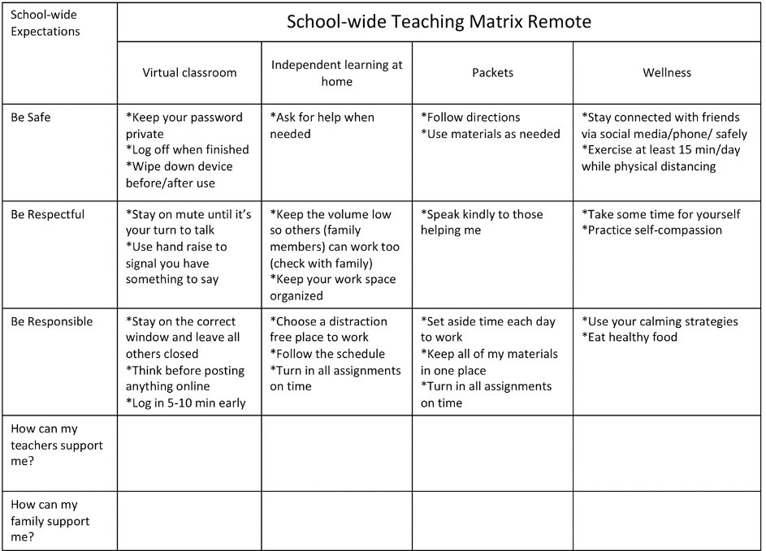
Adapted for remote instruction as needed
Notes:
Don’t dwell on this slide. Just indicate it matrices can be adapted when needed

Slide 93
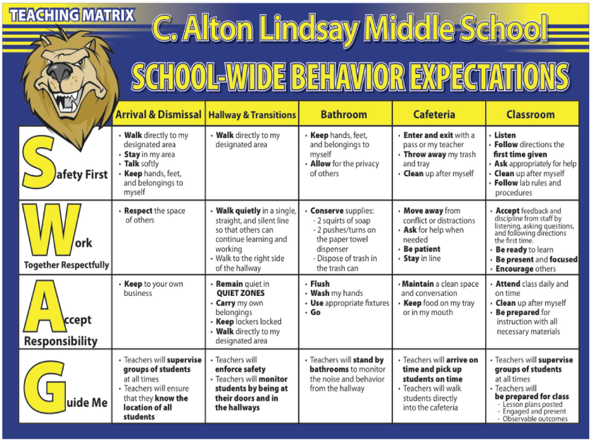
Lindsay Middle School incorporated student feedback and language into their SW matrix.
Includes how staff will support students
Notes:
Note the changes in expectations based on student input. Especially the GUIDE ME section that includes expectations for staff to follow supporting students.

Slide 94
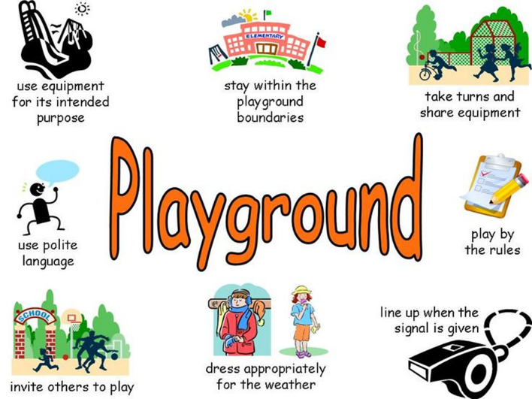
Use Visuals for Nonreaders or Language Learners

Slide 95
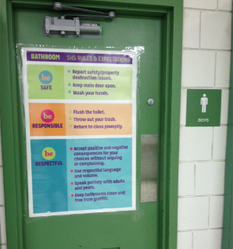
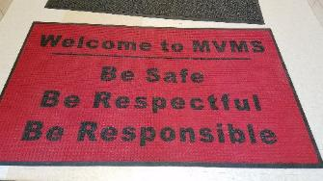
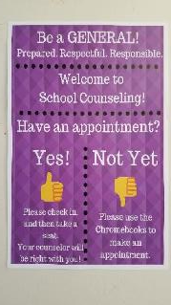


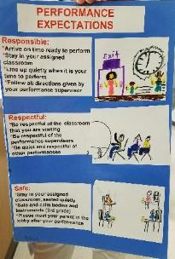
Remember Signage

Slide 96
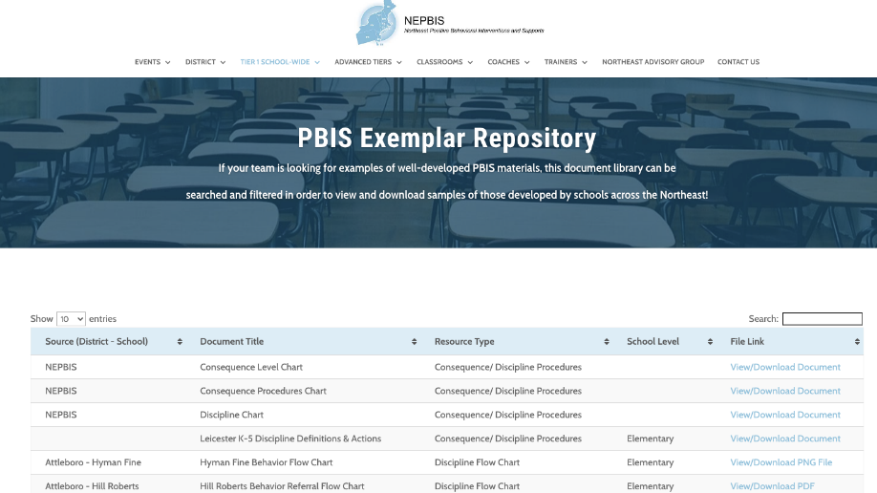
For more examples drawn from schools across the state, check out the NEPBIS Exemplar Repository NEPBIS Exemplar Repository
LINK
Notes:
https://nepbis.org/tier-1-school-wide/pbis-exemplar-resource-repository/
Trainer Note: Here include/show links to sample matricies in EDC website and NEPBIS Exemplar site

Slide 97

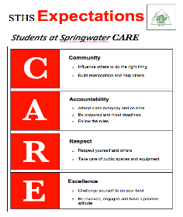
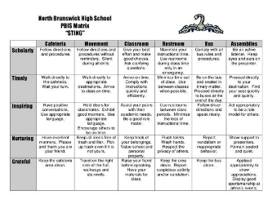
Your team and staff have identified school-wide expectations and developed a matrix...

Slide 98

Determine if the expectations and matrix fit your school community!
Collecting stakeholder input to guide our work helps with...
  Staff buy-in
  Ensuring our supports reflect each member of our school community (students, parents, community members).
  Ensuring different perspectives and cultural values are considered.
Notes:
Culturally Responsive Field Guide https://www.pbis.org/resource/pbis-cultural-responsiveness-field-guide-resources-for-trainers-and-coaches

Slide 99
Here is an opportunity to get input from important stakeholders!
Have our implicit biases impacted our schoolwide expectations?
Student feedback activity will be reviewed in Nov Coaches!
Do our expectations reflect the cultural values of the surrounding community?
Do expectations and specific rules serve a legitimate purpose within the setting,
as opposed to simply tradition or maintaining the status quo?
How can we involve staff and students in developing expectations?
Notes:
TRAINER NOTE: Use this to introduce the topic of soliciting input from stakeholders. If schools in your group already have matrices developed, please use the personal matrix content with them to encourage them to gain student and family feedback.

Slide 100


Consider a student activity similar to the school-wide behavior matrix.
“The Tweak”
Take school expectations and have students develop a home matrix:
Apply expectations to their home setting
Apply expectations to their community
Obtaining
Student
Voice!
Notes:
Consider implementing the following activity with students in your school, either a selected class, subsection, or with the entire student body, as a way to ensure expectations are meaningful to students and incorporate student perspective into the development of your school’s teaching matrix.

Slide 101
Expectation | At SCHOOL it looks like… | At HOME it looks like… | In my NEIGHBORHOOD it looks like…
Be Safe | Keep hands and feet to self Tell an adult if there is a problem | Protect your friends and family Don’t talk back | Stick up for your friends Don’t back down Keep an eye out
Be Respectful | Treat others how you want to be treated Include others Listen to adults | Do exactly what adults tell you to do Don’t stand out Don’t bring shame | Text back within 30 seconds Be nice to friends’ parents Share food
Be Responsible | Do my own work Personal best Follow directions Clean up messes | Help your family out first Own your mistakes Share credit for successes | Have each other’s backs Own your mistakes Check in about what to do
Provides the opportunities for students to:
articulate their expectations at home & community
discuss similarities & differences

Slide 102
Considering Students’ Personal Matrix
For the differences between school and other settings, are the “different” school rules necessary for positive student development?
NO
YES
Change the rules to align more with home and neighborhood
Acknowledge explicitly and provide additional teaching, practice, and acknowledgment
Notes:
Trainer Note: Here is a process for addressing discrepancies between school based and personal matrices.

Slide 103
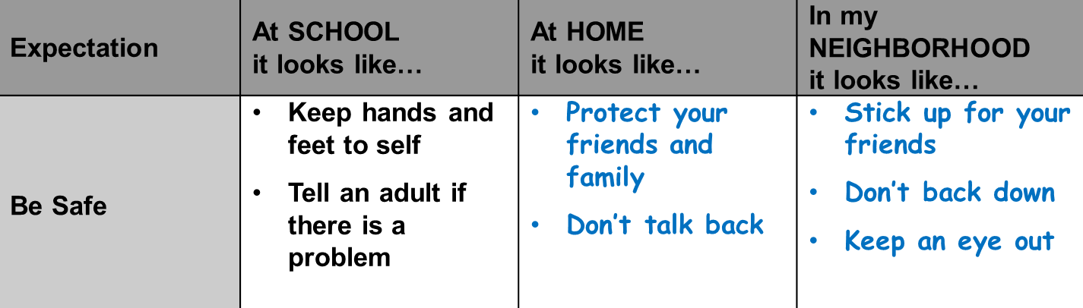
EXAMPLE
Are the different school rules necessary for positive student development?
  YES: Acknowledge explicitly and provide additional teaching, practice, and acknowledgment

Slide 104
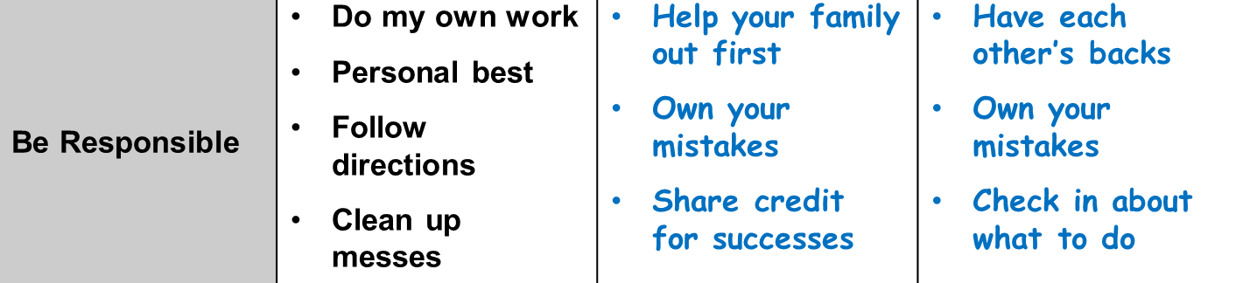
EXAMPLE
Are the different school rules necessary for positive student development?
  NO: Change the rules to align more with home and neighborhood

Slide 105

Remember to Share with families/community members and get their feedback. They may have questions or ideas!

Slide 106
ACTIVITY: BEHAVIORAL EXPECTATIONS
Move your way through these steps based upon your current implementation level.
For example:
if you already have a matrix, discuss how to get input from stakeholders
Or
Begin to create lesson plans
Draft School-Wide Behavior Expectations (If your school already has School-wide Expectations, evaluate if they meet the guidelines, consider ways to enhance visibility, and
Draft School-Wide Teaching Matrix
Consider how to obtain student voice and staff input and match community context.
Add items to your Action Plan as necessary
Teams
25 minutes
Notes:
Activity: Behavioral Expectations
Draft School-Wide Behavior Expectations (If your school already has School-wide Expectations, evaluate if they meet the guidelines, consider ways to enhance visibility, and
Draft School-Wide Teaching Matrix
Consider how to obtain student voice and match community context.
Add items to your Action Plan as necessary
Behavioral Expectations Teaching Matrix Template https://sebacademy.edc.org/behavior-teaching-matrix
Expectation Matrix Samples https://sebacademy.edc.org/list-of-pbis-resources?keyword=Sample+matrix&pbis_resource_type=All&pbis_resource_topic=All&sort_by=field_date_value&sort_order=DESC

Slide 107
Teaching Expectations
(we will cover this in-depth during coaches meeting and again in Jan)
(we will cover this in-depth during coaching meetings and again in Jan)
Notes:
This is for differentiation if schools already have everything complete. Do emphasize that they work on staff and student input first…but cover this if they have completed everything included goals, statement of purpose, team structures, Core Values & matrix. (Does anything need improving? Are there areas on the matrix the need to be added? Auditorium, Locker Room, Office, etc.)

Slide 108










GETTING STARTED WITH SWPBIS
Practices
Establish an effective leadership team
Develop a continuum to strengthen appropriate behaviors
Teach social behavior explicitly!
Develop a brief statement of purpose
Develop a continuum to discourage violations of expectations
Identify positive school-wide behavior expectations
Develop data-based procedures for monitoring
Develop procedures to teach school-wide expectations
Develop systems to support staff
Develop procedures to teach class-wide expectations
Build routines to ensure ongoing implementation

Slide 109
TEACHING ACADEMIC & SOCIAL BEHAVIORS
Define
Teach
Prompt
Monitor
Evaluate

Slide 110
GUIDELINES FOR TEACHING EXPECTATIONS
Include
Include main school settings/contexts/routines i.e. Arrival, Hallways, Cafeteria, Dismissal
Consider
Adapt or use lessons that already exist
Specify
List 2-3 observable, positive, examples for each expectation within each setting
Teach
Teach social behavior just like academic skills
Practice
Provide opportunities for students to new expectation
Prompt
Provide prompts, precorrections, & feedback in natural context
Schedule
Schedule time for introducing teaching plan to staff & getting feedback on lessons
Schedule
Schedule time for obtaining feedback from students, families, & community members
Plan
Schedule initial instruction in natural context
Review
Evaluate the feedback, reteach, practice, & follow-up as needed
Notes:
For their review – Don’t read entire slide

Slide 111
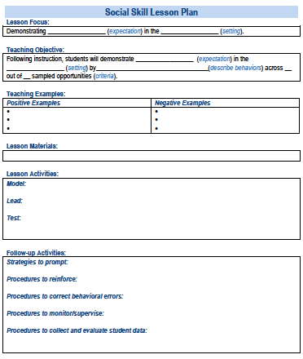
SOCIAL
SKILL
LESSON
PLAN
A lesson plan that prompts the critical features just described
Simonsen, Myers, Everett, Sugai, Spencer, & LaBreck (2012)
Notes:
Trainer Note: Here include/show links to sample lesson plans in EDC website and also nepbis.org exemplar lesson plans for examples!

Slide 112
TEACH RULES IN CONTEXT OF ROUTINES
Teach
Teach expectations directly
Provide examples & non-examples
Actively involve students in lesson (game, role-play, etc.) to check for their understanding
Provide opportunities to practice rule following behavior in the natural setting.
Remember, when expectations are different at school than at home/community, provide a rationale for the purpose of the school expectation, explicitly teach the differences (code-switching), and provide additional practice opportunities.

Slide 113
Expectations & behavioral skills are taught and recognized in context

Slide 114
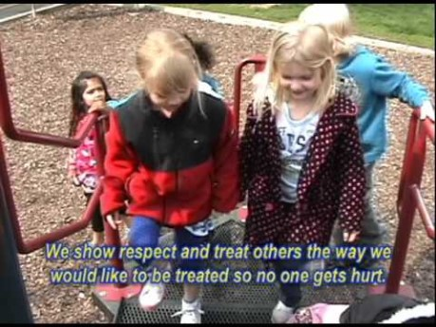
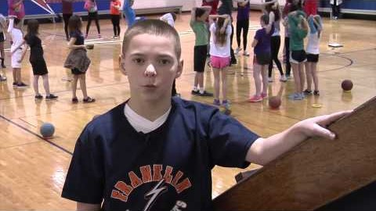
Example Teaching Videos

Slide 115
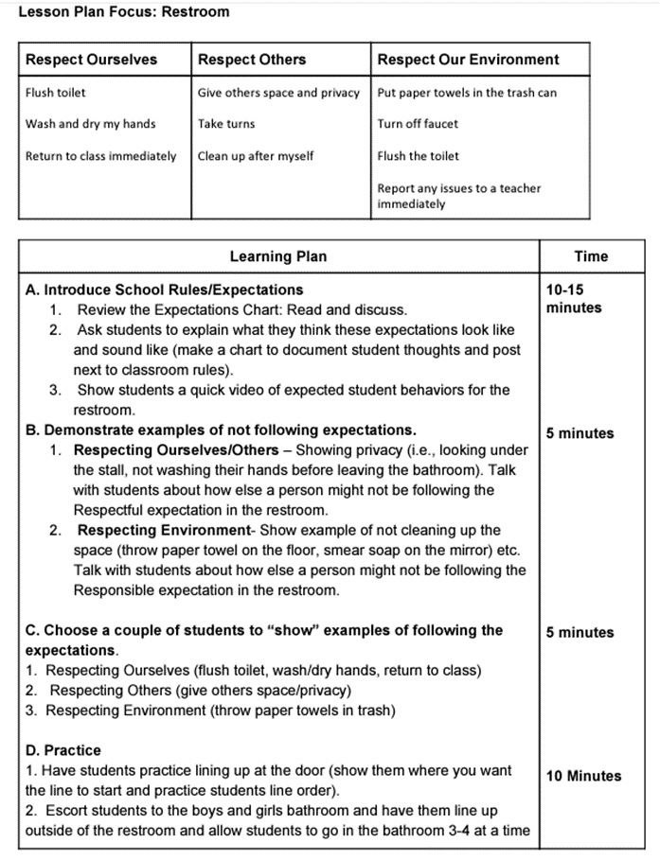
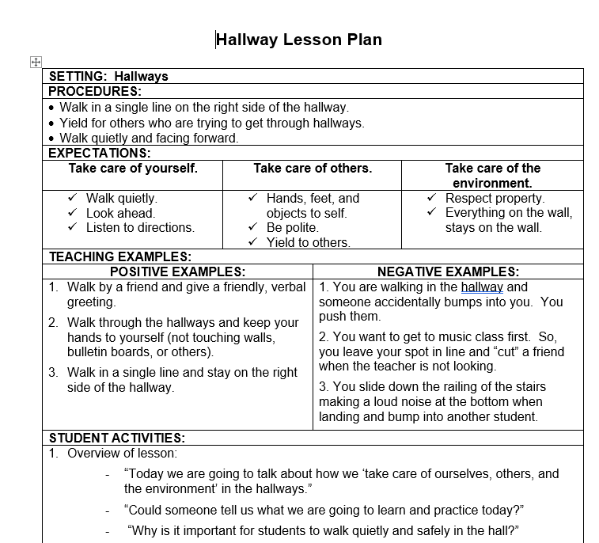
Creating Lesson Plans
Notes:
Lesson Plan Activity and Template https://sebacademy.edc.org/behavioral-lesson-plan-activity
Lesson Plan Samples https://sebacademy.edc.org/list-of-pbis-resources?keyword=Lesson+Plan+Sample&pbis_resource_type=All&pbis_resource_topic=All&sort_by=field_date_value&sort_order=DESC

Slide 116
Social Skill LESSON PLAN TEMPLATE
Skill Name
Getting Help: how to ask for assistance for difficulty tasks
Teaching Examples
1. When you’re working on a math problem that you can’t figure out, raise your hand and wait until the teacher can help you. 2. You and a friend are working together on a science experiment, but you are missing a piece of lab equipment, ask the teacher for the missing equipment. 3. You are reading a story but you don’t know the meaning of most of the words, ask the teacher to read and explain the word.
Kid Activity
1. Ask 2-3 students to give an example of a situation in which they needed help to complete a task, activity, or direction. 2. Ask students to indicate or show how they could get help. 3. Encourage and support appropriate discussion/responses. Minimize attention for inappropriate responses.
After the Lesson (During the Day)
1. Just before giving students difficult or new task, direction, or activity, ask them to tell you how they could get help if they have difficulty (precorrection). 2. When you see students having difficulty with a task (e.g., off task, complaining), ask them to indicate that they need help (reminder). 3. Whenever a student gets help the correct way, provide specific praise to the student.
Notes:
TRAINER NOTE: Lesson plan template available on website and link in resources section at the end of presentation
Lesson Plan Activity and Template https://sebacademy.edc.org/behavioral-lesson-plan-activity
Lesson Plan Samples https://sebacademy.edc.org/list-of-pbis-resources?keyword=Lesson+Plan+Sample&pbis_resource_type=All&pbis_resource_topic=All&sort_by=field_date_value&sort_order=DESC

Slide 117
Team
Action Planning Time

Slide 118
TEAM TIME
Meet with your team and discuss action steps related to the following items reviewed today:
1. Is your team composition set? Do you have norms and roles?
2. Is your statement of purpose complete?
3. How can your team support staff’s understanding PBIS?
4. Do we have Expectations / Core Values that have input from all stakeholders?
5. Have you begun to work on our school wide matrix?
6. If ready, draft one lesson plan together as a team.
Please update your action plans and share with your trainers.
Teams
90 minutes
Prepare to share 1 new action item or goal from your discussion.
Notes:
Lesson Plan Activity and Template https://sebacademy.edc.org/behavioral-lesson-plan-activity
Lesson Plan Samples https://sebacademy.edc.org/list-of-pbis-resources?keyword=Lesson+Plan+Sample&pbis_resource_type=All&pbis_resource_topic=All&sort_by=field_date_value&sort_order=DESC

Slide 119
SHARE OUT
What is one action item your team will continue to work on?
5 minutes
Whole Group

Slide 120
Agenda & Coaches' Tasks
Coaches’ Tasks:
Submit updated Action Plan with Goals
Presentation Content:
Academy Overview
Why PBIS / PBIS Overview
PBIS Teaming
Statement of Purpose and Goal Setting
PBIS Expectations and Matrix
Teaching Expectations – Lesson Plans
Complete Team Comminution List
What questions do you have on today’s content?
What questions do you have on the follow-up tasks?

Slide 121
HELPFUL RSOURCES
RESOURCES:
Team Roles Worksheet
Sample Meeting Norms
Action Plan Template
Behavioral Expectations Teaching Matrix Template
Personal Matrix Activity (students)
PBIS Cultural Responsiveness Field Guide
Lesson Plan Activity and Template
EDC – PBIS Resources (Matrix and Lesson Samples)
Northeast Exemplar Repository
Notes:
Team Roles Worksheet https://sebacademy.edc.org/pbis-team-roles-worksheet
Action Plan Template https://sebacademy.edc.org/action-plan-template-1-year-1-teams-team-meetings
Sample Meeting Norms - https://sebacademy.edc.org/sample-team-noms-expectation-matrix
Behavioral Expectations Teaching Matrix Template https://sebacademy.edc.org/behavior-teaching-matrix
Expectation Matrix Samples https://sebacademy.edc.org/list-of-pbis-resources?keyword=Sample+matrix&pbis_resource_type=All&pbis_resource_topic=All&sort_by=field_date_value&sort_order=DESC
Personal Matrix Activity (students) https://sebacademy.edc.org/personal-matrix-activity-students
PBIS Cultural Responsiveness Field Guide https://sebacademy.edc.org/pbis-cultural-responsiveness-field-guide
Lesson Plan Activity and Template https://sebacademy.edc.org/behavioral-lesson-plan-activity
Lesson Plan Samples https://sebacademy.edc.org/list-of-pbis-resources?keyword=Lesson+Plan+Sample&pbis_resource_type=All&pbis_resource_topic=All&sort_by=field_date_value&sort_order=DESC
Northeast Exemplar Repository https://sebacademy.edc.org/northeast-pbis-exemplar-resources

Slide 122
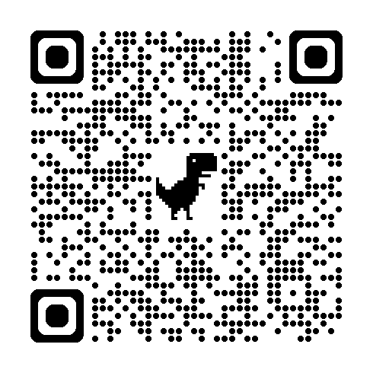
EVALUATION
Please remember to complete the evaluation!
Scan the QR code to access.
Notes:
TRAINERS -
Put link to evaluation (below) in the chat for those who do not use the QR code:
Evaluation Surveyhttps://docs.google.com/forms/d/e/1FAIpQLSdz32jKVAGdKiP3VzhqzA91uJEu8DkBOeJZo9-FDfnKBx_vDQ/viewform

