Slide 1


PBIS Coaches’ Training
Year 2: November 2024
Trainers Names
Created from content from the National Technical Assistance Center on Positive Behavioral Interventions and Supports
U.S. Department of Education, Office of Special Education Programs and Office of Elementary and Secondary Education
with support from NEPBIS Network, May Institute, & Broad Reach Consulting

Slide 2

EXPECTATIONS
Self
Others
Environment
Self-monitor
Mute when listening, unmute to talk​
Have your computer charged and ready to go​
If you have questions or comments:
Work as a team:
Keep necessary materials at hand
Are you participating?
Engaged as a learner?
Stretch, break, stand as needed​
unmute
use the chat box
Room for every voice
Reinforce participation
action plan
relevant docs
water/snacks
Minimize distractions if possible​

Slide 3
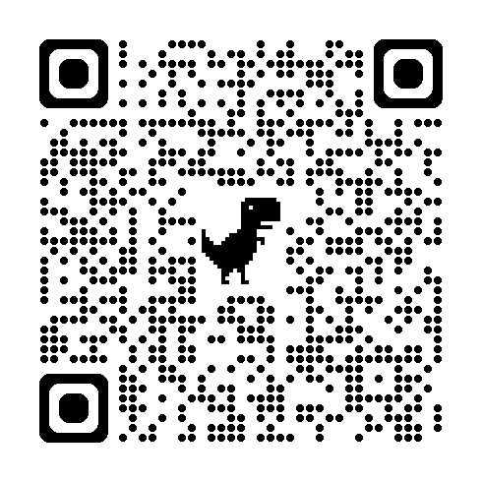
ACTIVITY: ATTENDANCE
Scan QR code on the left or follow the URL posted in the chat to access the online attendance survey
Follow prompts to enter attendance information
Notify trainers if you require assistance (e.g., identifying your cohort or cohort group)
Certificates of Attendance will be sent in January and June. Attendance records will be use as verification
1 minute
Notes:
ATTENDANCE: https://go.edc.org/SEB-Academy-Sign-In

Slide 4
Agenda & Coaches' Tasks
Coaches’ Tasks:
Presentation Content:
Glows & Grows: First In-Person Training
Decide how and when to solicit staff, student & family input: Focus Group, Feedback & Input Survey, School Created Survey – Add to Action Plan
Using Surveys to Gather Data
Family Engagement
Complete Family-School Practices Survey with your team

Slide 5
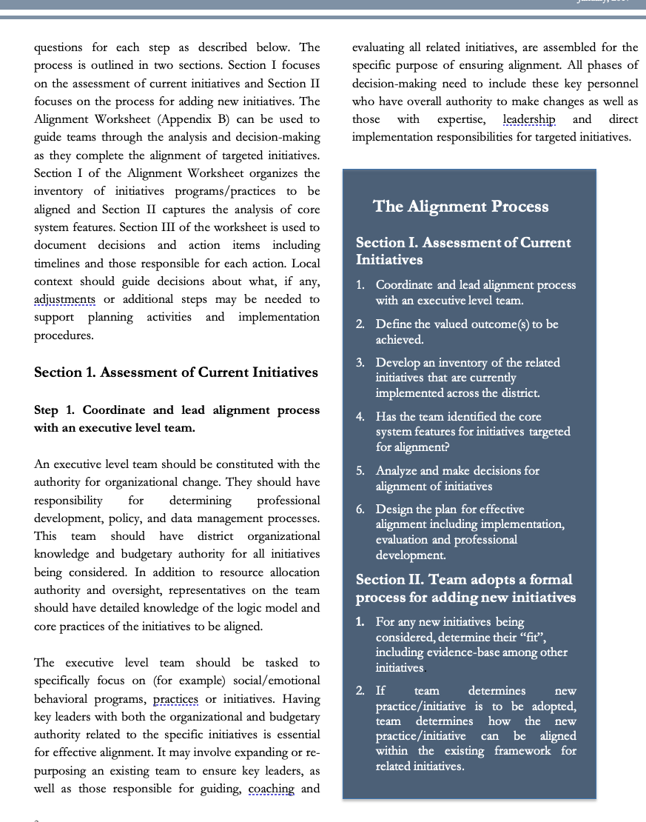
HELPFUL RESOURCES
RESOURCES:
Feedback & Input Survey Manual
Overview of the Feedback and Input Survey
Climate Survey Manual
Self-Assessment Surveys
Aligning and Integrating Family Engagement in Positive Behavioral Interventions and Supports:
School-Family Practices Survey
Article: 7 Ways to Partner with Students and Level Up Your Implementation
Video: Voice’s role in Implementation (Student, Family and Community Voice)
Notes:
RESOURCES:
Feedback & Input Survey Manual https://sebacademy.edc.org/pbis-feedback-input-survey-manual
Overview of the Feedback and Input Survey https://sebacademy.edc.org/overview-feedback-and-input-surveys
Climate Survey Manual- https://sebacademy.edc.org/pbis-climate-survey-manual
Self-Assessment Surveys - https://www.pbisapps.org/resource/self-assessment-survey
Family School Practices Survey: https://uconn.co1.qualtrics.com/jfe/form/SV_4U9QPw9ASvLr83z
Article: 7 Ways to Partner with Students and Level Up Your Implementation https://www.pbisapps.org/articles/7-ways-to-partner-with-students-and-level-up-your-implementation
Video: Voice’s role in Implementation (Student, Family and Community Voice) - https://www.pbisapps.org/articles/ep-5-voices-role-in-implementation
Aligning and Integrating Family Engagement in Positive Behavioral Interventions and Supports: https://www.pbis.org/Common/Cms/files/pbisresources/Family%20Engagement%20in%20PBIS.pdf

Slide 6

Glows & Grows:
Start of the Year
Notes:
12:30

Slide 7
Questions? Glows/Grows
Each coach share one glow or grow about first in person training day and/or your progress for the beginning of the year.
Whole Group
10 minutes

Slide 8
DATA SOURCES FOR EVALUATION
Resource Spotlight
Notes:
These should be repeats for year 2 schools– go through quickly

Slide 9
MONITORING & EVALUATING PBIS PRACTICES
Use data to monitor the implementation & effectiveness of PBIS practices
Linked with meaningful outcome goals
Communicates purpose
Guides action planning
Used to measure and demonstrate progress
It is important to collect both Qualitative (feedback) and Quantitative (outcome) data

Slide 10
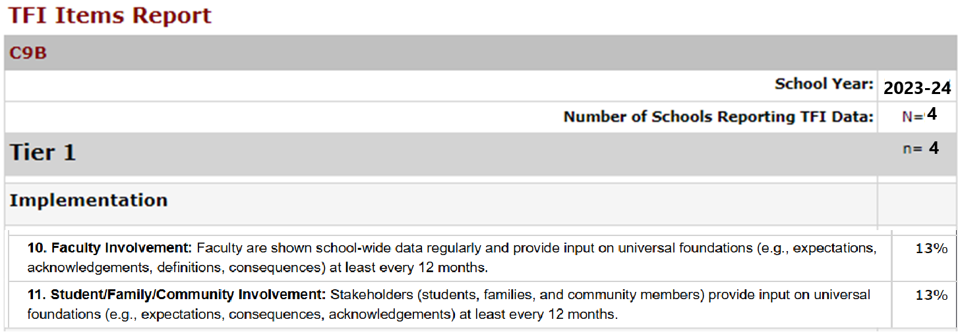
TFI 10 – Feedback and Input
TFI Questions 10 & 11: Teams typically report lower scores on these 2 questions
Staff Input (question 10)
3/4 Teams = 0%
1/4 Teams = 50%
Student/Family Input (question 11)
3/4 Teams = 0%
1/4 Teams = 50%

Slide 11
Climate Survey vs. Feedback & Input Survey
The School Climate Surveys are formal measures with strong evidence of reliability and validity for measuring quantitative perceptions of school climate.
The results are used to identify current status of school climate and to monitor progress over time. The School Climate Surveys are outcome measures.
The Feedback and Input Surveys give you more meaningful qualitative information about the experiences and suggestions of students, families, and school personnel. These surveys offer the entire school community a place to share their direct feedback with decision-makers.
The results are used to inform action plans to improve the effectiveness, efficiency, equity, and sustainability of Tier 1 behavior support systems. The Feedback and Input Surveys are feedback measures.

Slide 12
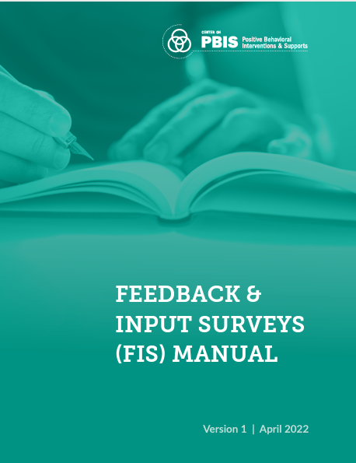
PBIS Assessment: Feedback & Input Surveys
The FIS is a set of four surveys to learn about how students, school personnel, and family members experience the school’s behavior support systems.
Surveys in the FIS include: (English & Spanish)
  Feedback and Input Survey: Elementary
  Feedback and Input Survey: Secondary
  Feedback and Input Survey: School Personnel
  Feedback and Input Survey: Family
Overview of Feedback and Input Survey
Available on PBIS Assessment – Used Annually
Notes:
Feedback & Input Survey Manual https://www.pbisapps.org/resource/feedback-input-surveys-fis-manual
Overview of Feedback and Input Survey - https://sebacademy.edc.org/overview-feedback-and-input-surveys

Slide 13
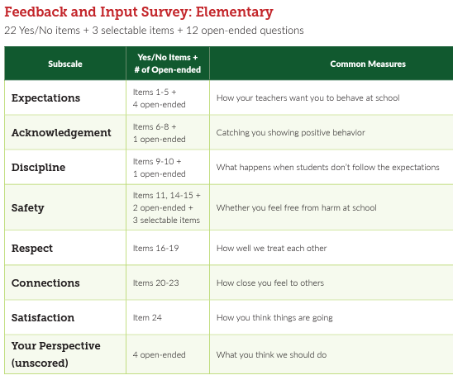
Student Surveys Elementary and Secondary
The student surveys are the same, but questions are phrased differently for the different age groups.
The secondary survey also has a few additional demographic categories
Elementary Grades: 3-6
Secondary Grades: 6-12

Slide 14
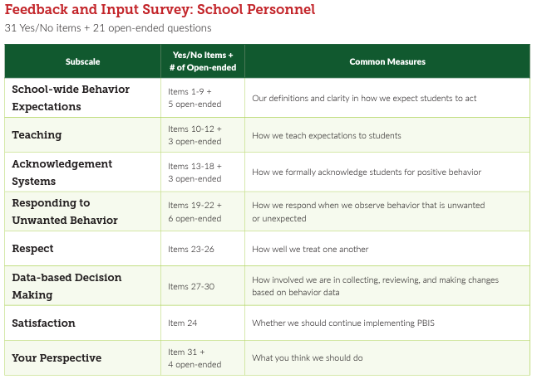
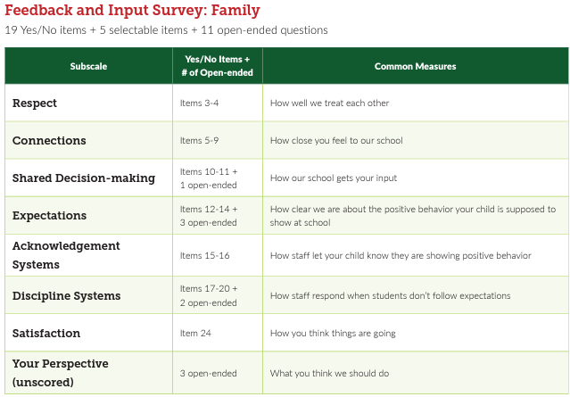
Staff and Family Input Surveys

Slide 15
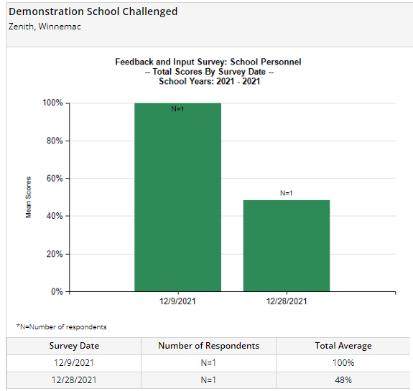
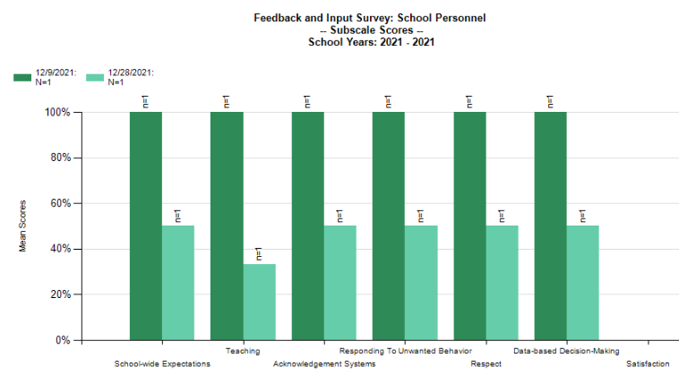
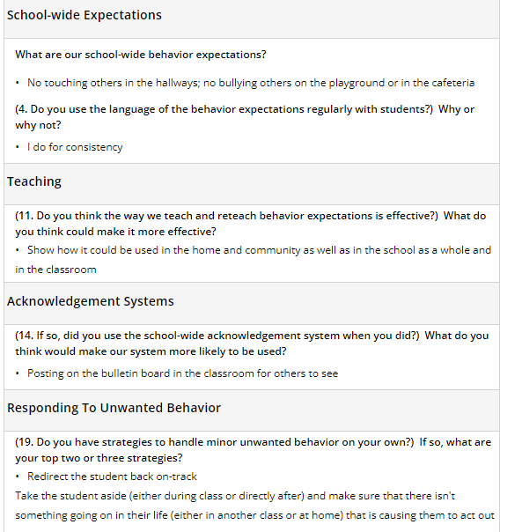
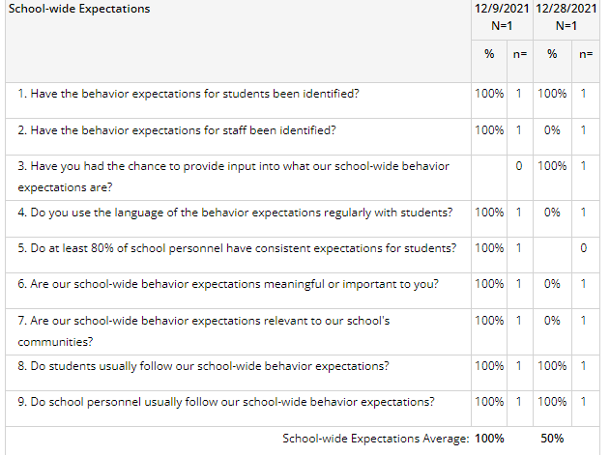
FEEDBACK & INPUT SURVEY REPORTS
Subscale
Comments
Total Score
Items

Slide 16

PBIS Assessment: Climate Surveys
The School Climate Survey Suite is a set of five multidimensional surveys to measure student, teacher, administrator, faculty, and family perceptions of school climate.
Climate Surveys include: (English & Spanish)
  Climate Survey: Elementary (3-6)
  Climate Survey: Secondary (6-12) (short or extended)
  Climate Survey: School Personnel
  Climate Survey: Family
Available on PBIS Assessment – Used Fall/Spring or Annually
Notes:
School Climate Surveys - https://sebacademy.edc.org/pbis-climate-survey-manual

Slide 18
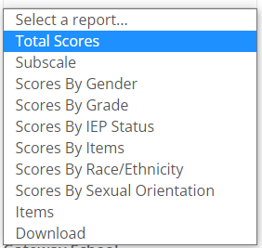
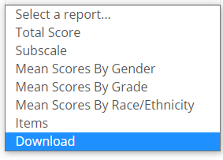
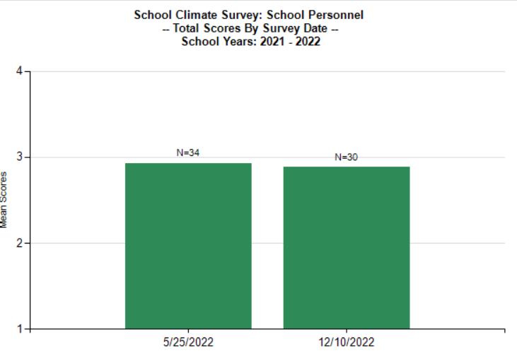
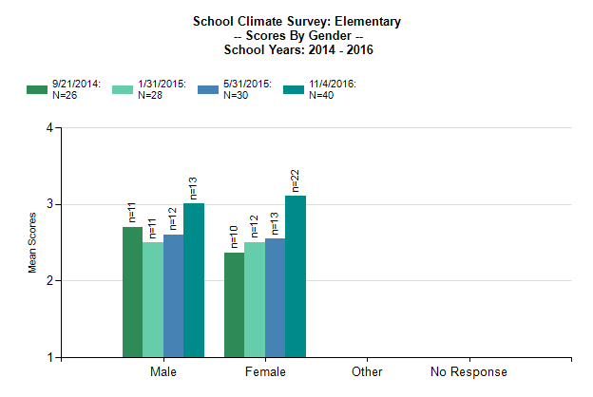
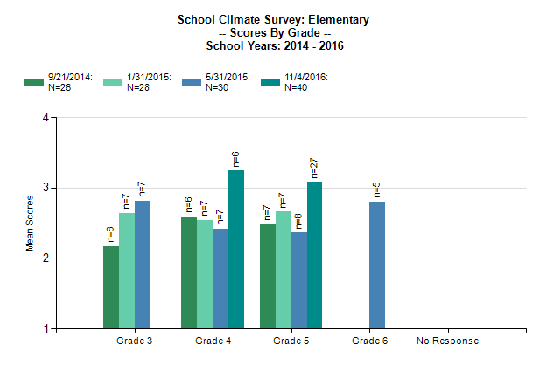
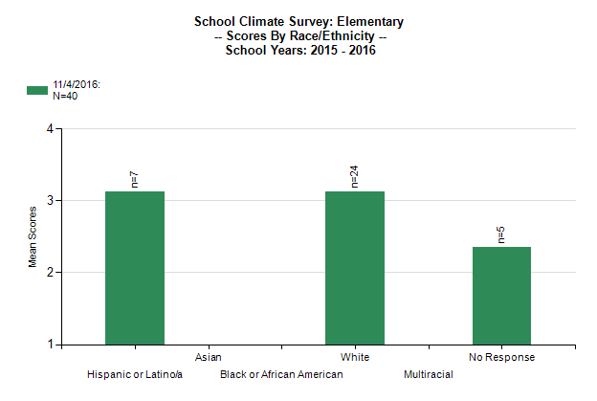
SCHOOL CLIMATE SURVEY REPORTS
Student Reports
Staff and Family Reports
Notes:
How Schools are Using the Climate Survey (national norms) - https://sebacademy.edc.org/how-are-schools-using-school-climate-surveys
How Schools are Using the Parent and Staff Climate Survey (national norms) - https://sebacademy.edc.org/how-are-schools-using-parent-and-personnel-school-climate-surveys

Slide 19
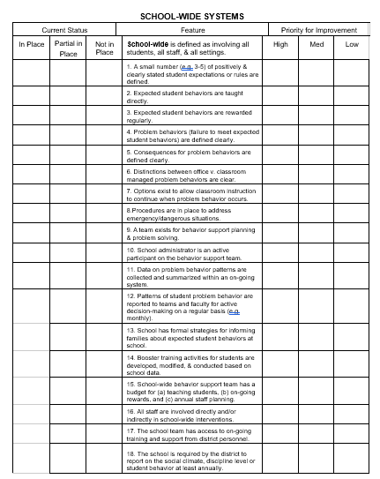
PBIS Assessment: Self-Assessment Survey (SAS)
The Self-Assessment Survey is a progress monitoring survey. It measures staff perception of the implementation status and improvement priority for:
  School-wide Systems
  Classroom Systems
  Non-classroom Systems
  Individual student systems.
Available on PBIS Assessment – Annually Or Bi-Annually

Slide 20
SELF ASSESSMENT SURVEY
SCHOOL-WIDE SYSTEMS
Current Status |  |  | Feature | Priority for Improvement
In Place | Partial in Place | Not in Place | School-wide is defined as involving all students, all staff, & all settings. | High | Med | Low
 |  |  | 1. A small number (e.g. 3-5) of positively & clearly stated student expectations or rules are defined.
 |  |  | 2. Expected student behaviors are taught directly.
 |  |  | 3. Expected student behaviors are rewarded regularly.
 |  |  | 4. Problem behaviors (failure to meet expected student behaviors) are defined clearly.
 |  |  | 5. Consequences for problem behaviors are defined clearly.
 |  |  | 6. Distinctions between office v. classroom managed problem behaviors are clear.
 |  |  | 7. Options exist to allow classroom instruction to continue when problem behavior occurs.

Slide 21
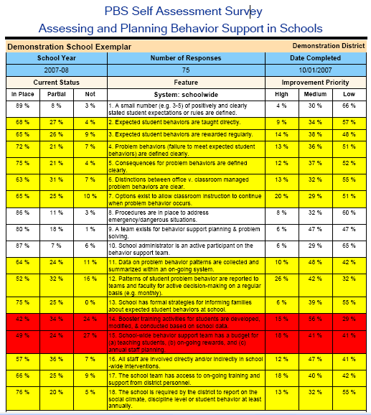
Let us know if you’re interested in conducting the SAS this year.
Notes:
Red – less than 50% in place
Yellow – 50-79% in place
White – 80% in place or higher

Slide 22

Guidelines for Efficient Data Review Routines
Protect team time to review data monthly
Identify 2-3 staff members to:
  manage data systems
  provide efficient, timely, and graphic displays of data
Establish structures and routines for staff members to receive weekly/monthly data reports about status of SW discipline

Slide 23
DISCUSSION: Feedback & Input
Download & Review The various survey manuals.
Review Surveys
Would this information be valuable to your team?
Do you already collect this type of data? From all groups?
Which group would you most like to survey this year?
10 minutes
10 minutes
Coach Review/Chat
Whole Group
Notes:
Climate Survey Manual - https://sebacademy.edc.org/pbis-climate-survey-manual
Feedback & Input Survey Manual https://sebacademy.edc.org/pbis-feedback-input-survey-manual

Slide 24
Big Idea!
PRACTICES:
FAMILY ENGAGEMENT
How do we ensure families are actively participating in our framework?
Notes:
TRAINER NOTE: This information was provided to coaches and teams last month. As this is review, please go through the slides at a quicker pace unless coaches have questions. Focus on the discussions and please express to the coaches that the importance of reviewing this information as part of a coach community is to now learn from each other about how to support more disaggregation with our data together.
So in a sense, last month was within teams, this month will be cross school discussions with this important feature.

Slide 25

What is family engagement?
Including families in PBIS implementation means families and school personnel work together and share in the responsibility making educational decisions and improving student outcomes.
(Center on PBIS, 2022)

Slide 26
Why family engagement? Students benefit!
Student Achievement (Fan & Chen, 2001)
Attendance (Simon, 2001)
xxx
Social-emotional-behavioral Outcomes (Fantuzzo et al., 2004; Garbacz & McIntyre, 2016)
Peer Group Affiliations (Garbacz et al., 2018)
xxx
School drop-out (Barnard, 2004)
Behavior Problems (Garbacz et al., 2020)
Notes:
Parents and teachers also benefit from working together. Parents’ report improvements in their efficacy for helping their children with schoolwork and their trust of teachers.
Teachers report improved job satisfaction and tend to request fewer transfers.
When parents and teachers collaborate to support children’s behavior, child behavior improves, parents and teachers report improvements in their problem-solving competences, and the relationship parents and teachers share improves.

Slide 27
Why family engagement? Parents and teachers benefit, too!
xxx
Parent efficacy and competence (Semke et al., 2010; Sheridan et al., 2012)
Parent trust of teachers (Santiago et al., 2016)
Teacher job satisfaction (Christenson, 1995)
Parent-teacher relationship (Sheridan et al., 2017)

Slide 28
What are the foundational elements of family engagement?
Two-Way Communication
Equity, Access, Representation
Meaningful Decision-Making
Intentionally obtain diverse and proportional input
Provide diverse range of opportunities for families to make shared decisions about PBIS systems and practices
Recognize family needs
Positive Relationships
Value cultural differences
Collect data on perceptions of home-school relationships
Engage in meaningful, two-way communication
Provide multiple avenues for families receive and provide information
Empower families with knowledge and skills to effectively support student learning
Cultivate social connections and networks among families
Effectively engage families in advanced student behavior supports
(Center on PBIS, 2022)

Slide 29

Family Engagement in PBIS
Reviews the reasons for family engagement in schools
Identifies practical strategies for promoting and supporting family engagement
Considers family engagement across diverse contexts and groups
(Center on PBIS, 2017)
Notes:
Aligning and Integrating Family Engagement in Positive Behavioral Interventions and Supports: https://www.pbis.org/Common/Cms/files/pbisresources/Family%20Engagement%20in%20PBIS.pdf

Slide 30

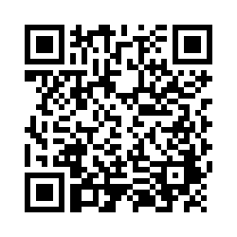
Examining School Approaches to Family Engagement in PBIS
The Family-School Practices Survey for school teams is a self-assessment and action planning tool.
Approaches to family engagement are assessed in several areas:
Communication
Family-School Activities
PBIS Practices at Home and School
Decision-Making/Shared-Ownership
Resources
(Garbacz, McIntosh, & Eagle, 2014)
Notes:
Take a few minutes to complete the self-assessment, identify areas of strength and need, and complete the action plan at the end of the tool to target areas of need that build on strengths
Link to assessment: https://uconn.co1.qualtrics.com/jfe/form/SV_4U9QPw9ASvLr83z

Slide 31

ACTIVITY: Family-School Practices Survey
As a Coach
Open the Family-School Practices Survey
Review the sections and questions
Consider about how this might be useful to your team
As a team:
Complete the Family-School Practices Survey
Add 2 to 3 items to your action plan based on priorities discussed while completing the survey
Review - 15 min
Share - 5 min
Notes:
Family School Practices Survey: https://uconn.co1.qualtrics.com/jfe/form/SV_4U9QPw9ASvLr83z

Slide 32
Looking Ahead
FAMILY ENGAGEMENT
How do we ensure families are actively participating in our framework?

Slide 33
WHY DISAGGREGATE OUTCOME DATA?
Allows comparisons between groups (e.g., grade, gender, (dis)ability, race/ethnicity, etc.)
Facilitates development of precise problem statements
Supports equitable decision-making

Slide 34
EXAMPLE 1: SURVEY DATA
Do students who are gay/lesbian feel safe at school?
“I feel safe…”
Average scores by sexual orientation
Does your school have survey data that can be disaggregated?

Slide 35
DISAGGREGATING DATA
What questions does your team or school have about equitable outcomes or experiences for students?
Bring student data that you can or have disaggregated to answer those questions. Such as:
Survey data (school climate, etc.)
Attendance
ODRs
Referrals to Special Education
Suspension
How can you ensure that all students have access to equitable educational opportunities?

Slide 36
Agenda & Coaches' Tasks- Debrief
Coaches’ Tasks:
Presentation Content:
Glows & Grows: First In-Person Training
Decide how and when to solicit staff, student & family input: Focus Group, Feedback & Input Survey, School Created Survey – Add to Action Plan
Using Surveys to Gather Data
Family Engagement
Complete Family-School Practices Survey with your team
What questions do you have on today’s content?
What questions do you have on the follow-up tasks?

Slide 37
HELPFUL RESOURCES
RESOURCES:
Feedback & Input Survey Manual
Overview of the Feedback and Input Survey
Climate Survey Manual
Self-Assessment Surveys
Aligning and Integrating Family Engagement in Positive Behavioral Interventions and Supports:
School-Family Practices Survey
Article: 7 Ways to Partner with Students and Level Up Your Implementation
Video: Voice’s role in Implementation (Student, Family and Community Voice)
Notes:
RESOURCES:
Feedback & Input Survey Manual https://sebacademy.edc.org/pbis-feedback-input-survey-manual
Overview of the Feedback and Input Survey https://sebacademy.edc.org/overview-feedback-and-input-surveys
Climate Survey Manual- https://sebacademy.edc.org/pbis-climate-survey-manual
Self-Assessment Surveys - https://www.pbisapps.org/resource/self-assessment-survey
Family School Practices Survey: https://uconn.co1.qualtrics.com/jfe/form/SV_4U9QPw9ASvLr83z
Article: 7 Ways to Partner with Students and Level Up Your Implementation https://www.pbisapps.org/articles/7-ways-to-partner-with-students-and-level-up-your-implementation
Video: Voice’s role in Implementation (Student, Family and Community Voice) - https://www.pbisapps.org/articles/ep-5-voices-role-in-implementation
Aligning and Integrating Family Engagement in Positive Behavioral Interventions and Supports: https://www.pbis.org/Common/Cms/files/pbisresources/Family%20Engagement%20in%20PBIS.pdf

Slide 38
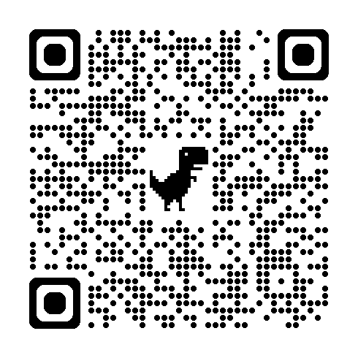
EVALUATION
Please remember to complete the evaluation!
Scan the QR code to access.
Notes:
TRAINERS -
Put link to evaluation (below) in the chat for those who do not use the QR code:
Evaluation Survey: https://go.edc.org/SEB-Academy-Event-Evaluation

