Slide 1


PBIS School-Wide Coach Meeting
Year 3: October 2023
Add Trainer Names
Created from content from the National Technical Assistance Center on Positive Behavioral Interventions and Supports
U.S. Department of Education, Office of Special Education Programs and Office of Elementary and Secondary Education
with support from NEPBIS Network, May Institute, & Broad Reach Consulting
Notes:
Add trainer names for your event

Slide 2

EXPECTATIONS
Self
Others
Environment
Self-monitor
Mute when listening, unmute to talk​
Have your computer charged and ready to go​
If you have questions or comments:
Work as a team:
Keep necessary materials at hand
Are you participating?
Engaged as a learner?
Stretch, break, stand as needed​
unmute
use the chat box
Room for every voice
Reinforce participation
action plan
relevant docs
water/snacks
Minimize distractions if possible​

Slide 3
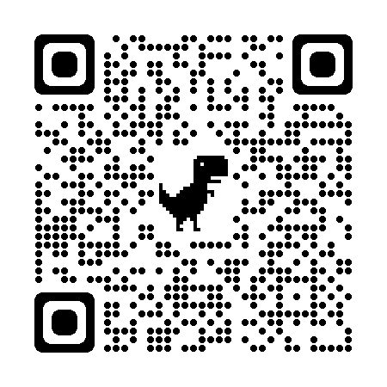
ACTIVITY: ATTENDANCE
Scan QR code on the left or follow the URL posted in the chat to access the online attendance survey Follow prompts to enter attendance information
Notify trainers if you require assistance (e.g., identifying your cohort or cohort group)
Certificates of Attendance will be sent in January and June. Attendance records and Zoom log in will be use as verification
You are in Cohort 8
1 minute
Notes:
TRAINERS – QR Code is updated
Add your cohort number
Post a link to the attendance survey (below) in the chat for those who do not use the QR code on the slide: https://edc.co1.qualtrics.com/jfe/form/SV_81vbI1jl3cwmLY2

Slide 4
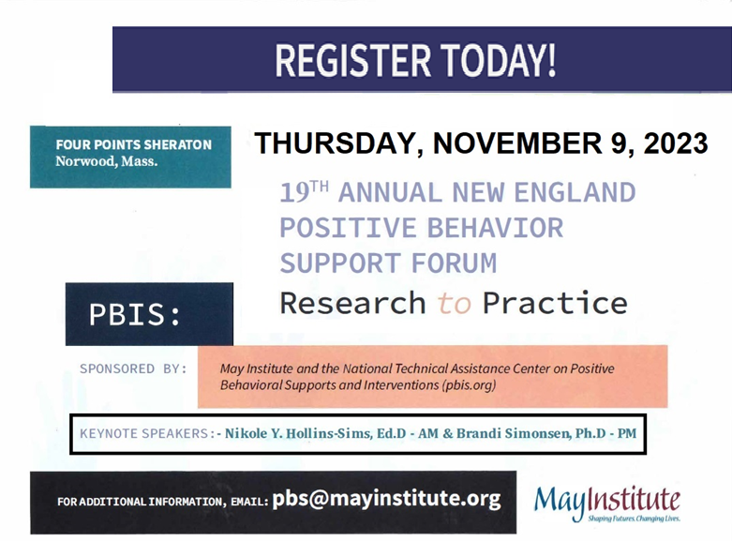
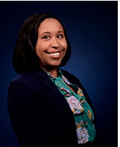
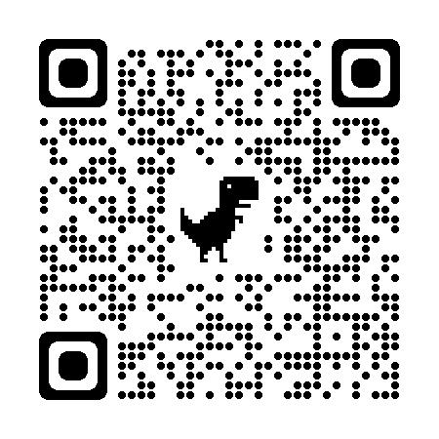
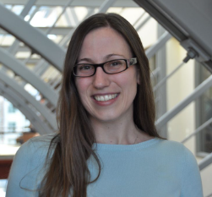
Nikole Hollins-Sims, Ed.D
Brandi Simonsen, Ph.D
https://www.mayinstitute.org/services-for-schools/pbis/forum.html
Notes:
https://www.mayinstitute.org/services-for-schools/pbis/forum.html

Slide 5
Agenda & Coaches' Tasks
Coaches’ Tasks:
Presentation Content:
PBIS Academy Year 3 Training and Support Structure
Complete and send in your PBIS Assessment Coordinator Form
Complete Communication List in your Google Account for list of team members with emails for event reminders
Submit Advanced Action Plan with Team/Meeting portion completed your assigned SEB Academy Google Drive
Glows & Grows: PBIS Rollout
Prepping for November Roundtables
Action Planning, Goals, Student Partners

Slide 6
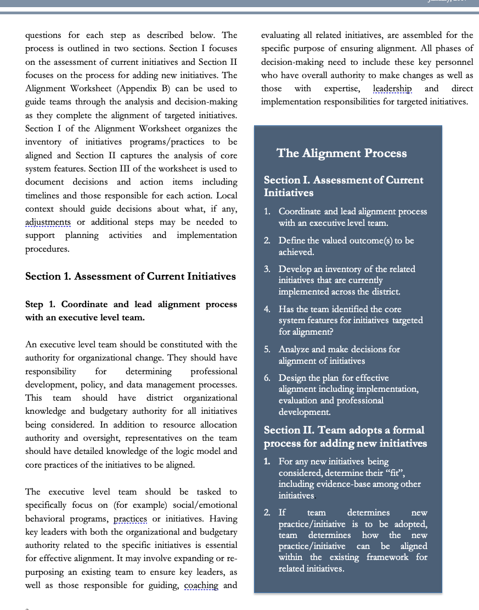
HELPFUL RESOURCES
RESOURCES:
Advanced Action Plan
Team meeting foundations checklist
PBIS Assessment Coordinator form
Logic Model Sample & Template
7 Ways to Partner with Students and Level Up Your Implementation
Notes:
RESOURCES – Strongly encourage coaches to down load these resources.
Advance Action Plan: https://sebacademy.edc.org/annual-action-plan-template-advanced
Team meeting foundations checklist: https://sebacademy.edc.org/team-meeting-foundations-checklist
PBIS Assessment Coordinator Form https://sebacademy.edc.org/pbis-assessment-coordinator-form
Logic Model Sample & Template https://sebacademy.edc.org/pbis-logic-model-activity-directions-samples-and-template
7 Ways to Partner with Students and Level Up Your Implementation - https://www.pbisapps.org/articles/7-ways-to-partner-with-students-and-level-up-your-implementation

Slide 7

SEB Academy
Support Structure

Slide 8
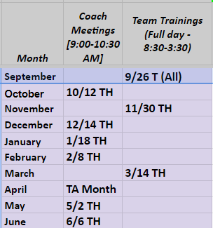
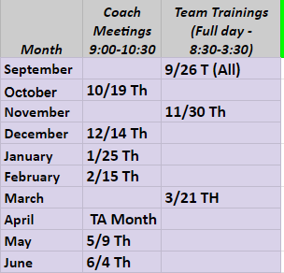
Cohort 8 Training Dates
Cohort 8A – Erik Maki
Cohort 8B – Christine Downs & Marcie Handler

Slide 9
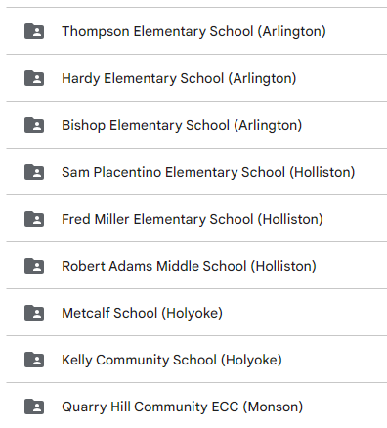
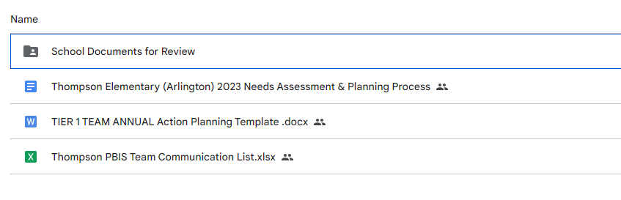
Google Drive – For Submitting Documents
All schools will be connected to their Google Folder.
Add documents here for review by your PBIS Trainer
Notes:
Review how to read directions and how to upload into canvas

Slide 10
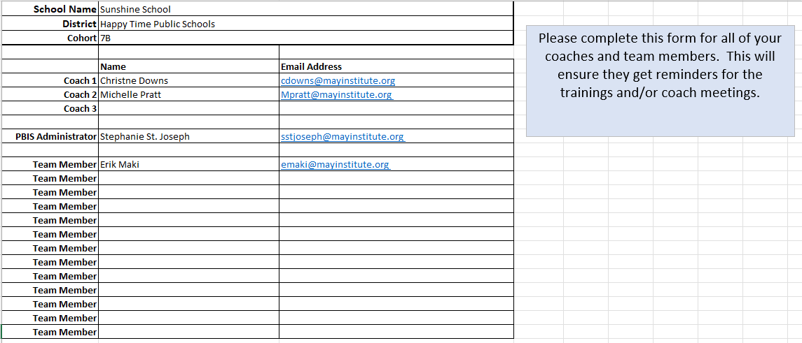
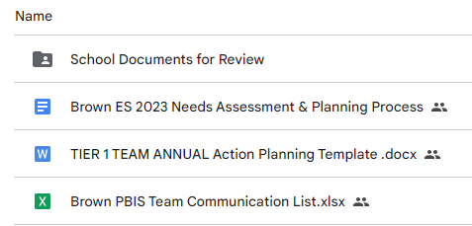
Communication Survey & Mail Chimp
Please add all your team’s contact information into the Communication Excel Sheet.
Move to School Documents for Review folder in your school’s Google Folder when completed
Communications List
Notes:
https://edc.co1.qualtrics.com/jfe/form/SV_db8zhNj6NJ3eXga
Go to website demonstrate how to download Team Member List and how to upload it.

Slide 11
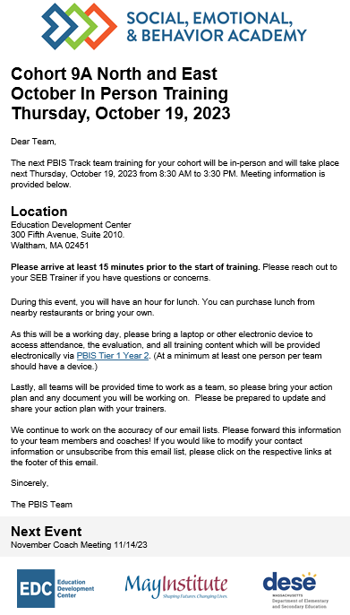
Communication Reminders
Email Reminders will be sent to all coaches, administrators and team members for our PBIS Events. The email will come from SEB Academy sebacademy@edc.org
Please review invitation for Date, Time, Location/Zoom Link, and any other important information included.
The next training or coach meeting will be displayed at the bottom
Share with other Coaches or Team Members

Slide 12
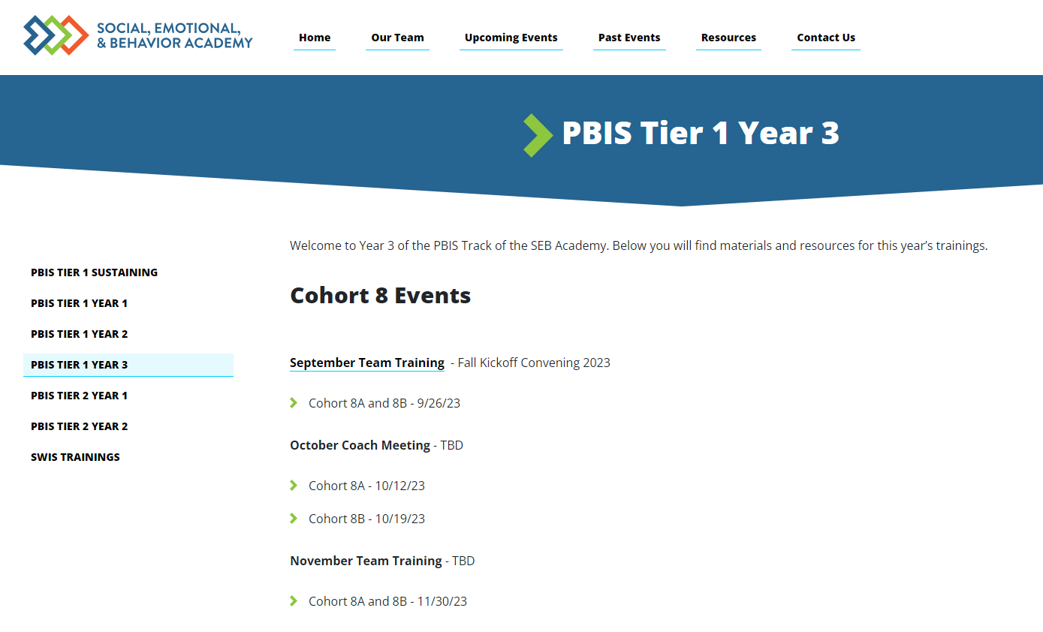
Year 3 page
Under Construction– All Monthly information will be displayed here soon!
Notes:
This page is in the process of being created/updated. Please be patient it will be functioning soon. Please check back. All information for each monthly training or meeting will be displayed here

Slide 13
Review: Google Drive
Log into your Google Folder
Review Communication Survey. Complete with your team and put back into your Google Folder for your Trainer to review.
Independent
5 minutes
Notes:
https://sebacademy.edc.org/annual-action-plan-template-advanced

Slide 14
Glows & Grows
Notes:
12:30

Slide 15
DISCUSSION: GLOWS & GROWS
Please Share
1 item to celebrate year (Glow)
1 item you’re working on (Grow)
Consider: Goals from last year, TFI Results from Last year, Summer Planning / Fall Kick Off
5 minutes
15 minutes
Independent Jot / Coach chat
Whole Group
Notes:
Try to keep this going quickly…there will be other times for teams to share.

Slide 16
Big Idea Check In:
Yearly Planning & Outcome Goals
Notes:
TRAINER NOTE: This is review contnent please be brief

Slide 17
DATA-INFORMED OUTCOME GOALS
Review the following with your team when considering your PBIS outcome goals for the year:
Fidelity Assessments (TFI, TIC)
Student Outcome Data (attendance, screening, discipline, grades)
Stakeholder Input (surveys, focus groups)
School/District Priorities (DIP, SIP)
Notes:
We will review Stakeholder Input Surveys (new on PBIS apps) in October.
Teams should consider these factors when setting goals for this year.

Slide 18
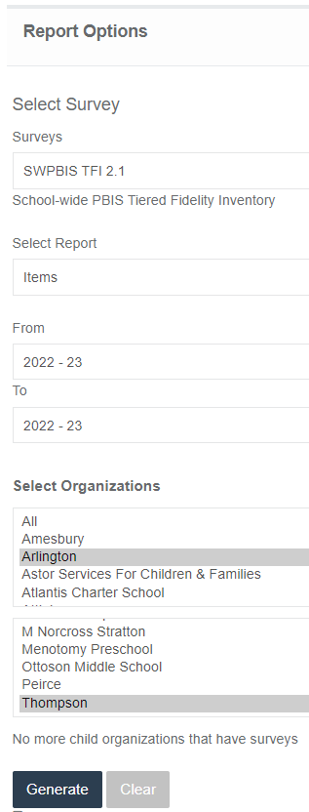
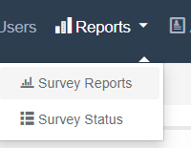
Review: TFI – Consider Goals for 23-24
Go to PBISapps.org and log into your PBIS Assessment account.
Go to REPORTS and choose Survey Reports
Choose SWPBIS TFI 2.1 Survey and Items Report for the 22-23 SY – You may need to select your district and school under Organizations. (see sample) and click GENERATE
7 minutes
3 minutes
Coach Chat
Whole Group
Notes:
https://sebacademy.edc.org/annual-action-plan-template-advanced
Quick share out on one thing that might be a goal for the year.

Slide 19

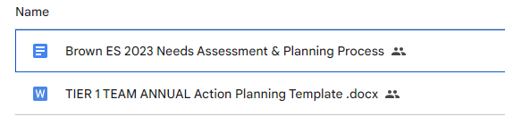
Action Plan – Annual Planning Advanced Years
Notes:
Ask Coaches to download this Action Plan for use this year. Will be reviewed in the next slide.
https://sebacademy.edc.org/annual-action-plan-template-advanced

Slide 20
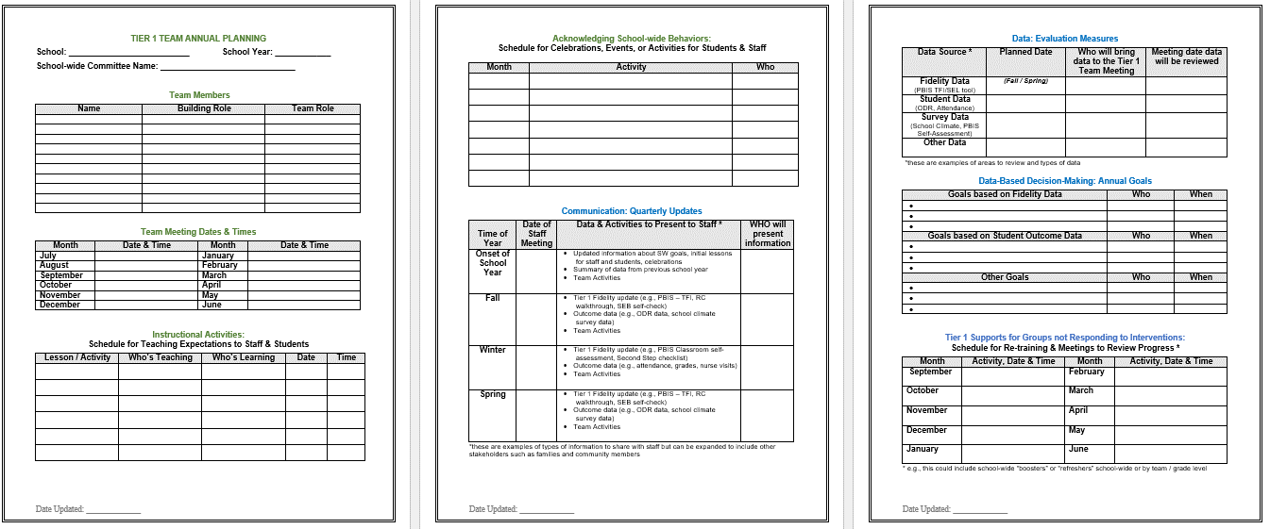
Action Plan – Annual Planning
Acknowledgment Plans
Evaluation Measures
Team
Info
Annual Goals
Teaching Expectations Plan
Communication
Tier 1 Student Follow Up
Notes:
This Action plan is more advanced and is intended for schools in years 2 and beyond. Review with the team.
https://sebacademy.edc.org/annual-action-plan-template-advanced

Slide 21
DISCUSSION: Action Planning & Systems
Open & Review Advanced Action Plan in your Google drive
Consider what parts you can fill in and what you need to work on. (This can be completed later with your team)
Add ideas for your possible 23-24 goal
5 minutes
5 minutes
Independent Jot
Whole Group
Notes:
https://sebacademy.edc.org/annual-action-plan-template-advanced also in their Google Folders

Slide 22
PBIS
Resource Spotlight:
PBIS Assessment: Student Involvement

Slide 23
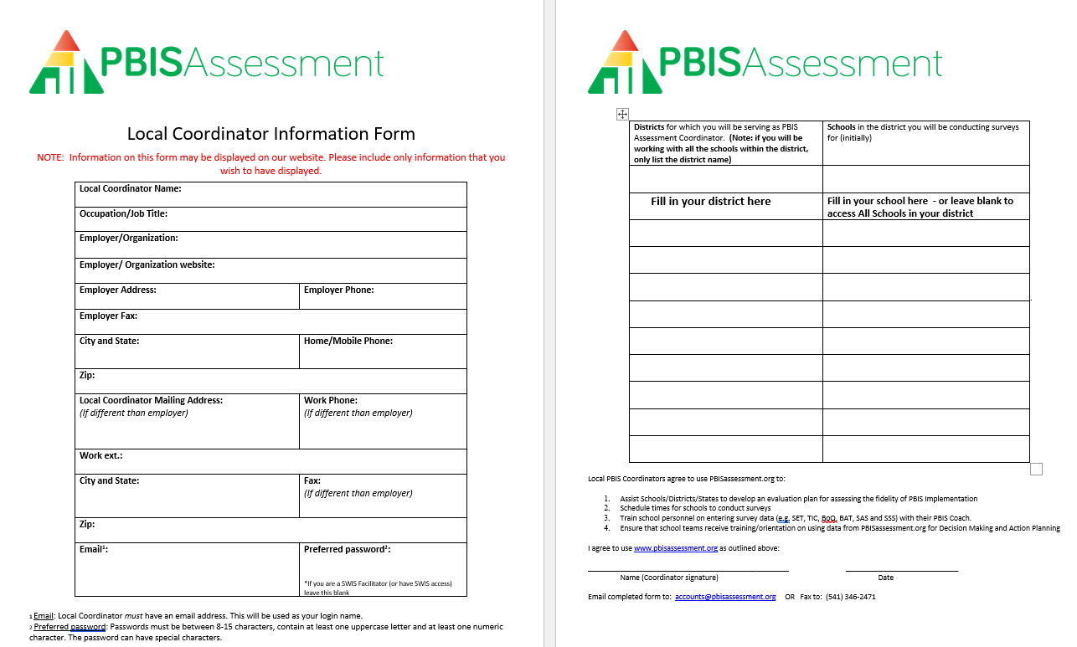
PBIS Assessments Coordinator
In October we will review how to open Assessments and surveys in PBIS Apps.
Please download and complete form and send to: accounts@pbisassessment.org
“Hello,
Please add me as a PBIS Assessment Coordinator. See attached form.
Thank you,”
Notes:
Have coaches download this form from the EDC PBIS Resource page. https://sebacademy.edc.org/pbis-assessment-coordinator-form
They should complete it and send it to accounts@pbisassessment.org with the script “Hello,
Please add me as a PBIS Assessment Coordinator. See attached form.
Thank you,”

Slide 24
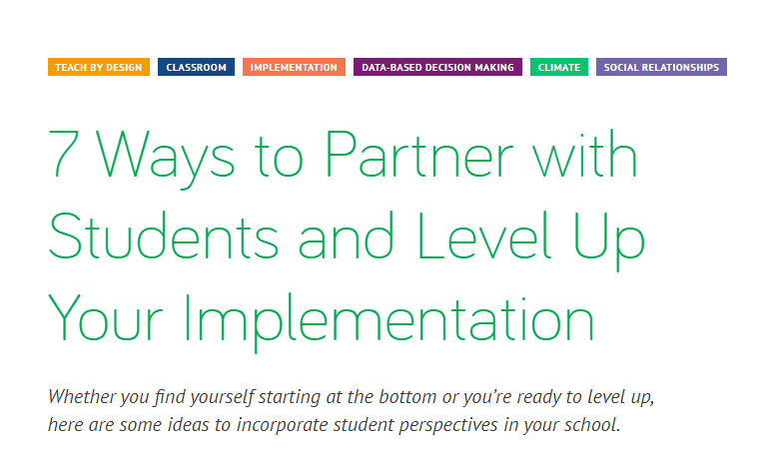
Partnering with Students
“By including student voices and perspectives in your decision-making process, they feel more empowered, more connected to their school, and start to think more critically about the systems around them. Even adults say working with young people had a positive effect on their own development and contributed to the overall effectiveness of their organizations.[4]”
Notes:
7 Ways to Partner with Students and Level Up Your Implementation - https://www.pbisapps.org/articles/7-ways-to-partner-with-students-and-level-up-your-implementation

Slide 25
Review
Review both resources
Complete the PBIS Assessment form and send to accounts@pbisassessment.org
Read Student Partner article and consider how it might impact your work. Share with Team
5 minutes
Independent Review
Notes:
https://sebacademy.edc.org/pbis-assessment-coordinator-form
7 Ways to Partner with Students and Level Up Your Implementation - https://www.pbisapps.org/articles/7-ways-to-partner-with-students-and-level-up-your-implementation

Slide 26
Looking Ahead

Slide 27

NOVEMBER Team Training
8A – November 30th 8:30-3:30 - Waltham
8B – November 30th 8:30-3:30 - Worcester
BIG IDEAS
Roundtable Sharing/Discussions
Classroom: Goals, Data, Assessments, & PD
PBIS Handbook Review

Slide 28
Logic Model Roundtable Discussions
Why are we doing this?
Schools report that the time spent sharing and learning from other cohort schools is incredibly valuable.
It becomes a concrete example for problem solving to share with your School Committee/Superintendent.
It helps with School Staff Buy In (families and community too) by showing how PBIS uses data to implement change within the school.
Excellent example to use when applying for funding/grants.
Creates a model you can use to chronical your PBIS school improvements and include in your end of year evaluation report.

Slide 29
ROUNDTABLE DISCUSSIONS
Purpose: present one example of how you have used Systems, Data, and Practices to achieve a specific outcome.
Present to team members from other schools
Outline your school’s example using the logic model template (outcomes, systems, data, practices).
Be prepared to share and take notes.
Take new ideas back to your team for action planning!
Notes:
TRAINER NOTE: This is preparation of a sharing activity for the November Team Training
Instructions for roundtable prep below:
Outline your school’s example using the template (outcomes, systems, data, practices).
Be prepared to share and take notes.
Take new ideas back to your team for action planning!

Slide 30



Washington School Logic Model
Outcome:
Increase consistancy in our ODR system to ensure equicty across our students
Systems
Clear definitions for problem behaviors both Major and Minor with examples.
Discipline Flow Chart updated to ensure all staff understand the strategies and process of behavioral management techniques before writing a referral.
Staff PD on how to write up a referral. Staff reviewed sample discipline scenarios to determine if it is a Minor, Major or a simple correction with no write up.
Discipline definitions and flowchart added to school handbook.
Data
Team examines equity reports monthly in SWIS as well as the drill down tool to ensure discpline is not disproportionate amongst different groups of students.
Data is shared with staff during faculty meeting to determine next steps
Highlight: Our ODR’s decreased signifantly once staff truly understood what should be a Major or Minor and after feeling comfortable with using the responding techniques that were practiced during PD
Lessons Learned:
Adults need lots of practice at writing referrals and keeping it unemotional.
Staff need lots of training and coaching on how to use behavior management
Practices
Teachers utilize the following:
Cool down space
Redirection/proximity/planned ignoring
Movement breaks
Mindfulness activities.
Only write up behaviors that fit a definition a Major

Slide 31
Lincoln School Logic Model
OUTCOME
How do we sustain this?
Explicit expectations taught & retaught, monitors trained and overlap with staff for first month, zones created & assigned to staff
Reduce injuries and referrals during recess
Recess monitors taught expectations with students at the start of the year. Four playground zones were created and staff were assigned to each zone and active monitoring was modeled by school staff for the first 3 weeks of school.
DATA
Office referrals, visits to the nurse, recess monitor weekly survey
How do we support staff to
implement this with fidelity?
SYSTEMS
What is one highlight
associated with this outcome?
Office referrals and injuries at recess have decreased. Monitors are more engaged with students and spend less time talking to one another.
What is one lesson learned?
Arranging schedules to overlap with monitors to train and model was challenging but critical.
Active monitoring at recess, expectations for behavior and use of equipment explicitly taught, each monitor acknowledges 5 students per recess for appropriate behavior
How do we know we are doing what we say we are doing? How do we know it is working?
What are we doing?
What do we want to be doing?
PRACTICES

Slide 32
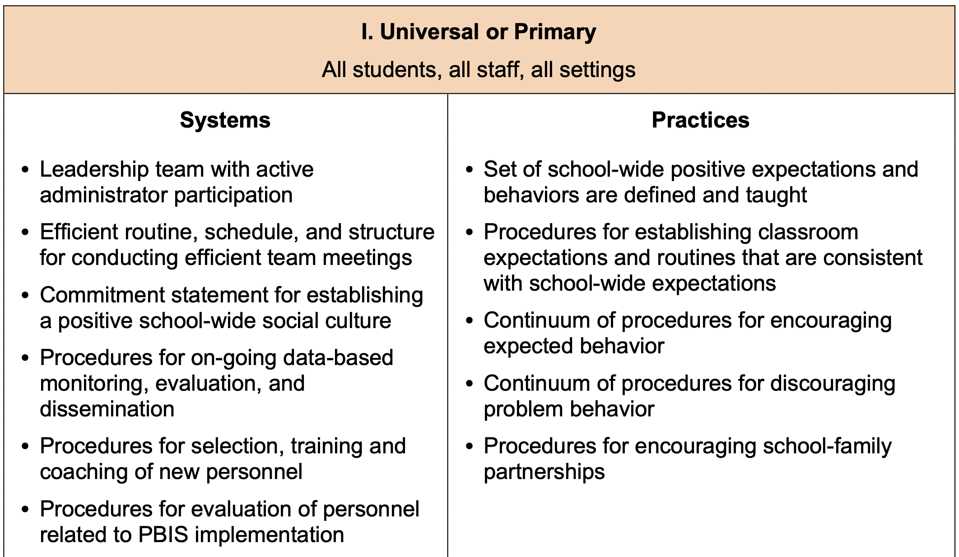
Examples of Systems and Practices

Slide 33
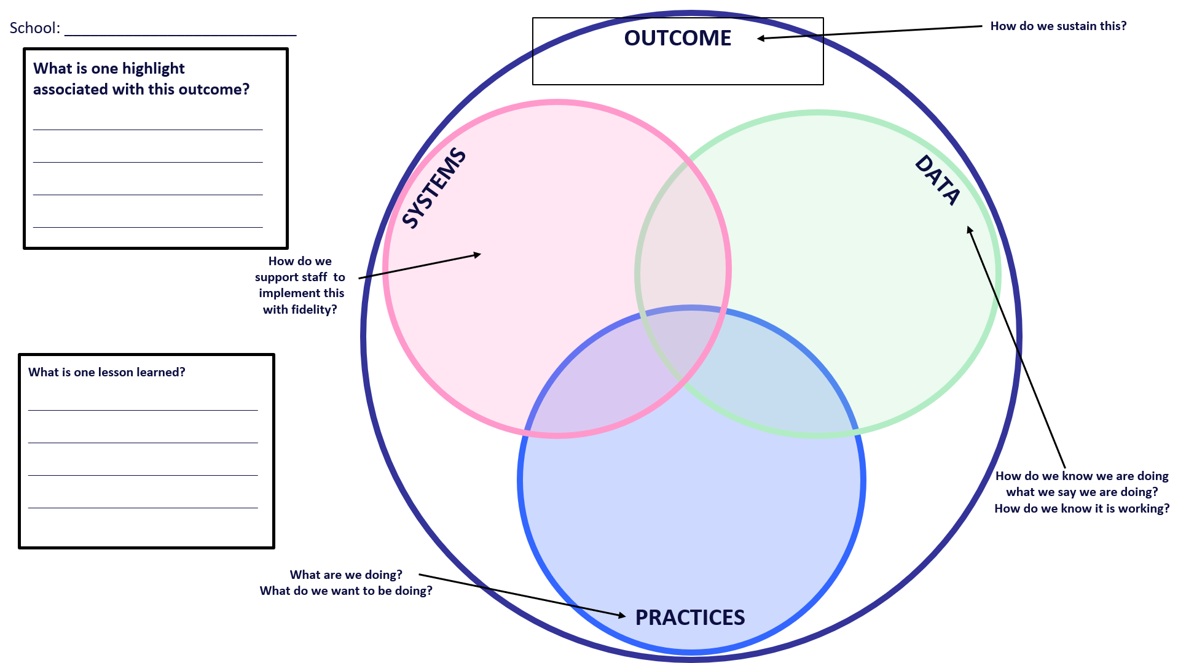
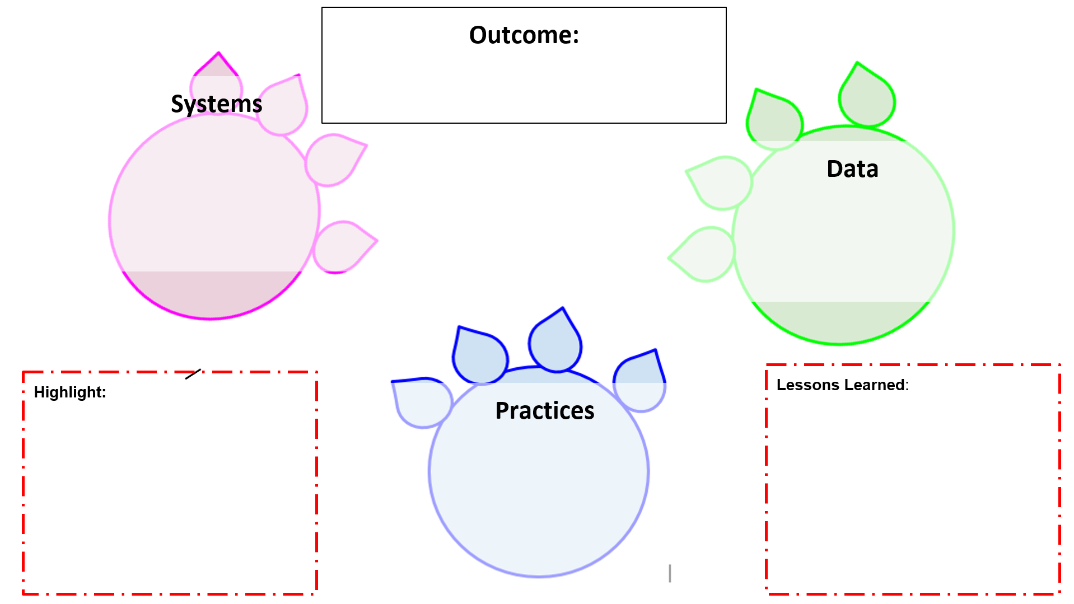
Optional Templates
Use one of these templates to organize your example. You may also create a word or other document.
Please ensure each member of your team has a copy and understands your example so they can share with others.
Notes:
Logic Model Sample & Template https://sebacademy.edc.org/pbis-logic-model-activity-directions-samples-and-template

Slide 34
School: ___________________________
Identify an outcome to focus on for this activity. For example:
Decrease ODRs on the playground
Increase consistency of response to behavior to ensure equity
Increase family engagement
How do we sustain this?
OUTCOME
Enter systems changes you made to help achieve your goal
Enter what dataa source you used to identify your goal and evaluate the results
How do we know we are doing what we say we are doing? How do we know it is working?
SYSTEMS
DATA
How do we support staff to
implement this with fidelity?
What is one highlight
associated with this outcome?
__________________________________
__________________________________
What is one lesson learned?
__________________________________
__________________________________
Enter Practices taught to achieve your goal
What are we doing?
What do we want to be doing?
PRACTICES

Slide 35
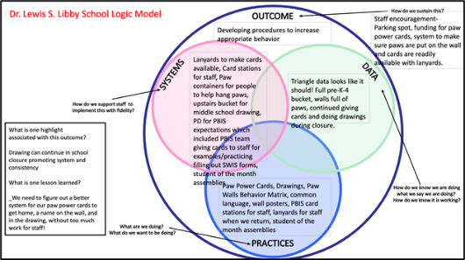
ACTIVITY: PLANNING ROUNDTABLES
Review roundtable template and examples.
Brainstorm potential outcomes you may want to target to highlight your school/team’s PBIS efforts.
What questions do you have?
Schedule a time to meet (or communicate) with your team to plan what your school wants to share.
All team members should have a copy
Find Logic Model Directions, Samples and Template on Website Resources
Co-coaches 5 minutes
Questions/full group 5 minutes
Notes:
Logic Model Directions, Samples and Template https://sebacademy.edc.org/pbis-logic-model-activity-directions-samples-and-template
TRAINER: Activity prompt below; allow 5 minutes
Review roundtable template and examples.
Brainstorm potential outcomes you may want to target to highlight your school/team’s PBIS efforts.
What questions do you have?
Schedule a time to meet (or communicate) with your team to plan what your school wants to share

Slide 36
Agenda & Coaches' Tasks
Coaches’ Tasks:
Presentation Content:
PBIS Academy Year 3 Training and Support Structure
Complete and send in your PBIS Assessment Coordinator Form
Complete Communication List in your Google Account for list of team members with emails for event reminders
Submit Advanced Action Plan with Team/Meeting portion completed your assigned SEB Academy Google Drive
Glows & Grows: PBIS Rollout
Action Planning, Goals, Student Partners
Prepping for November Roundtables
What questions do you have on today’s content?
What questions do you have on the follow-up tasks?

Slide 37
HELPFUL RESOURCES
RESOURCES:
Advanced Action Plan
Team meeting foundations checklist
PBIS Assessment Coordinator form
Logic Model Sample & Template
7 Ways to Partner with Students and Level Up Your Implementation
Notes:
RESOURCES – Strongly encourage coaches to down load these resources.
Advance Action Plan: https://sebacademy.edc.org/annual-action-plan-template-advanced
Team meeting foundations checklist: https://sebacademy.edc.org/team-meeting-foundations-checklist
PBIS Assessment Coordinator Form https://sebacademy.edc.org/pbis-assessment-coordinator-form
Logic Model Sample & Template https://sebacademy.edc.org/pbis-logic-model-activity-directions-samples-and-template
7 Ways to Partner with Students and Level Up Your Implementation - https://www.pbisapps.org/articles/7-ways-to-partner-with-students-and-level-up-your-implementation

Slide 38
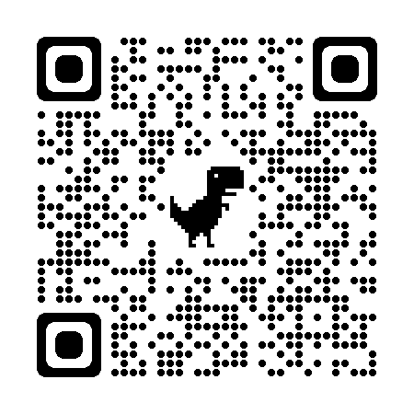
EVALUATION
Please remember to complete the evaluation!
Scan the QR code to access.
Notes:
TRAINERS -
Put link to evaluation (below) in the chat for those who do not use the QR code:
Evaluation Survey: https://edc.co1.qualtrics.com/jfe/form/SV_cBF9GI7gVEBsfSC

