Slide 1


PBIS Coaches’ Training
Year 3 - January
Marcie Handler & Christine Downs
Created from content from the National Technical Assistance Center on Positive Behavioral Interventions and Supports
U.S. Department of Education, Office of Special Education Programs and Office of Elementary and Secondary Education
with support from NEPBIS Network, May Institute, & Broad Reach Consulting

Slide 2

EXPECTATIONS
Self
Others
Environment
Self-monitor
Mute when listening, unmute to talk​
Have your computer charged and ready to go​
If you have questions or comments:
Work as a team:
Keep necessary materials at hand
Are you participating?
Engaged as a learner?
Stretch, break, stand as needed​
unmute
use the chat box
Room for every voice
Reinforce participation
action plan
relevant docs
water/snacks
Minimize distractions if possible​

Slide 3
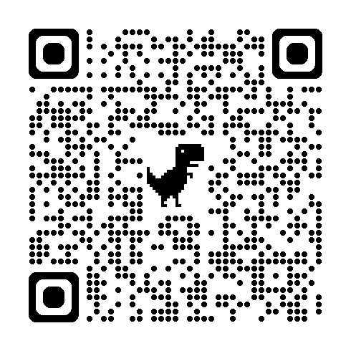
ACTIVITY: ATTENDANCE
Scan QR code on the left or follow the URL posted in the chat to access the online attendance survey Follow prompts to enter attendance information
Notify trainers if you require assistance (e.g., identifying your cohort or cohort group)
Certificates of Attendance will be sent in January and June. Attendance records and Zoom log in will be use as verification
1 minute
Notes:
TRAINERS – QR Code is updated
Post a link to the attendance survey (below) in the chat for those who do not use the QR code on the slide: https://docs.google.com/forms/d/e/1FAIpQLSf-la8kZA-l6ZXIR48DsDhimdXqFAX2d8Cw6xIXio0UxScqvw/viewform

Slide 4
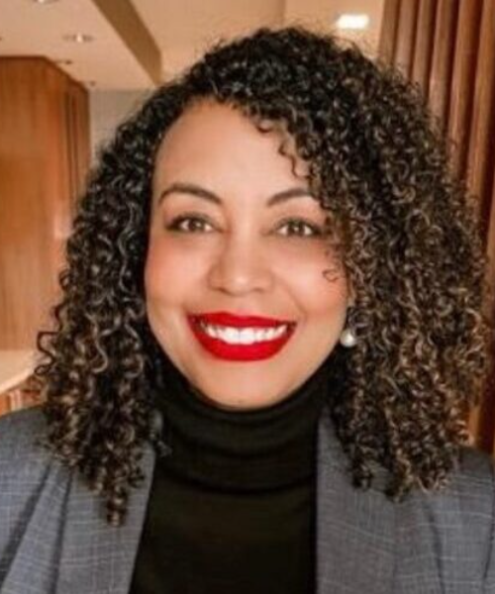



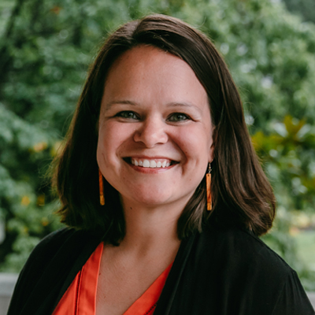
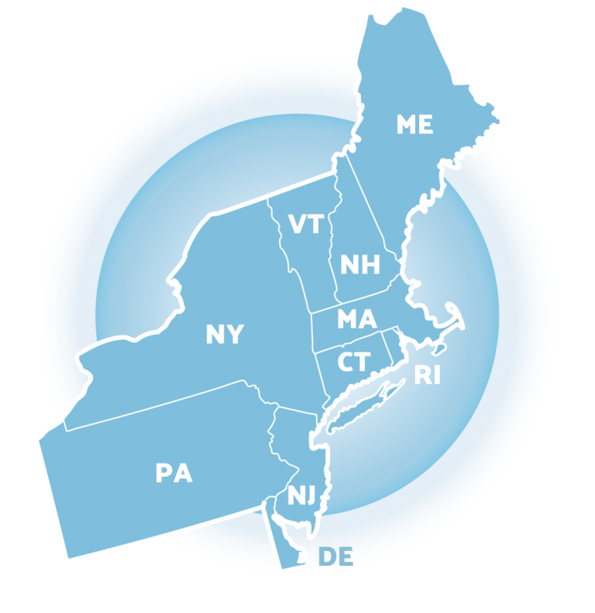
Mark your calendars now to join us at the
14th Annual NEPBIS LEADERSHIP FORUM
May 15-16, 2025
Mystic, CT
https://nepbis.org/forum/
ANNOUNCING OUR KEYNOTE PRESENTERS
PRE-CONFERENCE WORKSHOPS on MAY 14th
Come learn about how to improve attendance
through your PBIS framework!
Steve Goodman, Ph.D.
Cecelia Leong, M.P.P.
This workshop will focus on student voice as a critical component of PBIS implementation.
Clynita Grafenreed, Ph.D.
Kathleen Lynne Lane, Ph.D., BCBA-D, CF-L2
Sara Estrapala, Ph.D.

Slide 5
Agenda & Coaches' Tasks
Presentation Content
Coaches Tasks
Glows & Grows: Integration & Alignment
Family School Partnerships
Fidelity Assessment: Tiered Fidelity Inventory (TFI) Self-Assessment
Looking Ahead: April Poster session!
Discuss with team Family & School Partnership content. Complete the Family-School Partnership Survey as a team. Use the results to guide action planning.
Work with team to plan and complete the TFI Self-Assessment this or next month.
Discuss with your team what you may want to include on your poster during the April team training.

Slide 6

HELPFUL RESOURCES
RESOURCES:
Alignment Activity
Technical Guide for Alignment of Initiatives
11 Easy Tips to Really Engage with Families
Aligning and Integrating Family School Partnerships within PBIS
Enhancing Family-School Collaboration with Diverse Families
Working Systemically: Engaging Family and Community
Family School Partnership Survey
Tiered Fidelity Inventory
  TFI Tier 1 Quick Check Tip Sheet for Scoring
  PBIS TFI Walkthrough Tip Sheet
  Integrated TFI Companion Guide
Notes:
RESOURCES:
PBIS TFI Manual: https://sebacademy.edc.org/tiered-fidelity-inventory-tfi-manual
TFI Tier 1 Quick Check Tip Sheet for Scoring https://sebacademy.edc.org/tfi-tier-1-quick-check-tip-sheet-scoring
PBIS TFI Walkthrough Tip Sheet: https://sebacademy.edc.org/tfi-walk-through-tip-sheet
Integrated TFI Companion Guide: https://sebacademy.edc.org/integrated-tiered-fidelity-inventory-companion-guide
Technical Guide for Alignment of Initiatives: https://sebacademy.edc.org/technical-guide-alignment-initiatives-programs-and-practices-school-districts
Alignment Activity: https://sebacademy.edc.org/alignment-activit
11 Easy Tips to Really Engage in Families https://sebacademy.edc.org/11-easy-tips-really-engage-families
Family School Partnership Survey: https://uconn.co1.qualtrics.com/jfe/form/SV_4U9QPw9ASvLr83z
Aligning and Integrating Family School Partnerships within PBIS: https://sebacademy.edc.org/aligning-and-integrating-family-engagement-positive-behavioral-interventions-and-supports
Enhancing Family-School Collaboration with Diverse Families https://sebacademy.edc.org/enhancing-family-school-collaboration-diverse-families
Working Systemically: Engaging Family and Community https://sebacademy.edc.org/working-systemically-engaging-family-and-community

Slide 7
Glows & Grows:
Integration & Alignment
Notes:
12:30

Slide 8
GUIDELINES: EFFECTIVE ALIGNMENT
Organizational Level
Professional Development
Outcome Measures
Systems
Align multiple initiatives where common budget authority exists
Build aligned PD by comparing & combining core features of initiatives
Compare fundamental assumptions
Start with common “core features” & compare practices used to achieve these features
Determine how to incorporate additional core features efficiently
Build single PD curriculum that combines core features
Align multiple initiatives by using common measures to assess effectiveness
Logic Model
Resolve any logic model conflicts between initiatives
Notes:
Follow these guidelines to effectively align and integrate your initiatives.
Always start at the organizational level if possible – Can or does the same person have administrative and budget authority over the various initiatives? This can help to avoid redundancies in trainers, repetitive tasks, staffing and resources.
Use your Working Smarter matrix to align your common outcomes and outcome measures
Align and integrate the common core features into your practices and PD to be as efficient as possible with your time and resources.
Finally Resolve Logic Model Conflicts – Examine how everything flows together and resolve any issues where procedures might diverge. - such as one initiative might use Tangible reinforcers while another stresses only verbal feedback - work with your team to come up with a collaborative workable protocol or solution

Slide 9
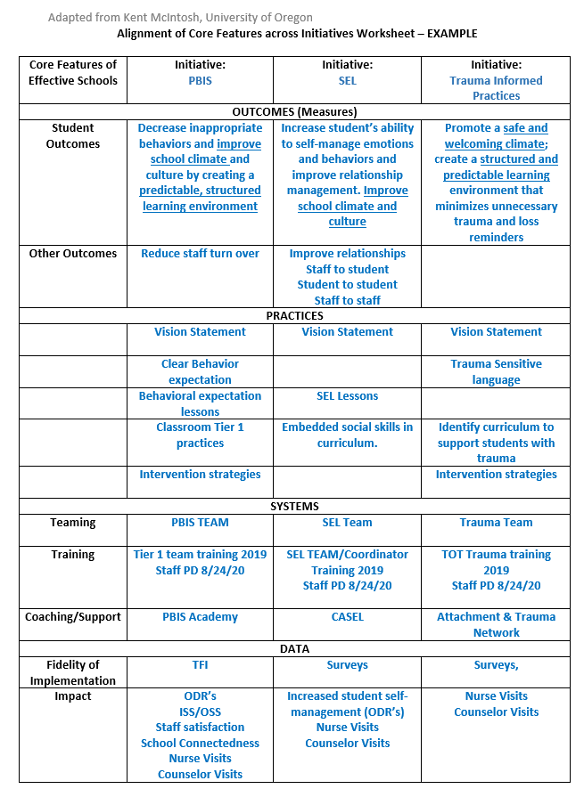
3. Identify core system features.
Notes:
Here is an example of The alignment activity you will work on this year. This one seeks to align PBIS with SEL and Trauma Informed Practices. This worksheet will help us align the Core System Features of each initiative. Let’s take a closer look.
Alignment Worksheet: https://nepbis.org/wp-content/uploads/2018/11/Alignment-Activity-1.docx

Slide 10
ALIGNING INITIATIVES, PROGRAMS, & PRACTICES
1. Define the valued outcome(s).
2. List related initiatives.
3. Identify core system features.
4. Analyze and make decisions for alignment.
5. Design the plan for effective alignment.
View
Technical
Guide on pbis.org
National TA Center on PBIS. (2017). Technical guide for alignment of initiatives, programs, practices in school districts. Eugene, OR: Retrieved from www.pbis.org
Notes:
https://sebacademy.edc.org/technical-guide-alignment-initiatives-programs-and-practices-school-districts
There are 5 steps to take when thinking about Aligning initiatives.
Define your valued outcomes – Like a Positive School Culture
List your related initiatives – Like PBIS, SEL, mental health, Bully Prevention
Identify core system features – Such as Teaching Lessons or Acknowledging students
Analyze and make decisions - How to combine PD Events
And plan for effective alignment – like combining teams and outcomes.
If you're interested in learning more about integration and alignment, you can download and read the "Technical guide for Alignment" on PBIS.org
You can use section 5C in your getting started workbook for more information.

Slide 11
DISCUSSION: INTEGRATION & ALIGNMENT
What practice models do you want to align with PBIS?
Have you completed the Alignment Activity?
What are your next action items?
Whole Group
2 minutes
13 minutes
Notes:
Technical Guide for Alignment of Initiatives: https://sebacademy.edc.org/technical-guide-alignment-initiatives-programs-and-practices-school-districts
Alignment Activity: https://sebacademy.edc.org/alignment-activity

Slide 12
FAMILY SCHOOL PARTNERSHIPS

Slide 13

What is family engagement?
Including families in PBIS implementation means families and school personnel work together and share in the responsibility making educational decisions and improving student outcomes.
(Center on PBIS, 2022)

Slide 14
Why family engagement? Students benefit!
Student Achievement (Fan & Chen, 2001)
Attendance
(Simon, 2001)
xxx
Social-emotional-behavioral Outcomes (Fantuzzo et al., 2004; Garbacz & McIntyre, 2016)
Peer Group Affiliations
(Garbacz et al., 2018)
xxx
School drop-out (Barnard, 2004)
Behavior Problems (Garbacz et al., 2020)
Notes:
Parents and teachers also benefit from working together. Parents’ report improvements in their efficacy for helping their children with schoolwork and their trust of teachers.
Teachers report improved job satisfaction and tend to request fewer transfers.
When parents and teachers collaborate to support children’s behavior, child behavior improves, parents and teachers report improvements in their problem-solving competences, and the relationship parents and teachers share improves.

Slide 15
Why family engagement? Parents and teachers benefit, too!
xxx
Parent efficacy and competence
(Semke et al., 2010; Sheridan et al., 2012)
Parent trust of teachers
(Santiago et al., 2016)
Teacher job satisfaction
(Christenson, 1995)
Parent-teacher relationship
(Sheridan et al., 2017)

Slide 16
What are the foundational elements of family engagement?
Two-Way Communication
Equity, Access, Representation
Meaningful Decision-Making
Intentionally obtain diverse and proportional input
Provide diverse range of opportunities for families to make shared decisions about PBIS systems and practices
Recognize family needs
Positive Relationships
Value cultural differences
Collect data on perceptions of home-school relationships
Engage in meaningful, two-way communication
Provide multiple avenues for families receive and provide information
Empower families with knowledge and skills to effectively support student learning
Cultivate social connections and networks among families
Effectively engage families in advanced student behavior supports
(Center on PBIS, 2022)

Slide 17

Family Engagement in PBIS
Researchers in Indiana sat down with families and staff from six schools to find out:
  What are the barriers or limitations to families attending school events?
  What can be done differently to increase family involvement?
They identified 4 barriers and offer 11 strategies for engagement.
(Center on PBIS, 2017)
Notes:
11 Easy Tips to Really Engage with Families - https://sebacademy.edc.org/11-easy-tips-really-engage-families

Slide 18

Family Engagement in PBIS
A more in depth look at:
The reasons for family engagement in schools
Practical strategies for promoting and supporting family engagement
Family engagement across diverse contexts and groups
(Center on PBIS, 2017)
Notes:
Aligning and Integrating Family Engagement in Positive Behavioral Interventions and Supports: https://sebacademy.edc.org/aligning-and-integrating-family-engagement-positive-behavioral-interventions-and-supports

Slide 19

Family Collaboration
Explores key strategies for promoting equity in family-school partnerships including:
  developing relationships,
  two-way home-school communication,
  shared decision-making.

Slide 20

Working Systemically: Engaging Family and Community
School improvement happens best when people and organizations come together to achieve common goals, recognizing that they can accomplish more together than separately.
The eight components in the Working Systemically approach:
Family and Community
Standards
Curriculum
Instruction
Assessment
Resources
Professional Staff
Policy and Governance
Notes:
https://sebacademy.edc.org/working-systemically-engaging-family-and-community

Slide 21
DISCUSSION: Slow the Climb: 4 De-escalation Strategies to Keep Behavior from Going Downhill
Independently or with your co-coach, review one of the 4 resources article. (10 minutes)
Whole group discussion of common take aways
(5 minutes)
10 minutes
5 minutes
Coach Review/Chat
Whole Group

Slide 22
PBIS Resource Spotlight:
The Family-School Practices Survey

Slide 23
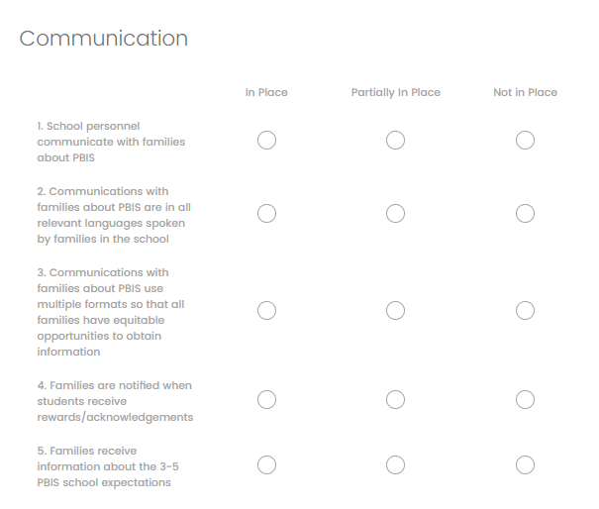
FAMILY ENGAGEMENT
How do we ensure families are actively participating in our framework?
Complete Family-School Practices survey
Identify action steps

Slide 24
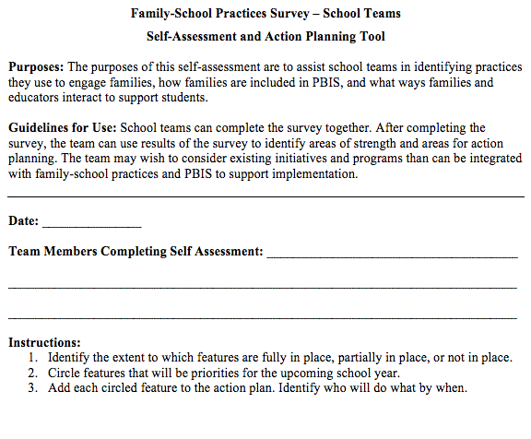
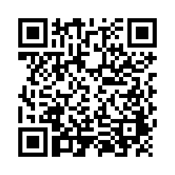
Examining School Approaches to Family Engagement in PBIS
The Family-School Practices Survey for school teams is a self-assessment and action planning tool.
Approaches to family engagement are assessed in several areas:
Communication
Family-School Activities
PBIS Practices at Home and School
Decision-Making/Shared-Ownership
Resources
(Garbacz, McIntosh, & Eagle, 2014)
Notes:
Take a few minutes to complete the self-assessment, identify areas of strength and need, and complete the action plan at the end of the tool to target areas of need that build on strengths
Link to assessment: https://sebacademy.edc.org/family-school-practices-survey

Slide 25

ACTIVITY: Family-School Practices Survey
As a coach:
Independently review the Family-School Practices Survey (6 minutes)
Plan when to complete this with your team and discuss key items.
Remember to your action plan based on priorities discussed while completing the survey.
Today let’s discuss how we can use this to guide team planning!
15 minutes
Notes:
Family School Practices Survey: https://uconn.co1.qualtrics.com/jfe/form/SV_4U9QPw9ASvLr83z

Slide 26
TFI SELF-ASSESSMENT

Slide 27

DATA: PBIS FIDELITY of IMPLEMENTATION
Are we effectively implementing a PBIS framework?
Complete TFI Self Assessment as a Team
Identify action steps

Slide 28
TIERED FIDELITY INVENTORY (TFI)
Purpose: | Assess evidence of critical features of school-wide PBS implementation; Progress over time; Helps team make data-based decisions on intervention and program efficacy; Guides action-planning.
Format: | Survey ratings of features in place (self-assessment). About 30 mins per tier.
Completed by: | Team members with the coaches. Walkthrough tool completed by external coach.
When? | Self-Assessment Fall and/or Winter & Annually with external trainer (in spring)
Have you completed and have your walkthrough data available?
Notes:
https://sebacademy.edc.org/tiered-fidelity-inventory-tfi-manual

Slide 29
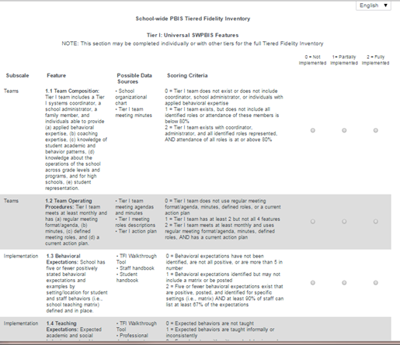
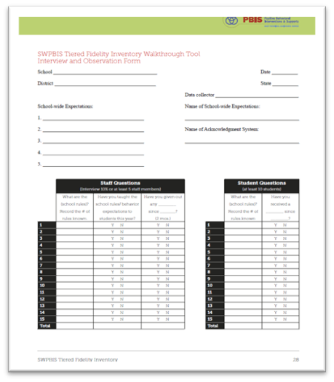
TIERED FIDELITY INVENTORY
PBIS Assessments - TFI
Walkthrough Tool
Notes:
The purpose of this content is to explicitly review the TFI Walkthrough tool to help coaches and teams collect this information independently.
Resource Link: https://sebacademy.edc.org/tiered-fidelity-inventory-tfi-manual
or
https://sebacademy.edc.org/tfi-tier-1-quick-check-tip-sheet-scoring

Slide 30
DISCUSSION: TFI SELF-ASSESSMENT PLANNING
Review the TFI on PBISapps
Has your team completed the walkthrough?
Plan when you will conduct the TFI with your team.
Plan adequate time so that you can action plan around areas that need improvement.
5 minutes
Whole Group
Notes:
https://sebacademy.edc.org/tfi-tier-1-quick-check-tip-sheet-scoring
https://sebacademy.edc.org/tfi-walk-through-tip-sheet
Resource link: https://sebacademy.edc.org/tiered-fidelity-inventory-tfi-manual - Appendix A, Page 27

Slide 31
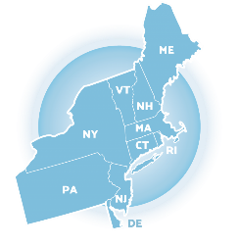
Preparing for April Training:
Poster Session!

Slide 32
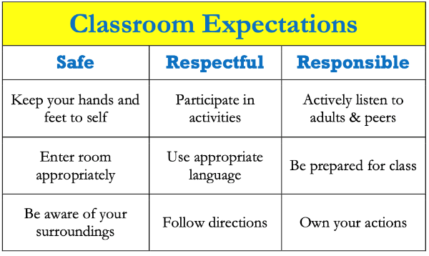
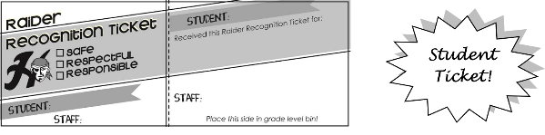
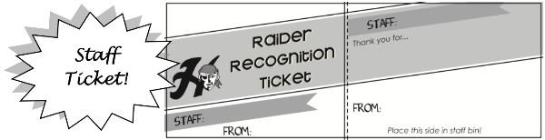
POSTER SESSION
Target Goal:
  Share examples of implementation of the PBIS Framework across districts and schools
Structure
  Show off! Each school will showcase aspects of your PBIS implementation with other teams
  Bring your poster! During March team training, we’ll have space with tables so you can show your posters with others.
  Get ideas! Bring ideas back to your
  school for follow up action planning
Notes:
This should be brief (5 minutes)

Slide 33
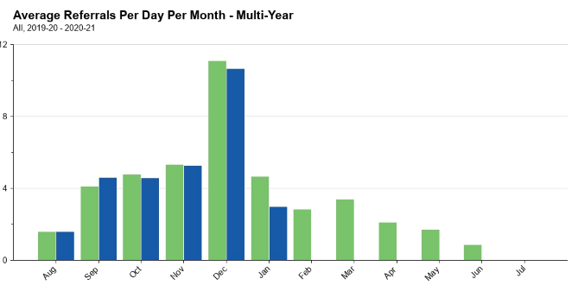
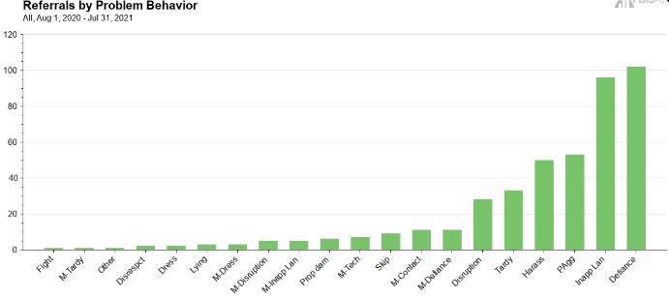
What to include on your poster
Examples of Systems, Data, and Practices!
Data Examples
  Fidelity Data (e.g., TFI or TIC)
  Outcome Data (e.g., ODR or attendance)
System Examples
  Team Action Plans
  Staff Survey
Practice Examples
  Lesson Plan
  Teaching Matrix
  Consequence Flow Chart
Please include data as part of your poster!
Notes:
This should be brief (5 minutes)

Slide 34
What to include on your poster
Consider including features that promote sustainability!
  PBIS Handbook image
  Newsletter sharing data with staff or families
  Picture of policy on school website
  Sample PD agenda to introduce new staff to PBIS
Notes:
This should be brief (5 minutes)

Slide 35
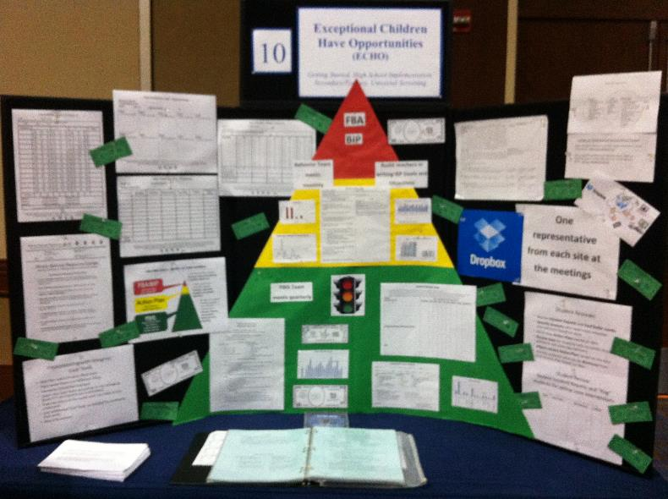
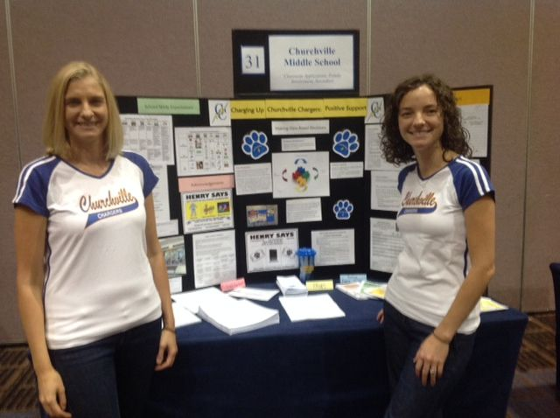
POSTER EXAMPLE
Notes:
TRAINER NOTE: Here is an example of a virtual poster from last year, created in google slides. You can click on the TV, fish, chalkboard, and computer screen to view various elements of PBIS, including the start of a PBIS Handbook. Feel free to get creative in your virtual poster design!

Slide 36
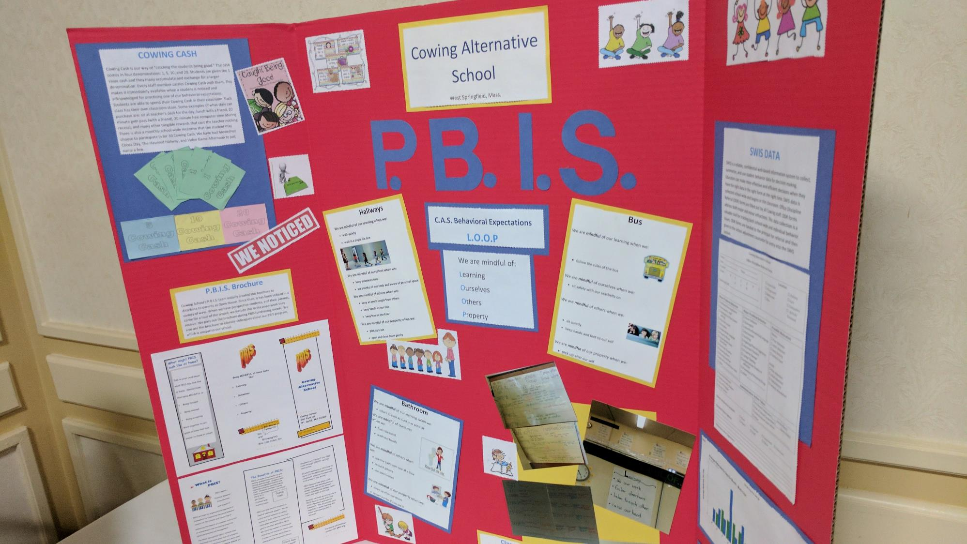

Slide 37


Slide 38
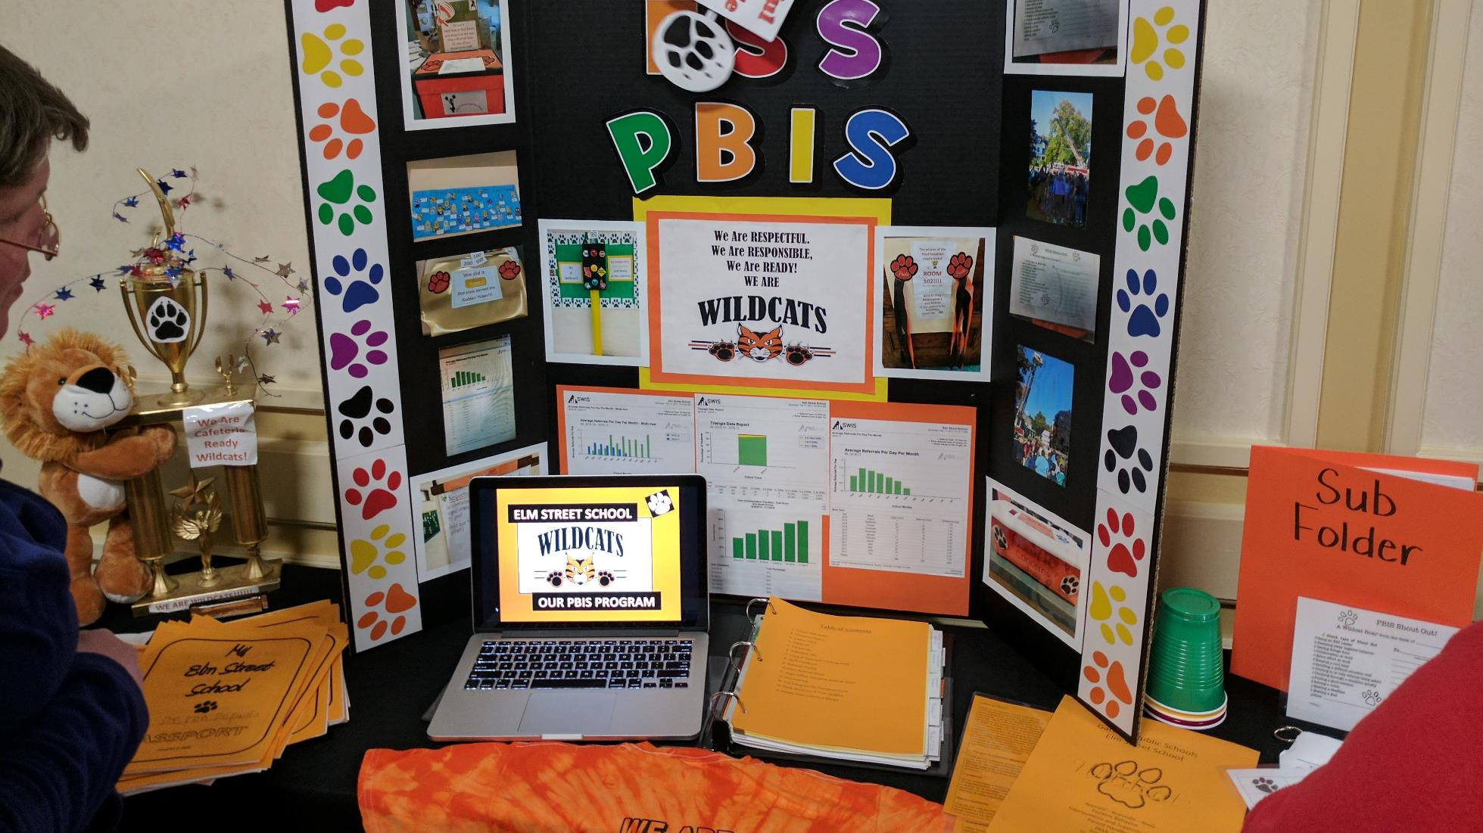

Slide 39
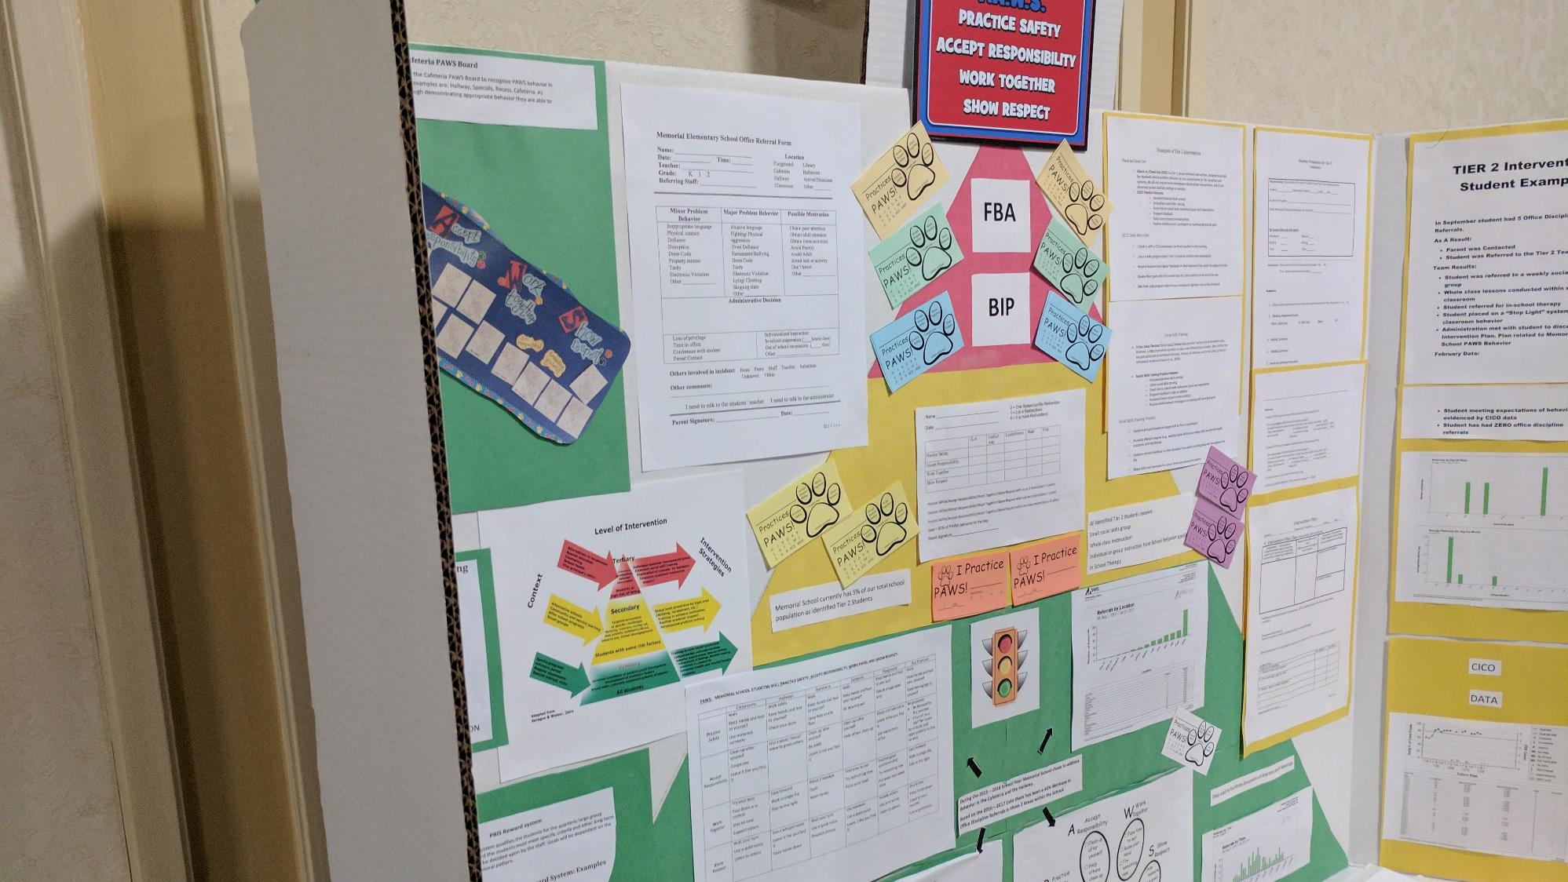

Slide 40
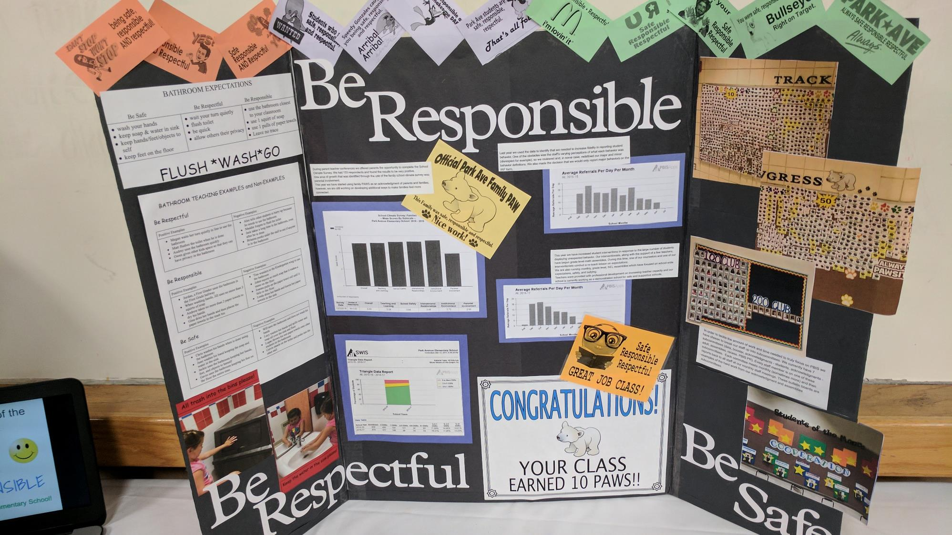

Slide 41
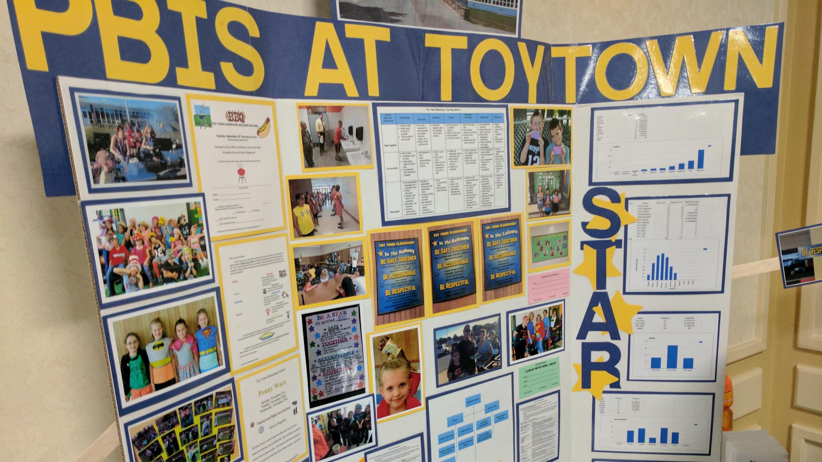

Slide 42
QUESTIONS?
Next Steps:
Decide what you want to show off with your poster.
Action plan the next steps need to be completed between now and the March team training.
We'll have more time at our February coaches meeting to discuss more about this sharing activity?
2 minutes
Whole Group

Slide 43
Agenda & Coaches' Tasks
Presentation Content:
Glows & Grows: Integration & Alignment
Family School Partnerships
Fidelity Assessment: Tiered Fidelity Inventory (TFI) Self-Assessment
Looking Ahead: April Poster session!
Coaches’ Tasks:
Discuss with team Family & School Partnership content. Complete the Family-School Partnership Survey as a team. Use the results to guide action planning.
Work with team to plan and complete the TFI Self-Assessment this or next month.
Discuss with your team what you may want to include on your poster during the April team training.
What questions do you have on today’s content?
What questions do you have on the follow-up tasks?

Slide 44
HELPFUL RESOURCES
RESOURCES:
Alignment Activity
Technical Guide for Alignment of Initiatives
11 Easy Tips to Really Engage with Families
Aligning and Integrating Family School Partnerships within PBIS
Enhancing Family-School Collaboration with Diverse Families
Working Systemically: Engaging Family and Community
Family School Partnership Survey
Tiered Fidelity Inventory
  TFI Tier 1 Quick Check Tip Sheet for Scoring
  PBIS TFI Walkthrough Tip Sheet
  Integrated TFI Companion Guide
Notes:
RESOURCES:
PBIS TFI Manual: https://sebacademy.edc.org/tiered-fidelity-inventory-tfi-manual
TFI Tier 1 Quick Check Tip Sheet for Scoring https://sebacademy.edc.org/tfi-tier-1-quick-check-tip-sheet-scoring
PBIS TFI Walkthrough Tip Sheet: https://sebacademy.edc.org/tfi-walk-through-tip-sheet
Integrated TFI Companion Guide: https://sebacademy.edc.org/integrated-tiered-fidelity-inventory-companion-guide
Technical Guide for Alignment of Initiatives: https://sebacademy.edc.org/technical-guide-alignment-initiatives-programs-and-practices-school-districts
Alignment Activity: https://sebacademy.edc.org/alignment-activit
11 Easy Tips to Really Engage in Families https://sebacademy.edc.org/11-easy-tips-really-engage-families
Family School Partnership Survey: https://uconn.co1.qualtrics.com/jfe/form/SV_4U9QPw9ASvLr83z
Aligning and Integrating Family School Partnerships within PBIS: https://sebacademy.edc.org/aligning-and-integrating-family-engagement-positive-behavioral-interventions-and-supports
Enhancing Family-School Collaboration with Diverse Families https://sebacademy.edc.org/enhancing-family-school-collaboration-diverse-families
Working Systemically: Engaging Family and Community https://sebacademy.edc.org/working-systemically-engaging-family-and-community

Slide 45
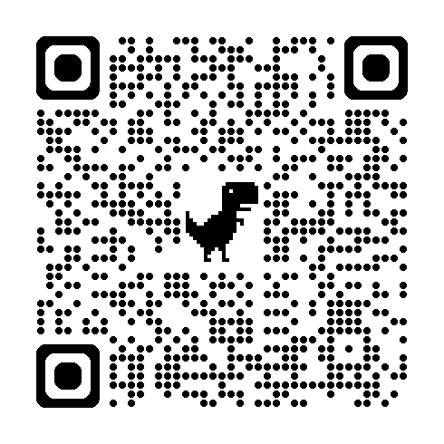
EVALUATION 9A
Please remember to complete the evaluation!
Scan the QR code to access.
Notes:
TRAINERS -
Put link to evaluation (below) in the chat for those who do not use the QR code:
Evaluation Survey: https://go.edc.org/Cohort-9A-Evaluation

Slide 46
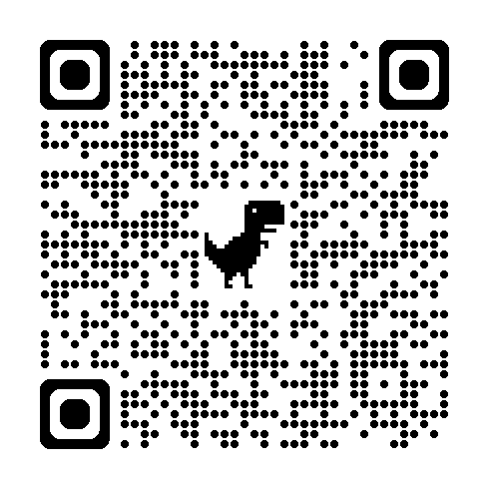
EVALUATION 9B
Please remember to complete the evaluation!
Scan the QR code to access.
Notes:
TRAINERS -
Put link to evaluation (below) in the chat for those who do not use the QR code: Evaluation- https://go.edc.org/SEB-Academy-Event-Evaluation

