Slide 1
PBIS Coaches’ Training Year 3 - February
Insert Trainer Names
Created from content from the National Technical Assistance Center on Positive Behavioral Interventions and Supports U.S. Department of Education, Office of Special Education Programs and Office of Elementary and Secondary Education
with support from NEPBIS Network, May Institute, & Broad Reach Consulting

Slide 2
EXPECTATIONS
Self
Others
Environment
Self-monitor
Mute when listening, unmute to talk​
Have your computer charged and ready to go​
If you have questions or comments:
Work as a team:
Keep necessary materials at hand
Are you participating?
Engaged as a learner?
Stretch, break, stand as needed​
unmute
use the chat box
Room for every voice
Reinforce participation
action plan
relevant docs
water/snacks
Minimize distractions if possible​

Slide 3
IN-PERSON TEAM TRAINING EVENT INCLEMENT WEATHER POLICY
In case of inclement weather, we will cancel our team training if the local school district where the training will be held is either delayed or cancelled due to inclement weather.
Please monitor school and district closings for the school district in which the training is being held. In any case that you feel it is not safe for you to travel to the cohort training, please make the decision that is most safe for you.
Your training site is [Trainers please fill in location] [Date of Next Training]

Slide 4
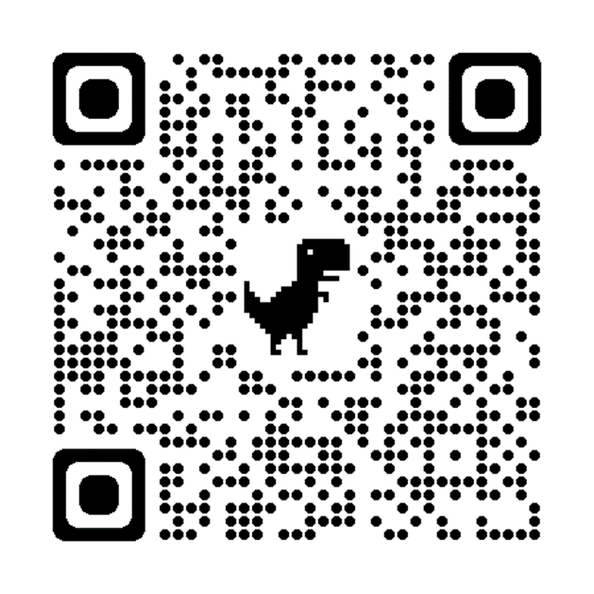
ACTIVITY: ATTENDANCE
Scan QR code on the left or follow the URL posted in the chat to access the online attendance survey
Follow prompts to enter attendance information
Notify trainers if you require assistance (e.g., identifying your cohort or cohort group)
Certificates of Attendance will be sent in January and June. Attendance records will be use as verification
You are in Cohort 8
1 minute
Notes:
ATTENDANCE: https://edc.co1.qualtrics.com/jfe/form/SV_81vbI1jl3cwmLY2

Slide 5
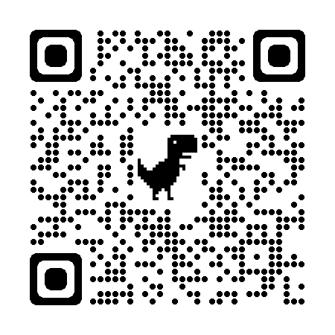
May 16 & 17, 2024
Mystic Marriott Hotel and Spa Mystic, CT
https://nepbis.org/forum/

Slide 6
Agenda & Coaches' Tasks
Presentation Content
Coaches Tasks
Glows & Grows: School-Family Partnerships
Resource Spotlight
Equity Review
Looking Ahead: March Poster session!
Review areas where your PBIS Framework can be more culturally responsive. Discuss with your team and action plan.
Discuss with your team what you may want to include on your poster during the March team training.

Slide 7
HELPFUL RESOURCES
RESOURCES:
Beginning to Address Equity in Tier 1 Systems
Integrated TFI Companion Guide
Culturally Responsive Field Guide
Discussing Race, Racism, and Important Events with Students
Centering Equity within the PBIS Framework: Overview and Evidence of Effectiveness
Poster Session Directions and Examples
Notes:
RESOURCES:
Centering Equity within the PBIS Framework: Overview and Evidence of Effectiveness: https://sebacademy.edc.org/centering-equity-within-pbis-framework-overview-and-evidence-effectiveness
Beginning to Address Equity in Tier 1 Systems: https://sebacademy.edc.org/beginning-address-equity-tier-1-systems
Discussing Race, Racism, and Important Events: https://sebacademy.edc.org/discussing-race-racism-and-important-current-events-students-guide-lesson-plans-and-resources
Integrated TFI Companion Guide -https://sebacademy.edc.org/integrated-tiered-fidelity-inventory-companion-guide
Culturally Responsive Field Guide -https://sebacademy.edc.org/pbis-cultural-responsiveness-field-guide
Poster Session Examples and Directions https://sebacademy.edc.org/poster-session-direction-and-examples

Slide 8
Glows & Grows: Family School Partnerships
Notes:
12:30

Slide 9
What are the foundational elements of family engagement?
Two-Way Communication
Equity, Access, Representation
Meaningful Decision-Making
Intentionally obtain diverse and proportional input
Provide diverse range of opportunities for families to make shared decisions about PBIS systems and practices
Recognize family needs
Positive Relationships
Value cultural differences
Collect data on perceptions of home-school relationships
Engage in meaningful, two-way communication
Provide multiple avenues for families receive and provide information
Empower families with knowledge and skills to effectively support student learning
Cultivate social connections and networks among families
Effectively engage families in advanced student behavior supports
(Center on PBIS, 2022)

Slide 10
DISCUSSION: FAMILY-SCHOOL PARTNERSHIPS
Did you complete the Family School Practices survey with your team?
How can we promote more shared decision making with our families?
What are your next action items that you discussed with your team?
Whole Group
10 minutes
Notes:
Link to School Family Practices Survey: https://sebacademy.edc.org/family-school-practices-survey
Family School Practices Survey: https://uconn.co1.qualtrics.com/jfe/form/SV_4U9QPw9ASvLr83z

Slide 11
PBIS Resource Spotlight: Discussing Race, Racism, and Current Events with Students
Notes:
https://sebacademy.edc.org/discussing-race-racism-and-important-current-events-students-guide-lesson-plans-and-resources

Slide 12
Discussing Race, and Racism...
This guide is intended to increase the frequency and quality of conversations about race, racism, and current events regarding race in K-12 classrooms to support students and provide voice and self-reflection.
Sections to take note...
Embed this work within existing systems
Build knowledge and expertise
Create an installation plan
Implement and monitor progress
Notes:
Resource Link: https://sebacademy.edc.org/discussing-race-racism-and-important-current-events-students-guide-lesson-plans-and-resources

Slide 13
DISCUSSION: Discussing Race, and Racism...
Independently Review the article and chat with your co-coaches (15 minutes)
Whole group discussion of common take aways (10 minutes)
How could this document be shared with your team and integrated into your current equity work.
Independ Review
Coach Review/Chat
Whole Group
5 Minutes
10 minutes
10 minutes
Notes:
https://sebacademy.edc.org/discussing-race-racism-and-important-current-events-students-guide-lesson-plans-and-resources

Slide 14
Big Idea Check-in: Vulnerable Decision Points and Risk Ratio
Notes:
TRAINER NOTE: This information was provided to coaches and teams last month. As this is review, please go through the slides at a quicker pace unless coaches have questions. Focus on the discussions and please express to the coaches that the importance of reviewing this information as part of a coach community is to now learn from each other about how to support more disaggregation with our data together.
So in a sense, last month was within teams, this month will be cross school discussions with this important feature.

Slide 15
What is Implicit Bias?
Unconscious, automatic
Based on stereotypes
We all have it (even those affected by it)
Generally, not an indication of what we believe or would endorse
More likely to influence:
Snap decisions
Decisions that are ambiguous

Slide 16
Implicit Bias in Early Learning (Gilliam et al., 2016)
Notes:
Youtube link: https://www.youtube.com/watch?v=ucEAcIMkS0c

Slide 17
Decision Points
What is an EQUITABLE Decision Point?
What is a VULNERABLE Decision Point?
A specific decision in which school/district data shows LITTLE TO NO disproportionality.
All student groups show equity in receiving a discipline referral for a specific behavior.
A specific decision that is more vulnerable to the effects of implicit bias. Some student groups show an inequitable distribution of discipline referrals
Two parts:
Elements of the SITUATION
The person’s DECISION STATE (internal state)

Slide 18
STEP 1: Identify vulnerable decision points
Disaggregating your data to identify vulnerable decision points:
By looking at data broken down by student type: race/ethnicity, IEP/504 status, EL status, gender, etc. we can find areas where our implicit biases or might have altered the way we respond to certain students. This is called disaggregation.
EXAMPLE
Identify a question
Identify the data source
Disaggregate the data to answer the question
Are students with disabilities being referred at the same rate?
Office Discipline Referrals
Disaggregate by disability status
Do our LGBTQ+ students feel safe at school?
School Climate Survey
Disaggregate by gender identity
Are racial groups chronically absent at the same rate?
Attendance
Disaggregate by race

Slide 19
EXAMPLE 3: ODRS
Can your school’s ODR data be disaggregated?
Are students with disabilities being referred at the same rate?
 | # of Enrolled Students | # of Students with Referrals | % of Students within Disability with Referrals | Risk Index
IEP | 45 | 17 | 38% | 0.38
504 | 25 | 6 | 24% | 0.24
None | 300 | 63 | 21% | 0.21
17 of the 45 students with IEPs have a discipline referral, so __?% of students with IEPs have a referral.
63 of the __ students without a disability have a discipline referral, so 21% of the students without a disability have a referral.

Slide 20
Calculating the Risk Ratio for a Group
The Risk Ratio is the likelihood for a specific group to receive at least one referral when compared to a different group of students.
Risk Ratio is calculated by dividing the risk of the specific group by the risk of a comparison group.
Teams analyzing this report look to answer the question: For a given group of students, how much more or less likely are they to receive at least one referral than students from another group?
A risk ratio greater than 1.0 indicates higher risk.
A risk ratio less than 1.0 indicates lower risk.
A risk ratio equal to 1.0 indicates an equal risk.

Slide 21
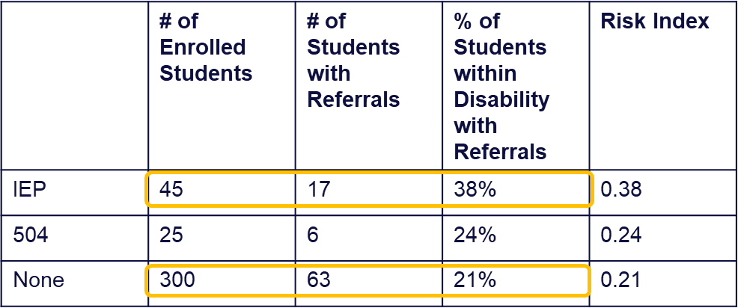
Risk Ratio
Risk Ratio is calculated by dividing the risk index of the specific group by the risk index of a comparison group.
Risk Ratio of students WITH an IEP getting an ODR = 1.8 compared to students with NO IEP (38/21=1.8)
Conclusion: Students with an IEP are 1.8 times MORE likely to get an ODR than non-IEP students.
A risk ratio greater than 1.0 indicates higher risk.
A risk ratio less than 1.0 indicates lower risk.
A risk ratio equal to 1.0 indicates an equal risk.

Slide 22
STEP 2: Questions to address disproportionality
Disproportionate referrals or exclusionary discipline
Do staff understand the definitions for behaviors?
Do staff understand the flow chart for behaviors and are they using it consistently with all groups?
Are administrators using progressive discipline for all students in the same way?
Is it time to develop a neutralizing routine? (more on this in March)
Disproportionate chronic absenteeism
Why does this group have higher absenteeism rates?
Are we applying excused and non-excused absents the same across groups?
How can we support them attending school more frequently?
Disproportionate feelings of safety or belonging
Does this group feel that they belong, are safe, and can succeed at school?
Are there implicit or explicit biases at play?
Can other data (attendance/discipline) shed light on this topic?
Notes:
Once we find disproportionality we need to ask questions to focus in on the problem before we can start of offer and create solutions.
We are going to focus on Disproportionate discipline to day.

Slide 23
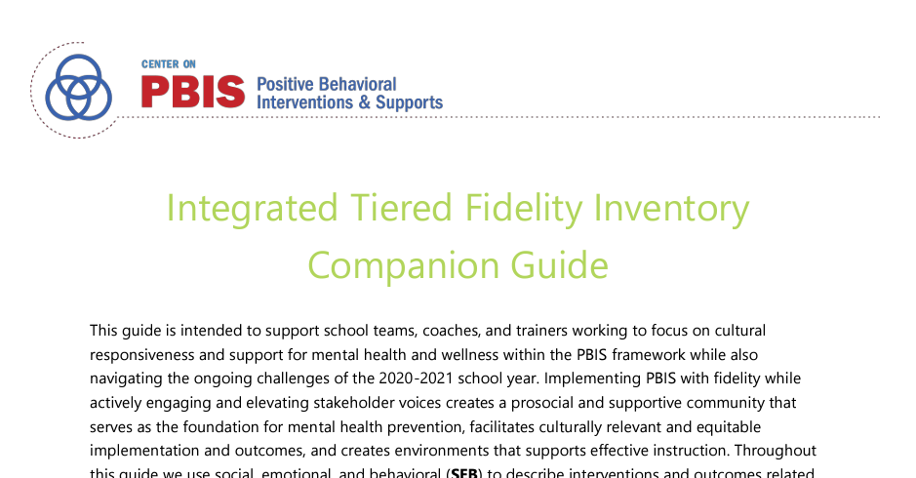
Culturally Responsive Field Guide
This guide is designed to assist trainers and coaches working with school SWPBIS teams (or other school leadership teams) seeking to implement culturally responsive practices systemically to enhance equity in school discipline
This guide as two important sections
Section 1: Identity Awareness
Section 2: TFI Cultural Responsiveness Field Guide
Integrated TFI Companion
Notes:
Resource Link: https://sebacademy.edc.org/pbis-cultural-responsiveness-field-guide
https://sebacademy.edc.org/integrated-tiered-fidelity-inventory-companion-guide

Slide 24
ACTIVITY: Disaggregation – Disproportionality and Risk
Discuss with your co-coach (10 minutes)
Can/have you disaggregated any data at your school?
Did you find disproportionality
Can you calculate the risk index for the vulnerable/marginalized group
Review Culturally Responsive Field guide in relation to your TFI scores. If you score a 2 look deeper to see if you are being culturally responsive to all groups.
Whole group share (10 minutes)
20 minutes

Slide 25
Preparing for March Training: Poster Session!

Slide 26
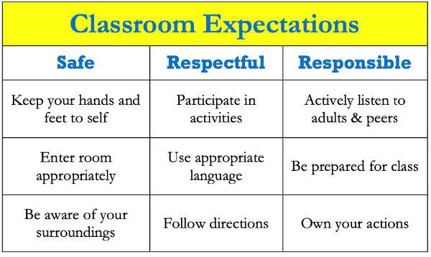
POSTER SESSION
Target Goal:
Share examples of implementation of the PBIS Framework across districts and schools
Structure
Show off! Each school will showcase aspects of your PBIS implementation with other teams
Bring your poster! During March team training, we’ll have space with tables so you can show your posters with others.
Get ideas! Bring ideas back to your school for follow up action planning
Notes:
This should be brief (5 minutes)

Slide 27
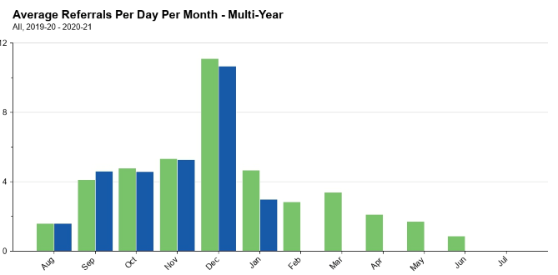
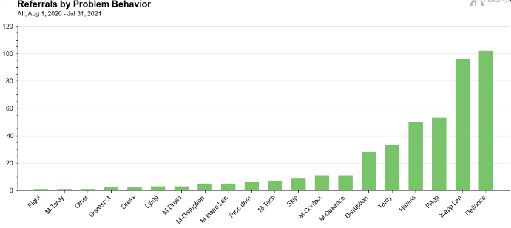
What to include on your poster
Examples of Systems, Data, and Practices!
Data Examples
Fidelity Data (e.g., TFI or TIC)
Outcome Data (e.g., ODR or attendance)
System Examples
Team Action Plans
Staff Survey
Practice Examples
Lesson Plan
Teaching Matrix
Consequence Flow Chart
Please include data as part of your poster!
Notes:
This should be brief (5 minutes)

Slide 28
What to include on your poster
Consider including features that promote sustainability!
PBIS Handbook image
Newsletter sharing data with staff or families
Picture of policy on school website
Sample PD agenda to introduce new staff to PBIS
Notes:
This should be brief (5 minutes)

Slide 29
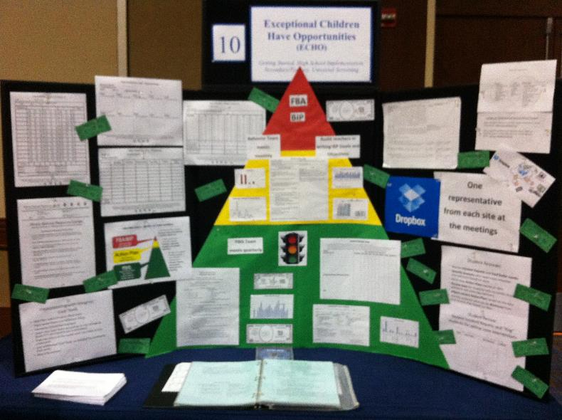
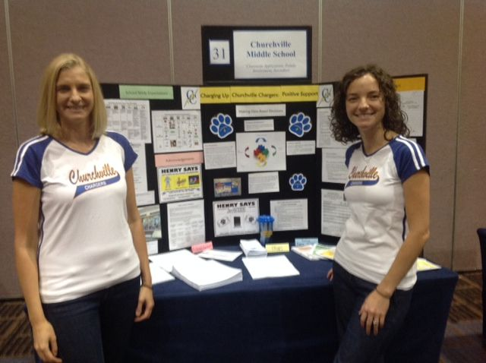
POSTER EXAMPLE
Notes:
TRAINER NOTE: Here is an example of a virtual poster from last year, created in google slides. You can click on the TV, fish, chalkboard, and computer screen to view various elements of PBIS, including the start of a PBIS Handbook. Feel free to get creative in your virtual poster design!

Slide 30
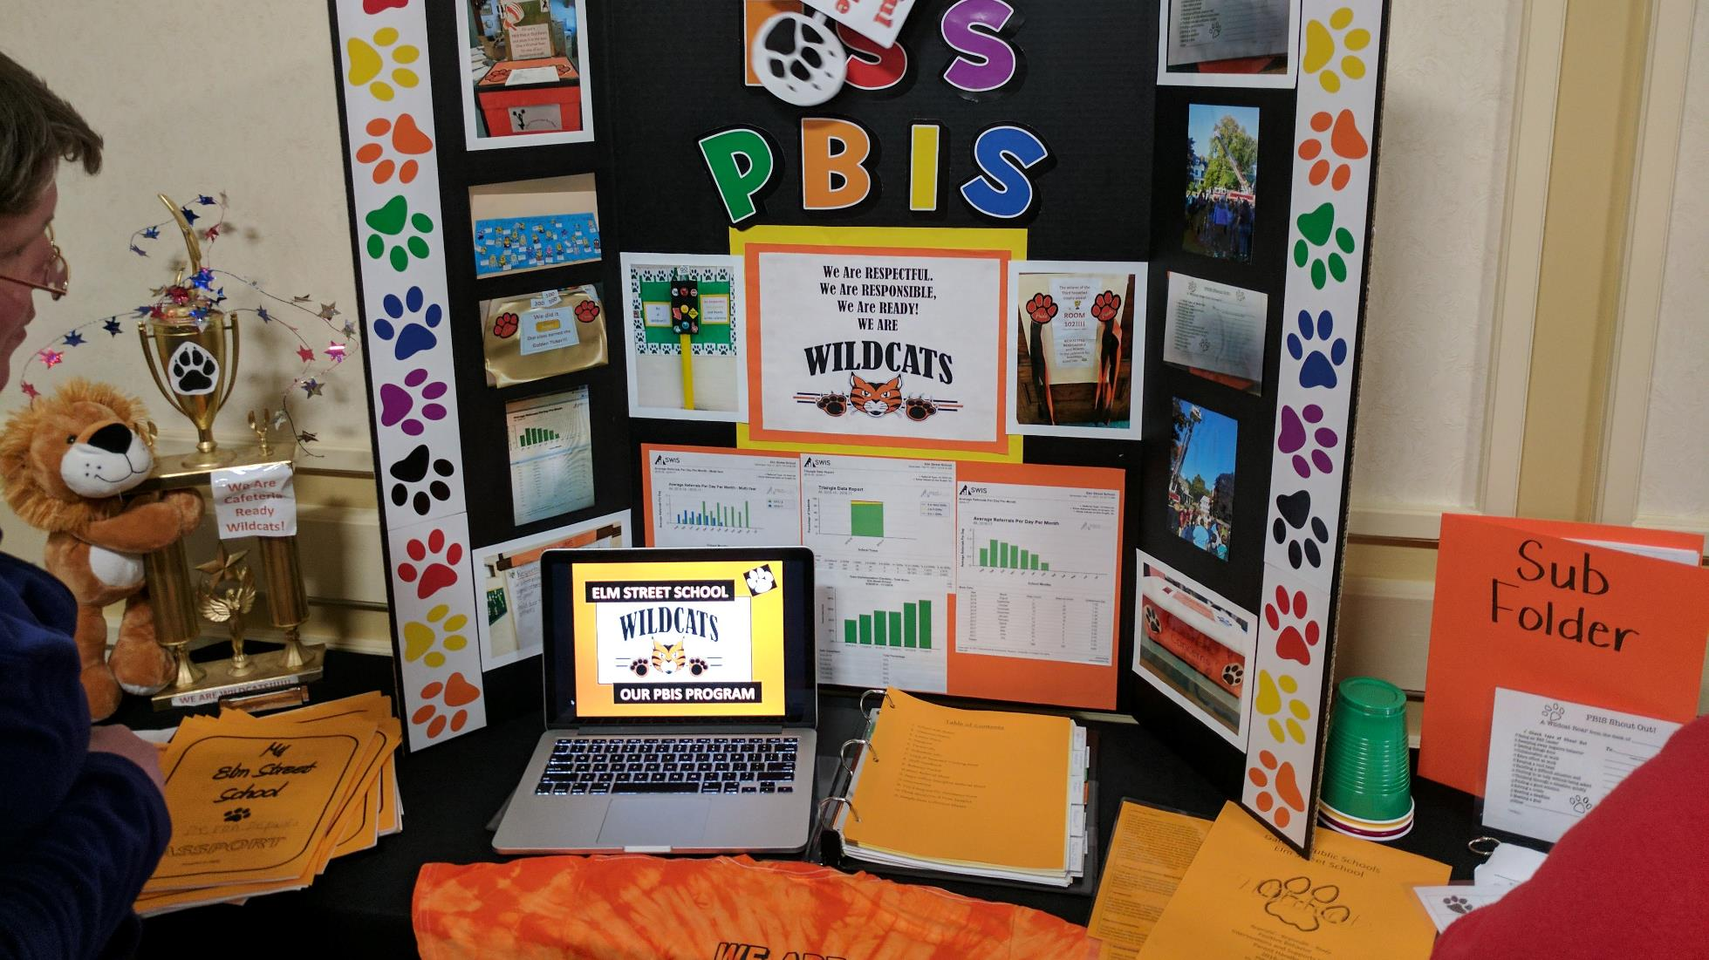

Slide 31
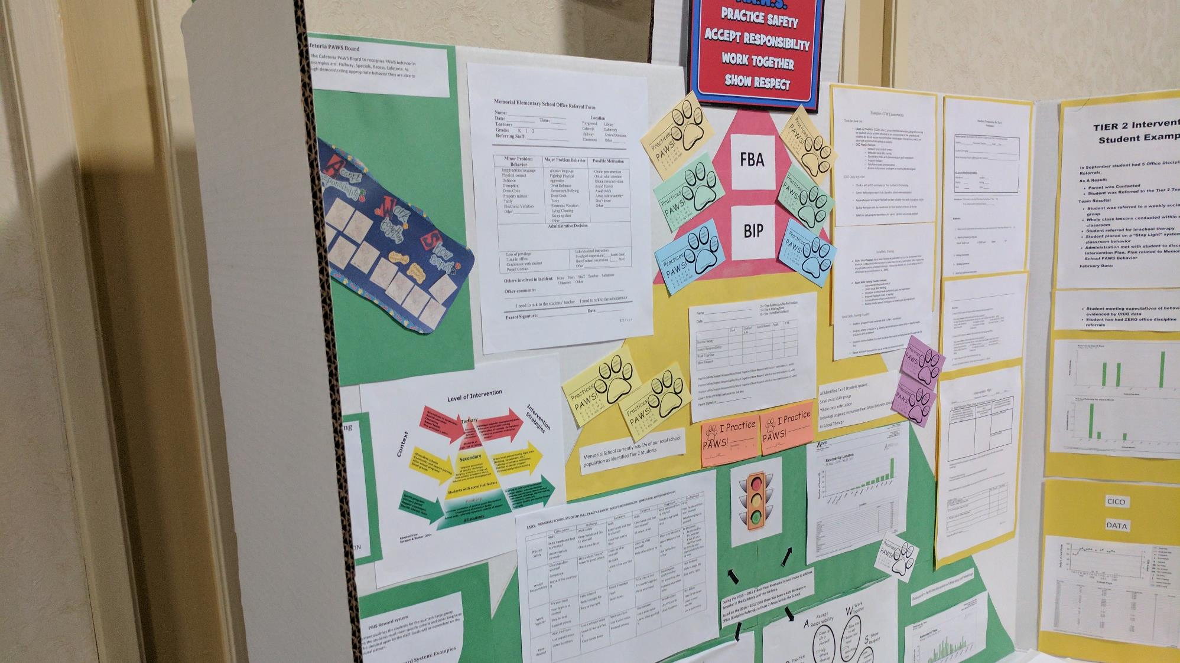

Slide 32
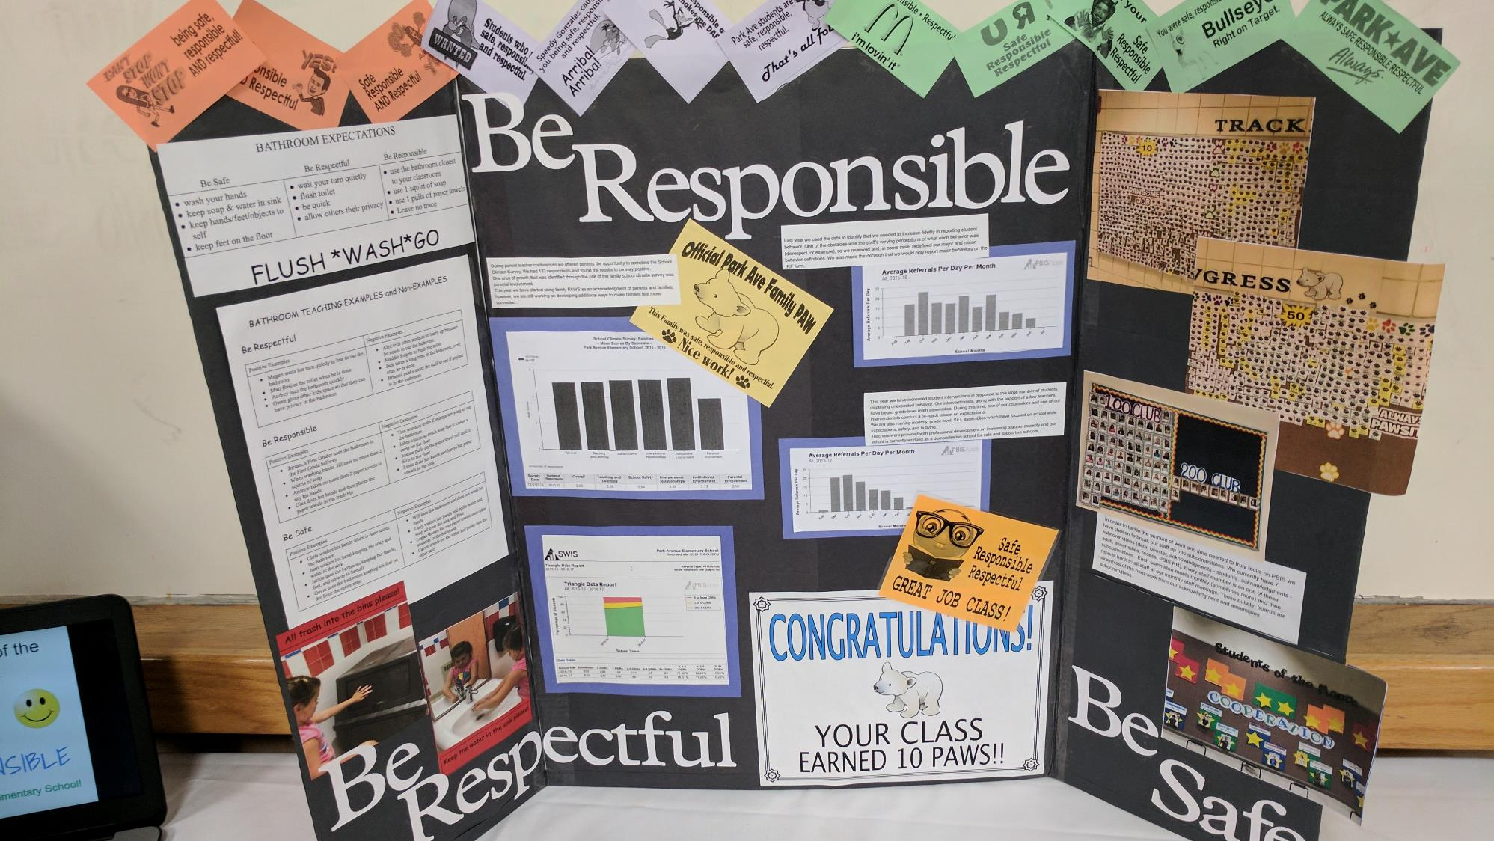

Slide 33
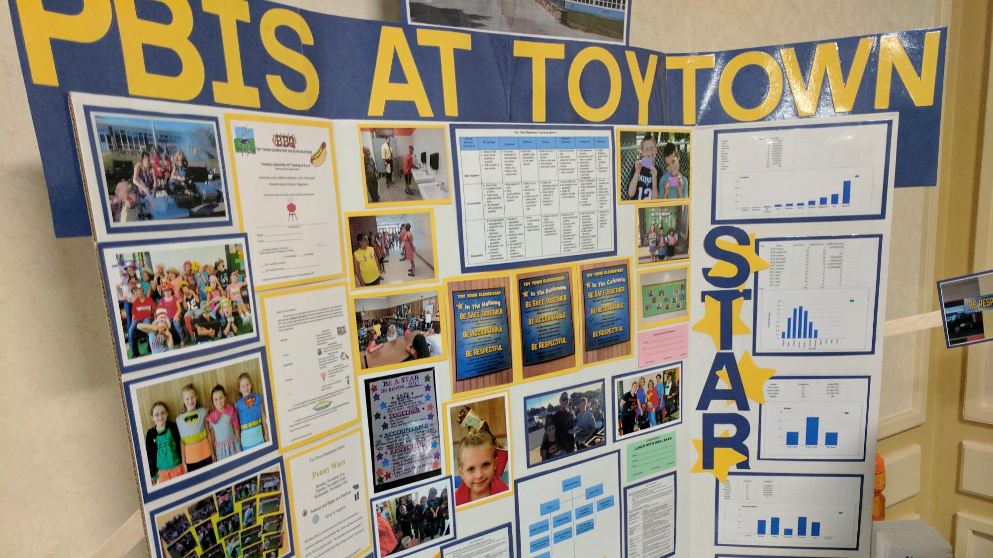

Slide 34
DISCUSSION: LOOKING AHEAD
Decide on a poster format and what you want to show off with your poster.
Discuss what next steps need to be completed between now and the March team training.
What further support do you need so you can support your team with this work?
5 minutes
5 minutes
With co-coach
Whole Group

Slide 35
Agenda & Coaches' Tasks
Presentation Content
Glows & Grows: School-Family Partnerships
Equity Review
Looking Ahead: March Poster session!
Coaches Tasks
Review areas where your PBIS Framework can be more culturally responsive. Discuss with your team and action plan.
Discuss with your team what you may want to include on your poster during the March team training.
Resource Spotlight
What questions do you have on today’s content?
What questions do you have on the follow-up tasks?

Slide 36
HELPFUL RESOURCES
RESOURCES:
Beginning to Address Equity in Tier 1 Systems
Integrated TFI Companion Guide
Culturally Responsive Field Guide
Discussing Race, Racism, and Important Events with Students
Centering Equity within the PBIS Framework: Overview and Evidence of Effectiveness
Poster Session Directions and Examples
Notes:
RESOURCES:
Centering Equity within the PBIS Framework: Overview and Evidence of Effectiveness: https://sebacademy.edc.org/centering-equity-within-pbis-framework-overview-and-evidence-effectiveness
Beginning to Address Equity in Tier 1 Systems: https://sebacademy.edc.org/beginning-address-equity-tier-1-systems
Discussing Race, Racism, and Important Events: https://sebacademy.edc.org/discussing-race-racism-and-important-current-events-students-guide-lesson-plans-and-resources
Integrated TFI Companion Guide -https://sebacademy.edc.org/integrated-tiered-fidelity-inventory-companion-guide
Culturally Responsive Field Guide -https://sebacademy.edc.org/pbis-cultural-responsiveness-field-guide
Poster Session Examples and Directions https://sebacademy.edc.org/poster-session-direction-and-examples

Slide 37
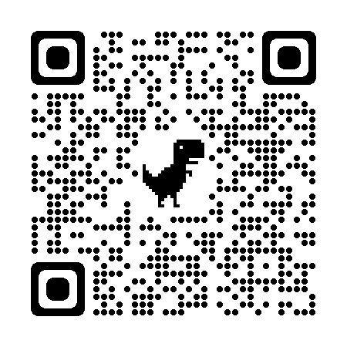
EVALUATION
Please remember to complete the evaluation!
Scan the QR code to access.
Notes:
TRAINERS -
Put link to evaluation (below) in the chat for those who do not use the QR code:
Evaluation Survey: https://edc.co1.qualtrics.com/jfe/form/SV_cBF9GI7gVEBsfSC

