Slide 1


PBIS Coaches’ Training
Year 3: December 2023
Insert Trainer Name
Created from content from the National Technical Assistance Center on Positive Behavioral Interventions and Supports
U.S. Department of Education, Office of Special Education Programs and Office of Elementary and Secondary Education
with support from NEPBIS Network, May Institute, & Broad Reach Consulting

Slide 2

EXPECTATIONS
Self
Others
Environment
Self-monitor
Listen while others are speaking​
Have your computer charged and ready to go​
If you have questions or comments:
Work as a team:
Keep necessary materials at hand
Are you participating?
Engaged as a learner?
Stretch, break, stand as needed​
Raise hand
Room for every voice
Reinforce participation
action plan
relevant docs
water/snacks
Minimize distractions if possible​

Slide 3
IN-PERSON TEAM TRAINING EVENT INCLEMENT WEATHER POLICY
In case of inclement weather, we will cancel our team training if the local school district where the training will be held is either delayed or cancelled due to inclement weather. Please monitor school and district closings for the school district in which the training is being held. In any case that you feel it is not safe for you to travel to the cohort training, please make the decision that is most safe for you.
Your training site is [Trainers please fill in location]

Slide 4
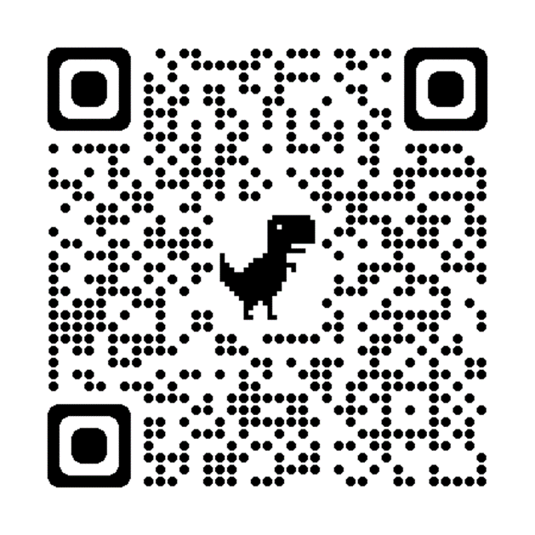
ACTIVITY: ATTENDANCE
Scan QR code on the left or follow the URL posted in the chat to access the online attendance survey
Follow prompts to enter attendance information
Notify trainers if you require assistance (e.g., identifying your cohort or cohort group)
Certificates of Attendance will be sent in January and June. Attendance records will be use as verification
You are in Cohort 8
1 minute
Notes:
ATTENDANCE: https://edc.co1.qualtrics.com/jfe/form/SV_81vbI1jl3cwmLY2

Slide 5
Agenda & Coaches' Tasks
Coaches’ Tasks:
Presentation Content:
Glows & Grows: Classroom Practices & Assessment
Discuss with team integration & alignment content. What other practice models should be integrated with PBIS supports? – Complete alignment activity and add to Google Folder.
Integration & Alignment
Fidelity Assessment: Walkthrough Planning
Work with team to plan and complete the TFI walkthrough prior to January Team training.

Slide 6
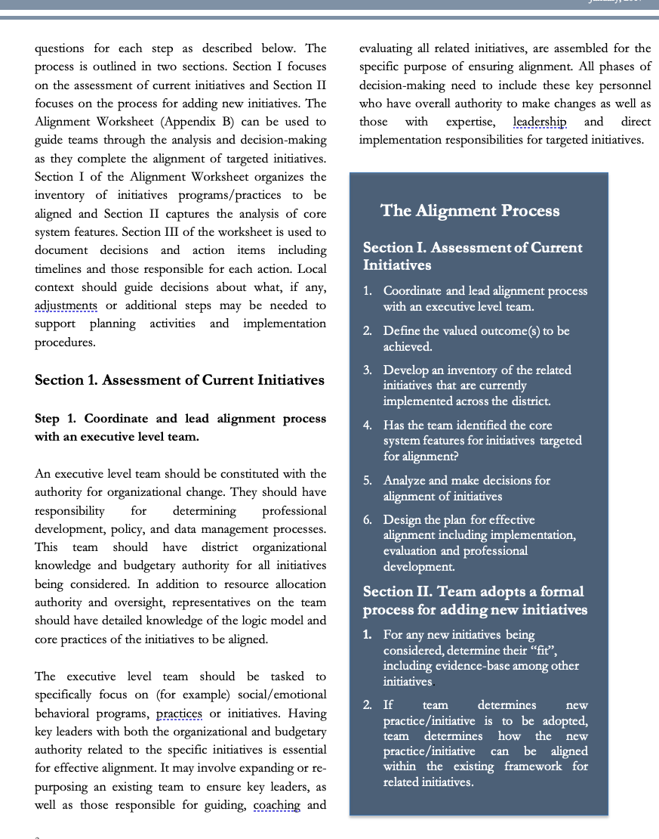
HELPFUL RESOURCES
RESOURCES:
Tiered Fidelity Inventory
PBIS TFI Walkthrough Tip Sheet
Integrated TFI Companion Guide
Working Smarter Matrix
Technical Guide for Alignment of Initiatives, Programs and Practices in School Districts
Alignment Activity
Notes:
RESOURCES:
PBIS TFI: Resource link: https://www.pbisapps.org/resource/tfi
PBIS TFI Walkthrough Tip Sheet: https://www.pbisapps.org/resource/tfi-walkthrough-tip-sheet
Integrated TFI Companion Guide: https://www.pbis.org/resource/integrated-tiered-fidelity-inventory-companion-guide
Technical Guide for Alignment of Initiatives: https://www.pbis.org/resource/technical-guide-for-alignment-of-initiatives-programs-and-practices-in-school-districts
Working Smarter Matrix: https://sebacademy.edc.org/tier-2-working-smarter-teams-activity

Slide 7

Glows & Grows:
Assessment
of Classroom Practices
Notes:
12:30

Slide 8
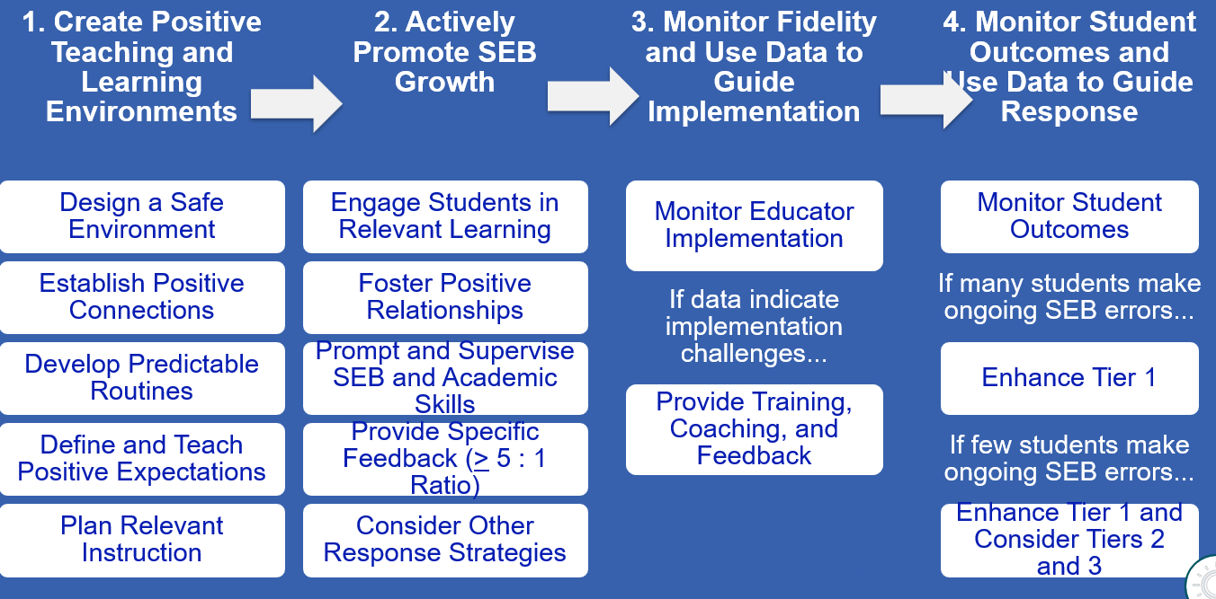

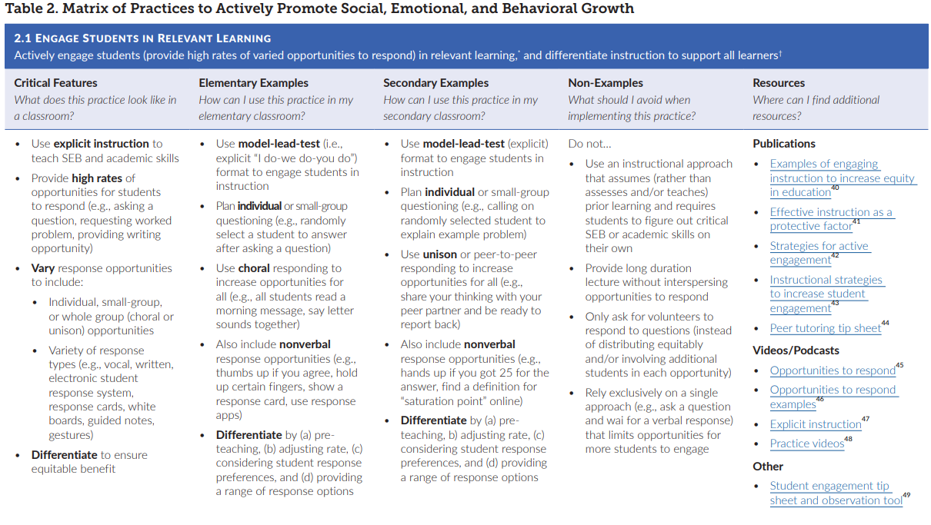
Supporting and Responding – Classroom Support Doc
First, be familiar with our resources
Notes:
Incorporate familiar resources, such as the Supporting and Responding to behavior document, which can be found on PBIS.org and provides useful tools for organizing class-wide supports.
Please add this document to the chat: https://www.pbis.org/resource/supporting-and-responding-to-behavior-evidence-based-classroom-strategies-for-teachers

Slide 9
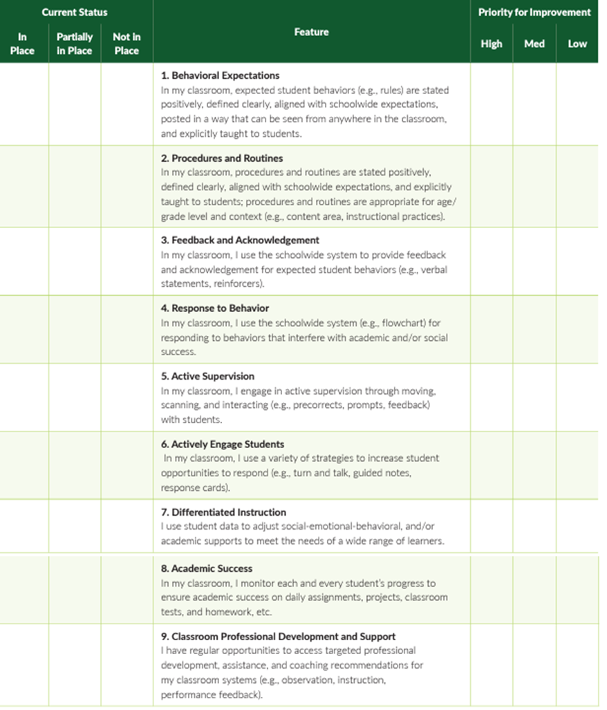
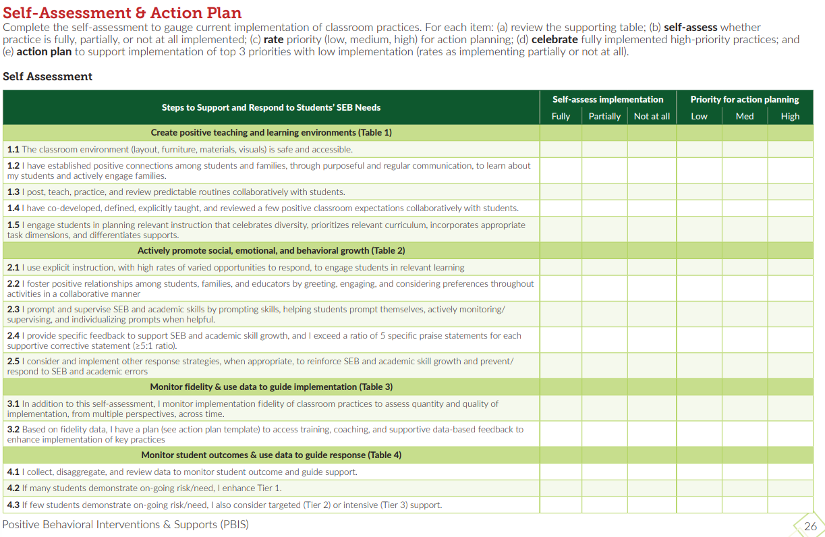
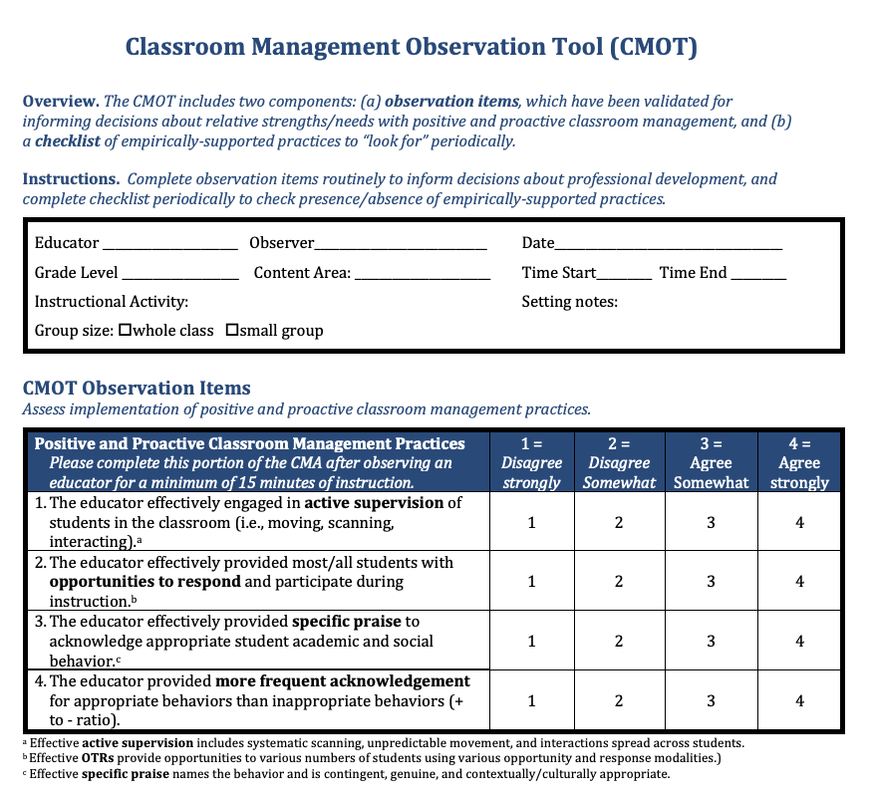
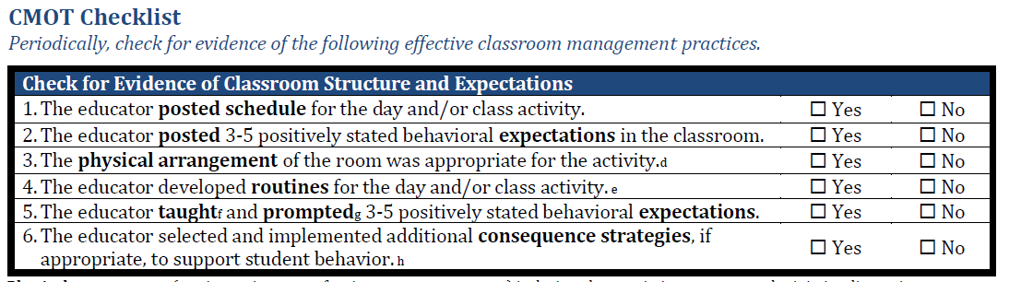
Assessment Tools
Page 26 of the Supporting & Responding Brief
SELF ASSESSMENT SURVEY
Classroom ASSESSMENT SURVEY
CMOT: Observation tool and Check List
Notes:
Cmot - https://sebacademy.edc.org/classroom-management-observation-tool-cmot
Supporting and responding to SEB Needs https://sebacademy.edc.org/supporting-and-responding-students-social-emotional-and-behavioral-needs-classrooms
Classroom Self Assessment Survey - www.pbisapps.org/resource/self-assessment-survey

Slide 10
DISCUSSION: CLASSROOM ASSESSMENT
How and when have you decided to assess classroom practices?
Independent Jot
Whole Group
3 minutes
7 minutes

Slide 11
INTEGRATION & ALIGNMENT WITH PBIS

Slide 12
BIG IDEAS: WHY ALIGN?
Systems
Data
Practices
Use one coherent implementation framework to align competing initiatives for the current context and avoid repeatedly shifting focus to new initiatives.
Articulate and simplify message so district, community/school leaders and staff see a coherent framework and can support an overall improvement strategy
Use the PBIS/MTSS core features as the guiding principles of the proactive/preventative approach.
Equity
Outcomes
Tier 3
Tier 2
Tier 1
Notes:
We know that every year schools are asked to add more onto their task list. It seems like just when schools are implementing near fidelity with one initiative or program another one gets thrown into the mix and we lose momentum with the last one. But they all seem so similar to each other…why can’t we just stick with one.
We’re not saying these aren’t important to the health of your school climate but how do you fully integrate everything together? We know PBIS has some explicit practices but mostly it’s an implementation framework that can be used to align initiatives and articulate a simplified message so that your stakeholders can support the overall improvement strategy rather then a series of disjointed practices that never get full attention. The PBIS/MTSS approach is proactive preventative and focuses on tiers of intervention. It’s within those systems and tiers that you can add new research and strategies to support your students.

Slide 13
ALIGNING INITIATIVES, PROGRAMS, & PRACTICES
1. Define the valued outcome(s).
2. List related initiatives.
3. Identify core system features.
4. Analyze and make decisions for alignment.
5. Design the plan for effective alignment.
View
Technical
Guide on pbis.org
National TA Center on PBIS. (2017). Technical guide for alignment of initiatives, programs, practices in school districts. Eugene, OR: Retrieved from www.pbis.org
Notes:
There are 5 steps to take when thinking about Aligning initiatives.
Define your valued outcomes – Like a Positive School Culture
List your related initiatives – Like PBIS, SEL, mental health, Bully Prevention
Identify core system features – Such as Teaching Lessons or Acknowledging students
Analyze and make decisions - How to combine PD Events
And plan for effective alignment – like combining teams and outcomes.
If you're interested in learning more about integration and alignment, you can download and read the "Technical guide for Alignment" on PBIS.org
You can use section 5C in your getting started workbook for more information.

Slide 14
WORKING SMARTER MATRIX
1. Define the valued outcome(s).
2. List related initiatives.
Initiative, Committee | Purpose | Outcome | Target Group | Staff Involved | SIP/SID
Attendance Committee | Increase attendance | Increase % of students attending daily | All students | Eric, Ellen, Marlee | Goal #2
SEL Initiative | Increase Social Emotional skills/improve behavior | Increased use of self and relationship management skills by students – Fewer office referrals | All students | Marlee, J.S., Ellen | Goal #3
STEM Academic Support Team | Improve STEM academic grades | Increase the number of students passing math and science | Students Failing or in danger of failing STEM Classes | Kim, Mary, Beth, Rick | Goal #1
School Spirit Committee | Enhance school spirit | Improve morale | All students | Has not met
Discipline Committee | Improve behavior | Decrease office referrals | Bullies, antisocial students, repeat offenders | Ellen, Eric, Marlee, Otis | Goal #3
Restorative practices | Improve behavior | Decrease referrals and exclusionary consequences | All students | Don | Goal #3
PBIS Initiative | Implement 3-tier model to improve behavior | Decrease office referrals, increase attendance, enhance academic engagement, improve grades | All students | Eric, Ellen, Marlee, Otis, Emma | Goal #2 Goal #3
Notes:
This is the working Smarter Matrix which helps us see where we have overlap with our teams and initiatives.
You can see right away that many of the initiatives have the same or similar purpose of improving behavior, They have the outcome goal of reducing office referrals which also seems related to Goal #3 in their School Improvement plan. and many also focus on ALL Students which is considered Tier 1. They even have many of the same staff on the teams which becomes a time drain with so many meetings to schedule and attend.
So isn’t it obvious that we should be combining efforts where we can? We think so!

Slide 15
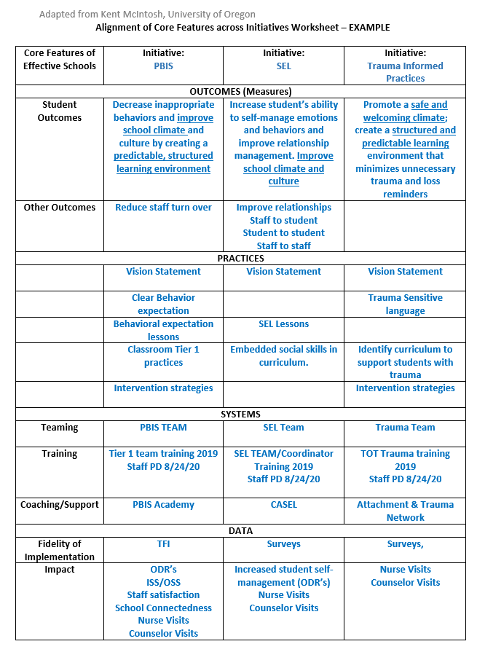
3. Identify core system features.
Notes:
Here is an example of The alignment activity you will work on this year. This one seeks to align PBIS with SEL and Trauma Informed Practices. This worksheet will help us align the Core System Features of each initiative. Let’s take a closer look.
Alignment Worksheet: https://nepbis.org/wp-content/uploads/2018/11/Alignment-Activity-1.docx

Slide 16
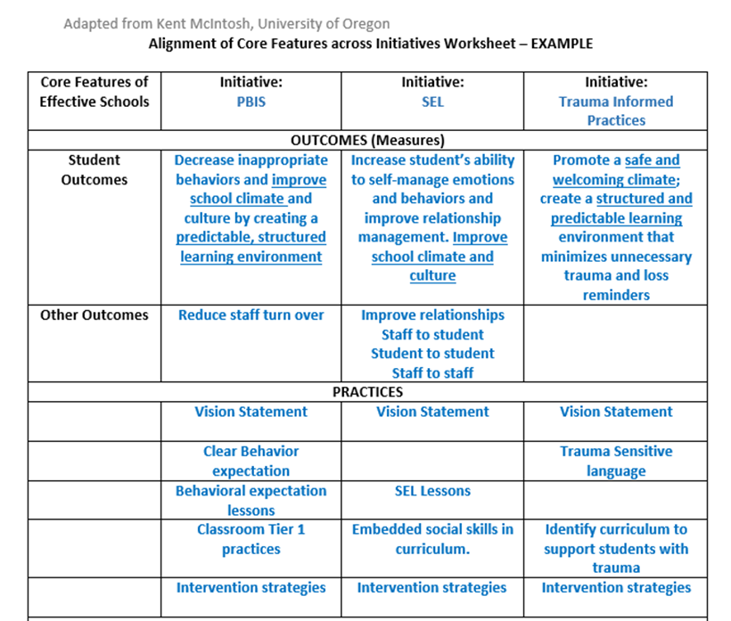
4. Analyze and make decisions for alignment.
5. Design the plan for effective alignment.
Notes:
We start by identifying our initiatives and then listing the desired Outcomes for each – CLICK
We see that overall our goal here is to improve the school climate and culture.
Next we list the various practice set align the practices so you can see where they overlap.
All 3 initiatives have a vision statement component. (we don’t need 3 separate statements but rather 1 that encompasses all 3 initiatives.)
We can also see other areas that overlap such as lessons and intervention strategies.

Slide 17
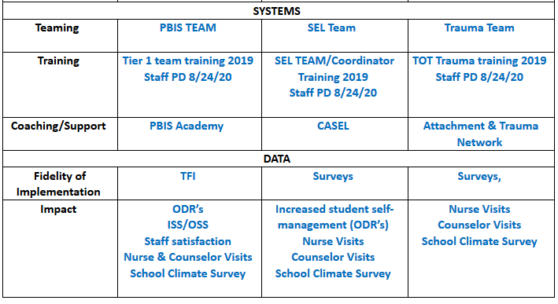
Notes:
The next ss to consider are Systems and Data –
You’ll want to list the team that was created to lead the initiative.
Can they be combined? Revisit your working smarter matrix and see if the same people are on multiple committees.
Next think of the training for staff -
Can we create staff PD that covers all 3 topics so that staff understand their interconnectedness?
Finally, consider what Fidelity and outcome data you will use to determine fidelity and effectiveness.
Here you can see that ODR’s, Nurse and counselor visits and the school climate survey will be outcome measures for all 3 initiatives

Slide 18
Teaching Matrix |  | INCORPORATE Coping Strategies for Managing Stress
 |  | All Settings | Hallways | Playgrounds | Lunch | Library/ Computer Lab | Assembly | Bus
Expectations | Respectful | Be on task. Give your best effort. Be prepared. | Walk. | Have a plan. | Invite those sitting alone to join in | Study, read, compute. | Sit in one spot. | Watch for your stop.
 | Achieving & Organized | Be kind. Hands/feet to self. Help/share with others. | Use normal voice volume. Walk to right. | Play safe. Include others. Share equipment. | Have a lunch plan and choose quiet or social lunch area | Whisper. Return books. | Listen/watch. Use appropriate applause. | Use a quiet voice. Stay in your seat.
 | Responsible | Recycle. Clean up after self. | Pick up litter. Maintain physical space. | Use equipment properly. Put litter in garbage can. | Use my breathing technique Listen to my signals | Push in chairs. Treat books carefully. | Pick up. Treat chairs appropriately. | Wipe your feet.
Notes:
For many schools who are returning to in person learning supporting students who have experienced high levels of stress and anxiety has become a priority. You can see how the team can develop strategies and skills and incorporate them into their social curriculum.
READ LUNCH Column - it would be a matter of teaching skills to students. – the matrix is the delivery mechanism to get skills out to EVERYONE!!! It’s the common language and script used to teach, acknowledge, pre-correct
This allows all staff to use the same approach for teaching and supporting across the school day and throughout the year.

Slide 19
PBIS FRAMEWORK & SEB CROSSWALK
Expectation | Specific Behavior or Social Emotional Skill
Be Safe | Keep hands and feet to self
 | I tell an adult when I am worried about a friend.
Be Respectful | Use the signal to ask a public or private question.
 | Make sure everyone gets a turn.
Be Responsible | Turn in all work on time
 | Check in with my feelings during the day
*SEB = Social, Emotional, & Behavioral
Notes:
Does your school have universal SEL practices (e.g., a curriculum such as Second Step, Zones of Regulation Restorative practices, Responsive Classroom)? If you said yes…how are you integrating them currently?
Specific behaviors are important and necessary, but we are also addressing social competency with all our students.

Slide 20
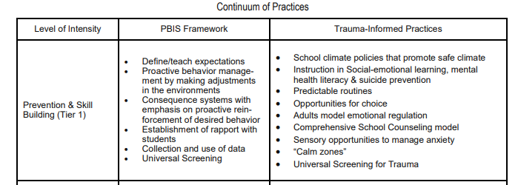
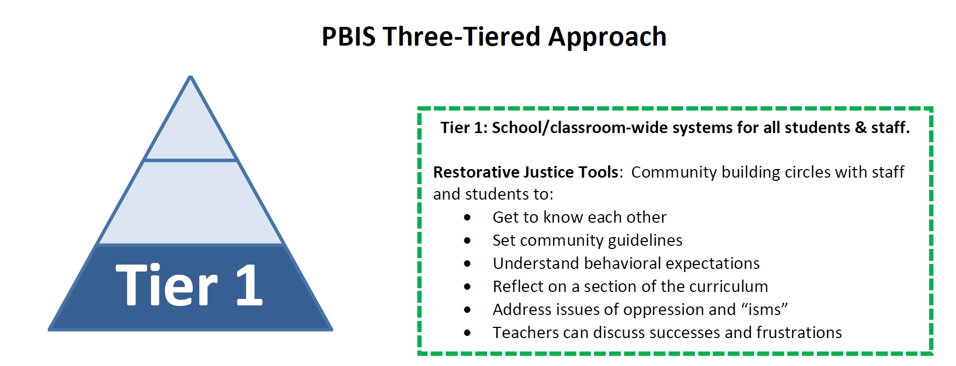
Trauma-Informed Practices & PBIS
Restorative Practices & PBIS
Notes:
As demonstrated in the sample, Trauma informed and restorative justice practices seamlessly integrated with PBIS and in fact have many of the same goals and outcomes.
So why do them all? Well, you don’t have to unless your data or climate indicate the need.
Each practice addresses a need or group of needs such as avoiding retraumatizing students or restoring relationships after conflict. You might have a gang prevention or bullying prevention program in your school that address those topics. But no matter the program you should use the MTSS/ PBIS framework to address it. Meaning you use your staff systems to inform and train staff, you use your teaching systems (advisory, SEL Block) to teach students, your communication systems to inform families and the broader community, and your data systems to analyzed your implementation and results.

Slide 21
GUIDELINES: EFFECTIVE ALIGNMENT
Organizational Level
Professional Development
Outcome Measures
Systems
Align multiple initiatives where common budget authority exists
Build aligned PD by comparing & combining core features of initiatives
Compare fundamental assumptions
Start with common “core features” & compare practices used to achieve these features
Determine how to incorporate additional core features efficiently
Build single PD curriculum that combines core features
Align multiple initiatives by using common measures to assess effectiveness
Logic Model
Resolve any logic model conflicts between initiatives
Notes:
Follow these guidelines to effectively align and integrate your initiatives.
Always start at the organizational level if possible – Can or does the same person have administrative and budget authority over the various initiatives? This can help to avoid redundancies in trainers, repetitive tasks, staffing and resources.
Use your Working Smarter matrix to align your common outcomes and outcome measures
Align and integrate the common core features into your practices and PD to be as efficient as possible with your time and resources.
Finally Resolve Logic Model Conflicts – Examine how everything flows together and resolve any issues where procedures might diverge. - such as one initiative might use Tangible reinforcers while another stresses only verbal feedback - work with your team to come up with a collaborative workable protocol or solution

Slide 22
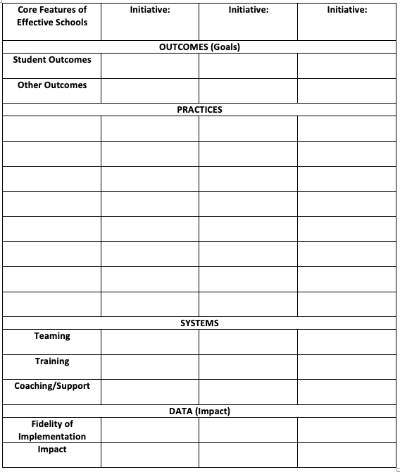
ACTIVITY: INTEGRATION & ALIGNMENT
Complete the Alignment Activity Worksheet
First consider what other practice models you want to align with your PBIS Framework
What action steps are necessary to begin this work?
Add relevant items to your action plan or adjust as needed.
Consider using your Working Smarter Matrix if necessary.
10 minutes
5 minutes
Coach Review/Chat
Whole Group
Notes:
Over this year work to complete the Integration and Alignment Activity that can be found on the platform.
Think about which initiatives you have in your building or district.
What resources might you need to help address the alignment
Do you need to review or recreate your Working Smarter Matrix?
Update your action plan.

Slide 23
PBIS
Resource Spotlight:
Teaching Social-Emotional Competencies within a PBIS Framework
Notes:
RESOURCE LINK: https://www.pbis.org/resource/teaching-social-emotional-competencies-within-a-pbis-framework

Slide 24
Topics for Alignment & Integration
TRAUMA
Integrating a Trauma-Informed Approach within PBIS Framework
2020 Forum Session E1
SUICIDE PREVENTION
2020 Forum Session A6
Interview from 2020 Forum
SOCIAL EMOTIONAL COMPETENCIES
Teaching Social Emotional Competencies within PBIS Framework
Video: Social Emotional Learning: Cultivating Essential Life Skills
Restorative Practices
Restorative Practices in PBIS (SCTG Webinar)
Mental Health
Aligning and Integrating Mental Health and PBIS to Build Priority for Wellness
SCREENING
Best Practices in Universal SEB Screening
SPECIAL TOPICS
Human Trafficking
Opioid
Notes:
Integrating a Trauma-Informed Approach within PBIS Framework - https://www.pbis.org/resource/integrating-a-trauma-informed-approach-within-a-pbis-framework
2020 Forum Session E1 - https://www.pbis.org/video/session-e1-pbis-forum-2020-integrating-a-trauma-informed-approach-within-a-pbis-framework
2020 Forum Session A6 - https://www.pbis.org/video/session-a6-pbis-forum-2020-applying-the-multi-tiered-framework-to-suicide-prevention
Interview from 2020 Forum - https://www.pbis.org/video/pbis-forum-2019-interview-tim-knoster
Teaching Social Emotional Competencies within PBIS Framework - https://www.pbis.org/resource/teaching-social-emotional-competencies-within-a-pbis-framework
Video: Social Emotional Learning: Cultivating Essential Life Skills - https://www.pbis.org/video/social-emotional-learning-cultivating-essential-life-skills
Aligning and Integrating Mental Health and PBIS to Build Priority for Wellness - https://www.pbis.org/resource/aligning-and-integrating-mental-health-and-pbis-to-build-priority-for-wellness
Restorative Practices in PBIS (SCTG Webinar) - https://www.pbis.org/video/restorative-practices-in-pbis-sctg-webinar
Aligning and Integrating Mental Health and PBIS to Build Priority for Wellness - https://www.pbis.org/resource/aligning-and-integrating-mental-health-and-pbis-to-build-priority-for-wellness
Best Practices in Universal SEB Screening - https://www.pbis.org/resource/best-practices-in-universal-social-emotional-and-behavioral-screening-an-implementation-guide
Human Trafficking - https://www.pbis.org/resource/addressing-the-growing-problem-of-domestic-sex-trafficking-in-minors-through-pbis
Opioid - https://www.pbis.org/resource/using-the-pbis-framework-to-address-the-opioid-crisis-in-schools

Slide 25
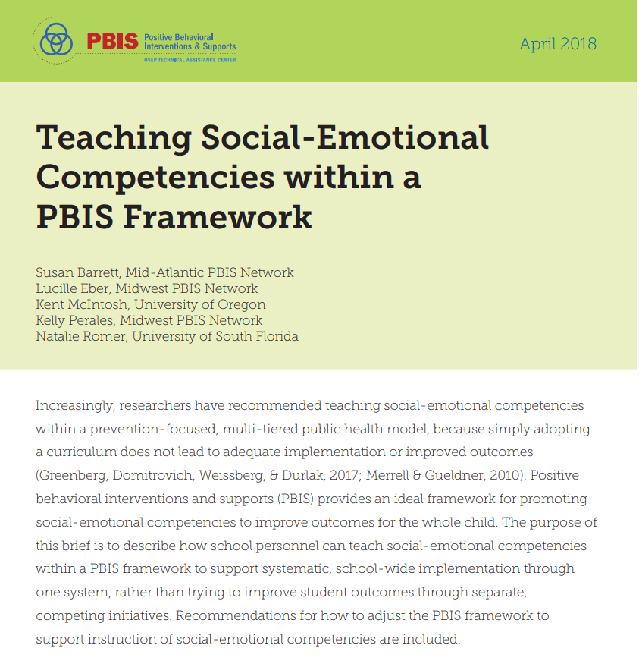
Teaching Social-Emotional Competencies within a PBIS Framework
The purpose of this brief is to describe how school personnel can teach social-emotional competencies within a PBIS framework to support systematic, school-wide implementation through one system, rather than trying to improve student outcomes through separate, competing initiatives.
Implement social-emotional and behavior support through a single item
Expand the data that teams use to identify which skills to teach.
Teach social-emotional competencies using PBIS instructional systems
Promote adult wellness by creating a nurturing environment

Slide 26
DISCUSSION: Teaching Social-Emotional Competencies within a PBIS Framework
Download & Review Teaching Social-Emotional Competencies within a PBIS Framework. (Or review one of the other resources)
Review Brief
What is your big takeaway? What from this brief resonates with you, and are you considering bringing back to your team?
10 minutes
10 minutes
Coach Review/Chat
Whole Group
Notes:
Resource Link: https://www.pbis.org/resource/integrated-tiered-fidelity-inventory-companion-guide

Slide 27
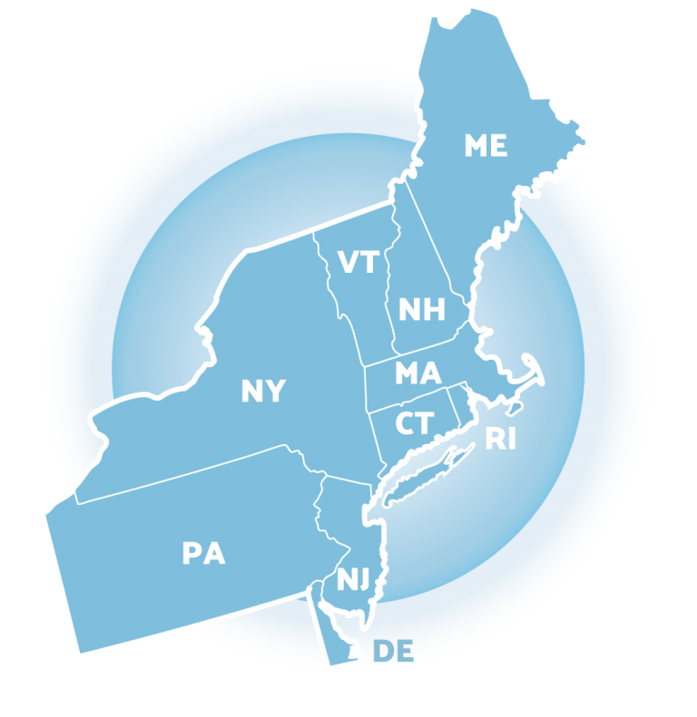
Preparing for Jan Training:
TFI Walkthrough Tool
Notes:
https://www.pbisapps.org/products/tfi

Slide 28
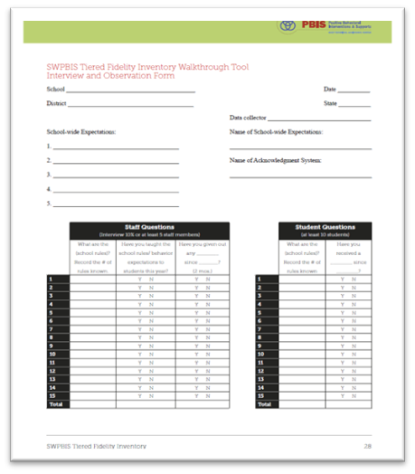
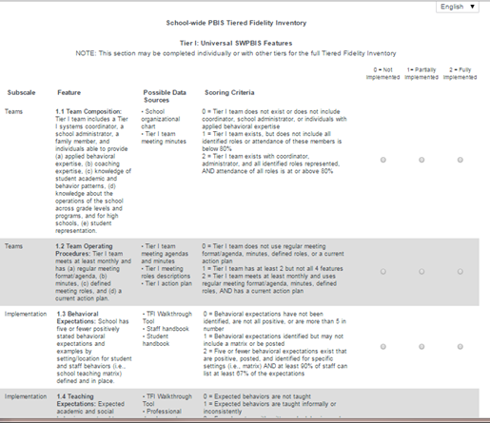
TIERED FIDELITY INVENTORY
PBIS Assessments
Walkthrough Tool – Appendix A
Notes:
The purpose of this content is to explicitly review the TFI Walkthrough tool to help coaches and teams collect this information independently.
Resource Link: https://www.pbisapps.org/resource/tfi

Slide 29
TFI WALKTHROUGH
Who should complete this tool? | Someone who is independent of the building.
 | Coach or team member who is internal for the purpose of a self-assessment.
 | District administrator
 | Coach or team member from another in-district building
Two Components | Staff Interviews (minimum of 10 people)
 | Student Interviews (minimum of 10 students)
Notes:
Resource link: https://www.pbisapps.org/resource/tfi
Appendix A, Page 27

Slide 30
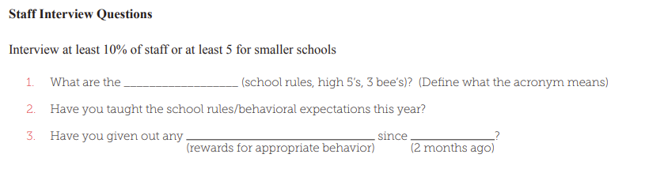
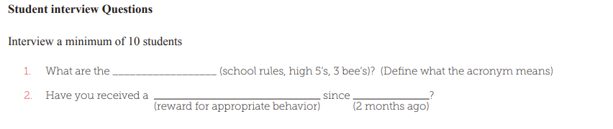
TFI WALKTHROUGH
Staff
interview Questions
Student interview Questions
Notes:
TRAINER NOTE: Remind evaluator to ask if they have "formally" taught the expectations to your students this year?
Resource link: https://www.pbisapps.org/resource/tfi
Appendix A, Page 27

Slide 31
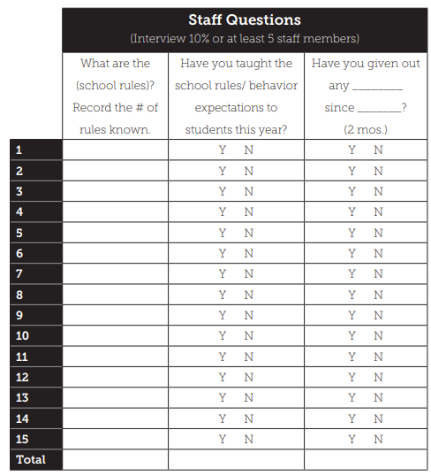
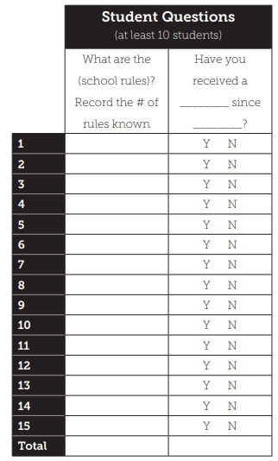
TFI WALKTHROUGH INTERVIEW FORM
Notes:
Resource link: https://www.pbisapps.org/resource/tfi
Appendix A, Page 27

Slide 32
ACTIVITY: TFI WALKTHROUGH PLANNING
Review the TFI Walkthrough Tool
Plan when you will conduct this walkthrough (try and collect this information in advance of our Jan training).
Plan who will conduct this walkthrough.
10 minutes
Coach Review/Chat
Notes:
Resource Link: https://www.pbisapps.org/resource/tfi-walkthrough-tip-sheet
Resource link: https://www.pbisapps.org/resource/tfi
Appendix A, Page 27

Slide 33
Agenda & Coaches' Tasks
Coaches’ Tasks:
Presentation Content:
Glows & Grows: Classroom Practices & Assessment
Discuss with team integration & alignment content. What other practice models should be integrated with PBIS supports? – Complete alignment activity and add to Google Folder.
Integration & Alignment
Fidelity Assessment: Walkthrough Planning
Work with team to plan and complete the TFI walkthrough prior to January Team training.
What questions do you have on today’s content?
What questions do you have on the follow-up tasks?

Slide 34
HELPFUL RESOURCES
RESOURCES:
Tiered Fidelity Inventory
PBIS TFI Walkthrough Tip Sheet
Integrated TFI Companion Guide
Working Smarter Matrix
Technical Guide for Alignment of Initiatives, Programs and Practices in School Districts
Alignment Activity Worksheet
Notes:
RESOURCES:
PBIS TFI: Resource link: https://www.pbisapps.org/resource/tfi
PBIS TFI Walkthrough Tip Sheet: https://www.pbisapps.org/resource/tfi-walkthrough-tip-sheet
Integrated TFI Companion Guide: https://www.pbis.org/resource/integrated-tiered-fidelity-inventory-companion-guide
Technical Guide for Alignment of Initiatives: https://www.pbis.org/resource/technical-guide-for-alignment-of-initiatives-programs-and-practices-in-school-districts
Working Smarter Matrix: https://sebacademy.edc.org/tier-2-working-smarter-teams-activity
Alignment Activity Worksheet - https://sebacademy.edc.org/alignment-activity

Slide 35
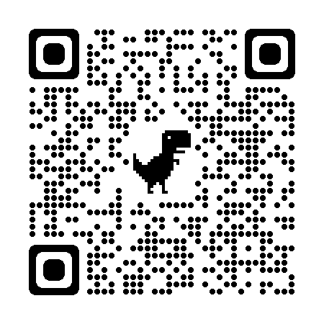
EVALUATION
Please remember to complete the evaluation!
Scan the QR code to access.
Notes:
TRAINERS -
Put link to evaluation (below) in the chat for those who do not use the QR code:
Evaluation Survey: https://edc.co1.qualtrics.com/jfe/form/SV_cBF9GI7gVEBsfSC

