Slide 1


PBIS Coaches’ Training
Year 2: February 2024
Insert Trainer Name
Created from content from the National Technical Assistance Center on Positive Behavioral Interventions and Supports
U.S. Department of Education, Office of Special Education Programs and Office of Elementary and Secondary Education
with support from NEPBIS Network, May Institute, & Broad Reach Consulting

Slide 2

EXPECTATIONS
Self
Others
Environment
Self-monitor
Mute when listening, unmute to talk​
Have your computer charged and ready to go​
If you have questions or comments:
Work as a team:
Keep necessary materials at hand
Are you participating?
Engaged as a learner?
Stretch, break, stand as needed​
unmute
use the chat box
Room for every voice
Reinforce participation
action plan
relevant docs
water/snacks
Minimize distractions if possible​

Slide 3
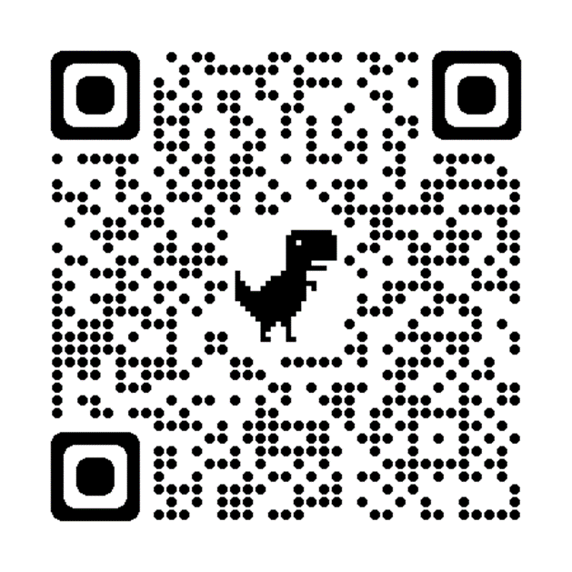
ACTIVITY: ATTENDANCE
Scan QR code on the left or follow the URL posted in the chat to access the online attendance survey
Follow prompts to enter attendance information
Notify trainers if you require assistance (e.g., identifying your cohort or cohort group)
Certificates of Attendance will be sent in January and June. Attendance records will be use as verification
You are in Cohort 9
1 minute
Notes:
ATTENDANCE: https://edc.co1.qualtrics.com/jfe/form/SV_81vbI1jl3cwmLY2

Slide 4


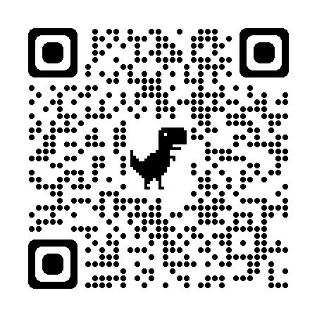

May 16 & 17, 2024
Mystic Marriott Hotel and Spa
Mystic, CT
https://nepbis.org/forum/

Slide 5
Agenda & Coaches' Tasks
Coaches’ Tasks:
Presentation Content:
Glows & Grows: TFI/Classroom
Share data with staff and direct them to focus on behavior/location/expectation
DBDM – Review Sharing Data
Resource Spotlight – 5 Questions Every Team Should Ask about Racial Disproportionality
Intro to School Family Partnerships
Review Disproportionality and Family Resources with team
Complete School-Family Practices Survey with team

Slide 6

HELPFUL RESOURCES
RESOURCES:
Tiered Fidelity Inventory
TFI Action Plan Template
Tidy up with the TFI
5 Questions Every Team Should Ask about Racial Disproportionality
The Family School Practices Survey
Notes:
RESOURCES:
PBIS TFI: https://sebacademy.edc.org/tiered-fidelity-inventory-tfi-manual
TFI Action Plan: https://sebacademy.edc.org/tfi-action-plan-template
Tidy Up with the TFI - https://sebacademy.edc.org/tidy-tfi
School Family Practices Survey - https://sebacademy.edc.org/family-school-practices-survey
5 Questions Every Team Should Ask about Racial Disproportionality - https://sebacademy.edc.org/5-questions-every-team-should-ask-about-racial-disproportionality

Slide 7

Glows & Grows:
Action Planning from TFI / Classroom Content
Notes:
12:30

Slide 8

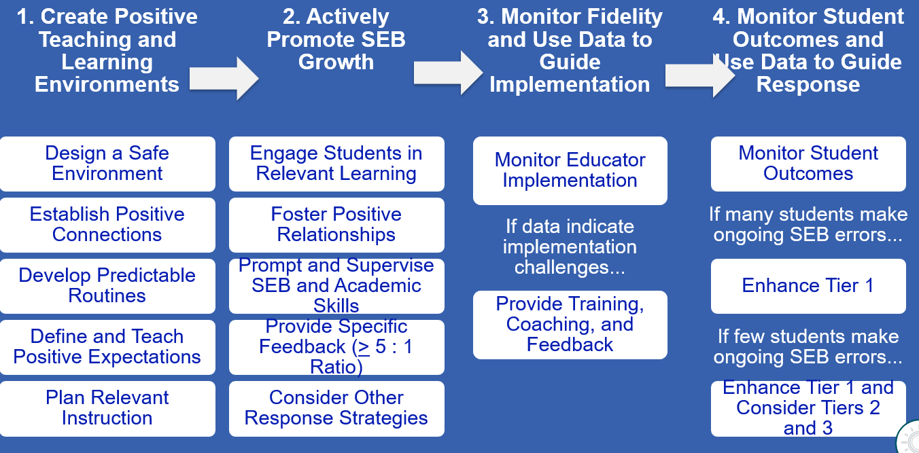
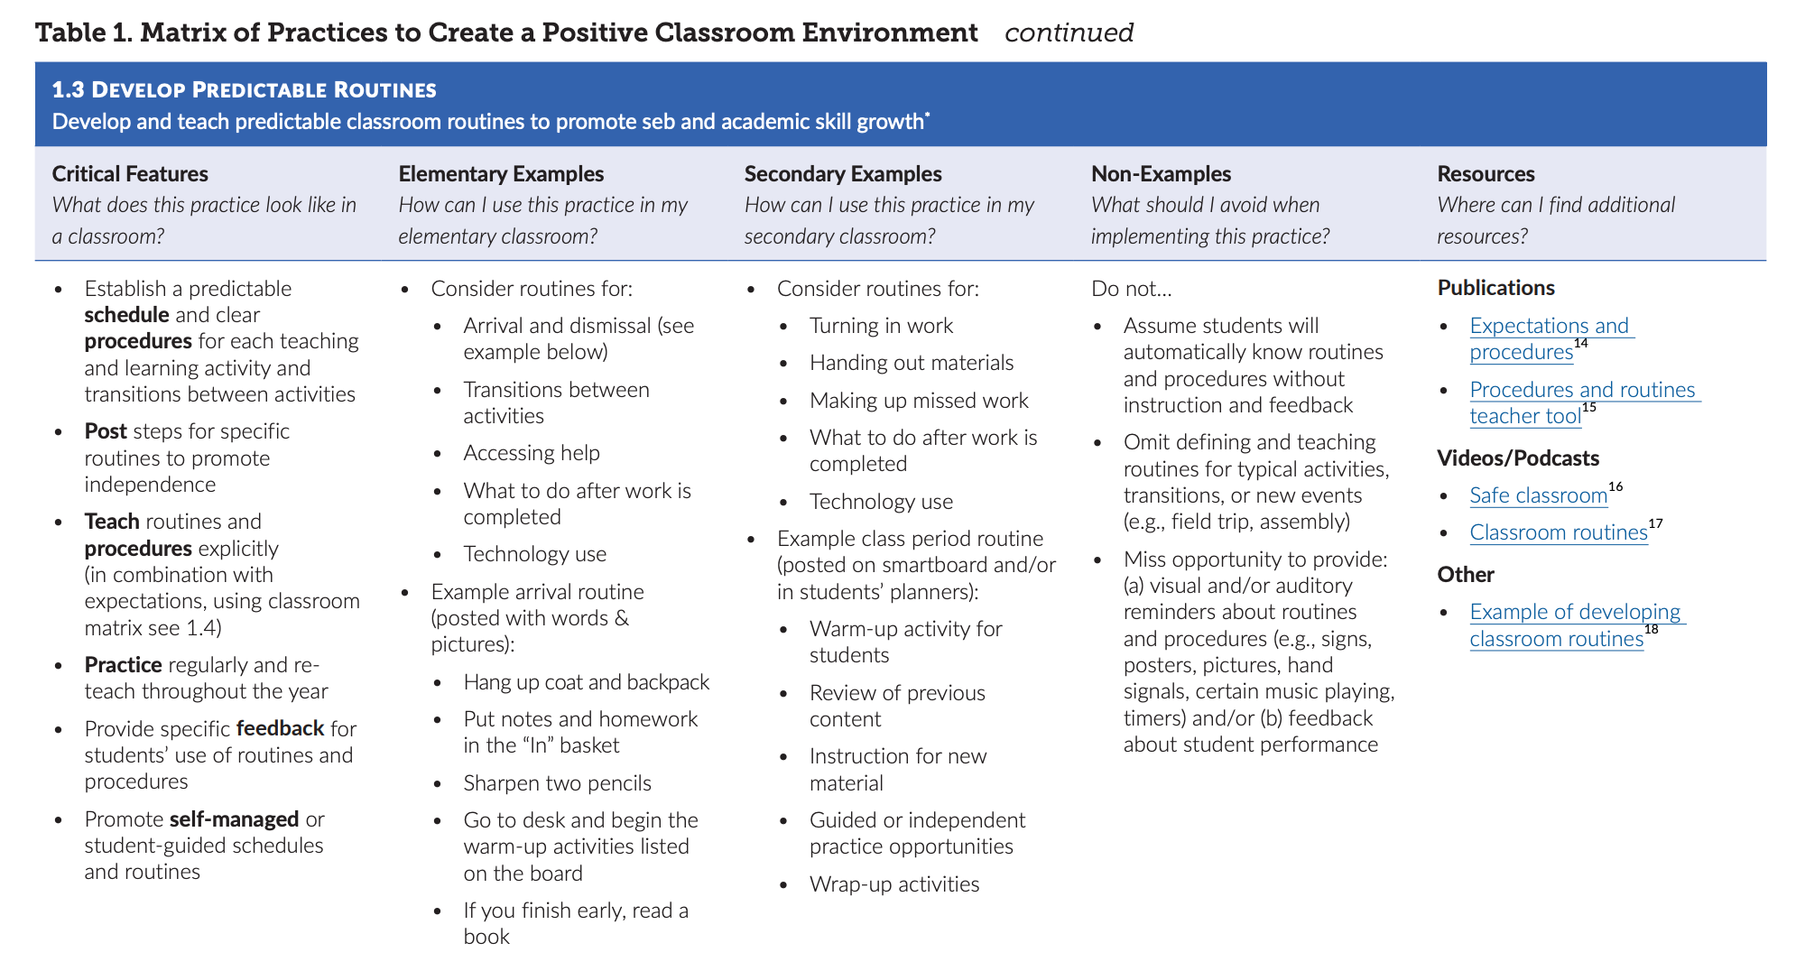
Center on PBIS. (2022). Supporting and responding to student’s social, emotional, and behavioral needs: Evidence-based practices for educators (Version 2.0). Center on PBIS, University of Oregon. www.pbis.org.
Notes:
Incorporate familiar resources, such as the Supporting and Responding to behavior document, which can be found on PBIS.org and provides useful tools for organizing class-wide supports.
Please add this document to the chat: https://www.pbis.org/resource/supporting-and-responding-to-behavior-evidence-based-classroom-strategies-for-teachers

Slide 9
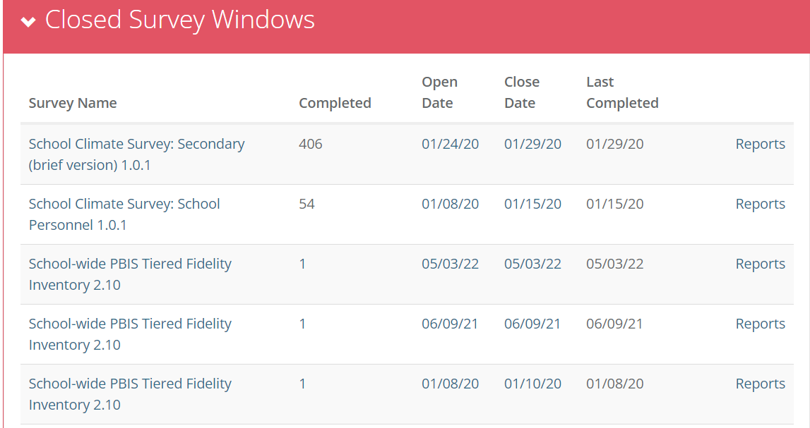
Have you updated your Action Plan based on your TFI results?
What was one or two things that you added to your action plan based on the TFI self-assessment last month?
Click on reports to access TFI Results!

Slide 10
DISCUSSION: Action Planning from TFI / Classroom Assessment and PD
What is one thing you action planned to do as a result of the TFI
Has your team discussed assessing or developing classroom supports?
How can this information be included in future professional development at your school?
Coach Chat
Whole Group
5 minutes
10 minutes

Slide 11

Big Idea Check-in:
DBDM – School Family Partnerships
Notes:
TRAINER NOTE: This information was provided to coaches and teams last month. As this is review, please go through the slides at a quicker pace unless coaches have questions. Focus on the discussions and please express to the coaches that the importance of reviewing this information as part of a coach community is to now learn from each other about how to support more disaggregation with our data together.
So in a sense, last month was within teams, this month will be cross school discussions with this important feature.

Slide 12

What is the single factor most related to high sustainability?
The frequency that data are presented to all school staff.
McIntosh, K., Kim, J. R., Pinkelman, S., Rasplica, C., Berg, T. & Strickland-Cohen, M. K. (2014).
Notes:
Christine
Key Points:
-Monthly may seem like it’s a lot, but remember that the factor most related to sustainability of PBIS is the frequency with which data are presented to the whole staff.
-So review your data monthly and make plans to share out your data with the school community as frequently as feasible.
-Remember, you can share your data using bulletin boards, emails, newsletters, etc. They all count as avenues for sharing.

Slide 13
Data-Based Decision Making
Decisions are more likely to be effective and efficient when they are based upon data.
  The quality of decision making depends most on the first step – defining problems to be solved.
    Precise (who, what, where, when, how often, why)
    Clear (general agreement across team)

Slide 14
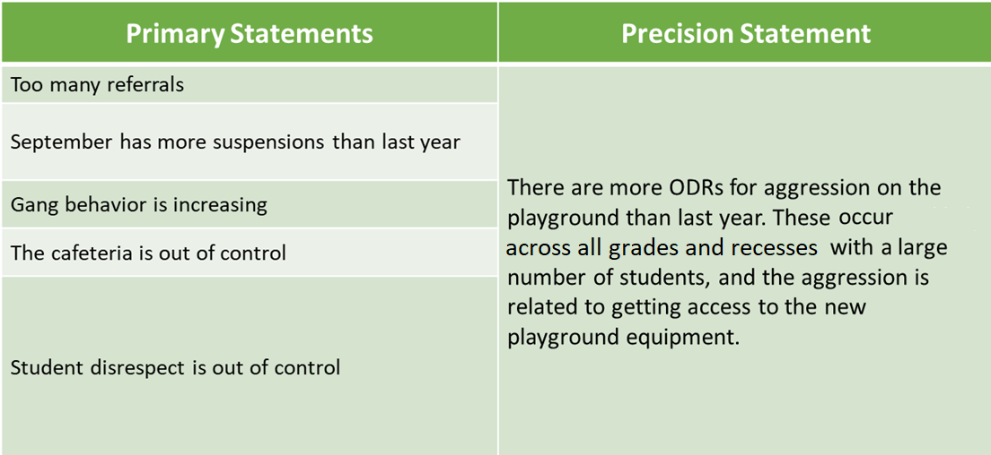
Primary vs. Precision Statements

Slide 15

Solution Development & Action Planning
Solution Component | Action Step(s)
Prevention | How can we avoid the problem context? Ex: schedule lunch times, Post rules near playground
Teaching | How can we define, teach, and monitor what we want? Ex: build “Safe” curriculum, teach playground expectations and games, Game Rules Packets for Monitors.
Recognition | How can we build in systematic rewards for positive behavior? Ex: 3 safe days = 5 extra minutes of social time (at lunch or end of day)
Extinction | How can we prevent problem behavior from being rewarded? Ex: public posting of results
Corrective Consequence | What are efficient, consistent consequences for problem behavior? Ex: continue current system (Major/Minor ODR)
Data Collection | Implementation fidelity? Ex: walkthrough reports, observations, self-assessments Impact on student outcomes? Ex: SWIS ODR data

Slide 16
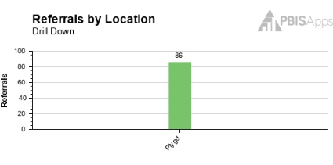
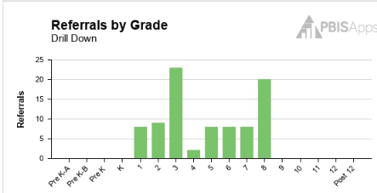

Present to staff
Problem: There are more ODRs for aggression on the playground than last year (average of 3 ODRs per day). These occur across all grades and recesses, with a large number of students, and the aggression is related to getting access to the new playground equipment.

Slide 17
Playground Improvement Goal
Less than 30 ODRs (major or minor) (average 1 referral per day) from the playground for next 30 days
Solution: The PBIS Team will
Buy and hang posters on the doors and fence around playground
Reteach students, by grade, the playground expectations for equipment
All staff please help us by:
Increasing your verbal feedback to students who are following Playground Expectations especially on new equipment.
Track safe recess’ by class - 3 days in a row class gets extra 5 minute of free time. (teacher/class choice)
Continue to write ODR’s for unsafe behaviors

Slide 18
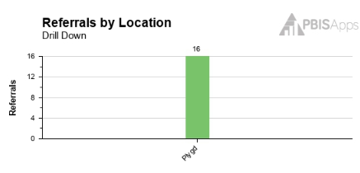

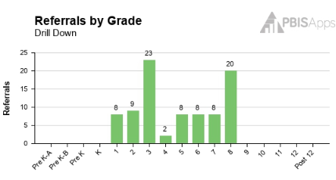
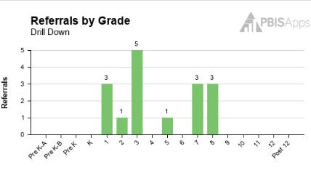
Present Results to staff
Less than 30 ODRs (major or minor) (average 1 referral per day) from the playground for next 30 days
GOAL MET!!!

Slide 19
ACTIVITY: Drilling into Data and Presenting Problem and Solutions to staff MONTHLY
Discuss with your co-coach (5 minutes)
  Are you drilling into our data to find problem areas/trends?
  Are you action planning on your findings and planning for solutions?
  Are you presenting the data and solutions to staff?
  If you answered YES to the above…have you started to disaggregate your data by subgroup?
Whole group share (5 minutes)
10 minutes

Slide 20
PBIS
Resource Spotlight:
5 Questions Every Team Should Ask about Racial Disproportionality
Notes:
RESOURCE LINK: https://www.pbis.org/resource/teaching-social-emotional-competencies-within-a-pbis-framework

Slide 21
5 QUESTIONS EVERY TEAM SHOULD ASK ABOUT RACIAL DISPROPORTIONALITY
Is there an inequity problem in our school?
What is it about our people, policies, and practices that contribute to this inequity?
Which equitable practices can address this discipline inequity?
Did the equity strategies decrease our discipline disparity?
Who is at the table when decisions are made about our school systems?
What is 1 question you feel is important to bring back to your team?
Notes:
This should be brief (5 minutes)
https://www.pbisapps.org/articles/5-questions-every-team-should-ask-about-racial-disproportionality

Slide 22
ACTIVITY: RESOURCE SPOTLIGHT
Review the shared resource independently.
With a partner discuss:
  What was your key takeaway from this resource?
  How might your team use this in the future?
  Can this be used to provide professional development to staff? How?
Be ready to provide a 1- minute share-out of your discussion
Independent
Whole Group
10 minutes
5 minutes

Slide 23
PBIS
Intro to Topic:
School-Family Partnerships

Slide 24
Why Family-School Partnerships
Results in positive outcomes for children, families, and teachers
Family-School Partnerships work
Particularly beneficial for families that are culturally, linguistically, and racially diverse

Slide 25
Family-School Partnerships –
Student Outcomes
Teacher and Family Outcomes
Increased academic performance (Barton & Coley, 2007; Cox 2005; Camarero-Figuerola et al., 2020; Desforges & Abouchaar, 2003; Eccles & Harold, 1993; Epstein 2001; Fan & Chen, 2001; Jeynes, 2005)
Increased positive student classroom behavior (Fantuzzo et al., 2004)
Increased student self-regulation (Stormshak et al., 2010; Wang et al., 2014)
Increased sense of security and belonging (Morgan, 2016)
Positive impact to teen’s access to college (Camarero-Figuerola et al., 2020)
Decreased school drop-out (Barnard, 2004)
Increased job satisfaction (Christenson, 1995)
Increased teacher retention and fewer transfer requests (Christenson, 1995; Lasater, 2016)
Increased family-teacher relationships (Christenson, 1995)
Higher principal ratings (Christenson, 1995)

Slide 26
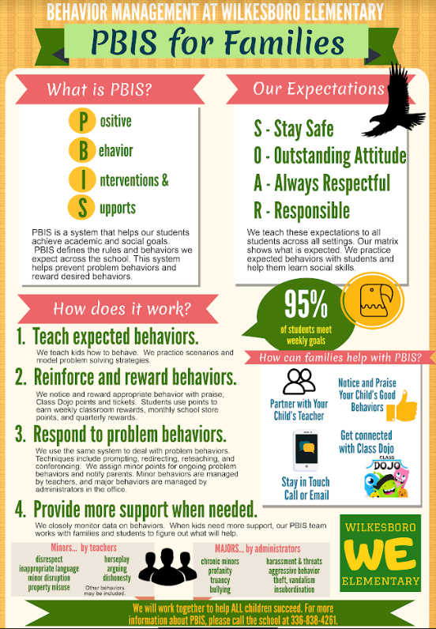

Include Families in Creating Products and in Acknowledgments

Slide 27
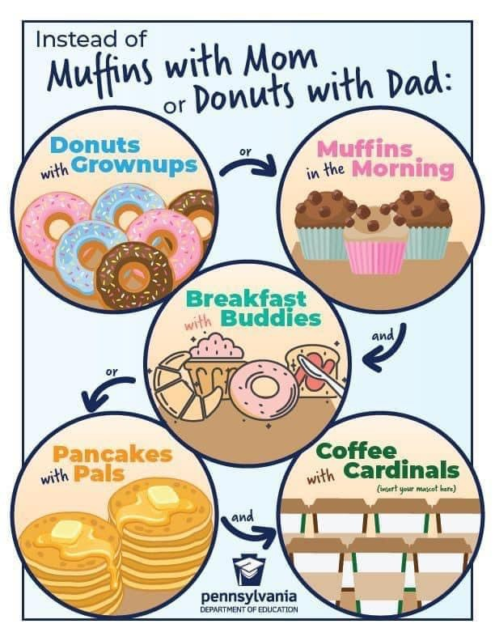

Creating a space for ALL Families
Think about the language of the materials you provide
Think about how you interact with families

Slide 28
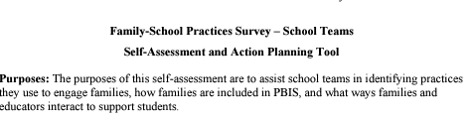
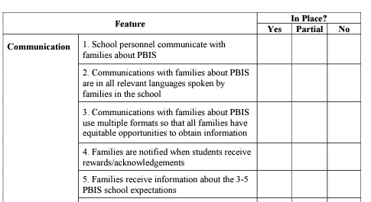
How do measure what we are already doing?
One way is….
The Family School Practices Survey
      35-item tool to assist with identifying practices and action planning
Notes:
https://sebacademy.edc.org/family-school-practices-survey

Slide 29
ACTIVITY: RESOURCE SPOTLIGHT
Review the shared resource
With a partner discuss:
  What was your key takeaway from this resource?
  How might your team use this in the future?
  Can this be used to provide professional development to staff? How?
Be ready to provide a 1- minute share-out of your discussion
Independent
Whole Group
5 minutes
5 minutes

Slide 30
Agenda & Coaches' Tasks -Debrief
Coaches’ Tasks:
Presentation Content:
Glows & Grows: TFI/Classroom
Share data with staff and direct them to focus on behavior/location/expectation
DBDM – Review Sharing Data
Resource Spotlight – 5 Questions Every Team Should Ask about Racial Disproportionality
Intro to School Family Partnerships
Review Disproportionality and Family Resources with team
Complete School-Family Practices Survey with team
What questions do you have on today’s content?
What questions do you have on the follow-up tasks?

Slide 31
HELPFUL RESOURCES
RESOURCES:
Tiered Fidelity Inventory
TFI Action Plan Template
Tidy up with the TFI
5 Questions Every Team Should Ask about Racial Disproportionality
The Family School Practices Survey
Notes:
RESOURCES:
PBIS TFI: https://sebacademy.edc.org/tiered-fidelity-inventory-tfi-manual
TFI Action Plan: https://sebacademy.edc.org/tfi-action-plan-template
Tidy Up with the TFI - https://sebacademy.edc.org/tidy-tfi
School Family Practices Survey - https://sebacademy.edc.org/family-school-practices-survey
5 Questions Every Team Should Ask about Racial Disproportionality - https://sebacademy.edc.org/5-questions-every-team-should-ask-about-racial-disproportionality

Slide 32
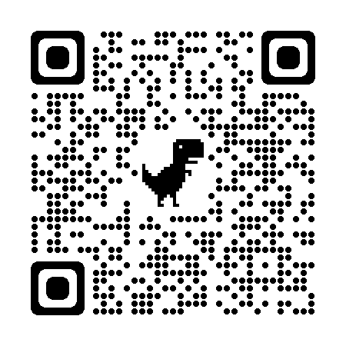
EVALUATION
Please remember to complete the evaluation!
Scan the QR code to access.
Notes:
TRAINERS -
Put link to evaluation (below) in the chat for those who do not use the QR code:
Evaluation Survey: https://edc.co1.qualtrics.com/jfe/form/SV_cBF9GI7gVEBsfSC

