Slide 1


PBIS Coaches’ Training
Year 2: December 2023
Trainers Names
Created from content from the National Technical Assistance Center on Positive Behavioral Interventions and Supports
U.S. Department of Education, Office of Special Education Programs and Office of Elementary and Secondary Education
with support from NEPBIS Network, May Institute, & Broad Reach Consulting

Slide 2

EXPECTATIONS
Self
Others
Environment
Self-monitor
Mute when listening, unmute to talk​
Have your computer charged and ready to go​
If you have questions or comments:
Work as a team:
Keep necessary materials at hand
Are you participating?
Engaged as a learner?
Stretch, break, stand as needed​
unmute
use the chat box
Room for every voice
Reinforce participation
action plan
relevant docs
water/snacks
Minimize distractions if possible​

Slide 3
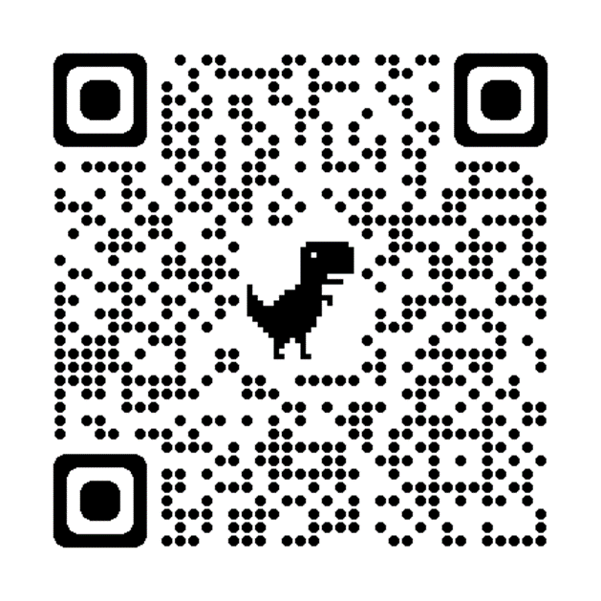
ACTIVITY: ATTENDANCE
Scan QR code on the left or follow the URL posted in the chat to access the online attendance survey
Follow prompts to enter attendance information
Notify trainers if you require assistance (e.g., identifying your cohort or cohort group)
Certificates of Attendance will be sent in January and June. Attendance records will be use as verification
You are in Cohort 10
1 minute
Notes:
ATTENDANCE: https://edc.co1.qualtrics.com/jfe/form/SV_81vbI1jl3cwmLY2

Slide 4
IN-PERSON TEAM TRAINING EVENT INCLEMENT WEATHER POLICY
In case of inclement weather, we will cancel our team training if the local school district where the training will be held is either delayed or cancelled due to inclement weather. Please monitor school and district closings for the school district in which the training is being held. In any case that you feel it is not safe for you to travel to the cohort training, please make the decision that is most safe for you.
Your training site is [Trainers please fill in location]

Slide 5
Agenda & Coaches' Tasks
Coaches’ Tasks:
Presentation Content:
Glows & Grows: Family Engagement/Involvement
Consider how you might work to include student culture into your PBIS practices – Add to Action Plan
Equity in PBIS
Starting to Disaggregate Data
Preparing for TFI in January
Work with team to plan and complete the TFI walkthrough prior to January Team training.

Slide 6
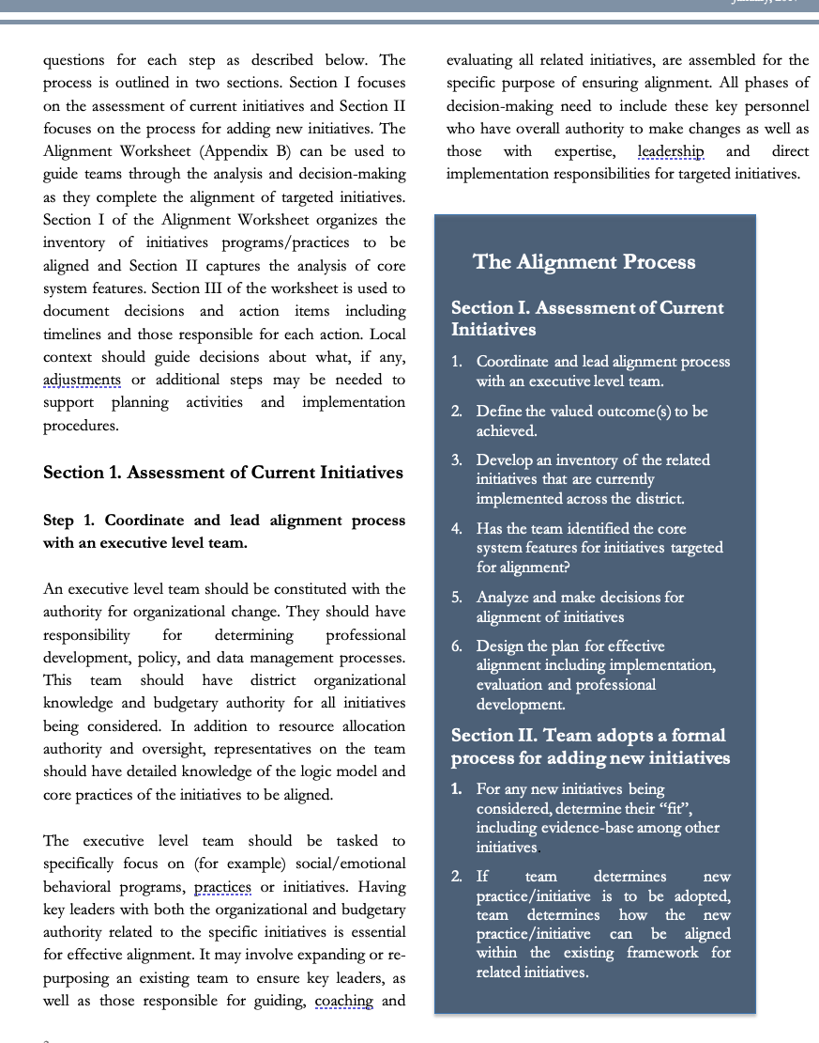
HELPFUL RESOURCES
RESOURCES:
Tiered Fidelity Inventory
TFI Tier 1 Quick Check Tip Sheet for Scoring TFI
PBIS TFI Walkthrough Tip Sheet
Integrated TFI Companion Guide
Examples of Engaging Instruction to Increase Equity in Education
Brief: A 5 Point Intervention Approach for Enhancing Equity in School Discipline
Article: Go, Engage, Connect: Welcome Student Identity & Improve Equity
Article: 5 Questions Every Team Should Ask about Racial Disproportionality
Video: SWIS Equity Report: Risk Index
Notes:
RESOURCES:
PBIS TFI: https://sebacademy.edc.org/tiered-fidelity-inventory-tfi-manual
Tier 1 Scoring Tip Sheet for TFI https://sebacademy.edc.org/tfi-tier-1-quick-check-tip-sheet-scoring
PBIS TFI Walkthrough Tip Sheet: https://sebacademy.edc.org/tfi-walk-through-tip-sheet
Integrated TFI Companion Guide: https://sebacademy.edc.org/integrated-tfi-companion-guide
https://sebacademy.edc.org/examples-engaging-instruction-increase-equity-education
Video: https://www.pbisapps.org/resource/equity-graph-1-risk-index
Article: https://www.pbisapps.org/articles/5-questions-every-team-should-ask-about-racial-disproportionality
Article: https://www.pbisapps.org/articles/go-engage-connect-welcome-student-identity-improve-equity

Slide 7

Glows & Grows:
Family Engagement
Notes:
12:30

Slide 8
Questions? Glows/Grows
Did you complete the Family Practices Survey?
What is one item you chose to work on?
Have you begun to work on this? If so how?
Whole Group
10 minutes

Slide 9
PBIS
Resource Spotlight:
5 Questions Every Team Should Ask about Racial Disproportionality
Notes:
RESOURCE LINK: https://www.pbis.org/resource/teaching-social-emotional-competencies-within-a-pbis-framework

Slide 10
5 QUESTIONS EVERY TEAM SHOULD ASK ABOUT RACIAL DISPROPORTIONALITY
What is 1 question you feel is important to bring back to your team?
Is there an inequity problem in our school?
What is it about our people, policies, and practices that contribute to this inequity?
Which equitable practices can address this discipline inequity?
Did the equity strategies decrease our discipline disparity?
Who is at the table when decisions are made about our school systems?
Notes:
https://www.pbisapps.org/articles/go-engage-connect-welcome-student-identity-improve-equity

Slide 11

Go, Engage, Connect: Welcome Student Identity & Improve Equity
What is 1 question you feel is important to bring back to your team?
Is there an inequity problem in our school?
Do all students feel welcomed in our school?
Have we incorporated student’s cultures into our school?
Are we expecting students to conform to the dominant culture?
How can we bring in more student/family voice?
Notes:
https://www.pbisapps.org/articles/5-questions-every-team-should-ask-about-racial-disproportionality

Slide 12
ACTIVITY: RESOURCE SPOTLIGHT
Go into your randomly assigned breakout room
Review the assigned resource independently.
With your group discuss:
  What was your key takeaway from this resource?
  How might your team use this in the future?
  Can this be used to provide professional development to staff? How?
Be ready to provide a 1- minute share-out of your discussion
10 minutes
10 minutes
Independent
Whole Group
Notes:
Trainers – Create 1-2 rooms for each article depending on size of group.
Randomly assign coaches to articles or manually assign so you can split up co-coaches.

Slide 13

Big Idea Check-in:
Disaggregating Data
Notes:
TRAINER NOTE: This information was provided to coaches and teams last month. As this is review, please go through the slides at a quicker pace unless coaches have questions. Focus on the discussions and please express to the coaches that the importance of reviewing this information as part of a coach community is to now learn from each other about how to support more disaggregation with our data together.
So in a sense, last month was within teams, this month will be cross school discussions with this important feature.

Slide 14
WHY DISAGGREGATE OUTCOME DATA?
Allows comparisons between groups (e.g., grade, gender, (dis)ability, race/ethnicity, etc.)
Facilitates development of precise problem statements
Supports equitable decision-making

Slide 15
Identify a question
Identify the data source
Disaggregate the data to answer the question
Are racial groups chronically absent at the same rate?
Attendance
Disaggregate by race
Are students with disabilities being referred at the same rate?
Office Discipline Referrals
Disaggregate by disability status
Do our LGBTQ+ students feel safe at school?
School Climate Survey
Disaggregate by gender identity
Notes:
TRAINERS: Please note the three examples when you put slide in slide show mode.

Slide 16
EXAMPLE 1: SURVEY DATA
Do students who are gay/lesbian feel safe at school?
“I feel safe…”
Average scores by sexual orientation
Does your school have survey data that can be disaggregated?

Slide 17
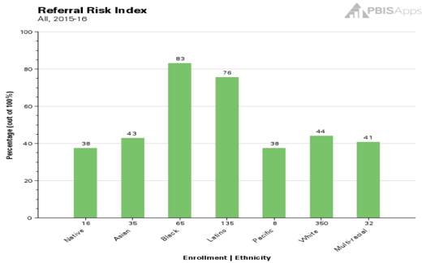
EXAMPLE 2: ATTENDANCE
Are racial groups chronically absent at the same rate?
Does your school have attendance data that can be disaggregated?
 | # of Enrolled Students | # of Students Identified as Chronically Absent | % of Students Within Ethnicity Identified as Chronically Absent | Risk Index
Native | 16 | 6 | 37.50% | 0.38
Asian | 35 | 15 | 42.86% | 0.43
Black | 65 | 54 | 83.08% | 0.83
Latino | 135 | 102 | 75.56% | 0.76
Pacific | 8 | 3 | 37.50% | 0.38
White | 350 | 154 | 44.00% | 0.44
Multi-racial | 32 | 13 | 40.63% | 0.41
Totals: | 641 | 347
Chronic Absenteeism Risk Index
54 of the 65 Black students are identified as chronically absent, so __?% of the Black students are missing significant instructional time.
102 of the __ Latino students are identified as chronically absent, so 76% of the Latino students are missing significant instructional time.

Slide 18
EXAMPLE 3: ODRS
Are students with disabilities being referred at the same rate?
Can your school’s ODR data that can be disaggregated?
 | # of Enrolled Students | # of Students with Referrals | % of Students within Disability with Referrals | Risk Index
IEP | 45 | 17 | 38% | 0.38
504 | 25 | 6 | 24% | 0.24
None | 300 | 63 | 21% | 0.21
17 of the 45 students with IEPs have a discipline referral, so __?% of students with IEPs have a referral.
63 of the __ students without a disability have a discipline referral, so 21% of the students without a disability have a referral.

Slide 19
DISAGGREGATING DATA
What questions does your team or school have about equitable outcomes or experiences for students?
Bring student data that you can or have disaggregated to answer those questions. Such as:
Survey data (school climate, etc.)
Attendance
ODRs
Referrals to Special Education
Suspension
How can you ensure that all students have access to equitable educational opportunities?

Slide 20
DISCUSSION: BIG IDEA CHECK-IN
What questions did your team or school have about equitable outcomes or experiences for students?
What data sources did you discuss disaggregating?
What are your next steps on your action plan?
What examples can you share?
3 minutes
12 minutes
Independent Jot
Whole Group

Slide 21
Preparing for Jan Training:
TFI Walkthrough Tool
Notes:
https://www.pbisapps.org/products/tfi

Slide 22
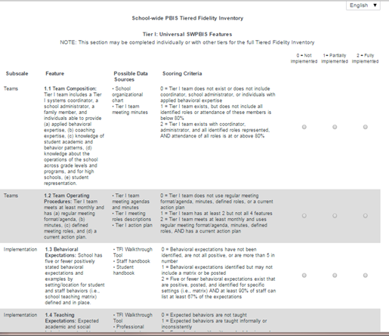
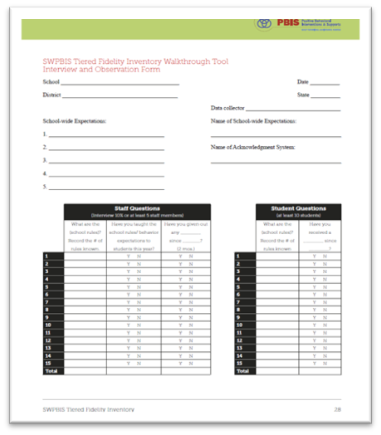
TIERED FIDELITY INVENTORY (TFI) AND WALKTHROUGH PLANNING
Walkthrough Tool
TFI - PBIS Assessments
Notes:
The purpose of this content is to explicitly review the TFI Walkthrough tool to help coaches and teams collect this information independently.
Resource Link: https://www.pbisapps.org/resource/tfi

Slide 23
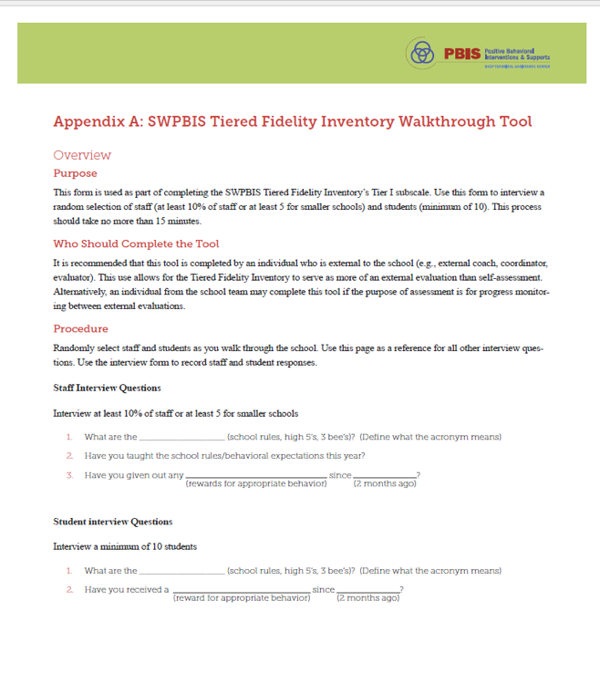
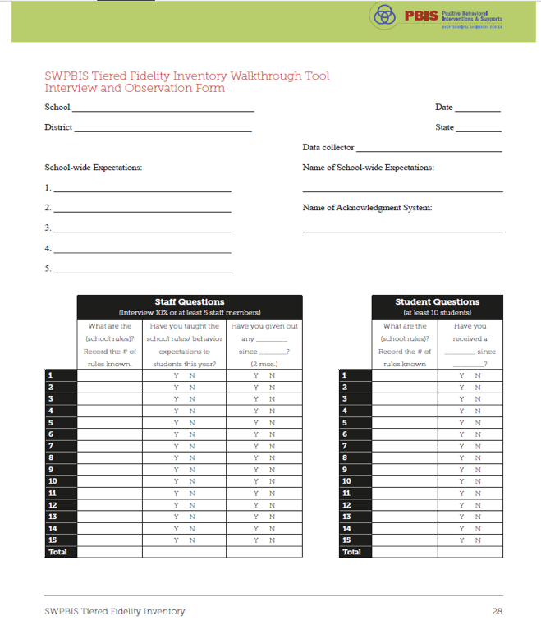
TFI Walkthrough: Appendix A
Notes:
The TFI Walkthrough Tool is Appendix A: pages 27-28 of the TFI. This is a tool that is used by a coach/external person to complete prior to the TFI. The first page provides an overview and the questions to ask staff and students. The second page is a place for recording the information. This provides an efficient way to calculate the percentages to assist with the TFI items.
https://www.pbisapps.org/resource/tfi

Slide 24
TFI WALKTHROUGH
Who should complete this tool? | Someone who is independent of the building.
 | Coach or team member who is internal for the purpose of a self-assessment.
 | District administrator
 | Coach or team member from another in-district building
Two Components | Staff Interviews (minimum of 10 people) (15 best)
 | Student Interviews (minimum of 10 students) (15 best)
Notes:
Resource link: https://www.pbisapps.org/resource/tfi
Appendix A, Page 27

Slide 25
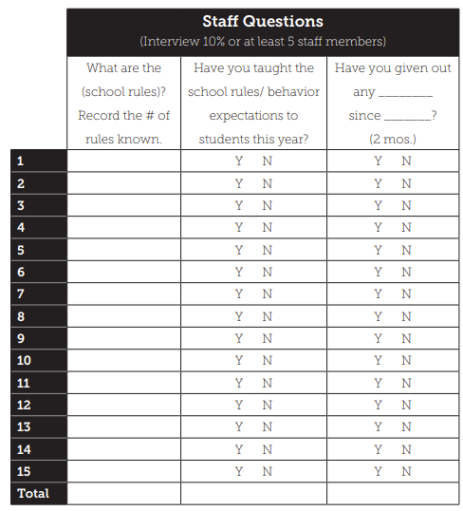
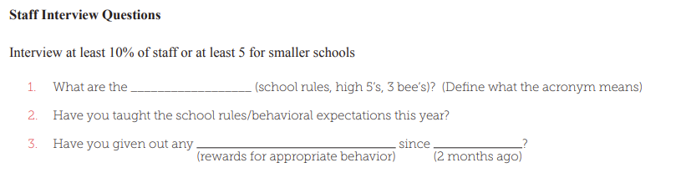
Staff TFI WALKTHROUGH Questions and Form
Notes:
TRAINER NOTE: Remind evaluator to ask if they have "formally" taught the expectations to your students this year?
Resource link: https://www.pbisapps.org/resource/tfi
Appendix A, Page 27

Slide 26
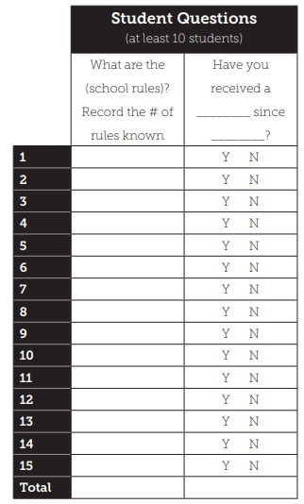
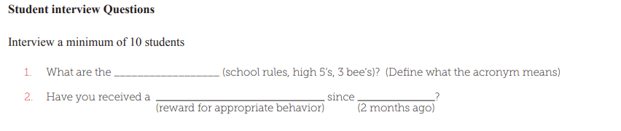
Student TFI WALKTHROUGH Questions and Form
Notes:
Resource link: https://www.pbisapps.org/resource/tfi
Appendix A, Page 27

Slide 27
ACTIVITY: TFI WALKTHROUGH PLANNING
Review the TFI Walkthrough Tool
Plan when you will conduct this walkthrough (try and collect this information in advance of our Jan training).
Plan who will conduct this walkthrough.
10 minutes
10 minutes
Coach Review/Chat
Whole Group
Notes:
Resource Link: https://www.pbisapps.org/resource/tfi-walkthrough-tip-sheet
Resource link: https://www.pbisapps.org/resource/tfi
Appendix A, Page 27

Slide 28
Agenda & Coaches' Tasks
Coaches’ Tasks:
Presentation Content:
Glows & Grows: Family Engagement/Involvement
Consider how you might work to include student culture into your PBIS practices – Add to Action Plan
Equity in PBIS
Starting to Disaggregate Data
Preparing for TFI in January
Work with team to plan and complete the TFI walkthrough prior to January Team training.
What questions do you have on today’s content?
What questions do you have on the follow-up tasks?

Slide 29
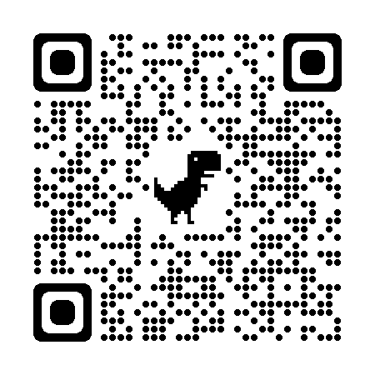
EVALUATION
Please remember to complete the evaluation!
Scan the QR code to access.
Notes:
TRAINERS -
Put link to evaluation (below) in the chat for those who do not use the QR code:
Evaluation Survey: https://edc.co1.qualtrics.com/jfe/form/SV_cBF9GI7gVEBsfSC

