Slide 1
PBIS Coaches’ Training Year 1: November 2023
Stephanie St. Joseph
Michelle Pratt
Created from content from the National Technical Assistance Center on Positive Behavioral Interventions and Supports U.S. Department of Education, Office of Special Education Programs and Office of Elementary and Secondary Education
with support from NEPBIS Network, May Institute, & Broad Reach Consulting

Slide 2
EXPECTATIONS
Self
Others
Environment
Self-monitor
Listen while others are speaking​
Have your computer charged and ready to go​
If you have questions or comments:
Work as a team:
Keep necessary materials at hand
Are you participating?
Engaged as a learner?
Stretch, break, stand as needed​
Raise hand
Room for every voice
Reinforce participation
action plan
relevant docs
water/snacks
Minimize distractions if possible​

Slide 3
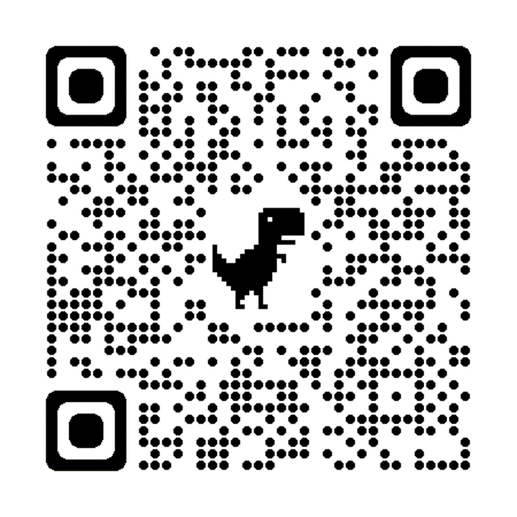
ACTIVITY: ATTENDANCE
Scan QR code on the left or follow the URL posted in the chat to access the online attendance survey
Follow prompts to enter attendance information
Notify trainers if you require assistance (e.g., identifying your cohort or cohort group)
Certificates of Attendance will be sent in January and June. Attendance records will be use as verification
You are in Cohort 10
1 minute
Notes:
ATTENDANCE: https://edc.co1.qualtrics.com/jfe/form/SV_81vbI1jl3cwmLY2

Slide 4
Agenda & Coaches' Tasks
Coaches’ Tasks:
Complete Coach Self-Assessment and put into Google Folder
Presentation Content:
Website/Google Review
PBIS Coaching Fundamentals
Gathering Partner Feedback

Slide 5
HELPFUL RESOURCES
RESOURCES:
Conducting Leadership Team Meetings Worksheet
Team Roles Worksheet
Sample Meeting Norms
Become a Better Team by Solving 3 Common Mistakes
Action Plan Templates
Tier 1 Action Plan and Team Profile
7 Ways to MacGyver Your Action Plans
Center on PBIS’ Coaching page
Coaches Self Assessment Survey – Tier 1
Notes:
Team Roles Worksheet https://sebacademy.edc.org/pbis-team-roles-worksheet
Action Plan Templates https://sebacademy.edc.org/list-of-pbis-resources?keyword=action+plan&pbis_resource_type=113&pbis_resource_topic=All&sort_by=field_date_value&sort_order=DESC
Sample Meeting Norms - https://sebacademy.edc.org/sample-team-noms-expectation-matrix
Conducting Leadership Team Meetings Worksheet - https://sebacademy.edc.org/conducting-leadership-team-meetings-worksheet
Become a Better Team by Solving 3 Common Mistakes - https://www.pbisapps.org/articles/become-a-better-team-by-solving-3-common-mistakes
7 Ways to MacGyver Your Action Plans - https://sebacademy.edc.org/action-plan-template-1-year-1-teams
Center on PBIS’ Coaching page - https://www.pbis.org/topics/coaching
Coaches Self Assessment Survey – Tier 1 - https://sebacademy.edc.org/coach-self-assessment-tier-1

Slide 6
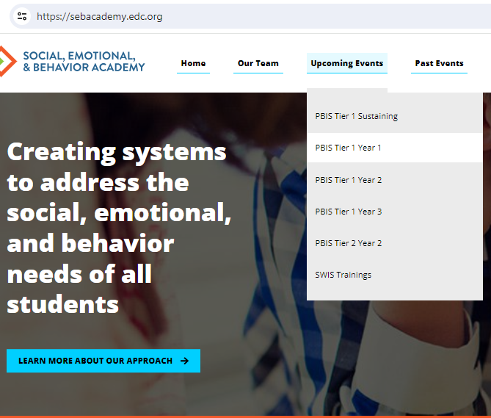
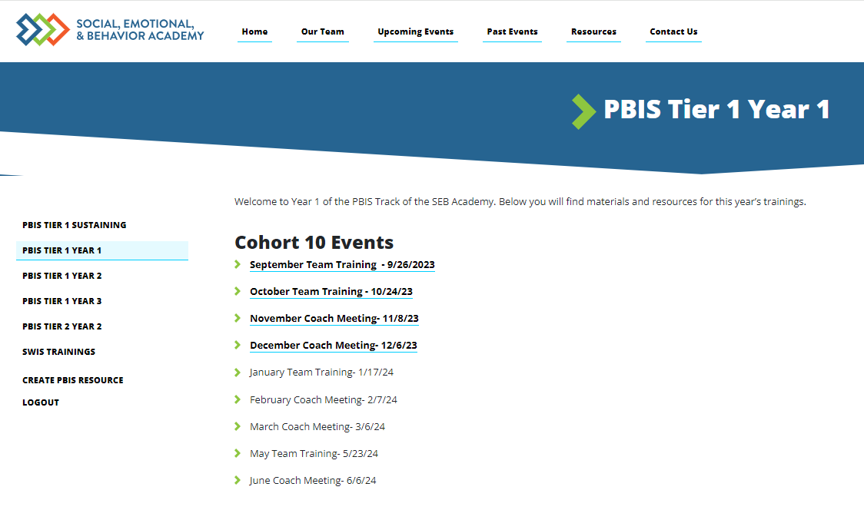
Tier 1 Year 1 - SEBAcademy.edc.org
Under Construction–
Notes:
This page is in the process of being created/updated. Please be patient it will be functioning soon. Please check back. All information for each monthly training or meeting will be displayed here
Upcoming Events -> PBIS Tier 1 Year 2 -> October

Slide 7
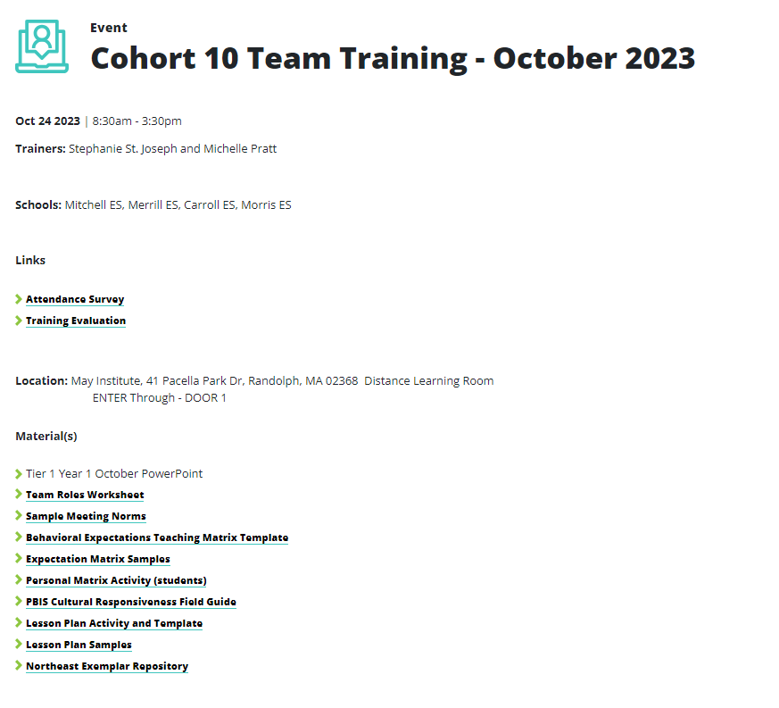
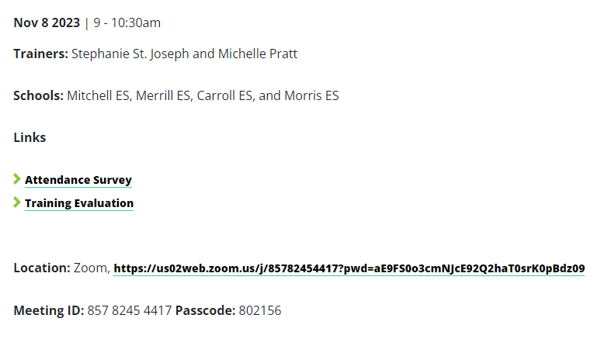
Accessing Materials on PBIS Website

Slide 8
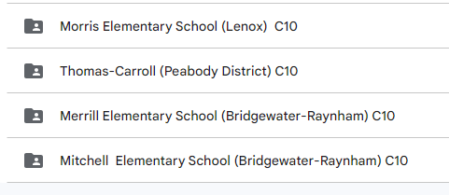
Google Drive – For Submitting Documents
All schools will be connected to their Google Folder.
Add documents here for review by your PBIS Trainer
Coaches will be linked to the school Google folder and can share with team

Slide 9
Questions? Glows/Grows
Take a minute to locate your google folder and explore the website – Do you have any Questions?
Each coach share one glow or grow about first in person training day
Whole Group
10 minutes

Slide 10
BRIEF INTRODUCTION TO COACHING
This is where you come in!

Slide 11
FUNCTIONS OF COACHING
Communication
Start-Up
Fidelity
Network
Sustainability & Accountability
Facilitation
Coaches provide team start-up support
Coaches improve and increase public relations and communication
Think of past experiences when you have been coached. What makes an effective coach?
Coaches promote fidelity of implementation
Coaches are linked:
Across schools
To leadership
To trainers
To teams
Coaches facilitate by providing:
Technical assistance
Problem solving
Positive reinforcement
Prompts (“positive nags”)
Coaches allow for local facilitation
Behavioral Capacity
Increases as coaches build their own skills
Notes:
These are basic functions of coaching. Coach should facilitate/oversee these tasks within the team. There may be similar roles for team members such as communications with staff.

Slide 12
Necessary
Preferred
COACHING COMPETENCIES
-Participate in team training, coaches training, and networking
-Facilitate team meetings at least monthly
-Work effectively with adults
-Knowledgeable about school operating systems
-Professional commitment
-Knowledge of SWPBIS
-Knowledge about behavior support practices at school-wide, class-wide, targeted, and individual levels
-Skilled in data collection & use of data for decision-making
Notes:
Have them consider 2 or 3 coaches to share the work.

Slide 13
COACHING ROLES
Poll:
Which role are you most comfortable with?
Poll:
Which role are you least
comfortable with?
Content Knowledge
Facilitate
Communicate
Content
Facilitate
Local PBS expert
Positive “nag”
Link to resources (e.g., pbis.org)
Communicate
Team meetings
Activities at training events
Implementation
Share advanced content with team
Share information at faculty meetings
Notes:
Which role are you most comfortable with:
a. Content knowledge
b. Facilitation
c. Communication
Which role are you least comfortable with:
a. Content knowledge
b. Facilitation
c. Communication

Slide 14
ACTION PLANNING
Specifies three features:
Foundation for all you do as a team
Vital for achieving goals
Action Plan
Who
What
When
1
2
3
Who is responsible…
…for doing what…
…by when?
Action Planning: The process of organizing resources to enable individuals to engage in activities designed to achieve specific and important outcomes.

Slide 15
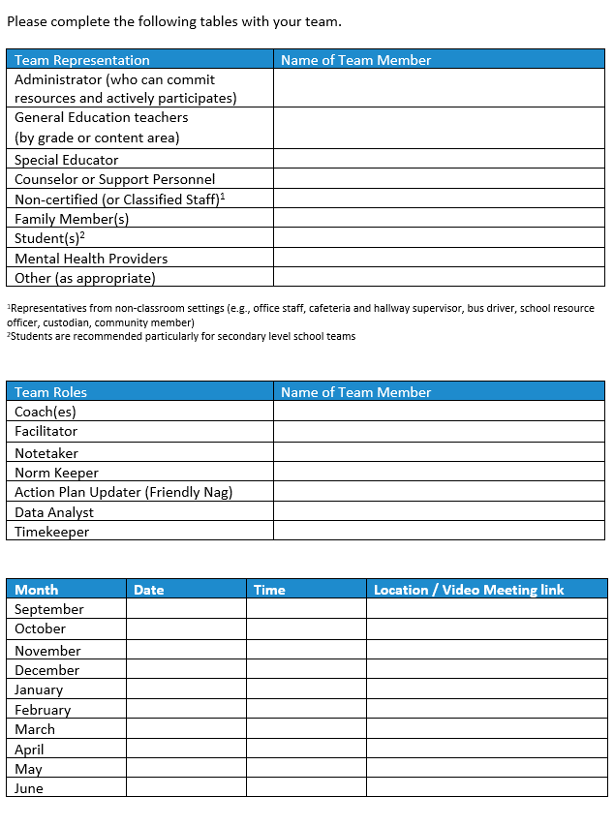
TIER 1 TEAM PROFILE AND MEETING SCHEDULE
Download the Team Profile and Meeting Schedule
Complete with your team and upload to your schools assigned Google Folder
Notes:
https://sebacademy.edc.org/action-plan-template-1-year-1-teams

Slide 16
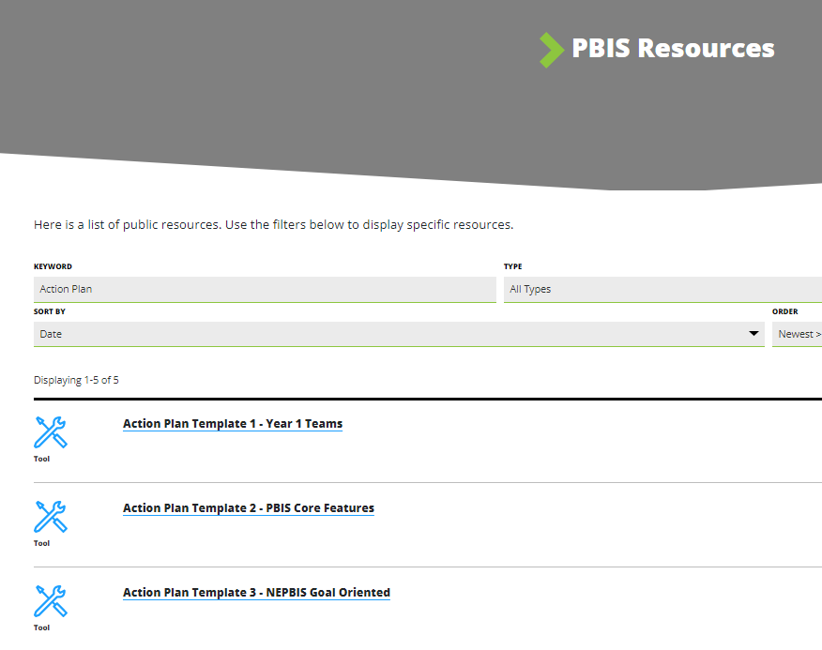
ACTION PLAN TEMPLATE
Preview the action plan templates, selecting one for your team to use as a foundation
How will you share access to documents with your team members? (Google Docs, School Common Drive, SharePoint)
Notes:
Review and remind they can use their School base action plan if they already use one.
Recommend - Action Plan #1 is simple and straight forward. Link to action plan #1—https://sebacademy.edc.org/action-plan-template-1-year-1-teams

Slide 17
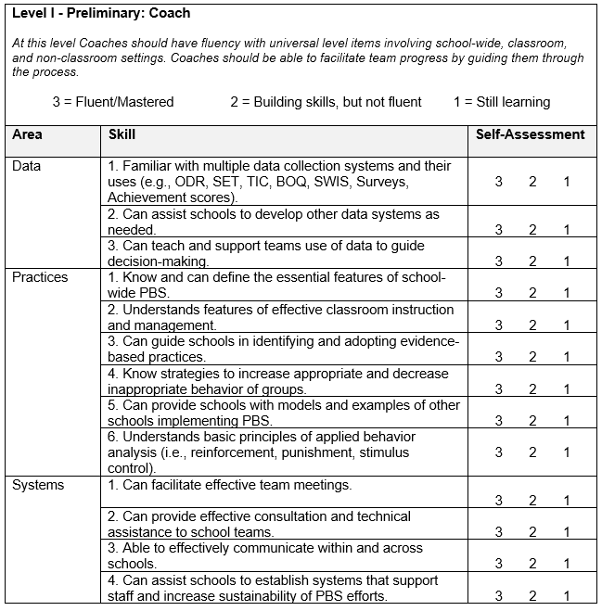
Coach Self Assessment

Slide 18
DISCUSSION: Intro to Coaching
Download and complete the Coach Self Assessment
Review with your Co-Coach
Identify one strength you have to support your work in this role.
What support do you need to do this work?
What questions do you have related to your role?
7 minutes
10 minutes
Independent Jot / Coach Chat
Whole Group

Slide 19
PBIS Resource Spotlight: PBIS APPS – Teach By Design
Notes:
RESOURCE LINK: https://www.pbis.org/resource/teaching-social-emotional-competencies-within-a-pbis-framework

Slide 20
Resources for Teaming
Notes:
https://www.pbisapps.org/articles/7-ways-to-macgyver-your-action-plans
https://www.pbisapps.org/articles/become-a-better-team-by-solving-3-common-mistakes

Slide 21
DISCUSSION: Intro to Coaching
Open and read one of the articles
Share out one thing that resonated with you
7 minutes
5 minutes
Independent Read
Whole Group

Slide 22
Gaining input for your matrix from all interested parties: Staff, Students, & Families

Slide 23
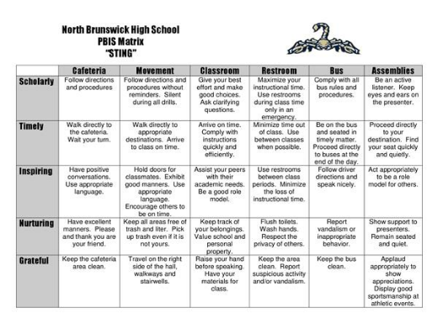
Your team and staff have identified school-wide expectations and developed a matrix...

Slide 24
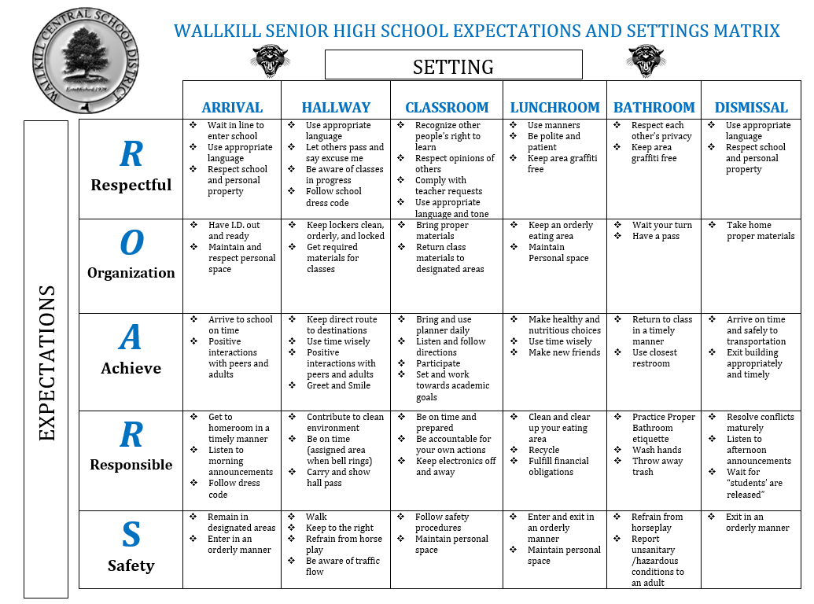
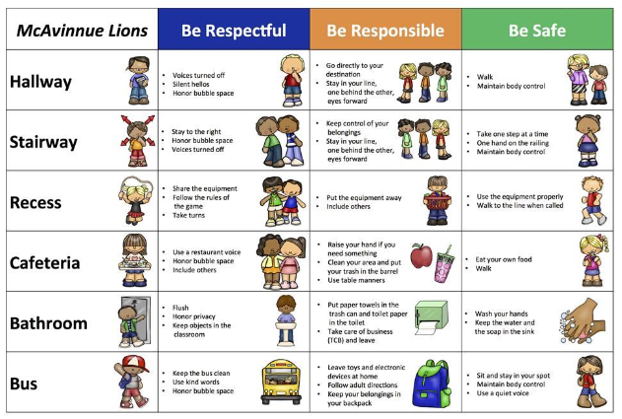
Getting Feedback on your Matrix
Notes:
Primary and Secondary examples

Slide 25
Determine if the expectations and matrix fit your school community!
Collecting input to guide our work helps with...
Staff buy-in
Ensuring our supports reflect each member of our school community (students, parents, community members).
Ensuring different perspectives and cultural values are considered.
Notes:
Please add link in the chat: https://sebacademy.edc.org/pbis-cultural-responsiveness-field-guide

Slide 26
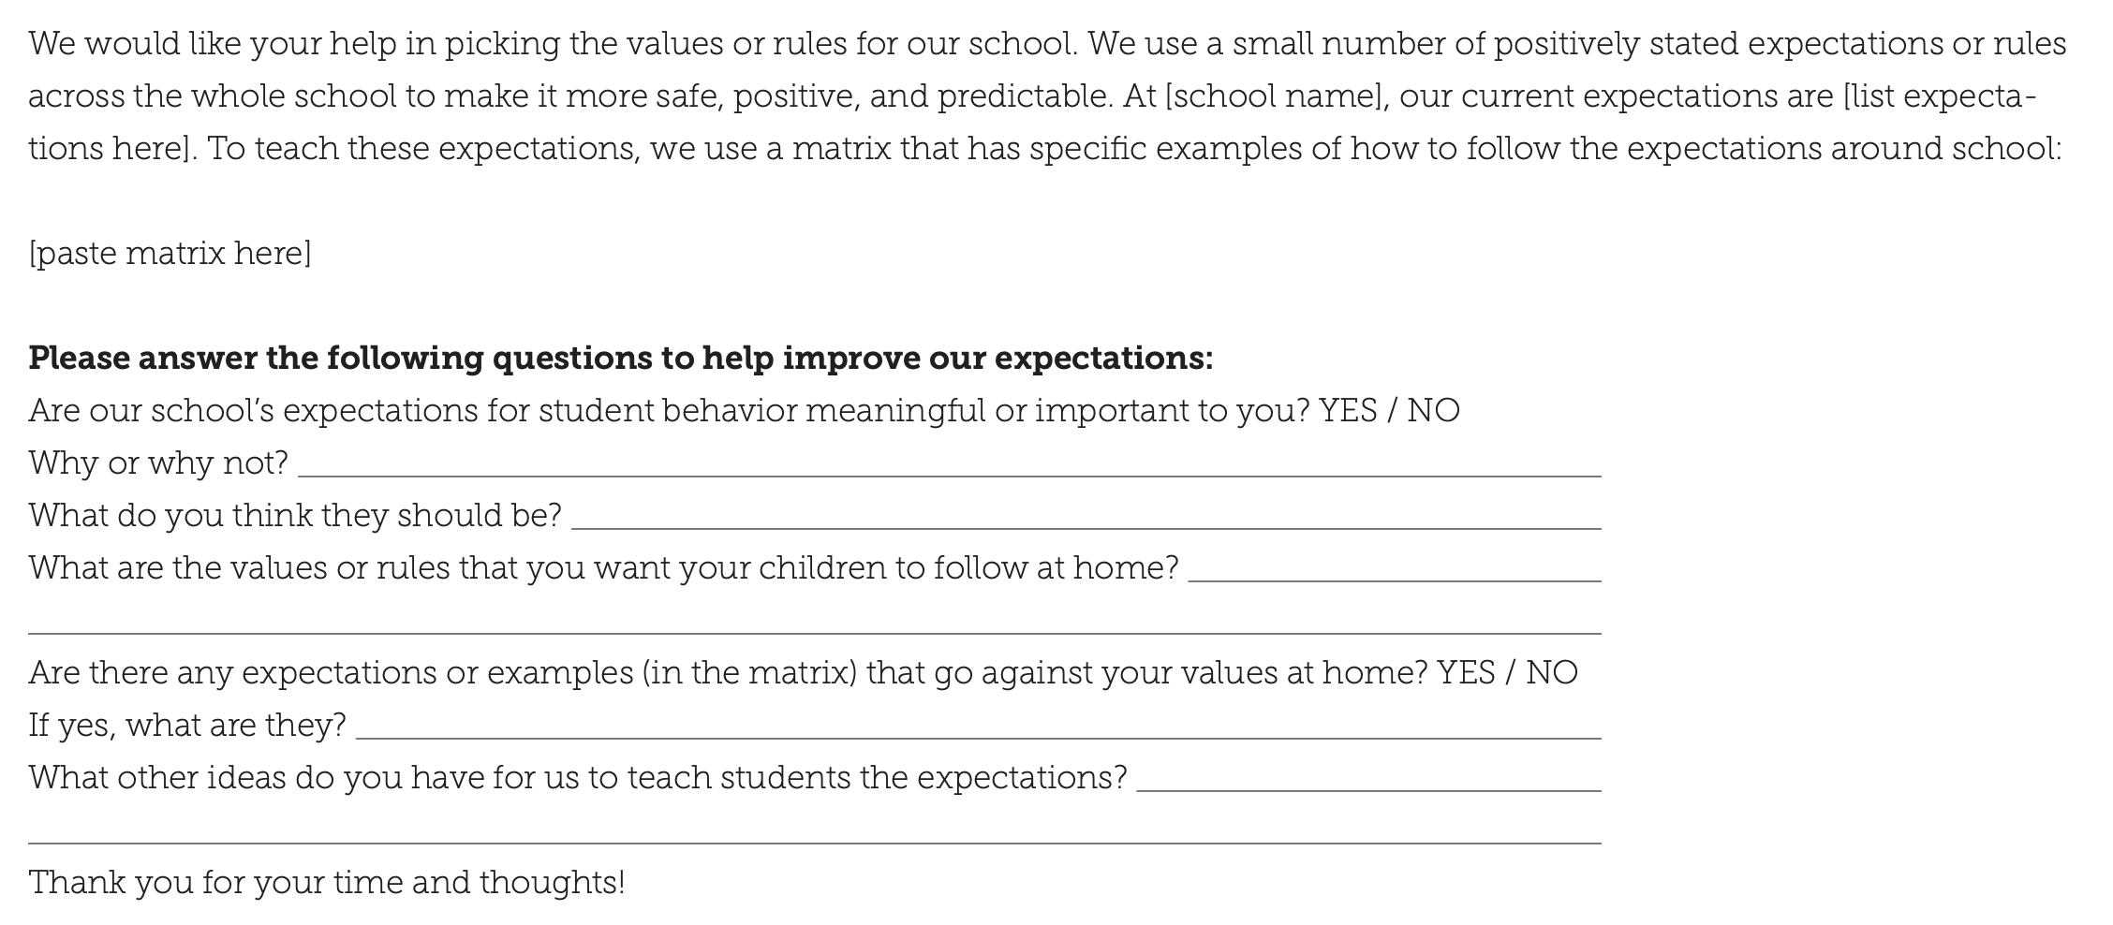
Assess existing expectations based on fit with values and needs of families and students
Sample survey
for
families/
community

Slide 27
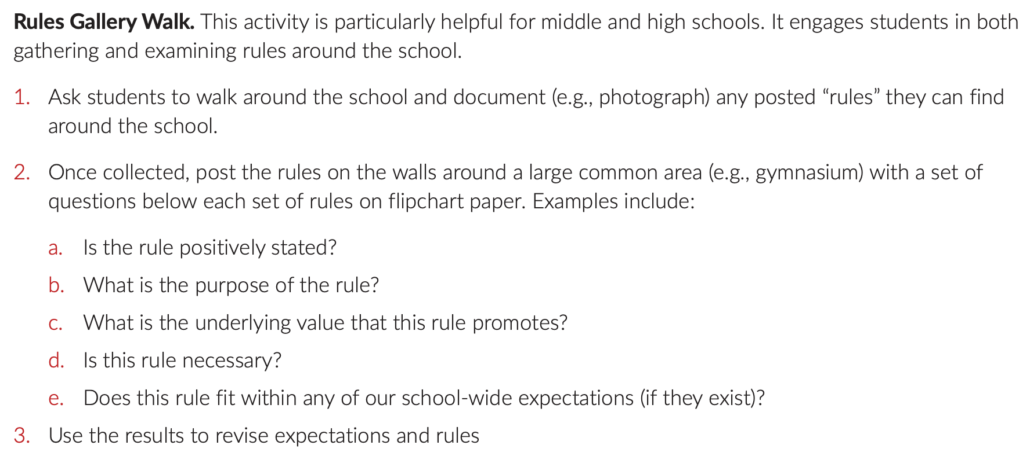
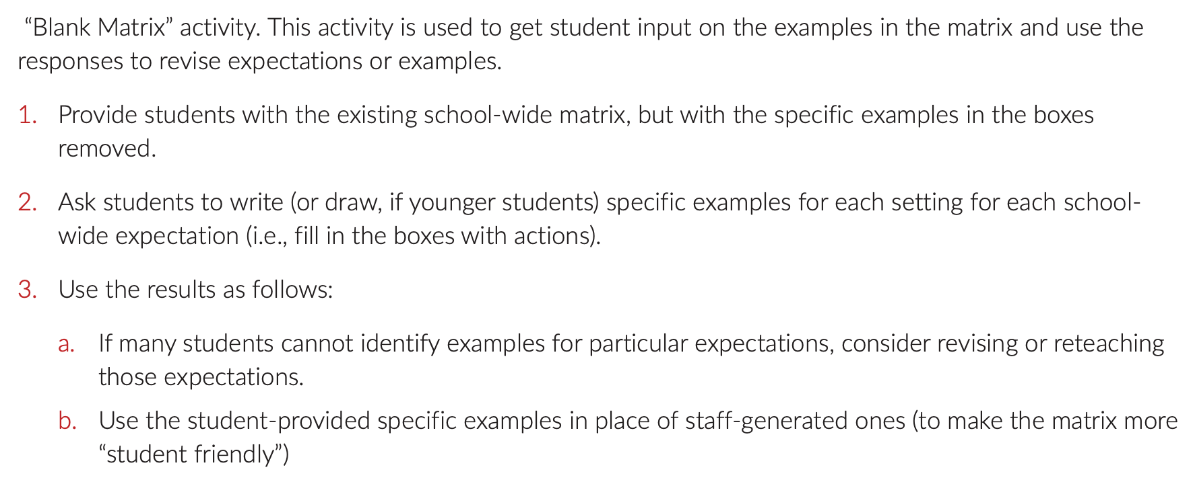
Gather student
input
Assess existing expectations based on fit with values and needs of staff, students, & families

Slide 28
Revise expectations and matrix based on feedback
Summarize the information you collected
Assess whether the existing expectations are valued by stakeholders.
If they are, move to creating lesson plans
If not, generate options for new expectations or specific examples for the matrix

Slide 29
Assess new options for expectations and matrix based on critical features (guidelines)
Linked to social culture of school
Appropriate cultural & contextual fit
Considerate of social skills that already exist
3-5 in number
1-3 words per expectation
Positively Stated
Supportive of academic achievement
Comprehensive in scope
Mutually exclusive (minimal overlap)

Slide 30
Agree on revised expectations and matrix
Build consensus
Revised expectations and matrix
Consider using input from more marginalized groups
Move on to Creating Lesson Plan
Consider a student vote among a few possible options
Difficulty reaching consensus?
Consensus reached?

Slide 31
DISCUSSION: Input from all parties
Is your Matrix ready for review? Have you followed the guidelines?
Have you reviewed and solicited input for your Expectations and Matrix with your:
Staff
Students
Families
Who do you still need to include? Have you included subgroups?
How will you share your final matrix?
Coach Chat
Whole Group
10 minutes
5 minutes

Slide 32
Agenda & Coaches' Tasks
Coaches’ Tasks:
Complete Coach Self-Assessment and put into Google Folder
Presentation Content:
Website/Google Review
PBIS Coaching Fundamentals
Gathering Partner Feedback

Slide 33
HELPFUL RESOURCES
RESOURCES:
Conducting Leadership Team Meetings Worksheet
Team Roles Worksheet
Sample Meeting Norms
Become a Better Team by Solving 3 Common Mistakes
Action Plan Templates
Tier 1 Action Plan and Team Profile
7 Ways to MacGyver Your Action Plans
Center on PBIS’ Coaching page
Coaches Self Assessment Survey – Tier 1
Notes:
Team Roles Worksheet https://sebacademy.edc.org/pbis-team-roles-worksheet
Action Plan Templates https://sebacademy.edc.org/list-of-pbis-resources?keyword=action+plan&pbis_resource_type=113&pbis_resource_topic=All&sort_by=field_date_value&sort_order=DESC
Sample Meeting Norms - https://sebacademy.edc.org/sample-team-noms-expectation-matrix
Conducting Leadership Team Meetings Worksheet - https://sebacademy.edc.org/conducting-leadership-team-meetings-worksheet
Become a Better Team by Solving 3 Common Mistakes - https://www.pbisapps.org/articles/become-a-better-team-by-solving-3-common-mistakes
7 Ways to MacGyver Your Action Plans - https://sebacademy.edc.org/action-plan-template-1-year-1-teams
Center on PBIS’ Coaching page - https://www.pbis.org/topics/coaching
Coaches Self Assessment Survey – Tier 1 - https://sebacademy.edc.org/coach-self-assessment-tier-1

Slide 34
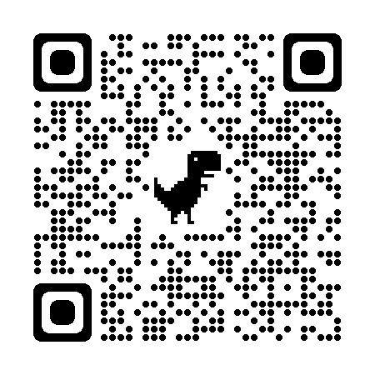
EVALUATION
Please remember to complete the evaluation!
Scan the QR code to access.
Notes:
TRAINERS -
Put link to evaluation (below) in the chat for those who do not use the QR code:
Evaluation Survey: https://edc.co1.qualtrics.com/jfe/form/SV_cBF9GI7gVEBsfSC

