Slide 1


PBIS Coach Training
Year 1: March 2024
Trainer Names
Created from content from the National Technical Assistance Center on Positive Behavioral Interventions and Supports
U.S. Department of Education, Office of Special Education Programs and Office of Elementary and Secondary Education
with support from NEPBIS Network, May Institute, & Broad Reach Consulting

Slide 2
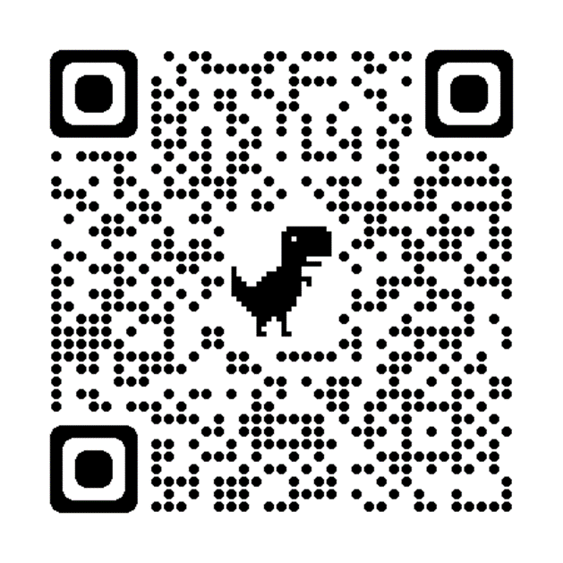
ACTIVITY: ATTENDANCE
Scan QR code on the left or follow the URL posted in the chat to access the online attendance survey
Follow prompts to enter attendance information
Notify trainers if you require assistance (e.g., identifying your cohort or cohort group)
Certificates of Attendance will be sent in June. Attendance records will be use as verification
You are in Cohort 10
1 minute
Notes:
ATTENDANCE: https://edc.co1.qualtrics.com/jfe/form/SV_81vbI1jl3cwmLY2

Slide 3

EXPECTATIONS
Self
Others
Environment
Self-monitor
Mute when listening, unmute to talk​
Have your computer charged and ready to go​
If you have questions or comments:
Work as a team:
Keep necessary materials at hand
Are you participating?
Engaged as a learner?
Stretch, break, stand as needed​
unmute
use the chat box
Room for every voice
Reinforce participation
action plan
relevant docs
water/snacks
Minimize distractions if possible​

Slide 4

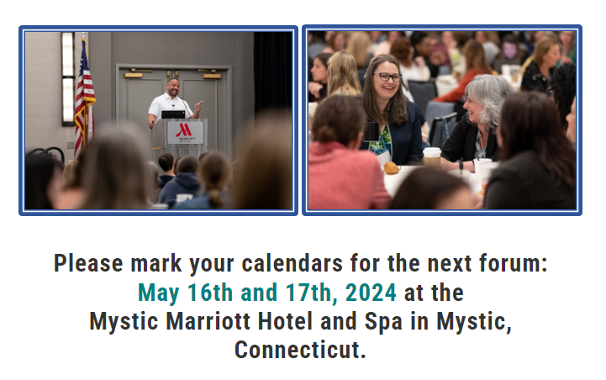
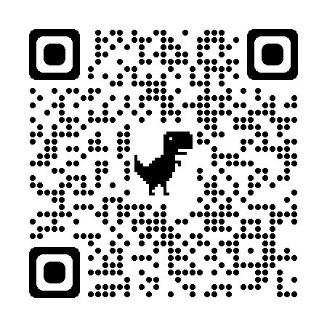

May 16 & 17, 2024
Mystic Marriott Hotel and Spa
Mystic, CT
https://nepbis.org/forum/

Slide 5
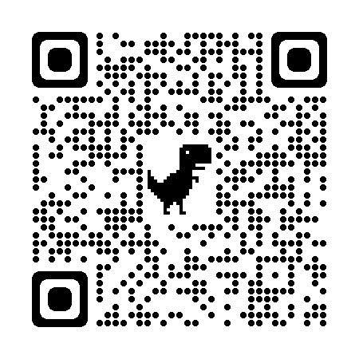
UPCOMING SEB EVENTS
REGISTER HERE https://sebacademy.edc.org/upcoming-events
Webinars:
March 7th 3:00-4:30: Leading For Change
April 9th 9:30-11:00: School Family Partnerships
Peer Sharing Calls:
Feb 28th 3:00-4:00: Newcomer Populations – Session 3
Feb 29th 3:00-4:00: Data Based Decision Making – Session 3: Using Data for Advanced Tiers
March 5th, 12th, 19th 2:00-3:00: Creating and Building Systems to Identify, Manage, and Monitor Students Needing Supports
Spring Convening – All TEAMS Invited
May 15th 8:30-3:30: Join your fellow academy participants to reflect on the past year, plan for next year, learn from graduating academy teams, and experience hands-on collaborative learning sessions. Engage in session on topics such as:
    Sustaining MTSS for SEB
    Mental Health and Mindfulness Supports
    Ending the Year on a Strong Note
    Planning for Next Year
Notes:
REGISTER FOR ALL EVENTS HERE https://sebacademy.edc.org/upcoming-events

Slide 6
Agenda & Coaches' Tasks
Coaches’ Tasks:
Presentation Content:
Glows and Grows
Staff/Students/Family input Check-in
Developing a Continuum to Respond to Behavior Errors
Resource Spotlight
Work to complete or update Flow Chart, Definitions and Referral Form.
Share video links with team
Notes:
Discipline Flow Chart Activity: https://sebacademy.edc.org/discipline-flow-chart-activity
Behavior Definition Activity: https://sebacademy.edc.org/behavior-definitions-activity
Referral Form Activity: https://sebacademy.edc.org/referral-form-activity

Slide 7
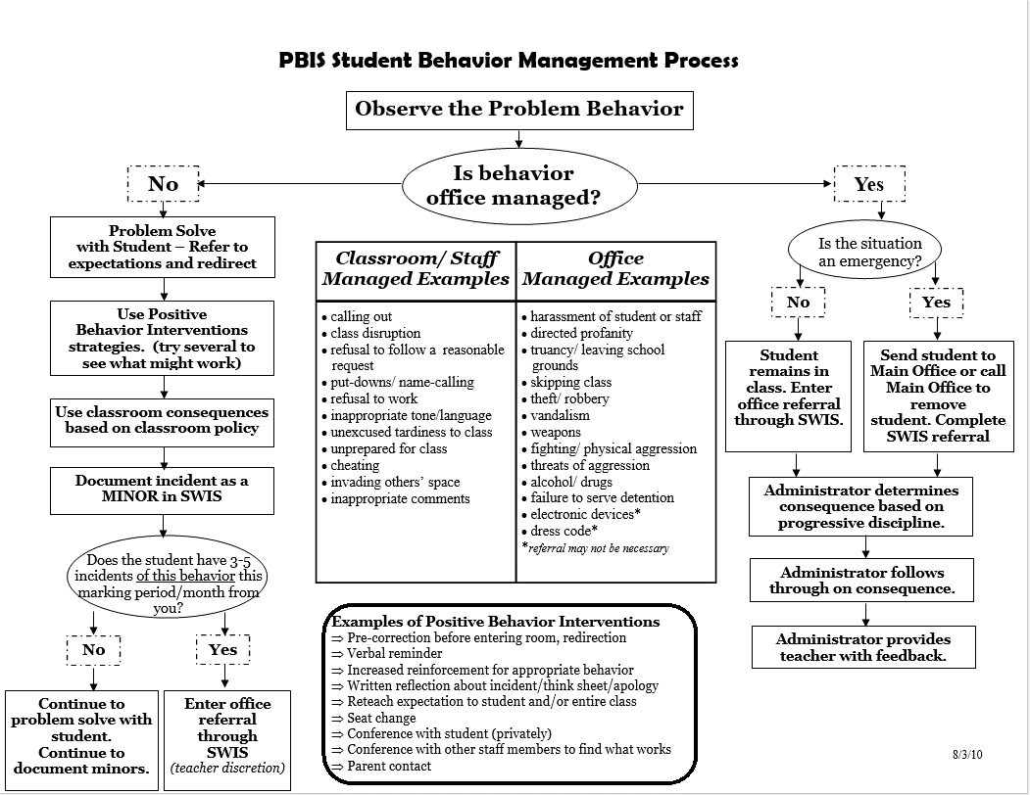
HELPFUL RESOURCES
RESOURCES:
Putting a Definition Back in Defiance (article)
Behavior Flow Chart Video
Defining Behaviors Video
Referral Form Video
Discipline Flow Chart Activity
Sample Flow Charts and Templates
Sample Behavior Definitions
Behavior Definition Activity
Sample Referral Forms
Referral Form Activity
Notes:
Putting a Definition Back in Defiance - https://sebacademy.edc.org/putting-definition-back-defiance
Behavior Flow Chart Video: https://sebacademy.edc.org/behavior-flow-chart-video
Defining Behaviors Video: https://sebacademy.edc.org/defining-behaviors-video
Referral Form Video: https://sebacademy.edc.org/referral-form-video
Sample Flow Charts and Templates: https://sebacademy.edc.org/list-of-pbis-resources?keyword=Flow+Chart&pbis_resource_type=All&pbis_resource_topic=All&sort_by=field_date_value&sort_order=DESC
Discipline Flow Chart Activity: https://sebacademy.edc.org/discipline-flow-chart-activity
Sample Definitions: https://sebacademy.edc.org/list-of-pbis-resources?keyword=Sample+-+behavior+definitions&pbis_resource_type=All&pbis_resource_topic=All&sort_by=field_date_value&sort_order=DESC
Behavior Definition Activity: https://sebacademy.edc.org/behavior-definitions-activity
Sample Referral Forms: https://sebacademy.edc.org/list-of-pbis-resources?keyword=Sample+Referral+Form&pbis_resource_type=All&pbis_resource_topic=All&sort_by=field_date_value&sort_order=DESC
Referral Form Activity: https://sebacademy.edc.org/referral-form-activity

Slide 8
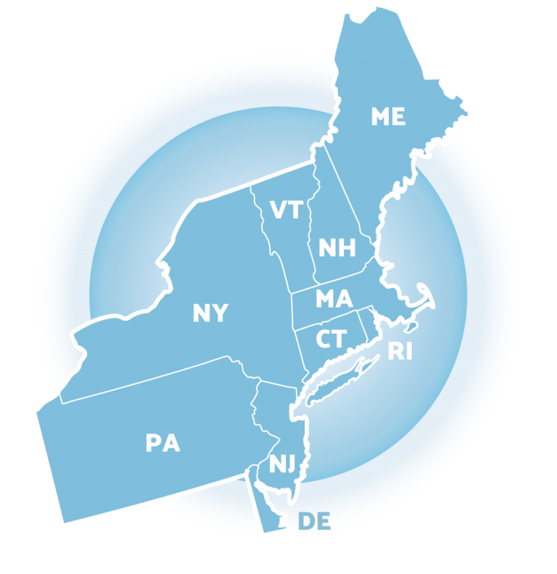

Glows & Grows
Notes:
9:05
Karen

Slide 9
MONITORING & EVALUATING PBIS PRACTICES
Use data to monitor the implementation & effectiveness of PBIS practices
Linked with meaningful outcome goals
Communicates purpose
Guides action planning
Used to measure and demonstrate progress
It is important to collect both Qualitative (feedback) and Quantitative (outcome) data

Slide 10

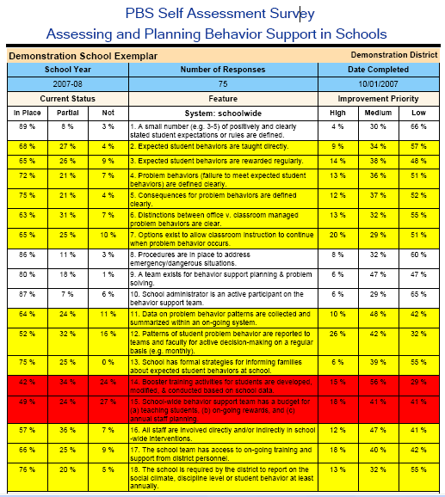
Feedback & Input Surveys
Climate Surveys
PBIS Self-Assessment Survey
Notes:
Feedback & Input Survey Manual https://www.pbisapps.org/resource/feedback-input-surveys-fis-manual
School Climate Survey - https://sebacademy.edc.org/pbis-climate-survey-manual
Self-Assessment Survey for Staff -https://sebacademy.edc.org/pbis-self-assessment-survey-sas

Slide 11
DISCUSSION: GLOWS & GROWS
What group or groups have you decided to collect input from? Staff Students or Families?
How (what source) are you collecting that data? Climate Survey, Feedback Input Survey, or PBIS Self-Assessment Survey
3 minutes
10 minutes
Co-Coach / Independent
Whole Group
Notes:
Discussion Prompt:
What is something to celebrate & something you’re working on regarding acknowledging students for demonstrating your schoolwide expectations ?

Slide 12
Big Idea
Check In
Understanding Behavior and Developing a Continuum to
Respond to Behavior Errors
Notes:
TRAINERS: This is a review of asynchronous material

Slide 13
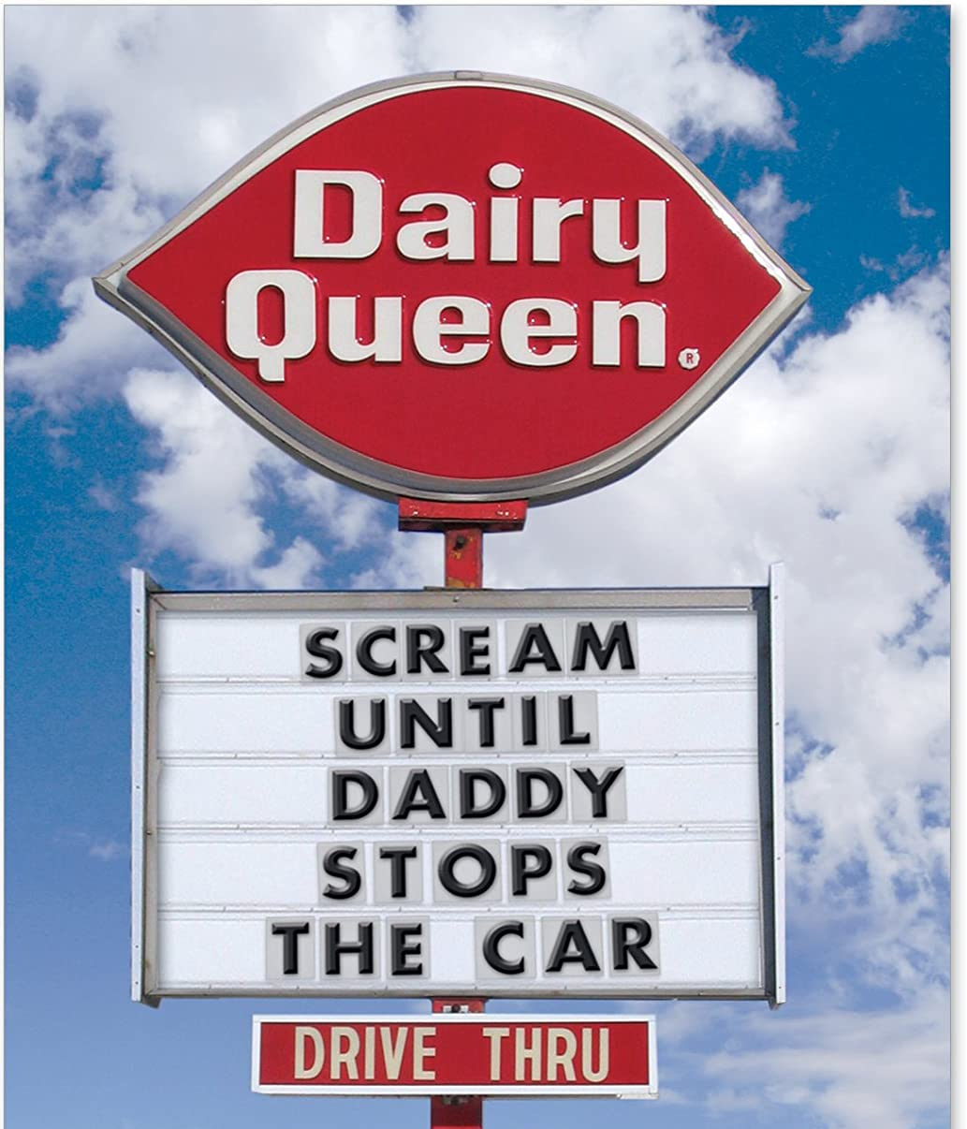
Before we can effectively encourage or discourage behavior, we need to understand why behavior happens AND how to identify why the behavior is continuing!

Slide 14
A basic understanding of the science of behavior change:
Gives us tools to observe, measure, teach, and correct behaviors effectively and efficiently.
Moves us away from perceptions, opinions, and assumptions about motivations or intentions
Shares the following assumptions (see right)
Behavior is communication.
Behavior occurs in the context of an antecedent and consequence.
Behavior is learned (function).
Behavior is lawful (function).
Behavior is escalated through successive interactions (practice).
Behavior can be changed through an instructional approach.
(Colvin & Sugai, 1989)

Slide 15
All behavior serves a function...
Get/Obtain
desired activities
tangible items
Avoid/Escape
aversive activities
tangible items
attention
sensory stimulation
attention
sensory stimulation
“Function” = outcome, result, purpose, consequence

Slide 16
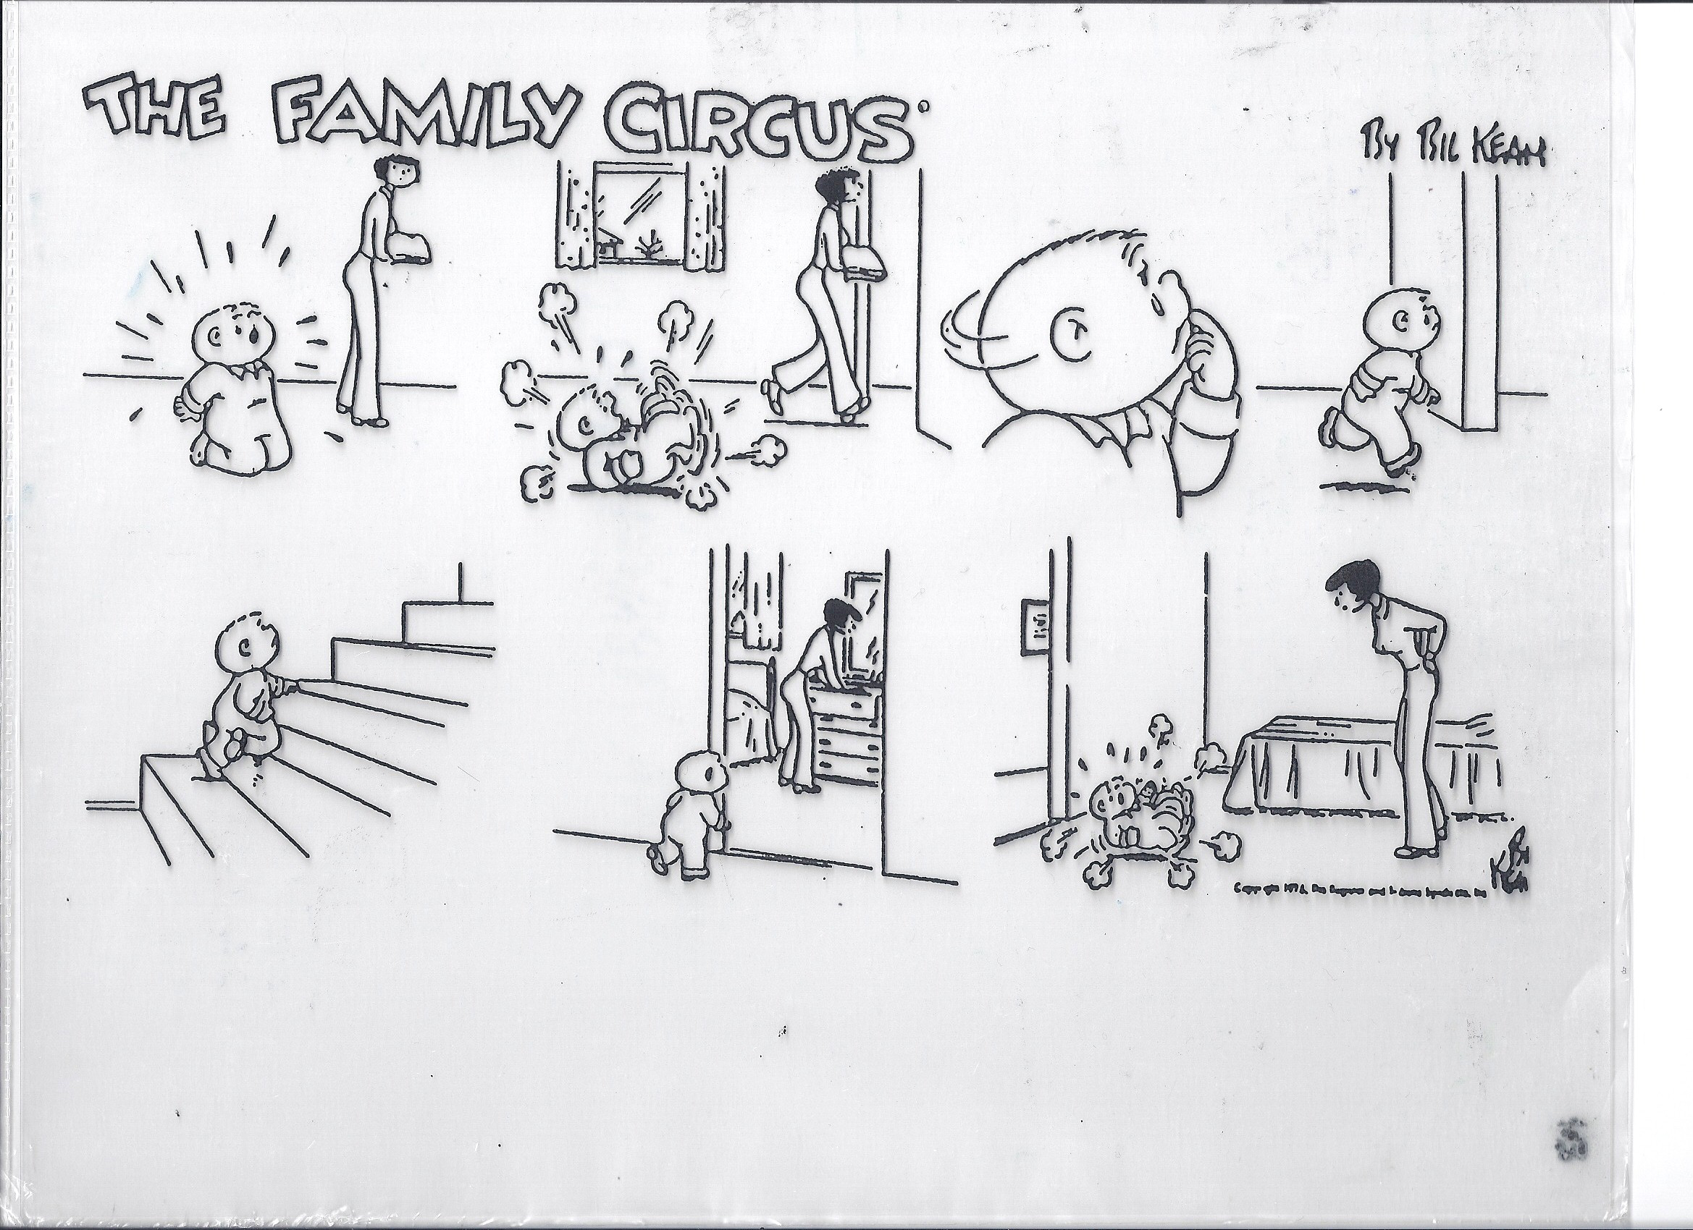
What's the function?

Slide 17
REINFORCEMENT & PUNISHMENT
Reinforcement
Punishment
when a consequence of a behavior functions to INCREASE the likelihood of future occurrences of that behavior
when a consequence of a behavior functions to DECREASE the likelihood of future occurrences of that behavior
The only way to know if a consequence was a punishment or reinforcement is to look at future behavior.

Slide 18

Non-examples of Function-Based Approach
“Latanya, you skipped 2 school days, so we’re going to suspend you for 2 more.”
“Phebe, I’m taking your book away because you obviously aren’t ready to learn.”
Why are these
NON-examples of a
function-based approach?
  “You want my attention?! I’ll show you attention…
  let’s take a walk down to the office & have a little chat with the principal.”

Slide 19
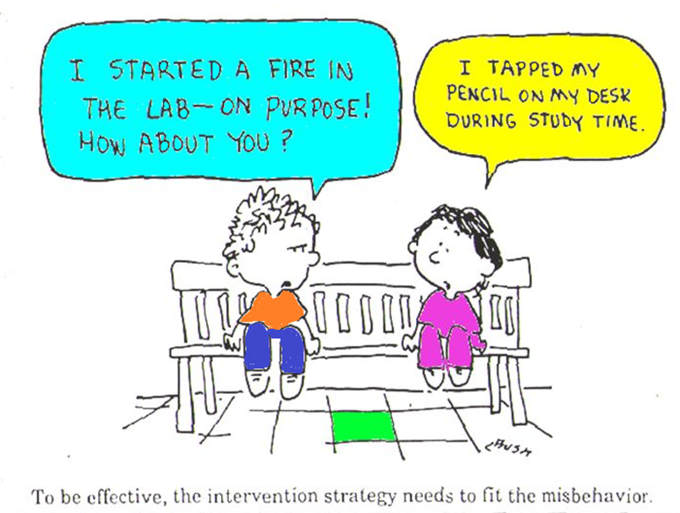
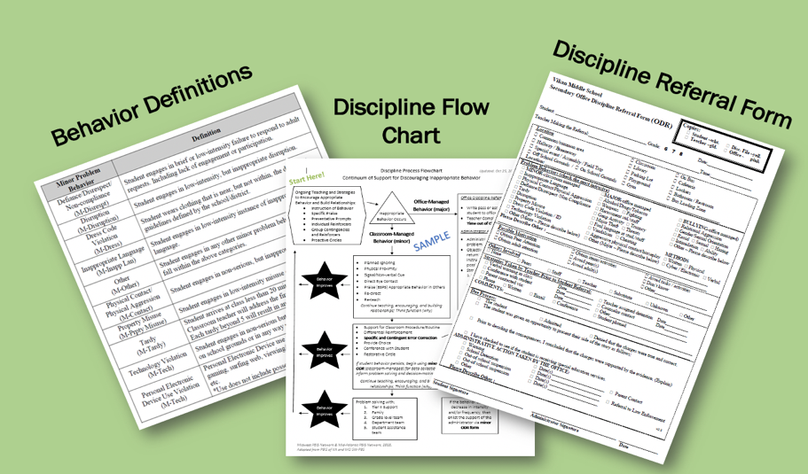
Developing a Continuum to Respond to Behavior Errors

Slide 20
Critical Features of a
Continuum to Respond to Behavior Errors
Relate to the function of the behavior!
Align with clearly defined school-wide expectations
Exist as one component of a larger system of behavior change for the student.
  Teaching expectations
  Acknowledging appropriate behaviors
System of support exists including review, teaching, and monitoring of current responses to problem behavior

Slide 21
Organizing Responses: 3 Important Components
Clearly Defined Behaviors
Discipline
Flow Chart
Discipline Referral Form
Are all staff knowledgeable on what responses are appropriate and the process for responding to violations of behavior expectations?
Are all staff consistent with recording and monitoring information when violations of behavior expectations occur?
There are 3 important videos linked on the Website to provide an in-depth understanding of this critical content to share with your team.
How can you plan for your team to watch/discuss those videos and action plan accordingly?
Are all staff consistent with how violations of behavior expectations are labeled?
Consistent Management & Tracking of Behaviors
Communication & Data Review
Consistent Responses
Notes:
Trainer note: DO NOT GO IN DEPTH with this slide! Please just review the content then reference the videos. The next set of slides go into each area in depth.
Behavior Flow Chart Video: https://sebacademy.edc.org/behavior-flow-chart-video
Defining Behaviors Video: https://sebacademy.edc.org/defining-behaviors-video
Referral Form Video: https://sebacademy.edc.org/referral-form-video

Slide 22
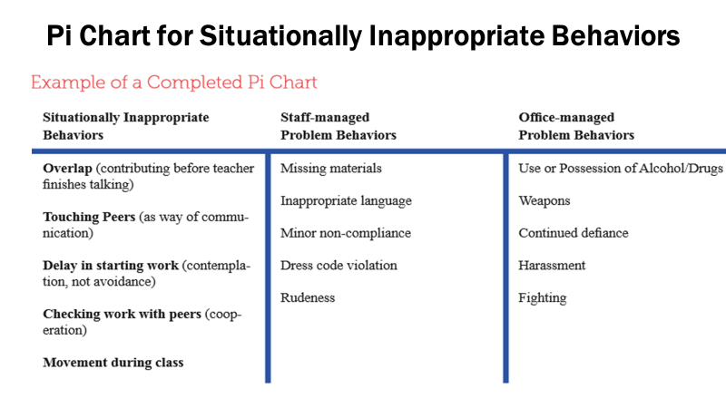
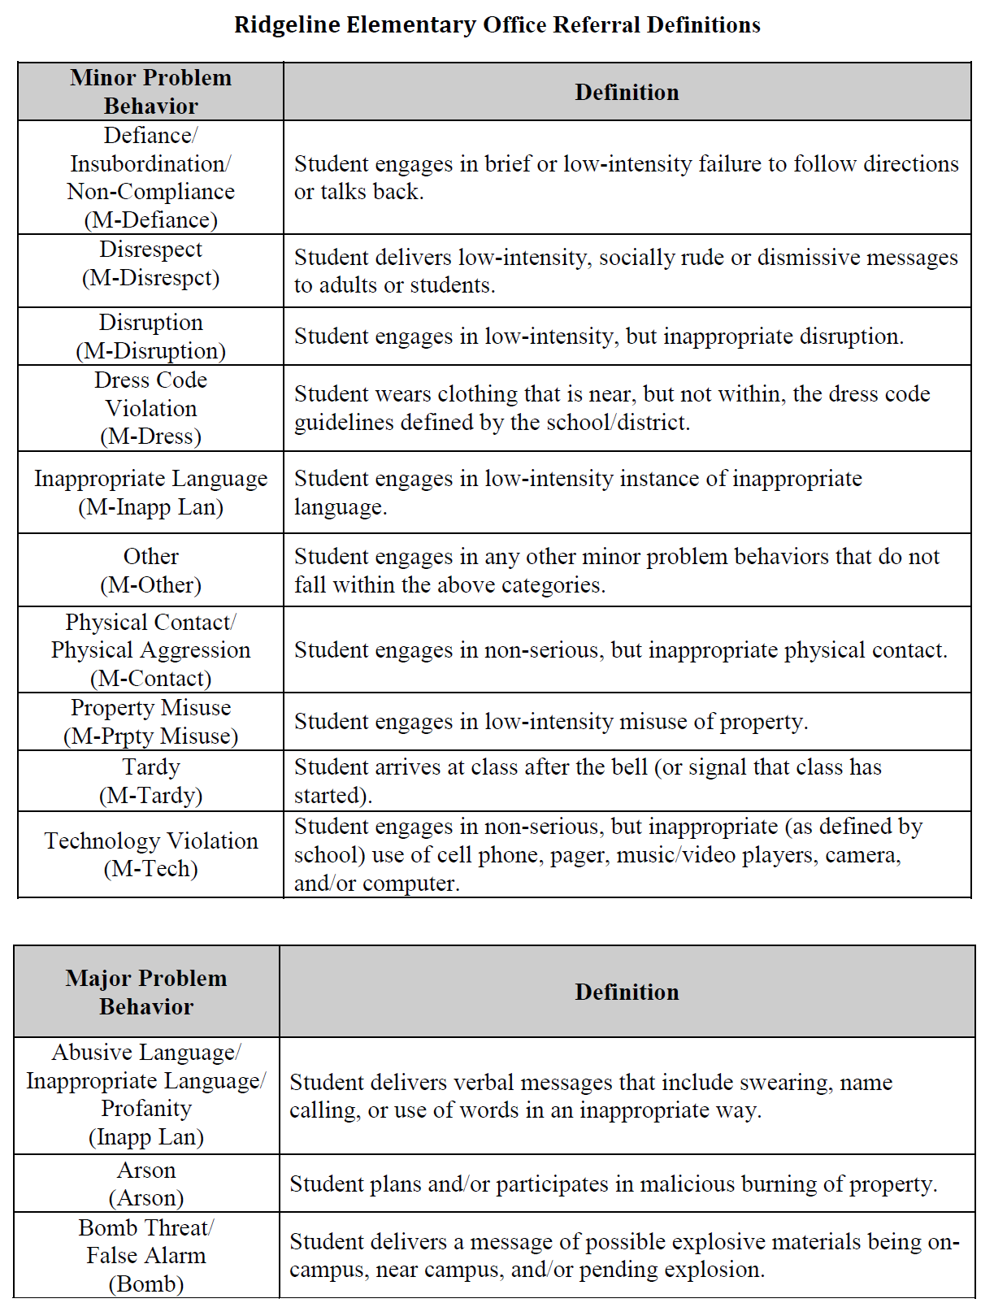
Clearly Defined Behaviors
Clearly Defined Behaviors
Organize your responses around those that are classroom managed & those that are office managed
Are all staff consistent with how violations of behavior expectations are labeled?
Minor Behaviors
Identify those behaviors that generally should be managed in the classroom
frequent, low intensity behaviors
Major Behaviors
Identify those behaviors that generally should be managed in the office
in-frequent, high intensity behaviors
Communication & Data Review
Notes:
Defining Behaviors Video: https://sebacademy.edc.org/defining-behaviors-video

Slide 23
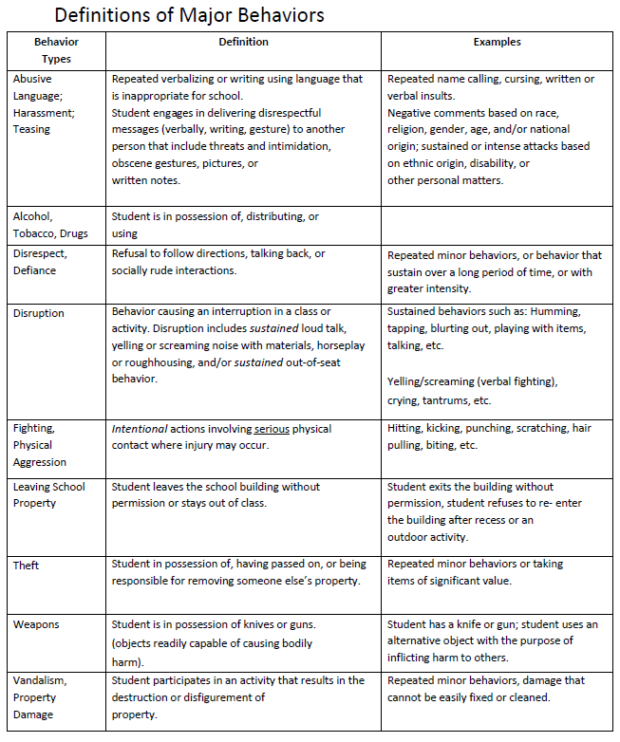
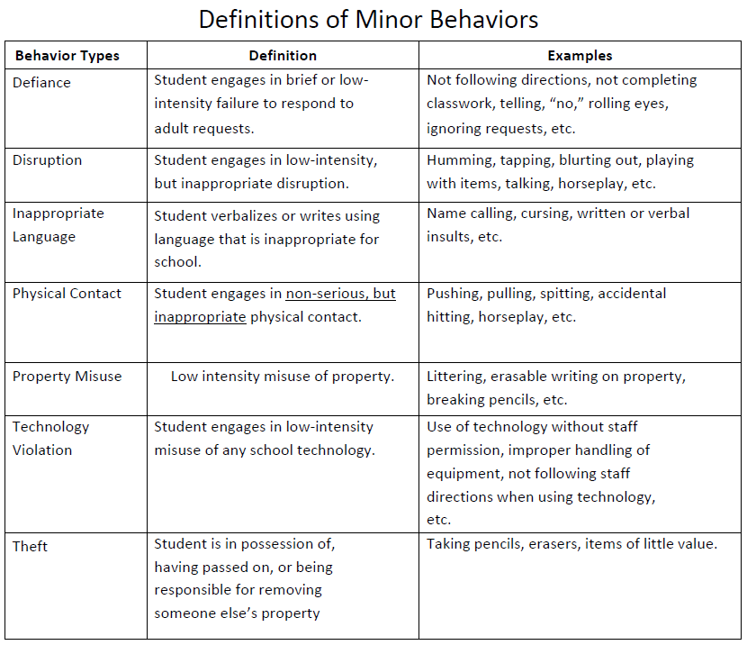
Definition
Sample

Slide 24
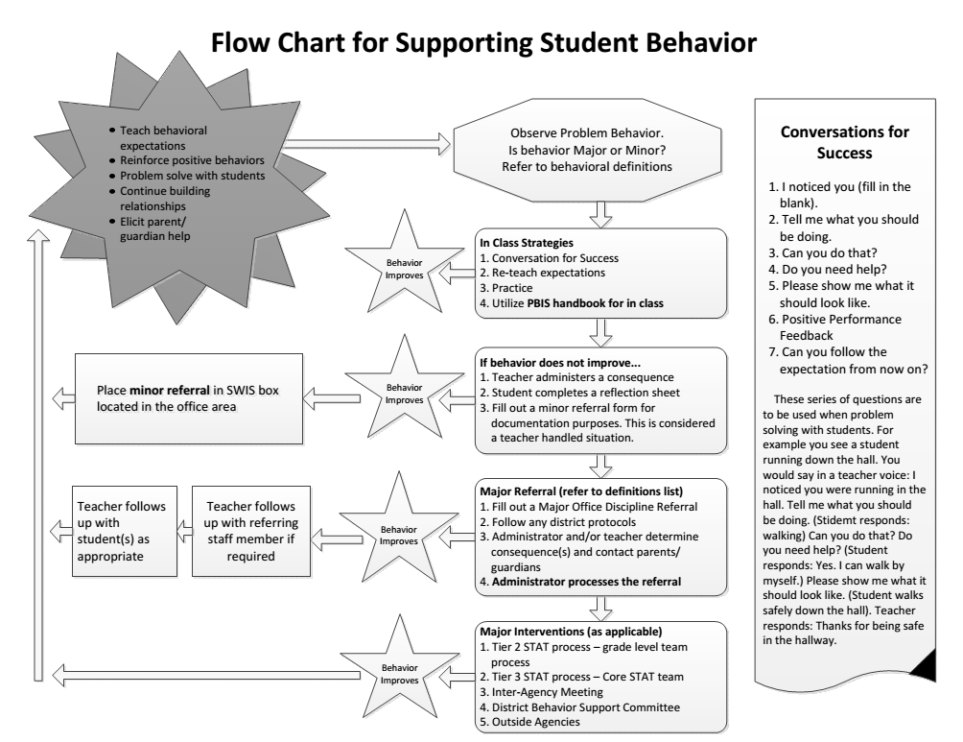
Discipline Flow Chart
Clearly outline process for responding to behavior as well as
how we track student/staff behavior
Discipline
Flow Chart
Staff Responses
Outline responses linked to various levels of behavior and a process for both classroom and office managed behavior that is clear to both staff and students.
Behavior Tracking
Outline what information is tracked at which points and where that data will be collected and housed.
Are all staff knowledgeable on what responses are appropriate and the process for responding to violations of behavior expectations?
Consistent Responses

Slide 25
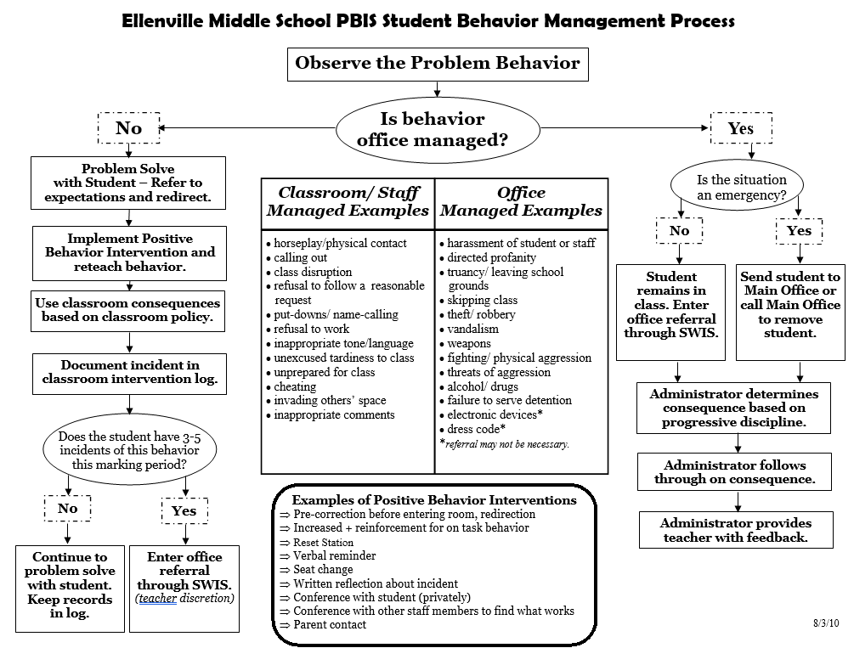
FLOW Chart
Sample
Notes:
Behavior Flow Chart Video: https://sebacademy.edc.org/behavior-flow-chart-video

Slide 26
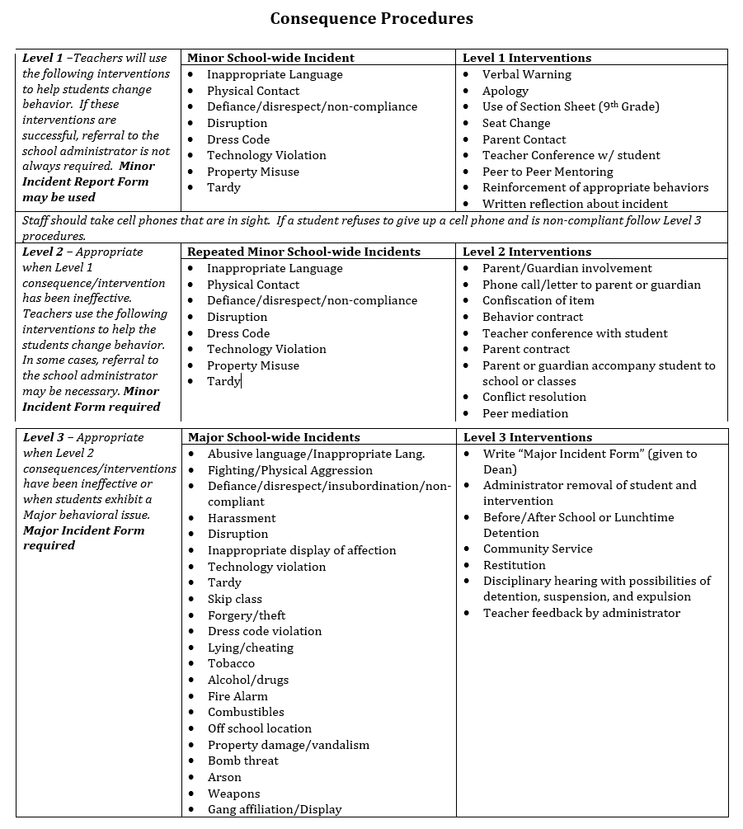
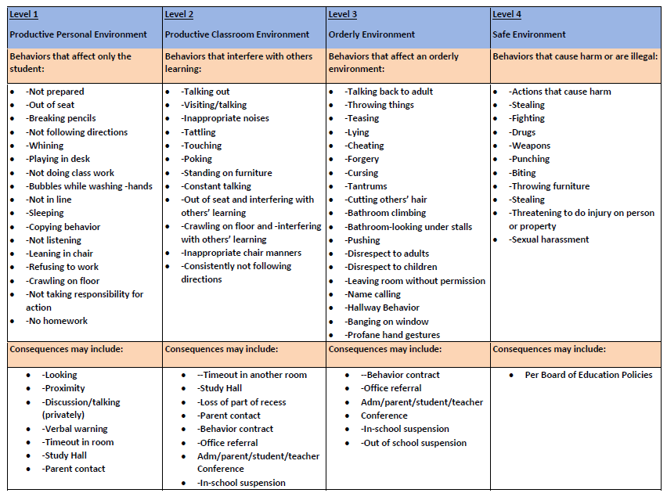

Slide 27
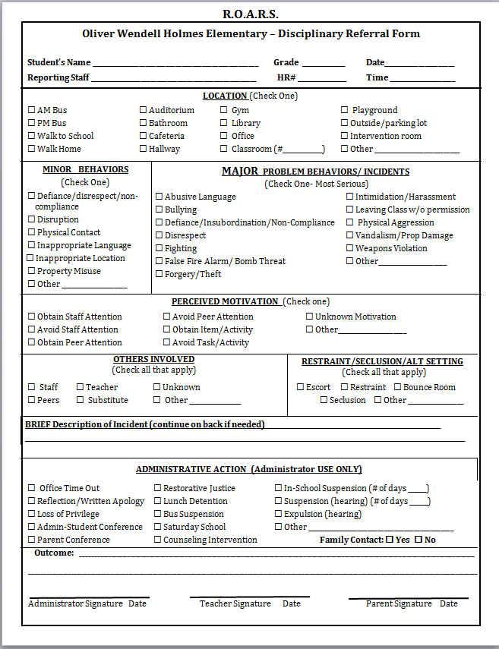
Discipline Referral Form
Clearly outline a system for tracking behavioral infractions that will support decision making.
Discipline Referral Form
Referral Form(s)
Develop referral forms with adequate specificity to support data-based decision making at the universal level.
System to Support Fidelity
Ensure language is consistent with behavior definitions and flow chart, form can be completed quickly, and staff are trained and supported with use.
Are all staff consistent with recording and monitoring information when violations of behavior expectations occur?
Consistent Management & Tracking of Behaviors
Notes:
Referral Form Video: https://sebacademy.edc.org/referral-form-video

Slide 28
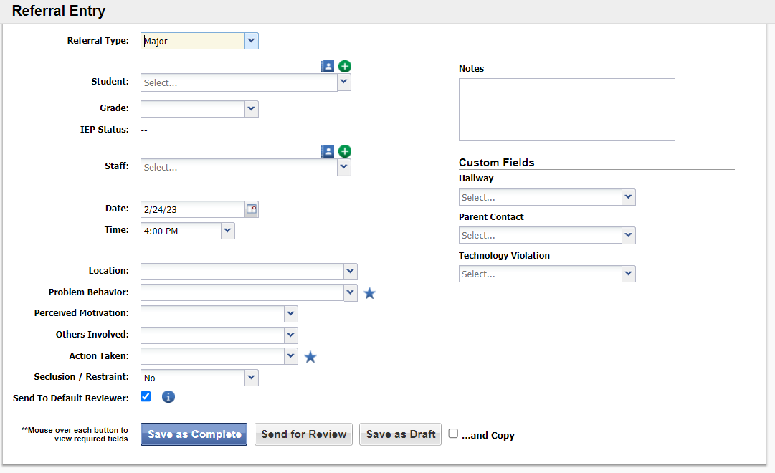
SWIS has Electronic Referral Option

Slide 29

Office Discipline Referral (ODR) Form
IT IS…
IT IS NOT…
Clear, mutually exclusive, exhaustive definitions
Underestimation of actual behavior
Piece of information used to make decisions
A reflection on teacher’s skills
A way to change or re-teach behavior
Punishment
An interaction between Kid - Staff Member - Administrator
Allows teacher to continue teaching
A first attempt at correcting behavior

Slide 30
DISCUSSION: Developing a Continuum to Respond to Behavior Errors
What does your school use currently to identify and respond to behavioral errors?
What further support do you need so you can support your team with this work?
What examples can you share?
5 minutes
10 minutes
Independent Jot
Whole Group
Notes:
Discussion Prompt:
How has your team moved forward with developing a continuum to respond to behavior errors?
What further support do you need so you can support your team with this work?
What examples can you share?

Slide 31
Resource
Spotlight
Notes:
Erik
10:00

Slide 32

Putting a Definition Back in Defiance
When it comes to our referral process, knowing what subjective behaviors like defiance and disrespect feel like isn’t enough. We need to define them precisely and we better do it fast.
Notes:
Putting a Definition Back in Defiance - https://sebacademy.edc.org/putting-definition-back-defiance

Slide 33
ACTIVITY: PREVIEW Discipline Article
Review the Article.
Consider how you can share with your team and staff to inform implementation of PBIS at your school.
With Co-Coach
10 minutes
Notes:
TRAINERS:
Integrated TFI Companion Guide: https://www.pbis.org/resource/integrated-tiered-fidelity-inventory-companion-guide

Slide 34
Looking Ahead
Notes:
Erik
10:20

Slide 35
MONITORING & EVALUATING PBIS PRACTICES
Use data to monitor the implementation & effectiveness of PBIS practices
Linked with meaningful outcome goals
Communicates purpose
Guides action planning
Used to measure and demonstrate progress

Slide 36
STEPS FOR SELECTING, MONITORING, & EVALUATING SWPBIS PRACTICES
Step 1: Develop evaluation questions.
Step 2: Identify indicators or measures.
Step 3: Develop methods for collecting and analyzing indicators.
What do you want to know?
What information can be collected?
How/when should information be gathered?
Step 4: Make decisions and action plan from analysis of indicators.
How will the question answered and what should be done next?

Slide 37
SCHEDULE YOUR SPRING TFI WITH YOUR TRAINER
Trainer will come to your school to conduct a walkthrough to interview approximately 15 staff and 15 students. (If possible please have a coach available to shadow the walk through for training)
After the walk-through your trainer will set up a time to conduct the TFI with you and your team

Slide 38
AGENDA & FOLLOW-UP
Coaches’ Tasks:
Work to complete or update Flow Chart, Definitions and Referral Form.
Presentation Content:
Acknowledgement Systems Check-in
Developing a Continuum to Respond to Behavior Errors
Resource Spotlight
Share video links with team
What questions do you have on today’s content?
What questions do you have on the follow-up tasks?

Slide 39
HELPFUL RESOURCES
RESOURCES:
Putting a Definition Back in Defiance (article)
Behavior Flow Chart Video
Defining Behaviors Video
Referral Form Video
Discipline Flow Chart Activity
Sample Flow Charts and Templates
Sample Behavior Definitions
Behavior Definition Activity
Sample Referral Forms
Referral Form Activity
Notes:
Putting a Definition Back in Defiance - https://sebacademy.edc.org/putting-definition-back-defiance
Behavior Flow Chart Video: https://sebacademy.edc.org/behavior-flow-chart-video
Defining Behaviors Video: https://sebacademy.edc.org/defining-behaviors-video
Referral Form Video: https://sebacademy.edc.org/referral-form-video
Sample Flow Charts and Templates: https://sebacademy.edc.org/list-of-pbis-resources?keyword=Flow+Chart&pbis_resource_type=113&pbis_resource_topic=All&sort_by=field_date_value&sort_order=DESC
Discipline Flow Chart Activity: https://sebacademy.edc.org/discipline-flow-chart-activity
Sample Definitions: https://sebacademy.edc.org/list-of-pbis-resources?keyword=Sample+behavior+definitions&pbis_resource_type=All&pbis_resource_topic=All&sort_by=field_date_value&sort_order=DESC
Behavior Definition Activity: https://sebacademy.edc.org/behavior-definitions-activity
Sample Referral Forms: https://sebacademy.edc.org/list-of-pbis-resources?keyword=Sample+Referral+Form&pbis_resource_type=All&pbis_resource_topic=All&sort_by=field_date_value&sort_order=DESC
Referral Form Activity: https://sebacademy.edc.org/referral-form-activity

Slide 40
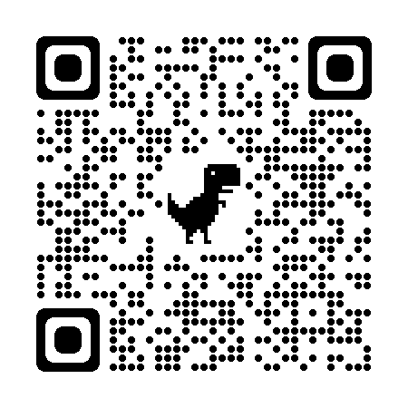
EVALUATION
Please remember to complete the evaluation!
Scan the QR code to access.
Notes:
TRAINERS -
Put link to evaluation (below) in the chat for those who do not use the QR code:
Evaluation Survey: https://edc.co1.qualtrics.com/jfe/form/SV_cBF9GI7gVEBsfSC

