Slide 1
PBIS School-Wide Coach Meeting Year 1: June 2023
PBIS Track
Insert Trainer Names
with support from NEPBIS Network, May Institute & Broad Reach Consulting
Notes:
Add trainer names for your event

Slide 2
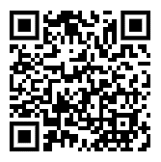
ACTIVITY: ATTENDANCE
Scan QR code on the left or follow the URL posted in the chat to access the online attendance survey
Follow prompts to enter attendance information
Notify trainers if you require assistance (e.g., identifying your cohort or cohort group)
Certificates of Attendance will be sent in January and June. Attendance records and Zoom log in will be use as verification
You are in Cohort 9
1 minute
Notes:
TRAINERS – QR Code is updated
Add your cohort letter – PLEASE review Certificates of Attendance process – They will automatically be sent in Jan and June based upon attendance and Zoom Log in info.
Post a link to the attendance survey (below) in the chat for those who do not use the QR code on the slide:
ATTENDANCE: https://edc.co1.qualtrics.com/jfe/form/SV_5BiXqi4bxzOCMS2

Slide 3
EXPECTATIONS
Self
Others
Environment
Self-monitor
Mute when listening, unmute to talk​
Have your computer charged and ready to go​
If you have questions or comments:
Work as a team:
Keep necessary materials at hand
Are you participating?
Engaged as a learner?
Stretch, break, stand as needed​
unmute
use the chat box
Room for every voice
Reinforce participation
action plan
relevant docs
water/snacks
Minimize distractions if possible​

Slide 4
AGENDA & Coaches’ Tasks
Coaches’ Tasks:
Complete and Share End of Year Evaluation
Presentation Content:
Check In: Continuum to Respond to Behavior Errors & Classroom Matrix
Rollout Planning
Prepare for Fall Rollout to Staff, Students, and Families
End of Year Evaluation

Slide 5
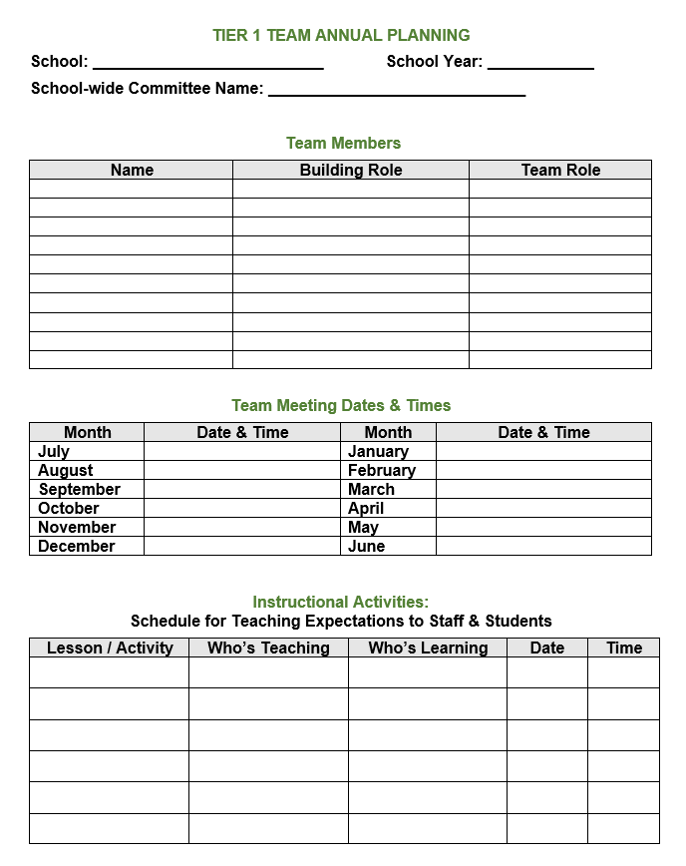
HELPFUL RESOURCES
Supporting and Responding to Students’ SEB Needs: Evidence-Based Practices for Educators (Classrooms)
Supportive Environments Create Classroom Community
Creating a Classroom Teaching Matrix
Annual PBIS Evaluation Report Template
Annual PBIS Evaluation Report – SAMPLE
Coaches Year at a Glance Document
Rollout Check List
Annual Action Plan for Advanced Years
Sample PBIS Handbooks
Sample Staff Slide Deck
Sample Student PBIS Slide Deck
Notes:
RESOURCES:
Action Plan with Goals: https://sebacademy.edc.org/action-plan-template-1-year-1-teams
TFI Action Plan: https://sebacademy.edc.org/tfi-action-plan-template
Coaches Year at a Glance: https://sebacademy.edc.org/coaches-year-glance
Annual Action Plan: https://sebacademy.edc.org/annual-action-plan-template-advanced-years
Integrated TFI Companion Guide: https://www.pbis.org/resource/integrated-tiered-fidelity-inventory-companion-guide
TFI: https://www.pbisapps.org/products/tfi

Slide 6
Glows & Grows Review
Notes:
9:05
Karen

Slide 7
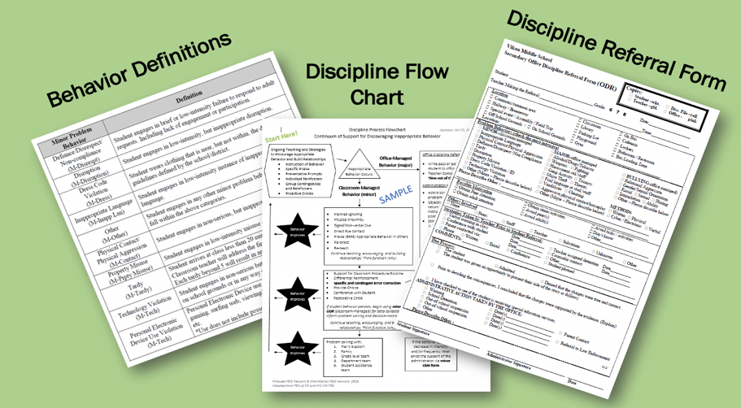
Develop a continuum to discourage
violations of expectations
Notes:
You will also clarify how staff should respond when contextually inappropriate behaviors occur by clearly defining, determining who’s responsible for responding, identifying clear responses, and recording the behaviors.

Slide 8
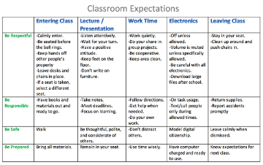
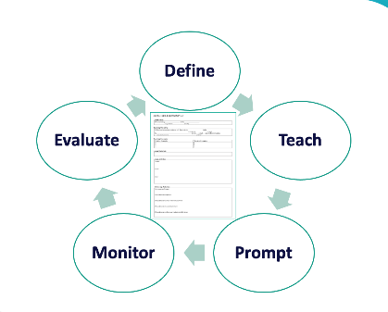
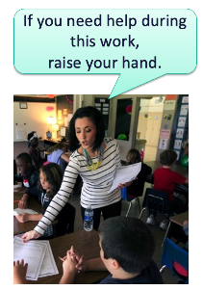
1. Create Positive Teaching and Learning Environments
Design a Safe Environment
Establish Positive Connections
Develop Predictable Routines
Define and Teach Positive Expectations
Plan Relevant Instruction

Slide 9
DISCUSSION: GLOWS & GROWS
Have you begun work on any of these items?
Definitions
Flow Chart/Levels
Office Discipline Referral Form
Have you reviewed the Classroom Support Document?
Have you considered having teacher create a classroom matrix?
3 minutes
7 minutes
Co-Coach / Independent
Whole Group
Notes:
Discussion Prompt:
What is something to celebrate & something you’re working on regarding acknowledging students for demonstrating your schoolwide expectations ?

Slide 10
Big Idea: Annual Evaluation Report
Notes:
TRAINER NOTE: This is review content please be brief

Slide 11
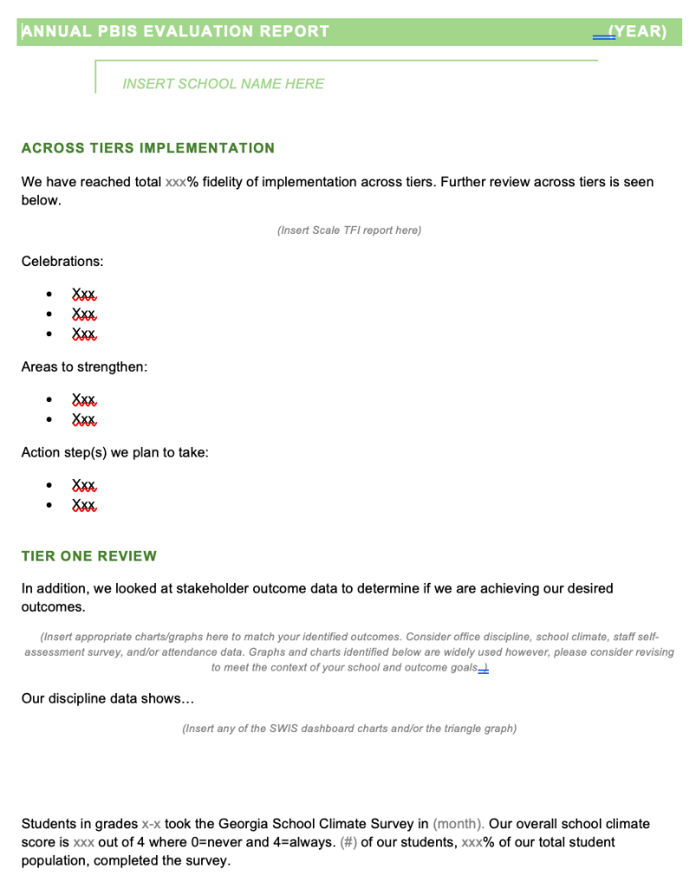
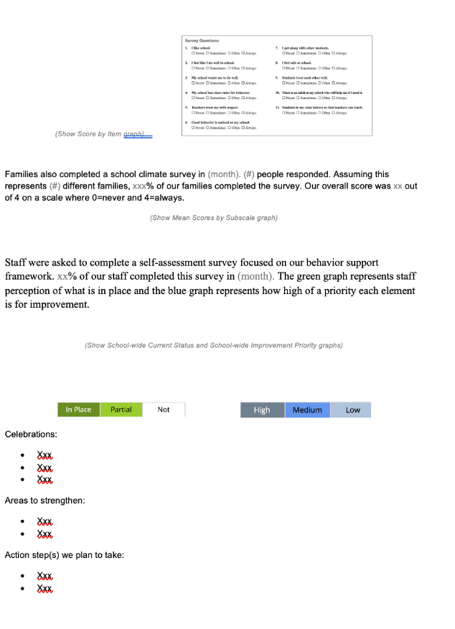
EVALUATION TEMPLATE
Add your data
Match your school’s context
Share with stakeholders
Notes:
TRAINER NOTE: This template is meant to be used as a guide. Schools should add/delete to meet their school context.
Annual Evaluation Template link: https://sebacademy.edc.org/annual-evaluation-report-template
Sample - Annual Evaluation : https://sebacademy.edc.org/annual-evaluation-report-sample

Slide 12
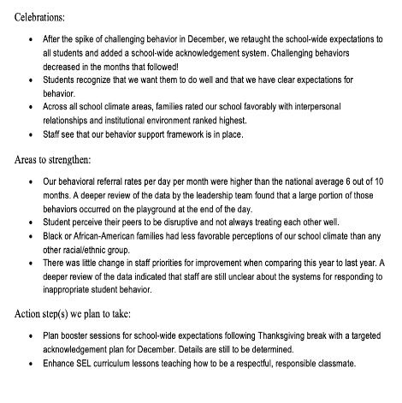
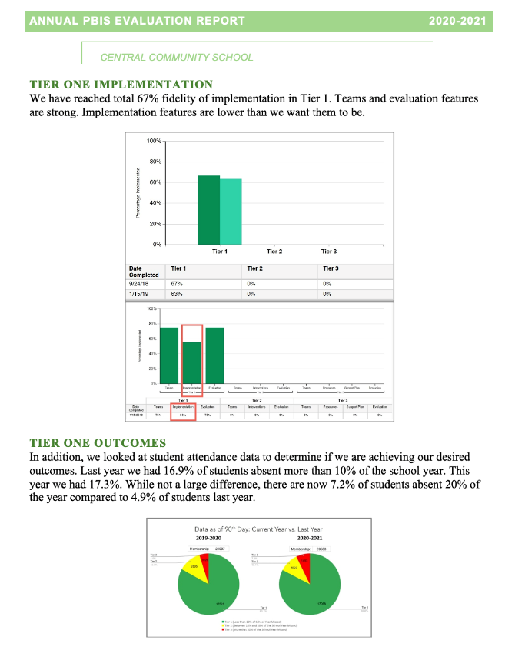
Implementation of the core components of PBIS is more likely if the Tier I team assesses the implementation status at least annually and provides “snapshot” reports to the staff, community, school board.
Notes:
Annual Tier 1 Evaluation Report (Sample school):

Slide 13
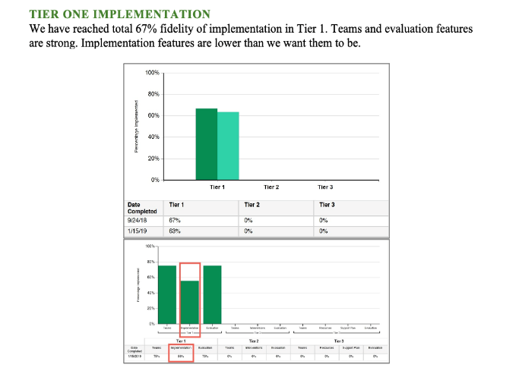
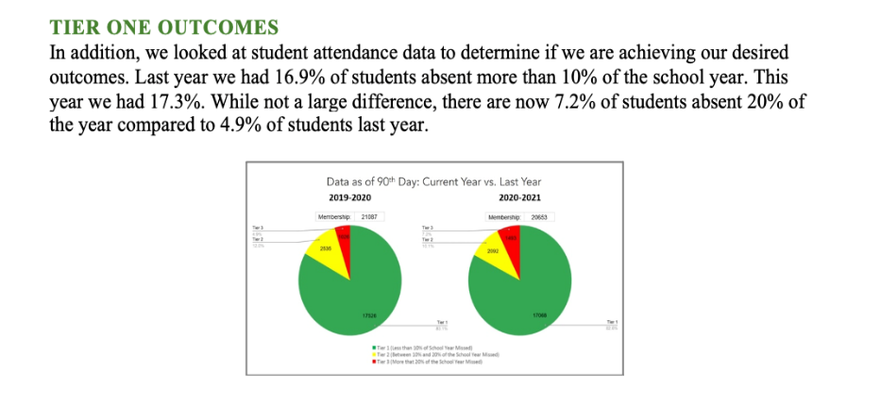
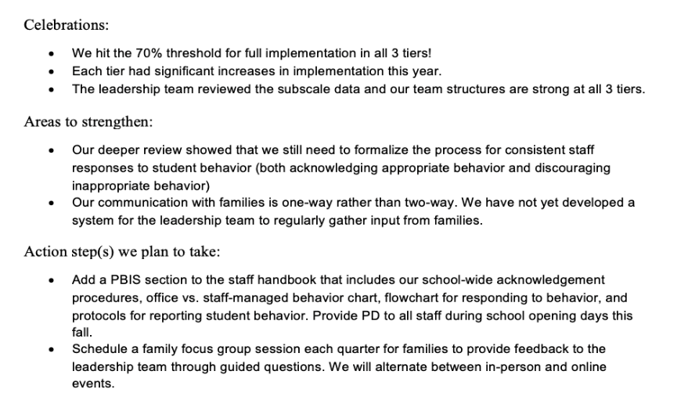
Outcome Data
Celebrations
Areas to strengthen
Action Steps
Fidelity Data
Notes:
TRAINER NOTE: Use this sample to discuss what each school might choose to include in a “snapshot” evaluation report

Slide 14
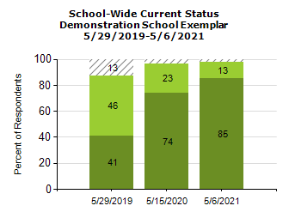
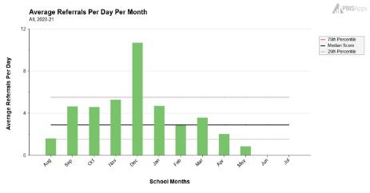
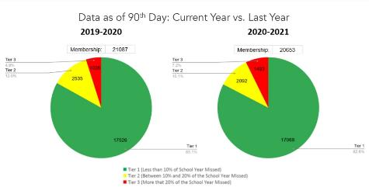
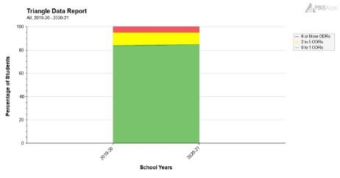
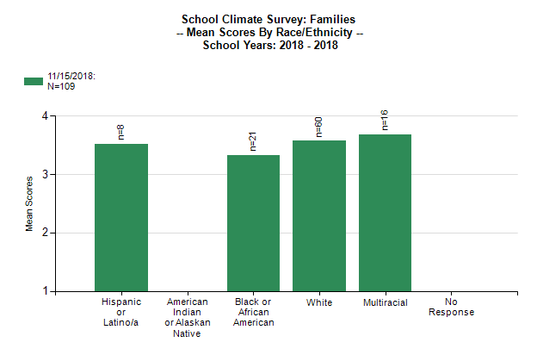
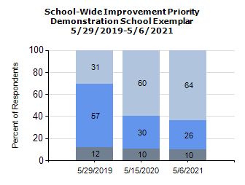
What Tier 1 outcome data can you use to complement your TFI data?
(Remember to consider your team's desired outcomes/goals as you decide!)
School climate data
(students, staff, families)
Staff Self-assessment survey data
Behavior data
Attendance data

Slide 15
ACTIVITY: Evaluation Report
Open the Report Template
Get TFI graph from PBISapps.org to paste into Template
Consider what outcome data you might use
List AT LEAST one celebration item, one area to improve item, and one action step – Be prepared to share out to group.
Complete with your team and share with Trainers, Your Administration, Staff, Families, and Post to your Website
Coaches
20 minutes
10 minutes

Slide 16
PBIS Resource Spotlight:
Roll out Checklist, Coaches Year at a Glance, & Annual Action Plan
Notes:
RESOURCE LINK: https://sebacademy.edc.org/equitable-outcomes-require-finding-vulnerable-decisions

Slide 17
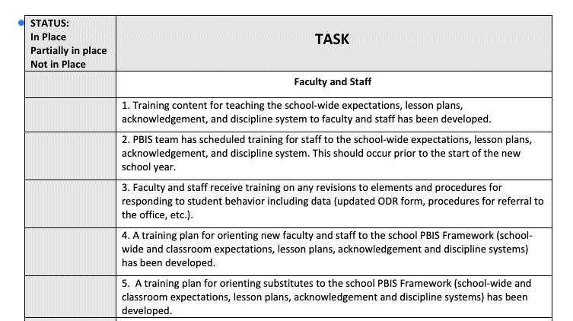
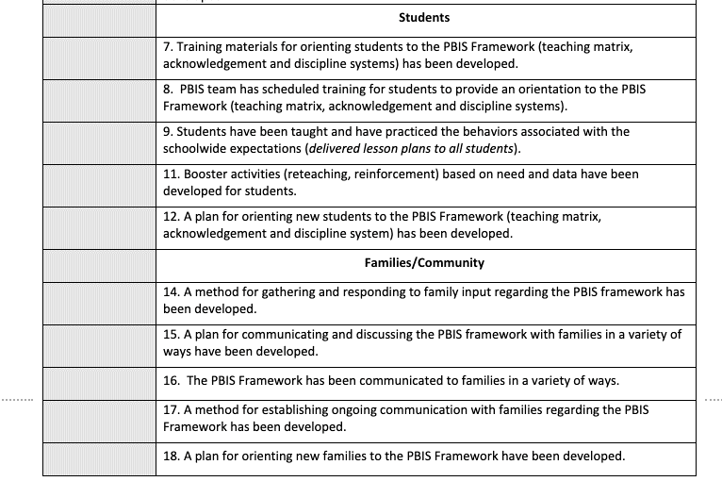
PBIS ROLLOUT CHECKLIST

Slide 18
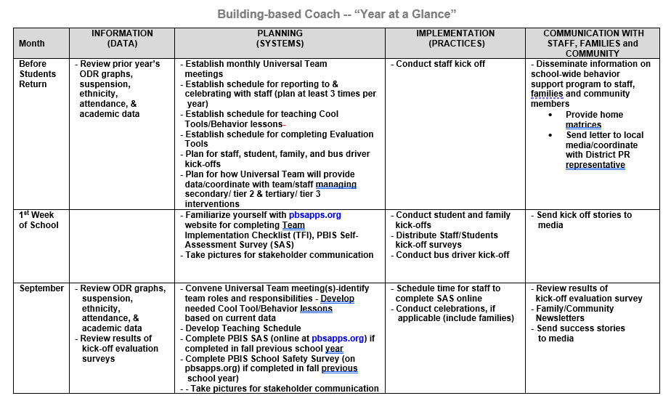
Coaches Year at a Glance
Month by month resources for coaches:
Organizes what data should be reviewed when (for planning purposes)
Prompts for coaches’ and team activities that support planning
What practices should be conducted across the year.
Ideas for communicating with Staff, Families, and Community.
Create your own coaches’ plan!
Notes:
https://sebacademy.edc.org/coaches-year-glance

Slide 19
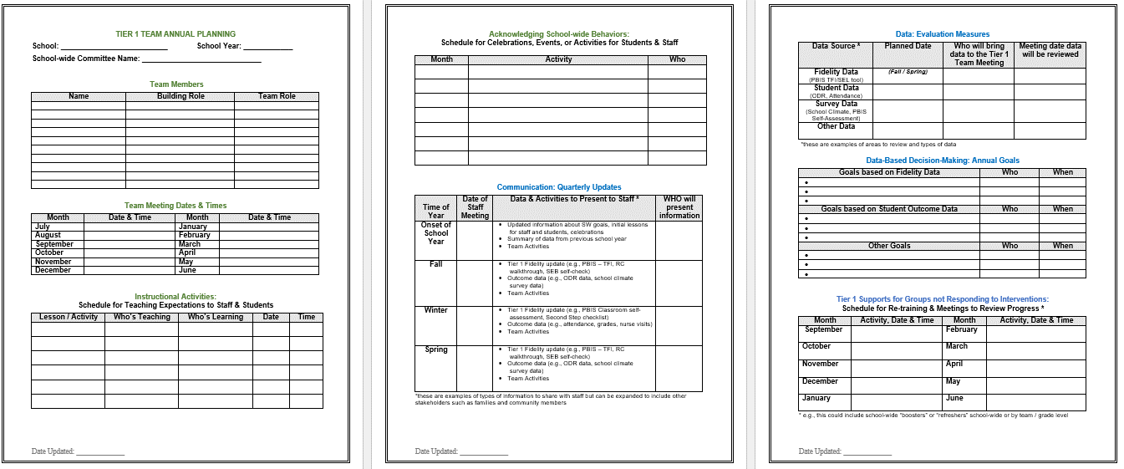
Annual Action Planning - Advanced
All in one - year long organizer action plan document that provides you a one stop document to share the following information:
Team membership and meeting dates
Lesson plan dates
Acknowledgement activities
Assessment activities
Additional support activities
Notes:
This Action plan is more advanced and is intended for schools in years 2 and beyond. Review with the team.
Advanced Action Plan https://sebacademy.edc.org/annual-action-plan-template-advanced

Slide 20
Membership, Roles, and Meeting Dates
Reserve meeting time
What role will team members fulfill?
Notes:
https://sebacademy.edc.org/annual-action-plan-template-advanced-years

Slide 21
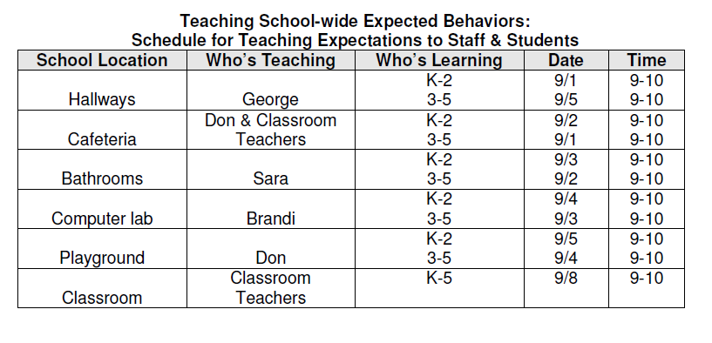
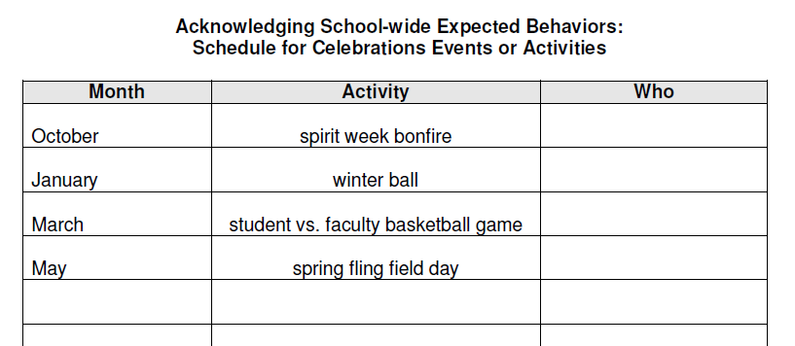
Teaching / Acknowledgement and Celebration Schedule
What’s your school’s plan for teaching expected behaviors to staff and students?
Any long-term, school-wide celebrations, assemblies, or events can be recorded here.
Notes:
https://sebacademy.edc.org/annual-action-plan-template-advanced-years

Slide 22
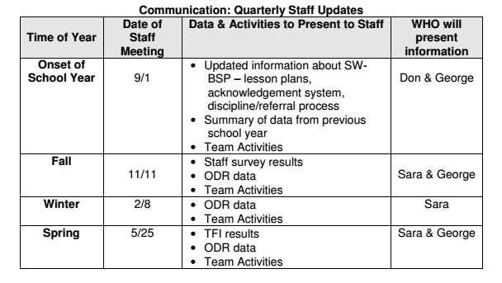
Communication
What data and info will be shared with staff when
Notes:
https://sebacademy.edc.org/annual-action-plan-template-advanced-years

Slide 23
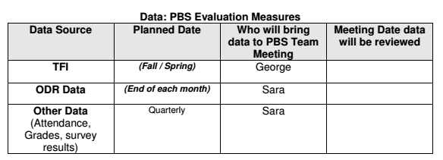
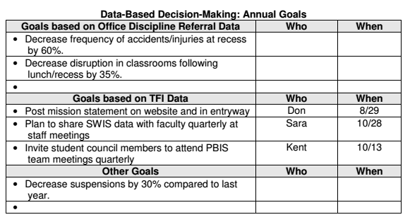
Evaluation Measures & Measurable Goals
What evaluation measures will the team use to assess implementation? When?
What do your data indicate as areas of priority?
What goals will you set for next year? Are they measurable?
Action plan based on TFI, or survey results
Notes:
https://sebacademy.edc.org/annual-action-plan-template-advanced-years

Slide 24
Looking to add more staff to your team? Sample PBIS Team Application form
Don’t forget to recruit student reps and non-staff family members!
Notes:
This is a sample team application that some school use to identify new team members. https://sebacademy.edc.org/pbis-team-member-application-sample

Slide 25
ACTIVITY: RESOURCE SPOTLIGHT
Review the shared resources independently.
With a partner discuss:
How could these resources serve as a prompt for annual action planning?
What is your key takeaway from these resources?
Be ready to provide a 1 minute share-out of your discussion
Coach Chat
Whole Group
5 minutes
10 minutes
Notes:
https://sebacademy.edc.org/annual-action-plan-template-advanced-years

Slide 26
Revisiting Goals

Slide 27
Understanding the PBIS Framework
Start of Year 1
End
of Year 3
Identifying your hopes and goals
Greater understanding
Need to revisit your outcome goals

Slide 28
Outcomes are our GOALS for implementation
As a result of
implementing PBIS,
student behavior will improve, and the school will feel better.
Based on data
Locally important and meaningful
Applicable to all (culturally equitable)
Students’ social competence and academic achievement
Staff implementation of critical skills
Observable and measurable
Written as a goal
As a result of implementing PBIS during the 20XX-20XY school year, student reports of school climate will improve by 20%
By the end of the year support for implementing PBIS will be rated “Highly Important” by at least 80% of staff as measured by PBIS staff survey.
By spring break, staff, students, and families will provide input into creation of School Wide PBIS Matrix as demonstrated by responses to questionnaires, class focus groups, and faculty meetings

Slide 29
ACTIVITY: Revisiting Purpose and Outcomes
Review your goals from October
Are they still applicable or do they need revising?
When you meet with your team identify 1 measurable outcome for the year ahead
Add to your action plan as needed.
10 minutes

Slide 30
AGENDA & Coaches’ Tasks
Coaches’ Tasks:
Complete and Share End of Year Evaluation
Presentation Content:
Check In: Continuum to Respond to Behavior Errors & Classroom Matrix
Rollout Planning
Prepare for Fall Rollout to Staff, Students, and Families
End of Year Evaluation
What questions do you have on today’s content?
What questions do you have on the follow-up tasks?

Slide 31
HELPFUL RESOURCES
Supporting and Responding to Students’ SEB Needs: Evidence-Based Practices for Educators (Classrooms)
Supportive Environments Create Classroom Community
Creating a Classroom Teaching Matrix
Annual PBIS Evaluation Report Template
Annual PBIS Evaluation Report – SAMPLE
Coaches Year at a Glance Document
Rollout Check List
Annual Action Plan for Advanced Years
Sample PBIS Handbooks
Sample Staff Slide Deck
Sample Student PBIS Slide Deck
Notes:
RESOURCES:
Action Plan with Goals: https://sebacademy.edc.org/action-plan-template-1-year-1-teams
TFI Action Plan: https://sebacademy.edc.org/tfi-action-plan-template
Coaches Year at a Glance: https://sebacademy.edc.org/coaches-year-glance
Annual Action Plan: https://sebacademy.edc.org/annual-action-plan-template-advanced-years
Integrated TFI Companion Guide: https://www.pbis.org/resource/integrated-tiered-fidelity-inventory-companion-guide
TFI: https://www.pbisapps.org/products/tfi

Slide 32
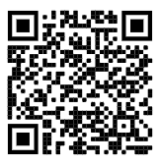
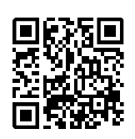
If you were NOT at the Team Training in May, Please remember to complete the End Of Year Evaluation!
.
Today’s Evaluation
Scan the QR code to access or look in the Chat Box for link
End of Year Evaluation
Scan the QR code to access or look in the Chat Box for link
Notes:
TRAINERS -
Today’s Evaluation: https://edc.co1.qualtrics.com/jfe/form/SV_cBF9GI7gVEBsfSC
End of Year Evaluation: https://edc.co1.qualtrics.com/jfe/form/SV_cHpKO4n8KJKPRdA

