Slide 1


PBIS Coach Training
Year 1: December 2023
Trainer Names
Created from content from the National Technical Assistance Center on Positive Behavioral Interventions and Supports
U.S. Department of Education, Office of Special Education Programs and Office of Elementary and Secondary Education
with support from NEPBIS Network, May Institute, & Broad Reach Consulting

Slide 2

EXPECTATIONS
Self
Others
Environment
Self-monitor
Mute when listening, unmute to talk​
Have your computer charged and ready to go​
If you have questions or comments:
Work as a team:
Keep necessary materials at hand
Are you participating?
Engaged as a learner?
Stretch, break, stand as needed​
unmute
use the chat box
Room for every voice
Reinforce participation
action plan
relevant docs
water/snacks
Minimize distractions if possible​

Slide 3
IN-PERSON TEAM TRAINING EVENT INCLEMENT WEATHER POLICY
In case of inclement weather, we will cancel our team training if the local school district where the training will be held is either delayed or cancelled due to inclement weather. Please monitor school and district closings for the school district in which the training is being held. In any case that you feel it is not safe for you to travel to the cohort training, please make the decision that is most safe for you.
Your training site is Enter Location and DATE

Slide 4
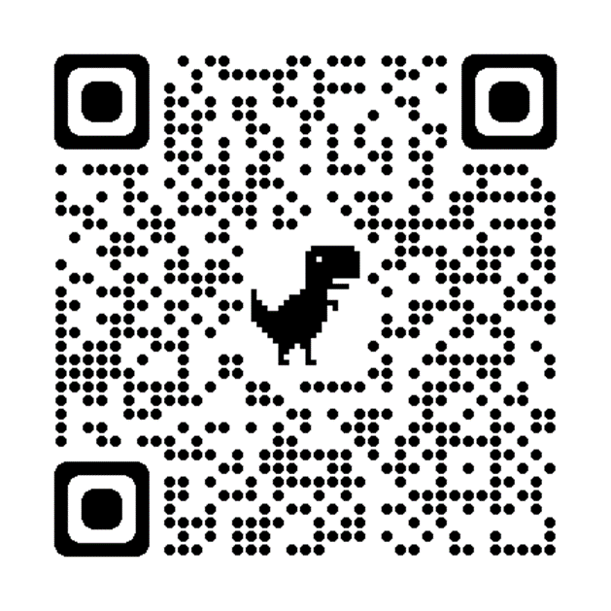
ACTIVITY: ATTENDANCE
Scan QR code on the left or follow the URL posted in the chat to access the online attendance survey
Follow prompts to enter attendance information
Notify trainers if you require assistance (e.g., identifying your cohort or cohort group)
Certificates of Attendance will be sent in January and June. Attendance records will be use as verification
You are in Cohort 10
1 minute
Notes:
ATTENDANCE: https://edc.co1.qualtrics.com/jfe/form/SV_81vbI1jl3cwmLY2

Slide 5
Agenda & Coaches' Tasks
Coaches’ Tasks:
Work with team to plan development of teaching expectations and lesson plans.
Presentation Content:
Review/Grow and Glow: Gaining Partner input
Discussion: Developing Lesson & Teaching Plans
Review acknowledgement system content and list current school and classroom acknowledgements
Preview of January Training Celebrations and Sharing
Plan for 1 PBIS feature for all team members to share at January training
Preview of Acknowledgement Systems
Preview of TFI Self-Assessment

Slide 6
Agenda & Coaches' Tasks
Coaches’ Tasks:
Work with team to plan development of teaching expectations and lesson plans.
Presentation Content:
Review: Student Voice and Personal Matrix
Discussion: Developing Lesson & Teaching Plans
Preview of Step #6: Acknowledgement Systems
Review acknowledgement system content and list current school and classroom acknowledgements
Preview of January Training Celebrations and Sharing
Preview of TFI Self-Assessment
Plan for 1 PBIS feature for all team members to share at January training

Slide 7
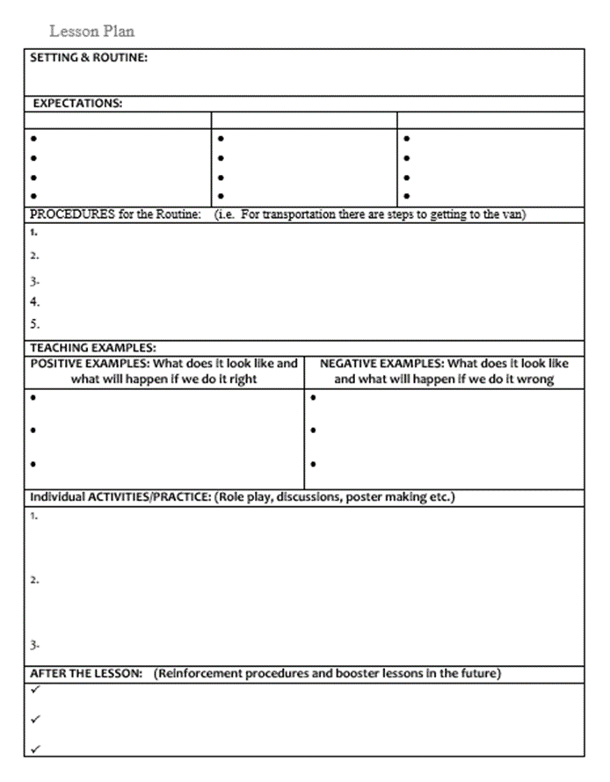
RESOURCES
RESOURCES:
Tiered Fidelity Inventory (TFI)
TFI Quick tip sheet
Lesson Plan activity
Acknowledgement System activity
Exemplar Repository
Article - Including Student Voice in Your PBIS Implementation
Notes:
Tiered Fidelity Inventory: https://www.pbisapps.org/products/tfi or https://sebacademy.edc.org/tiered-fidelity-inventory-tfi-manual
TFI Quick Sheet: https://sebacademy.edc.org/tfi-quick-check-tip-sheet
Lesson Plan Activity: https://sebacademy.edc.org/behavioral-lesson-plan-activity
Exemplar Repository https://nepbis.org/tier-1-school-wide/pbis-exemplar-resource-repository/
Article - Including Student Voice in Your PBIS Implementation https://www.pbisapps.org/articles/including-student-voice-in-your-pbis-implementation

Slide 8
Gaining input for your matrix from all interested parties: Staff, Students, & Families

Slide 9
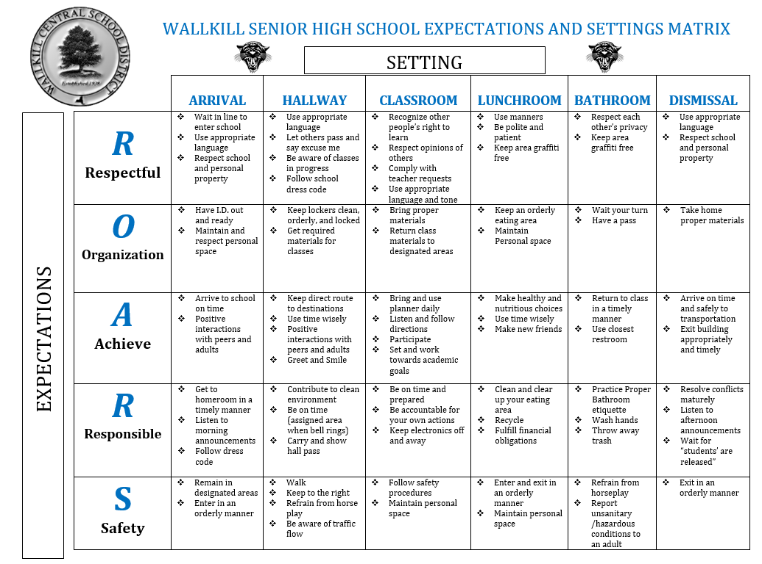
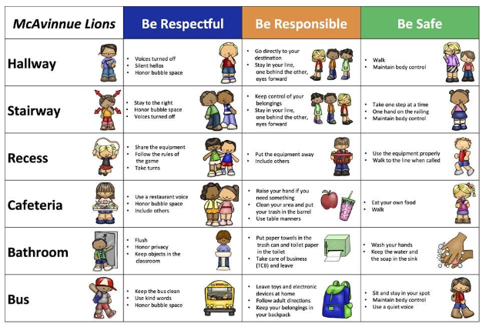
Getting Feedback on your Matrix
Notes:
Primary and Secondary examples

Slide 10
Revise expectations and matrix based on feedback
Summarize the information you collected
Assess whether the existing expectations are valued by stakeholders.
  If they are, move to creating lesson plans
  If not, generate options for new expectations or specific examples for the matrix

Slide 11
Agree on revised expectations and matrix
Build consensus
Revised expectations and matrix
Consider using input from more marginalized groups
Move on to Creating Lesson Plan
Consider a student vote among a few possible options
Difficulty reaching consensus?
Consensus reached?

Slide 12
Glows/Grows
Have you reached out to Staff, Students, & Families for input on your matrix?
  If so, how did you reach out? And what feedback did they give?
  If not, when will you reach out? How will you reach out to your different partners?
Whole Group
10 minutes

Slide 13
REVIEW
Lesson and Teaching Plans

Slide 14
TEACHING ACADEMIC & SOCIAL BEHAVIORS
Define
Teach
Prompt
Monitor
Evaluate

Slide 15

TEACH RULES IN CONTEXT OF ROUTINES
Teach expectations directly
Provide examples & non-examples
Actively involve students in lesson (game, role-play, etc.) to check for their understanding
Provide opportunities to practice rule following behavior in the natural setting.

Slide 16
Expectations & behavioral skills are taught and recognized in context

Slide 17
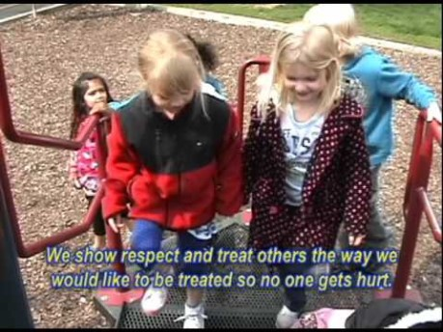

Example Teaching Videos

Slide 18
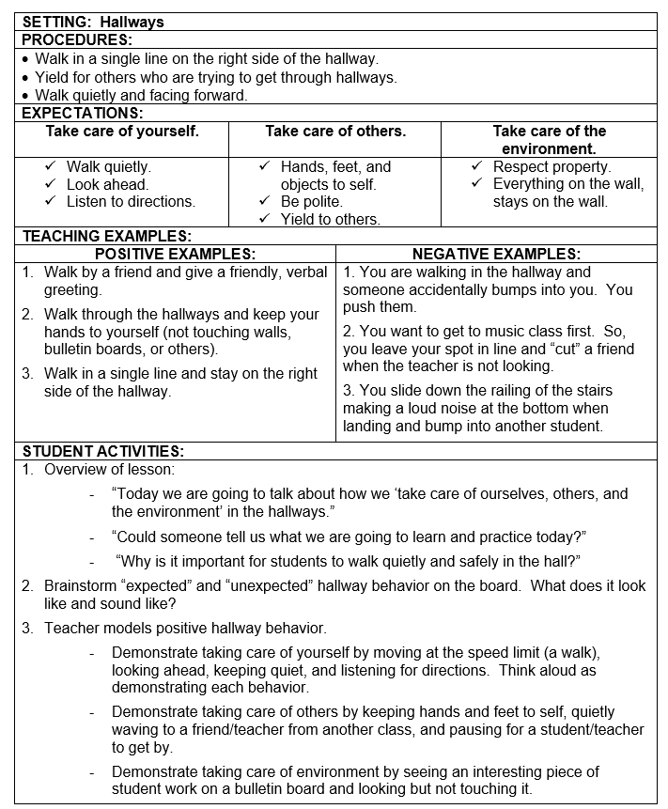
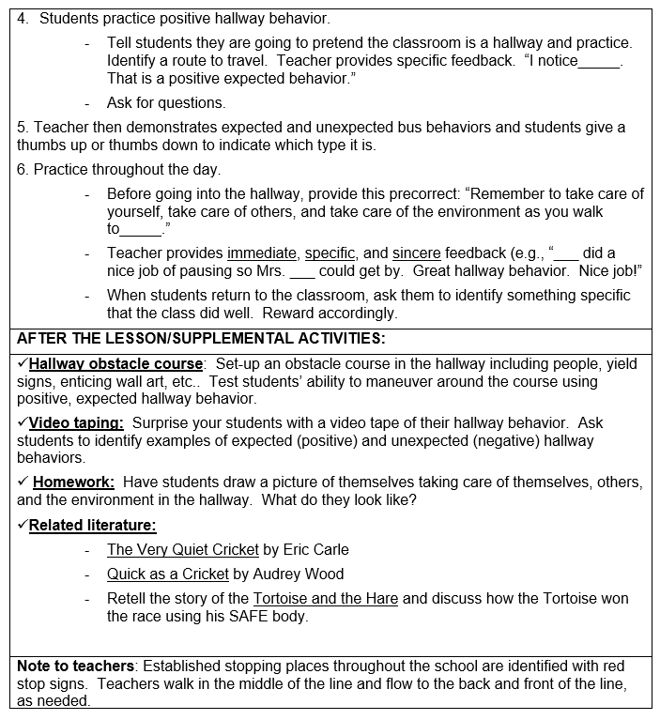

Slide 19
GUIDELINES FOR TEACHING EXPECTATIONS
Include
Include main school settings/contexts/routines i.e. Arrival, Hallways, Cafeteria, Dismissal
Consider
Adapt or use lessons that already exist
Specify
List 2-3 observable, positive, examples for each expectation within each setting
Teach
Teach social behavior just like academic skills
Practice
Provide opportunities for students to new expectation
Prompt
Provide prompts, precorrections, & feedback in natural context
Schedule
Schedule time for introducing teaching plan to staff & getting feedback on lessons
Schedule
Schedule time for obtaining feedback from students, families, & community members
Plan
Schedule initial instruction in natural context
Review
Evaluate the feedback, reteach, practice, & follow-up as needed
Notes:
For their review – Don’t read entire slide

Slide 20
Creating a Schoolwide Teaching Plan

Slide 21
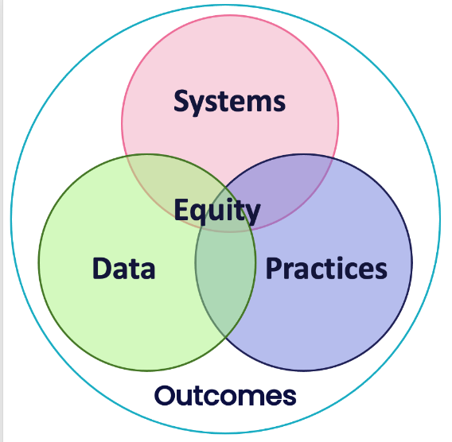
Provide SYSTEMS to support staff to teach the lessons
Be sure lesson plans are readily available
Plan whole school SW expectations teaching events
Develop a calendar of expected teaching windows (e.g. All staff are expected to reteach SW expectations on the day after holiday break, during the month of November, reteach hallway behavior)
Send weekly/monthly email prompts to staff

Slide 22
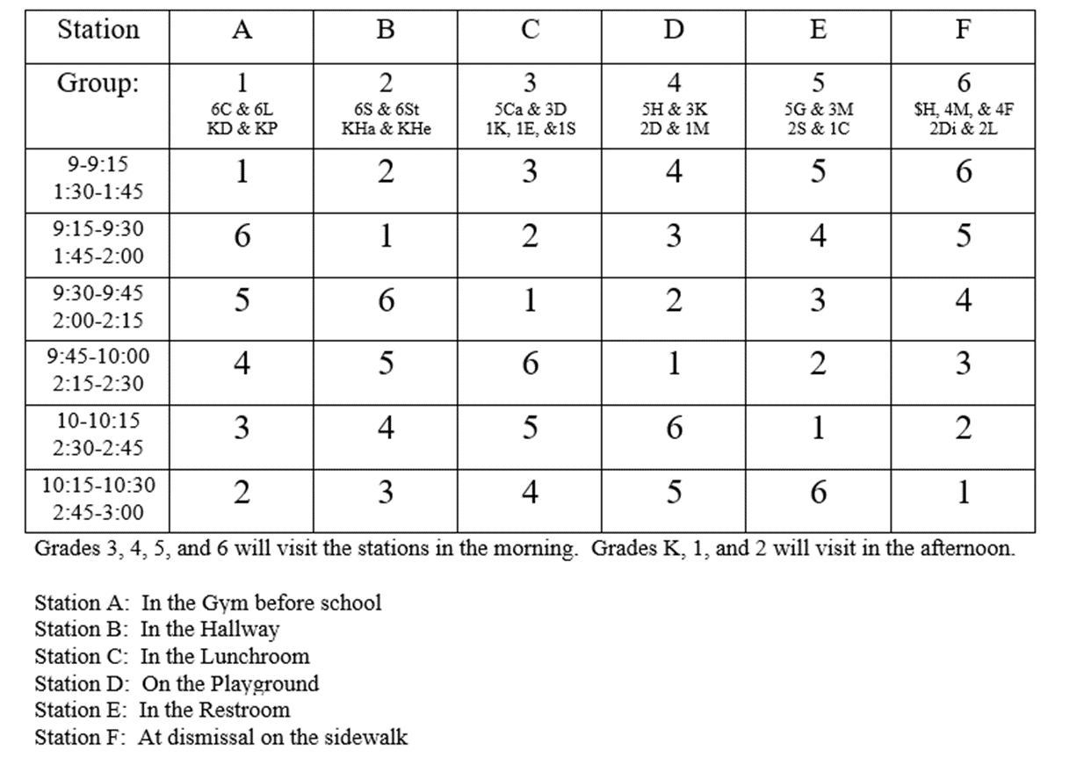
Teaching Plan
How will students be taught the Matrix, Routines, and Social Skills?
  By Classroom Teacher?
  Teaching Stations
  Combination
Do we have enough support?
  Parent Volunteers
  Support Staff

Slide 23
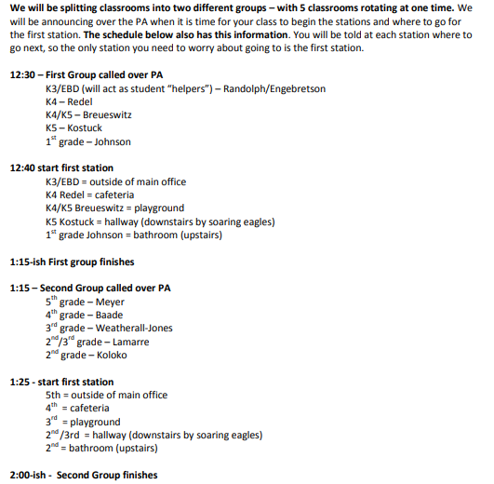
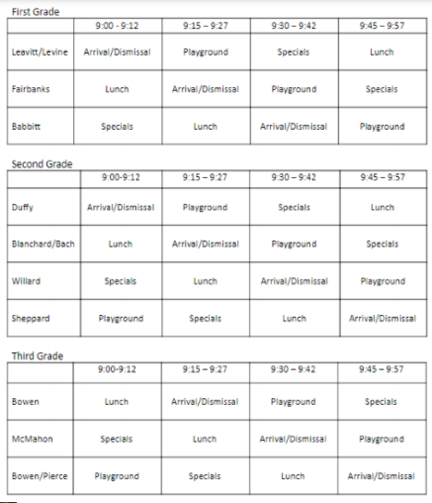
Teaching Schedule

Slide 24

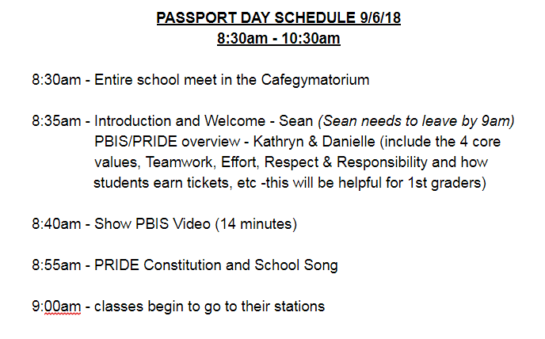
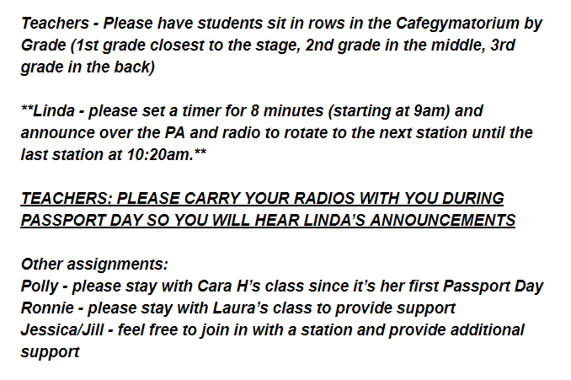
PASSPORT
Walkers/ Cars | Arrival/ Dismissal | Lunch | Assemblies
Recess | Stairways& Hallways | Bathrooms | Field Trips
Be sure to have your passport stamped
before leaving each location.
Name: _________________________
Grade: _________________________
Teacher: ________________________
Date: ___________________________

Slide 25
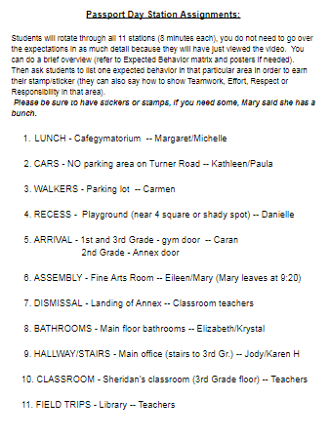
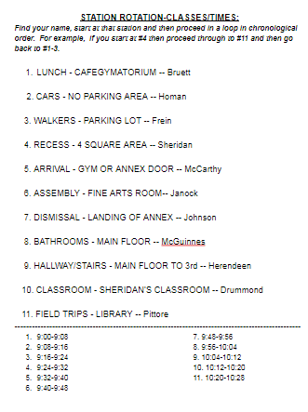

Slide 26
DISCUSSION: Lesson & Teaching Plans
Where are you at with creating your lesson plans?
How will you review them with teachers?
How will you teach your lesson Plans?
  Using school wide stations?
  Every teacher teaches independently
How will you ensure every class has been taught?
Individual Jot
Coach Chat
10 minutes
5 minutes

Slide 27
TFI SELF-ASSESSMENT

Slide 28

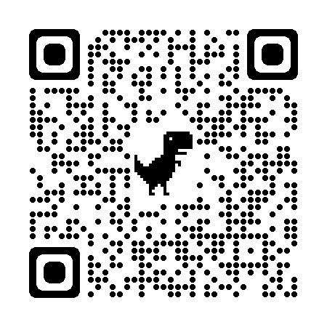
As you build your PBIS framework, it is important to recognize what is already in place and where you aim to be!
The purpose of the SWPBIS Tiered Fidelity Inventory (TFI) is to provide a valid, reliable, and efficient measure of the extent to which school personnel are applying the core features of school-wide positive behavioral interventions and supports.
Only Tier 1 will be completed in JAN as a self-assessment during our January team training.
Your team can choose to complete the additional tiers on your own.
Tier 1 Subscales:
Teams
Implementation
Evaluation
Tier 2 Subscales:
Teams
Interventions
Evaluation
Tier 3 Subscales:
Teams
Resources
Support Plans
Evaluation
Notes:
TFI: https://www.pbisapps.org/resource/tfi

Slide 29
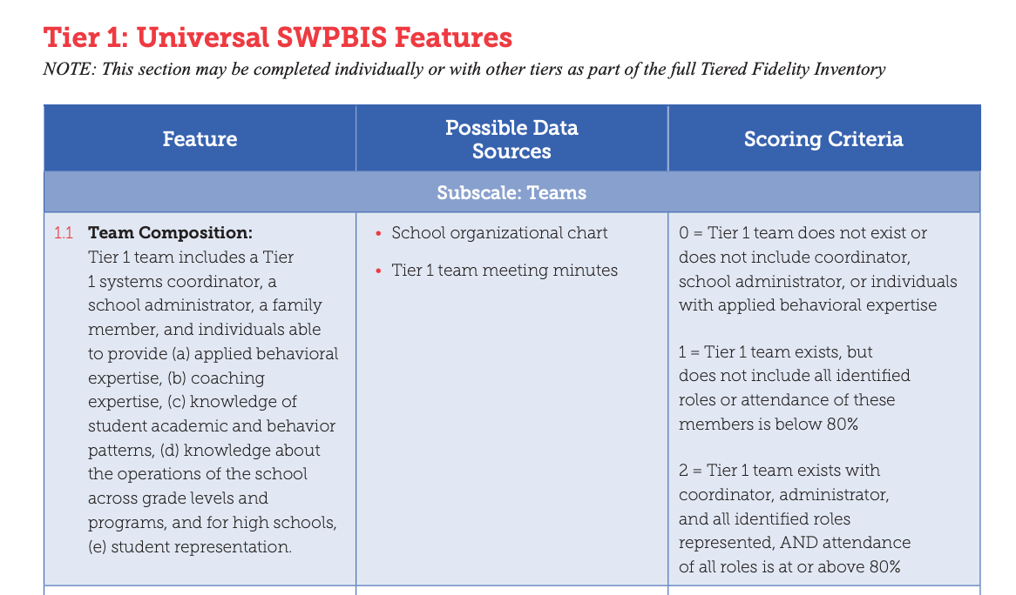
0
1
2
Notes:
Link to TFI: https://www.pbisapps.org/resource/tfi

Slide 30
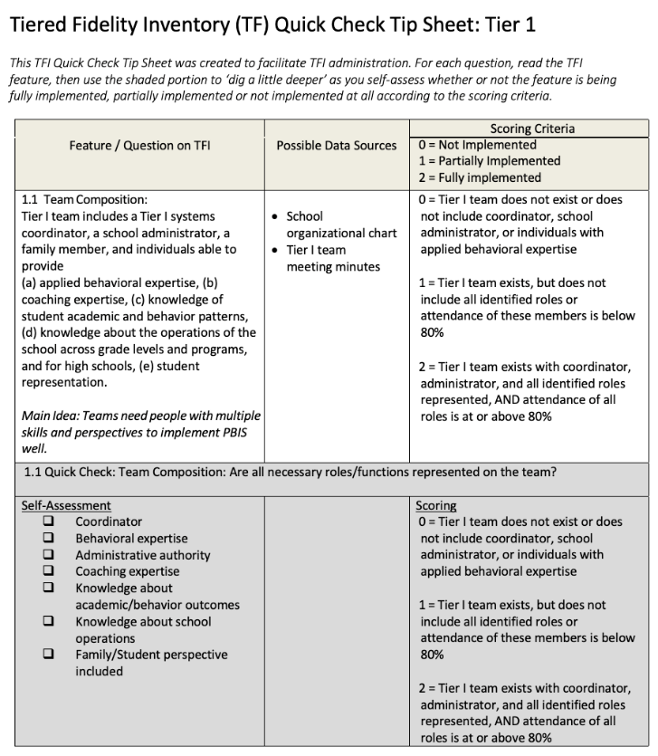
TFI Quick Check Tip Sheet
This guide will assist in:
identifying scoring for each item
action planning on items that need support
We'll drop the link to this document into the chat
Review this before the January training so that you can move through it quickly.
Notes:
Link to document: https://sebacademy.edc.org/tfi-quick-check-tip-sheet

Slide 31
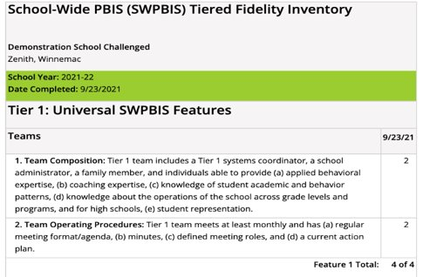
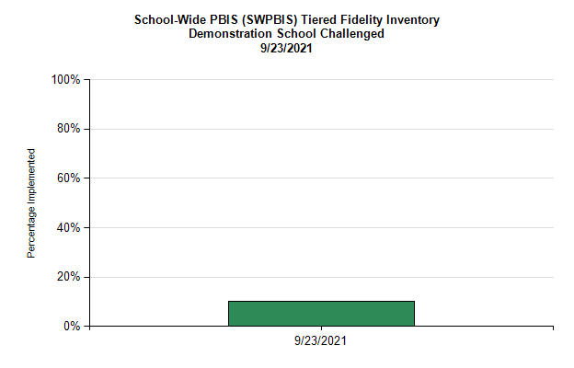
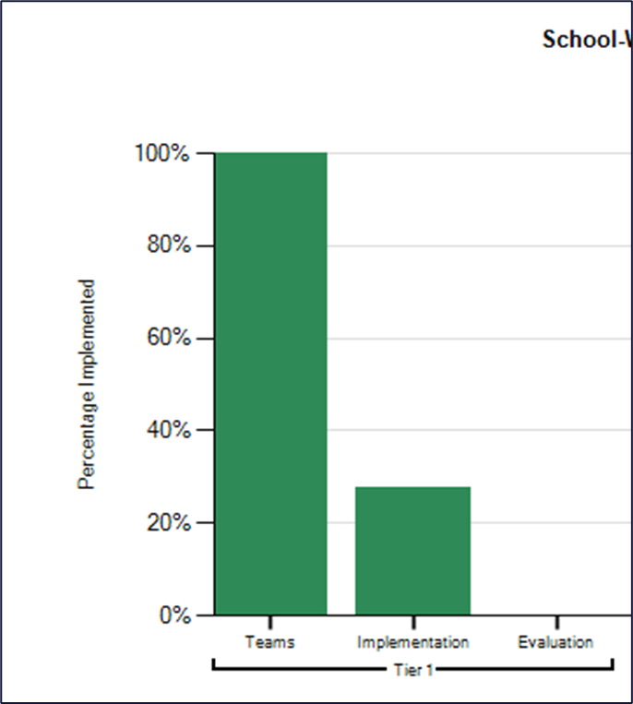
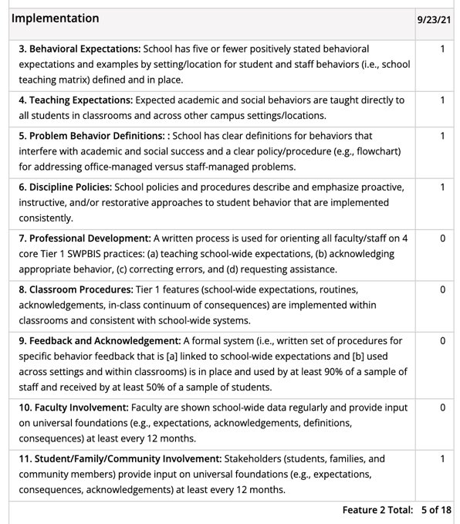
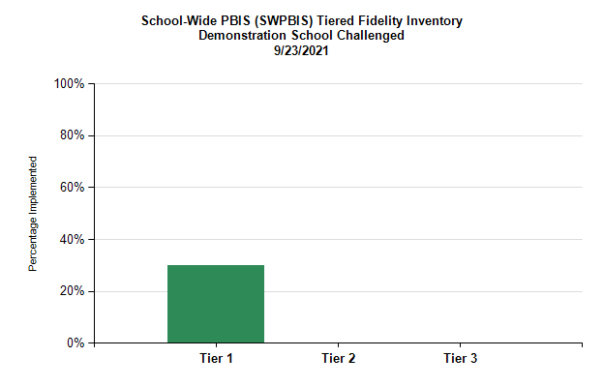
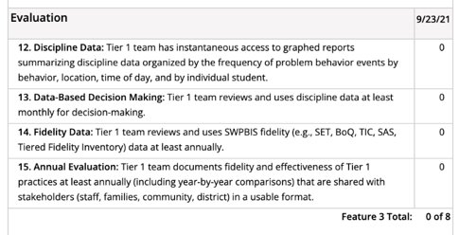
TFI Reports for Action Planning
Individual Items
Subscales for each tier
Total across
all 3 tiers
Total at each tier

Slide 32
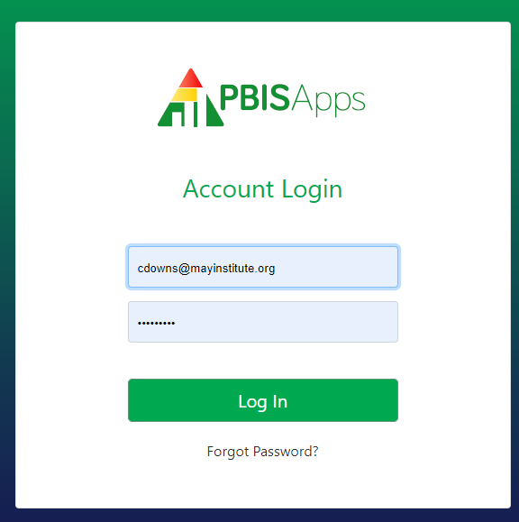
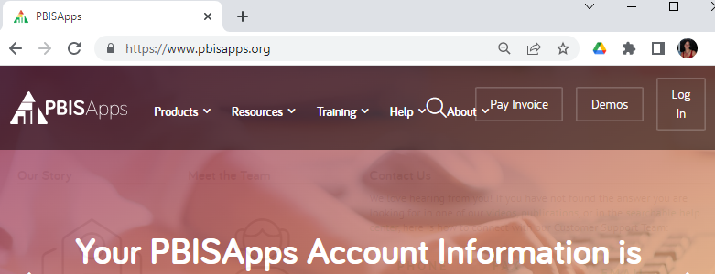
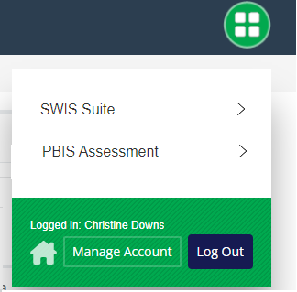
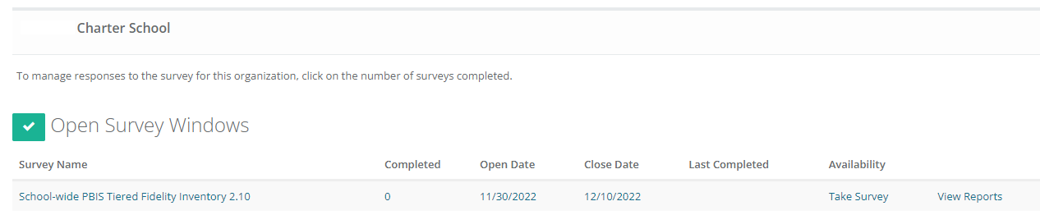
Practice: Logging into PBIS Assessment to complete TFI
1.
2.
If you also have a SWIS account, you will need to select PBIS Assessment from the selector icon.
3.
4.
Notes:
Let coaches sign in…any issues can be delt with after meeting individually

Slide 33
Preview:
January Training

Slide 34
Preview:
Celebrations and Sharing

Slide 35
Let's learn from one another!
Choose 1 feature to share with others in a small group
Expectations Created
Teaching Matrix Developed
Lesson Plans Written and Shared
Identified hope/goal for PBIS implementation
Consistent Team Schedule and Protocols
Representative Team including Family and Students

Slide 36
JAN ACTIVITY: CELEBRATION SHARING
To be shared at Jan Team Training in small breakout groups:
Identify 1 PBIS feature your team has developed.
Share with your team the process for creating your feature, gathering feedback, and finalizing your feature.
Each team member should be prepared to share with other teams in small groups.
  Samples are encouraged i.e. Matrix, Lesson Plan, Poster
Notes:
TRAINER NOTE:
At the training we will set up randomized tables with 4-5 people each.
PROMPT:
In small breakout groups:
Share 1 PBIS feature your team has developed. If possible, show the product to your group members.
Within your small group, discuss how you have been sharing information and gathering feedback with your staff.
Solicit some feedback from the groups.

Slide 37
Preview:
Acknowledging Expected Behavior

Slide 38
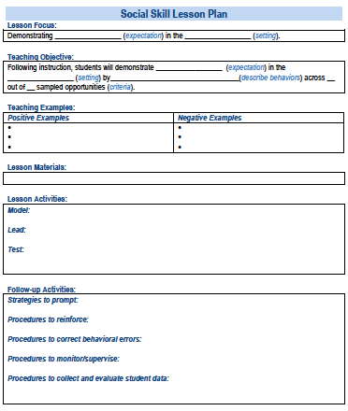
TEACH SW EXPECTATIONS BY FOLLOWING THESE KEY STEPS
Define
Teach
Prompt
Monitor
Evaluate

Slide 39

Praise is perhaps the most powerful and important type of acknowledgement.
Therefore, any acknowledgement system needs to be paired with specific praise!
"You read that whole passage yourself! Way to go.
You earned a point for your perseverance!"

Slide 40
As teacher praise rates increase, student outcomes improve!
Teacher praise rates
Student engagement and on-task behavior
Disruptive behavior from students
Provide more acknowledgement
than corrections.
Strive for 5⁺ > 1⁻
(e.g. Caldarella et al., 2020; Cook et al., 2017; Reinke et al., 2016)

Slide 41

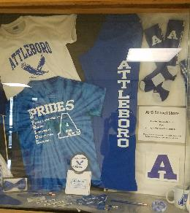

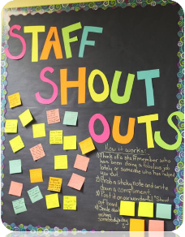
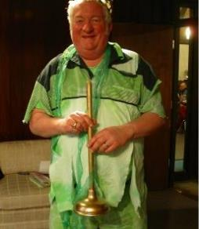
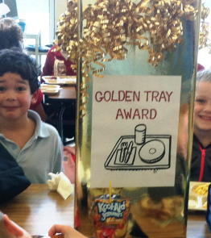
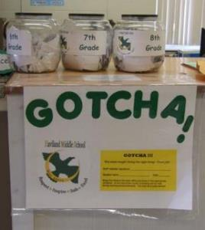
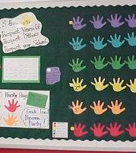
Acknowledgment Systems
Design structures and mechanisms for regular recognition of positive behaviors, events, and activities of the school
Staff-Student – Develop ways to identify, communicate and publicly recognize expected and exceptional behaviors
Staff-Staff – Create and promote opportunities for staff/admin to recognize and appreciate other staff
Student-Staff – Create ways for students to share appreciation of staff
Student-Student– Create opportunities for students to give each other ‘shout-outs’ for social, emotional, behavioral & academic success and effort.
School-Student – Attendance, grades, behavior, state assessment, improvement, etc. (i.e. Attendance Campaign)
Notes:
Examples of Popular Student Incentives

Slide 42
Types of Acknowledgements
High Frequency
Provided daily
Predictable
Specific Praise
Tickets/Notes
Coupons to school store
Announcements
Intermittent
Provided weekly, quarterly, monthly
Student of the Month
Class Pizza Party
Recognition at School Assembly
Long Term
Few times per year
Involves groups of students
Whole school pajama day
Honors banquet
Freshmen class picnic
(adapted from MO-PBS)

Slide 43
Agenda & Coaches' Tasks
Coaches’ Tasks:
Work with team to plan development of teaching expectations and lesson plans.
Presentation Content:
Review/Grow and Glow: Gaining Partner input
Discussion: Developing Lesson & Teaching Plans
Review acknowledgement system content and list current school and classroom acknowledgements
Preview of January Training Celebrations and Sharing
Plan for 1 PBIS feature for all team members to share at January training
Preview of Acknowledgement Systems
Preview of TFI Self-Assessment
What questions do you have on today’s content?
What questions do you have on the follow-up tasks?

Slide 44
RESOURCES
RESOURCES:
Tiered Fidelity Inventory (TFI)
TFI Quick tip sheet
Lesson Plan activity
Acknowledgement System activity
Exemplar Repository
Article - Including Student Voice in Your PBIS Implementation
Notes:
Tiered Fidelity Inventory: https://www.pbisapps.org/products/tfi or https://sebacademy.edc.org/tiered-fidelity-inventory-tfi-manual
TFI Quick Sheet: https://sebacademy.edc.org/tfi-quick-check-tip-sheet
Lesson Plan Activity: https://sebacademy.edc.org/behavioral-lesson-plan-activity
Exemplar Repository https://nepbis.org/tier-1-school-wide/pbis-exemplar-resource-repository/
Article - Including Student Voice in Your PBIS Implementation https://www.pbisapps.org/articles/including-student-voice-in-your-pbis-implementation

Slide 45
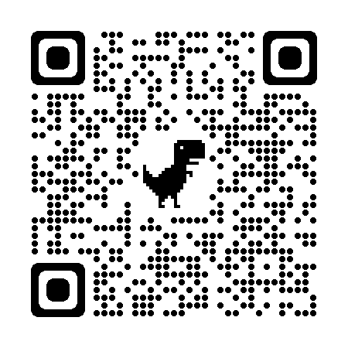
EVALUATION
Please remember to complete the evaluation!
Scan the QR code to access.
Notes:
TRAINERS -
Put link to evaluation (below) in the chat for those who do not use the QR code:
Evaluation Survey: https://edc.co1.qualtrics.com/jfe/form/SV_cBF9GI7gVEBsfSC

