Slide 1


PBIS Coaches’ Training
Year 3 - May
Insert Trainer Names
Created from content from the National Technical Assistance Center on Positive Behavioral Interventions and Supports
U.S. Department of Education, Office of Special Education Programs and Office of Elementary and Secondary Education
with support from NEPBIS Network, May Institute, & Broad Reach Consulting

Slide 2
Agenda & Team Tasks
Coaches Tasks
Presentation Content
Revisit Goals – Set New Goals
Sustainability Factors
Work with your team to complete evaluate this year’s goals and set new goals
Annual Evaluation Report
Work with your team to develop your year end report.
Prep for next year’s Roll Out to staff and students
Resource Spotlight – Coaches Year at a Glance

Slide 3
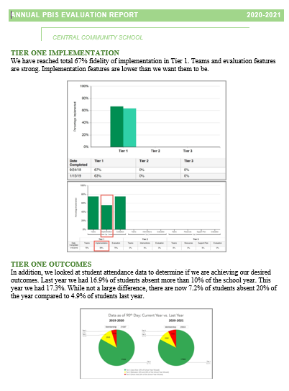
HELPFUL READINGS & RESOURCES
RESOURCES:
Annual PBIS Evaluation Report Template
Annual PBIS Evaluation Report – SAMPLE
Advanced Action Plan
Team Meeting (Leadership) Foundations Checklist
Evaluation Schedule (with sample)
Feedback and Input Survey Manual
Climate Survey Manual
TFI Manual
Integrated Companion Guide
Culturally Responsive Field Guide
Sustainability Checklist
Classroom Practice Brief
Classroom Systems & Data Brief
Sample PBIS Handbooks
Sample Staff Slide Deck
Sample Student PBIS Slide Deck
Notes:
PBIS Evaluation Report https://sebacademy.edc.org/annual-evaluation-report-template
PBIS Evaluation Report Sample https://sebacademy.edc.org/annual-evaluation-report-sample
Advanced Action Plan - https://sebacademy.edc.org/annual-action-plan-template-advanced-years
Team Meeting (Leadership) Foundations Checklist - https://sebacademy.edc.org/team-meeting-foundations-checklist
Evaluation Schedule (with sample) – https://sebacademy.edc.org/evaluation-schedule
Feedback and Input & Climate Survey Manuals - https://sebacademy.edc.org/list-of-pbis-resources?keyword=Survey+manual&pbis_resource_type=113&pbis_resource_topic=All&sort_by=field_date_value&sort_order=DESC
TFI Manual - https://sebacademy.edc.org/tiered-fidelity-inventory-tfi-manual
Integrated Companion Guide - https://sebacademy.edc.org/integrated-tiered-fidelity-inventory-companion-guide
Culturally Responsive Field Guide - https://sebacademy.edc.org/pbis-cultural-responsiveness-field-guide
Sustainability Checklist - https://sebacademy.edc.org/subsist-pbis-sustainability-checklist
Classroom Practice Brief - https://sebacademy.edc.org/supporting-and-responding-students-social-emotional-and-behavioral-needs-classrooms
Classroom Systems & Data Brief - https://sebacademy.edc.org/supporting-and-responding-educators-classroom-pbis-implementation-needs-guide-classroom-systems-and
Sample PBIS Handbooks: https://sebacademy.edc.org/list-of-pbis-resources?keyword=Sample+PBIS+Handbook&pbis_resource_type=All&pbis_resource_topic=All&sort_by=field_date_value&sort_order=DESC
Sample Student Slide Deck https://sebacademy.edc.org/sample-pbis-student-slide-deck
Sample Staff Slide Deck https://sebacademy.edc.org/sample-pbis-staff-slide-deck

Slide 4

EXPECTATIONS
Self
Others
Environment
Self-monitor
Listen while others are speaking​
Have your computer charged and ready to go​
If you have questions or comments:
Work as a team:
Keep necessary materials at hand
Are you participating?
Engaged as a learner?
Stretch, break, stand as needed​
Raise hand
Room for every voice
Reinforce participation
action plan
relevant docs
water/snacks
Minimize distractions if possible​

Slide 5
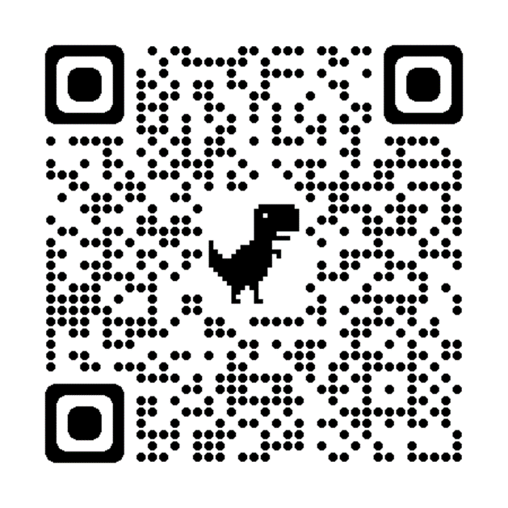
ACTIVITY: ATTENDANCE
Scan QR code on the left or follow the URL posted in the chat to access the online attendance survey
Follow prompts to enter attendance information
Notify trainers if you require assistance (e.g., identifying your cohort or cohort group)
Certificates of Attendance will be sent in January and June. Attendance records will be use as verification
You are in Cohort 8
1 minute
Notes:
ATTENDANCE: https://edc.co1.qualtrics.com/jfe/form/SV_81vbI1jl3cwmLY2

Slide 6
Glows and Grows:
  What has been you experience in the PBIS/SEB Academy?
  What have you learned?
  What do you still want to explore?
  What do you wish you could change about your experience?
  What do you want others to know about the PBIS track of the SEB academy?
  Are you interested in participating in a TIER 2 Academy?

Slide 7
REVIEW:
Annual Evaluation Report
Notes:
TRAINER NOTE: This is review content please be brief

Slide 8
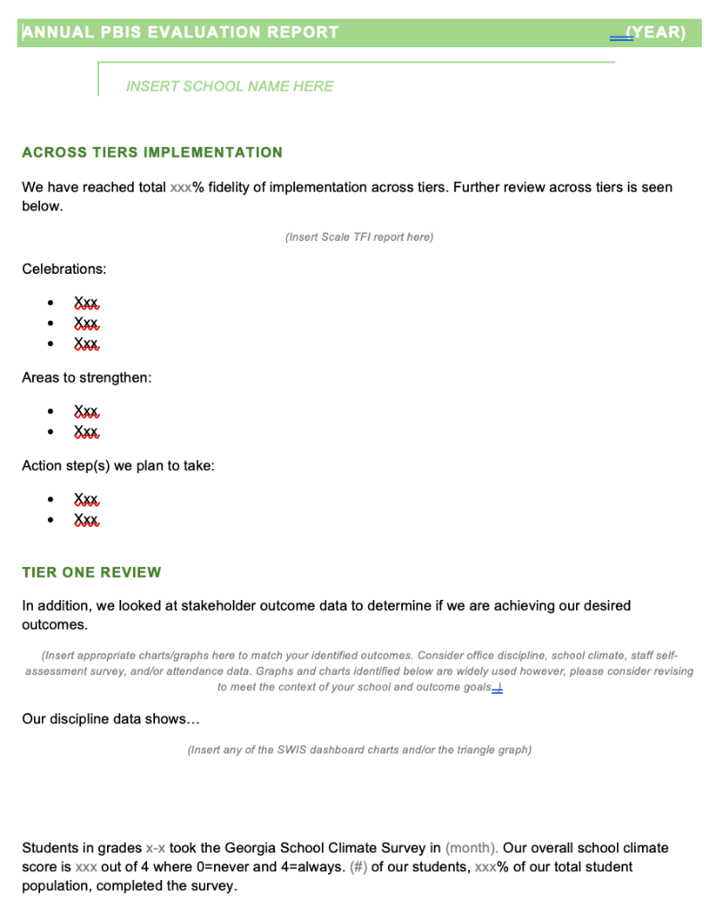
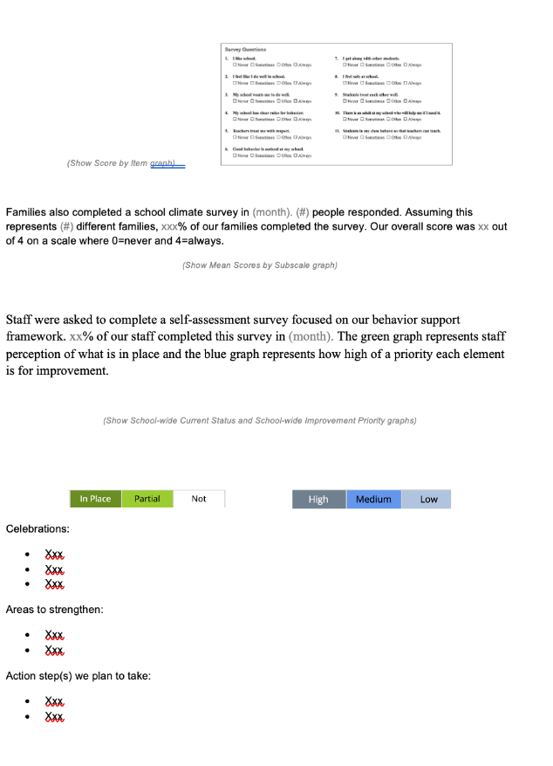
EVALUATION TEMPLATE
Add your data
Match your school’s context
Share with stakeholders
Notes:
TRAINER NOTE: This template is meant to be used as a guide. Schools should add/delete to meet their school context.
Annual Evaluation Template link: https://sebacademy.edc.org/annual-evaluation-report-template
Sample - Annual Evaluation : https://sebacademy.edc.org/annual-evaluation-report-sample

Slide 9
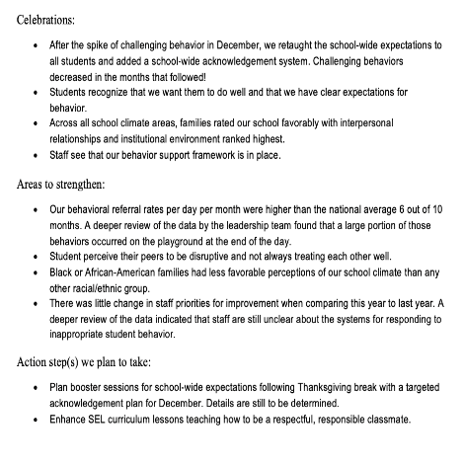
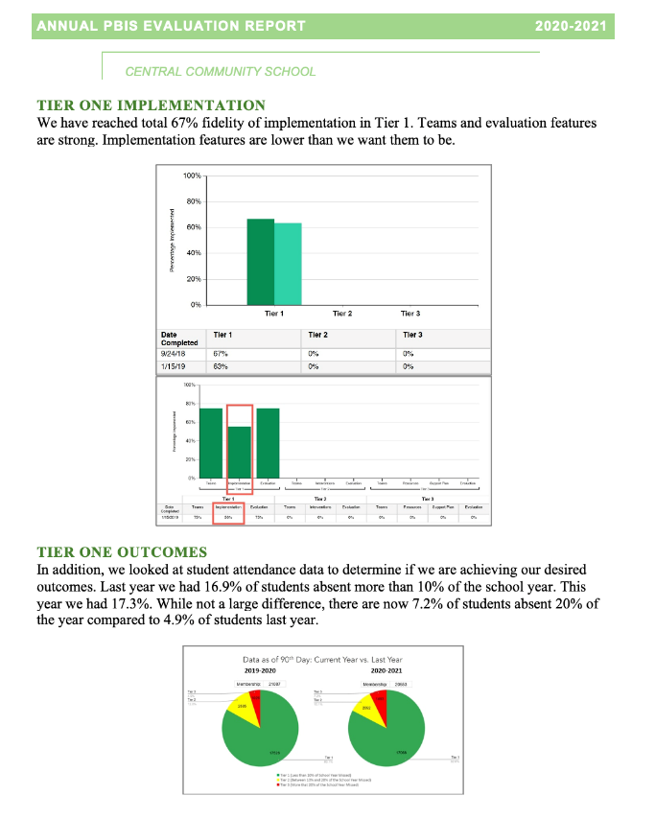
Implementation of the core components of PBIS is more likely if the Tier I team assesses the implementation status at least annually and provides “snapshot” reports to the staff, community, school board.
Notes:
Annual Tier 1 Evaluation Report (Sample school):

Slide 10
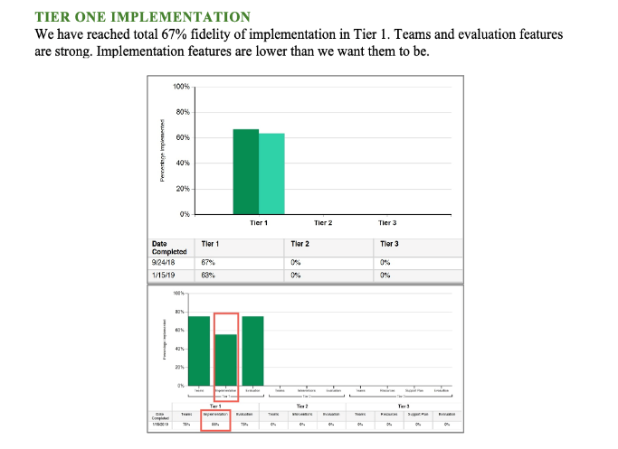
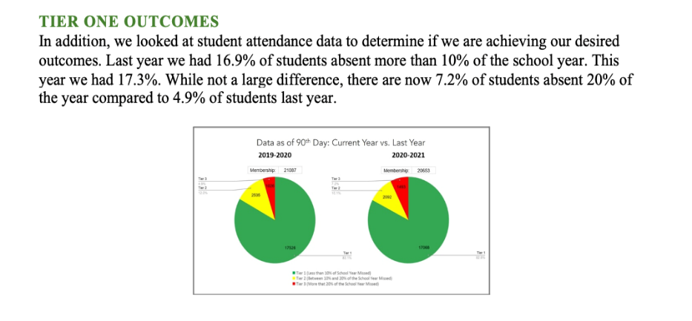
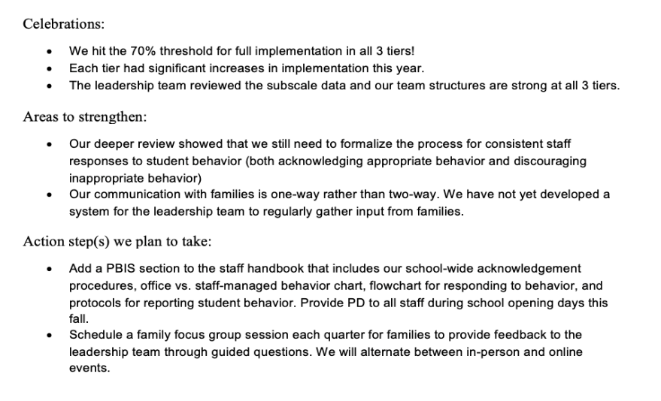
Outcome Data
Fidelity Data
Celebrations
Areas to strengthen
Action Steps
Notes:
TRAINER NOTE: Use this sample to discuss what each school might choose to include in a “snapshot” evaluation report

Slide 11
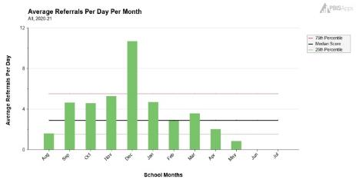
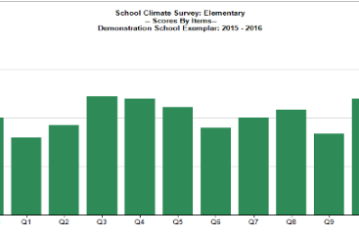
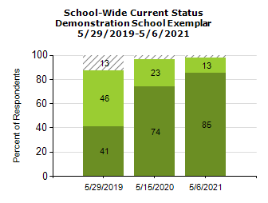
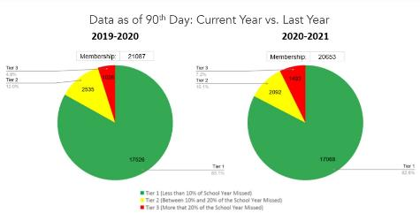
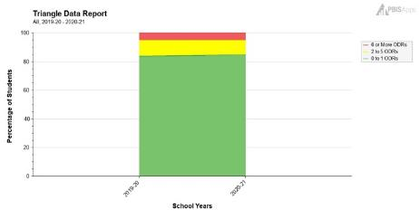
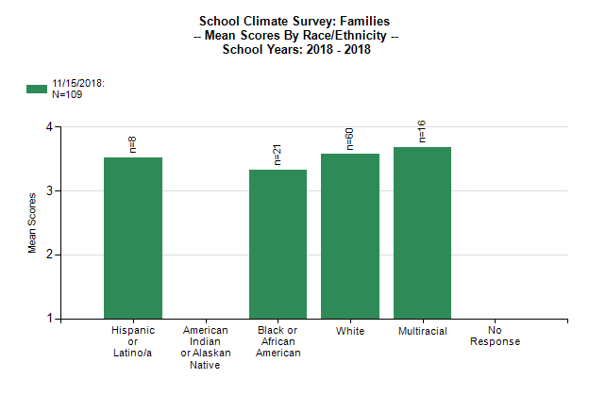
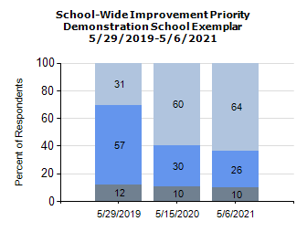
What Tier 1 outcome data can you use to complement your TFI data?
(Remember to consider your team's desired outcomes/goals as you decide!)
Staff
Self-assessment survey data
Behavior data
School climate data
(students, staff, families)
Attendance data

Slide 12
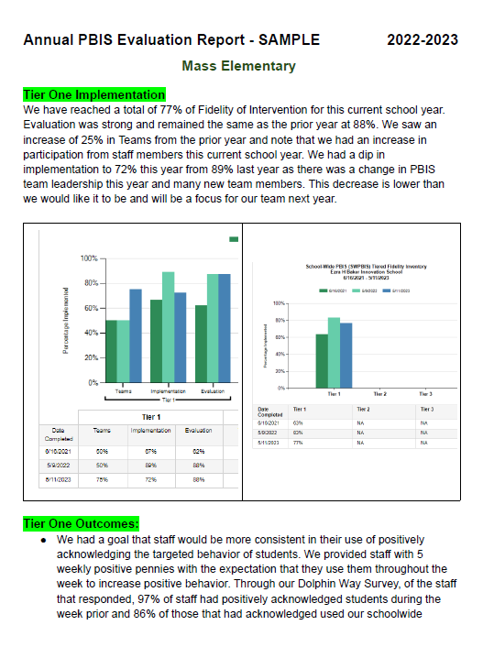
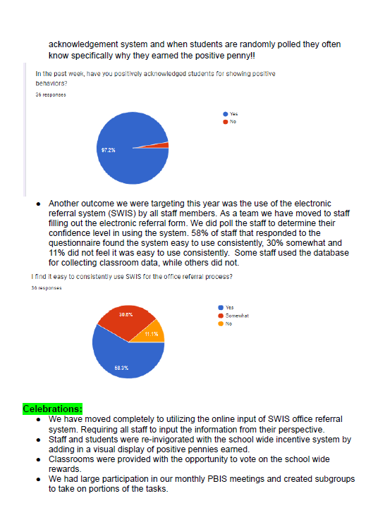
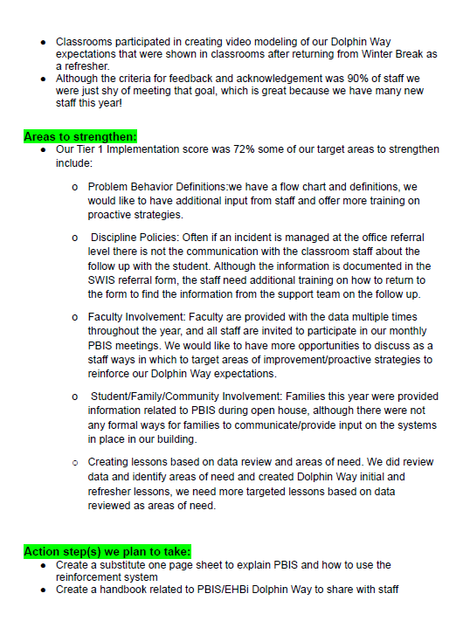
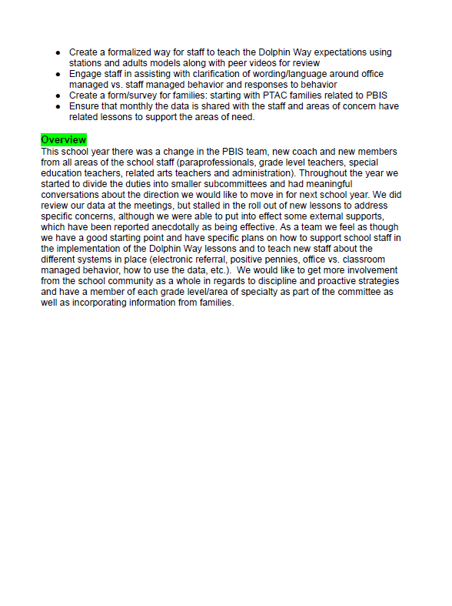
Completed Sample

Slide 13
ACTIVITY: Evaluation Report and Planning
Complete one bullet for each area
  Celebrations
  Areas to Strengthen
  Action Item
Identify which data sources you will show case
  Fidelity
  Outcomes
Be prepared to share out
10 minutes
5 minutes
Coach Review
Whole Group

Slide 14

REVIEW:
Sustainablity
Factors
Notes:
12:30

Slide 15

Factors supporting sustaining of PBIS
Strong Leadership Team
What is the current state of your school leadership team?
What if anything needs improvement with your team?

Slide 16
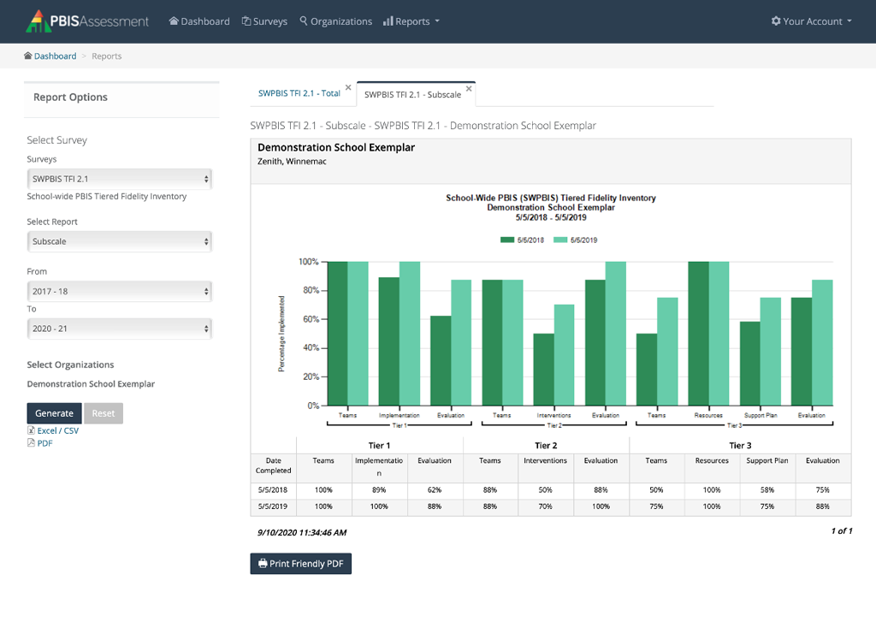
Factors supporting sustaining of PBIS
Strong Leadership Team
Use fidelity data to
improve support
Have you completed your Fidelity check this year?
Have you used these data to update your team’s action plan?

Slide 17
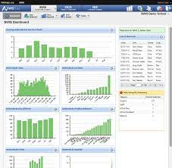
Factors supporting sustaining of PBIS
Strong Leadership Team
Use fidelity data to
improve support
Use your school’s
discipline data
Have you used your discipline data to make decisions?
Have you shared your discipline data with your staff this year?

Slide 18

Factors supporting sustaining of PBIS
Strong Leadership Team
Use fidelity data to
improve support
Use your school’s
discipline data
Implement PBIS in
the classroom
Have you assessed the use of positive classroom practices?
Have you provided PD on positive classroom practices?

Slide 19










GETTING STARTED WITH SWPBIS
Establish an effective leadership team
Develop a continuum to strengthen appropriate behaviors
Develop a brief statement of purpose
Develop a continuum to discourage violations of expectations
Identify positive school-wide behavior expectations
Develop data-based procedures for monitoring
Develop procedures to teach school-wide expectations
Develop systems to support staff
Develop procedures to teach class-wide expectations
Build routines to ensure ongoing implementation
Notes:
Emphasise the 4 ideas from the video
1 – Keep a strong team (next slide)
2 – Use TFI data to improve systems (we will do this at the November training)
3 – Use your school discipline data – slide to come with all data mentioned…good for goal planning
4 – Implement PBIS in the Classroom (Nov Training)

Slide 20

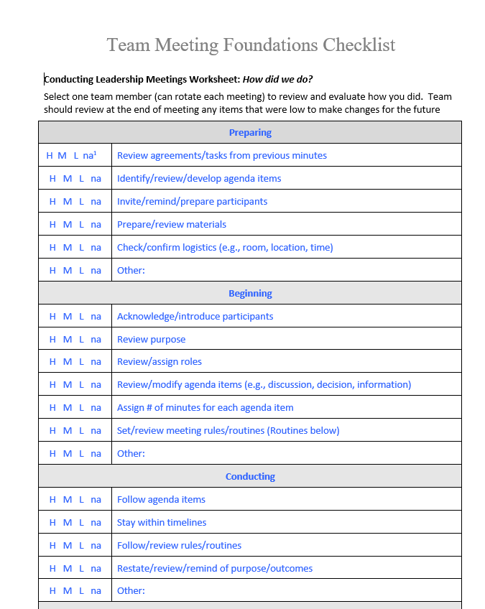
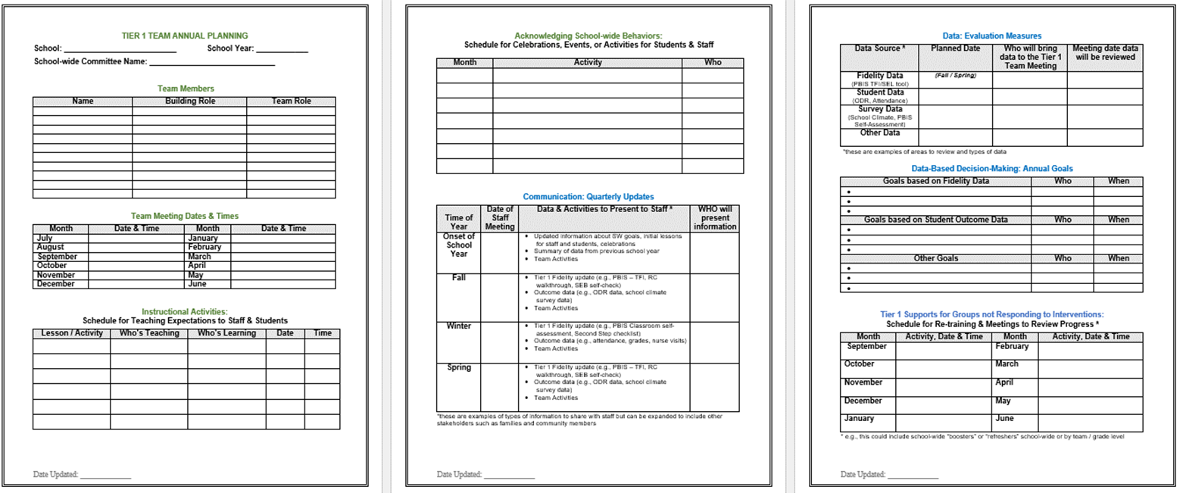
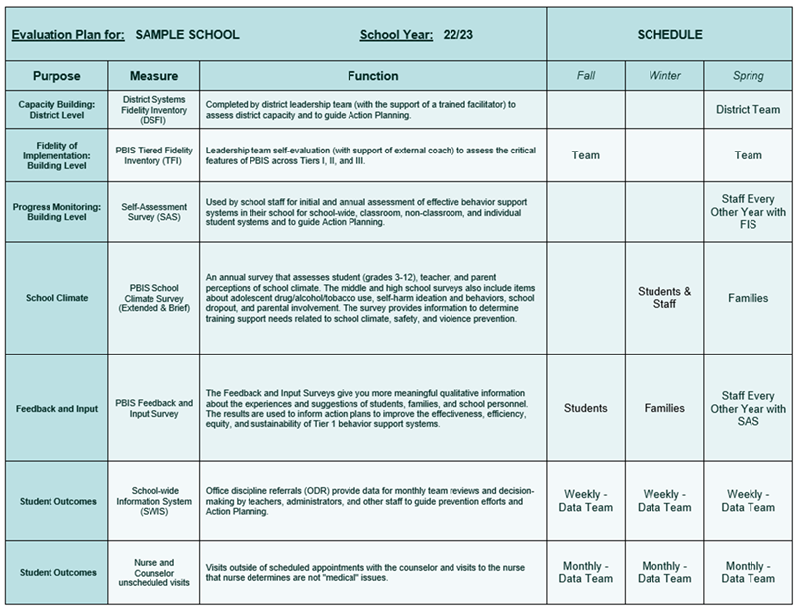

Sustainability Resources
Advanced Action Plan
Leadership Team Checklist
Evaluation Schedule
Climate and Feedback Surveys
Notes:
Advanced Action Plan - https://sebacademy.edc.org/annual-action-plan-template-advanced-years
Team Meeting (Leadership) Foundations Checklist - https://sebacademy.edc.org/team-meeting-foundations-checklist
Evaluation Schedule (with sample) – https://sebacademy.edc.org/evaluation-schedule
Feedback and Input & Climate Survey Manuals - https://sebacademy.edc.org/list-of-pbis-resources?keyword=Survey+manual&pbis_resource_type=113&pbis_resource_topic=All&sort_by=field_date_value&sort_order=DESC

Slide 21



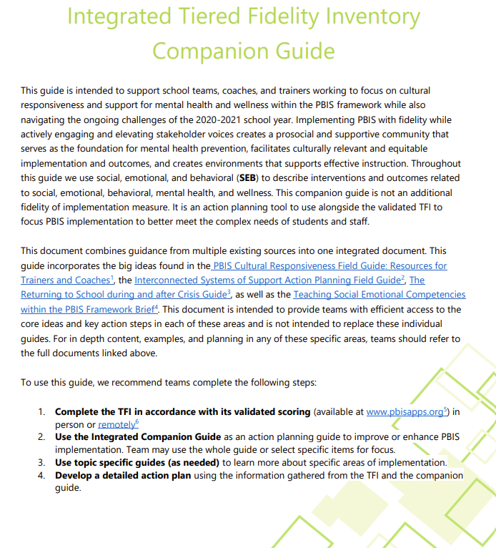
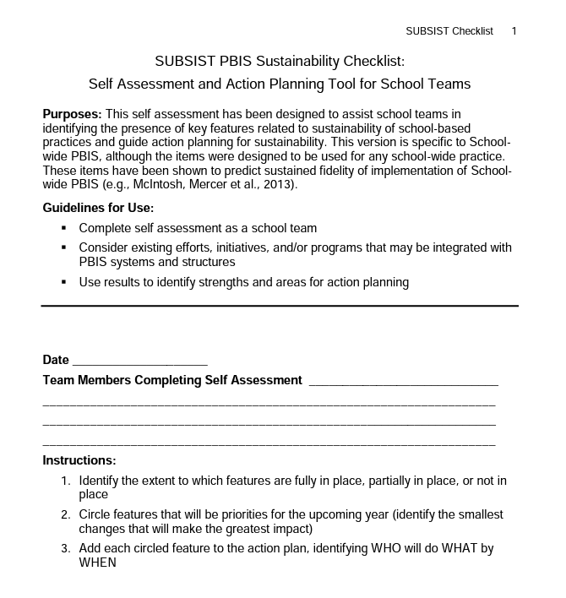

Sustainability Resources
Classroom Practices Brief
TFI Manual / Integrated Companion Guide / Culturally Responsive Field Guide
Classroom Systems & Data Brief - Teachers
Sustainability Checklist
Notes:
TFI Manual - https://sebacademy.edc.org/tiered-fidelity-inventory-tfi-manual
Integrated Companion Guide - https://sebacademy.edc.org/integrated-tiered-fidelity-inventory-companion-guide
Culturally Responsive Field Guide - https://sebacademy.edc.org/pbis-cultural-responsiveness-field-guide
Sustainability Checklist - https://sebacademy.edc.org/subsist-pbis-sustainability-checklist
Classroom Practice Brief - https://sebacademy.edc.org/supporting-and-responding-students-social-emotional-and-behavioral-needs-classrooms
Classroom Systems & Data Brief - https://sebacademy.edc.org/supporting-and-responding-educators-classroom-pbis-implementation-needs-guide-classroom-systems-and

Slide 22
DISCUSSION: SUSTAINABILITY FACTORS
What is something to celebrate & something you’re working on related to Sustainability Factors of:
Team functioning
Using implementation data
Using discipline data
Positive classroom practices
10 minutes
5 minutes
Coach Review
Whole Group

Slide 23
REVIEW CURRENT AND FUTURE SCHOOL WIDE GOALS
Notes:
TRAINER NOTE: The purpose of this next section is to support the teams to review their goals this year, review their data, and revise their goals for next year.

Slide 24
Why Use Data for Decision Making?
Decisions are more likely to be
effective and efficient when they are based on data.
The quality of decision making depends most on defining problems with precision & clarity.
Data help
place the “problem” in the context
rather than in the students.
Use data to:
identify problems
refine problems
define the questions that lead to a solution
monitor implementation and outcomes
guide implementation
engage in problem solving

Slide 25

Why use data for decision-making?
To continuously improve
your Tier 1 framework!
Are we achieving our desired outcomes?
Which groups are benefiting from our plan? Which are not?
Are we implementing as planned?
What needs to be strengthened? Revised?
Are students receiving adequate support to achieve positive outcomes?

Slide 26

IDENTIFY PROBLEM
with precision
IDENTIFY GOAL
for change
IDENTIFY SOLUTION
and implementation plan
IMPLEMENT SOLUTION
with fidelity
MONITOR & EVALUATE
implementation fidelity and impact
MAKE DECISION
to maintain, modify, or terminate plan
Collect & Use
DATA
(Chaparro, E., et. al, 2022)

Slide 27
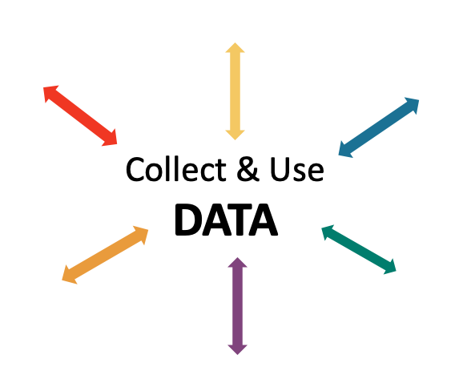


EXAMPLE: Reviewing & Analyzing School-wide Behavior Data to Develop, Inform, and Refine Tier 1
Most ODRs were given when students didn’t throw away trash.
IDENTIFY PROBLEM
IDENTIFY GOAL
IDENTIFY SOLUTION
IMPLEMENT SOLUTION
MONITOR & EVALUATE
MAKE DECISION
Booster lessons, prompts and acknowledgement continued
Increase rate of students throwing away trash
During a monthly meeting PBIS Leadership Team at Miller Middle School, the data analyst showed that ODRs from the cafeteria had doubled from the previous month. Upon further review, 75% of the ODRs were for disrespect.
Teach students clean up procedures; provide frequent prompts and acknowledgement
ODRs from the cafeteria were reviewed by the team for the next 3 months; ODRs for disrespect steadily decreased
PBIS team members paired with the cafeteria monitors during lunch blocks to teach, prompt, acknowledge

Slide 28

NON-EXAMPLE: Reviewing & Analyzing School-wide Behavior Data to Develop, Inform, and Refine Tier 1
At Portview High School, an increasing number of students were late to advisory block.
Because there were no systems to set up to monitor implementation or evaluate impact, there was a small decrease in late arrivals but, after a week previous patterns returned.
IDENTIFY PROBLEM
IMPLEMENT SOLUTION
Students were late to advisory
Staff were asked to prompt students lingering in the hall

Slide 29

ACTIVITY: Using School-wide Behavior Data for Decision-Making
Review your school-wide behavior data.
Apply the decision-making steps to 1 current problem in your school.
Review your goal and revise for next school year.
Add to your action plan, as needed.
Be prepared to share 2-3 big ideas with the group.
IDENTIFY PROBLEM
IDENTIFY GOAL
IDENTIFY SOLUTION
IMPLEMENT SOLUTION
MONITOR & EVALUATE
MAKE DECISION
Independent: 10 minutes
Whole Group: 10 minutes

Slide 30
Resource Spotlight:
Coaches Year at a Glance Document
Prepping for next year

Slide 31

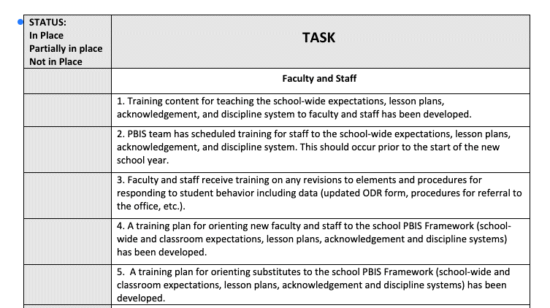



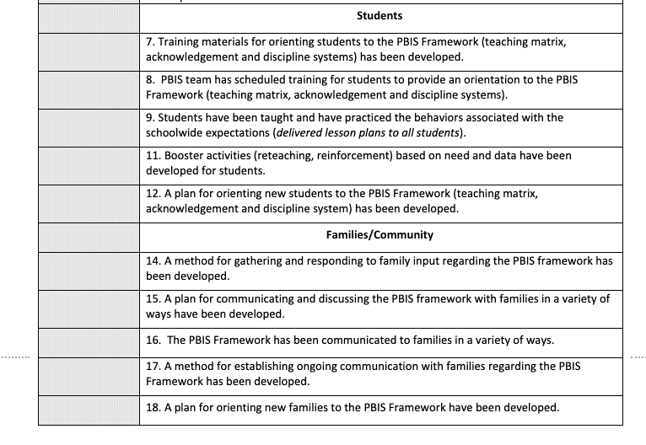
PBIS Rollout Check List, Handbook & Orientation Examples
Rollout Checklist
PBIS Handbook
PBIS Staff Orientation Slides
PBIS Student Orientation Slides
Notes:
PBIS Rollout Checklist
PBIS Handbook Examples: https://sebacademy.edc.org/list-of-pbis-resources?keyword=Sample+PBIS+Handbook&pbis_resource_type=All&pbis_resource_topic=All&sort_by=field_date_value&sort_order=DESC
PBIS Staff Orientation Slides: https://sebacademy.edc.org/staff-presentation-sample
PBIS Student Orientation Slides: https://sebacademy.edc.org/sample-pbis-student-slide-deck

Slide 32
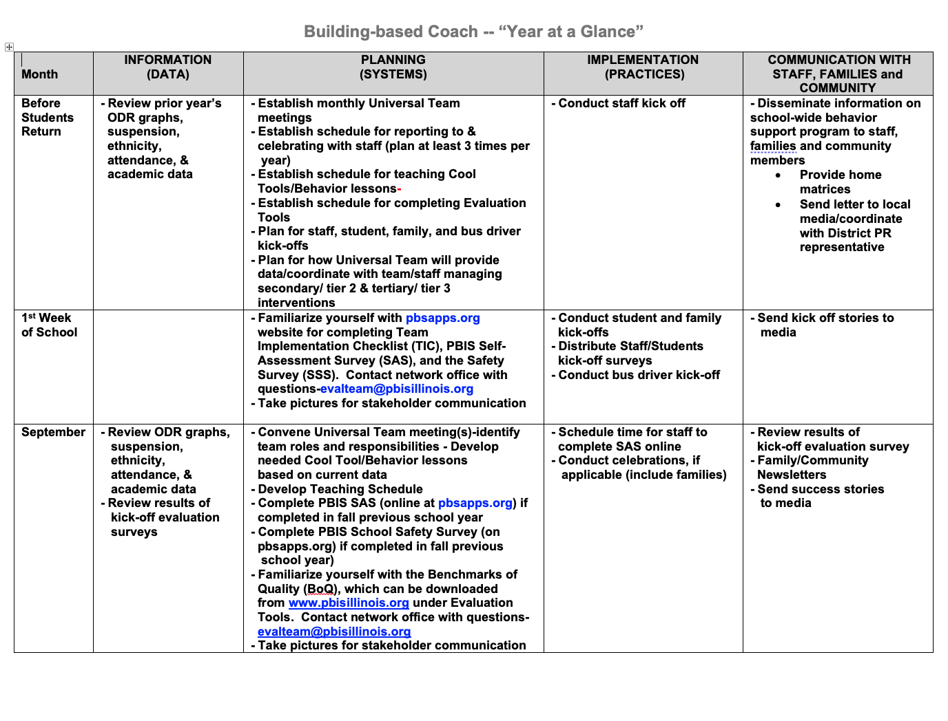
Coaches Year at a Glance
Month by month resources for coaches:
Organizes what data should be reviewed when (for planning purposes)
Prompts for coaches’ and team activities that support planning
What practices should be conducted across the year.
Ideas for communicating with Staff, Families, and Community.
Create your own coaches’ plan!
Notes:
https://sebacademy.edc.org/coaches-year-glance

Slide 33
RESOURCE SPOTLIGHT:
Review Coaches Year at a Glance Document
What activities are relevant to your team’s goals?
How could you modify this document, so you have a personal coaching guide for your school?
10 minutes
5 minutes
Coach Review
Whole Group
Notes:
https://sebacademy.edc.org/coaches-year-glance

Slide 34
Agenda & Team Tasks
Coaches Tasks
Presentation Content
Revisit Goals – Set New Goals
Review: Sustainability Factors
Work with your team to complete evaluate this year’s goals and set new goals
Review: Annual Evaluation Report
Work with your team to develop your year end report.
Prep for next year’s Roll Out to staff and students
Resource Spotlight – Coaches Year at a Glance

Slide 35
HELPFUL READINGS & RESOURCES
RESOURCES:
Annual PBIS Evaluation Report Template
Annual PBIS Evaluation Report – SAMPLE
Advanced Action Plan
Team Meeting (Leadership) Foundations Checklist
Evaluation Schedule (with sample)
Feedback and Input & Climate Survey Manuals
TFI Manual
Integrated Companion Guide
Culturally Responsive Field Guide
Sustainability Checklist
Classroom Practice Brief
Classroom Systems & Data Brief
Sample PBIS Handbooks
Sample Staff Slide Deck
Sample Student PBIS Slide Deck
Notes:
PBIS Evaluation Report https://sebacademy.edc.org/annual-evaluation-report-template
PBIS Evaluation Report Sample https://sebacademy.edc.org/annual-evaluation-report-sample
Advanced Action Plan - https://sebacademy.edc.org/annual-action-plan-template-advanced-years
Team Meeting (Leadership) Foundations Checklist - https://sebacademy.edc.org/team-meeting-foundations-checklist
Evaluation Schedule (with sample) – https://sebacademy.edc.org/evaluation-schedule
Feedback and Input & Climate Survey Manuals - https://sebacademy.edc.org/list-of-pbis-resources?keyword=Survey+manual&pbis_resource_type=113&pbis_resource_topic=All&sort_by=field_date_value&sort_order=DESC
TFI Manual - https://sebacademy.edc.org/tiered-fidelity-inventory-tfi-manual
Integrated Companion Guide - https://sebacademy.edc.org/integrated-tiered-fidelity-inventory-companion-guide
Culturally Responsive Field Guide - https://sebacademy.edc.org/pbis-cultural-responsiveness-field-guide
Sustainability Checklist - https://sebacademy.edc.org/subsist-pbis-sustainability-checklist
Classroom Practice Brief - https://sebacademy.edc.org/supporting-and-responding-students-social-emotional-and-behavioral-needs-classrooms
Classroom Systems & Data Brief - https://sebacademy.edc.org/supporting-and-responding-educators-classroom-pbis-implementation-needs-guide-classroom-systems-and
Sample PBIS Handbooks: https://sebacademy.edc.org/list-of-pbis-resources?keyword=Sample+PBIS+Handbook&pbis_resource_type=All&pbis_resource_topic=All&sort_by=field_date_value&sort_order=DESC
Sample Student Slide Deck https://sebacademy.edc.org/sample-pbis-student-slide-deck
Sample Staff Slide Deck https://sebacademy.edc.org/sample-pbis-staff-slide-deck

Slide 36
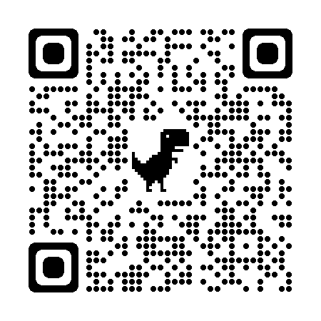
https://go.edc.org/pbis-end-of-year-evaluation
End of Year Evaluation
Please remember to complete the evaluation!
Scan the QR code to access.
Notes:
TRAINERS -
Put link to evaluation (below) in the chat for those who do not use the QR code:
https://go.edc.org/pbis-end-of-year-evaluation

