Slide 1


PBIS Coaches’ Training
Year 3
Insert Trainer Names
Created from content from the National Technical Assistance Center on Positive Behavioral Interventions and Supports
U.S. Department of Education, Office of Special Education Programs and Office of Elementary and Secondary Education
with support from NEPBIS Network, May Institute, & Broad Reach Consulting

Slide 2
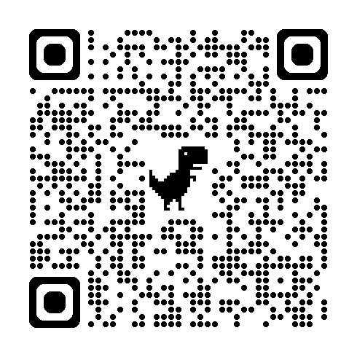
ACTIVITY: ATTENDANCE
Scan QR code on the left or follow the URL posted in the chat to access the online attendance survey Follow prompts to enter attendance information
Notify trainers if you require assistance (e.g., identifying your cohort or cohort group)
Certificates of Attendance will be sent in February and June. Attendance records and Zoom log in will be use as verification
1 minute
Notes:
TRAINERS – QR Code is updated
Post a link to the attendance survey (below) in the chat for those who do not use the QR code on the slide:
https://docs.google.com/forms/d/e/1FAIpQLSf-la8kZA-l6ZXIR48DsDhimdXqFAX2d8Cw6xIXio0UxScqvw/viewform

Slide 3

EXPECTATIONS
Self
Others
Environment
Self-monitor
Listen while others are speaking​
Have your computer charged and ready to go​
If you have questions or comments:
Work as a team:
Keep necessary materials at hand
Are you participating?
Engaged as a learner?
Stretch, break, stand as needed​
Raise hand
Room for every voice
Reinforce participation
action plan
relevant docs
water/snacks
Minimize distractions if possible​

Slide 4
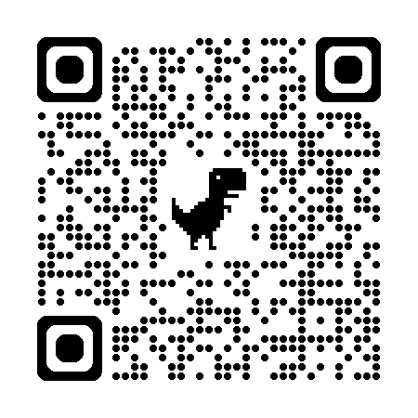
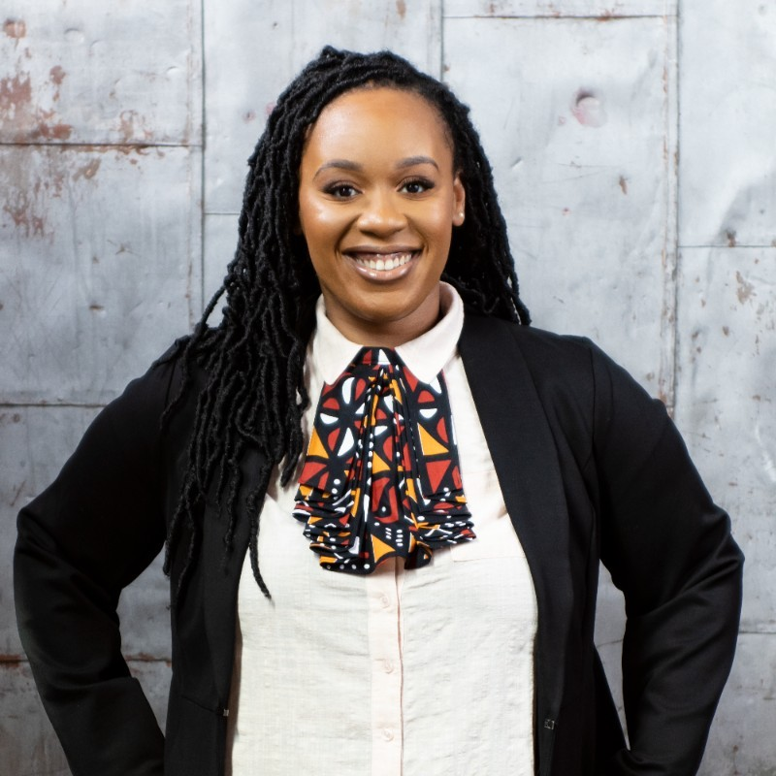
May Institute’s 21ST Annual New England Positive Behavioral Support Forum
Friday, November 21, 2025 - Norwood, Mass.
Morning Keynote
STRANDS TO INCLUDE:
PBIS Foundations
PBIS and Families
Mental Health / Wellness
Classrooms
Equity
IDD and PBS
Dr. Erika McDowell: Co-CEO Black Wildflowers Fund, NJ governor’s award recipient, “Ted” Carr Early Career Practitioner Award, Educator/Advocate/Disruptor
Registration Opens 5/23/25 – https://www.mayinstitute.org/services-for-schools/pbis/forum.html

Slide 5
Agenda & Team Tasks
Coaches Tasks
Presentation Content
Resource Spotlight: Rollout Checklist
Review: Sustainability
Work with your team to ensure sustainability
Review: Annual Evaluation Report
Work with your team to develop your year end report.

Slide 6
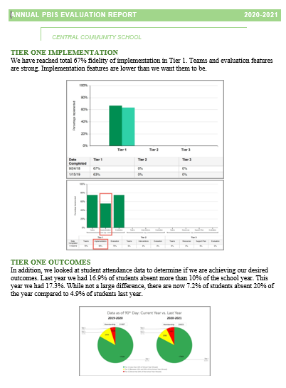
HELPFUL READINGS & RESOURCES
RESOURCES:
Classroom PBIS: Systems & Data Brief
Supportive Environments Create Classroom Community
Coaches Self Assessment Survey – Tier 1
Annual PBIS Evaluation Report Template
Annual PBIS Evaluation Report – SAMPLE
Embedded Professional Development Activity
Rollout Check List
Coaches Year at a Glance
Sample Staff Slide Deck
Sample Student PBIS Slide Deck
Notes:
Classroom PBIS: Systems & Data Brief: https://sebacademy.edc.org/supporting-and-responding-educators-classroom-pbis-implementation-needs-guide-classroom-systems-and
Embedded Professional Development Activity: https://sebacademy.edc.org/embedded-professional-development-planning-activity
PBIS Evaluation Report https://sebacademy.edc.org/annual-evaluation-report-template
PBIS Evaluation Report Sample https://sebacademy.edc.org/annual-evaluation-report-sample
Coaches Year at a Glance https://sebacademy.edc.org/coaches-year-glance
Rollout Checklist - https://sebacademy.edc.org/rollout-checklist
Sample Student Slide Deck https://sebacademy.edc.org/sample-pbis-student-slide-deck
Sample Staff Slide Deck https://sebacademy.edc.org/sample-pbis-staff-slide-deck

Slide 7


You are Graduating from the SEB Academy!!!!
CONGRATULATIONS

Slide 8
REVIEW:
Annual Evaluation Report

Slide 9
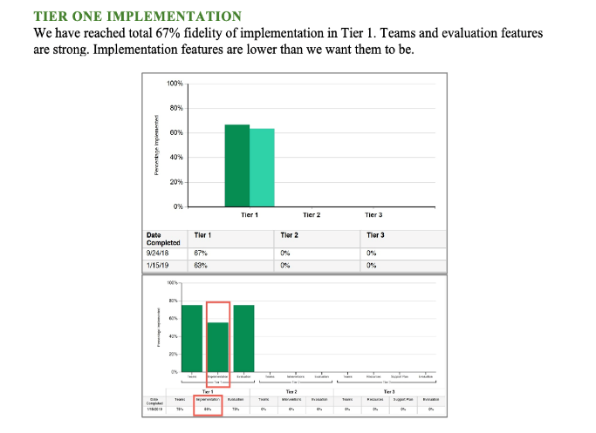
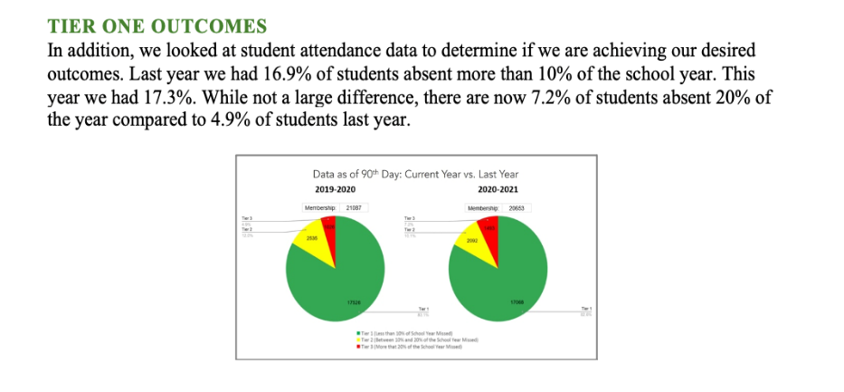
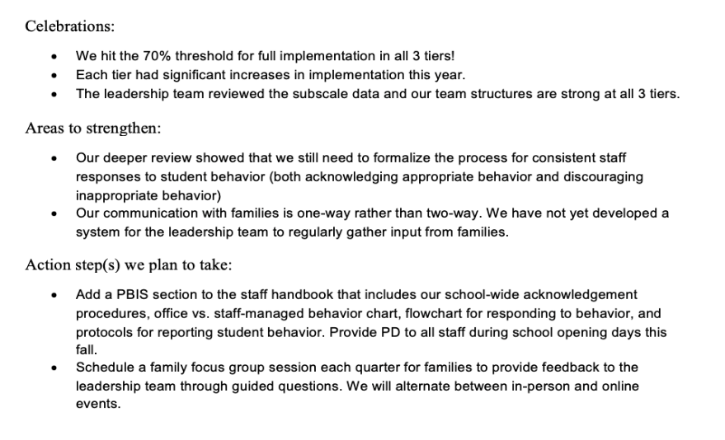
Outcome Data
Fidelity Data
Celebrations
Areas to strengthen
Action Steps
Notes:
TRAINER NOTE: Use this sample to discuss what each school might choose to include in a “snapshot” evaluation report

Slide 10
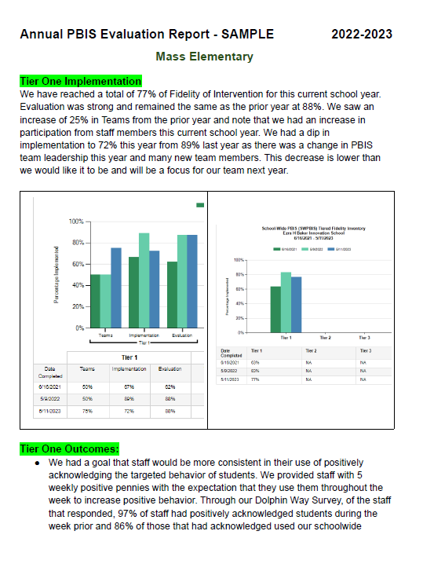
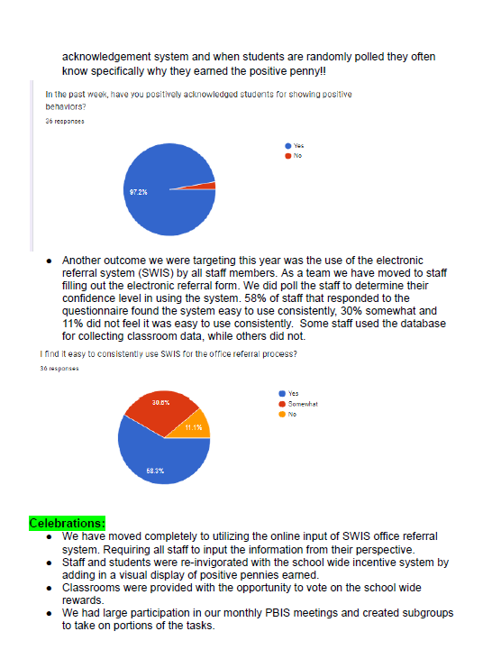
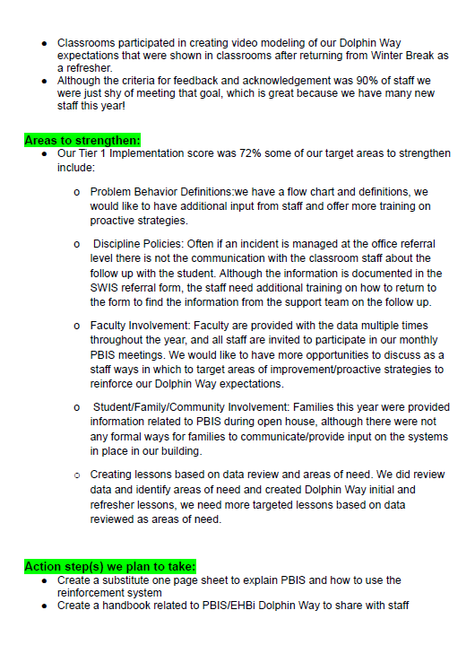
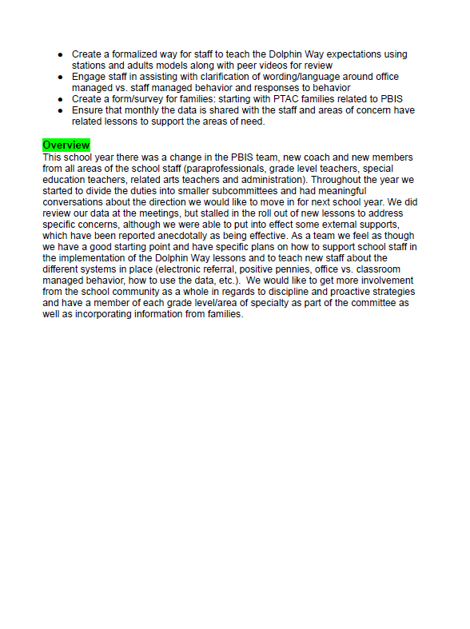
Completed Sample

Slide 11
ACTIVITY: Evaluation Report and Planning
Complete one bullet for each area
  Celebrations
  Areas to Strengthen
  Action Item
Identify which data sources you will show case
  Fidelity
  Outcomes
Be prepared to share out
10 minutes
10 minutes
Work Time
Whole Group

Slide 12
Setting Annual SCHOOL WIDE GOALS
Notes:
TRAINER NOTE: The purpose of this next section is to support the teams to review their goals this year, review their data, and revise their goals for next year.

Slide 13
Have you met your yearly goal
Did you include your goal in your Year End Evaluation?
What will your goal be for next year?
  It is a SMART goal?
  What data will you use to measure that goal?
  Are your data routines set up so that data is monitored and used for decision making throughout the year?

Slide 14

Outcomes tell us if we achieve our purpose and guide framework implementation
By spring break, staff, students, and families will provide input into creation of School Wide PBIS Matrix as demonstrated by responses to questionnaires, class focus groups, and faculty meetings
Based on data
Locally important and meaningful
Applicable to all (culturally equitable)
  Students’ social competence and academic achievement
  Staff implementation of critical skills
Observable and measurable
Written as a goal

Slide 15

Outcomes are our GOALS for implementation
Based on data
Locally important and meaningful
Applicable to all (culturally equitable)
  Students’ social competence and academic achievement
  Staff implementation of critical skills
Observable and measurable
Written as a goal
By the end of the year support for implementing PBIS will be rated “Highly Important” by at least 80% of staff as measured by PBIS staff survey.
As a result of implementing PBIS during the 20XX-20XY school year, student reports of school climate will improve by 20%
As a result of
implementing PBIS,
student behavior will improve, and the school will feel better.
As a result of implementing PBIS during the
20XX-20XY school year, behavior incident data will decrease by __% relative to that same period the prior year.

Slide 16
Identifying Outcomes/Goals
What outcomes are you hoping to achieve this year?
(Consider BOTH implementation fidelity and student outcomes)
Step 1: Develop evaluation questions.
Step 2: Identify indicators or measures.
Step 3: Develop methods for collecting & analyzing indicators.
What do you want to know?
What information can be collected?
How/when should information be gathered?
Step 4: Make decisions and action plan from analysis of indicators.
How will the question be answered & what should be done next?

Slide 17

PBIS centers equity in all decisions...
Remember to always consider Equity in:
  Access
  Representation
  Meaningful Participation
  Positive Outcomes
Ensuring inclusion means you need to include staff, students, and families outside of your dominant culture. Disaggregating data should be part of your data review and goals
Notes:
https://www.pbis.org/topics/equity

Slide 18
Significant Predictors of Equitable Outcomes
Data-based decision making
Classroom PBIS Systems
Formal reward systems
Tobin & Vincent (2011)
Tobin & Vincent (2011)
Barclay (2017),
Tobin & Vincent (2011)

Slide 19
ACTIVITY: DISCUSSION
What are your primary goal for PBIS implementation in our school going forward?
Yearly your first order of business should be to identify a primary yearly goal, record it on your action plan.
Consider and discuss
15 minutes
Notes:
TRAINER NOTE: This is a hope / goal statement. They probably aren’t ready and don’t have the data for a full data driven goal yet.
Team Discussion:
What is our primary goal for PBIS implementation in our school?
How will we gain input from others on our goals?
Do our goals align with district/school strategic plans?
Identify your draft primary goal, record it on your action plan and submit your action plan to your trainer in Canvas.

Slide 20

Resource Spotlight:
Coaches Year at a Glance Document

Slide 21
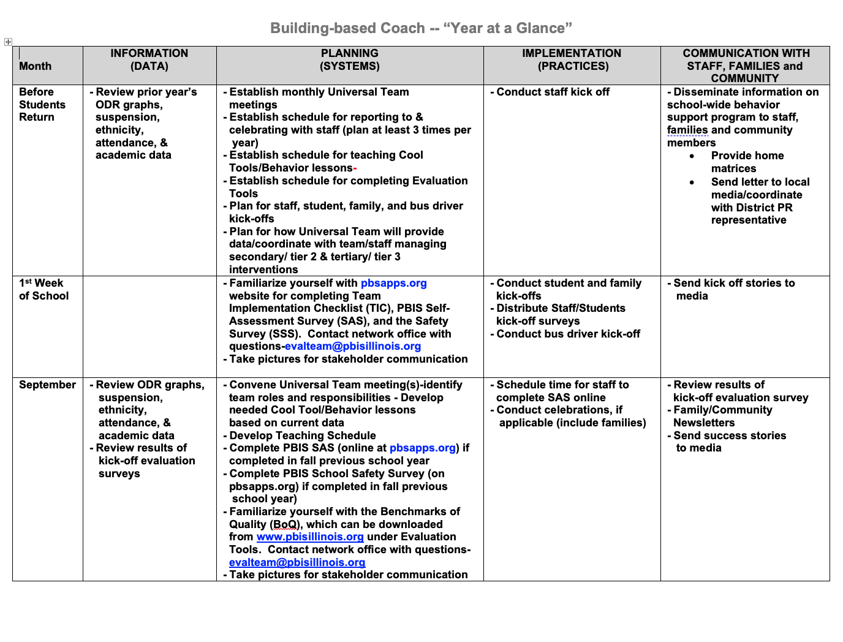
Coaches Year at a Glance
Month by month resources for coaches:
Organizes what data should be reviewed when (for planning purposes)
Prompts for coaches’ and team activities that support planning
What practices should be conducted across the year.
Ideas for communicating with Staff, Families, and Community.
Create your own coaches’ plan!
Notes:
https://sebacademy.edc.org/coaches-year-glance

Slide 22
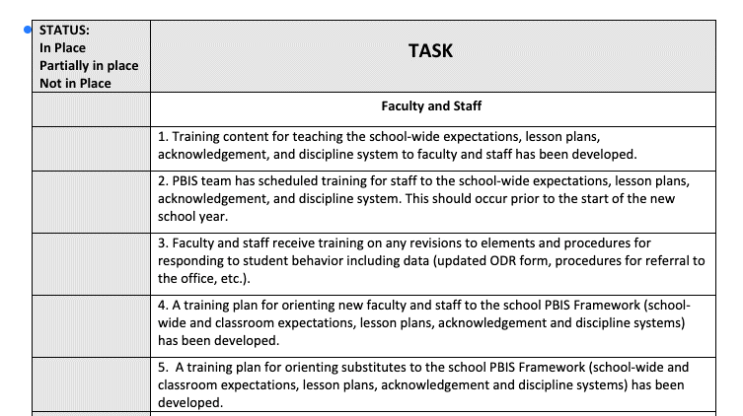
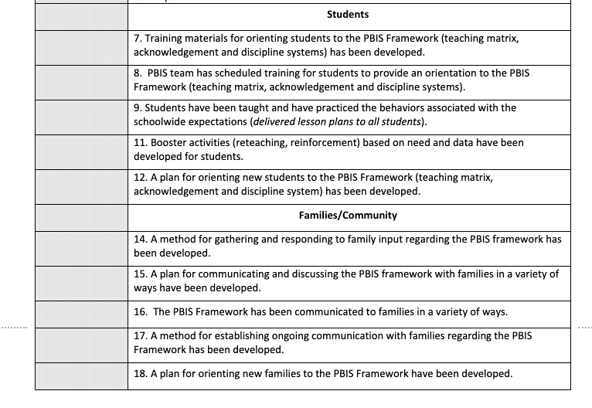
PBIS ROLLOUT CHECKLIST
Notes:
Rollout Check List

Slide 23
RESOURCE SPOTLIGHT:
Review Coaches Year at a Glance and Rolout Checklist
What activities are relevant to your team’s goals?
How could you modify this document, so you have a personal coaching guide for your school?
10 minutes
5 minutes
Coach Review
Whole Group
Notes:
https://sebacademy.edc.org/coaches-year-glance

Slide 24
REVIEW:
Sustainablity
Factors
Notes:
12:30

Slide 25

Factors supporting sustaining of PBIS
Strong Leadership Team
Use fidelity data to
improve support
Use your school’s
discipline data
Implement PBIS in
the classroom

Slide 26
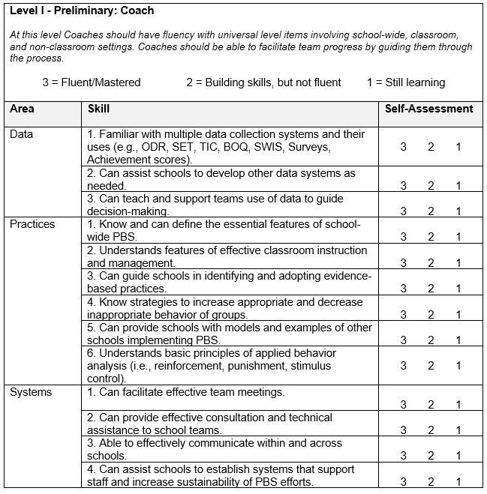
Coach Self Assessment
Complete the Coach Self-Assessment.
Where do you still see gaps in your knowledge or confidence?
What more do you feel you need to be a successfully coach?
Notes:
Coaches Self Assessment Survey – Tier 1

Slide 27
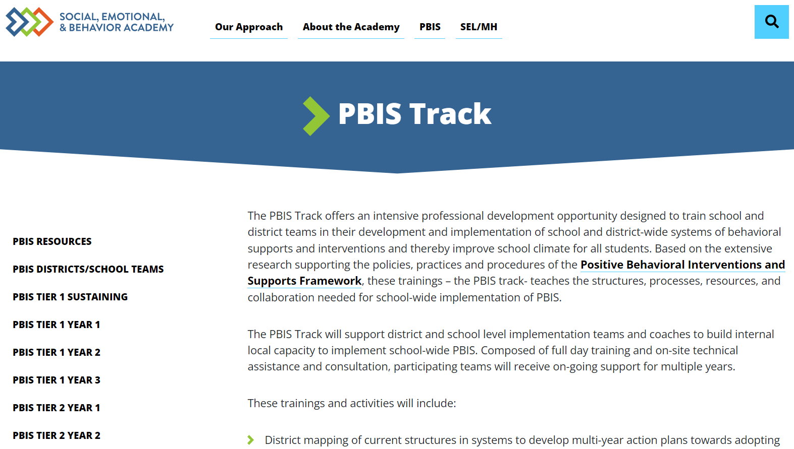
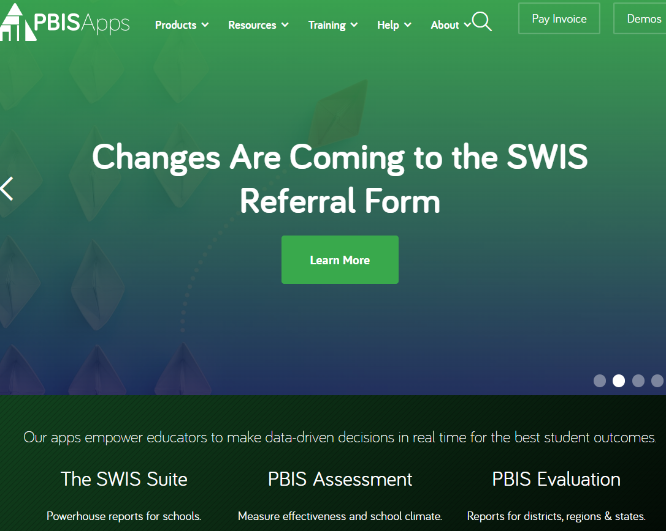
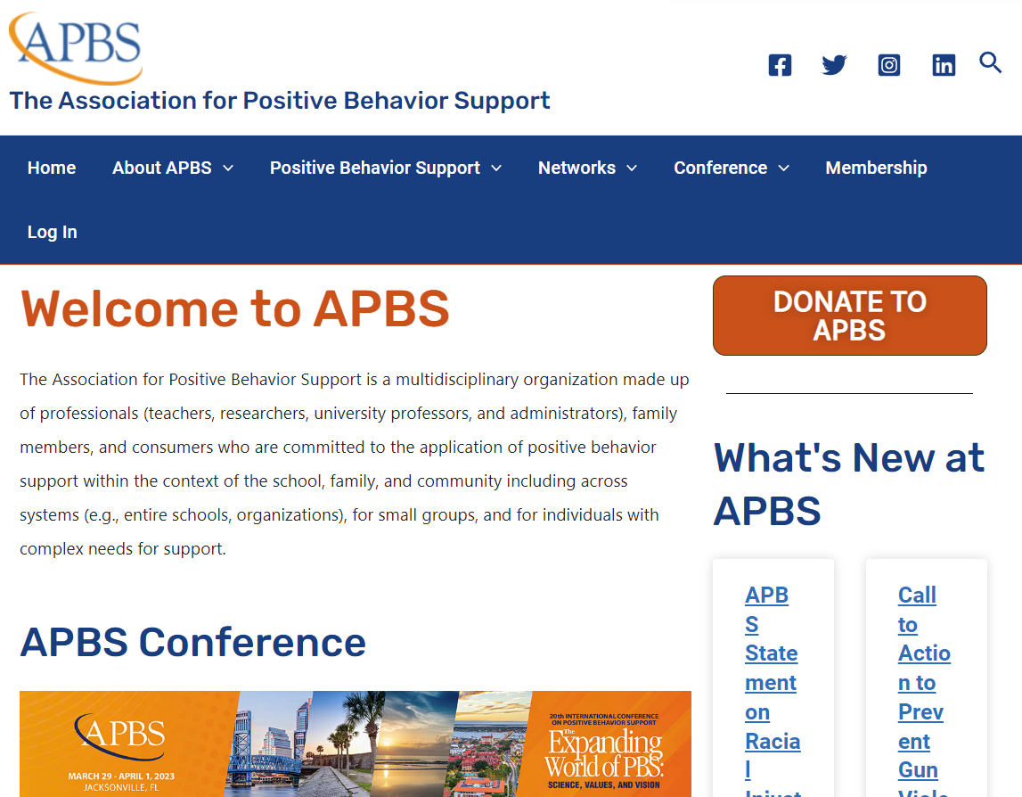


Important and Helpful PBIS Websites
PBISApps.org
(SWIS and your TFI’s live here)
EDC Website
NEPBIS.org
PBIS.org
APBS.org
Notes:
EDC SEBAcademy: https://sebacademy.edc.org/pbis-track
NEPBIS: Nepbis.org
National Center on PBIS: PBIS.org
PBISApps: PBISApps.org
Association of Positive Behavior Supports: APBS.org

Slide 28

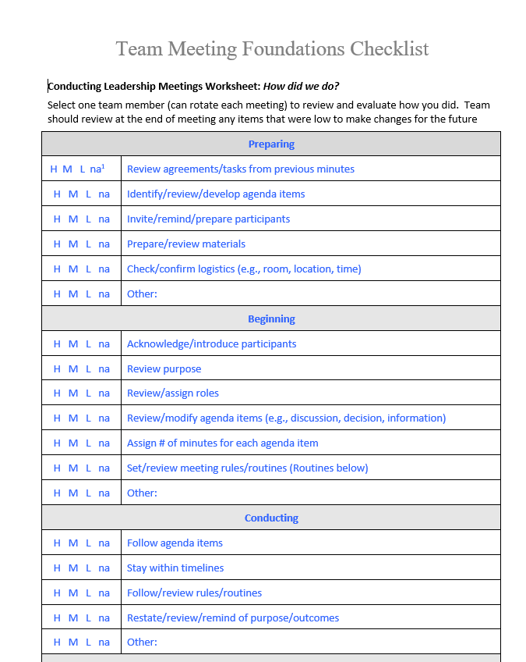
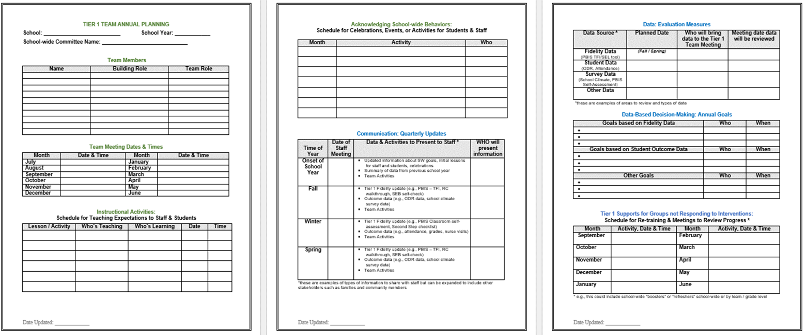
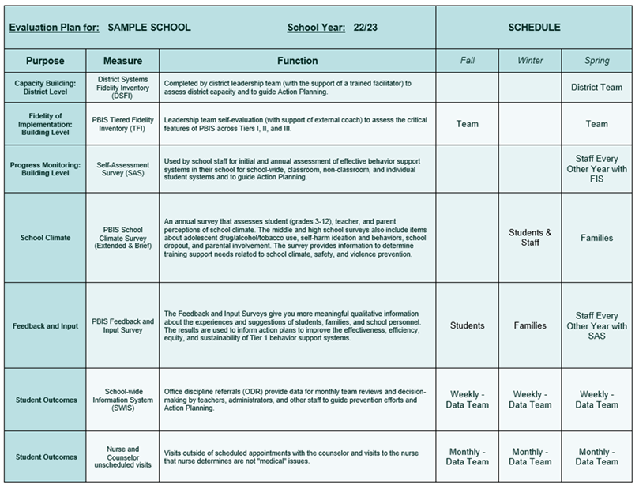

Sustainability Resources
Advanced Yearly Planning
Leadership Team Checklist
Evaluation Schedule
Climate and Feedback Surveys
Notes:
Coaches Year at a Glance: https://sebacademy.edc.org/coaches-year-glance
Leadership Team Checklist: https://sebacademy.edc.org/team-meeting-foundations-checklist
Evaluation Plan Template - https://sebacademy.edc.org/evaluation-schedule
School Climate Surveys: https://sebacademy.edc.org/pbis-school-climate-surveys
Feedback and Input Surveys: https://sebacademy.edc.org/pbis-feedback-input-survey-manual

Slide 29



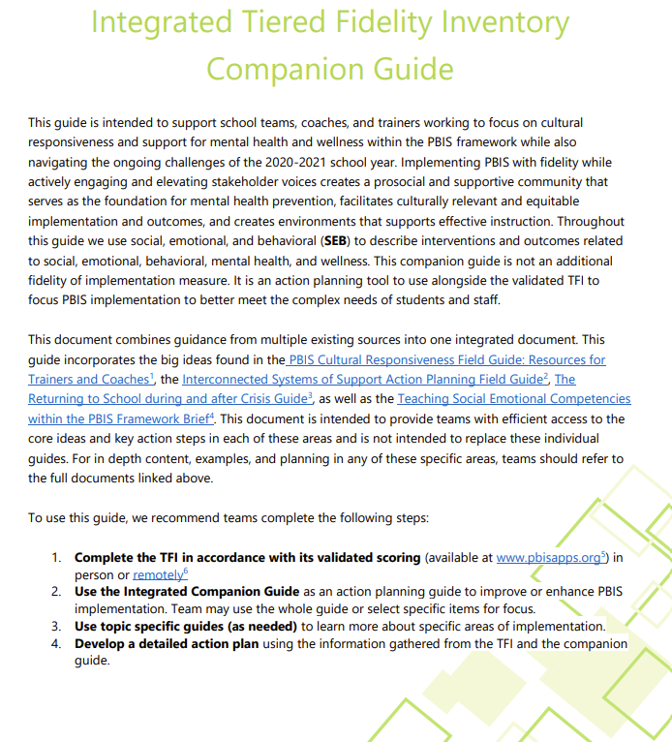
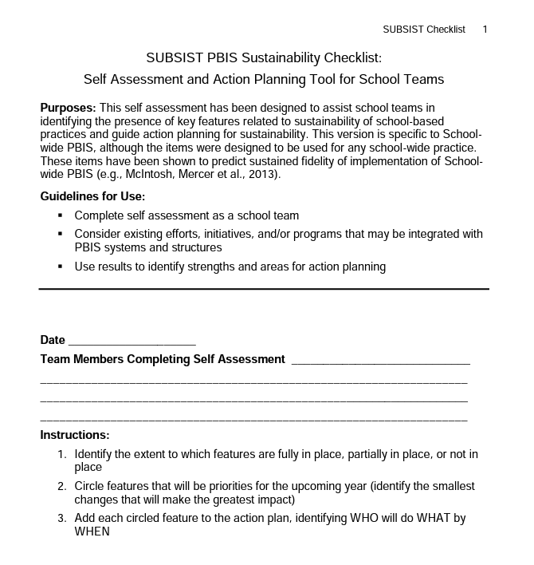

Sustainability Resources
Classroom Practices Brief
TFI / Integrated Companion Guide / Culturally Responsive Field Guide
Classroom Systems & Data Brief - Teachers
Sustainability Checklist
Notes:
Tiered Fidelity Inventory: https://sebacademy.edc.org/tiered-fidelity-inventory-tfi-manual
TFI Integrated Companion Guide: https://sebacademy.edc.org/integrated-tiered-fidelity-inventory-companion-guide
Culturally Responsive Field Guide: https://sebacademy.edc.org/pbis-cultural-responsiveness-field-guide
Data Routines Activity: https://sebacademy.edc.org/developing-data-routines-activity
Subsist PBIS Sustainability Checklist: https://sebacademy.edc.org/subsist-pbis-sustainability-checklist
Classroom Practices Brief: https://sebacademy.edc.org/supporting-and-responding-students-social-emotional-and-behavioral-needs-classrooms
Classroom Systems and Data Brief: https://sebacademy.edc.org/supporting-and-responding-educators-classroom-pbis-implementation-needs-guide-classroom-systems-and

Slide 30
DISCUSSION: SUSTAINABILITY FACTORS
What is something to celebrate & something you’re working on related to Sustainability Factors of:
Team functioning
Using implementation data
Using discipline data
Positive classroom practices
10 minutes
10 minutes
Coach Review
Whole Group

Slide 31
Agenda & Team Tasks
Coaches Tasks
Presentation Content
Resource Spotlight: Rollout Checklist
Review: Sustainability
Work with your team to ensure sustainability
Review: Annual Evaluation Report
Work with your team to develop your year end report.

Slide 32
HELPFUL READINGS & RESOURCES
RESOURCES:
Classroom PBIS: Systems & Data Brief
Supportive Environments Create Classroom Community
Coaches Self Assessment Survey – Tier 1
Annual PBIS Evaluation Report Template
Annual PBIS Evaluation Report – SAMPLE
Embedded Professional Development Activity
Rollout Check List
Coaches Year at a Glance
Sample Staff Slide Deck
Sample Student PBIS Slide Deck
Notes:
Classroom PBIS: Systems & Data Brief: https://sebacademy.edc.org/supporting-and-responding-educators-classroom-pbis-implementation-needs-guide-classroom-systems-and
Embedded Professional Development Activity: https://sebacademy.edc.org/embedded-professional-development-planning-activity
PBIS Evaluation Report https://sebacademy.edc.org/annual-evaluation-report-template
PBIS Evaluation Report Sample https://sebacademy.edc.org/annual-evaluation-report-sample
Coaches Year at a Glance https://sebacademy.edc.org/coaches-year-glance
Rollout Checklist - https://sebacademy.edc.org/rollout-checklist
Sample Student Slide Deck https://sebacademy.edc.org/sample-pbis-student-slide-deck
Sample Staff Slide Deck https://sebacademy.edc.org/sample-pbis-staff-slide-deck

Slide 33
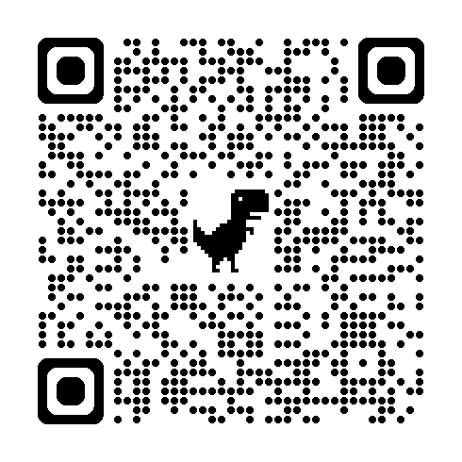
EVALUATION 9A
Please remember to complete the evaluation!
Scan the QR code to access.
Notes:
TRAINERS -
Put link to evaluation (below) in the chat for those who do not use the QR code:
Evaluation Survey: https://go.edc.org/Cohort-9A-Evaluation

Slide 34
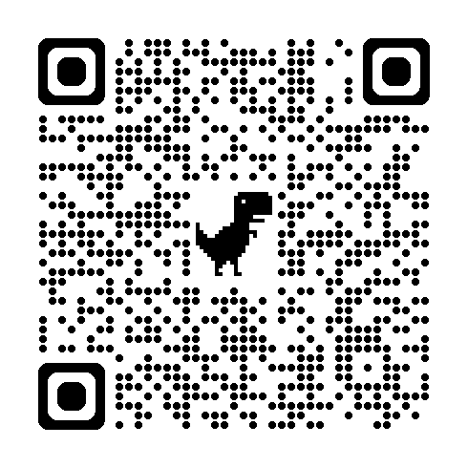
EVALUATION 9B
Please remember to complete the evaluation!
Scan the QR code to access.
Notes:
TRAINERS -
Put link to evaluation (below) in the chat for those who do not use the QR code: Evaluation- https://go.edc.org/SEB-Academy-Event-Evaluation

