Slide 1


PBIS Coaches’ Training
Year 3
Insert Trainer Names
Created from content from the National Technical Assistance Center on Positive Behavioral Interventions and Supports
U.S. Department of Education, Office of Special Education Programs and Office of Elementary and Secondary Education
with support from NEPBIS Network, May Institute, & Broad Reach Consulting

Slide 2
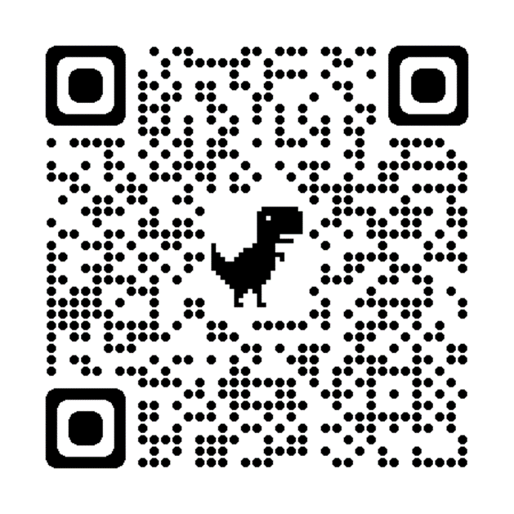
ACTIVITY: ATTENDANCE
Scan QR code on the left or follow the URL posted in the chat to access the online attendance survey
Follow prompts to enter attendance information
Notify trainers if you require assistance (e.g., identifying your cohort or cohort group)
Certificates of Attendance will be sent in January and June. Attendance records will be use as verification
You are in Cohort 8
1 minute
Notes:
ATTENDANCE: https://edc.co1.qualtrics.com/jfe/form/SV_81vbI1jl3cwmLY2

Slide 3

EXPECTATIONS
Self
Others
Environment
Self-monitor
Listen while others are speaking​
Have your computer charged and ready to go​
If you have questions or comments:
Work as a team:
Keep necessary materials at hand
Are you participating?
Engaged as a learner?
Stretch, break, stand as needed​
Raise hand
Room for every voice
Reinforce participation
action plan
relevant docs
water/snacks
Minimize distractions if possible​

Slide 4
Agenda & Team Tasks
TFI Scheduling check-in
Coaches Tasks
Presentation Content
Resource Spotlight
Review: Systems to Support Staff
Work with your team to complete your Working Smarter Worksheet.
Review: Annual Evaluation Report
Work with your team to develop your year end report.
Discuss and plan your school’s participation in the Tier 2 AND Sustaining Academies

Slide 5
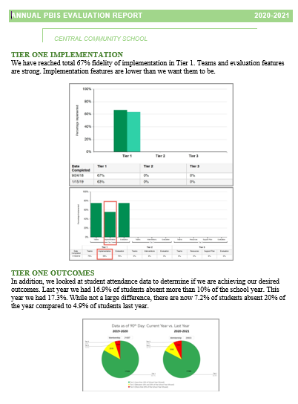
HELPFUL READINGS & RESOURCES
RESOURCES:
Classroom PBIS: Systems & Data Brief
Supportive Environments Create Classroom Community
Coaches Self Assessment Survey – Tier 1
Annual PBIS Evaluation Report Template
Annual PBIS Evaluation Report – SAMPLE
Embedded Professional Development Activity
Rollout Check List
Coaches Year at a Glance
Sample Staff Slide Deck
Sample Student PBIS Slide Deck
Notes:
Classroom PBIS: Systems & Data Brief: https://sebacademy.edc.org/supporting-and-responding-educators-classroom-pbis-implementation-needs-guide-classroom-systems-and
Embedded Professional Development Activity: https://sebacademy.edc.org/embedded-professional-development-planning-activity
PBIS Evaluation Report https://sebacademy.edc.org/annual-evaluation-report-template
PBIS Evaluation Report Sample https://sebacademy.edc.org/annual-evaluation-report-sample
Coaches Year at a Glance https://sebacademy.edc.org/coaches-year-glance
Rollout Checklist - https://sebacademy.edc.org/rollout-checklist
Sample Student Slide Deck https://sebacademy.edc.org/sample-pbis-student-slide-deck
Sample Staff Slide Deck https://sebacademy.edc.org/sample-pbis-staff-slide-deck

Slide 6
Yearly Product Review
Team Meeting Schedule / Action Plan - All
2 of the following:
  Classroom: Sample Classroom Routine Matrix or Classroom Assessment
  Alignment: Working Smarter Matrix or Alignment Activity
  Equity: Neutralizing Routine or Equity Action Items
  Other: Other products you worked on this year
Please show trainer your products for Check Off or upload them to your Google Folder
Notes:
Trainer Note: If a team has another item that would fit into Classroom, Alignment or Equity, they can let us know and we can consider it. Most things will be approved.

Slide 7


You are Graduating from the SEB Academy!!!!
CONGRATULATIONS

Slide 8
2024-2025 SEB Academy:
Congratulations! You are Graduating!!!
But you are still in the SEB family
A calendar of topics and dates will be posted to the website in September and emailed to Coaches.
Please join us in these Learning Opportunities
Monthly Webinars (available to all school staff)
Monthly Peer Sharing Calls
(Series of 3 virtual meetings on various topics)
Continued Support Options
PBIS Advanced Tiers (1 year)
Continued Support with SEL/Mental Health/Belonging – Re-apply to the academy and work with an SEB coach (3 years)
Your Trainers are always just an email away if you have any questions next year
Notes:
Trainer note: Review support options for next year.

Slide 9
REVIEW:
Annual Evaluation Report

Slide 10
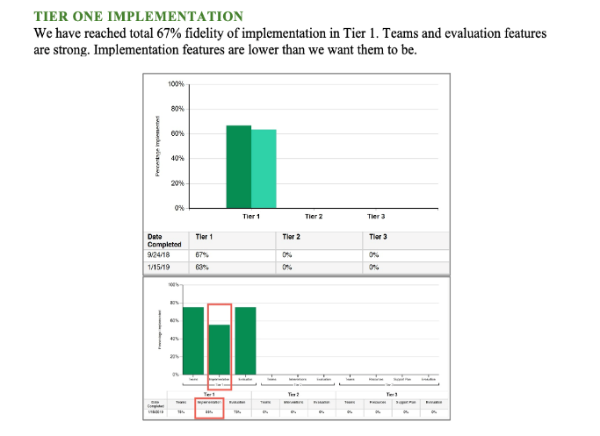
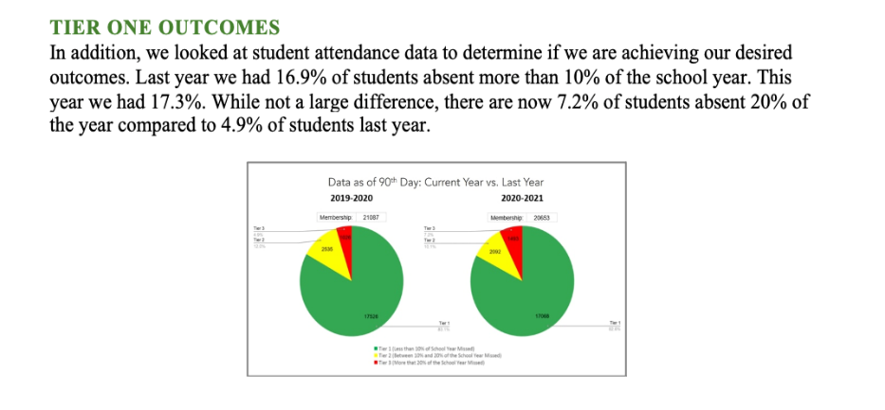
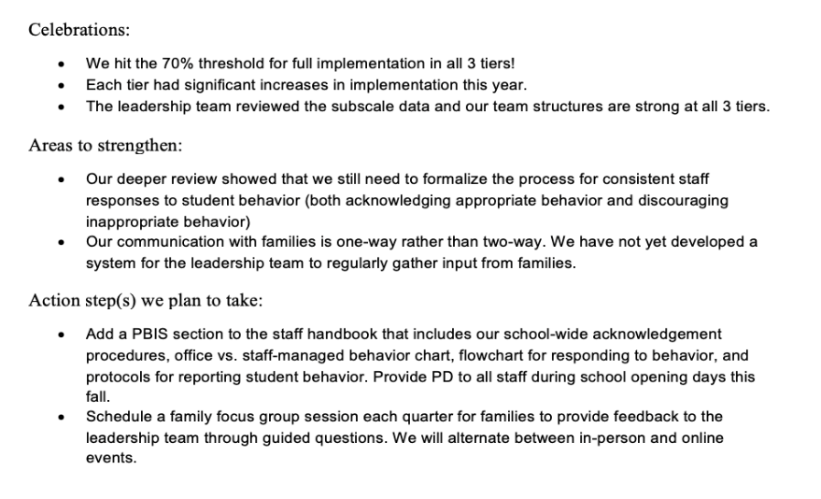
Outcome Data
Fidelity Data
Celebrations
Areas to strengthen
Action Steps
Notes:
TRAINER NOTE: Use this sample to discuss what each school might choose to include in a “snapshot” evaluation report

Slide 11
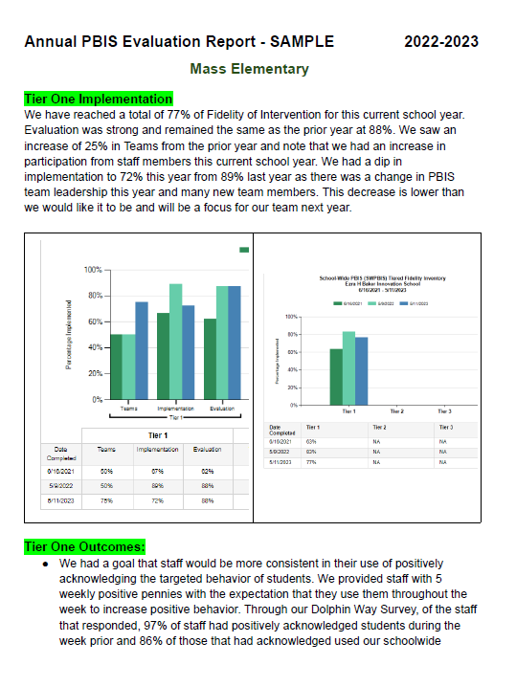
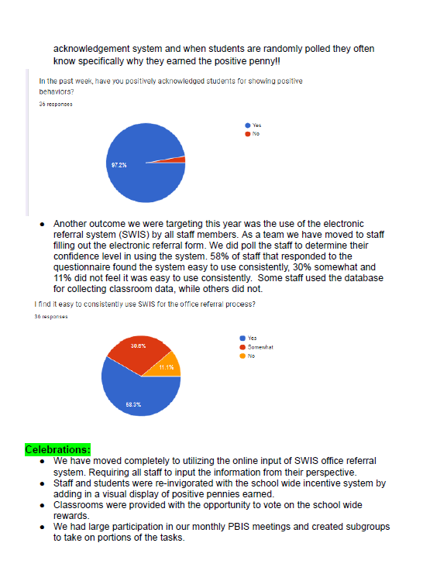
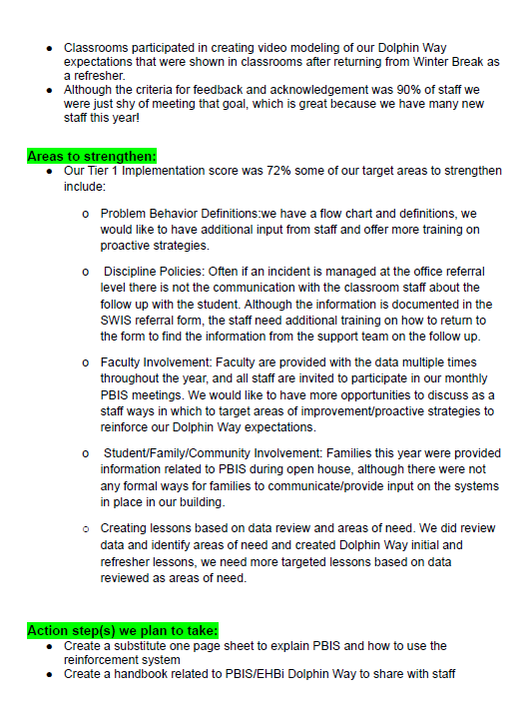
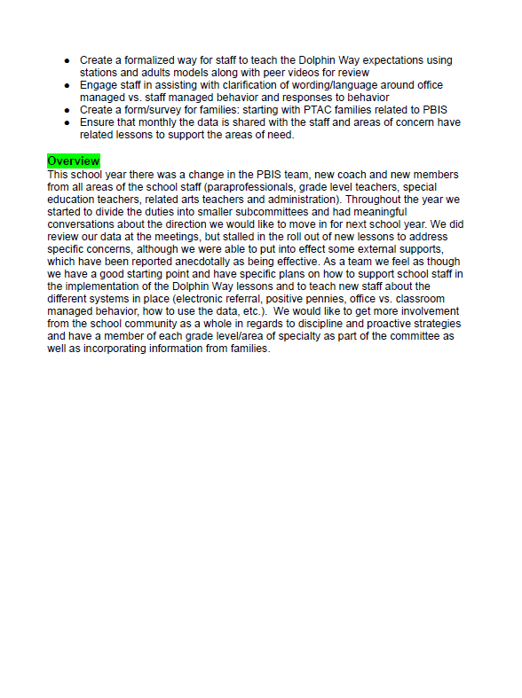
Completed Sample

Slide 12
ACTIVITY: Evaluation Report and Planning
Complete one bullet for each area
  Celebrations
  Areas to Strengthen
  Action Item
Identify which data sources you will show case
  Fidelity
  Outcomes
Be prepared to share out
10 minutes
10 minutes
Work Time
Whole Group

Slide 13
Setting Annual SCHOOL WIDE GOALS
Notes:
TRAINER NOTE: The purpose of this next section is to support the teams to review their goals this year, review their data, and revise their goals for next year.

Slide 14
Have you met your yearly goal
Did you include your goal in your Year End Evaluation?
What will your goal be for next year?
  It is a SMART goal?
  What data will you use to measure that goal?
  Are your data routines set up so that data is monitored and used for decision making throughout the year?

Slide 15

Outcomes tell us if we achieve our purpose and guide framework implementation
By spring break, staff, students, and families will provide input into creation of School Wide PBIS Matrix as demonstrated by responses to questionnaires, class focus groups, and faculty meetings
Based on data
Locally important and meaningful
Applicable to all (culturally equitable)
  Students’ social competence and academic achievement
  Staff implementation of critical skills
Observable and measurable
Written as a goal

Slide 16

Outcomes are our GOALS for implementation
Based on data
Locally important and meaningful
Applicable to all (culturally equitable)
  Students’ social competence and academic achievement
  Staff implementation of critical skills
Observable and measurable
Written as a goal
By the end of the year support for implementing PBIS will be rated “Highly Important” by at least 80% of staff as measured by PBIS staff survey.
As a result of implementing PBIS during the 20XX-20XY school year, student reports of school climate will improve by 20%
As a result of
implementing PBIS,
student behavior will improve, and the school will feel better.
As a result of implementing PBIS during the
20XX-20XY school year, behavior incident data will decrease by __% relative to that same period the prior year.

Slide 17
Identifying Outcomes/Goals
What outcomes are you hoping to achieve this year?
(Consider BOTH implementation fidelity and student outcomes)
Step 1: Develop evaluation questions.
Step 2: Identify indicators or measures.
Step 3: Develop methods for collecting & analyzing indicators.
What do you want to know?
What information can be collected?
How/when should information be gathered?
Step 4: Make decisions and action plan from analysis of indicators.
How will the question be answered & what should be done next?

Slide 18

PBIS centers equity in all decisions...
Remember to always consider Equity in:
  Access
  Representation
  Meaningful Participation
  Positive Outcomes
Ensuring inclusion means you need to include staff, students, and families outside of your dominant culture. Disaggregating data should be part of your data review and goals
Notes:
https://www.pbis.org/topics/equity

Slide 19
Significant Predictors of Equitable Outcomes
Data-based decision making
Classroom PBIS Systems
Formal reward systems
Tobin & Vincent (2011)
Tobin & Vincent (2011)
Barclay (2017),
Tobin & Vincent (2011)

Slide 20
ACTIVITY: DISCUSSION
What are your primary goal for PBIS implementation in our school going forward?
Yearly your first order of business should be to identify a primary yearly goal, record it on your action plan.
Consider and discuss
15 minutes
Notes:
TRAINER NOTE: This is a hope / goal statement. They probably aren’t ready and don’t have the data for a full data driven goal yet.
Team Discussion:
What is our primary goal for PBIS implementation in our school?
How will we gain input from others on our goals?
Do our goals align with district/school strategic plans?
Identify your draft primary goal, record it on your action plan and submit your action plan to your trainer in Canvas.

Slide 21

REVIEW:
Sustainablity
Factors
Notes:
12:30

Slide 22

Factors supporting sustaining of PBIS
Strong Leadership Team
Use fidelity data to
improve support
Use your school’s
discipline data
Implement PBIS in
the classroom

Slide 23
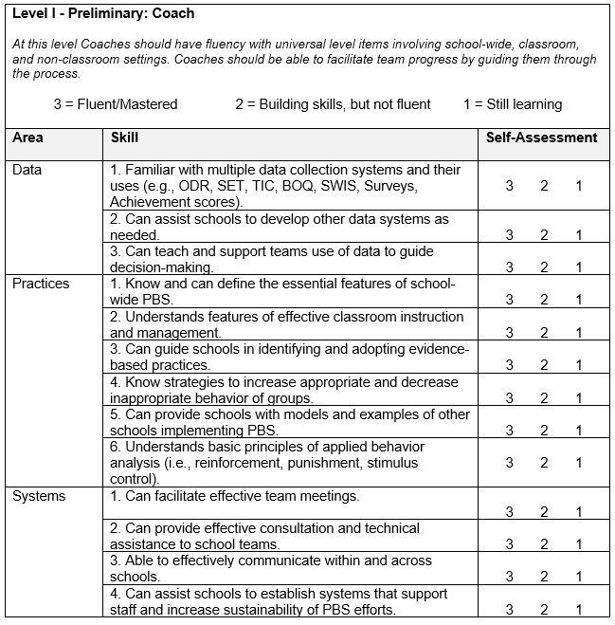
Coach Self Assessment
Complete the Coach Self-Assessment.
Where do you still see gaps in your knowledge or confidence?
What more do you feel you need to be a successfully coach?
Notes:
Coaches Self Assessment Survey – Tier 1

Slide 24
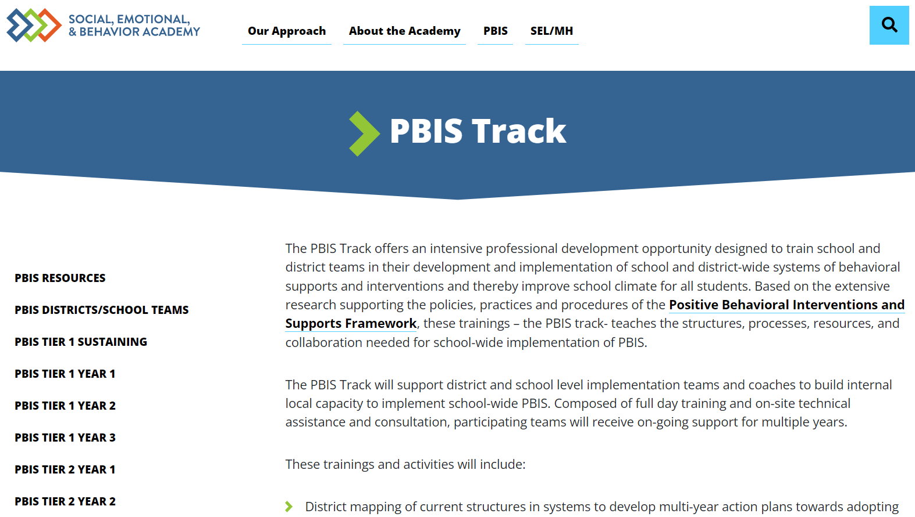
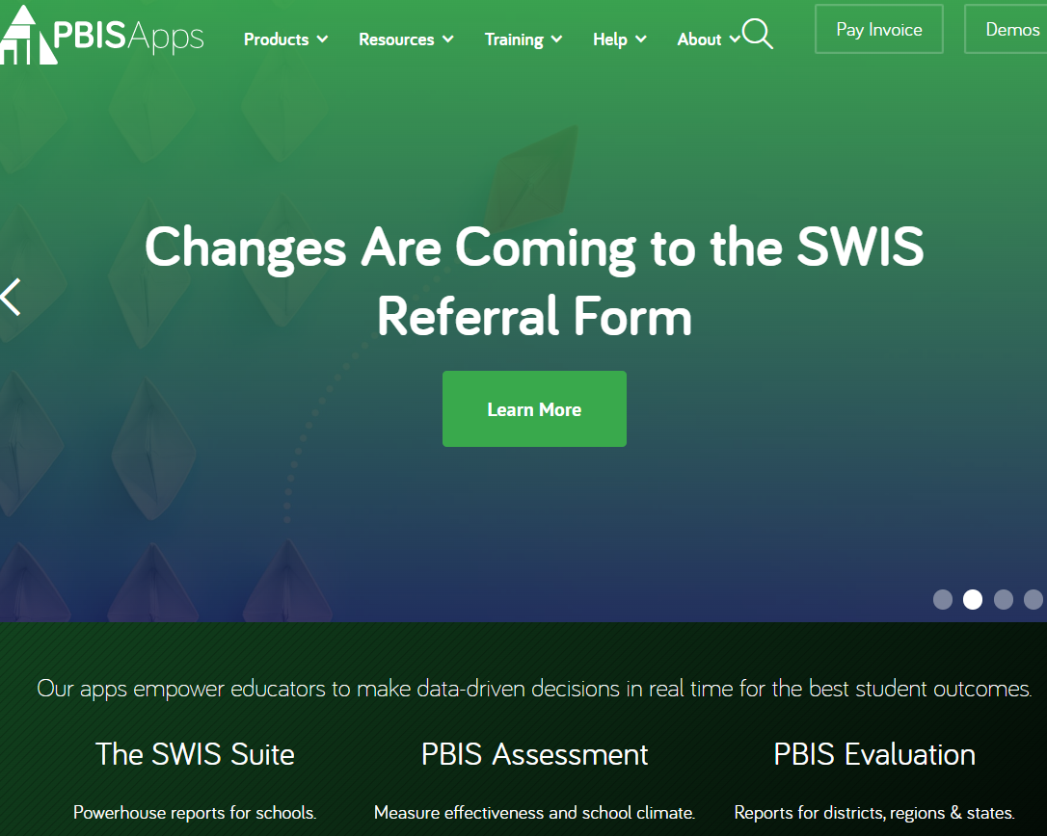
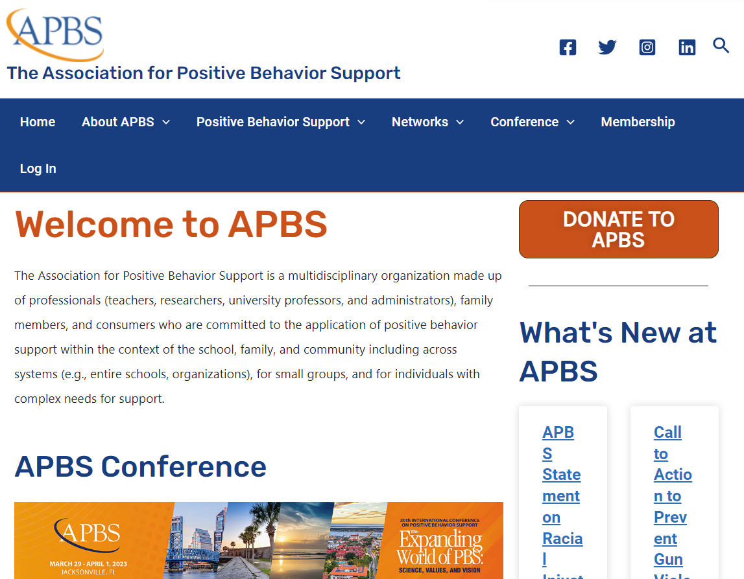


Important and Helpful PBIS Websites
PBISApps.org
(SWIS and your TFI’s live here)
EDC Website
NEPBIS.org
PBIS.org
APBS.org
Notes:
EDC SEBAcademy: https://sebacademy.edc.org/pbis-track
NEPBIS: Nepbis.org
National Center on PBIS: PBIS.org
PBISApps: PBISApps.org
Association of Positive Behavior Supports: APBS.org

Slide 25

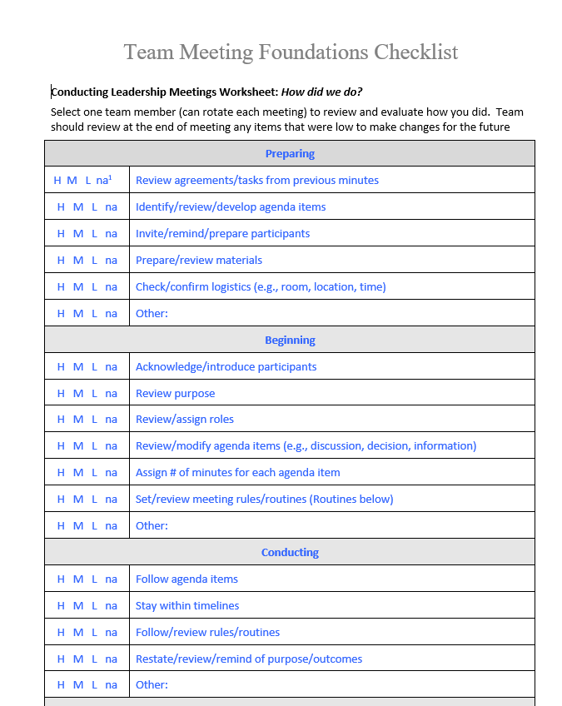
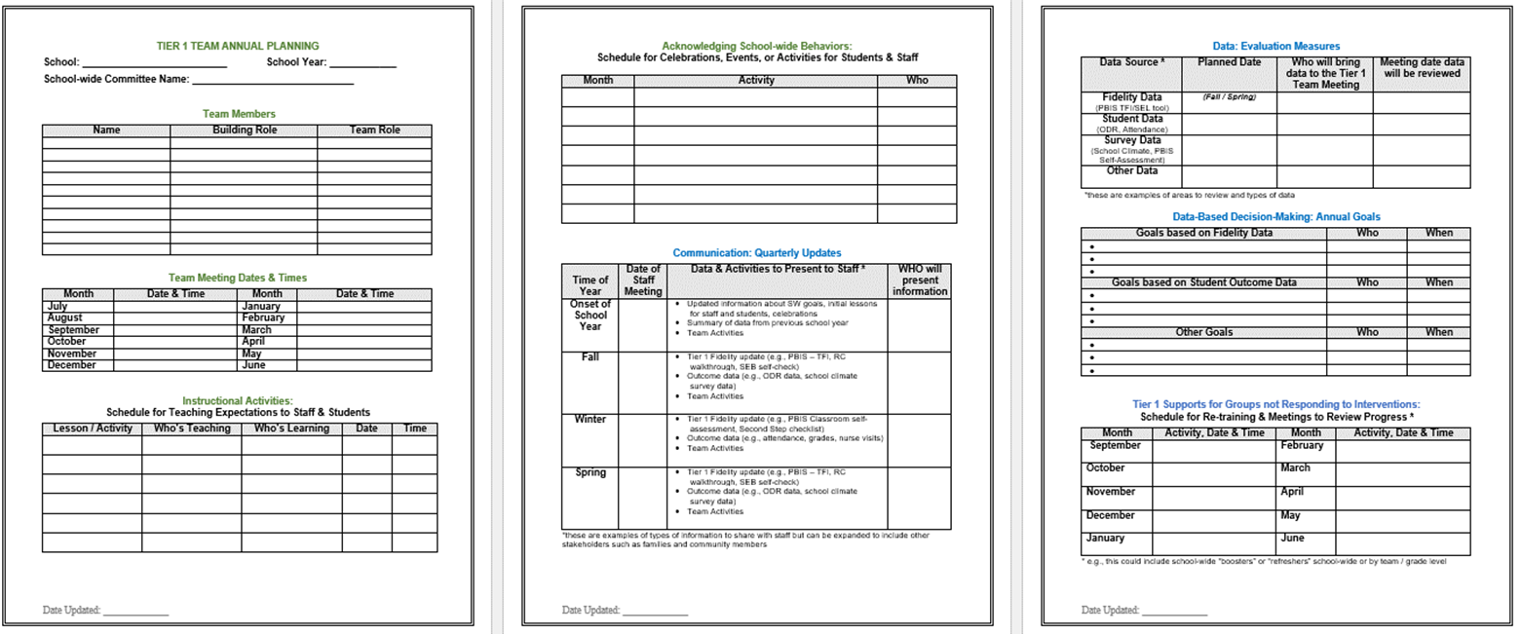
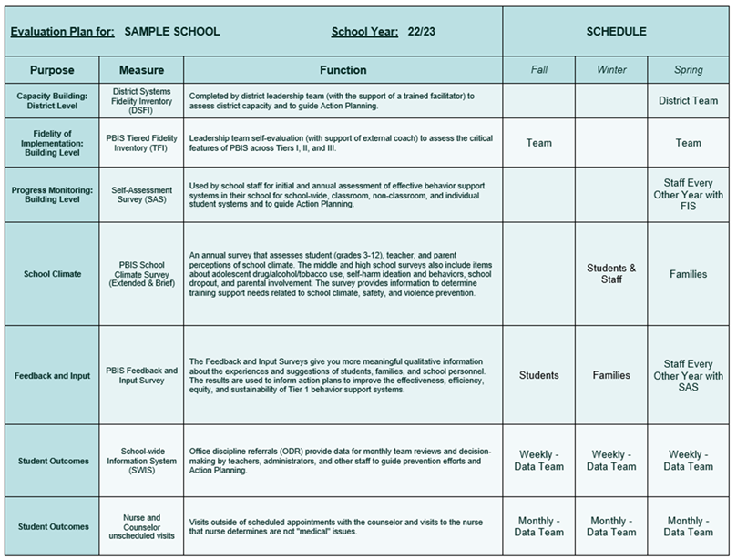

Sustainability Resources
Advanced Yearly Planning
Leadership Team Checklist
Evaluation Schedule
Climate and Feedback Surveys
Notes:
Coaches Year at a Glance: https://sebacademy.edc.org/coaches-year-glance
Leadership Team Checklist: https://sebacademy.edc.org/team-meeting-foundations-checklist
Evaluation Plan Template - https://sebacademy.edc.org/evaluation-schedule
School Climate Surveys: https://sebacademy.edc.org/pbis-school-climate-surveys
Feedback and Input Surveys: https://sebacademy.edc.org/pbis-feedback-input-survey-manual

Slide 26



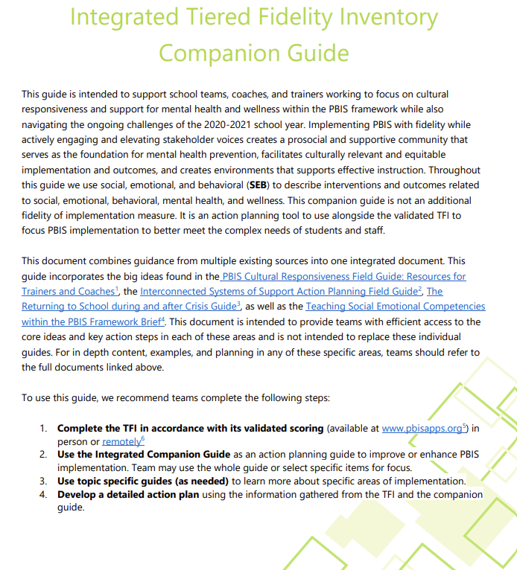
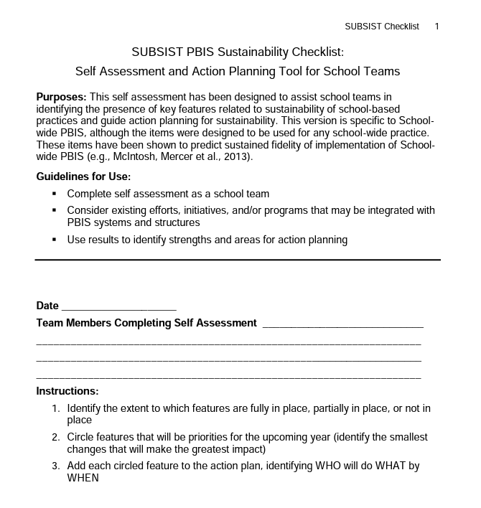

Sustainability Resources
Classroom Practices Brief
TFI / Integrated Companion Guide / Culturally Responsive Field Guide
Classroom Systems & Data Brief - Teachers
Sustainability Checklist
Notes:
Tiered Fidelity Inventory: https://sebacademy.edc.org/tiered-fidelity-inventory-tfi-manual
TFI Integrated Companion Guide: https://sebacademy.edc.org/integrated-tiered-fidelity-inventory-companion-guide
Culturally Responsive Field Guide: https://sebacademy.edc.org/pbis-cultural-responsiveness-field-guide
Data Routines Activity: https://sebacademy.edc.org/developing-data-routines-activity
Subsist PBIS Sustainability Checklist: https://sebacademy.edc.org/subsist-pbis-sustainability-checklist
Classroom Practices Brief: https://sebacademy.edc.org/supporting-and-responding-students-social-emotional-and-behavioral-needs-classrooms
Classroom Systems and Data Brief: https://sebacademy.edc.org/supporting-and-responding-educators-classroom-pbis-implementation-needs-guide-classroom-systems-and

Slide 27
DISCUSSION: SUSTAINABILITY FACTORS
What is something to celebrate & something you’re working on related to Sustainability Factors of:
Team functioning
Using implementation data
Using discipline data
Positive classroom practices
10 minutes
10 minutes
Coach Review
Whole Group

Slide 28
Resource Spotlight:
Coaches Year at a Glance Document

Slide 29
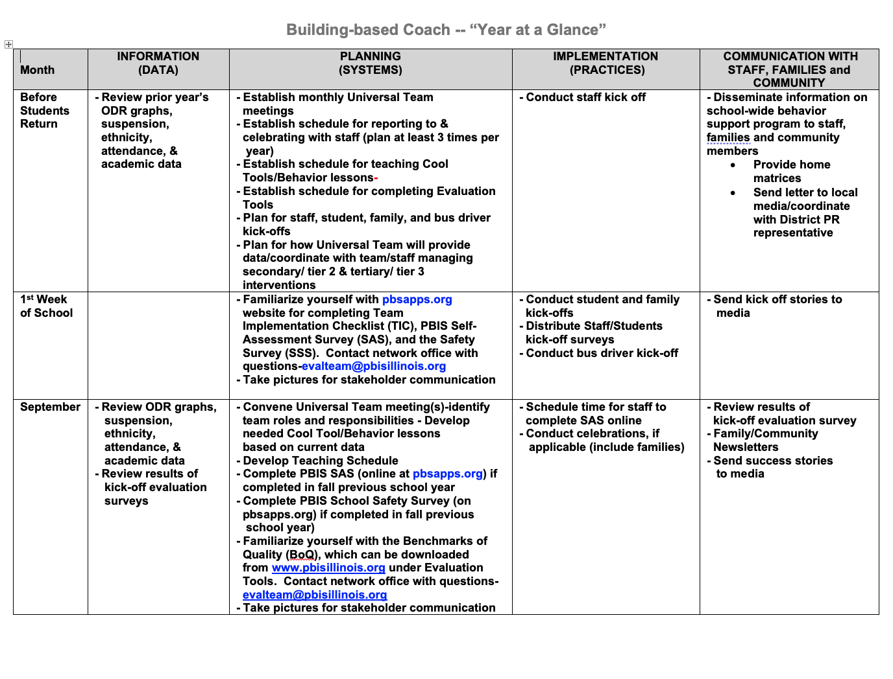
Coaches Year at a Glance
Month by month resources for coaches:
Organizes what data should be reviewed when (for planning purposes)
Prompts for coaches’ and team activities that support planning
What practices should be conducted across the year.
Ideas for communicating with Staff, Families, and Community.
Create your own coaches’ plan!
Notes:
https://sebacademy.edc.org/coaches-year-glance

Slide 30
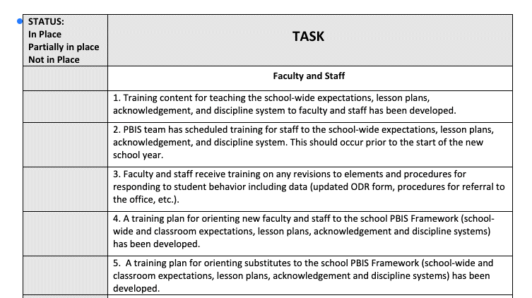
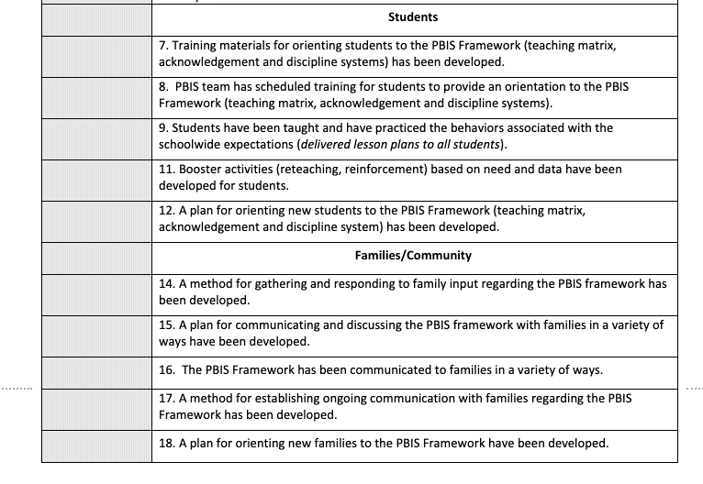
PBIS ROLLOUT CHECKLIST
Notes:
Rollout Check List

Slide 31
RESOURCE SPOTLIGHT:
Review Coaches Year at a Glance and Rolout Checklist
What activities are relevant to your team’s goals?
How could you modify this document, so you have a personal coaching guide for your school?
10 minutes
5 minutes
Coach Review
Whole Group
Notes:
https://sebacademy.edc.org/coaches-year-glance

Slide 32
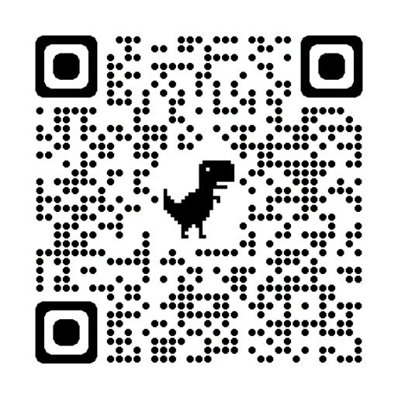
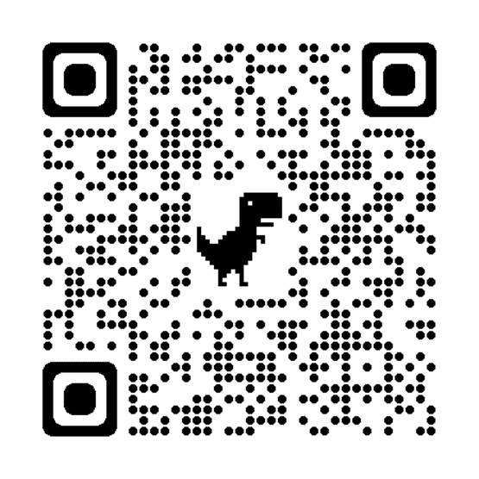
Today’s Evaluation
If you were NOT at the Team Training in May, Please remember to complete the End Of Year Evaluation!
.
Scan the QR code to access or look in the Chat Box for link
End of Year Evaluation
Scan the QR code to access or look in the Chat Box for link
Notes:
TRAINERS -
Today’s Evaluation: https://edc.co1.qualtrics.com/jfe/form/SV_cBF9GI7gVEBsfSC
End of Year Evaluation: https://go.edc.org/pbis-end-of-year-evaluation

Slide 33
HELPFUL READINGS & RESOURCES
RESOURCES:
Classroom PBIS: Systems & Data Brief
Supportive Environments Create Classroom Community
Coaches Self Assessment Survey – Tier 1
Annual PBIS Evaluation Report Template
Annual PBIS Evaluation Report – SAMPLE
Embedded Professional Development Activity
Rollout Check List
Coaches Year at a Glance
Sample Staff Slide Deck
Sample Student PBIS Slide Deck
Notes:
Classroom PBIS: Systems & Data Brief: https://sebacademy.edc.org/supporting-and-responding-educators-classroom-pbis-implementation-needs-guide-classroom-systems-and
Embedded Professional Development Activity: https://sebacademy.edc.org/embedded-professional-development-planning-activity
PBIS Evaluation Report https://sebacademy.edc.org/annual-evaluation-report-template
PBIS Evaluation Report Sample https://sebacademy.edc.org/annual-evaluation-report-sample
Coaches Year at a Glance https://sebacademy.edc.org/coaches-year-glance
Rollout Checklist - https://sebacademy.edc.org/rollout-checklist
Sample Student Slide Deck https://sebacademy.edc.org/sample-pbis-student-slide-deck
Sample Staff Slide Deck https://sebacademy.edc.org/sample-pbis-staff-slide-deck

