Slide 1
PBIS Coaches’ Training Year 3 – April 2024
Insert Trainer Names
Created from content from the National Technical Assistance Center on Positive Behavioral Interventions and Supports U.S. Department of Education, Office of Special Education Programs and Office of Elementary and Secondary Education
with support from NEPBIS Network, May Institute, & Broad Reach Consulting

Slide 2
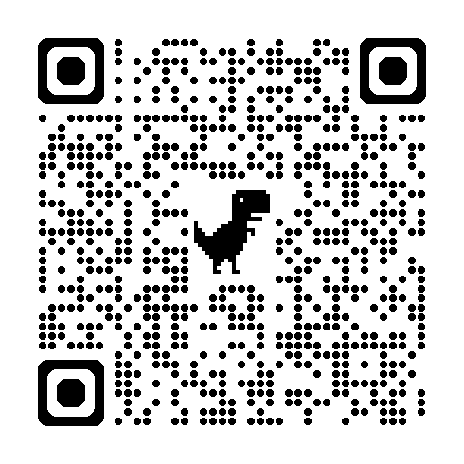
ACTIVITY: ATTENDANCE
Scan QR code on the left or follow the URL posted in the chat to access the online attendance survey Follow prompts to enter attendance information
Notify trainers if you require assistance (e.g., identifying your cohort or cohort group)
Certificates of Attendance will be sent in January and June. Attendance records and Zoom log in will be use as verification
1 minute
Notes:
https://docs.google.com/forms/d/e/1FAIpQLSf-la8kZA-l6ZXIR48DsDhimdXqFAX2d8Cw6xIXio0UxScqvw/viewform

Slide 3
EXPECTATIONS
Self
Others
Environment
Self-monitor
Listen while others are speaking​
Have your computer charged and ready to go​
If you have questions or comments:
Work as a team:
Keep necessary materials at hand
Are you participating?
Engaged as a learner?
Stretch, break, stand as needed​
Raise hand
Room for every voice
Reinforce participation
action plan
relevant docs
water/snacks
Minimize distractions if possible​

Slide 4
Agenda & Team Tasks
Team time
Team Tasks
Presentation Content
Sharing: Poster Session
PBIS Annual Evaluation and Planning for Next Year
Plan how your team will support Classroom PBIS practices across your building.
Supporting Staff and Embedded Professional Development
Draft or revise your evaluation plan for PBIS implementation.
Identify a goal for this year’s PBIS implementation and add to your action plan
Share w/Trainer: Updated Action Plan with Goal Statement.

Slide 5
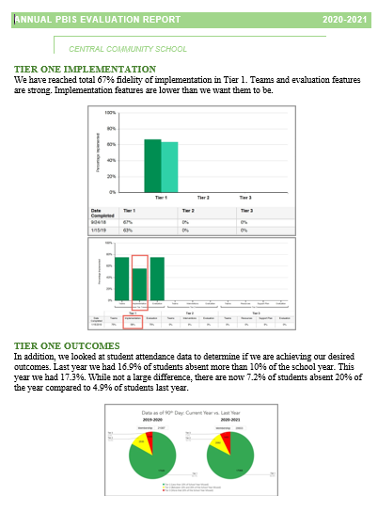
HELPFUL READINGS & RESOURCES
RESOURCES:
Classroom PBIS: Systems & Data Brief
Supportive Environments Create Classroom Community
Rollout Checklist
Annual PBIS Evaluation Report Template
Annual PBIS Evaluation Report – SAMPLE
Embedded Professional Development Activity
Sample Staff Slide Deck
Sample Student PBIS Slide Deck
Sample PBIS Handbooks
Elementary 1
Elementary 2
Secondary 1
Secondary 2
Notes:
Classroom PBIS: Systems & Data Brief: https://sebacademy.edc.org/supporting-and-responding-educators-classroom-pbis-implementation-needs-guide-classroom-systems-and
Embedded Professional Development Activity: https://sebacademy.edc.org/embedded-professional-development-planning-activity
PBIS Evaluation Report https://sebacademy.edc.org/annual-evaluation-report-template
PBIS Evaluation Report Sample https://sebacademy.edc.org/annual-evaluation-report-sample
Sample PBIS Handbooks: https://sebacademy.edc.org/resources?type=All&tag=All&keyword=handbook
Sample Student Slide Deck https://sebacademy.edc.org/sample-pbis-student-slide-deck
Sample Staff Slide Deck https://sebacademy.edc.org/sample-pbis-staff-slide-deck

Slide 6
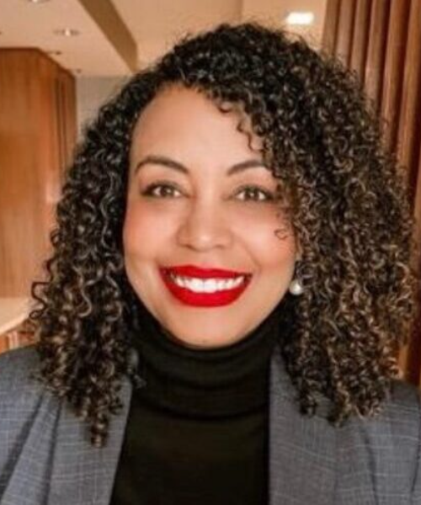
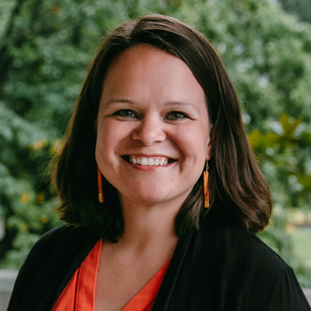
Mark your calendars now to join us at the
14th Annual NEPBIS LEADERSHIP FORUM
May 15-16, 2025
Mystic, CT
https://nepbis.org/forum/
ANNOUNCING OUR KEYNOTE PRESENTERS
PRE-CONFERENCE WORKSHOPS on MAY 14th
Come learn about how to improve attendance
through your PBIS framework!
Steve Goodman, Ph.D.
Cecelia Leong, M.P.P.
This workshop will focus on student voice as a critical component of PBIS implementation.
Clynita Grafenreed, Ph.D.
Kathleen Lynne Lane, Ph.D., BCBA-D, CF-L2
Sara Estrapala, Ph.D.

Slide 7
Supporting Staff and Embedded Professional Development
Notes:
TRAINER NOTE: This is review content please be brief

Slide 8
Systems
Practices
Data
Continue to invest in systems to support high-fidelity implementation over time. Leverage existing leadership teams to guide planning and implementation, and consider effective means to support educators’ professional learning and wellness given current resources, experience, and expertise.
Equity
Outcomes

Slide 9
What are SYSTEMS? systems are what we do to support the adults!
The way schools operate are their foundational systems.
In PBIS, these systems support:
accurate, durable implementation of practices
the effective use of data to achieve better outcomes (pbis.org)

Slide 10
Step 8: Develop Systems to Support Staff
Systems
Promoting and Sustaining Staff Engagement
Continuous Action Planning
Team-Based Implementation
Embedded and Ongoing Professional Development
Staff Recognition
Data Routines
Notes:
TRAINER NOTE: There are various ways in which we support our staff to implement our PBIS Framework. Today we are going to focus on a couple of these systems to learn how we can enhance them to support our implementation.

Slide 11
Provide Universal Professional Development to ALL Staff instead of ”Training and Hoping”
Sound familiar?
We can do better!
REACT to problem behavior
Select and ADD Practice
Hire EXPERT to Train Practice
Expect, but HOPE for, Implementation
WAIT for New Problem

Slide 12
Continuum of Multi-tiered Professional Development Support
Tier 3
What do we do for the FEW staff needing intensive support?
Intensive Professional Development:
Data-driven Consultation
Performance Feedback:
Routine Walkthrough and Self-management Data Reviews
Tier 1
What do we do for
ALL Staff?
Universal Professional Development:
Training and Self-management
Universal Screening:
Walk-through and Student Data Review
~5%
~15%
Tier 2
What do for the SOME staff needing more support?
Targeted Professional Development:
Self-management with Peer or Coaching Support
Progress Monitoring:
Walkthrough, Student Data Review,
Teacher Collected Data
For now,
focus on providing ALL staff Tier 1 professional development
~80% of Staff

Slide 13
Key Systems supporting Positive Classroom Supports
Establish foundations to support Positive Classroom Supports
Explicitly teach and coach
Monitor systems implementation and use continuous improvement process
Monitor educator implementation and use continuous improvement process
Monitor equitable student benefit and use continuous improvement process

Slide 14
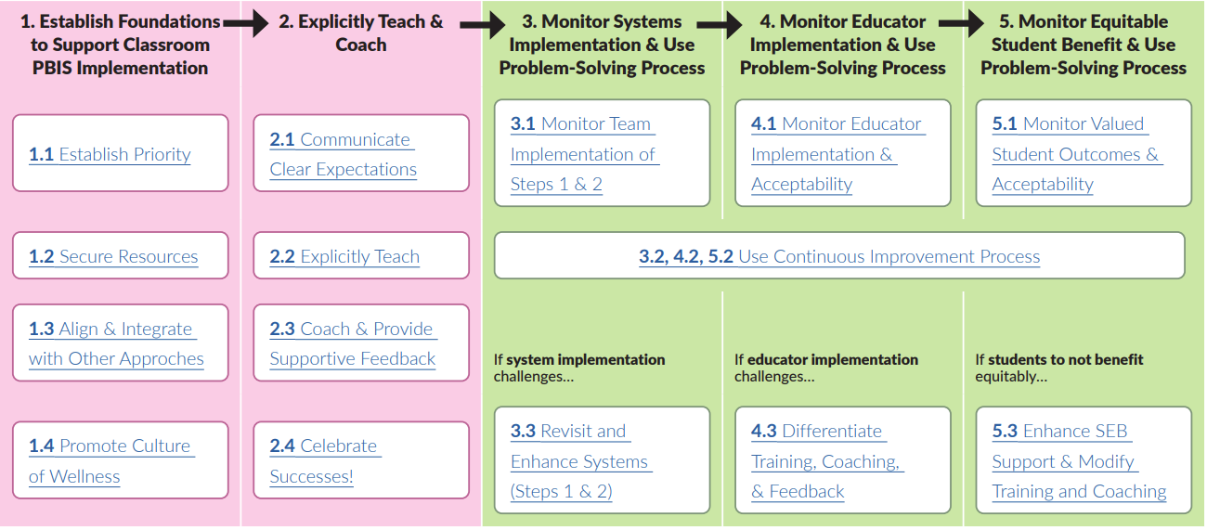
STEPS TO SUPPORT EDUCATORS' IMPLEMENTATION
Page 14
Notes:
RESOURCE LINK (p.14): https://sebacademy.edc.org/supporting-and-responding-educators-classroom-pbis-implementation-needs-guide-classroom-systems-and

Slide 15
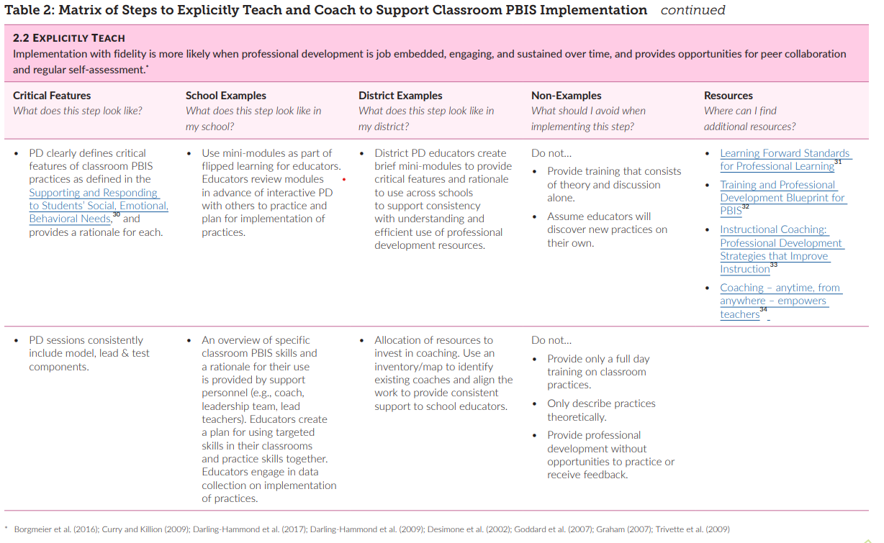
Example System Feature table (2.2 Explicitly Teach)
Page 22
Notes:
TRAINER NOTE: Please explain how each system feature has a corresponding table that outlines that critical features of the system component, examples, and non-examples, and resources. You may mention the document and click through to show that (1) that there are tables for each of the system components, but also that some tables span multiple pages.
RESOURCE LINK (p.22): https://sebacademy.edc.org/supporting-and-responding-educators-classroom-pbis-implementation-needs-guide-classroom-systems-and

Slide 16
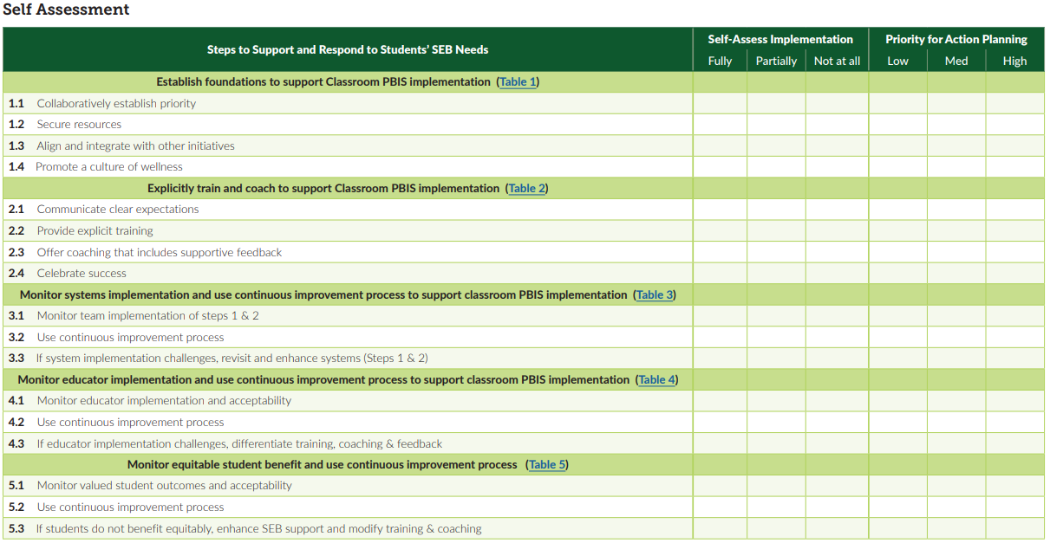
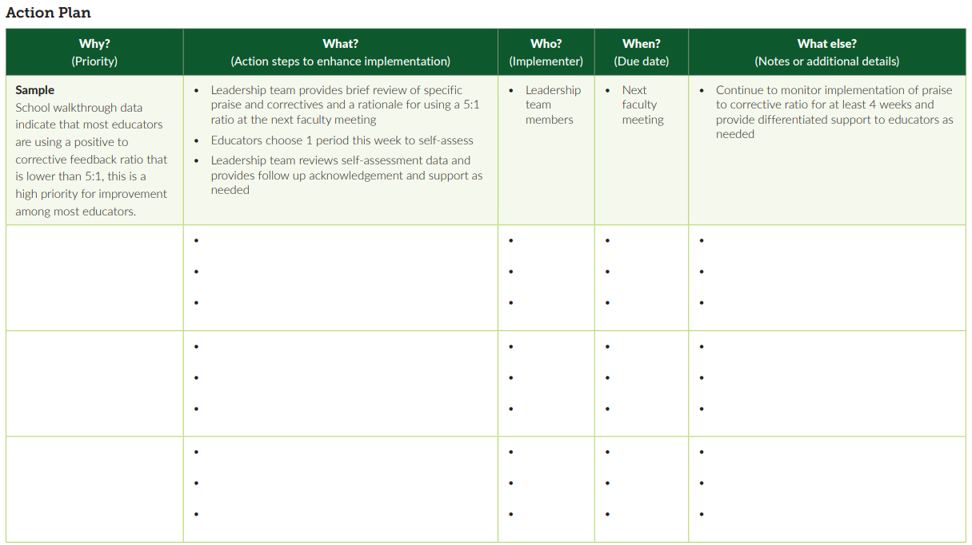
SELF-ASSESSMENT AND ACTION PLAN
Pages 47 & 48
Notes:
TRAINER NOTE: Please explain how at the end of this section teams will have more time to review this document and reflect on how this tool can assist them in action planning future professional development (targeting positive classroom supports, hopefully!).
RESOURCE LINK (p.47-48): https://sebacademy.edc.org/supporting-and-responding-educators-classroom-pbis-implementation-needs-guide-classroom-systems-and

Slide 17
STEPS TO SUPPORT EDUCATORS' IMPLEMENTATION
Let’s take a few minutes to focus on Step #2!
Page 14
Notes:
RESOURCE LINK (p.14): https://sebacademy.edc.org/supporting-and-responding-educators-classroom-pbis-implementation-needs-guide-classroom-systems-and

Slide 18
Embedded and Ongoing Professional Development
First, identify what staff need to know, then, provide…
Coaching/
Prompting
Explicit Training
Performance Feedback

Slide 19
CRITICAL TOPICS FOR STAFF PD
PBIS Rationale and Purpose
PBIS Handbook (e.g., matrix, discipline flow chart)
De-escalation Strategies (e.g., Neutralizing Routines)
Function of Behavior/Classroom information
Integrated Culturally Responsive Practices

Slide 20
ADDITIONAL STAFF PD CONSIDERATIONS
Behavioral principles to understand and support student behavior
Mental health and trauma informed care foundations
Community culture, values, and historical perspectives (in partnership with families & local community supports)
Effectively applying core practices with cultural competence
If your data from staff, student, family surveys or outcomes indicate a need, these areas may also be beneficial PD topics
Integrated TFI Companion Guide, 2021

Slide 21
Embedded and Ongoing Professional Development
First, identify what staff need to know, then, provide…
Coaching/
Prompting
Explicit Training
Performance Feedback

Slide 22
Embedded and Ongoing Professional Development
First, identify what staff need to know, then, provide…
Coaching/
Prompting
Explicit Training
Performance Feedback
Model, lead, test format
Demonstrate desired skill (I do)
Provide effective examples/non-examples
Provide sufficient group practice (We do)
Provide opportunities to demonstrate and receive feedback (You do)
Connected to/embedded in typical practice/routines
Brief training/practice spaced out

Slide 23
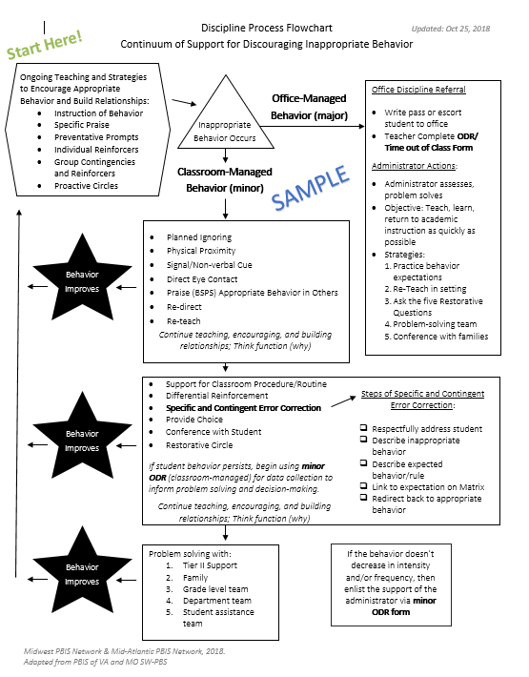
Train and Hope Method
Leadership Team shares the newly developed discipline flowchart with staff over email and asks everyone to start using it.

Slide 24
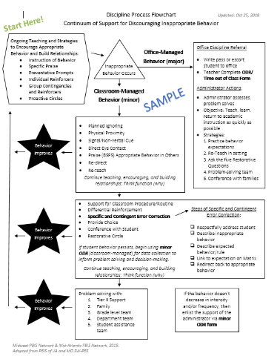
Explicit Training Example
Center School’s PBIS Leadership Team shares the finalized Discipline Flowchart (developed with staff input) to ALL staff.
A student scenario is provided and a team member performs a “think aloud” to model her interaction with a student. (I do)
Additional examples and non-examples of student-staff interactions are provided with opportunities for questions to be asked.
Another scenario is provided and small groups of staff discuss how to use the flowchart as a guide to their response. (We do)
One more scenario is provided. Each staff member writes down how they would respond and then shares the response with a colleague. (You do)
All staff are provided laminated copies of the Discipline Flowchart and are asked to focus on using it during dismissal time.
Next month…
each person writes an example of how they used the flowchart during dismissal and adds it to a Jamboard.
Staff are then asked to use the Discipline Flowchart throughout their daily routines.

Slide 25
Embedded and Ongoing Professional Development
First, identify what staff need to know, then, provide…
Coaching/
Prompting
Explicit Training
Performance Feedback
Prompt and remind educators of targeted practices implementation.
Provide supportive data-based feedback and suggestions for improving implementation.
Consider function not form: Supports may be delivered by internal or external coach, mentor, peer, or self).

Slide 26
Coaching Support
COACH
School/district coach conducts walkthrough observations and provides specific, supportive feedback
Mentors assigned to new educators provide feedback on use of PBIS practices
PEER
Educator pairs visit each other during instruction to gather data on specific practices and provide specific feedback/ support to one another
Communities of Practice are created to review critical features, share experiences, gather examples of core PBIS practices
SELF
Individuals commit to being a coach and providing support for 1 identified practice
Educators choose 1 practice to set goals for themselves, self-monitor (with a provided data collection tool) & self-reinforce when they meet their goal

Slide 27
Additional Coaching/Prompting Examples
For 8 weeks, a weekly email is sent out to staff reminding them to use the discipline flowchart when responding to student behavior incidents.
During grade level/ department meetings, teams discuss using the discipline flowchart and what works well and how to overcome barriers.
When staff follow the flowchart procedures for office-supported incidents, the administrator provides specific praise to the staff member.

Slide 28
Embedded and Ongoing Professional Development
First, identify what staff need to know, then, provide…
Coaching/
Prompting
Explicit Training
Performance Feedback
Data-based feedback (based on self-, peer-, or consultant collected data)
Summary of key observations
Delivered frequently (daily or weekly)
Specific suggestions for improvement or acknowledgements of good performance

Slide 29
Performance Feedback Example
After 3 months of a trial period, the Leadership Team shows staff ODR data and compares before and after PBIS implementation.
Staff receive specific, supportive feedback and targeted coaching support, as needed, to promote consistency with following procedures.

Slide 30
Align PBIS Practices to Fidelity Monitoring Procedures
FIRST...
THEN...
Provide explicit training, coaching/prompting, and performance feedback
Consider adding PBIS practices in evaluation procedures
Gather positive-to-corrective educator/student interaction ratio data
Share amount of time spent actively supervising during cafeteria duty
Count number of specific praise statements provided during a lesson

Slide 31
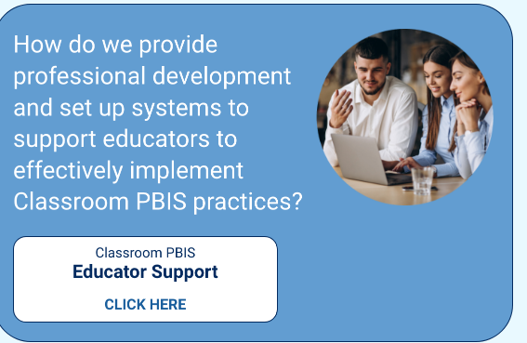
NEPBIS.org
CLASSROOM PBIS
Provides links to more information about systems to support educators!
Educator Support
CLICK HERE
Notes:
Classroom PBIS Educator Support Link: https://nepbis.org/classroom-pbis/educator-support/

Slide 32
Embedded and Ongoing Professional Development
First, identify what staff need to know, then, provide…
Coaching/
Prompting
Explicit Training
Performance Feedback
We need to provide staff with universal training and support for all components of the PBIS framework if we want them to implement!

Slide 33
Professional Development Planning
What content? | When will it be explicitly taught? | By who? | How will prompting and coaching occur? | How will staff be provided performance feedback?
Notes:
RESOURCE LINK: https://sebacademy.edc.org/embedded-professional-development-planning-activity

Slide 34
Guidelines for Embedded and Ongoing Professional Development
Ensure PD includes explicit training, performance feedback and ongoing coaching
Develop a PBIS PD Calendar and routines (e.g. 15 minutes of every staff meeting, 1 hour of early release days)
Align staff evaluation procedures with expected practices where possible

Slide 35
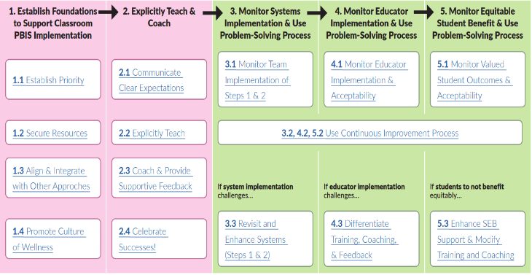
ACTIVITY: Developing a System of Embedded and Ongoing Professional Development
Consider how you will provide embedded and ongoing professional development to staff.
Review the Classroom PBIS: Systems and Data document. In particular, the system features supporting teaching and coaching.
Plan how you will incorporate these best practices on professional development and coaching using the PD planning activity document.
As always update your action plan and be prepared to report out!
25 minutes
Notes:
Classroom PBIS: Systems & Data Brief: https://sebacademy.edc.org/supporting-and-responding-educators-classroom-pbis-implementation-needs-guide-classroom-systems-and
Embedded Professional Development Activity: https://sebacademy.edc.org/embedded-professional-development-planning-activity

Slide 36
15-minute break

Slide 37
Planning for Next Year

Slide 38
As each step is read aloud, your thumb to identify your team’s current implementation level
We’ve got it!
We’re almost there!
We’re working on it!
Notes:
TRAINERS: Use this a lead into the next slide and refresher on getting started steps. Keep it quick with very brief descriptions/examples for each step

Slide 39
PREPARING FOR NEXT YEAR
What is Your Current Implementation Level?
10 Getting Started Steps are firmly in place and have sustained this past year
10 Getting Started Steps are developed by the team but need to be introduced to staff, students, and families
Plan for a rollout in the fall
Identify what worked well, adjust, and prepare for fall
10 Getting Started Steps are being developed by team
Identify what areas need to be developed and delegate tasks

Slide 40
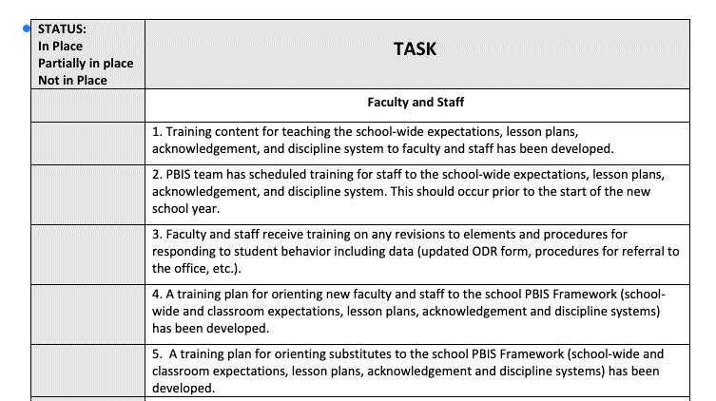
PBIS ROLLOUT CHECKLIST
Notes:
https://sebacademy.edc.org/rollout-checklist

Slide 41
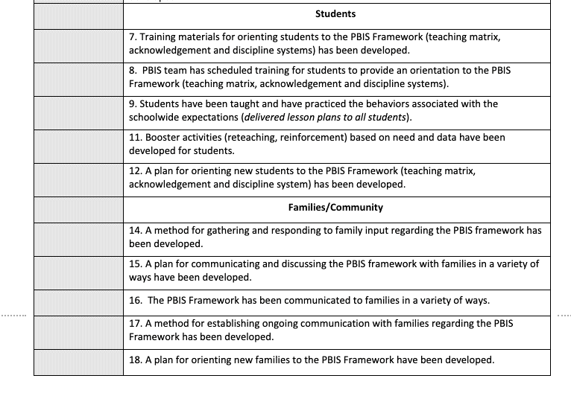
Notes:
https://sebacademy.edc.org/rollout-checklist

Slide 42
Create a PBIS Handbook
Staff Handbook
Student Handbook
Description of PBIS
SW Expectations
School Matrix
Lesson Plans
Overview of Acknowledgement System
Overview of Consequences
Classroom continuum of consequences
Problem behavior definitions
Discipline flowchart
Office Referral form
Request for Assistance form
Description of PBIS
SW Expectations
School Matrix
Home Matrix
Overview of Acknowledgement System
Overview of Consequences
Create a word document or slide deck! Upload it to a common folder.

Slide 43
PBIS Handbook and Orientation Examples
PBIS Handbook
PBIS Staff Orientation Slides
PBIS Student Orientation Slides
Notes:
PBIS Handbook Examples: https://sebacademy.edc.org/resources?type=All&tag=All&keyword=handbook
PBIS Staff Orientation Slides: https://sebacademy.edc.org/sample-pbis-staff-slide-deck
PBIS Student Orientation Slides: https://sebacademy.edc.org/sample-pbis-student-slide-deck

Slide 44
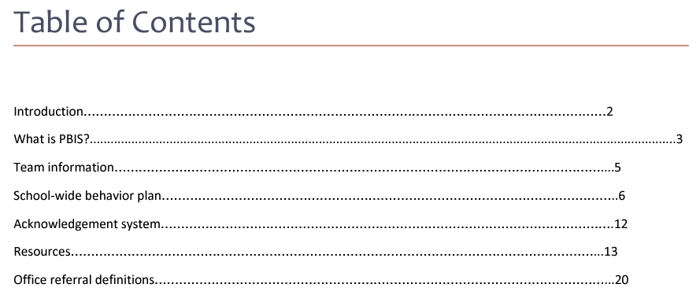
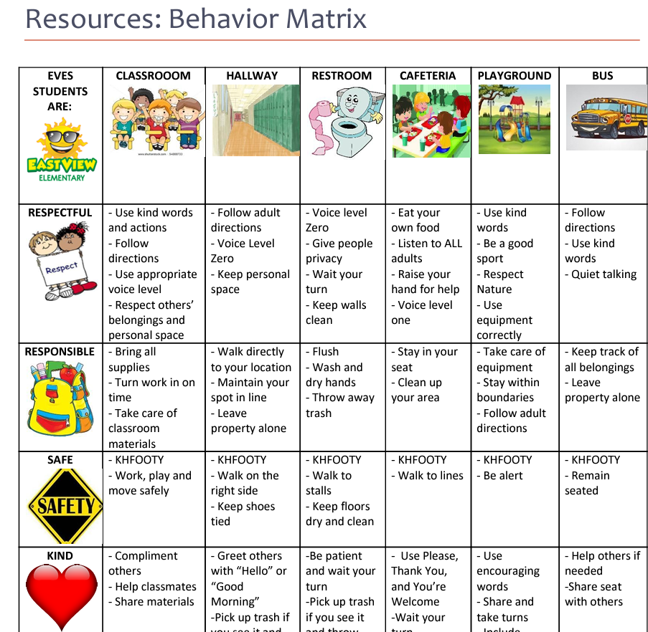
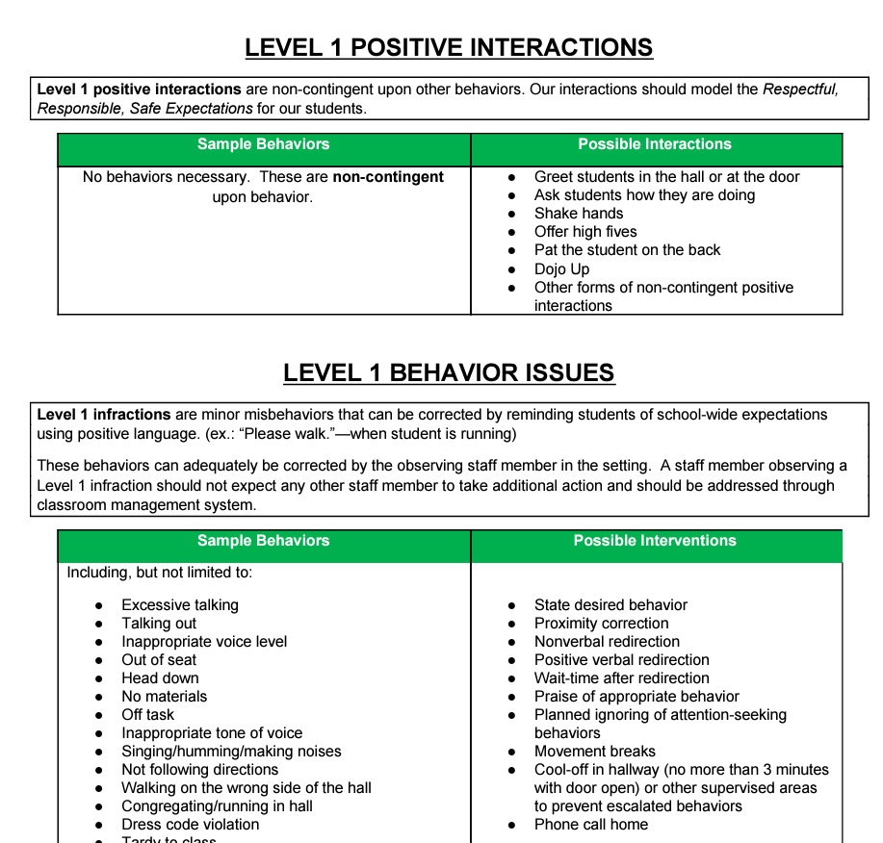
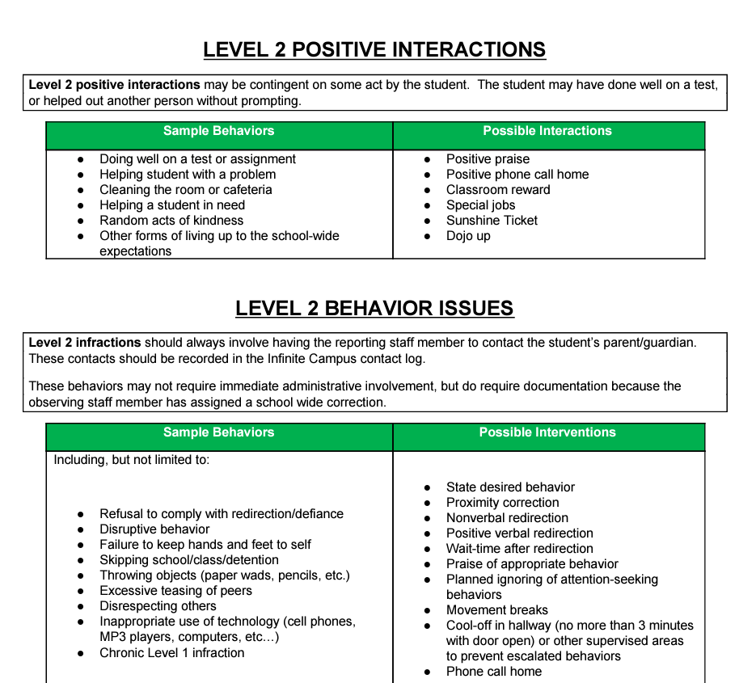
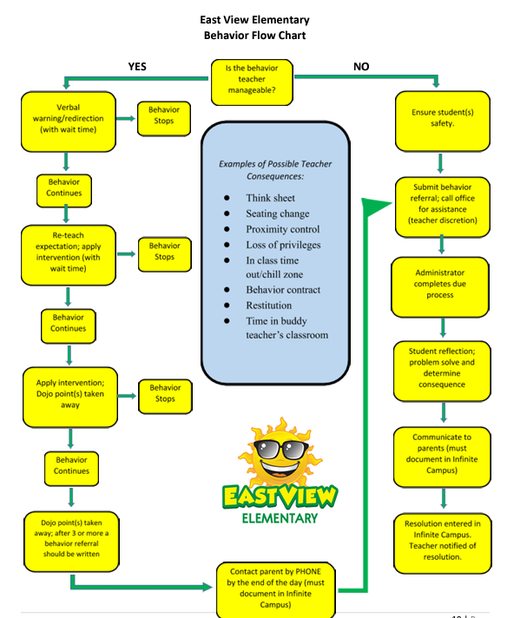
PBIS Handbook
Notes:
PBIS Handbook Examples: https://sebacademy.edc.org/resources?type=All&tag=All&keyword=handbook

Slide 45
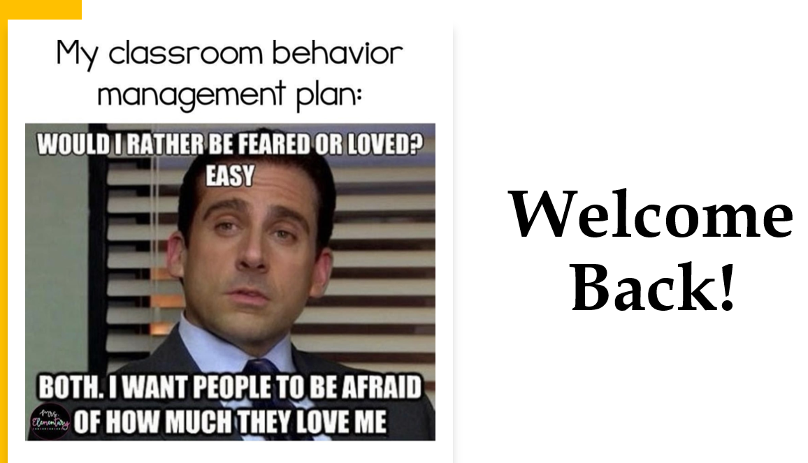
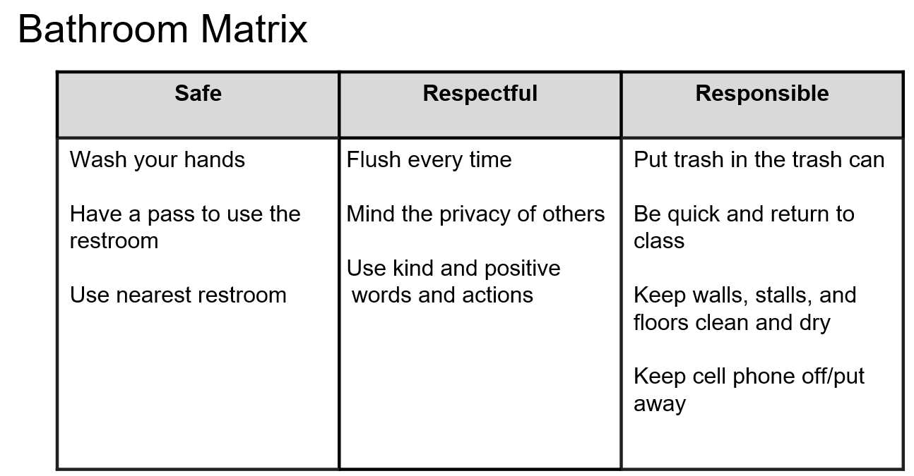
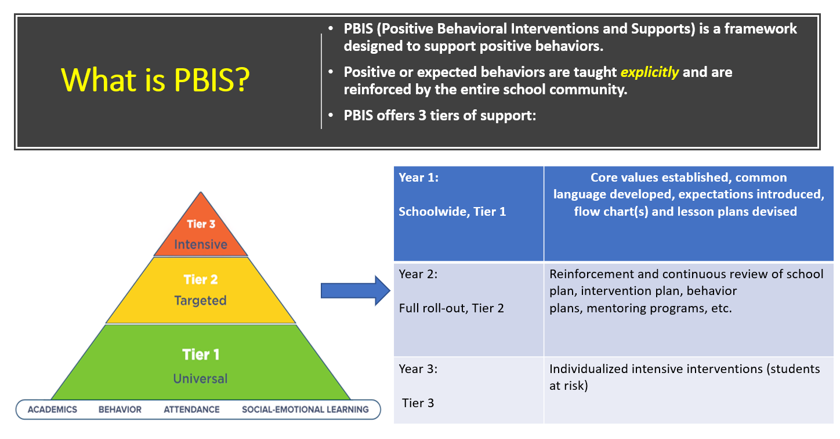
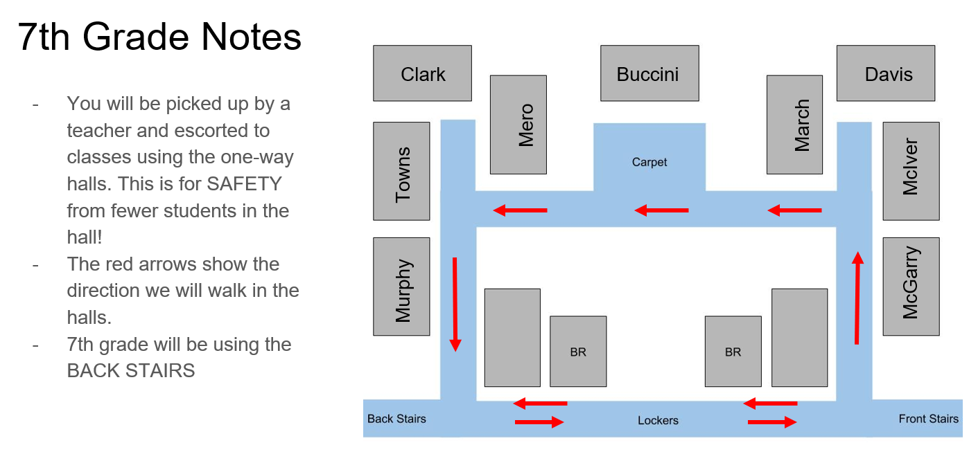
Slide Shows
STUDENTS
STAFF
Notes:
PBIS Staff Orientation Slides: https://sebacademy.edc.org/sample-pbis-staff-slide-deck
PBIS Student Orientation Slides: https://sebacademy.edc.org/sample-pbis-student-slide-deck

Slide 46
Looking Ahead: End of Year Evaluation
Notes:
Erik
10:20

Slide 47
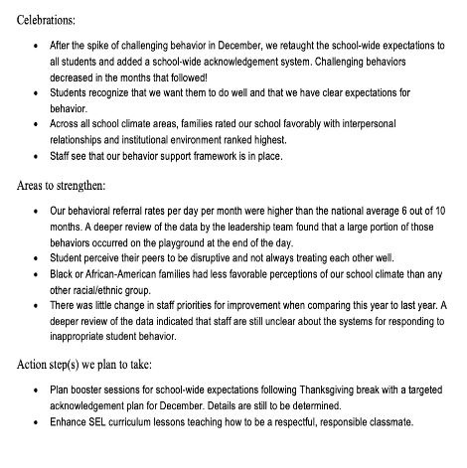
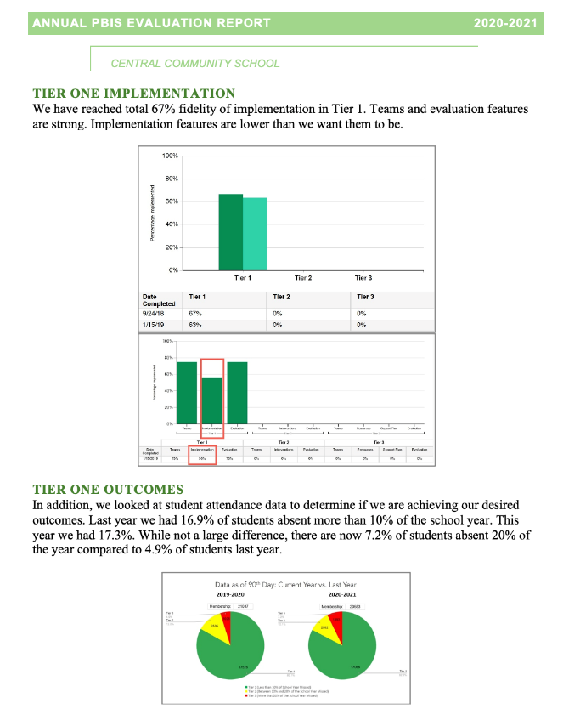
Implementation of the core components of PBIS is more likely if the Tier I team assesses the implementation status at least annually and provides “snapshot” reports to the staff, community, school board.
Notes:
Annual Tier 1 Evaluation Report (Sample school):

Slide 48
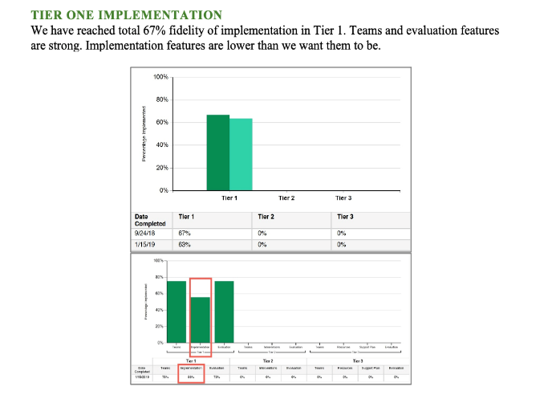
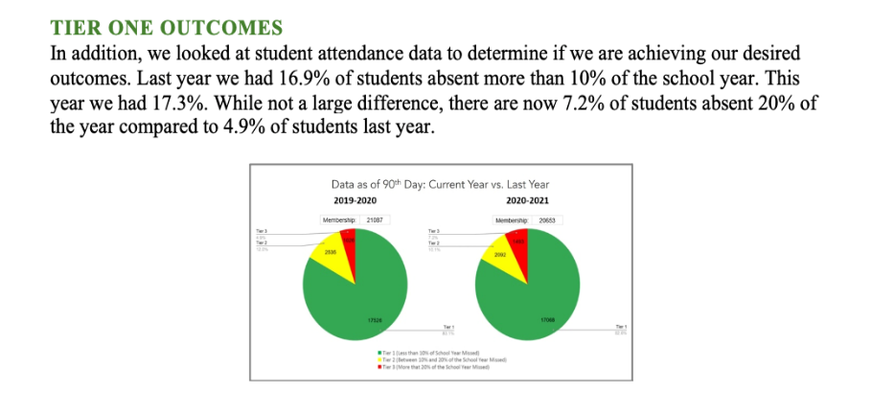
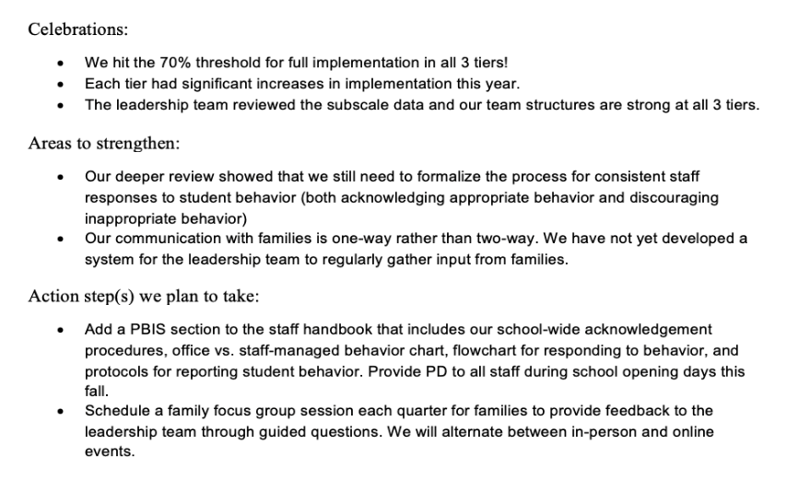
Outcome Data
Fidelity Data
Celebrations
Areas to strengthen
Action Steps
Notes:
TRAINER NOTE: Use this sample to discuss what each school might choose to include in a “snapshot” evaluation report

Slide 49
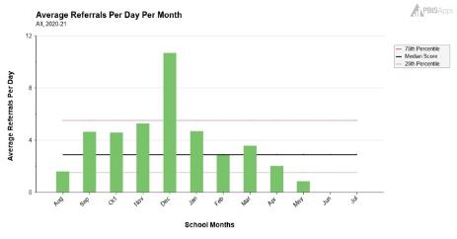
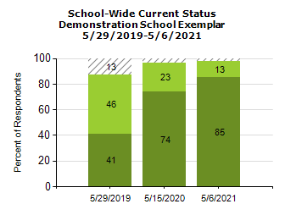
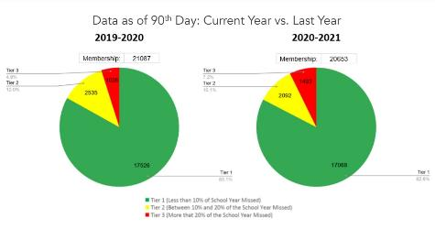
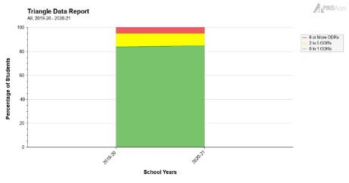
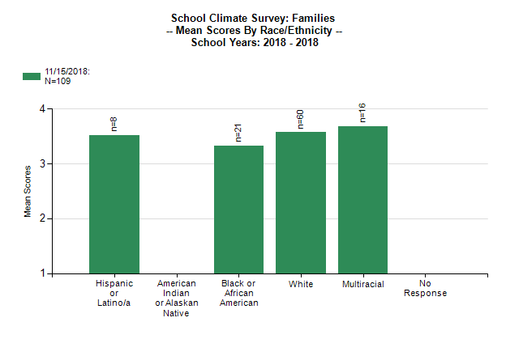
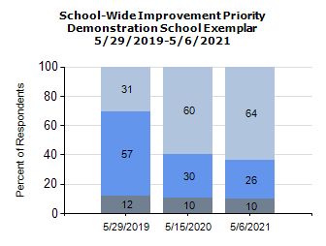
What Tier 1 outcome data can you use to complement your TFI data?
(Remember to consider your team's desired outcomes/goals as you decide!)
Staff
Self-assessment survey data
Behavior data
School climate data
(students, staff, families)
Attendance data

Slide 50
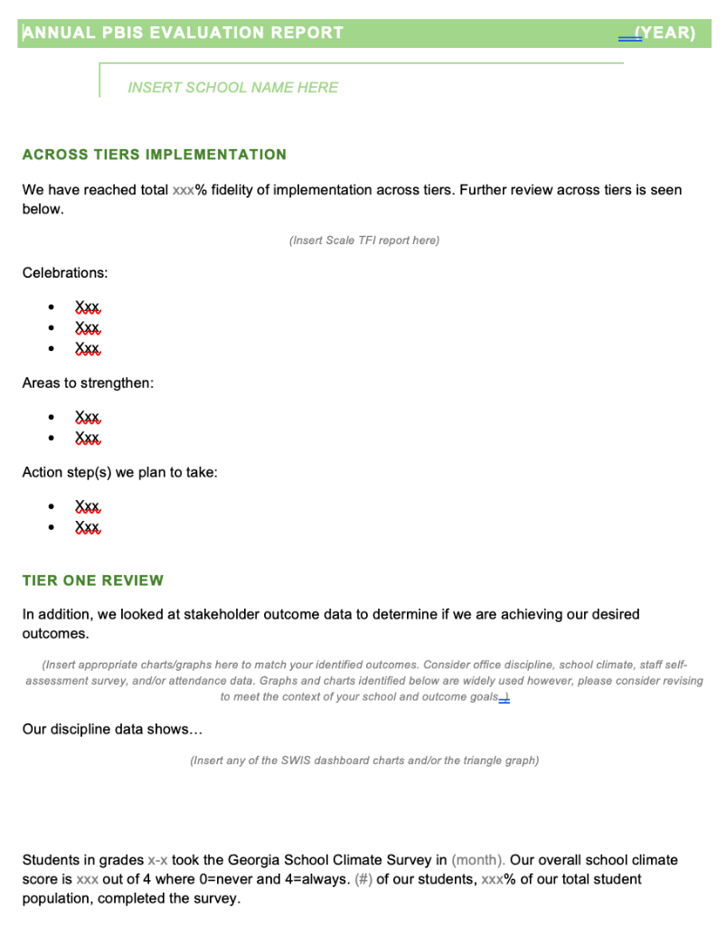
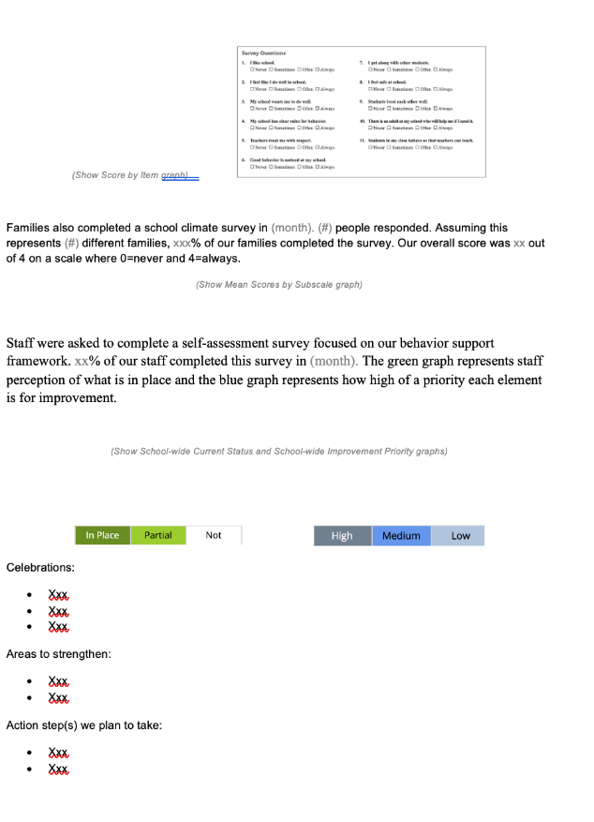
EVALUATION TEMPLATE
Add your data
Match your school’s context
Share with stakeholders
Notes:
TRAINER NOTE: This template is meant to be used as a guide. Schools should add/delete to meet their school context.
Annual Evaluation Template link: https://sebacademy.edc.org/annual-evaluation-report-template
Sample - Annual Evaluation : https://sebacademy.edc.org/annual-evaluation-report-sample

Slide 51
ACTIVITY: Evaluation Report and Planning
Review your goals and accomplishments from this year. What data relates to these?
Review your PBIS Handbook
Review planning for next year content with your team.
Identify priorities and action steps
How will this be shared?
Add to your action plan as needed
Notes:
Trainers: Place in team-based breakout rooms
Then ask for a few people to share with the whole group
Activity:
Discuss with your team:
What data can we add?
What can we celebrate? strengthen?
What action steps can be taken?
How will this get completed?
Who will we share this with? How?
Add to your action plan as needed
Be prepared to share what data you will share and who you will share it with.

Slide 52
LUNCH
Notes:
I tried to make lunch 11:30-12:30 Adapt as needed.

Slide 53
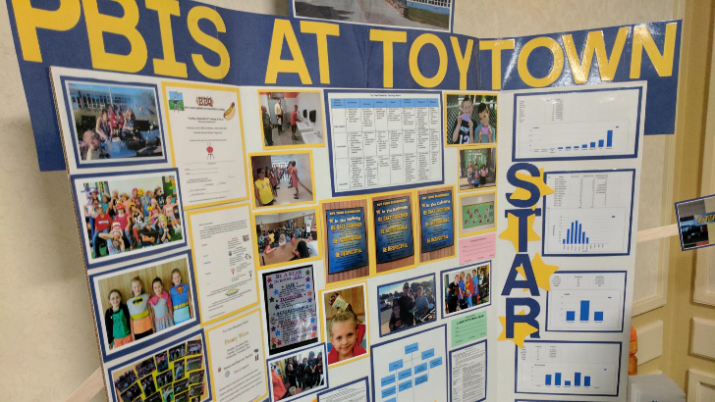
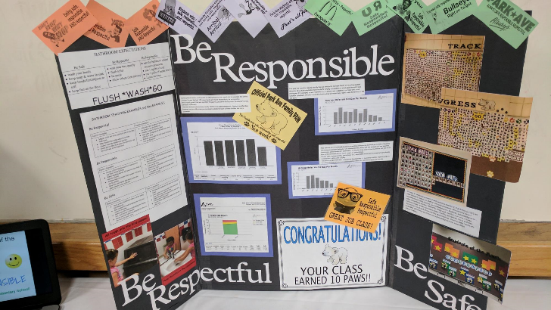
ACTIVITY: POSTER SESSION
First 10 minutes:
Set up your poster so that it is visible.
Second 50 minutes:
Each team will present their poster to the group
Ask questions / collect ideas
Take turns walking around and reviewing other school’s posters.
Bring information back for discussions with your team during action planning time.

Slide 54
TEAM TIME
1. Meet with your team and review notes from your poster discussions. What great ideas did you take away?
Choose your own adventure (or divide and conquer!), depending on your priorities and outcome goals for this year:
2. Review the Annual Evaluation Report template on website and plan to compile one this year.
3. Review an update your PBIS Handbook Have you included an overview of PBIS, Team Members, Matrix, Lesson Plans, Kick Off Teaching Plan, Acknowledgement System, Discipline Docs, Other Supporting Documents.
4. Update your team's action plan!
5. Share Out: What was one action item or goal your team identified?
Prepare to share 1 new action item or goal from your discussion.

Slide 55
HELPFUL READINGS & RESOURCES
RESOURCES:
Classroom PBIS: Systems & Data Brief
Supportive Environments Create Classroom Community
Rollout Checklist
Annual PBIS Evaluation Report Template
Annual PBIS Evaluation Report – SAMPLE
Embedded Professional Development Activity
Sample Staff Slide Deck
Sample Student PBIS Slide Deck
Sample PBIS Handbooks
Elementary 1
Elementary 2
Secondary 1
Secondary 2
Notes:
Classroom PBIS: Systems & Data Brief: https://sebacademy.edc.org/supporting-and-responding-educators-classroom-pbis-implementation-needs-guide-classroom-systems-and
Embedded Professional Development Activity: https://sebacademy.edc.org/embedded-professional-development-planning-activity
PBIS Evaluation Report https://sebacademy.edc.org/annual-evaluation-report-template
PBIS Evaluation Report Sample https://sebacademy.edc.org/annual-evaluation-report-sample
Sample PBIS Handbooks: https://sebacademy.edc.org/resources?type=All&tag=All&keyword=handbook
Sample Student Slide Deck https://sebacademy.edc.org/sample-pbis-student-slide-deck
Sample Staff Slide Deck https://sebacademy.edc.org/sample-pbis-staff-slide-deck

Slide 56
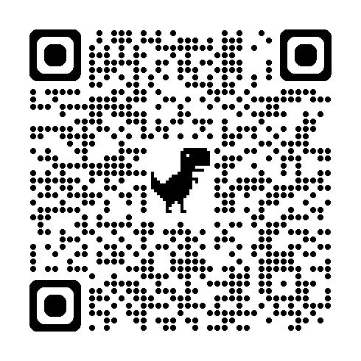
Cohort 9A EVALUATION
Please remember to complete the evaluation!
Scan the QR code to access.
Notes:
TRAINERS -
Put link to evaluation (below) in the chat for those who do not use the QR code:
Evaluation Survey: https://go.edc.org/Cohort-9A-Evaluation

Slide 57
Cohort 9B EVALUATION
Please remember to complete the evaluation!
Scan the QR code to access.
Notes:
TRAINERS -
Put link to evaluation (below) in the chat for those who do not use the QR code:
Evaluation Survey: https://docs.google.com/forms/d/e/1FAIpQLSdz32jKVAGdKiP3VzhqzA91uJEu8DkBOeJZo9-FDfnKBx_vDQ/viewform

