Slide 1


PBIS School-Wide Team Training
Year 2: January 24
Trainer Names Here
Created from content from the National Technical Assistance Center on Positive Behavioral Interventions and Supports
U.S. Department of Education, Office of Special Education Programs and Office of Elementary and Secondary Education
with support from NEPBIS Network, May Institute, & Broad Reach Consulting

Slide 2

EXPECTATIONS
Self
Others
Environment
Self-monitor
Listen while others are speaking​
Have your computer charged and ready to go​
If you have questions or comments:
Work as a team:
Keep necessary materials at hand
Are you participating?
Engaged as a learner?
Stretch, break, stand as needed​
Raise hand
Room for every voice
Reinforce participation
action plan
relevant docs
water/snacks
Minimize distractions if possible​

Slide 3
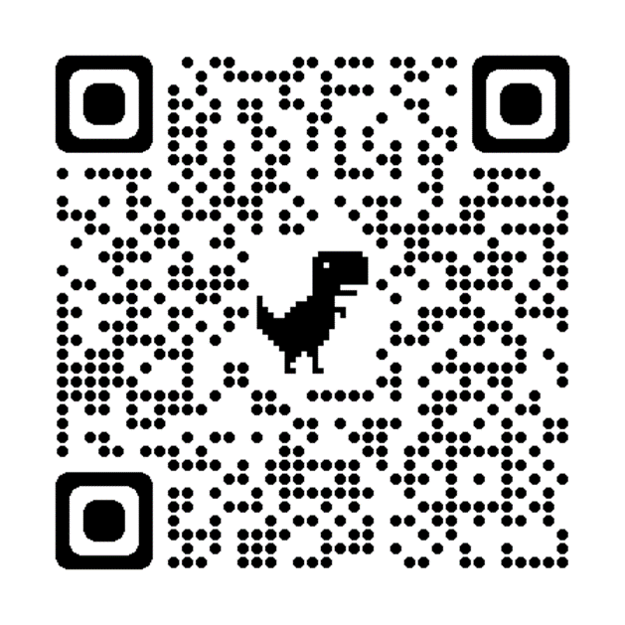
ACTIVITY: ATTENDANCE
Scan QR code on the left or follow the URL posted in the chat to access the online attendance survey
Follow prompts to enter attendance information
Notify trainers if you require assistance (e.g., identifying your cohort or cohort group)
Certificates of Attendance will be sent in January and June. Attendance records will be use as verification
You are in Cohort 9
1 minute
Notes:
ATTENDANCE: https://edc.co1.qualtrics.com/jfe/form/SV_81vbI1jl3cwmLY2

Slide 4
Agenda & Team Tasks
Team Tasks
Presentation Content
Discuss what you might need in order to disaggregate data to better tailor your school wide supports.
Plan to assess classroom strategies and present classroom practices
Sharing: Acknowledgement Systems
Function of Behavior
Classroom Practices Part 2 and Review Classroom Assessment
Implicit Bias
Disaggregating Data
Tiered Fidelity Inventory (TFI) Self-Assessment & Team time
Complete TFI Self-Assessment as a team and update your Action Plan (Share updated action plan with your trainer).
We’ve planned 90 mins of team time during this training event

Slide 5
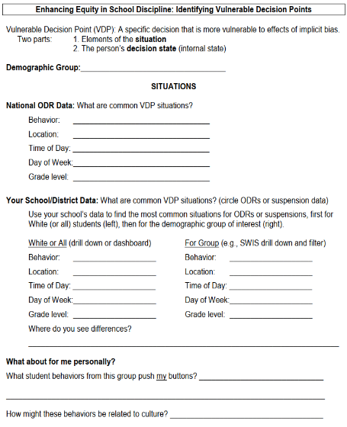
HELPFUL READINGS & RESOURCES
RESOURCES:
Supporting & Responding to Student's Social, Emotional, and Behavioral Needs (Classrooms)
Supportive Environments Create Classroom Community
Classroom Support Systems Brief
The Classroom Management Observation Tool (CMOT)
Self-Assessment Survey
Implicit Bias in Early Learning Video
Tiered Fidelity Inventory
TFI Tier 1 Quick Check Tip Sheet
TFI Action Plan
Notes:
Supporting & Responding to Student's Social, Emotional, and Behavioral Needs (Classrooms) - https://sebacademy.edc.org/supporting-and-responding-students-social-emotional-and-behavioral-needs-classrooms
Supportive Environments Create Classroom Community - https://sebacademy.edc.org/supporting-and-responding-students-social-emotional-and-behavioral-needs-classrooms
Classroom Support Systems Brief - https://sebacademy.edc.org/classroom-support-systems-brief
The Classroom Management Observation Tool (CMOT) - https://sebacademy.edc.org/classroom-management-observation-tool-cmot
Self-Assessment Survey www.pbisapps.org/resource/self-assessment-survey
Nepbis.org Classroom PBIS website: https://nepbis.org/classroom-pbis/
SWIS Drill Down Worksheet: https://sebacademy.edc.org/swis-drill-down-worksheet
Implicit Bias in Early Education Video: https://www.youtube.com/watch?v=ucEAcIMkS0c
Vulnerable Decision Points Worksheet: https://sebacademy.edc.org/vulnerable-decision-points-vdp-worksheet
Tiered Fidelity Inventory: https://sebacademy.edc.org/tiered-fidelity-inventory-tfi-manual
TFI Tier 1 Quick Check Tip Sheet: https://sebacademy.edc.org/tfi-tier-1-quick-check-tip-sheet-scoring
TFI Action Plan: https://sebacademy.edc.org/tfi-action-plan-template

Slide 6
SEB Academy – PBIS Track Website
https://sebacademy.edc.org/

Slide 7

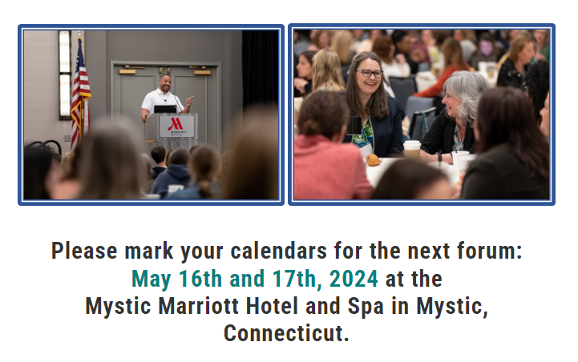
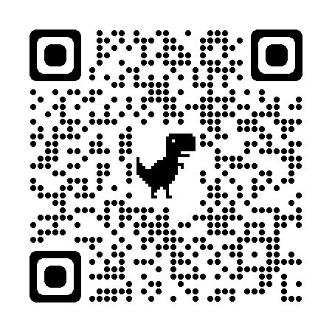
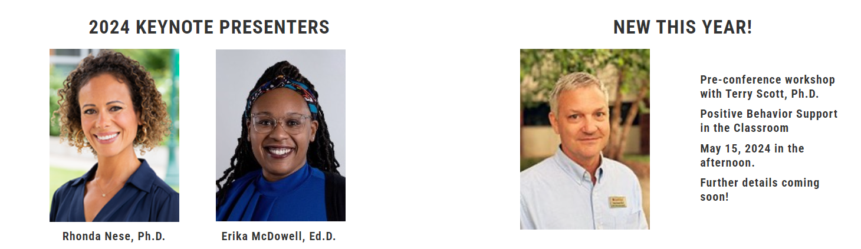
May 16 & 17, 2024
Mystic Marriott Hotel and Spa
Mystic, CT
https://nepbis.org/forum/

Slide 8
SHARING:
ACKNOWLEDGEMENTS

Slide 9
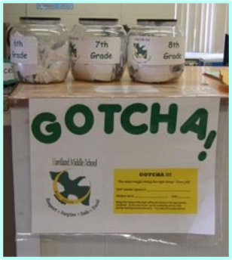
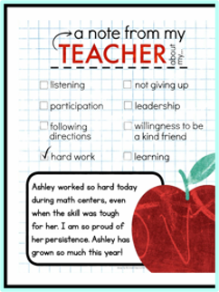
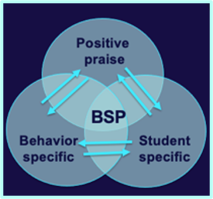
SHARING: How Do you Acknowledge students and staff for using school-wide expectations
Suggested items for sharing with others today.
How do you acknowledge your students/adults?
What are the different types of acknowledgements that you use for different types of motivation?
How were students involved in identifying acknowledgments?
What went well this year? And what would you like to change for next year?

Slide 10
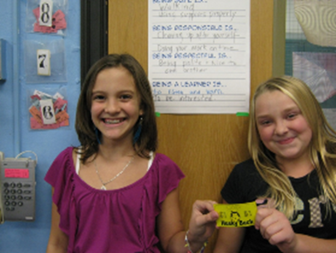
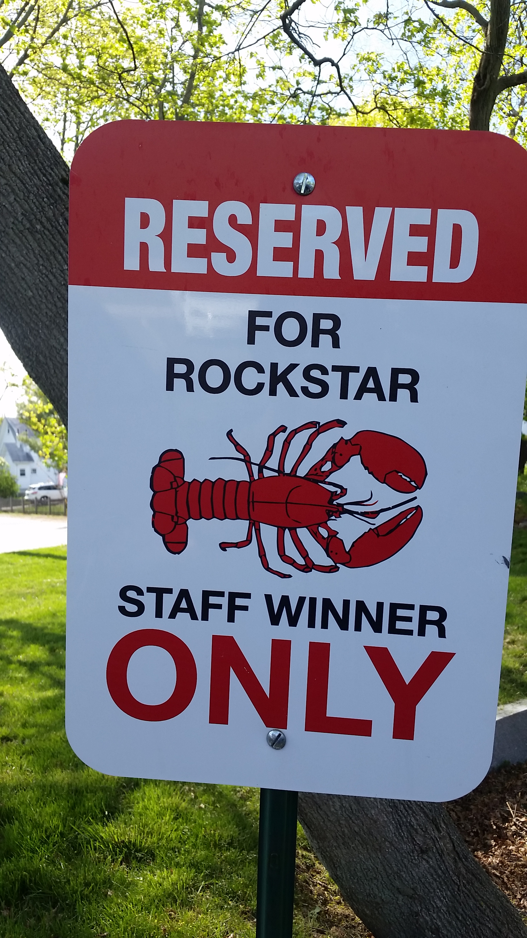
ACTIVITY: CROSS-SCHOOL SHARING
1. Randomize participants into 4 or 5 groups.
2. In each group take turns sharing how your Acknowledge students and staff for demonstrating the school wide expectations.
3. Ask questions and take good notes.
4. Bring new examples back to your team for action planning!
20 minutes
Randomized Groups

Slide 11

FUNCTION OF BEHAVIOR

Slide 12
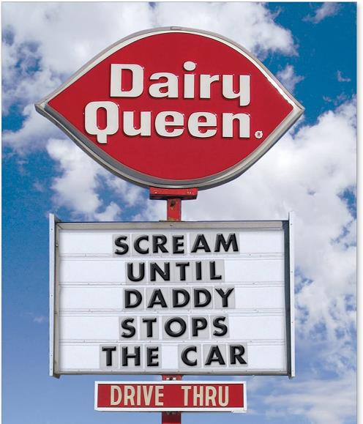
Before we can effectively encourage or discourage behavior, we need to understand why behavior happens AND how to identify why the behavior is continuing!

Slide 13
A basic understanding of the science of behavior change:
Gives us tools to observe, measure, teach, and correct behaviors effectively and efficiently.
Moves us away from perceptions, opinions, and assumptions about motivations or intentions
Shares the following assumptions (see right)
Behavior is communication.
Behavior occurs in the context of an antecedent and consequence.
Behavior is learned (function).
Behavior is lawful (function).
Behavior is escalated through successive interactions (practice).
Behavior can be changed through an instructional approach.
(Colvin & Sugai, 1989)

Slide 14
All behavior serves a function...
Get/Obtain
desired activities
tangible items
Avoid/Escape
aversive activities
tangible items
attention
sensory stimulation
attention
sensory stimulation
“Function” = outcome, result, purpose, consequence

Slide 15
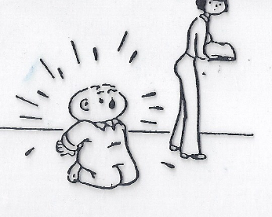
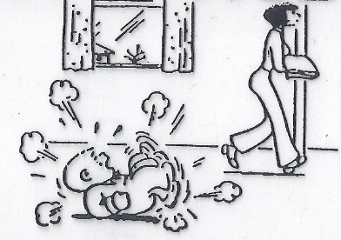
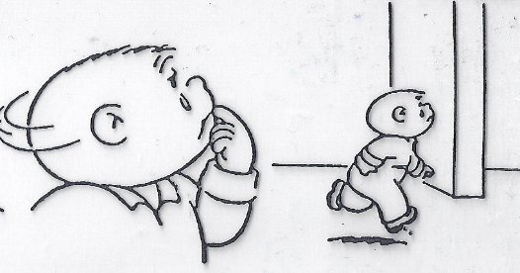
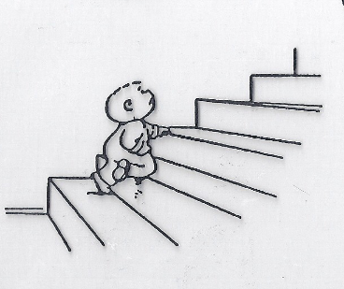
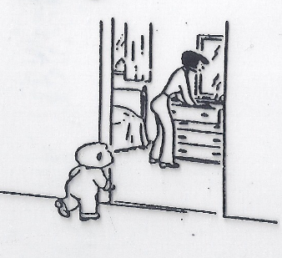
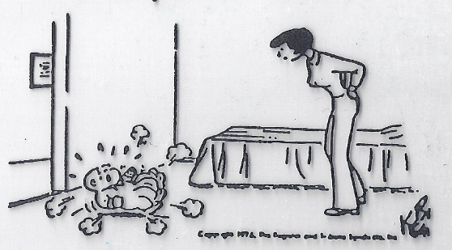

What's the function?
Notes:
Child function = Get Parental Attention
Adult Function = Escape tantruming child

Slide 16
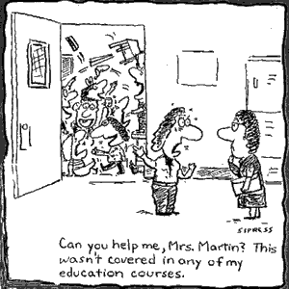
What's the function?
I’m sending my whole class to the office!

Slide 17

Non-examples of Function-Based Approach
“Lantana, you skipped 2 school days, so we’re going to suspend you for 2 more.”
“Phebe, I’m taking your book away because you obviously aren’t ready to learn.”
Why are these
NON-examples of a
function-based approach?
  “You want my attention?! I’ll show you attention…
  let’s take a walk down to the office & have a little chat with the principal.”

Slide 18
BUILDING BLOCKS OF BEHAVIOR: Three Term Contingency
What typically precedes?
What do the behaviors look like?
What typically follows?
Antecedent
Behavior
Consequence
Based on observing patterns across time,
we can infer the probable function of behavior.

Slide 19

Let's practice...
During teacher lecture, Martha repeatedly and loudly calls out (without raising her hand). Each time, the teacher gives her a look, a redirection, or occasionally calls on her.
Teacher lecture (limited attention)
Calling out repeatedly
Teacher attention
Antecedent?
Behavior?
Consequence?
What Function?
Get/obtain Attention
Notes:
TRAINER NOTE: It is recommended that you practice a couple of the practice items. The additional practice items are available if additional practice is necessary or requested.

Slide 20
When given a difficult writing assignment Susannah regularly throws her pencil down, rips up her paper, and puts her head down. Her teacher ignores this behavior (and Susannah never completes her assignment).
Difficult writing assignment
Throw pencil, rip paper, head down
Nothing (doesn’t do assignment)
Antecedent?
Behavior?
Consequence?
What Function?
Escape task

Slide 21
A 6th grade teacher found that over 30% of the behavioral incident reports coming from her classroom occurred as students were being dismissed from class.
Physical contact & arguing
Getting to the hallway
Too many students leaving the room at once & confusion over where to turn in work
Antecedent?
Behavior?
Consequence?
What Function?
Getting access to peers in hallway

Slide 22

By understanding function, we can intervene more effectively.
How can we prevent?
What should we teach the student to do instead?
How do we respond to make sure the new skill “works”?
Prevent
Teach
Respond
We can make simple tweaks to the antecedents, behaviors, and consequences, to prevent, teach, and respond, respectively.

Slide 23
Let’s practice
During teacher lecture, Martha repeatedly and loudly calls out (without raising her hand). Each time, the teacher gives her a look, a redirection, or occasionally calls on her.
Provide attention ahead of lecture and frequent eye contact during
Teach and prompt hand raising
Call on her ONLY when she raises her hand (otherwise ignore)
Prevent?
Teach?
Respond/
Reinforce?
Simple strategies like this are part of effective
“Tier 1” responses to minor contextually inappropriate behavior.

Slide 24
When given a difficult writing assignment Susannah regularly throws her pencil down, rips up her paper, and puts her head down. Her teacher ignores this behavior (and Susannah never completes her assignment)
Modify writing assignment
Teach and prompt her to ask for help/break
Give immediate help/break when asked. Otherwise, redirect to task.
Prevent?
Teach?
Respond/
Reinforce?
With these simple tweaks, we’ve made it less likely for her to
engage in contextually inappropriate behavior to escape difficult tasks.

Slide 25
A 6th grade teacher found that over 30% of the behavioral incident reports coming from her classroom occurred as students were being dismissed from class.
Dismiss one table or row at a time.
Collect student work before dismissal.
Teach and prompt waiting behavior (how to keep busy while waiting) and traffic flow routines.
Provide acknowledgement to students waiting, walking, and using accurate traffic flow patterns.
Prevent?
Teach?
Respond/
Reinforce?
With these strategies, we’ve reduced opportunities for crowding, taught
the expectations and reinforced students for meeting the expectations.

Slide 26

ACTIVITY: Function of Behavior
Practice applying a function-based approach to a Tier 1 problem:
  Identify a common problem behavior in a non-classroom or classroom setting (e.g. students pushing one another while waiting in cafeteria line; many students not completing assignments)
  Describe the “ABCs”
  Identify strategies to prevent, teach, and respond/reinforce
Plan how this content can be incorporated in current PD provided to staff on school or classroom support?
Be ready to present 2-3 “big ideas” from your discussion.
15 minutes

Slide 27
WHOLE GROUP DEBRIEF: Function of Behavior
Share 1-2 highlights from your team discussion.
What support will you need to promote function-based thinking within your school?
5 minutes

Slide 28
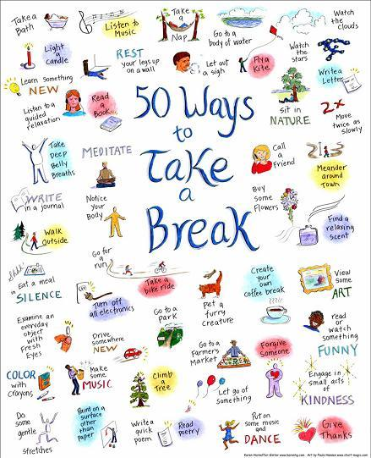
10-minute break

Slide 29
CLASSROOM BEHAVIOR SUPPORT PRACTICES & SUPPORT SYSTEMS

Slide 30

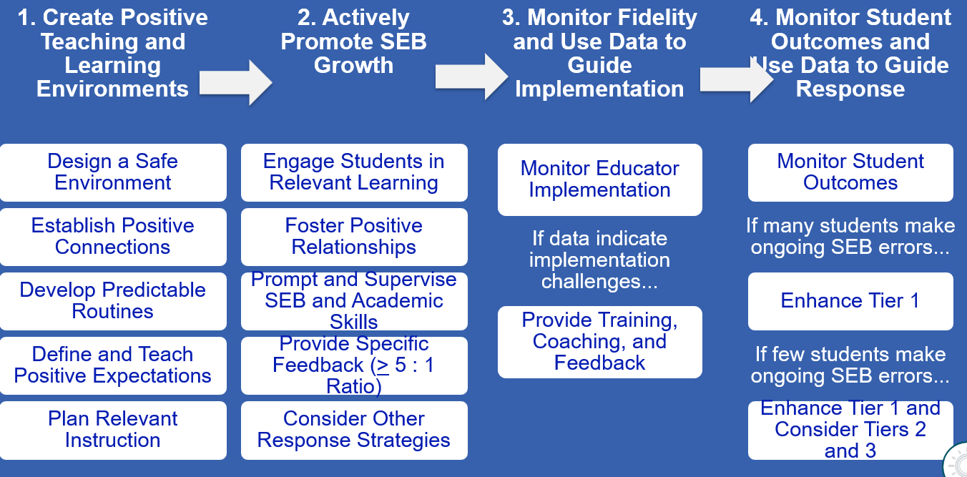
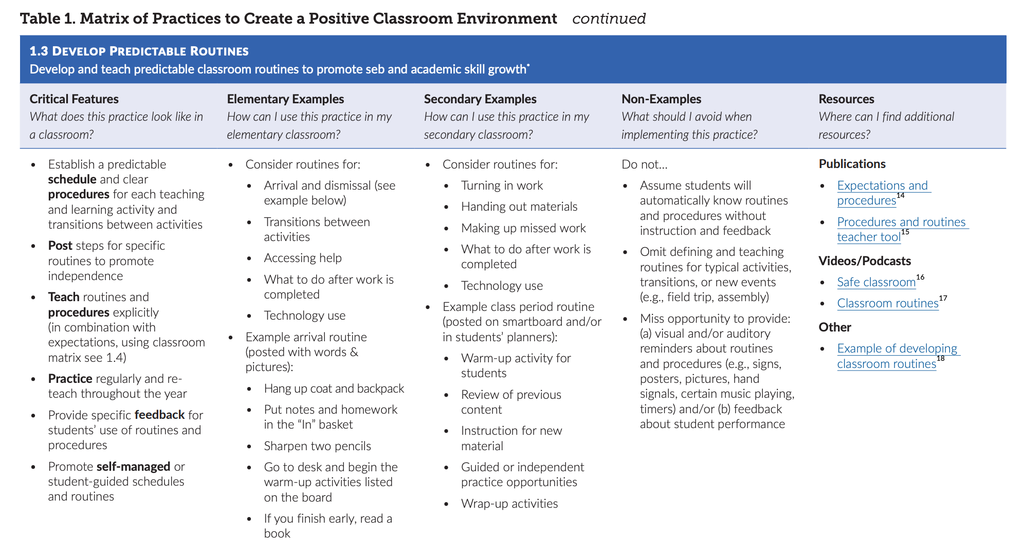
Center on PBIS. (2022). Supporting and responding to student’s social, emotional, and behavioral needs: Evidence-based practices for educators (Version 2.0). Center on PBIS, University of Oregon. www.pbis.org.
Notes:
Incorporate familiar resources, such as the Supporting and Responding to behavior document, which can be found on PBIS.org and provides useful tools for organizing class-wide supports.
Please add this document to the chat: https://www.pbis.org/resource/supporting-and-responding-to-behavior-evidence-based-classroom-strategies-for-teachers

Slide 31
1. Create Positive Teaching and Learning Environments
Design a Safe Environment
Establish Positive Connections
Develop Predictable Routines
Define and Teach Positive Expectations
Plan Relevant Instruction
REVIEW
Have you shared this with staff? Do classrooms have routine matrices?
Notes:
Supporting & Responding to Student Behavior: https://www.pbis.org/resource/supporting-and-responding-to-behavior-evidence-based-classroom-strategies-for-teachers

Slide 32

Design a Safe Environment
REVIEW
Match classroom layout to common instructional activities
Arrange furniture for smooth traffic flow by teachers and students
Maintain neat, orderly, accessible instructional materials for all students
Consider unique student needs and ensure accessibility
Post visuals to support critical content and reflect diversity of classroom community
Notes:
Help teachers ensure that their classroom is save and conducive to learning. Have teachers with effective environments help other staff or take photos to shar.

Slide 33

Establish Positive Connections
REVIEW
Engage in purposeful communication with students and families
Build in regular opportunities for positive connection throughout the year
Use formal and informal approaches to learn about students and their learning histories, identities, and preferences
Authentically engage families as partners in learning
Validate and affirm personal and cultural learning histories
Notes:
Teachers need to take every opportunity to get to know students and their families. Strong classroom connections help to reduce problem behaviors or avoid escalation

Slide 34

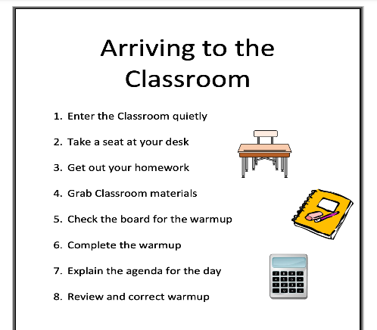
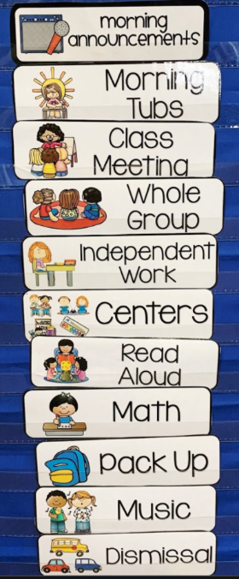
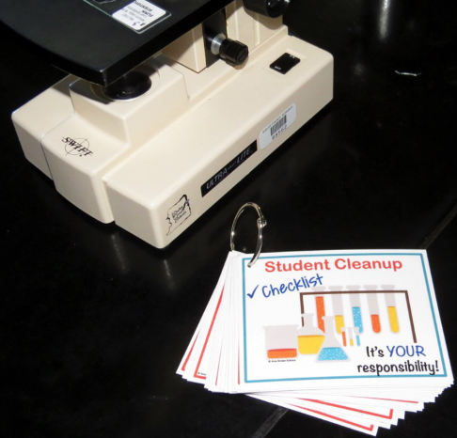
Develop Predictable Routines
REVIEW
Establish a predictable schedule and clear procedures for each activity and transition
For each routine/procedure:
Post steps to promote independence
Teach explicitly
Practice regularly and reteach frequently
Provide specific feedback on student use
Notes:
Clear, predictable routines are paramount! Routines need to be explicitly taught to students and practiced often.

Slide 35

Classroom Matrix SAMPLE
REVIEW
 | Entering Class | Lecture/ Presentation | Work Time | Electronics | Leaving Class
Be Respectful | Enter calmly. Be seated before the bell rings. Keep hands off other people’s property. Leave desks and chairs in place. | Listen attentively. Wait for your turn. Have a positive attitude. Keep feet on the floor. | Work quietly. Do your share in group projects. Be cooperative. Keep area clean. | Keep off until needed. Turn off volume. Use gently and carefully. Download large files after school. | Stay in your seat. Clean up around your desk. Push chairs in.
Be Responsible | Have books and materials out and ready to go. | Take notes. Meet deadlines. Focus on your learning. | Follow directions. Get help when needed. Do your own work. | Stay on task. Text/call people only during allowed times. | Return supplies. Report accidents promptly.
Be Safe | Walk | Be thoughtful and considerate of others. | Let others do their work. | Model digital citizenship. | Leave calmly when dismissed.
Be Prepared | Bring all materials. | Remain in your seat. | Use time wisely. | Have computer charged and ready to use. | Know expectations for next class.

Slide 36

Plan Relevant Instruction
REVIEW
Ensure instructional materials and activities celebrate diversity of students and families
Select curricula (or adapt existing curricula) and activities that are relevant for your students’ learning history and needs
Consider various dimensions of each activity (e.g., difficulty, duration of task, choice, communication needs)
Plan differentiation to meet the needs of all learners
Notes:
Engaging lessons with lots of student input and opportunities to respond keep students on task and engaged. Embedding diversity into your instructional materials and differentiating for a variety of learners ensures all students can comprehend the topic and keeps it meaningful for all.

Slide 37
3 Key Positive and Proactive Practices
1. Create Positive Teaching and Learning Environments
Design a Safe Environment
2. Actively Promote SEB Growth
Engage Students in Relevant Learning
Establish Positive Connections
Develop Predictable Routines
Define and Teach Positive Expectations
Foster Positive Relationships
Prompt and Supervise SEB and Academic Skills
Provide Specific Feedback (> 5 : 1 Ratio)
Consider Other Response Strategies
Plan Relevant Instruction
Prompts
Opportunities to Respond
Specific Praise

Slide 38
Prompts

Slide 39

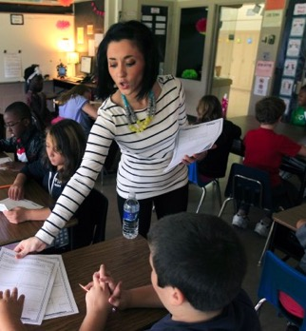
Prompts happen BEFORE opportunities for errors begin!
If you need help during this work,
raise your hand.
Before sending students off to work in small groups, provide a quick reminder about the expectations

Slide 40

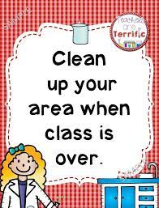
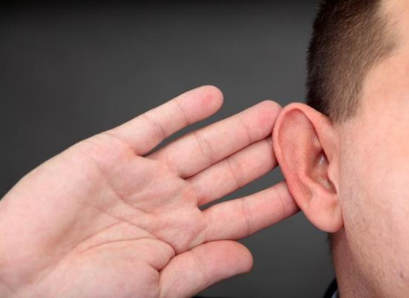

Classroom Prompt Examples
WELCOME
As you come in,
did you remember:
something to write with?
your homework?
your planner?
our textbook?
Visual reminders
Gestural reminders

Slide 41


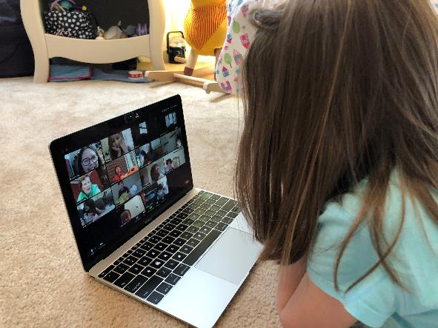

Classroom Prompt Examples
“As you head out, remember to use talk quietly in the hallway."
Verbal reminders
“Remember to mute unless its your turn”
“Remember to read to yourself”

Slide 42

Video Example: Prompting HS students before a test
https://youtu.be/fcnG1F-lQyA?t=258

Slide 43
Specific Praise
≥5:1 Ratio

Slide 44

What is it?
Behavior Specific Praise
“a positive statement, typically provided by the teacher, when a desired behavior occurs (contingent) to inform students specifically what they did well.”
"That was a hard problem and you stuck with it.
Great job!
"Nice hand raise!"
"It was kind to help your friend like that!"
"Clear pronunciation. Well done."
"You asked for help when you needed it! Terrific!"
"You walked to get into line. Way to go!"
(Simonsen et al. 2008, pp. 362, 364, emphasis added)

Slide 45
Provide Specific Feedback (>5⁺ : 1⁻ ratio)
Use specific praise to encourage SEB and academic skills
Use brief specific corrections to reduce errors
Provide at least 5 praise statements for each correction
Engage students in providing specific praise to one another

Slide 46

Bad Stronger than Good
The brain handles positive and negative information in different hemispheres, negative emotions generally involve more thinking, and the information is processed more thoroughly than positive ones.
Negative events wear off more slowly than good ones.
Most people can take in only one critical comment at a time.
We need to increase the positives to compensate.
We tend to ruminate more about unpleasant events — and use stronger words to describe them — than pleasant ones.
Roy F. Baumeister Florida State University, 2001, “Bad Is Stronger Than Good,”

Slide 47

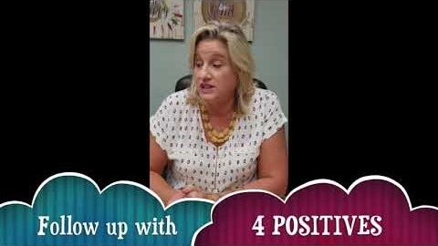


https://youtu.be/Cr_s3kzjX-g?t=2
https://youtu.be/ziooxzOF11o
https://youtu.be/0dcQuyK5Pqg
https://youtu.be/Owj81Q-dBOw

Slide 48
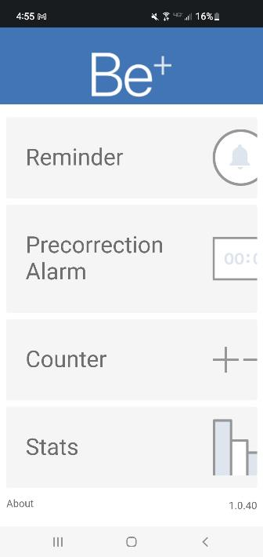
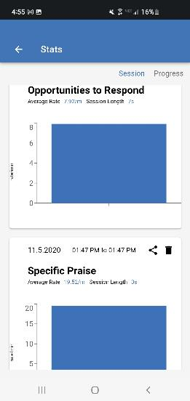
Receive Frequent Recognition & Encouragement
B+ App
Available through your phone’s app store
Failure/Correction
(punishment)
Success
(acknowledgement)
5 : 1
(Scott, 2008)
Notes:
Studies show that in order to be successful the positives need to exceed the negatives by a ratio of more than 5 to 1.
If the consequence was access to technology and the behavior increased, then the access was a reinforcer.
If the consequence was sending the student to the office and the behavior increased, then the removal was a reinforcer.
If the consequence was a reprimand (which included adult attention), and the behavior increased, then the reprimand was a reinforcer.

Slide 49
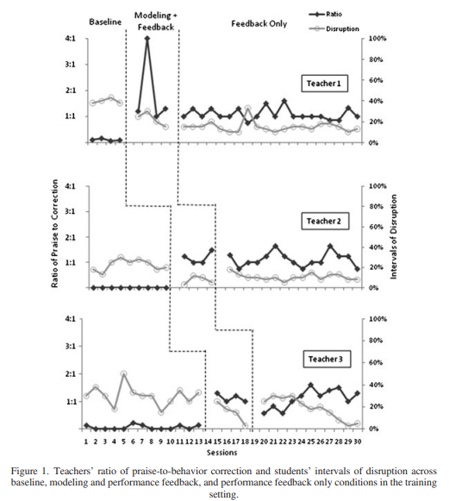
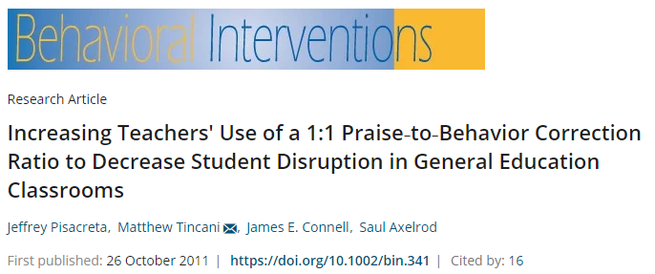
Ratio of Praise to Correction
Upon increase of praise to behavior correction to a 1:1 ratio, problem behavior decreased

Slide 50
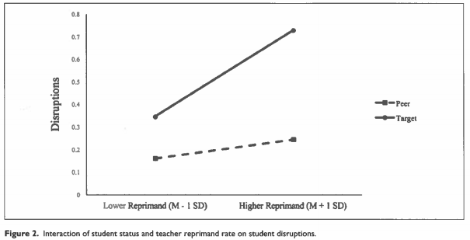
Ratio of Praise to Correction
Higher reprimands were associated with higher rates of disruptions, especially students at risk of EBD.
Students at risk of EBD
Peers
Lower Reprimand
Higher Reprimand
(Downs et al., 2019, p. 143)

Slide 51
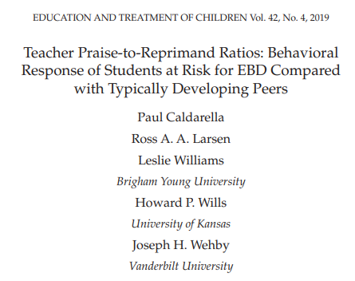
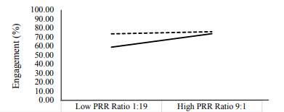
Ratio of Praise to Correction
For students with at risk for EBD the praise to reprimand ratio (PRR) needs to be 9:1 to produce the same levels of engagement as neurotypical peers.

Slide 52
Opportunities to Respond

Slide 53


What is it?
(OTRs)
“An Opportunity to Respond (OTR) is a teacher behavior that…solicits a student response (e.g., asking a question, presenting a demand).”
Provide high rates of opportunities to respond (OTRs)
Consider various observable ways to engage students
Link engagement with outcome objectives
OTR’s Helps with students actively practicing the instructed skill, helps with assessing learning, supports engagement, and decreases disruptive behavior.
https://classroomcheckup.org/increasing-opportunities-to-respond/
(Simonsen, Fairbanks, Briesch, Myers, & Sugai, 2008)

Slide 54

Examples of OTRs
Explicit, Direct
Instruction
Choral
Responding
Class-wide Peer Tutoring
Electronic
Clickers
Response
Cards
Computer Assisted Instruction
Guided
Notes
Non-Verbal
Responses

Slide 55

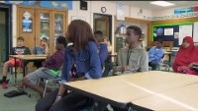
Choral Responding
Thumbs Up
https://youtu.be/g9kyl_WPFhU
https://youtu.be/37CTCDTesWA

Slide 56
HAVE YOU ASSESSED POSITIVE CLASSROOM PRACTICES?

Slide 57
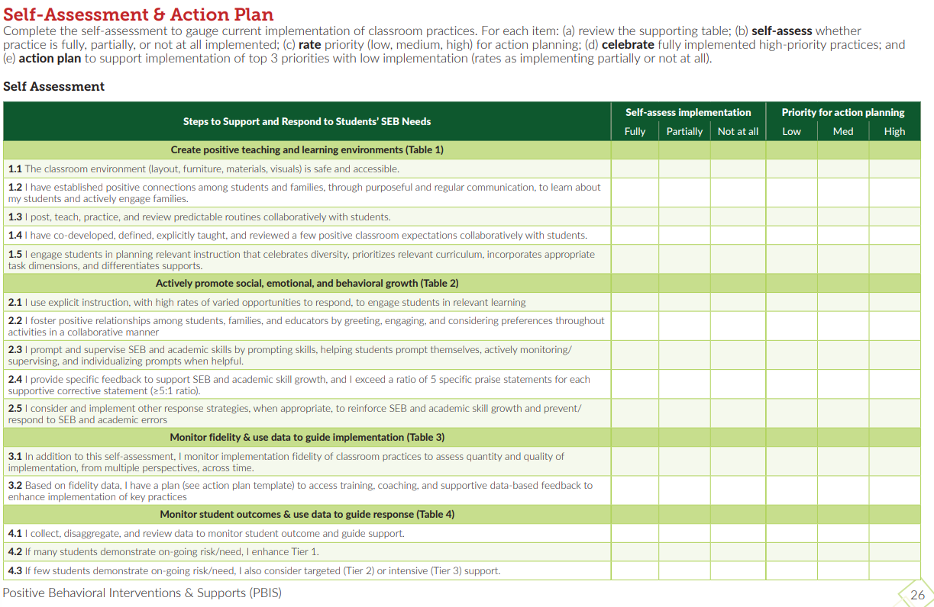
Classroom Self-Assessment
Page 26 of the Supporting & Responding Brief
Notes:
Resource: https://www.pbis.org/resource/supporting-and-responding-to-behavior-evidence-based-classroom-strategies-for-teachers

Slide 58
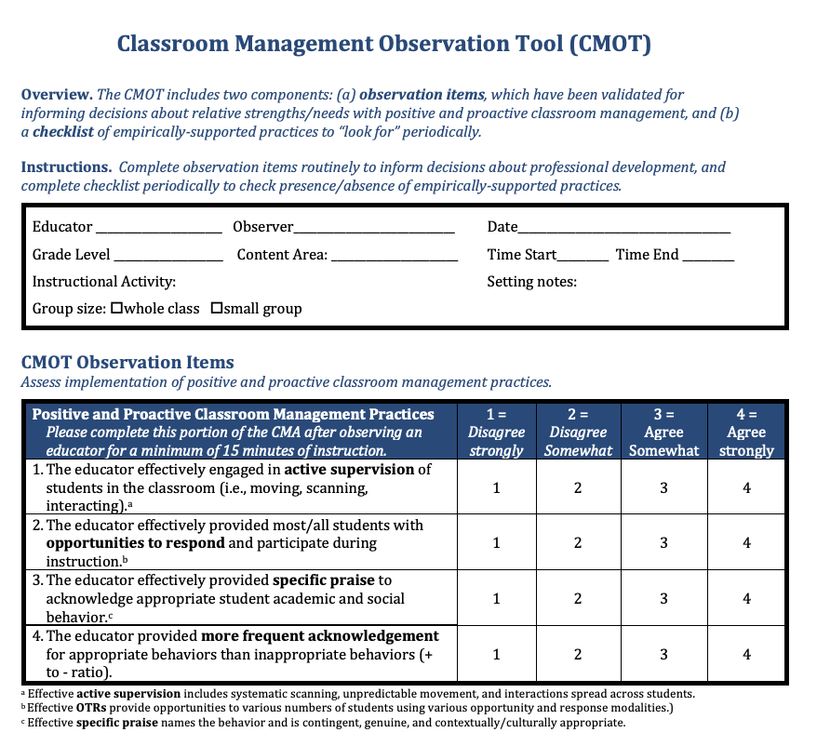
Observation tool
CMOT
2 Components:
Validated Observation Tool (min 15 mins)
Checklist of empirically supported practices
Notes:
The Classroom Management Observation Tool (CMOT) mentioned in
https://nepbis.org/wp-content/uploads/2020/06/CMOT-5.1.20.pdf

Slide 59
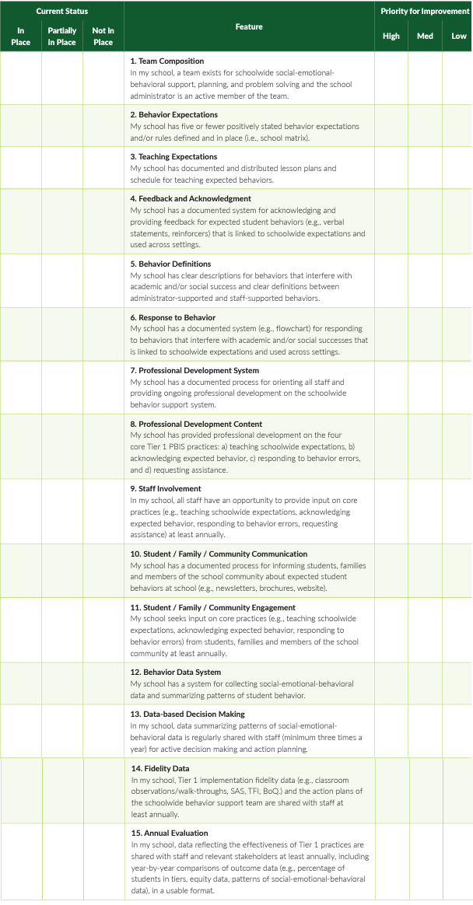
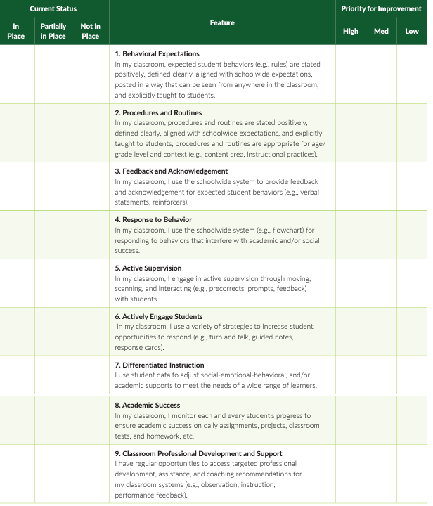
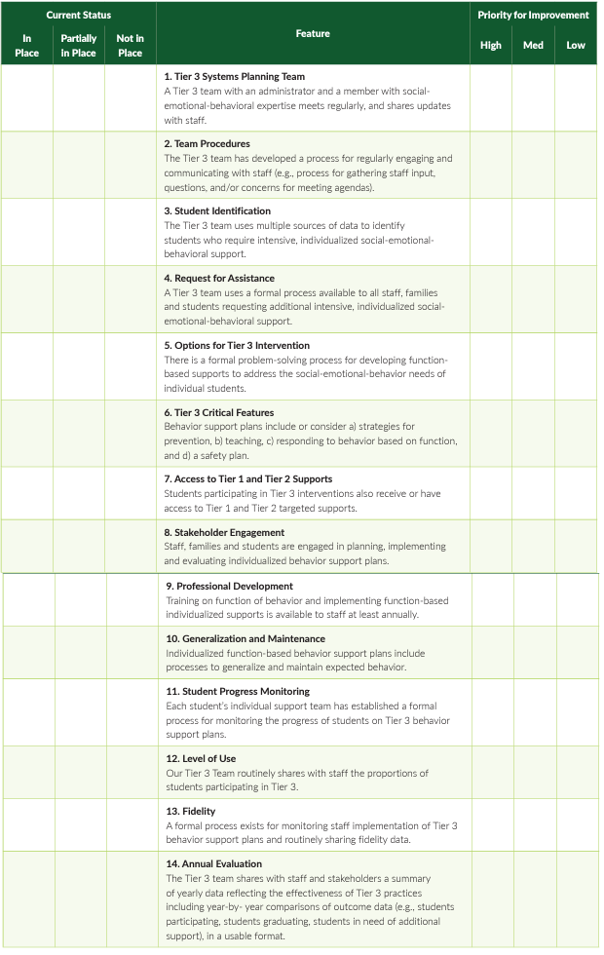
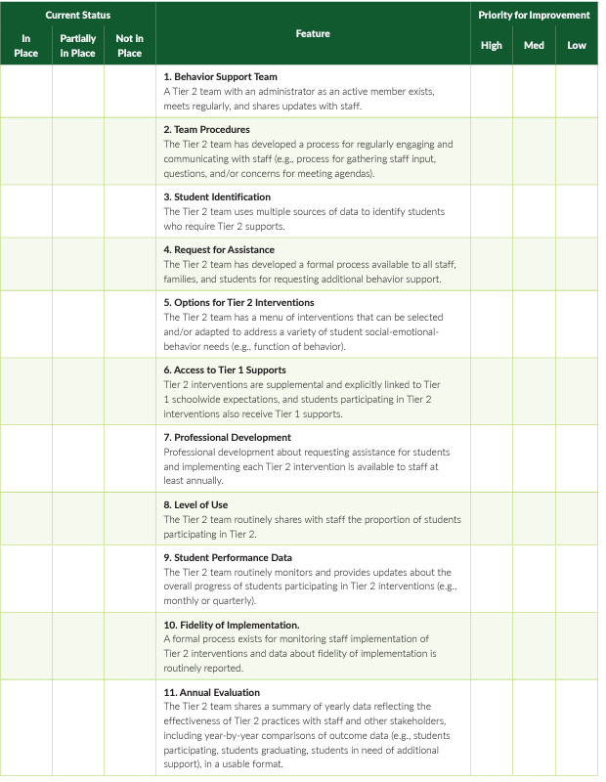
Self Assessment Survey (SAS) Updated June 2023
School Wide – 15
Classroom – 9 items
Tier 3 – 14
Tier 2 – 11
Notes:
Self-Assessment Survey www.pbisapps.org/resource/self-assessment-survey

Slide 60
SELF ASSESSMENT SURVEY
CLASSROOM SYSTEMS
Notes:
Review of question and how to complete survey.

Slide 61
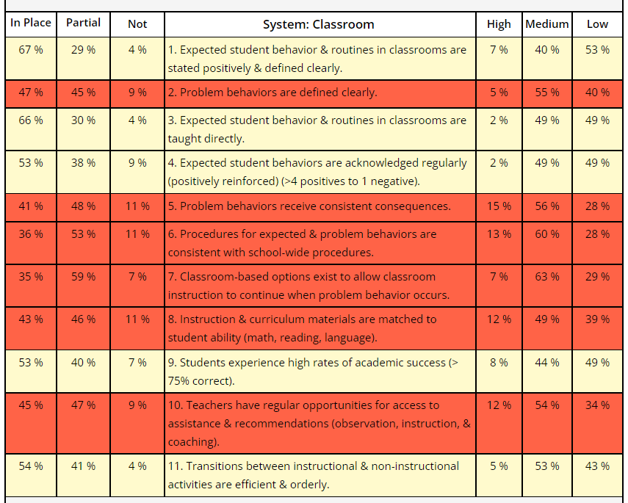
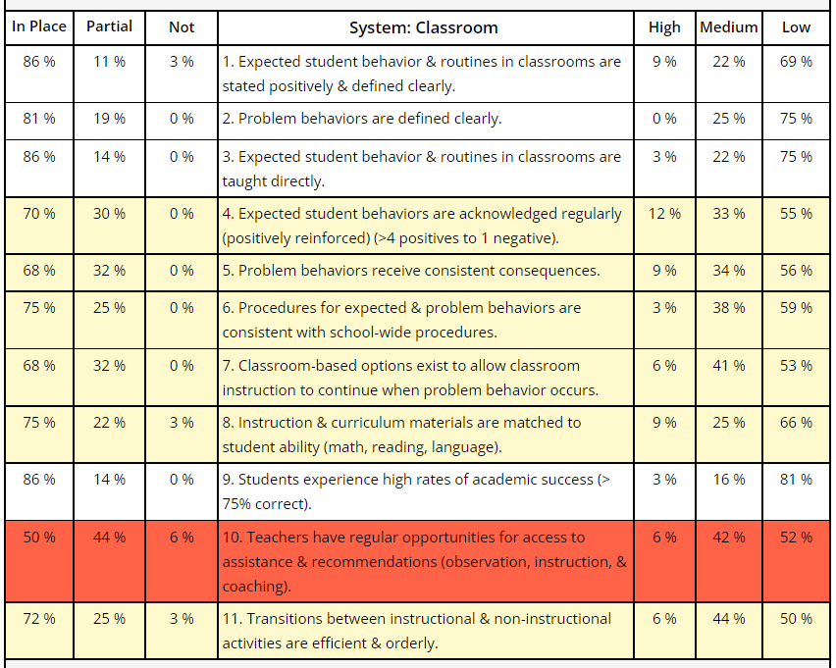
Classroom Items Report
From this → ------------------------ → To this
Notes:
Review of item graph as a quick action plan and tool for staff buy-in.
Red – less than 50% in place
Yellow – 50-79% in place
White – 80% in place or higher
If you want to take the SAS ask your training
Date Ranges for survey period
Recommend giving staff time to complete it during a staff meeting or PD.

Slide 62
ACTIVITY: SUPPORTING CLASSROOM PRACTICES
Review the shared classroom resources.
In your teams discuss:
  Have you used one of these tools to assess implementation of Classroom PBIS? If not, what is your plan to assess classroom practices?
  Do you have data (survey data?) that can help identify which positive classroom practices are needed to share with staff at an upcoming PD
  Have you begun to provide Classroom PD to your staff? If not, when and how will you share this information?
Be ready to provide a 1-minute share-out of your discussion
Team Time
20 minutes

Slide 63

LUNCH

Slide 64
Implicit Bias and Vulnerable Decision Points

Slide 65
Equity in Discipline
Knowing the function of behavior can help us prevent the behavior in the future…but
Do we respond to all incidences of the same misbehavior in the same way?
Do we treat all students who do similar behavior the same? Do they get the same intervention/punishment?
What might make us treat different students or different incidences in a different manner?
Notes:
Let’s look further at implicit bias.

Slide 66
What is Implicit Bias?
Unconscious, automatic
Based on stereotypes
  We all have it (even those affected by it)
  Generally, not an indication of what we believe or would endorse
More likely to influence:
  Snap decisions
  Decisions that are ambiguous
Notes:
Let’s look further at implicit bias.

Slide 67

Implicit Bias in Early Learning
(Gilliam et al., 2016)
Notes:
Youtube link: https://www.youtube.com/watch?v=ucEAcIMkS0c

Slide 68
WHOLE GROUP DEBRIEF: Implicit Bias
What factors have created implicit biases?
Who is affected by implicit biases?
Where might we see implicit biases?
5 minutes

Slide 69
A Multi-Dimensional View of Bias
Racial Bias
Disproportionate Discipline
SITUATION
What discipline decisions are influenced by implicit bias?
Notes:
TRAINER NOTE:
This simplified model of the research indicates that racial bias, even when it is implicit, has a direct and disproportionate impact on student discipline outcomes.
But this model has 2 problems:
1. it focuses solely on one variable that has been shown in many studies to be highly resistant to change (Racial bias)
2. fails to consider contextual variables that may be as critical to biased decision making but are much more malleable.
CLICK
However, when we recognize that the context or situation can influence someone’s response and that individuals may selectively show racial bias in different decision situations, we develop a multidimensional view of bias that can be altered with intervention. For example, a teacher may make more equitable discipline decisions at the start of the day but be more likely to send students of color to the office at the end of the day

Slide 70
Decision Points
What is an EQUITABLE Decision Point?
What is a VULNERABLE Decision Point?
A specific decision in which school/district data shows LITTLE TO NO disproportionality.
All student groups show equity in receiving a discipline referral for a specific behavior.
A specific decision that is more vulnerable to the effects of implicit bias. Some student groups show an inequitable distribution of discipline referrals
Two parts:
  Elements of the SITUATION
  The person’s DECISION STATE (internal state)

Slide 71

Decision States: Resource Depletion
What are some of your vulnerable decision states?
Unmute or type in chat.
As we become fatigued, our filters for appropriate behavior can be affected
Effects of hunger (Gailliot et al., 2009)
Decreases in willpower later in day
  “The Morning Morality Effect” (Kouchaki & Smith, 2014)
E.g., The best time to go before a judge is first thing in the morning or right after lunch
E.g., Handwashing compliance drops 8.7% over the course of a 12-hr shift
Notes:
MAIN IDEA: We’re all prone to vulnerable decision states, the key is recognizing them so we don’t act on impulse.

Slide 72
VDPs from National ODR Data
Ambiguity
Subjective problem behavior
  Defiance, Disrespect, Disruption
  Major vs. minor
Non-classroom areas
  Hallways
  Arrival/Dismissal
Classrooms
Afternoons
Lack of Contact
Demands? Relevance?
Fatigue

Slide 73
First step to neutralizing vulnerable decision points is to identify them.
Disaggregating your data to identify vulnerable decision points:
By looking at data broken down by student type: race/ethnicity, IEP/504 status, EL status, gender, etc. we can find areas where our implicit biases or might have altered the way we respond to certain students. This is called disaggregation.

Slide 74
WHY DISAGGREGATE OUTCOME DATA?
Allows comparisons between groups (e.g., grade, gender, (dis)ability, race/ethnicity, etc.)
Facilitates development of precise problem statements
Supports equitable decision-making

Slide 75
DISAGGREGATING DATA
How can you ensure that all students have access to equitable educational opportunities?
What questions does your team or school have about equitable outcomes or experiences for students?
Bring student data that you can or have disaggregated to answer those questions. Such as:
Survey data (school climate, etc.)
Attendance
ODRs
Suspension
Referrals to Special Education or out of district placement

Slide 76
EXAMPLE
Identify a question
Identify the data source
Disaggregate the data to answer the question
Are racial groups chronically absent at the same rate?
Attendance
Disaggregate by race
Are students with disabilities being referred at the same rate?
Office Discipline Referrals
Disaggregate by disability status
Do our LGBTQ+ students feel safe at school?
School Climate Survey
Disaggregate by gender identity
Notes:
TRAINERS: Please note the three examples when you put slide in slide show mode.

Slide 77
EXAMPLE 1: SURVEY DATA
Do students who are gay/lesbian feel safe at school?
“I feel safe…”
Average scores by sexual orientation

Slide 78
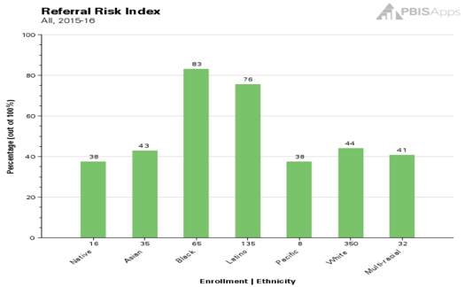
EXAMPLE 2: ATTENDANCE
Are racial groups chronically absent at the same rate?
 | # of Enrolled Students | # of Students Identified as Chronically Absent | % of Students Within Ethnicity Identified as Chronically Absent | Risk Index
Native | 16 | 6 | 37.50% | 0.38
Asian | 35 | 15 | 42.86% | 0.43
Black | 65 | 54 | 83.08% | 0.83
Latino | 135 | 102 | 75.56% | 0.76
Pacific | 8 | 3 | 37.50% | 0.38
White | 350 | 154 | 44.00% | 0.44
Multi-racial | 32 | 13 | 40.63% | 0.41
Totals: | 641 | 347
Chronic Absenteeism Risk Index
54 of the 65 Black students are identified as chronically absent, so 83.08% of the Black students are missing significant instructional time.
102 of the 135 Latino students are identified as chronically absent, so 76% of the Latino students are missing significant instructional time.

Slide 79
EXAMPLE 3: ODRS
Are students with disabilities being referred at the same rate?
 | # of Enrolled Students | # of Students with Referrals | % of Students within Disability with Referrals | Risk Index
IEP | 45 | 17 | 38% | 0.38
504 | 25 | 6 | 24% | 0.24
None | 300 | 63 | 21% | 0.21
17 of the 45 students with IEPs have a discipline referral, so 38% of students with IEPs have a referral.
63 of the 300 students without a disability have a discipline referral, so 21% of the students without a disability have a referral.

Slide 80
ACTIVITY: Explore Vulnerable Decision Points & Develop a Neutralizing Routine
Individually (5 minutes)
  Use the VDP worksheet to:
    Identify what you think might be possible VDPs (situations or states) for you?
Discuss with your team (10 minutes)
  What are some common factors in your school that might lead to inequitable responses?
  What are some common VDPs for adults in schools?
  How could you introduce disaggregation and VDPs to your colleagues?
Whole group share (5 minutes)
20 minutes
Notes:
TRAINERS:
Encourage participants to jot down responses to the individual questions using the Identify Potential VDPs worksheet (link below and in syllabus) prior to sending people to team-based breakout rooms
https://sebacademy.edc.org/vulnerable-decision-points-vdp-worksheet

Slide 81
Two-Step Neutralizing Routine
PREVIEW
When you see unwanted behavior or the
start of a power struggle, stop and ask yourself:
Is this a VDP?
  What are the elements of the situation?
  What is my internal decision state?
If so, use a pre-determined agreed-upon alternative response.

Slide 82
Neutralizing Routines
PRREVIEW
SELF-ASSESSMENT:
“Am I triggered or agitated?”
SETTING EVENT
ANTECEDENT
BEHAVIOR
CONSEQUENCE
Lack of positive interactions with student
Fatigue
Loud complaints about work (subjective behavior)
Send student to the office (ODR)
Student leaves class
(escape social interaction)
ALTERNATIVE RESPONSE:
Take a deep breath & model desired behavior.
Notes:
This is ME (my routine)
“You can’t punish skills into a child”

Slide 83
Elements of a Good Neutralizing Routine
PREVIEW
If-Then Statement
Brief
Clear Steps
Doable
Interrupts the Chain of Events
Notes:
interruption

Slide 84


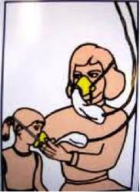
Neutralizing Routine Examples
PREVIEW
If I am triggered or agitated, then I will...
  Delay a decision until I can think clearly
    “See me after class/at the next break”
  Reframe the situation
    “How do we do that at school?”
  Take care of myself
    Recognize my upset feelings and let them go

Slide 85
TFI
Self-Assessment

Slide 86


The purpose of the SWPBIS Tiered Fidelity Inventory (TFI) is to provide a valid, reliable, and efficient measure of the extent to which school personnel are applying the core features of school-wide positive behavioral interventions and supports.
Only Tier 1 will be required for this training.
Your team can choose to complete the additional tiers.
Tier 1 Subscales:
Teams
Implementation
Evaluation
Tier 2 Subscales:
Teams
Interventions
Evaluation
Tier 3 Subscales:
Teams
Resources
Support Plans
Evaluation

Slide 87
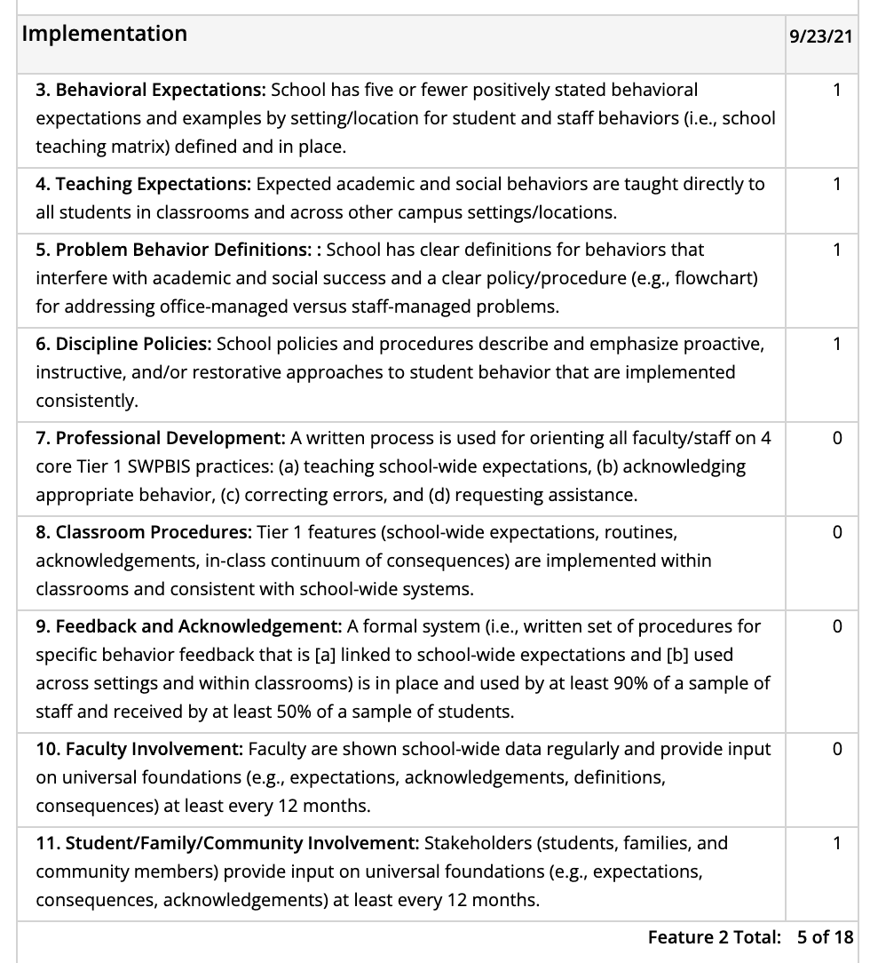
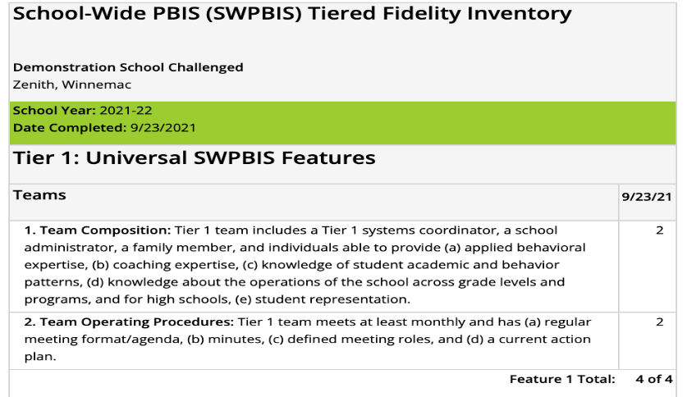
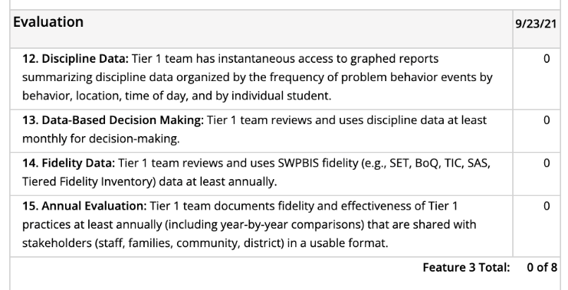
Individual items

Slide 88

Select action steps based upon data from the TFI AND
your identified outcomes!
behavior incidents will decrease by __% relative to the same period as the prior year.
incidents of exclusionary discipline (suspension/expulsion) will decrease by __ % relative to the same period as the prior year

Slide 89

behavior incidents will decrease by __% relative to the same period as the prior year.
incidents of exclusionary discipline (suspension/expulsion) will decrease by __ % relative to the same period as the prior year
Implementing these features can support us to achieve our identified outcomes.
What do we need to do?
How? Who? By when?
1
4. Teaching Expectations
5. Problem Behavior Definitions
1
6. Discipline Policies
1
7. Professional Development
0

Slide 90

ACTIVITY: Using the TFI to Self-Assess and Action Plan
Coaches:
Go to www.pbisapps.org
Click on PBIS Assessment in the black navigation bar
Locate the TFI on your dashboard
Click on Take Survey
As a team:
Complete the Tier 1 section of the survey
Consider the following recommendations:
  When in doubt, score lower rather than higher
  If unable to come to consensus, vote and move on
  Unless you have walkthrough/survey data, the maximum score on items requiring data (1.3, 1.4 and 1.9) is 1
Add items to your action plan as needed
This is a baseline self-assessment and will be completed throughout implementation to promote fidelity and action planning
20 minutes
Notes:
Tiered Fidelity Inventory: https://sebacademy.edc.org/tiered-fidelity-inventory-tfi-manual
TFI Tier 1 Quick Check Tip Sheet: https://sebacademy.edc.org/tfi-tier-1-quick-check-tip-sheet-scoring
TFI Action Plan: https://sebacademy.edc.org/tfi-action-plan-template

Slide 91

WHOLE GROUP DEBRIEF:
Using the TFI to Self-Assess and Action Plan
What did your team identify as strengths as a result of completing this self-assessment?
What action steps will you take achieve your outcomes?
5 minutes
Notes:
TFI Action Plan: https://sebacademy.edc.org/tfi-action-plan-template

Slide 92
Team
Action Planning Time

Slide 93
TEAM TIME
Meet with your team and discuss action steps related to the following items reviewed today:
1. Review notes from our sharing activity today. What great ideas did you take away?
2. What are your next steps with assessment data or PD for supporting classroom practices?
3. Discuss how your team can identify a neutralizing routine for staff.
4. Discuss how your school can disaggregate data to better tailor schoolwide supports?
5. What are some major features that still need support after you completed your TFI Self-Assessment
Please update your action plans and share with your trainers.
Or use the TFI Action Plan Document
Teams
90 minutes
Prepare to share 1 new action item or goal from your discussion.
Notes:
https://sebacademy.edc.org/tfi-action-plan-template

Slide 94
SHARE OUT
What was one action item or goal your team identified?
5 minutes
Whole Group
Notes:
https://sebacademy.edc.org/tfi-action-plan-template

Slide 95
Agenda & Team Tasks
Team Tasks
Presentation Content
Discuss what you might need in order to disaggregate data to better tailor your school wide supports.
Plan to assess classroom strategies and present classroom practices
Sharing: Acknowledgement Systems
Function of Behavior
Classroom Practices Part 2 and Review Classroom Assessment
Implicit Bias
Disaggregating Data
Tiered Fidelity Inventory (TFI) Self-Assessment & Team time
Complete TFI Self-Assessment as a team and update your Action Plan (Share updated action plan with your trainer).
What questions do you have on today’s content?
What questions do you have on the follow-up tasks?

Slide 96
HELPFUL READINGS & RESOURCES
RESOURCES:
Supporting & Responding to Student's Social, Emotional, and Behavioral Needs (Classrooms)
Supportive Environments Create Classroom Community
Classroom Support Systems Brief
The Classroom Management Observation Tool (CMOT)
Self-Assessment Survey
Implicit Bias in Early Learning Video
Tiered Fidelity Inventory
TFI Tier 1 Quick Check Tip Sheet
TFI Action Plan
Notes:
Supporting & Responding to Student's Social, Emotional, and Behavioral Needs (Classrooms) - https://sebacademy.edc.org/supporting-and-responding-students-social-emotional-and-behavioral-needs-classrooms
Supportive Environments Create Classroom Community - https://sebacademy.edc.org/supporting-and-responding-students-social-emotional-and-behavioral-needs-classrooms
Classroom Support Systems Brief - https://sebacademy.edc.org/classroom-support-systems-brief
The Classroom Management Observation Tool (CMOT) - https://sebacademy.edc.org/classroom-management-observation-tool-cmot
Self-Assessment Survey www.pbisapps.org/resource/self-assessment-survey
Nepbis.org Classroom PBIS website: https://nepbis.org/classroom-pbis/
SWIS Drill Down Worksheet: https://sebacademy.edc.org/swis-drill-down-worksheet
Implicit Bias in Early Education Video: https://www.youtube.com/watch?v=ucEAcIMkS0c
Vulnerable Decision Points Worksheet: https://sebacademy.edc.org/vulnerable-decision-points-vdp-worksheet
Tiered Fidelity Inventory: https://sebacademy.edc.org/tiered-fidelity-inventory-tfi-manual
TFI Tier 1 Quick Check Tip Sheet: https://sebacademy.edc.org/tfi-tier-1-quick-check-tip-sheet-scoring
TFI Action Plan: https://sebacademy.edc.org/tfi-action-plan-template

Slide 97

EVALUATION
Please remember to complete the evaluation!
Scan the QR code to access.
Notes:
TRAINERS -
Put link to evaluation (below) in the chat for those who do not use the QR code:
Evaluation Survey: https://edc.co1.qualtrics.com/jfe/form/SV_cBF9GI7gVEBsfSC

