Slide 1


PBIS Coaches’ Training
Year 2: April 2024
Michelle Pratt and Christine Downs
Created from content from the National Technical Assistance Center on Positive Behavioral Interventions and Supports
U.S. Department of Education, Office of Special Education Programs and Office of Elementary and Secondary Education
with support from NEPBIS Network, May Institute, & Broad Reach Consulting

Slide 2

EXPECTATIONS
Self
Others
Environment
Self-monitor
Mute when listening, unmute to talk​
Have your computer charged and ready to go​
If you have questions or comments:
Work as a team:
Keep necessary materials at hand
Are you participating?
Engaged as a learner?
Stretch, break, stand as needed​
unmute
use the chat box
Room for every voice
Reinforce participation
action plan
relevant docs
water/snacks
Minimize distractions if possible​

Slide 3
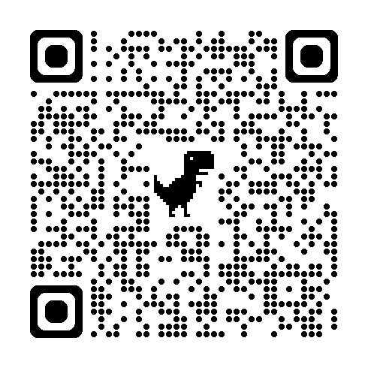
ACTIVITY: ATTENDANCE
Scan QR code on the left or follow the URL posted in the chat to access the online attendance survey
Follow prompts to enter attendance information
Notify trainers if you require assistance (e.g., identifying your cohort or cohort group)
Certificates of Attendance will be sent in February and June. Attendance records will be use as verification
1 minute
Notes:
https://go.edc.org/SEB-Academy-Sign-In

Slide 4
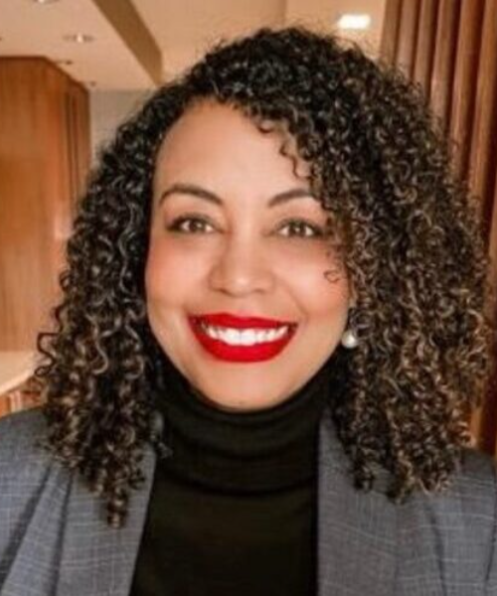
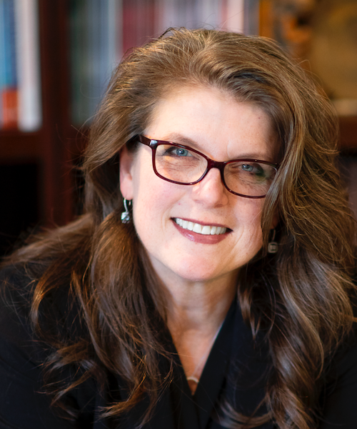

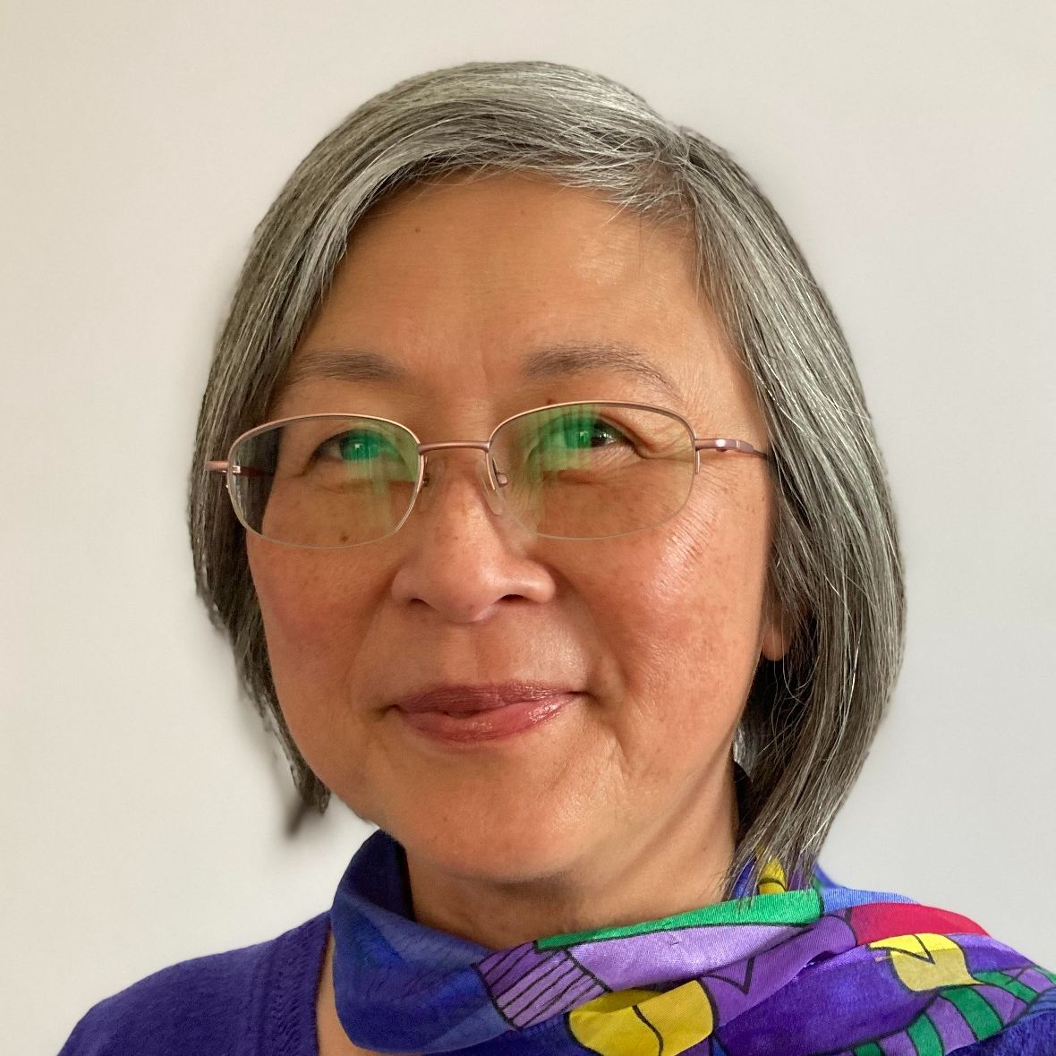
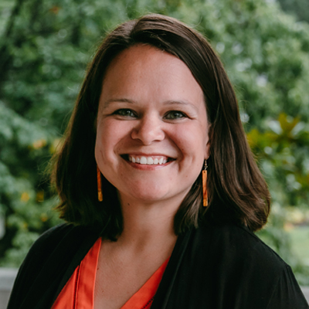

Mark your calendars now to join us at the
14th Annual NEPBIS LEADERSHIP FORUM
May 15-16, 2025
Mystic, CT
https://nepbis.org/forum/
ANNOUNCING OUR KEYNOTE PRESENTERS
PRE-CONFERENCE WORKSHOPS on MAY 14th
Come learn about how to improve attendance
through your PBIS framework!
Steve Goodman, Ph.D.
Cecelia Leong, M.P.P.
This workshop will focus on student voice as a critical component of PBIS implementation.
Clynita Grafenreed, Ph.D.
Kathleen Lynne Lane, Ph.D., BCBA-D, CF-L2
Sara Estrapala, Ph.D.

Slide 5
Agenda & Coaches' Tasks
Coaches’ Tasks:
Presentation Content:
Glows & Grows: Data Based Decision Making
Share data with staff and direct them to focus on behavior/location/expectation
Big Idea – School Family Partnerships – Part 2
Review Family Resources with team
Complete School-Family Practices Survey with team
Resource Spotlight – Team and Staff Morale
Consider some ways to improve Staff Morale

Slide 6
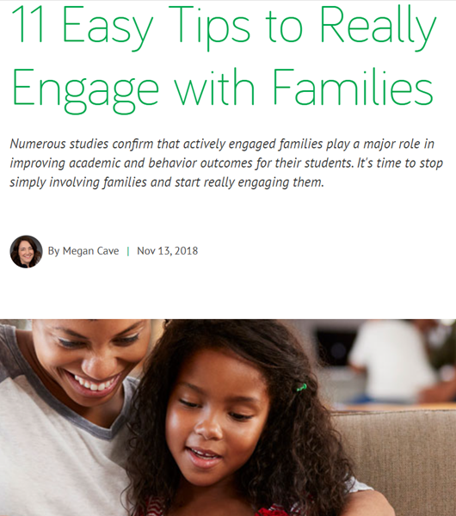
HELPFUL RESOURCES
RESOURCES:
The Family School Practices Survey
11 Easy Tips to Really Engage in Families
Enhancing Family-School Collaboration with Diverse Families
Feedback & Input Surveys (FIS) Manual
5 Ways School Leaders Can Boost Team Morale
5 Ways to Boost Staff Morale
Notes:
RESOURCES:
School Family Practices Survey - https://sebacademy.edc.org/family-school-practices-survey
11-easy-tips-really-engage-families - https://sebacademy.edc.org/11-easy-tips-really-engage-families
Enhancing Family-School Collaboration with Diverse Families -https://sebacademy.edc.org/enhancing-family-school-collaboration-diverse-families
Feedback & Input Surveys (FIS) Manual - https://sebacademy.edc.org/pbis-feedback-input-survey-manual
5 Ways School Leaders Can Boost Team Morale https://www.studiesweekly.com/boost-team-morale/
5 Ways to Boost Staff Morale https://www.pbisrewards.com/blog/5-ways-to-boost-staff-morale/

Slide 7

Glows & Grows:
Data Based Decision Making
Notes:
12:30

Slide 8
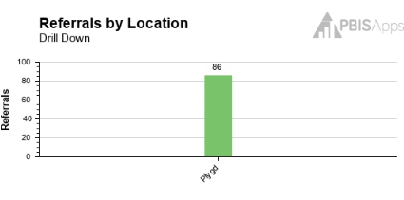
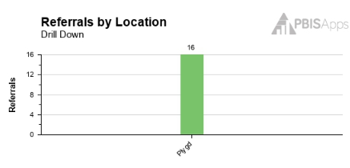


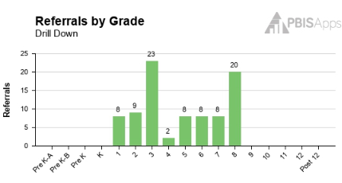
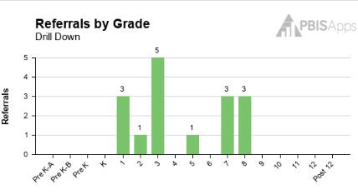
Present Results to staff
Less than 30 ODRs (major or minor) (average 1 referral per day) from the playground for next 30 days
GOAL MET!!!

Slide 9
DISCUSSION: Data Based Decision Making
What is one piece of data you have used this year for decision making?
How well did the process go for your team?
Did you present to staff?
How did staff respond?
What are your barriers to using data?
Coach Chat
Whole Group
5 minutes
10 minutes

Slide 10
PBIS
Continuing Topic:
School-Family Partnerships

Slide 11
Why Family-School Partnerships
Results in positive outcomes for children, families, and teachers
Family-School Partnerships work
Particularly beneficial for families that are culturally, linguistically, and racially diverse

Slide 12
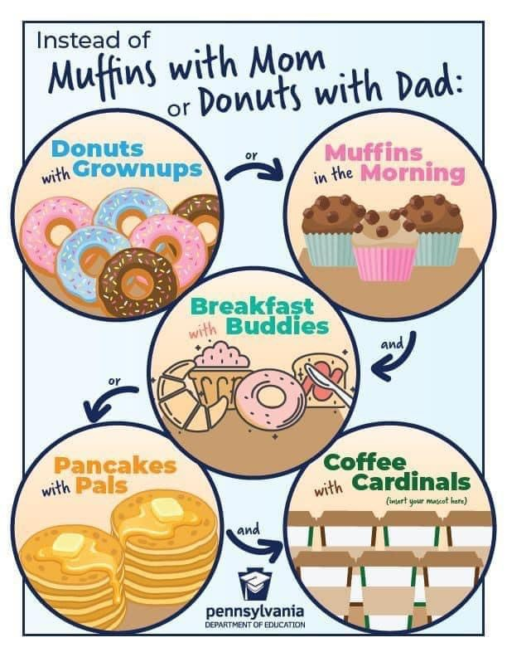
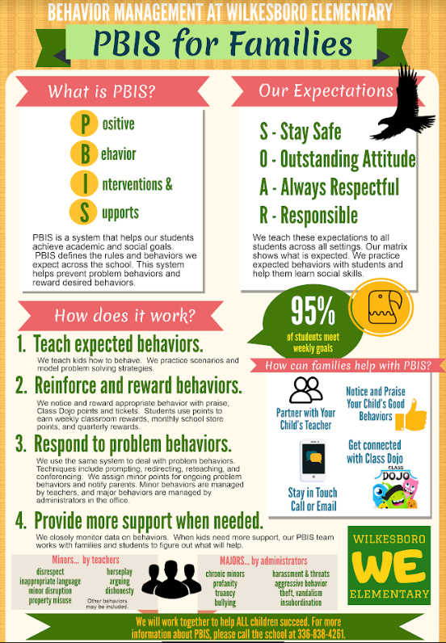
Include Families in Creating Products and in Acknowledgments
Think about the language of the materials you provide
Think about how you interact with families
Creating a space for ALL Families

Slide 13
How do we engage and partner with families?
Establish family representation on the Tier 1 team
Develop or review family-friendly PBIS materials
Create a family advisory group that can advise or review products for the Tier 1 team
Ex. Home Matrix activity or PBIS handout
Establish systems to support multidirectional communication

Slide 14

11 Easy Tips to Really Engage with Families
Randomize into 4 breakout rooms: one for each Barrier.
Groups review their Barrier and discuss
Identify one or more strategies that could help with the Barrier you reviewed
Be prepared to share out with the group
Breakout Groups
Whole Group
10 minutes
5 minutes
Notes:
https://sebacademy.edc.org/11-easy-tips-really-engage-families

Slide 15
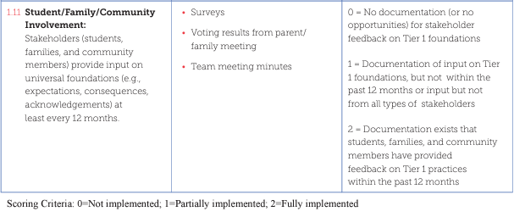
TFI – Items 1.11, 3.6
Have your families received information and been given the opportunity to give feedback on:
  PBIS Matrix
  Acknowledgement System
  Discipline Documents

Slide 16
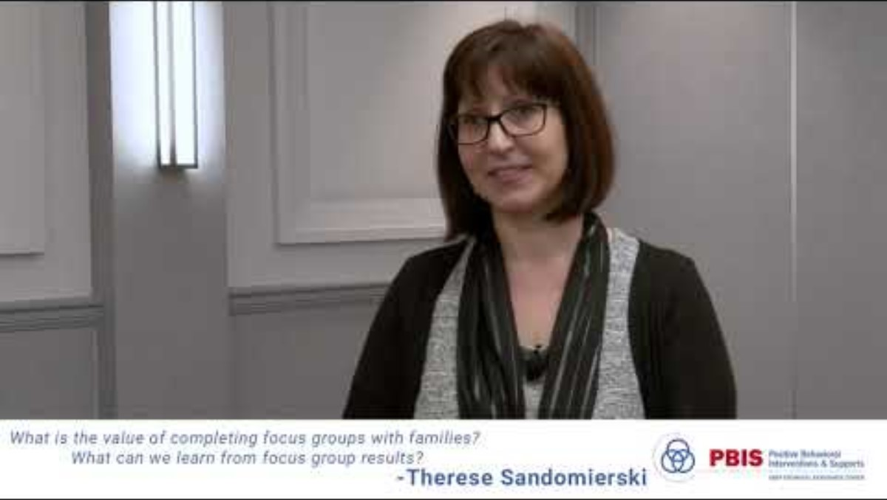
Value of Family Focus Groups

Slide 17
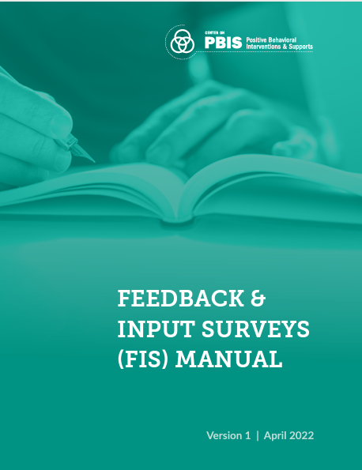
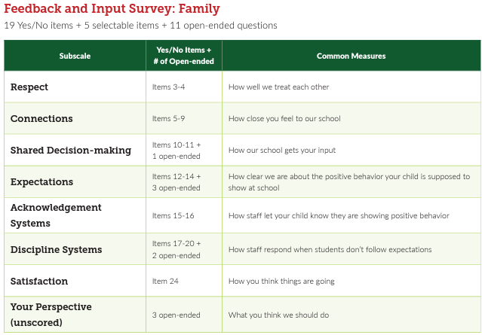
Family Input Surveys
Notes:
https://sebacademy.edc.org/pbis-feedback-input-survey-manual

Slide 18
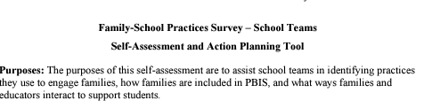
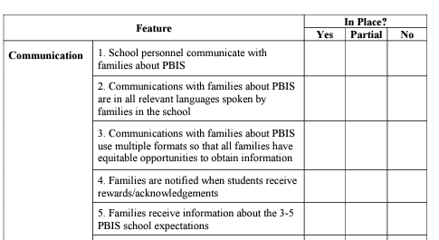

ACTIVITY:
How would you like to partner with families?
Consider how you already are partnering with families or might do so in the future.
Some ideas to consider:
  Review data
  Attend some of the PBIS tier 1 meetings
  Focus groups
  Surveys or voting
  Family communication
  Materials for Families
  Social media posts/blog posts/ newsletter
15 Minutes
-Report out
Notes:
If they did not do the survey, they can review it now…or they can discuss one action item the identified to work on.
https://sebacademy.edc.org/family-school-practices-survey

Slide 19
PBIS
Resource Spotlight:
Staff Morale
Notes:
RESOURCE LINK: https://www.pbis.org/resource/teaching-social-emotional-competencies-within-a-pbis-framework

Slide 20

Boosting Staff Morale
Show Appreciation
Welcome Feedback
Value their Time
Promote Health and Wellness
Foster Staff Relationships
Create Staff Challenges
Play Virtual Games
How do you address Staff Morale at your school?
Notes:
https://www.pbisrewards.com/blog/5-ways-to-boost-staff-morale/
https://www.studiesweekly.com/boost-team-morale/

Slide 21
ACTIVITY: RESOURCE SPOTLIGHT
Review the t wo shared resources independently or with a co-coach
Consider
  What was your key takeaway from this resource?
  How might your team use this in the future?
  Would this help with PBIS implementation and staff morale?
Be ready to provide a 1- minute share-out of your discussion
Independent
Whole Group
10 minutes
5 minutes
Notes:
https://www.pbisrewards.com/blog/5-ways-to-boost-staff-morale/
https://www.studiesweekly.com/boost-team-morale/

Slide 22
Agenda & Coaches' Tasks
Coaches’ Tasks:
Presentation Content:
Glows & Grows: Data Based Decision Making
Share data with staff and direct them to focus on behavior/location/expectation
Big Idea – School Family Partnerships – Part 2
Review Family Resources with team
Complete School-Family Practices Survey with team
Resource Spotlight – Team and Staff Morale
Consider some ways to improve Staff Morale
What questions do you have on today’s content?
What questions do you have on the follow-up tasks?

Slide 23
HELPFUL RESOURCES
RESOURCES:
The Family School Practices Survey
11 Easy Tips to Really Engage in Families
Enhancing Family-School Collaboration with Diverse Families
Feedback & Input Surveys (FIS) Manual
5 Ways School Leaders Can Boost Team Morale
5 Ways to Boost Staff Morale
Notes:
RESOURCES:
School Family Practices Survey - https://sebacademy.edc.org/family-school-practices-survey
11-easy-tips-really-engage-families - https://sebacademy.edc.org/11-easy-tips-really-engage-families
Enhancing Family-School Collaboration with Diverse Families -https://sebacademy.edc.org/enhancing-family-school-collaboration-diverse-families
Feedback & Input Surveys (FIS) Manual - https://sebacademy.edc.org/pbis-feedback-input-survey-manual
5 Ways School Leaders Can Boost Team Morale https://www.studiesweekly.com/boost-team-morale/
5 Ways to Boost Staff Morale https://www.pbisrewards.com/blog/5-ways-to-boost-staff-morale/

Slide 24
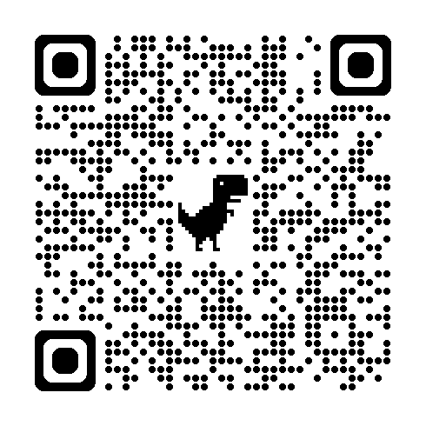
EVALUATION
Please remember to complete the evaluation!
Scan the QR code to access.
Notes:
TRAINERS -
Put link to evaluation (below) in the chat for those who do not use the QR code:
Evaluation Survey: https://go.edc.org/SEB-Academy-Event-Evaluation

