Slide 1


PBIS School-Wide Team Training
Year 1: January 2025
TRAINERS NAMES
Created from content from the National Technical Assistance Center on Positive Behavioral Interventions and Supports
U.S. Department of Education, Office of Special Education Programs and Office of Elementary and Secondary Education
with support from NEPBIS Network, May Institute, & Broad Reach Consulting

Slide 2

EXPECTATIONS
Self
Others
Environment
Self-monitor
Listen while others are speaking​
Have your computer charged and ready to go​
If you have questions or comments:
Work as a team:
Keep necessary materials at hand
Are you participating?
Engaged as a learner?
Stretch, break, stand as needed​
Raise hand
Room for every voice
Reinforce participation
action plan
relevant docs
water/snacks
Minimize distractions if possible​

Slide 3
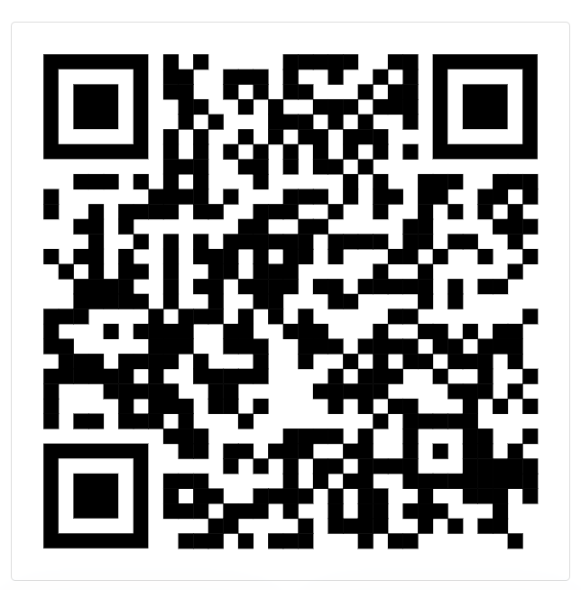
ACTIVITY: ATTENDANCE
Scan QR code on the left or follow the URL posted in the chat to access the online attendance survey
Follow prompts to enter attendance information
Notify trainers if you require assistance
Certificates of Attendance will be sent in February and June. Attendance records will be use as verification
1 minute
Notes:
ATTENDANCE: https://go.edc.org/SEB-Academy-Sign-In

Slide 4
Agenda & Coaches' Tasks
Coaches’ Tasks:
Submit Acknowledgement Activity
Presentation Content:
PBIS Review: Teaming, Purpose Statement, Matrix
Teaching Expectations – Lesson Plans & Teaching Plans
Acknowledgement System
TFI – Complete as a Team
Team Time

Slide 5

HELPFUL RESOURCES
RESOURCES:
Lesson Plan Activity and Template
Acknowledgement Activity and Template
Samples: Use keyword: Lesson Plan or Acknowledgement
Northeast Exemplar Repository
TFI Quick Check Scoring Sheet
Articles:
5 Ways to Reward Students the Right Way
3 Ways to Ensure School Is a Place Everyone Wants to Be
Beginning to Address Equity in Tier 1 Systems
Notes:
Lesson Plan Activity and Template https://sebacademy.edc.org/behavioral-lesson-plan-activity
Lesson Plan Samples and Acknowledgement Samples - https://sebacademy.edc.org/resources (Use Keyword Lesson Plan or Acknowledgement)
Acknowledgement Activity and Template - https://sebacademy.edc.org/acknowledgement-system-activity
Northeast Exemplar Repository https://sebacademy.edc.org/northeast-pbis-exemplar-resources
TFI Quick Check Scoring Sheet - https://sebacademy.edc.org/tfi-tier-1-quick-check-tip-sheet-scoring
5 Ways to Reward Students the Right Way -https://sebacademy.edc.org/5-ways-reward-students-right-way
3 Ways to Ensure School is a Place Everyone Wants to Be - https://sebacademy.edc.org/3-ways-ensure-school-place-everyone-wants-be
Beginning to Address Equity in Tier 1 Systems- https://sebacademy.edc.org/beginning-address-equity-tier-1-systems

Slide 6
PBIS Review

Slide 7
School-wide PBIS is a...
Framework for enhancing adoption & implementation of
Continuum of evidence-based interventions to achieve
Academically & behaviorally important outcomes for
All students
Notes:
Quick review of PBIS main Core Components – We will dig deeper into the overview in October at the team training

Slide 8

Continuum of School-Wide Instructional
& Positive Behavior Support
What do we do for the FEW needing intensive support?
Tertiary Prevention:
Specialized
Individualized
Systems for Students with High-Risk Behavior
What do we do for ALL?
Primary Prevention:
School-/Classroom-
Wide Systems for
All Students,
Staff, & Settings
~5%
~15%
What do we do for the SOME needing more support?
Secondary Prevention:
Specialized Group
Systems for Students with
At-Risk Behavior
~80% of Students will respond

Slide 9
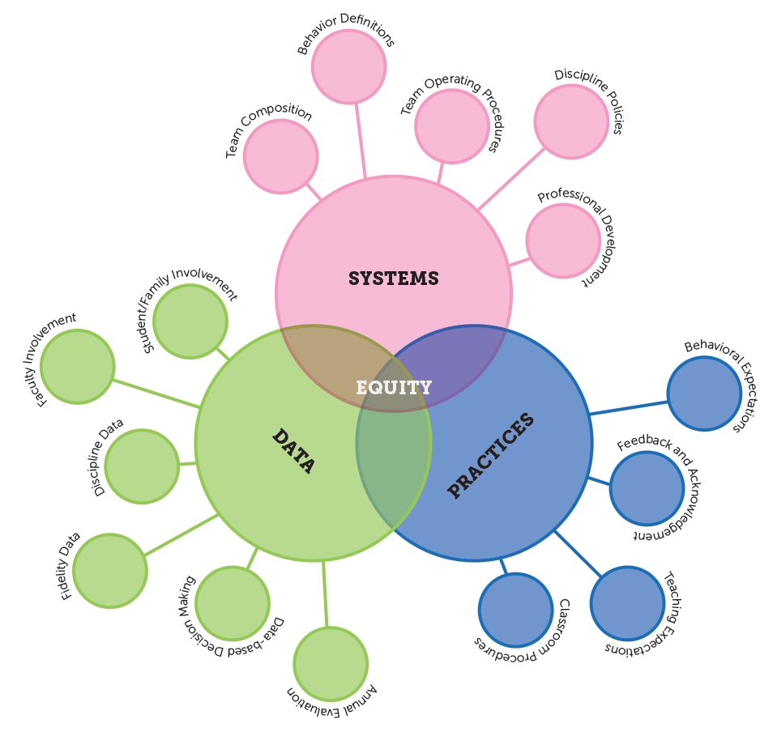
PBIS Core Features
-Problem Solving Model
Support Educators
through Equity-focused PD
Disaggregate
All Data by
Student Group
Adapt Practices
to Meet
Needs and Values
Outcomes
High Expectations for Each Student

Slide 10
GETTING STARTED WITH PBIS
1
Establish an effective leadership team
6
Develop a continuum to strengthen demonstrations of expectations
2
Develop a brief statement of purpose & define outcomes
7
Develop a continuum to discourage violations of expectations
3
Identify positive school-wide behavior expectations
8
Develop data-based procedures for monitoring
4
Develop procedures to teach school-wide expectations
9
Develop systems to support staff
5
Develop procedures to teach class-wide expectations
10
Build routines to ensure ongoing implementation

Slide 11
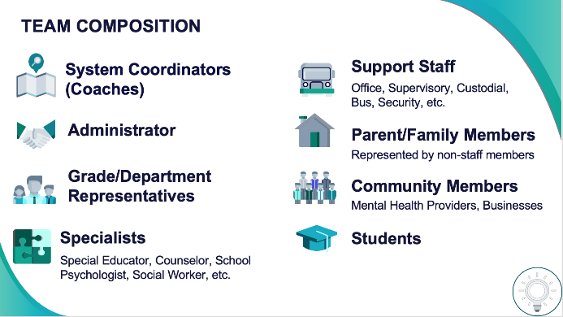
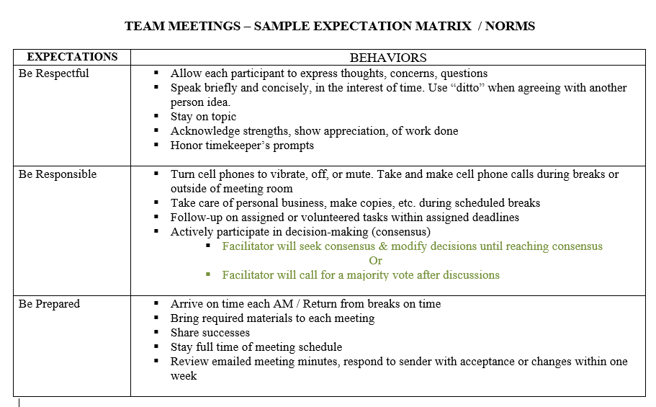
1
Establish an effective leadership team
Supports Relevance & Equity
Improves student outcomes
Promotes Engagement
Notes:
Your first step is to create a representative team to lead your school’s PBIS efforts.

Slide 12
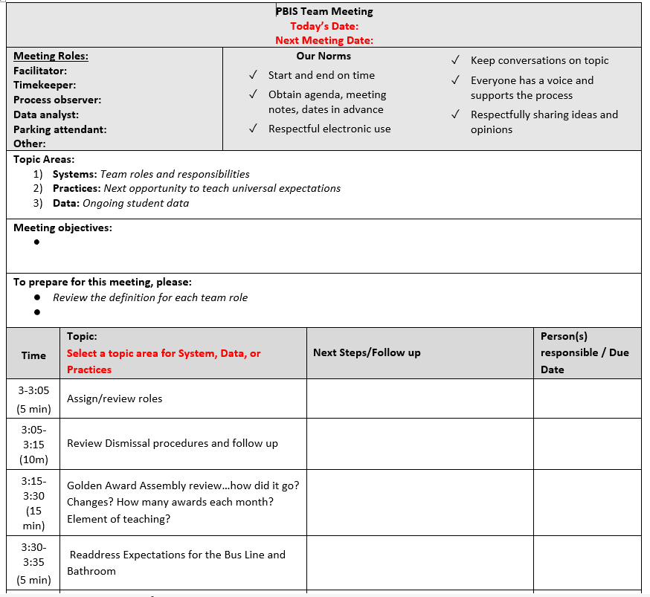
ACTION PLANNING
Specifies three features:
Action Plan
Foundation for all you do as a team
Vital for achieving goals
1
2
3
Who is responsible…
…by when?
Who
…for doing what…
When
What

Slide 13

2
Develop a brief statement of purpose & define outcomes
Purpose statement identifies WHY you are implementing PBIS at your school
Positively stated
2 to 3 sentences in length
Supportive of academic achievement and social-emotional-behavioral (SEB) health
Comprehensive in scope (relevant to all students, staff & settings)
Ensure all students develop the social-emotional-behavioral (SEB) skills needed to be effective learners through the implementation of evidence-based interventions and use of data to inform decisions.

Slide 14

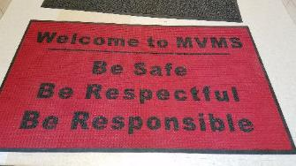
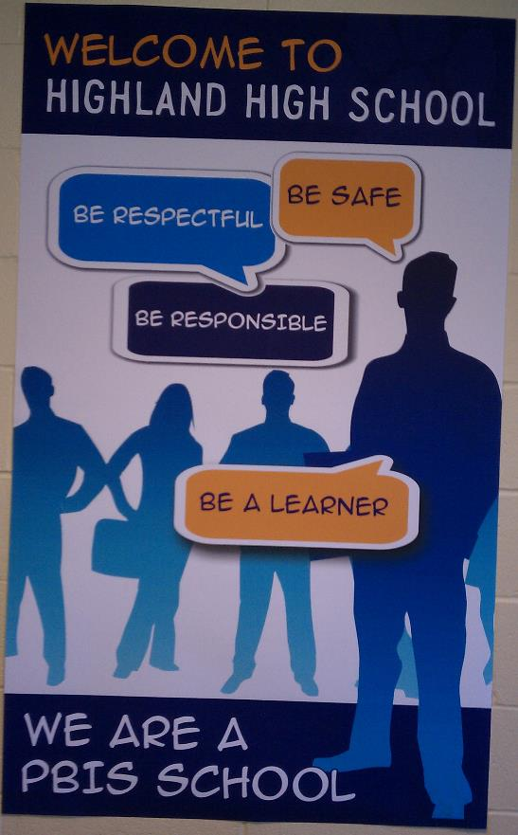


3
Identify positive school-wide behavior expectations
Define
Teach
Prompt
Monitor
Evaluate
Notes:
Your team will work with your school community to uncover what you value and use those values to identify your schoolwide expectations

Slide 15
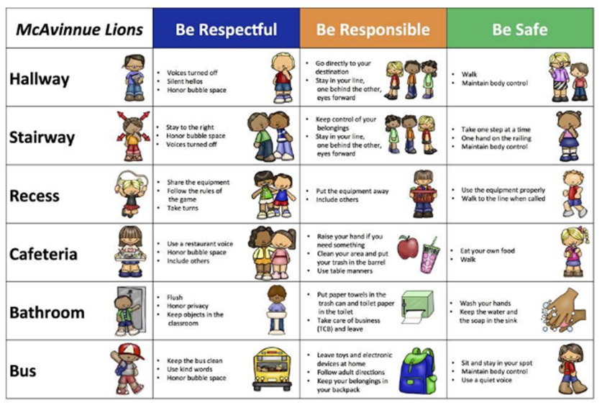
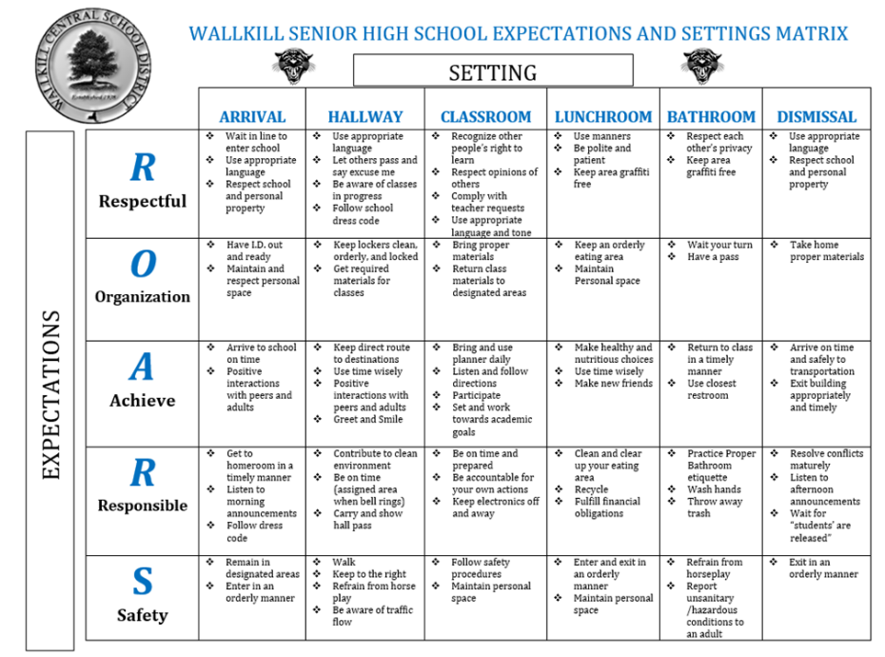
Behavioral Expectations
Define

Slide 16


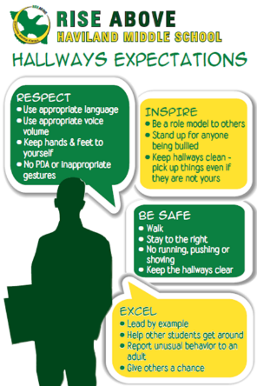
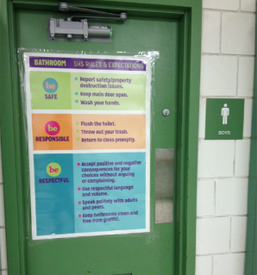
Remember Signage

Slide 17
Grows and Glows
How far have you gotten with the first 3 steps?
Have you asked staff, students and families for feedback?
What do you still need to work on?
Teams
3 minutes
5 minutes
Whole Group

Slide 18
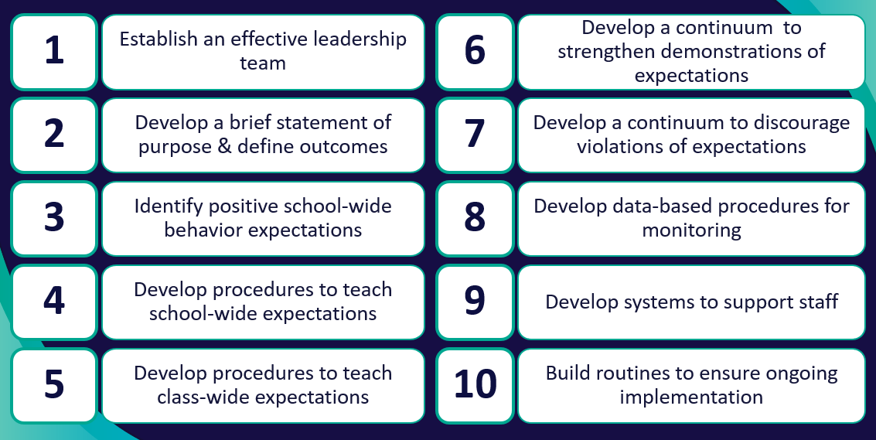
ACTIVITY: Sharing Grows and Glows
1. Randomize participants into 4 or 5 groups.
2. In each group take turns sharing . one PBIS feature your team has developed. (4 or 5 mins) Share the process your team had for creating that feature, gathering feedback, and finalizing that features. i.e. expectations, teaching matrix, lesson plans, a hope/goal identified, consistent team schedule & protocols, representative team including family and students, staff presentation
3. Ask questions and take good notes.
4. Bring new examples back to your team for action planning!
Randomized Small Groups
20 minutes
Notes:
This can be done before lunch, after lunch or after the TFI. Depending on where you feel you have the most time.

Slide 19
GETTING STARTED WITH PBIS
1
Establish an effective leadership team
6
Develop a continuum to strengthen demonstrations of expectations
2
Develop a brief statement of purpose & define outcomes
7
Develop a continuum to discourage violations of expectations
3
Identify positive school-wide behavior expectations
8
Develop data-based procedures for monitoring
4
Develop procedures to teach school-wide expectations
9
Develop systems to support staff
5
Develop procedures to teach class-wide expectations
10
Build routines to ensure ongoing implementation
Notes:
(Add to TRAINER Workbook)...
TRAINER NOTES- for this section- Create tension for teams without shutting them down- goal is that they walk away understanding they need to prioritize time and resources to get this done

Slide 20
Teaching Expectations
Notes:
This is for differentiation if schools already have everything complete. Do emphasize that they work on staff and student input first…but cover this if they have completed everything included goals, statement of purpose, team structures, Core Values & matrix. (Does anything need improving? Are there areas on the matrix the need to be added? Auditorium, Locker Room, Office, etc.)

Slide 21
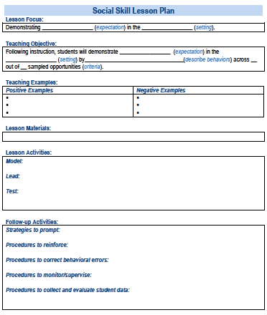
SOCIAL
SKILL
LESSON
PLAN
4
Develop procedures to teach school-wide expectations
Define
Teach
Prompt
Monitor
Evaluate
Simonsen, Myers, Everett, Sugai, Spencer, & LaBreck (2012)
Notes:
Using those identified expectations, you’ll define what those expectations look and sound like in key routines/settings throughout your school. This is organized through a behavioral matrix. Using the schoolwide matrix, your team will develop lessons that will be explicitly taught to students at the beginning of the year (and boosted throughout the year) so that they know how to be successful within each context (like the hallway, cafeteria, assemblies, etc.)

Slide 22
Teaching Matrix |  | Settings
 |  | All Settings | Hallways | Playgrounds | Cafeteria | Library/ Computer Lab | Assembly | Bus
Expectations | Respect Ourselves | Be on task. Give your best effort. Be prepared. | Walk. | Have a plan. | Eat all your food. Select healthy foods. | Study, read, compute. | Sit in one spot. | Watch for your stop.
 | Respect Others | Be kind. Hands/feet to self. Help/share with others. | Use normal voice volume. Walk to right. | Play safe. Include others. Share equipment. | Practice good table manners | Whisper. Return books. | Listen/watch. Use appropriate applause. | Use a quiet voice. Stay in your seat.
 | Respect Property | Recycle. Clean up after self. | Pick up litter. Maintain physical space. | Use equipment properly. Put litter in garbage can. | Replace trays & utensils. Clean up eating area. | Push in chairs. Treat books carefully. | Pick up. Treat chairs appropriately. | Wipe your feet. Sit appropriately.
2. NATURAL CONTEXT
1. SOCIAL SKILL
3. BEHAVIOR EXAMPLES

Slide 23
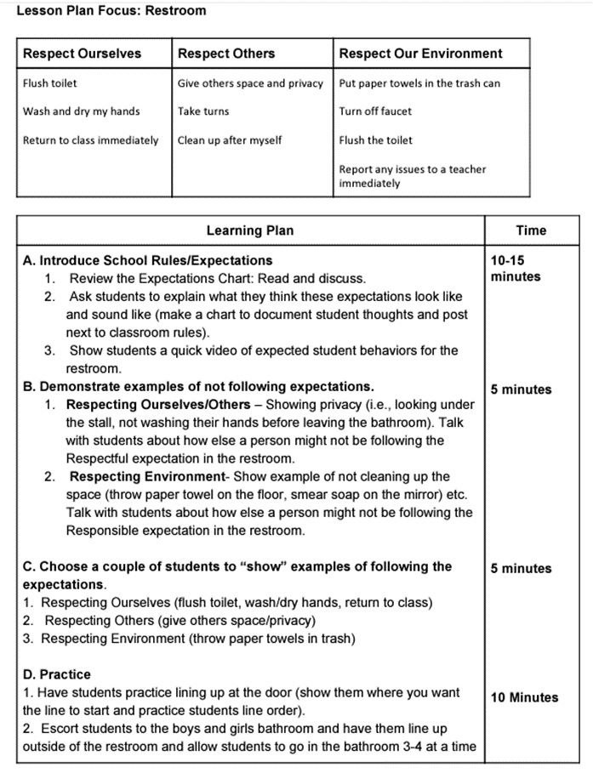
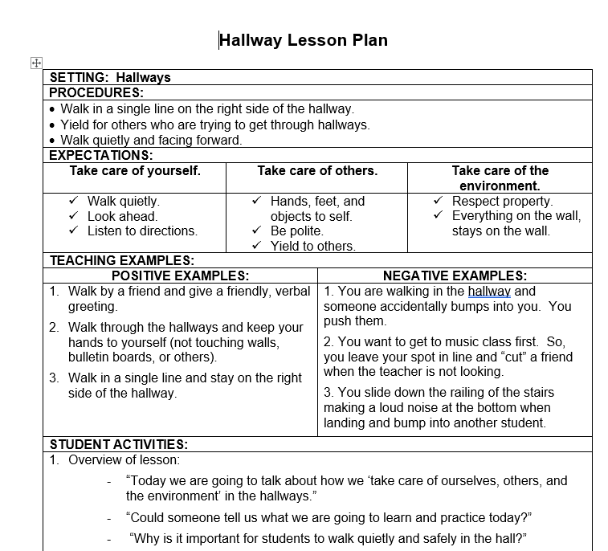
Creating Lesson Plans

Slide 24
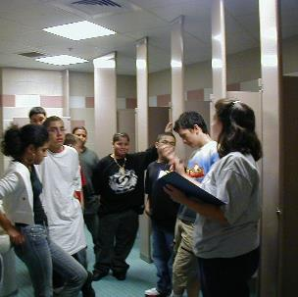
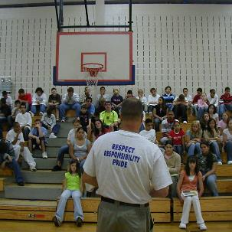

Expectations & behavioral skills are taught in context

Slide 25
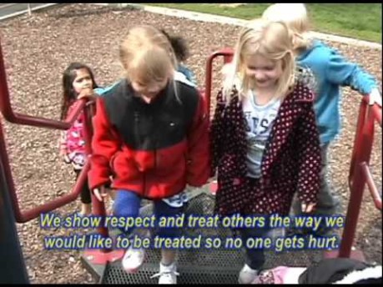
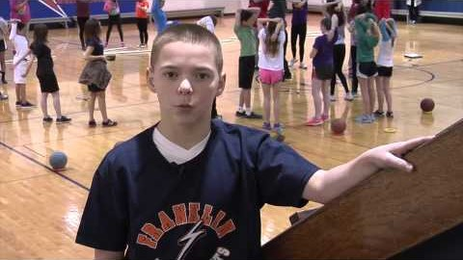
Example Teaching Videos

Slide 26
GUIDELINES FOR TEACHING EXPECTATIONS
Include main school settings/contexts
Consider lessons that already exist
Specify 2-3 observable, positive examples for each expectation within each setting and 2-3 non-examples of behaviors for each setting
Schedule for introducing teaching plan to staff & getting feedback on lessons
Schedule for obtaining feedback from students, families, & community members
Teach directly & provide opportunities for students to practice
Actively involve students in lesson (game, role-play, etc.) to check for their understanding
Provide prompts, precorrections, & feedback in natural context
Schedule initial instruction in natural context/setting
Schedule for regular review, practice, & follow-up

Slide 27
Creating a Schoolwide Teaching Plan

Slide 28
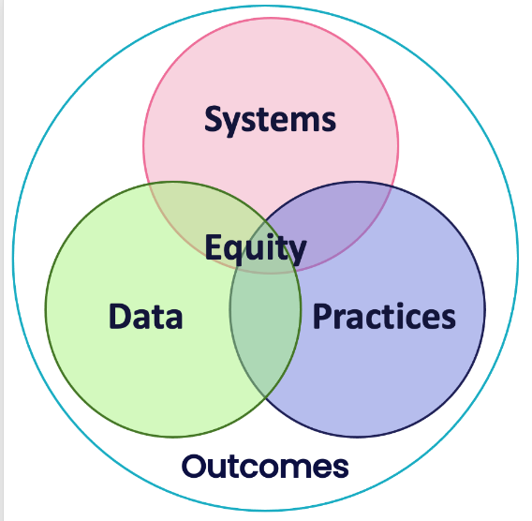
Provide SYSTEMS to support staff to teach the lessons
Be sure lesson plans are readily available
Plan whole school SW expectations teaching events
Develop a calendar of expected teaching windows (e.g. All staff are expected to reteach SW expectations on the day after holiday break, during the month of November, reteach hallway behavior)
Send weekly/monthly email prompts to staff

Slide 29

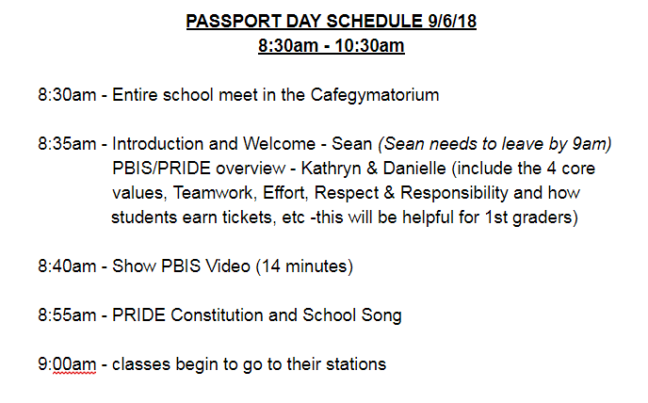
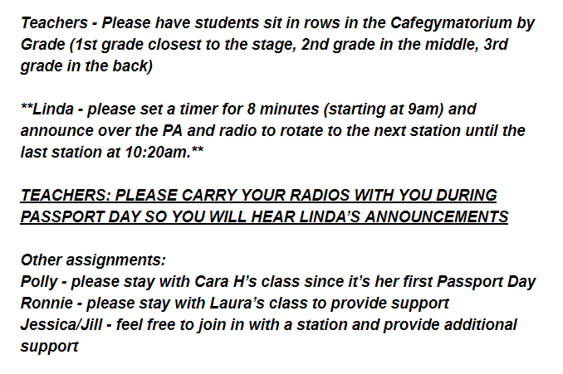
PASSPORT
Walkers/ Cars | Arrival/ Dismissal | Lunch | Assemblies
Recess | Stairways& Hallways | Bathrooms | Field Trips
Be sure to have your passport stamped
before leaving each location.
Name: _________________________
Grade: _________________________
Teacher: ________________________
Date: ___________________________

Slide 30
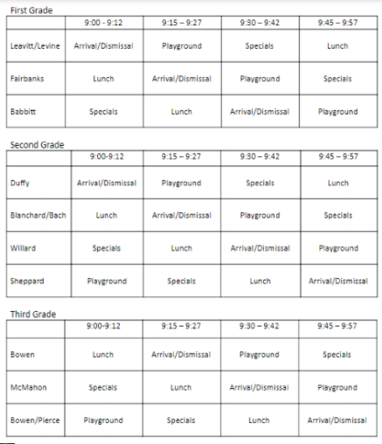
EXAMPLES
Scheduling for
PBIS Teaching Stations
Remember to leave time
for rotating to the next station

Slide 31
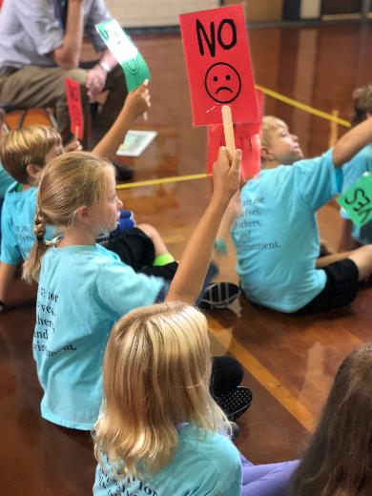
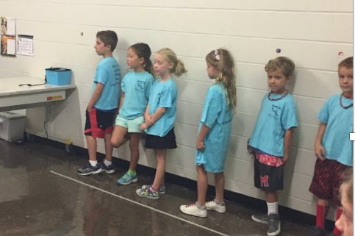
Engagement and Practice
EXAMPLES
My name is ____,
I order pizza for lunch. Thank you!
Notes:
Over the years, teachers have made taken their bellopoly lessons to the next level. Here are 2 examples of how teachers got creative

Slide 32
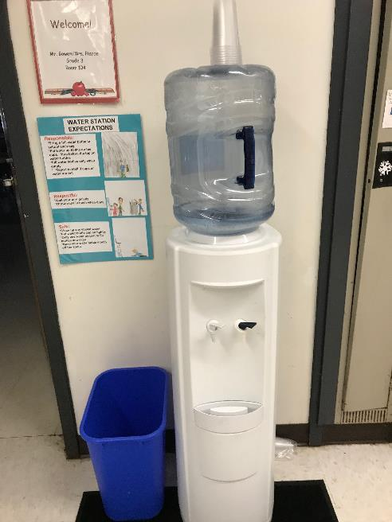
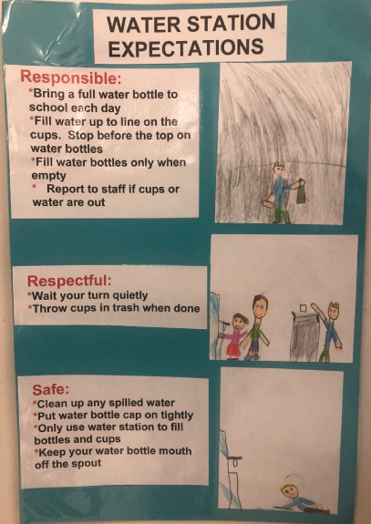
New Areas…New expectations
EXAMPLES
Science Fair
Field Day
Winter Musical Performance
Fine Arts Night
Field Trips
3rd Grade Moving On Event
Whole School Celebrations

Slide 33
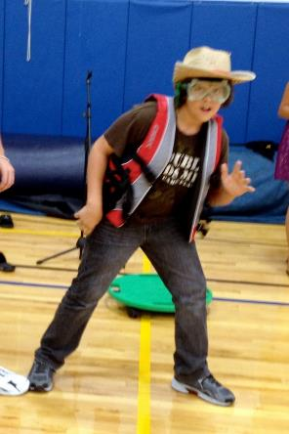
Reteaching Throughout the Year
Re-teaching or “booster” sessions should be scheduled at different times of the year
  After vacations
  When negative behaviors begin to resurface
  When data shows one group/location/time etc… need more practice
Create games, events, activities to keep lessons fun and relevant. Can be teacher led, grade level, or whole school
  Jeopardy
  Word search
  Create videos, songs, pledges
  Minute to win it

Slide 34
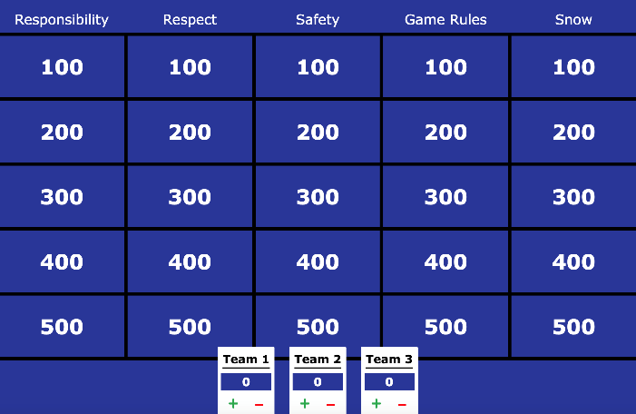
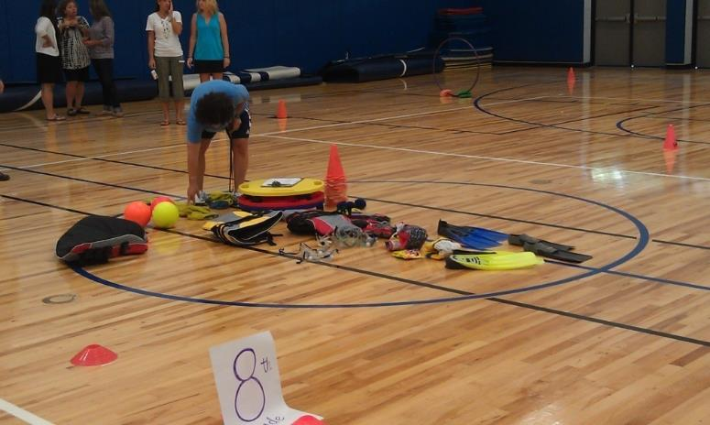
Review during the year – Jeopardy / Games
EXAMPLES

Slide 35
EXAMPLES
Passport "Renewal" Week
Students need a “refresher” of expected behaviors in high traffic areas of our school. We will dedicate a week in January to “Passport Renewal Week.” Each day of the week is dedicated to a different area of the school. These behaviors were taught by classroom teachers!
Teacher Instructions:
Please spend 10-15 minutes on the assigned day to review the “lesson” of the day.
Please travel with your students to the designated areas and re-teach the expectations for those areas and have the students practice the expected behaviors.
Please refer to the PBIS posters in those areas as a way to remind and reinforce the expected behaviors.
Send email to the PBIS team to when you have completed all areas of teaching, or if you require assistance.
Monday – Arrival/Dismissal & Walkers/Cars
Tuesday – Lunch/Recess
Wednesday – Hallways/Stairwells & Bathrooms
Thursday – Assemblies
Friday – Field Trips/Buses & Classrooms

Slide 36


EQUITY CHECK
Are expectations clear to everyone?
Do you need to have signage in multiple languages
Do you need visuals on signs for language learners or nonreaders?
How will you teach lessons to various grades and languages?
How will you check for understanding from all students?
Did you get input from Staff, Students, and Families
Did you include your sub-separate classrooms?

Slide 37
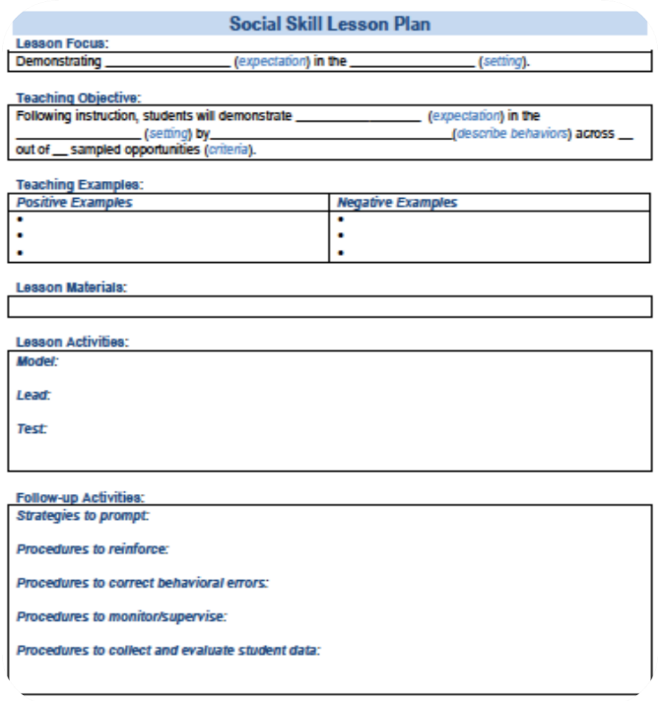
ACTIVITY: Teaching PBIS Expectations
Create, modify, or review your Behavioral Lesson Plans.
Consider how you will get teacher feedback for the lessons.
Consider when and how you will teach the expectations, what is your Plan for Teaching the expectations? (i.e. Sept – teaching stations, Jan/April-teachers reteach, Feb video review )
Consider how you will review the lessons and teaching plan with staff.
Teams
30 minutes

Slide 38

15-minute break

Slide 39










A formal acknowledgement system is a key predictor of reduced disproportionality!
STEP 6:
DEVELOP A CONTINUUM
TO STRENGTHEN DEMONSTRATIONS OF EXPECTATIONS
How do we increase the likelihood of our SW expectations happening?
Establish an effective leadership team
Develop a continuum to strengthen appropriate behaviors
Develop a brief statement of purpose
Develop a continuum to discourage violations of expectations
Identify positive school-wide behavior expectations
Develop data-based procedures for monitoring
Begin planning a school-wide acknowledgement system
Develop procedures to teach school-wide expectations
Develop systems to support staff
Develop procedures to teach class-wide expectations
Build routines to ensure ongoing implementation

Slide 40
TEACH SW EXPECTATIONS BY FOLLOWING THESE KEY STEPS
Define
Teach
Prompt
Monitor
Evaluate

Slide 41
Benefits of Acknowledgement Systems
Creates positive student-to-teacher interactions
Increases the likelihood that desired behaviors will be repeated by letting students know what they are doing “right”
01
03
Clarifies school expectations for appropriate behavior
Reduces the need for engaging in time-consuming disciplinary measures
02
04

Slide 42

Behavior is likely to occur again when it is reinforced…
When a student experiences something desirable following a behavior, that behavior is strengthened and more likely to occur again.
If a student is given verbal praise for persisting with a difficult assignment, the student is likely to persist on later difficult assignments.
  If a student is removed from the classroom after refusing to do a difficult assignment, the student will likely act up later when he does not want to (or cannot) complete work.
We need to be intentional about which behaviors are reinforced!

Slide 43

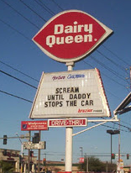


All Behavior Serves a Function:
To get something or avoid something
Behavior
Obtain/Get
Something
Escape/Avoid
Something
Positive Reinforcement
Negative Reinforcement
Remember: Negative Reinforcement makes behavior stronger too.
We avoid or escape from things we don’t like.
Notes:
Reinforce that NR is not reinforcement for negative behavior.

Slide 44

Praise is perhaps the most powerful and important type of acknowledgement.
Therefore, any acknowledgement system needs to be paired with specific praise!
"You read that whole passage yourself! Way to go.
You earned a point for that!"

Slide 45
As teacher praise rates increase, student outcomes improve!
Teacher praise rates
Student engagement and on-task behavior
Disruptive behavior from students
Provide more acknowledgement
than corrections.
Strive for 5⁺ > 1⁻
(e.g. Caldarella et al., 2020; Cook et al., 2017; Reinke et al., 2016)

Slide 46

Bad Stronger than Good
\
The brain handles positive and negative information in different hemispheres. Negative emotions generally involve more thinking, and the information is processed more thoroughly than positive ones. Therefore:
We tend to ruminate more about unpleasant events — and use stronger words to describe them — than happy ones.
Negative events wear off more slowly than good ones.
Most people can take in only one critical comment at a time.
We need to increase the positives to compensate!

Slide 47
Frequent Recognition & Encouragement is needed to offset Correction
Failure
(correction)
Success
(acknowledgement)
5 : 1
(Scott, 2008)
Notes:
Studies show that in order to be successful the positives need to exceed the negatives by a ratio of more than 4 to 1. The BOQ recommends at least 5:1.
If the consequence was access to technology and the behavior increased, then the access was a reinforcer.
If the consequence was sending the student to the office and the behavior increased, then the removal was a reinforcer.
If the consequence was a reprimand (which included adult attention), and the behavior increased, then the reprimand was a reinforcer.

Slide 48

FEEDBACK:
Reinforcement
List and share as many ways as you can think of for how adults are reinforced in everyday life.

Slide 49


Slide 50

ACTIVITY:
School-Wide Acknowledgements Discussion
Consider how you would respond to the following questions about acknowledgement. Your team should have a consistent message.
  Is it fair to all students?
  They are in high school; students don’t need to be acknowledged.
  It’s bribery!
  Why can’t we just tell them they’re doing a good job?
  You’re building a token society.
  Why are we rewarding them for what they’re supposed to do?
  Intrinsic vs. extrinsic motivation
Add items to your Action Plan as necessary
Minutes
-Report out
Notes:
Do a random share out of possible answers from teams.

Slide 51
Key Features of Acknowledgement Systems
Relevant
Efficiently Delivered
  Tied to school-wide expectations
  Age appropriate and culturally relevant (get feedback from students, staff, families at least annually)
  Varied types that are valuable to diverse groups of students (tangible, social, privilege) (individual and group contingencies)
  Allow for choice – at least in some parts of the system
  Fit into daily activities - Avoids interrupting instructional time
  Easy to teach, implement, etc.
Predictable and Dense Schedule
  Allow for all students to be eligible to earn acknowledgements daily
  Layered: daily, weekly, monthly, quarterly, etc.
Available to Both Students and Staff

Slide 52
Types of Acknowledgements
Layering acknowledgements allows staff to shape behavior of students still learning expectations while having a way to acknowledge students who consistently follow expectations
High Frequency
Provided daily
Predictable
Specific Praise
Tickets/Notes
Coupons to school store
Announcements
Post cards sent home
Intermittent
Provided weekly, quarterly, monthly
Student of the Month
Classroom celebration
Recognition at school assembly/on cctv/website
Random drawing of tickets
Prize/activity for students with no referrals for quarter
Long Term
Few times per year
Involves groups of students
Whole school celebration
Honors banquet
Freshmen class picnic
(adapted from MO-PBS)

Slide 53
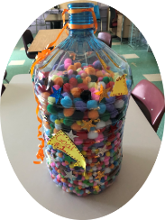
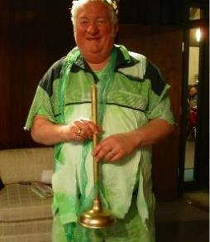
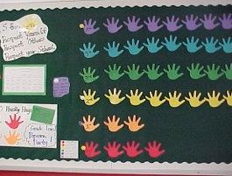
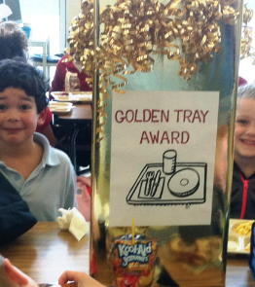
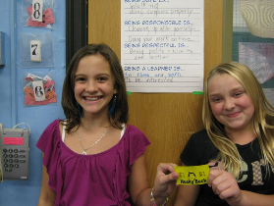
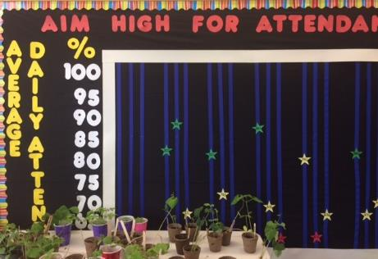
Acknowledgment Systems
Staff-Student – Develop ways to identify, communicate and publicly recognize expected and exceptional behaviors
Staff-Staff – Create and promote opportunities for staff/admin to recognize and appreciate other staff
Student-Staff – Create ways for students to share appreciation of staff
Student-Student– Create opportunities for students to give each other ‘shout-outs’ for social, emotional, behavioral & academic success and effort.
School-Student – Attendance, grades, behavior, state assessment, improvement, etc. (i.e. Attendance Campaign)
Notes:
Examples of Popular Student Incentives

Slide 54

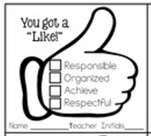
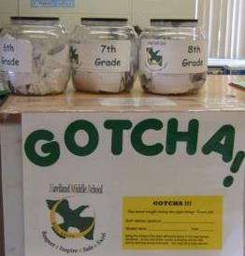

Examples of Acknowledgement Systems
Providing staff with tangible ways to acknowledge students prompts them to notice students demonstrating expectations AND lets students know what they were doing so they can do it more often!
Tangible forms/tickets can be collected and entered in a drawing for further recognition.
The more you earn, the more likely you are to access further recognition!
Notes:
More variety post cards, dojo, verbal, Tickets. (school store – hard to manage, costly etc… if use be sure it has a LOT of free items…ie. Cut to front of lunch line)

Slide 55
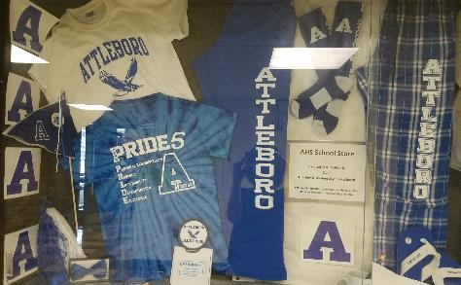
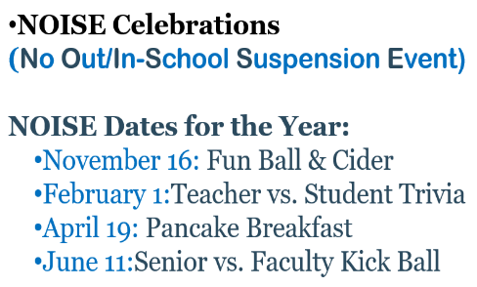
Acknowledgement Systems for Older Students?
Adolescents typically need a more intense experience to recognize it as rewarding (Sprague, 2008).
High schools already recognize students
Honor roll acknowledgement breakfast
Athletic award assemblies
PA announcements
Newsletters home
Teacher to student kudos
Consider how to address
ALL behaviors and ALL students!

Slide 56


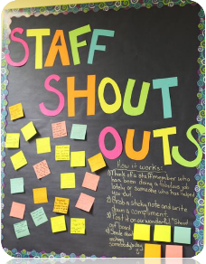

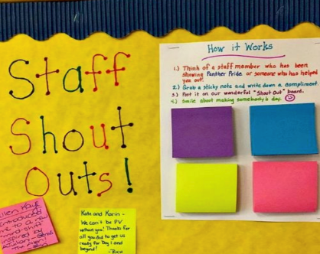
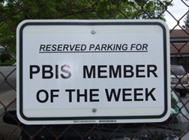
Don’t forget to Acknowledge the Adults too!
Notes:
STAFF Acknowledgement Matrix – Sample https://sebacademy.edc.org/adult-acknowledgement-matrix-sample
Acknowledgements for STAFF - https://sebacademy.edc.org/acknowledgements-staff-laura-riffel

Slide 57
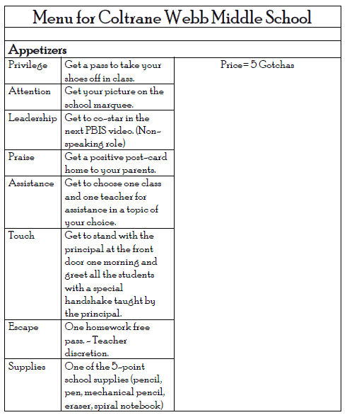
Consider these no or low-cost options
(*Full list compiled by Laura Riffel)
Laura and other’s research found that what PALPATES a student’s heart with reinforcements was the following:
1. Privileges
2. Attention
3. Leadership
4. Praise
5. Assistance
6. Touch
7. Escape
8. Supplies
Notes:
https://sebacademy.edc.org/acknowledgement-reinforcement-idea-book-laura-riffel

Slide 58




https://youtu.be/Cr_s3kzjX-g?t=2
https://youtu.be/ziooxzOF11o
https://youtu.be/0dcQuyK5Pqg
https://youtu.be/Owj81Q-dBOw

Slide 59
Are “Rewards” Dangerous?
Judy Cameron, 2002 –(Reviewed 150 studies on motivation and rewards)
“…our research team has conducted a series of reviews and analysis of (the reward) literature; our conclusion is that there is no inherent negative property of reward. Our analyses indicate that the argument against the use of rewards is an overgeneralization based on a narrow set of circumstances.”
(Cameron, 2002; Cameron & Pierce, 1994, 2002; Cameron et al., 2001)

Slide 60
Engage vested partners by co-designing and revising your acknowledgement system based on data
Schoolwide Acknowledgement System
TEAM develops a draft at a team training
STAFF review the draft and provide input
STUDENTS share ideas about what is and is not reinforcing to them
FAMILY advisory group provides feedback about cultural relevancy

Slide 61
Considerations for the Effective Use of Rewards
Provide reinforcement consistent with students’ phase of learning (e.g., more reinforcement when a skill is new)
Provide reinforcement in a manner that is considerate of the student’s developmental and cultural characteristics and learning history
Ensure ALL students have access to acknowledgement system
Be Specific!
Provide greater attention for the contextually appropriate social skill than for the problem behavior
Do not use removal of positive feedback as a threat or bribe, to “encourage” social skills

Slide 62
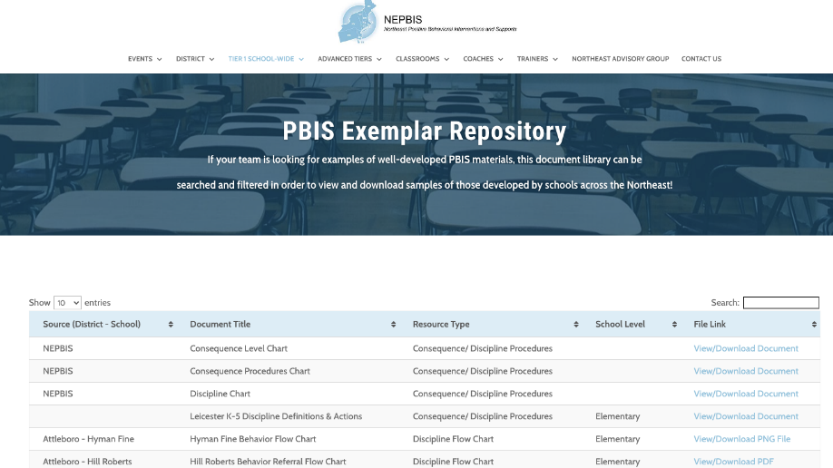
For more examples drawn from schools across the state, check out the NEPBIS Exemplar Repository NEPBIS Exemplar Repository
LINK
Notes:
https://nepbis.org/tier-1-school-wide/pbis-exemplar-resource-repository/
Trainer Note: Here include/show links to sample matricies in EDC website and NEPBIS Exemplar site

Slide 63
EQUITY CHECK
Are acknowledgement systems clear to everyone?
Do tickets need to be in multiple languages?
Do you need visuals on tickets for language learners or nonreaders?
Will you send home PBIS/Acknowledgment info in multiple languages?
Are acknowledgements culturally appropriate for your school community?
Does your acknowledgement schedule work for all students (immediate vs. delayed)

Slide 64

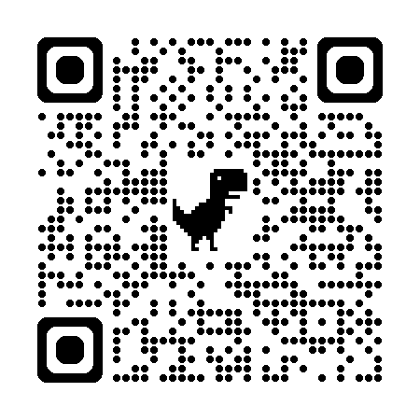
Helpful Article
Review article to help staff with understanding how to reinforces students the correct way.
https://sebacademy.edc.org/5-ways-reward-students-right-way
Notes:
https://sebacademy.edc.org/5-ways-reward-students-right-way

Slide 65
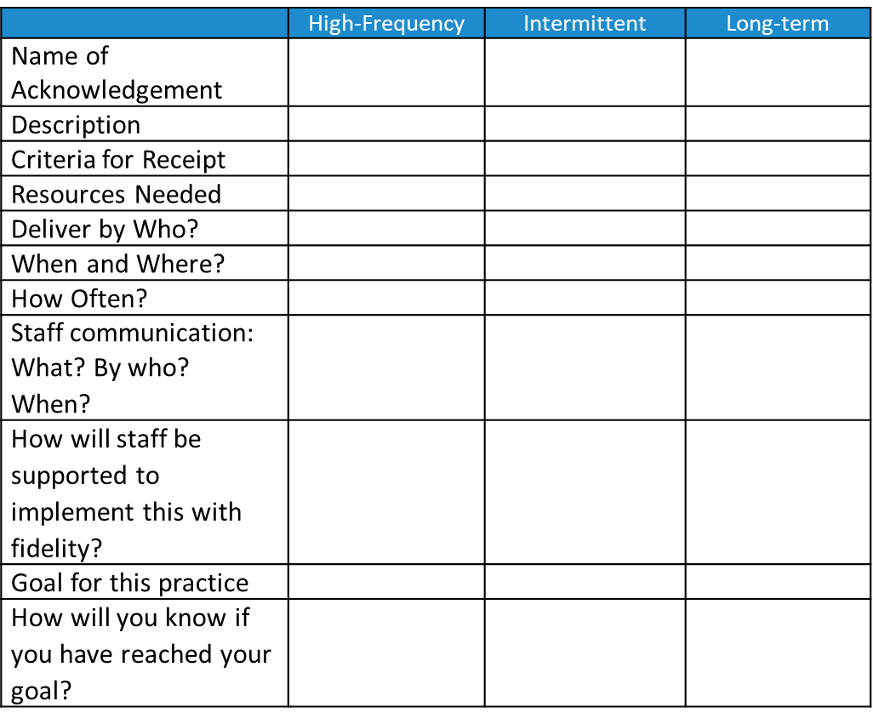
ACTIVITY: School-Wide Acknowledgements
As a team:
Begin drafting your Acknowledgements Worksheet by listing what acknowledgements you currently have at your school for STUDENTS and STAFF.
Consider what is missing/you would like to add. i.e. “Grade level” “Most Improved” Class-wide, Building-wide.
Review this resource “5 Ways to Reward Students the Right Way”
Remember to add this to your staff presentation.
Present 2-3 “big ideas” from your group (1 min. reports)
30 minutes
Notes:
Acknowledgement Activity and Template - https://sebacademy.edc.org/acknowledgement-system-activity
Acknowledgement Article https://sebacademy.edc.org/5-ways-reward-students-right-way

Slide 66

LUNCH
Notes:
I tried to make lunch 11:30-12:30 Adapt as needed.

Slide 67
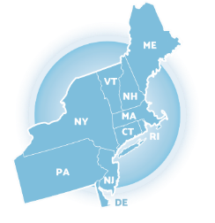

TFI SELF-ASSESSMENT

Slide 68


As you build your PBIS framework, it is important to recognize what is already in place and where you aim to be!
The purpose of the SWPBIS Tiered Fidelity Inventory (TFI) is to provide a valid, reliable, and efficient measure of the extent to which school personnel are applying the core features of school-wide positive behavioral interventions and supports.
Only Tier 1 will be required for MA Academy.
Your team can choose to complete the additional tiers.
Tier 1 Subscales:
Teams
Implementation
Evaluation
Tier 2 Subscales:
Teams
Interventions
Evaluation
Tier 3 Subscales:
Teams
Resources
Support Plans
Evaluation
Notes:
TFI: https://www.pbisapps.org/resource/tfi

Slide 69

0
1
2
Notes:
Link to TFI: https://www.pbisapps.org/resource/tfi

Slide 70

TFI Quick Check Tip Sheet
This guide can assist in (1) identifying scoring for each item and (2) action planning on times that need support!
Notes:
Link to document: https://sebacademy.edc.org/tfi-tier-1-quick-check-tip-sheet-scoring

Slide 71


ACTIVITY: Tiered Fidelity Inventory (Self-Assessment)
Coaches:
Go to www.pbisapps.org
Click on PBIS Assessment in the black navigation bar
Locate the TFI on your dashboard
Click on Take Survey
Select Team without external coach
Select TFI Walkthrough Tool not completed
(if not completed)
This is a self-assessment and will be completed throughout implementation to promote fidelity and action planning
Select Tier 1 for today's self-assessment
Notes:
TRAINER NOTE: Because this is a baseline self-assessment, we will not be asking teams to conduct a walkthrough. In future years, a walkthrough may be included.
TFI: www. pbisapps.org

Slide 72



Total across all 3 tiers
Subscales for each tier
Total at each tier

Slide 73



Individual items

Slide 74

TFI using EXCEL

Slide 75


Excel Graphs

Slide 76

ACTIVITY: Using the TFI to Self-Assess and Action Plan
Coaches:
Go to www.pbisapps.org
Click on PBIS Assessment in the black navigation bar
Locate the TFI on your dashboard
Click on Take Survey
As a team:
Complete the Tier 1 section of the survey
Consider the following recommendations:
  When in doubt, score lower rather than higher
  If unable to come to consensus, vote and move on
  Unless you have walkthrough/survey data, the maximum score on items requiring data (1.3, 1.4 and 1.9) is 1
Add items to your action plan as needed
This is a baseline self-assessment and will be completed throughout implementation to promote fidelity and action planning
20 minutes
Notes:
Tiered Fidelity Inventory: https://sebacademy.edc.org/tiered-fidelity-inventory-tfi-manual
TFI Tier 1 Quick Check Tip Sheet: https://sebacademy.edc.org/tfi-tier-1-quick-check-tip-sheet-scoring
TFI Action Plan: https://sebacademy.edc.org/tfi-action-plan-template

Slide 77
Team
Action Planning Time

Slide 78
TEAM TIME
Meet with your team and discuss action steps related to the following items reviewed today:
1. Is your team composition set? Do you have norms and roles?
2. Is your statement of purpose complete?
3. How can your team support staff’s understanding PBIS?
4. Do we have Expectations / Core Values that have input from all stakeholders?
5. Have you begun to work on our school wide matrix?
6. If ready, draft one lesson plan together as a team.
7. Create an acknowledgement matrix when ready.
Teams
90 minutes
Prepare to share 1 new action item or goal from your discussion.
Please update your action plans and share with your trainers.
Notes:
Lesson Plan Activity and Template https://sebacademy.edc.org/behavioral-lesson-plan-activity
Lesson Plan Samples https://sebacademy.edc.org/list-of-pbis-resources?keyword=Lesson+Plan+Sample&pbis_resource_type=All&pbis_resource_topic=All&sort_by=field_date_value&sort_order=DESC

Slide 79
SHARE OUT
What is one action item your team will continue to work on?
5 minutes
Whole Group

Slide 80

7
Develop a continuum to discourage violations of expectations

Slide 81
Agenda & Coaches' Tasks
What questions do you have on today’s content?
Coaches’ Tasks:
Submit Acknowledgement Activity
Presentation Content:
PBIS Review: Teaming, Purpose Statement, Matrix
Acknowledgement System
TFI – Complete as a Team
Team Time
Teaching Expectations – Lesson Plans & Teaching Plans
What questions do you have on the follow-up tasks?

Slide 82
HELPFUL RESOURCES
RESOURCES:
Lesson Plan Activity and Template
Acknowledgement Activity and Template
Samples: Use keyword: Lesson Plan or Acknowledgement
Northeast Exemplar Repository
TFI Quick Check Scoring Sheet
Articles:
5 Ways to Reward Students the Right Way
3 Ways to Ensure School Is a Place Everyone Wants to Be
Beginning to Address Equity in Tier 1 Systems
Notes:
Lesson Plan Activity and Template https://sebacademy.edc.org/behavioral-lesson-plan-activity
Lesson Plan Samples and Acknowledgement Samples - https://sebacademy.edc.org/resources (Use Keyword Lesson Plan or Acknowledgement)
Acknowledgement Activity and Template - https://sebacademy.edc.org/acknowledgement-system-activity
Northeast Exemplar Repository https://sebacademy.edc.org/northeast-pbis-exemplar-resources
TFI Quick Check Scoring Sheet - https://sebacademy.edc.org/tfi-tier-1-quick-check-tip-sheet-scoring
5 Ways to Reward Students the Right Way -https://sebacademy.edc.org/5-ways-reward-students-right-way
3 Ways to Ensure School is a Place Everyone Wants to Be - https://sebacademy.edc.org/3-ways-ensure-school-place-everyone-wants-be
Beginning to Address Equity in Tier 1 Systems- https://sebacademy.edc.org/beginning-address-equity-tier-1-systems

Slide 83

EVALUATION
Please remember to complete the evaluation!
Scan the QR code to access.
Notes:
TRAINERS -
Put link to evaluation (below) in the chat for those who do not use the QR code:
Evaluation Surveyhttps://docs.google.com/forms/d/e/1FAIpQLSdz32jKVAGdKiP3VzhqzA91uJEu8DkBOeJZo9-FDfnKBx_vDQ/viewform

