Slide 1
December 2024 Year 1 Team Lead Meeting
Created from content from the National Technical Assistance Center on Positive Behavioral Interventions and Supports
U.S. Department of Education, Office of Special Education Programs and Office of Elementary and Secondary Education
with support from NEPBIS Network, May Institute, Broad Reach Consulting, & EDC

Slide 2
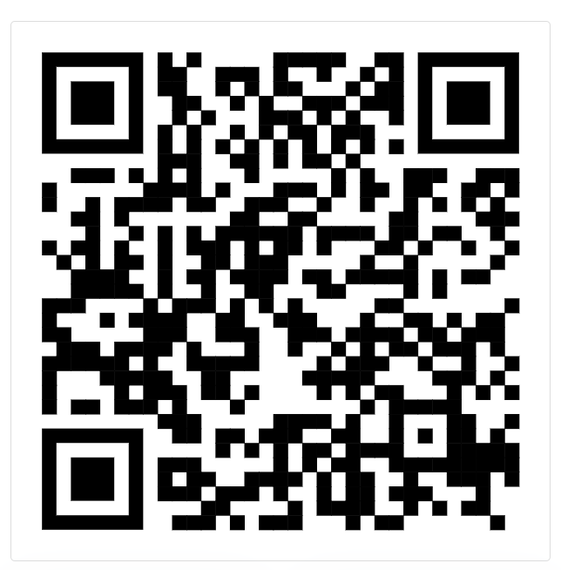
December
Year 1 Team Lead
Cohort Meeting
Please sign in with our attendance form
Presenter:
Notes:
https://go.edc.org/SEB-Academy-Sign-In

Slide 3
IN-PERSON TEAM TRAINING EVENT INCLEMENT WEATHER POLICY
In case of inclement weather, we will cancel our team training if the local school district where the training will be held is either delayed or cancelled due to inclement weather. Please monitor school and district closings for the school district in which the training is being held. In any case that you feel it is not safe for you to travel to the cohort training, please make the decision that is most safe for you.
Your training site is EDC Offices - Waltham, MA

Slide 4
Glows and Grows
Gathering Feedback from Partners
Co-Creating Positive Learning Environments
TFI Overview
Closing

Slide 5
RESOURCES
SEB Academy Tiered Supports Inventory: https://sebacademy.edc.org/tiered-support-inventory
Commonly Used Assessments, Surveys, and Screeners: https://sebacademy.edc.org/commonly-used-assessments-surveys-and-screeners
Family-School Partnership Survey: https://sebacademy.edc.org/family-school-partnership-survey
Family-School PRACTICES Survey: https://sebacademy.edc.org/family-school-practices-survey
Climate Survey: Staff, Students, Families: https://sebacademy.edc.org/pbis-climate-survey-manual
How Are Schools Using School Climate Surveys? https://sebacademy.edc.org/how-are-schools-using-school-climate-surveys
How Are Schools Using Parent and Personnel School Climate Data?: https://sebacademy.edc.org/how-are-schools-using-parent-and-personnel-school-climate-surveys
Feedback and Input Survey: https://sebacademy.edc.org/pbis-feedback-input-survey-manual
Empathy Interview Tool https://sebacademy.edc.org/empathy-interview-tool
Focus Groups - https://www.simplypsychology.org/what-is-a-focus-group.html

Slide 6
Glows and Grows
Share one Glow and one Grow for your team from the last month:
Glow – How has your team grown and what steps have you take with action planning?
Grow – What systems or practices do you need more support with from the Academy?
Notes:
20 minutes, whiteboard

Slide 7
Co-Creating Positive Learning Environments

Slide 8
HOW SCHOOLS HAVE TRADITIONALLY OPERATED
Set policies
Choose curricula
Set schedule
Determine professional development
Set mandates for physical environment
Maintain compliance with local and state laws
Given expectations and requirements
Might be given an opportunity to collectively set classroom norms
Held accountable for adherence to policies and expectations through discipline
One-Way Power Dynamic
Students
Staff
Expectations communicated to families
Invited to participate in specific ways
Families
Notes:
Often, teachers and administrators decide on the norms, policies, expectations, and practices of school without including other members of the school community. This can lead to feelings of confusion, frustration, and misunderstanding. This also puts onus entirely on school staff to maintain these norms, expectations, and practices.
Instead, we want to co-create.
This means including

Slide 9
CO-CREATING POSITIVE ENVIRONMENTS
Makes suggestions for policies, curricula, practices, and PD
Works with decision-makers
Connects with students, staff, and families
Shared Power and Partnership
Give feedback and input into decisions
Feel ownership
Uphold expectations and hold one another accountable
Students
Staff
Diverse and Representative Team
Families

Slide 10
Share Out
How might your team bring in more diverse voices?
What are your barriers?
Notes:
Group Dicussion

Slide 11
TIERED SUPPORTS FOR POSITIVE LEARNING ENVIRONMENTS
Group discussion: What are you currently doing in these areas with families and students and non traditional staff?
i.e. Designing signage, Helping with translations, Events
Environmental Supports
accessible spaces, signage, decorations, collaborative spaces
posted expectations/matrix, accessible signage, positive acknowledgement system, common language and expectations
Behavioral Supports
i.e. home matrices, behavior lesson support, linking and designing meaningful acknowledgement systems,
calming spaces, environmental supports, Tier 1 SEL curriculum, common language and understanding of SEL
SEL Supports
i.e. Social stories, supporting social skills practice at home, sharing home successes
positive relationships, community focused spaces and schedule, inclusive policies, diverse curricula and representation
Belonging Supports
i.e. Sharing cultural practices and traditions, norms around school/education, creating diverse clubs/groups for staff & students, school as a community center
counseling, referral to outside services, environmental supports, destigmatizing mental health supports
Mental Health Supports
i.e. Linking with community services, sharing coping and wellness practices, inviting speakers, sharing stories
Notes:
Group discussion: What are you currently doing in these areas with families and students? Other considerations? What are we missing?

Slide 12
Obtaining Partner Feedback and Input

Slide 13
IDENTIFY TOPICS FOR INPUT/FEEDBACK
+
+
SEL Tier 1 Curricula
Behavior Expectations/Matrix
SEB Team Goals
Policies (attendance, dress code, etc.)
Practices (acknowledgement, traditions, communications practices, etc.)
Tiered Supports
+
+
+
+

Slide 14
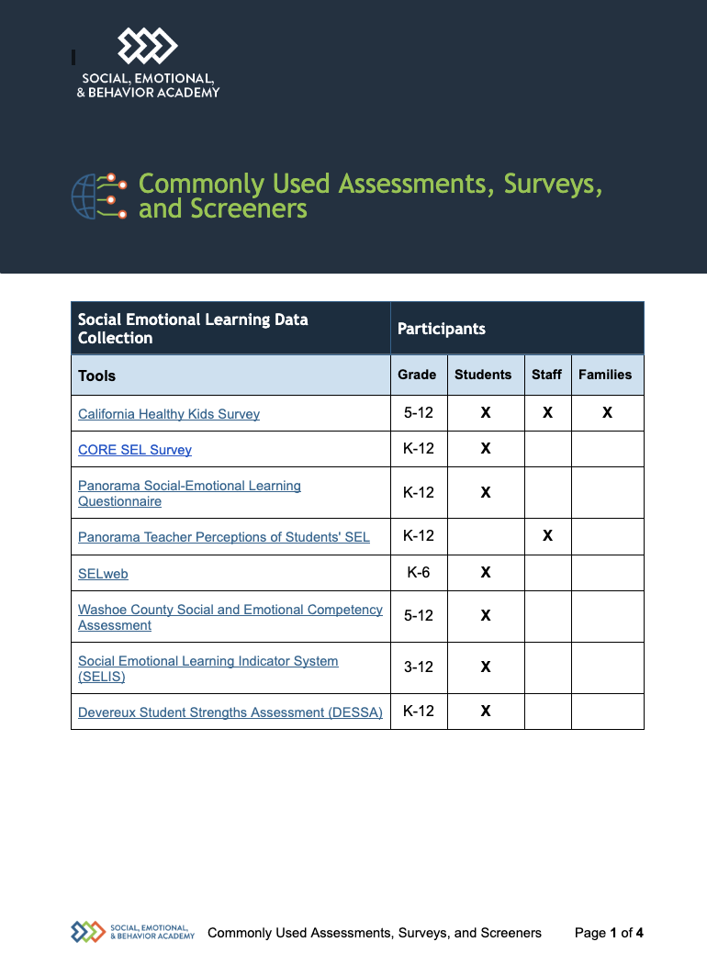
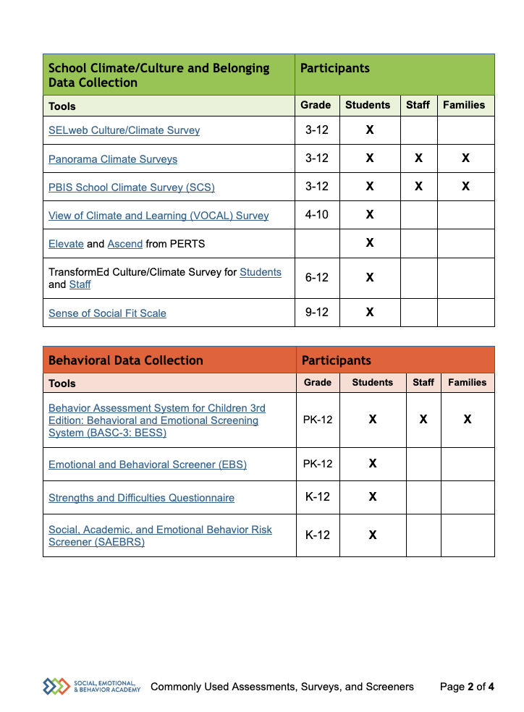
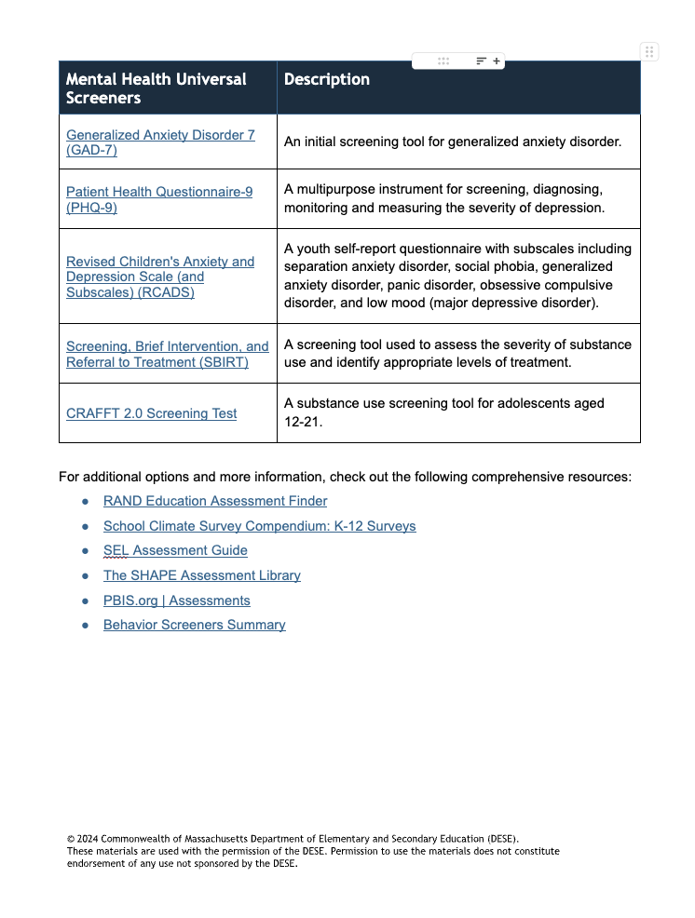
SELECT FEEDBACK METHOD(S)
+
Surveys
Empathy Interviews
Focus Groups
Feedback Protocol (Glow/Grow, Start/Stop/Continue)
+
+
+
+

Slide 15
Quantitative vs Qualitative
Quantitative Research/Data
Use of statistics and “numbers” to measure variables, support hypothesis, make predictions, etc.
Uses directional verbs: effect, influence, cause, relate, etc..
Looks for “what”, ”to what extent”, etc.
Sample QT question:
What is the effect of PBIS in reducing ODRs in our school?
Qualitative Research/Data
Asks “why” or “how” questions in an open-ended design
Uses exploratory verbs: report, describe, discover, generate, explore
Looks for emergent themes from personal reports, focus groups, etc.
Sample of QL question
One thing teachers and staff could do to help me feel like I belong at my school is: ___________________.

Slide 16
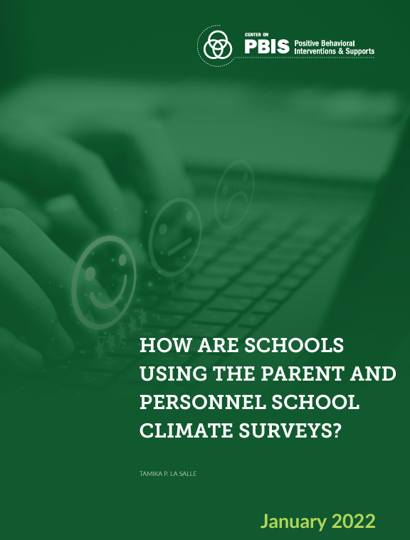
Surveys: School Climate Surveys
May be completed in English or Spanish (or translated via personal device)
School Climate Survey - The School Climate Survey Suite is a set of five multidimensional surveys to measure student, teacher, administrator, faculty, and family perceptions of school climate.
• School Climate Survey: Elementary
• School Climate Survey: Secondary (extended version)
• School Climate Survey: Secondary (brief version)
• School Climate Survey: School Personnel
• School Climate Survey: Family
The surveys are brief, reliable, and valid for assessing perceived school climate among students in Grades 3-12. Teams can use each survey separately or in combination to assess perceptions. Each survey includes a set of demographic questions about the participant and a number of questions related to school climate with Likert-scale response option.
How are Schools Using the School Climate Surveys? The purpose of this brief is to provide information about how to evaluate school climate at the primary and secondary levels. Norms and ranges are provided and based on a national data; this data can help schools to contextualize local data. Information for interpreting the data and unit if for data-based decision making is also included.
How are Schools Using Parent and Personnel School Climate Surveys? When school personnel and parents complete school climate surveys, results can inform team action planning to improve perceptions of school climate. This brief is intended to guide how districts and schools collect and disaggregate school climate data at the personnel and parent level to support data-based decision making.
This can be sent out and reviewed electronically through PBIS Assessments.
We can set you up with a free account if desired.
NOTE: The School Climate Survey Suite was developed by the Georgia Department of Education, led by Tamika LaSalle. The Center on PBIS has adopted these original surveys and renamed them for national use.
Notes:
Climate Survey: Staff, Students, Families: https://sebacademy.edc.org/pbis-climate-survey-manual
How Are Schools Using School Climate Surveys? https://sebacademy.edc.org/how-are-schools-using-school-climate-surveys
How Are Schools Using Parent and Personnel School Climate Data?: https://sebacademy.edc.org/how-are-schools-using-parent-and-personnel-school-climate-surveys

Slide 17
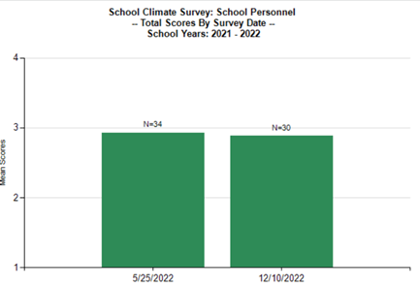
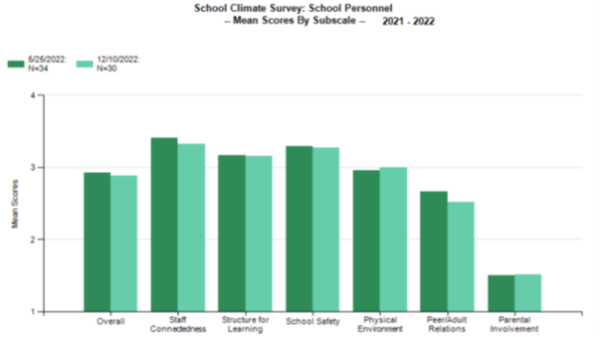
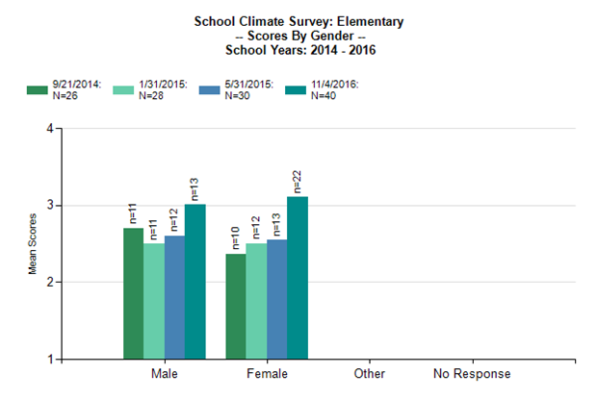
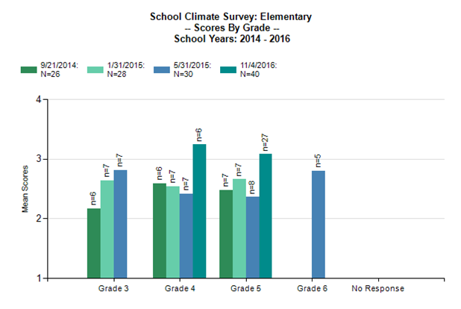
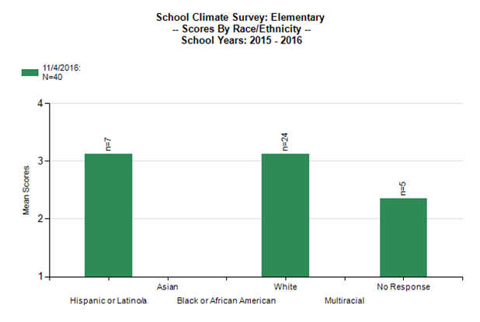
SCHOOL CLIMATE SURVEY REPORTS

Slide 18
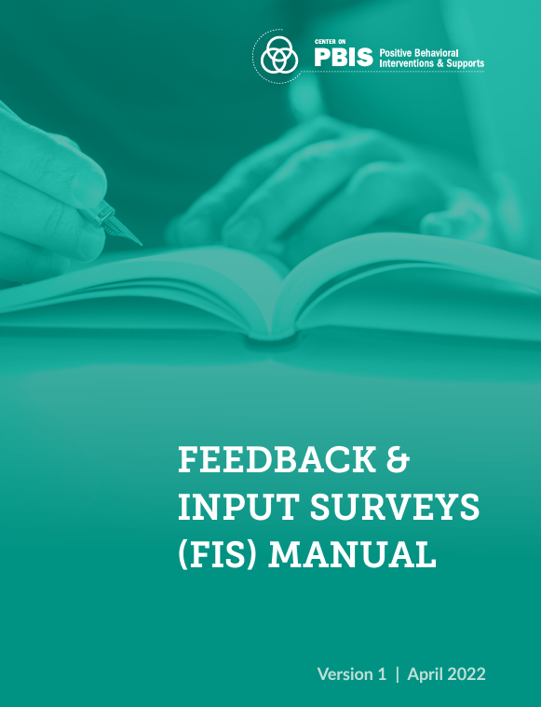
Surveys: Feedback and Input Surveys
The Feedback and Input Survey Suite is a set of four surveys for school teams to learn about how students, school personnel, and family members are experiencing the school’s behavior support systems and obtain detailed feedback for increasing the effectiveness, efficiency, equity, and sustainability of those systems.
The FIS includes open and closed ended questions and all surveys may be sent in English or Spanish.
This can be sent out and reviewed electronically through PBIS Assessments. We can set you up with a free account if desired.
Notes:
Feedback and Input Survey: https://sebacademy.edc.org/pbis-feedback-input-survey-manual

Slide 19
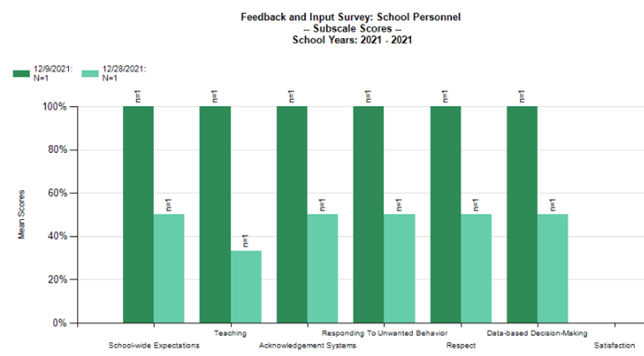
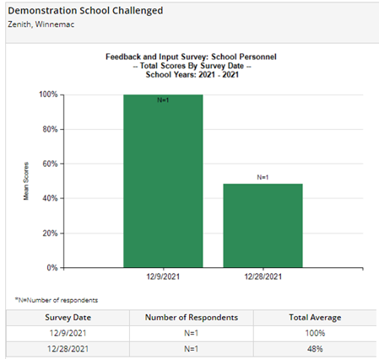
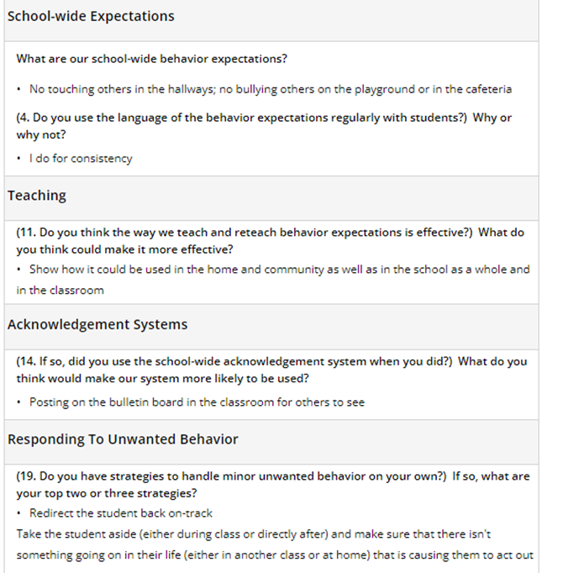
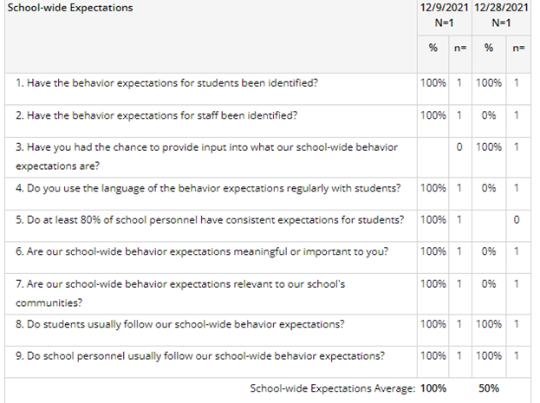
Surveys: Feedback and Input Survey Reports

Slide 20
Focus Groups
A focus group is a way to collect data in which a group of participants gathers to share knowledge, voices, opinions, beliefs, and attitudes about a specific topic or concept. Focus groups can help schools learn rich details of students' experiences.
Structured focus groups ask specific questions to help you better understand a specific topic such as the findings from an earlier quantitative analysis. In a structured interview, the interviewer has prepared specific open-ended questions and will ask follow-up questions as needed.
Unstructured focus groups will also lead you to understand your data but in a way that is much more like a natural conversation. In an unstructured interview, the questions are open-ended, but the interviewer strives to create a flow of natural conversation and uses follow up questions to further understand the participants’ experiences.
Whether you take a structured or unstructured approach, make sure to plan a script so that it is easy to take notes and keep the conversation on track. A script also improves the likelihood that you will get relevant and beneficial information and ensures similar experiences if you conduct multiple interviews or focus groups.
The Learning Accelerator https://practices.learningaccelerator.org/strategies/how-to-run-a-focus-group

Slide 21
What is the value of completing focus groups with families? What can we learn from focus group results?

Slide 22
Empathy Interviews
Empathy interviews usually are one-on-one conversations that use open-ended questions to elicit stories about specific experiences that help uncover unacknowledged needs. A protocol allows the interviewer to probe more deeply into stories than a more traditional interview. Empathy interviews help ensure that the diverse lived experiences of people are centered in decisions and actions.
Nelsestuen & Smith 2020 www.learningforward.org
Notes:
Empathy Interview Tool https://sebacademy.edc.org/empathy-interview-tool

Slide 23
Share Out
Do you currently use any of these tools to obtain feedback?
Notes:
Group Dicussion

Slide 24
Resource Review: In random breakouts review and discuss the survey you are assigned. Be prepared to share out.
Climate Survey
Feedback & Input Survey
Focus Group
Empathy Interview
Notes:
Climate Survey: Staff, Students, Families: https://sebacademy.edc.org/pbis-climate-survey-manual
Feedback and Input Survey: https://sebacademy.edc.org/pbis-feedback-input-survey-manual
Empathy Interview Tool https://sebacademy.edc.org/empathy-interview-tool
Focus Groups -
https://www.simplypsychology.org/what-is-a-focus-group.html
Center on PBIS | Video: PBIS Forum 2019 Interview: Therese Sandomierski

Slide 25
Share Out
What’s one big idea you want to share about this tool?
How might this tool be used at a school?
What barriers might schools anticipate with this tool?

Slide 26
Action Planning to Gather Feedback

Slide 27
CONSIDERATIONS FOR GATHERING FEEDBACK
Surveys allow you to gather feedback from more people, but are less personal than interviews or focus groups
Plan your timeline – by when will you have gathered feedback? By when will you have analyzed feedback?
Plan for how you will gather responses from the people who do not typically respond
Plan to share results and next steps with anyone you collect feedback from

Slide 28
Action Planning
Take a look at your team’s action plan:
Are there opportunities to gather feedback built into your action plan?
If not, how might you add feedback opportunities?
If yes, what considerations do you need to plan for?
How will you bring back this information and share it with your team?

Slide 29
Closing and Next Steps

Slide 30
REFLECTION & CLOSING
Share in the Chat: What is one small shift you can make to co-create a positive learning environment or collect meaningful partner input in the next 3 weeks?

Slide 31
UPCOMING EVENTS
https://sebacademy.edc.org/upcoming-events
Webinars
Setting Positive Behavior Norms and Expectations
Wednesday, January 22 – 9:30-11:00 AM
Equitable Data Use in MTSS for SEB
Tuesday, January 28 – 9:30-11:00 AM
Peer Sharing Calls
Enhancing the Identification, Matching, and Monitoring Process for Advanced Tiers - 2pm-3pm on 12/9, 1/13, 2/10
Supporting Adult Belonging - 10am-11am on 12/10, 1/14, 2/11
Supporting Students of Immigrant and Refugee Origins - 2:30-3:30 on 12/10, 1/7, 2/4
Next Team Lead Meeting
Wednesday, February 5
9:00 - 10:30 AM

Slide 32
RESOURCES
SEB Academy Tiered Supports Inventory: https://sebacademy.edc.org/tiered-support-inventory
Commonly Used Assessments, Surveys, and Screeners: https://sebacademy.edc.org/commonly-used-assessments-surveys-and-screeners
Family-School Partnership Survey: https://sebacademy.edc.org/family-school-partnership-survey
Family-School PRACTICES Survey: https://sebacademy.edc.org/family-school-practices-survey
Climate Survey: Staff, Students, Families: https://sebacademy.edc.org/pbis-climate-survey-manual
How Are Schools Using School Climate Surveys? https://sebacademy.edc.org/how-are-schools-using-school-climate-surveys
How Are Schools Using Parent and Personnel School Climate Data?: https://sebacademy.edc.org/how-are-schools-using-parent-and-personnel-school-climate-surveys
Feedback and Input Survey: https://sebacademy.edc.org/pbis-feedback-input-survey-manual
Empathy Interview Tool https://sebacademy.edc.org/empathy-interview-tool
Focus Groups - https://www.simplypsychology.org/what-is-a-focus-group.html

Slide 33
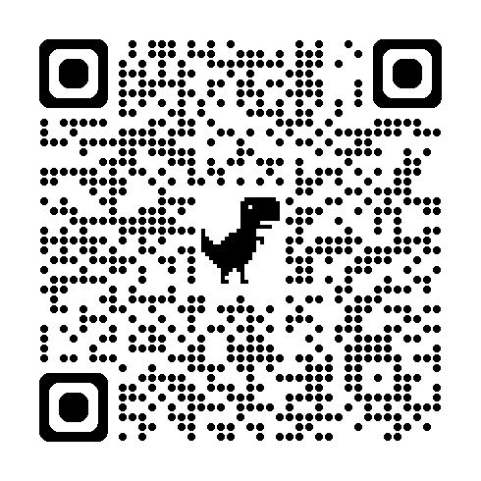
EVALUATION
Thank You
Notes:
https://docs.google.com/forms/d/e/1FAIpQLSdz32jKVAGdKiP3VzhqzA91uJEu8DkBOeJZo9-FDfnKBx_vDQ/viewform

