Slide 1


PBIS School-Wide Team Training
Year 3: November 2024
PBIS Track
Trainer Names
with support from NEPBIS Network, May Institute & Broad Reach Consulting
Notes:
Add trainer names for your event

Slide 2

EXPECTATIONS
Self
Others
Environment
Self-monitor
Listen while others are speaking​
Have your computer charged and ready to go​
If you have questions or comments:
Work as a team:
Keep necessary materials at hand
Are you participating?
Engaged as a learner?
Stretch, break, stand as needed​
Raise hand
Room for every voice
Reinforce participation
action plan
relevant docs
water/snacks
Minimize distractions if possible​

Slide 3
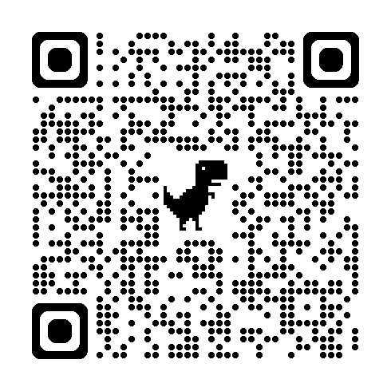
ACTIVITY: ATTENDANCE
Scan QR code on the left or follow the URL posted in the chat to access the online attendance survey Follow prompts to enter attendance information
Notify trainers if you require assistance (e.g., identifying your cohort or cohort group)
Certificates of Attendance will be sent in January and June. Attendance records and Zoom log in will be use as verification
1 minute
Notes:
https://docs.google.com/forms/d/e/1FAIpQLSf-la8kZA-l6ZXIR48DsDhimdXqFAX2d8Cw6xIXio0UxScqvw/viewform

Slide 4
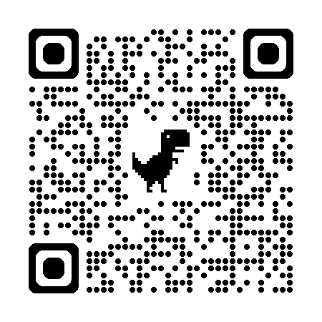
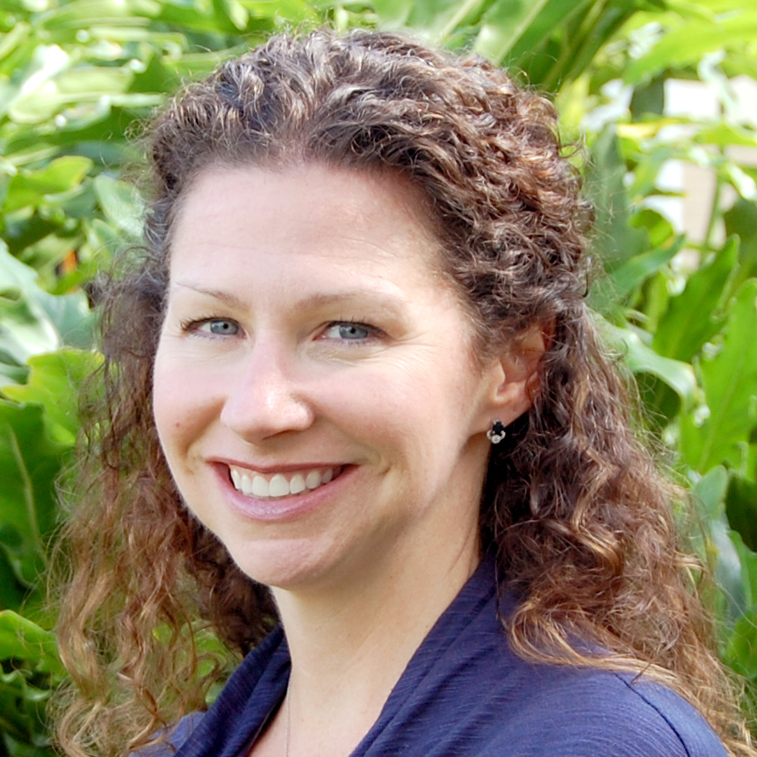
May Institute’s’20th Annual New England Positive Behavioral Support Forum
Friday, November 15, 2024 - Norwood, Mass.
Morning Keynote
STRANDS TO INCLUDE:
PBIS Foundations
PBIS and Families
Mental Health / Wellness
Classrooms
Equity
IDD and PBS
Heather George: Co-Director National Technical Assistance Center on Positive Behavioral Interventions and Supports
Registration Opens 5/30/24 – https://www.mayinstitute.org/services-for-schools/pbis/forum.html

Slide 5
Agenda & Team Tasks
Team time
Team Tasks
Presentation Content
Classroom PBIS Systems to Support
Identify a goal for this year’s PBIS implementation and add to your action plan
Sharing: Logic Model
Evaluation Plan
Review TFI results from last year and update your action plan for this year.
Plan how your team will support Classroom PBIS practices across your building.
Share your evaluation plan for PBIS implementation. – Google Folder
Share Updated Action Plan with Goal Statement. – Google Folder
Sustainability Factors
Goal Setting
We’ve planned 90 mins of team time during this training event

Slide 6

HELPFUL READINGS & RESOURCES
RESOURCES:
Start With Why: How to Put Purpose Back in Your Work
Data Decision Rules Activity
Evaluation Plan Template
Advance Action Plan
Supporting & Responding to Student's Social, Emotional, and Behavioral Needs (Classrooms)
Supportive Environments Create Classroom Community
Classroom Support Systems Brief
The Classroom Management Observation Tool (CMOT)
Self-Assessment Survey
Notes:
Start With Why: How to Put Purpose Back in Your Work -https://sebacademy.edc.org/start-why-how-put-purpose-back-your-work
Data Decision Rules Activity - https://sebacademy.edc.org/developing-data-routines-activity
Evaluation Plan Template - https://sebacademy.edc.org/evaluation-schedule
Advance Action Plan: https://sebacademy.edc.org/annual-action-plan-template-advanced
Supporting & Responding to Student's Social, Emotional, and Behavioral Needs (Classrooms) - https://sebacademy.edc.org/supporting-and-responding-students-social-emotional-and-behavioral-needs-classrooms
Supportive Environments Create Classroom Community - https://sebacademy.edc.org/supporting-and-responding-students-social-emotional-and-behavioral-needs-classrooms
Classroom Support Systems Brief - https://sebacademy.edc.org/classroom-support-systems-brief
The Classroom Management Observation Tool (CMOT) - https://sebacademy.edc.org/classroom-management-observation-tool-cmot
Self-Assessment Survey www.pbisapps.org/resource/self-assessment-survey

Slide 7
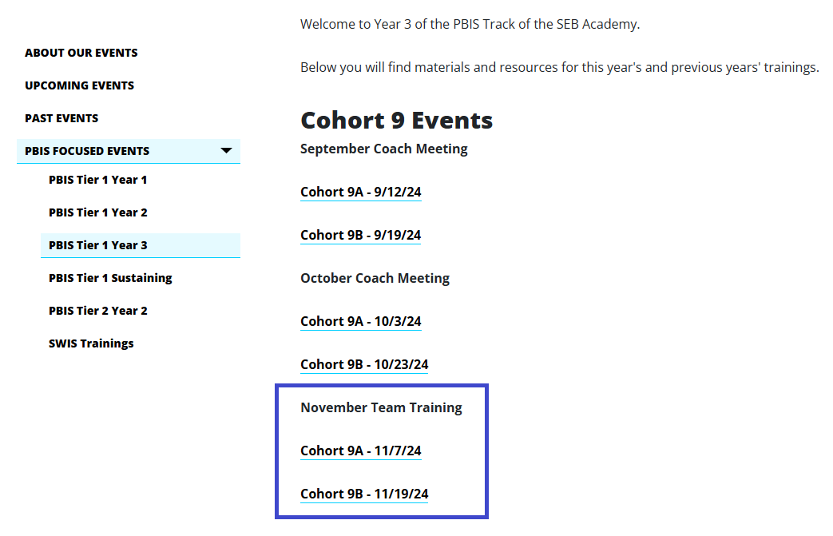
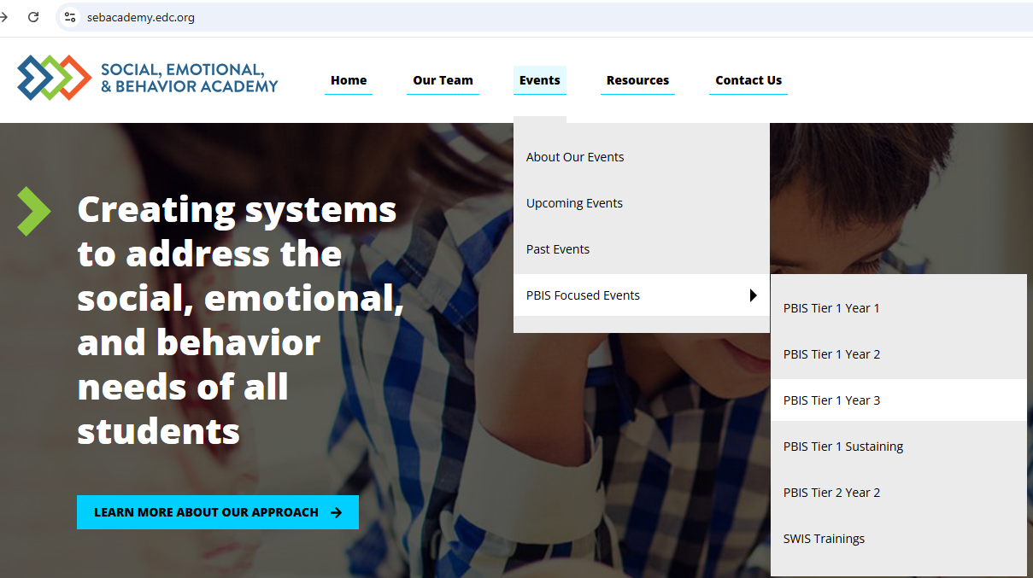
Tier 1 Year 3 - SEBAcademy.edc.org

Slide 8
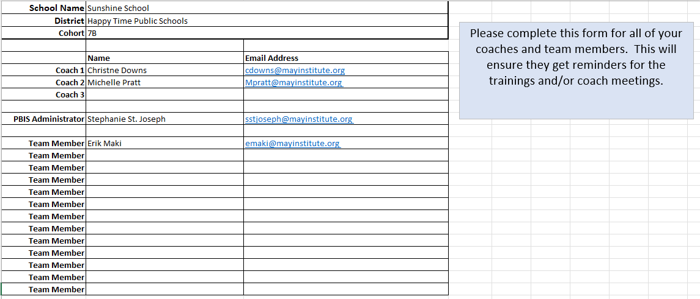
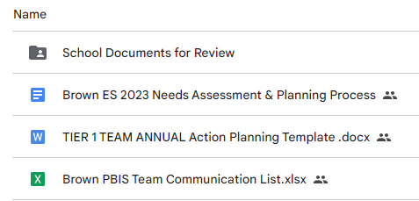
Google Folder, Communication Survey
Please add all your team’s contact information into the Communication Excel Sheet.
Move to School Documents for Review folder in your school’s Google Folder when completed
TEAM Communications List

Slide 9
Cohort 9A Google Folders
Nichols MS - https://drive.google.com/drive/u/0/folders/1MecvAHzZMsaBzkl6zavACn21NTasjC2X
Berkland ES - https://drive.google.com/drive/u/0/folders/17WuSfGdwiaMX-gr9jN6jkUl9A9D-l4Rq
Memorial ECC - https://drive.google.com/drive/u/0/folders/1mBTD21oMO2KhPsrsF0-FCitKlu_sjuyh
Goode ES - https://drive.google.com/drive/u/0/folders/1b8rKfr1DNPvGA3hP1_UW4PDrrMBHslI_
Gardner HS – https://drive.google.com/drive/u/0/folders/1rhDaS70sLaB9tGXUOCPLe0QKZScSJnJT
John Glen MS - https://drive.google.com/drive/u/0/folders/1JzhMJVSgJX8YJaHiiRYrI9GT9458W-pX
Bridgewater-Raynham HS -https://drive.google.com/drive/u/0/folders/1EDLprCiebaGYHvRNU9Tn6nahLgynUGVk
Shay ES - https://drive.google.com/drive/u/0/folders/1svOPA5KiXY6SEh13CQttKf5IOKtHnM2r

Slide 10
Cohort 9B Google Folders
North Grafton - https://drive.google.com/drive/u/0/folders/1S0382zmqwPDWv3zy0mud0IZQ4fapGScn
South Grafton - https://drive.google.com/drive/u/0/folders/1vLX2lo5cstAx79VIRDnKjW4cAFurBse5
King Phillip -
https://drive.google.com/drive/u/0/folders/1xl3bbqH54xu7-z7YkOaKbIW4JUNCG9Nv
Burgess - https://drive.google.com/drive/u/0/folders/1tPpdq2SUMJaJ722_9Gwv_PfMg01onwOX

Slide 11
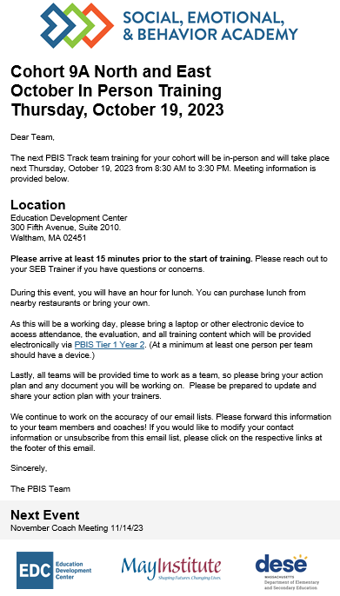
Communication Reminders
Email Reminders will be sent to all coaches, administrators and team members for our PBIS Events. The email will come from SEB Academy sebacademy@edc.org
Please review invitation for Date, Time, Location/Zoom Link, and any other important information included.
The next training or coach meeting will be displayed at the bottom
Share with other Coaches or Team Members

Slide 12
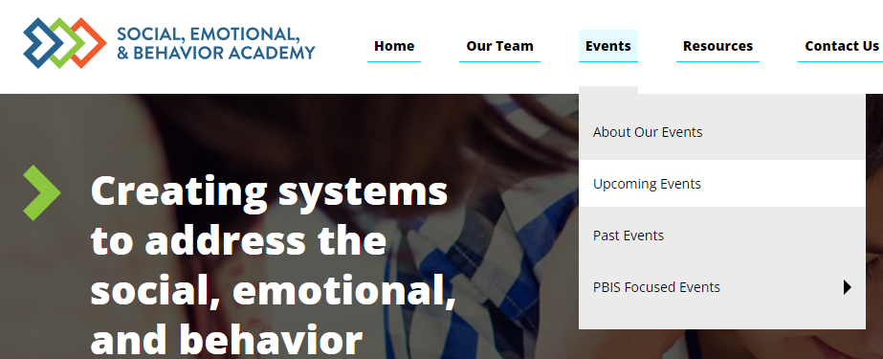
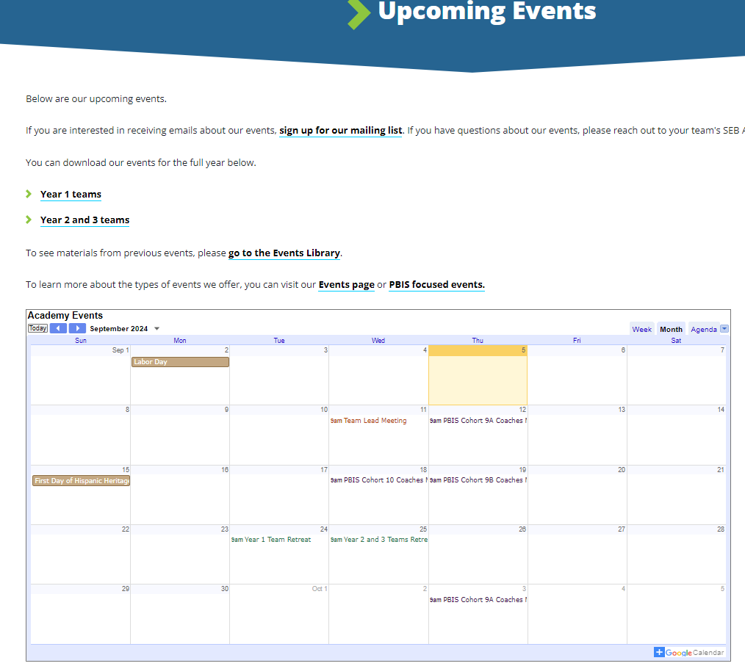
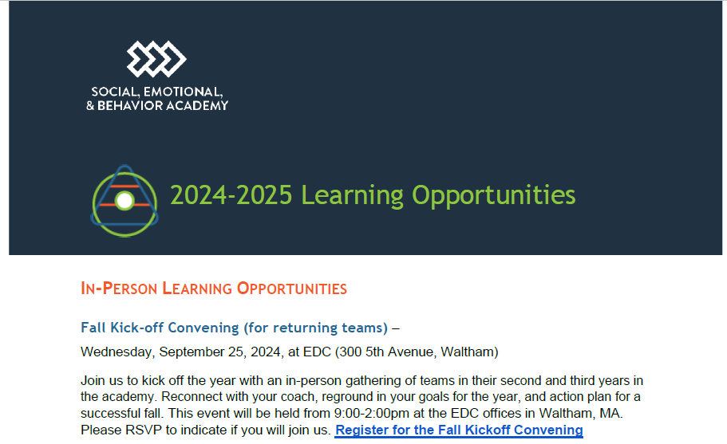
Other Upcoming Events
https://sebacademy.edc.org/upcoming-events
Notes:
https://sebacademy.edc.org/upcoming-events
Put the 24-25 Learning opportunities doc in the Chat or send by email. All of the PBIS dates for the cohort plus extra learning opportunities are in that doc.

Slide 13
VIRTUAL LEARNING OPPORTUNITIES
Virtual Workshops – Open to ALL STAFF
Below is a list of dates and topics for our 2024-2025 virtual workshops.
Virtual workshops are open to any educator in your school or district.
Please share these dates with anyone who might be interested in attending.
More information about our virtual workshops can be found on our About Our Events page.
+ Surveys and Screeners to inform MTSS for SEB - Tuesday, October 8 from 9:30-11:00 AM
+ MTSS Through an Equity Lens - Tuesday, October 15 from 9:30-11:00 AM
+ Supporting Educator Wellbeing - Tuesday, October 22 from 9:30-11:00 AM
+ Centering Belonging - Tuesday, October 29 from 9:30-11:00 AM
+ Strengthening Family-School Partnerships - Tuesday, November 19 from 9:30-11:00 AM
+ Integrating SEL and Mental Health Supports - Wednesday, December 4 from 9:30-11:00 AM
+ Setting Positive Behavior Norms & Expectations - Wednesday, January 22 from 9:30-11:00 AM
+ Equitable Data Use in MTSS for SEB - Tuesday, January 28 from 9:30-11:00 AM
+ Sustainability: Going from Good to Great - Wednesday, February 12 from 9:30-11:00 AM

Slide 14
VIRTUAL LEARNING OPPORTUNITIES
Peer Sharing Call Series
Peer sharing calls bring together members of the academy around a shared topic area or goal for three sessions of facilitated conversation around successes and challenges. These calls are facilitated by members of the SEB Academy team and may contain short presentations of content related to the topic area of focus. Peer sharing calls are open to any educator in your school or district. Winter sessions will run in December, January, and February, and Spring sessions will run in March, April, and May. Please share these dates with anyone who might be interested in attending. More information about our peer sharing calls can be found on our About Our Events page.
+ Supporting Adult Belonging - Winter
+ Creating Strong Relationships and Community with Tier 1 Supports - Winter
+ Effective Data Use in MTSS for SEB - Winter
+ Supporting Students of Immigrant and Refugee Origins - Winter
+ Enhancing the Identification, Matching, & Monitoring Process for Advanced Tiers - Winter
+ Supporting LGBTQIA+ Students - Spring
+ Sustaining Progress - Spring
+ Strengthening Family-School Partnerships - Spring
+ Supporting ELL Students - Spring
+ Increasing Buy-In Through Strategic Communication - Spring

Slide 15
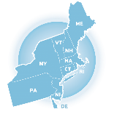

Big Idea Check In:
Yearly Planning & Outcome Goals
Notes:
TRAINER NOTE: This is review contnent please be brief

Slide 16

4 Tips for Sustaining PBIS
https://youtu.be/xPt9pGkOgIo?t=7
Notes:
Trainers: Play this entire 4.41-minute video as a set up for the slides to come. (Be sure you shared your Sound when you shared your screen)
https://www.pbis.org/video/four-tips-for-sustaining-pbis

Slide 17










GETTING STARTED WITH SWPBIS
Establish an effective leadership team
Develop a continuum to strengthen appropriate behaviors
Develop a brief statement of purpose
Develop a continuum to discourage violations of expectations
Identify positive school-wide behavior expectations
Develop data-based procedures for monitoring
Develop procedures to teach school-wide expectations
Develop systems to support staff
Develop procedures to teach class-wide expectations
Build routines to ensure ongoing implementation
Notes:
Emphasise the 4 ideas from the video
1 – Keep a strong team (next slide)
2 – Use TFI data to improve systems (we will do this at the November training)
3 – Use your school discipline data – slide to come with all data mentioned…good for goal planning
4 – Implement PBIS in the Classroom (Nov Training)

Slide 18
GUIDELINES FOR TEAMS
Membership
Systems
Scheduling
Systems
Representative of school/community demographics
1-2 members with behavior/classroom management competence
1-2 family members
Active participation from administrator
Integrated with other behavior-related initiatives/programs
Given appropriate priority relative to school/district goals
Established rules/agreements
Coaching support (at the school, district, or regional level)
Monthly meetings
Monthly presentations to staff
Annual self-assessments
Notes:
TRAINER NOTE: This is review contnent please be brief

Slide 19
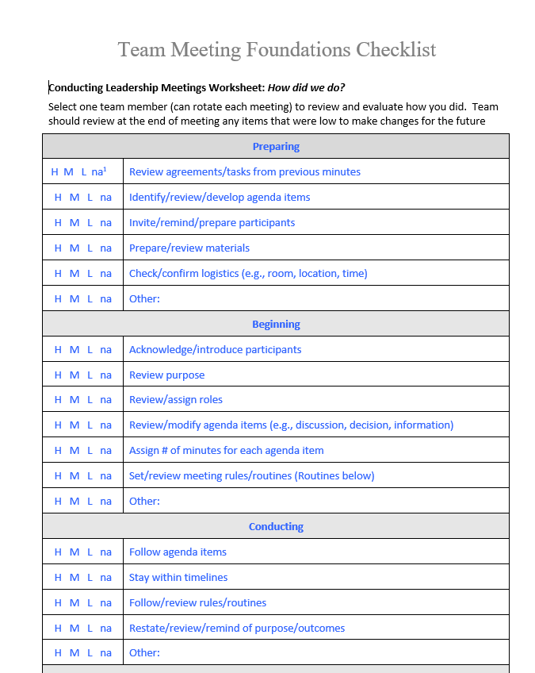
Meeting Foundation Checklist
This is a great way to prepare for and evaluate your team meetings
Use it as a coach to prepare for your meetings
Ask one team member each meeting to complete the checklist as best as possible throughout your meeting to evaluate your meeting.
Review checklist at the end of the meeting
Adjust practices / systems for items that receive an L (low) rating.
Notes:
https://sebacademy.edc.org/team-meeting-foundations-checklist

Slide 20
ACTION PLANNING
Action Plan
Foundation for all you do as a team
Vital for achieving goals
Specifies three features:
1
2
3
Who
What
When
Who is responsible…
…for doing what…
…by when?
Action Planning: The process of organizing resources to enable individuals to engage in activities designed to achieve specific and important outcomes.
Notes:
TRAINER NOTE: Keep this brief, this is review content

Slide 21

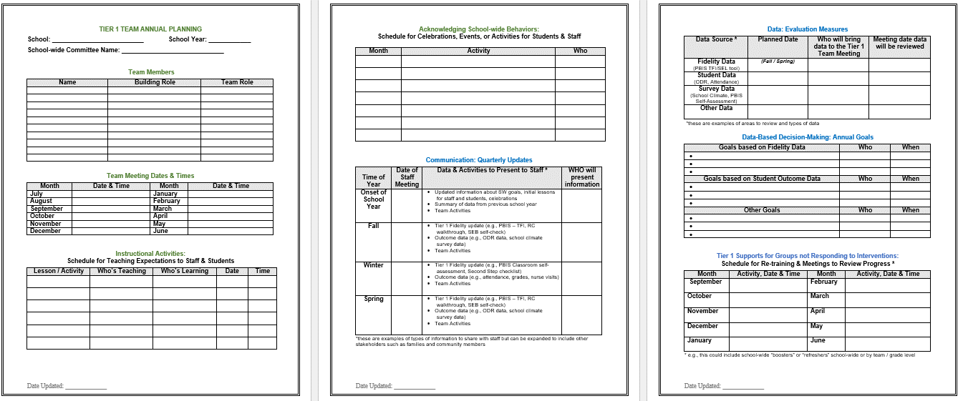
Annual Action Planning - Advanced
Evaluation Measures
Acknowledgment Plans
Team
Info
Annual Goals
Teaching Expectations Plan
Communication
Tier 1 Student Follow Up
Notes:
This Action plan is more advanced and is intended for schools in years 2 and beyond. Review with the team.
Advanced Action Plan https://sebacademy.edc.org/annual-action-plan-template-advanced

Slide 22
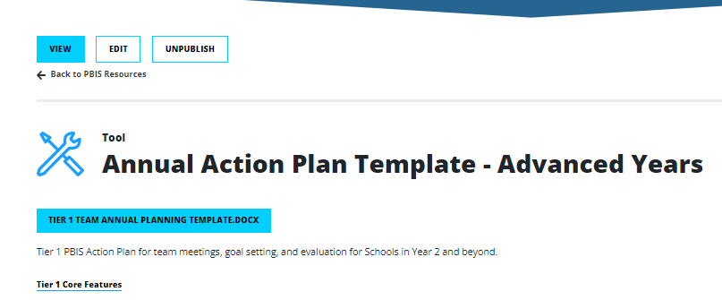
Action Plan – Annual Planning Advanced Years
https://sebacademy.edc.org/annual-action-plan-template-advanced
Notes:
Ask Coaches to download this Action Plan for use this year. Will be reviewed in the next slide.
https://sebacademy.edc.org/annual-action-plan-template-advanced

Slide 23
DATA-INFORMED OUTCOME GOALS
Review the following with your team when considering your PBIS outcome goals for the year:
Fidelity Assessments (TFI, TIC)
Student Outcome Data (attendance, screening, discipline, grades)
Stakeholder Input (surveys, focus groups)
School/District Priorities (DIP, SIP)
Notes:
We will review Stakeholder Input Surveys (new on PBIS apps) in October.
Teams should consider these factors when setting goals for this year.

Slide 24

Outcomes tell us if we achieve our purpose and guide framework implementation
As a result of implementing PBIS during the 20XX-20XY school year, student reports of school climate will improve by 20%
Based on data
Locally important and meaningful
Applicable to all (culturally equitable)
  Students’ social competence and academic achievement
  Staff implementation of critical skills
Observable and measurable
Written as a goal

Slide 25
What would it look like if all students developed the SEB skills needed to be effective learners?
As a result of implementing PBIS during the 20XX-20XY school year:
behavior incidents will decrease by __% relative to the same period as the prior year.
incidents of exclusionary discipline (suspension/expulsion) will decrease by __ % relative to the same period as the prior year
Behavior referrals and exclusionary discipline would decrease
disproportionate discipline would decrease
students would be in class consistently
all students would meet academic standards
use of disproportionate discipline will decrease by __%
% of students who are chronically absent will decrease by __%
% of students meeting grade level academic standards will increase by __%

Slide 26
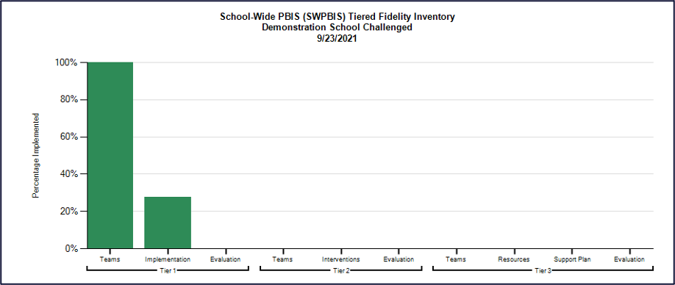
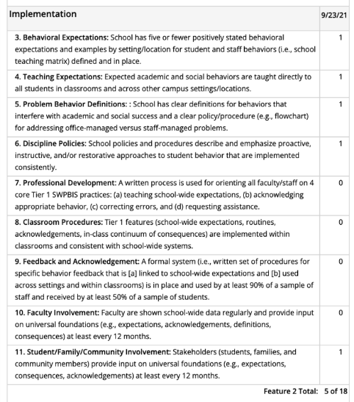
Use TFI data to guide your action planning!
Select action steps based upon TFI data
AND
your identified goals (outcomes)!

Slide 27
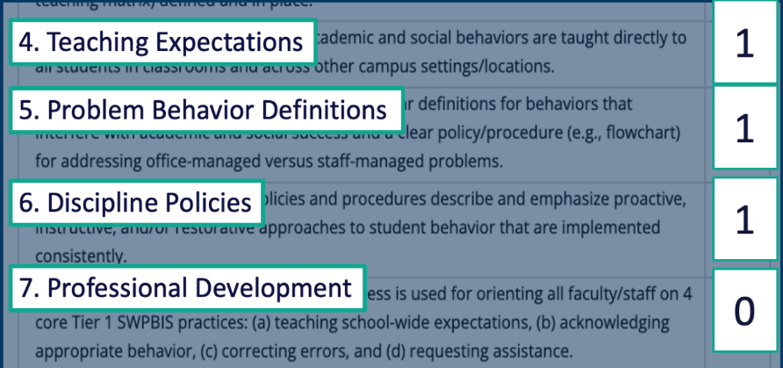
EXAMPLE
Identified goal (outcome):
behavior incidents will decrease by __% relative to the same period as the prior year.
Team determines that implementing these features can help achieve identified outcomes.
So, the team engages in targeted action planning:
What do we need to do?
How?
Who?
By when?
Team assessment of TFI features:

Slide 28
Identifying Outcomes/Goals
What outcomes are you hoping to achieve this year?
(Consider BOTH implementation fidelity and student outcomes)
Step 1: Develop evaluation questions.
Step 2: Identify indicators or measures.
Step 3: Develop methods for collecting & analyzing indicators.
What do you want to know?
What information can be collected?
How/when should information be gathered?
Step 4: Make decisions and action plan from analysis of indicators.
How will the question be answered & what should be done next?

Slide 29
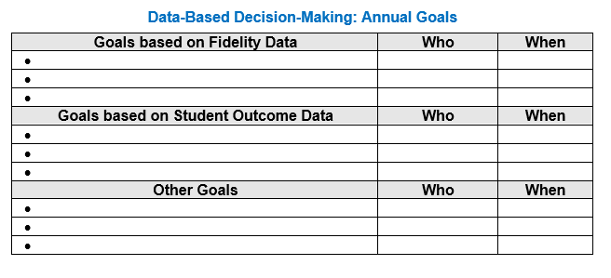
Goals and Outcomes
Notes:
Have them begin to think about their Goals for This year. They should come to the Oct team training prepared to identify goals and the data sources they will use to measure the goal.
This will be an October team activity. Coaches should start to think about these based upon last years goals, the TFI, and other Data

Slide 30
DISCUSSION: TEAMING
Download & Review Advanced Action Plan.
Complete Team and Goals Section and share with trainers.
Consider what other parts you can fill in and what you need to work on.
Be prepared to share out one goal with group
15 minutes
10 minutes
Team Discussion
Whole Group
Notes:
https://sebacademy.edc.org/annual-action-plan-template-advanced

Slide 31
DATA ROUTINES & EVALUATION PLAN

Slide 32

Systems
Data
Data
Use data to inform decisions about which students, families, and educators need which supports, as well as whether supports should be continued, adjusted, or faded. Data should be used to ensure that all recipients experience benefit and that supports are implemented with fidelity.
Equity
Outcomes

Slide 33
Data used in PBIS implementation
Data
Fidelity Data
Did we implement the systems and practices we agreed upon?
Outcome Data
Is the plan resulting in progress towards our goals (student benefit)

Slide 34
Why develop data routines?
To continuously improve
your Tier 1 framework!
Are we achieving our desired outcomes?
Which groups are benefiting from our plan? Which are not?
Are we implementing as planned?
What needs to be strengthened? Revised?
Are students receiving adequate support to achieve positive outcomes?

Slide 35
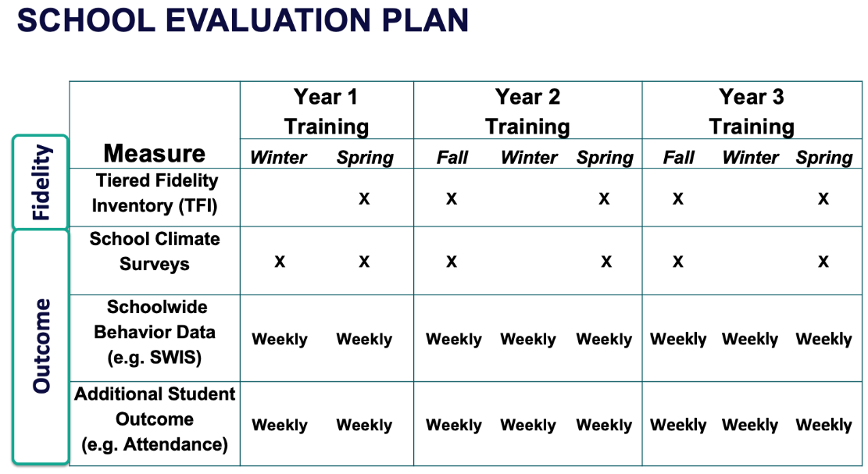
Strengthen Routines to Gather Fidelity and Outcome Data

Slide 36

Establish and Strengthen Data Routines
1. Identify the RIGHT data
Outcome data tied to goals
Fidelity data tied to evaluation plan
3. Identify the RIGHT people
Who needs to see these data to inform decisions? (e.g., PBIS team, grade level teams, family groups, other committees?)
4. Identify the RIGHT time & format
When/how often should these data be reviewed to inform decisions?
What format will facilitate decision making?
2. Assess data integrity
Consider staff training & buy-in, systems, response rates

Slide 37
EXAMPLE: School-wide Behavior Data
1. Identify the RIGHT data
Office discipline referrals
3. Identify the RIGHT people
PBIS Leadership Team
4. Identify the RIGHT time & format
Team’s data analyst provides monthly report at meeting
Core SWIS reports reviewed each month and compared to previous years
2. Assess data integrity
Staff trained and coached on completing ODR forms and following discipline procedures
Data shown to whole staff to determine if it matches their perceptions

Slide 38

NON-EXAMPLE: School-wide Behavior Data
September
Student Behavior Data System Established
June
ODR data for the year shared at a PBIS Leadership meeting for the first time all year

Slide 39
EXAMPLE: Student Attendance
1. Identify the RIGHT data
Student attendance records
3. Identify the RIGHT people
PBIS Leadership Team
4. Identify the RIGHT time & format
Team’s data analyst provides monthly report at meeting
Table of students who have missed more than 5%, 10%, 20% of cumulative school days
2. Assess data integrity
Completed by homeroom staff and checked by administrative assistant daily

Slide 40
Establish Routines to Share Data with Vested Partners Regularly
The frequency that data are presented to all school staff is the factor most related to high levels of sustainability!
(Pinkelman et al., 2015)
School Board Families
Student Community
Share with other vested partners to increase commitment, accountability, and support

Slide 41
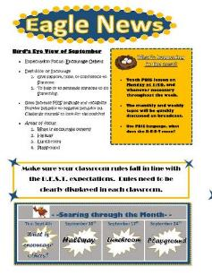
Ideas for Sharing Data
1. Share Annual Outcome Goals:
  When everyone understands the goals and sees progress from their efforts, vested partners are more likely to engage with interventions to meet those goals.
2. Email a Monthly/Quarterly Report:
      Give context, provide connections, suggest next steps
  Examples:
  Referrals from the hallway, month by month pre/post intervention
  Number of days since last playground referral

Slide 42
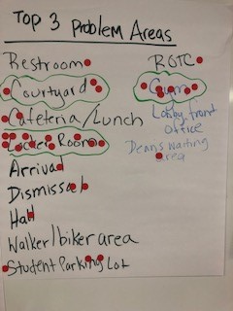
Ideas for Sharing Data
3. Create a data wall focusing on data related to school-wide goals:
Display data related to school-wide goals so everyone walking through can see the progress
4. Share data at monthly staff/PTO/student council meetings
  Invite members to actively participate in generating solutions

Slide 43
Developing Data Routines
Data Source | Date(s) for administration | Who brings data to team meeting | Meeting date to review data | Plan to share data
TFI
Behavior (ODR)
School Climate
Other Outcome
Establishing consistent, efficient data routines will enhance your team’s ability to effectively use data for decision-making!

Slide 44
Do you have an EVALUATION PLAN?
At a minimum, it is strongly recommended that teams include the following in an evaluation plan:
School-wide student outcomes (weekly)
Student and staff perceptions (annually)
Fidelity (annually with the TFI)
DISTRICTS/SCHOOLS IN TRAINING |  |  | SCHEDULE
Purpose | Measure | Function | Year 1 Training |  | Year 2 Training
 |  |  | Winter | Spring | Fall | Winter | Spring
Capacity Building—District Level | District Systems Fidelity Inventory (DSFI) | Completed by district leadership team (with the support of a trained facilitator) to assess district capacity and to guide Action Planning. |  | X |  |  | X
Fidelity of Implementation—Building Level | PBIS Tiered Fidelity Inventory (TFI) | Leadership team self-evaluation (with support of external coach) to assess the critical features of PBIS across Tiers I, II, and III. |  | X | X |  | X
Progress Monitoring—Building Level | Self-Assessment Survey (SAS) | Used by school staff for initial and annual assessment of effective behavior support systems in their school and to guide Action Planning. |  | X |  |  | X
Progress Monitoring—Team Level | Team Implementation Checklist (TIC) | A self-assessment tool that serves as a multi-level guide for creating School-Wide PBIS Action Plans and evaluating the status of implementation activities. | X | X | X | X | X
School Climate | PBIS School Climate Survey (Extended & Brief) | An annual survey that assesses student (grades 3-12), teacher, and parent perceptions of school climate. The middle and high school surveys also include items about adolescent drug/alcohol/tobacco use, self-harm ideation and behaviors, school dropout, and parental involvement. The survey provides information to determine training support needs related to school climate, safety, and violence prevention. |  | X | X
Student Outcomes | School-wide Information System (SWIS) | Office discipline referrals (ODR) provide data for monthly team reviews and decision-making by teachers, administrators, and other staff to guide prevention efforts and Action Planning. | Weekly | Weekly | Weekly | Weekly | Weekly
A written plan will support the sustainability of PBIS.
Notes:
Evaluation Schedule template: https://nepbis.org/tier-1-workbook-and-supplemental-materials/

Slide 45
Use your planning Document
Evaluation Plan
Goals
Notes:
Advance Action Plan: https://sebacademy.edc.org/annual-action-plan-template-advanced

Slide 46

Guidelines for Efficient Data Collection Routines
What Data?
  Limit to information that answers important student, classroom, and school questions
How should information be gathered?
  Integrate data collection procedures into typical routines (e.g., ODRs, attendance, behavior incident reports)
  Schedule data collection and staffing to ensure that data are current
When?
  No more than 1% of time each day for managing data
By whom?
  Ensure access to all necessary information (e.g., student records)
  Data collection reports regularly checked for accuracy

Slide 47
Guidelines for Efficient Data Review Routines
Protect team time to review data monthly
Identify 2-3 staff members to:
  manage data systems
  provide efficient, timely, and graphic displays of data
Establish structures and routines for staff members to receive weekly/monthly data reports about status of SW discipline

Slide 48
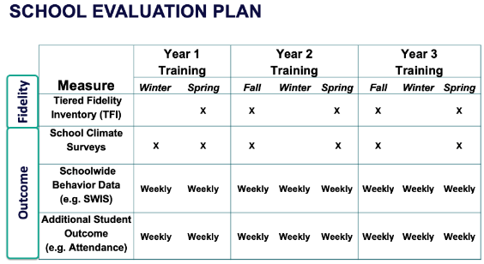
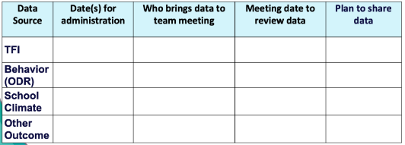

ACTIVITY: Data Routines
As a team,
Review your evaluation plan and identify what still needs to be completed this year.
Plan your data routines for the year ahead.
Add items to your Action Plan as necessary.
Be ready to present 2-3 “big ideas” from your discussion.
20 minutes

Slide 49
WHOLE GROUP DEBRIEF:
Routines for Gathering and Reviewing Data
How will you:
Develop and maintain your evaluation plan
Identify and progress monitor your outcome goals
Share data with vested partners?
What further support will you need to implement these routines?
5 minutes

Slide 50

10 minute break

Slide 51
SHARING TIME:
LOGIC MODEL

Slide 52

Small Group Discussions
Purpose: Share and compare across Systems, Data, Practices.
Share with other school team members the great data, system features, and practices you developed.
Discussions in small groups.
*Have your school's visual ready (outcomes, systems, data, practices)
*Be prepared to share and take notes​
*Take new ideas back to your team for action planning!​

Slide 53
School: ___________________________
Identify an outcome to focus on for this activity
(see examples below)
Implement Tier 1 PBIS with fidelity (≥ 70 on TFI)
Developing a continuum of responses to increase appropriate behavior
Reduce disruptive behavior across the school day
OUTCOME
How do we
sustain this?
SYSTEMS
DATA
How do we support staff to
implement this with fidelity?
What is one highlight
associated with this outcome?
__________________________________
__________________________________
What is one lesson learned?
__________________________________
__________________________________
How do we know we are doing what we say we are doing? How do we know it is working?
What are we doing?
What do we want to be doing?
PRACTICES

Slide 54
Lincoln School Logic Model
OUTCOME
How do we sustain this?
Explicit expectations taught & retaught, monitors trained and overlap with staff for first month, zones created & assigned to staff
Reduce injuries and referrals during recess
Recess monitors taught expectations with students at the start of the year. Four playground zones were created and staff were assigned to each zone and active monitoring was modeled by school staff for the first 3 weeks of school.
DATA
Office referrals, visits to the nurse, recess monitor weekly survey
How do we support staff to
implement this with fidelity?
SYSTEMS
What is one highlight
associated with this outcome?
Office referrals and injuries at recess have decreased. Monitors are more engaged with students and spend less time talking to one another.
What is one lesson learned?
Arranging schedules to overlap with monitors to train and model was challenging but critical.
Active monitoring at recess, expectations for behavior and use of equipment explicitly taught, each monitor acknowledges 5 students per recess for appropriate behavior
How do we know we are doing what we say we are doing? How do we know it is working?
What are we doing?
What do we want to be doing?
PRACTICES

Slide 55
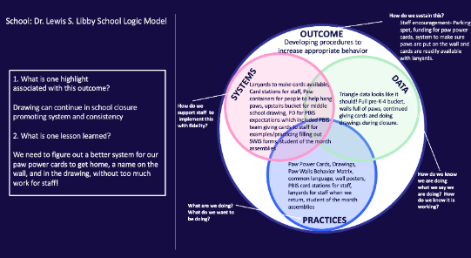
ACTIVITY: SMALL GROUP DISCUSSIONS
1. Randomize participants into 4 or 5 groups.
2. In each group take turns sharing how your logic model including outcomes, systems, data, and practices (4 or 5 mins).
3. Ask questions and take good notes.
4. Bring new examples back to your team for action planning!
20 minutes
Randomized Small Groups

Slide 56

LUNCH

Slide 57
CLASSROOM BEHAVIOR SUPPORT PRACTICES & SUPPORT SYSTEMS

Slide 58

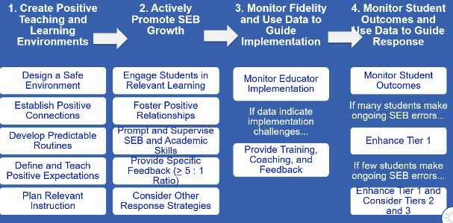
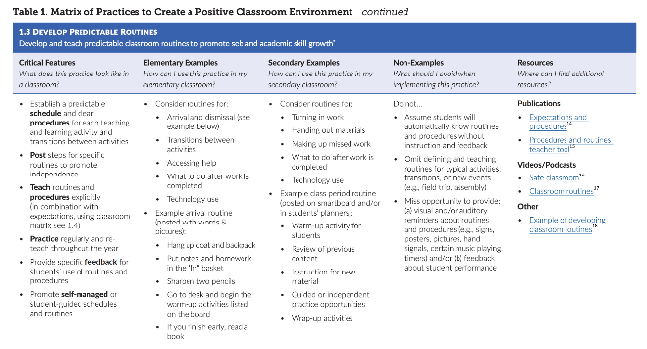
Center on PBIS. (2022). Supporting and responding to student’s social, emotional, and behavioral needs: Evidence-based practices for educators (Version 2.0). Center on PBIS, University of Oregon. www.pbis.org.
Notes:
Incorporate familiar resources, such as the Supporting and Responding to behavior document, which can be found on PBIS.org and provides useful tools for organizing class-wide supports.
Please add this document to the chat: https://www.pbis.org/resource/supporting-and-responding-to-behavior-evidence-based-classroom-strategies-for-teachers

Slide 59
1. Create Positive Teaching and Learning Environments
Design a Safe Environment
Establish Positive Connections
Develop Predictable Routines
Define and Teach Positive Expectations
Plan Relevant Instruction
REVIEW
Have you shared this with staff? Do classrooms have routine matrices?
Notes:
Supporting & Responding to Student Behavior: https://www.pbis.org/resource/supporting-and-responding-to-behavior-evidence-based-classroom-strategies-for-teachers

Slide 60

Design a Safe Environment
REVIEW
Match classroom layout to common instructional activities
Arrange furniture for smooth traffic flow by teachers and students
Maintain neat, orderly, accessible instructional materials for all students
Consider unique student needs and ensure accessibility
Post visuals to support critical content and reflect diversity of classroom community
Notes:
Help teachers ensure that their classroom is save and conducive to learning. Have teachers with effective environments help other staff or take photos to shar.

Slide 61

Establish Positive Connections
REVIEW
Engage in purposeful communication with students and families
Build in regular opportunities for positive connection throughout the year
Use formal and informal approaches to learn about students and their learning histories, identities, and preferences
Authentically engage families as partners in learning
Validate and affirm personal and cultural learning histories
Notes:
Teachers need to take every opportunity to get to know students and their families. Strong classroom connections help to reduce problem behaviors or avoid escalation

Slide 62

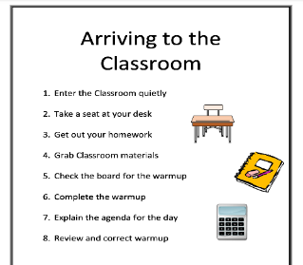
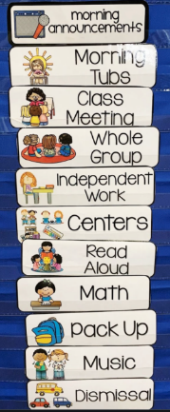
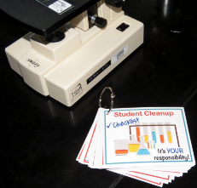
Develop Predictable Routines
REVIEW
Establish a predictable schedule and clear procedures for each activity and transition
For each routine/procedure:
Post steps to promote independence
Teach explicitly
Practice regularly and reteach frequently
Provide specific feedback on student use
Notes:
Clear, predictable routines are paramount! Routines need to be explicitly taught to students and practiced often.

Slide 63

Classroom Matrix SAMPLE
REVIEW
 | Entering Class | Lecture/ Presentation | Work Time | Electronics | Leaving Class
Be Respectful | Enter calmly. Be seated before the bell rings. Keep hands off other people’s property. Leave desks and chairs in place. | Listen attentively. Wait for your turn. Have a positive attitude. Keep feet on the floor. | Work quietly. Do your share in group projects. Be cooperative. Keep area clean. | Keep off until needed. Turn off volume. Use gently and carefully. Download large files after school. | Stay in your seat. Clean up around your desk. Push chairs in.
Be Responsible | Have books and materials out and ready to go. | Take notes. Meet deadlines. Focus on your learning. | Follow directions. Get help when needed. Do your own work. | Stay on task. Text/call people only during allowed times. | Return supplies. Report accidents promptly.
Be Safe | Walk | Be thoughtful and considerate of others. | Let others do their work. | Model digital citizenship. | Leave calmly when dismissed.
Be Prepared | Bring all materials. | Remain in your seat. | Use time wisely. | Have computer charged and ready to use. | Know expectations for next class.

Slide 64

Plan Relevant Instruction
REVIEW
Ensure instructional materials and activities celebrate diversity of students and families
Select curricula (or adapt existing curricula) and activities that are relevant for your students’ learning history and needs
Consider various dimensions of each activity (e.g., difficulty, duration of task, choice, communication needs)
Plan differentiation to meet the needs of all learners
Notes:
Engaging lessons with lots of student input and opportunities to respond keep students on task and engaged. Embedding diversity into your instructional materials and differentiating for a variety of learners ensures all students can comprehend the topic and keeps it meaningful for all.

Slide 65
3 Key Positive and Proactive Practices
1. Create Positive Teaching and Learning Environments
Design a Safe Environment
2. Actively Promote SEB Growth
Engage Students in Relevant Learning
Establish Positive Connections
Develop Predictable Routines
Define and Teach Positive Expectations
Foster Positive Relationships
Prompt and Supervise SEB and Academic Skills
Provide Specific Feedback (> 5 : 1 Ratio)
Consider Other Response Strategies
Plan Relevant Instruction
Prompts
Opportunities to Respond
Specific Praise

Slide 66
Prompts

Slide 67
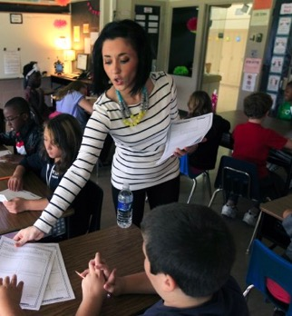
Prompts happen BEFORE opportunities for errors begin!
If you need help during this work,
raise your hand.
Before sending students off to work in small groups, provide a quick reminder about the expectations

Slide 68

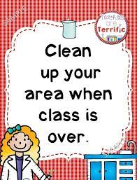


Classroom Prompt Examples
WELCOME
As you come in,
did you remember:
something to write with?
your homework?
your planner?
our textbook?
Visual reminders
Gestural reminders

Slide 69

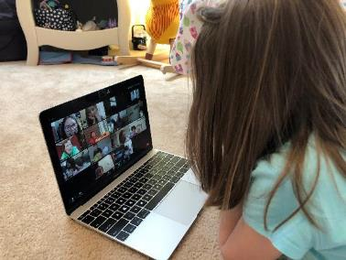
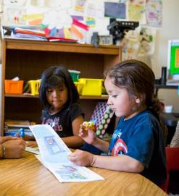

Classroom Prompt Examples
“As you head out, remember to use talk quietly in the hallway."
Verbal reminders
“Remember to mute unless its your turn”
“Remember to read to yourself”

Slide 70
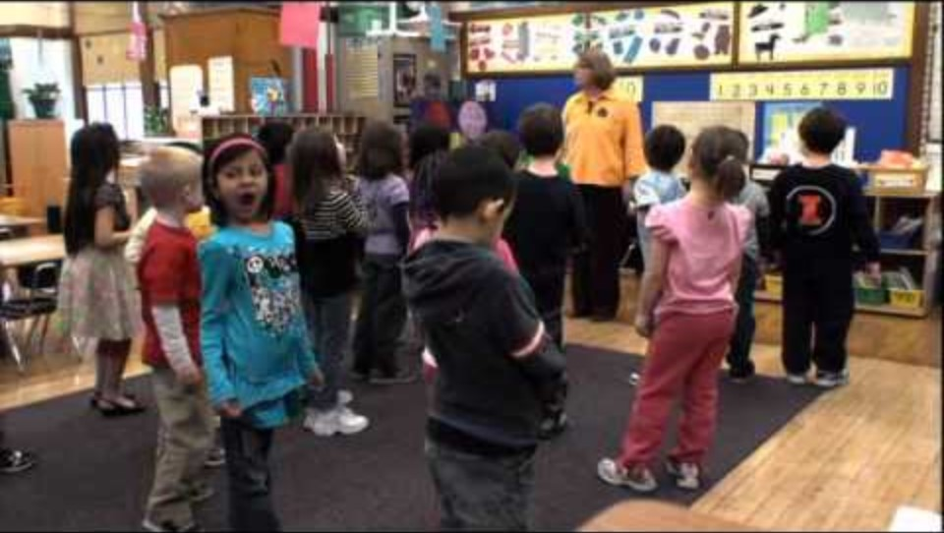
Prompting Expected Behavior
ES
https://youtu.be/1xdHZw5_sMw?si=NScz3u2Txdvk1oA4&t=50
Notes:
https://youtu.be/1xdHZw5_sMw?si=NScz3u2Txdvk1oA4&t=50

Slide 71

Video Example: Prompting HS students before a test
https://youtu.be/fcnG1F-lQyA?t=258

Slide 72
Specific Feedback
≥5:1 Ratio

Slide 73
What is it?
Behavior Specific Praise
“a positive statement, typically provided by the teacher, when a desired behavior occurs (contingent) to inform students specifically what they did well.”
"Nice hand raise!"
"That was a hard problem and you stuck with it.
Great job!
"You walked to get into line. Way to go!"
"Clear pronunciation. Well done."
"It was kind to help your friend like that!"
"You asked for help when you needed it! Terrific!"
(Simonsen et al. 2008, pp. 362, 364, emphasis added)

Slide 74
Provide Specific Feedback (>5⁺ : 1⁻ ratio)
Use specific praise to encourage SEB and academic skills
Use brief specific corrections to reduce errors
Provide at least 5 praise statements for each correction
Engage students in providing specific praise to one another

Slide 75

Bad Stronger than Good
The brain handles positive and negative information in different hemispheres, negative emotions generally involve more thinking, and the information is processed more thoroughly than positive ones.
Negative events wear off more slowly than good ones.
Most people can take in only one critical comment at a time.
We need to increase the positives to compensate.
We tend to ruminate more about unpleasant events — and use stronger words to describe them — than pleasant ones.
Roy F. Baumeister Florida State University, 2001, “Bad Is Stronger Than Good,”

Slide 76



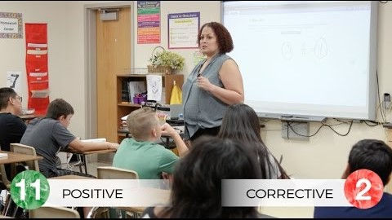
https://youtu.be/ziooxzOF11o
https://youtu.be/Cr_s3kzjX-g?t=2
https://youtu.be/0dcQuyK5Pqg
https://youtu.be/Owj81Q-dBOw

Slide 77
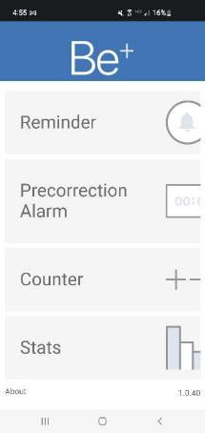
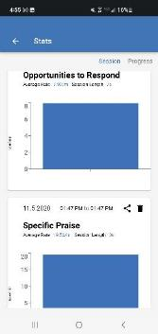
Receive Frequent Recognition & Encouragement
B+ App
Available through your phone’s app store
Failure/Correction
(punishment)
Success
(acknowledgement)
5 : 1
(Scott, 2008)
Notes:
Studies show that in order to be successful the positives need to exceed the negatives by a ratio of more than 5 to 1.
If the consequence was access to technology and the behavior increased, then the access was a reinforcer.
If the consequence was sending the student to the office and the behavior increased, then the removal was a reinforcer.
If the consequence was a reprimand (which included adult attention), and the behavior increased, then the reprimand was a reinforcer.

Slide 78
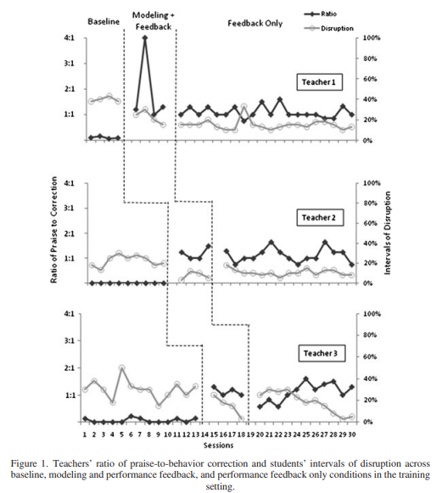

Ratio of Praise to Correction
Upon increase of praise to behavior correction to a 1:1 ratio, problem behavior decreased

Slide 79
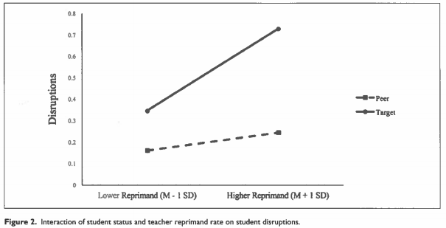
Ratio of Praise to Correction
Higher reprimands were associated with higher rates of disruptions, especially students at risk of EBD.
Students at risk of EBD
Peers
Lower Reprimand
Higher Reprimand
(Downs et al., 2019, p. 143)

Slide 80
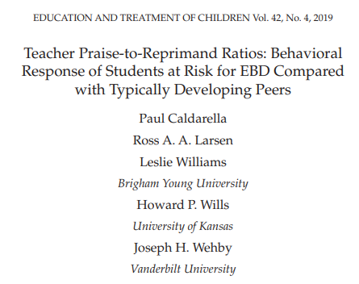
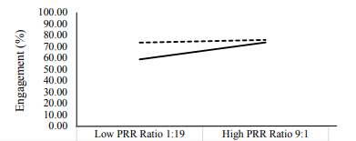
Ratio of Praise to Correction
For students with at risk for EBD the praise to reprimand ratio (PRR) needs to be 9:1 to produce the same levels of engagement as neurotypical peers.

Slide 81
Opportunities to Respond

Slide 82

What is it?
(OTRs)
“An Opportunity to Respond (OTR) is a teacher behavior that…solicits a student response (e.g., asking a question, presenting a demand).”
Provide high rates of opportunities to respond (OTRs)
Consider various observable ways to engage students
Link engagement with outcome objectives
(Simonsen, Fairbanks, Briesch, Myers, & Sugai, 2008)

Slide 83

Examples of OTRs
Explicit, Direct
Instruction
Choral
Responding
Class-wide Peer Tutoring
Electronic
Clickers
Response
Cards
Computer Assisted Instruction
Guided
Notes
Non-Verbal
Responses

Slide 84


Choral Responding
Thumbs Up
https://youtu.be/g9kyl_WPFhU
https://youtu.be/37CTCDTesWA

Slide 85
HOW CAN WE ASSESS THE USE OF POSITIVE CLASSROOM PRACTICES?

Slide 86
Support Staff with Implementing Classroom PBIS
How can we support staff to use these practices?
Professional Development
What? Select 1 or 2 practices at a time, based on data
Coaching
Who? Identify staff with dedicated time to support classroom PBIS practices
How? Support classroom PBIS along with academic coaching support
Acknowledgement
Implementation and outcome data are shared & reviewed with staff and progress is recognized and celebrated
When? Set time aside at staff, grade level, or PLC meetings to discuss & problem solve
Notes:
This should be very brief (5 minutes)

Slide 87
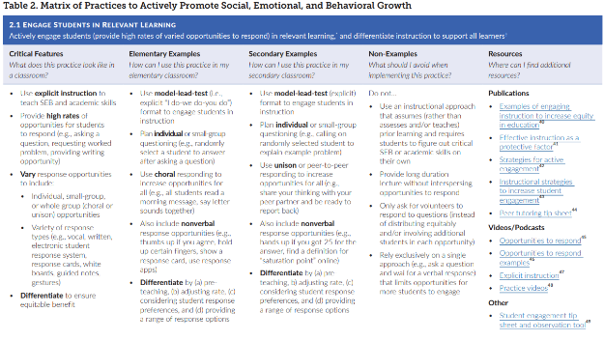
First, be familiar with important resources
Notes:
Incorporate familiar resources, such as the Supporting and Responding to behavior document, which can be found on PBIS.org and provides useful tools for organizing class-wide supports.
Please add this document to the chat: https://www.pbis.org/resource/supporting-and-responding-to-behavior-evidence-based-classroom-strategies-for-teachers

Slide 88
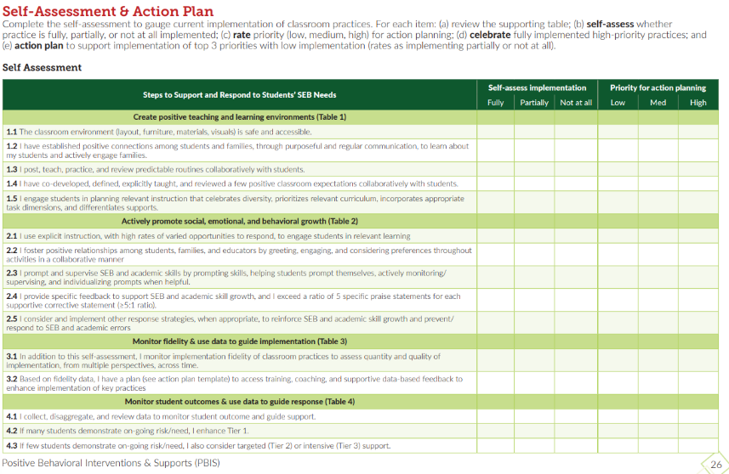
Classroom Self-Assessment
Page 26 of the Supporting & Responding Brief
Notes:
Resource: https://www.pbis.org/resource/supporting-and-responding-to-behavior-evidence-based-classroom-strategies-for-teachers

Slide 89
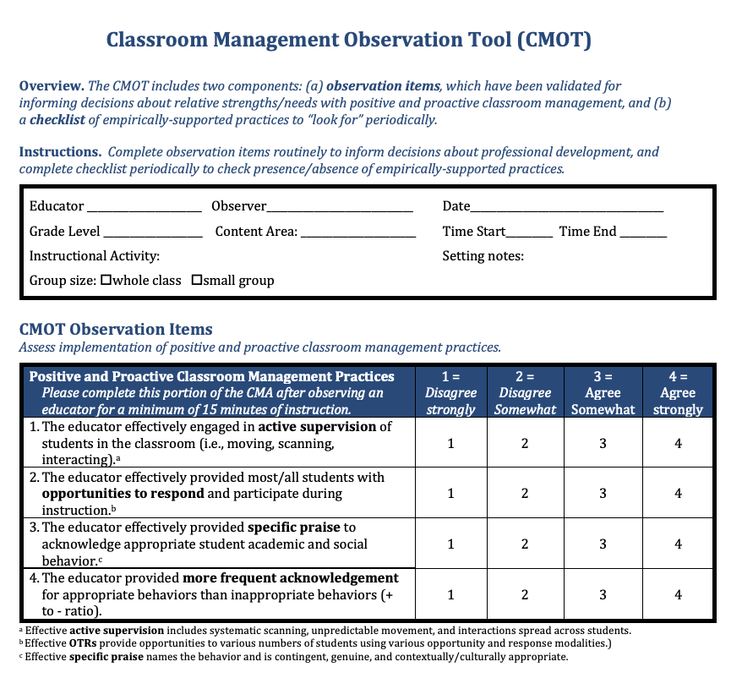
Observation tool
CMOT
2 Components:
Validated Observation Tool (min 15 mins)
Checklist of empirically supported practices
Notes:
The Classroom Management Observation Tool (CMOT) mentioned in
https://nepbis.org/wp-content/uploads/2020/06/CMOT-5.1.20.pdf

Slide 90
EXAMPLE: CMOT
Summarize data
Compile data (e.g., in Excel)
Review school-wide average
Consider disaggregating by grade (are there differences?)
Generate graphs of results
Set goal
Average ratio of 4:1 (currently 2:1)

Slide 91
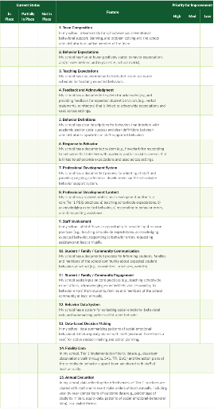
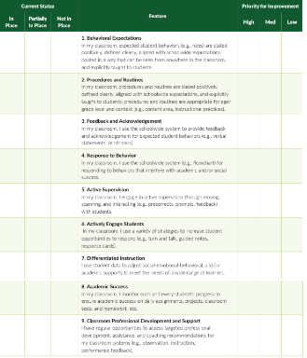
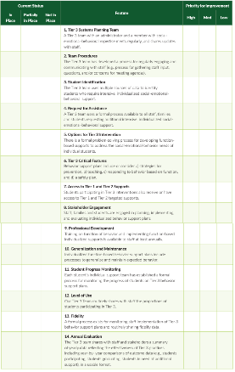
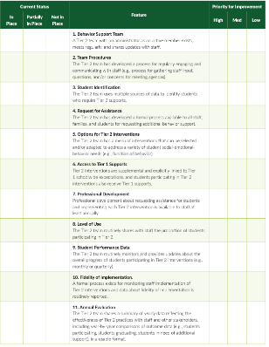
Self Assessment Survey (SAS) Updated June 2023
School Wide – 15
Classroom – 9
Tier 3 – 14
Tier 2 – 11
Notes:
Self-Assessment Survey www.pbisapps.org/resource/self-assessment-survey

Slide 92
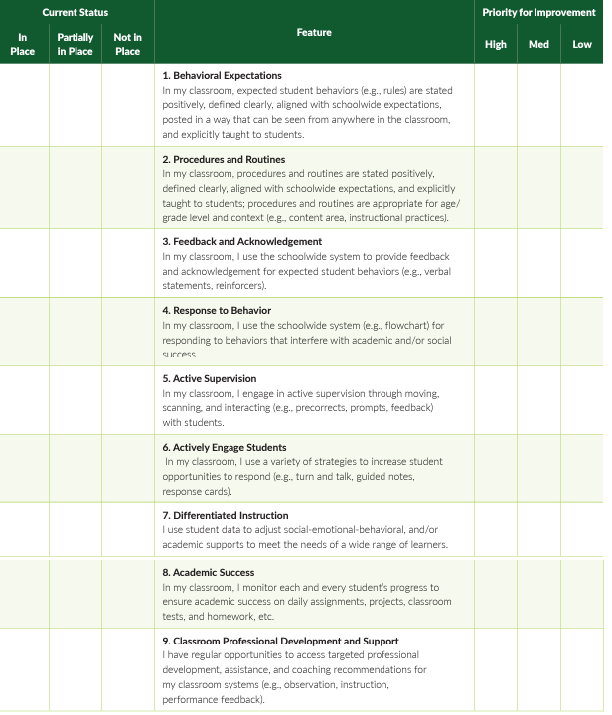
SELF ASSESSMENT SURVEY
CLASSROOM SYSTEMS
Notes:
Review of question and how to complete survey.

Slide 93


Classroom Items Report
From this → ------------------------ → To this
Notes:
Review of item graph as a quick action plan and tool for staff buy-in.
Red – less than 50% in place
Yellow – 50-79% in place
White – 80% in place or higher
If you want to take the SAS ask your training
Date Ranges for survey period
Recommend giving staff time to complete it during a staff meeting or PD.

Slide 94
ACTIVITY: SUPPORTING CLASSROOM PRACTICES
Review the shared resources.
In your teams discuss:
  What Classroom Practices need supporting?
  How might your team use one of these tools to assess implementation of Classroom PBIS?
  Can these tools be used to provide professional development to staff? How?
Be ready to provide a 1-minute share-out of your discussion
Team Time
20 minutes

Slide 95
Team
Action Planning Time

Slide 96
TEAM TIME
Meet with your team and discuss action steps related to the following items reviewed today:
1. Review notes from our sharing activity today. What great ideas did you take away?
2. What are your next steps with PBIS critical features?
3. Work together as a team to draft or revise your data routines and evaluation plan?
4. Discuss your school's current use of classroom PBIS. How could assess staff’s use of these strategies?
Please update your action plans and share with your trainers.
Prepare to share 1 new action item or goal from your discussion.
Teams
90 minutes

Slide 97
SHARE OUT
What was one action item or goal your team identified?
5 minutes
Whole Group

Slide 98
Agenda & Team Tasks
What questions do you have on today’s content?
Team time
Team Tasks
Presentation Content
Classroom PBIS Systems to Support
Identify a goal for this year’s PBIS implementation and add to your action plan
Sharing: Logic Model
Evaluation Plan
Review TFI results from last year and update your action plan for this year.
Plan how your team will support Classroom PBIS practices across your building.
Share your evaluation plan for PBIS implementation. – Google Folder
Share Updated Action Plan with Goal Statement. – Google Folder
Sustainability Factors
Goal Setting
What questions do you have on the follow-up tasks?

Slide 99
HELPFUL READINGS & RESOURCES
RESOURCES:
Start With Why: How to Put Purpose Back in Your Work
Data Decision Rules Activity
Evaluation Plan Template
Advance Action Plan
Supporting & Responding to Student's Social, Emotional, and Behavioral Needs (Classrooms)
Supportive Environments Create Classroom Community
Classroom Support Systems Brief
The Classroom Management Observation Tool (CMOT)
Self-Assessment Survey
Notes:
Start With Why: How to Put Purpose Back in Your Work -https://sebacademy.edc.org/start-why-how-put-purpose-back-your-work
Data Decision Rules Activity - https://sebacademy.edc.org/developing-data-routines-activity
Evaluation Plan Template - https://sebacademy.edc.org/evaluation-schedule
Advance Action Plan: https://sebacademy.edc.org/annual-action-plan-template-advanced
Supporting & Responding to Student's Social, Emotional, and Behavioral Needs (Classrooms) - https://sebacademy.edc.org/supporting-and-responding-students-social-emotional-and-behavioral-needs-classrooms
Supportive Environments Create Classroom Community - https://sebacademy.edc.org/supporting-and-responding-students-social-emotional-and-behavioral-needs-classrooms
Classroom Support Systems Brief - https://sebacademy.edc.org/classroom-support-systems-brief
The Classroom Management Observation Tool (CMOT) - https://sebacademy.edc.org/classroom-management-observation-tool-cmot
Self-Assessment Survey www.pbisapps.org/resource/self-assessment-survey

Slide 100

Cohort 9A EVALUATION
Please remember to complete the evaluation!
Scan the QR code to access.
Notes:
TRAINERS -
Put link to evaluation (below) in the chat for those who do not use the QR code:
Evaluation Survey: https://go.edc.org/Cohort-9A-Evaluation

Slide 101
Cohort 9B EVALUATION
Please remember to complete the evaluation!
Scan the QR code to access.
Notes:
TRAINERS -
Put link to evaluation (below) in the chat for those who do not use the QR code:
Evaluation Survey: https://docs.google.com/forms/d/e/1FAIpQLSdz32jKVAGdKiP3VzhqzA91uJEu8DkBOeJZo9-FDfnKBx_vDQ/viewform

