Slide 1


PBIS School-Wide Team Training
Year 2: October 24
Trainer Names
Created from content from the National Technical Assistance Center on Positive Behavioral Interventions and Supports
U.S. Department of Education, Office of Special Education Programs and Office of Elementary and Secondary Education
with support from NEPBIS Network, May Institute, & Broad Reach Consulting

Slide 2

EXPECTATIONS
Self
Others
Environment
Self-monitor
Listen while others are speaking​
Have your computer charged and ready to go​
If you have questions or comments:
Work as a team:
Keep necessary materials at hand
Are you participating?
Engaged as a learner?
Stretch, break, stand as needed​
Raise hand
Room for every voice
Reinforce participation
action plan
relevant docs
water/snacks
Minimize distractions if possible​

Slide 3
ACTIVITY: ATTENDANCE
Scan QR code on the left or follow the URL posted in the chat to access the online attendance survey
Follow prompts to enter attendance information
Notify trainers if you require assistance (e.g., identifying your cohort or cohort group)
Certificates of Attendance will be sent in January and June. Attendance records will be use as verification
1 minute
Notes:
Long link: https://docs.google.com/forms/d/1eieTJFKrfaHDEKmw0Yf3cIPLjHOhK5XKAeR1ahr5p nI/edit
Short link to include in slide decks: go.edc.org/SEBAttendance

Slide 4
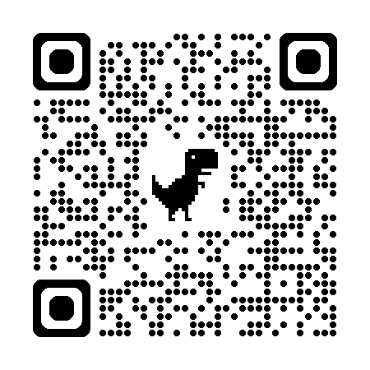
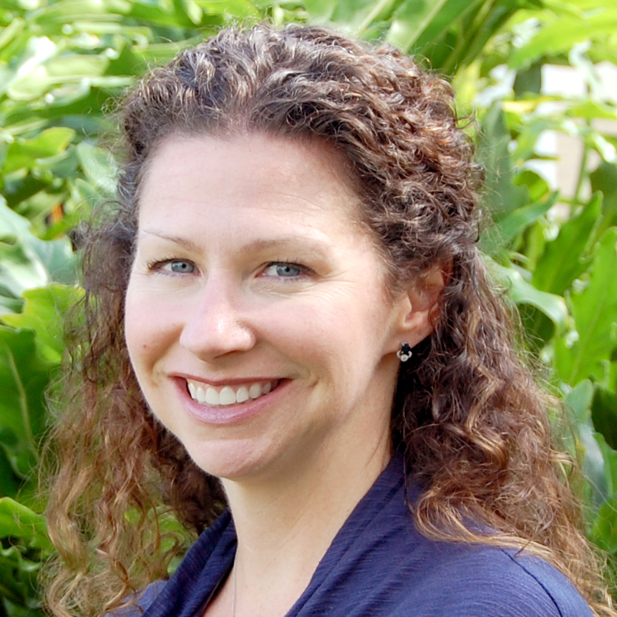
May Institute’s’20th Annual New England Positive Behavioral Support Forum
Friday, November 15, 2024 - Norwood, Mass.
Morning Keynote
STRANDS TO INCLUDE:
PBIS Foundations
PBIS and Families
Mental Health / Wellness
Classrooms
Equity
IDD and PBS
Heather George: Co-Director National Technical Assistance Center on Positive Behavioral Interventions and Supports
Registration Opens 5/30/24 – https://www.mayinstitute.org/services-for-schools/pbis/forum.html

Slide 5
Agenda & Team Tasks
Team time
Team Tasks
Presentation Content
Classroom PBIS Practices
Identify a targeted data driven outcome measure to focus on this year.
Sharing: Teaching Expectations
Share in Google Folder: Updated Action Plan with Goal Statement & Team Communication List
Tier 1 Foundation Check
Goal Setting / Precision Problem Statement
Plan evaluation of Classroom PBIS practices in your building.
Data Based Decision Making
Evaluate and complete your getting started steps
We’ve planned 90 mins of team time during this training event

Slide 6

HELPFUL READINGS & RESOURCES
RESOURCES:
Start With Why: How to Put Purpose Back in Your Work
SWIS Drill Down Work Sheet
Supporting & Responding to Student Behavior (Classroom Practices Document)
Motive, Motivate, Motivation: Why are my students doing that?
Supportive Environments Create Classroom Community
Classroom Support Systems Brief
The Classroom Management Observation Tool (CMOT)
PBIS Self-Assessment Survey (SAS)
Creating a Classroom Teaching Matrix
Notes:
Classroom Support Systems Brief: https://www.pbis.org/resource/pbis-technical-brief-on-systems-to-support-teachers-implementation-of-positive-classroom-behavior-support
Putting the Purpose back in your work: https://www.pbisapps.org/articles/start-with-why-how-to-put-purpose-back-in-your-work
Supporting & Responding to Student Behavior: https://www.pbis.org/resource/supporting-and-responding-to-behavior-evidence-based-classroom-strategies-for-teachers
Motive, Motivate, Motivation: Why are my students doing that? https://www.pbisapps.org/articles/motive-motivate-motivation-why-are-my-students-doing-that
Supportive Environments Create Classroom Community: https://www.pbisapps.org/articles/supportive-environments-create-classroom-community
Creating a Classroom Teaching Matrix: https://www.pbis.org/resource/creating-a-classroom-teaching-matrix
The Classroom Management Observation Tool (CMOT) - https://sebacademy.edc.org/classroom-management-observation-tool-cmot
PBIS Self-Assessment Survey (SAS)- https://sebacademy.edc.org/pbis-self-assessment-survey-sas
SWIS Drill Down Work Sheet - https://sebacademy.edc.org/swis-drill-down-worksheet

Slide 7


SEB Academy
Support Structure

Slide 8
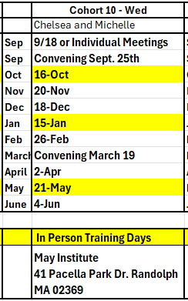
Cohort 10 Training Dates: Michelle Pratt & Chelsea Salvatore
Cohort 10
Michelle Pratt mpratt@mayinstitute.org
Chelsea Salvatore csalvatore@mayinstitute.org
Virtual Coach Meetings- 9:00-10:30
In Person Team Training – 8:30-3:00

Slide 9
Google Drive – For Submitting Documents
All schools will be connected to their Google Folder.
Add documents here for review by your PBIS Trainer
Morris ES –
https://drive.google.com/drive/u/0/folders/1b7uBu61U0sQDTP66EICO6mG4Nx-RT8mV
Mitchell ES – https://drive.google.com/drive/u/0/folders/1StgbYjkOuKCLhbvaXjKwe6Ob60HL6Ff4
Merrill ES –
https://drive.google.com/drive/u/0/folders/1o8Pnz-vEYi5re2UnJb4uU1VDtLIu3U0H
Carroll ES - https://drive.google.com/drive/u/0/folders/1wejEb5B0Yc13auOa6OQDwkUqKFdq7T_q
Coaches will be linked to the school Google folder and can share with team

Slide 10
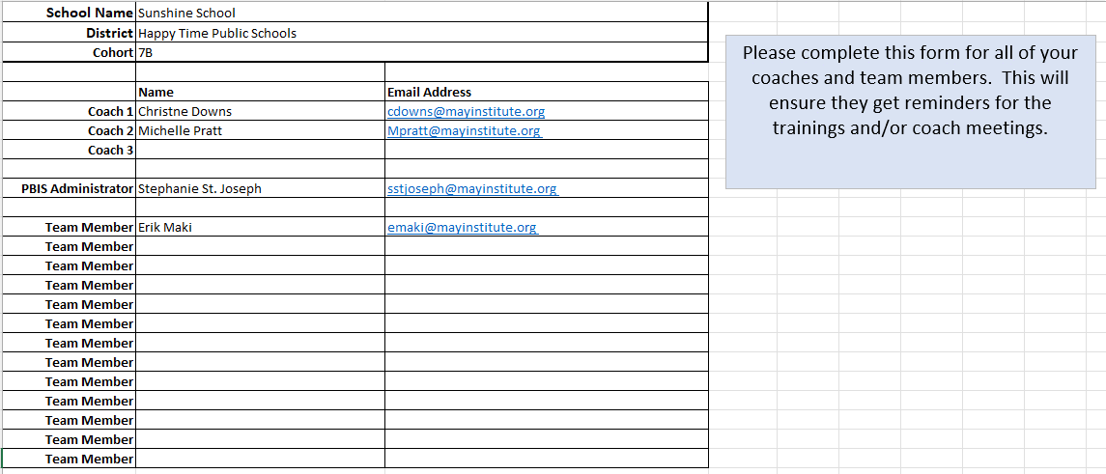
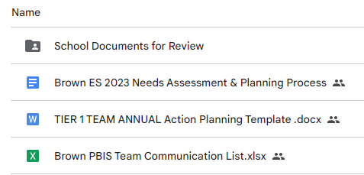
Communication Survey & Mail Chimp
Please add all your team’s contact information into the Communication Excel Sheet.
Move to School Documents for Review folder in your school’s Google Folder when completed
TEAM Communications List

Slide 11
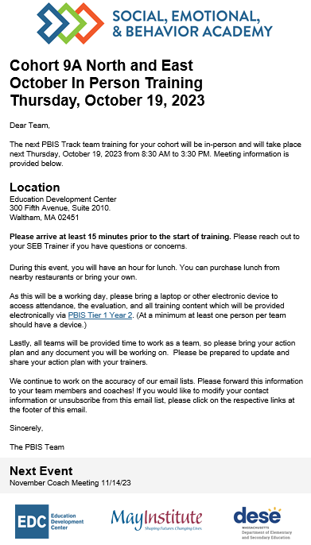
Communication Reminders
Email Reminders will be sent to all coaches, administrators and team members for our PBIS Events. The email will come from SEB Academy sebacademy@edc.org
Please review invitation for Date, Time, Location/Zoom Link, and any other important information included.
The next training or coach meeting will be displayed at the bottom
Share with other Coaches or Team Members

Slide 12
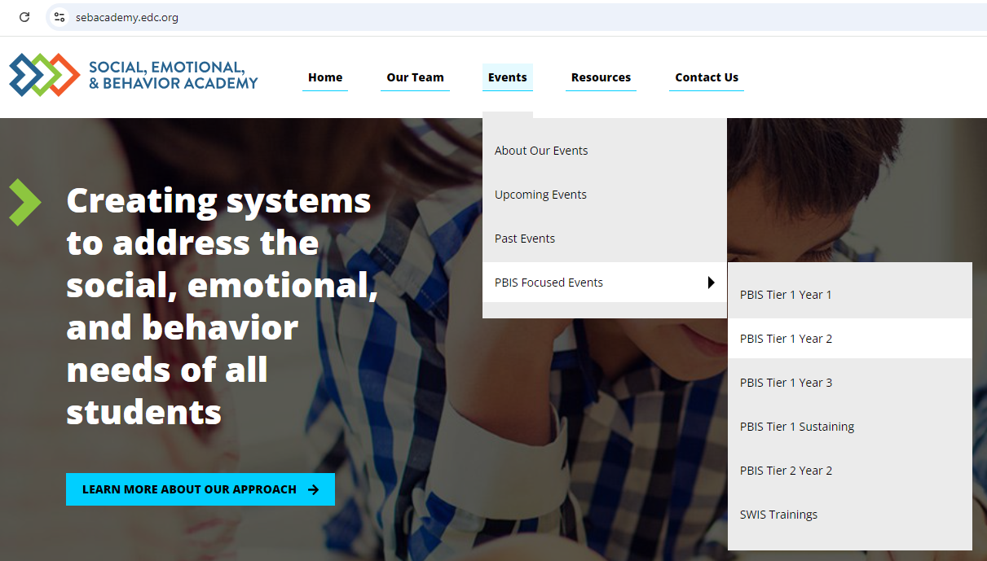
Year 2 Page SEBAcademy.edc.org
Notes:
Make this bigger

Slide 13
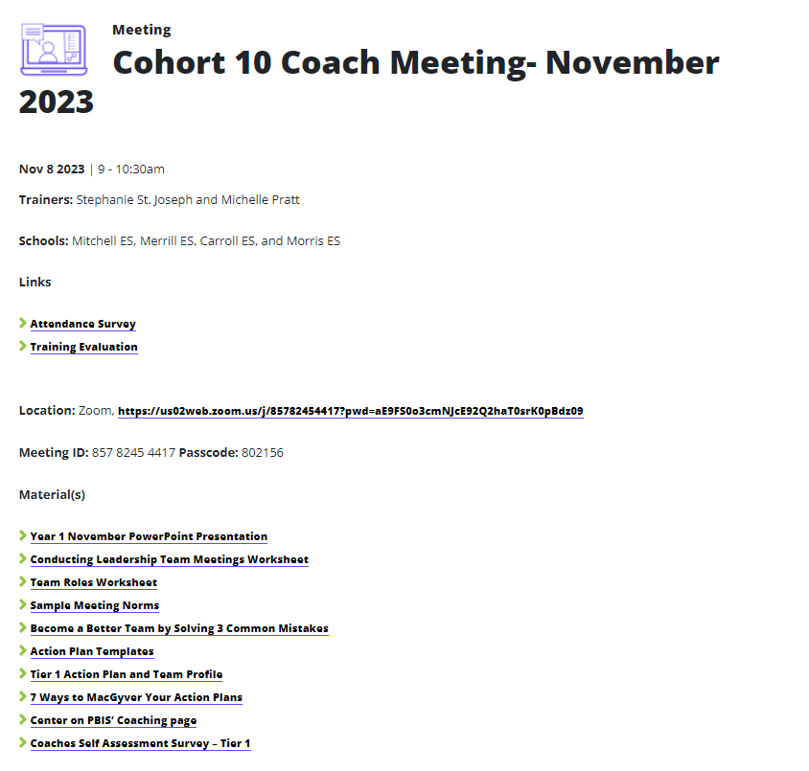
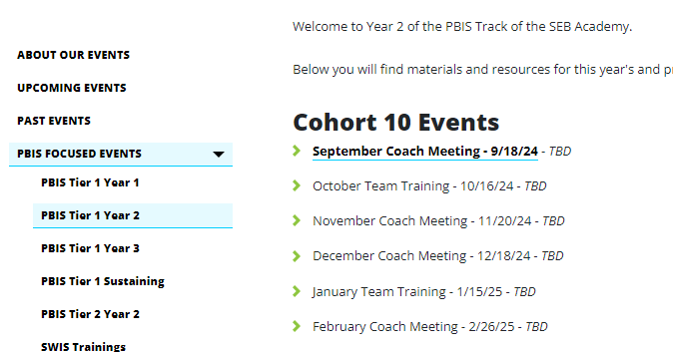
Training Pages
Trainers and Teams
Attendance and Evaluation Links
Zoom Link
Under Construction
Materials/Resources

Slide 14
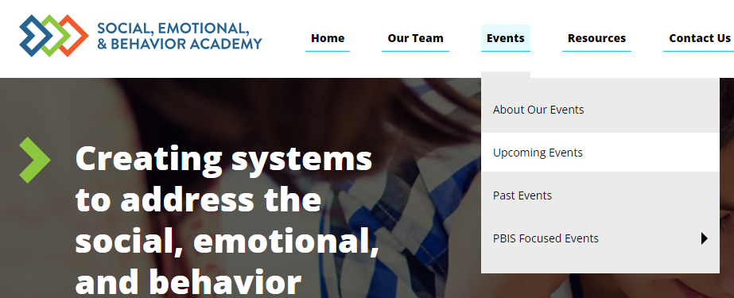
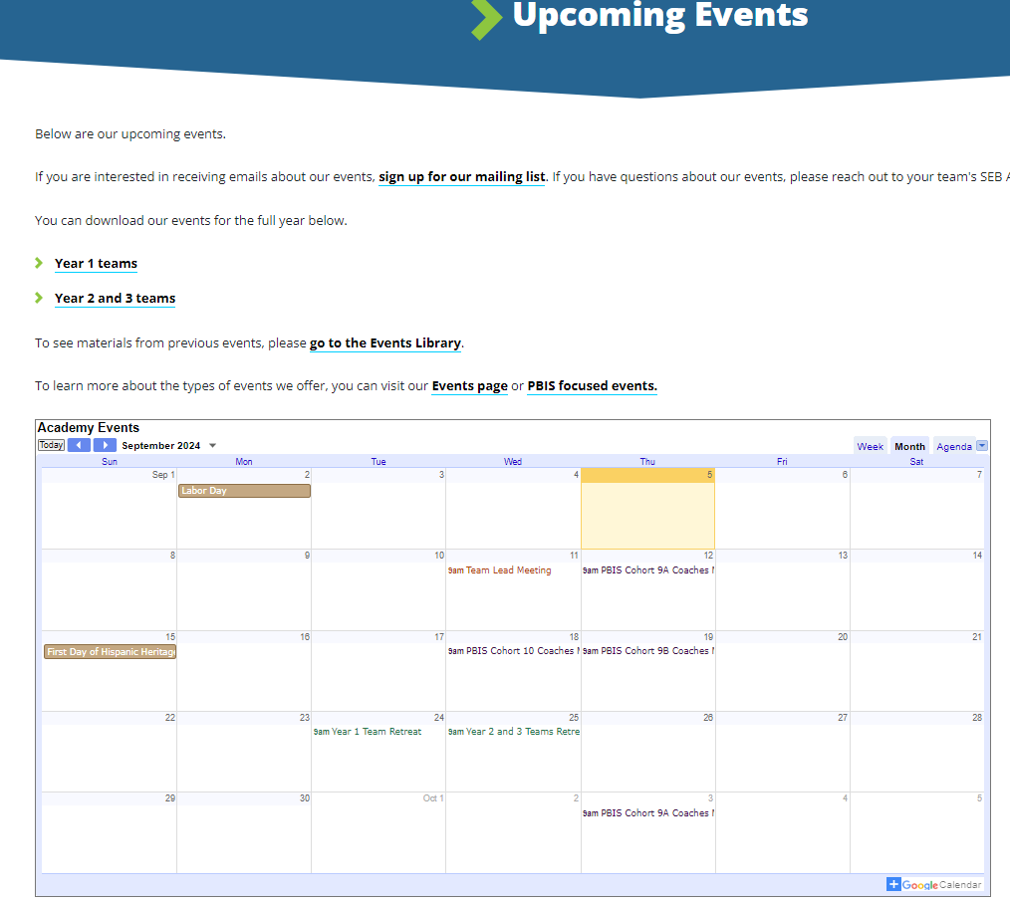
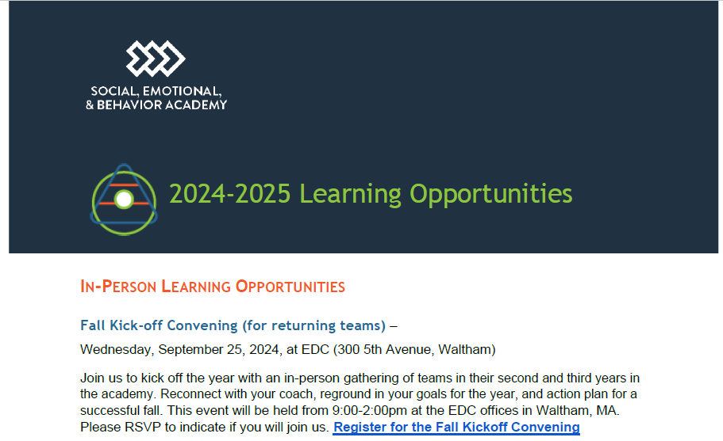
Other Upcoming Events
https://sebacademy.edc.org/upcoming-events
Notes:
https://sebacademy.edc.org/upcoming-events
Put the 24-25 Learning opportunities doc in the Chat or send by email. All of the PBIS dates for the cohort plus extra learning opportunities are in that doc.

Slide 15

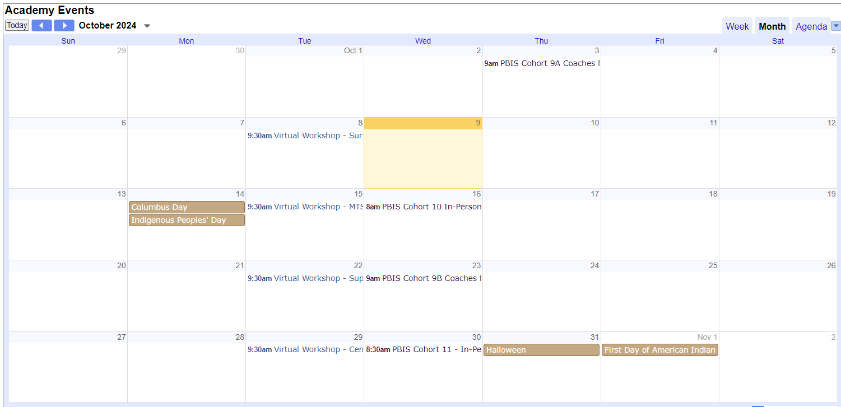
Webinars and Peer Sharing Calls
In addition to our Coaching Meeting and Team Trainings, all schools are invited to monthly Webinars and Peer Sharing Calls.
Webinars/Virtual Workshops: Expert-facilitated sessions focused on highly-relevant topics requested by teams. All webinars are recorded and will be available on EDC website for asynchronous learning.
Peer Sharing Calls: Lightly-facilitated virtual calls intended to bring teams with similar interests together to share ideas, ask questions, and strengthen networks.
See calendar for topics & times. All team-members welcome!
https://sebacademy.edc.org/upcoming-events

Slide 16
SELF CHECK:
Foundational elements of PBIS

Slide 17
Reviewing the Getting Started Steps
6
Develop a continuum to strengthen appropriate behaviors
1
Establish an effective leadership team
2
Develop a brief statement of purpose
7
Develop a continuum to discourage violations of expectations
3
Identify positive school-wide behavior expectations
8
Develop data-based procedures for monitoring
4
Develop procedures to teach school-wide expectations
9
Develop systems to support staff
5
Develop procedures to teach class-wide expectations
10
Build routines to ensure ongoing implementation

Slide 18
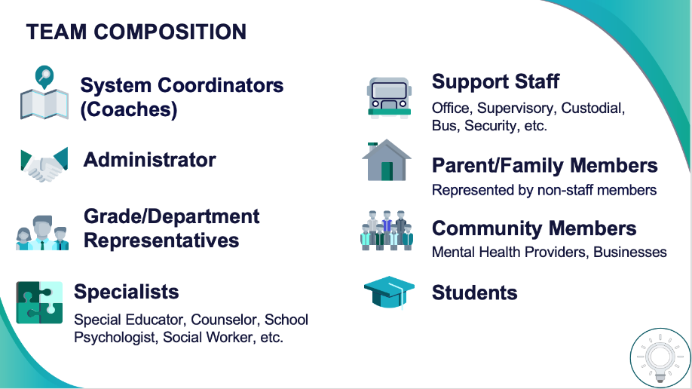
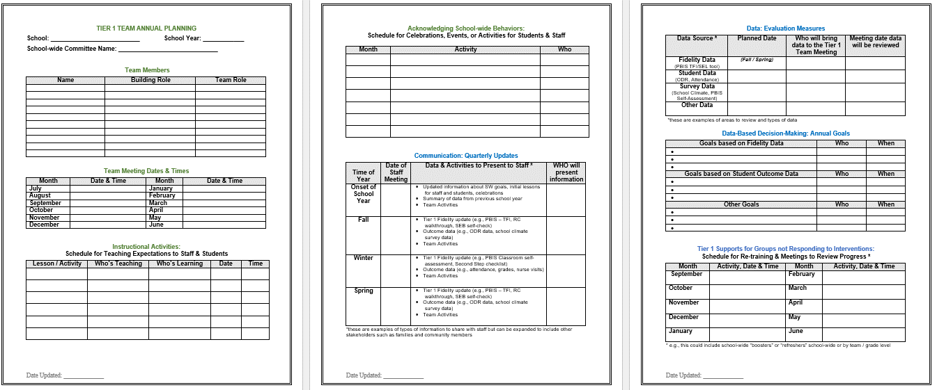
QUICK REFRESHER: Teaming and Purpose
Establish an effective and representative leadership team
Membership representative of school community including administration?
Meeting at least monthly with agenda, minutes, action plan?
PBIS identified as a top priority with allocated time for team to share with staff?
Learn More:
Tier 1 Coordination and Problem-Solving Team: Meeting Foundations and Action Planning
Establish Leadership Team
Notes:
Video on Team Meeting Foundations https://youtu.be/zs2z6dVtX1I
Team Profile https://sebacademy.edc.org/tier-1-team-profile-and-pbis-meeting-schedule-activity

Slide 19

QUICK REFRESHER: Teaming and Purpose
Develop brief statement of behavioral purpose
Does the statement match the primary outcome(s) of PBIS implementation in your school?
Is it positively stated, short, and comprehensive?
Do staff know it exists and why it was created?
"Our mission is to provide a positive, safe, healthy, nurturing and respectful environment in which all students have the opportunity to become productive members of society."
Purpose
“As a result of implementing PBIS during the 20XX-20XY school year, student reports of school climate will improve by 20%.”
Outcome
Learn More:
Tier 1 Coordination and Problem-Solving Team: Meeting Foundations and Action Planning
Establish Leadership Team
Notes:
Video on Team Meeting Foundations https://youtu.be/zs2z6dVtX1I
Team Profile https://sebacademy.edc.org/tier-1-team-profile-and-pbis-meeting-schedule-activity

Slide 20
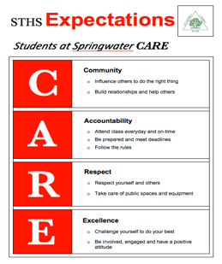
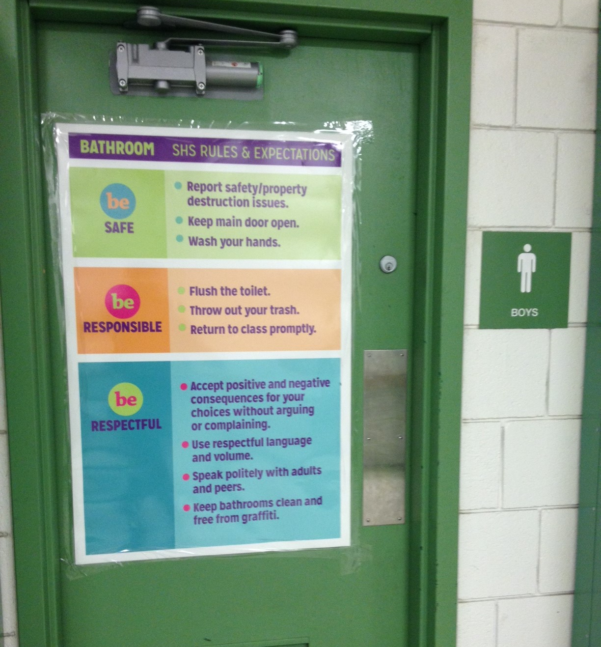
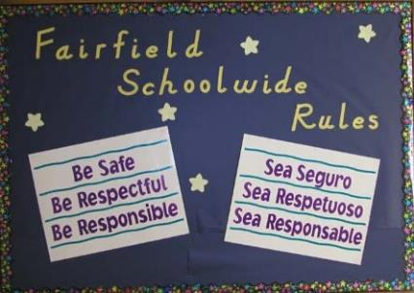

QUICK REFRESHER: Developing and Teaching School-wide Expectations
Identify positive SW behavioral expectations
Do you have 3-5 positively stated expectations?
Do they match your school context?
Have your stakeholders helped to create them or provided feedback and know what they are?
Additional Videos:
Creating school wide expectations
Teaching expectations
Notes:
Creating SW-Expectations https://www.youtube.com/watch?v=QQCaKy6U50s&feature=youtu.be
Teaching SW Expectations https://youtu.be/K1DCgiJiIGk

Slide 21
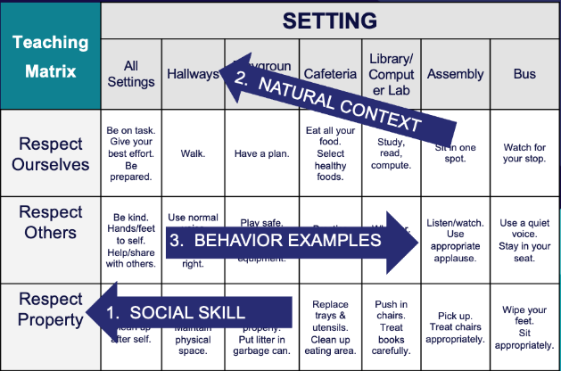
QUICK REFRESHER: Developing and Teaching School-wide Expectations
Develop procedures for teaching SW expectations
Have you developed a teaching matrix with participation from all stakeholders?
Is there a teaching calendar with lesson plans created?
Have booster sessions been planned for reteaching?
Define
Teach
Prompt
Monitor
Evaluate
Additional Videos:
Creating school wide expectations
Teaching expectations
Notes:
Creating SW-Expectations https://www.youtube.com/watch?v=QQCaKy6U50s&feature=youtu.be
Teaching SW Expectations https://youtu.be/K1DCgiJiIGk

Slide 22
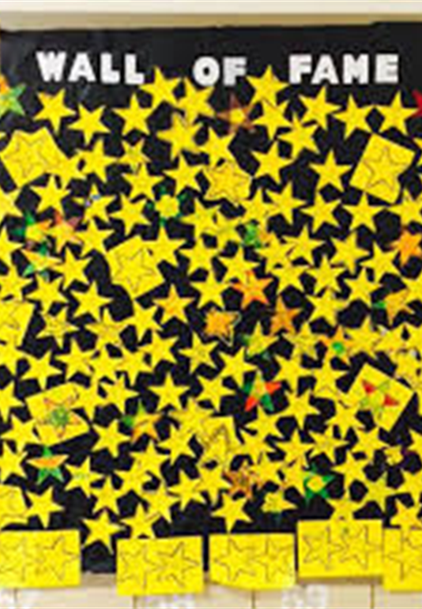
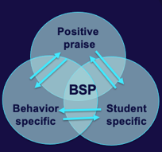
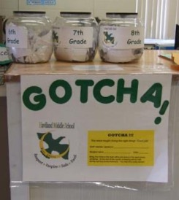
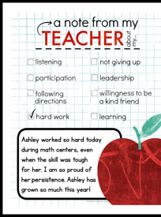
QUICK REFRESHER: Responding to Behavior
Develop continuum for strengthening appropriate behavior
Have you developed an efficient acknowledgement system that provides predictable, relevant feedback to students?
Have you gathered input from staff, students and families?
Are you acknowledging staff for their efforts
Additional Videos:
Developing acknowledgement systems
Responding to challenging behavior: Major v minor
Responding to challenging behavior: Discipline flow chart
Responding to challenging behavior: Referral form and data collection
Notes:
Developing Acknowledgement Systems https://youtu.be/7M1OfJYMPcg
Major vs. Minor https://youtu.be/6-w19VJu1RU
Discipline Flow Chart https://youtu.be/ZJCU28XSLqQ
Referral form and data collection https://youtu.be/hq8kfsJLADQ

Slide 23
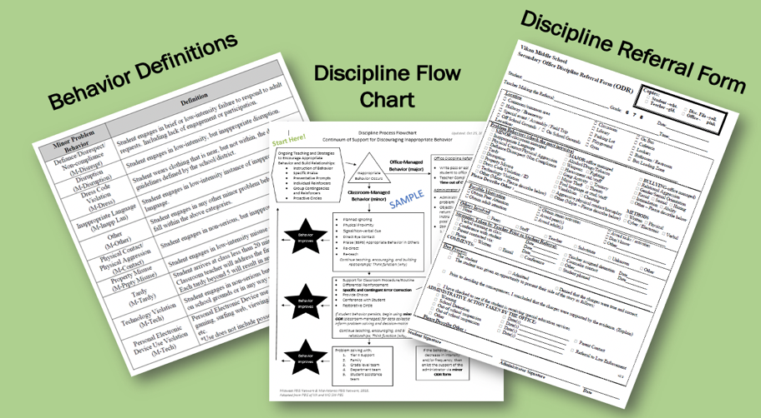
QUICK REFRESHER: Responding to Behavior
Have you defined and determined which behaviors are staff vs. office managed?
Have you created a flowchart of ways to respond to undesired behavior and taught staff how to use it?
How are you documenting behavior violations for decision-making and interventions?
Develop continuum for discouraging violations of expectations
Additional Videos:
Developing acknowledgement systems
Responding to challenging behavior: Major v minor
Responding to challenging behavior: Discipline flow chart
Responding to challenging behavior: Referral form and data collection
Notes:
Developing Acknowledgement Systems https://youtu.be/7M1OfJYMPcg
Major vs. Minor https://youtu.be/6-w19VJu1RU
Discipline Flow Chart https://youtu.be/ZJCU28XSLqQ
Referral form and data collection https://youtu.be/hq8kfsJLADQ

Slide 24
QUICK REFRESHER: Systems Check
What is your efficient process for collecting student outcome data?
Develop data-based procedures for monitoring
Build routines to ensure on-going implementation
Develop systems to support staff
What structures and routines are in place to ensure regular review and sharing of data?
How are you monitoring the fidelity and effectiveness of PBIS implementation?
How are you gathering your staff voice as your implementation continues?
When do staff get to view outcome and fidelity data?
How are staff being trained in and supported with PBIS?
How will you continue to increase staff capacity?
How can PBIS be integrated into your school routines and systems?
What plans need to be made for next year?
Are systems formally documented (in writing)?
Additional Videos:
Data decisions & monitoring
Developing systems to support staff
Notes:
Data decisions & monitoring https://youtu.be/IvpbUWvl44g
Developing systems to support staff https://www.youtube.com/watch?v=VE94EWTJo4Y&feature=youtu.be

Slide 25
TEAM TIME
Meet with your team and discuss action steps related to the systems check content:
1. Review and update your action plan document so your team can identify what is still needed to complete and what has been completed?
2. Has your team completed the Tiered Fidelity Inventory (TFI) in the Spring? If so, please use your action plan created to help guide this process.
Based on your discussions... Update your team's action plan!
Prepare to share 1 new action item or goal from your discussion.
Teams
30 minutes

Slide 26
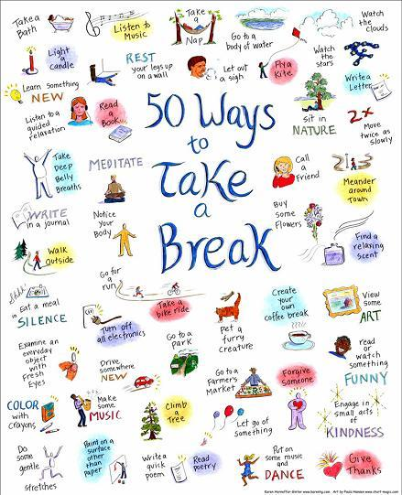
10-minute break

Slide 27
SHARING:
TEACHING EXPECTATIONS

Slide 28
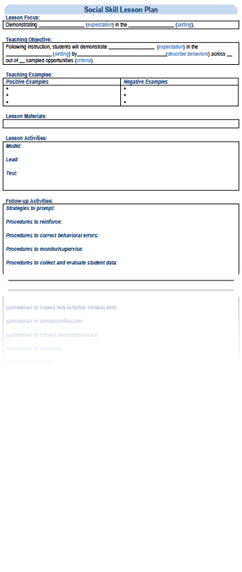
SHARING: How have you taught school-wide expectations to your students?
Suggested items for sharing with others today.
What is your lesson plan format?
How were lesson plans reviewed with faculty in advance of lesson plan delivery?
How were students involved in the lesson planning?
What went well this year? And what would you like to change for next year?

Slide 29
ACTIVITY: CROSS-SCHOOL SHARING
1. Randomize participants into 4 or 5 groups.
2. In each group take turns sharing how your school taught your expectations to your students, describe your lesson plan and teaching format, activities (4 or 5 mins).
3. Ask questions and take good notes.
4. Bring new examples back to your team for action planning!
Randomized Groups
20 minutes
Notes:
TRAINER NOTE: Please make sure that your zoom settings are set to allow screen sharing for all participants.

Slide 30
Steps for this year
6
Develop a continuum to strengthen appropriate behaviors
1
Establish an effective leadership team
2
Develop a brief statement of purpose
7
Develop a continuum to discourage violations of expectations
3
Identify positive school-wide behavior expectations
8
Develop data-based procedures for monitoring
4
Develop procedures to teach school-wide expectations
9
Develop systems to support staff
5
Develop procedures to teach class-wide expectations
10
Build routines to ensure ongoing implementation
Notes:
Today and this year we will be really digging into these 3 areas.

Slide 31
REVIEW:
Goal Setting
Notes:
TRAINER NOTE: This is review content please be brief

Slide 32
Why are we doing this?

Slide 33



Purpose statement identifies WHY you are implementing PBIS at your school
Positively stated
2 to 3 sentences in length
Supportive of academic achievement and social-emotional-behavioral (SEB) health
Comprehensive in scope (relevant to all students, staff & settings)
Ensure all students develop the social-emotional-behavioral (SEB) skills needed to be effective learners through the implementation of evidence-based interventions and use of data to inform decisions.
We will have a positive climate.
To develop and implement universal systems and interventions supporting the academic and social success of each student.

Slide 34
How will we get there?

Slide 35
Critical Features of PBIS
Systems
Practices
Data
Equity
Make student growth and benefit central to all decisions. Student outcomes that reflect equitable learning opportunities must be the ultimate criteria for all decisions.
Outcomes

Slide 36
Outcomes are our GOALS for implementation
Based on data
Locally important and meaningful
Applicable to all (culturally equitable)
  Students’ social competence and academic achievement
  Staff implementation of critical skills
Observable and measurable
Written as a goal
As a result of
implementing PBIS,
student behavior will improve, and the school will feel better.
As a result of implementing PBIS during the
20XX-20XY school year, behavior incident data will decrease by __% relative to that same period the prior year.
As a result of implementing PBIS during the 20XX-20XY school year, student reports of school climate will improve by 20%

Slide 37
What would it look like if all students developed the SEB skills needed to be effective learners?
Examples of Outcome Goals
As a result of implementing PBIS during the 20XX-20XY school year:
behavior incidents will decrease by __% relative to the same period as the prior year.
incidents of exclusionary discipline (suspension/expulsion) will decrease by __ % relative to the same period as the prior year
Behavior referrals and exclusionary discipline would decrease
disproportionate discipline would decrease
students would be in class consistently
all students would meet academic standards
use of disproportionate discipline will decrease by __%
% of students who are chronically absent will decrease by __%
% of students meeting grade level academic standards will increase by __%

Slide 38
Identifying Outcomes/Goals
What outcomes are you hoping to achieve this year?
(Consider BOTH implementation fidelity and student outcomes)
Step 1: Develop evaluation questions.
Step 2: Identify indicators or measures.
Step 3: Develop methods for collecting & analyzing indicators.
What do you want to know?
What information can be collected?
How/when should information be gathered?
Step 4: Make decisions and action plan from analysis of indicators.
How will the question be answered & what should be done next?

Slide 39
ACTIVITY: Creating Goals
As a team, review your team’s identified goal or purpose statement for PBIS implementation in your school.
Consider what data/resource you can use to create a goal for this year. - SEB - Needs Assessment, TFI, Attendance, Discipline Referrals, Climate Surveys, School or District Improvement Goals.
What are 1-2 observable, measurable outcome statements that you can set as goals for this year?
Be ready to share your 1 goal.
As a result of implementing PBIS during the 20XX-20XY school year, student reports of school climate will improve by 20%
Teams
20 minutes
Notes:
TRAINER NOTE: Remember last year folks prepared a hope / goal statement. Shifting this goal / purpose statement to be more data driven this year.

Slide 40
Data Informed Decision Making

Slide 41

What is the single factor most related to high sustainability?
The frequency that data are presented to all school staff.
McIntosh, K., Kim, J. R., Pinkelman, S., Rasplica, C., Berg, T. & Strickland-Cohen, M. K. (2014).
Notes:
Christine
Key Points:
-Monthly may seem like it’s a lot, but remember that the factor most related to sustainability of PBIS is the frequency with which data are presented to the whole staff.
-So review your data monthly and make plans to share out your data with the school community as frequently as feasible.
-Remember, you can share your data using bulletin boards, emails, newsletters, etc. They all count as avenues for sharing.

Slide 42
Critical Features of PBIS
Systems
How do we use data to inform school-wide decisions?
Data
Practices
Equity
Outcomes

Slide 43
Data-Based Decision Making
Decisions are more likely to be effective and efficient when they are based upon data.
  The quality of decision making depends most on the first step – defining problems to be solved.
    Precise (who, what, where, when, how often, why)
    Clear (general agreement across team)

Slide 44
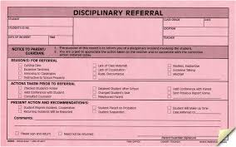
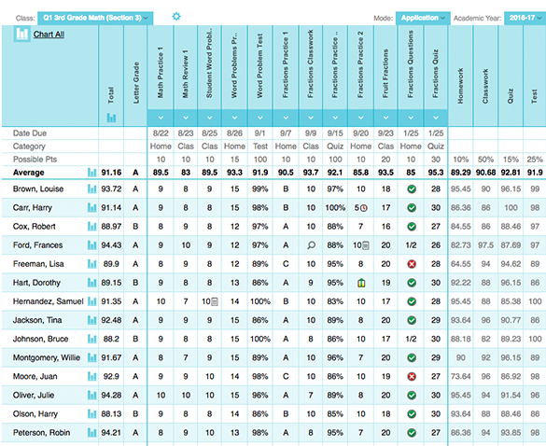
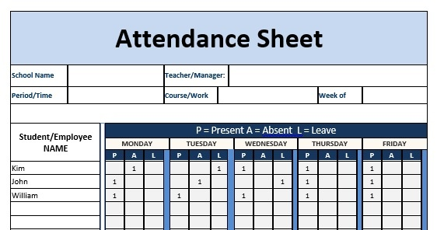
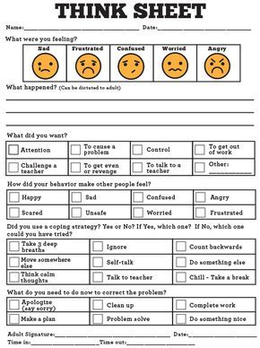
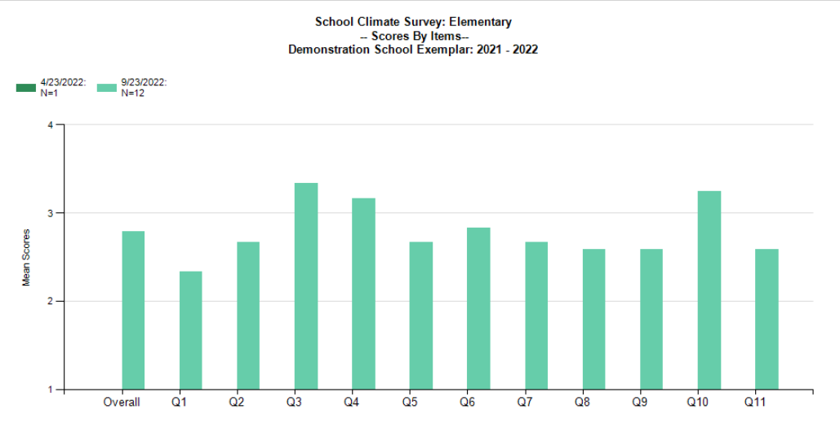
Outcome Data
Academic Data
State Testing
Attendance Data
Discipline Data
Climate Survey
Other Data
Nurse visits
Counselor visits

Slide 45
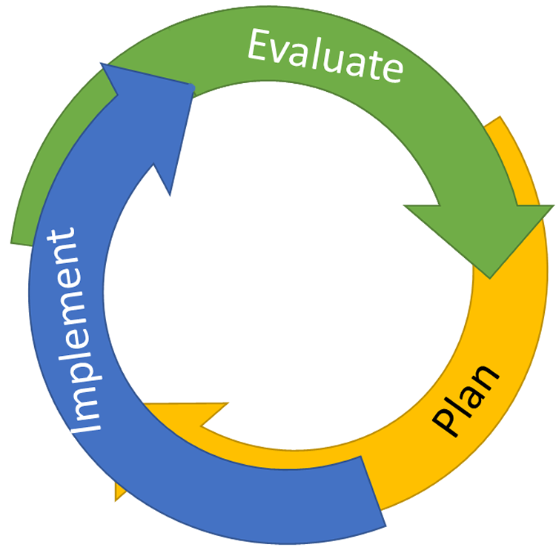
CONTINUOUS QUALITY IMPROVEMENT
Reassess and revise solution(s) as needed
Identify problems with precision
Monitor outcomes and compare
to goal(s)
DATA
Establish goal(s)
Develop solution(s)
Implement solution(s) with integrity and fidelity
Notes:
Trainer Note:
We want to interrupt the traditional cycle of admiring the problem, by talking and talking about the problem before quickly launching into determining solutions.
We can do this by building a system for improved decision making.

Slide 46
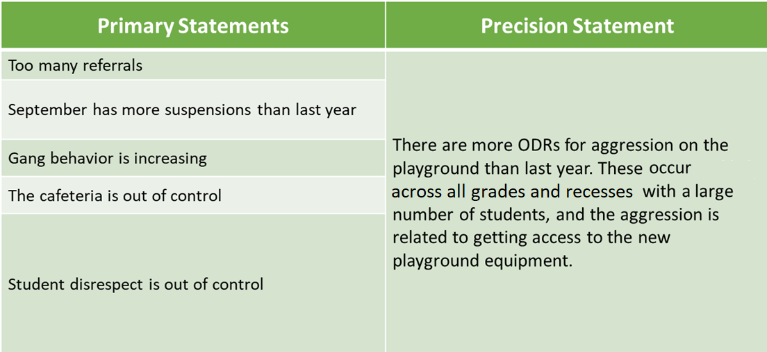
Primary vs. Precision Statements

Slide 47
Solvable (Precise) Problems
Question | Description
What | What problem behavior is occurring?
How Often | Is this an ongoing problem, new problem, old problem, small-group problem, school-wide (big) problem?
Where | Are there locations where the problem is more likely to occur?
Who | How many students and which sub-groups are more likely to engage in the problem?
When | Are there times of day or days of week when the problem is more likely to occur?
Why | In the context above, are students trying to access or avoid something? Is it about attention, tasks/activities, or resources (items)?
Notes:
Research about behavior and decision making suggests that problems can’t effectively and efficiently be solved until we have all the right information, which means we need to know the right questions to ask. These are all basic W/H questions, and data can usually help us narrow down the questions.
Who, what, where, when, and how often are the questions that tell us the context that is making it easier to use problem behavior than following the expectations.
The last question is always “why,” and this is going to be new for many people. Asking “Why” is about narrowing down that context and identifying what is the strongest, function-based reason why students continue to engage in that problem.
We need to narrow down the context so we can focus our attention, efforts, and resources, but we need the “why” to tell us what is or isn’t likely to help the problem.
Behavioral Research tells us that trying to solve problems without the “why” has a 50/50 chance of making the problem better or worse. That’s huge!
Part of adopting SWIS means that we are committed to helping all staff in the school think about not only the context but also why they believe the student engaged in that behavior. It’s okay to be wrong, and sometimes students can actually tell us what the motivation was…for example: they hit the student because they knew they would get out of the speech they had to deliver after lunch…(avoiding a task). It’s still important to ask the question.
This is now a required part of the referral form, and we need to support each other to think about the “why” and give it our best guess. Otherwise, our decisions are going to have that 50/50 chance of being wrong, which takes more of our limited time and resources.

Slide 48
Solvable (Precise) Problem
There are more ODRs for aggression on the playground than last year (average of 3 ODRs per day). These are occur across all grades, with a large number of students, and the aggression is related to getting access to the new playground equipment.
  What? more ODRs for aggression
  How often average of 3 referrals per day
  Where? on the playground
  Who? a large number of students
  When? across all grades
  Why? Get access to the new playground equipment
Notes:
We now have a solvable or precise problem statement. Look at that… the playground aggression seems to be related to accessing items. A few additional conversations tell us that there are a few new rubber balls and jump ropes, and the kids are shoving and pushing to get access to them.
The solutions we discussed before might still be helpful, and we should always take the time to provide instruction to students about the appropriate way to request what they want and need. But we can relieve a lot of the tension by requesting a few more pieces of equipment, so that there are enough to go around. Then, we can be specific with our instruction, praise, and correction. We don’t need more staff or to re-teach all the playground expectations. We can focus our energy where it is needed.

Slide 49
If your current data system does not present behavior data in a usable format…
Consider SWIS!
Meaningful referral data
Reports that support decision-making
Focus on equity
Multiple data-entry options (paper or paperless)
Data integration with your existing Student Information System
$400 annually per school

Slide 50
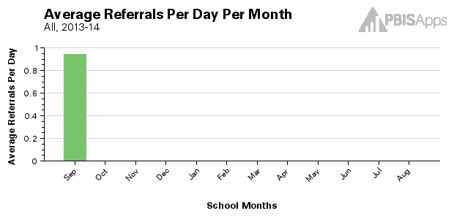
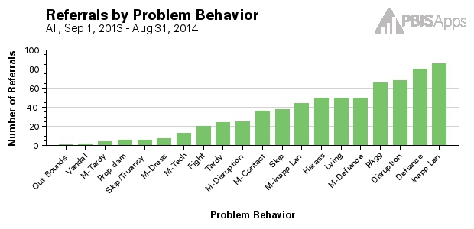
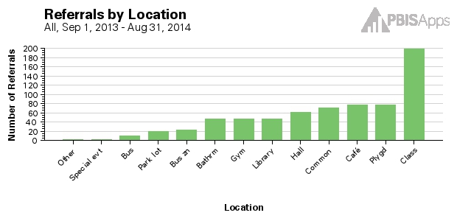
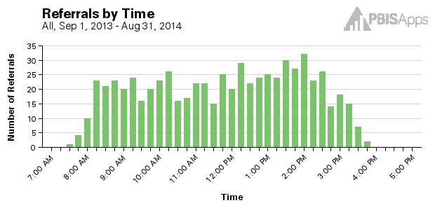
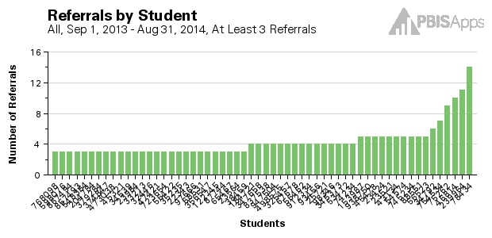
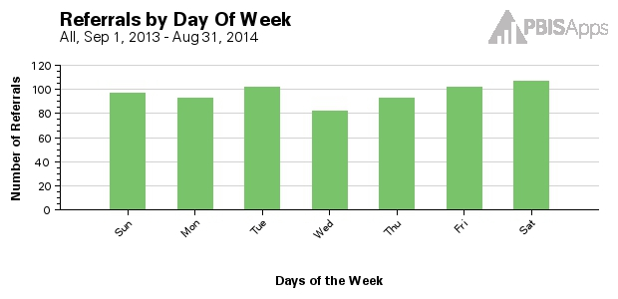
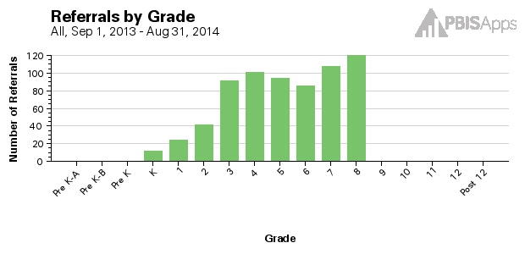
Core SWIS Reports
Notes:
For example, you might notice in the Core SWIS reports that there are many referrals coming from the cafeteria than what is expected or desired.
Another red flag might be that there the 7th and 8th grade students are receiving more referrals than other grade levels. Another might be that there seem to be a lot of activity in the afternoon after 1:30.

Slide 51
CONTINUOUS QUALITY IMPROVEMENT
Reassess and revise solution(s) as needed
Identify problems with precision
Monitor outcomes and compare
to goal(s)
DATA
Establish goal(s)
Develop solution(s)
Implement solution(s) with integrity and fidelity
Notes:
Trainer Note:
We want to interrupt the traditional cycle of admiring the problem, by talking and talking about the problem before quickly launching into determining solutions.
We can do this by building a system for improved decision making.

Slide 52
DEFINING GOALS
Problem | Current Status | Goal
There are more ODRs for aggression on the playground than last year (average of 3 ODRs per day). These occur across all grades and recesses, with a large number of students, and the aggression is related to getting access to the new playground equipment. | 86 (major and minor) ODRs last month from the playground (average of 3 referrals per pay) over last 30 days) | Less than 30 ODRs (major or minor) (average 1 referral per day) from the playground for next 30 days
Notes:
***This slide is designed to be an example and to be moved through quickly.***
I Do. Click to remove boxes that cover current status and goal.
Example Think Aloud:
“OK, I first define my problem with precision. I know that many students are leaving garbage in the cafeteria because it is easy to do and this results in conflict with adults and ODRs from the cafeteria supervisors.
(Click) I know that we have an average of 22 ODRs per month from the cafeteria, and the supervisors rate the cleanliness at a low (1 out of 5). That’s my level or current status .
(Click) With this information, I can design an appropriate goal. We need to decrease to less than 5 ODRs per month from the cafeteria, and we need cafeteria supervisors to rate the cleanliness at a 4 or higher for two consecutive weeks.”
First, define the problem with precision (Level/amount). Then, define what would be a reasonable goal to work towards. Once the goal is defined, use the goal to guide the solution development.

Slide 53
CONTINUOUS QUALITY IMPROVEMENT
Reassess and revise solution(s) as needed
Identify problems with precision
Monitor outcomes and compare
to goal(s)
DATA
Establish goal(s)
Develop solution(s)
Implement solution(s) with integrity and fidelity
Notes:
Trainer Note:
We want to interrupt the traditional cycle of admiring the problem, by talking and talking about the problem before quickly launching into determining solutions.
We can do this by building a system for improved decision making.

Slide 54

Solution Development & Action Planning
Solution Component | Action Step(s)
Prevention | How can we avoid the problem context? Ex: schedule lunch times, Post rules near playground
Teaching | How can we define, teach, and monitor what we want? Ex: build “Safe” curriculum, teach playground expectations and games, Game Rules Packets for Monitors.
Recognition | How can we build in systematic rewards for positive behavior? Ex: 3 safe days = 5 extra minutes of social time (at lunch or end of day)
Extinction | How can we prevent problem behavior from being rewarded? Ex: public posting of results
Corrective Consequence | What are efficient, consistent consequences for problem behavior? Ex: continue current system (Major/Minor ODR)
Data Collection | Implementation fidelity? Ex: walkthrough reports, observations, self-assessments Impact on student outcomes? Ex: SWIS ODR data

Slide 55
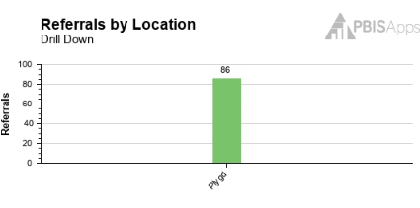
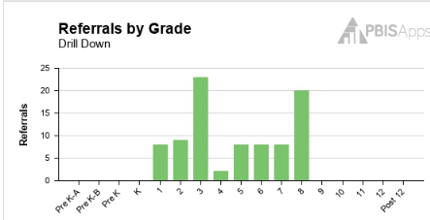

Present to staff
Problem: There are more ODRs for aggression on the playground than last year (average of 3 ODRs per day). These occur across all grades and recesses, with a large number of students, and the aggression is related to getting access to the new playground equipment.

Slide 56
Playground Improvement Goal
Less than 30 ODRs (major or minor) (average 1 referral per day) from the playground for next 30 days
Solution: The PBIS Team will
Buy and hang posters on the doors and fence around playground
Reteach students, by grade, the playground expectations for equipment
All staff please help us by:
Increasing your verbal feedback to students who are following Playground Expectations especially on new equipment.
Track safe recess’ by class - 3 days in a row class gets extra 5 minute of free time. (teacher/class choice)
Continue to write ODR’s for unsafe behaviors

Slide 57
CONTINUOUS QUALITY IMPROVEMENT
Reassess and revise solution(s) as needed
Identify problems with precision
Monitor outcomes and compare
to goal(s)
DATA
Establish goal(s)
Develop solution(s)
Implement solution(s) with integrity and fidelity
Notes:
Trainer Note:
We want to interrupt the traditional cycle of admiring the problem, by talking and talking about the problem before quickly launching into determining solutions.
We can do this by building a system for improved decision making.

Slide 58
Present Results to staff
Problem: There are more ODRs for aggression on the playground than last year (average of 3 ODRs per day). These are most likely to occur during first recess, with a large number of students, and the aggression is related to getting access to the new playground equipment.
Solution: The PBIS Team and Recess Monitors will
Buy and hang posters on the doors and fence around playground
Reteach students, by grade, the playground expectations for equipment
All staff please help us by:
Increasing your verbal feedback to students who are following Playground Expectations especially on new equipment.
Track safe recess’ by class - 3 days in a row class gets extra 5 minute of free time. (teacher/class choice)
Continue to write ODR’s for unsafe behaviors

Slide 59
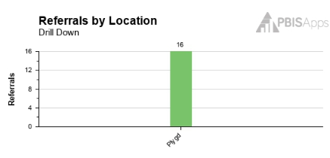

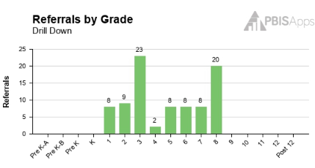
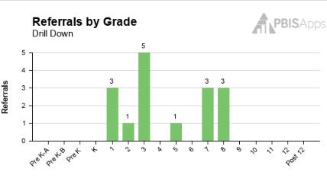
Present Results to staff
Less than 30 ODRs (major or minor) (average 1 referral per day) from the playground for next 30 days
GOAL MET!!!

Slide 60

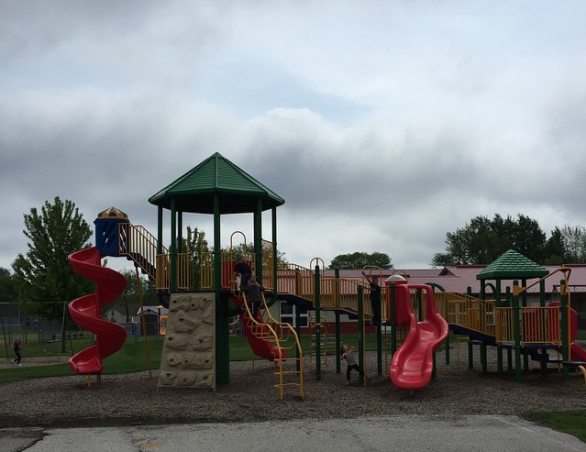
WE DID IT!
Thank you to everyone who stepped up and supported our students being safe on the playground!
Especially our recess monitors who helped to reteach and acknowledge our students on the playground!
Let's keep it going!

Slide 61
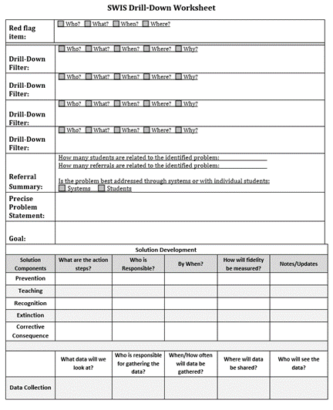
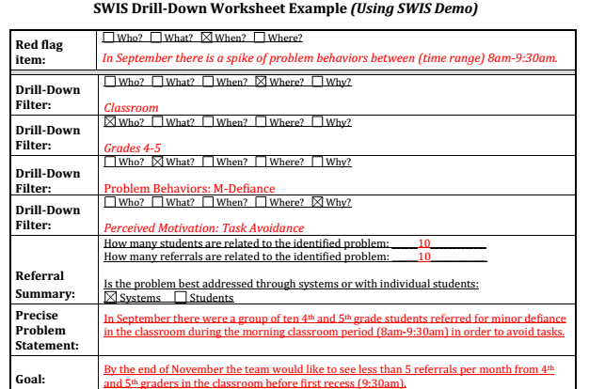
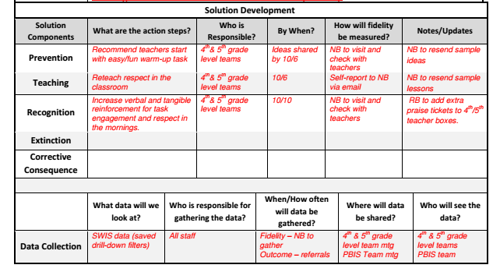
SWIS Drill down worksheet (for use with any system)
Notes:
SWIS Drill Down Work Sheet - https://sebacademy.edc.org/swis-drill-down-worksheet

Slide 62

ACTIVITY: Defining Problems with Precision
Identify what data you have available to compose a precision problem statement
Does your team have access to necessary data in a usable format to allow you to define problems with precision?
Who will be responsible for reviewing and bringing data to the team meeting?
Are you interested in SWIS?
Teams: 10 min
Whole group: 5 min
Notes:
SWIS website: https://www.pbisapps.org/products/swis

Slide 63

LUNCH

Slide 64
Crisis and Desclation: CLASSROOM BEHAVIOR SUPPORT PRACTICES

Slide 65

Supporting and Responding to Students’ SEB Needs
Practices
Summarizes evidence-based, positive, and proactive practices that support and respond to students’ social, emotional, and behavioral (SEB) needs in classrooms.
Center on PBIS. (2022). Supporting and responding to student’s social, emotional, and behavioral needs: Evidence-based practices for educators (Version 2.0). Center on PBIS, University of Oregon. www.pbis.org.
Notes:
https://www.pbis.org/resource/supporting-and-responding-to-behavior-evidence-based-classroom-strategies-for-teachers
Go through these 3 slides QUICKLY just point out that it is the resources we introduced them to last year and a QUICK review of how the hyperlinks work.

Slide 66

Supporting and Responding to Students’ SEB Needs
1. Create Positive Teaching and Learning Environments
Design a Safe Environment
2. Actively Promote SEB Growth
Engage Students in Relevant Learning
3. Monitor Fidelity and Use Data to Guide Implementation
Monitor Educator Implementation
4. Monitor Student Outcomes and Use Data to Guide Response
Establish Positive Connections
Develop Predictable Routines
Define and Teach Positive Expectations
Plan Relevant Instruction
Foster Positive Relationships
Prompt and Supervise SEB and Academic Skills
Provide Specific Feedback (> 5 : 1 Ratio)
Consider Other Response Strategies
Provide Training, Coaching, and Feedback
If data indicate implementation challenges...
Monitor Student Outcomes
Enhance Tier 1
If many students make ongoing SEB errors...
Enhance Tier 1 and Consider Tiers 2 and 3
If few students make ongoing SEB errors...

Slide 67
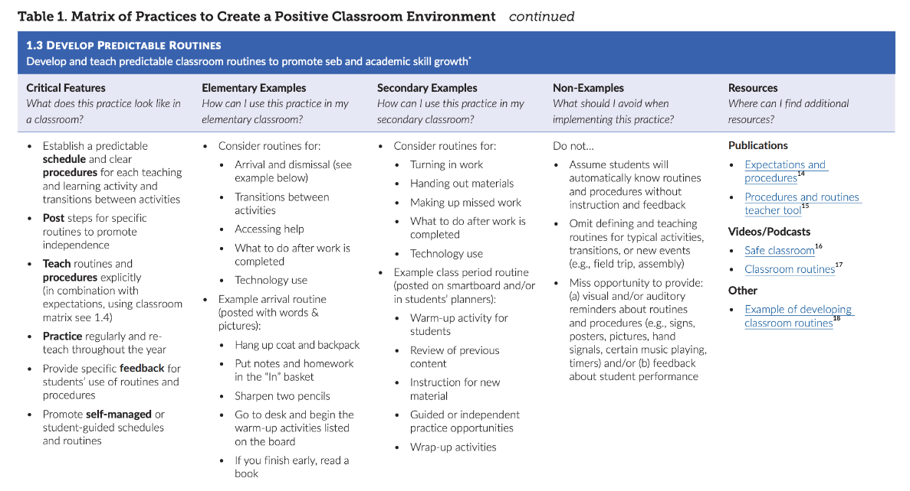

Slide 68

Crisis Escalation & De-escalation
High
Peak
Acceleration
De-escalation
Prevention
Agitation
Trigger
Calm
Recovery
Low
(Colvin & Sugai, 1989)
Notes:
Just reference the escalation cycle quickly with a focus on supporting students before a Crisis while they are in the Calm Stage. This is the work of PBIS and the better we do here the fewer escalation issues they will have.

Slide 69



Avoiding Escalation
Adult Decision States: Resource Depletion
As we become fatigued, our filters for appropriate behavior can be affected
Effects of hunger (Gailliot et al., 2009)
Decreases in willpower later in day
  “The Morning Morality Effect” (Kouchaki & Smith, 2014)
If I am triggered or agitated, then I will...
  Delay a decision until I can think clearly
    “See me after class/at the next break”
  Reframe the situation
    “How do we do that at school?”
  Take care of myself
    Breath
    Take a drink of water
    Recognize my upset feelings and let them go
Notes:
MAIN IDEA: We’re all prone to vulnerable decision states, the key is recognizing them so we don’t act on impulse.

Slide 70
The Escalation Cycle: Calm
High
Peak
Acceleration
De-escalation
Agitation
Trigger
Calm
Recovery
Low
(Colvin & Sugai, 1989)

Slide 71
Crisis Cycle Stage: Calm
Description
Intervention : Prevention Focused
Student is cooperative
Accepts corrective feedback
Follows directives
Sets personal goals
Ignores distractions
Accepts praise
Assess problem behavior/Know the student
  Triggers
  Function
  Academic & behavioral learning history
Arrange for high rates of successful academic & social engagements
Communicate positive expectations
Use positive reinforcement
Teach social skills.
  Problem solving
  Relaxation strategy
  Self-management
(Colvin & Sugai, 1989)

Slide 72
1. Create Positive Teaching and Learning Environments
Design a Safe Environment
Establish Positive Connections
Develop Predictable Routines
Define and Teach Positive Expectations
Plan Relevant Instruction
Have you shared this with staff? Do classrooms have routine matrices?
Notes:
Supporting & Responding to Student Behavior: https://www.pbis.org/resource/supporting-and-responding-to-behavior-evidence-based-classroom-strategies-for-teachers

Slide 73

Design a Safe Environment
Match classroom layout to common instructional activities
Arrange furniture for smooth traffic flow by teachers and students
Maintain neat, orderly, accessible instructional materials for all students
Consider unique student needs and ensure accessibility
Post visuals to support critical content and reflect diversity of classroom community
Notes:
Help teachers ensure that their classroom is save and conducive to learning. Have teachers with effective environments help other staff or take photos to shar.

Slide 74

Establish Positive Connections
Engage in purposeful communication with students and families
Build in regular opportunities for positive connection throughout the year
Use formal and informal approaches to learn about students and their learning histories, identities, and preferences
Authentically engage families as partners in learning
Validate and affirm personal and cultural learning histories
Notes:
Teachers need to take every opportunity to get to know students and their families. Strong classroom connections help to reduce problem behaviors or avoid escalation

Slide 75




Develop Predictable Routines
Establish a predictable schedule and clear procedures for each activity and transition
For each routine/procedure:
Post steps to promote independence
Teach explicitly
Practice regularly and reteach frequently
Provide specific feedback on student use
Notes:
Clear, predictable routines are paramount! Routines need to be explicitly taught to students and practiced often.

Slide 76

Classroom Matrix SAMPLE
 | Entering Class | Lecture/ Presentation | Work Time | Electronics | Leaving Class
Be Respectful | Enter calmly. Be seated before the bell rings. Keep hands off other people’s property. Leave desks and chairs in place. | Listen attentively. Wait for your turn. Have a positive attitude. Keep feet on the floor. | Work quietly. Do your share in group projects. Be cooperative. Keep area clean. | Keep off until needed. Turn off volume. Use gently and carefully. Download large files after school. | Stay in your seat. Clean up around your desk. Push chairs in.
Be Responsible | Have books and materials out and ready to go. | Take notes. Meet deadlines. Focus on your learning. | Follow directions. Get help when needed. Do your own work. | Stay on task. Text/call people only during allowed times. | Return supplies. Report accidents promptly.
Be Safe | Walk | Be thoughtful and considerate of others. | Let others do their work. | Model digital citizenship. | Leave calmly when dismissed.
Be Prepared | Bring all materials. | Remain in your seat. | Use time wisely. | Have computer charged and ready to use. | Know expectations for next class.

Slide 77

Helpful Resource
This brief provides guidance for creating and using a classroom teaching matrix to explicitly identify, define, and teach:
predictable classroom routines
positive classroom expectations
critical social, emotional, and behavioral (SEB) skills
Notes:
Creating a Classroom Teaching Matrix: https://www.pbis.org/resource/creating-a-classroom-teaching-matrix

Slide 78

Plan Relevant Instruction
Ensure instructional materials and activities celebrate diversity of students and families
Select curricula (or adapt existing curricula) and activities that are relevant for your students’ learning history and needs
Consider various dimensions of each activity (e.g., difficulty, duration of task, choice, communication needs)
Plan differentiation to meet the needs of all learners
Notes:
Engaging lessons with lots of student input and opportunities to respond keep students on task and engaged. Embedding diversity into your instructional materials and differentiating for a variety of learners ensures all students can comprehend the topic and keeps it meaningful for all.

Slide 79

ACTIVITY: Creating Positive Teaching and Learning Environments
Create Positive Teaching and Learning Environments
Design a Safe Environment
Establish Positive Connections
Develop Predictable Routines
Define and Teach Positive Expectations
Plan Relevant Instruction
Consider how you will support educators to create positive teaching and learning environments incorporating the evidence-based practices just presented.
When will you introduce PBIS in the Classroom?
When might you have teachers create a class matrix?
Add items to your Action Plan as necessary
Be ready to present “big ideas” from your discussion.
15 minutes

Slide 80
USING ASSESSMENT TO GUIDE SUPPORTS
To create a professional development training for your staff it will be important to know where your staff’s strengths and weaknesses are in relation to the classroom environment. Time is valuable so it is wise to evaluate your classroom practices first.
Use data to set goals & plan supports
Summarize data
Conduct classroom assessment

Slide 81



PBIS IN THE CLASSROOM
Tools for collecting data on classroom implementation
Observation: Classroom Management Observation Tool (CMOT)
Self-Assessment: Classroom Management Self-Assessment
Survey: Self-Assessment Survey: Classroom subscale
Notes:
There are several tools that can be used to assess classroom implementation: CMOT, Classroom Management Self-Assessment, or the SAS – classroom subscale.
Today, we’ll explore the next step of using these data to guide decision making around professional development supports.

Slide 82
EXAMPLE: CMOT
2 Components:
Validated Observation Tool (min 15 mins)
Checklist of empirically supported practices
Notes:
The Classroom Management Observation Tool (CMOT) mentioned in
https://sebacademy.edc.org/classroom-management-observation-tool-cmot

Slide 83
EXAMPLE: CMOT
Summarize data
Compile data (e.g., in Excel)
Review school-wide average
Consider disaggregating by grade (are there differences?)
Generate graphs of results
Set goal
Average ratio of 4:1 (currently 2:1)

Slide 84

Self Assessment & Action Plan for Classrooms – pg. 26
Notes:
Page 26 in the document

Slide 85

EXAMPLE: SAS CLASSROOM SUBSCALE
Summarize data
Review survey reports
Consider both sets of scores (implementation & priority)
Set goal
Transitions are efficient and orderly 60% in place (currently 45%)
Notes:
PBIS Self-Assessment Survey (SAS)- https://sebacademy.edc.org/pbis-self-assessment-survey-sas

Slide 86
ACTIVITY: Promoting Positive, Proactive Classroom Practices with Staff
As a team,
Plan how you will evaluate classroom management practices?
Which tool will you use?
When can you share the results with staff?
Add items to your action plan.
Share out one action item.
10-minute discussion
5-minute share out

Slide 87
Team
Action Planning Time

Slide 88
TEAM TIME
Meet with your team and discuss action steps related to the following items reviewed today:
1. Review notes from our sharing activity today. What great ideas did you take away?
2. What are your next steps with PBIS getting started steps?
3. How can your team support school PD on understanding function of behavior?
4. Discuss your school's current use of classroom PBIS. How could assess staff’s use of these strategies?
Please update your action plans and share with your trainers.
Teams
90 minutes
Prepare to share 1 new action item or goal from your discussion.

Slide 89
SHARE OUT
What was one action item or goal your team identified?
5 minutes
Whole Group

Slide 90
Agenda & Team Tasks
What questions do you have on today’s content?
Team time
Team Tasks
Presentation Content
Classroom PBIS Practices
Identify a targeted data driven outcome measure to focus on this year.
Sharing: Teaching Expectations
Share in Google Folder: Updated Action Plan with Goal Statement & Team Communication List
Tier 1 Foundation Check
Goal Setting / Precision Problem Statement
Plan evaluation of Classroom PBIS practices in your building.
Data Based Decision Making
Evaluate and complete your getting started steps
What questions do you have on the follow-up tasks?

Slide 91
HELPFUL READINGS & RESOURCES
RESOURCES:
Start With Why: How to Put Purpose Back in Your Work
SWIS Drill Down Work Sheet
Supporting & Responding to Student Behavior (Classroom Practices Document)
Motive, Motivate, Motivation: Why are my students doing that?
Supportive Environments Create Classroom Community
Classroom Support Systems Brief
The Classroom Management Observation Tool (CMOT)
PBIS Self-Assessment Survey (SAS)
Creating a Classroom Teaching Matrix
Notes:
Working Smarter Matrix: https://nepbis.org/wp-content/uploads/2020/09/Working-Smarter-Activity.docx
Classroom Support Systems Brief: https://www.pbis.org/resource/pbis-technical-brief-on-systems-to-support-teachers-implementation-of-positive-classroom-behavior-support
Putting the Purpose back in your work: https://www.pbisapps.org/articles/start-with-why-how-to-put-purpose-back-in-your-work
Supporting & Responding to Student Behavior: https://www.pbis.org/resource/supporting-and-responding-to-behavior-evidence-based-classroom-strategies-for-teachers
Motive, Motivate, Motivation: Why are my students doing that? https://www.pbisapps.org/articles/motive-motivate-motivation-why-are-my-students-doing-that
Supportive Environments Create Classroom Community: https://www.pbisapps.org/articles/supportive-environments-create-classroom-community
Creating a Classroom Teaching Matrix: https://www.pbis.org/resource/creating-a-classroom-teaching-matrix
The Classroom Management Observation Tool (CMOT) - https://sebacademy.edc.org/classroom-management-observation-tool-cmot
PBIS Self-Assessment Survey (SAS)- https://sebacademy.edc.org/pbis-self-assessment-survey-sas
SWIS Drill Down Work Sheet - https://sebacademy.edc.org/swis-drill-down-worksheet

Slide 92

EVALUATION
Please remember to complete the evaluation!
Scan the QR code to access.
Notes:
Long link: https://docs.google.com/forms/d/1zgU2LSCxZRDdepXsGKHTTnDIowLgoykfza9UzYOP0r0/edit
Short link to include in slide decks: go.edc.org/SEBEval

