Slide 1
TIER 2 Year 2 Coaches’ Training JUNE
Marcie Handler
Created from content from the National Technical Assistance Center on Positive Behavioral Interventions and Supports U.S. Department of Education, Office of Special Education Programs and Office of Elementary and Secondary Education
with support from NEPBIS Network, May Institute, & Broad Reach Consulting

Slide 2
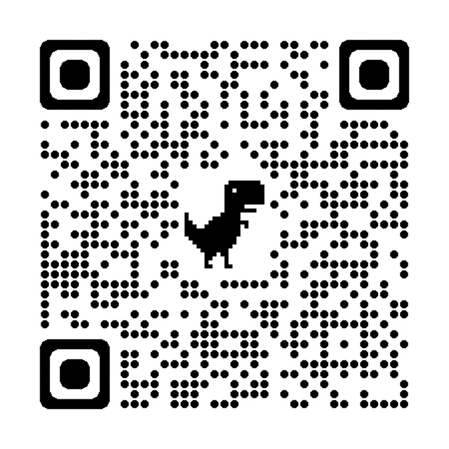
ACTIVITY: ATTENDANCE
Scan QR code on the left or follow the URL posted in the chat to access the online attendance survey
Follow prompts to enter attendance information
Notify trainers if you require assistance (e.g., identifying your cohort or cohort group)
Certificates of Attendance will be sent in January and June. Attendance records will be use as verification
You are in Tier 2 Yr 2
1 minute
Notes:
ATTENDANCE: https://edc.co1.qualtrics.com/jfe/form/SV_81vbI1jl3cwmLY2

Slide 3
Agenda & Team Tasks
Goal Setting
Coaches Tasks
Content
Review the Tier 2 Annual Planning Tool to get ready for next year
RESOURCES
Celebrate!
Tier 2 Annual Planning Tool
Annual Evaluation Report
Pbisapps.org coordinator form
Notes:
https://www.pbisapps.org/resource/local-pbis-coordinator-information-form

Slide 4
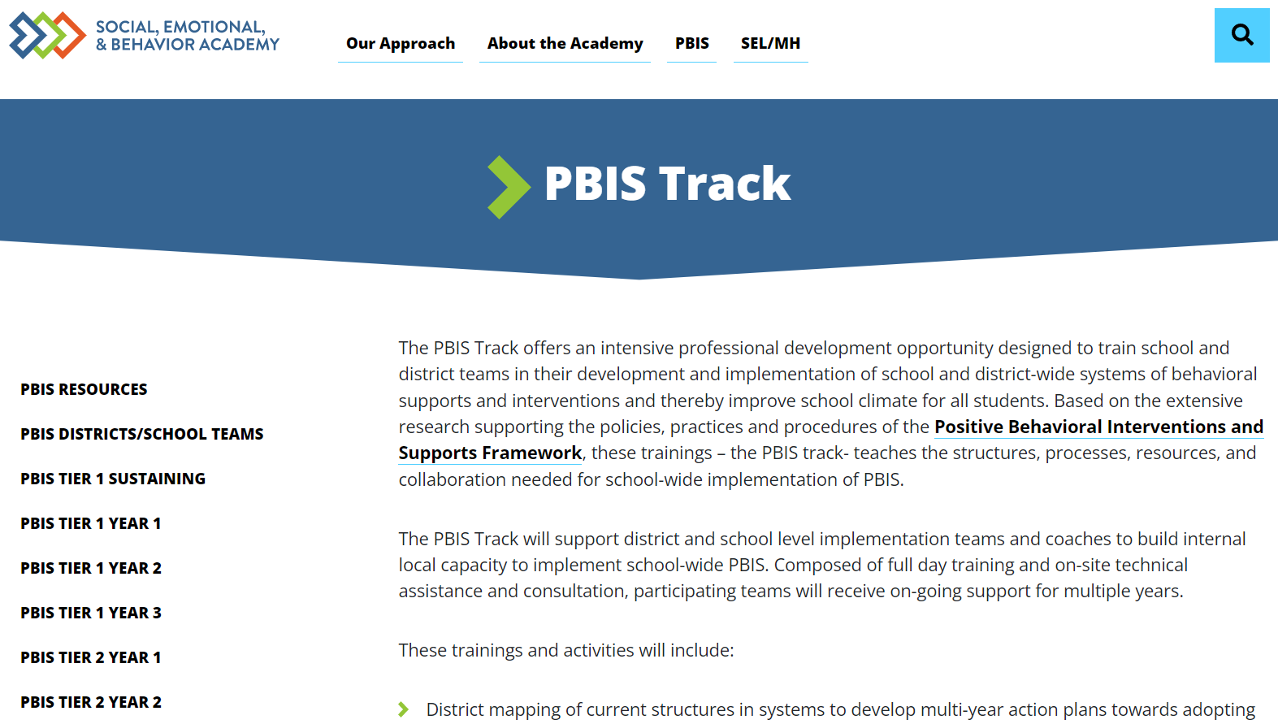
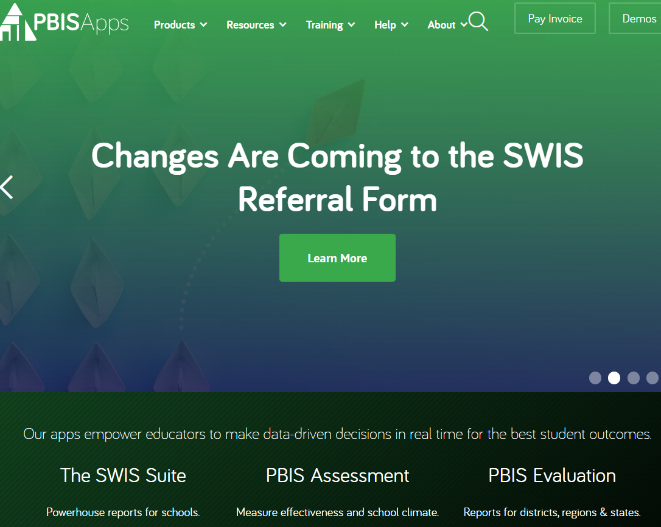
Important and Helpful PBIS Websites
PBISApps.org
(SWIS and your TFI’s live here)
EDC Website
NEPBIS.org
PBIS.org
APBS.org
Notes:
EDC SEBAcademy: https://sebacademy.edc.org/pbis-track
NEPBIS: Nepbis.org
National Center on PBIS: PBIS.org
PBISApps: PBISApps.org
Association of Positive Behavior Supports: APBS.org

Slide 5
HELPFUL RESOURCES
OTHER WEBSITES:
What Works Clearinghouse
National Center on Intensive Intervention
Intensive Intervention Tools Charts
OSEP Ideas That Work
CASEL Program Guide - SELect Programs

Slide 6
You are Graduating from the SEB Academy!!!!
CONGRATULATIONS

Slide 7
2024-2025 SEB Academy:
Congratulations! You are Graduating!!!
But you are still in the SEB family
A calendar of topics and dates will be posted to the website in September and emailed to Coaches.
Please join us in these Learning Opportunities
Monthly Webinars (available to all school staff)
Monthly Peer Sharing Calls (Series of 3 virtual meetings on various topics)
Continued Support Options
Continued Support with SEL/Mental Health/Belonging if your school or district wants to re-apply to the academy and work with an SEB coach (3 years)
Your Trainers are always just an email away if you have any questions next year
Notes:
Trainer note: Review support options for next year.

Slide 8
Annual Evaluation Report What will you Celebrate?
Remember the last question on the TFI?
Annual Evaluation Report TIER 2
Notes:
Completing your annual evaluation “report” (1-2pages) is a great opportunity to reflect on the TFI, goals you set this year, outcomes, and goals for next year sa part of a continuous quality improvement cycle.
https://sebacademy.edc.org/annual-evaluation-report-tier-2

Slide 9
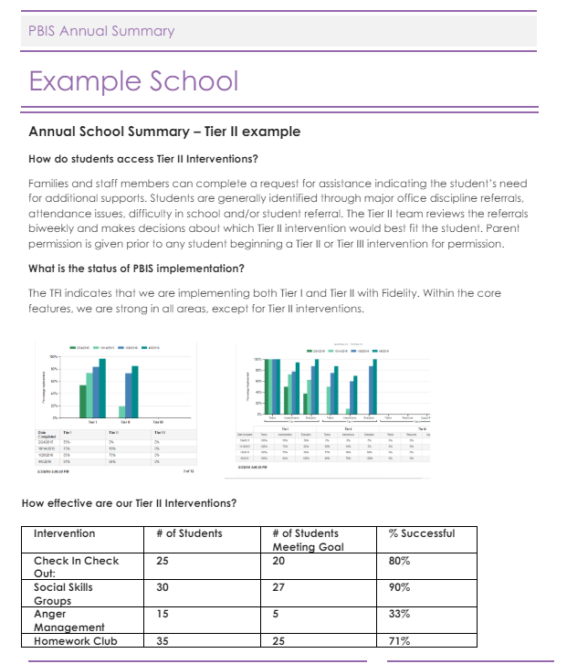
Fidelity Data
Outcome Data
Notes:
TRAINER NOTE: Use this sample to discuss what each school might choose to include in a “snapshot” evaluation report

Slide 10
What are some of your TEAM GOALS for next year?
Notes:
TRAINER NOTE: The purpose of this next section is to support the teams to review their goals this year, review their data, and revise their goals for next year.

Slide 11
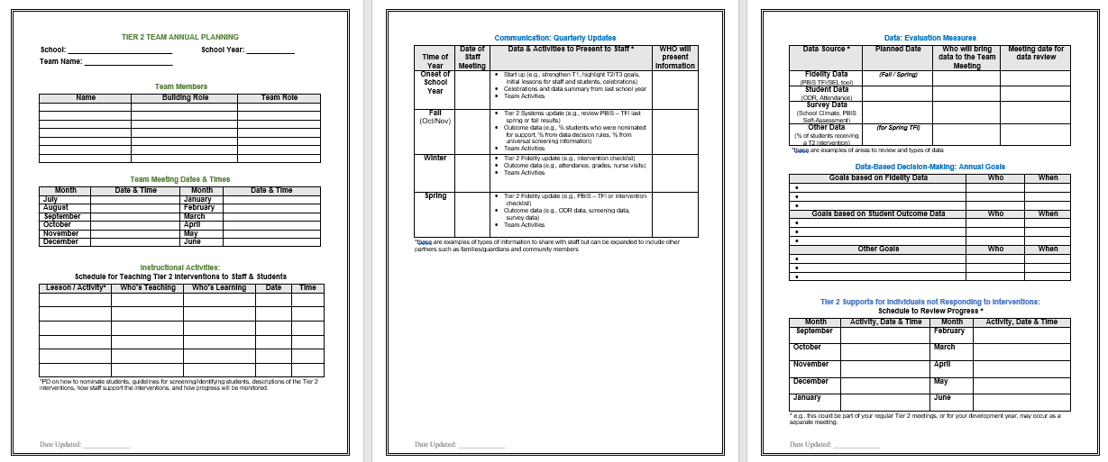
Consider using the Annual Planning Tool
Annual Planning Tool

Slide 12
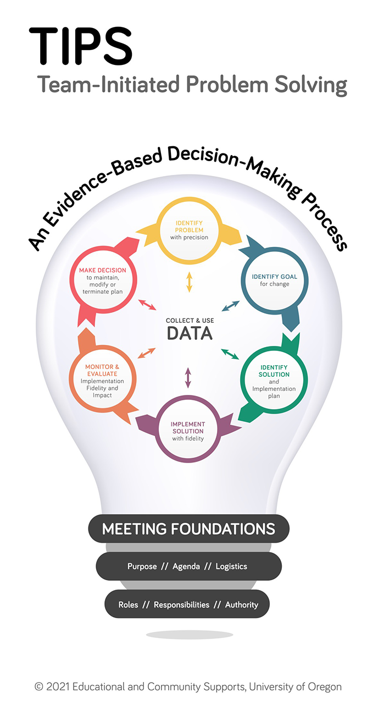
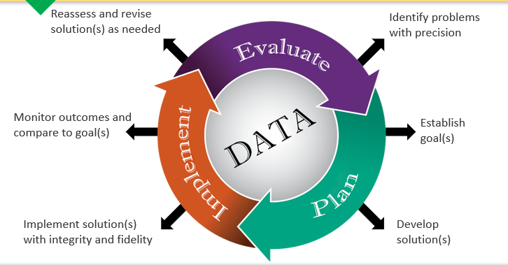
FINAL MESSAGE

Slide 13
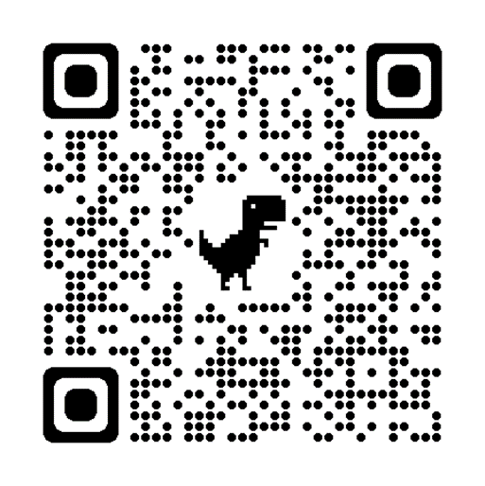
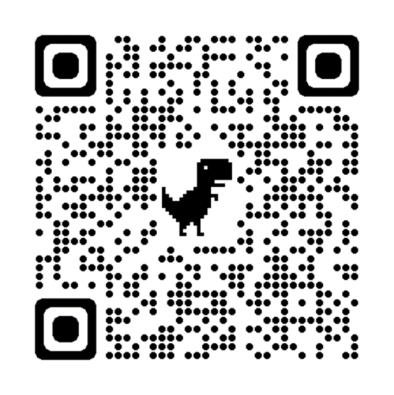
Today’s Evaluation
If you were NOT at the Team Training in May, Please remember to complete the End Of Year Evaluation!
.
Scan the QR code to access or look in the Chat Box for link
End of Year Evaluation
Scan the QR code to access or look in the Chat Box for link
Notes:
TRAINERS -
Today’s Evaluation: https://edc.co1.qualtrics.com/jfe/form/SV_cBF9GI7gVEBsfSC
End of Year Evaluation: https://go.edc.org/pbis-end-of-year-evaluation

