Slide 1


PBIS Coach Training
Year 2: June 2024
Trainer Names
Created from content from the National Technical Assistance Center on Positive Behavioral Interventions and Supports
U.S. Department of Education, Office of Special Education Programs and Office of Elementary and Secondary Education
with support from NEPBIS Network, May Institute, & Broad Reach Consulting

Slide 2

EXPECTATIONS
Self
Others
Environment
Self-monitor
Mute when listening, unmute to talk​
Have your computer charged and ready to go​
If you have questions or comments:
Work as a team:
Keep necessary materials at hand
Are you participating?
Engaged as a learner?
Stretch, break, stand as needed​
unmute
use the chat box
Room for every voice
Reinforce participation
action plan
relevant docs
water/snacks
Minimize distractions if possible​

Slide 3
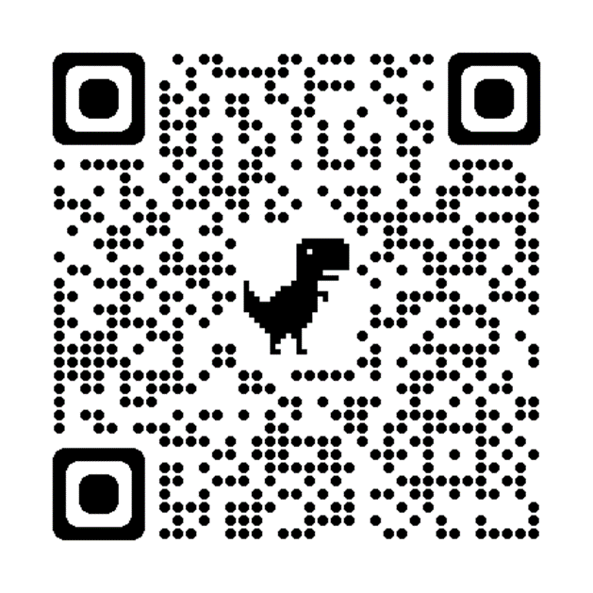
ACTIVITY: ATTENDANCE
Scan QR code on the left or follow the URL posted in the chat to access the online attendance survey
Follow prompts to enter attendance information
Notify trainers if you require assistance (e.g., identifying your cohort or cohort group)
Certificates of Attendance will be sent in January and June. Attendance records will be use as verification
You are in Cohort 9
1 minute
Notes:
ATTENDANCE: https://edc.co1.qualtrics.com/jfe/form/SV_81vbI1jl3cwmLY2

Slide 4
Agenda & Coaches' Tasks
Coaches’ Tasks:
Presentation Content:
Review of current and revision of goals.
Review with your team the activities reviewed in the Coaches Year at a Glance document and update your action plan.
Celebrations from this past year
Review the Annual Action Plan document and update with dates and activities for next year.
Resource Spotlight: Coaches Year at a Glance & Annual Action Plan
Preparing for next year
Revise your School and Classroom wide goals for next year.

Slide 5
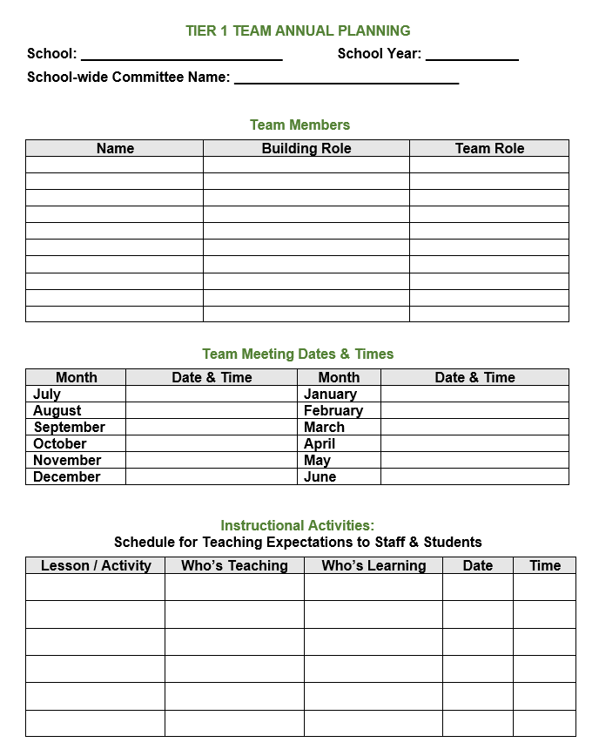
HELPFUL RESOURCES
RESOURCES:
Team Meeting Action Plan with Goals
Annual Yearly Planning Template - Advanced Years
Coaches Year at a Glance Document
Annual PBIS Evaluation Report Template
Annual PBIS Evaluation Report – SAMPLE
Sample PBIS Handbook Elementary
Sample PBIS Handbook Secondary
Sample Staff Slide Deck
Sample Student PBIS Slide Deck
Notes:
RESOURCES:
Team Meeting Action Plan with Goals: https://sebacademy.edc.org/action-plan-template-1-year-1-teams
Coaches Year at a Glance: https://sebacademy.edc.org/coaches-year-glance
Annual Planning Template: https://sebacademy.edc.org/annual-action-plan-template-advanced-years
Annual PBIS Evaluation Report Template -https://sebacademy.edc.org/annual-evaluation-report-template
Annual PBIS Evaluation Report – SAMPLE - https://sebacademy.edc.org/annual-evaluation-report-sample
Sample PBIS Handbook Elementary - https://sebacademy.edc.org/sample-pbis-handbook-elementary
Sample PBIS Handbook Secondary https://sebacademy.edc.org/sample-pbis-handbook-elementary
Sample Staff Slide Deck - https://sebacademy.edc.org/sample-pbis-staff-slide-deck
Sample Student PBIS Slide Deck - https://sebacademy.edc.org/sample-pbis-student-slide-deck

Slide 6
2024-2025 SEB Academy: PBIS Track Support Sturcture
Years
01
02
03
Attendees
Team Training (Minimum):
        Administrator
        Grade-Level Representatives
        Support Staff
        Coaches
Coaches Training:
2-3 Coaches
  Technical Assistance:
  Administrator
  Coach
  Data Entry Staff
  Faculty/Staff
Support
6 – 1.5 hr. Monthly Coach Meetings (Virtual)
2 Full Day - Team Trainings Meetings (In Person) (Nov. & March)
1 day (8 hr.) Technical Assistance per school
SWIS Data System & Training
OPTIONAL Learning Opportunities
Monthly Webinars
Monthly Peer Sharing Calls
(Series of 3 virtual meetings on various topics)
Notes:
Trainer note: Review support options for next year.

Slide 7
Yearly Product Review
Team Meeting Schedule / Action Plan - All
2 of the following:
  Discipline: Definitions or Flow Chart
  Feedback/Surveys: Staff / Students / Families
  Classroom: Sample Classroom Routine Matrix or Classroom Assessment
Please show trainer your products for Check Off. You do not need to turn them into us. (But we love examples of your great work!)
Notes:
Trainer Note:

Slide 8
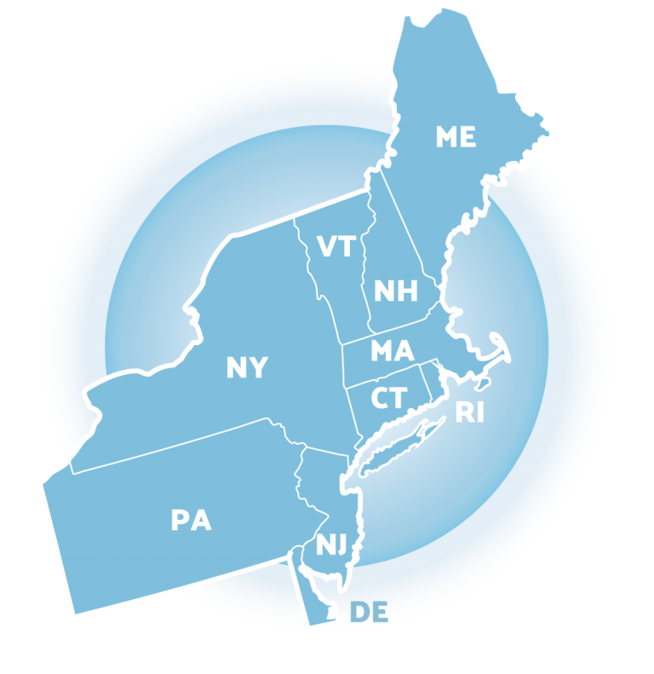

CELEBRATIONS AND LEARNINGS FROM THIS PAST YEAR

Slide 9
DISCUSSION: GLOWS & GROWS
What is something to celebrate & something you learned, and something you hope to learn next year, related to one or more of the following.
School progress this past year
Coaching with your team this past year
3 minutes
12 minutes
Independent Jot
Whole Group

Slide 10
Review:
Current and revision of school-wide goals
Notes:
12:30

Slide 11
What Social Emotional Behavior (SEB) Data has your team collected this year?
Implementation Fidelity
Outcome Data
Other data sources:
Discipline Data
School Climate Data
Attendance
Nurse visits
Time out of class
Staff Survey
Family Surveys
Other data?
PBIS Document feedback
Tiered Fidelity Inventory
PBIS Self-Assessment Survey
Walkthrough Information
Classroom Practices
When your various data sources are reviewed together, what does it say is going well? What does your data say is needed next?

Slide 12

IDENTIFY PROBLEM
with precision
IDENTIFY GOAL
for change
IDENTIFY SOLUTION
and implementation plan
IMPLEMENT SOLUTION
with fidelity
MONITOR & EVALUATE
implementation fidelity and impact
MAKE DECISION
to maintain, modify, or terminate plan
Collect & Use
DATA
(Chaparro, E., et. al, 2022)

Slide 13
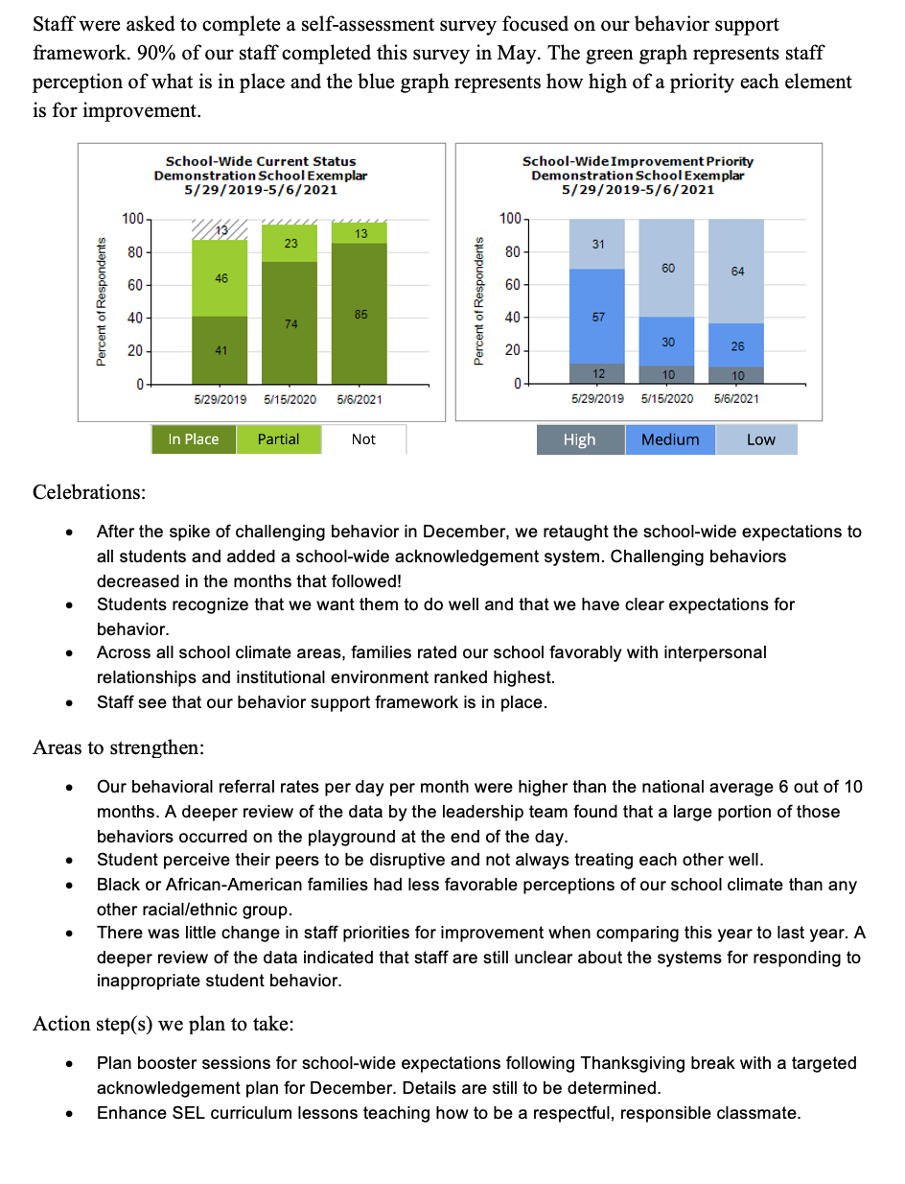
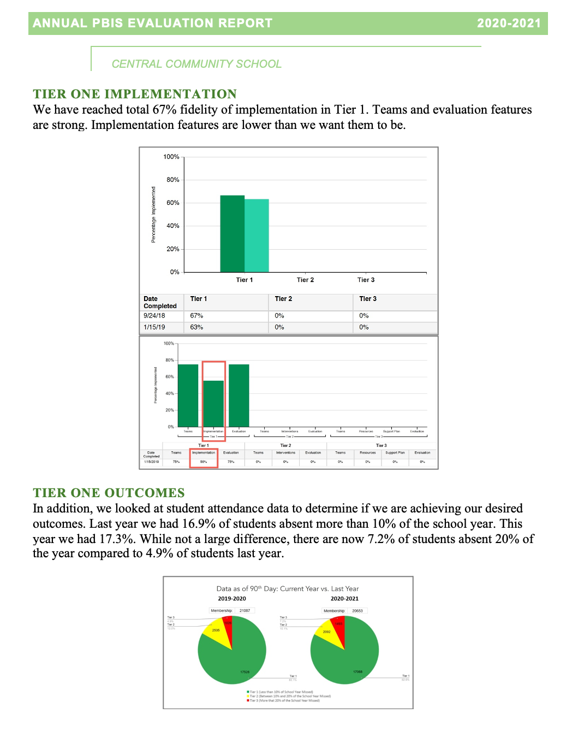
Implementation of the core components of PBIS is more likely if the Tier I team assesses the implementation status at least annually and provides “snapshot” reports to the staff, community, school board.
Remember to continue to work on your Annual Evaluation Report. Please share a copy with your trainers!
Notes:
Annual Tier 1 Evaluation Report (Sample school): https://sebacademy.edc.org/annual-evaluation-report-sample

Slide 14
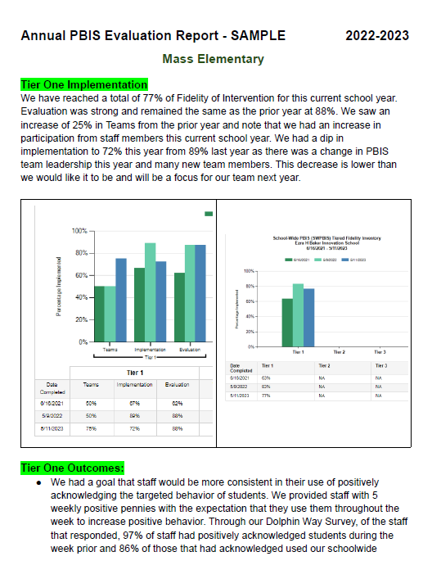
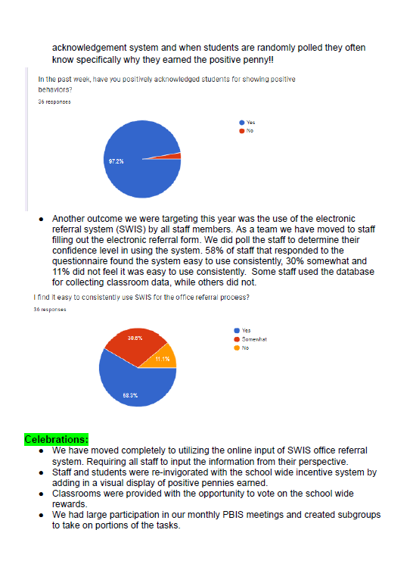
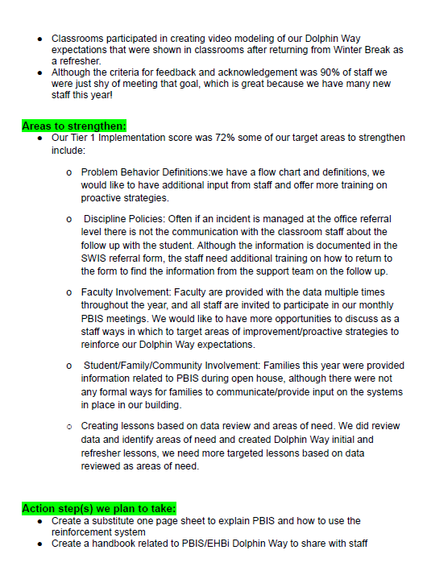
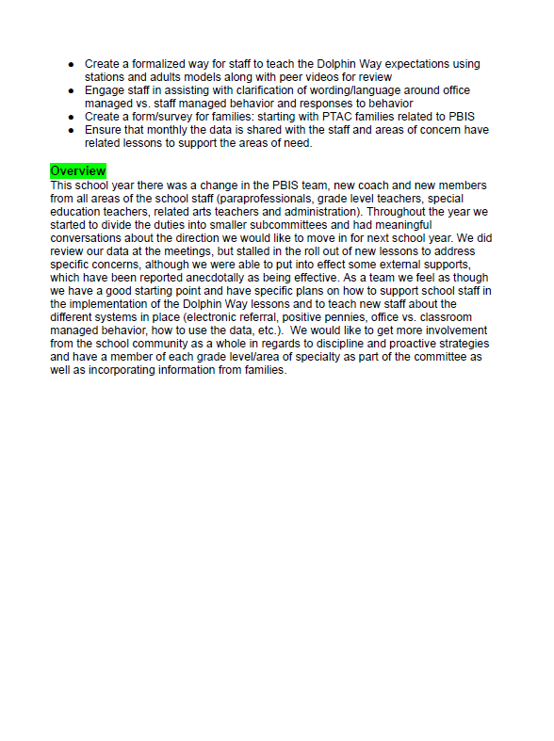
Completed Sample

Slide 15
DISCUSSION: Goals
What conversations and planning have your team had around data and review of goals?
What goals have you and your team discussed for next year?
Whole Group
10 minutes

Slide 16
PBIS
Resource Spotlight:
Coaches Year-at-a-Glance, Roll out Checklist
& Annual Action Plan
Notes:
RESOURCE LINK: https://sebacademy.edc.org/equitable-outcomes-require-finding-vulnerable-decisions

Slide 17
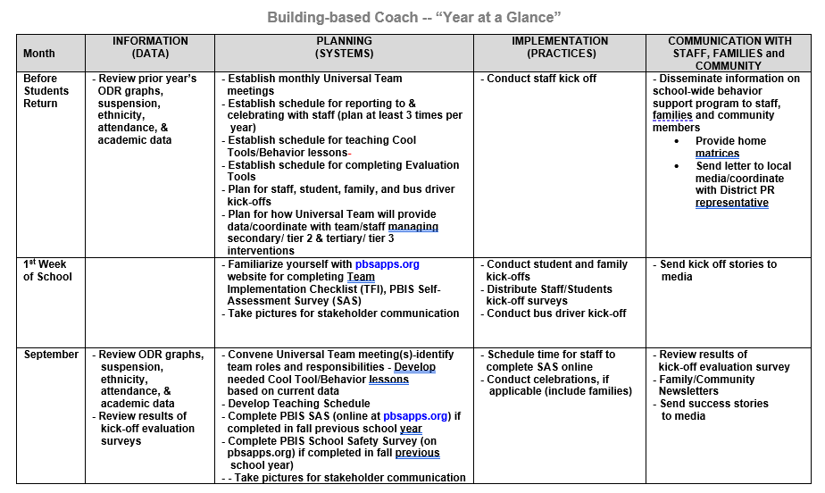
Coaches Year at a Glance
Month by month resources for coaches:
Organizes what data should be reviewed when (for planning purposes)
Prompts for coaches’ and team activities that support planning
What practices should be conducted across the year.
Ideas for communicating with Staff, Families, and Community.
Create your own coaches’ plan!
Notes:
https://sebacademy.edc.org/coaches-year-glance

Slide 18
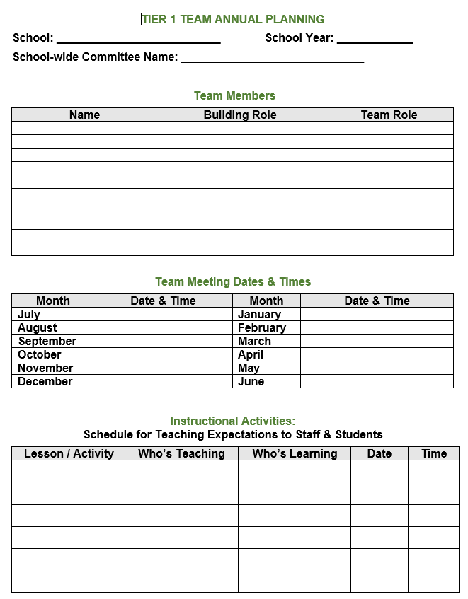
Annual Action Plan
All in on year long organizer action plan document that provides you a one stop document to share the following information:
Team membership and meeting dates
Lesson plan dates
Acknowledgement activities
Assessment activities
Additional support activities
Notes:
https://sebacademy.edc.org/coaches-year-glance

Slide 19
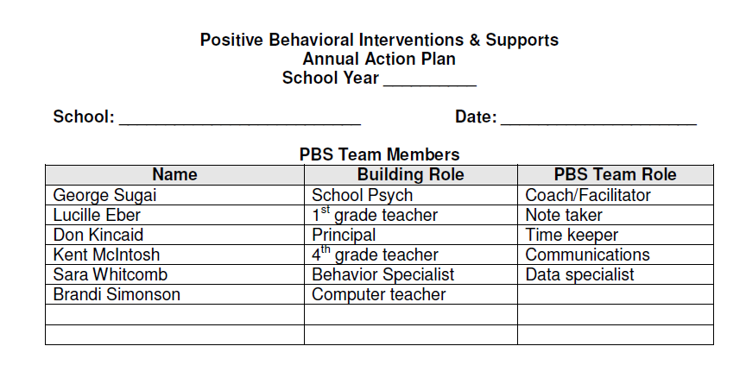
Annual Planning Template - Advanced Years
What role will team members fulfill?
Notes:
https://sebacademy.edc.org/annual-action-plan-template-advanced-years

Slide 20
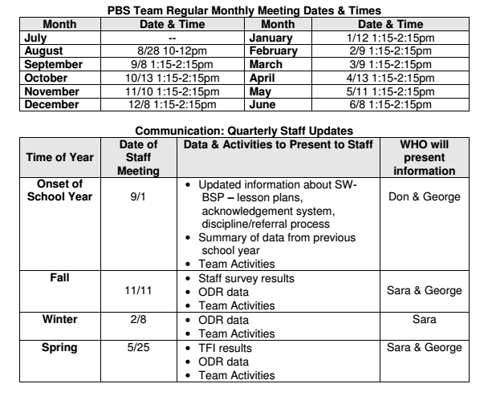
Reserve meeting time
What data will be shared with staff when
Notes:
https://sebacademy.edc.org/annual-action-plan-template-advanced-years

Slide 21
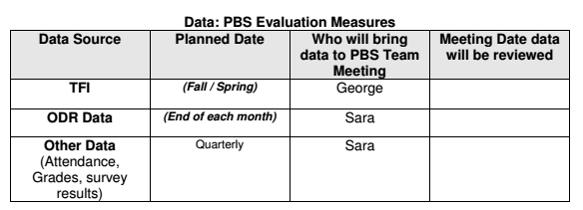
What evaluation measures will the team use to assess implementation? When?
  Recommend: TFI in the spring
When will the team review ODR data? Who is responsible for preparing these data for the meeting?
What additional data are the team interested in reviewing?
  Align with your school’s valued outcomes
Notes:
https://sebacademy.edc.org/annual-action-plan-template-advanced-years

Slide 22
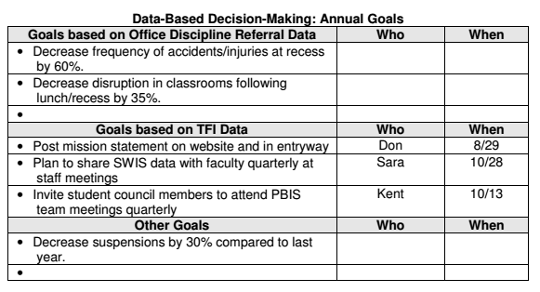
What do your data indicate as areas of priority?
Action plan based on TFI, TIC, or survey results
Notes:
https://sebacademy.edc.org/annual-action-plan-template-advanced-years

Slide 23
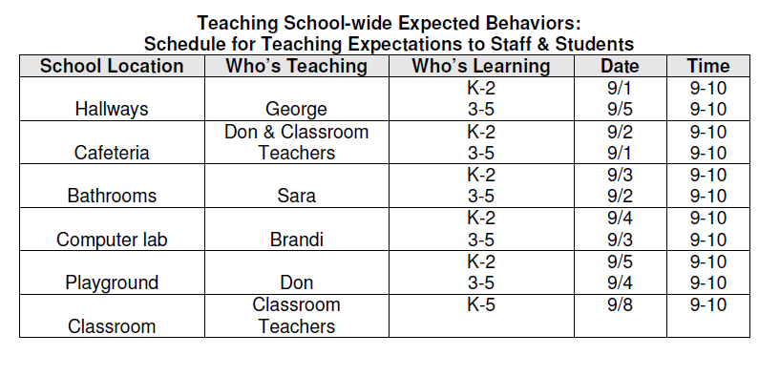
What’s your school’s plan for teaching expected behaviors to staff and students?
Notes:
https://sebacademy.edc.org/annual-action-plan-template-advanced-years

Slide 24
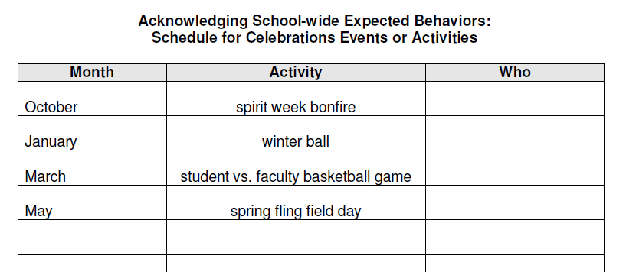
Any long-term, school-wide celebrations, assemblies, or events can be recorded here.
Notes:
https://sebacademy.edc.org/annual-action-plan-template-advanced-years

Slide 25
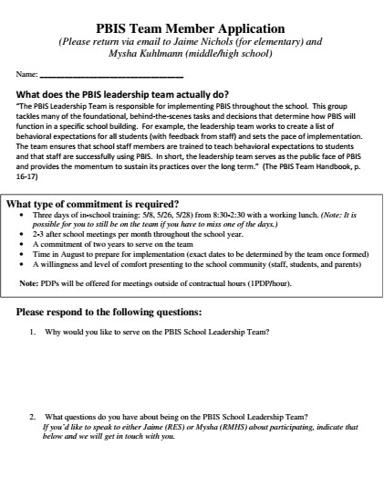
Looking for New Team Members? Here is a Sample PBIS Team Application form
Notes:
This is a sample team application that some school use to identify new team members.

Slide 26
ACTIVITY: RESOURCE SPOTLIGHT
Review the shared resources independently.
With a partner discuss:
  How could these resources serve as a prompt for annual action planning?
  What is your key takeaway from these resources?
Be ready to provide a 1 minute share-out of your discussion
Independent Jot
Whole Group
5 minutes
10 minutes
Notes:
https://sebacademy.edc.org/annual-action-plan-template-advanced-years

Slide 27
Looking Ahead
Notes:
https://www.pbisapps.org/products/tfi

Slide 28
Prepping for Year 3: Plan To Succeed
Staff Professional Development – Before schools starts and throughout school year
Student Teaching – How will you teach in Sept and throughout the school year
Review:
  Acknowledgement System (Students & Staff)
  Discipline Documents (Definitions and Flow Chart)
Include: Student Voice and Family Voice
Ensure: Every team meeting includes DATA
Create or Update:
      Staff PBIS Handbook
      Student/Family handbook to include PBIS

Slide 29
ACTIVITY: RESOURCE SPOTLIGHT
Review the Look Ahead List
With a partner discuss:
  Which of these do you need to make a goal?
  What action steps can you list to begin work on your goal?
Independent Jot
Whole Group
10 minutes
5 minutes
Notes:
https://sebacademy.edc.org/annual-action-plan-template-advanced-years

Slide 30
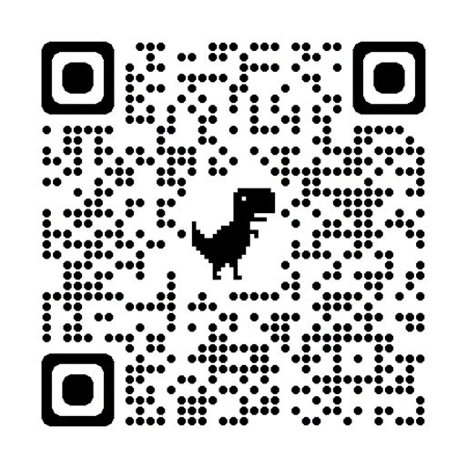
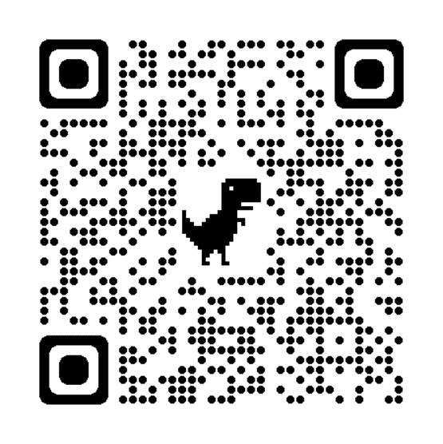
Today’s Evaluation
If you were NOT at the Team Training in May, Please remember to complete the End Of Year Evaluation!
.
Scan the QR code to access or look in the Chat Box for link
End of Year Evaluation
Scan the QR code to access or look in the Chat Box for link
Notes:
TRAINERS -
Today’s Evaluation: https://edc.co1.qualtrics.com/jfe/form/SV_cBF9GI7gVEBsfSC
End of Year Evaluation: https://go.edc.org/pbis-end-of-year-evaluation

Slide 31
Agenda & Coaches' Tasks- Debrief
Presentation Content:
Review of current and revision of goals.
Celebrations from this past year
Resource Spotlight #1: Coaches Year at a Glance & Annual
Action Plan
Preparing for next year
Coaches’ Tasks:
Revise your School and Classroom wide goals for next year.
Review with your team the activities reviewed in the Coaches Year at a Glance document and update your action plan.
Review the Annual Action Plan document and update with dates and activities for next year.
What questions do you have on today’s content?
What questions do you have on the follow-up tasks?

Slide 32
HELPFUL RESOURCES
RESOURCES:
Team Meeting Action Plan with Goals
Annual Yearly Planning Template - Advanced Years
Coaches Year at a Glance Document
Annual PBIS Evaluation Report Template
Annual PBIS Evaluation Report – SAMPLE
Sample PBIS Handbook Elementary
Sample PBIS Handbook Secondary
Sample Staff Slide Deck
Sample Student PBIS Slide Deck
Notes:
RESOURCES:
Team Meeting Action Plan with Goals: https://sebacademy.edc.org/action-plan-template-1-year-1-teams
Coaches Year at a Glance: https://sebacademy.edc.org/coaches-year-glance
Annual Planning Template: https://sebacademy.edc.org/annual-action-plan-template-advanced-years
Annual PBIS Evaluation Report Template -https://sebacademy.edc.org/annual-evaluation-report-template
Annual PBIS Evaluation Report – SAMPLE - https://sebacademy.edc.org/annual-evaluation-report-sample
Sample PBIS Handbook Elementary - https://sebacademy.edc.org/sample-pbis-handbook-elementary
Sample PBIS Handbook Secondary https://sebacademy.edc.org/sample-pbis-handbook-elementary
Sample Staff Slide Deck - https://sebacademy.edc.org/sample-pbis-staff-slide-deck
Sample Student PBIS Slide Deck - https://sebacademy.edc.org/sample-pbis-student-slide-deck

