Slide 1


PBIS Coach Training
Year 1: February 2024
Trainer Names
Created from content from the National Technical Assistance Center on Positive Behavioral Interventions and Supports
U.S. Department of Education, Office of Special Education Programs and Office of Elementary and Secondary Education
with support from NEPBIS Network, May Institute, & Broad Reach Consulting

Slide 2

EXPECTATIONS
Self
Others
Environment
Self-monitor
Mute when listening, unmute to talk​
Have your computer charged and ready to go​
If you have questions or comments:
Work as a team:
Keep necessary materials at hand
Are you participating?
Engaged as a learner?
Stretch, break, stand as needed​
unmute
use the chat box
Room for every voice
Reinforce participation
action plan
relevant docs
water/snacks
Minimize distractions if possible​

Slide 3
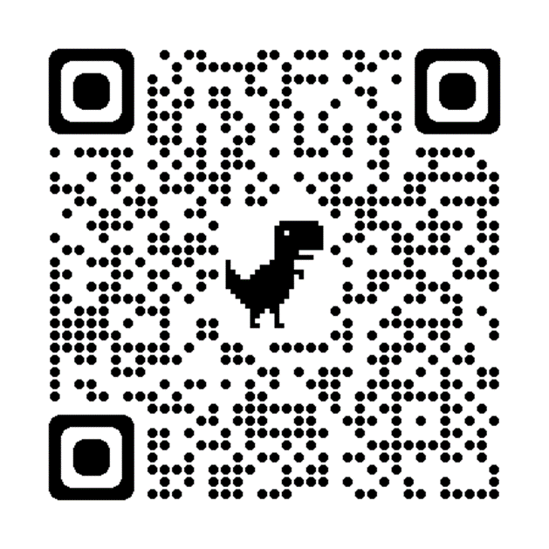
ACTIVITY: ATTENDANCE
Scan QR code on the left or follow the URL posted in the chat to access the online attendance survey
Follow prompts to enter attendance information
Notify trainers if you require assistance (e.g., identifying your cohort or cohort group)
Certificates of Attendance will be sent in January and June. Attendance records will be use as verification
You are in Cohort 10
1 minute
Notes:
ATTENDANCE: https://edc.co1.qualtrics.com/jfe/form/SV_81vbI1jl3cwmLY2

Slide 4
Agenda & Coaches' Tasks
Coaches’ Tasks:
Presentation Content:
Glows and Grows
Schoolwide Acknowledgement Systems Check-in
Obtaining Feedback from Students, Staff, & Families
Action Plan for getting feedback from Students, Staff and Families
PREVIEW: Response System
Support your team with developing a schoolwide acknowledgement system

Slide 5
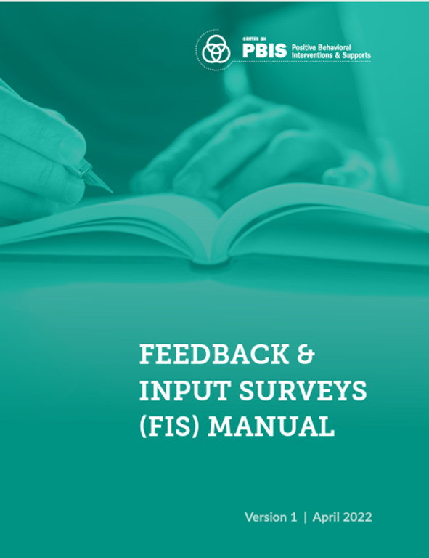
HELPFUL RESOURCES
RESOURCES:
The Student/Teacher Game
High School Acknowledgement Systems
Feedback and Input Survey (FIS)
Overview of Feedback & Input Survey(FIS)
School Climate Survey Manual
How Schools are Using the student Climate Survey (national norms)
How Schools are Using the Parent and Staff Climate Survey (national norms)
Self-Assessment Survey for Staff
Response System Videos
Defining Behaviors
Behavior Flow Chart
Referral Forms
Notes:
The Student/Teacher Game: https://sebacademy.edc.org/studentteacher-game
High School Acknowledgement Systems: https://sebacademy.edc.org/high-school-acknowledgement-systems
Feedback and Input Survey - https://sebacademy.edc.org/pbis-feedback-input-survey-manual
Overview of Feedback and Input Survey - https://sebacademy.edc.org/overview-feedback-and-input-surveys
School Climate Survey - https://sebacademy.edc.org/pbis-climate-survey-manual
How Schools are Using the Climate Survey (national norms) - https://sebacademy.edc.org/how-are-schools-using-school-climate-surveys
How Schools are Using the Parent and Staff Climate Survey (national norms) - https://sebacademy.edc.org/how-are-schools-using-parent-and-personnel-school-climate-surveys
Self-Assessment Survey for Staff -https://sebacademy.edc.org/pbis-self-assessment-survey-sas
Defining Behaviors - https://sebacademy.edc.org/defining-behaviors-video
Behavior Flow Chart - https://sebacademy.edc.org/behavior-flow-chart-video
Referral Forms - https://sebacademy.edc.org/referral-form-video

Slide 6
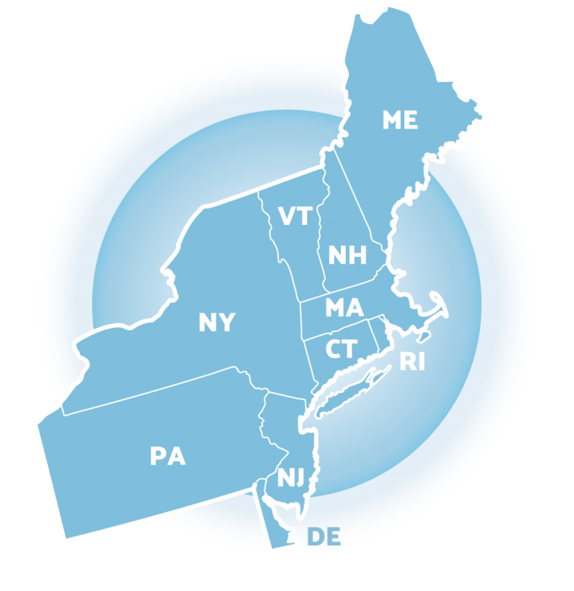

Glows & Grows

Slide 7
DISCUSSION: GLOWS & GROWS
Team
Evaluation
Implementation
Since you completed the TFI Self-Assessment last month,
what is something to celebrate & something you’re working on with Tier 1 PBIS implementation?
3 minutes
8 minutes
Co-Coach / Independent
Whole Group
Notes:
Discussion Prompt:
Since you completed the TFI Self-Assessment last month,
what is something to celebrate & something you’re working on with Tier 1 PBIS implementation?

Slide 8
Big Idea
Check In
Schoolwide Acknowledgement Systems
Notes:
TRAINER NOTE: Please review this content quickly as it is review from asynchronous content https://youtu.be/7M1OfJYMPcg

Slide 9
When a student experiences something desirable following a behavior, that behavior is strengthened and more likely to occur again.
As teacher praise rates increase, student outcomes improve!
Teacher praise rates
Student engagement and on-task behavior
Disruptive behavior from students
Provide more acknowledgement
than corrections.
Strive for 5⁺ > 1⁻
(e.g. Caldarella et al., 2020; Cook et al., 2017; Reinke et al., 2016)

Slide 10
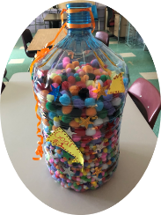
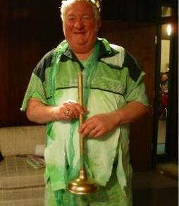
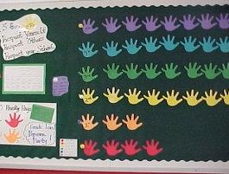
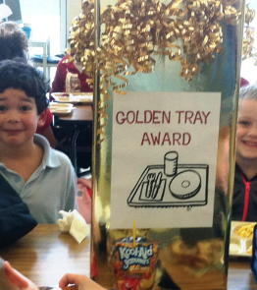

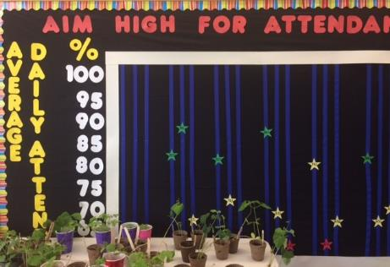
Acknowledgment Systems
Staff-Student – Develop ways to identify, communicate and publicly recognize expected and exceptional behaviors
Staff-Staff – Create and promote opportunities for staff/admin to recognize and appreciate other staff
Student-Staff – Create ways for students to share appreciation of staff
Student-Student– Create opportunities for students to give each other ‘shout-outs’ for social, emotional, behavioral & academic success and effort.
School-Student – Attendance, grades, behavior, state assessment, improvement, etc. (i.e. Attendance Campaign)
Notes:
Examples of Popular Student Incentives

Slide 11
Types of Acknowledgements
High Frequency
Provided daily
Predictable
Specific Praise
Tickets/Notes
Coupons to school store
Announcements
Intermediately
Provided weekly, quarterly, monthly
Student of the Month
Class Pizza Party
Recognition at School Assembly
Long Term
Few times per year
Involves groups of students
Whole school pajama day
Honors banquet
Freshmen class picnic
(adapted from MO-PBS)

Slide 12
DISCUSSION:
Schoolwide Acknowledgement Systems
How has your team moved forward with schoolwide acknowledgement systems?
What further support do you need so you can support your team with this work?
What examples can you share?
2 minutes
8 minutes
Independent Jot
Whole Group
Notes:
Discussion Prompt:
How has your team moved forward with schoolwide acknowledgement systems?
What further support do you need so you can support your team with this work?
What examples can you share?

Slide 13
Resource
Spotlight

Slide 14
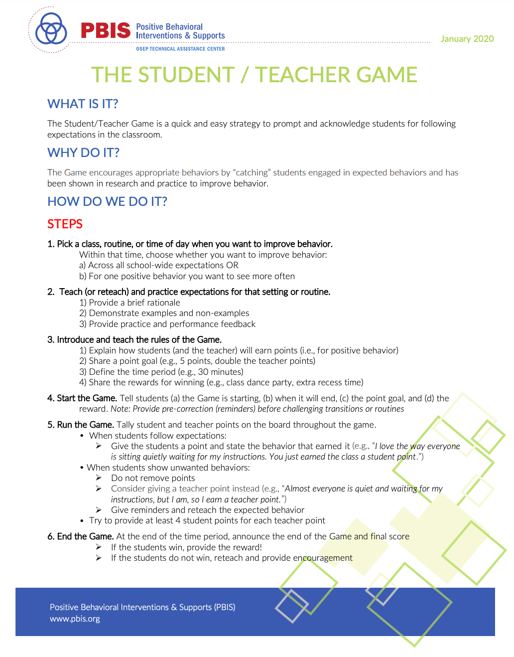

Teacher Student Game
https://sebacademy.edc.org/student-teacher-game
Notes:
The Student Teacher Game - https://sebacademy.edc.org/student-teacher-game
Give example
- Teach quiet signal with a 5 second count down.
Explain the game
-When I use the signal and start counting if the whole class is quiet and listening by the count of 5, the class earns a point
-If you are still talking at the count of 5 I earn a point.
-if the class earns 10 points (or beats the teacher score, or doubles the teachers points…etc.) we will get 10 extra minutes of recess.
-Lets practice (shows signal and counts down)
-Start to the game
**it is not a trick; we are building a habit…always use the signal and count down the same way (or give the reminder for the taught behavior the same way)
-If students win be sure to give them the reward ASAP – ALL students get the reward. If the reward will happen the next day…write it on the board or display where students can see it.
-if student don’t win…reteach the skill, give encouragement, and consider doing the game again later in the day or the next day. Let them know they will have other opportunities to play and hopefully win the game. (Not winning is the consequence---don’t give an additional punishment)

Slide 15
ACTIVITY: RESOURCE SPOTLIGHT
Identify:
  Would staff benefit from this tool?
  Can this be used to provide professional development to staff? How? When?
Whole Group
5 minutes
Notes:
Activity Prompt:
Discuss as a group
Would your staff benefit from this tool?
Can this be used to provide professional development to staff? How? When?

Slide 16
PBIS
Resource Spotlight:
PBIS Assessment: Feedback and Input Surveys

Slide 17
MONITORING & EVALUATING PBIS PRACTICES
Use data to monitor the implementation & effectiveness of PBIS practices
Linked with meaningful outcome goals
Communicates purpose
Guides action planning
Used to measure and demonstrate progress
It is important to collect both Qualitative (feedback) and Quantitative (outcome) data

Slide 18
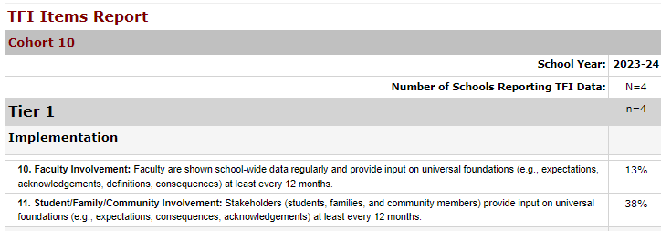
TFI 10 – Feedback and Input
TFI Questions 10 & 11: Teams typically report lower scores on these 2 questions
Staff Input (question 10)
3/4 Teams = 0%
1/4 Teams = 50%
Student/Family Input (question 11)
1/4Teams = 0%
2/4 Teams = 50%
1/4 Teams = 100%
Notes:
Teams really MUST include staff in creating products (expectations, matrix, ack system, response system) in order to achieve staff buy in support for PBIS.
Families and students should be included as well!

Slide 19

PBIS Assessment: Feedback & Input Surveys
The FIS is a set of four surveys to learn about how students, school personnel, and family members experience the school’s behavior support systems.
Surveys in the FIS include: (English & Spanish)
  Feedback and Input Survey: Elementary
  Feedback and Input Survey: Secondary
  Feedback and Input Survey: School Personnel
  Feedback and Input Survey: Family
Overview of Feedback and Input Survey
Available on PBIS Assessment – Used Annually
Notes:
Feedback & Input Survey Manual https://www.pbisapps.org/resource/feedback-input-surveys-fis-manual
Overview of Feedback and Input Survey - https://sebacademy.edc.org/overview-feedback-and-input-surveys

Slide 20
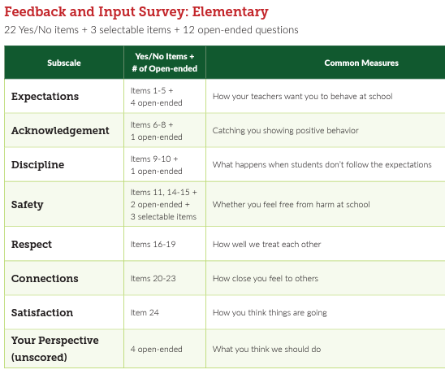
Student Surveys Elementary and Secondary
The student surveys are the same, but questions are phrased differently for the different age groups.
The secondary survey also has a few additional demographic categories
Elementary Grades: 3-6
Secondary Grades: 6-12

Slide 21
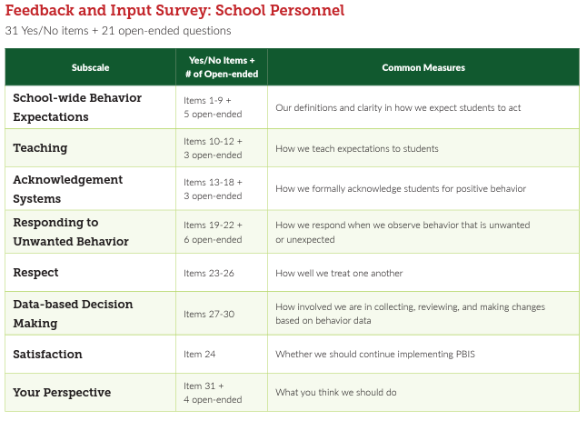
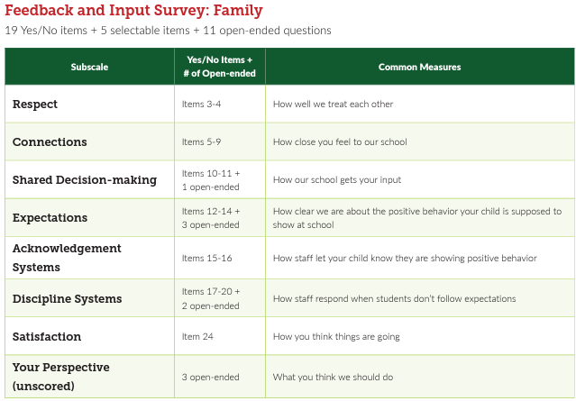
Staff and Family Input Surveys

Slide 22
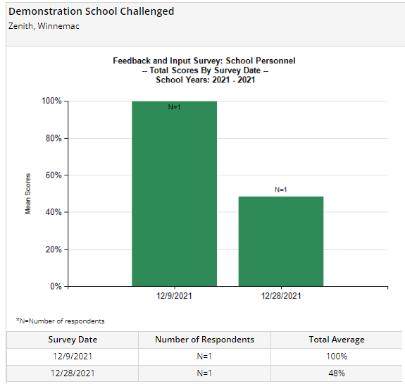
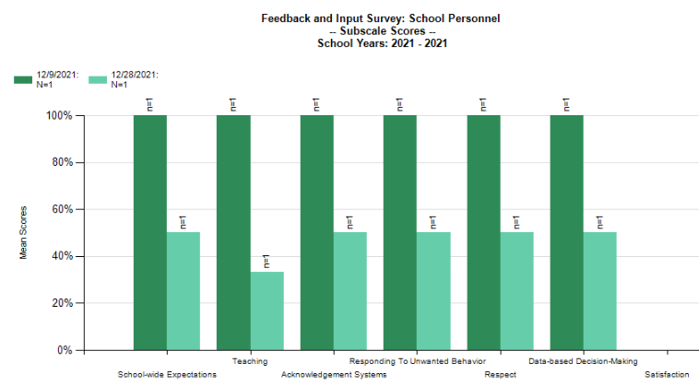
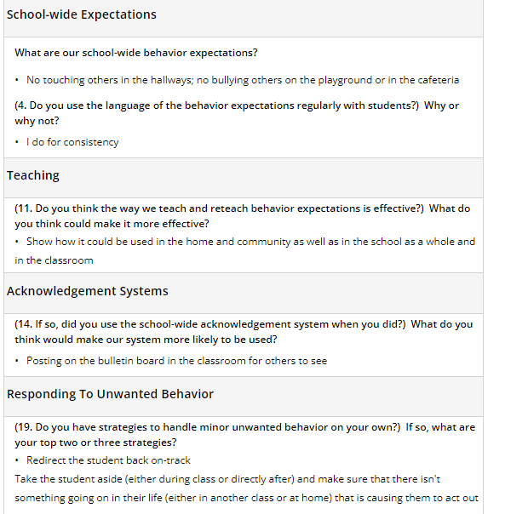
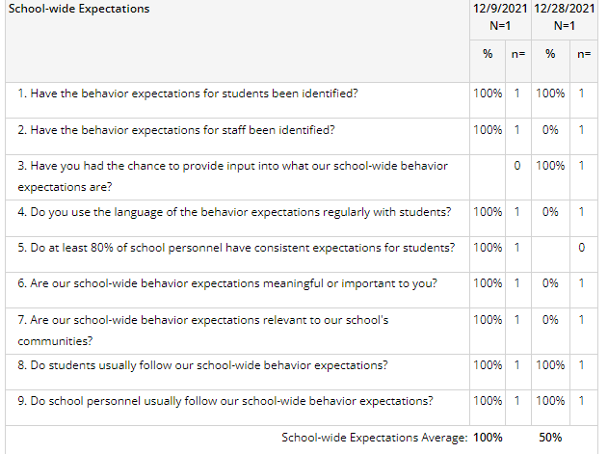
FEEDBACK & INPUT SURVEY REPORTS
Subscale
Comments
Total Score
Items

Slide 23
PBIS Assessment: Climate Surveys
The School Climate Survey Suite is a set of five multidimensional surveys to measure student, teacher, administrator, faculty, and family perceptions of school climate.
Climate Surveys include: (English & Spanish)
  Climate Survey: Elementary (3-6)
  Climate Survey: Secondary (6-12) (short or extended)
  Climate Survey: School Personnel
  Climate Survey: Family
Available on PBIS Assessment – Used Fall/Spring or Annually
Notes:
School Climate Surveys - https://sebacademy.edc.org/pbis-climate-survey-manual

Slide 24
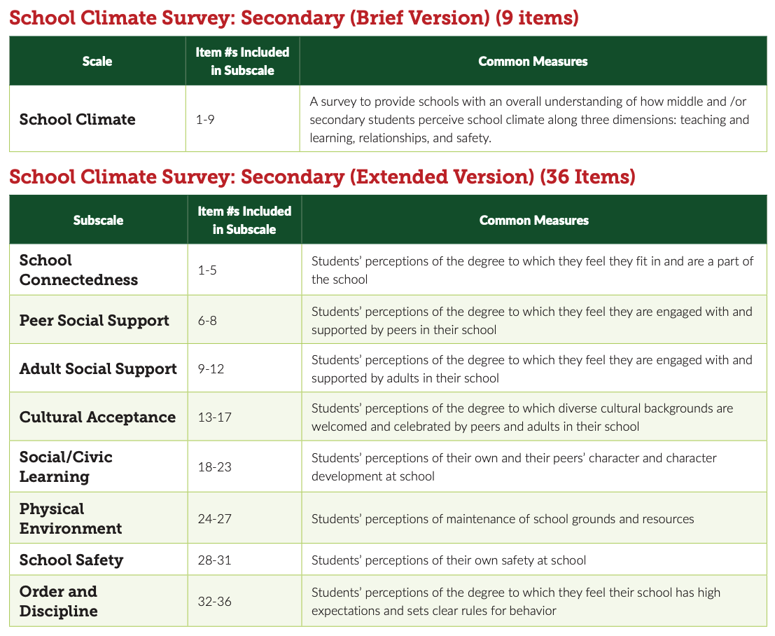
Secondary student survey is available in both brief AND extended versions.

Slide 25
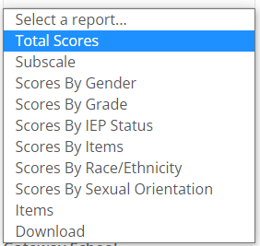
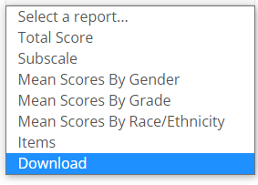
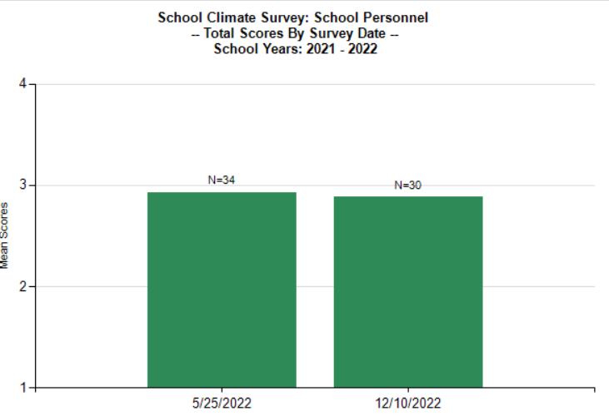
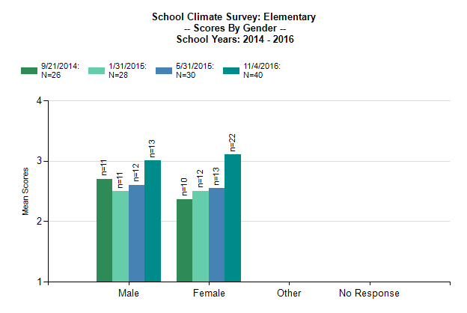
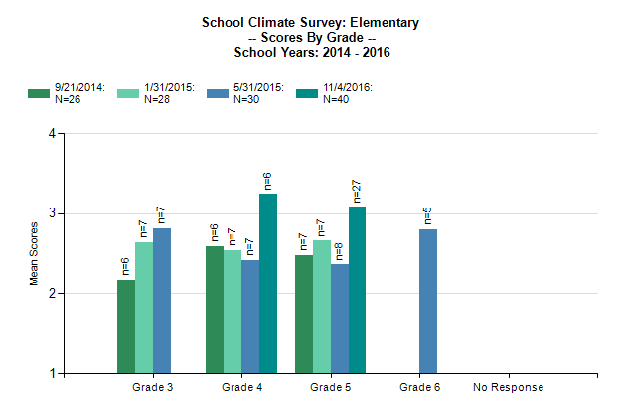
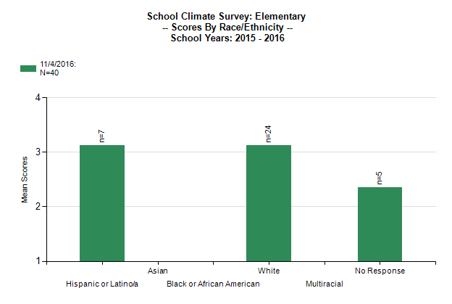
SCHOOL CLIMATE SURVEY REPORTS
Student Reports
There are National Norms to compare your climate survey results to. See Resources
Staff and Family Reports
Notes:
How Schools are Using the Climate Survey (national norms) - https://sebacademy.edc.org/how-are-schools-using-school-climate-surveys
How Schools are Using the Parent and Staff Climate Survey (national norms) - https://sebacademy.edc.org/how-are-schools-using-parent-and-personnel-school-climate-surveys

Slide 26
Climate Survey vs. Feedback & Input Survey
The School Climate Surveys are formal measures with strong evidence of reliability and validity for measuring quantitative perceptions of school climate.
The results are used to identify current status of school climate and to monitor progress over time. The School Climate Surveys are outcome measures.
The Feedback and Input Surveys give you more meaningful qualitative information about the experiences and suggestions of students, families, and school personnel. These surveys offer the entire school community a place to share their direct feedback with decision-makers.
The results are used to inform action plans to improve the effectiveness, efficiency, equity, and sustainability of Tier 1 behavior support systems. The Feedback and Input Surveys are feedback measures.

Slide 27
Quantitative vs Qualitative
Quantitative Research/Data
Use of statistics and “numbers” to measure variables, support hypothesis, make predictions, etc.
Uses directional verbs: effect, influence, cause, relate, etc..
Looks for “why”, ”to what extent”, etc.
Sample QT question:
What is the effect of PBIS in reducing ODRs in our school?
Qualitative Research/Data
Asks “what” or “how” questions in an open-ended design
Uses exploratory verbs: report, describe, discover, generate, explore
Looks for emergent themes from personal reports, focus groups, etc.
Sample of QL question (from Feedback Survey):
One thing teachers and staff could do better to improve behavior in my school is: ___________________

Slide 28
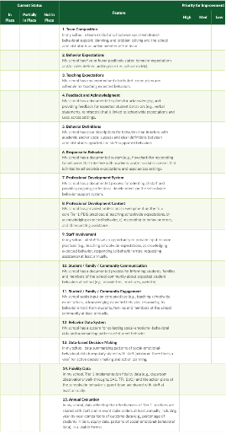
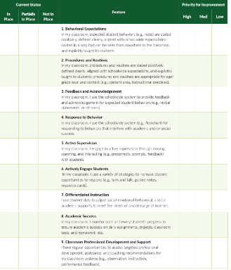
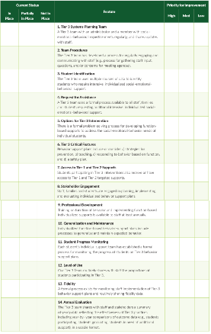
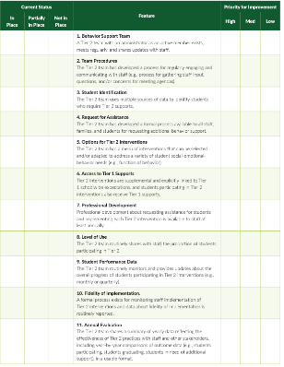
Self Assessment Survey (SAS) Updated June 2023
School Wide – 15
Classroom – 9
Tier 3 – 14
Tier 2 – 11
Notes:
Self-Assessment Survey www.pbisapps.org/resource/self-assessment-survey

Slide 29
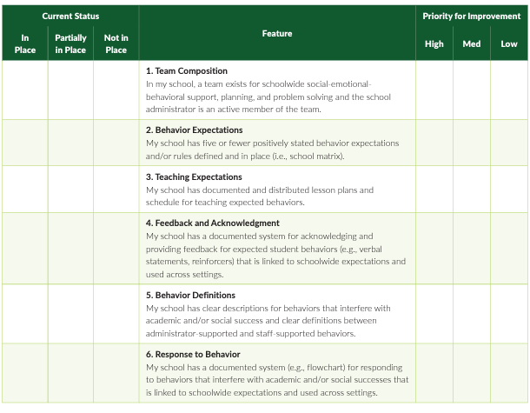
SELF ASSESSMENT SURVEY
SCHOOL-WIDE SYSTEMS
The purpose of the Self-Assessment Survey (SAS) is to examine the status and improvement needs of Tier 1 (schoolwide and classroom), Tier 2, and Tier 3 behavior supports.
The SAS is intended to be used by school staff for initial and annual assessment of positive behavior support systems.

Slide 30
Report Highlighting in the Items Report allows you to quickly see which items are in place and which need to be improved
Red – >50% in place
Yellow – 50-79% in place
White – 80% in place or higher
Let us know if you’re interested in conducting the SAS this year.
Notes:
Red – less than 50% in place
Yellow – 50-79% in place
White – 80% in place or higher

Slide 31
DISCUSSION: BIG IDEA CHECK-IN
Which survey is a best fit for your PBIS leadership team goals? – Review that survey.
What survey could you complete with your team this year?
What further support do you need so you can support your team with this work?
7 minutes
8 minutes
Independent Jot
Whole Group

Slide 32
Looking Ahead
Continuum for Responding to Behavior Errors

Slide 33
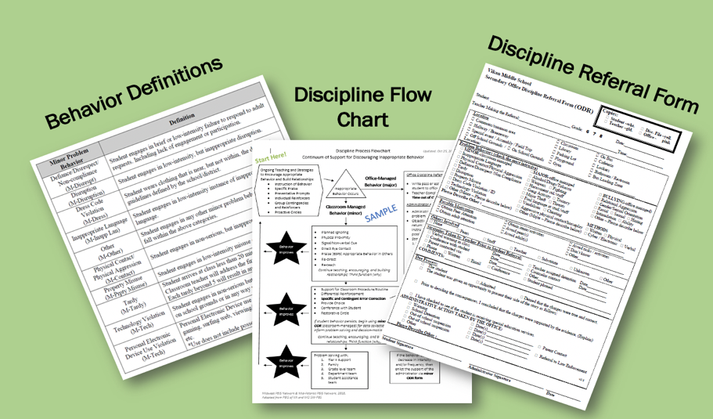
To begin work on this you and your team can review the following videos. We will go more in-depth with this topic in March and May
  https://sebacademy.edc.org/defining-behaviors-video
  https://sebacademy.edc.org/behavior-flow-chart-video
  https://sebacademy.edc.org/referral-form-video
Notes:
https://sebacademy.edc.org/defining-behaviors-video
https://sebacademy.edc.org/behavior-flow-chart-video
https://sebacademy.edc.org/referral-form-video

Slide 34
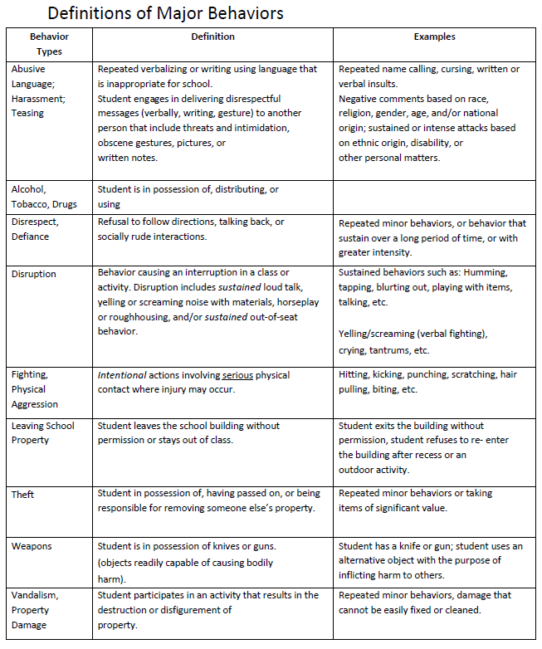
Definition
Sample

Slide 35
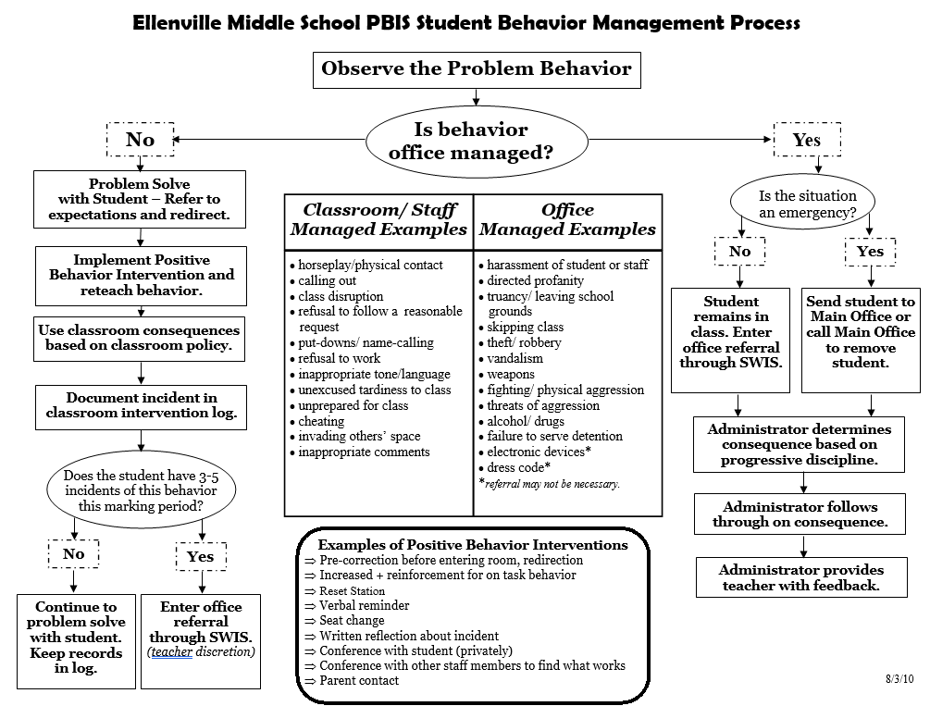
FLOW Chart
Sample
Notes:
Behavior Flow Chart Video: https://sebacademy.edc.org/behavior-flow-chart-video

Slide 36
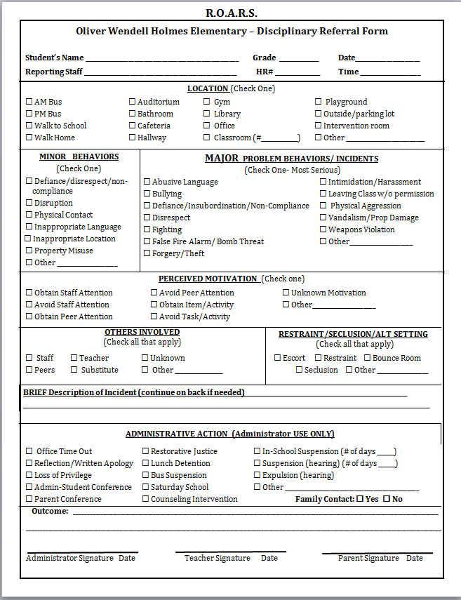
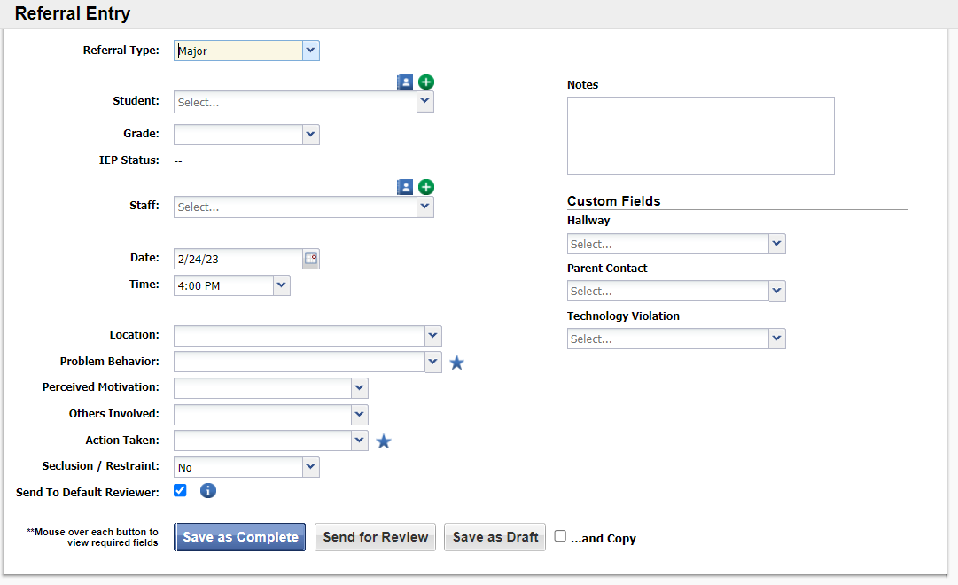
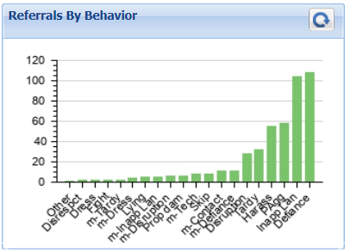
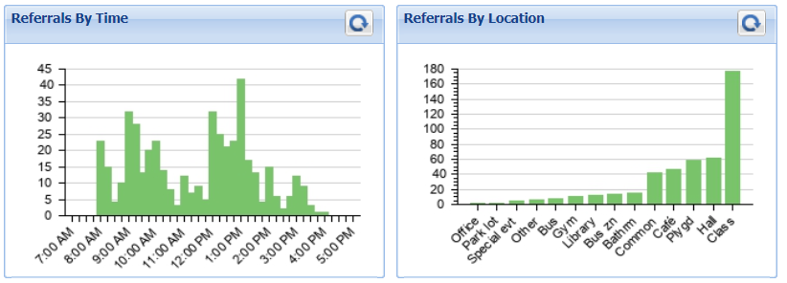
Discipline Referral Form – Tracking Discipline DATA
Notes:
Referral Form Video: https://sebacademy.edc.org/referral-form-video

Slide 37
DISCUSSION: LOOKING AHEAD
What further support do you need so you can support your team with this content?
What current questions do you have?
5 minutes
Whole Group
Notes:
Discussion Prompt:
What further support do you need so you can support your team with this content?
What current questions do you have?

Slide 38
AGENDA & FOLLOW-UP
Coaches’ Tasks:
Support your team with developing a schoolwide acknowledgement system
Presentation Content:
Schoolwide Acknowledgement Systems Check-in
Obtaining Feedback from Students, Staff, & Families
Action Plan for getting feedback from Students, Staff and Families
PREVIEW: Response System
What questions do you have on today’s content?
What questions do you have on the follow-up tasks?

Slide 39
HELPFUL RESOURCES
RESOURCES:
The Student/Teacher Game
High School Acknowledgement Systems
Feedback and Input Survey (FIS)
Overview of Feedback & Input Survey(FIS)
School Climate Survey Manual
How Schools are Using the student Climate Survey (national norms)
How Schools are Using the Parent and Staff Climate Survey (national norms)
Self-Assessment Survey for Staff
Response System Videos
Defining Behaviors
Behavior Flow Chart
Referral Forms
Notes:
The Student/Teacher Game: https://sebacademy.edc.org/studentteacher-game
High School Acknowledgement Systems: https://sebacademy.edc.org/high-school-acknowledgement-systems
Feedback and Input Survey - https://sebacademy.edc.org/pbis-feedback-input-survey-manual
Overview of Feedback and Input Survey - https://sebacademy.edc.org/overview-feedback-and-input-surveys
School Climate Survey - https://sebacademy.edc.org/pbis-climate-survey-manual
How Schools are Using the Climate Survey (national norms) - https://sebacademy.edc.org/how-are-schools-using-school-climate-surveys
How Schools are Using the Parent and Staff Climate Survey (national norms) - https://sebacademy.edc.org/how-are-schools-using-parent-and-personnel-school-climate-surveys
Self-Assessment Survey for Staff -https://sebacademy.edc.org/pbis-self-assessment-survey-sas
Defining Behaviors - https://sebacademy.edc.org/defining-behaviors-video
Behavior Flow Chart - https://sebacademy.edc.org/behavior-flow-chart-video
Referral Forms - https://sebacademy.edc.org/referral-form-video

Slide 40
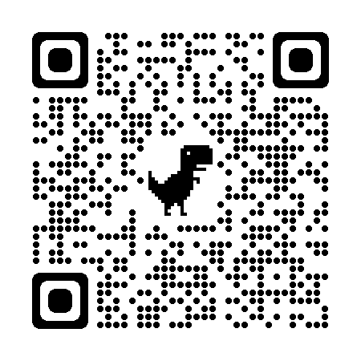
EVALUATION
Please remember to complete the evaluation!
Scan the QR code to access.
Notes:
TRAINERS -
Put link to evaluation (below) in the chat for those who do not use the QR code:
Evaluation Survey: https://edc.co1.qualtrics.com/jfe/form/SV_cBF9GI7gVEBsfSC

