Slide 1

PBIS Rollout
September 2021

Slide 2
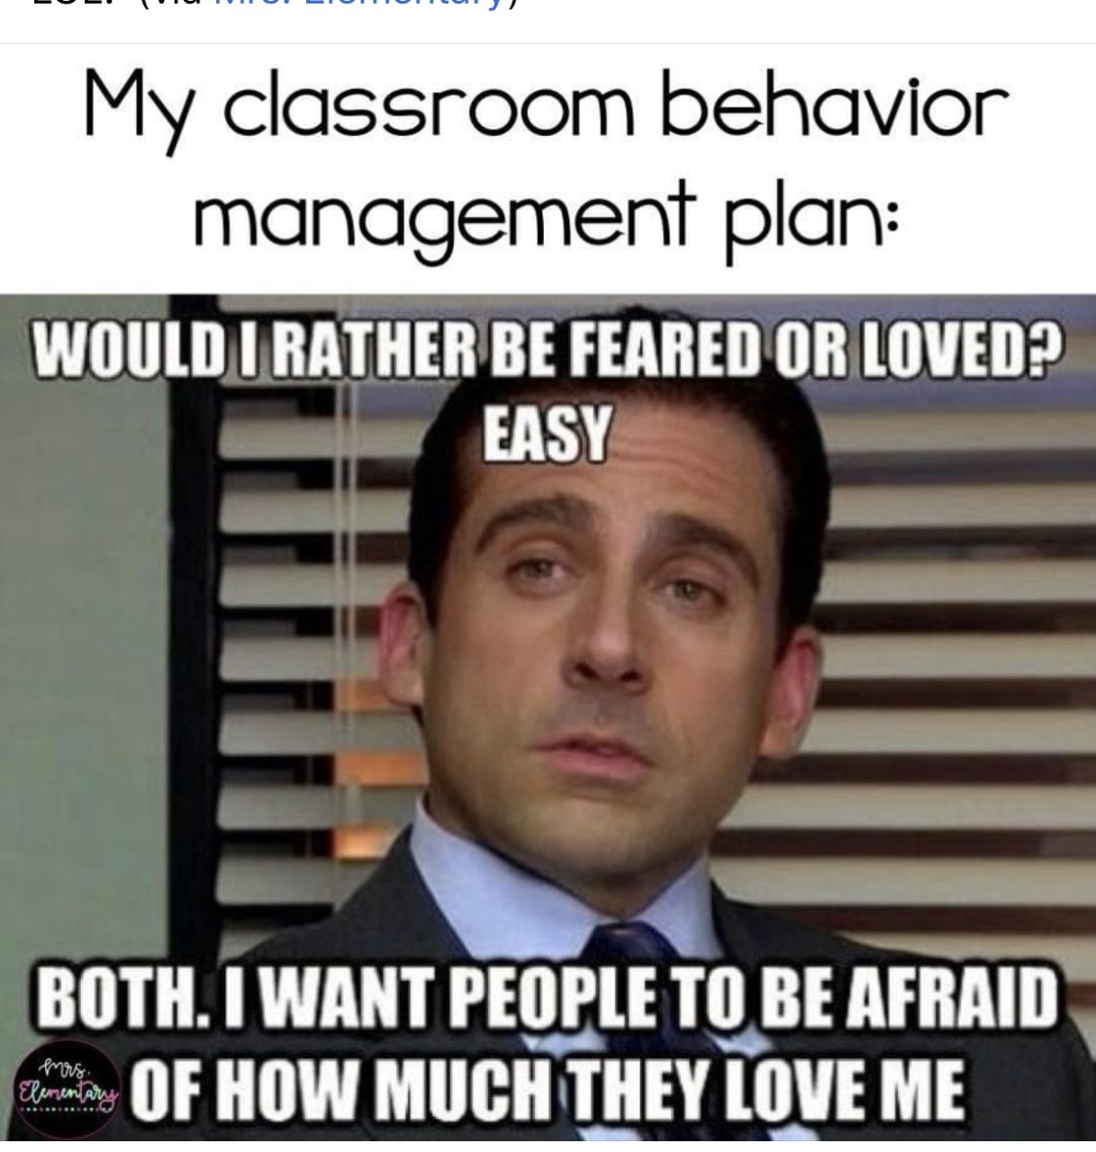
Welcome Back!

Slide 3

Objectives:
One will be able to:
define what PBIS stands for and what it is.
determine which Tier of the three we are presently engaged in.
differentiate why PBIS is a proactive not reactive approach.
identify each attribute of R.O.A.R and the behavioral expectations for different locations at South
comprehend the importance of common language within PBIS.
locate and embrace lesson plans for use within the first weeks
collaborate on grade level acknowledgement systems highlighting positive student behavior

Slide 4
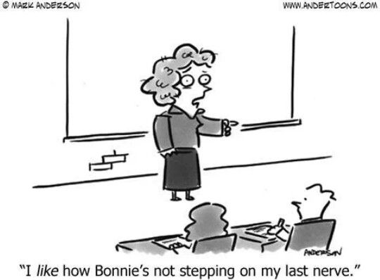
PBIS is a...
        Framework that is customizable yet focuses on school –wide expectations that support student outcomes and academic success.
        framework where much of it is focused on best practices as to what is important at SMS, therefore building relationships are vital. PBIS cannot be adequately implemented without student-staff positive relationships
        framework that is proactive, not reactive.
        framework that uses data to assess which students need additional or more intensive support.
        framework that focuses on the preferred behavior, rather than telling students what not to do.

Slide 5
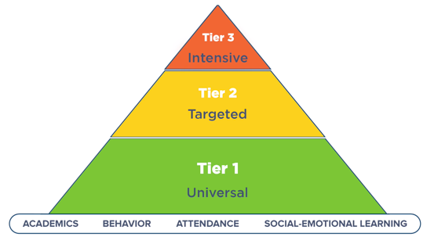
What is PBIS?
PBIS (Positive Behavioral Interventions and Supports) is a framework designed to support positive behaviors.
Positive or expected behaviors are taught explicitly and are reinforced by the entire school community.
PBIS offers 3 tiers of support:
Year 1: Schoolwide, Tier 1​ | Core values established, common language developed, expectations introduced, flow chart(s) and lesson plans devised ​
Year 2: Full roll-out, Tier 2​ | Reinforcement and continuous review of school plan, intervention plan, behavior plans, mentoring programs, etc.​
Year 3: Tier 3​ | Individualized intensive interventions (students at risk)​

Slide 6
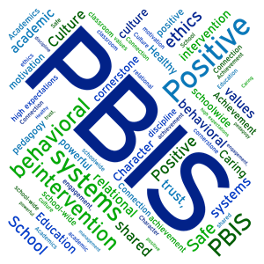
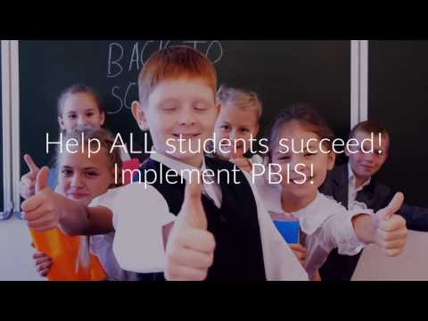
What is PBIS? A recap

Slide 7
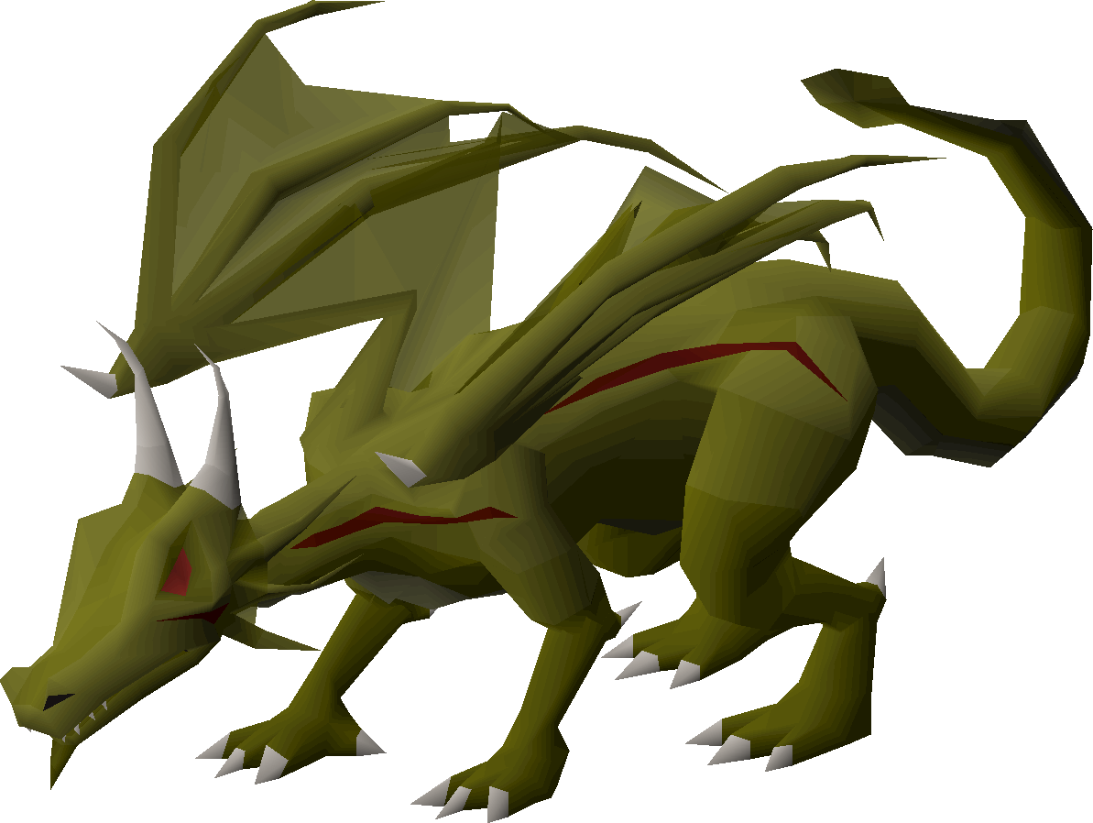
ROAR!!
Our Motto is ROAR!
Respect
Ownership
Attitude
Responsibility
This Photo by Unknown Author is licensed under CC BY-SA-NC

Slide 9
Let’s Use Common Language!
T&T
What examples of Common Language can you think of that you have used in your classroom?
What examples of Common Language can you think of that we have at South Middle School?
What examples of Clear Expectations can you think of that you have in your classroom?
What examples of Clear Expectations can you think of that we have at South Middle School?

Slide 10
How do we encourage appropriate behaviors by “catching” students engaged in expected behaviors?
What does this sound like when you “flip the script?”:
Pre-correction Prompt
“When we are participating in class, be sure to raise your hand and wait to be called on." | “Remember we need to be respectful of one another and raise our hand when we want to be heard."
“When I am discussing slides in the PowerPoint, use only thoughtful comments or questions like we had discussed and practiced earlier in the week.” | “Over this past week, this class has overwhelmingly shown such a positive attitude, especially in the way each of you has shown ownership of your appropriate comments and responses.”
“Before we break into separate groups for group work, if you need help – remember you can ask a peer in your group quietly for help using your level 2 voice, and if they don’t know the answer, raise your hand to ask me to clarify.” | “Remember it is your responsibility to be mindful(aware) of your voice level and ask for additional help if you are not understanding something.”

Slide 11

Student/Teacher Game

Slide 12

ROAR Phrases/Language
What are some ways/phrases we can use to emphasize being RESPECTFUL while other students are talking, sharing, asking questions, or struggling with technology?
What are some ways/phrases we can use to emphasize OWNERSHIP of our technology, time management, content, schedules, actions?
What are some ways/phrases we can use to emphasize our ATTITUDE towards our struggles with each other's struggles while in class, content, getting up and being ready for your educational day?
What are some ways/phrases we can use to emphasize RESPONSIBILITY of our technology, time management, asking for help, following through with deadlines, supporting each other, etc.?

Slide 13
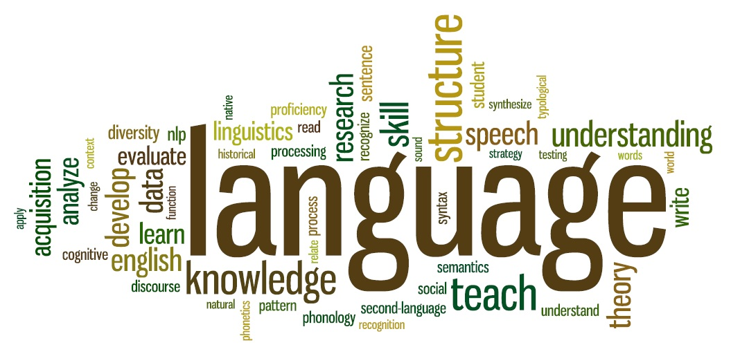
Clear Expectations- Let’s Use Common Language!
PBIS works best when we all use the same or common language and outline clear, consistent expectations for all our students
For example, “Stay in Your Personal Space” appears in our matrix. So, the more we all say it, the more familiar students become with the expectation!
This Photo by Unknown author is licensed under CC BY-SA-NC.

Slide 14
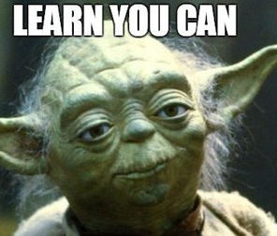
Teaching Explicitly - Lesson Plans
Students need be explicitly taught these expectations with fidelity. This is done through lesson plans, in the moment teaching, re-caps, mini lessons, and constant reminders/reinforcements.
PBIS expectations are taught by location. What does ROAR look like in the cafeteria, hallways, and bathrooms?
We will also teach ROAR (Respect, Ownership, Attitude, Responsibility) with a lesson plan for each. These plans are created for you.

Slide 15
Next Steps
Full implementation of PBIS takes years. We will be beginning Tier 2 implementation this year..
To reinforce positive or expected behaviors, it is imperative to have an acknowledgement system.
To discourage negative or unexpected behaviors, it is imperative to have fair, consistent consequences.

Slide 16
Acknowledgement Systems
What type of system did you use last year?
Will you make changes to your system this year?
If you are new, what ideas first popped into your head for creating an acknowledgement system in your own class?
Feel free to share ideas! Please discuss! T&T!

Slide 17
What is the DRAGON Acknowledgement System?
Each teacher may have implemented it differently, but most South teachers used his/her own
Dragon Acknowledgement System!
Individual Acknowledgement System
Whole Group Acknowledgement System
Individual:
Individual students may earn his/her own DRAGONS. They can be ‘rewarded’ when they earn a certain number of dragons, or maybe they earned the most at the end of a certain time period!
For example, at the end of each month, you can reward which individual student earned the most DRAGONS!
Whole Group:
Classes earned a certain number of DRAGONS when they made good choices as a whole group. They were ‘rewarded’ when they reached a certain number of dragons, or if they earned enough dragons at the end of a time period!
For example, at the end of each month, you can reward which class earned the most DRAGONS!

Slide 18
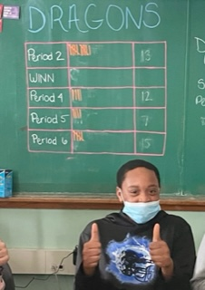
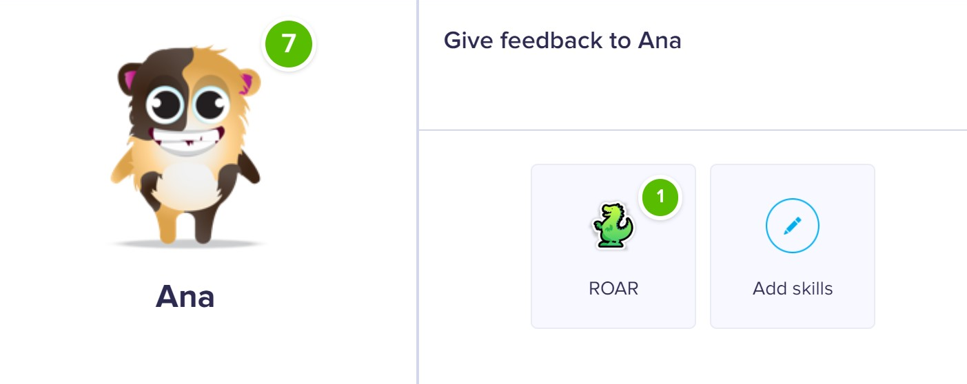
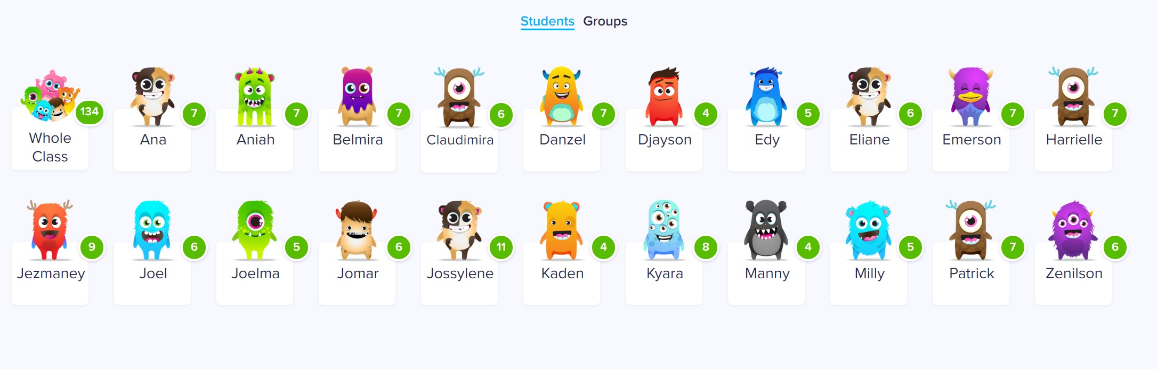
Examples of DRAGON Acknowledgement Systems
Class Dojo
Raffle Tickets
Individual Dragons
Stickers
Dragon Competition

Slide 19
Examples of Dragon Rewards/Incentives
Free Time
Breakfast/Lunch with Teacher
Game Day
Computer Time
Phone Minutes
Ice Cream Party
Please check this link out for more ideas!
https://www.pbisrewards.com/wp-content/uploads/acknowledging-students-remote-learning-expectations.pdf
Check out this link for more ideas!
https://www.pbisrewards.com/wp-content/uploads/acknowledging-students-remote-learning-expectations.pdf

Slide 20
Future Tasks
Teach ROAR values to grade 6
7 and 8 will already be familiar with ROAR, so lessons will be of a "review" format
Tier II Implementation will begin

Slide 21
Planning and Support
Please spend the rest of this PD time reviewing the Matrix, Lesson Plans, and other essential portions of PBIS.
In your Grade Level Meetings, you will:
  1. Discuss implementing PBIS in your classes
  2. Brainstorm acknowledgements for the grade level cluster
  Link to sample Lesson Plan: https://brocktonpublicschools.sharepoint.com/:w:/t/PBIS768/EQbGDp6LsNZElGS3wMGSN7wB53E4Y-d9CrYgqnRpon-4gg?e=E2R92Q
  *All lesson plans with be shared with you.
  *We will teach ROAR to our students in September, then again in the near future to ensure all students are present.

Slide 22
Wrap up slide with padlet?

