Slide 1
Revisiting Schoolwide Expectations
Safety-Respect-Responsibility-Achievement- Teamwork

Slide 2
Our Vision/Goal
We envision a climate & culture that fosters (encourages) safety, belonging, and high academic achievement.
Every student, everyday, will have experiences that make them feel that teachers and staff at Southbridge Middle School are here to support and help them be the best versions of themselves.
Teachers and staff will work together to create, implement (use), and sustain (keep it going) systems of student support that reach students across grades six through eight, regardless of their level of need.

Slide 3
Masks, Hygiene, & Cleaning

Slide 4
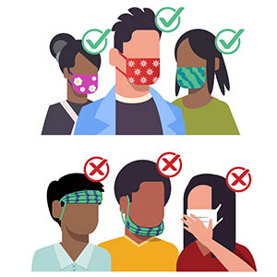
Masks 101
Wear a mask that covers your nose and mouth
If you touch your mask, please wash your hands or use hand sanitizer to disinfect​
Notes:
https://www.cdc.gov/coronavirus/2019-ncov/prevent-getting-sick/how-to-wear-cloth-face-coverings.html#:~:text=%E2%80%A2%20Wash%20your%20hands%20before,an%20exhalation%20valve%20or%20vent

Slide 5
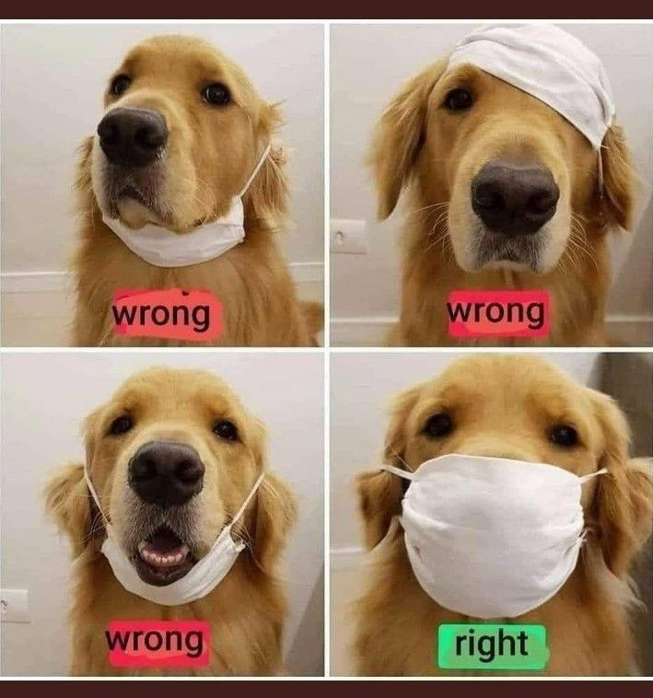
Make sure your mask always covers your nose and your mouth!

Slide 6
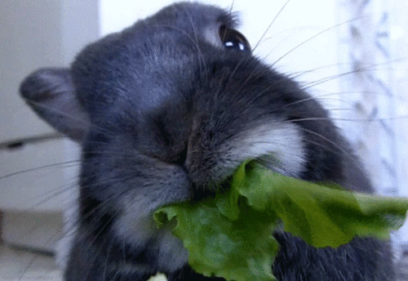
Masks should only be taken off during meals and during designated mask breaks.
Taking off your mask at other times will result in a consequence.

Slide 7
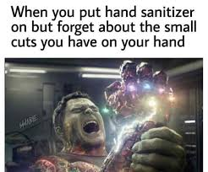
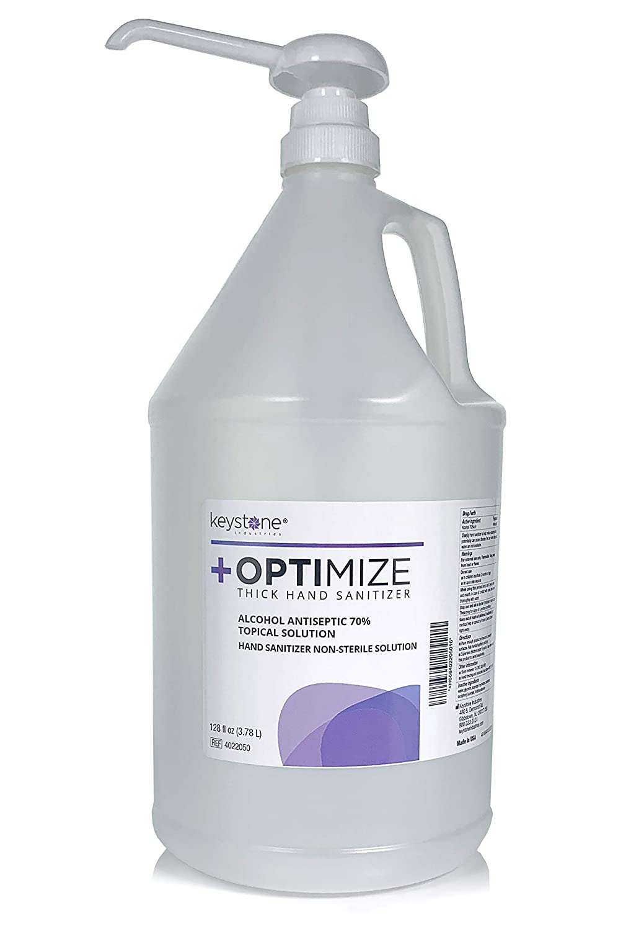
Entering/Exiting Class
Sanitize your hands with hand sanitizer when you walk into or out of a room.
Sanitize your desk with the materials given to you by your teacher. Dispose of your materials according to your teacher’s directions.

Slide 8
Sharing Items
To prevent the spread of Covid-19, students may not share items like pencils, computers, chargers, or food.
If you must borrow an item from a teacher, be sure that it is sanitized before and after you use it!

Slide 9
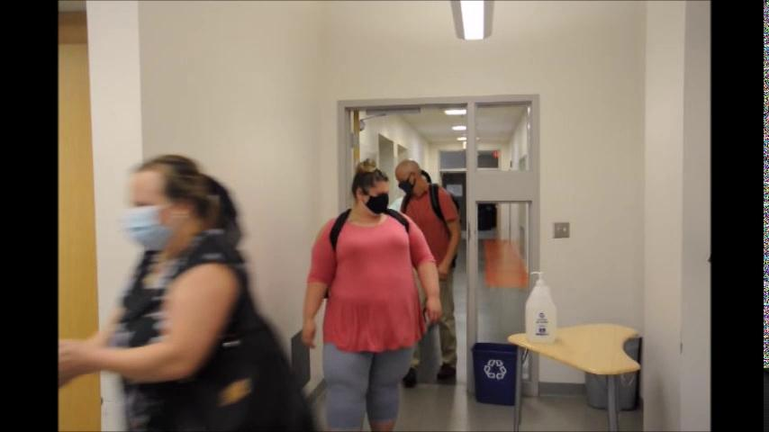

Slide 10
Bathrooms

Slide 11
Bathroom Matrix
Safe | Respectful | Responsible
Wash your hands Have a pass to use the restroom Use nearest restroom | Flush every time Mind the privacy of others Use kind and positive words and actions | Put trash in the trash can Be quick and return to class Keep walls, stalls, and floors clean and dry Keep cell phone off/put away

Slide 12
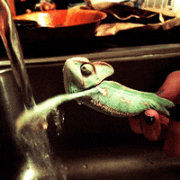
Bathroom Procedure
Get permission from your teacher
Fill out a pass and get it signed by your teacher
Follow the one-way signs and walk to the bathroom.
Check in with the bathroom monitor. .
Follow directions of the bathroom monitor.
Only one student in the bathroom at a time
If waiting, use 6-foot markings on floor and wait calmly in line
Use the bathroom.
Wash your hands for at least 20 seconds using soap.
Return to class following the one-way signs.
Don’t forget to wash your hands!

Slide 13
Breakfast & Lunch

Slide 14
Eating in Classrooms Matrix
Safe | Respectful | Responsible
Dispose of food in a trash container. Follow all safety and cleaning rules. Keep your hands to yourself. | Be kind to all staff involved in lunch procedures. Listen to teachers and staff and follow their direction. Stay at your desk. | At the end of lunch, be sure that your space is ready for class. Follow mask rules.

Slide 15
Notes about eating in classrooms
Clean your desk before you eat and after you eat.
Sanitize your hands before and after eating.
Phones can be out as long as you are following the phone rules and put them away when breakfast/lunch has ended.
If you need to get up, your mask must be on.
Throw out all trash.
Follow the directions of staff during meals.

Slide 16
Hallways & Transitions

Slide 17
Hallway Matrix
Safe | Respectful | Responsible
Keep all body parts to yourself. Walk to the right in hallways and stairways. Walk at all times. Keep all materials and objects to yourself. | Appropriately greet and listen to staff. Use inside voices. Keep hallways clean. Respect others’ learning in classrooms. | Keep personal items, including food, in your locker. Have a pass and show politely when asked. Walk to your destination. Own your behavior. Tell adults about any safety concerns.

Slide 18
Additional Hallway Expectations
6 feet distance between all individuals. Use markings on the floor to help you gauge 6 feet.
Teachers will be monitoring hallways or escorting groups during transitions. Be sure to listen and follow directions for safety!
Masks must be worn
One-way hallway at all times. Use signs on the walls to be sure you are moving in the correct direction.

Slide 19
Important Transition Reminders
Students MUST remain at their seats until they are picked up by a teacher to go to their next class. This is a SAFETY issue to prevent the spread of Covid-19.

Slide 20
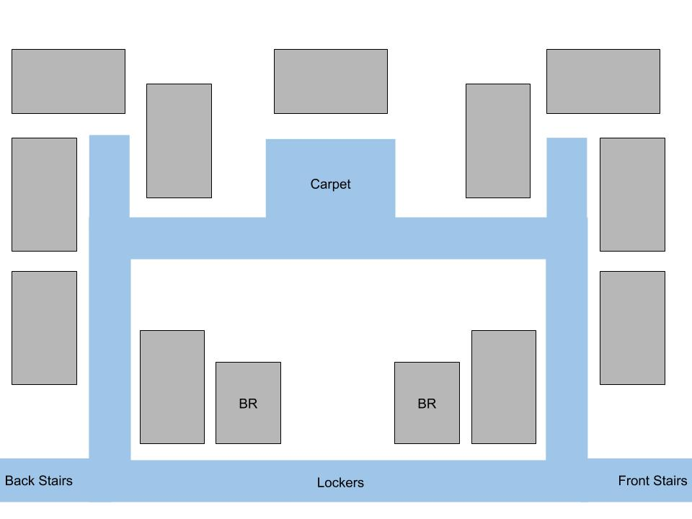
6th Grade Notes
LaRochelle
Lyon
Union
You will be picked up by a teacher and escorted to classes using the one-way halls. This is for SAFETY from fewer students in the hall!
The red arrows show the direction we will walk in the halls.
6th grade will be using the FRONT STAIRS
Sanchez
Lombardi
Murray
Teczar
Hebert
Hanlan
Scott

Slide 21
7th Grade Notes
Clark
Buccini
Davis
You will be picked up by a teacher and escorted to classes using the one-way halls. This is for SAFETY from fewer students in the hall!
The red arrows show the direction we will walk in the halls.
7th grade will be using the BACK STAIRS
Mero
March
Towns
McIver
Murphy
McGarry

Slide 22
8th Grade Notes
Batista
Yoder
Pierce
You will be picked up by a teacher and escorted to classes using the one-way halls. This is for SAFETY from fewer students in the hall!
The red arrows show the direction we will walk in the halls.
McDonald
Khoda
Dyer
Fournier
SSC
Hatch
McEachern
Gutiérrez

Slide 23
Lockdowns & Fire Drills

Slide 24
Lockdown/Fire Drill Matrix
Safe | Respectful | Responsible
Walk calmly Keep hands, body, and objects to self Remain with your group/teacher Remain silent | Listen to and follow staff directions Pay attention and respond during attendance Keep cell phone | Remain socially distant if possible Remain silent

Slide 25
Lockdown Procedure
When a lockdown is called, you should go into the corner of the room away from the door and the windows.
Your teacher will be locking the door, turning off the lights and projector, closing the curtains, and directing you to the appropriate spot in the classroom.
All students and staff should be SILENT until the lockdown is over.
Cell phones should be put away.
If you are in the hallway when a lockdown is called, go into the closest classroom.
Notes:
Teachers - if a lockdown is called, you should STOP teaching and direct students to the nearest part of your classroom that CANNOT be seen from the door/windows. If you have any windows, the blinds should be closed. You should also lock your door (pull the magnetic strip off your door). All technologies should be off as well (this includes student chromebooks and the projector). If there are any students out in the hall near your room, have them come into your room. Staff and students should remain silent until the lockdown is lifted when an announcement comes over the loudspeaker. Once the lockdown has been lifted, you may begin teaching again.

Slide 26
Fire Drill Procedure
Calmly walk to the nearest exit and exit the building.
Once outside, students and staff will line up with a 6 foot distance between all individuals.
Your teacher will take attendance for the class. Be sure to pay attention and respond when your name is called.
If you are in the bathroom, exit the building and check in with a teacher. If there is a bathroom duty teacher, exit the building with them.
If you are in a staff office (the nurse, SAC, or SSC), go with that staff member.
As much as possible maintain a 6 foot distance between you and others.
Notes:
Teachers - When you are presenting, please let students know how to exit the building from the room that you are in. You should have a clipboard with the red and green signs and attendance lists for ALL classes somewhere where you can easily grab it. Escort students outside (making sure to turn off the lights, pull the magnetic strip/lock your door, and close all windows as you exit the room). Once outside, take attendance. If you are missing any students or have extra students, hold up the red sign. If you have all students, hold up the green sign. As we wait for the call to go back into the building, monitior students, making sure that cell phones are away, students are being socially distant, and are not talking.

Slide 27
7th Grade
Lines Here
8th Grade
Lines Here
6th Grade Lines Here
Back of School Building

Slide 28
Code of Conduct/Consequence Ladder

Slide 29
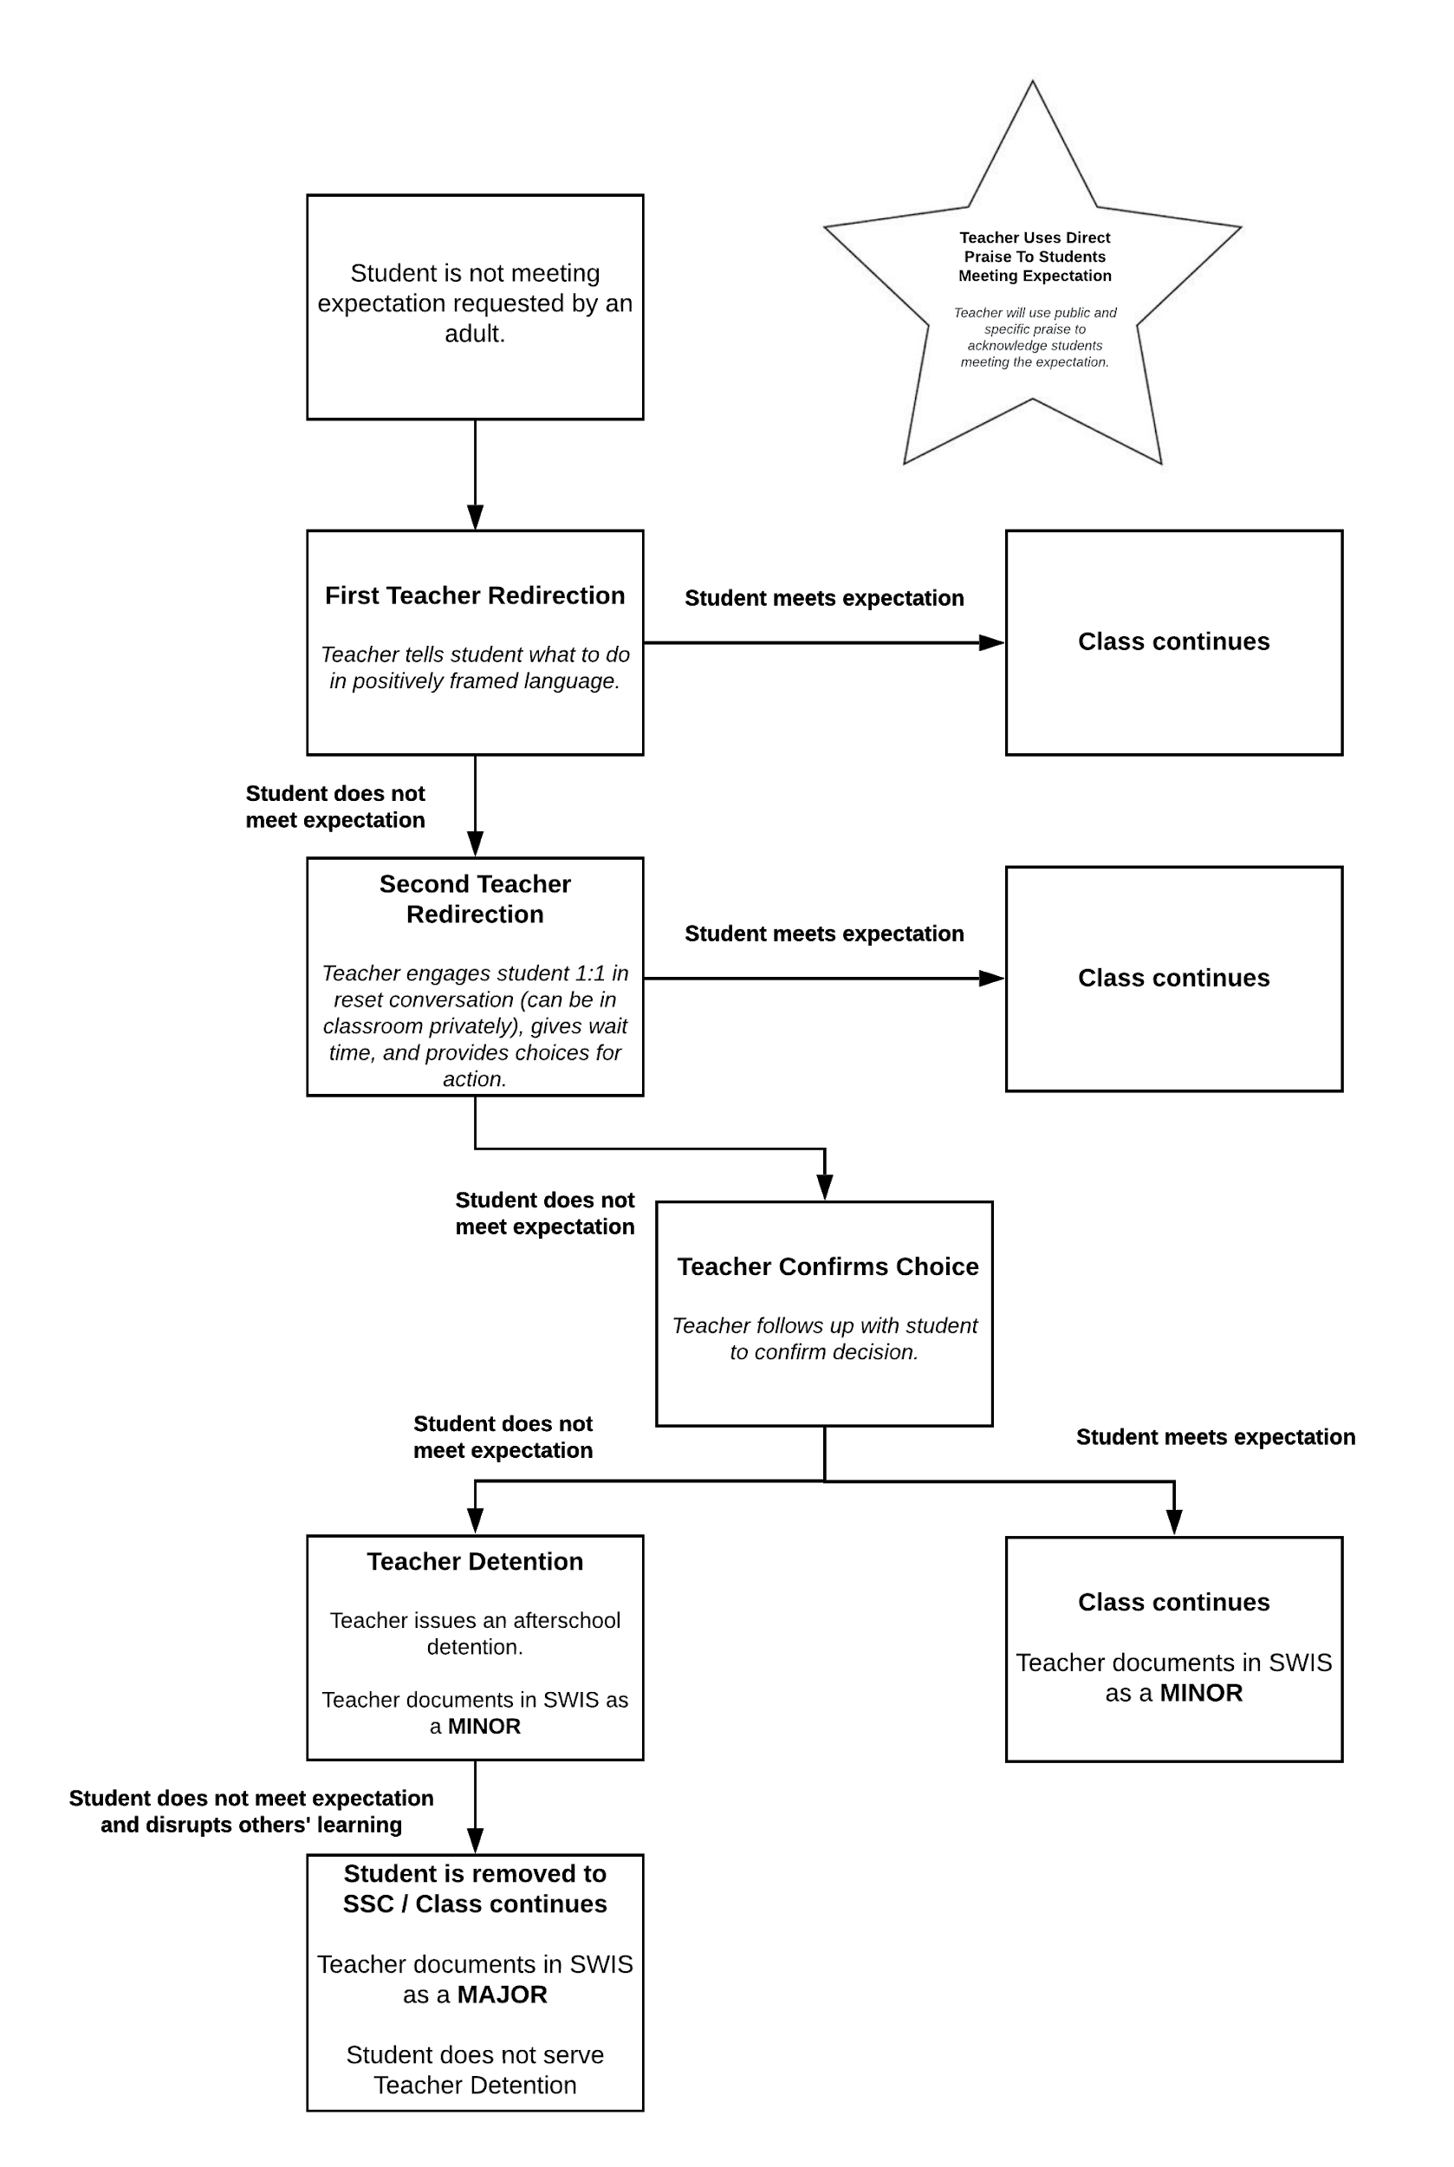
The Non-Compliance
Flowchart
These are the steps that teachers and staff will take when students are making a poor choice.
This is the whole picture, but we will zoom in to the sections.

Slide 31
Teacher Consequence
Teacher issues a consequence (ie: call home)
Teacher documents in SWIS as a MINOR
Notes:
7th and 8th grade can point out that we aren’t using “are you refusing?” this year but we are going to ask the student if they are consciously making the choice to continue with their behavior.

Slide 32
Teacher Consequence
Teacher issues a consequence (ie: call home)
Teacher documents in SWIS as a MINOR

Slide 33
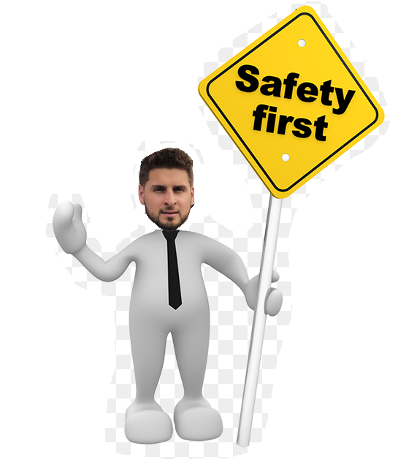
Heads Up!
That flowchart will be followed for choices that do not present immediate danger to yourself or others.
If a student is being incredibly unsafe or threatening, that will be handled by SSC or admin more quickly to prevent injury.

Slide 34
Time to Practice!
Teachers - it’s time to be a student!
Students - it’s time to be a teacher!
Notes:
Teachers - please choose a student or two to model a teacher. Teachers, then please model what NOT to do with a cell phone while having the selected student model what the teacher should do.

Slide 35
Support Staff Offices

Slide 36
Support Staff Offices Matrix
Safe | Respectful | Responsible
Be in the location/office you have a pass for. Return to class directly once visit is complete. | Acknowledge and listen to the staff member in charge of space. Sit in appropriate seating and wait until it is your turn. | Plan ahead and make an appointment with a staff member (if possible). Be prepared to advocate for your needs. Be sure to have an appropriate reason for visiting the office.

Slide 37
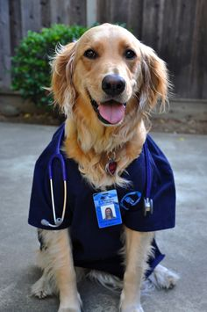
Notes about Support Staff Offices
Always get a pass from your teacher first.
Go directly to the office and return to class when you’re done.
Be patient if you have to wait to go to the staff office.

Slide 38
Arrival, Dismissal & Bus Procedures

Slide 39
What are the expectations for how we arrive at school?
Notes:
If you feel comfortable, you could do a Jamboard here for the students.

Slide 40
Arrival Procedures
Wait in your seat calmly on your bus until it is unloaded by a staff member. It may take a few minutes, so please be patient. (It’s to avoid crowding and to be safe!)
Walk directly to the Middle School doors.
If you forgot a mask, get one in the foyer just inside the doors.
Walk directly to your homeroom with your belongings.
6th grade: Use the middle staircase, then follow one-direction hallways.
7th grade: Use the back staircase, then follow one-direction hallways.
8th grade: Take first right into 8th grade pod and follow one-direction hallways.

Slide 41
What are the expectations for how we leave school?
Notes:
If you feel comfortable, you could do a Jamboard here for the students.

Slide 42
Dismissal Procedures
Students will be called by bus from their Period 5 class.
The bus numbers will be announced over the loudspeaker, so it is important that everyone is able to hear the announcements. Please be respectful and allow ALL students to hear the bus numbers as they are called.
When your bus number is called, your teacher will check the bus list and make sure that you are on the correct bus. Switching buses will not be allowed.
You will leave the classroom and walk to your appropriate bus.
8th - go out main hallway
7th - go down the backstairs and go down main hallway
6th - go down the middle stairs
Be sure to follow all social distancing guidelines by keeping 6 feet apart and wearing your mask.

Slide 43
Bus Matrix
Safe | Respectful | Responsible
Keep personal items, including food, in your bag. Keep your bus clean. | Acknowledge and listen to the bus driver. Keep conversations quiet enough to hear the person next to you. Use kind and positive words and actions. | Stay seated until your stop. Keep all body parts to yourself.

