Slide 1
Welcome tO THE Tier 2 COACHES’ MEETing!
GETTING STARTED:
Update your display name in Zoom to read: [Your School], [Your Name] (e.g., Eastside HS, Joe Clark)
Complete the Attendance Survey
Bookmark link to find training resources at : SEB PBIS Tier 2 Academy
Google drive
In the chat, please share with me links to your 2023-2024 TIER 2 TEAM FOLDER (if new)
~15%
Notes:
LINKS for today:
Attendance Survey
Evaluation Survey
EDC Website for SEB Academy
https://sebacademy.edc.org/
Google link to folder:
PBIS (SEB) Academy Tier 2 Year 2 2023-2024 - Google drive

Slide 2
PBIS Coaching Meeting TIER 2, Year 2 November 2023
Marcie Handler
with support from EDC, NEPBIS Network, May Institute & Broad Reach Consulting
Notes:
Add trainer names for your event

Slide 3
ACKNOWLEDGEMENTS
PBIS.org
Northeast PBIS Network (nepbis.org)
Michigan Integrated Behavior & Learning Support Initiative
FLPBIS
Missouri PBIS
Midwest PBIS Network
Drs. Leanne Hawken, Deanne Crone, & Rob Horner
CASEL

Slide 4
Expect to Connect!

Slide 5
EXPECTATIONS
Self
Others
Environment
Self-monitor
Mute when listening, unmute to talk​
Have electronics ready to use
Obtain help from peers and trainers
Work as a team:
Keep necessary materials at hand
Are you participating?
Engaged as a learner?
Stretch, break, stand as needed​
Room for every voice
Reinforce participation
action plan
relevant docs
water/snacks
Minimize distractions if possible​
Complete tasks efficiently
Share examples, celebrations and barriers
Communicating your needs?
Notes:
Taking CARE of…

Slide 6
LEGEND
Timing
Example
Activity
Non-example
Guidelines
Preview
Big Idea
Review
Organization

Slide 7
PBIS MEETING DATES – for us!
Coaching Meetings / Peer Share Calls (9-11am)*
Thursday, October 5, 2023
Thursday, November 2, 2023
Tuesday, December 5, 2023
Thursday, January 4, 2024
Thursday, February 1, 2024
Tuesday, March 5, 2024
Thursday, April 4, 2024 – considering 4/2 or 4/11
Thursday, June 6, 2024
* Meetings may end at 10:30am to provide additional opportunities for school specific technical assistance.
TA
Fall Connection
Winter Connection
Spring Connection
* Individual meetings will be scheduled in April/May for Tier 2 TFI self-assessments.

Slide 8
SEB Academy Updates
Website https://sebacademy.edc.org
SEB ACADEMY Overview & Calendar
Webinar 10/17 - Screening and Surveys
November PSC series on Tier 2 – 11/9, 11/14, 11/30
(review for you, but consider as an “overview” for new team members)
Webinar 11/16, 3-4:30pm: MTSS through an Equity Lens
Webinar 12/12, 9:30-11: High Leverage Classroom Practices
Notes:
TRAINER NOTE: Please share the website address https://sebacademy.edc.org

Slide 9
NEW RESOURCES
RESOURCES:
https://sebacademy.edc.org/list-of-pbis-resources
Needs Assessment and Planning Process

Slide 10
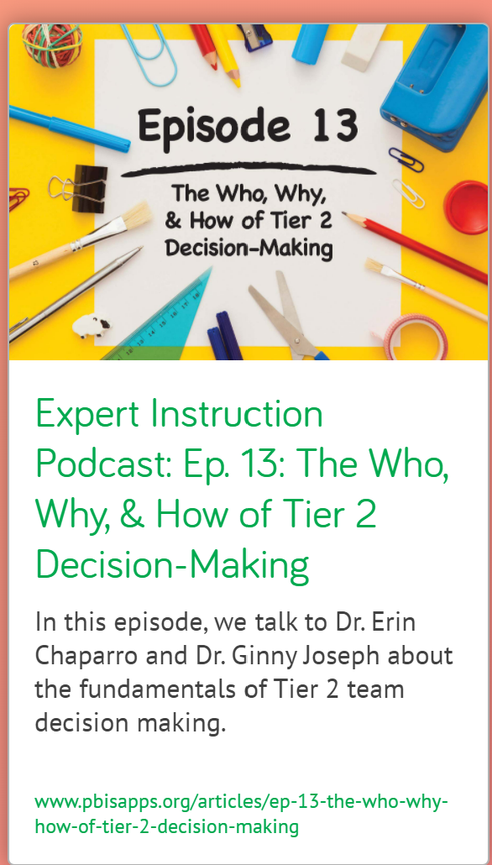
HELPFUL RESOURCES
RESOURCES:
Expert Instruction Podcast: The Who Why How of Tier 2 Decision Making
The October Catch: The Future is Now for Students who Need More Support
Multi-tiered system of supports in the classroom (see Tier 2)
Video example of a TIPS Tier 2/3 Meeting
Notes:
Update

Slide 11
Agenda & Coaches' Tasks
Coaches’ Tasks:
As you update… Share documents or folder with access to:
Presentation Content:
Glows and Grows: Goal setting and Foundation Steps
BIG IDEAS: From Installing to Full Implementation
IDENTIFYING: Nomination Form, Decision Rules, Universal Screening overview
MATCHING: Targeted Intervention Organizer
SYSTEMS: Action plan doc – goals, annual action planning doc
Resources: Measuring Fidelity of Tier 2 Systems and Practices

Slide 12
Resources: Measuring Fidelity of Tier 2 Systems and Practices
Notes:
Measuring Fidelity of Tier 2 Systems and Practices
https://assets-global.website-files.com/5d3725188825e071f1670246/641c7addc35f27e4ccbd4452_Measuring%20Fidelity%20of%20Core%20Features%20of%20Tier%202%20Systems%20and%20Practices%20in%20Schools%20(1).pdf

Slide 13
TEAM FOUNDATION QUICK CHECK
Which features are in place?
What barriers have you encountered?
How can they be navigated/changed?
Representative Team
(admin, behavior specialist, coordinators, T1)
Effective and efficient action plan
Family/Student Feedback
Communication routines (Across teams? Regarding referred students? Students receiving supports?)
Scheduled meetings with agendas and roles
Identified goals

Slide 14
TEAM STRUCTURES
Review team membership; if needed, invite new team members to make it representative
Start a 2023-2024 action planning document or revisit the one from last year
Discuss GOALS for the year (guided by self-assessments like TFI, needs assessment, CICO tool).
Establish a regular (monthly) team meeting schedule
https://sebacademy.edc.org/list-of-pbis-resources
Have you completed and shared this doc?
Notes:
Find action plan templates, team membership and meeting schedule tool under “pbis resources” on the website
https://sebacademy.edc.org/list-of-pbis-resources
https://sebacademy.edc.org/tier-2-team-profile-and-meeting-schedule

Slide 15
3-Tiered System of Support
Necessary Conversations (Teams)
Universal
Team
Targeted Systems Team
Problem Solving Team
Tertiary Systems Team
Plans SW & class-wide supports
Uses process data; determines overall intervention effectiveness
Standing team; uses FBA/BIP process for one youth at a time
Uses Process data; determines overall intervention effectiveness
WORKING SMARTER
ACTIVITY
How do your teams work together to support students and staff?
How does the Tier 2 Team ‘fit’ with other teams?
Notes:
15
15
If you’re in a smaller school, you may want to use an existing team as your Tier 2 team.
Your Tier 2 team could be the same or a subset of your Tier 1 team.
Tier 2 teams are often smaller than Tier 1 teams (4-6 members). Dedicate one meeting per month to Tier 2 systems.
Or Tier 2 team could be your existing problem solving team.
Or you may want a separate team to oversee the development and implementation of Tier 2 interventions and systems and have a separate Tier 2 team, especially if you are in a large school with a variety of Tier 2 interventions to coordinate and monitor.

Slide 16
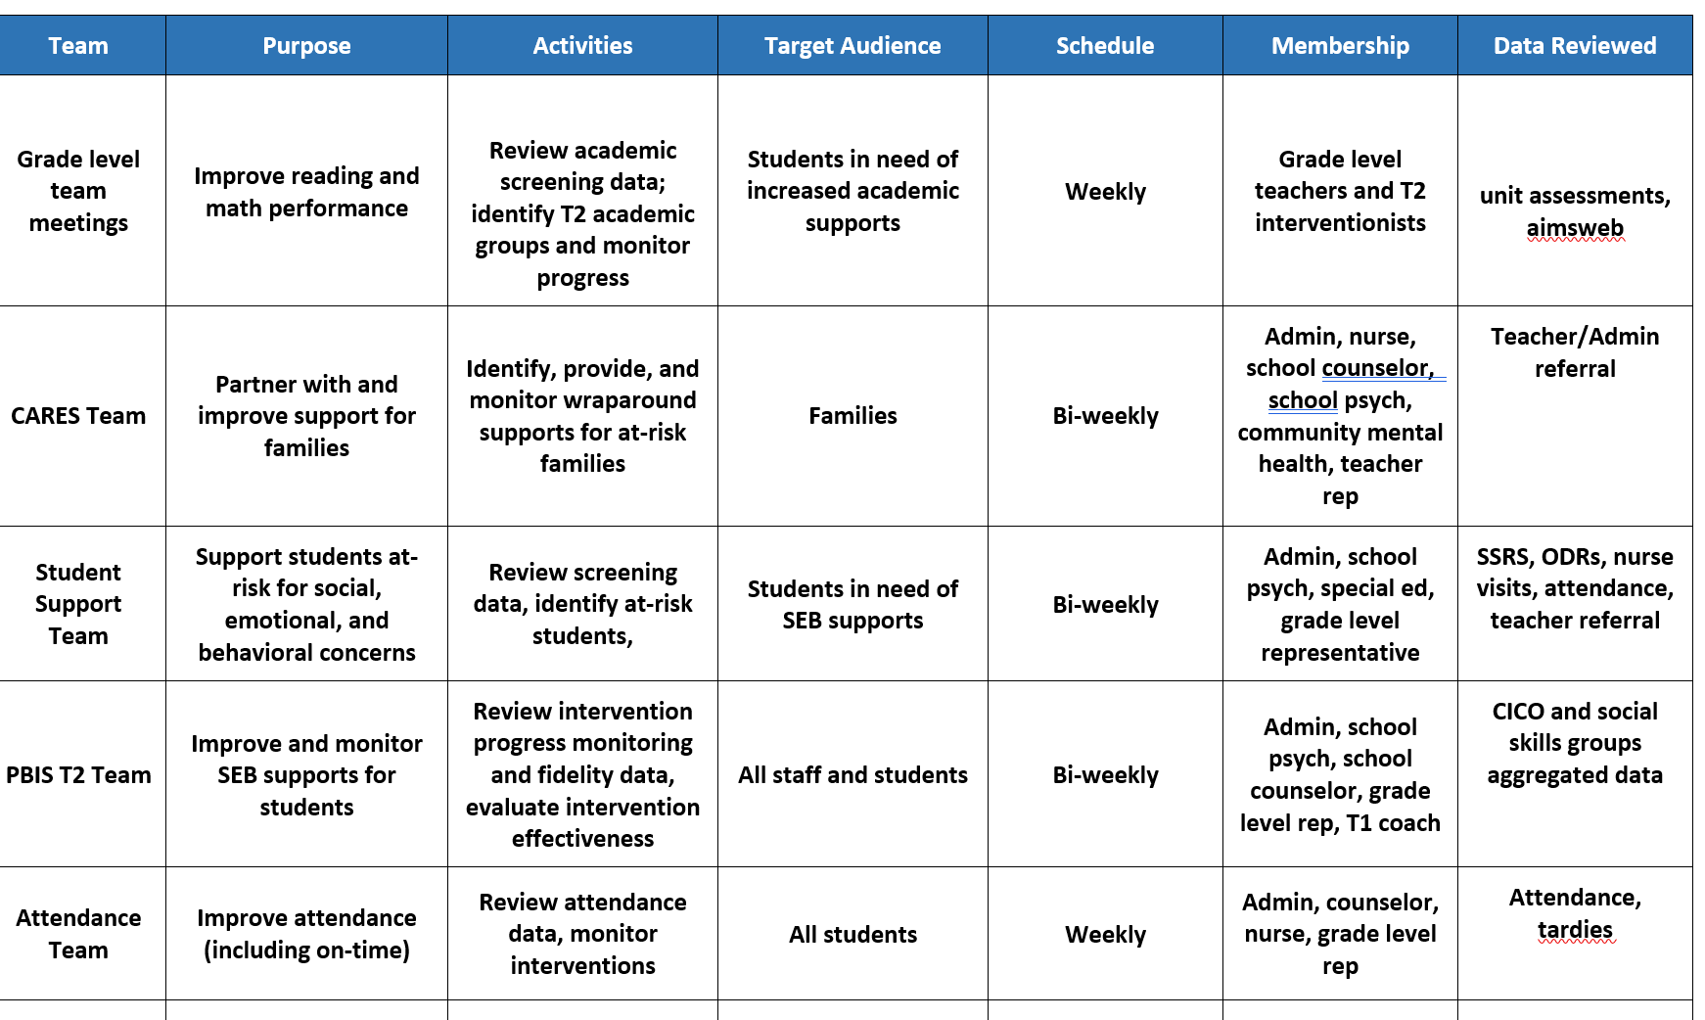
Working Smarter at Tier 2

Slide 17
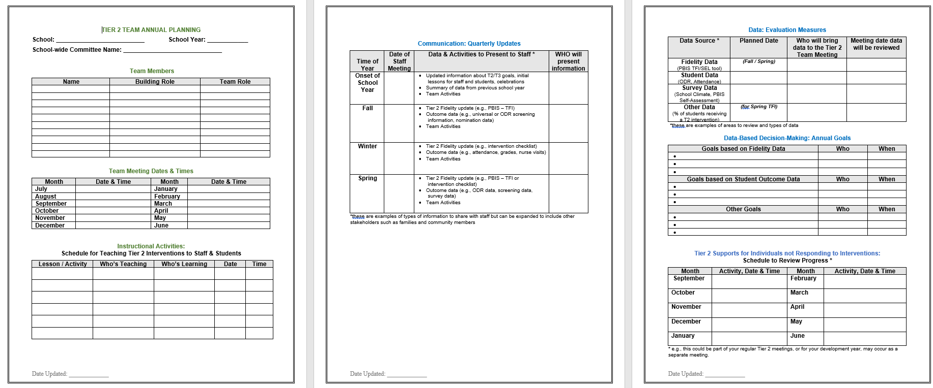
BUILD SYSTEMS: TIER 2 ANNUAL PLANNING
Acknowledgment Plans
Evaluation Measures
Team
Info
Annual Goals
Teaching T2 Routines
Communication
Tier 2 Student Follow Up
Notes:
This Action plan is more advanced and is intended for schools in years 2 and beyond. Review with the team.
https://sebacademy.edc.org/annual-action-plan-template-advanced
TIER 1 ANNUAL TEMPLATE
https://docs.google.com/document/d/1Pbgwf6u4tXLXPFK_4wvMpFGFKmGMKDhC/edit?usp=drive_link&ouid=113908941090752513118&rtpof=true&sd=true

Slide 18
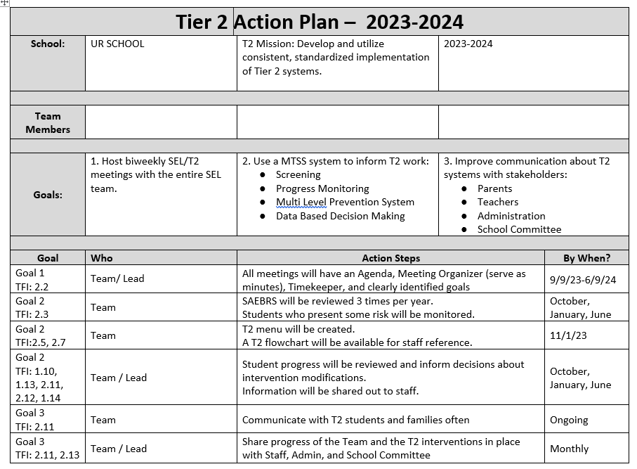
Sample Action Plan

Slide 19
ACTIVITY: IDENTIFY TEAM GOALS
Last month you were using your TFI Spring assessment (and possibly the SEB Needs Assessment) to IDENTIFY TEAM GOALS
Today…SHARE
TIER 2 YR 2 PBIS Coaches share 2023-2024
5 minutes
5 minutes
Independent Jot
Independent Review
Notes:
Virtual “gallery walk” – add to the shared google doc and review what others indicate are team goals.

Slide 20
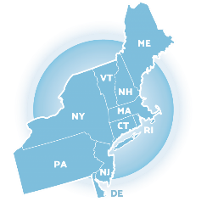
Glows & Grows: Tier 2 Foundational Systems to support Implementation

Slide 21
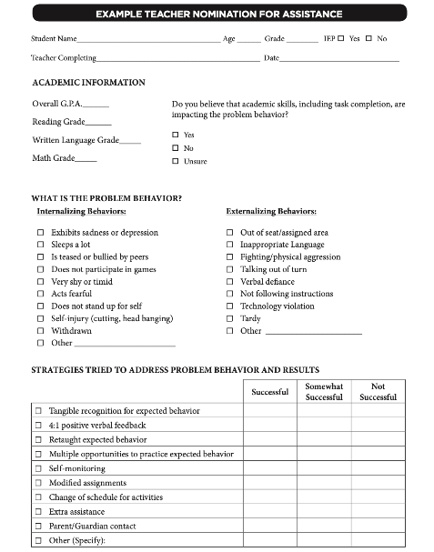
Methods for Identification
Gather information for the November meeting
Nomination
Data Decision Rules
Screening
Do we have something simple?
What are some of our data sources?
Is the school using a universal screener?
Notes:
Initial step:
Have you rolled out the nomination form?
Identified data sources?
Advanced steps:
Are the decision rules clear for various data sources? When do you review that data?
Can you provide a one page overview for staff and families about the universal screener?
Additional Resources to guide your team discussion:
https://sebacademy.edc.org/identification-matching-and-monitoring-process

Slide 22
ACTIVITY & DISCUSSION: GLOWS & GROWS
What is something to celebrate & something you’re working on related to:
Tier 2 organizational systems
Consider:
Teaming
Data systems
PD / roll out to staff, students, and families
Add to our shared doc
5 minutes
15 minutes
Independent Jot
Whole Group
Notes:
https://docs.google.com/presentation/d/1cs8kepbXc1DDpL8440wTcwUHu0BRGgBxgPKTZPhIauI/edit?usp=drive_link

Slide 23
NOVEMBER: REVIEW METHODS TO IDENTIFY STUDENTS
Share examples of your school’s Nomination / request for assistance form (RFA) (3 examples)
Share examples of your school’s Data decision Guidelines
Share example of your school’s Screening process (if applicable)
DISCUSS: Common themes, barriers to implementation
https://sebacademy.edc.org/list-of-pbis-resources
Questions?
Notes:
Last month we shared examples from BCS
Who else will share this month?

Slide 24
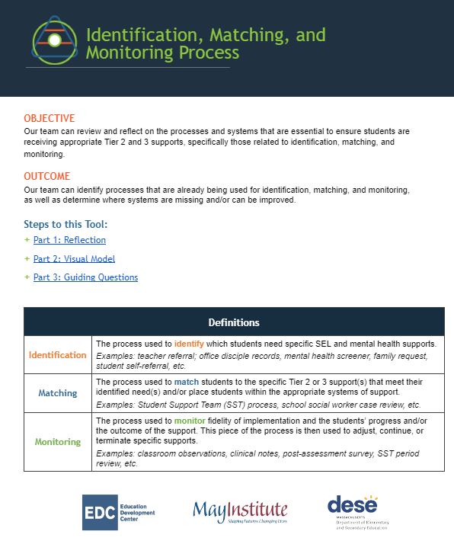
ADDITIONAL RESOURCES
https://sebacademy.edc.org/identification-matching-and-monitoring-process
Guidance for Systematic Screening: Lessons Learned from Practitioners
Selecting a Universal Behavior Screening Tool: Questions to Consider
Notes:
RESOURCES
Identification, Matching, and Monitoring Process
https://sebacademy.edc.org/identification-matching-and-monitoring-process
or
https://docs.google.com/document/d/1iF5paaTaJdyiW5KCVNdsKTdzJF1rvPobXyBc-K7LGu4/edit?usp=drive_link

Slide 25
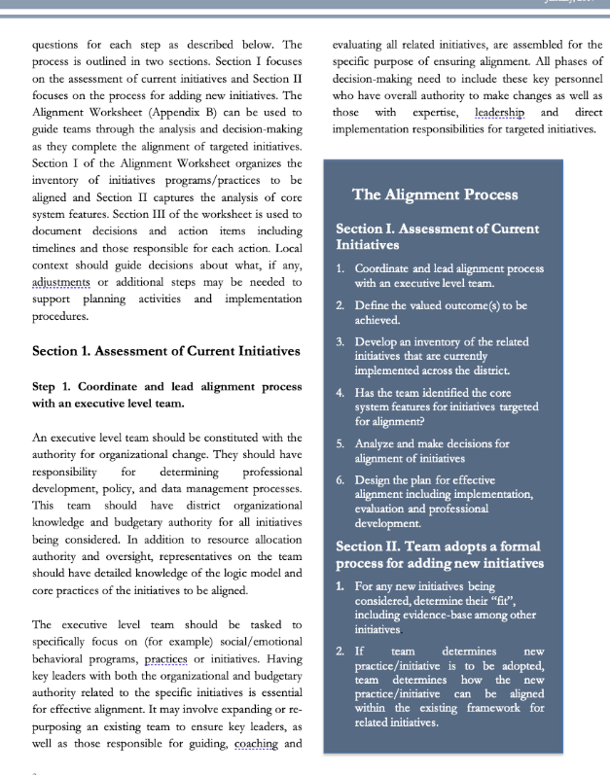
ADDITIONAL RESOURCES
RESOURCES:
Guidance for Systematic Screening: Lessons Learned from Practitioners
Selecting a Universal Behavior Screening Tool: Questions to Consider
Notes:
RESOURCES
- Team meeting profile & meeting schedule: https://nepbis.org/wp-content/uploads/2021/08/Team-Profile-and-Meeting-Schedule-Document-1.docx
- Team meeting foundations checklist: https://nepbis.org/wp-content/uploads/2020/09/Conducting-Leadership-Meetings-Worksheet.docx
- Alignment Checklist: https://nepbis.org/wp-content/uploads/2021/09/MA-Academy-Integration-and-Alignment-Activity.docx
READINGS:
- Technical Guide for Aligning Programs: https://www.pbis.org/resource/technical-guide-for-alignment-of-initiatives-programs-and-practices-in-school-districts
- Integration & Aligning Family Engagement in PBIS: https://www.pbis.org/resource/aligning-and-integrating-family-engagement-in-pbis
- PBIS & SEL as Essential Life Skills: https://www.pbis.org/video/social-emotional-learning-cultivating-essential-life-skills

Slide 26
Resources: Measuring Fidelity of Tier 2 Systems and Practices
Notes:
Measuring Fidelity of Tier 2 Systems and Practices
https://assets-global.website-files.com/5d3725188825e071f1670246/641c7addc35f27e4ccbd4452_Measuring%20Fidelity%20of%20Core%20Features%20of%20Tier%202%20Systems%20and%20Practices%20in%20Schools%20(1).pdf

Slide 27
BREAKOUT ROOM ACTIVITY
Divide into 2 groups
ALL READ: Page 3 first column “Importance of Tier 2 PBIS”
GROUP 1 read: page 3-5 “Core Features of Tier 2 Organizational Systems
READ: page 5-6 Core Features of Tier 2 Practices
In each group… DISCUSS 2-3 of the 7 features;
What has your team has put in place related to that feature?
Read ahead… measuring fidelity of the INTERVENTIONS.
Thoughts?
Barriers?
15 minutes
Notes:
What is in place? What needs to be developed? What needs to be improved?

Slide 28
Big Ideas Check In: Match to Intervention

Slide 29
Tier 2 FOUNDATION STEPS
Develop an equitable process for matching student need to practices
1
Establish a representative T2 leadership team
6
2
Develop a collaborative process for identifying students
Develop a process for progress monitoring, data-based decision rules
7
3
Evaluate, select and adopt culturally appropriate tier 2 practices
Develop procedures for modifying/ adjusting implementation
8
4
Develop a process to install selected practices
Develop evaluation routines for fidelity and outcome data
9
5
Develop procedures to train staff and students; partner with families and community
Document and share routines, practices, and policies
10
Notes:
COACHES:
Seeing all of these steps can be uncomfortable or overwhelming – the goal is to walk away with an understanding of the elements and need to prioritize time and resources to get the steps achieved over a period of time.

Slide 30
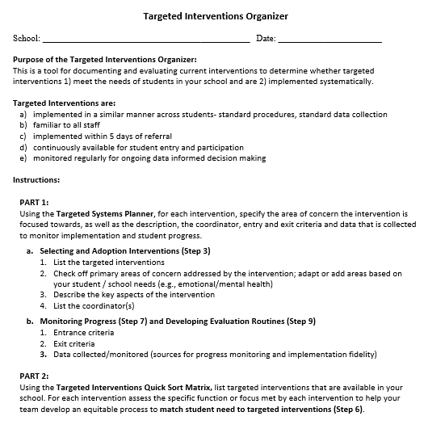
TARGETED INTERVENTIONS ORGANIZER
Systems
Purpose :
Document and evaluate current interventions
Determine whether targeted interventions
1) meet the needs of students, and
2) are implemented systematically
+ ENHANCED Communication
Notes:
The Targeted Interventions ORGANIZER gives teams some guidance to document and evaluate their current interventions.
During this process, we try to consider “fit” and “resources” in order to enhance, eliminate, or add interventions.
By establishing SYSTEMS, teams will be able to evaluate how meaningful and effective the interventions, if aspects need to be refined for them to work better, and what other interventions might be needed to address student needs.

Slide 31
DECEMBER: MATCH TO INTERVENTION
1. Share examples of your school’s Targeted Intervention Organizer
2. Share examples of your T2 INTERVENTION CHECKLIST - self-assess systems/features
e.g., CICO Rollout or CICO Self-Assessment
3. Consider or prepare additional PD for partners
DISCUSS: Common themes, barriers to implementation
https://sebacademy.edc.org/list-of-pbis-resources
Questions?
Notes:
Targeted Intervention Organizer - Elmwood example?

Slide 32
FALL Technical Assistance (TA) SCHEDULE DATES / SET GOALS
1:1 Coaching Support
or
Team Support
Establish
Routines
Work
smarter!
Review
Practices
Data-based Decisions
Evaluate
outcomes
Problem solve barriers
Notes:
Fall Objectives: 1) self-reflection 2) set annual goals 3) fidelity of organizational systems / routines

Slide 33
ACTIVITY: SELF-ASSESS TIER 2 TFI (WINTER)
Login to www.pbisapps.org
Click on PBIS assessments, then “open survey window.”
Click on SWPBIS TFI 2.1; “take survey”
Choose today’s date, team members w/o coach, and no walkthrough
Complete only Tier 2 items as a team
(2.1-2.13)
Add priority items to your action plan
PBIS TFI document
Plan for 30 minutes
Notes:
TRAINERS – Prompts for activity below; allow 30 minutes. Emphasize baseline for action planning
Login to www.pbisapps.org
Click on PBIS assessments, then “open survey window.”
Click on SWPBIS TFI 2.1; “take survey”
Choose today’s date, team members w/o external coach, and no walkthrough
Complete only Tier 2 items as a team (2.1-2.13)
Add items to your action plan; remember this is just a baseline!

Slide 34
WINTER Coaches Meeting
Communicate Interest in Topic Areas
December/January
BIG IDEAS
Matching & Selecting Tier 2 Practices
Evaluating T2 outcomes
Possible Topics:
Data based decisions (drill down using the T2/T3 student monitoring tool)
Evidence-based interventions (e.g., CBT, Skills Groups, Check and Connect, Mentoring)
Notes:
UP NEXT:
Selecting T2 EBP
Data based decisions – when progress monitoring indicates the need for modifications
CICO adaptations
Skills Groups

Slide 35
Agenda & Coaches' Tasks
WHAT”S NEXT FOR US??? Coaches’ Tasks:
Share documents or folder with access to:
Nomination Form, Decision Rules, Universal Screening overview
Targeted Intervention Organizer
Annual Action Plan - Team Profile, Meeting Schedule, Goals, etc.

Slide 36
EVALUATION
CONTACT INFORMATION:
Marcie Handler
mwhandler@gmail.com
Please remember to complete the evaluation to receive your Certificate of Attendance!

