Slide 1
Welcome tO THE Tier 2 COACHES’ MEETing!
GETTING STARTED:
Update your display name in Zoom to read: [Your School], [Your Name] (e.g., Eastside HS, Joe Clark)
Complete the Attendance Survey
Bookmark link to find training resources at : SEB PBIS Tier 2 Academy
Google drive
In the chat, please share with me links to your 2023-2024 TIER 2 TEAM FOLDER (if new)
~15%
Notes:
LINKS for today:
Attendance Survey
Evaluation Survey
EDC Website for SEB Academy
https://sebacademy.edc.org/
Google link to folder:
PBIS (SEB) Academy Tier 2 Year 2 2023-2024 - Google drive

Slide 2
PBIS Coaching Meeting TIER 2, Year 2 October 2023
Marcie Handler
with support from EDC, NEPBIS Network, May Institute & Broad Reach Consulting
Notes:
Add trainer names for your event

Slide 3
ACKNOWLEDGEMENTS
PBIS.org
Northeast PBIS Network (nepbis.org)
Michigan Integrated Behavior & Learning Support Initiative
FLPBIS
Missouri PBIS
Midwest PBIS Network
Drs. Leanne Hawken, Deanne Crone, & Rob Horner
CASEL

Slide 4
Expect to Connect!
Please share:
Name
School and district
Role in the school
Favorite fall beverage

Slide 5
EXPECTATIONS
Self
Others
Environment
Self-monitor
Mute when listening, unmute to talk​
Have electronics ready to use
Obtain help from peers and trainers
Work as a team:
Keep necessary materials at hand
Are you participating?
Engaged as a learner?
Stretch, break, stand as needed​
Room for every voice
Reinforce participation
action plan
relevant docs
water/snacks
Minimize distractions if possible​
Complete tasks efficiently
Share examples, celebrations and barriers
Communicating your needs?
Notes:
Taking CARE of…

Slide 6
LEGEND
Timing
Example
Activity
Non-example
Guidelines
Preview
Big Idea
Review
Organization

Slide 7
OVERVIEW – SEB ACADEMY
What’s New?
Additional Learning Opportunities
What’s Similar? Learning Opportunities and TA
Content focused
Monthly Webinars (* October 17th 9:30-11 on Screening)
Peer Networking and sharing
Technical Assistance when needed
Integrated Content
Access to content Experts in areas outside our scope / goal areas

Slide 8
SEB PBIS TIER 2 TRAINING MODEL
Year 1
Exploration and Installation of 10 Getting Started Steps
Year 2
Initial Implementation of 10 Getting Started Steps
½ days of team training (Oct/Jan/May) + 7 coaches’ trainings
Networking and content through coaches meetings
Meet with coaches or teams (Fall, Winter, Spring)
TFI (April/May)
Free year of SWIS + CICO
TA support

Slide 9
PBIS MEETING DATES – for us!
Coaching Meetings / Peer Share Calls (9-11am)*
Thursday, October 5, 2023
Thursday, November 2, 2023
Tuesday, December 5, 2023
Thursday, January 4, 2024
Thursday, February 1, 2024
Tuesday, March 5, 2024
Thursday, April 4, 2024 – considering 4/2 or 4/11
Thursday, June 6, 2024
* Meetings may end at 10:30am to provide additional opportunities for school specific technical assistance.
TA
Fall Connection
Winter Connection
Spring Connection
* Individual meetings will be scheduled in April/May for Tier 2 TFI self-assessments.

Slide 10
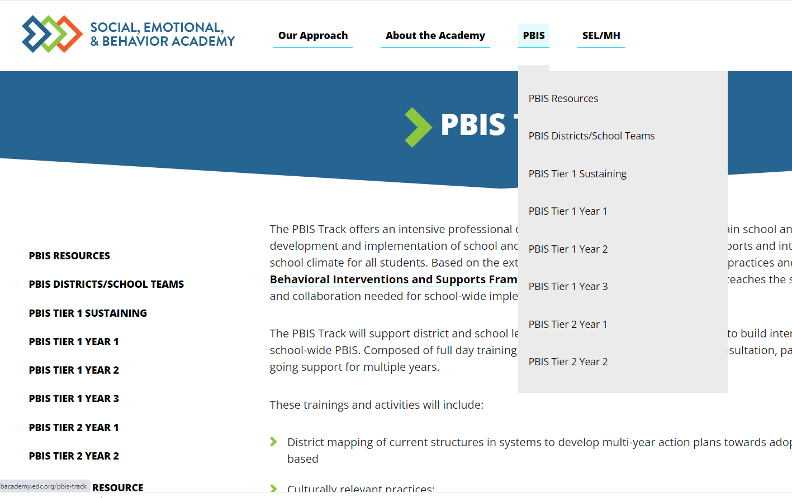
PBIS Academy Support Structure
What is it?
Your team's guide for training content, readings, and resources for both each monthly event.
Purpose:
Monthly organized resource repository for your team to access all PBIS Academy content
Website https://sebacademy.edc.org
Notes:
TRAINER NOTE: Please share the website address https://sebacademy.edc.org/pbis-track
NOTE: SWIS page with training dates will be up shortly

Slide 11
ONGOING RESOURCES - websites
RESOURCES:
Pbis.org
https://www.pbis.org/pbis/tier-2
https://www.pbis.org/topics/coaching
Pbisapps.org
Become a Better Team by Solving 3 Common Mistakes
7 Ways to MacGyver Your Action Plans
https://sebacademy.edc.org/list-of-pbis-resources
Notes:
Center on PBIS’ Coaching Page: https://www.pbis.org/topics/coaching
Other:
Become a Better Team by Solving 3 Common Mistakes: https://www.pbisapps.org/articles/become-a-better-team-by-solving-3-common-mistakes
7 Ways to MacGyver Your Action Plans: https://www.pbisapps.org/articles/7-ways-to-macgyver-your-action-plans

Slide 12
NEW RESOURCES
RESOURCES:
https://sebacademy.edc.org/list-of-pbis-resources
Needs Assessment and Planning Process

Slide 13
Agenda & Coaches' Tasks
Coaches’ Tasks:
As you update… Share documents or folder with access to:
Presentation Content:
Resources: Building on Tier 1; Measuring Fidelity of Tier 2
BIG IDEAS: From Installing to Full Implementation
Nomination Form, Decision Rules, Universal Screening overview
Targeted Intervention Organizer
Glows and Grows: Foundation Steps
Team Profile and Meeting Schedule, 2023-2024 Action Plan/Goals

Slide 14
Resources: Measuring Fidelity of Tier 2 Systems and Practices
Notes:
Measuring Fidelity of Core Features of Tier 2 Systems and Practices in Schools

Slide 15
BREAKOUT ROOM ACTIVITY
Divide into 2 groups
ALL READ: Page 3 first column “Importance of Tier 2 PBIS”
GROUP 1 read: page 3-5 “Core Features of Tier 2 Organizational Systems
GROUP 2 read: page 5-6 Core Features of Tier 2 Practices
In each group… DISCUSS 2-3 of the 7 features;
What your team has put in place related to that feature?
If you can/want to, read ahead for next time on measuring fidelity of the INTERVENTIONS.
Pull up your team Spring TFI Action Plan to inform the discussion
15 minutes

Slide 16
WRITE: TIER 2 CRITICAL FEATURES

Slide 17
TIER 2 CRITICAL FEATURES
Consistent, standardized implementation across students
Easily accessible (e.g., within a few days of referral)
Continuous availability
Implemented by all school staff
Consistent with and extra doses of school-wide expectations and interventions

Slide 18
Resources: Enhancing Implementation and Sustainability

Slide 19
RESOURCES 1. Enhance Tier 1 Sustainability
RESOURCES
Advanced TIER 1 Action Plan:
Organize your annual activities with team membership and schedules for meetings, teaching opportunities, recognition, staff feedback, progress monitoring and evaluation
READINGS
9 thing you might have forgotten how to do in pbisapps
Refresher on beginning-of-year tasks such as updating student enrollment, entering school days, revising staff lists, and entering paperless referrals can be found in this resource from pbisapps.org .
Notes:
Schools will get more information on this in the Year 3 and sustaining academies
TIER 1 ANNUAL PLANNING TEMPLATE (adapted from pbis academy template)
https://sebacademy.edc.org/annual-action-plan-template-advanced
Start of year pbisapps Check-up (pbisapps.org)
PBISApps | News—9 Things You Might Have Forgotten How to Do in PBISApps
Refresher on beginning-of-year tasks such as updating student enrollment, entering school days, revising staff lists, and entering paperless referrals can be found in this resource from pbisapps.org

Slide 20
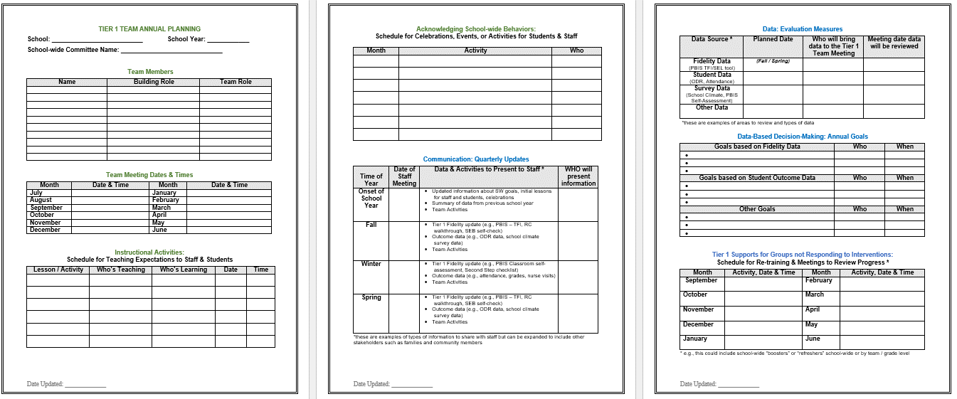
SYSTEMS: Annual Planning Tier 1
Acknowledgment Plans
Evaluation Measures
Team
Info
Annual Goals
Teaching Expectations Plan
Tier 1 Student Follow Up
Communication
Notes:
This Action plan is more advanced and is intended for schools in years 2 and beyond. Review with the team.
https://sebacademy.edc.org/annual-action-plan-template-advanced

Slide 21
Q: Why “BUILD on” and intentionally link to Tier 1 Team?
A: If schools do not have a solid Tier 1 foundation…
Lack of solid Tier 1 foundation
Too many students identified
Strain on resources
Staff frustration
Limited support options for students in need
Reluctance to identify students in need
Unmet student needs
Notes:
Rationale:
Without a Tier 1 behavioral system on campus, too many students will be misidentified as needing more advanced supports (i.e., Tiers 2 & 3). It is essential that a Tier 1 system be implemented first with fidelity to truly identify the students that are not responding well to the universal interventions on campus. A campus will not have the resources to provide advanced supports to many or all students on their campus. It is also more cost effective to use a preventative approach and provide Tier 1 supports for all.
Remember the following:
Tier 1 is a building block for identifying students in need of Tier 2 supports when the team is assured of implementation with high fidelity
(2) Provides better information for planning & problem solving

Slide 22
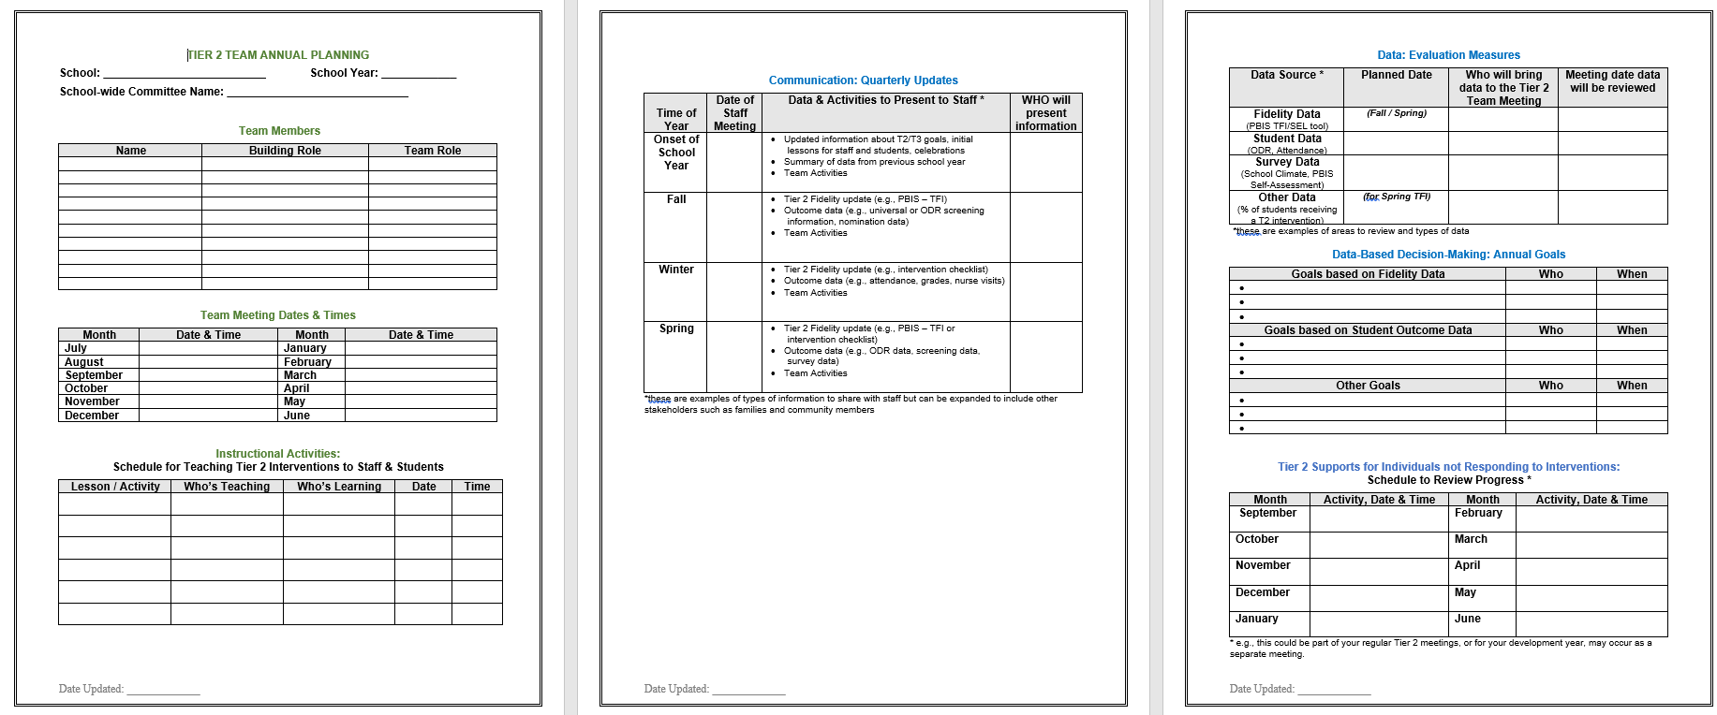
2. BUILD SYSTEMS: TIER 2 ANNUAL PLANNING
Acknowledgment Plans
Evaluation Measures
Team
Info
Annual Goals
Teaching T2 Routines
Communication
Tier 2 Student Follow Up
Notes:
This Action plan is more advanced and is intended for schools in years 2 and beyond. Review with the team.
https://sebacademy.edc.org/annual-action-plan-template-advanced
TIER 1 ANNUAL TEMPLATE
https://docs.google.com/document/d/1Pbgwf6u4tXLXPFK_4wvMpFGFKmGMKDhC/edit?usp=drive_link&ouid=113908941090752513118&rtpof=true&sd=true

Slide 23
RESOURCES 3. BUILD DATA ROUTINES
RESOURCES
Annual SWIS Tasks
READINGS
9 thing you might have forgotten how to do in pbisapps
Refresher on beginning-of-year tasks such as updating student enrollment, entering school days, revising staff lists, and entering paperless referrals can be found in this resource from pbisapps.org .
Notes:
Annual SWIS Tasks
Start of year pbisapps Check-up (pbisapps.org)
PBISApps | News—9 Things You Might Have Forgotten How to Do in PBISApps
Refresher on beginning-of-year tasks such as updating student enrollment, entering school days, revising staff lists, and entering paperless referrals can be found in this resource from pbisapps.org

Slide 24
Big Ideas Check In: Tier 2 Foundation Steps
Notes:
TRAINER NOTE:
Use this section to do a BRIEF check in on initial team composition and action planning steps. The activity was already presented in Canvas.
The question prompts are meant to serve as self-checks rather than in-depth conversations.
If challenges with getting started exist, TA time can be used to address those needs.

Slide 25
Tier 2 FOUNDATION STEPS
Develop an equitable process for matching student need to practices
1
Establish a representative T2 leadership team
6
2
Develop a collaborative process for identifying students
Develop a process for progress monitoring, data-based decision rules
7
3
Evaluate, select and adopt culturally appropriate tier 2 practices
Develop procedures for modifying/ adjusting implementation
8
4
Develop a process to install selected practices
Develop evaluation routines for fidelity and outcome data
9
5
Develop procedures to train staff and students; partner with families and community
Document and share routines, practices, and policies
10
Notes:
COACHES:
Seeing all of these steps can be uncomfortable or overwhelming – the goal is to walk away with an understanding of the elements and need to prioritize time and resources to get the steps achieved over a period of time.

Slide 26
3-Tiered System of Support
Necessary Conversations (Teams)
Universal
Team
Targeted Systems Team
Problem Solving Team
Tertiary Systems Team
Plans SW & class-wide supports
Uses process data; determines overall intervention effectiveness
Standing team; uses FBA/BIP process for one youth at a time
Uses Process data; determines overall intervention effectiveness
Universal Support
CICO
SAIG
Brief
FBA/BIP
Complex
FBA/BIP
Group w/ individual
feature
WRAP
How do your teams work together to support students and staff?
Brief FBA/BIP
Notes:
26
26
Team structure
Universal or Tier 1 PBIS team
Targeted or Tier 2 Systems team
Problem Solving team (SAT, SST, CST) – individual discussions about students (e.g., 2-3 students in a meeting) and more frequent meetings (e.g., weekly or biweekly)
*click* Tertiary or Tier 3 Systems team
How many are on that intervention and how many are responding
PROBLEM solving team - (2-3 kids in 60 minutes) more intensive
SAIG - social and academic intervention groups
CICO - Check in / Check Out
FBA - Functional Behavioral Assessment
BIP - Behavior Intervention Plan

Slide 27
3-Tiered System of Support
Necessary Conversations (Teams)
Universal
Team
Targeted Systems Team
Problem Solving Team
Tertiary Systems Team
Plans SW & class-wide supports
Uses process data; determines overall intervention effectiveness
Standing team; uses FBA/BIP process for one youth at a time
Uses Process data; determines overall intervention effectiveness
WORKING SMARTER
ACTIVITY
How do your teams work together to support students and staff?
How does the Tier 2 Team ‘fit’ with other teams?
Notes:
27
27
If you’re in a smaller school, you may want to use an existing team as your Tier 2 team.
Your Tier 2 team could be the same or a subset of your Tier 1 team.
Tier 2 teams are often smaller than Tier 1 teams (4-6 members). Dedicate one meeting per month to Tier 2 systems.
Or Tier 2 team could be your existing problem solving team.
Or you may want a separate team to oversee the development and implementation of Tier 2 interventions and systems and have a separate Tier 2 team, especially if you are in a large school with a variety of Tier 2 interventions to coordinate and monitor.

Slide 28
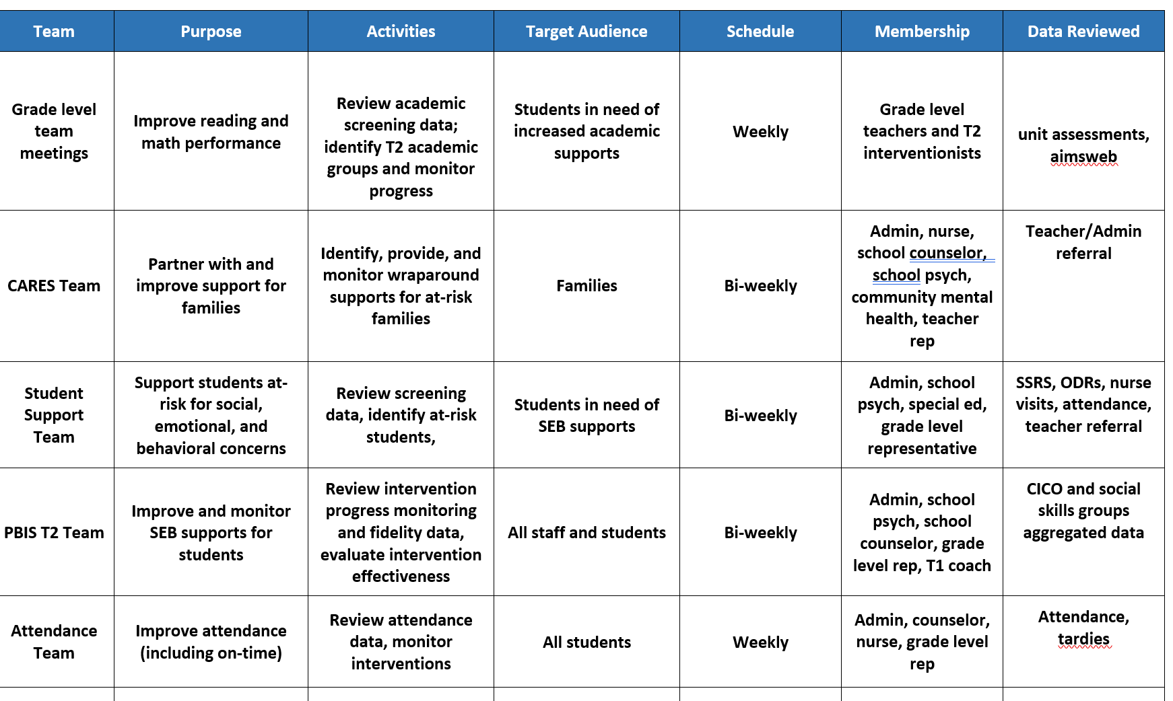
Working Smarter at Tier 2

Slide 29
GUIDELINES FOR TEAMS
Systems
ACTION PLAN GUIDES ACTIVITIES
SYSTEMS
Integrated with other behavior-related initiatives/programs
Given appropriate priority relative to school/district goals
Established rules/agreements/roles
Regular meeting times
Coaching support (at the district or regional level)

Slide 30
Team Roles
Is this a routine?
Facilitator
Note Taker
Time Keeper
Norm Keeper
“Friendly Nag”
Family/Student Voice

Slide 31
ACTION PLANNING
Foundation for all you do as a team
Action Plan
Vital for achieving goals
Specifies three features:
1
2
3
Who
What
When
Who is responsible…
…for doing what…
…by when?
Action Planning: The process of organizing resources to enable individuals to engage in activities designed to achieve specific and important outcomes.

Slide 32
REVIEW YOUR TEAM STRUCTURES
Access team TFI results from last year. What is still in place?
Review team membership; if needed, invite new team members to make it representative
Start a 2023-2024 action planning document or revisit the one from last year; Discuss GOALS for the year.
Establish a regular (monthly) team meeting schedule
https://sebacademy.edc.org/list-of-pbis-resources
Do you need to modify the team?
Have you updated your action plan for this year?
15 minutes
Notes:
Find action plan templates, team membership and meeting schedule tool under “pbis resources” on the website
https://sebacademy.edc.org/list-of-pbis-resources
https://sebacademy.edc.org/tier-2-team-profile-and-meeting-schedule

Slide 33
Tier 2 FOUNDATION STEPS
Develop an equitable process for matching student need to practices
1
Establish a representative T2 leadership team
6
2
Develop a collaborative process for identifying students
Develop a process for progress monitoring, data-based decision rules
7
3
Evaluate, select and adopt culturally appropriate tier 2 practices
Develop procedures for modifying/ adjusting implementation
8
4
Develop a process to install selected practices
Develop evaluation routines for fidelity and outcome data
9
5
Develop procedures to train staff and students; partner with families and community
Document and share routines, practices, and policies
10
Notes:
COACHES:
Seeing all of these steps can be uncomfortable or overwhelming – the goal is to walk away with an understanding of the elements and need to prioritize time and resources to get the steps achieved over a period of time.

Slide 34
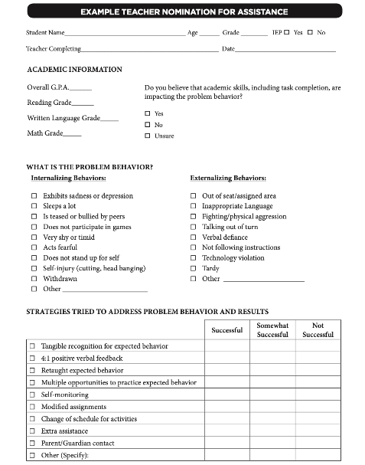
Methods for Identification
Gather information for the November meeting
Nomination
Data Decision Rules
Screening
Do we have something simple?
What are some of our data sources?
Is the school using a universal screener?
Notes:
Initial step:
Have you rolled out the nomination form?
Identified data sources?
Advanced steps:
Are the decision rules clear for various data sources? When do you review that data?
Can you provide a one page overview for staff and families about the universal screener?
Additional Resources to guide your team discussion:
https://sebacademy.edc.org/identification-matching-and-monitoring-process

Slide 35
Possible Data Sources for Identifying Students
ATTENDANCE | BEHAVIOR | ACADEMICS
Absences Tardies (to school and/or to individual classes) Visits to nurse, guidance, office, restroom | Office discipline referrals Classroom managed behaviors Suspensions (in or out of school) Detentions | Course grades GPA Number of failures Academic screener scores Standardized test scores
Additional data to consider: teacher referrals, universal behavior screeners, parent/student requests, Early Warning Indicators

Slide 36
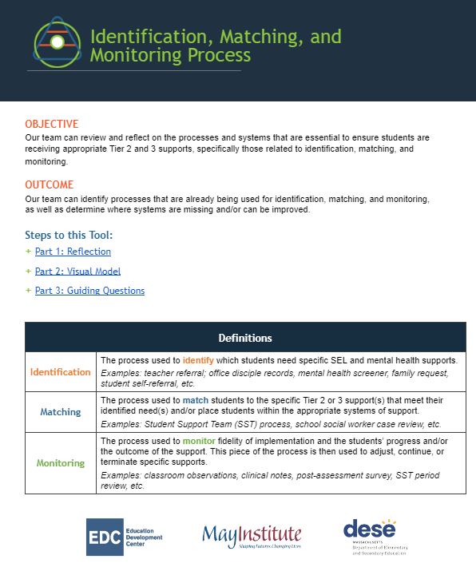
ADDITIONAL RESOURCES
https://sebacademy.edc.org/identification-matching-and-monitoring-process
Guidance for Systematic Screening: Lessons Learned from Practitioners
Selecting a Universal Behavior Screening Tool: Questions to Consider
Notes:
RESOURCES
Identification, Matching, and Monitoring Process
https://sebacademy.edc.org/identification-matching-and-monitoring-process
or
https://docs.google.com/document/d/1iF5paaTaJdyiW5KCVNdsKTdzJF1rvPobXyBc-K7LGu4/edit?usp=drive_link

Slide 37
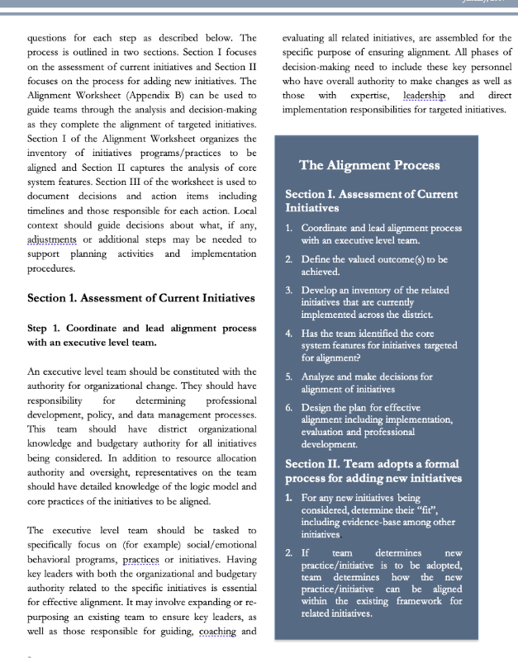
ADDITIONAL RESOURCES
RESOURCES:
Guidance for Systematic Screening: Lessons Learned from Practitioners
Selecting a Universal Behavior Screening Tool: Questions to Consider
Notes:
RESOURCES
- Team meeting profile & meeting schedule: https://nepbis.org/wp-content/uploads/2021/08/Team-Profile-and-Meeting-Schedule-Document-1.docx
- Team meeting foundations checklist: https://nepbis.org/wp-content/uploads/2020/09/Conducting-Leadership-Meetings-Worksheet.docx
- Alignment Checklist: https://nepbis.org/wp-content/uploads/2021/09/MA-Academy-Integration-and-Alignment-Activity.docx
READINGS:
- Technical Guide for Aligning Programs: https://www.pbis.org/resource/technical-guide-for-alignment-of-initiatives-programs-and-practices-in-school-districts
- Integration & Aligning Family Engagement in PBIS: https://www.pbis.org/resource/aligning-and-integrating-family-engagement-in-pbis
- PBIS & SEL as Essential Life Skills: https://www.pbis.org/video/social-emotional-learning-cultivating-essential-life-skills

Slide 38
NOVEMBER: REVIEW METHODS TO IDENTIFY STUDENTS
Share examples of your school’s nomination / request for assistance form (3 examples)
Share examples of your school’s Data decision Guidelines
Share example of your school’s Screening process
DISCUSS: Common themes, barriers to implementation
https://sebacademy.edc.org/list-of-pbis-resources
Questions?

Slide 39
GETTING STARTED WITH Tier 2
Develop an equitable process for matching student need to practices
1
Establish a representative T2 leadership team
6
2
Develop a collaborative process for identifying students
Develop a process for progress monitoring, data-based decision rules
7
3
Evaluate, select and adopt culturally appropriate tier 2 practices
Develop procedures for modifying/ adjusting implementation
8
4
Develop a process to install selected practices
Develop evaluation routines for fidelity and outcome data
9
5
Develop procedures to train staff and students; partner with families and community
Document and share routines, practices, and policies
10
Notes:
COACHES:
Seeing all of these steps can be uncomfortable or overwhelming – the goal is to walk away with an understanding of the elements and need to prioritize time and resources to get the steps achieved over a period of time.

Slide 40
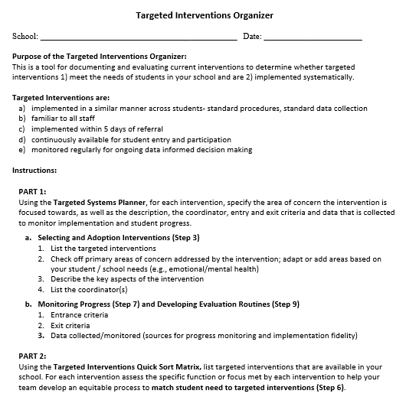
TARGETED INTERVENTIONS ORGANIZER
Systems
Purpose :
Document and evaluate current interventions
Determine whether targeted interventions
1) meet the needs of students, and
2) are implemented systematically
+ ENHANCED Communication
Notes:
The Targeted Interventions ORGANIZER gives teams some guidance to document and evaluate their current interventions.
During this process, we try to consider “fit” and “resources” in order to enhance, eliminate, or add interventions.
By establishing SYSTEMS, teams will be able to evaluate how meaningful and effective the interventions, if aspects need to be refined for them to work better, and what other interventions might be needed to address student needs.

Slide 41
Glows & Grows: Tier 2 Foundations for Implementation
Notes:
TRAINER NOTE:
Use this time to check in with coaches and gauge their existing knowledge base of PBIS and determine whether or not they already watched the PBIS Overview.
The following 2 slides provide an opportunity for a BRIEF review and chance to develop a basic common understanding. It is not intended to be a full explanation.

Slide 42
DISCUSSION: GLOWS & GROWS
What is something to celebrate & something you’re working on related to:
Tier 2 organizational systems
Consider:
Teaming
Data systems
PD / roll out to staff, students, and families
Add to our shared doc
5 minutes
15 minutes
Independent Jot
Whole Group
Notes:
https://docs.google.com/presentation/d/1cs8kepbXc1DDpL8440wTcwUHu0BRGgBxgPKTZPhIauI/edit?usp=drive_link

Slide 43
FALL Technical Assistance (TA) SCHEDULE DATES / SET GOALS
1:1 Coaching Support
or
Team Support
Establish
Routines
Work
smarter!
Review
Practices
Data-based Decisions
Evaluate
outcomes
Problem solve barriers
Notes:
Fall Objectives: 1) self-reflection 2) set annual goals 3) fidelity of organizational systems / routines

Slide 44
ACTIVITY: SELF-ASSESS TIER 2 TFI (November/Dec)
Login to www.pbisapps.org
Click on PBIS assessments, then “open survey window.”
Click on SWPBIS TFI 2.1; “take survey”
Choose today’s date, team members w/o coach, and no walkthrough
Complete only Tier 2 items as a team
(2.1-2.13)
Add priority items to your action plan
PBIS TFI document
Plan for 30 minutes
Notes:
TRAINERS – Prompts for activity below; allow 30 minutes. Emphasize baseline for action planning
Login to www.pbisapps.org
Click on PBIS assessments, then “open survey window.”
Click on SWPBIS TFI 2.1; “take survey”
Choose today’s date, team members w/o external coach, and no walkthrough
Complete only Tier 2 items as a team (2.1-2.13)
Add items to your action plan; remember this is just a baseline!

Slide 45
WINTER Coaches Meeting
Communicate Interest in Topic Areas
December/January
BIG IDEAS
EXPAND on: Evaluating and Selecting Tier 2 Practices using the Targeted Intervention Organizer
Possible Topics:
Data based decisions (drill down using the T2/T3 student monitoring tool)
Additional interventions (e.g., CBT, Social Skills Groups, Check and Connect)
What do you want to make sure we cover this year either individually or as a group?
Notes:
TRAINER NOTE:
Prompt coaches to begin these conversations with their teams prior to the team training

Slide 46
Agenda & Coaches' Tasks
WHAT”S NEXT FOR US??? Coaches’ Tasks:
Share documents or folder with access to:
Nomination Form, Decision Rules, Universal Screening overview
Targeted Intervention Organizer
Team Profile and Meeting Schedule, 2022-2023 Action Plan

Slide 47
EVALUATION
CONTACT INFORMATION:
Marcie Handler
mwhandler@gmail.com
Please remember to complete the evaluation to receive your Certificate of Attendance!
Notes:
Attendance Survey
Evaluation Survey

