Slide 1
Welcome to Tier 2 Coaches meeting!
GETTING STARTED:
Complete the ATTENDANCE
WHILE YOU WAIT:
Preview SEB ACADEMY overview
AT THE END:
Complete the EVALUATION
BE PREPARED:
Find training resources at : SEB PBIS Tier 2 Academy
Google docs
Share TFI ACTION PLAN with trainers and team
~15%
Notes:
LINKS for today:
Attendance
https://edc.co1.qualtrics.com/jfe/form/SV_5BiXqi4bxzOCMS2
EDC Website for SEB Academy
https://sebacademy.edc.org/
Event Evaluation (at the end)
https://edc.co1.qualtrics.com/jfe/form/SV_cBF9GI7gVEBsfSC
DESE MTSS Academy applications
https://www.doe.mass.edu/sfss/prof-dev/
https://www.doe.mass.edu/csdp/sel-behavior-academy-at-a-glance.pptx

Slide 2
PBIS Tier 2 Coaches Training Year 1 June 2023
Marcie Handler & Katie Meyer
with support from NEPBIS Network, May Institute & Broad Reach Consulting

Slide 3
ACKNOWLEDGEMENTS
02
03
04
Northeast PBIS Network (nepbis.org) / UCONN
01
Michigan Integrated Behavior & Learning Support Initiative
Dr. Heather George & FLPBIS
Missouri PBIS
Drs. Leanne Hawken, Deanne Crone, & Rob Horner
05
06
Midwest PBIS Network

Slide 4
EXPECTATIONS
Self
Others
Environment
Self-monitor
Mute when listening, unmute to talk​
Have electronics ready to use
Obtain help from peers and trainers
Work as a team:
Keep necessary materials at hand
Are you participating?
Engaged as a learner?
Stretch, break, stand as needed​
Room for every voice
Reinforce participation
action plan
relevant docs
water/snacks
Minimize distractions if possible​
Complete tasks efficiently
Notes:
Taking CARE of…

Slide 5
LEGEND
Timing
Example
Activity
Non-example
Guidelines
Preview
Big Idea
Review
Organization

Slide 6
Agenda & Coaching Tasks
Training Overview
Coaching Tasks
Identify documents to be developed next year
Planning for next year
Document procedures and policies
Establish routines
Sharing practices and outcomes
Plan implementation features for next year with the team

Slide 7
GETTING STARTED WITH Tier 2
Develop an equitable process for matching student need to practices
1
Establish a representative T2 leadership team
6
2
Develop a collaborative process for identifying students
Develop a process for progress monitoring, data-based decision rules
7
3
Evaluate, select and adopt culturally appropriate tier 2 practices
Develop procedures for modifying/ adjusting implementation
8
4
Develop a process to install selected practices
Develop evaluation routines for fidelity and outcome data
9
5
Develop procedures to train staff and students; partner with families and community
Document and share routines, practices, and policies
10
Notes:
COACHES:
Seeing all of these steps can be uncomfortable or overwhelming – the goal is to walk away with an understanding of the elements and strategies to prioritize time and resources to get the steps achieved over a period of time.
TEAM MEMBERS
How will you participation in aspects of these steps support the process?

Slide 8
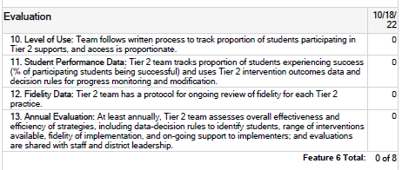
REVIEW GUIDELINES: DEVELOPING EVALUATION ROUTINES
Data
Schedule regular evaluation of level of use, student response, & student access to Tier 2 supports
Identify data sources & develop regular routines to evaluate fidelity of implementation
Schedule annual evaluation of Tier 2 systems & supports, share outcomes with school/district leadership, update action plan accordingly

Slide 9
DISCUSSION: GLOWS & GROWS for monitoring student progress
Did you review or adopt anything to measure:
Level of use?
Intervention fidelity?
Progress by student?
Across students?
Share screen with example
HINT: Use your TFI action plan to guide discussion / priorities for next year?
20 minutes
Independent Jot and Share

Slide 10
RESOURCES
Tools to monitor intervention fidelity
Tools to monitor OUTCOMES and level of use
T2 Response Organizer
TIER 2 ANNUAL ACTION PLAN
TFI Action plan
Document and share routines
PBIS Annual Summary Tier 2
Tier 2 Staff Overview or here
Annual Summary to report to partners

Slide 11
GETTING STARTED WITH Tier 2
Develop an equitable process for matching student need to practices
1
Establish a representative T2 leadership team
6
2
Develop a collaborative process for identifying students
Develop a process for progress monitoring, data-based decision rules
7
3
Evaluate, select and adopt culturally appropriate tier 2 practices
Develop procedures for modifying/ adjusting implementation
8
4
Develop a process to install selected practices
Develop evaluation routines for fidelity and outcome data
9
5
Develop procedures to train staff and students; partner with families and community
Document and share routines, practices, and policies
10
Notes:
COACHES:
Seeing all of these steps can be uncomfortable or overwhelming – the goal is to walk away with an understanding of the elements and strategies to prioritize time and resources to get the steps achieved over a period of time.
TEAM MEMBERS
How will you participation in aspects of these steps support the process?

Slide 12
EVALUATING TIER 2 INTERVENTION FIDELITY
Are we doing what we said we’d do?
How will we know?
How will we directly measure this?
How will we ensure that we assess fidelity on a (minimum) monthly basis?
Notes:
A simpler measure that could be used monthly (prior example—annual measure)
Rationale:
Not all curricula have intervention fidelity checklists available.
Trainer’s Notes:
This is a generic Tier 2 Intervention Fidelity Checklist that can be used with any Tier 2 intervention. It is available in the MISC section of this training binder.

Slide 13
Fidelity Data at Tier 2 Examples
Fidelity to SWPBIS Framework at Tier 2
Tiered Fidelity Inventory (TFI) –
Tier 2 Section
Fidelity to specific Tier 2 interventions
CICO, Social Skills groups, etc.
CICO Self-Assessment
Group Assessments
Counseling Group Lesson Plan
Observations
Interviews
Surveys
Quick “Micro” Checks
Notes:
Let’s start by looking at samples of fidelity data.
Think about three levels of fidelity, although you can certainly dissect it further.
First, we are at a PBIS conference which implies that we are at some level of implementation of the SWPBIS framework. We need a fidelity measure to let us know how well we are implementing the basic features of PBIS and where we might need to improve our efforts.
Second, at Tier 2 we have a menu of intervention options that are offered when a student is identified to be at-risk of school failure. Each of those interventions has a set of critical components that should be monitored as well. As you know we’re focusing on CICO as the primary Tier 2 intervention today but you should verify that any Tier 2 intervention has a fidelity measure or some set of critical features that can be reviewed periodically.
A third level might be observing implementation directly or asking staff members to review protocols and complete quick surveys… the micro-level of implementation.

Slide 14
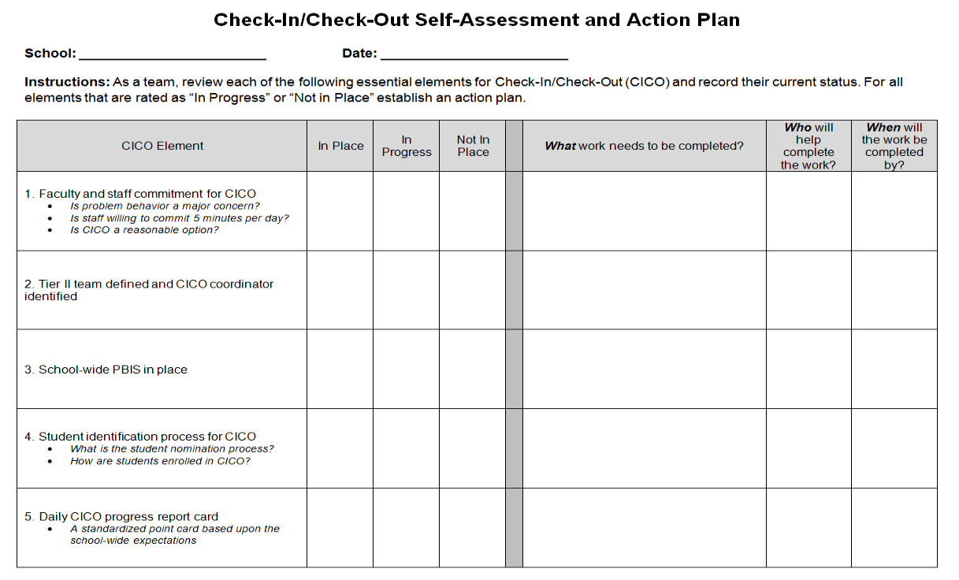
CICO Intervention Fidelity
Item 2.12
2
1
1
0
2
Available on www.pbisapps.org
Notes:
One option is to use the CICO Self-Assessment and Action Plan document which is available on the PBIS Applications website.
This was designed as a tool to get teams started on CICO and breaks down 17 elements of the CICO intervention.
Teams identify which elements are in place, in progress, or not in place. These can easily be converted into a 0-2 scoring system and used similarly to the BEP-FIM.
This one is nice because there is a built-in action plan.

Slide 15
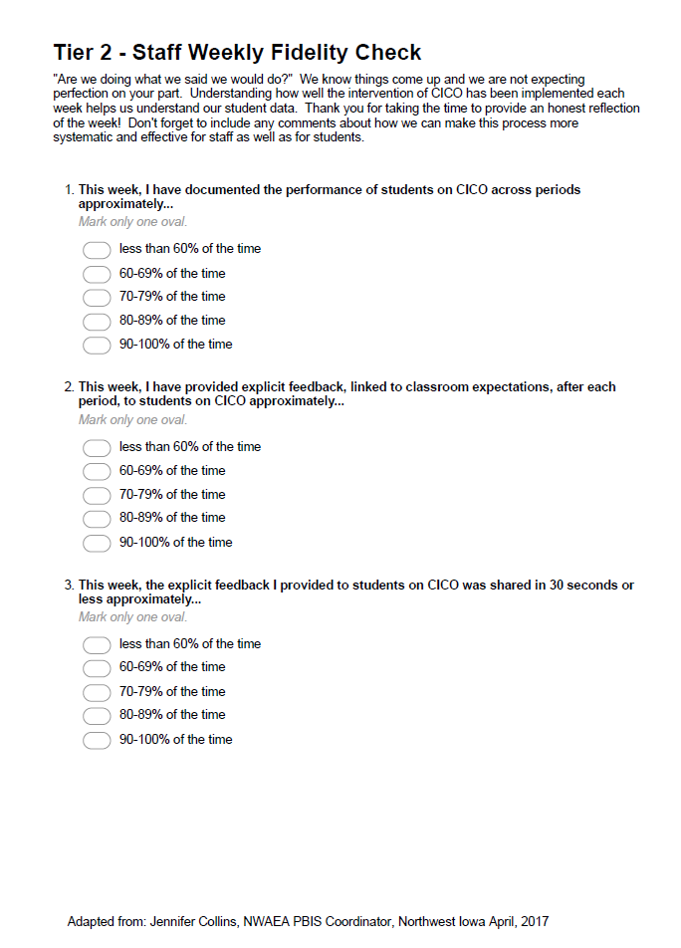
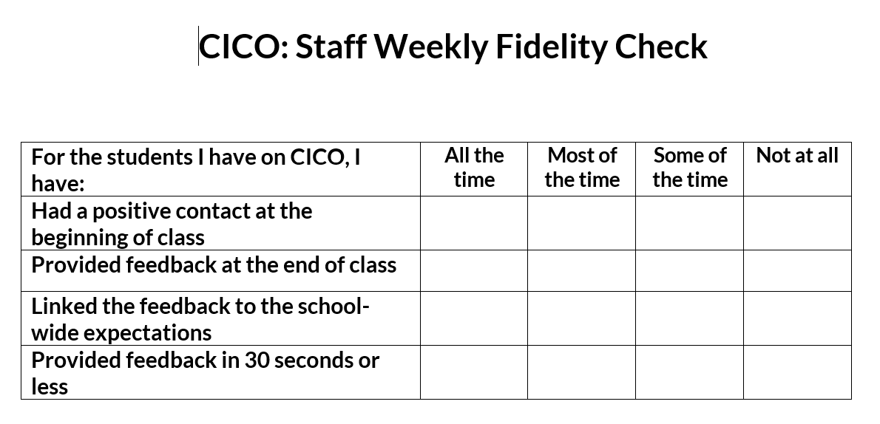
CICO Weekly Fidelity Check
Item 2.12
Observations
Morning & Afternoon Checks
Teacher Checks
Team Meetings
Review permanent products (e.g., point cards)
Quick surveys or interviews
Adapted from Jennifer Collins, NWAEA (Iowa)
Notes:
Adapted from Jennifer Collins, Iowa

Slide 16
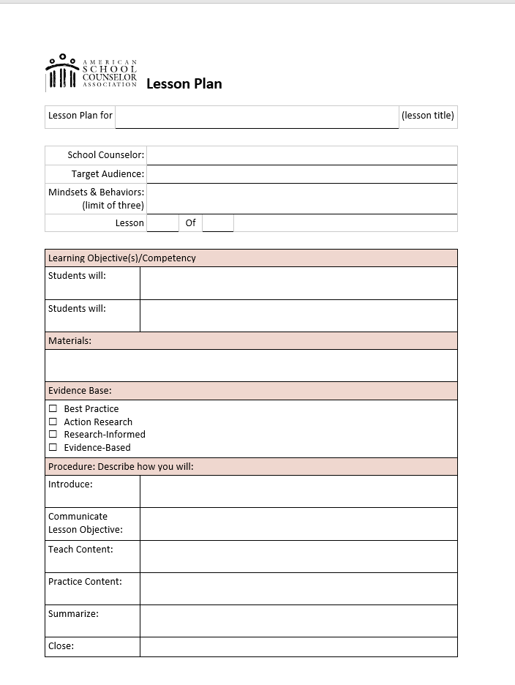
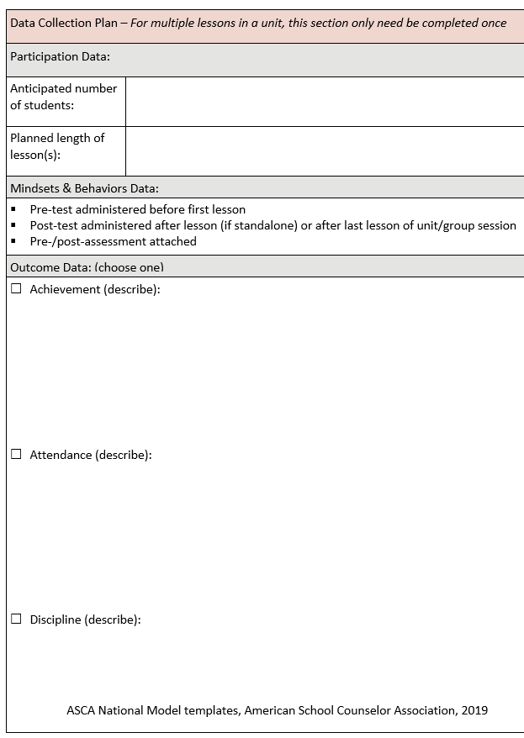
Group Lesson Plan
Item 2.12
Lesson Plans
Ensures fidelity of the intervention strategy (social skills & counseling groups)
Replicable/ sustainable
American School Counselor Association
Notes:
Lesson plan template from the American School Counselor Association. The lesson plan format is used when planning social skills and other counseling groups. Using a format like this promotes implementing lessons with fidelity.

Slide 17
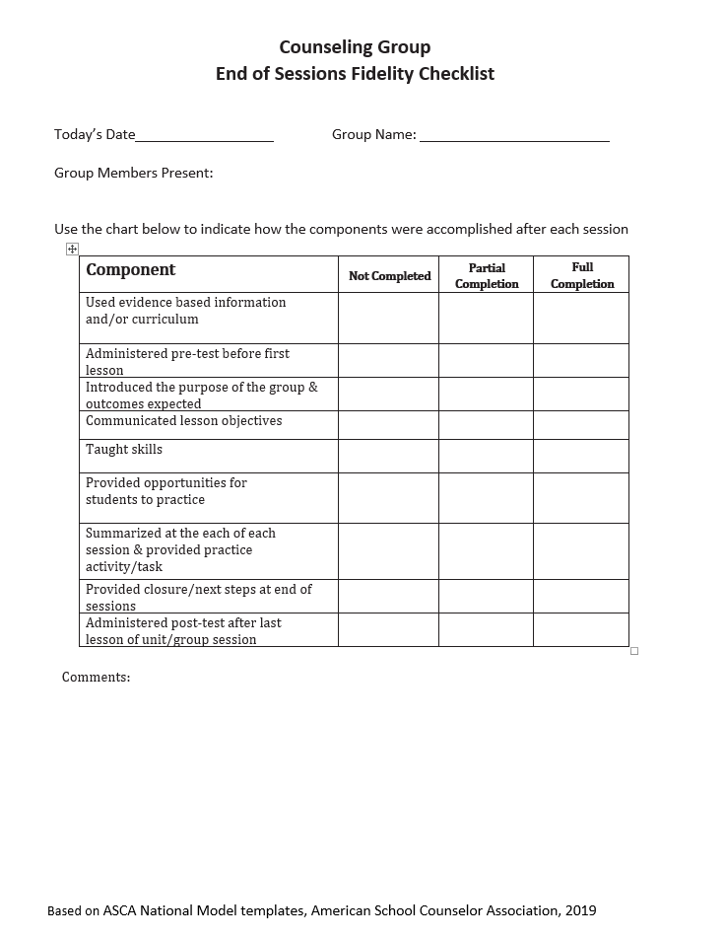
Counseling Group Fidelity Checklist
Item 2.12
American School Counselor Association
Notes:
This is a checklist that I developed using information from the ASCA lesson plan.

Slide 18
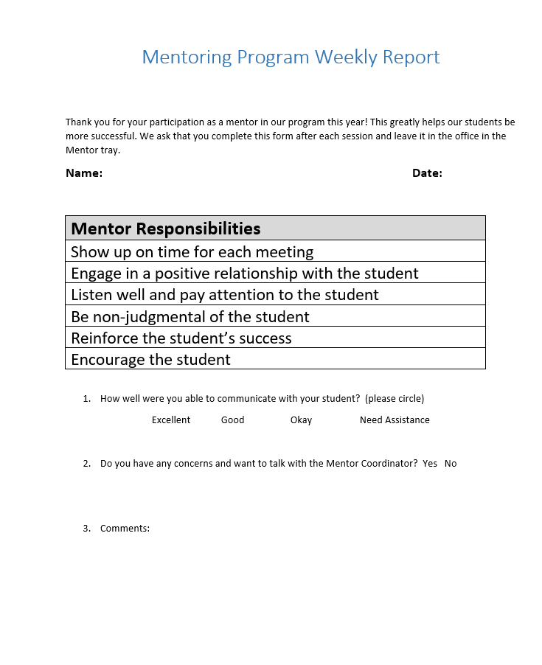
Mentor Program Fidelity Checklist
Notes:
This is one that I drafted as an example.

Slide 19
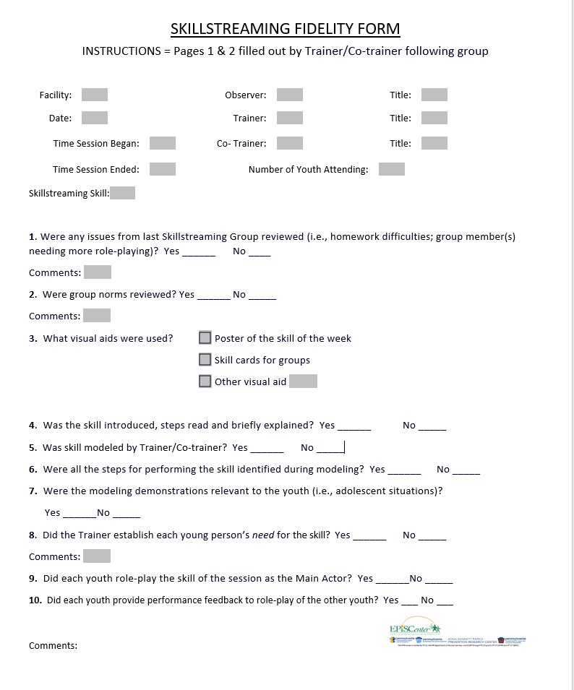
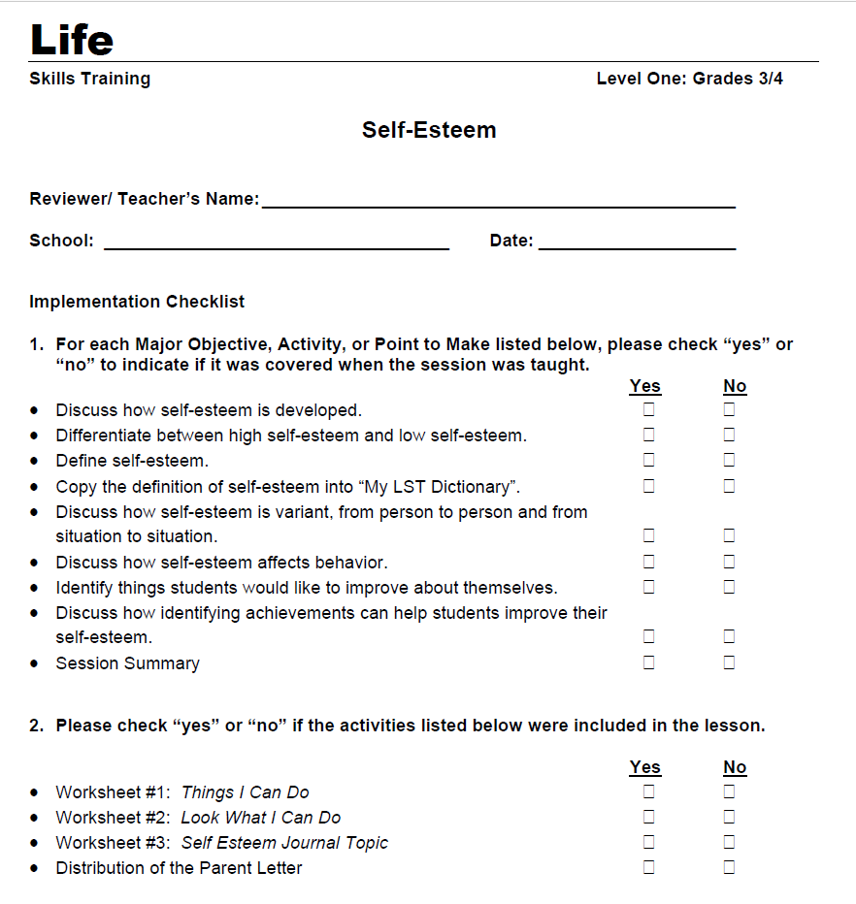
Fidelity Checks: Social Skills Groups
Life Skills Training; Skillstreaming; Strong Kids
Notes:
Many of the research based social skills programs have their own fidelity checks. Examples: Life Skills Training; Skillstreaming; Strong Kids;

Slide 20
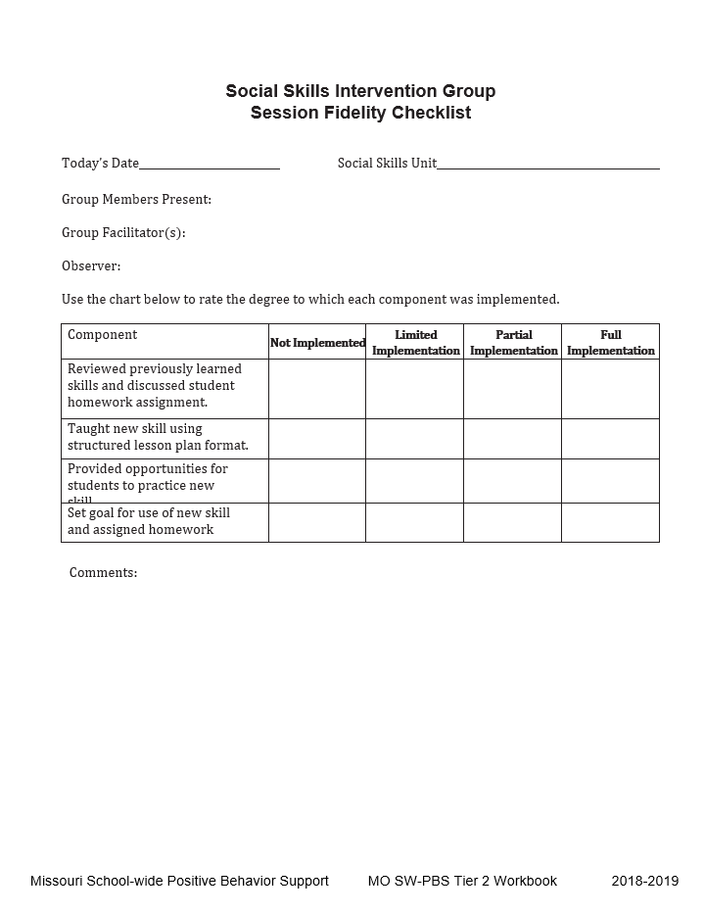
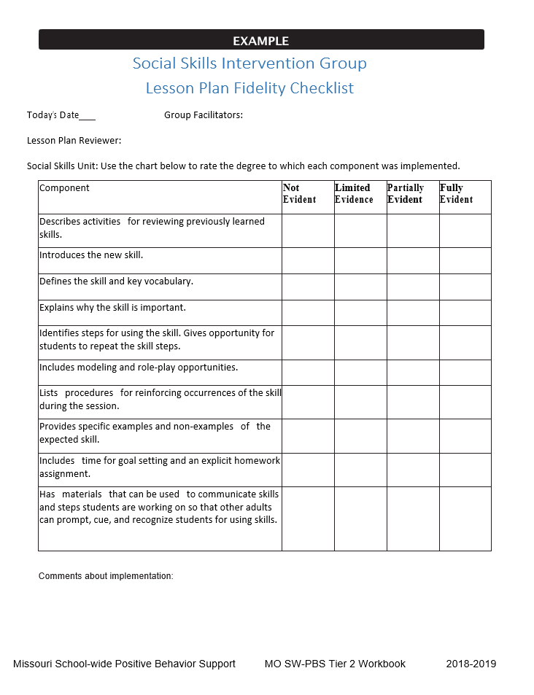
Social Skills Fidelity Checklists
Missouri SWPBIS
Notes:
Missouri PBIS site has many Tier 2 materials available. The two shown here are from their Tier 2 handbook. Michigan also has a strong Tier 2 section.

Slide 21
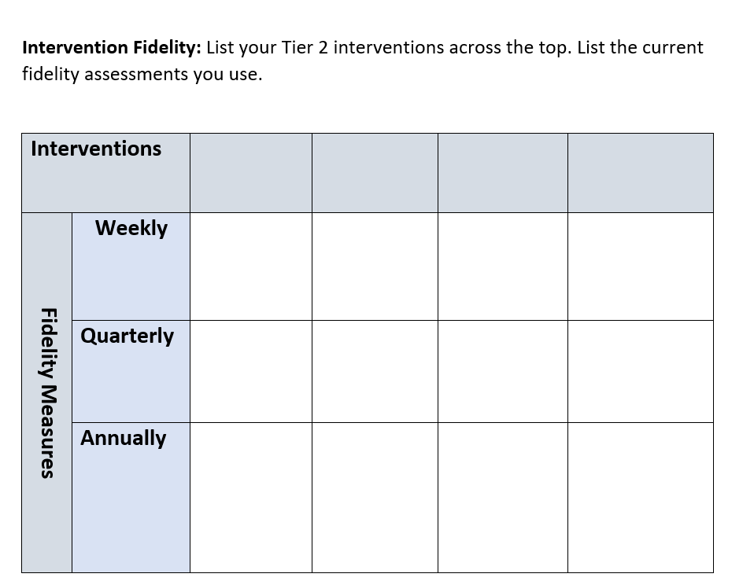
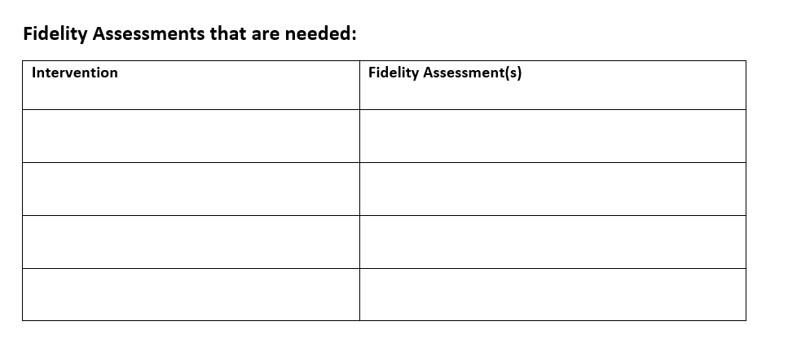
Intervention Fidelity Activity
List the Tier 2 interventions at your school
List any fidelity measures used for the interventions
List any fidelity measures to consider adding at your school:
Notes:
Give participants time to complete for their current evaluation plan. Have group share out of some of the measures that are used.

Slide 22
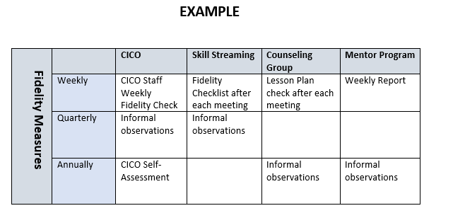
Fidelity Assessment Organizer
“If you fail to plan, you plan to fail”
- Harry Wong

Slide 23
GETTING STARTED WITH Tier 2
Develop an equitable process for matching student need to practices
1
Establish a representative T2 leadership team
6
2
Develop a collaborative process for identifying students
Develop a process for progress monitoring, data-based decision rules
7
3
Evaluate, select and adopt culturally appropriate tier 2 practices
Develop procedures for modifying/ adjusting implementation
8
4
Develop a process to install selected practices
Develop evaluation routines for fidelity and outcome data
9
5
Develop procedures to train staff and students; partner with families and community
Document and share routines, practices, and policies
10
Notes:
COACHES:
Seeing all of these steps can be uncomfortable or overwhelming – the goal is to walk away with an understanding of the elements and strategies to prioritize time and resources to get the steps achieved over a period of time.
TEAM MEMBERS
How will you participation in aspects of these steps support the process?

Slide 24
DOCUMENT ROUTINES, PRACTICES, & POLICIES

Slide 25
GUIDELINES: DOCUMENTING PROCEDURES, POLICIES, & PRACTICES AND ESTABLISHING ROUTINES
Systems
Create Documents
Establishing Routines
For your Tier 2 Team
For training & updating staff, administration, families
For data collection & evaluation
Student screening products & process
Notifying staff, students, & families
Tier 2 practices: intervention components, routines, training materials
Student information

Slide 26
CRITICAL FEATURES: DOCUMENT PROCEDURES, POLICIES & PRACTICES
Student identification/screening: products & process
Notifying staff, students, & families
Tier 2 Practices
Intervention components and routines
Training materials for students and staff
Evaluation
Monitoring student progress
Monitoring fidelity
Evaluating interventions & level of use

Slide 27
WHY DOCUMENT? WHAT TO DOCUMENT?
Student Identification Process
Data sources
Decision rules
Staff training
Notifying Referring Teachers & Families
Process to notify within 10 days of referral
Monitoring & Evaluation (students receiving Tier 2 supports)
Number of students, program fidelity, & student progress
Share with faculty (at least quarterly)
Adapted from the Benchmarks for Advanced Tiers (2012)

Slide 28
WHY DOCUMENT? WHAT TO DOCUMENT?
Notifying Teachers & Families
Progress updates
Updating Administrators
Who is receiving Tier 2 supports (at least monthly)
Progress updates
Tier 2 Practices (intervention process & procedures)
Process for teaching behaviors
Progress monitoring tools
Core features, functions, & systems of the strategy
Orientation materials for substitutes, staff, families, & volunteers
Changes to plans/supports
Adapted from the Benchmarks for Advanced Tiers (2012)

Slide 29
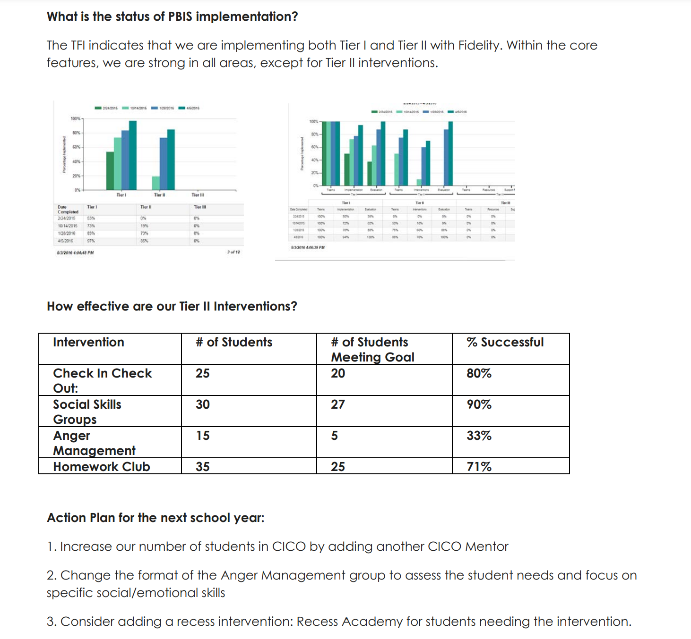
EXAMPLE: ANNUAL SCHOOL SUMMARY - TIER 2

Slide 30
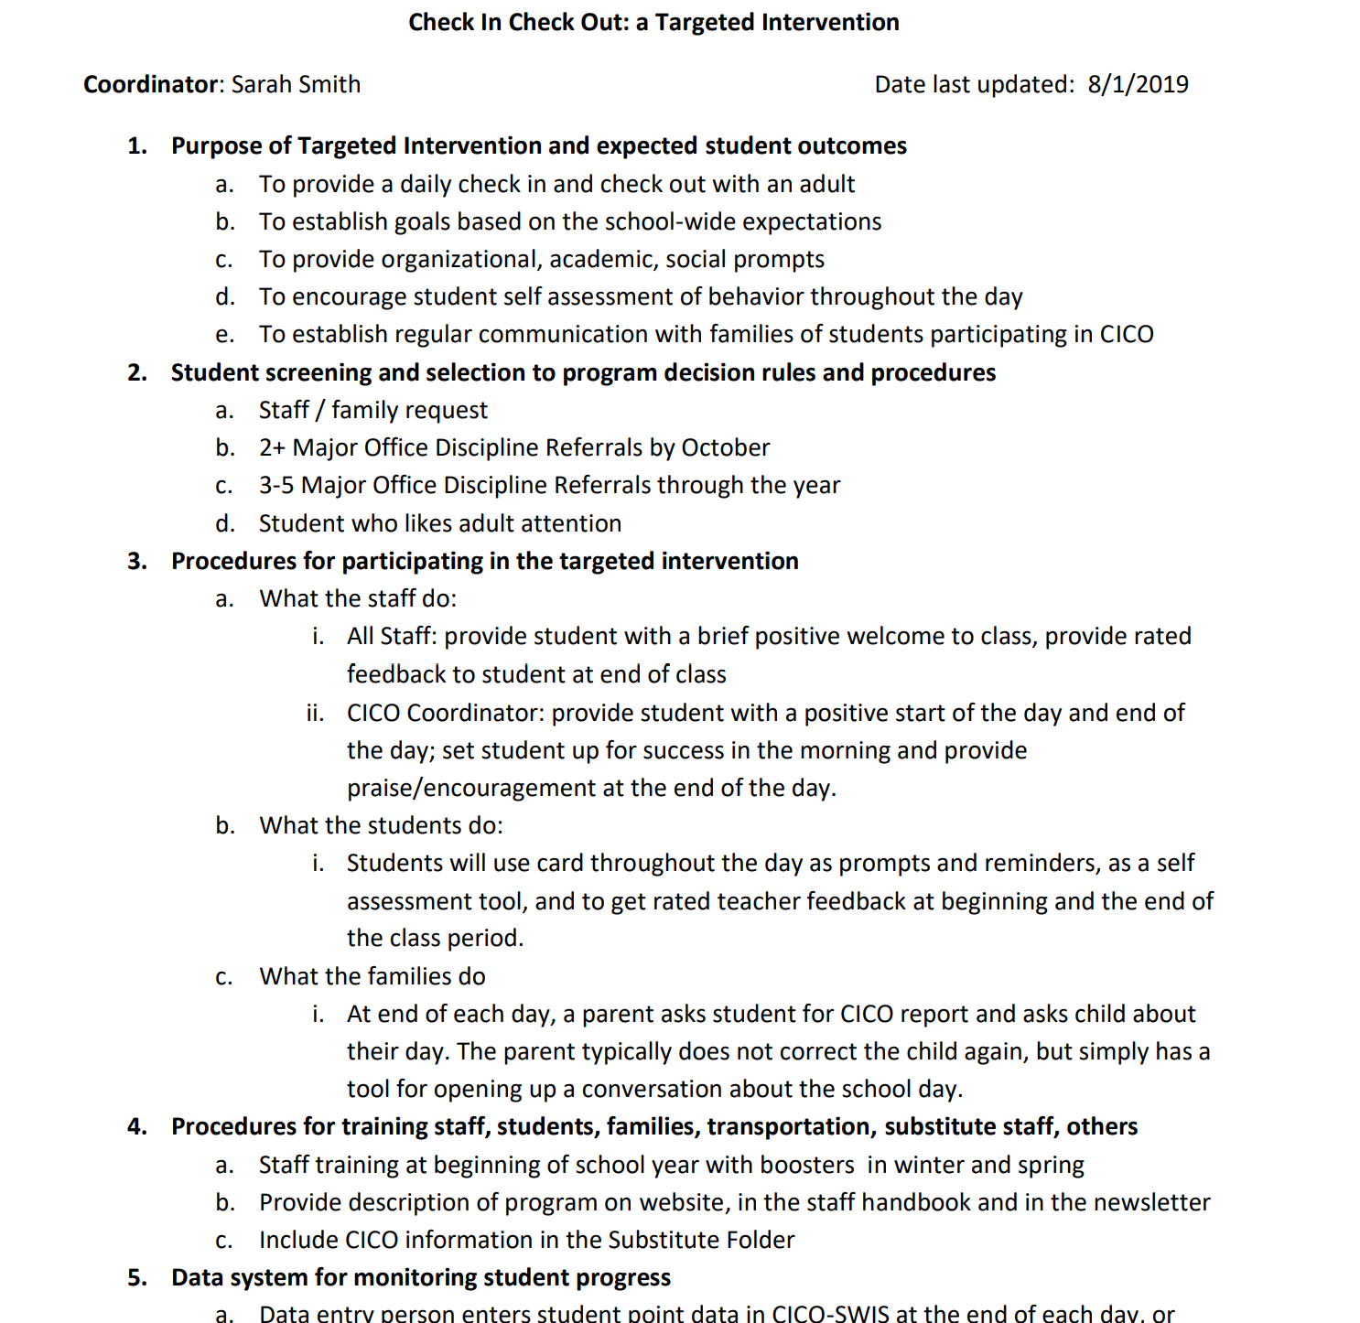
Sample Program Description for Staff
Notes:
https://www.pbisapps.org/resource/cico-intervention-descriptions
https://drive.google.com/file/d/1c9fc5_wzrw2UhJsBxUkC2vLFyzW7ifDA/view?usp=drive_link

Slide 31
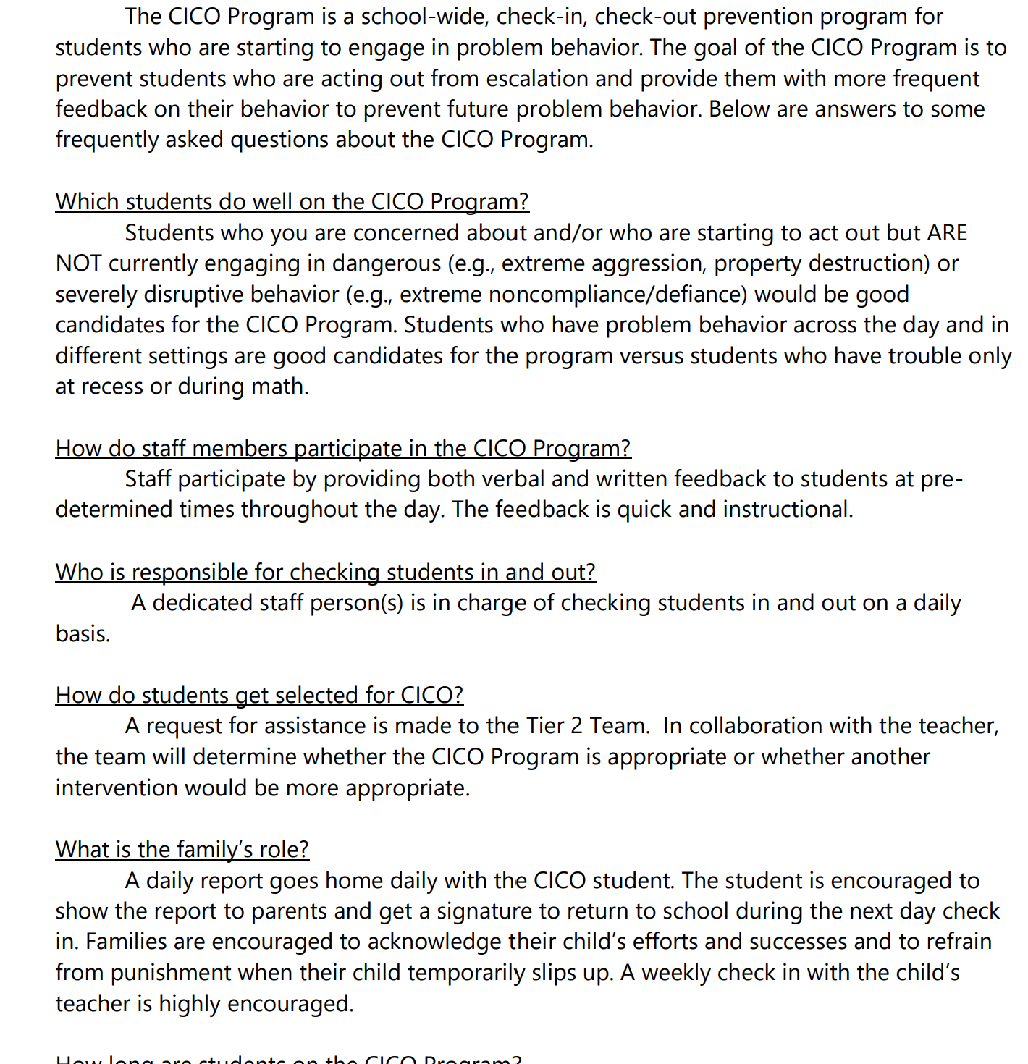
Sample Program Description for Families

Slide 32
ACTIVITY: MONITORING, EVALUATING & DOCUMENTING
How will you collect information on level of use and overall student progress for each intervention?
How are you monitoring fidelity for each intervention?
Has your team developed decision rules for organizing this process and modifying interventions as needed?
How will you ensure your systems and practices are documented? Who will be responsible?
How will you continue to evaluate your implementation?
Chat or Unmute & Share
10 minutes
Notes:
1
Highlight 1, 2, and 4? This could be a team breakout or a whole group discussion

Slide 33
PLANNING FOR NEXT YEAR
Notes:
With DESE Academy support
Regardless of Academy support

Slide 34
POSSIBLE FUTURE GOALS
Data-based decision making at Tier 2
Screening
Decision rules (for identifying students in need of support, adjusting implementation for students receiving supports)
Additional evidence based Tier 2 practices
Adjusting or modifying Tier 2 interventions
Using function to match student need to practices or modify interventions
Integration and alignment with SEL and mental health systems

Slide 35
Resources

Slide 36
RESOURCES
Tools to monitor intervention fidelity
Tools to monitor OUTCOMES and level of use
T2 Response Organizer
TIER 2 ANNUAL ACTION PLAN
TFI Action plan
Document and share routines
PBIS Annual Summary Tier 2
Tier 2 Staff Overview or here
Annual Summary to report to partners

Slide 37
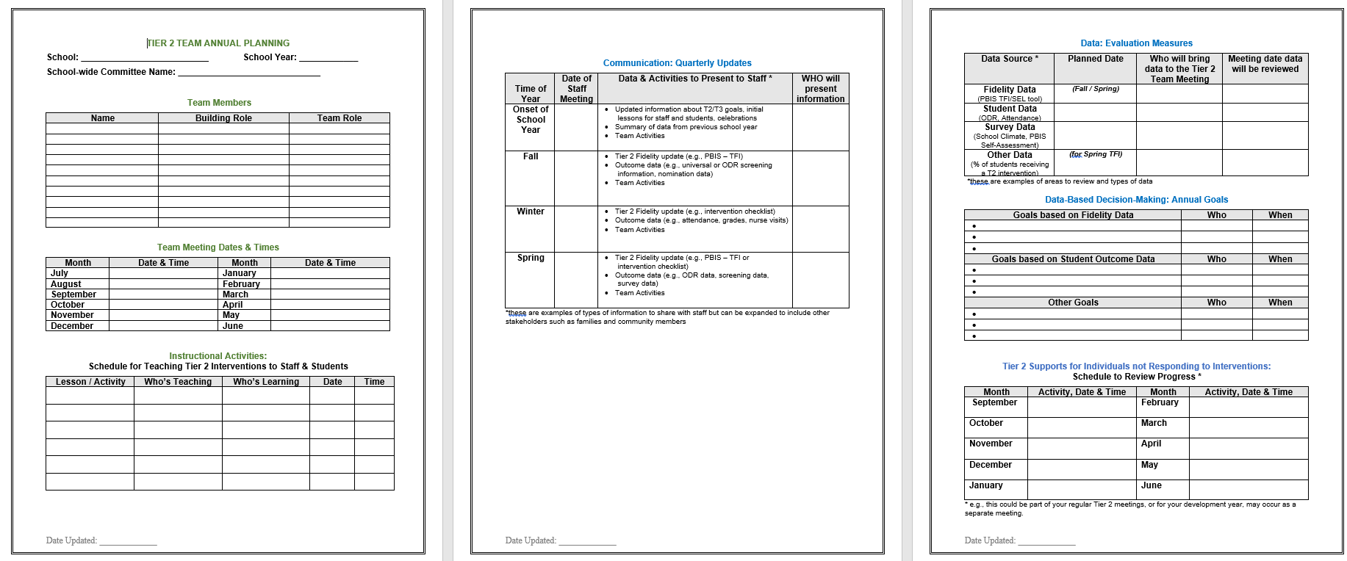
TIER 2 ANNUAL ACTION PLAN
Notes:
https://sebacademy.edc.org/tier-2-team-annual-action-planning-template

Slide 38
What are our options?
“Done”
Stay on list serv and when webinars or events become available, opt in or not
No TA through the DESE Academy
Advanced Tiers Support
Through the SEB academy
SEB Academy
Additional or other goals aligned with the academy
Apply to the SEB Academy
Notes:
build an integrated social, emotional, and behavior multi-tiered system of support
https://www.doe.mass.edu/sfss/prof-dev/
https://www.doe.mass.edu/csdp/sel-behavior-academy-at-a-glance.pptx

Slide 39
Did you see the Survey re: “interest” for next year?
Apply Here!
We don’t intend to continue with DESE Academy coaching activities
We would like to continue receiving “support” through the SEB ACADEMY
1) for advanced tiers support
2) for other goals
Coaching per school
2 in person events
Potential webinars
SWIS-CICO paid for by the academy
NOTE: Schools need to re-apply to the Academy, and "interest" at this stage does not assume or guarantee participation. It gives us an idea of potential numbers for further follow up.

Slide 40
Social, Emotional, Behavior Academy
Center for School & District Partnership
Program Description
The Social, Emotional, Behavioral Academy is a 3-year MTSS Academy that aims to help school and/or district teams cultivate joyful, culturally and linguistically sustaining learning environments and implement multi-tiered systems of social, emotional, and behavioral support. The MTSS Academy includes both professional learning and individual technical assistance/coaching to help teams identify specific goals related to tiered social, emotional, and behavioral support and work towards those goals with a team of colleagues.
Contact Information: Shai Fuxman
sfuxman@edc.org
To learn more, watch our video overview
Goals/Outcomes: All participating teams will…
develop a clear understanding of what an effective, proactive, culturally and linguistically sustaining MTSS entails for social, emotional, and behavioral support;
build an integrated social, emotional, and behavior multi-tiered system of support, with the ability to focus on specific goals and local context/needs; and
improve the learning experience and outcomes for students.
Program Expectations and Commitments
Academy participants will in a two-pronged mode of support:
Targeted Coaching: Participating teams are expected to meet at least monthly throughout school year with their academy-assigned coach. Coaches will support teams to assess needs, identify & prioritize areas of growth, develop & implement action plans, & monitor progress.
Learning Opportunities: Participants will be expected to participate in bi-annual, academy-wide, in-person convenings. In addition, optional professional development events will be offered including webinars, peer-sharing calls, and onsite PD.
Alignment to DESE Strategic Priority #1:
Cultivate systems to support the whole child and foster joyful, healthy, and supportive learning environments so that all students feel valued and connected.
Notes:
https://www.doe.mass.edu/sfss/prof-dev/
https://www.doe.mass.edu/csdp/sel-behavior-academy-at-a-glance.pptx

Slide 41
Social Emotional, Behavior Academy
Center for School & District Partnership
Team Composition
Each participating school or district team should include at least one of the following members:
district administrator/leader
school administrator/leader
student support staff
classroom educator
family member(s)
Readiness Requirements
Teams should be prepared to:
School/district leadership commitment to a process of needs assessment, identification and prioritization of areas for growth, action planning and implementation, and progress monitoring
Time for team members to meet with academy coach and participate in bi-annual in-person events.
Contact Information: Shai Fuxman
sfuxman@edc.org
Apply Here!
To learn more, watch our video overview
Topics covered through the SEB Academy:
Tier 1 (universal) social, emotional, and behavior supports: selecting and implementing culturally and linguistically sustaining tier 1 SEL programs and practices, strengthening school climate by cultivating student and adult sense of belonging, establishing positive behavioral interventions and support systems (PBIS).
Tier 2 and 3 (targeted & intensive) interventions: strengthening capacity to provide evidence-based interventions for students requiring more targeted supports, and strengthening systems to leverage and collaborate with community partners.
Strengthening overall systems and structures: identifying and addressing existing inequities related to social, emotional, and behavioral development; and creating systems to proactively identify, support, and monitor students needing additional supports.
“The Academy is an important resource that can help schools and
district advance SEL/MH work, and I appreciate the…personalized
technical assistance approach.”
Academy participant

Slide 42
SEB Academy “support” and commitment COACHING + Learning Opportunities
COACHING - Direct Support / Technical Assistance
Coaching:
Participating teams are expected to meet monthly throughout school year with their academy-assigned coach. Coaches will support teams to assess needs, identify & prioritize areas of growth, develop & implement action plans, & monitor progress.
Learning Opportunities
Learning Opportunities: Participants will be expected to participate in (2) bi-annual, academy-wide, in-person convenings.
Optional activities
Optional professional development events will be offered including webinars, peer-sharing calls, and on-site PD.
Notes:
Coaching
Likely monthly contact
Can be as a cohort if enough participants

Slide 43
ACTIVITY: PLANNING TIME
How are you thinking about planning for next year?
What are your goals/priorities?
What Tier 2 interventions do you plan to continue or expand?
Prepare to present 1 goal or accomplishment from your group to share in June.
Coaches
Remaining time

Slide 44
TRAINING EVALUATION (and look for an end of year ACADEMY Evaluation)
CONTACT INFORMATION:
Marcie Handler
mwhandler@gmail.com
Katie Meyer
Katherine.meyer@uconn.edu
Please remember to complete the evaluation to receive your Certificate of Attendance!
Notes:
Evaluation Link
https://edc.co1.qualtrics.com/jfe/form/SV_cBF9GI7gVEBsfSC

