Slide 1


PBIS School-Wide Team Training
Year 1: May 2023
PBIS Track
Add trainer names here
with support from NEPBIS Network, May Institute & Broad Reach Consulting
Notes:
Add trainer names for your event

Slide 2

EXPECTATIONS
Self
Others
Environment
Self-monitor
Listen while others are speaking​
Have your computer charged and ready to go​
If you have questions or comments:
Work as a team:
Keep necessary materials at hand
Are you participating?
Engaged as a learner?
Stretch, break, stand as needed​
Raise hand
Room for every voice
Reinforce participation
action plan
relevant docs
water/snacks
Minimize distractions if possible​

Slide 3
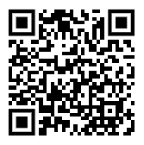
ACTIVITY: ATTENDANCE
Scan QR code on the left or follow the URL posted in the chat to access the online attendance survey
Follow prompts to enter attendance information
Notify trainers if you require assistance (e.g., identifying your cohort or cohort group)
Certificates of Attendance will be sent in January and June. Attendance records and Zoom log in will be use as verification
You are in Cohort 9
1 minute
Notes:
TRAINERS – QR Code is updated
Add your cohort letter – PLEASE review Certificates of Attendance process – They will automatically be sent in Jan and June based upon attendance and Zoom Log in info.
Post a link to the attendance survey (below) in the chat for those who do not use the QR code on the slide:
ATTENDANCE: https://edc.co1.qualtrics.com/jfe/form/SV_5BiXqi4bxzOCMS2

Slide 4
LUNCH REMINDERS
Make reservations during break if eating as a whole group.
Ask for check when food is brought to table for quicker check out.
We will start promptly at 1pm so please keep that in mind.

Slide 5
Agenda & Coaches' Tasks
Team Tasks:
Develop a continuum of consequences and its relevant components.
Presentation Content:
Quick review
Continuum of consequences
Creating Positive Teaching and Learning Environments
Preparing for Rollout
Revisiting Purpose and Outcomes
Decide how to support classroom educators with creating positive teaching and learning environments.
Prepare for rollout in the fall.
Revisit your purpose statement and outcomes.

Slide 6
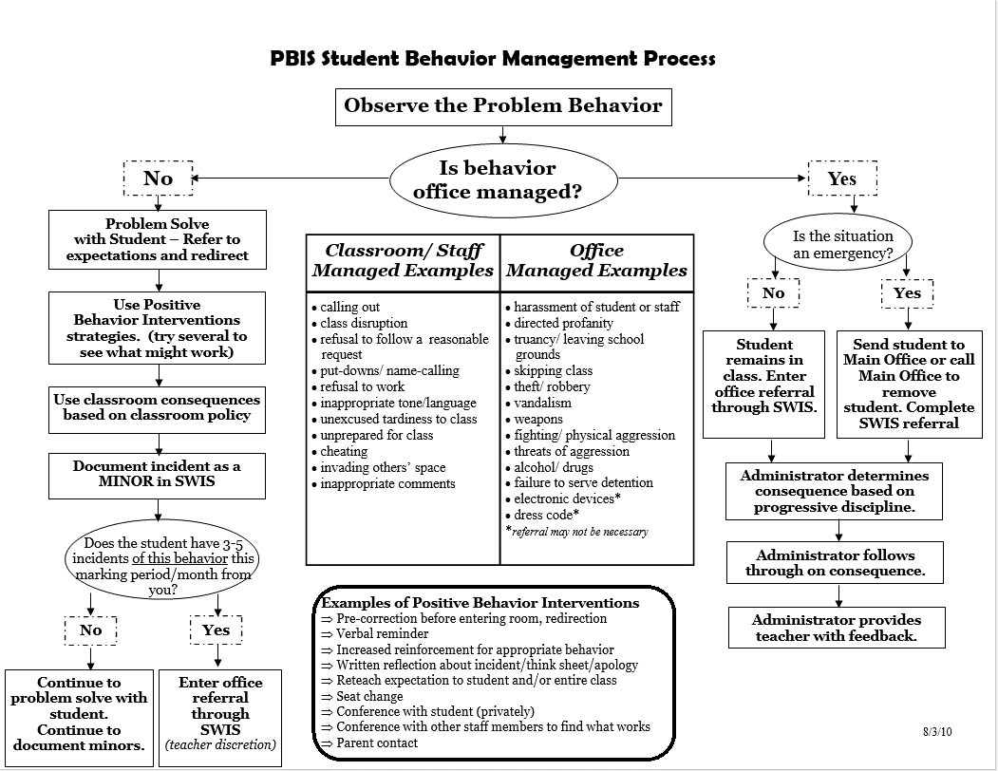
HELPFUL RESOURCES
Rollout Materials
Sample PBIS Handbooks
Sample Staff Slide Deck
Sample Student PBIS Slide Deck
Rollout Check List
Year-at-a-Glance Doc
RESOURCES:
Discipline System
Putting a Definition Back in Defiance (article)
Behavior Flow Chart Video
Defining Behaviors Video
Referral Form Video
Discipline Flow Chart Activity
Sample Flow Charts and Templates
Sample Behavior Definitions
Behavior Definition Activity
Sample Referral Forms
Referral Form Activity
CLASSROOM
Supporting and Responding to Students’ Social, Emotional, and Behavioral Needs: Evidence-Based Practices for Educators
Sample Classroom Routine Matrix
Classroom Matrix Video
Classroom Matrix Activity
Creating Effective Classroom Environments Plan Template
Creating a Classroom Teaching Matrix
De-escalation Strategies that keep behavior from going downhill
Notes:
Putting a Definition Back in Defiance - https://sebacademy.edc.org/putting-definition-back-defiance
Behavior Definition Activity: https://sebacademy.edc.org/behavior-definitions-activity
Defining Behaviors Video: https://sebacademy.edc.org/defining-behaviors-video
Sample Definitions: https://sebacademy.edc.org/list-of-pbis-resources?keyword=Sample+-+behavior+definitions&pbis_resource_type=All&pbis_resource_topic=All&sort_by=field_date_value&sort_order=DESC
Sample Flow Charts and Templates: https://sebacademy.edc.org/list-of-pbis-resources?keyword=Flow+Chart&pbis_resource_type=All&pbis_resource_topic=All&sort_by=field_date_value&sort_order=DESC
Behavior Flow Chart Video: https://sebacademy.edc.org/behavior-flow-chart-video
Discipline Flow Chart Activity: https://sebacademy.edc.org/discipline-flow-chart-activity
Referral Form Video: https://sebacademy.edc.org/referral-form-video
Sample Referral Forms: https://sebacademy.edc.org/list-of-pbis-resources?keyword=Sample+Referral+Form&pbis_resource_type=All&pbis_resource_topic=All&sort_by=field_date_value&sort_order=DESC
Referral Form Activity: https://sebacademy.edc.org/referral-form-activity
Supporting and Responding to Students’ Social, Emotional, and Behavioral Needs: Evidence-Based Practices for Educators - https://sebacademy.edc.org/supporting-and-responding-students-social-emotional-and-behavioral-needs-classrooms
Sample Classroom Routine Matrix https://sebacademy.edc.org/sample-classroom-routine-matrix
Classroom Matrix Video https://sebacademy.edc.org/classroom-matrix-video
Classroom Matrix Activity https://sebacademy.edc.org/classroom-matrix-activity
Creating Effective Classroom Environments Plan Template: https://www.pbis.org/resource/creating-effective-classroom-environments-plan-template
Creating a Classroom Teaching Matrix: https://www.pbis.org/resource/creating-a-classroom-teaching-matrix
Sample PBIS Handbooks: https://sebacademy.edc.org/list-of-pbis-resources?keyword=Sample+PBIS+Handbook&pbis_resource_type=All&pbis_resource_topic=All&sort_by=field_date_value&sort_order=DESC
Sample Student Slide Deck https://sebacademy.edc.org/sample-pbis-student-slide-deck
Sample Staff Slide Deck https://sebacademy.edc.org/sample-pbis-staff-slide-deck
Rollout Check List https://sebacademy.edc.org/rollout-checklist
Coaches Year at a Glance https://sebacademy.edc.org/coaches-year-glance

Slide 7
Yearly Product Review
Team Meeting Schedule / Action Plan - All
2 of the following:
  Expectations: Behavioral Matrix
  Acknowledgement: Acknowledgement Matrix or Written Instructions for Acknowledgment System
  Teaching: Lesson Plan or Teaching Plan (How you will structure your kick-off teaching to students)
Please show trainer your products for Check Off. You do not need to turn them into us. (But we love examples of your great work!)
Notes:
Trainer Note: If a team has another item that would fit into Classroom, Alignment or Equity, they can let us know and we can consider it. Most things will be approved.
https://www.doe.mass.edu/sfss/prof-dev/ Application for the Social Emotional Behavioral Academy – For Tier 2 or if you want specific

Slide 8
PBIS Review

Slide 9
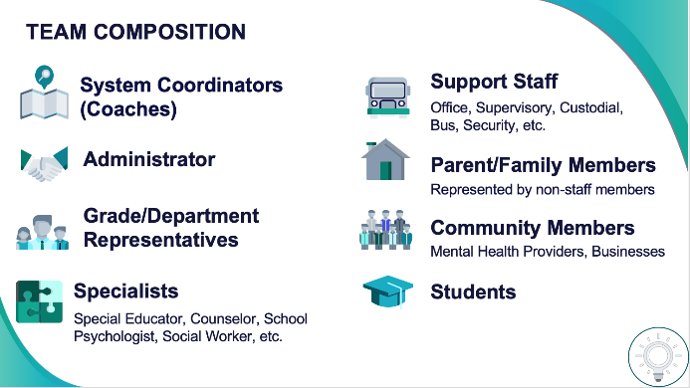
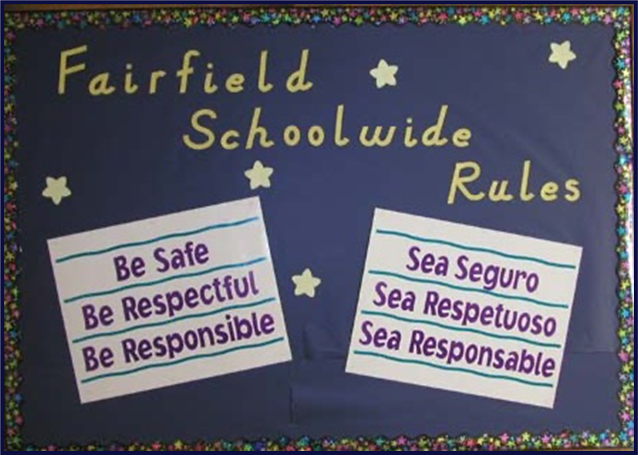
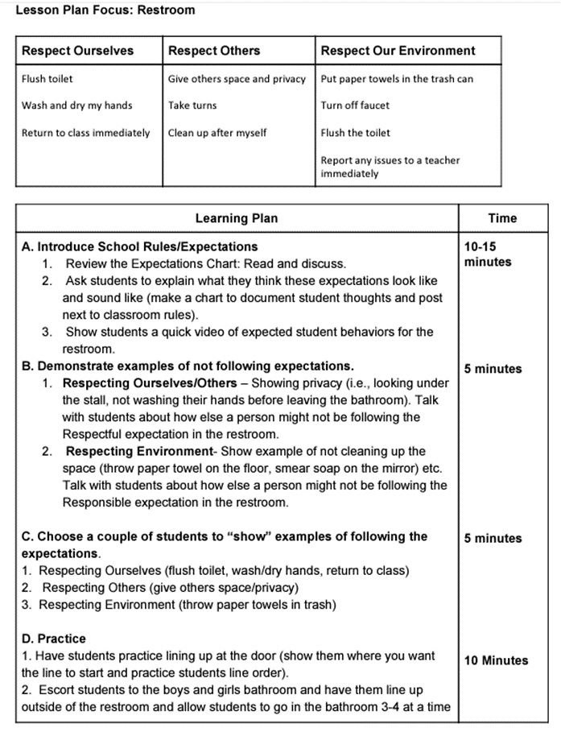
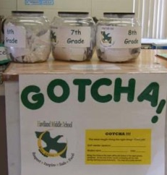
Establish an effective leadership team
Ensure all students develop the social-emotional-behavioral (SEB) skills needed to be effective learners through the implementation of evidence-based interventions and use of data to inform decisions.
Develop a brief statement of purpose & define outcomes
Identify positive school-wide behavior expectations
Develop procedures to teach school-wide behavior expectations
Develop a continuum to strengthen demonstrations of expectations

Slide 10
PBIS Next Steps

Slide 11
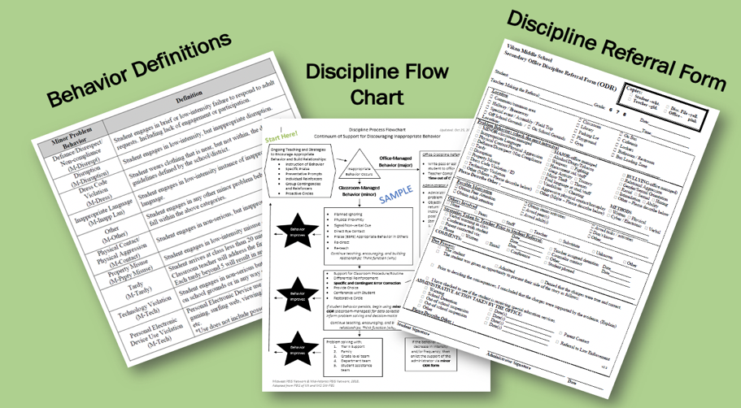
Develop a continuum to discourage
violations of expectations
Notes:
You will also clarify how staff should respond when contextually inappropriate behaviors occur by clearly defining, determining who’s responsible for responding, identifying clear responses, and recording the behaviors.

Slide 12
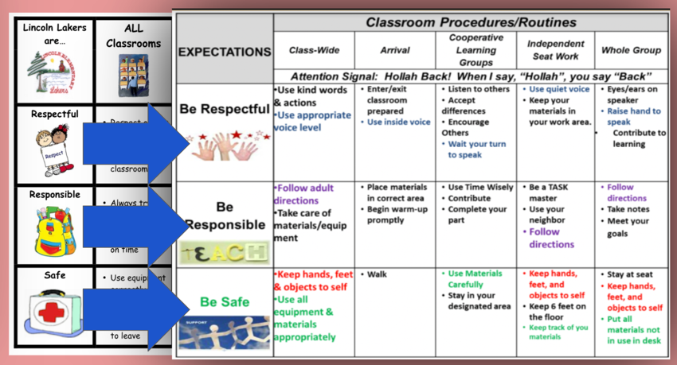
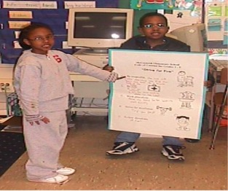
Develop procedures to teach class-wide expectations

Slide 13
Develop data-based procedures for monitoring
Collect Data!
Present the data in a user-friendly fashion
(i.e., graph)
Use the data to make decisions
Notes:
All the while you’ll be gathering data:
-to identify solutions to contextually inappropriate behavior
-to evaluate the fidelity to which you’re implementing PBIS
-to evaluate whether you’re getting your desired outcomes (such as increased attendance, fewer ODRs, and improved state test scores)

Slide 14
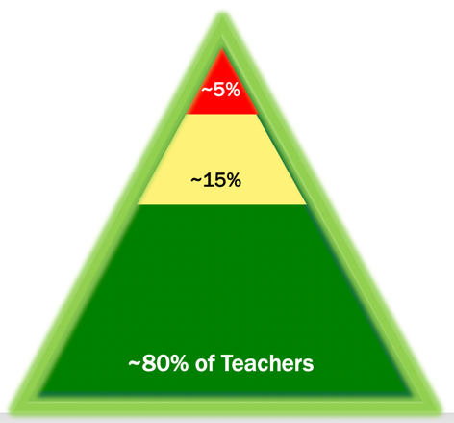
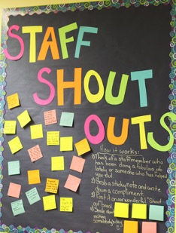

Develop systems to support staff
Notes:
PBIS is ineffective if it isn’t living and breathing within your entire school staff. Your team will spend time and effort on building and sustaining staff buy-in and building their capacities to use positive behavioral practices. Just like our students, our staff may need different levels of support to buy-in and implement PBIS.

Slide 15


Build routines to ensure ongoing implementation
Notes:
Finally, your team will work towards building systems and routines to ensure that the PBIS framework continuously improves and sustains over time.

Slide 16
ACTIVITY: TEAM DISCUSSION
Where are you with your PBIS Framework Implementation?
Which components need to be completed before you roll out to students in the fall?
Teams
Share Out
5 minutes
5 minutes

Slide 17
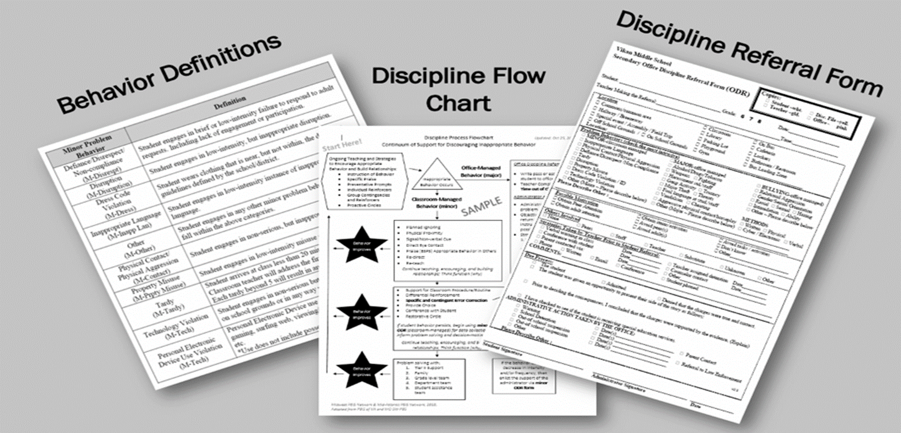
Developing a Continuum to Discourage Violations of Expectations
Notes:
Trainers: Coaches have seen this materials you might want to poll the group to see where they are at. You can go quicker if they have already started these items.

Slide 18
Identifying, teaching and reinforcing our school-wide and class-wide expectations is critical!
But, we also need to prepare staff for responding to contextually inappropriate behavior...
This requires :
Understanding the science of behavior
Clarifying definitions of behavior
Establishing consistent school-wide responses

Slide 19
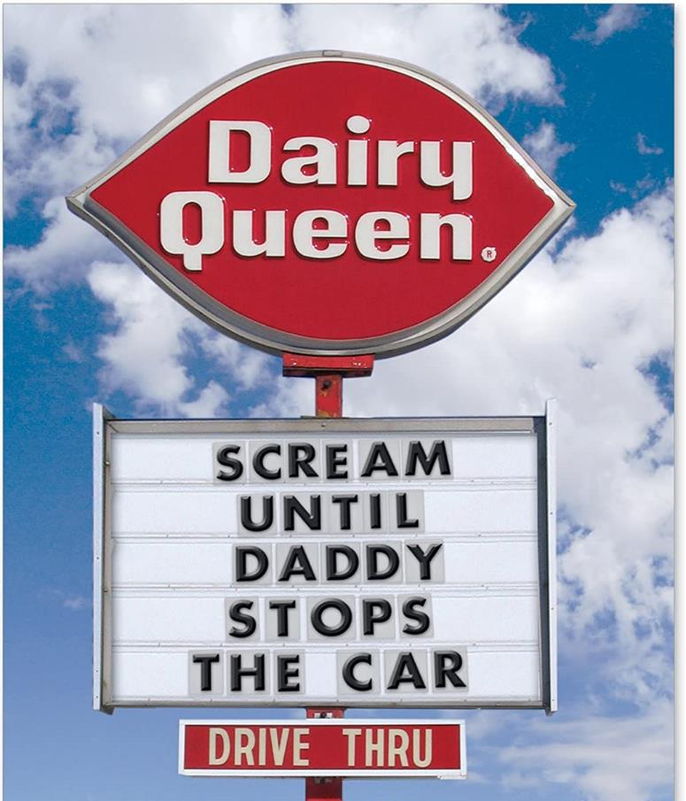
Before we can effectively encourage or discourage behavior, we need to understand why behavior happens AND how to identify why the behavior is continuing!

Slide 20
A basic understanding of the science of behavior change:
Gives us tools to observe, measure, teach, and correct behaviors effectively and efficiently.
Moves us away from perceptions, opinions, and assumptions about motivations or intentions
Shares the following assumptions (see right)
Behavior is communication.
Behavior occurs in the context of an antecedent and consequence.
Behavior is learned (function).
Behavior is lawful (function).
Behavior is escalated through successive interactions (practice).
Behavior can be changed through an instructional approach.
(Colvin & Sugai, 1989)

Slide 21
All behavior serves a function...
Get/Obtain
desired activities
tangible items
Avoid/Escape
aversive activities
tangible items
attention
sensory stimulation
attention
sensory stimulation
“Function” = outcome, result, purpose, consequence

Slide 22
REINFORCEMENT & PUNISHMENT
Reinforcement
Punishment
when a consequence of a behavior functions to INCREASE the likelihood of future occurrences of that behavior
when a consequence of a behavior functions to DECREASE the likelihood of future occurrences of that behavior
The only way to know if a consequence was a punishment or reinforcement is to look at future behavior.

Slide 23
Non-examples of Function-Based Approach
“Latanya, you skipped 2 school days, so we’re going to suspend you for 2 more.”
“Phebe, I’m taking your book away because you obviously aren’t ready to learn.”
Why are these
NON-examples of a
function-based approach?
  “You want my attention?! I’ll show you attention…
  let’s take a walk down to the office & have a little chat with the principal.”

Slide 24
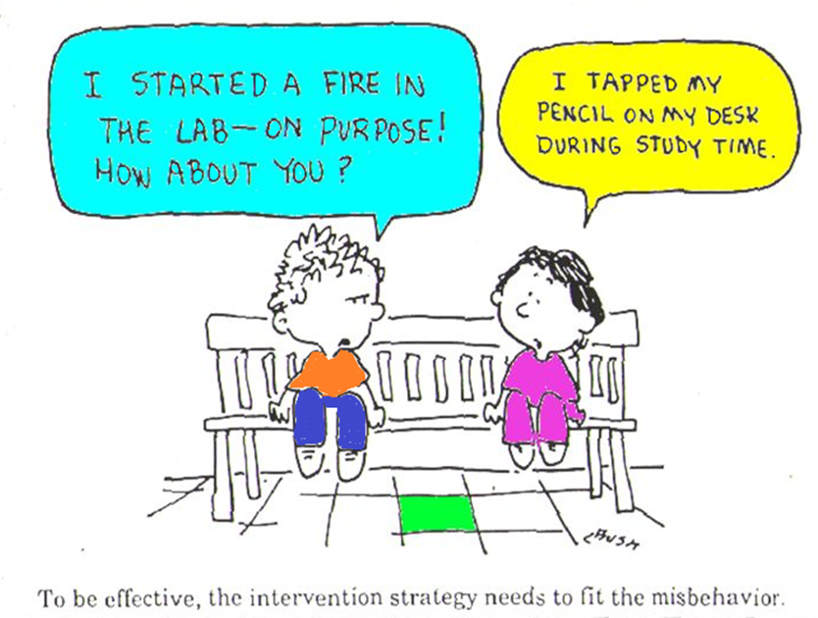
Why a Continuum of Consequences?
To ensure that the same consequence is not applied to all rule violations occurring in a school.
To establish a hierarchy from least to most severe consequences that are aligned with rule violations.
To better address the needs of a variety of students.

Slide 25
Before we begin…
What does contextually inappropriate behavior mean?
Behaviors or actions that are inappropriate in a given context but may be appropriate in another context.
We intentionally use the term contextually inappropriate behavior rather than unwanted or inappropriate behavior to emphasize the role of context in judgments about what behaviors are and are not accepted.
Calling out
While others are speaking
Replying to a choral response
Inappropriate
Appropriate
Yelling
In classroom
At recess
Inappropriate
Appropriate
Getting help from peers
During a test
During group work
Inappropriate
Appropriate

Slide 26
Clarifying which behaviors are
contextually inappropriate, classroom-managed, and office-managed can:
promote consistency
lessen ambiguity
reduce implicit bias

Slide 27
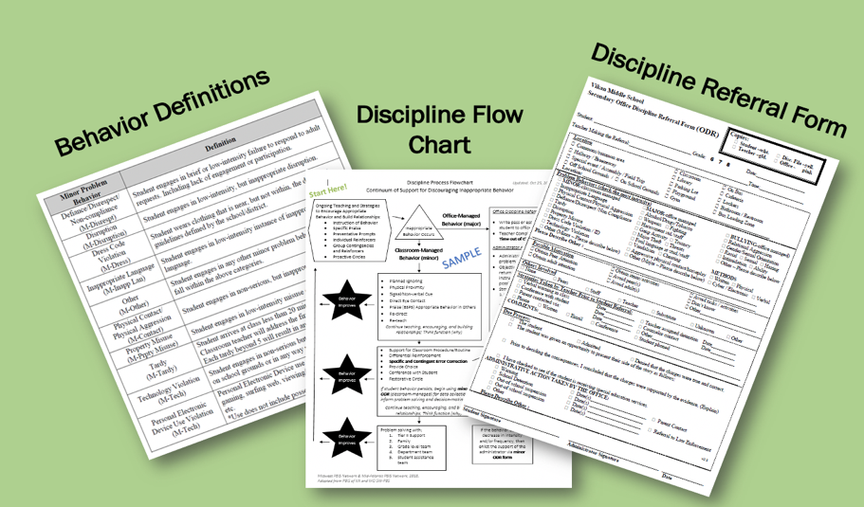
Developing a Continuum to Respond to Behavior Errors

Slide 28
Defiance, Disruption, Disrespect…Some Considerations
Are you and your colleagues likely to define these the same way?
Will your response to these behaviors be consistent regardless of your physical/emotional state?
When does defiant, disruptive or disrespectful behavior require an administrator supported response?
Does everyone in your school think similarly?

Slide 29
Critical Features of a
Continuum to Respond to Behavior Errors
Relate to the function of the behavior!
Align with clearly defined school-wide expectations
Exist as one component of a larger system of behavior change for the student.
  Teaching expectations
  Acknowledging appropriate behaviors
System of support exists including review, teaching, and monitoring of current responses to problem behavior

Slide 30
Organizing Responses: 3 Important Components
Clearly Defined Behaviors
Discipline
Flow Chart
Discipline Referral Form
Are all staff consistent with how violations of behavior expectations are labeled?
Are all staff knowledgeable on what responses are appropriate and the process for responding to violations of behavior expectations?
Are all staff consistent with recording and monitoring information when violations of behavior expectations occur?
Consistent Management & Tracking of Behaviors
Communication & Data Review
Consistent Responses
Notes:
Trainer note:

Slide 31
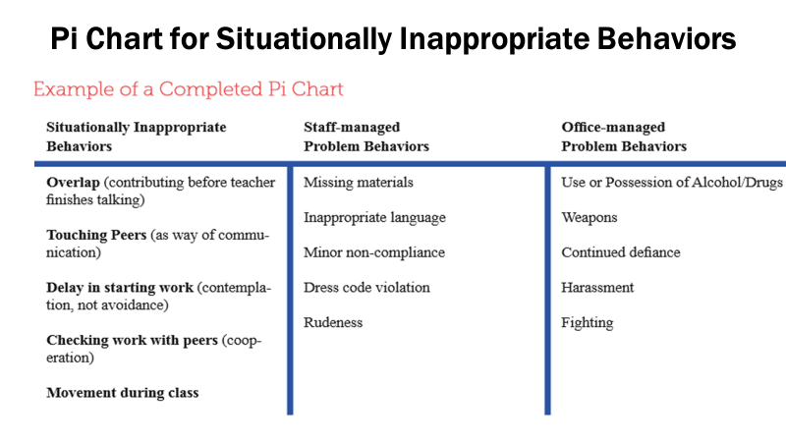
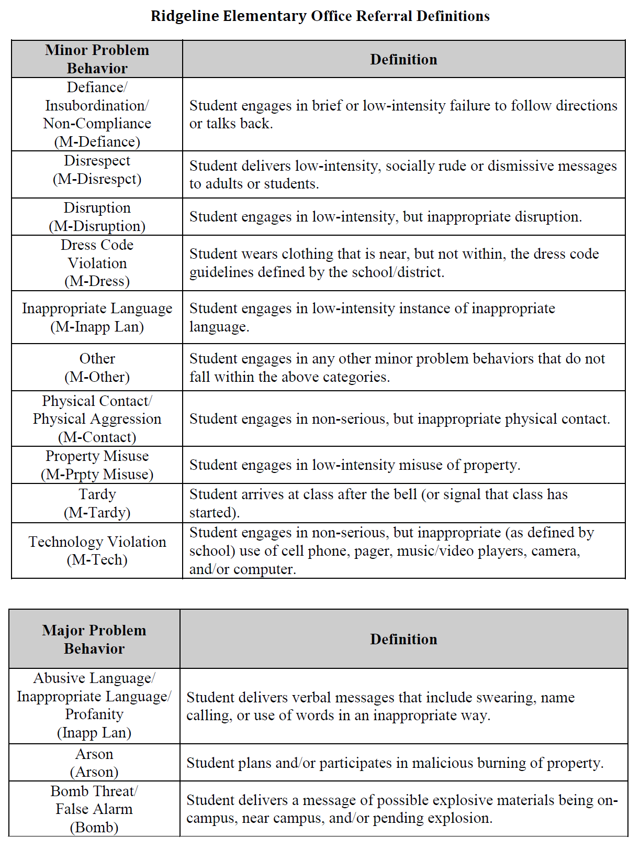
Clearly Defined Behaviors
Clearly Defined Behaviors
Organize your responses around those that are
staff-managed & those that are administrator-managed
Are all staff consistent with how violations of behavior expectations are labeled?
Minor Behaviors
Identify those behaviors that generally should be managed in the classroom
frequent, low intensity behaviors
Major Behaviors
Identify those behaviors that generally should be managed in the office
in-frequent, high intensity behaviors
Communication & Data Review
Notes:
Defining Behaviors Video: https://sebacademy.edc.org/defining-behaviors-video

Slide 32
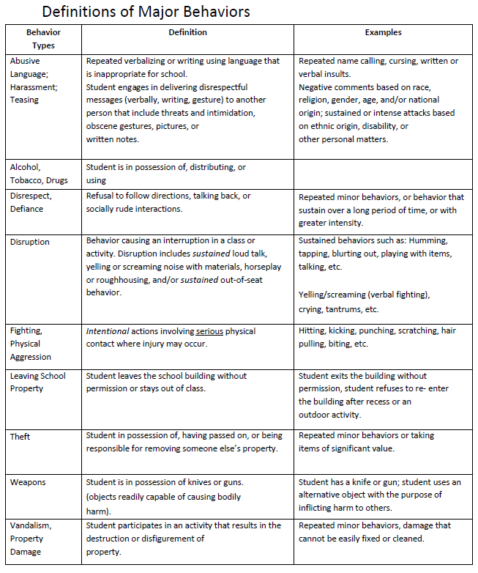
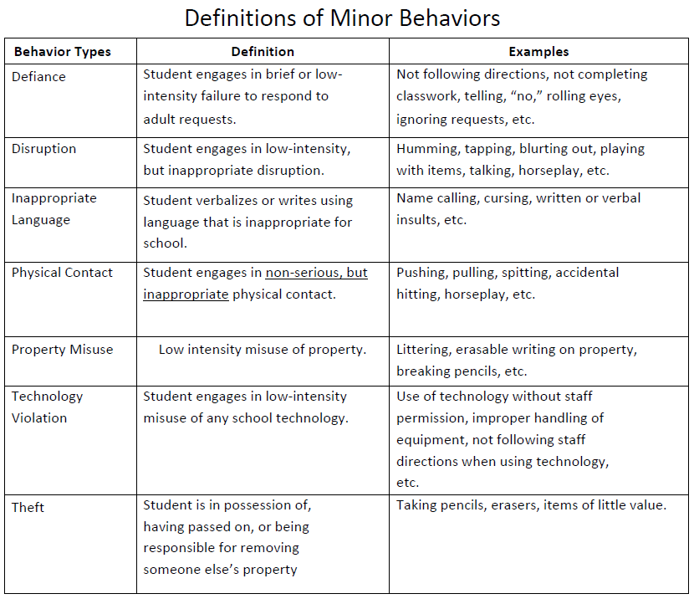
Definition
Sample
Administrator-Managed Behaviors
Staff-Managed Behaviors

Slide 33
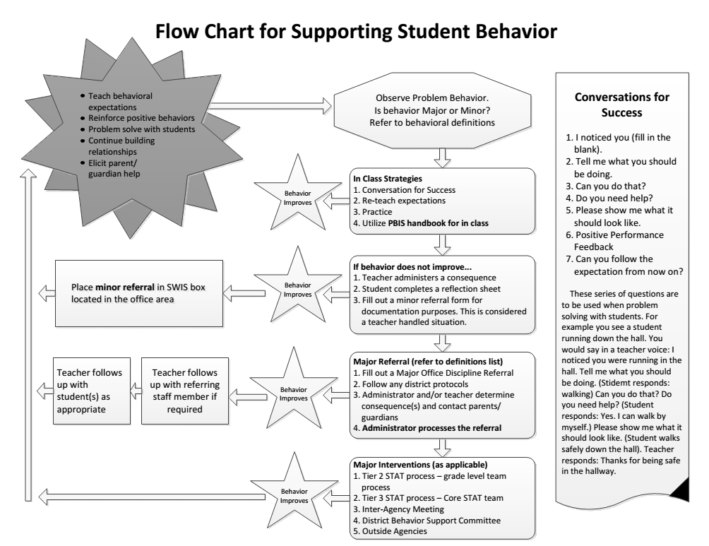
Discipline Flow Chart
Clearly outline process for responding to behavior as well as
how we track student/staff behavior
Discipline
Flow Chart
Are all staff knowledgeable on what responses are appropriate and the process for responding to violations of behavior expectations?
Behavior Tracking
Outline what information is tracked at which points and where that data will be collected and housed.
Staff Responses
Outline responses linked to various levels of behavior and a process for both classroom and office managed behavior that is clear to both staff and students.
Consistent Responses

Slide 34
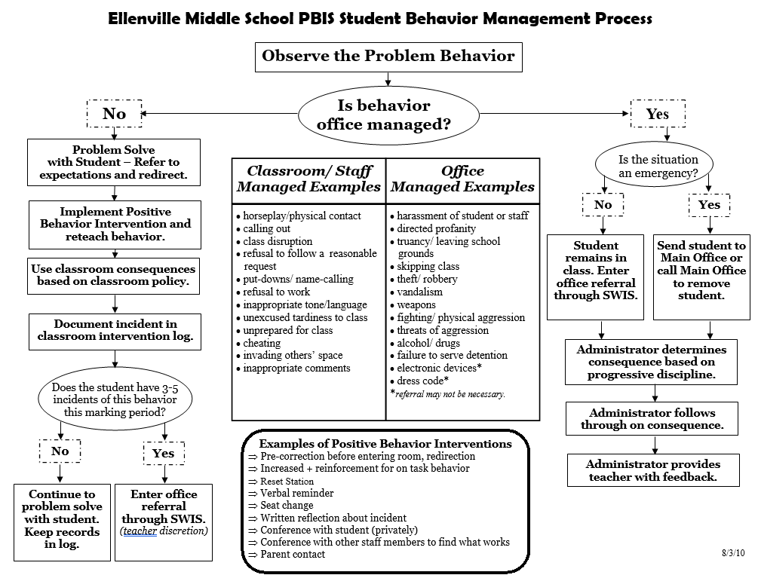
FLOW Chart
Sample
Notes:
Behavior Flow Chart Video: https://sebacademy.edc.org/behavior-flow-chart-video

Slide 35
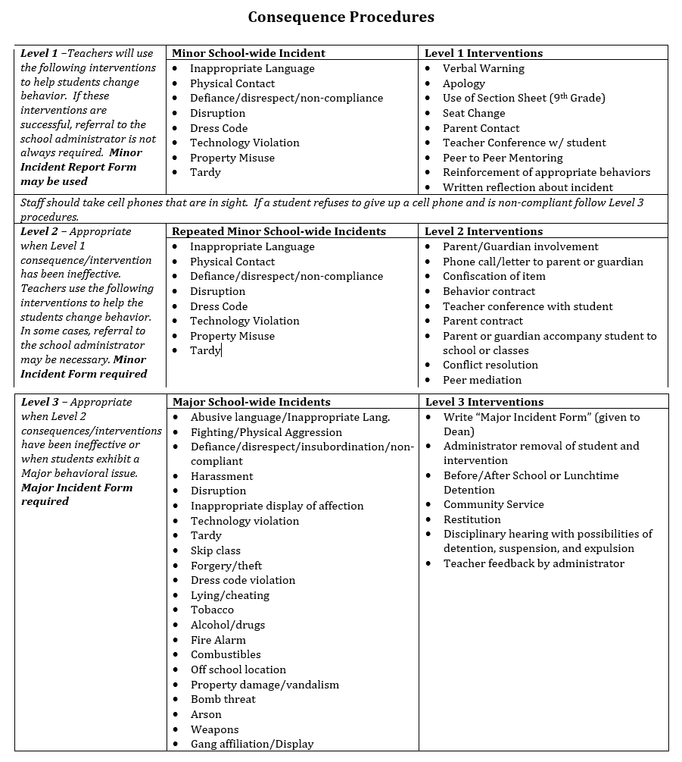
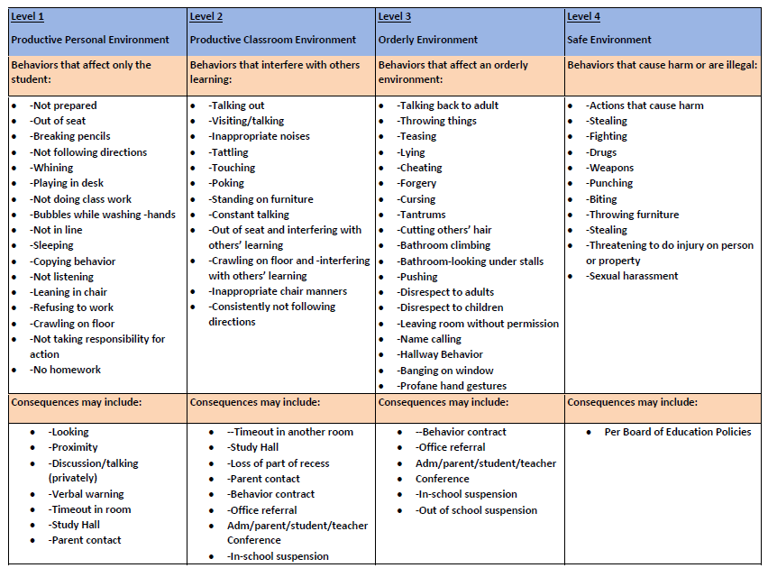

Slide 36
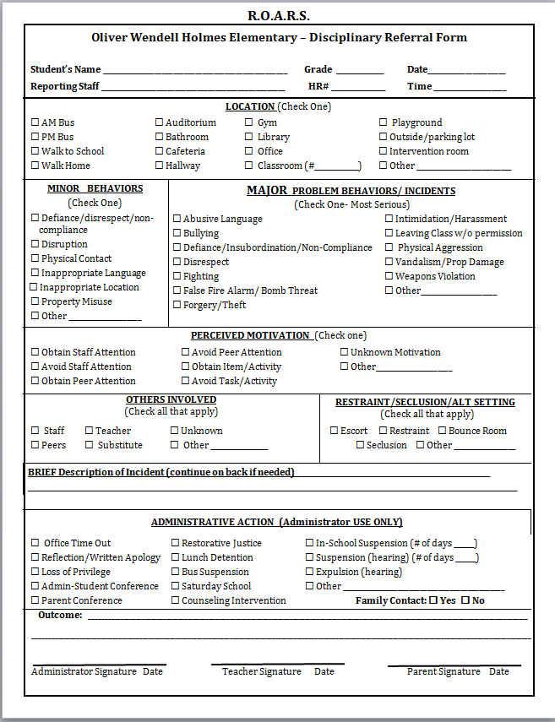
Discipline Referral Form
Clearly outline a system for tracking behavioral infractions that will support decision making.
Discipline Referral Form
Referral Form(s)
Develop referral forms with adequate specificity to support data-based decision making at the universal level.
System to Support Fidelity
Ensure language is consistent with behavior definitions and flow chart, form can be completed quickly, and staff are trained and supported with use.
Are all staff consistent with recording and monitoring information when violations of behavior expectations occur?
Consistent Management & Tracking of Behaviors
Notes:
Referral Form Video: https://sebacademy.edc.org/referral-form-video

Slide 37
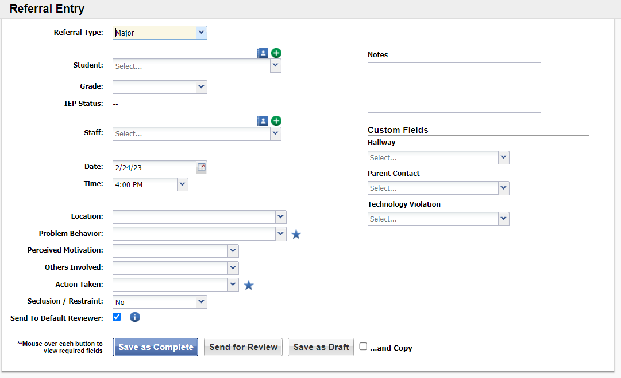
SWIS has Electronic Referral Option

Slide 38


Referral Form
IT IS…
IT IS NOT…
Clear, mutually exclusive, exhaustive definitions
Underestimation of actual behavior
Piece of information used to make decisions
A reflection on teacher’s skills
A way to change or re-teach behavior
Punishment
An interaction between Kid - Staff Member - Administrator
Allows teacher to continue teaching
A first attempt at correcting behavior

Slide 39
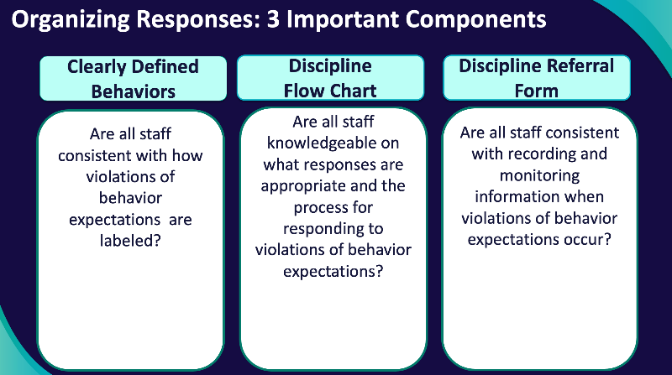
DISCUSSION: Developing a Continuum to Respond to Behavior Errors
As a team:
Assess which of these components are already developed and which need to be developed.
Develop components as needed.
Consider how you will gather input from staff.
Identify what further support do you need to develop these components.
Add items to your action plan.
Prepare to share out with the larger group.
30 minutes

Slide 40
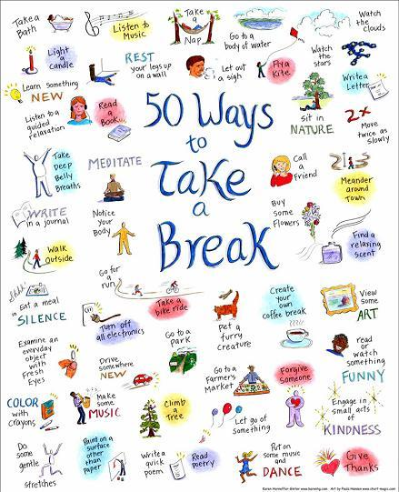
15-minute break

Slide 41
Creating Positive Teaching and Learning Environments

Slide 42

Supporting and Responding to Students’ SEB Needs
Practices
Summarizes evidence-based, positive, and proactive practices that support and respond to students’ social, emotional, and behavioral (SEB) needs in classrooms.
Center on PBIS. (2022). Supporting and responding to student’s social, emotional, and behavioral needs: Evidence-based practices for educators (Version 2.0). Center on PBIS, University of Oregon. www.pbis.org.
Notes:
https://www.pbis.org/resource/supporting-and-responding-to-behavior-evidence-based-classroom-strategies-for-teachers

Slide 43

Supporting and Responding to Students’ SEB Needs
1. Create Positive Teaching and Learning Environments
Design a Safe Environment
2. Actively Promote SEB Growth
Engage Students in Relevant Learning
3. Monitor Fidelity and Use Data to Guide Implementation
Monitor Educator Implementation
4. Monitor Student Outcomes and Use Data to Guide Response
Establish Positive Connections
Develop Predictable Routines
Define and Teach Positive Expectations
Plan Relevant Instruction
Foster Positive Relationships
Prompt and Supervise SEB and Academic Skills
Provide Specific Feedback (> 5 : 1 Ratio)
Consider Other Response Strategies
Provide Training, Coaching, and Feedback
If data indicate implementation challenges...
Monitor Student Outcomes
Enhance Tier 1
If many students make ongoing SEB errors...
Enhance Tier 1 and Consider Tiers 2 and 3
If few students make ongoing SEB errors...

Slide 44
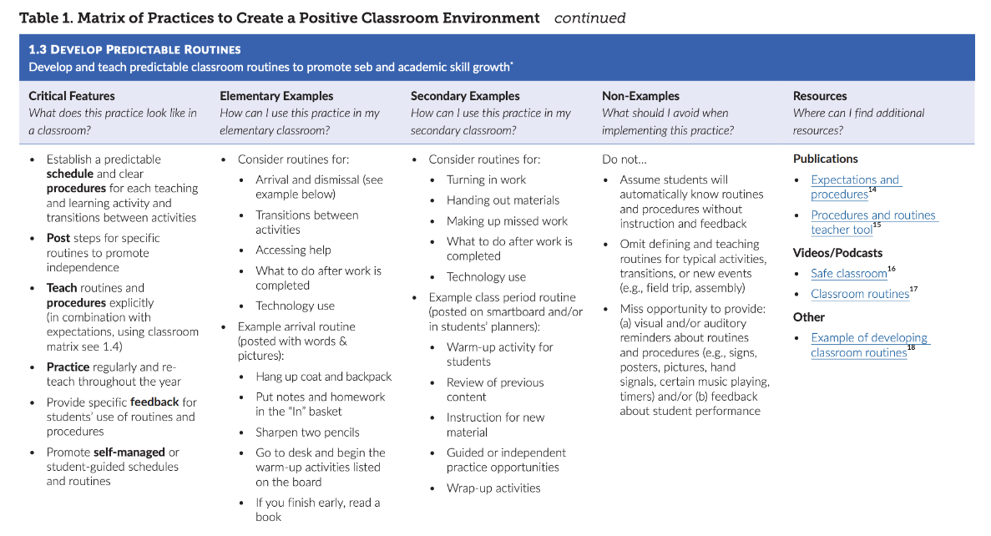

Slide 45
Supporting and Responding to Students’ SEB Needs
1. Create Positive Teaching and Learning Environments
Design a Safe Environment
2. Actively Promote SEB Growth
Engage Students in Relevant Learning
3. Monitor Fidelity and Use Data to Guide Implementation
Monitor Educator Implementation
4. Monitor Student Outcomes and Use Data to Guide Response
Establish Positive Connections
Develop Predictable Routines
Define and Teach Positive Expectations
Plan Relevant Instruction
Foster Positive Relationships
Prompt and Supervise SEB and Academic Skills
Provide Specific Feedback (> 5 : 1 Ratio)
Consider Other Response Strategies
Provide Training, Coaching, and Feedback
If data indicate implementation challenges...
Monitor Student Outcomes
Enhance Tier 1
If many students make ongoing SEB errors...
Enhance Tier 1 and Consider Tiers 2 and 3
If few students make ongoing SEB errors...
Today’s Focus

Slide 46
1. Create Positive Teaching and Learning Environments
Design a Safe Environment
Establish Positive Connections
Develop Predictable Routines
Define and Teach Positive Expectations
Plan Relevant Instruction
Practices to Create
Positive Teaching and Learning Environments

Slide 47
Establish Positive Connections
Engage in purposeful communication with students and families
Build in regular opportunities for positive connection throughout the year
Use formal and informal approaches to learn about students and their learning histories, identities, and preferences
Authentically engage families as partners in learning
Validate and affirm personal and cultural learning histories

Slide 48
Relationships Matter
A Review of Educational Research analysis of 46 studies found that strong teacher-student relationships were associated in both the short- and long-term with improvements on practically every measure schools care about:
higher student academic engagement
attendance
grades
fewer disruptive behaviors and suspensions
lower school dropout rates
https://www.edweek.org/teaching-learning/why-teacher-student-relationships-matter/2019/03

Slide 49


Building Relationships: Thresholding / Greeting Students at the Door
https://youtu.be/IHc7K_8JGT8
https://youtu.be/956br98qWbE

Slide 50
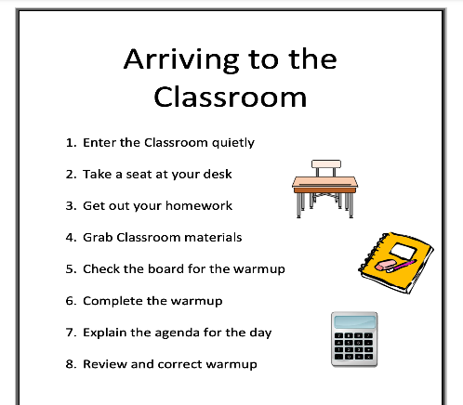
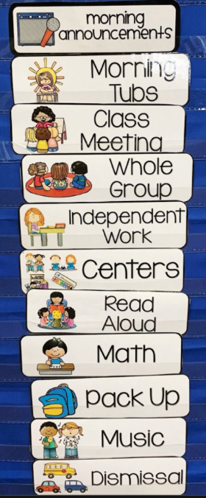
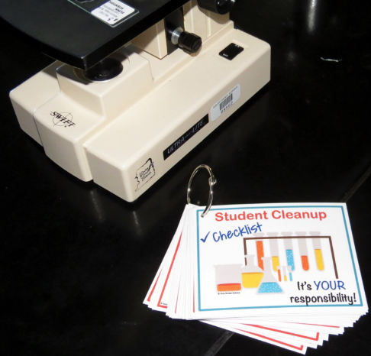
Develop Predictable Routines
Establish a predictable schedule and clear procedures for each activity and transition
For each routine/procedure:
Post steps to promote independence
Teach explicitly
Practice regularly and reteach frequently
Provide specific feedback on student use

Slide 51
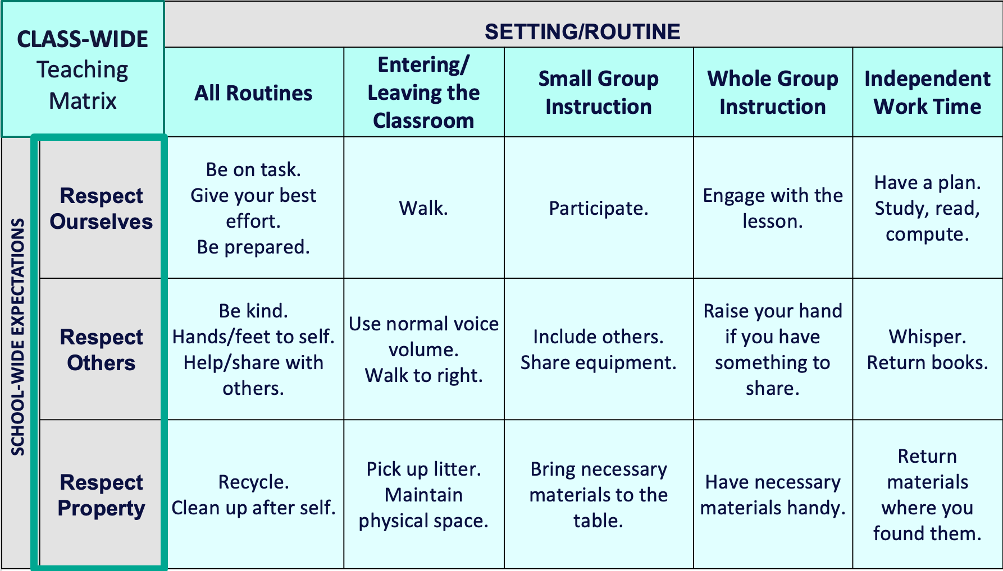
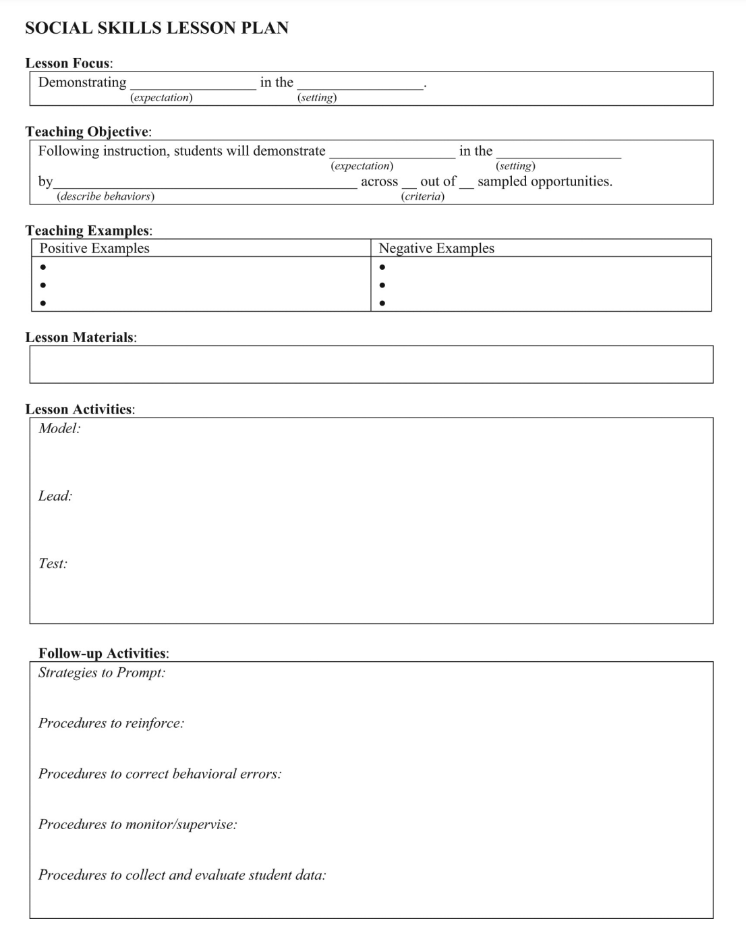

Define and Teach Positive Expectations
Define
Teach
Prompt
Monitor
Evaluate

Slide 52
Classroom Matrix
Expectation | Start of class | During individual tests | During lecture in class | Outside of class time preparation
Be here and ready On time Prepared | Arrive on time to class. Bring your notebook and writing materials. Listen for when class begins. | Be focused on the current unit tests. Remember to follow procedures for individual tests. Organize and get to work promptly. | Be focused on the current unit of instruction. Use your notebook for taking notes. | Review prior class notes before next class. Adequately prepare by doing readings and assignments. Keep your materials organized.
Be responsible Quality work Collaborate | Arrive on time to class. Come prepared by completing all assignments and readings. Follow all procedures in course organizer if you miss a class. | Remember to follow procedures for individual tests. Organize and get to work promptly Make a good effort on each question. Be on task and ask for clarification as needed | Listen and think about points raised in the lecture. Ask questions and respond to questions. Share your perspective on relevant issues to the topic at hand | Keep your materials organized.
Be respectful Encourage others Recognize others | Politely greet classmates and teacher when arriving to class. Ask others how things are going. Provide guidance to classmates who may have been absent from last class. | Get to work quickly on individual tests. Work quietly. | Follow along when someone is speaking . Think about the concepts and practices being described; get the most you can out of class. | Be patient when emailing your teacher with questions or concerns.
(adapted from Knoster, 2019)

Slide 53
Classroom Matrix SAMPLE
 | Entering Class | Lecture/ Presentation | Work Time | Electronics | Leaving Class
Be Respectful | Enter calmly. Be seated before the bell rings. Keep hands off other people’s property. Leave desks and chairs in place. | Listen attentively. Wait for your turn. Have a positive attitude. Keep feet on the floor. | Work quietly. Do your share in group projects. Be cooperative. Keep area clean. | Keep off until needed. Turn off volume. Use gently and carefully. Download large files after school. | Stay in your seat. Clean up around your desk. Push chairs in.
Be Responsible | Have books and materials out and ready to go. | Take notes. Meet deadlines. Focus on your learning. | Follow directions. Get help when needed. Do your own work. | Stay on task. Text/call people only during allowed times. | Return supplies. Report accidents promptly.
Be Safe | Walk | Be thoughtful and considerate of others. | Let others do their work. | Model digital citizenship. | Leave calmly when dismissed.
Be Prepared | Bring all materials. | Remain in your seat. | Use time wisely. | Have computer charged and ready to use. | Know expectations for next class.

Slide 54
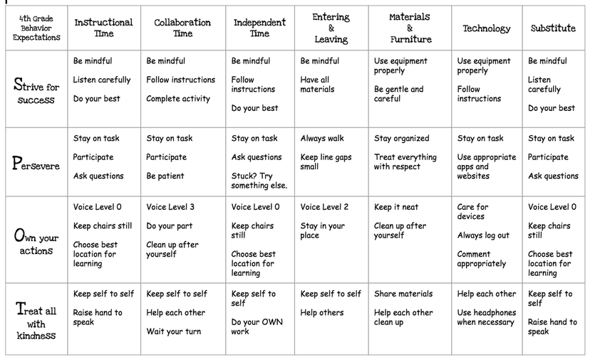
Classroom Matrix SAMPLE

Slide 55
Classroom Matrix SAMPLE

Slide 56
Enhance student voice by co-constructing the classroom matrix
Ms. L's Room | Entering | Group Work | Whole Group Instruction | Independent Work Time
Be Prepared
Be Safe
Be Respectful
Educators can engage students in identifying examples of what it looks and sounds like to meet expectations during each routine.
Students can also add routines that need to be added to the matrix

Slide 57

Helpful Resource
This brief provides guidance for creating and using a classroom teaching matrix to explicitly identify, define, and teach:
predictable classroom routines
positive classroom expectations
critical social, emotional, and behavioral (SEB) skills
Notes:
Creating a Classroom Teaching Matrix: https://www.pbis.org/resource/creating-a-classroom-teaching-matrix

Slide 58
Define
Teach
Prompt
Monitor
Evaluate

Slide 59
Teach
Rules in the context of routines
Teach expectations directly.
  Define rule in operational terms—tell students what the rule looks like within routine.
  Provide students with examples and non-examples of rule-following within routine.
Actively involve students in lesson—game, role-play, etc. to check for their understanding.
Provide opportunities to practice rule following behavior in the natural setting.

Slide 60

Teaching and Practicing Routines
MS Structures for Success
https://youtu.be/vaedonG8-_Q?t=299
Notes:
Play video through to the end

Slide 61
Prompt
or remind students of the rule
Use pre-corrections, which include “verbal reminders, behavioral rehearsals, or demonstrations of rule-following or socially appropriate behaviors that are presented in or before settings where problem behavior is likely”
- Colvin, Sugai, Good, & Lee (1997)

Slide 62
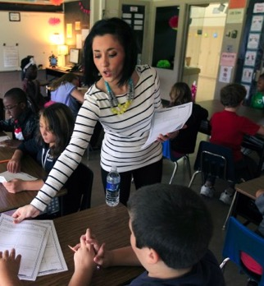
Prompts happen BEFORE opportunities for errors begin!
If you need help during this work,
raise your hand.
Before sending students off to work in small groups, provide a quick reminder about the expectations

Slide 63

Video Example: Prompting HS students before a test
https://youtu.be/fcnG1F-lQyA?t=258

Slide 64
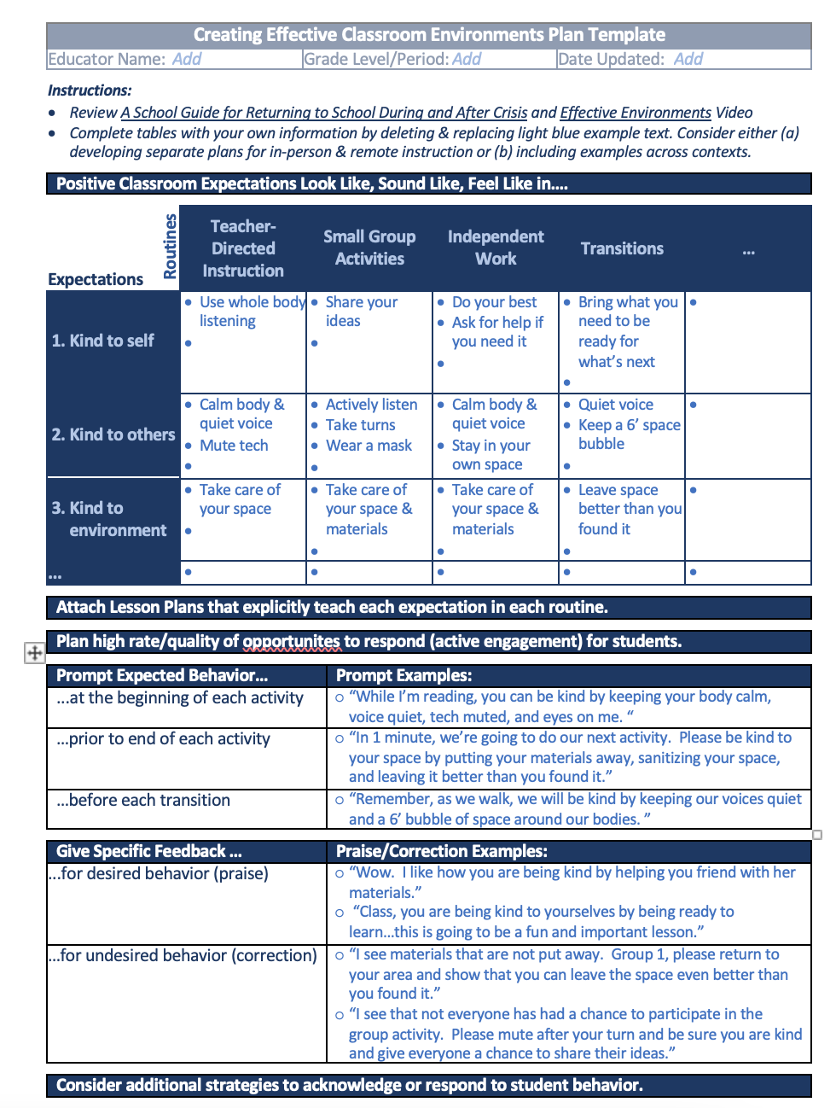
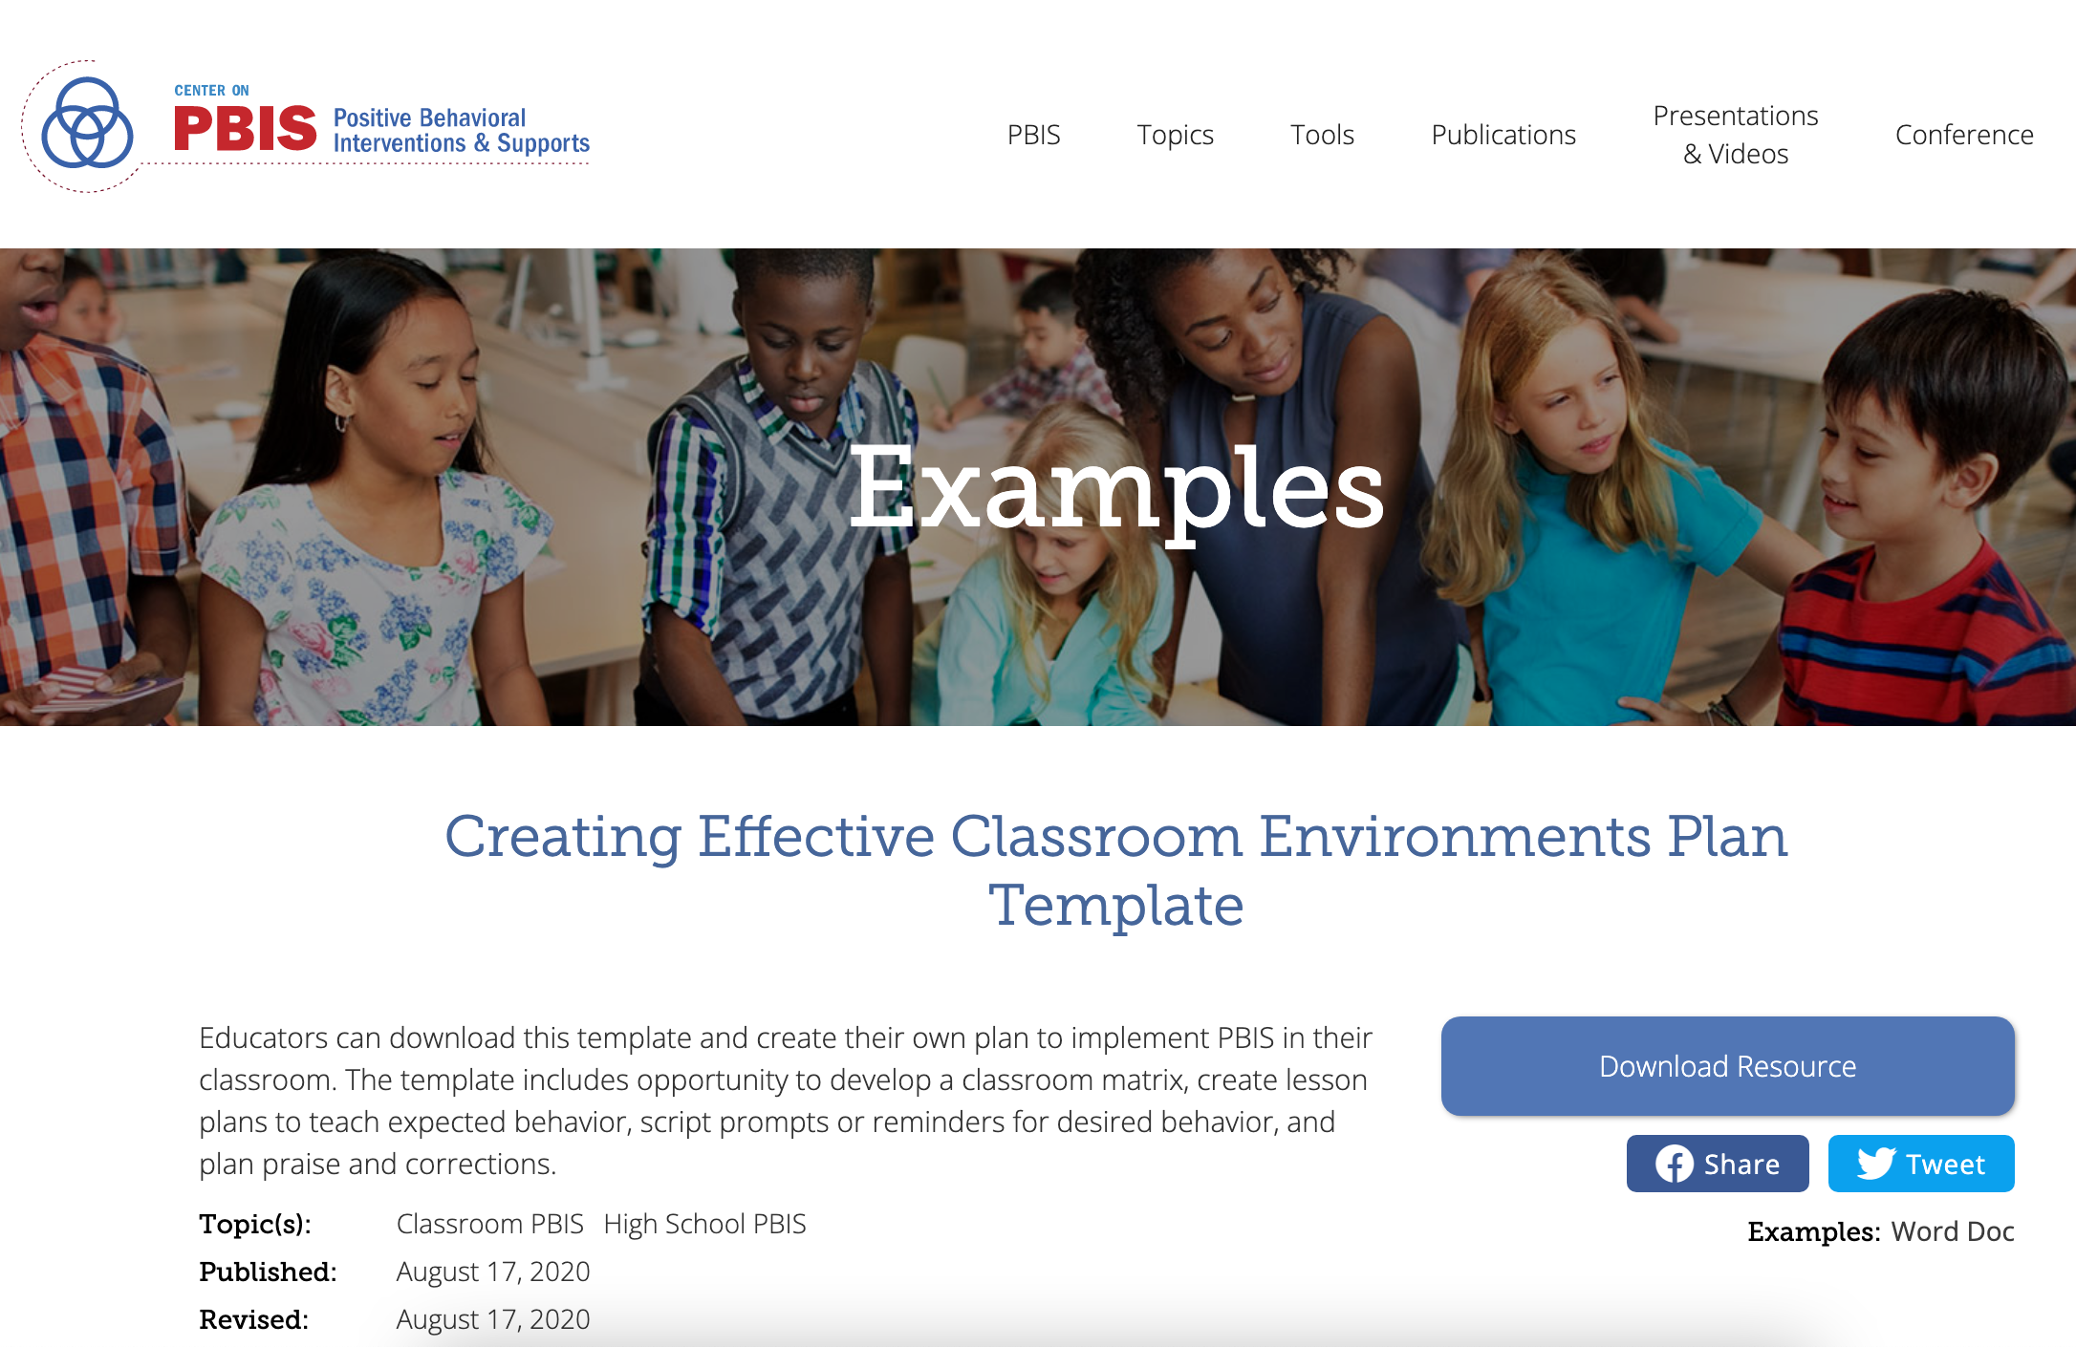
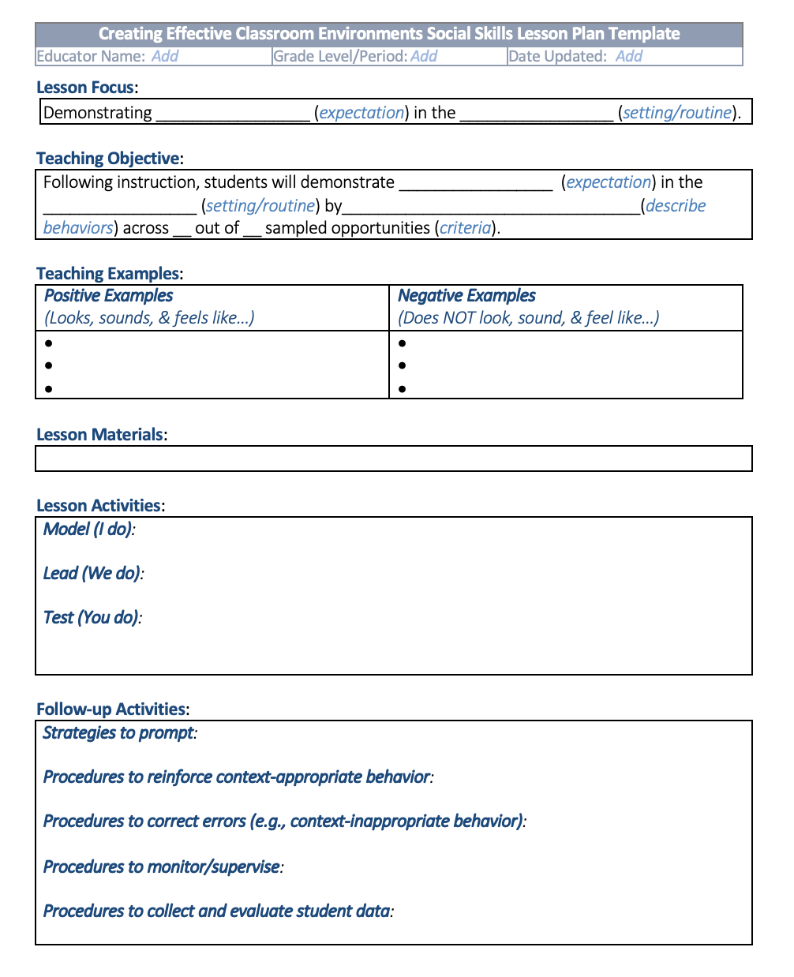
Helpful Resource
Creating Effective Classroom Environments Plan Template
Educators can download this template and create their own plan to implement PBIS in their classroom. The template includes opportunity to develop a classroom matrix, create lesson plans to teach expected behavior, script prompts or reminders for desired behavior, and plan praise and corrections.
Notes:
https://www.pbis.org/resource/creating-effective-classroom-environments-plan-template

Slide 65

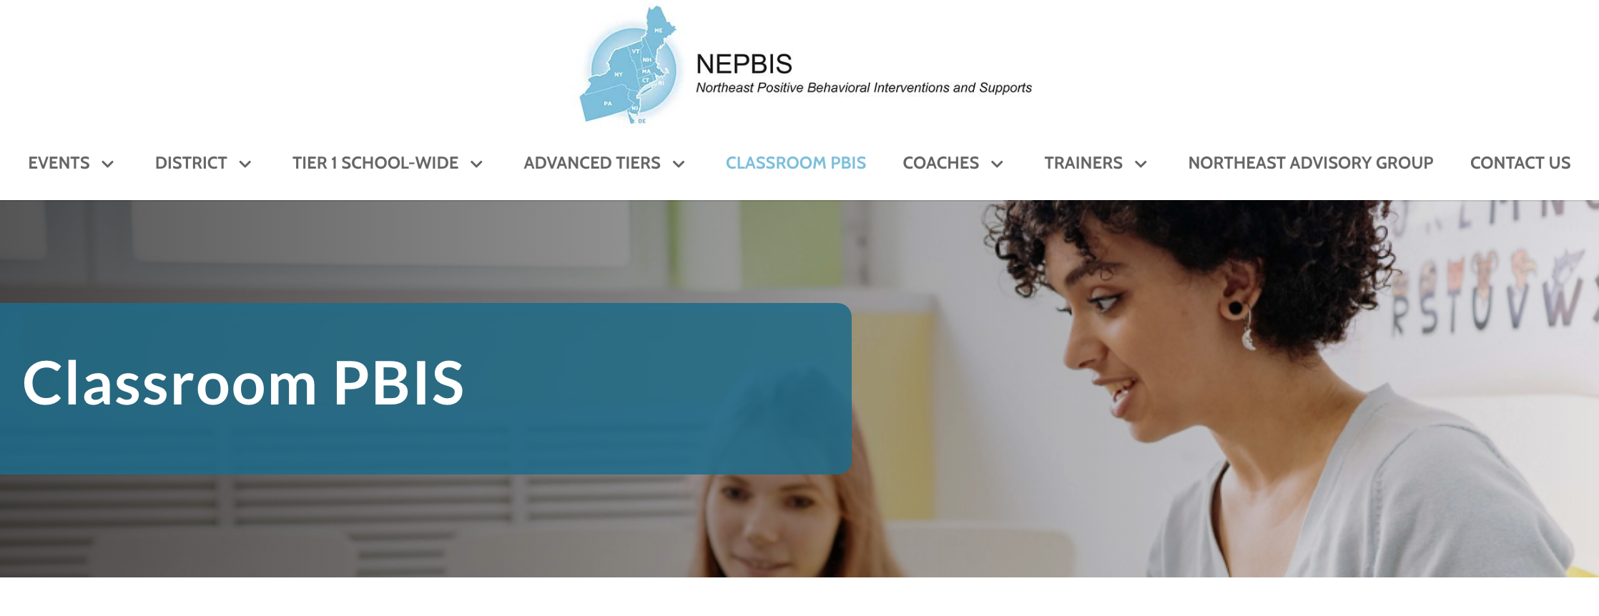
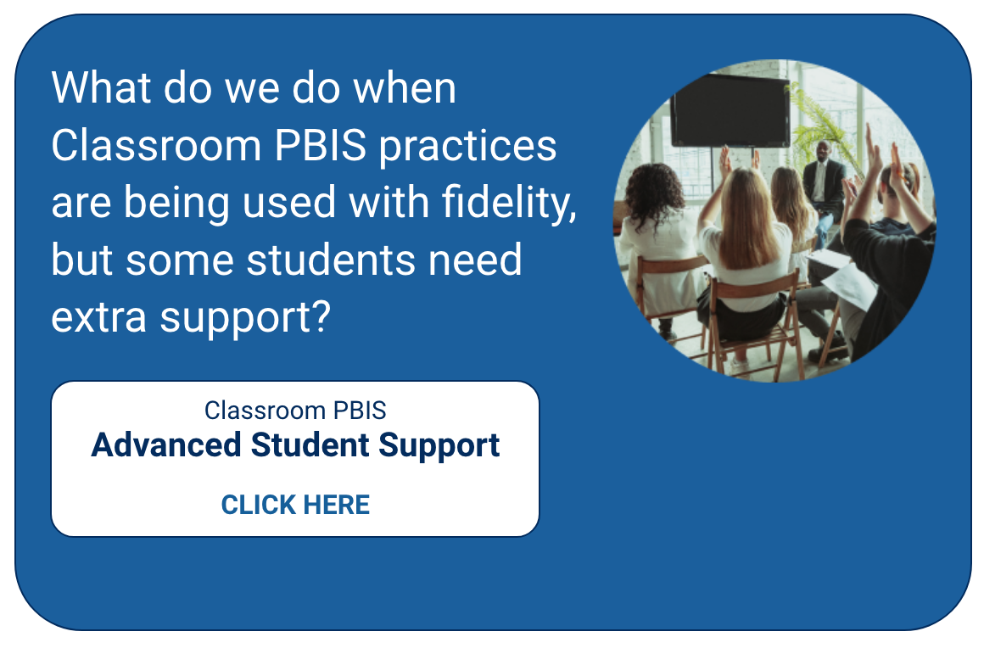
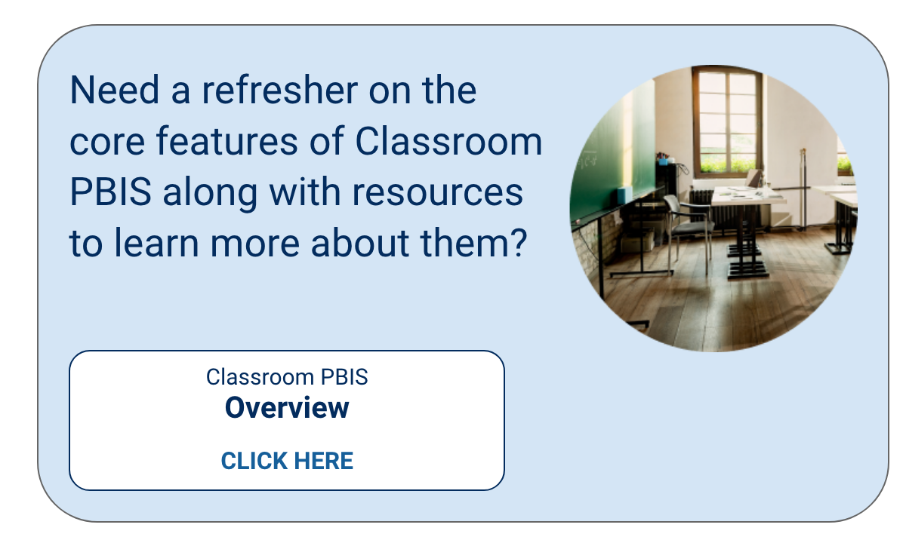
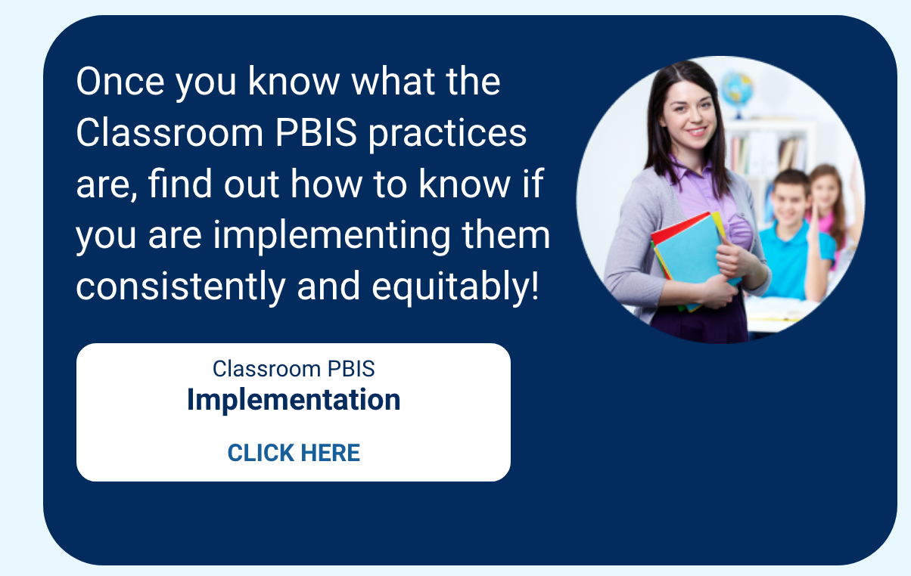
Learn More
Notes:
https://nepbis.org/classroom-pbis/

Slide 66
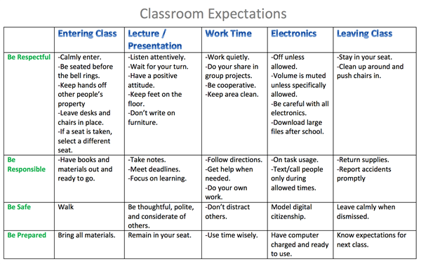

ACTIVITY: Creating Positive Teaching and Learning Environments
Create Positive Teaching and Learning Environments
Design a Safe Environment
Establish Positive Connections
Develop Predictable Routines
Define and Teach Positive Expectations
Plan Relevant Instruction
Consider how you will support educators to create positive teaching and learning environments incorporating the evidence-based practices just presented.
When will you introduce PBIS in the Classroom?
When might you have teacher create a class matrix?
Add items to your Action Plan as necessary
Be ready to present “big ideas” from your discussion.
15 minutes

Slide 67

LUNCH

Slide 68
Planning for Rollout

Slide 69
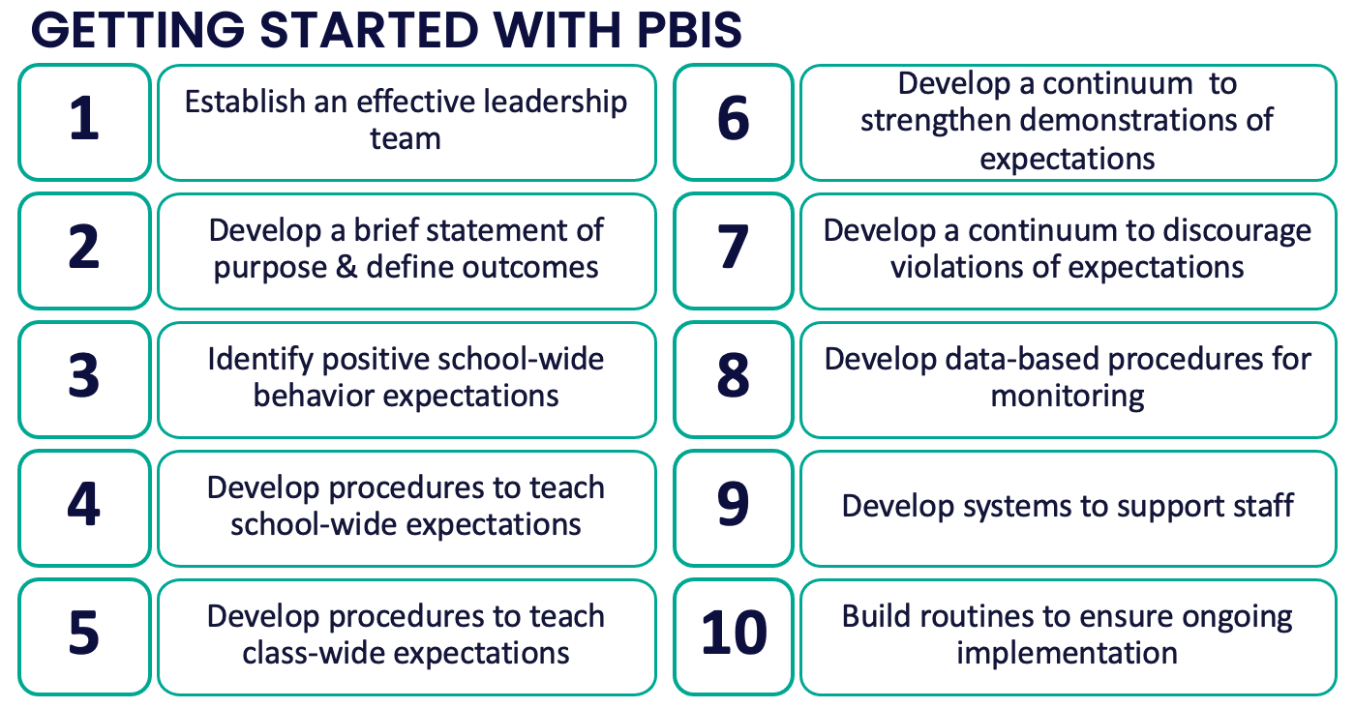
Ready
Set
Go

Slide 70
Maintain a school-wide shared calendar including:
Mark your calendar!
Leadership team meeting times
(at least monthly)
School-wide Expectations Teaching and Booster Schedule
(Start Day 1!)
Professional development
Staff updates
(at least quarterly)
Evaluation Plan Routines
“Time is the scarcest resource and unless it is managed nothing else can be managed.” ~Peter F. Drucker

Slide 71
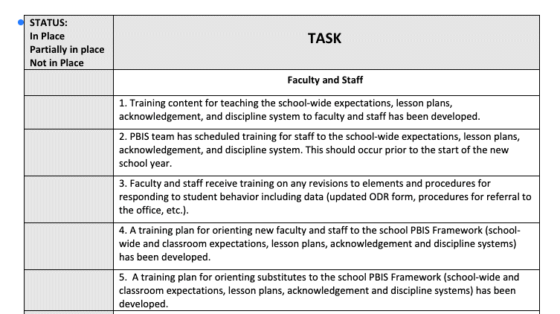
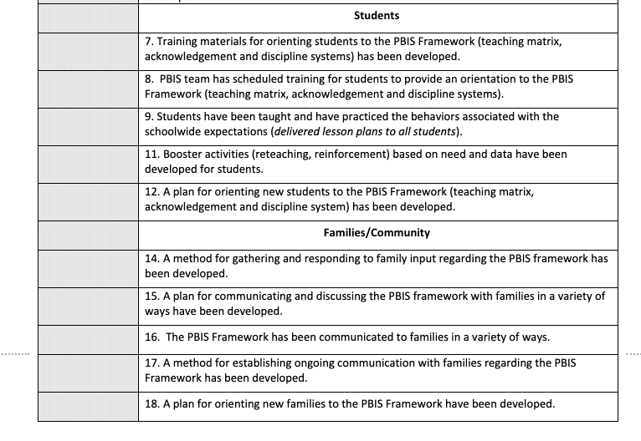
PBIS ROLLOUT CHECKLIST

Slide 72
Organize Your Resources
For Staff
Description of PBIS
SW Expectations
School Matrix
Lesson Plans
Overview of Acknowledgement System
Overview of Consequences
Problem behavior definitions
Discipline flowchart
Office Referral form
Request for Assistance form

Slide 73

Embedded and Ongoing Professional Development
First, identify what staff need to know, then, provide…
Coaching/
Prompting
Explicit Training
Performance Feedback

Slide 74
Continuum of Multi-tiered Staff PD Support
Tier 3
What do we do for the FEW staff needing intensive support?
Intensive Professional Development:
Data-driven Consultation
Performance Feedback:
Routine Walkthrough and Self-management Data Reviews
Tier 1
What do we do for
ALL Staff?
Universal Professional Development:
Training and Self-management
Universal Screening:
Walk-through and Student Data Review
~5%
~15%
Tier 2
What do for the SOME staff needing more support?
Targeted Professional Development:
Self-management with Peer or Coaching Support
Progress Monitoring:
Walkthrough, Student Data Review,
Teacher Collected Data
For now,
focus on providing ALL staff Tier 1 professional development
~80% of Staff
*Beginning of the year PBIS PD for ALL Staff

Slide 75
CRITICAL TOPICS FOR STAFF PD
PBIS Rationale and Purpose
Expectations Matrix
Lesson Plans and Teaching Schedule
Acknowledgement Procedures
Consequence Procedures

Slide 76
Embedded and Ongoing Professional Development
First, identify what staff need to know, then, provide…
Coaching/
Prompting
Explicit Training
Performance Feedback

Slide 77
Embedded and Ongoing Professional Development
First, identify what staff need to know, then, provide…
Coaching/
Prompting
Explicit Training
Performance Feedback
Model, lead, test format
  Demonstrate desired skill (I do)
  Provide effective examples/non-examples
  Provide sufficient group practice (We do)
  Provide opportunities to demonstrate and receive feedback (You do)
Connected to/embedded in typical practice/routines
Brief training/practice spaced out

Slide 78
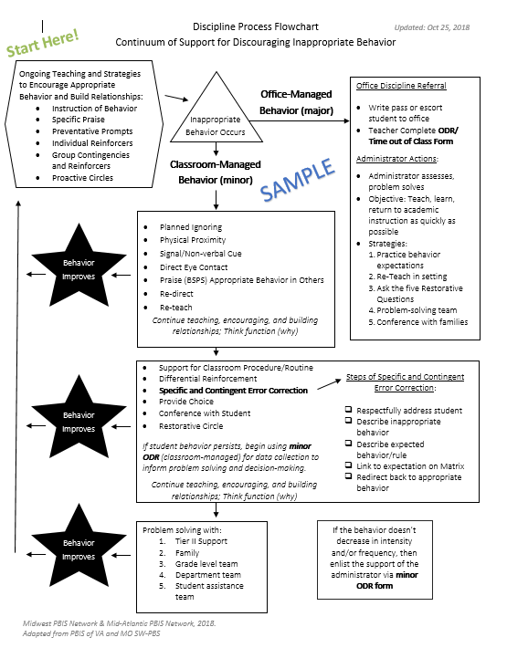
Train and Hope Method
Leadership Team shares the newly developed discipline flowchart with staff over email and asks everyone to start using it.

Slide 79
Explicit Training Example
Center School’s PBIS Leadership Team shares the finalized Discipline Flowchart (developed with staff input) to ALL staff.
A student scenario is provided and a team member performs a “think aloud” to model her interaction with a student. (I do)
Additional examples and non-examples of student-staff interactions are provided with opportunities for questions to be asked.
Another scenario is provided and small groups of staff discuss how to use the flowchart as a guide to their response. (We do)
One more scenario is provided. Each staff member writes down how they would respond and then shares the response with a colleague. (You do)
All staff are provided laminated copies of the Discipline Flowchart and are asked to focus on using it during dismissal time.
Next month…
each person writes an example of how they used the flowchart during dismissal and adds it to a Jamboard.
Staff are then asked to use the Discipline Flowchart throughout their daily routines.

Slide 80
Embedded and Ongoing Professional Development
First, identify what staff need to know, then, provide…
Coaching/
Prompting
Explicit Training
Performance Feedback
Prompt and remind educators of targeted practices implementation.
Provide supportive data-based feedback and suggestions for improving implementation.
Consider function not form: Supports may be delivered by internal or external coach, mentor, peer, or self).
More on this next year

Slide 81
Embedded and Ongoing Professional Development
First, identify what staff need to know, then, provide…
Coaching/
Prompting
Explicit Training
Performance Feedback
More on this next year
Data-based feedback (based on self-, peer-, or consultant collected data)
Summary of key observations
Delivered frequently (daily or weekly)
Specific suggestions for improvement or acknowledgements of good performance

Slide 82

Professional Development Planning for Staff
What content? | When will it be explicitly taught? | By who? | How will prompting and coaching occur? | How will staff be provided performance feedback?
When will your review PBIS with your staff and explicitly teach them how to :
Teach and reveiw the Expectations throughout the year
Prompt the Expectations DAILY
Reinforce the Expectations throughout the school day?

Slide 83

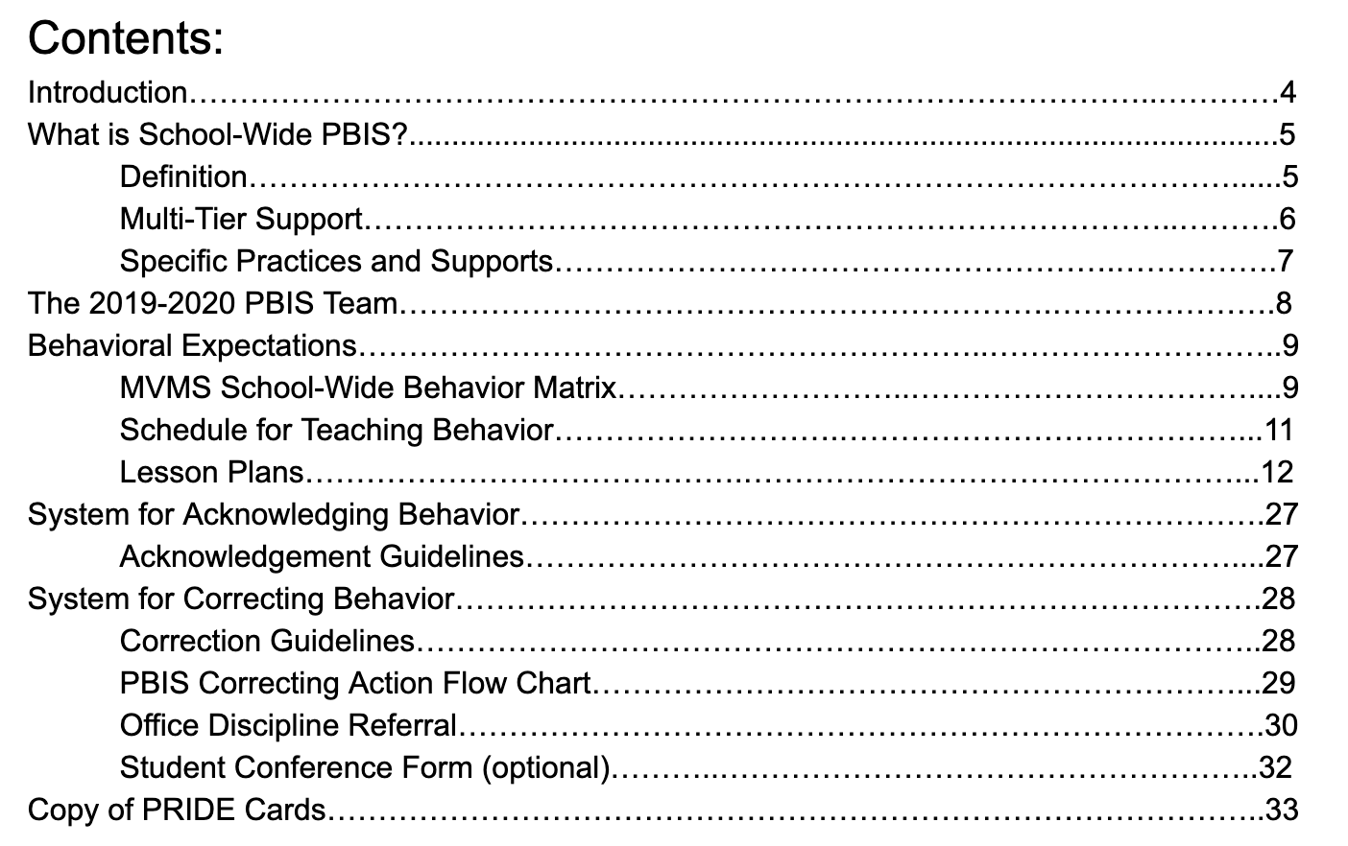
Ensure staff have access to what they need…

Slide 84
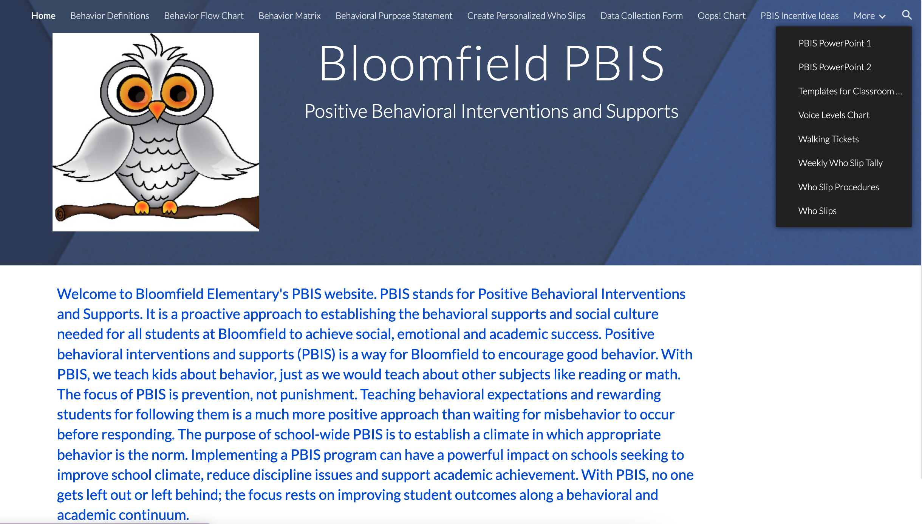
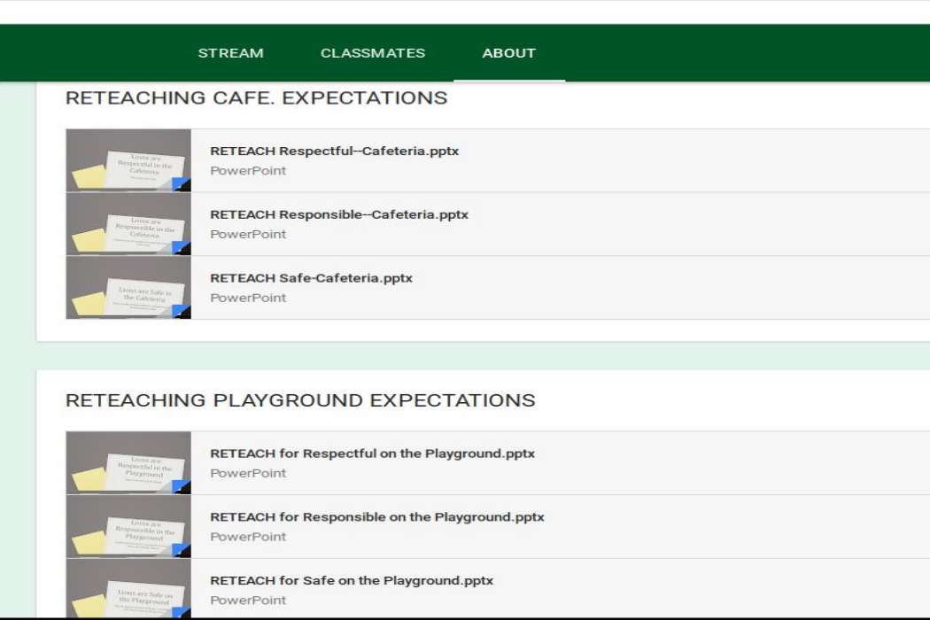




Website with All Resources
Google Classroom
for Staff Only
Shared Doc with Hyperlinks to Resources

Slide 85




Ensure staff understand how your Kickoff will work. Schedule, Examples, Model Lesson, etc.

Slide 86
Organize Your Resources
For Students and Families
SW Expectations
School Matrix
Sample Home Matrix
Overview of Acknowledgement System
Problem Behavior Definitions
Overview of Consequences
Description of PBIS

Slide 87




PBIS Handbook and Orientation Examples
PBIS Handbook
PBIS Staff Orientation Slides
PBIS Student Orientation Slides
Notes:
PBIS Handbook Examples: https://sebacademy.edc.org/list-of-pbis-resources?keyword=Sample+PBIS+Handbook&pbis_resource_type=All&pbis_resource_topic=All&sort_by=field_date_value&sort_order=DESC
PBIS Staff Orientation Slides: https://sebacademy.edc.org/staff-presentation-sample
PBIS Student Orientation Slides: https://sebacademy.edc.org/sample-pbis-student-slide-deck

Slide 88





Students and families too…
Student Handbook
(Shared with Families)
School Website

Slide 89


Tri-fold Brochure
Inform Families

Slide 90



Expectations & behavioral skills are taught in context

Slide 91
Team
Action Planning Time

Slide 92
TEAM TIME
Meet with your team and discuss action steps related to the following items reviewed today:
Consider next steps regarding a continuum of consequences and its relevant components.
Decide how you will support classroom educators with creating positive teaching and learning environments.
Prepare for rollout in the fall.
Revisit your purpose statement and outcomes.
Teams
90 minutes
Prepare to share 1 new action item or goal from your discussion.
Please update your action plans and share with your trainers.

Slide 93
SHARE OUT
What is one action item your team will continue to work on?
5 minutes
Whole Group

Slide 94
Agenda & Coaches' Tasks
Team Tasks:
Develop a continuum of consequences and its relevant components.
Presentation Content:
Quick review
Continuum of consequences
Creating Positive Teaching and Learning Environments
Preparing for Rollout
Revisiting Purpose and Outcomes
Decide how to support classroom educators with creating positive teaching and learning environments.
Prepare for rollout in the fall.
Revisit your purpose statement and outcomes.
What questions do you have on today’s content?
What questions do you have on the follow-up tasks?

Slide 95
HELPFUL RESOURCES
Rollout Materials
Sample PBIS Handbooks
Sample Staff Slide Deck
Sample Student PBIS Slide Deck
Rollout Check List
Year-at-a-Glance Doc
RESOURCES:
Discipline System
Putting a Definition Back in Defiance (article)
Behavior Flow Chart Video
Defining Behaviors Video
Referral Form Video
Discipline Flow Chart Activity
Sample Flow Charts and Templates
Sample Behavior Definitions
Behavior Definition Activity
Sample Referral Forms
Referral Form Activity
CLASSROOM
Supporting and Responding to Students’ Social, Emotional, and Behavioral Needs: Evidence-Based Practices for Educators
Sample Classroom Routine Matrix
Classroom Matrix Video
Classroom Matrix Activity
Creating Effective Classroom Environments Plan Template
Creating a Classroom Teaching Matrix
De-escalation Strategies that keep behavior from going downhill
Notes:
Putting a Definition Back in Defiance - https://sebacademy.edc.org/putting-definition-back-defiance
Behavior Definition Activity: https://sebacademy.edc.org/behavior-definitions-activity
Defining Behaviors Video: https://sebacademy.edc.org/defining-behaviors-video
Sample Definitions: https://sebacademy.edc.org/list-of-pbis-resources?keyword=Sample+-+behavior+definitions&pbis_resource_type=All&pbis_resource_topic=All&sort_by=field_date_value&sort_order=DESC
Sample Flow Charts and Templates: https://sebacademy.edc.org/list-of-pbis-resources?keyword=Flow+Chart&pbis_resource_type=All&pbis_resource_topic=All&sort_by=field_date_value&sort_order=DESC
Behavior Flow Chart Video: https://sebacademy.edc.org/behavior-flow-chart-video
Discipline Flow Chart Activity: https://sebacademy.edc.org/discipline-flow-chart-activity
Referral Form Video: https://sebacademy.edc.org/referral-form-video
Sample Referral Forms: https://sebacademy.edc.org/list-of-pbis-resources?keyword=Sample+Referral+Form&pbis_resource_type=All&pbis_resource_topic=All&sort_by=field_date_value&sort_order=DESC
Referral Form Activity: https://sebacademy.edc.org/referral-form-activity
Supporting and Responding to Students’ Social, Emotional, and Behavioral Needs: Evidence-Based Practices for Educators - https://sebacademy.edc.org/supporting-and-responding-students-social-emotional-and-behavioral-needs-classrooms
Sample Classroom Routine Matrix https://sebacademy.edc.org/sample-classroom-routine-matrix
Classroom Matrix Video https://sebacademy.edc.org/classroom-matrix-video
Classroom Matrix Activity https://sebacademy.edc.org/classroom-matrix-activity
Creating Effective Classroom Environments Plan Template: https://www.pbis.org/resource/creating-effective-classroom-environments-plan-template
Creating a Classroom Teaching Matrix: https://www.pbis.org/resource/creating-a-classroom-teaching-matrix
Sample PBIS Handbooks: https://sebacademy.edc.org/list-of-pbis-resources?keyword=Sample+PBIS+Handbook&pbis_resource_type=All&pbis_resource_topic=All&sort_by=field_date_value&sort_order=DESC
Sample Student Slide Deck https://sebacademy.edc.org/sample-pbis-student-slide-deck
Sample Staff Slide Deck https://sebacademy.edc.org/sample-pbis-staff-slide-deck
Rollout Check List https://sebacademy.edc.org/rollout-checklist
Coaches Year at a Glance https://sebacademy.edc.org/coaches-year-glance

Slide 96

https://edc.co1.qualtrics.com/jfe/form/SV_cHpKO4n8KJKPRdA
End of Year Evaluation
Please remember to complete the evaluation!
Scan the QR code to access.
Notes:
Trainer note:
https://edc.co1.qualtrics.com/jfe/form/SV_cHpKO4n8KJKPRdA

