Slide 1
PBIS School-Wide Coach Meeting Year 3: May 2023
PBIS Track
Insert Trainers Names
with support from NEPBIS Network, May Institute & Broad Reach Consulting
Notes:
Add trainer names for your event

Slide 2
Agenda & Team Tasks
Coaches Tasks
Presentation Content
Revisit Goals – Set New Goals
Review: Sustainability Factors
Work with your team to complete evaluate this year’s goals and set new goals
Review: Annual Evaluation Report
Work with your team to develop your year end report.
Prep for next year’s Roll Out to staff and students
Resource Spotlight – Coaches Year at a Glance

Slide 3
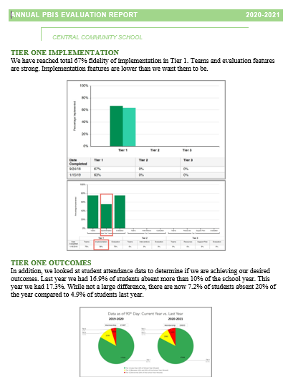
HELPFUL READINGS & RESOURCES
RESOURCES:
Annual PBIS Evaluation Report Template
Annual PBIS Evaluation Report – SAMPLE
Advanced Action Plan
Team Meeting (Leadership) Foundations Checklist
Evaluation Schedule (with sample)
Feedback and Input & Climate Survey Manuals
TFI Manual
Integrated Companion Guide
Culturally Responsive Field Guide
Sustainability Checklist
Classroom Practice Brief
Classroom Systems & Data Brief
Sample PBIS Handbooks
Sample Staff Slide Deck
Sample Student PBIS Slide Deck
Notes:
PBIS Evaluation Report https://sebacademy.edc.org/annual-evaluation-report-template
PBIS Evaluation Report Sample https://sebacademy.edc.org/annual-evaluation-report-sample
Advanced Action Plan - https://sebacademy.edc.org/annual-action-plan-template-advanced-years
Team Meeting (Leadership) Foundations Checklist - https://sebacademy.edc.org/team-meeting-foundations-checklist
Evaluation Schedule (with sample) – https://sebacademy.edc.org/evaluation-schedule
Feedback and Input & Climate Survey Manuals - https://sebacademy.edc.org/list-of-pbis-resources?keyword=Survey+manual&pbis_resource_type=113&pbis_resource_topic=All&sort_by=field_date_value&sort_order=DESC
TFI Manual - https://sebacademy.edc.org/tiered-fidelity-inventory-tfi-manual
Integrated Companion Guide - https://sebacademy.edc.org/integrated-tiered-fidelity-inventory-companion-guide
Culturally Responsive Field Guide - https://sebacademy.edc.org/pbis-cultural-responsiveness-field-guide
Sustainability Checklist - https://sebacademy.edc.org/subsist-pbis-sustainability-checklist
Classroom Practice Brief - https://sebacademy.edc.org/supporting-and-responding-students-social-emotional-and-behavioral-needs-classrooms
Classroom Systems & Data Brief - https://sebacademy.edc.org/supporting-and-responding-educators-classroom-pbis-implementation-needs-guide-classroom-systems-and
Sample PBIS Handbooks: https://sebacademy.edc.org/list-of-pbis-resources?keyword=Sample+PBIS+Handbook&pbis_resource_type=All&pbis_resource_topic=All&sort_by=field_date_value&sort_order=DESC
Sample Student Slide Deck https://sebacademy.edc.org/sample-pbis-student-slide-deck
Sample Staff Slide Deck https://sebacademy.edc.org/sample-pbis-staff-slide-deck

Slide 4
EXPECTATIONS
Self
Others
Environment
Self-monitor
Listen while others are speaking​
Have your computer charged and ready to go​
If you have questions or comments:
Work as a team:
Keep necessary materials at hand
Are you participating?
Engaged as a learner?
Stretch, break, stand as needed​
Raise hand
Room for every voice
Reinforce participation
action plan
relevant docs
water/snacks
Minimize distractions if possible​

Slide 5
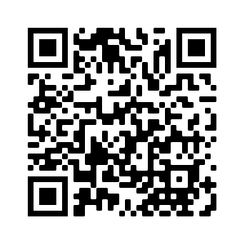
ACTIVITY: ATTENDANCE
Scan QR code on the left or follow the URL posted in the chat to access the online attendance survey
Follow prompts to enter attendance information
Notify trainers if you require assistance (e.g., identifying your cohort or cohort group)
Certificates of Attendance will be sent in January and June. Attendance records will be use as verification
You are in Cohort 7
1 minute
Notes:
Link to attendance form is here: https://edc.co1.qualtrics.com/jfe/form/SV_5BiXqi4bxzOCMS2
Add your cohort number
Post a link to the attendance survey (below) in the chat for those who do not use the QR code on the slide:
ATTENDANCE: https://edc.co1.qualtrics.com/jfe/form/SV_5BiXqi4bxzOCMS2

Slide 6
Yearly Product Review
Team Meeting Schedule / Action Plan - All
2 of the following:
Classroom: Sample Classroom Routine Matrix or Classroom Assessment
Alignment: Working Smarter Matrix or Alignment Activity
Equity: Neutralizing Routine or Equity Action Items
Please show trainer your products for Check Off. You do not need to turn them into us. (But we love examples of your great work!)
Notes:
Trainer Note: If a team has another item that would fit into Classroom, Alignment or Equity, they can let us know and we can consider it. Most things will be approved.

Slide 7
REVIEW: Annual Evaluation Report
Notes:
TRAINER NOTE: This is review content please be brief

Slide 8
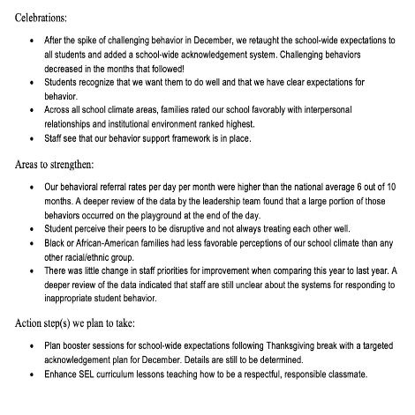
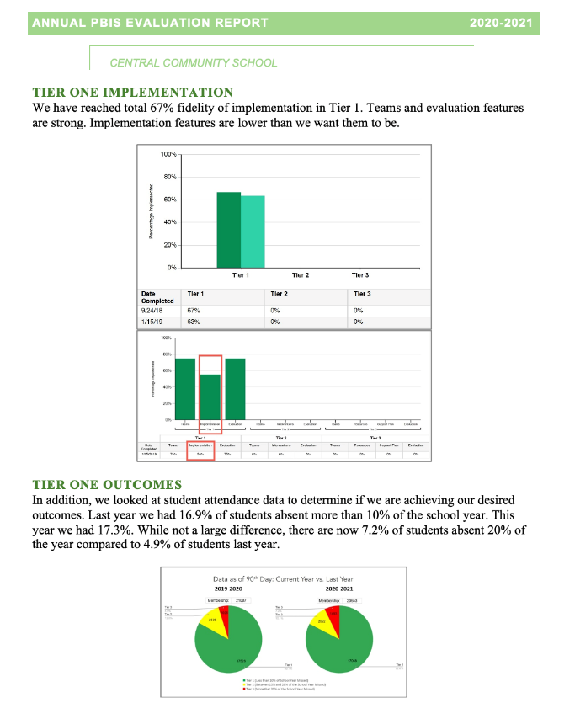
Implementation of the core components of PBIS is more likely if the Tier I team assesses the implementation status at least annually and provides “snapshot” reports to the staff, community, school board.
Notes:
Annual Tier 1 Evaluation Report (Sample school):

Slide 9
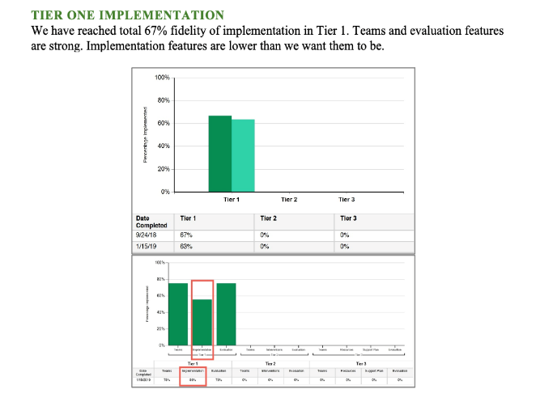
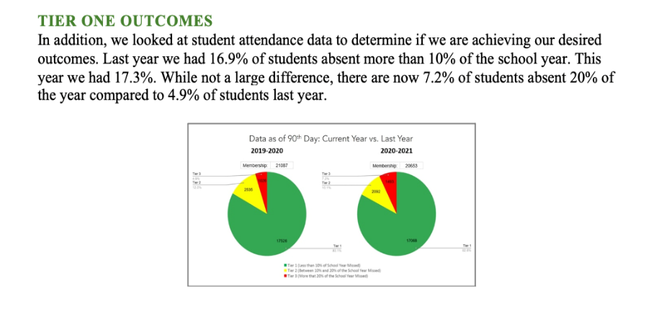
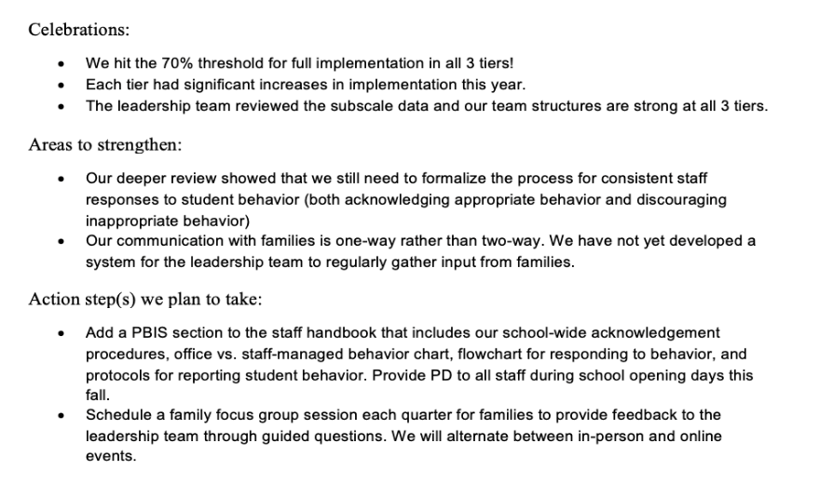
Outcome Data
Fidelity Data
Celebrations
Areas to strengthen
Action Steps
Notes:
TRAINER NOTE: Use this sample to discuss what each school might choose to include in a “snapshot” evaluation report

Slide 10
ACTIVITY: Evaluation Report and Planning
Complete one bullet for each area
Celebrations
Areas to Strengthen
Action Item
Identify which data sources you will show case
Fidelity
Outcomes
Be prepared to share out
10 minutes
5 minutes
Coach Review
Whole Group

Slide 11
REVIEW: Sustainablity Factors
Notes:
12:30

Slide 12
Factors supporting sustaining of PBIS
Strong Leadership Team
What is the current state of your school leadership team?
What if anything needs improvement with your team?

Slide 13
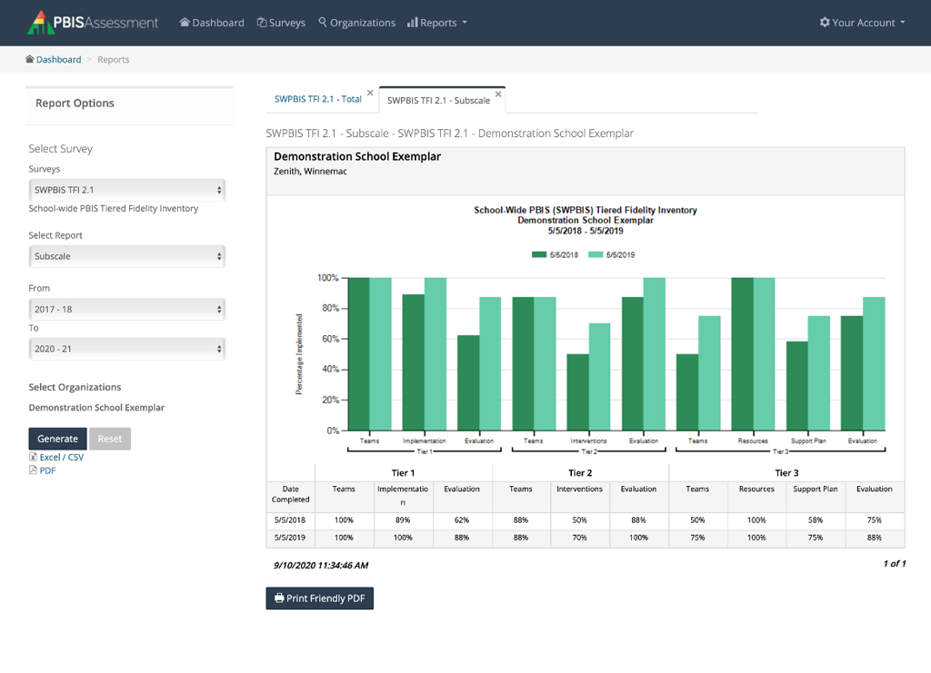
Factors supporting sustaining of PBIS
Strong Leadership Team
Use fidelity data to improve support
Have you completed your Fidelity check this year?
Have you used these data to update your team’s action plan?

Slide 14
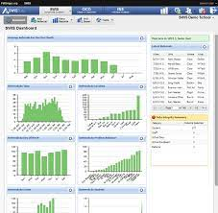
Factors supporting sustaining of PBIS
Strong Leadership Team
Use fidelity data to improve support
Use your school’s discipline data
Have you used your discipline data to make decisions?
Have you shared your discipline data with your staff this year?

Slide 15
Factors supporting sustaining of PBIS
Strong Leadership Team
Use fidelity data to improve support
Use your school’s discipline data
Implement PBIS in the classroom
Have you assessed the use of positive classroom practices?
Have you provided PD on positive classroom practices?

Slide 16
GETTING STARTED WITH SWPBIS
Establish an effective leadership team
Develop a continuum to strengthen appropriate behaviors
Develop a brief statement of purpose
Develop a continuum to discourage violations of expectations
Identify positive school-wide behavior expectations
Develop data-based procedures for monitoring
Develop procedures to teach school-wide expectations
Develop systems to support staff
Develop procedures to teach class-wide expectations
Build routines to ensure ongoing implementation
Notes:
Emphasise the 4 ideas from the video
1 – Keep a strong team (next slide)
2 – Use TFI data to improve systems (we will do this at the November training)
3 – Use your school discipline data – slide to come with all data mentioned…good for goal planning
4 – Implement PBIS in the Classroom (Nov Training)

Slide 17
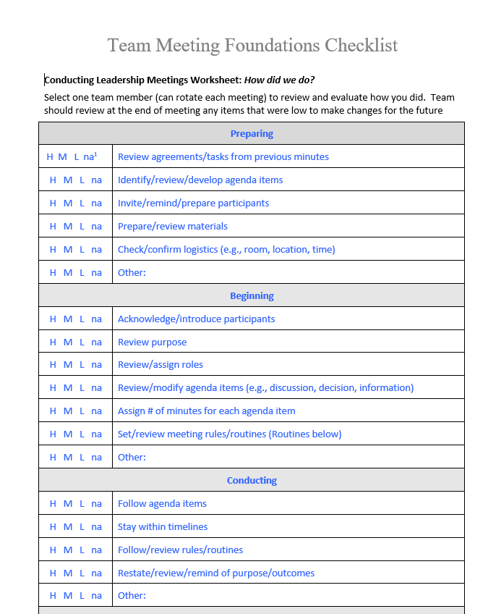
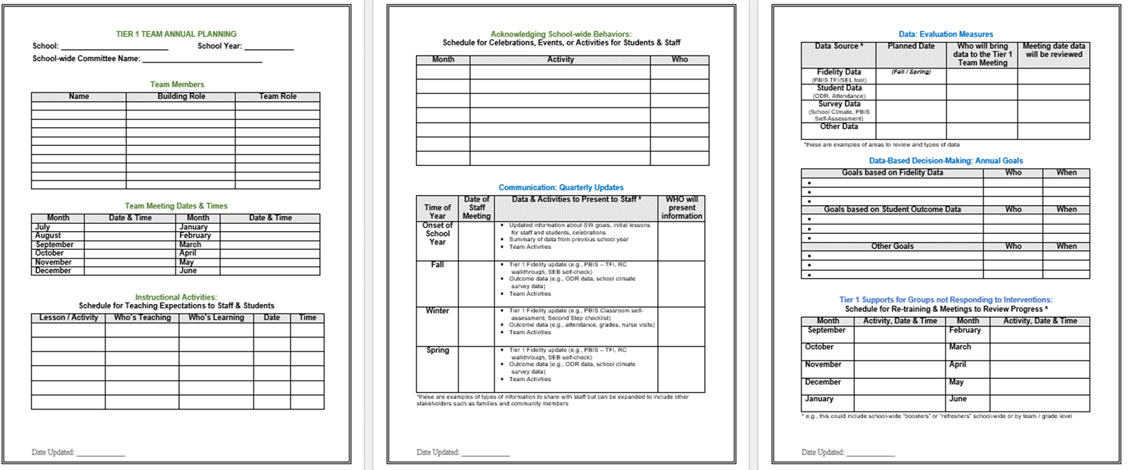
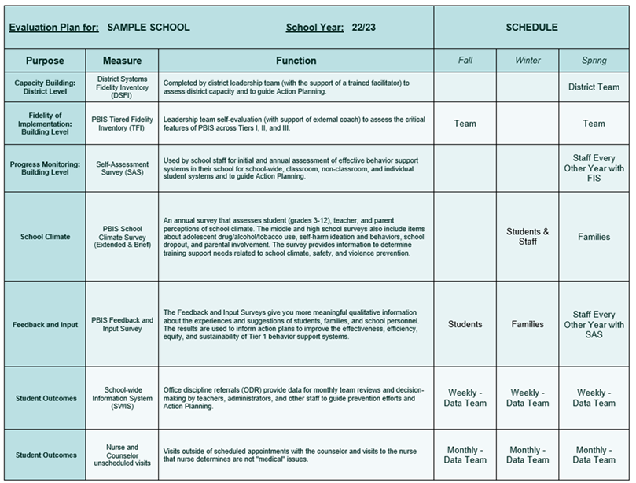
Sustainability Resources
Advanced Action Plan
Leadership Team Checklist
Evaluation Schedule
Climate and Feedback Surveys
Notes:
Advanced Action Plan - https://sebacademy.edc.org/annual-action-plan-template-advanced-years
Team Meeting (Leadership) Foundations Checklist - https://sebacademy.edc.org/team-meeting-foundations-checklist
Evaluation Schedule (with sample) – https://sebacademy.edc.org/evaluation-schedule
Feedback and Input & Climate Survey Manuals - https://sebacademy.edc.org/list-of-pbis-resources?keyword=Survey+manual&pbis_resource_type=113&pbis_resource_topic=All&sort_by=field_date_value&sort_order=DESC

Slide 18
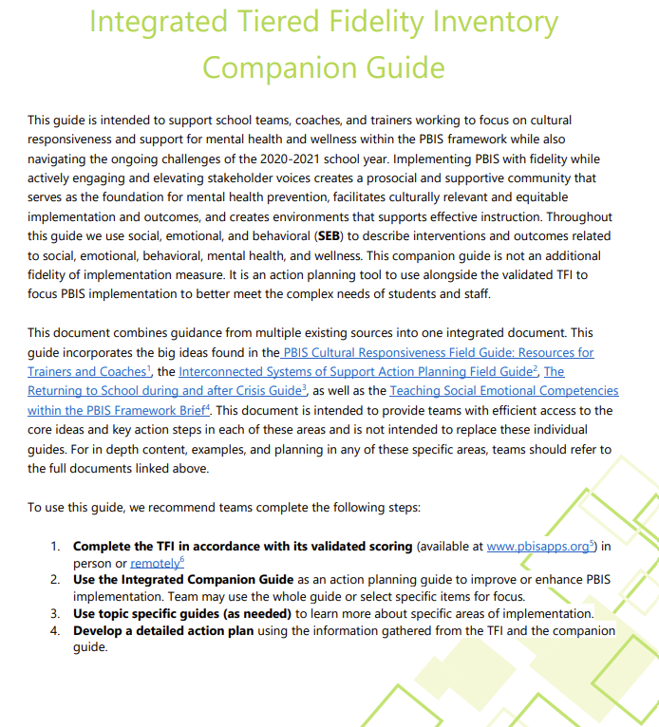
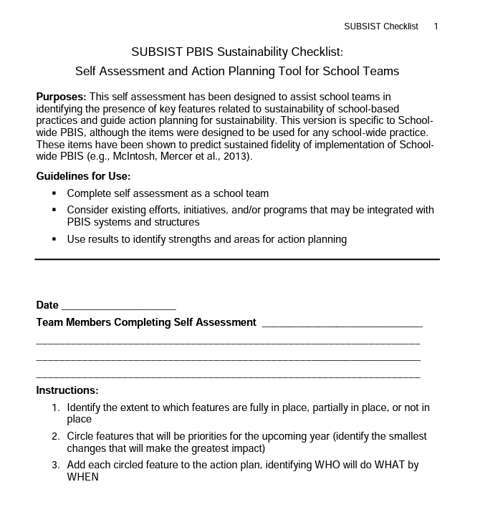
Sustainability Resources
Classroom Practices Brief
TFI Manual / Integrated Companion Guide / Culturally Responsive Field Guide
Classroom Systems & Data Brief - Teachers
Sustainability Checklist
Notes:
TFI Manual - https://sebacademy.edc.org/tiered-fidelity-inventory-tfi-manual
Integrated Companion Guide - https://sebacademy.edc.org/integrated-tiered-fidelity-inventory-companion-guide
Culturally Responsive Field Guide - https://sebacademy.edc.org/pbis-cultural-responsiveness-field-guide
Sustainability Checklist - https://sebacademy.edc.org/subsist-pbis-sustainability-checklist
Classroom Practice Brief - https://sebacademy.edc.org/supporting-and-responding-students-social-emotional-and-behavioral-needs-classrooms
Classroom Systems & Data Brief - https://sebacademy.edc.org/supporting-and-responding-educators-classroom-pbis-implementation-needs-guide-classroom-systems-and

Slide 19
DISCUSSION: SUSTAINABILITY FACTORS
What is something to celebrate & something you’re working on related to Sustainability Factors of:
Team functioning
Using implementation data
Using discipline data
Positive classroom practices
10 minutes
5 minutes
Coach Review
Whole Group

Slide 20
REVIEW CURRENT AND FUTURE SCHOOL WIDE GOALS
Notes:
TRAINER NOTE: The purpose of this next section is to support the teams to review their goals this year, review their data, and revise their goals for next year.

Slide 21
Why Use Data for Decision Making?
Decisions are more likely to be
effective and efficient when they are based on data.
The quality of decision making depends most on defining problems with precision & clarity.
Data help
place the “problem” in the context
rather than in the students.
Use data to:
identify problems
refine problems
define the questions that lead to a solution
monitor implementation and outcomes
guide implementation
engage in problem solving

Slide 22
Why use data for decision-making?
To continuously improve
your Tier 1 framework!
Are we achieving our desired outcomes?
Which groups are benefiting from our plan? Which are not?
Are we implementing as planned?
What needs to be strengthened? Revised?
Are students receiving adequate support to achieve positive outcomes?

Slide 23
IDENTIFY PROBLEM
with precision
IDENTIFY GOAL
for change
IDENTIFY SOLUTION
and implementation plan
IMPLEMENT SOLUTION
with fidelity
MONITOR & EVALUATE
implementation fidelity and impact
MAKE DECISION
to maintain, modify, or terminate plan
Collect & Use
DATA
(Chaparro, E., et. al, 2022)

Slide 24
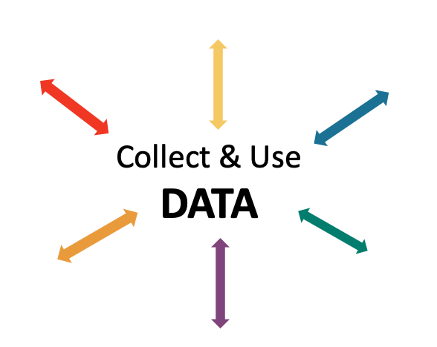
EXAMPLE: Reviewing & Analyzing School-wide Behavior Data to Develop, Inform, and Refine Tier 1
Most ODRs were given when students didn’t throw away trash.
IDENTIFY PROBLEM
IDENTIFY GOAL
IDENTIFY SOLUTION
IMPLEMENT SOLUTION
MONITOR & EVALUATE
MAKE DECISION
Booster lessons, prompts and acknowledgement continued
Increase rate of students throwing away trash
During a monthly meeting PBIS Leadership Team at Miller Middle School, the data analyst showed that ODRs from the cafeteria had doubled from the previous month. Upon further review, 75% of the ODRs were for disrespect.
Teach students clean up procedures; provide frequent prompts and acknowledgement
ODRs from the cafeteria were reviewed by the team for the next 3 months; ODRs for disrespect steadily decreased
PBIS team members paired with the cafeteria monitors during lunch blocks to teach, prompt, acknowledge

Slide 25
NON-EXAMPLE: Reviewing & Analyzing School-wide Behavior Data to Develop, Inform, and Refine Tier 1
At Portview High School, an increasing number of students were late to advisory block.
Because there were no systems to set up to monitor implementation or evaluate impact, there was a small decrease in late arrivals but, after a week previous patterns returned.
IDENTIFY PROBLEM
IMPLEMENT SOLUTION
Students were late to advisory
Staff were asked to prompt students lingering in the hall

Slide 26
ACTIVITY: Using School-wide Behavior Data for Decision-Making
Review your school-wide behavior data.
Apply the decision-making steps to 1 current problem in your school.
Review your goal and revise for next school year.
Add to your action plan, as needed.
Be prepared to share 2-3 big ideas with the group.
IDENTIFY PROBLEM
IDENTIFY GOAL
IDENTIFY SOLUTION
IMPLEMENT SOLUTION
MONITOR & EVALUATE
MAKE DECISION
Independent: 10 minutes
Whole Group: 10 minutes

Slide 27
Resource Spotlight: Coaches Year at a Glance Document Prepping for next year

Slide 28
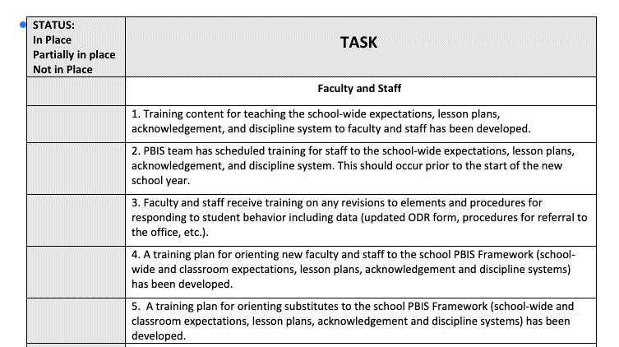
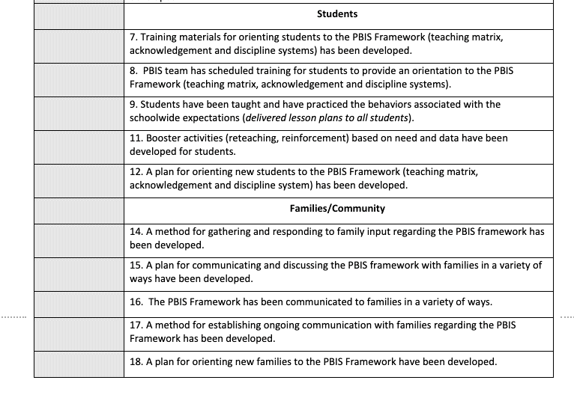
PBIS Rollout Check List, Handbook & Orientation Examples
Rollout Checklist
PBIS Handbook
PBIS Staff Orientation Slides
PBIS Student Orientation Slides
Notes:
PBIS Rollout Checklist
PBIS Handbook Examples: https://sebacademy.edc.org/list-of-pbis-resources?keyword=Sample+PBIS+Handbook&pbis_resource_type=All&pbis_resource_topic=All&sort_by=field_date_value&sort_order=DESC
PBIS Staff Orientation Slides: https://sebacademy.edc.org/staff-presentation-sample
PBIS Student Orientation Slides: https://sebacademy.edc.org/sample-pbis-student-slide-deck

Slide 29
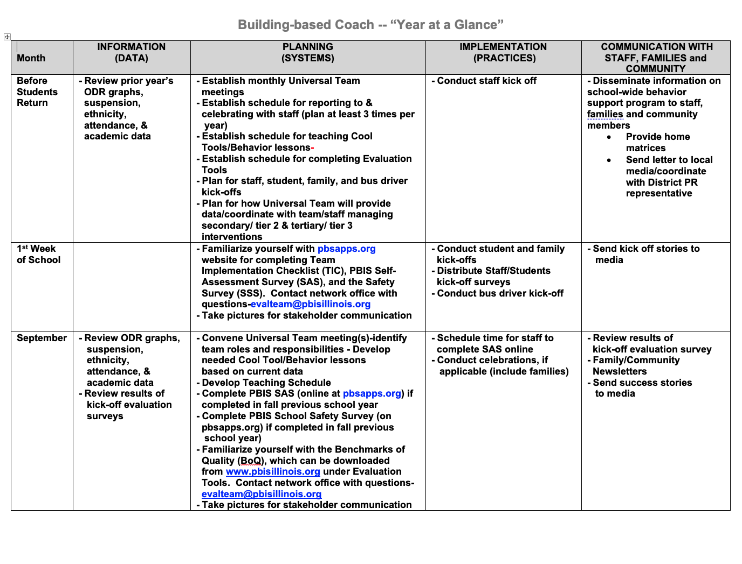
Coaches Year at a Glance
Month by month resources for coaches:
Organizes what data should be reviewed when (for planning purposes)
Prompts for coaches’ and team activities that support planning
What practices should be conducted across the year.
Ideas for communicating with Staff, Families, and Community.
Create your own coaches’ plan!
Notes:
https://sebacademy.edc.org/coaches-year-glance

Slide 30
RESOURCE SPOTLIGHT:
Review Coaches Year at a Glance Document
What activities are relevant to your team’s goals?
How could you modify this document, so you have a personal coaching guide for your school?
10 minutes
5 minutes
Coach Review
Whole Group
Notes:
https://sebacademy.edc.org/coaches-year-glance

Slide 31
Agenda & Team Tasks
Coaches Tasks
Presentation Content
Revisit Goals – Set New Goals
Review: Sustainability Factors
Work with your team to complete evaluate this year’s goals and set new goals
Review: Annual Evaluation Report
Work with your team to develop your year end report.
Prep for next year’s Roll Out to staff and students
Resource Spotlight – Coaches Year at a Glance

Slide 32
HELPFUL READINGS & RESOURCES
RESOURCES:
Annual PBIS Evaluation Report Template
Annual PBIS Evaluation Report – SAMPLE
Advanced Action Plan
Team Meeting (Leadership) Foundations Checklist
Evaluation Schedule (with sample)
Feedback and Input & Climate Survey Manuals
TFI Manual
Integrated Companion Guide
Culturally Responsive Field Guide
Sustainability Checklist
Classroom Practice Brief
Classroom Systems & Data Brief
Sample PBIS Handbooks
Sample Staff Slide Deck
Sample Student PBIS Slide Deck
Notes:
PBIS Evaluation Report https://sebacademy.edc.org/annual-evaluation-report-template
PBIS Evaluation Report Sample https://sebacademy.edc.org/annual-evaluation-report-sample
Advanced Action Plan - https://sebacademy.edc.org/annual-action-plan-template-advanced-years
Team Meeting (Leadership) Foundations Checklist - https://sebacademy.edc.org/team-meeting-foundations-checklist
Evaluation Schedule (with sample) – https://sebacademy.edc.org/evaluation-schedule
Feedback and Input & Climate Survey Manuals - https://sebacademy.edc.org/list-of-pbis-resources?keyword=Survey+manual&pbis_resource_type=113&pbis_resource_topic=All&sort_by=field_date_value&sort_order=DESC
TFI Manual - https://sebacademy.edc.org/tiered-fidelity-inventory-tfi-manual
Integrated Companion Guide - https://sebacademy.edc.org/integrated-tiered-fidelity-inventory-companion-guide
Culturally Responsive Field Guide - https://sebacademy.edc.org/pbis-cultural-responsiveness-field-guide
Sustainability Checklist - https://sebacademy.edc.org/subsist-pbis-sustainability-checklist
Classroom Practice Brief - https://sebacademy.edc.org/supporting-and-responding-students-social-emotional-and-behavioral-needs-classrooms
Classroom Systems & Data Brief - https://sebacademy.edc.org/supporting-and-responding-educators-classroom-pbis-implementation-needs-guide-classroom-systems-and
Sample PBIS Handbooks: https://sebacademy.edc.org/list-of-pbis-resources?keyword=Sample+PBIS+Handbook&pbis_resource_type=All&pbis_resource_topic=All&sort_by=field_date_value&sort_order=DESC
Sample Student Slide Deck https://sebacademy.edc.org/sample-pbis-student-slide-deck
Sample Staff Slide Deck https://sebacademy.edc.org/sample-pbis-staff-slide-deck

Slide 33
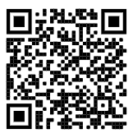
https://edc.co1.qualtrics.com/jfe/form/SV_cBF9GI7gVEBsfSC EVALUATION
Please remember to complete the evaluation!
Scan the QR code to access.
Notes:
TRAINERS -
Put link to evaluation (below) in the chat for those who do not use the QR code:
https://edc.co1.qualtrics.com/jfe/form/SV_cBF9GI7gVEBsfSC

