Slide 1
PBIS School-Wide Coach Meeting Year 3: June 2023
PBIS Track
Insert Trainers Names
with support from NEPBIS Network, May Institute & Broad Reach Consulting
Notes:
Add trainer names for your event

Slide 2
Agenda & Team Tasks
Coaches Tasks
Presentation Content
Celebrations from these past years
Resource Spotlight: Annual Action Plan
Work with your team to complete your Annual Evaluation Report. Please share a copy with your trainers as we are looking for examples.
Refresh your roll out for next year. Use the Coaches Year at a Glance or Annual Action Plan document to assist with this process.
Review: Annual Evaluation Report
End of Year Survey

Slide 3
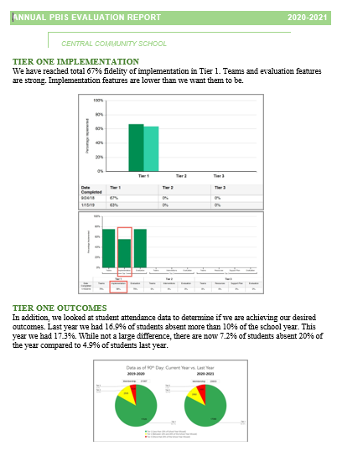
HELPFUL READINGS & RESOURCES
RESOURCES:
Annual PBIS Evaluation Report Template
Annual PBIS Evaluation Report – SAMPLE
Advanced Action Plan
Evaluation Schedule (with sample)
TFI Manual
Integrated Companion Guide
Culturally Responsive Field Guide
Sustainability Checklist
Sample PBIS Handbooks
Sample Staff Slide Deck
Sample Student PBIS Slide Deck
Notes:
PBIS Evaluation Report https://sebacademy.edc.org/annual-evaluation-report-template
PBIS Evaluation Report Sample https://sebacademy.edc.org/annual-evaluation-report-sample
Advanced Action Plan - https://sebacademy.edc.org/annual-action-plan-template-advanced-years
Team Meeting (Leadership) Foundations Checklist - https://sebacademy.edc.org/team-meeting-foundations-checklist
Evaluation Schedule (with sample) – https://sebacademy.edc.org/evaluation-schedule
TFI Manual - https://sebacademy.edc.org/tiered-fidelity-inventory-tfi-manual
Integrated Companion Guide - https://sebacademy.edc.org/integrated-tiered-fidelity-inventory-companion-guide
Sustainability Checklist - https://sebacademy.edc.org/subsist-pbis-sustainability-checklist
Sample PBIS Handbooks: https://sebacademy.edc.org/list-of-pbis-resources?keyword=Sample+PBIS+Handbook&pbis_resource_type=All&pbis_resource_topic=All&sort_by=field_date_value&sort_order=DESC
Sample Student Slide Deck https://sebacademy.edc.org/sample-pbis-student-slide-deck
Sample Staff Slide Deck https://sebacademy.edc.org/sample-pbis-staff-slide-deck

Slide 4
EXPECTATIONS
Self
Others
Environment
Self-monitor
Listen while others are speaking​
Have your computer charged and ready to go​
If you have questions or comments:
Work as a team:
Keep necessary materials at hand
Are you participating?
Engaged as a learner?
Stretch, break, stand as needed​
Raise hand
Room for every voice
Reinforce participation
action plan
relevant docs
water/snacks
Minimize distractions if possible​

Slide 5
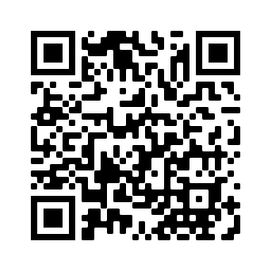
ACTIVITY: ATTENDANCE
Scan QR code on the left or follow the URL posted in the chat to access the online attendance survey
Follow prompts to enter attendance information
Notify trainers if you require assistance (e.g., identifying your cohort or cohort group)
Certificates of Attendance will be sent in January and June. Attendance records will be use as verification
You are in Cohort 7
1 minute
Notes:
Link to attendance form is here: https://edc.co1.qualtrics.com/jfe/form/SV_5BiXqi4bxzOCMS2
Add your cohort number
Post a link to the attendance survey (below) in the chat for those who do not use the QR code on the slide:
ATTENDANCE: https://edc.co1.qualtrics.com/jfe/form/SV_5BiXqi4bxzOCMS2

Slide 6
Yearly Product Review
Team Meeting Schedule / Action Plan - All
2 of the following:
Classroom: Sample Classroom Routine Matrix or Classroom Assessment
Alignment: Working Smarter Matrix or Alignment Activity
Equity: Neutralizing Routine or Equity Action Items
Please show trainer your products for Check Off. You do not need to turn them into us. (But we love examples of your great work!)
Notes:
Trainer Note: If a team has another item that would fit into Classroom, Alignment or Equity, they can let us know and we can consider it. Most things will be approved.

Slide 7
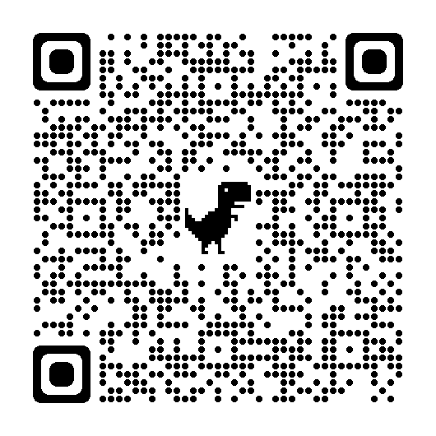
PLANNING FOR NEXT YEAR
We want your feedback on how best to support you next year.
Please complete the following survey to help us identify which areas you would be interested in receiving support.
If you are not looking for any formalized continued support, we will keep you on the mailing list and share upcoming webinars available to you and your school.
https://forms.gle/7Z95vTVKVd4XvVtD7
5 minutes
Coach Review
Notes:
Survey Link: https://forms.gle/7Z95vTVKVd4XvVtD7
Thank you for a productive and informative year! The purpose of this survey is to help us identify how we can best continue our support for you next year. Specifically, we would like to learn where we should focus our resources. Please review the support options below and let me know which ones you would be interested in and/or would like to learn more about. Feel free to select more than one.
Below are areas of potential interest for support. Please note that this information will be used to determine whether there is sufficient interest in securing resources for particular types of support.

Slide 8
REVIEW: Annual Evaluation Report
Notes:
TRAINER NOTE: This is review content please be brief

Slide 9
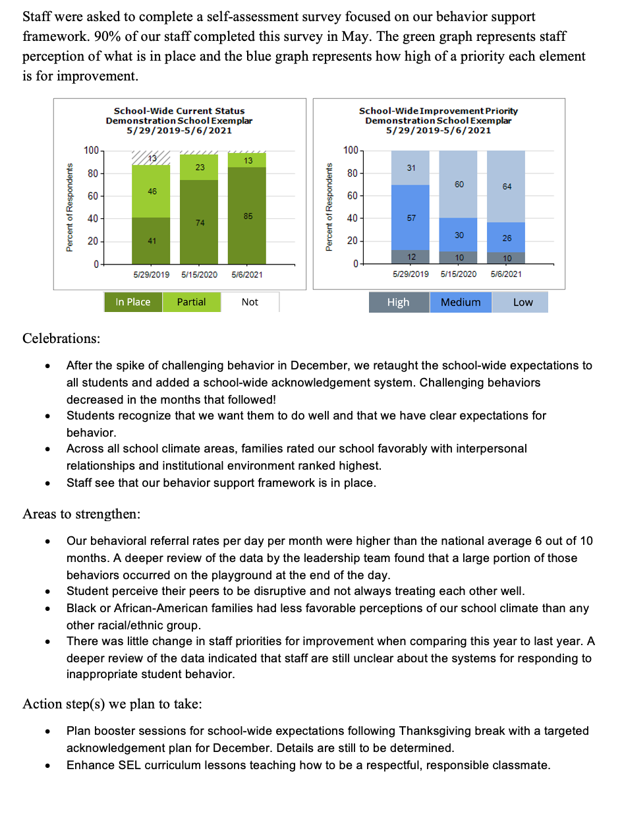
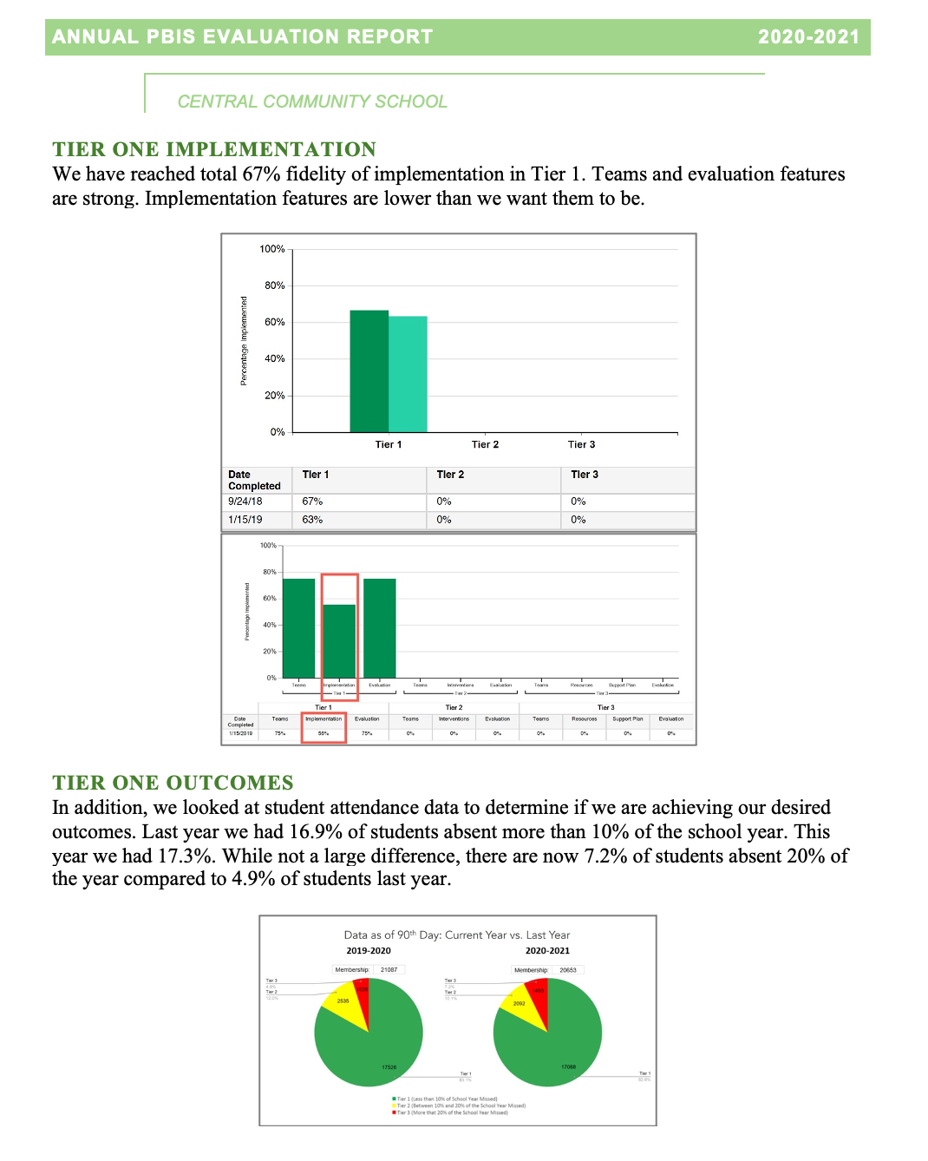
Implementation of the core components of PBIS is more likely if the Tier I team assesses the implementation status at least annually and provides “snapshot” reports to the staff, community, school board.
Notes:
Annual Evaluation Template: https://sebacademy.edc.org/annual-evaluation-report-template
Annual Evaluation Sample: https://sebacademy.edc.org/annual-evaluation-report-sample

Slide 10
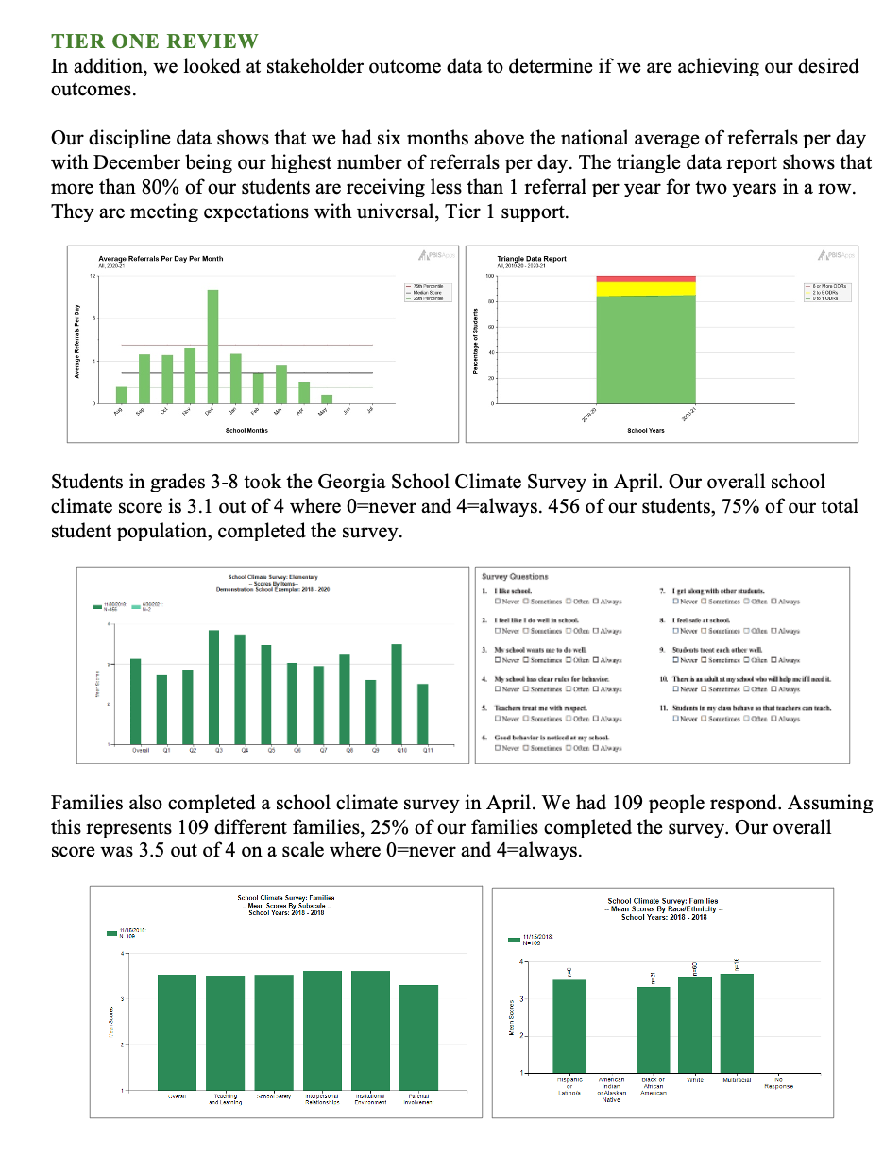
Annual Evaluation Report
Outcome Data
Fidelity Data
Celebrations
Areas to Strengthen
Action Steps
Notes:
Annual Evaluation Template: https://sebacademy.edc.org/annual-evaluation-report-template
Annual Evaluation Sample: https://sebacademy.edc.org/annual-evaluation-report-sample

Slide 11
ACTIVITY: Annual Evaluation Report and Planning
Review Annual Evaluation Samples and Templates
What summary information has been shared already, What can you add?
If you do not have any information summarized, please review and draft some ideas to share with your team.
Be prepared to share out
10 minutes
10 minutes
Coach Review
Whole Group
Notes:
Annual Evaluation Template: https://sebacademy.edc.org/annual-evaluation-report-template
Annual Evaluation Sample: https://sebacademy.edc.org/annual-evaluation-report-sample

Slide 12
PBIS Resource Spotlight: Annual Action Plan
Notes:
RESOURCE LINK: https://sebacademy.edc.org/equitable-outcomes-require-finding-vulnerable-decisions

Slide 13
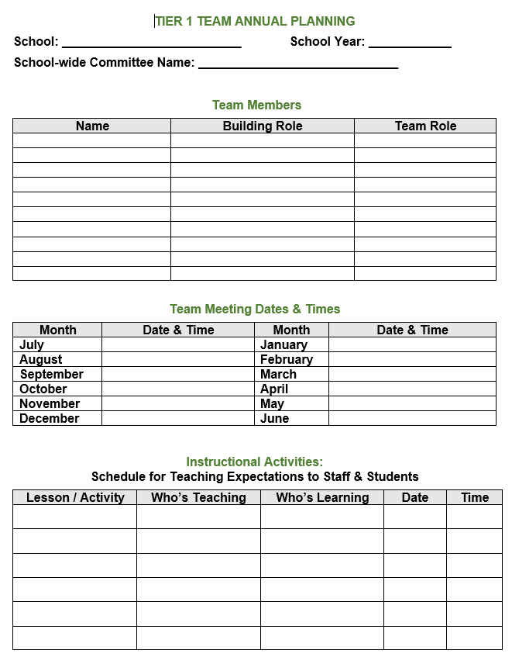
Annual Action Plan
All in on year long organizer action plan document that provides you a one stop document to share the following information:
Team membership and meeting dates
Lesson plan dates
Acknowledgement activities
Assessment activities
Additional support activities
Notes:
https://sebacademy.edc.org/coaches-year-glance

Slide 14
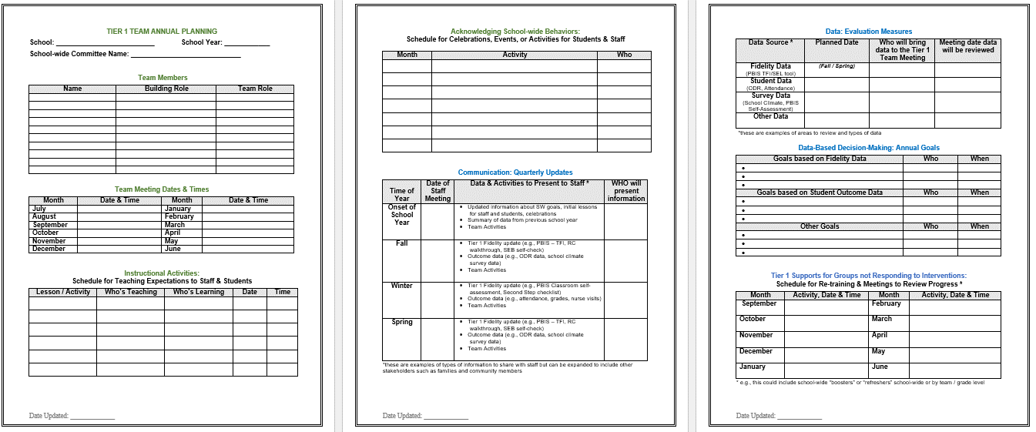
Annual Action Planning - Advanced
Evaluation Measures
Acknowledgment Plans
Team
Info
Annual Goals
Teaching Expectations Plan
Communication
Tier 1 Student Follow Up
Notes:
This Action plan is more advanced and is intended for schools in years 2 and beyond. Review with the team.
Advanced Action Plan https://sebacademy.edc.org/annual-action-plan-template-advanced

Slide 15
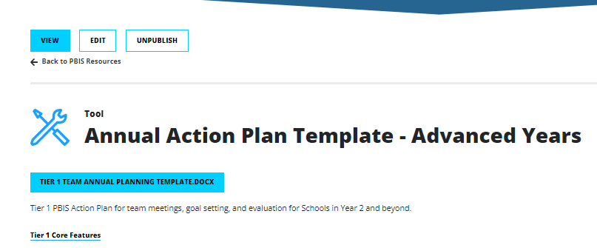
Action Plan – Annual Planning Advanced Years
https://sebacademy.edc.org/annual-action-plan-template-advanced
Notes:
Ask Coaches to download this Action Plan for use this year. Will be reviewed in the next slide.
https://sebacademy.edc.org/annual-action-plan-template-advanced

Slide 16
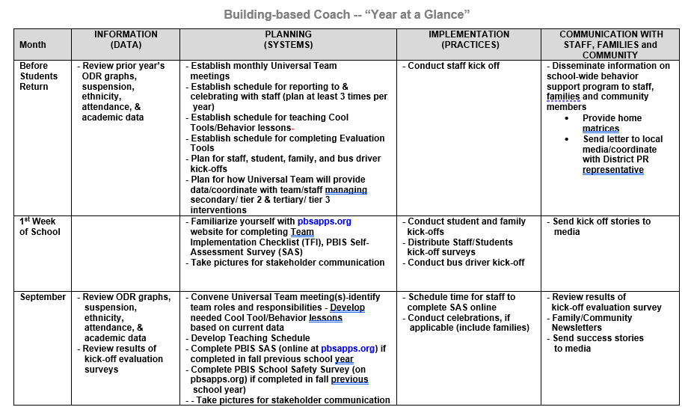
Coaches Year at a Glance
Month by month resources for coaches:
Organizes what data should be reviewed when (for planning purposes)
Prompts for coaches’ and team activities that support planning
What practices should be conducted across the year.
Ideas for communicating with Staff, Families, and Community.
Create your own coaches’ plan!
Remember your Coaches Year At A Glance Document. You may prefer this to the Annual Action Plan.
Notes:
https://sebacademy.edc.org/coaches-year-glance

Slide 17
ACTIVITY: RESOURCE SPOTLIGHT
Review the shared resource independently.
With a partner discuss:
How could this resource serve as a prompt for annual action planning?
What is your key takeaway from these resources?
Be ready to provide a 1 minute share-out of your discussion
Independent Jot
Whole Group
5 minutes
10 minutes
Notes:
https://sebacademy.edc.org/annual-action-plan-template-advanced-years

Slide 18
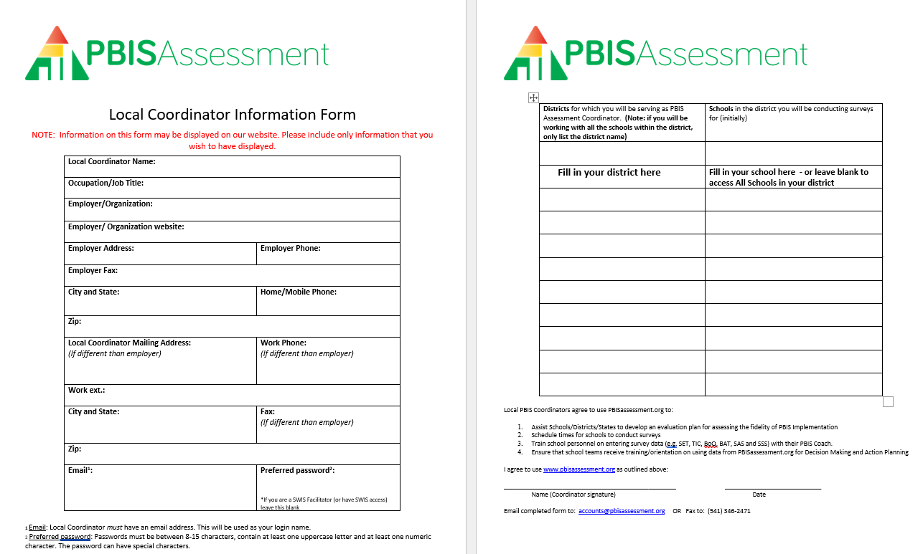
PBIS Assessments Coordinator
Did you complete form and send it in? If not, please download now and complete form and send to: accounts@pbisassessment.org
“Hello, Please add me as a PBIS Assessment Coordinator. See attached form.
Thank you,”
We wanted to check in again on this and see if we can support you!
Notes:
If they have not yet done so-----
Have coaches download this form from the EDC PBIS Resource page. https://sebacademy.edc.org/pbis-assessment-coordinator-form
Complete Form
Send it to accounts@pbisassessment.org with the script “Hello, Please add me as a PBIS Assessment Coordinator. See attached form.
Thank you,”

Slide 19
Celebrations from the past three years!
Notes:
12:30

Slide 20
GETTING STARTED WITH SWPBIS
Classroom Supports
Integration & Alignment
Establish an effective leadership team
Develop a continuum to strengthen appropriate behaviors
We did it!
Develop a brief statement of purpose
Develop a continuum to discourage violations of expectations
Identify positive school-wide behavior expectations
Develop data-based procedures for monitoring
Equity
Develop procedures to teach school-wide expectations
Sustainability
Develop systems to support staff
Develop procedures to teach class-wide expectations
Build routines to ensure ongoing implementation
Notes:
Emphasise the 4 ideas from the video
1 – Keep a strong team (next slide)
2 – Use TFI data to improve systems (we will do this at the November training)
3 – Use your school discipline data – slide to come with all data mentioned…good for goal planning
4 – Implement PBIS in the Classroom (Nov Training)

Slide 21
DISCUSSION: CELEBRATIONS!
Reflect on our journey together these past three years!
What is one or two things that you want to celebrate!
5 minutes
25 minutes
Coach Review
Whole Group

Slide 22
Looking Ahead Review Rollout & Coaches Year at a Glance

Slide 23
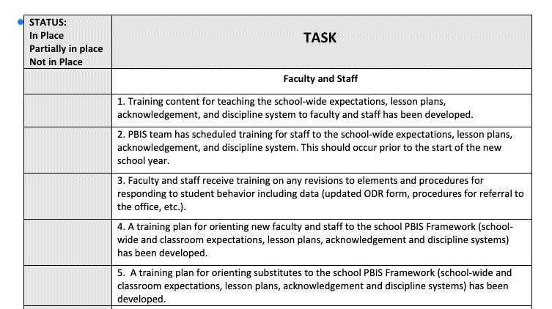
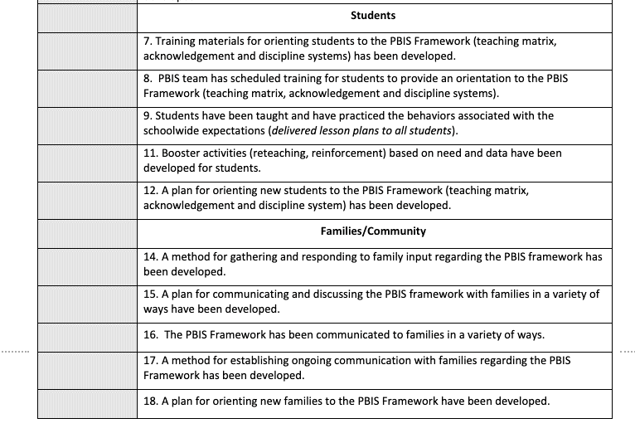
PBIS Rollout Check List, Handbook & Orientation Examples
Rollout Checklist
PBIS Handbook
PBIS Staff Orientation Slides
PBIS Student Orientation Slides
Remember your resources for planning for next year’s PD.
Notes:
PBIS Rollout Checklist
PBIS Handbook Examples: https://sebacademy.edc.org/list-of-pbis-resources?keyword=Sample+PBIS+Handbook&pbis_resource_type=All&pbis_resource_topic=All&sort_by=field_date_value&sort_order=DESC
PBIS Staff Orientation Slides: https://sebacademy.edc.org/staff-presentation-sample
PBIS Student Orientation Slides: https://sebacademy.edc.org/sample-pbis-student-slide-deck

Slide 24
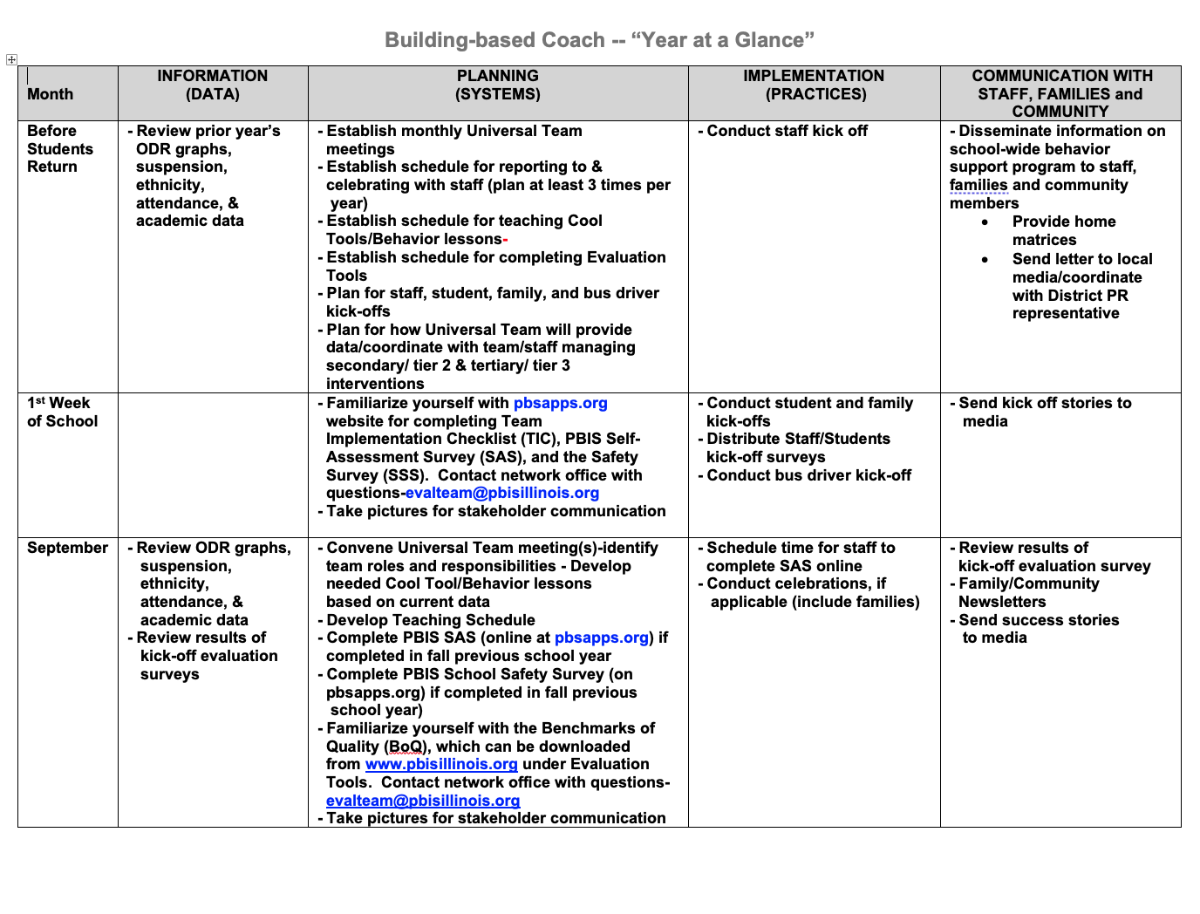
Coaches Year at a Glance
Month by month resources for coaches:
Organizes what data should be reviewed when (for planning purposes)
Prompts for coaches’ and team activities that support planning
What practices should be conducted across the year.
Ideas for communicating with Staff, Families, and Community.
Create your own coaches’ plan!
Notes:
https://sebacademy.edc.org/coaches-year-glance

Slide 25
RESOURCE SPOTLIGHT:
Review Coaches Year at a Glance Document
What activities are relevant to your team’s goals?
How could you modify this document, so you have a personal coaching guide for your school?
10 minutes
5 minutes
Coach Review
Whole Group
Notes:
https://sebacademy.edc.org/coaches-year-glance

Slide 26
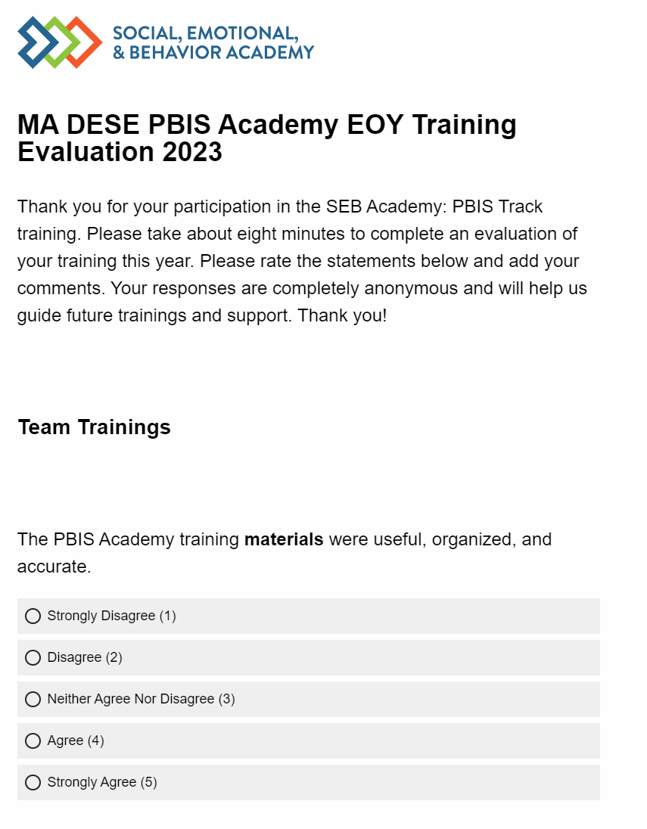
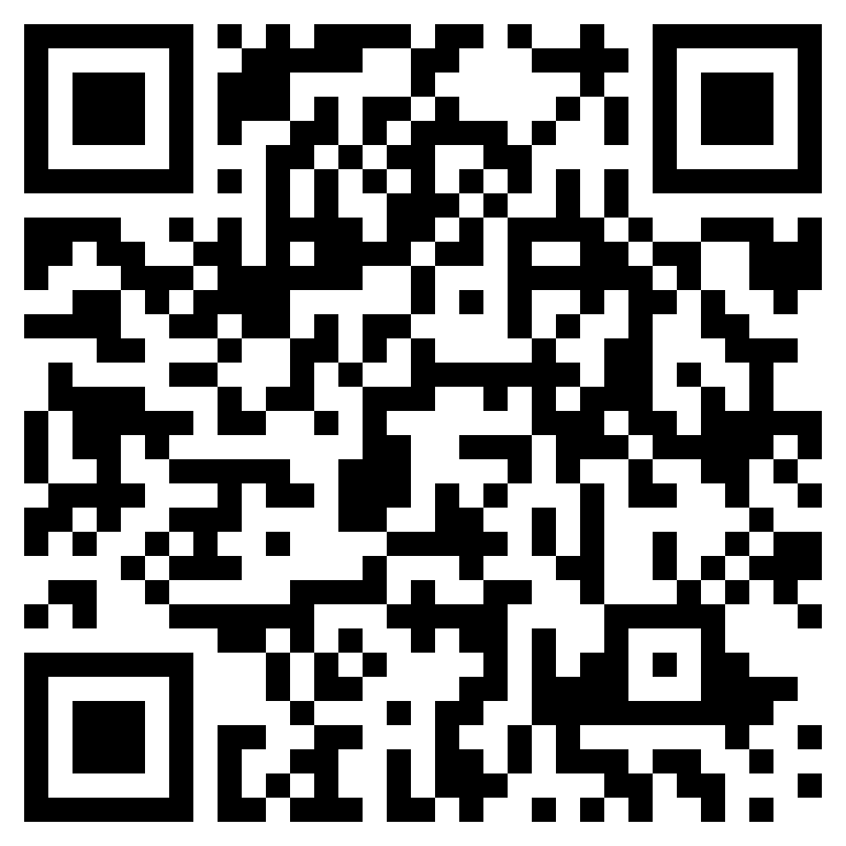
END OF YEAR EVALUATION
We value your feedback!
Please take 10 minutes and complete the end of year evaluation so we know what you have liked and how you think we can improve next year.
Please click on the link that will be placed in the chat or use the QR code on this slide!
10 minutes
Independent
Notes:
Trainer note: Please add link to chat.
https://edc.co1.qualtrics.com/jfe/form/SV_cHpKO4n8KJKPRdA

Slide 27
Review Agenda & Team Tasks
Presentation Content
Review: Annual Evaluation Report
Resource Spotlight: Annual Action Plan
Celebrations from these past years
End of Year Survey
Coaches Tasks
Work with your team to complete your Annual Evaluation Report. Please share a copy with your trainers as we are looking for examples.
Refresh your roll out for next year. Use the Coaches Year at a Glance or Annual Action Plan document to assist with this process.

Slide 28
HELPFUL READINGS & RESOURCES
RESOURCES:
Annual PBIS Evaluation Report Template
Annual PBIS Evaluation Report – SAMPLE
Advanced Action Plan
Evaluation Schedule (with sample)
TFI Manual
Integrated Companion Guide
Culturally Responsive Field Guide
Sustainability Checklist
Sample PBIS Handbooks
Sample Staff Slide Deck
Sample Student PBIS Slide Deck
Notes:
PBIS Evaluation Report https://sebacademy.edc.org/annual-evaluation-report-template
PBIS Evaluation Report Sample https://sebacademy.edc.org/annual-evaluation-report-sample
Advanced Action Plan - https://sebacademy.edc.org/annual-action-plan-template-advanced-years
Team Meeting (Leadership) Foundations Checklist - https://sebacademy.edc.org/team-meeting-foundations-checklist
Evaluation Schedule (with sample) – https://sebacademy.edc.org/evaluation-schedule
TFI Manual - https://sebacademy.edc.org/tiered-fidelity-inventory-tfi-manual
Integrated Companion Guide - https://sebacademy.edc.org/integrated-tiered-fidelity-inventory-companion-guide
Sustainability Checklist - https://sebacademy.edc.org/subsist-pbis-sustainability-checklist
Sample PBIS Handbooks: https://sebacademy.edc.org/list-of-pbis-resources?keyword=Sample+PBIS+Handbook&pbis_resource_type=All&pbis_resource_topic=All&sort_by=field_date_value&sort_order=DESC
Sample Student Slide Deck https://sebacademy.edc.org/sample-pbis-student-slide-deck
Sample Staff Slide Deck https://sebacademy.edc.org/sample-pbis-staff-slide-deck

