Slide 1
Welcome to Tier 2 TEAM meeting!
GETTING STARTED:
Complete the ATTENDANCE
WHILE YOU WAIT:
Add GROWS and GLOWS to the TEAM SHARE
AT THE END:
Complete the EVALUATION
BE PREPARED:
Find training resources at : SEB PBIS Tier 2 Academy
or
Google docs
Open your Tier 2 shared folder
Open your team ongoing ACTION PLAN
~15%
Notes:
LINKS for today:
Attendance
https://edc.co1.qualtrics.com/jfe/form/SV_5BiXqi4bxzOCMS2
New team member communications survey - https://edc.co1.qualtrics.com/jfe/form/SV_db8zhNj6NJ3eXga
EDC Website for SEB Academy
https://sebacademy.edc.org/
Event Evaluation (at the end)
https://edc.co1.qualtrics.com/jfe/form/SV_cBF9GI7gVEBsfSC

Slide 2
PBIS Tier 2 TEAM Training Year 1 APRIL 2023
Marcie Handler
Katie Meyer
with support from NEPBIS Network, May Institute & Broad Reach Consulting

Slide 3
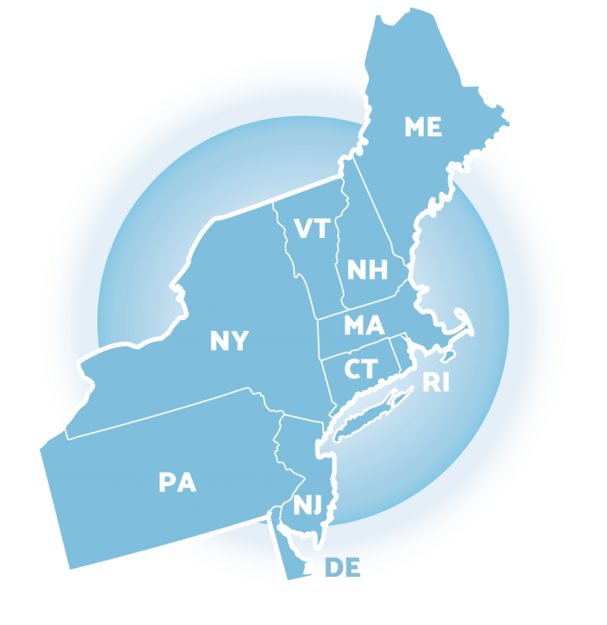
ACKNOWLEDGEMENTS
02
03
04
Northeast PBIS Network (nepbis.org) / UCONN Susannah Everett
01
Michigan Integrated Behavior & Learning Support Initiative
Dr. Heather George & FLPBIS
Missouri PBIS
Drs. Leanne Hawken, Deanne Crone, & Rob Horner
05
06
Midwest PBIS Network

Slide 4
EXPECTATIONS
Self
Others
Environment
Self-monitor
Mute when listening, unmute to talk​
Have electronics ready to use
Obtain help from peers and trainers
Work as a team:
Keep necessary materials at hand
Are you participating?
Engaged as a learner?
Stretch, break, stand as needed​
Room for every voice
Reinforce participation
action plan
relevant docs
water/snacks
Minimize distractions if possible​
Complete tasks efficiently
Notes:
Taking CARE of…

Slide 5
LEGEND
Timing
Example
Activity
Non-example
Guidelines
Preview
Big Idea
Review
Organization

Slide 6
Agenda & Coaching Tasks
Training Overview
Team Tasks – Use the Targeted Intervention Organizer to:
Match targeted interventions to types of student need
Evaluation Steps:
Select tools to progress monitor for each intervention in place
Matching student need to practices
Draft data “guidelines” for monitoring student progress, adjusting and exiting
Adjusting / modifying interventions based on progress monitoring
Methods of progress monitoring
Notes:
Evaluation Steps:
Progress Monitoring – what and how often, using what tools
Data-based decision guidelines for progress monitoring – monitoring fidelity of implementation, adjusting/modifying the intervention, developing fading and exit criteria

Slide 7
Look ahead to April Team training day…
1
Establish a representative T2 leadership team
6
Develop an equitable process for matching student need to practices
2
Develop a collaborative process for identifying students
Develop a process for progress monitoring, data-based decision guidelines
7
3
Evaluate, select and adopt culturally appropriate tier 2 practices
Develop procedures for modifying/ adjusting implementation
8
4
Develop a process to install selected practices
Develop evaluation routines for fidelity and outcome data
9
5
Develop procedures to train staff and students; partner with families and community
Document and share routines, practices, and policies
10
Notes:
COACHES:
Seeing all of these steps can be uncomfortable or overwhelming – the goal is to walk away with an understanding of the elements and strategies to prioritize time and resources to get the steps achieved over a period of time.
TEAM MEMBERS
How will you participation in aspects of these steps support the process?

Slide 8
CHECKING IN & PLANNING AHEAD
What’s something you’d like to celebrate around T2 planning or implementation?
What’s a challenge you’ve encountered around T2 planning and implementation?
What’s a question you have about T2 planning or implementation?
What’s one specific goal you’d like to work on with your team today?
What supports do you need for Tier 2 implementation?
Have you scheduled your TFI yet?
15 minutes
Notes:
Meet with your group to discuss (5 min)
Share as a whole group (8-10 min)

Slide 9
DATA FOR DECISIONS
AT TIER 2

Slide 10
CRITICAL FEATURES OF TIER 2 SYSTEMS
Formal process for screening & identifying students in need of more than Tier 1 support
Increased precision in data collection related to implementation fidelity & progress monitoring
Access to training & technical assistance on Tier 2 practices and supports
Tier 2 leadership team including staff with behavioral expertise, led by a coordinator organizes:
Notes:
What’s different about data at tier 2? Ask about how this differs w/regard to academic systems…at specific school
Highlight 2nd 2; data collection and review is more intense at t2

Slide 11
SELECTING, MONITORING, & EVALUATING SWPBIS TIER 2 PRACTICES
Step 1: Develop evaluation questions
Step 2: Identify indicators or measures
Step 3: Develop methods for collecting & analyzing indicators
Step 4: Make decisions & action plan from analysis of indicators
What do you want to know?
What information can be collected?
How & when should information be gathered?
How was the question answered & what should be done next?
Notes:
Same as tier 1! Fix animation

Slide 12
QUESTIONS TO ASK ABOUT YOUR DATA
Scope of the Problem
Type of Problem
Academic errors
Attendance issues
Behavioral issues
Time
Location
Topography
Function
All Students
Small Group
One
Student
Notes:
Think about the evaluation questions in two ways: scope and type of the problem.
Remind teams workbook appendices are also posted on nepbis.org

Slide 13
GUIDLINES: DATA
Data
At Tier 2, data collection should be more frequent and precise, and teams should use data for the following:
Identifying students in need of additional support (e.g., screening)
Selecting & adopting contextually appropriate Tier 2 supports
Matching students’ need with interventions
Monitoring student progress and developing rules for accessing, adjusting, & exiting interventions
Evaluating intervention fidelity and intervention effectiveness
Monitoring school-wide level of use

Slide 14
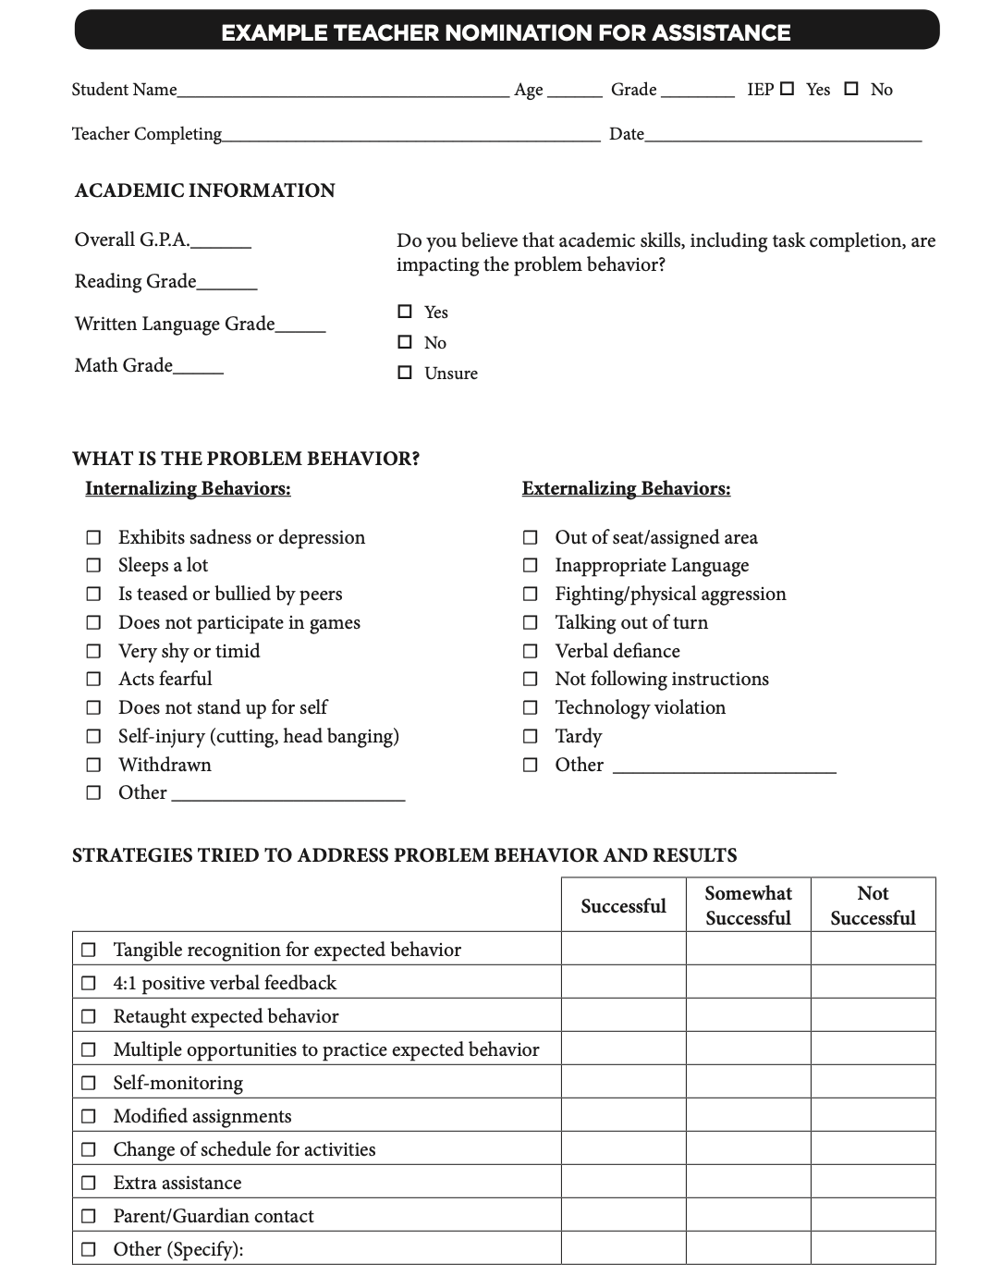
METHODS FOR IDENTIFICATION
Nomination
Data Decision Rules
Screening
Notes:
TRAINER NOTES: these slides are review! Consider an OTR (s): did you develop/revise your nomination form? And/or what is your comfort level with these data sources? Have you started thinking about decision rules? Etc.
The process for identifying students for Tier 2 supports typically
relies on existing data sources
provides information regarding function of behavior
Methods for identifying students include
nomination
teacher/staff
parent
self
data decision rules
extant data
NOTE: screening data is wonderful, but we don’t have time to cover in this training. If you are interested, there are more resources in the syllabus, you can talk to your trainers, and also there are districts in the state who do use universal screening with whom you could connect

Slide 15
DATA SOURCES FOR IDENTIFYING STUDENTS
Attendance | Behavior | Courses/Academics
Absences Tardies (to school/class) Visits to Nurse, Guidance, Office, Restroom | Office Discipline Referrals Classroom-Managed Behaviors Suspensions (in-school, out-of-school) Detentions | Course Grades GPA # Failures Academic Screener Scores Standardized Test Scores
Additional Data to Consider:
Teacher Referrals, Universal Behavior/SEL Screeners, Parent/Student Requests

Slide 16
Data Decision Guidelines
Must be contextually & culturally appropriate
What works in one school may not work in another!
Should be established to guide both entry to and exit from Tier 2 supports
Consider:
Current needs of students in the school
Available resources
Existing programs
Feasibility of starting new programs
Capacity to implement interventions

Slide 17
EXAMPLE: Determining Need
Sample Decision Rules
Measure | Proficient Score | At-Risk | High Risk
1. Classroom Minors | 0-4 | 5 or more | 15 or more
2. Major/ODR | 0-1 | 2 – 5 | 6 or more
3. Absences | <5/trimester | 5+/trimester | 10/trimester
4. Tardy | <4/trimester | 4+/trimester | 10/trimester
5. ISS | 0-1 | 2 | 4 or more
6. OSS | 0 | 1 | 2
7. Course Grades | 2.5 or higher | D or F in any course | Ds or Fs in multiple courses
8. Reading Inventory | 800+ | 799 or lower | 599 or lower
9. Writing Assessment | 3 or 4 | 2 | NS; 1
10. Nurse (non-medication) | 0-1 (no pattern) | 2 – 5 (patterns of regular visits) | 6 or more (pattern of regular visits)
Notes:
Sample decision rules across academic and behavioral sources of data; needs to fit context

Slide 18
Which students might benefit from Targeted/Tier II support?
First Quarter of School Year
Name | Grade Level | Time out of Class (nurse, counselor visits) | Major Behavior Referrals/Minor Classroom Reports | Core Grades | Attendance
Jana | 8 | 0 | 4 minors | 1 D 1 F | 82%
Blake | 5 | Average 3 visits to nurse/week | 0 | 3F | 70%
Toby | 5 | 0 | 16 minors; 3 majors | 2D 1 F | 84%
Doug | 5 | Average 2 visits to counselor/week | 22 majors; 3 suspensions | 4 F | 62%
Yvonne | 8 | 0 | 2 minors | 2 D 1 F | 86%
Lin | 7 | Average 4 visits to nurse /week | 0 | 1 F | 90%
Maria | 6 | 0 | 16 minors; 1 suspensions | 4 D 1 F | 74%
Tyrone | 8 | 0 | 2 majors | 1 F | 81%
Paul | 6 | 0 | 5 minors | 2 D | 89%
Drake | 6 | 0 | 13 majors; 1 suspension | 2D 1 F | 87%
Carlos | 5 | 0 | 1 major | 1 D | 86%
Tia | 6 | 0 | 1 minor | 2 C | 60%
EXAMPLE

Slide 19
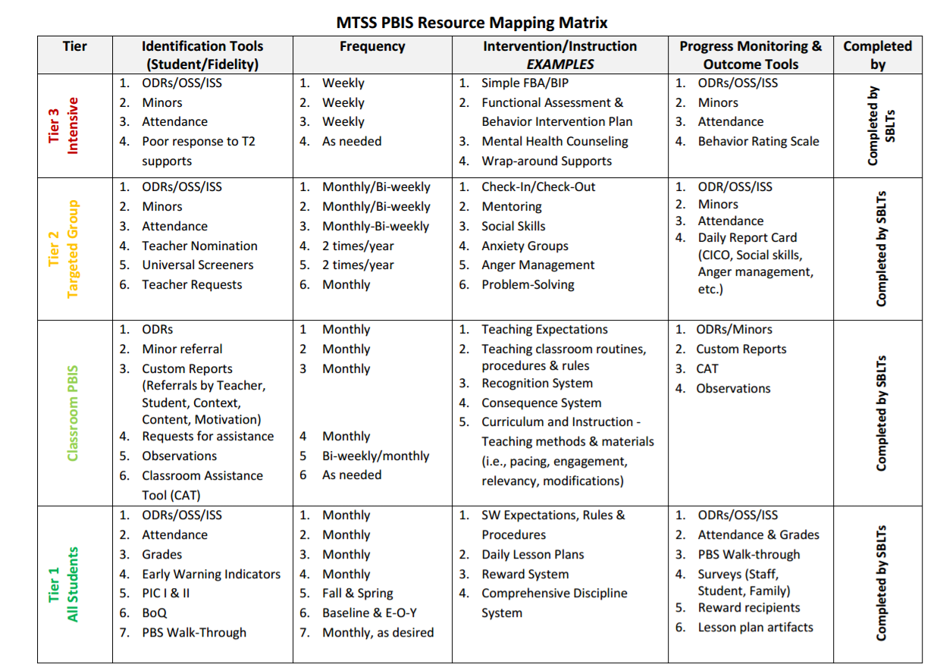
RESOURCE
MAPPING
EXAMPLE
Notes:
Example:
APPENDIX E

Slide 20
GUIDING QUESTIONS: DATA SOURCES
Systems
What data sources do we already use and review?
Do we need to add any additional sources?
What about for this year?
Are there data sources we’ve added this year that we should continue reviewing?
Who will be responsible for collecting and summarizing these data?
How often (once a month, once a quarter) will we review what data?
Are there clear routines for timely response to requests for assistance?

Slide 21
MATCHING STUDENT NEED
Step 6: Develop Processes to Match Student Needs to Practices

Slide 22
QUESTIONS TO ASK YOUR DATA: SMALL GROUPS

Slide 23
CRITICAL FEATURES: MATCHING PRACTICES TO STUDENT NEED
Match students to interventions based on specific NEEDS (e.g., academic & behavioral skills, performance vs. skill deficits)
Match students to interventions using relevant DATA
Consider both intensity of student’s behavior & behavioral FUNCTION
Multiple Tier 2 interventions (w/ documented evidence of effectiveness) in place to match student need
Consider cultural & contextual factors, adapt accordingly
Notes:
Matching students in need of additional supports with Tier 2 interventions should take into consideration student need and cultural and contextual fit. Leadership teams must consider their data sources, how often they will review, and decision rules for access or entry criteria.

Slide 24
ALIGN PRACTICES
Infraction | Failure to Comply | Inappropriate Language | Tardiness
Link SW Expectation | Responsible | Respectful & Reflective | Responsible
Define what you want the student to do | Cooperate with instructions & directions timely | Use appropriate words to express sentiment (e.g., considerate, polite, kind, professional, etc.) | Be in seat when bell rings
Social and Emotional Skill (SEL) Options to Teach | Asking for help Active listening Paraphrasing understanding Managing frustration (e.g., positive self-statements, deep breaths) | Stop-think-act Managing disappointment Turning the conversation Making a complaint Reframing negative thoughts | Managing transition time Planning ahead Self monitoring Using conversation enders (e.g., “catch you later”)

Slide 25
SELECTING, MONITORING, & EVALUATING SWPBIS TIER 2 PRACTICES
Step 1: Develop evaluation questions
Step 2: Identify indicators or measures
Step 3: Develop methods for collecting & analyzing indicators
Step 4: Make decisions & action plan from analysis of indicators
How will we match student need to our Tier 2 interventions?
What data sources will we use to support these decisions?
How & when should information be gathered? How often will the Tier 2 team review this data? What decision rules will we develop for access/entry criteria?
What do we need to add to our action plan? How will we share this data with staff?
Notes:
Same as tier 1! Fix animation

Slide 26
GUIDING QUESTIONS: GROUPING COMMON NEEDS
Systems
Do identified students have similar instructional needs?
Do identified students have both academic and emotional/behavioral needs?
Are identified students’ academic needs similar?
Are the functions of behavior (assessed informally) similar across students?

Slide 27
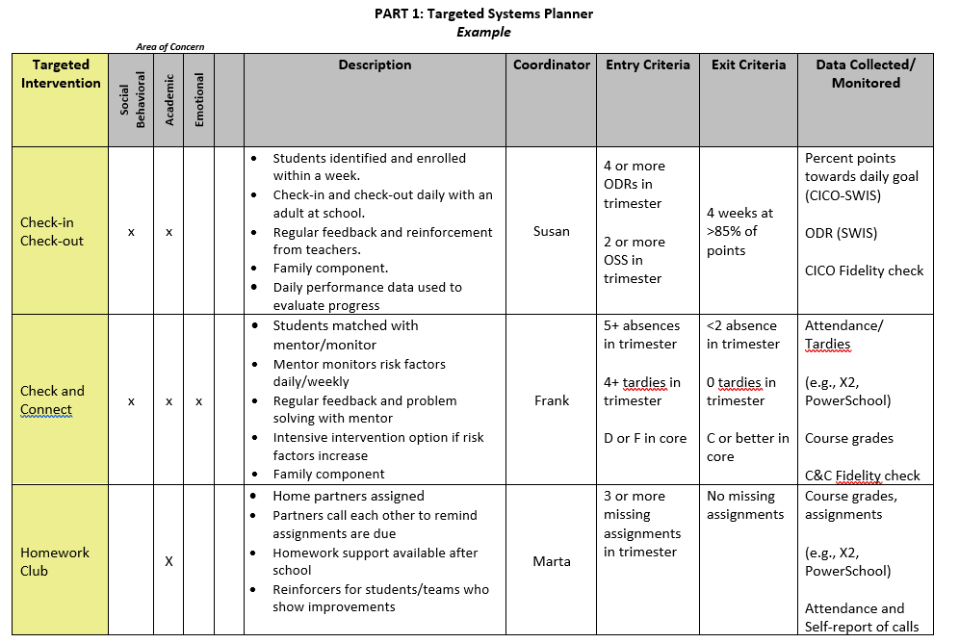
MEETING STUDENT NEEDS: PART 1
by Spring TFI
TEAM TIME
Notes:
Now we are ready for the TOOL
Part 1 is called the Targeted Systems Planner. This part provides teams with the chance to reflect on each intervention and how it may (or may not be) implemented systematically to provide meaningful outcomes.
On the left is the name of the intervention. Across the top some teams do a quick check off of whether they consider the intervention goals in area of concern (academic, social/behavioral, emotional or mental health focused).
This aligns well with Step 3 – select and adopt – first we need to see what we have and what global areas of concerns they address.
Then they describe the “essence” of the intervention – a few details and perhaps the purpose.
Teams might want to list the current year’s coordinator for each intervention to assist in planning and support for staff.
ADVANCED STEP: Sometimes teams expand the columns to show the frequency of the intervention (e.g., delivered daily, 1x per week, options of Monday or Wed). The name of the intervention, coordinator, and frequency of the intervention can also be something you put in a table at the end of the document if that seems easier.
The last three columns are areas you may not be quite ready for yet, but are critical for installing systems for data-based decisions.
Teams discuss what data will be considered to access or “enter” the intervention (e.g., ODRs, absences, missed assignments) and what data goal would indicate it’s time to “exit” or graduate from the intervention.
The last column reminds us of the data being collected to monitor implementation of the intervention (Fidelity) and student progress – what type of data, where can the team find the data that will be used to assess response to the intervention?
Reminders:
Don’t feel overwhelmed if your team doesn’t have each box filled in yet - that’s expected. Use this to identify those gaps and action plan as a team around a reasonable timeline to get aspects developed for ONE intervention.
Do that well and it will be easier to replicate for the next ones.

Slide 28
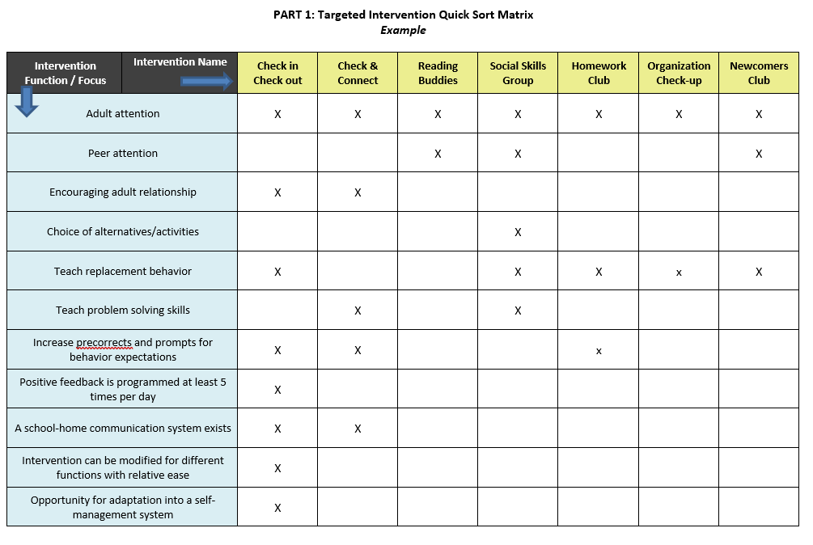
MEETING STUDENT NEEDS WITH TIER 2 PRACTICES
Notes:
From the TFI.. CICO should meet all of the 9 items.
It’s ok if your team doesn’t have it all defined for each intervention
You might not have more than 2-3 to begin with

Slide 29
MATCHING INTERVENTION TO NEED: CICO
&
APPROPRIATE
Low-level problem behavior (reoccurring minor incidents)
2-5 referrals (office referrals)
Behavior occurs across multiple locations
Examples
talking out
minor disruption
work completion
INAPPROPRIATE
Serious or violent behaviors/ infractions
Chronic extreme behavior (8-10+ referrals)
Require more individualized support
Functional assessment
Wraparound services
Notes:
Review from last training…
MIDWEST
Check for understanding that CICO is a low level intervention and not intended to be the only intervention tried for more serious or chronic behaviors.

Slide 30
CONTEXTUAL FIT: PERSONNEL & STUDENT MATCH
Identify staff skill sets
Match staff skills to student needs, given available resources
Based on screening data, determine how many students need each Tier 2 support
Evaluate any gaps between student needs & staff skill set
Determine how you will address the gap:
Train additional staff
Partner with neighboring schools to share staff and/or resources
Connect with community partners to assist with delivering or supporting interventions
Notes:
Rationale:
Personnel can “make or break” the likelihood of an intervention being successful (even if it was appropriately matched to the student).
Personnel are the stakeholders and should be considered when implementing the intervention with a student.
Trainer’s Notes:
Brainstorm with the larger group ways that they have been able to address the issue of personnel.

Slide 31
EXAMPLE: STAFF-STUDENT MATCH
Identification Process
Intervention
REP (Resilience Education Program)
How much time is needed for implementation?
45 minutes per week
How many times per week will it be implemented?
1 day per week
Who will teach/ implement the intervention?
School Psychologist
Notes:
Rationale:
Consider the stakeholder (personnel) on campus who may be the best fit to implement the intervention.
Trainer’s Notes:
Here are the questions you want to ask for each intervention to determine what you need to do for scheduling and identifying the appropriate personnel.

Slide 32
EXAMPLE: DATA REVIEW SUMMARY
Results/Conclusions: MTSS team had 25 students this quarter needing additional supports
Areas of Concern:
Prosocial Skills
Replacement behaviors for avoidance, withdrawal, etc.
Examples: Friendship Skills and Relationship Building
Problem-Solving Skills
Replacement behaviors for fighting, arguing, etc.
Examples: Anger Management Skills and Self Management
Academic Behavior Skills
Replacement behaviors for getting out of seat, poor study habits, talking out during instruction, etc.
Examples: Study/Organizational Skills & Self-Management Skills
(adapted from PBIS Illinois, 2014)
Notes:
Rationale:
Tier 2 interventions are supplemental supports that are provided to groups of students. Based upon data, not all students will need or successfully respond to the same intervention.
Trainer’s Notes:
This school identified three groups of student need: (1) Pro-social skills, (2) Problem-solving skills, AND (3) Academic Behavior skills.

Slide 33
CONTEXTUAL FIT
School has 25 students needing Tier 2 supports (~11% of the student population)
Areas in which students need supports:
Problem-Solving Skills: anger management
Academic Behavior Skills: organization
Prosocial Skills: coping with anxiety & depression
Supports currently available:
Weekly Social Skills Group: school counselor supporting 6 students (maximum)
CICO: 1 adult supporting 5 students
Mentor Program: started, not consistently coordinated
Nothing for students with anxiety concerns

Slide 34
WHAT IF TIER 2 SUPPORTS CANNOT ACCOMMODATE ALL STUDENTS’ NEEDS?
Social Skills
Administrator identifies teacher to run second group
Teacher given extra planning period once per week to teach group
Check-In, Check-Out (CICO)
Administrator identifies additional staff to monitor CICO
Music teacher, custodian, & all administrators
Mentoring Program
School counselor contacts community agency to restart mentoring program
Staff responsible for community involvement access agencies interested in program
Notes:
Rationale:
Once students are identified, grouped, and interventions selected, the timing of delivering those interventions (a.k.a., scheduling) needs to be carefully considered.
Trainer’s Notes:
This is an example school.

Slide 35
GUIDELINES: MATCHING STUDENTS WITH TIER 2 SUPPORTS
Data
Data reviewed includes information across multiple domains (e.g., behavior, academic, social)
Data organization allows for efficient matching of students to Tier 2 supports with minimal discussion
Data collected aligns with intervention decisions & student match
Data reviewed includes information about function of behavior & skill/ performance deficits
Contextual & cultural fit considered when matching students with support
Tier 2 supports organized from least to most intensive
Tier 2 supports organized to consider function of behavior/ academic need (i.e., accuracy vs. fluency)

Slide 36
Activity: Matching Student Need to Practices
Pull up your Targeted Intervention Organizer
LIST TIER 2 Interventions on the ‘quick sort matrix’ that your school uses, and try to “match” to type of practice.
Summarize student data and match to Tier 2 interventions.
How will you will evaluate whether your existing interventions meet student needs, and if there’s need to add new practices.
Update your Action Plan.
20 minutes
Notes:
Following this meeting, or in the upcoming TEAM meeting, summarize student data and match to Tier 2 interventions (e.g., we have 5 students needing XXX type of intervention).

Slide 37
DISCUSSION
What are some of the challenges you anticipate regarding developing decision guidelines? How might you navigate those? What do you see as some advantages of developing these guidelines?
As a team, how can you review student data to inform the practices you have in place?
Whole Group
5 minutes
Notes:
TRAINERS – Discussion prompts; allow 5 minutes.

Slide 38
Evaluation Steps: Progress Monitoring
Applying data-based decisions to evaluate student progress and intervention effectiveness

Slide 39
Progress Monitoring
Data
Developing measures/tools to monitor student progress

Slide 40
PROGRESS MONITORING
Progress Monitoring (PM) is the process of systematically planning, collecting, & evaluating data to inform programming decisions
Provides basis for determining whether an intervention is effective for a given student
Assists with developing effective intervention plans and making more informed instructional decisions
National Center on Intensive Intervention
PM Evaluation Questions:
How do we know if the student is responding to the intervention and making progress towards the goal?
How do we know if the intervention is effective for most of the students receiving the intervention?
How will we know if the intervention being implemented with fidelity?

Slide 41
PROGRESS MONITORING TOOLS & ROUTINES: CRITICAL FEATURES
Progress Monitoring Tools
Progress Monitoring Routines
Can be administered efficiently & repeatedly
Allow for sharing with staff
Brief, reliable, & valid measures of specific skills
Sensitive to change
Comparison of performance across time within & across students
Consistent with Tier 1 systems
Allow for regular review of student progress
Notes:
Sharing with staff – how often and what data to share?

Slide 42
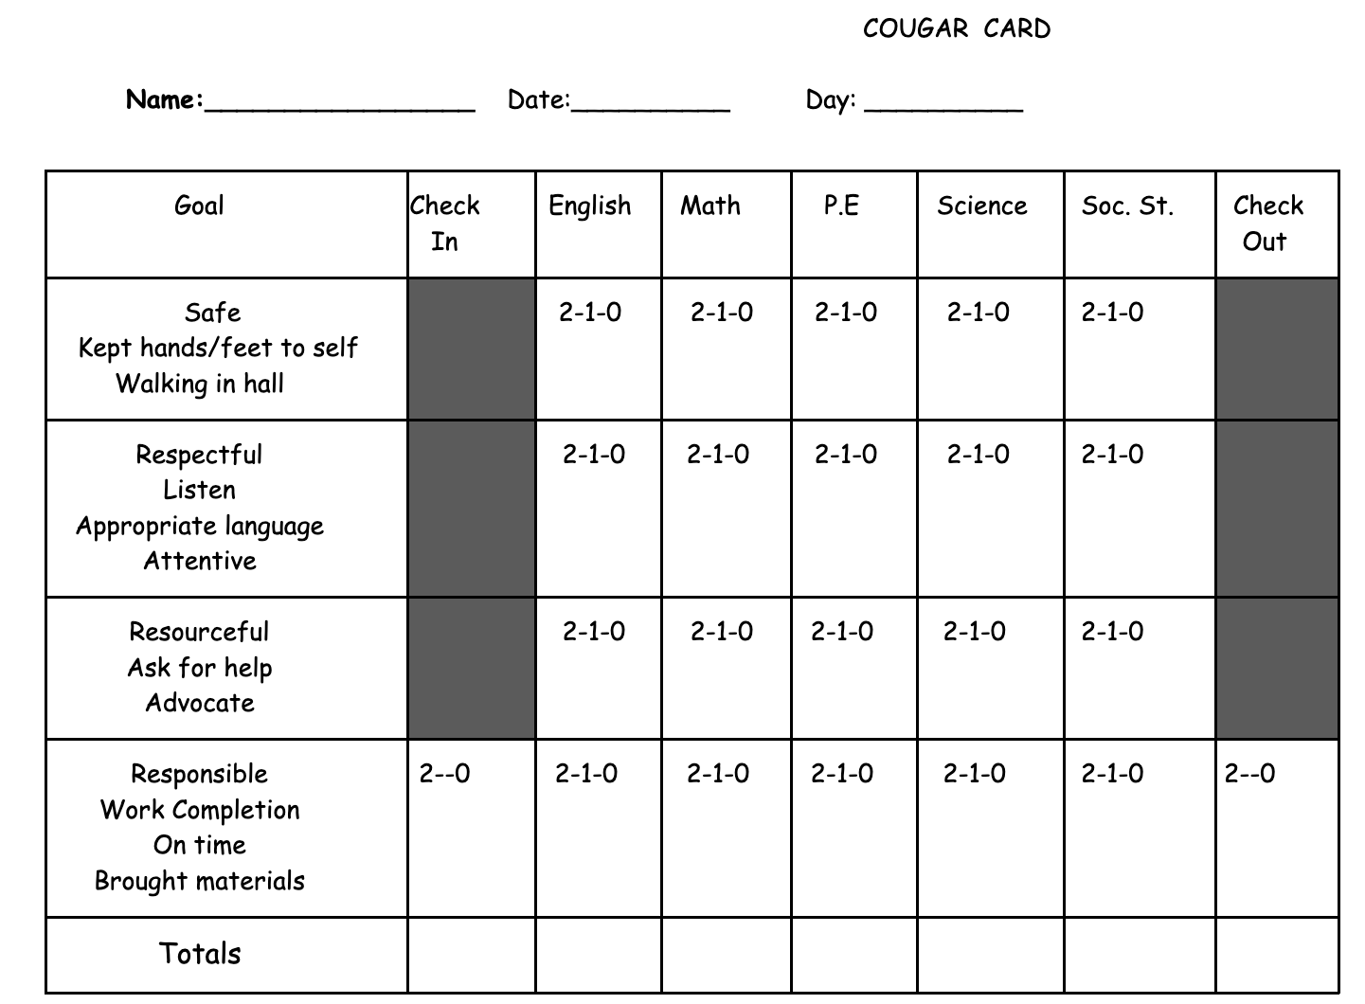
Progress Monitoring Tools: Examples Measure student outcomes
CICO Daily Progress Report
Targeted Social Skills: Daily or Weekly Progress Report
Self-Management: Student Self-Ratings
Check and Connect: Monitoring Sheet
Direct Behavior Ratings (DBRs) (can use for a # of interventions)

Slide 43
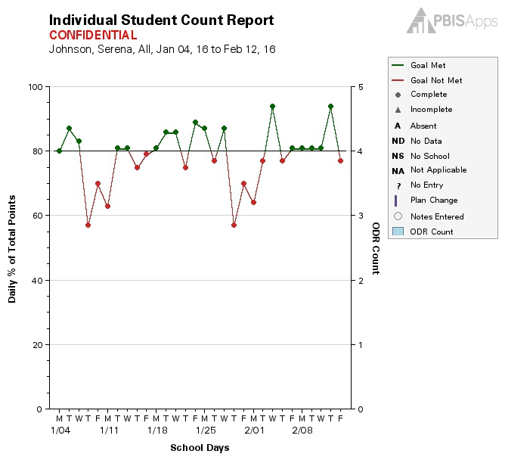
EXAMPLE: CICO SWIS MONITORING INDIVIDUAL STUDENT PROGRESS

Slide 44
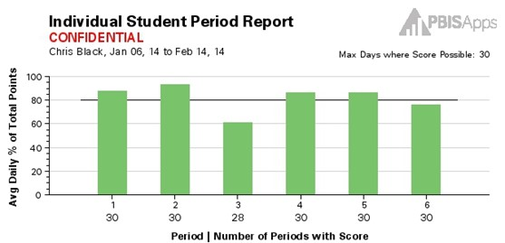
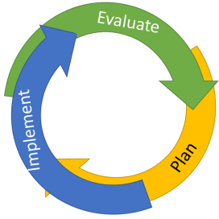
EXAMPLE: CICO SWIS INDIVIDUAL STUDENT PERIOD REPORT
The Student Period Report helps evaluate:
What does one student’s average day look like?

Slide 45
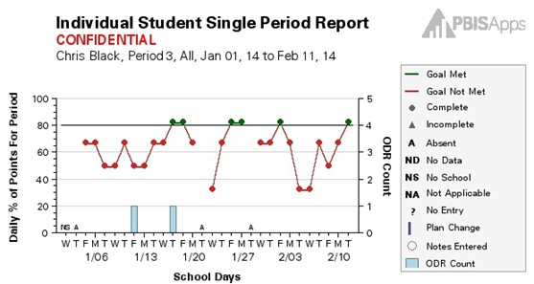
EXAMPLE: CICO SWIS INDIVIDUAL STUDENT SINGLE PERIOD REPORT
The Student Period Report helps evaluate:
What is one student’s pattern over time in a single period?

Slide 46
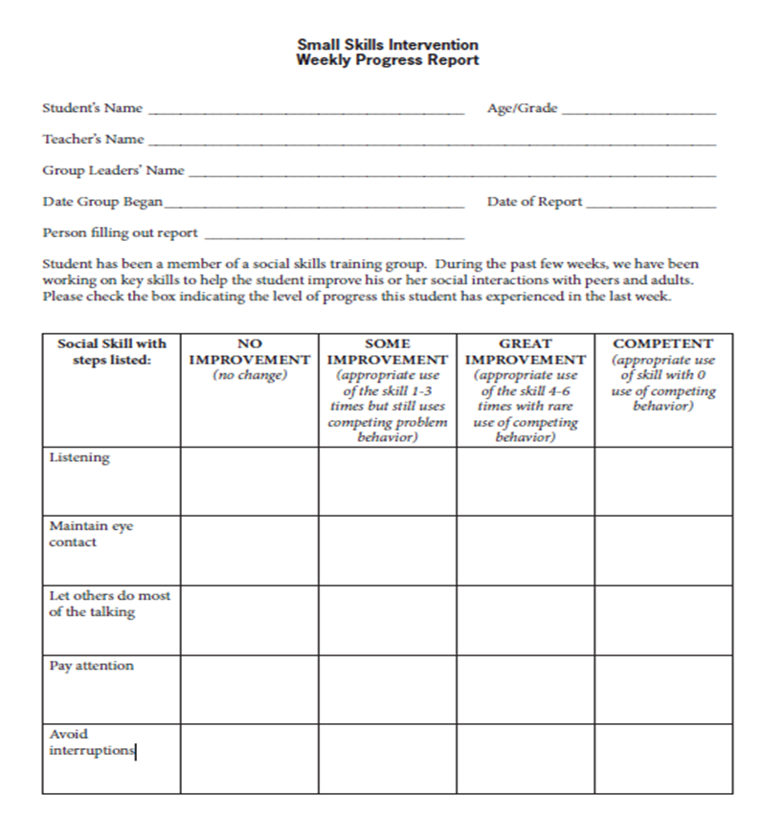
EXAMPLE: WEEKLY PROGRESS REPORT FOR SOCIAL SKILLS
Missouri PBIS

Slide 47
EXAMPLE: DBR PROGRESS REPORT
Notes:
Templates of forms available at https://dbr.education.uconn.edu/library/information-for-parents-and-professionals/
System to track progress? – would need an excel tracking form or could look at I-SWIS

Slide 48
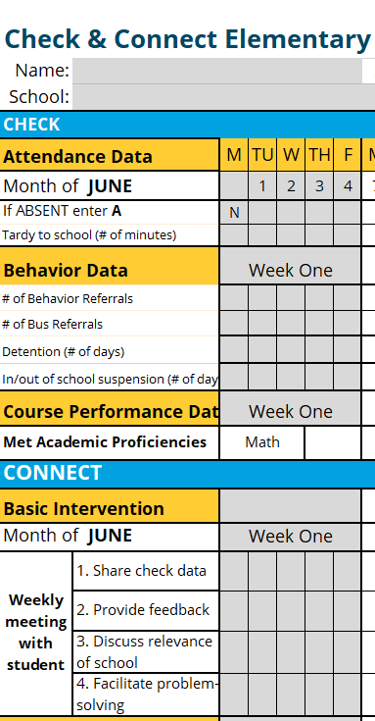
EXAMPLE: CHECK AND CONNECT

Slide 49
CROSS TEAM JIGSAW DISCUSSION: Progress Monitoring Tools
1. Do you have any tools in place to monitor student progress for your T2 interventions? * Are there tools you need to add/develop?
2. How has your team planned for collecting and summarizing data?
3. How frequently do you use data for decision making?
15 minutes
ACROSS TEAMS

Slide 50
DEVELOP A PROCESS FOR ADJUSTING OR MODIFYING IMPLEMENTATION

Slide 51
QUESTIONS TO ASK YOUR DATA: INDIVIDUAL STUDENTS

Slide 52
CRITICAL FEATURES: PROCESS FOR ADJUSTING OR MODIFYING TIER 2 INTERVENTIONS
Outcome & fidelity data reviewed concurrently to determine what aspects of supports need modification
Clear exit criteria for students who are successful with Tier 2 practices
Clear decision rules for students who are not responding to Tier 2 practices
Team reviewing data includes members with behavioral/ academic expertise & implementers of Tier 2 supports

Slide 53
Data Decision Rules—Considerations
• Length of intervention before reviewing data
- e.g., At least X weeks
• Minimum number of data points to collect before reviewing data
- e.g., At least X number of data points
• Decision rules…
– Positive response to intervention
– Questionable response to intervention
– Poor response to intervention
– When to fade an intervention
e.g., 4 of 5 data points above 80% per week, for 4 or more consecutive weeks

Slide 54
Were data collected?
YES
NO
Problem solve data collection—determine how to get data
Collect data for 2 weeks and reconvene
Are goals being met?
YES
NO
Celebrate and continue
Develop a plan for fading
Is plan being implemented as designed?
YES
NO
Maintain or Increase intervention
Adjust or Modify intervention
Change Intervention
Problem solve barriers to implementation
Collect data and reconvene

Slide 56
WHAT ARE DECISION RULES?
Guidelines for interpreting data
Recommendations for common scenarios
Used in conjunction with problem solving process
Guidance on when to make changes to students’ support
Maintain / Increase
Adjust/Modify
Fade/Graduate
Help to improve:
Consistency of support delivery
Efficiency of problem-solving meetings
Notes:
Rationale:
Decision rules provide guidelines for interpreting data. Decision points are needed at Tier 2 to determine if we have a need for Tier 2 support or another issue (e.g., Tier 1 problem). Data help guide the Tier 2 team in the identification, review, and (if applicable) support of eligible students.
Trainer’s Notes:
Description of what decision rules are and why they are important. Each item will be introduced individually through animation with a click.

Slide 57
DECISION RULES FOR EACH INTERVENTION: GUIDING QUESTIONS
Monitoring Student Progress
How often will progress monitoring occur?
What is the criteria to receive the intervention?
What defines a positive response to the goal?
When & how will the intervention be faded if it is “successful”?
What defines “lack of progress” toward the goal?
How will the team respond if progress is questionable or poor?
Intervention Implementation
What is the goal?
When will the goal be achieved?
What defines intervention implementation fidelity?
How will the team respond if the intervention is not being implemented with fidelity?
Notes:
Rationale:
These guiding questions are essential for every type of Tier 2 intervention. Given that each intervention is implemented differently (e.g., frequency), the decision rules established for determining goal setting may vary.

Slide 58
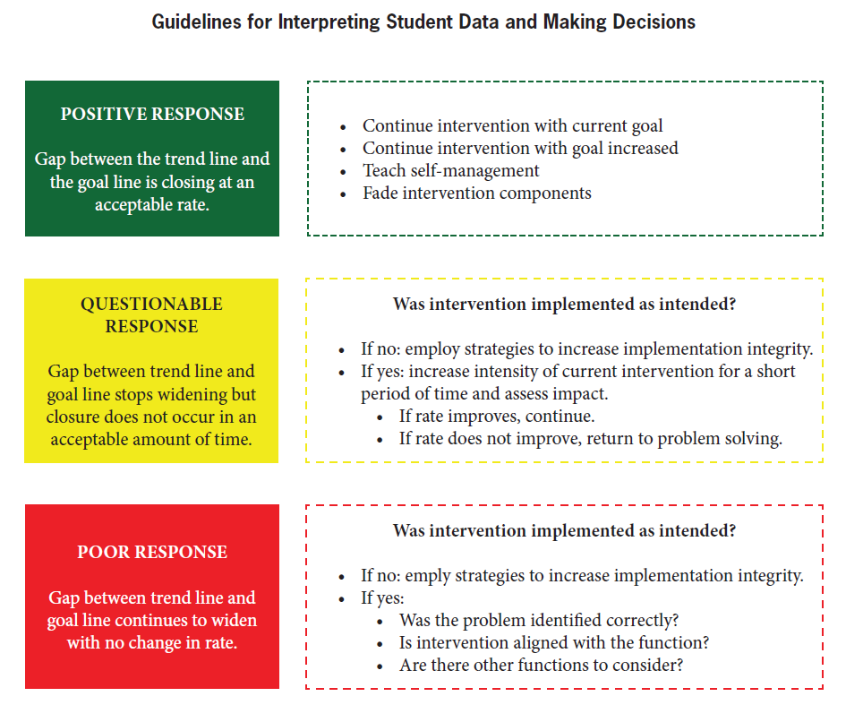
Source: MO PBIS
Notes:
Did we match the best intervention?
Do we need additional interventions?
Do we need more time for the intervention?
Do we need to modify for function?

Slide 59
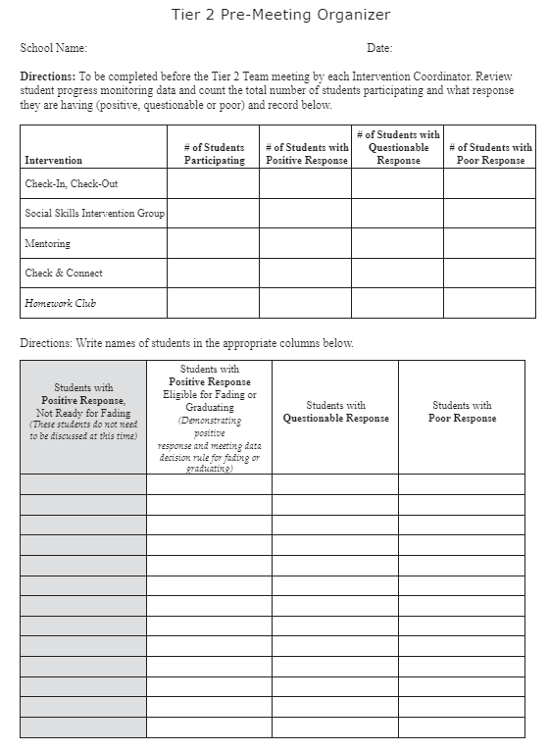
EVALUATION PREVIEW Develop methods to: 1. DETERMINE LEVEL OF USE and 2. RESPONSE TO INTERVENTIONS

Slide 60
Source: MO PBIS

Slide 61
POSITIVE RESPONSE TO INTERVENTION
What defines a positive response?
Criterion (e.g., 80%)?
Length of time (e.g., 4 weeks?)
Decision Options
Continue with current goal or intervention
Increase current goal or focus on generalization
Teach and implement self-management
Fade intervention components (e.g., fewer check in periods, fewer social skills groups)
Mentor other students
Graduate (and celebrate!)

Slide 62
EVIDENCE-BASED PRACTICES: SELF-MANAGEMENT

Slide 63
TEACH SELF-MANAGEMENT
Self-Management: the ability of an individual to make changes in her/his environment that result in changes to her/his behavior
→ Often implemented in conjunction with other interventions (e.g., CICO) with varied levels of teacher support or scaffolding
→ Can be used to:
Maintain behavior change once interventions are faded
Support the overall goal of CICO - to teach students to self-manage their behavior
Self-management can be used as a stand-alone intervention, or as part of the fading process for students who have responded positively to intervention
(Cheney & Yong, 2014; Cooper, Heron, & Heward, 2007; Crone, Hawken, & Horner, 2010; Miller, Dugrene, Olmi, Tingstrom, & Filce, 2015; Skinner, 1953).

Slide 64
ADVANTAGES & BENEFITS OF SELF-MANAGEMENT
Addresses problem behaviors privately
Reduces adults’ efforts
Promotes generalization and maintenance of behavior change
Efficient! A few self-management tactics can address many behaviors
Works for a wide-ranging population
As effective as other external strategies
Contributes to a more efficient and effective classroom environment
Students who are successful can be peer leaders or ambassadors for others
Self-management is an ultimate goal of education: an important skill to teach!

Slide 65
MOVING TOWARDS SELF-MANAGEMENT: CICO
Teach student to rate their behavior (self-evaluation)
Compare student & teacher behavior ratings → discuss discrepancies and reinforce for accuracy
Once accuracy is established, reinforce for behavior (rather than accuracy)
Continue self-evaluation; add self-reinforcement & fade check-in (1x/day)
Continue to fade CICO

Slide 66
CICO FORM (DAILY PROGRESS REPORT): REVIEW
CICO Form
Name: ________________ Date: ______________
2 = great 1= OK 0= hard time
 | Safe | Responsible | Respectful
Check In | 2 1 0 | 2 1 0 | 2 1 0
Before Recess | 2 1 0 | 2 1 0 | 2 1 0
Before Lunch | 2 1 0 | 2 1 0 | 2 1 0
After Recess | 2 1 0 | 2 1 0 | 2 1 0
Check Out | 2 1 0 | 2 1 0 | 2 1 0
Today’s goal: |  | Today’s total points:
Comments:
Notes:
Discuss student self-rating; matching with teacher…

Slide 67
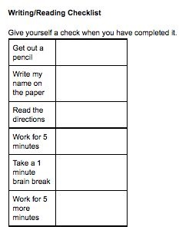
EXAMPLE: SELF-MONITORING, TRADITIONAL PAPER & PENCIL
Traditional Self-Monitoring
Technology-Based Self-Monitoring (TBSM)

Slide 68
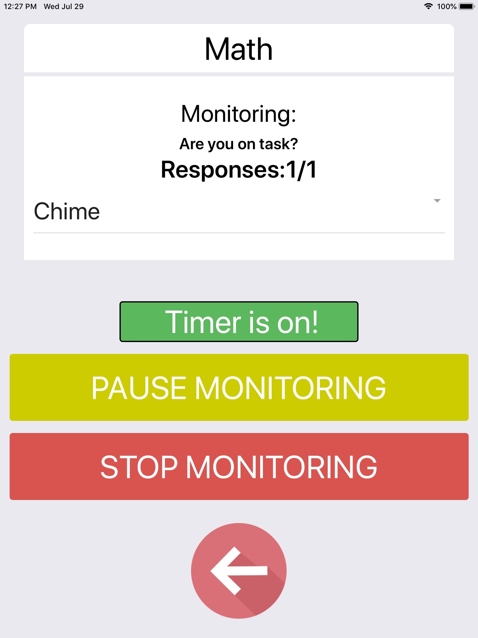
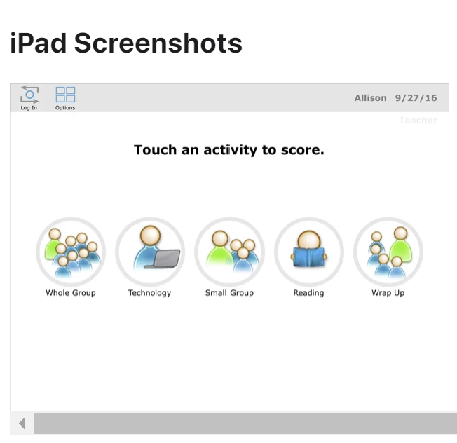
EXAMPLE: TECHNOLOGY-BASED SELF-MONITORING (TBSM)
Respond in the Chat:
What strategies have you used to SM your students? What students would respond to SM? How will you plan for this?
I-Connect
SCOREIT
CellF-Monitoring

Slide 69
Source: MO PBIS

Slide 70
QUESTIONABLE RESPONSE TO INTERVENTION
Was the intervention implemented as intended (fidelity)?
If not sure, MEASURE IT
If no, implement strategies to increase fidelity
If yes…
Decision Options
Continue with current goal (“more time”)
Caution: Avoid leaving students in CICO or other Tier 2 interventions without fading or intensifying for too long of a period of time.
Make modifications
Increase intensity (e.g., increase check in periods, frequency of skills groups)
Modify intervention components (e.g., bring a friend to check out, change or increase reinforcers, change adult check out)

Slide 71
EXAMPLE: FIDELITY CHECKLIST
EVALUATING TIER 2 INTERVENTION FIDELITY
Notes:
A simpler measure that could be used monthly
Not all curricula have intervention fidelity checklists available. Teams might have to create them.
Trainer’s Notes:
FIDELITY CHECK for CICO: https://nepbis.org/wp-content/uploads/2022/05/Tier-2-Intervention-Fidelity-Checklist.docx
Other fidelity checklists / tools next month

Slide 72
TIER 2 MODIFICATIONS: 5 “W’s”
1
2
3
4
WHO
Modify who is offering the intervention (e.g., preferred adult, peer)
WHAT
Modify what is being offered (e.g., intervention type)
WHERE
Modify where the intervention is occurring (e.g., classroom, SP office)
WHEN
Modify when it is being offered (e.g., frequency, intensity)
5
WHY
Modify WHY the intervention (e.g., consider FUNCTION, consult data)
Notes:
Make modifications
Increase intensity (e.g., increase check in periods, frequency of skills groups)
Modify intervention components (e.g., bring a friend to check out, change or increase reinforcers, change adult check out)

Slide 73
Let’s try an Example for “Questionable Response”
As a team you are asked to look at a specific student response to intervention.

Slide 74
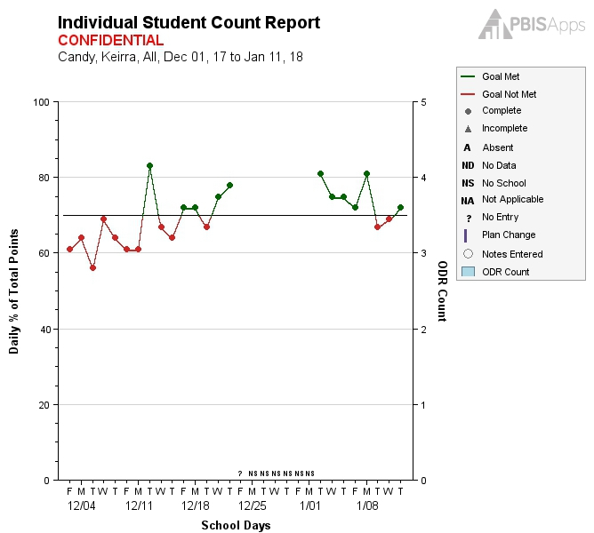
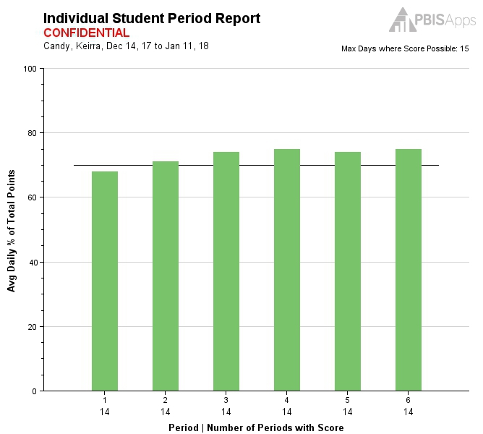
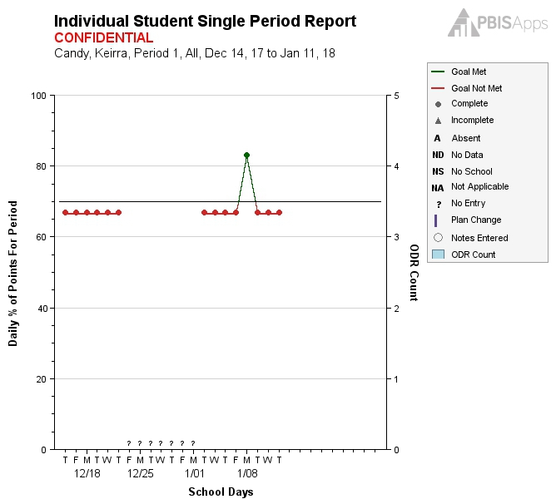
EXAMPLE: KIERA’S REPORTS (GOAL = 70%)
Only met her goal during First Period one day.
Meeting goal in all periods except First Period.
Current Goal: 70%
Current Avg.: 72.82%
Notes:
Now, we will move to the student’s individual reports: Student Count Report, Student Period Report, and Student Single Period Report. Kiera’s reports show that she is meeting her goal in all classes except First Period. She has only met the goal one day in First Period. The data analyst would use the data-decision rules to recommend modifications be made to assist Kiera to be more successful.

Slide 75
EXAMPLE: DECISION RULES
CICO Decision Rules | Criteria
Stay as-is | Less than 6 weeks of success & upward trend
Make modifications | Less than 6 weeks of success and/or even or downward trend
Move to fading or self-management | At least 6 weeks with 4 days per week of success
Move to more intensive supports | 2 weeks without improvement after fidelity has been monitored & modifications have been made
Graduate off CICO | 4-6 weeks of success on fading /self-management
Notes:
This is one example of a school’s CICO decision rules.
What might your team decide here?

Slide 76
EXAMPLE: KIERA’S SUMMARY REPORT
Student | Days with Data | Student Goal | Avg. Daily Points | Progress /Success | Barriers/ Challenges | Recommended Status (see Decision Rules*)
Kiera | 30 | 70% | 72.82% | She is meeting her goal in Periods 2-5. | Period 1: Reading Earns average of 55% Consistently turning in work late Many tardies Has difficulty with 3 students in the class | Needs modifications
Notes:
The data analyst would bring this information to the team meeting.

Slide 77
EXAMPLE: KIERA’S CURRENT STATUS & GOAL
Current:
Period 1: Reading earning an average of 55%
Consistently turning in work late
Many tardies
Has difficulty with three students in the class
Goal:
Period 1 Reading: Earn an average of 80%
Turn in work on time - 80% of the time
No tardies in Period 1

Slide 78
EXAMPLE: TIER 2 MEETING AGENDA
Student | Gr. | Identified Problems & Supporting Data | Response Actions & Next Steps | Who? | When? | Goal
Kiera | 5 | Period 1: Reading Earns average of 55% Consistently turning in work late Many tardies Has difficulty with three students in the class | Kiera will have a seating change in Reading Class Assess needs and provide academic support in Reading Kiera will receive a Tiger Ticket each day she is on time in Period 1 | Mrs. G. Mr. J. Mrs. G. | Tomorrow Monday Tomorrow | Kiera will receive an average of 80% of her points in Reading Kiera will have 0 tardies in Reading
Notes:
The team then develops an action plan to assist Kiera

Slide 79
EXAMPLE: MODIFYING CICO FOR STUDENT WITH PEER ATTENTION-MAINTAINED BEHAVIOR
Have student check in with a peer
Consider an older student or a student that has completed self-management phase.
Modify reinforcement system so that they earn time with a peer / friend
Earn access to work or engage in free time

Slide 80
EXAMPLE: BREAKS ARE BETTER
Escape Motivated (work demands)
Similar CICO Routines
Check in with coordinator to review expectations, ensure materials ready for the day
Hand in DPR to teachers, feedback at the end of each class/subject
Check out at the end of the day
Modifications
Can request a predetermined # of brief (e.g., 2 minute) breaks throughout the day, recorded on DPR
During breaks, students can engage in approved activity (e.g., drawing, books, alternative assignments)
Break routines taught and reinforced

Slide 81
What students would respond to BrB? How will you plan for this?
Activity
Points Possible
How Points are Earned
Morning Check-in
2
Student attends Check-in (1) and has materials
Feedback
Up to 2 per Expectation
Meet behavioral and academic expectations
Break Tracker
1 per feedback session
Taking breaks appropriately when needed
Afternoon Check-out
2
Attended check-out and (1) and have teacher(s) ratings (1)

Slide 82
CAUTION: WHEN BREAKS may NOT BE BETTER?
Escape Motivated (Anxiety)
When students have anxiety, breaks could go either way….
Modifications
ASK THE STUDENT – identify “zone” or rate level of anxiety after trying break
Brief breaks but in the classroom vs. purposeful ones outside the room
During breaks, students can engage in approved activity (e.g., drawing, books, object that calms or serves as a distraction)
Break routines explicitly taught
Opportunity to re-focus, escape discomfort and practice a strategy without ‘pressure’ of others around
Opportunity to get “stuck” on the distorted or rigid thoughts contributing to the anxiety.

Slide 83
EXAMPLE: ACADEMIC MODIFICATIONS TO CICO
Modify goals to address academic organization needs
E.g., planner use & maintenance, notebook organization, goal setting for academic/ social behaviors, tracking progress, test taking, study strategies (Swain-Bradway & Horner, 2010)
If using CICO, have students have 3 to 5 minute academic skills practice at end of day during check-out
Modify plan to address academic needs
Refer to academic interventions team

Slide 84
Modifications: Consider Function!
Function | Modified CICO | SAIG | Academic Seminar | Mentoring | FBA/BIP and/or Individual Plan
Access to Adult Attention | ✔ | ✔ | ✔ | ✔ | ✔
Access to Peer Attention | ✔ | ✔ | ✔ | ✔ | ✔
Access to Tangible | ✔ |  |  |  | ✔
Avoiding Peer Attention | ✔ |  |  |  | ✔
Avoiding adult Attention | ✔ |  |  |  | ✔
Avoid work/ demands | ✔ | ✔ | ✔ | ✔ | ✔
Avoid internal (e.g., anxiety) | ✔ | ✔
Notes:
Add note about function related to escape from internal anxiety. Modify CICO to include the skills being developed.

Slide 85
EXAMPLE: MODIFYING CICO FOR STUDENT WITH PEER ATTENTION-MAINTAINED BEHAVIOR
Have student check in with a peer
Consider an older student or a student that has completed self-management phase.
Modify reinforcement system so that they earn time with a peer / friend
Earn access to work or engage in free time

Slide 86
EXAMPLE: BREAKS ARE BETTER
Escape Motivated CICO
Similar CICO Routines
Check in with coordinator to review expectations, ensure materials ready for the day
Hand in DPR to teachers, feedback at the end of each class/subject
Check out at the end of the day
Modifications
Can request a predetermined # of brief (e.g., 2 minute) breaks throughout the day, recorded on DPR
During breaks, students can engage in approved activity (e.g., drawing, books, alternative assignments)
Break routines taught and reinforced

Slide 87
What students would respond to BrB? How will you plan for this?
Activity
Points Possible
How Points are Earned
Morning Check-in
2
Student attends Check-in (1) and has materials
Feedback
Up to 2 per Expectation
Meet behavioral and academic expectations
Break Tracker
1 per feedback session
Taking breaks appropriately when needed
Afternoon Check-out
2
Attended check-out and (1) and have teacher(s) ratings (1)

Slide 88
CAUTION: WHEN BREAKS may NOT BE BETTER?
Escape Motivated (Anxiety)
When students have anxiety, breaks could go either way….
Modifications
ASK THE STUDENT – identify “zone” or rate level of anxiety after trying break
Brief breaks but in the classroom vs. purposeful ones outside the room
During breaks, students can engage in approved activity (e.g., drawing, books, object that calms or serves as a distraction)
Break routines explicitly taught
Opportunity to re-focus, escape discomfort and practice a strategy without ‘pressure’ of others around
Opportunity to get “stuck” on the distorted or rigid thoughts contributing to the anxiety.

Slide 89
EXAMPLE: ACADEMIC MODIFICATIONS TO CICO
Modify goals to address academic organization needs
E.g., planner use & maintenance, notebook organization, goal setting for academic/ social behaviors, tracking progress, test taking, study strategies (Swain-Bradway & Horner, 2010)
If using CICO, have students have 3 to 5 minute academic skills practice at end of day during check-out
Modify plan to address academic needs
Refer to academic interventions team

Slide 90
EXAMPLE: CICO PLUS ACADEMIC SUPPORTS
How could you modify your CICO DPR to add academic expectations and behaviors?

Slide 91
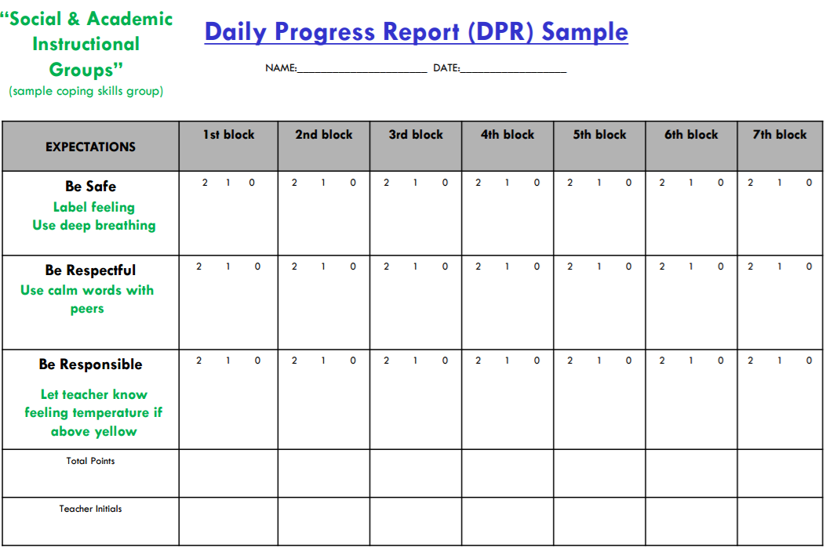
INTEGRATION WITH ADDITIONAL INTERVENTIONS (Eber, 2016)
Notes:
Replace with example of earning points with 3 SKILLS identified – coping, self-regulation, CBT,

Slide 92
INTEGRATION WITH ADDITIONAL INTERVENTIONS (Eber, 2016)

Slide 93
Source: MO PBIS

Slide 94
POOR RESPONSE TO INTERVENTION
What defines a “poor” response?
Criterion?
Length of time?
Was the intervention implemented as intended (fidelity)?
If no, go back to implementation steps
If yes,
Decision Options
Conduct brief functional behavioral assessment to develop individualized supports
Consider alternate Tier 2 interventions aligned with function
Design and implement individualized interventions
Notes:
FACTS (Functional Assessment Checklist) can be used to conduct a very brief functional behavioral assessment to develop more individualized supports https://www.vbisd.org/cms/lib6/MI01000711/Centricity/Domain/138/FACTS%20-%20Revised.pdf
Usually done by the T3 / problem solving team

Slide 95
Modifications: Consider Function!
Function | Modified CICO | SAIG | Academic Seminar | Mentoring | FBA/BIP and/or Individual Plan
Access to Adult Attention | ✔ | ✔ | ✔ | ✔ | ✔
Access to Peer Attention | ✔ | ✔ | ✔ | ✔ | ✔
Access to Tangible | ✔ |  |  |  | ✔
Avoiding Peer Attention | ✔ |  |  |  | ✔
Avoiding adult Attention | ✔ |  |  |  | ✔
Avoid work/ demands | ✔ | ✔ | ✔ | ✔ | ✔
Avoid internal (e.g., anxiety) | ✔ | ✔
Notes:
Add note about function related to escape from internal anxiety. Modify CICO to include the skills being developed.

Slide 96
GUIDELINES: ADJUSTING/MODIFYING INTERVENTION IMPLEMENTATION
Data
Determine how frequently & when intervention effectiveness and student response is reviewed
Determine criteria & process for intervention revisions
Develop plan for how team will respond for interventions not implemented with fidelity
Develop plan for fading/ graduating Tier 2 practices when students meet pre-determined observable & measurable criteria
Develop plan for students not responding to Tier 2 practices

Slide 97
ACTIVITY: INDIVIDUAL STUDENT PROGRESS MONITORING, continued
Using PART 1 of the Targeted Interventions Assessment Tool, for each Tier 2 intervention you have listed, answer the following:
How often will we review progress monitoring and fidelity data?
What is our fade/exit criteria? What is a positive response? And for how long?
What are our options for fading interventions?
How might we help staff, students, and families with “graduation?” (it’s hard!)
How will we share this information?
Add items to your action plan.
Teams
20 minutes
Notes:
Targeted Interventions Assessment Tool: https://nepbis.org/wp-content/uploads/2022/04/Targeted-Interventions-Assessment-Tool-pbisapps-modified.docx

Slide 98
GUIDELINES: DATA
Data
At Tier 2, data collection should be more frequent and precise, and teams should use data for the following:
Identifying students in need of additional support (e.g., screening)
Selecting & adopting contextually appropriate Tier 2 supports
Matching students’ need with interventions
Monitoring student progress and developing rules for accessing, adjusting, & exiting interventions
Evaluating intervention fidelity and intervention effectiveness
Monitoring school-wide level of use

Slide 99
DISCUSSION: Using Progress Monitoring Tools for Decision Making
1. How might you use your baseline data to set individual student goals?
2. How might you use PM data to make intervention decisions? What support do you need to develop decision rules?
3. How can this data help you make decisions school-wide?
5 minutes
10 minutes
Teams
Whole Group

Slide 100
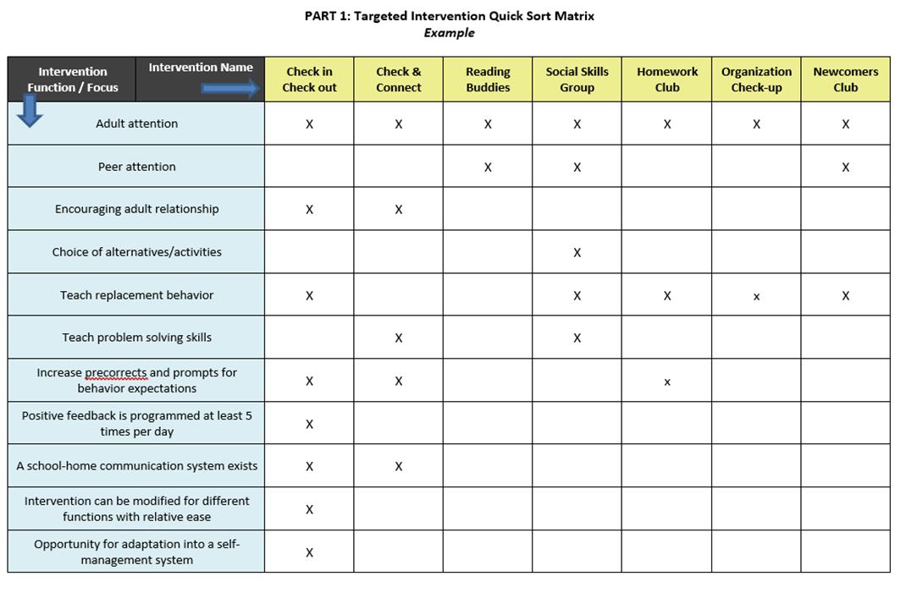
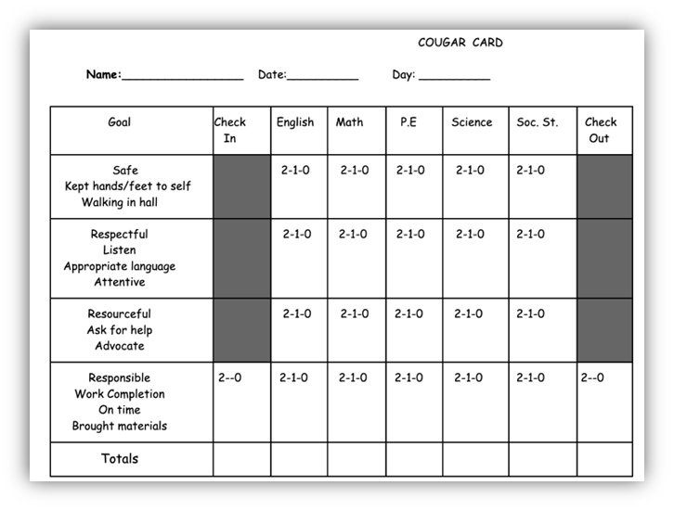
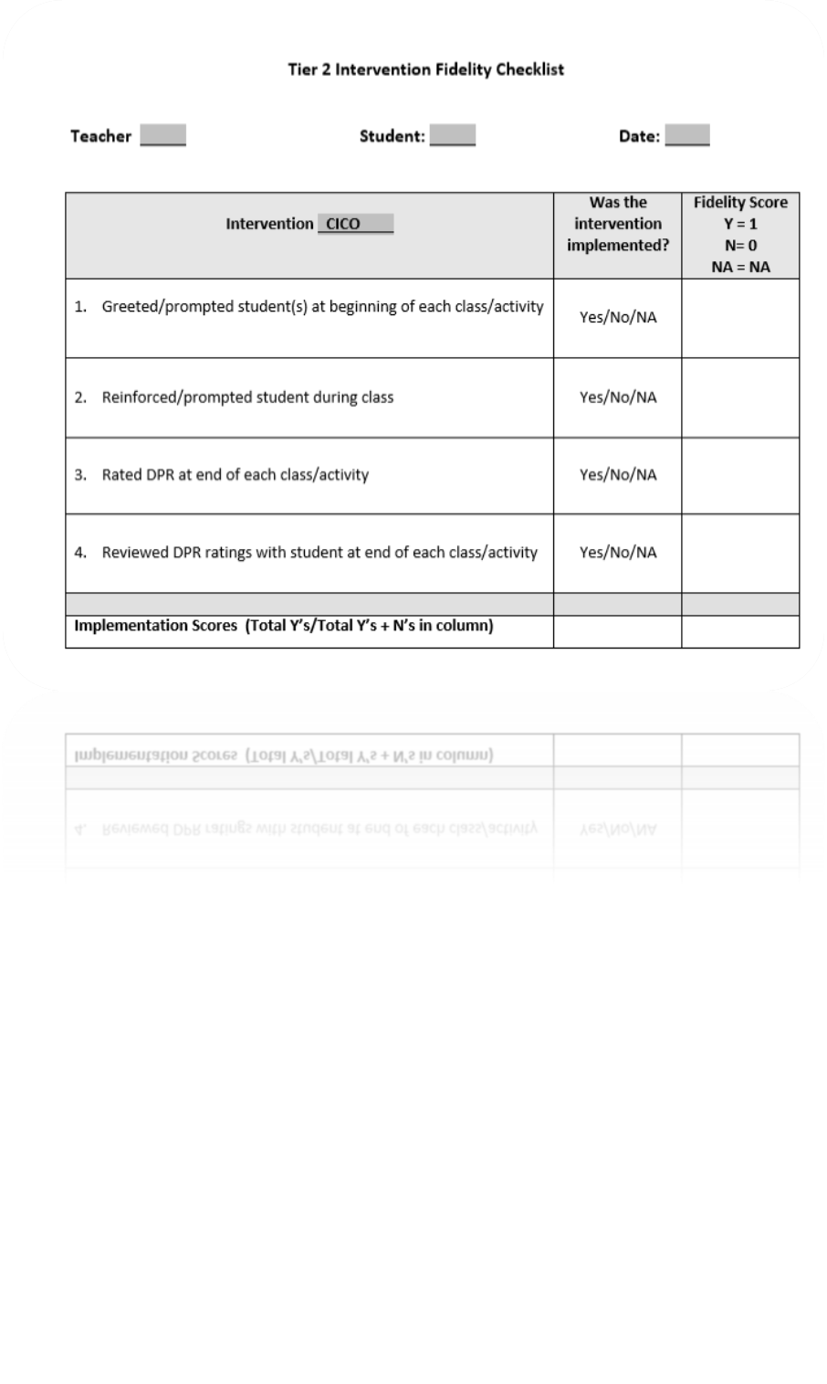
Preparing for your TFI

Slide 101
AGENDA & FOLLOW-UP
Training Overview
Matching student need to practices
Team Tasks
Match targeted interventions to types of student need
Evaluation Steps:
Methods of progress monitoring
Adjusting / modifying interventions based on progress monitoring
Select tools to progress monitor for each intervention in place
Draft data “guidelines” for monitoring student progress, adjusting and exiting
What questions do you have on today’s content?
What questions do you have on the follow-up team tasks?

Slide 102
Agenda & Coaching Tasks
Training Overview
Team Tasks – Use the Targeted Intervention Organizer to:
Match targeted interventions to types of student need
Evaluation Steps:
Select tools to progress monitor for each intervention in place
Matching student need to practices
Draft data “guidelines” for monitoring student progress, adjusting and exiting
Adjusting / modifying interventions based on progress monitoring
Methods of progress monitoring
Notes:
Evaluation Steps:
Progress Monitoring – what and how often, using what tools
Data-based decision guidelines for progress monitoring – monitoring fidelity of implementation, adjusting/modifying the intervention, developing fading and exit criteria

Slide 103
EVALUATION
CONTACT INFORMATION:
Marcie Handler
mwhandler@gmail.com
Katie Meyer
Katherine.meyer@uconn.edu
Please remember to complete the evaluation to receive your Certificate of Attendance!
Notes:
Evaluation Link
https://edc.co1.qualtrics.com/jfe/form/SV_cBF9GI7gVEBsfSC

