Slide 1


PBIS School-Wide Coach Meeting
Year 1: April 2023
PBIS Track
Michelle Pratt & Christine Downs
with support from NEPBIS Network, May Institute & Broad Reach Consulting
Notes:
Add trainer names for your event

Slide 2
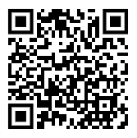
ACTIVITY: ATTENDANCE
Scan QR code on the left or follow the URL posted in the chat to access the online attendance survey
Follow prompts to enter attendance information
Notify trainers if you require assistance (e.g., identifying your cohort or cohort group)
Certificates of Attendance will be sent in January and June. Attendance records and Zoom log in will be use as verification
You are in Cohort 9
1 minute
Notes:
TRAINERS – QR Code is updated
Add your cohort letter – PLEASE review Certificates of Attendance process – They will automatically be sent in Jan and June based upon attendance and Zoom Log in info.
Post a link to the attendance survey (below) in the chat for those who do not use the QR code on the slide:
ATTENDANCE: https://edc.co1.qualtrics.com/jfe/form/SV_5BiXqi4bxzOCMS2

Slide 3

EXPECTATIONS
Self
Others
Environment
Self-monitor
Mute when listening, unmute to talk​
Have your computer charged and ready to go​
If you have questions or comments:
Work as a team:
Keep necessary materials at hand
Are you participating?
Engaged as a learner?
Stretch, break, stand as needed​
unmute
use the chat box
Room for every voice
Reinforce participation
action plan
relevant docs
water/snacks
Minimize distractions if possible​

Slide 4
AGENDA & Coaches’ Tasks
Coaches’ Tasks:
Consider how you will present Classroom Content to staff.
Presentation Content:
Check In: Developing a Continuum to Respond to Behavior Errors
Resource Spotlight
Share video links with team
Classroom Systems

Slide 5
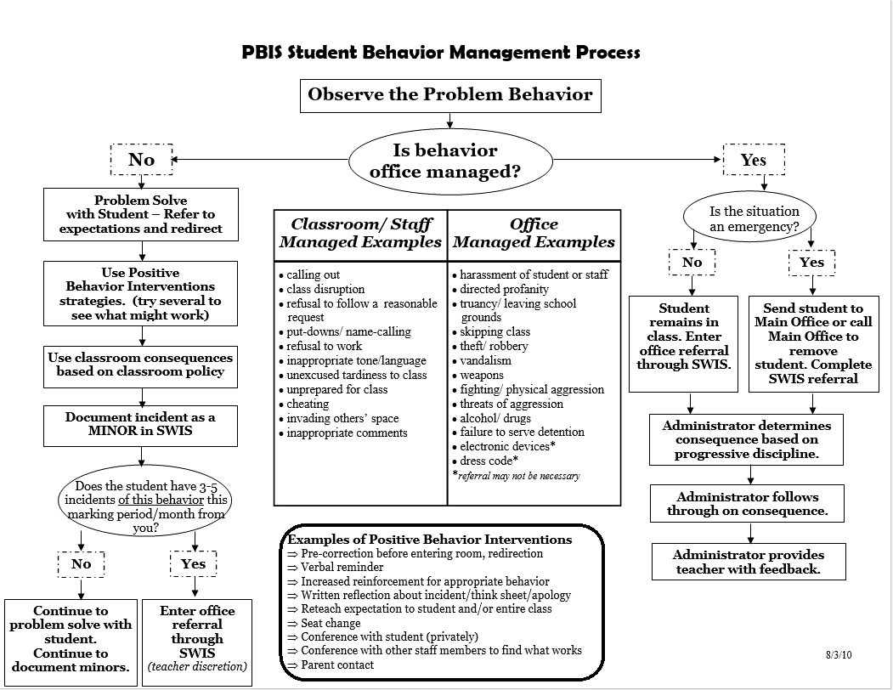
HELPFUL RESOURCES
RESOURCES:
Sample Flow Charts and Templates
Sample Behavior Definitions
Sample Referral Forms
Supporting and Responding to Students’ Social, Emotional, and Behavioral Needs:
Sample Classroom Routine Matrix
Classroom Matrix Video
Classroom Systems Video
Classroom Matrix Activity
De-escalation Strategies that keep behavior from going downhill
Notes:
Putting a Definition Back in Defiance - https://sebacademy.edc.org/putting-definition-back-defiance
Behavior Flow Chart Video: https://sebacademy.edc.org/behavior-flow-chart-video
Defining Behaviors Video: https://sebacademy.edc.org/defining-behaviors-video
Referral Form Video: https://sebacademy.edc.org/referral-form-video
Sample Flow Charts and Templates: https://sebacademy.edc.org/list-of-pbis-resources?keyword=Flow+Chart&pbis_resource_type=All&pbis_resource_topic=All&sort_by=field_date_value&sort_order=DESC
Sample Definitions: https://sebacademy.edc.org/list-of-pbis-resources?keyword=Sample+-+behavior+definitions&pbis_resource_type=All&pbis_resource_topic=All&sort_by=field_date_value&sort_order=DESC
Sample Referral Forms: https://sebacademy.edc.org/list-of-pbis-resources?keyword=Sample+Referral+Form&pbis_resource_type=All&pbis_resource_topic=All&sort_by=field_date_value&sort_order=DESC
Sample Classroom Routine Matrix https://sebacademy.edc.org/sample-classroom-routine-matrix
Classroom Matrix Video https://sebacademy.edc.org/classroom-matrix-video
Classroom Systems Video https://sebacademy.edc.org/classroom-systems-video
Classroom Matrix Activity https://sebacademy.edc.org/classroom-matrix-activity
Supporting and Responding to Students’ Social, Emotional, and Behavioral Needs: Evidence-Based Practices for Educators - https://sebacademy.edc.org/supporting-and-responding-students-social-emotional-and-behavioral-needs-classrooms
https://sebacademy.edc.org/slow-climb-4-de-escalation-strategies-keep-behavior-going-downhill

Slide 6
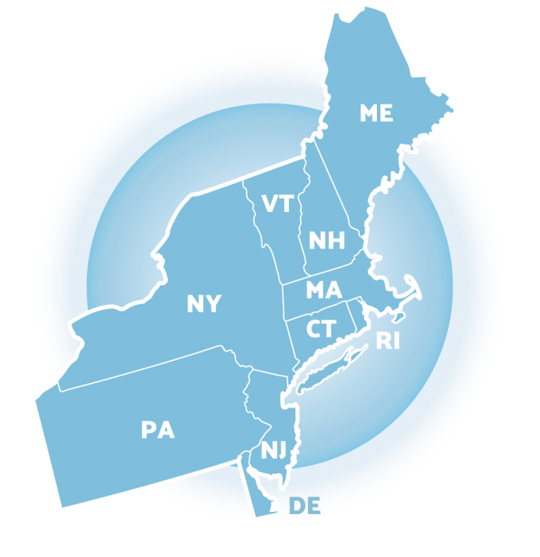

Glows & Grows
Review
Notes:
9:05
Karen

Slide 7
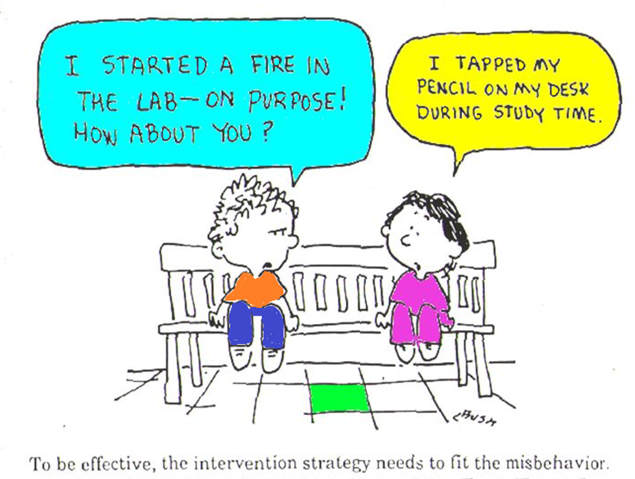
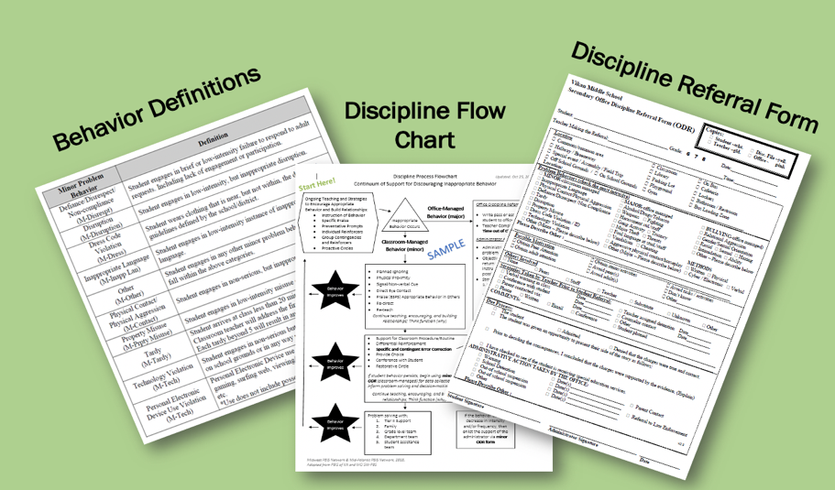
Developing a Continuum to Respond to Behavior Errors

Slide 8

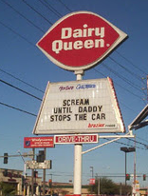


All Behavior Serves a Function:
To get something or avoid something
Behavior
Obtain/Get
Something
Escape/Avoid
Something
Positive Reinforcement
Negative Reinforcement
Remember: Negative Reinforcement makes behavior stronger too.
We avoid or escape from things we don’t like.

Slide 9
REINFORCEMENT & PUNISHMENT
Reinforcement
Punishment
when a consequence of a behavior functions to INCREASE the likelihood of future occurrences of that behavior
when a consequence of a behavior functions to DECREASE the likelihood of future occurrences of that behavior
Works Best
The only way to know if a consequence was a punishment or reinforcement is to look at future behavior.

Slide 10
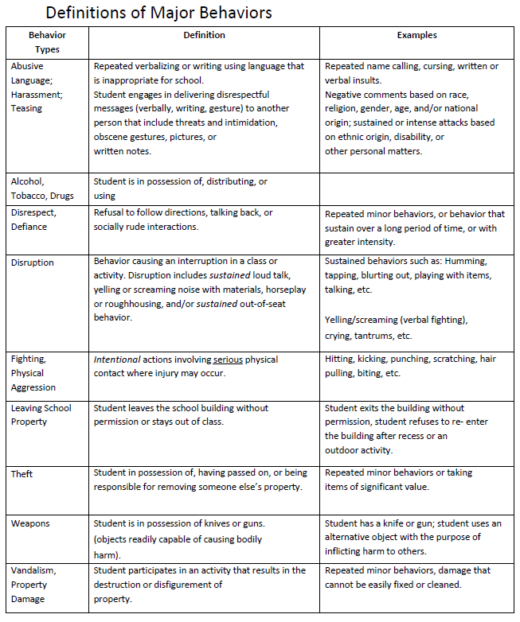
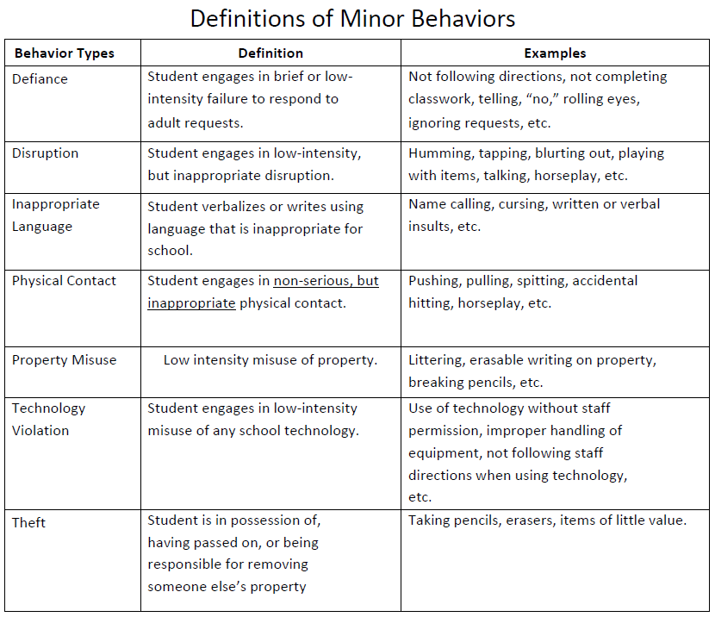
Definitions for Infractions
(Sample)

Slide 11
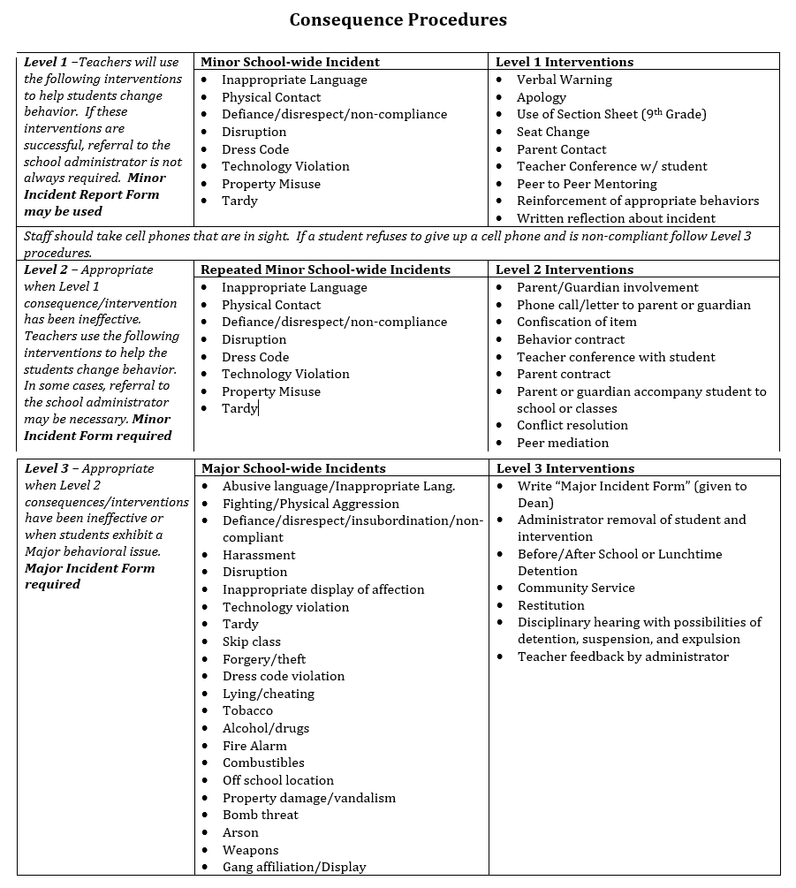
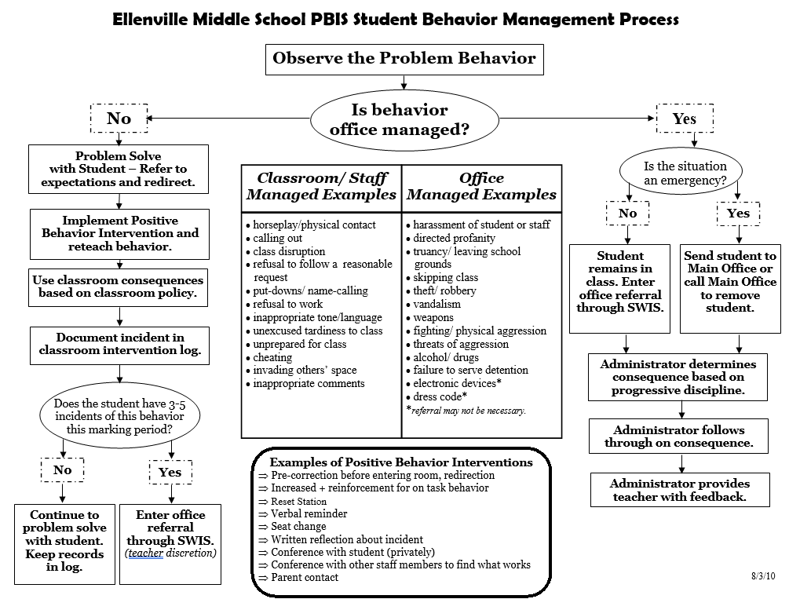
Behavioral Levels and/or FLOW Chart
(Samples)
Notes:
Behavior Flow Chart Video: https://sebacademy.edc.org/behavior-flow-chart-video

Slide 12
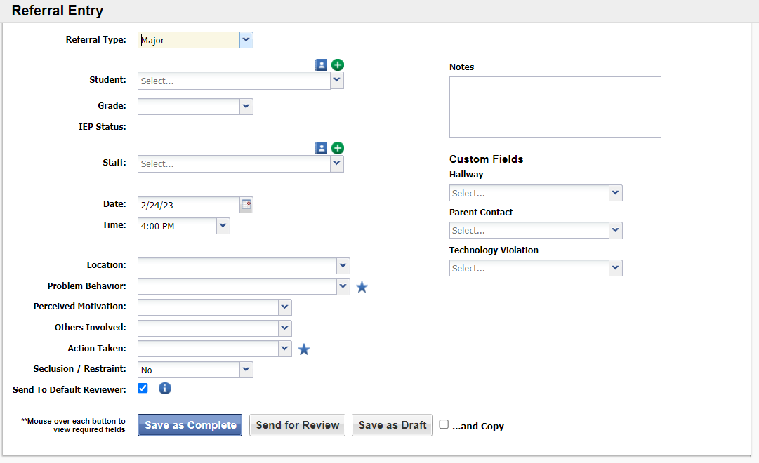
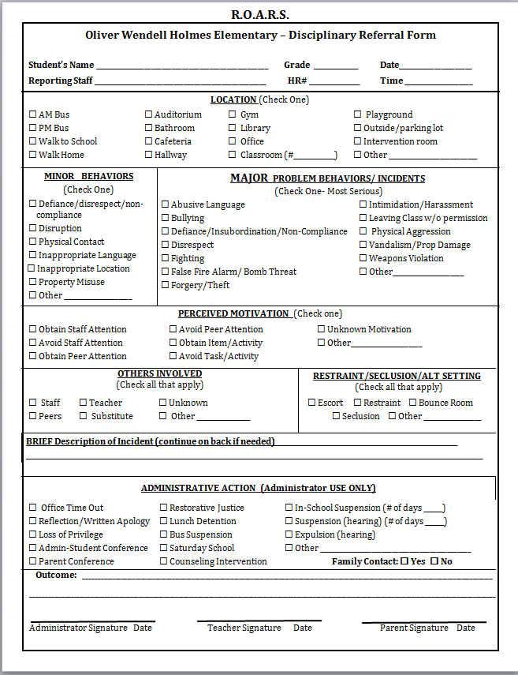
Office Discipline Referral
(Samples)

Slide 13
DISCUSSION: GLOWS & GROWS
Have you presented this content to the rest of your team?
Have you begun work on any of these items?
  Definitions
  Flow Chart/Levels
  Office Discipline Referral Form
Which item is your priority?
Do you need any support?
3 minutes
7 minutes
Co-Coach / Independent
Whole Group
Notes:
Discussion Prompt:
What is something to celebrate & something you’re working on regarding acknowledging students for demonstrating your schoolwide expectations ?

Slide 14

CLASSROOM BEHAVIOR SUPPORT PRACTICES
Big Idea
Check In

Slide 15

Supporting and Responding to Students’ SEB Needs
Practices
Center on PBIS. (2022). Supporting and responding to student’s social, emotional, and behavioral needs: Evidence-based practices for educators (Version 2.0). Center on PBIS, University of Oregon. www.pbis.org.
Notes:
https://sebacademy.edc.org/supporting-and-responding-educators-classroom-pbis-implementation-needs-guide-classroom-systems-and

Slide 16

Supporting and Responding to Students’ SEB Needs
1. Create Positive Teaching and Learning Environments
Design a Safe Environment
2. Actively Promote SEB Growth
Engage Students in Relevant Learning
3. Monitor Fidelity and Use Data to Guide Implementation
Monitor Educator Implementation
4. Monitor Student Outcomes and Use Data to Guide Response
Establish Positive Connections
Develop Predictable Routines
Define and Teach Positive Expectations
Plan Relevant Instruction
Foster Positive Relationships
Prompt and Supervise SEB and Academic Skills
Provide Specific Feedback (> 5 : 1 Ratio)
Consider Other Response Strategies
Provide Training, Coaching, and Feedback
If data indicate implementation challenges...
Monitor Student Outcomes
Enhance Tier 1
If many students make ongoing SEB errors...
Enhance Tier 1 and Consider Tiers 2 and 3
If few students make ongoing SEB errors...

Slide 17
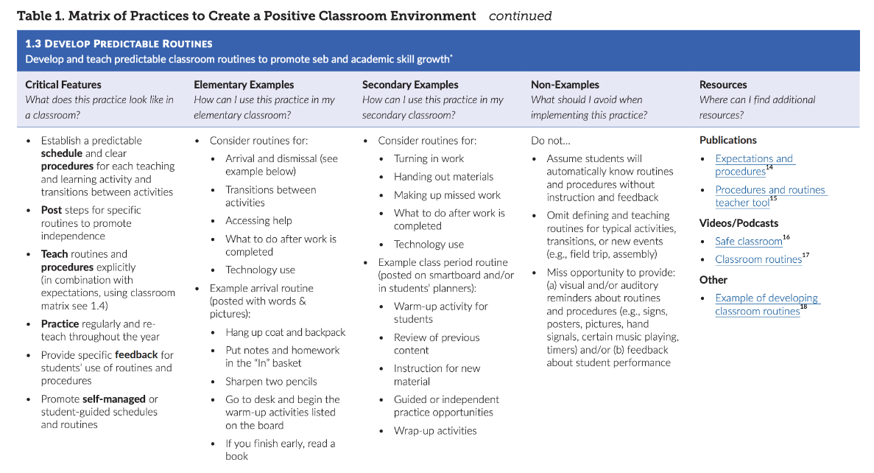

Slide 18
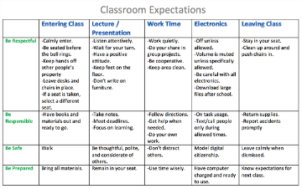
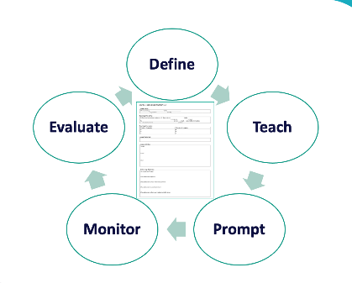
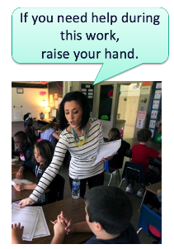
1. Create Positive Teaching and Learning Environments
Design a Safe Environment
2. Actively Promote SEB Growth
Engage Students in Relevant Learning
Establish Positive Connections
Develop Predictable Routines
Define and Teach Positive Expectations
Plan Relevant Instruction
Foster Positive Relationships
Provide Specific Feedback (> 5 : 1 Ratio)
Consider Other Response Strategies
Prompt and Supervise SEB and Academic Skills

Slide 19
SCHOOL-WIDE Teaching Matrix |  | ROUTINE
 |  | All Settings | Hallways | Playgrounds | Cafeteria | Library/ Computer Lab | Assembly | Bus
 | Respect Ourselves | Be on task. Give your best effort. Be prepared. | Walk. | Have a plan. | Eat all your food. Select healthy foods. | Study, read, compute. | Sit in one spot. | Watch for your stop.
 | Respect Others | Be kind. Hands/feet to self. Help/share with others. | Use normal voice volume. Walk to right. | Play safe. Include others. Share equipment. | Practice good table manners | Whisper. Return books. | Listen/watch. Use appropriate applause. | Use a quiet voice. Stay in your seat.
 | Respect Property | Recycle. Clean up after self. | Pick up litter. Maintain physical space. | Use equipment properly. Put litter in garbage can. | Replace trays & utensils. Clean up eating area. | Push in chairs. Treat books carefully. | Pick up. Treat chairs appropriately. | Wipe your feet. Sit appropriately.
CLASS-WIDE
Teaching Matrix
All Routines | Entering/ Leaving the Classroom | Small Group Instruction | Whole Group Instruction | Independent Work Time
Be on task. Give your best effort. Be prepared. | Walk. | Participate. | Engage with the lesson. | Have a plan. Study, read, compute.
Be kind. Hands/feet to self. Help/share with others. | Use indoor voice volume. Walk to right. | Include others. Share equipment. | Raise your hand if you have something to share. | Whisper. Return books.
Recycle. Clean up after self. | Pick up litter. Maintain physical space. | Bring necessary materials to the table. | Have necessary materials handy. | Return materials where you found them.
1. SOCIAL SKILL
2. NATURAL CONTEXT
SCHOOL-WIDE EXPECTATIONS
3. BEHAVIOR EXAMPLES

Slide 20
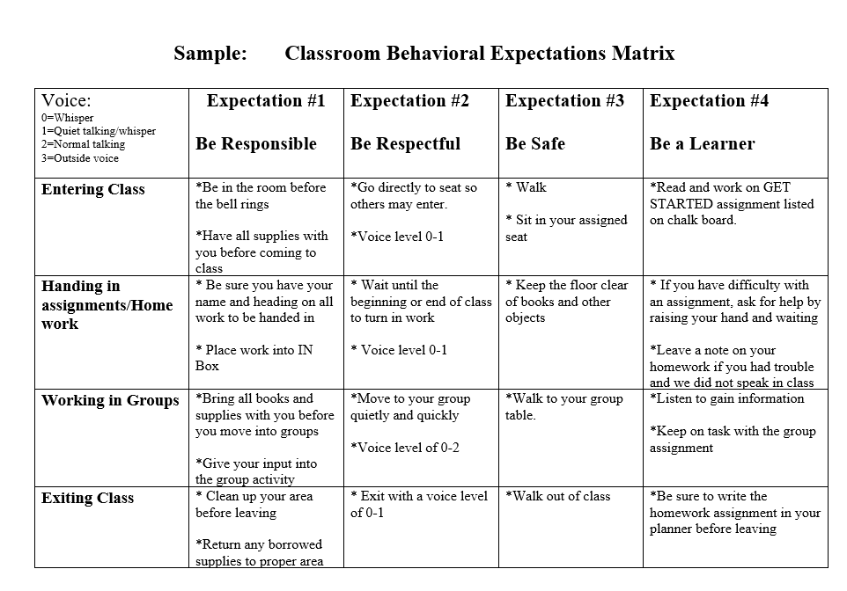
Maximize structure and predictability

Slide 21
Develop procedures to teach class-wide expectations
Ms. L's Room | Entering | Group Work | Whole Group Instruction | Independent Work Time
Be Prepared
Be Safe
Be Respectful
Educators can engage students in identifying examples of what it looks and sounds like to meet expectations during each routine.
Students can also add routines that need to be added to the matrix

Slide 22
Build System (pd, time, support) for teachers to teach Classroom Routines

Slide 23

Teaching and Practicing Routines
MS Structures for Success
https://youtu.be/vaedonG8-_Q?t=299
Notes:
Play video through to the end

Slide 24
Building Relationships
A Review of Educational Research analysis of 46 studies found that strong teacher-student relationships were associated in both the short- and long-term with improvements on practically every measure schools care about: higher student academic engagement, attendance, grades, fewer disruptive behaviors and suspensions, and lower school dropout rates.
https://www.edweek.org/teaching-learning/why-teacher-student-relationships-matter/2019/03

Slide 25


Thresholding / Greeting Students at the Door
https://youtu.be/956br98qWbE
https://www.youtube.com/watch?v=IHc7K_8JGT8
Notes:
Play TUMS fully and then a few seconds of the Secondary Example

Slide 26
ACTIVITY: 3 Key Classroom Practices
With your co-coach, consider how you might create a PD for staff around these classroom practices
Draft examples Classroom Matrix showing typical routines
Add items to your Action Plan as necessary
Be ready to present a “big idea” from your discussion.
15 minutes
5 minutes
Co-Coach / Independent
Whole Group
Notes:
TRAINER NOTE: If your school(s) are not ready for this step, support them to work on Creating Positive Teaching Learning Environments.

Slide 27
PBIS
Resource Spotlight:
Slow the Climb: De-escalation Strategies to keep behavior from going uphill.

Slide 28
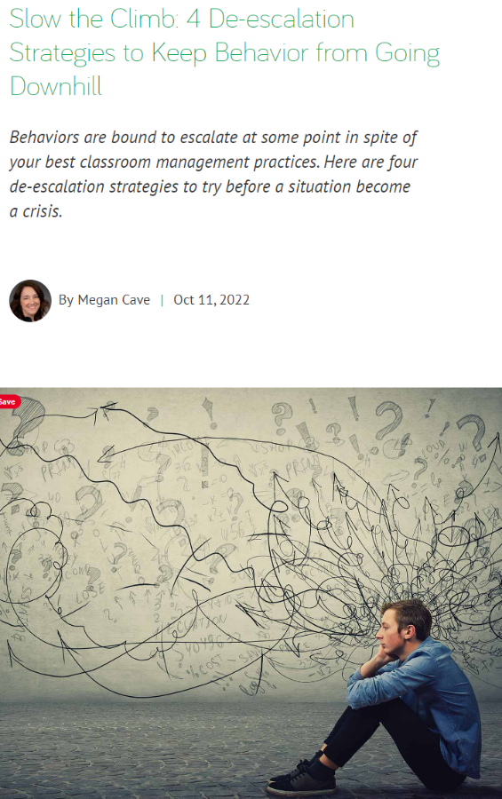
De-escalation Strategies Article
The purpose of this article is to provide information about the escalation de-escalation cycle and potential strategies to try before a crisis.
Some potential key areas to review are listed here.
Seven phases of the escalation de-escalation cycle.
Strategies for de-escalation prior to a crisis.
Notes:
Resource Link: https://sebacademy.edc.org/slow-climb-4-de-escalation-strategies-keep-behavior-going-downhill

Slide 29
DISCUSSION: Slow the Climb: 4 De-escalation Strategies to Keep Behavior from Going Downhill
Independently Review the article independently (5 minutes)
Divide up into randomized discussion groups, and discuss your biggest takeaways (10 minutes)
Whole group discussion of common take aways (5 minutes)
7 minutes
5 minutes
Coach Review/Chat
Whole Group
Notes:
https://sebacademy.edc.org/slow-climb-4-de-escalation-strategies-keep-behavior-going-downhill

Slide 30
Looking Ahead: Planning for Roll Out
Notes:
Erik
10:20

Slide 31
Leadership Team: Next Steps
Create an electronic document of your PBIS Framework
Present the plan to school staff
Present the plan to students
Serve as role models, coaches, and cheerleaders to support implementation and build internal capacity
Share with families and community

Slide 32
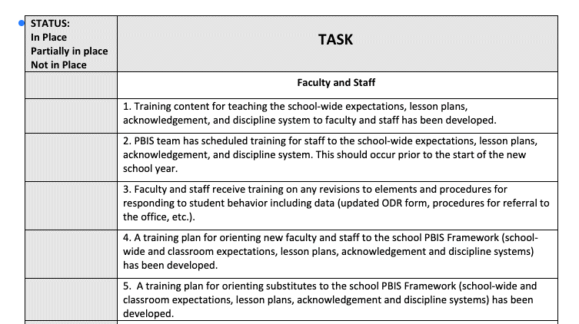
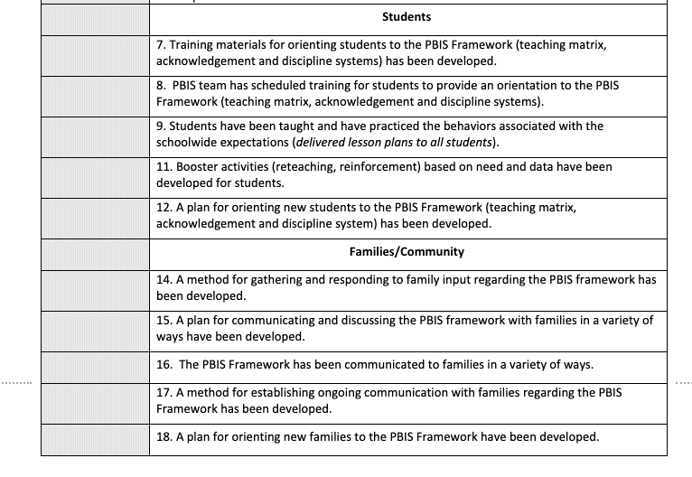
PBIS ROLLOUT CHECKLIST

Slide 33




PBIS Handbook and Orientation Examples
PBIS Handbook
PBIS Staff Orientation Slides
PBIS Student Orientation Slides
Notes:
PBIS Handbook Examples: https://sebacademy.edc.org/list-of-pbis-resources?keyword=Sample+PBIS+Handbook&pbis_resource_type=All&pbis_resource_topic=All&sort_by=field_date_value&sort_order=DESC
PBIS Staff Orientation Slides: https://sebacademy.edc.org/staff-presentation-sample
PBIS Student Orientation Slides: https://sebacademy.edc.org/sample-pbis-student-slide-deck

Slide 34
SCHEDULE YOUR SPRING TFI WITH YOUR TRAINER
If you have rolled out to students, a trainer will come to your school to conduct a walkthrough to interview approximately 15 staff and 15 students. (If possible, please have a coach available to shadow the walk through for training)
After the walk-through your trainer will set up a time to conduct the TFI with you and your team

Slide 35
AGENDA & FOLLOW-UP
Coaches’ Tasks:
Consider how you will present Classroom Content to staff.
Presentation Content:
Check In: Developing a Continuum to Respond to Behavior Errors
Resource Spotlight
Share video links with team
Classroom Systems
What questions do you have on today’s content?
What questions do you have on the follow-up tasks?

Slide 36
HELPFUL RESOURCES
RESOURCES:
Sample Flow Charts and Templates
Sample Behavior Definitions
Sample Referral Forms
Supporting and Responding to Students’ Social, Emotional, and Behavioral Needs:
Sample Classroom Routine Matrix
Classroom Matrix Video
Classroom Systems Video
Classroom Matrix Activity
De-escalation Strategies that keep behavior from going downhill
Notes:
Putting a Definition Back in Defiance - https://sebacademy.edc.org/putting-definition-back-defiance
Behavior Flow Chart Video: https://sebacademy.edc.org/behavior-flow-chart-video
Defining Behaviors Video: https://sebacademy.edc.org/defining-behaviors-video
Referral Form Video: https://sebacademy.edc.org/referral-form-video
Sample Flow Charts and Templates: https://sebacademy.edc.org/list-of-pbis-resources?keyword=Flow+Chart&pbis_resource_type=All&pbis_resource_topic=All&sort_by=field_date_value&sort_order=DESC
Sample Definitions: https://sebacademy.edc.org/list-of-pbis-resources?keyword=Sample+-+behavior+definitions&pbis_resource_type=All&pbis_resource_topic=All&sort_by=field_date_value&sort_order=DESC
Sample Referral Forms: https://sebacademy.edc.org/list-of-pbis-resources?keyword=Sample+Referral+Form&pbis_resource_type=All&pbis_resource_topic=All&sort_by=field_date_value&sort_order=DESC
Sample Classroom Routine Matrix https://sebacademy.edc.org/sample-classroom-routine-matrix
Classroom Matrix Video https://sebacademy.edc.org/classroom-matrix-video
Classroom Systems Video https://sebacademy.edc.org/classroom-systems-video
Classroom Matrix Activity https://sebacademy.edc.org/classroom-matrix-activity
Supporting and Responding to Students’ Social, Emotional, and Behavioral Needs: Evidence-Based Practices for Educators - https://sebacademy.edc.org/supporting-and-responding-students-social-emotional-and-behavioral-needs-classrooms
https://sebacademy.edc.org/slow-climb-4-de-escalation-strategies-keep-behavior-going-downhill

Slide 37
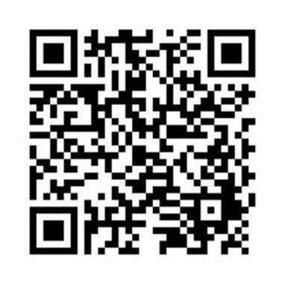
EVALUATION
Please remember to complete the evaluation to receive your PDPs!
Scan the QR code to access.
Notes:
TRAINERS -
Put link to evaluation (below) in the chat for those who do not use the QR code:
https://uconn.co1.qualtrics.com/jfe/form/SV_7PBRl9EB3mmOG4C

