Slide 1
PBIS School-Wide Coach Meeting Sustaining Academy May 2023
PBIS Track
Enter Trainers Names
with support from NEPBIS Network, May Institute & Broad Reach Consulting
Notes:
Add trainer names for your event

Slide 2
EXPECTATIONS
Self
Others
Environment
Self-monitor
Mute when listening, unmute to talk​
Have your computer charged and ready to go​
If you have questions or comments:
Work as a team:
Keep necessary materials at hand
Are you participating?
Engaged as a learner?
Stretch, break, stand as needed​
unmute
use the chat box
Room for every voice
Reinforce participation
action plan
relevant docs
water/snacks
Minimize distractions if possible​

Slide 3
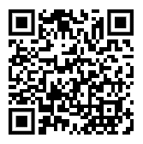
ACTIVITY: ATTENDANCE
Scan QR code on the left or follow the URL posted in the chat to access the online attendance survey
Follow prompts to enter attendance information
Notify trainers if you require assistance (e.g., identifying your cohort or cohort group)
Certificates of Attendance will be sent in January and June. Attendance records and Zoom log in will be use as verification
You are in Sustaining Cohort
1 minute
Notes:
TRAINERS – QR Code is updated
Add your cohort number
Post a link to the attendance survey (below) in the chat for those who do not use the QR code on the slide:
ATTENDANCE: https://edc.co1.qualtrics.com/jfe/form/SV_5BiXqi4bxzOCMS2

Slide 4
Agenda & Coaches' Tasks
Coaches’ Tasks:
Presentation Content:
Revisit: Sustainability Factors
Review your PBIS Plan for sustainability
Review and revise your PBIS School and Classroom wide goals for next year.
Revisit: Annual Evaluation Planning
Revisit: Coaches Year at a Glance
Goal Planning for next year
Plan how you will review with your team your evaluation process including your Annual Evaluation.
Plan to update your Coaches Year at Glance document for next year’s supports.

Slide 5
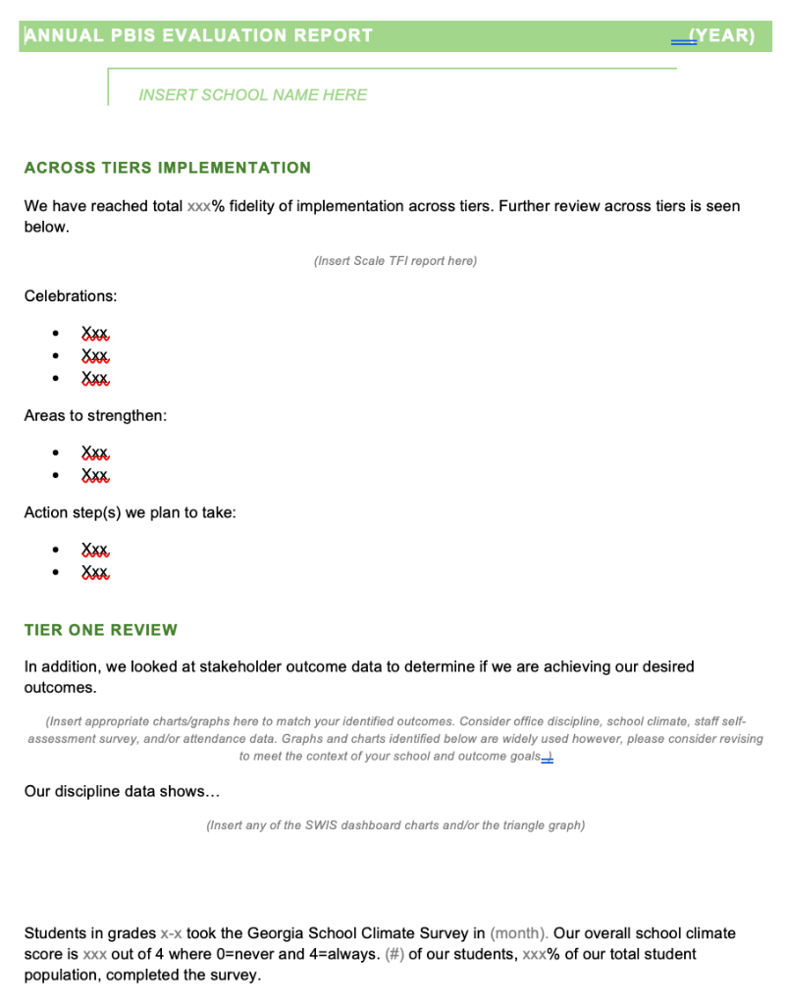
HELPFUL RESOURCES
RESOURCES:
Tiered Fidelity Inventory
TFI Tier 1 Quick Check Tip Sheet for Scoring
Integrated TFI Companion Guide
Data Decision Rules Activity
Evaluation Plan Template
Annual Evaluation Template
Annual Evaluation Sample
Notes:
PBIS TFI: Resource link: https://www.pbisapps.org/resource/tfi
TFI Tier 1 Quick Check Tip Sheet for Scoring https://sebacademy.edc.org/tfi-tier-1-quick-check-tip-sheet-scoring
PBIS TFI Walkthrough Tip Sheet: https://www.pbisapps.org/resource/tfi-walkthrough-tip-sheet
Integrated TFI Companion Guide: https://www.pbis.org/resource/integrated-tiered-fidelity-inventory-companion-guide
Data Decision Rules Activity - https://sebacademy.edc.org/developing-data-routines-activity
Evaluation Plan Template - https://sebacademy.edc.org/evaluation-schedule
Annual Evaluation Template: https://sebacademy.edc.org/annual-evaluation-report-template
Sample - Annual Evaluation: https://sebacademy.edc.org/annual-evaluation-report-sample

Slide 6
REVIEW: Sustainablity Factors
Notes:
12:30

Slide 7
4 Tips for Sustaining PBIS
https://youtu.be/xPt9pGkOgIo?t=7
Notes:
Trainers: Use this slide if you feel your group would benefit. Play this entire 4.41-minute video as a set up for the slides to come. (Be sure you shared your Sound when you shared your screen)
https://www.pbis.org/video/four-tips-for-sustaining-pbis

Slide 8
Factors supporting sustaining of PBIS
Strong Leadership Team
What is the current state of your school leadership team?
What if anything needs improvement with your team?

Slide 9
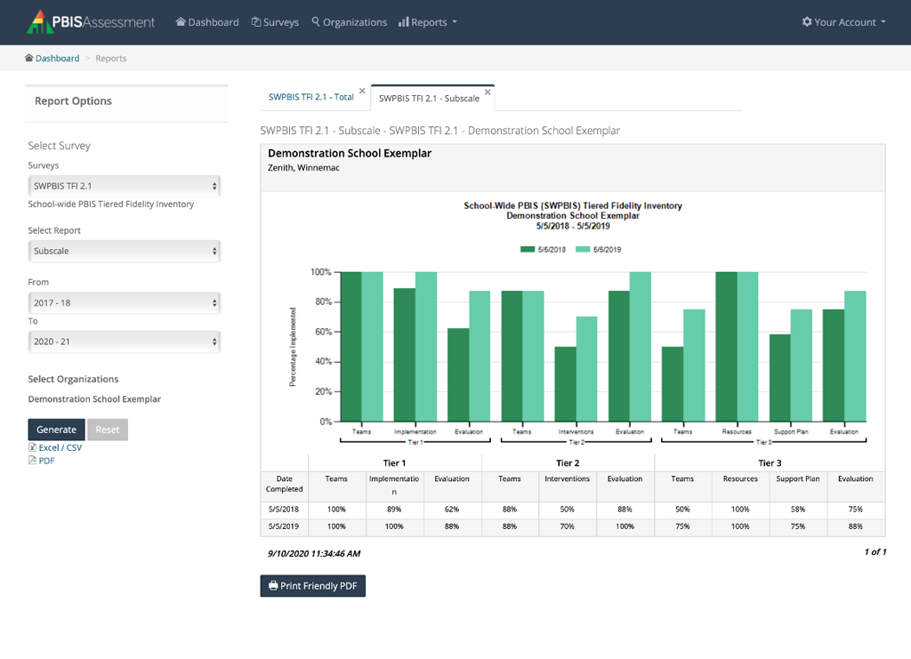
Factors supporting sustaining of PBIS
Strong Leadership Team
Use Fidelity Data to Improve Support
Have you completed your Fidelity check this year?
Have you used these data to update your team’s action plan?

Slide 10
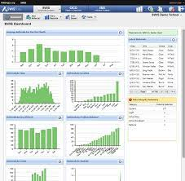
Factors supporting sustaining of PBIS
Strong leadership team
Use fidelity data to improve support
Use your school’s discipline data
Have you used your discipline data to make decisions?
Have you shared your discipline data with your staff this year?

Slide 11
Factors supporting sustaining of PBIS
Strong leadership team
Use fidelity data to improve support
Use your school’s discipline data
Implement PBIS in the classroom
Have you assessed the use of positive classroom practices?
Have you provided PD on positive classroom practices?

Slide 12
GETTING STARTED WITH SWPBIS
Establish an effective leadership team
Develop a continuum to strengthen appropriate behaviors
Develop a brief statement of purpose
Develop a continuum to discourage violations of expectations
Identify positive school-wide behavior expectations
Develop data-based procedures for monitoring
Develop procedures to teach school-wide expectations
Develop systems to support staff
Develop procedures to teach class-wide expectations
Build routines to ensure ongoing implementation
Notes:
Emphasise the 4 ideas from the video
1 – Keep a strong team (next slide)
2 – Use TFI data to improve systems (we will do this at the November training)
3 – Use your school discipline data – slide to come with all data mentioned…good for goal planning
4 – Implement PBIS in the Classroom (Nov Training)

Slide 13
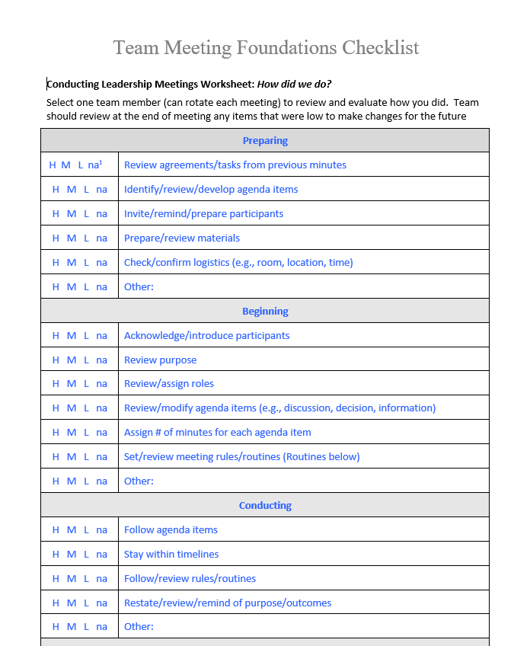
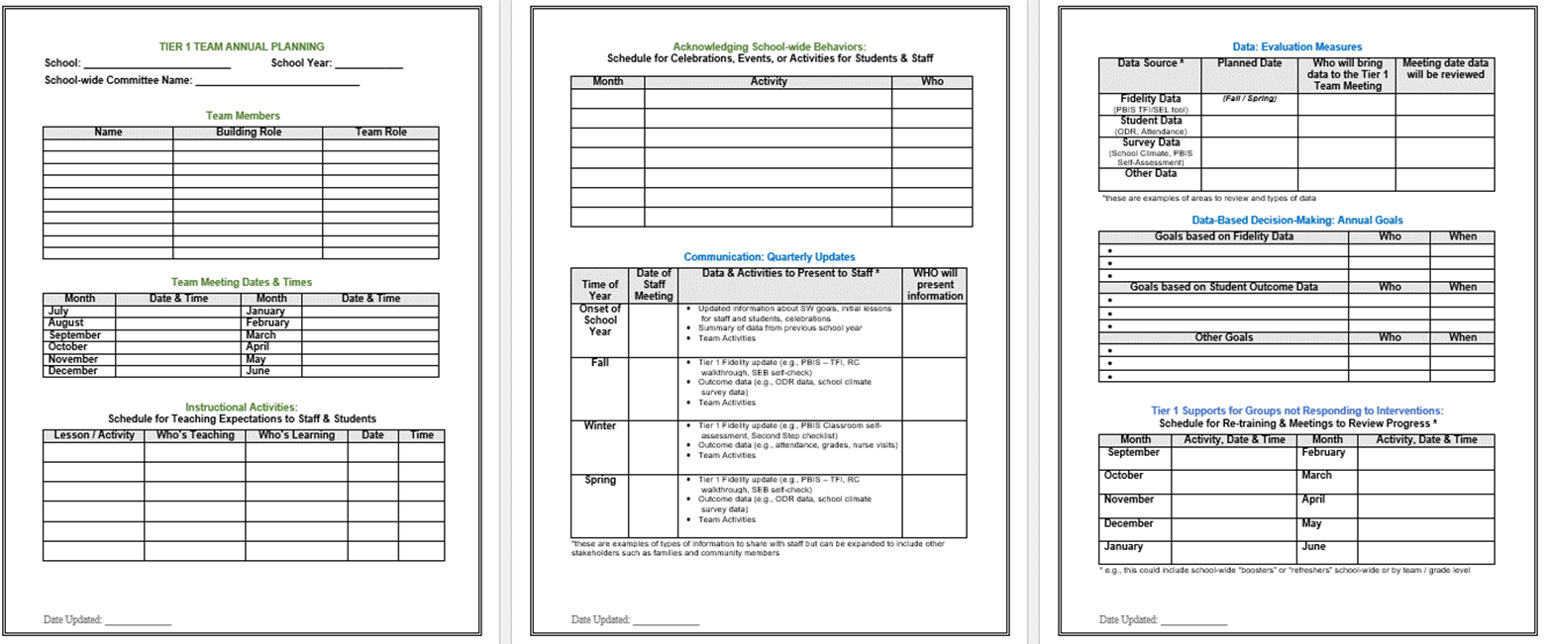
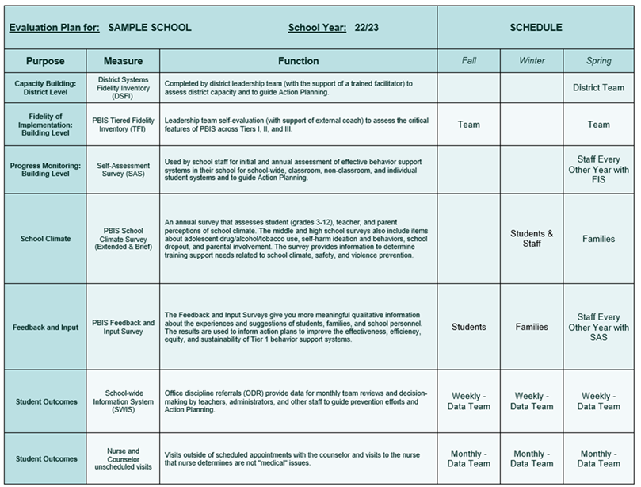
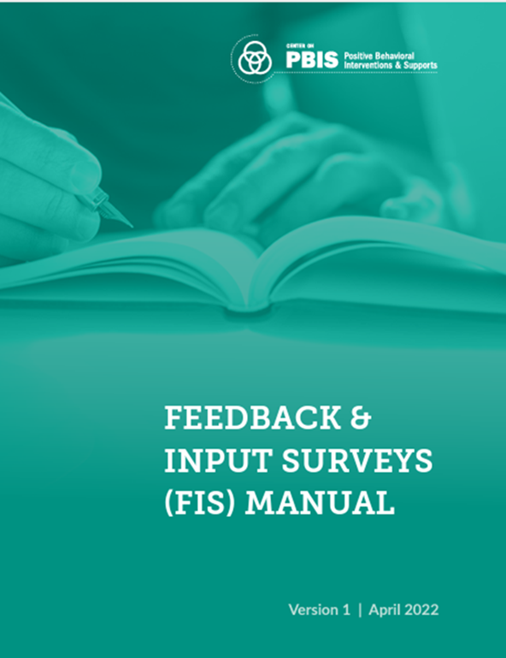
Sustainability Resources
Advanced Action Plan
Leadership Team Checklist
Evaluation Schedule
Climate and Feedback Surveys
Notes:
Coaches Year at a Glance: https://sebacademy.edc.org/coaches-year-glance
Leadership Team Checklist: https://sebacademy.edc.org/team-meeting-foundations-checklist
Evaluation Plan Template - https://sebacademy.edc.org/evaluation-schedule
School Climate Surveys: https://sebacademy.edc.org/pbis-school-climate-surveys
Feedback and Input Surveys: https://sebacademy.edc.org/pbis-feedback-input-survey-manual

Slide 14
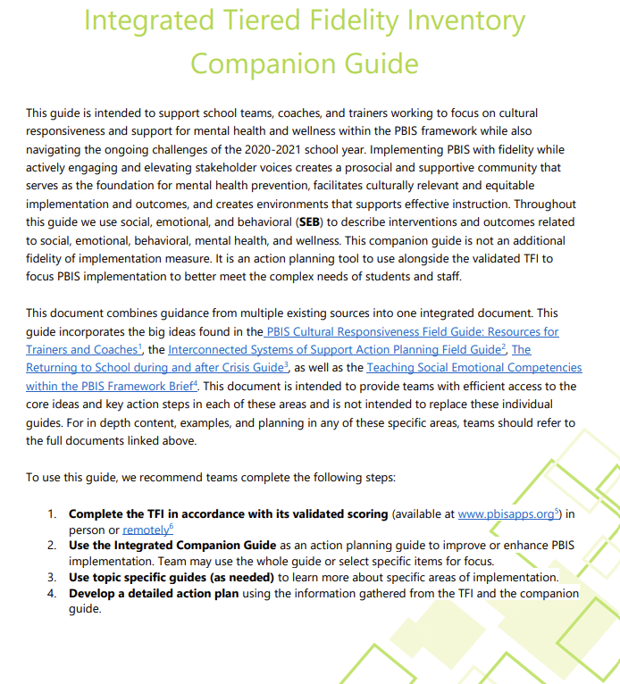
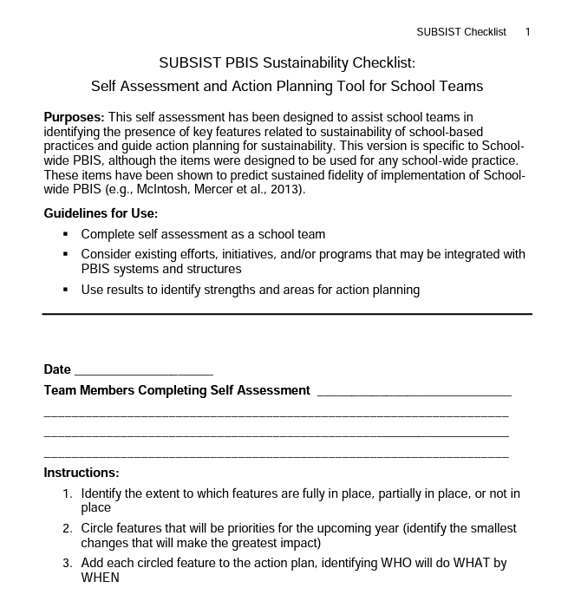
Sustainability Resources
Classroom Practices Brief
TFI / Integrated Companion Guide / Culturally Responsive Field Guide
Classroom Systems & Data Brief - Teachers
Sustainability Checklist
Notes:
Tiered Fidelity Inventory: https://sebacademy.edc.org/tiered-fidelity-inventory-tfi-manual
TFI Integrated Companion Guide: https://sebacademy.edc.org/integrated-tiered-fidelity-inventory-companion-guide
Culturally Responsive Field Guide: https://sebacademy.edc.org/pbis-cultural-responsiveness-field-guide
Data Routines Activity: https://sebacademy.edc.org/developing-data-routines-activity
Subsist PBIS Sustainability Checklist: https://sebacademy.edc.org/subsist-pbis-sustainability-checklist
Classroom Practices Brief: https://sebacademy.edc.org/supporting-and-responding-students-social-emotional-and-behavioral-needs-classrooms
Classroom Systems and Data Brief: https://sebacademy.edc.org/supporting-and-responding-educators-classroom-pbis-implementation-needs-guide-classroom-systems-and

Slide 15
DISCUSSION: SUSTAINABILITY FACTORS
What sustainability features do you have in place? Which features need more attention?:
Review the Sustainability Checklist to evaluate your SW plan and which features you have in place.
Identify one or two items to add to your action plan.
10 minutes
10 minutes
Independent
Whole Group
Notes:
Subsist PBIS Sustainability Checklist: https://sebacademy.edc.org/subsist-pbis-sustainability-checklist

Slide 16
Review: Annual Evaluation
Annual evaluation helps support sustainability!

Slide 17
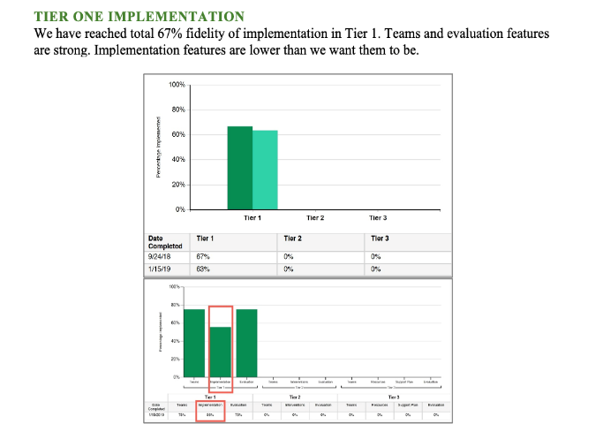
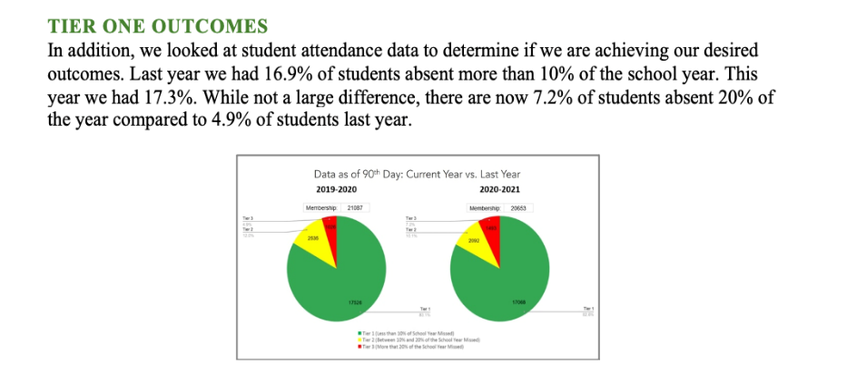
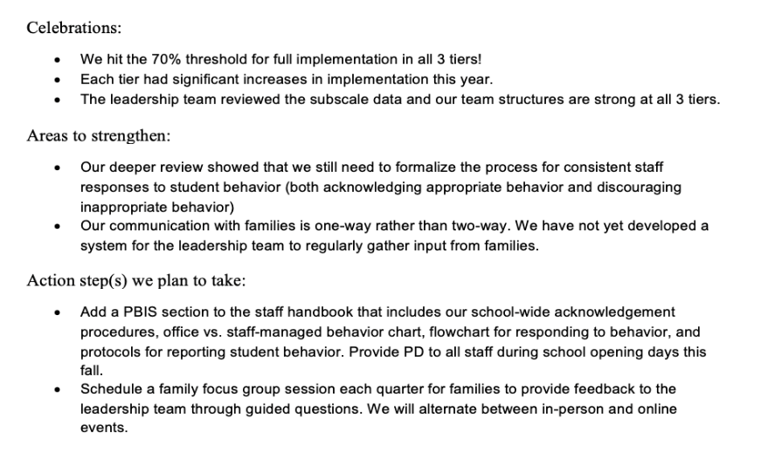
Outcome Data
Fidelity Data
Celebrations
Areas to strengthen
Action Steps
Notes:
TRAINER NOTE: Use this sample to discuss what each school might choose to include in a “snapshot” evaluation report

Slide 18
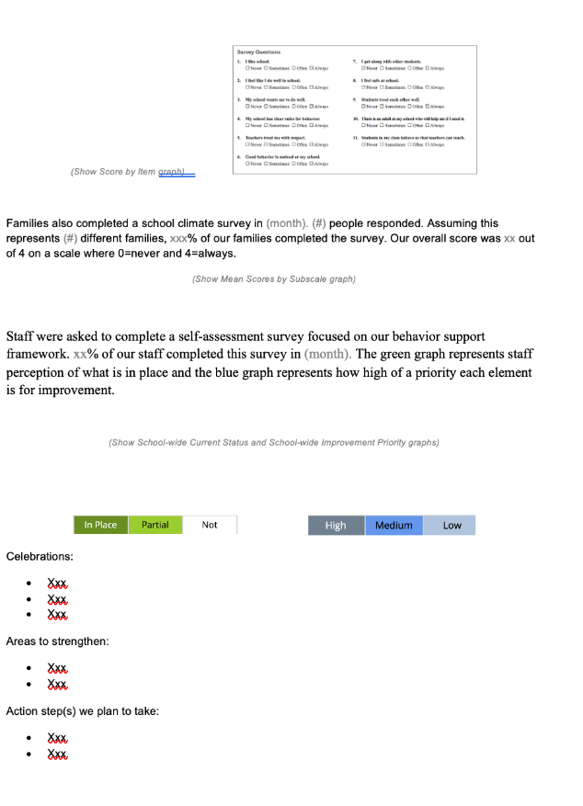
EVALUATION TEMPLATE
Add your data
Match your school’s context
Share with stakeholders
Notes:
TRAINER NOTE: This template is meant to be used as a guide. Schools should add/delete to meet their school context.
Annual Evaluation Template link: https://sebacademy.edc.org/annual-evaluation-report-template
Sample - Annual Evaluation : https://sebacademy.edc.org/annual-evaluation-report-sample

Slide 19
DISCUSSION: Review Evaluation Report
Do you have a report from previous years that you can revise?
List your data sources that you can share in the report.
List your successes and challenges that should be included in the report.
What are some goals / targets for next year?
Add to your action plan as needed
Have you discussed an evaluation report with your team this year?
Do you have a past report you can revise for this year?
10 minutes
Whole Group

Slide 20
REVIEW CURRENT AND FUTURE SCHOOL WIDE GOALS
Notes:
TRAINER NOTE: The purpose of this next section is to support the teams to review their goals this year, review their data, and revise their goals for next year.

Slide 21
Why Use Data for Decision Making?
Decisions are more likely to be
effective and efficient when they are based on data.
The quality of decision making depends most on defining problems with precision & clarity.
Data help
place the “problem” in the context
rather than in the students.
Use data to:
identify problems
refine problems
define the questions that lead to a solution
monitor implementation and outcomes
guide implementation
engage in problem solving

Slide 22
Why use data for decision-making?
To continuously improve
your Tier 1 framework!
Are we achieving our desired outcomes?
Which groups are benefiting from our plan? Which are not?
Are we implementing as planned?
What needs to be strengthened? Revised?
Are students receiving adequate support to achieve positive outcomes?

Slide 23
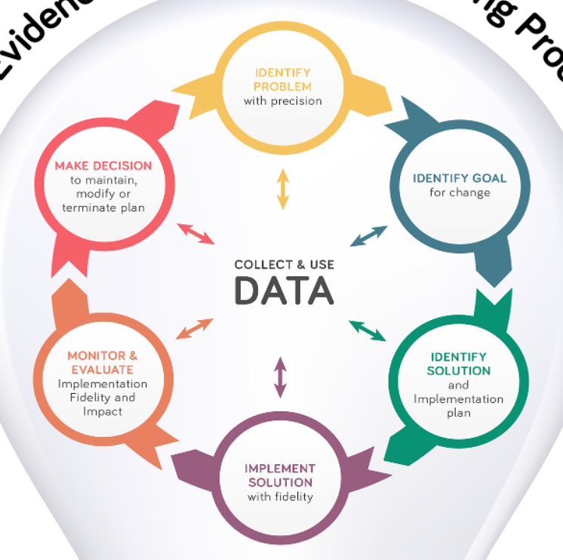
Once data routines are established…
1. Identify the RIGHT data
Outcome data tied to goals
Fidelity data tied to evaluation plan
3. Identify the RIGHT people
Who needs to see these data to inform decisions? (e.g., PBIS team, grade level teams, family groups, other committees?)
4. Identify the RIGHT time & format
When/how often should these data be reviewed to inform decisions?
What format will facilitate decision making?
2. Assess data integrity
Consider staff training & engagement, systems, response rates
…use the data to guide decision-making!

Slide 24
IDENTIFY PROBLEM
with precision
IDENTIFY GOAL
for change
IDENTIFY SOLUTION
and implementation plan
IMPLEMENT SOLUTION
with fidelity
MONITOR & EVALUATE
implementation fidelity and impact
MAKE DECISION
to maintain, modify, or terminate plan
Collect & Use
DATA
(Chaparro, E., et. al, 2022)

Slide 25
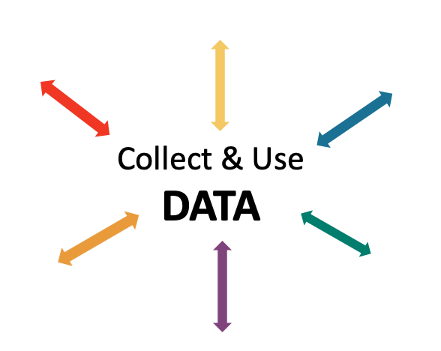
EXAMPLE: Reviewing & Analyzing School-wide Behavior Data to Develop, Inform, and Refine Tier 1
Most ODRs were given when students didn’t throw away trash.
IDENTIFY PROBLEM
IDENTIFY GOAL
IDENTIFY SOLUTION
IMPLEMENT SOLUTION
MONITOR & EVALUATE
MAKE DECISION
Booster lessons, prompts and acknowledgement continued
Increase rate of students throwing away trash
During a monthly meeting PBIS Leadership Team at Miller Middle School, the data analyst showed that ODRs from the cafeteria had doubled from the previous month. Upon further review, 75% of the ODRs were for disrespect.
Teach students clean up procedures; provide frequent prompts and acknowledgement
ODRs from the cafeteria were reviewed by the team for the next 3 months; ODRs for disrespect steadily decreased
PBIS team members paired with the cafeteria monitors during lunch blocks to teach, prompt, acknowledge

Slide 26
NON-EXAMPLE: Reviewing & Analyzing School-wide Behavior Data to Develop, Inform, and Refine Tier 1
At Portview High School, an increasing number of students were late to advisory block.
Because there were no systems to set up to monitor implementation or evaluate impact, there was a small decrease in late arrivals but, after a week previous patterns returned.
IDENTIFY PROBLEM
IMPLEMENT SOLUTION
Students were late to advisory
Staff were asked to prompt students lingering in the hall

Slide 27
EXAMPLE: Reviewing & Analyzing School-wide Behavior Data to Develop, Inform, and Refine Tier 1
Average daily support request calls due to safety concerns from the playground > 5.
IDENTIFY PROBLEM
IDENTIFY GOAL
IDENTIFY SOLUTION
IMPLEMENT SOLUTION
MONITOR & EVALUATE
MAKE DECISION
Support call requests decreased slightly. Team modifys plan by providing booster PD on active supervision to all duty teachers
Students demonstrate safety while on the playground
At Central School, behavior support staff were being called to the playground several times each day due to safety concerns.
Increase active supervision and reinforce students who demonstrate safe behavior
Rates of average daily support request calls are reviewed weekly by the PBIS coach
Duty teachers asked to deliver 5 schoolwide acknowledgement tickets each recess. Tickets are entered into a weekly raffle for students and staff.

Slide 28
Lincoln School Logic Model
OUTCOME
How do we sustain this?
Explicit expectations taught & retaught, monitors trained and overlap with staff for first month, zones created & assigned to staff
Consider revising your team’s logic model?
Reduce injuries and referrals during recess
Recess monitors taught expectations with students at the start of the year. Four playground zones were created and staff were assigned to each zone and active monitoring was modeled by school staff for the first 3 weeks of school.
Review and revise your goal from this year?
DATA
Office referrals, visits to the nurse, recess monitor weekly survey
How do we support staff to
implement this with fidelity?
SYSTEMS
What is one highlight
associated with this outcome?
Office referrals and injuries at recess have decreased. Monitors are more engaged with students and spend less time talking to one another.
What is one lesson learned?
Arranging schedules to overlap with monitors to train and model was challenging but critical.
Active monitoring at recess, expectations for behavior and use of equipment explicitly taught, each monitor acknowledges 5 students per recess for appropriate behavior
How do we know we are doing what we say we are doing? How do we know it is working?
What are we doing?
What do we want to be doing?
PRACTICES

Slide 29
Washington School Logic Model
Outcome:
Increase consistancy in our ODR system to ensure equicty across our students
Systems
Clear definitions for problem behaviors both Major and Minor with examples.
Discipline Flow Chart updated to ensure all staff understand the strategies and process of behavioral management techniques before writing a referral.
Staff PD on how to write up a referral. Staff reviewed sample discipline scenarios to determine if it is a Minor, Major or a simple correction with no write up.
Discipline definitions and flowchart added to school handbook.
Data
Team examines equity reports monthly in SWIS as well as the drill down tool to ensure discpline is not disproportionate amongst different groups of students.
Data is shared with staff during faculty meeting to determine next steps
Review and revise your goal from this year?
Highlight: Our ODR’s decreased signifantly once staff truly understood what should be a Major or Minor and after feeling comfortable with using the responding techniques that were practiced during PD
Lessons Learned:
Adults need lots of practice at writing referrals and keeping it unemotional.
Staff need lots of training and coaching on how to use behavior management
Practices
Teachers utilize the following:
Cool down space
Redirection/proximity/planned ignoring
Movement breaks
Mindfulness activities.
Only write up behaviors that fit a definition a Major

Slide 30
ACTIVITY: Using School-wide Behavior Data for Decision-Making
Review your school-wide behavior data.
Apply the decision-making steps to 1 current problem in your school.
Review your goal and revise for next school year.
Add to your action plan, as needed.
Be prepared to share 2-3 big ideas with the group.
IDENTIFY PROBLEM
IDENTIFY GOAL
IDENTIFY SOLUTION
IMPLEMENT SOLUTION
MONITOR & EVALUATE
MAKE DECISION
Independent: 10 minutes
Whole Group: 10 minutes

Slide 31
Resource Spotlight: Coaches Year at a Glance Document

Slide 32
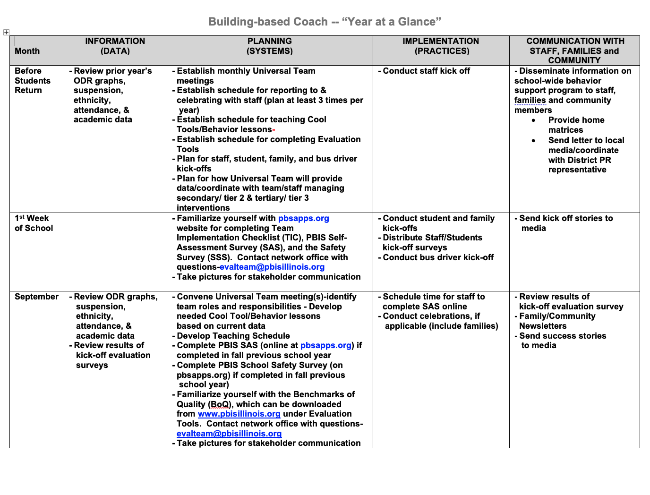
Systems planning for next year
Now that we have reviewed and revised our goals (or outcomes) for next year…
1. Consider which systems need review and revision?
2. What data sources and routines need to be planned for next year?
3. What new or revised practices will be included?
We’ll revisit our Coaches Year at a Glance document to help us plan

Slide 33
Coaches Year at a Glance
Month by month resources for coaches:
Organizes what data should be reviewed when (for planning purposes)
Prompts for coaches’ and team activities that support planning
What practices should be conducted across the year.
Ideas for communicating with Staff, Families, and Community.
Create your own coaches’ plan!
Notes:
https://sebacademy.edc.org/coaches-year-glance

Slide 34
RESOURCE SPOTLIGHT:
Review Coaches Year at a Glance Document
What activities are relevant to your team’s goals?
How could you modify this document, so you have a personal coaching guide for your school?
5 minutes
12 minutes
Independent Jot
Whole Group
Notes:
https://sebacademy.edc.org/coaches-year-glance

Slide 35
Planning our Data Routines and Evaluation for next School Year
Notes:
https://www.pbisapps.org/products/tfi

Slide 36
Systems
Data
Data
Use data to inform decisions about which students, families, and educators need which supports, as well as whether supports should be continued, adjusted, or faded. Data should be used to ensure that all recipients experience benefit and that supports are implemented with fidelity.
Equity
Outcomes

Slide 37
Strengthen Routines to Gather Fidelity and Outcome Data

Slide 38
EVALUATION PLAN: Review / Revise
At a minimum, it is strongly recommended that teams include the following in an evaluation plan:
School-wide student outcomes (weekly)
Student and staff perceptions (annually)
Fidelity (annually with the TFI)
What has changed this year that we should add to our evaluation plan?
What do we want to make sure we include for next year?
A written plan will support the sustainability of PBIS.
Notes:
Evaluation Schedule template: https://sebacademy.edc.org/evaluation-schedule

Slide 39
Developing Data Routines
Data Source | Date(s) for administration | Who brings data to team meeting | Meeting date to review data | Plan to share data
TFI
Behavior (ODR)
School Climate
Other Outcome
Remember:
When adding new data sources, this activity can be a helpful resource with your team
Establishing consistent, efficient data routines will enhance your team’s ability to effectively use data for decision-making!
Notes:
Data Routines Activity: https://sebacademy.edc.org/developing-data-routines-activity

Slide 40
Guidelines for Efficient Data Collection Routines
What Data?
Limit to information that answers important student, classroom, and school questions
How should information be gathered?
Integrate data collection procedures into typical routines (e.g., ODRs, attendance, behavior incident reports)
Schedule data collection and staffing to ensure that data are current
When?
No more than 1% of time each day for managing data
By whom?
Ensure access to all necessary information (e.g., student records)
Data collection reports regularly checked for accuracy
Review these guidelines with your team!
Help increase efficiency!

Slide 41
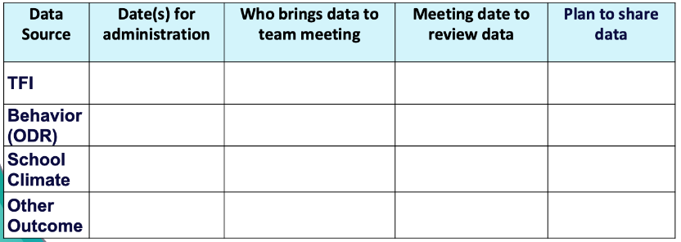
ACTIVITY: Data Routines
Independently or with a co-coach… Plan how you may review these systems with your team.
Review your evaluation plan and identify what still needs to be completed this year.
Plan your data routines for the year ahead.
Add items to your Action Plan as necessary.
Be ready to present 2-3 “big ideas” from your discussion.
20 minutes

Slide 42
Logic Model Planning for Next Year
Notes:
https://www.pbisapps.org/products/tfi

Slide 43
Logic Model Planning for Next Year
Purpose of this Activity: Plan your vision for your updated PBIS framework next year.
Answer the following questions:
What are your goals for next year? (Outcomes)
What data will you collect to support your goals? (Data)
What practices do you want to keep? What practices do you want to add? (Practices)
What new features do you need to support staff? (Systems)
Share the vision with your team and work together to update.

Slide 44
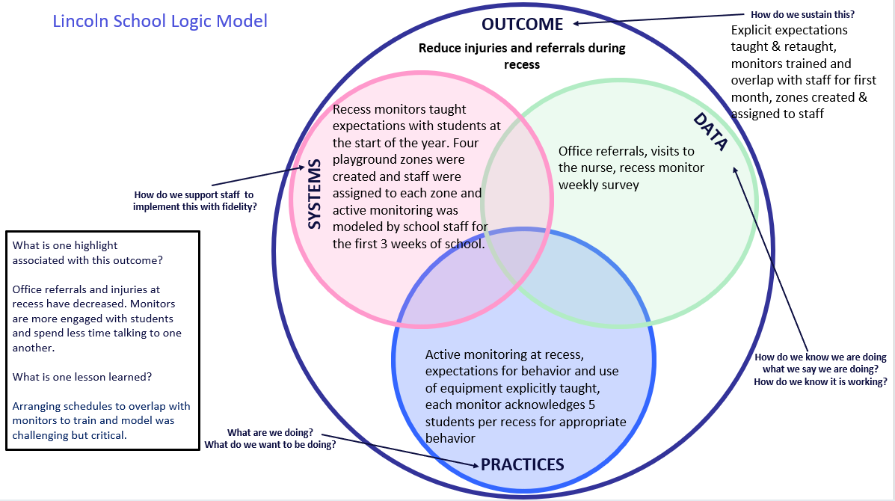
Remember your logic model from September?
Let’s revisit and plan ahead!
We can use this information to backwards plan
This can help us action plan what we need to do for next year!

Slide 45
School: ___________________________
Identify an outcome to focus on for this activity. For example:
Decrease ODRs on the playground
Increase consistency of response to behavior to ensure equity
Increase family engagement
How do we sustain this?
OUTCOME
Enter systems changes you made to help achieve your goal
Enter what dataa source you used to identify your goal and evaluate the results
How do we know we are doing what we say we are doing? How do we know it is working?
SYSTEMS
DATA
How do we support staff to
implement this with fidelity?
What is one highlight
associated with this outcome?
__________________________________
__________________________________
What is one lesson learned?
__________________________________
__________________________________
Enter Practices taught to achieve your goal
What are we doing?
What do we want to be doing?
PRACTICES

Slide 46
School: ___________________________
OUTCOME
How do we sustain this?
What is one highlight
associated with this outcome?
__________________________________
__________________________________
__________________________________
__________________________________
SYSTEMS
DATA
How do we support staff to
implement this with fidelity?
What is one lesson learned?
__________________________________
__________________________________
__________________________________
__________________________________
How do we know we are doing what we say we are doing? How do we know it is working?
What are we doing?
What do we want to be doing?
PRACTICES
Notes:
Template 2

Slide 47
Outcome:
Systems
Data
Highlight:
Lessons Learned:
Practices
Notes:
Template 2

Slide 48
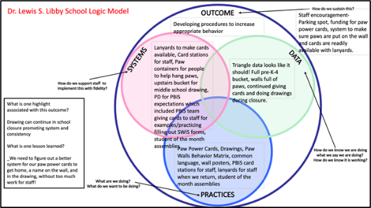
ACTIVITY: PLANNING ROUNDTABLES
Review your past logic model (if you have access to it).
Brainstorm and draft what you want to see in place next year?
What questions do you have?
Schedule a time to meet (or communicate) with your team to collectively brainstorm, update, and action plan!
Logic Model Directions, Samples and Template
https://sebacademy.edc.org/pbis-logic-model-activity-directions-samples-and-template
Co-coaches 5 minutes
Questions/full group 5 minutes
Notes:
https://sebacademy.edc.org/pbis-logic-model-activity-directions-samples-and-template
TRAINER: Activity prompt below; allow 5 minutes
Review roundtable template and examples.
Brainstorm potential outcomes you may want to target to highlight your school/team’s PBIS efforts.
What questions do you have?
Schedule a time to meet (or communicate) with your team to plan what your school wants to share

Slide 49
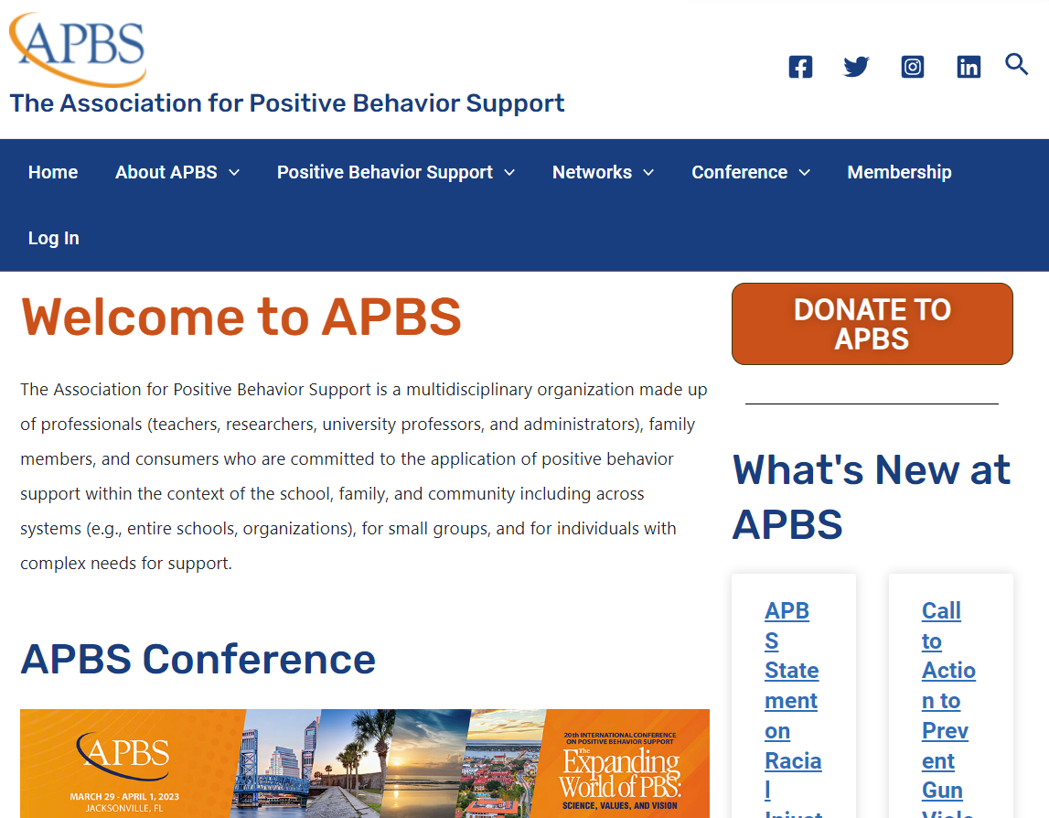
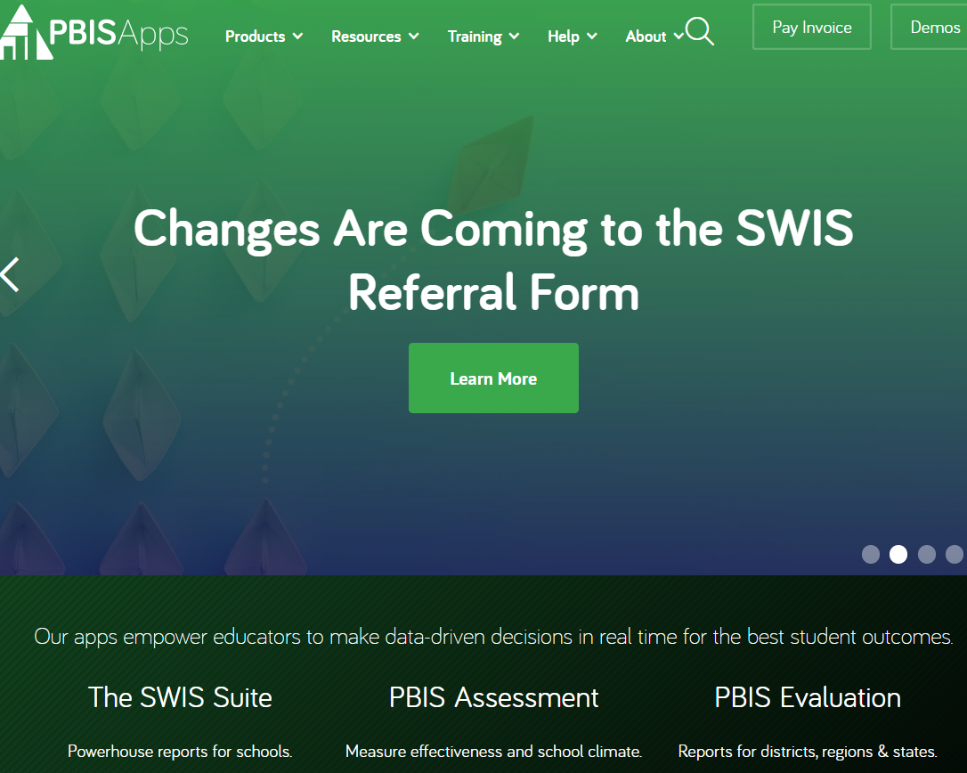
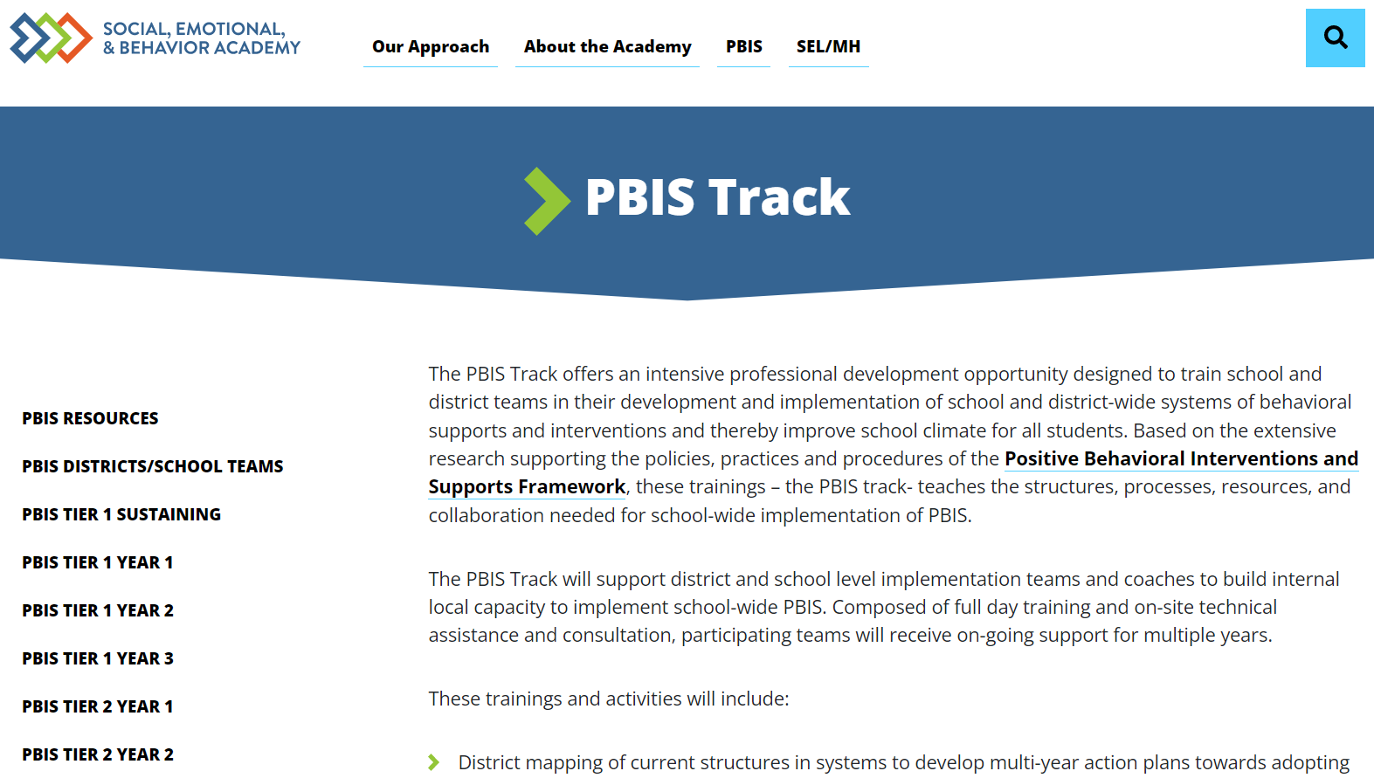
Thank you for a great Year!
Please come back and revisit your resource sites!
NEPBIS.org
EDC Website
PBIS.org
PBISApps.org
APBS.org
Notes:
EDC SEBAcademy: https://sebacademy.edc.org/pbis-track
NEPBIS: Nepbis.org
National Center on PBIS: PBIS.org
PBISApps: PBISApps.org
Association of Positive Behavior Supports: APBS.org

Slide 50
Our turn to plan for next year!
Please make sure we have your updated contact information for our mailing list.
Invite you to future events and training opportunities.
Future Social Emotional Behavior (SEB) webinars from EDC and the May Institute

Slide 51
Agenda & Coaches' Tasks- Debrief
Presentation Content:
Revisit: Sustainability Factors
Goal Planning for next year
Revisit: Annual Evaluation Planning
Revisit: Coaches Year at a Glance
Coaches’ Tasks:
Review your PBIS Plan for sustainability
Review and revise your PBIS School and Classroom wide goals for next year.
Plan how you will review with your team your evaluation process including your Annual Evaluation.
Plan to update your Coaches Year at Glance document for next year’s supports.
What questions do you have on today’s content?
What questions do you have on the follow-up tasks?

Slide 52
HELPFUL RESOURCES
RESOURCES:
Tiered Fidelity Inventory
TFI Tier 1 Quick Check Tip Sheet for Scoring
Integrated TFI Companion Guide
Data Decision Rules Activity
Evaluation Plan Template
Annual Evaluation Template
Annual Evaluation Sample
Notes:
PBIS TFI: Resource link: https://www.pbisapps.org/resource/tfi
TFI Tier 1 Quick Check Tip Sheet for Scoring https://sebacademy.edc.org/tfi-tier-1-quick-check-tip-sheet-scoring
PBIS TFI Walkthrough Tip Sheet: https://www.pbisapps.org/resource/tfi-walkthrough-tip-sheet
Integrated TFI Companion Guide: https://www.pbis.org/resource/integrated-tiered-fidelity-inventory-companion-guide
Data Decision Rules Activity - https://sebacademy.edc.org/developing-data-routines-activity
Evaluation Plan Template - https://sebacademy.edc.org/evaluation-schedule
Annual Evaluation Template: https://sebacademy.edc.org/annual-evaluation-report-template
Sample - Annual Evaluation: https://sebacademy.edc.org/annual-evaluation-report-sample

Slide 53
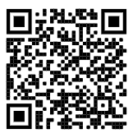
https://edc.co1.qualtrics.com/jfe/form/SV_cBF9GI7gVEBsfSC EVALUATION
Please remember to complete the evaluation!
Scan the QR code to access.
Notes:
TRAINERS -
Put link to evaluation (below) in the chat for those who do not use the QR code:
https://edc.co1.qualtrics.com/jfe/form/SV_cBF9GI7gVEBsfSC

