Slide 1
PBIS School-Wide Coach Meeting Year 3: April 2023
PBIS Track
Insert Trainers Names
with support from NEPBIS Network, May Institute & Broad Reach Consulting
Notes:
Add trainer names for your event

Slide 2
Agenda & Team Tasks
TFI Scheduling check-in
Coaches Tasks
Presentation Content
Resource Spotlight
Review: Systems to Support Staff
Work with your team to complete your Working Smarter Worksheet.
Review: Annual Evaluation Report
Work with your team to develop your year end report.
Discuss and plan your school’s participation in the Tier 2 AND Sustaining Academies

Slide 3
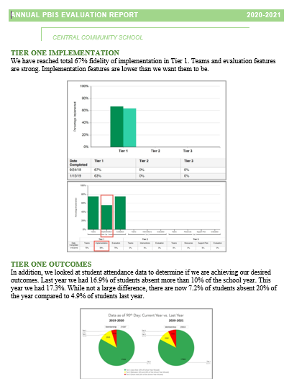
HELPFUL READINGS & RESOURCES
RESOURCES:
Classroom PBIS: Systems & Data Brief
Supportive Environments Create Classroom Community
Annual PBIS Evaluation Report Template
Annual PBIS Evaluation Report – SAMPLE
Embedded Professional Development Activity
Sample PBIS Handbooks
Sample Staff Slide Deck
Sample Student PBIS Slide Deck
Notes:
Classroom PBIS: Systems & Data Brief: https://sebacademy.edc.org/supporting-and-responding-educators-classroom-pbis-implementation-needs-guide-classroom-systems-and
Embedded Professional Development Activity: https://sebacademy.edc.org/embedded-professional-development-planning-activity
PBIS Evaluation Report https://sebacademy.edc.org/annual-evaluation-report-template
PBIS Evaluation Report Sample https://sebacademy.edc.org/annual-evaluation-report-sample
Sample PBIS Handbooks: https://sebacademy.edc.org/list-of-pbis-resources?keyword=Sample+PBIS+Handbook&pbis_resource_type=All&pbis_resource_topic=All&sort_by=field_date_value&sort_order=DESC
Sample Student Slide Deck https://sebacademy.edc.org/sample-pbis-student-slide-deck
Sample Staff Slide Deck https://sebacademy.edc.org/sample-pbis-staff-slide-deck

Slide 4
EXPECTATIONS
Self
Others
Environment
Self-monitor
Listen while others are speaking​
Have your computer charged and ready to go​
If you have questions or comments:
Work as a team:
Keep necessary materials at hand
Are you participating?
Engaged as a learner?
Stretch, break, stand as needed​
Raise hand
Room for every voice
Reinforce participation
action plan
relevant docs
water/snacks
Minimize distractions if possible​

Slide 5
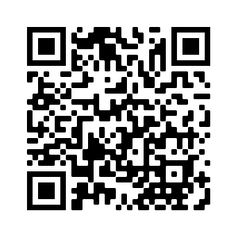
ACTIVITY: ATTENDANCE
Scan QR code on the left or follow the URL posted in the chat to access the online attendance survey
Follow prompts to enter attendance information
Notify trainers if you require assistance (e.g., identifying your cohort or cohort group)
Certificates of Attendance will be sent in January and June. Attendance records will be use as verification
You are in Cohort 7
1 minute
Notes:
Link to attendance form is here: https://edc.co1.qualtrics.com/jfe/form/SV_5BiXqi4bxzOCMS2
Add your cohort number
Post a link to the attendance survey (below) in the chat for those who do not use the QR code on the slide:
ATTENDANCE: https://edc.co1.qualtrics.com/jfe/form/SV_5BiXqi4bxzOCMS2

Slide 6
Yearly Product Review
Team Meeting Schedule / Action Plan - All
2 of the following:
Classroom: Sample Classroom Routine Matrix or Classroom Assessment
Alignment: Working Smarter Matrix or Alignment Activity
Equity: Neutralizing Routine or Equity Action Items
Please show trainer your products for Check Off. You do not need to turn them into us. (But we love examples of your great work!)
Notes:
Trainer Note: If a team has another item that would fit into Classroom, Alignment or Equity, they can let us know and we can consider it. Most things will be approved.

Slide 7
REVIEW: Annual Evaluation Report
Notes:
TRAINER NOTE: This is review content please be brief

Slide 8
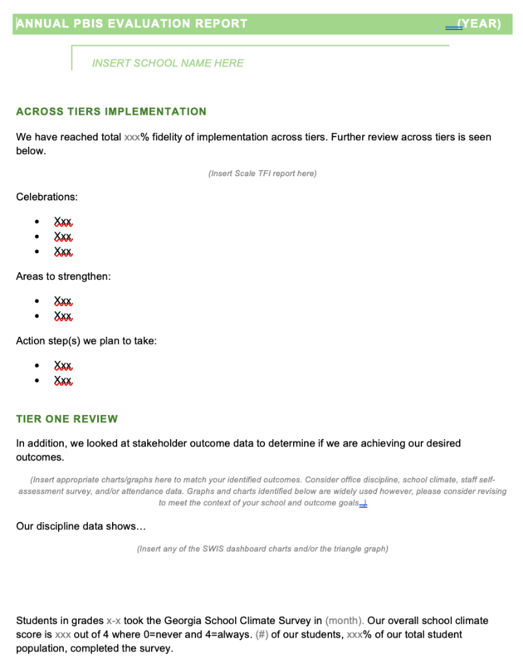
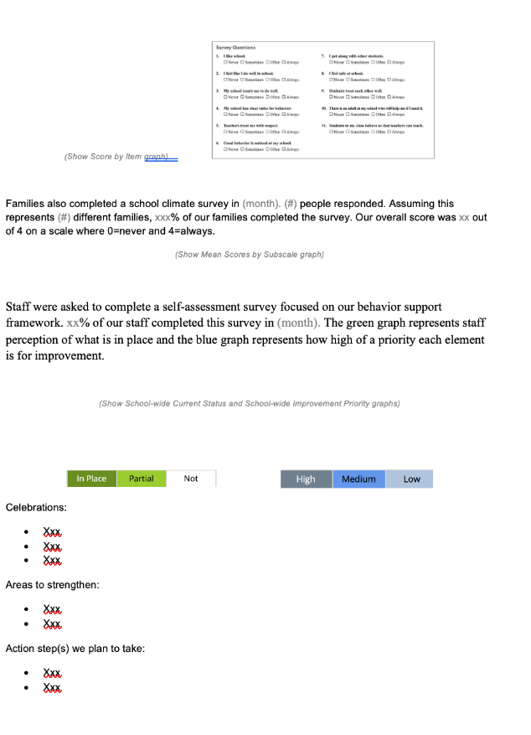
EVALUATION TEMPLATE
Add your data
Match your school’s context
Share with stakeholders
Notes:
TRAINER NOTE: This template is meant to be used as a guide. Schools should add/delete to meet their school context.
Annual Evaluation Template link: https://sebacademy.edc.org/annual-evaluation-report-template
Sample - Annual Evaluation : https://sebacademy.edc.org/annual-evaluation-report-sample

Slide 9
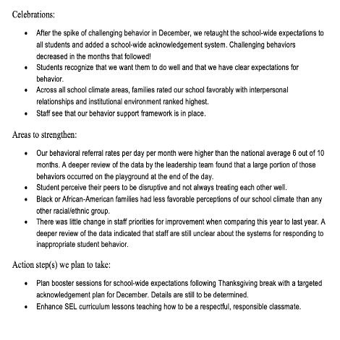
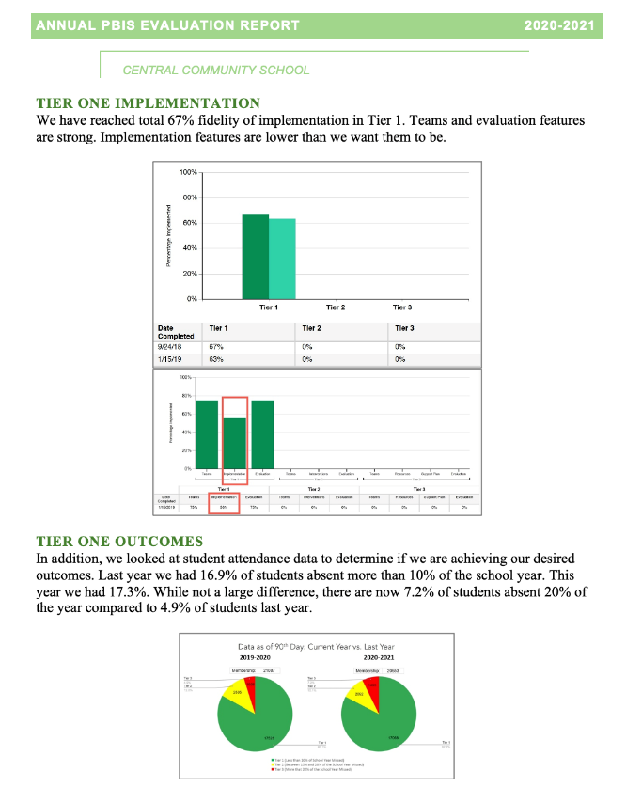
Implementation of the core components of PBIS is more likely if the Tier I team assesses the implementation status at least annually and provides “snapshot” reports to the staff, community, school board.
Notes:
Annual Tier 1 Evaluation Report (Sample school):

Slide 10
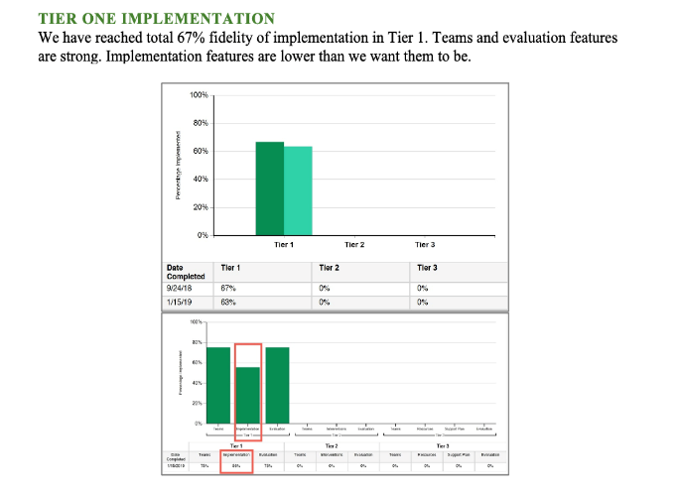
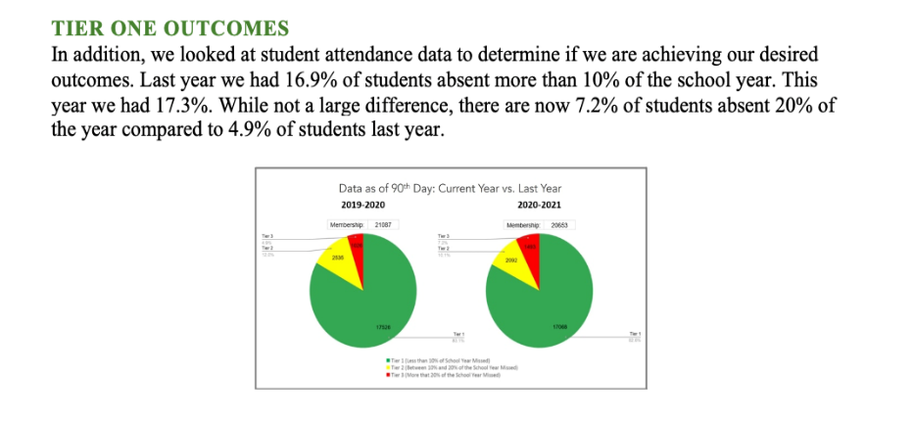
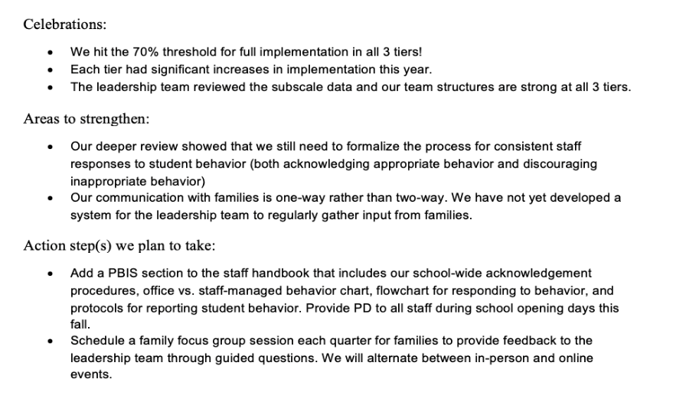
Outcome Data
Fidelity Data
Celebrations
Areas to strengthen
Action Steps
Notes:
TRAINER NOTE: Use this sample to discuss what each school might choose to include in a “snapshot” evaluation report

Slide 11
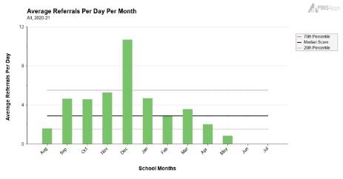
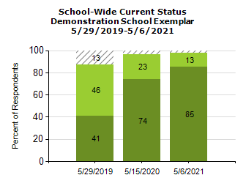
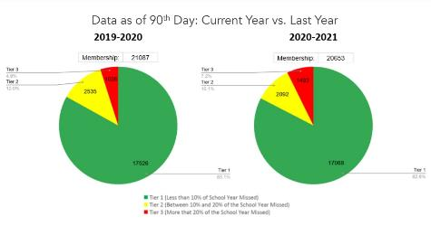
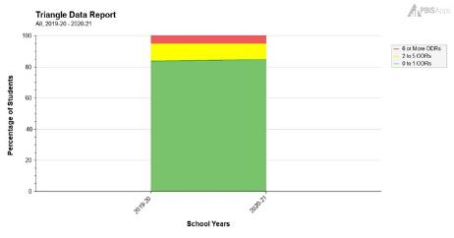
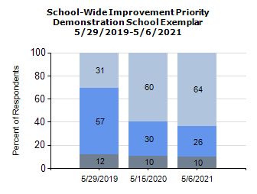
What Tier 1 outcome data can you use to complement your TFI data?
(Remember to consider your team's desired outcomes/goals as you decide!)
Staff
Self-assessment survey data
Behavior data
School climate data
(students, staff, families)
Attendance data

Slide 12
ACTIVITY: Evaluation Report and Planning
Review your goals and accomplishments from this year. What data relates to these?
Review your PBIS Handbook
Review planning for next year content with your team.
Revise priorities and action steps
How will this be shared?
Which items on this list are on your action plan?
How can we support you in this task?
Whole group
15 minute

Slide 13
REVIEW: Systems to Support Staff

Slide 14
Systems
Practices
Data
Continue to invest in systems to support high-fidelity implementation over time. Leverage existing leadership teams to guide planning and implementation, and consider effective means to support educators’ professional learning and wellness given current resources, experience, and expertise.
Equity
Outcomes

Slide 15
Step 8: Develop Systems to Support Staff
Systems
Promoting and Sustaining Staff Engagement
Continuous Action Planning
Team-Based Implementation
Embedded and Ongoing Professional Development
Staff Recognition
Data Routines
Notes:
TRAINER NOTE: There are various ways in which we support our staff to implement our PBIS Framework. Today we are going to focus on a couple of these systems to learn how we can enhance them to support our implementation.

Slide 16
Continuum of Multi-tiered Professional Development Support
Tier 3
What do we do for the FEW staff needing intensive support?
Intensive Professional Development:
Data-driven Consultation
Performance Feedback:
Routine Walkthrough and Self-management Data Reviews
Tier 1
What do we do for
ALL Staff?
Universal Professional Development:
Training and Self-management
Universal Screening:
Walk-through and Student Data Review
~5%
~15%
Tier 2
What do for the SOME staff needing more support?
Targeted Professional Development:
Self-management with Peer or Coaching Support
Progress Monitoring:
Walkthrough, Student Data Review,
Teacher Collected Data
For now,
focus on providing ALL staff Tier 1 professional development
~80% of Staff

Slide 17
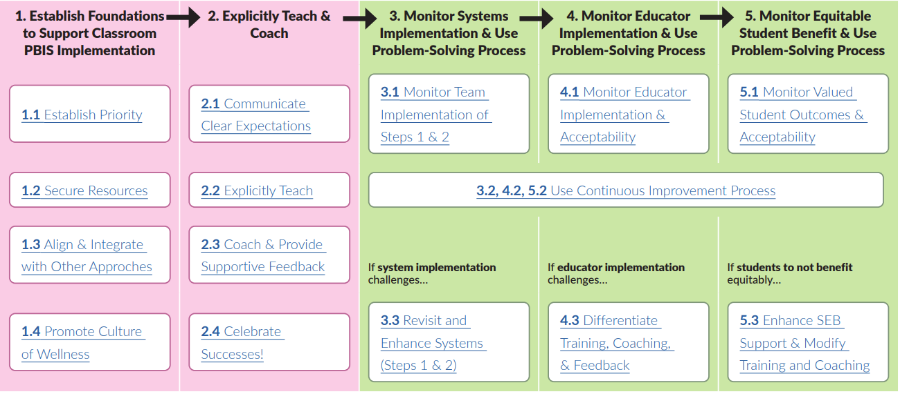
STEPS TO SUPPORT EDUCATORS' IMPLEMENTATION
Page 14
Notes:
RESOURCE LINK (p.14): https://sebacademy.edc.org/supporting-and-responding-educators-classroom-pbis-implementation-needs-guide-classroom-systems-and

Slide 18
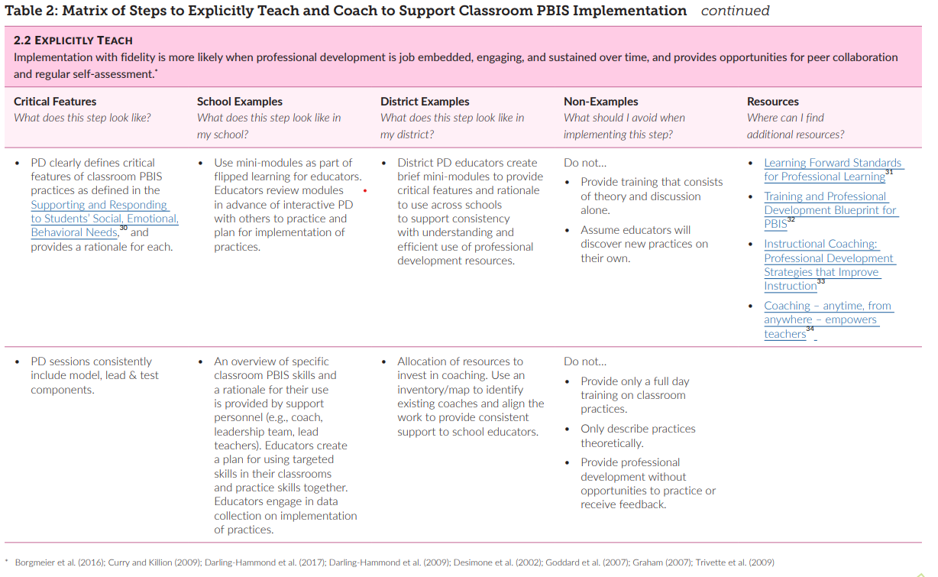
Example System Feature table (2.2 Explicitly Teach)
Page 22
Notes:
TRAINER NOTE: Please explain how each system feature has a corresponding table that outlines that critical features of the system component, examples, and non-examples, and resources. You may mention the document and click through to show that (1) that there are tables for each of the system components, but also that some tables span multiple pages.
RESOURCE LINK (p.22): https://sebacademy.edc.org/supporting-and-responding-educators-classroom-pbis-implementation-needs-guide-classroom-systems-and

Slide 19
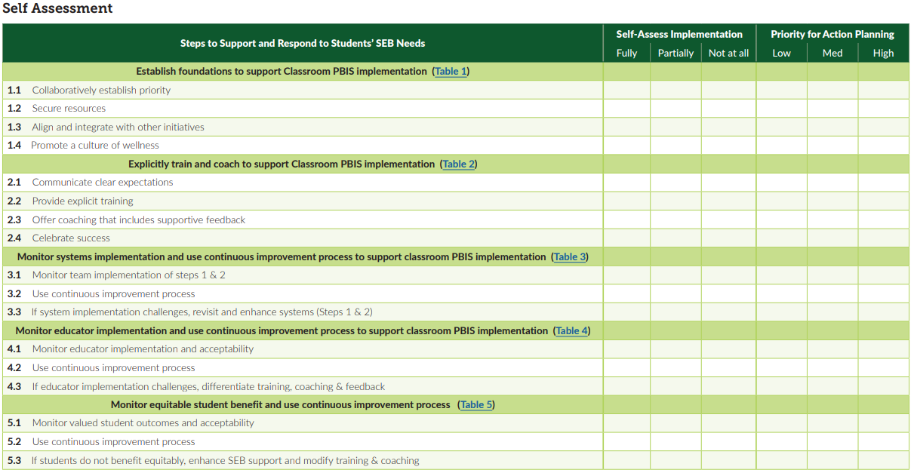
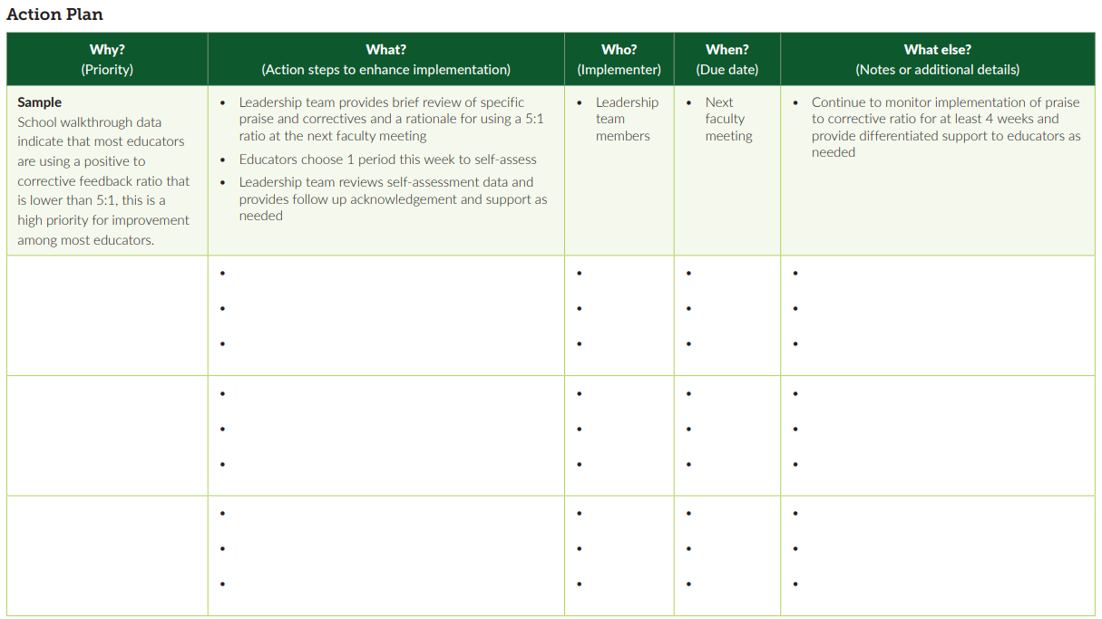
SELF-ASSESSMENT AND ACTION PLAN
Pages 47 & 48
Notes:
TRAINER NOTE: Please explain how at the end of this section teams will have more time to review this document and reflect on how this tool can assist them in action planning future professional development (targeting positive classroom supports, hopefully!).
RESOURCE LINK (p.47-48): https://sebacademy.edc.org/supporting-and-responding-educators-classroom-pbis-implementation-needs-guide-classroom-systems-and

Slide 20
Embedded and Ongoing Professional Development
First, identify what staff need to know, then, provide…
Coaching/
Prompting
Explicit Training
Performance Feedback

Slide 21
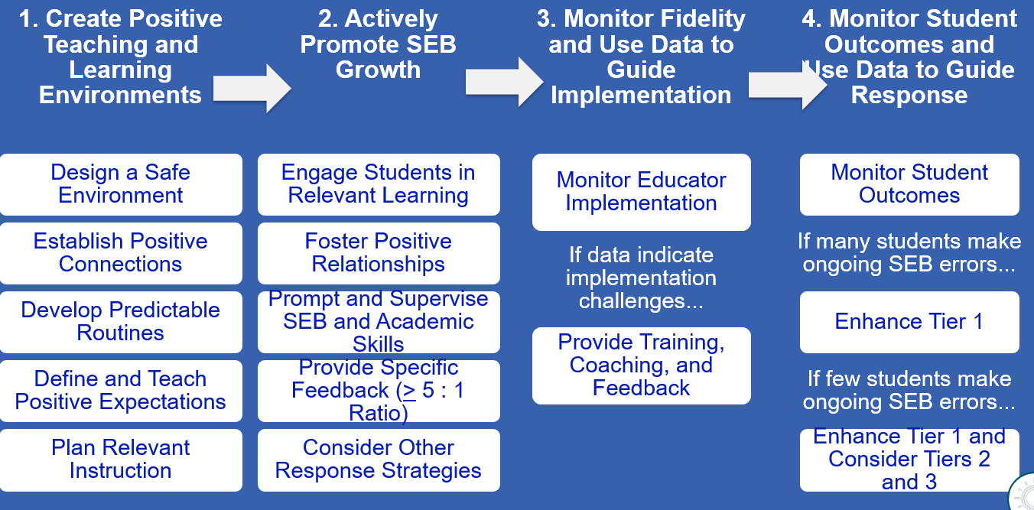
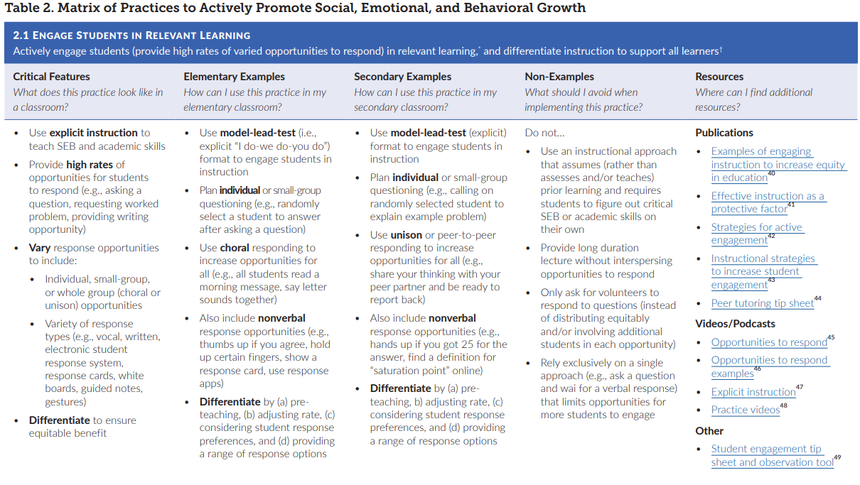
Remember some classroom support resources
Notes:
Incorporate familiar resources, such as the Supporting and Responding to behavior document, which can be found on PBIS.org and provides useful tools for organizing class-wide supports.
Please add this document to the chat: https://www.pbis.org/resource/supporting-and-responding-to-behavior-evidence-based-classroom-strategies-for-teachers

Slide 22
NEPBIS.org
CLASSROOM PBIS
Provides links to more information about systems to support educators!
Educator Support
CLICK HERE
Notes:
Classroom PBIS Educator Support Link: https://nepbis.org/classroom-pbis/educator-support/

Slide 23
Professional Development Planning
What content? | When will it be explicitly taught? | By who? | How will prompting and coaching occur? | How will staff be provided performance feedback?
Notes:
RESOURCE LINK: https://sebacademy.edc.org/embedded-professional-development-planning-activity

Slide 24
Guidelines for Embedded and Ongoing Professional Development
Ensure PD includes explicit training, performance feedback and ongoing coaching
Develop a PBIS PD Calendar and routines (e.g. 15 minutes of every staff meeting, 1 hour of early release days)
Align staff evaluation procedures with expected practices where possible

Slide 25
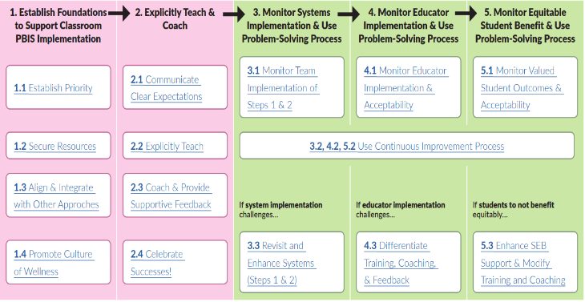
DISCUSSION: Developing a System of Embedded and Ongoing Professional Development
What discussions did you and your team have following this content last month?
What areas of the systems to support staff resonated with you and your team?
What action steps did you add to your action plan?
15 minutes
Notes:
Classroom PBIS: Systems & Data Brief: https://sebacademy.edc.org/supporting-and-responding-educators-classroom-pbis-implementation-needs-guide-classroom-systems-and
Embedded Professional Development Activity: https://sebacademy.edc.org/embedded-professional-development-planning-activity

Slide 26
Resource: Integrated TFI Companion Guide

Slide 27
Integrated TFI Companion Guide
Combines guidance from:
Cultural Responsiveness
Mental Health
SEL
Complete the TFI
Use the Integrated Companion as an action planning guide to improve or enhance implementation (select items or whole guide)
Develop a detailed action plan
Notes:
Integrated TFI Companion Guide: https://www.pbis.org/resource/integrated-tiered-fidelity-inventory-companion-guide

Slide 28
ACTIVITY: RESOURCE SPOTLIGHT
Pull out your calendar to schedule the TFI with your trainer!
Review the shared resource independently.
With a partner discuss:
What was your key takeaway from this resource?
How might your team use this in the future?
Can this be used to provide professional development to staff? How?
Be ready to provide a 1 minute share-out of your discussion
Independent
Whole Group
5 minutes
10 minutes
Notes:
TRAINER NOTE: You can use this time to hop in breakout rooms to schedule the TFI with your schools.

Slide 29
Spring TFI Scheduling
Notes:
Erik
10:20

Slide 30
DISCUSSION: LOOKING AHEAD
Have you scheduled your Spring TFI with your Trainer?
10 minutes
Whole Group

Slide 31
Agenda & Team Tasks
What questions do you have on today’s content?
Presentation Content
Review: Annual Evaluation Report
Coach Tasks
Work with your team to develop your year end report.
Review: Systems to Support Staff
Resource Spotlight
TFI Scheduling check-in
Work with your team to complete your Working Smarter Worksheet.
Discuss and plan your school’s participation in the Tier 2 AND Sustaining Academies
What questions do you have on the follow-up tasks?

Slide 32
HELPFUL READINGS & RESOURCES
RESOURCES:
Classroom PBIS: Systems & Data Brief
Supportive Environments Create Classroom Community
Annual PBIS Evaluation Report Template
Annual PBIS Evaluation Report – SAMPLE
Embedded Professional Development Activity
Sample PBIS Handbooks
Sample Staff Slide Deck
Sample Student PBIS Slide Deck
Notes:
Classroom PBIS: Systems & Data Brief: https://sebacademy.edc.org/supporting-and-responding-educators-classroom-pbis-implementation-needs-guide-classroom-systems-and
Embedded Professional Development Activity: https://sebacademy.edc.org/embedded-professional-development-planning-activity
PBIS Evaluation Report https://sebacademy.edc.org/annual-evaluation-report-template
PBIS Evaluation Report Sample https://sebacademy.edc.org/annual-evaluation-report-sample
Sample PBIS Handbooks: https://sebacademy.edc.org/list-of-pbis-resources?keyword=Sample+PBIS+Handbook&pbis_resource_type=All&pbis_resource_topic=All&sort_by=field_date_value&sort_order=DESC
Sample Student Slide Deck https://sebacademy.edc.org/sample-pbis-student-slide-deck
Sample Staff Slide Deck https://sebacademy.edc.org/sample-pbis-staff-slide-deck

Slide 33
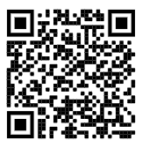
https://edc.co1.qualtrics.com/jfe/form/SV_cBF9GI7gVEBsfSC EVALUATION
Please remember to complete the evaluation!
Scan the QR code to access.
Notes:
TRAINERS -
Put link to evaluation (below) in the chat for those who do not use the QR code:
https://edc.co1.qualtrics.com/jfe/form/SV_cBF9GI7gVEBsfSC

