Slide 1
Welcome to Tier 2 Coaches meeting!
GETTING STARTED:
Complete the ATTENDANCE
WHILE YOU WAIT:
Notice: TEAM SHARE from Jan/Feb
AT THE END:
Complete the EVALUATION
BE PREPARED:
Find training resources at : SEB PBIS Tier 2 Academy
Google docs
Open or establish a Tier 2 shared folder
Open your team ongoing ACTION PLAN
~15%
Notes:
LINKS for today:
Attendance
https://edc.co1.qualtrics.com/jfe/form/SV_5BiXqi4bxzOCMS2
New team member communications survey - https://edc.co1.qualtrics.com/jfe/form/SV_db8zhNj6NJ3eXga
EDC Website for SEB Academy
https://sebacademy.edc.org/
Event Evaluation (at the end)
https://edc.co1.qualtrics.com/jfe/form/SV_cBF9GI7gVEBsfSC

Slide 2
PBIS Tier 2 Coaches Training Year 1 March 2023
Marcie Handler & Katie Meyer
with support from NEPBIS Network, May Institute & Broad Reach Consulting

Slide 3
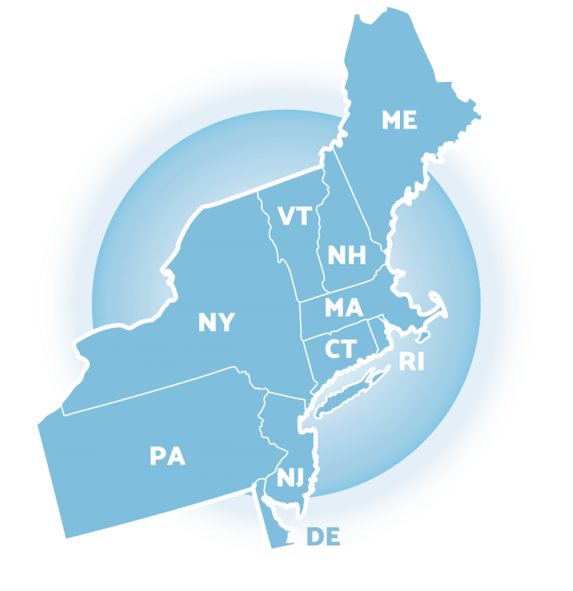
ACKNOWLEDGEMENTS
02
03
04
Northeast PBIS Network (nepbis.org) / UCONN
01
Michigan Integrated Behavior & Learning Support Initiative
Dr. Heather George & FLPBIS
Missouri PBIS
Drs. Leanne Hawken, Deanne Crone, & Rob Horner
05
06
Midwest PBIS Network

Slide 4
EXPECTATIONS
Self
Others
Environment
Self-monitor
Mute when listening, unmute to talk​
Have electronics ready to use
Obtain help from peers and trainers
Work as a team:
Keep necessary materials at hand
Are you participating?
Engaged as a learner?
Stretch, break, stand as needed​
Room for every voice
Reinforce participation
action plan
relevant docs
water/snacks
Minimize distractions if possible​
Complete tasks efficiently
Notes:
Taking CARE of…

Slide 5
LEGEND
Timing
Example
Activity
Non-example
Guidelines
Preview
Big Idea
Review
Organization

Slide 6
AGENDA & FOLLOW-UP
Training Overview
Develop a process for matching student need to practices
Coaching Tasks
Targeted Intervention Organizer – Part 1 complete and review your “decision rules” or guidelines for matching student need to practices
Preview Part 2 of the Targeted Intervention Organizer
Preview progress monitoring
Prepare for April team training (TIO Part 2)
Complete this doc for to schedule your TFI spring assessment

Slide 7
Coaches’ (and TEAM) Reminders
Coaches’ Tasks March:
Share with us:
Agenda
Critical features self-check for installing your T2 practices
Identify barriers/concerns
Navigating resources
Decision guidelines (part of TIO)
Targeted Intervention Organizer – Part 1 complete
Dates for your TFI spring assessment
Notes:
IF YOU HAVE NOT PARTICIPATED IN TA yet, please make a point to schedule this 1:1.
Reminder:
Fall, Winter (Dec, Jan, Feb), and Spring TA (in addition to team TFI if time allows)
Special note: if schools want to complete the BL TFI that did not in Nov, we can re-open those surveys
March: Targeted Intervention Organizer, Part 2 preview
End of April/May will be TFI assessments with trainers

Slide 8
GETTING STARTED WITH Tier 2
Develop an equitable process for matching student need to practices
1
Establish a representative T2 leadership team
6
2
Develop a collaborative process for identifying students
Develop a process for progress monitoring, data-based decision rules
7
3
Evaluate, select and adopt culturally appropriate tier 2 practices
Develop procedures for modifying/ adjusting implementation
8
4
Develop a process to install selected practices
Develop evaluation routines for fidelity and outcome data
9
5
Develop procedures to train staff and students; partner with families and community
Document and share routines, practices, and policies
10
Notes:
COACHES:
Seeing all of these steps can be uncomfortable or overwhelming – the goal is to walk away with an understanding of the elements and strategies to prioritize time and resources to get the steps achieved over a period of time.
TEAM MEMBERS
How will you participation in aspects of these steps support the process?

Slide 9
Common Tier 2 Interventions
Social / Emotional skills (e.g., self-regulation)
Coping skills (anxiety, depression)
Academic / organizational skills
CBT (e.g., REP, Coping Cat)
Check In/ Mentoring
Skills Groups
Counseling Groups
Classroom Interventions
Check in (with an adult)
Check in Check Out (CICO-BEP)
Check and Connect (Monitoring + Mentoring)
Enhance social skills instruction in the classroom (CW-FIT)
SEB curriculums, lessons on classroom ‘survival’ skills)
Therapeutic focus
Topic specific (e.g., grief, trauma, gender identity)
Diversion programs
Notes:
CW-FIT:
The CW-FIT program is a multilevel group contingency intervention that broadly addresses common functions of problem behavior. The CW-FIT is considered a classroom-level primary intervention because it is used with all students in a class. For students not responding to the primary-level intervention-group contingency, secondary-level or targeted interventions of self-management and help-card procedures are implemented. Students that do not respond to either primary or secondary intervention are candidates for tertiary level support.
https://www.youtube.com/watch?v=PR_D291by4E
https://charts.intensiveintervention.org/intervention/toolSGL/3539f6442db882bf
https://www.ncbi.nlm.nih.gov/pmc/articles/PMC4532396/

Slide 10
Empirically-Supported Tier 2 Interventions
1. Check-in Check-out (CICO)
2. Check and Connect (Mentoring with Monitoring and goal setting)
3. SAIG – Social Academic Instructional Groups (“skills”) groups
Classroom skills
Organizational skills
Social / Emotional skills
4. Mentoring
5. Class-wide Function-Based Intervention (CW-FIT)
6. REP – Resilience Education Program (CBT+CICO)
7. Freshman Success (HS)
What are some Common Features?
Notes:
These are Tier 2 practices that schools often implement and we are using these as examples to help demonstrate the various system, data, and practices features.
What do these interventions have in common? What are some critical features?
https://checkandconnect.umn.edu/
Overview video - https://www.youtube.com/watch?v=3_-AFbDLn9c
https://smhcollaborative.org/rep/
Milwaukee PBIS Social Academic Intervention Groups (SAIG) – go to the website for a list of lessons

Slide 11
Installing Tier 2 Practices: Critical Features
Self-check
Formal process for teaching student skills and appropriate behaviors
Increased structure and predictability for students
Regular opportunities for students to perform and get feedback on appropriate behaviors and skills
Establish the Tier 2 strategy within the school so that it does not need unique development for each participating student
Documentation describing the support process and procedures for each selected practice including all supporting materials
Staff informed on support details and provide feedback
Orientation materials provide information for staff/substitutes who have students using the practice
Fidelity of implementation (AND PROGRESS MONITORING) measures are used

Slide 12
DATA FOR DECISIONS
AT TIER 2

Slide 13
CRITICAL FEATURES OF TIER 2 SYSTEMS
Formal process for screening & identifying students in need of more than Tier 1 support
Increased precision in data collection related to implementation fidelity & progress monitoring
Access to training & technical assistance on Tier 2 practices and supports
Tier 2 leadership team including staff with behavioral expertise, led by a coordinator organizes:
Notes:
What’s different about data at tier 2? Ask about how this differs w/regard to academic systems…at specific school
Highlight 2nd 2; data collection and review is more intense at t2

Slide 14
SELECTING, MONITORING, & EVALUATING SWPBIS TIER 2 PRACTICES
Step 1: Develop evaluation questions
Step 2: Identify indicators or measures
Step 3: Develop methods for collecting & analyzing indicators
Step 4: Make decisions & action plan from analysis of indicators
What do you want to know?
What information can be collected?
How & when should information be gathered?
How was the question answered & what should be done next?
Notes:
Same as tier 1! Fix animation

Slide 15
QUESTIONS TO ASK ABOUT YOUR DATA
Scope of the Problem
Type of Problem
Academic errors
Attendance issues
Behavioral issues
Time
Location
Topography
Function
All Students
Small Group
One
Student
Notes:
Think about the evaluation questions in two ways: scope and type of the problem.
Remind teams workbook appendices are also posted on nepbis.org

Slide 16
GUIDLINES: DATA
Data
At Tier 2, data collection should be more frequent and precise, and teams should use data for the following:
Identifying students in need of additional support (e.g., screening)
Selecting & adopting contextually appropriate Tier 2 supports
Matching students’ need with interventions
Monitoring student progress and developing rules for accessing, adjusting, & exiting interventions
Evaluating intervention fidelity and intervention effectiveness
Monitoring school-wide level of use

Slide 17
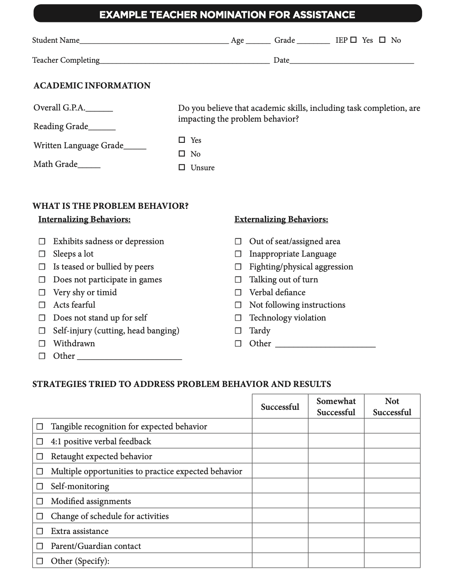
METHODS FOR IDENTIFICATION
Nomination
Data Decision Rules
Screening
Notes:
TRAINER NOTES: these slides are review! Consider an OTR (s): did you develop/revise your nomination form? And/or what is your comfort level with these data sources? Have you started thinking about decision rules? Etc.
The process for identifying students for Tier 2 supports typically
relies on existing data sources
provides information regarding function of behavior
Methods for identifying students include
nomination
teacher/staff
parent
self
data decision rules
extant data
NOTE: screening data is wonderful, but we don’t have time to cover in this training. If you are interested, there are more resources in the syllabus, you can talk to your trainers, and also there are districts in the state who do use universal screening with whom you could connect

Slide 18
DATA SOURCES FOR IDENTIFYING STUDENTS
Attendance | Behavior | Academics
Absences Tardies (to school/class) Visits to Nurse, Guidance, Office, Restroom | Office Discipline Referrals Classroom-Managed Behaviors Suspensions (in-school, out-of-school) Detentions | Course Grades GPA # Failures Academic Screener Scores Standardized Test Scores
Additional Data to Consider:
Teacher Referrals, Universal Behavior/SEL Screeners, Parent/Student Requests

Slide 19
Data Decision Rules
Must be contextually & culturally appropriate
What works in one school may not work in another!
Should be established to guide both entry to and exit from Tier 2 supports
Consider:
Current needs of students in the school
Available resources
Existing programs
Feasibility of starting new programs
Capacity to implement interventions

Slide 20
DECISION RULES EXAMPLE
Sample Decision Rules
Measure | Proficient Score | At-Risk | High Risk
1. Classroom Minors | 0-4 | 5 or more | 15 or more
2. Major/ODR | 0-1 | 2 – 5 | 6 or more
3. Absences | <5/trimester | 5+/trimester | 10/trimester
4. Tardy | <4/trimester | 4+/trimester | 10/trimester
5. ISS | 0-1 | 2 | 4 or more
6. OSS | 0 | 1 | 2
7. Course Grades | 2.5 or higher | D or F in any course | Ds or Fs in multiple courses
8. Reading Inventory | 800+ | 799 or lower | 599 or lower
9. Writing Assessment | 3 or 4 | 2 | NS; 1
10. Nurse (non-medication) | 0-1 (no pattern) | 2 – 5 (patterns of regular visits) | 6 or more (pattern of regular visits)
Notes:
Sample decision rules across academic and behavioral sources of data; needs to fit context

Slide 21
Which students might benefit from Targeted/Tier II support?
First Quarter of School Year
Name | Grade Level | Time out of Class (nurse, counselor visits) | Major Behavior Referrals/Minor Classroom Reports | Core Grades | Attendance
Jana | 2 | 0 | 4 minors | 1 D 1 F | 82%
Blake | 5 | Average 3 visits to nurse/week | 0 | 3F | 70%
Toby | 5 | 0 | 16 minors; 3 majors | 2D 1 F | 84%
Doug | 5 | Average 2 visits to counselor/week | 22 majors; 3 suspensions | 4 F | 62%
Yvonne | 2 | 0 | 2 minors | 2 D 1 F | 86%
Lin | 1 | Average 4 visits to nurse /week | 0 | 1 F | 90%
Maria | K | 0 | 16 minors; 1 suspensions | 4 D 1 F | 74%
Tyrone | 4 | 0 | 2 majors | 1 F | 81%
Paul | 3 | 0 | 5 minors | 2 D | 89%
Drake | 3 | 0 | 13 majors; 1 suspension | 2D 1 F | 87%
Carlos | 2 | 0 | 1 major | 1 D | 86%
Tia | 1 | 0 | 1 minor | 2 C | 60%
EXAMPLE

Slide 22
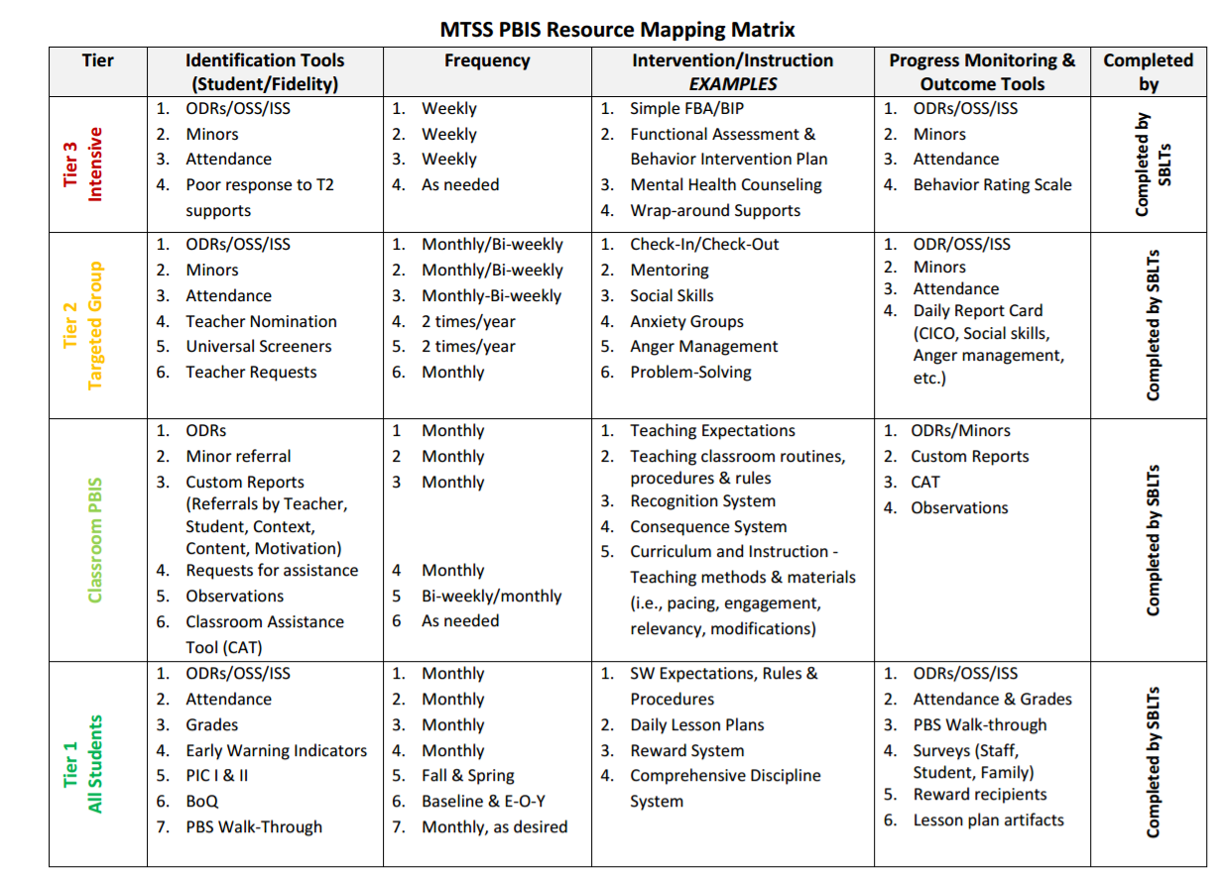
RESOURCE
MAPPING
EXAMPLE
Notes:
Example:
APPENDIX E

Slide 23
GUIDING QUESTIONS: DATA SOURCES
Systems
What data sources do we already use and review?
Do we need to add any additional sources?
What about for this year?
Are there data sources we’ve added this year that we should continue reviewing?
Who will be responsible for collecting and summarizing these data?
How often (once a month, once a quarter) will we review school-wide extant data?
Are there clear routines for timely response to requests for assistance?

Slide 24
MATCHING STUDENT NEED
Develop Processes to Match Practices with Needs

Slide 25
QUESTIONS TO ASK YOUR DATA: SMALL GROUPS

Slide 26
CRITICAL FEATURES: MATCHING PRACTICES TO STUDENT NEED
Match students to interventions based on specific needs (e.g., academic & behavioral skills, performance vs. skill deficits)
Match students to interventions using relevant data
Consider both intensity of student’s behavior & behavioral function
Multiple Tier 2 interventions (w/ documented evidence of effectiveness) in place to match student need
Consider cultural & contextual factors, adapt accordingly
Notes:
Matching students in need of additional supports with Tier 2 interventions should take into consideration student need and cultural and contextual fit. Leadership teams must consider their data sources, how often they will review, and decision rules for access or entry criteria.

Slide 27
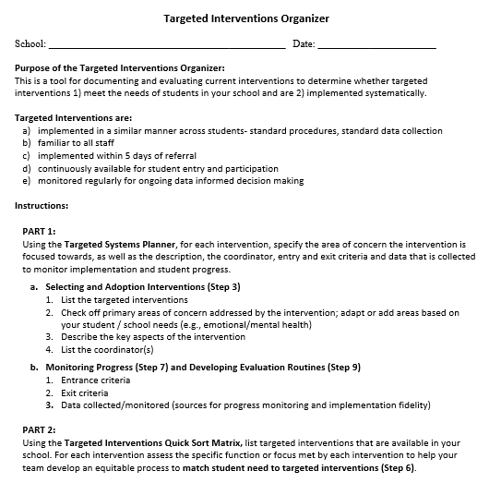
TARGETED INTERVENTIONS ORGANIZER
Systems
Purpose :
Document and evaluate current interventions
Determine whether targeted interventions
1) meet the needs of students, and
2) are implemented systematically
+ ENHANCED Communication
Notes:
The Targeted Interventions ORGANIZER gives teams some guidance to document and evaluate their current interventions.
During this process, we try to consider “fit” and “resources” in order to enhance, eliminate, or add interventions.
By establishing SYSTEMS, teams will be able to evaluate how meaningful and effective the interventions, if aspects need to be refined for them to work better, and what other interventions might be needed to address student needs.

Slide 28
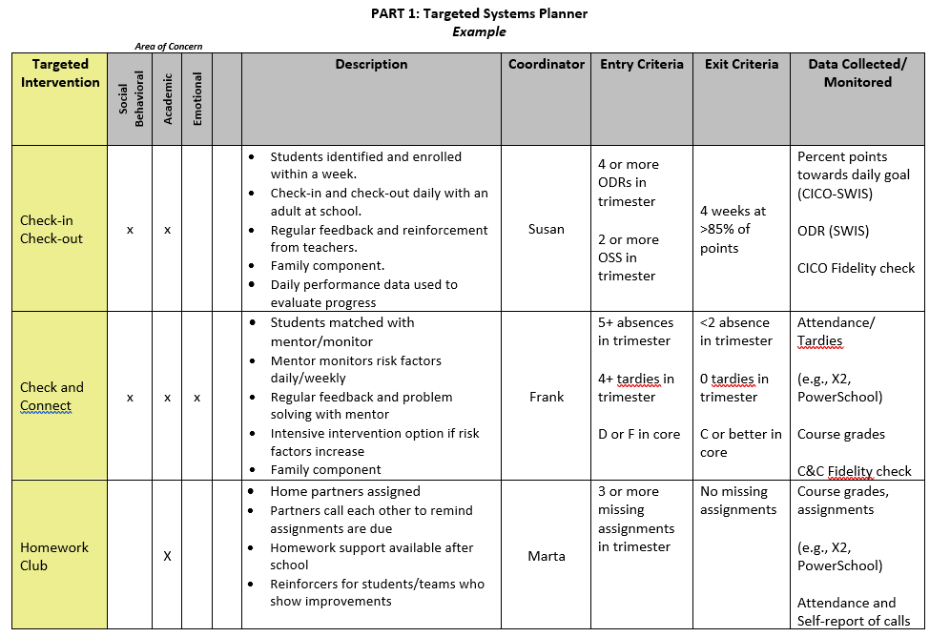
MEETING STUDENT NEEDS: PART 1
by Spring TFI
Notes:
Now we are ready for the TOOL
Part 1 is called the Targeted Systems Planner. This part provides teams with the chance to reflect on each intervention and how it may (or may not be) implemented systematically to provide meaningful outcomes.
On the left is the name of the intervention. Across the top some teams do a quick check off of whether they consider the intervention goals in area of concern (academic, social/behavioral, emotional or mental health focused).
This aligns well with Step 3 – select and adopt – first we need to see what we have and what global areas of concerns they address.
Then they describe the “essence” of the intervention – a few details and perhaps the purpose.
Teams might want to list the current year’s coordinator for each intervention to assist in planning and support for staff.
ADVANCED STEP: Sometimes teams expand the columns to show the frequency of the intervention (e.g., delivered daily, 1x per week, options of Monday or Wed). The name of the intervention, coordinator, and frequency of the intervention can also be something you put in a table at the end of the document if that seems easier.
The last three columns are areas you may not be quite ready for yet, but are critical for installing systems for data-based decisions.
Teams discuss what data will be considered to access or “enter” the intervention (e.g., ODRs, absences, missed assignments) and what data goal would indicate it’s time to “exit” or graduate from the intervention.
The last column reminds us of the data being collected to monitor implementation of the intervention (Fidelity) and student progress – what type of data, where can the team find the data that will be used to assess response to the intervention?
Reminders:
Don’t feel overwhelmed if your team doesn’t have each box filled in yet - that’s expected. Use this to identify those gaps and action plan as a team around a reasonable timeline to get aspects developed for ONE intervention.
Do that well and it will be easier to replicate for the next ones.

Slide 29
DISCUSSION
What are some of the challenges you anticipate regarding developing decision rules? How might you navigate those? What do you see as some advantages of developing these rules?
How might your team review student data to inform the practices you have in place?
Whole Group
5 minutes
Notes:
TRAINERS – Discussion prompts; allow 5 minutes.

Slide 30
GUIDING QUESTION: GROUPING COMMON NEEDS
Systems
Do identified students have similar instructional needs?
Skills to develop vs. Skills to practice/improve using (skill deficits) (performance deficits)
Do identified students have both academic and emotional/behavioral needs?
Are identified students’ academic needs similar?
Are the functions of behavior (assessed informally) similar across students?
Notes:
When we think about how students might be grouped for targeted interventions, remember that we are considering the similar manner in which the intervention is delivered across students because of their need – so staff gain efficiency in intervention design, standard procedures, and standard data collection and multiple students receiving a standard intervention. It does not necessarily mean the intervention is always received in a group format. That can sometimes be confusing to school teams.
So we ask as a guiding question when we consider the TYPES of targeted interventions if there are common needs.
Common needs = standard, quicker access interventions and more groups of students getting support
Do identified students have similar instructional needs?
Do identified students have both academic and emotional/behavioral needs?
Are identified students’ academic needs similar?
Are the functions of behavior (assessed informally) similar across students? (meaning can we make some informed assumptions about what the function is and deliver an intervention that meets the function?)

Slide 31
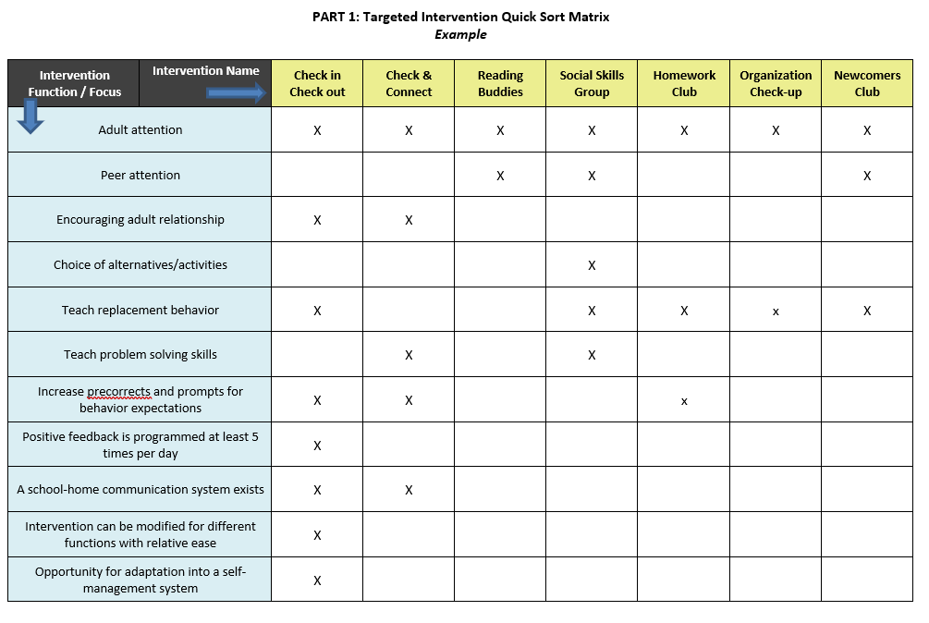
MEETING STUDENT NEEDS WITH TIER 2 PRACTICES
Notes:
From the TFI.. CICO should meet all of the 9 items.
It’s ok if your team doesn’t have it all defined for each intervention
You might not have more than 2-3 to begin with

Slide 32
ALIGNMENT EXAMPLE
Infraction | Failure to Comply | Inappropriate Language | Tardiness
Linked SW Expectation | Responsible | Respectful & Reflective | Responsible
What You Want The Student To Do | Cooperate with instructions & directions timely | Use appropriate words to express sentiment (e.g., considerate, polite, kind, professional, etc.) | Be in seat when bell rings
Social and Emotional Skill Options to Teach | Asking for help Active listening Paraphrasing understanding Managing frustration (e.g., positive self-statements, deep breaths) | Stop-think-act Managing disappointment Turning the conversation Making a complaint Reframing negative thoughts | Managing transition time Planning ahead Self monitoring Using conversation enders (e.g., “catch you later”)

Slide 33
CONTEXTUAL FIT: PERSONNEL & STUDENT MATCH
Identify staff skill sets
Match staff skills to student needs, given available resources
Based on screening data, determine how many students need each Tier 2 support
Evaluate any gaps between student needs & staff skill set
Determine how you will address the gap:
Train additional staff
Partner with neighboring schools to share staff and/or resources
Connect with community partners to assist with delivering or supporting interventions
Notes:
Rationale:
Personnel can “make or break” the likelihood of an intervention being successful (even if it was appropriately matched to the student).
Personnel are the stakeholders and should be considered when implementing the intervention with a student.
Trainer’s Notes:
Brainstorm with the larger group ways that they have been able to address the issue of personnel.

Slide 34
EXAMPLE: STAFF-STUDENT MATCH
Identification Process
Intervention
REP (Resilience Education Program)
How much time is needed for implementation?
45 minutes per week
How many times per week will it be implemented?
1 day per week
Who will teach/ implement the intervention?
School Psychologist
Notes:
Rationale:
Consider the stakeholder (personnel) on campus who may be the best fit to implement the intervention.
Trainer’s Notes:
Here are the questions you want to ask for each intervention to determine what you need to do for scheduling and identifying the appropriate personnel.

Slide 35
EXAMPLE: DATA REVIEW SUMMARY
Results/Conclusions: MTSS team had 25 students this quarter needing additional supports
Areas of Concern:
Prosocial Skills
Replacement behaviors for avoidance, withdrawal, etc.
Examples: Friendship Skills and Relationship Building
Problem-Solving Skills
Replacement behaviors for fighting, arguing, etc.
Examples: Anger Management Skills and Self Management
Academic Behavior Skills
Replacement behaviors for getting out of seat, poor study habits, talking out during instruction, etc.
Examples: Study/Organizational Skills & Self-Management Skills
(adapted from PBIS Illinois, 2014)
Notes:
Rationale:
Tier 2 interventions are supplemental supports that are provided to groups of students. Based upon data, not all students will need or successfully respond to the same intervention.
Trainer’s Notes:
This school identified three groups of student need: (1) Pro-social skills, (2) Problem-solving skills, AND (3) Academic Behavior skills.

Slide 36
CONTEXTUAL FIT
School has 25 students needing Tier 2 supports (~11% of the student population)
Areas in which students need supports:
Problem-Solving Skills: anger management
Academic Behavior Skills: organization
Prosocial Skills: coping with anxiety & depression
Supports currently available:
Weekly Social Skills Group: school counselor supporting 6 students (maximum)
CICO: 1 adult supporting 5 students
Mentor Program: started, not consistently coordinated
Nothing for students with anxiety concerns

Slide 37
WHAT IF TIER 2 SUPPORTS CANNOT ACCOMMODATE ALL STUDENTS’ NEEDS?
Social Skills
Administrator identifies teacher to run second group
Teacher given extra planning period once per week to teach group
Check-In, Check-Out (CICO)
Administrator identifies additional staff to monitor CICO
Music teacher, custodian, & all administrators
Mentoring Program
School counselor contacts community agency to restart mentoring program
Staff responsible for community involvement access agencies interested in program
Notes:
Rationale:
Once students are identified, grouped, and interventions selected, the timing of delivering those interventions (a.k.a., scheduling) needs to be carefully considered.
Trainer’s Notes:
This is an example school.

Slide 38
GUIDELINES: MATCHING STUDENTS WITH TIER 2 SUPPORTS
Data
Data reviewed includes information across multiple domains (e.g., behavior, academic, social)
Data organization allows for efficient matching of students to Tier 2 supports with minimal discussion
Data collected aligns with intervention decisions & student match
Data reviewed includes information about function of behavior & skill/ performance deficits
Contextual & cultural fit considered when matching students with support
Tier 2 supports organized from least to most intensive
Tier 2 supports organized to consider function of behavior/ academic need (i.e., accuracy vs. fluency)

Slide 39
Preview Activity: Matching Student Need to Practices
Pull up your Targeted Intervention Organizer
LIST TIER 2 Interventions on the ‘quick sort matrix’ that your school uses, and try to “match” to type of practice.
Summarize student data and match to Tier 2 interventions.
How will you will evaluate whether your existing interventions meet student needs, and if there’s need to add new practices.
Update your Action Plan.
10 minutes
Notes:
Following this meeting, or in the upcoming TEAM meeting, summarize student data and match to Tier 2 interventions (e.g., we have 5 students needing XXX type of intervention).

Slide 40
Progress Monitoring
Data
(Preview)
Intro to progress monitoring, data-based decisions

Slide 41
Progress Monitoring
Data
Developing measures/tools to monitor student progress

Slide 42
PROGRESS MONITORING
Data
Progress Monitoring (PM) is the process of systematically planning, collecting, & evaluating data to inform programming decisions
Provides basis for determining whether an intervention is effective for a given student
Assists with developing effective intervention plans and making more informed instructional decisions
National Center on Intensive Intervention
PM Evaluation Questions:
How do we know if the student is responding to the intervention and making progress towards the goal?
How do we know if the intervention is effective for most of the students receiving the intervention?
How will we know if the intervention being implemented with fidelity?

Slide 43
PROGRESS MONITORING TOOLS & ROUTINES: CRITICAL FEATURES
Progress Monitoring Tools
Progress Monitoring Routines
Can be administered efficiently & repeatedly
Allow for sharing with staff
Brief, reliable, & valid measures of specific skills
Sensitive to change
Allow for comparison of performance across time within & across students
Consistent with Tier 1 systems
Allow for regular review of student progress

Slide 44
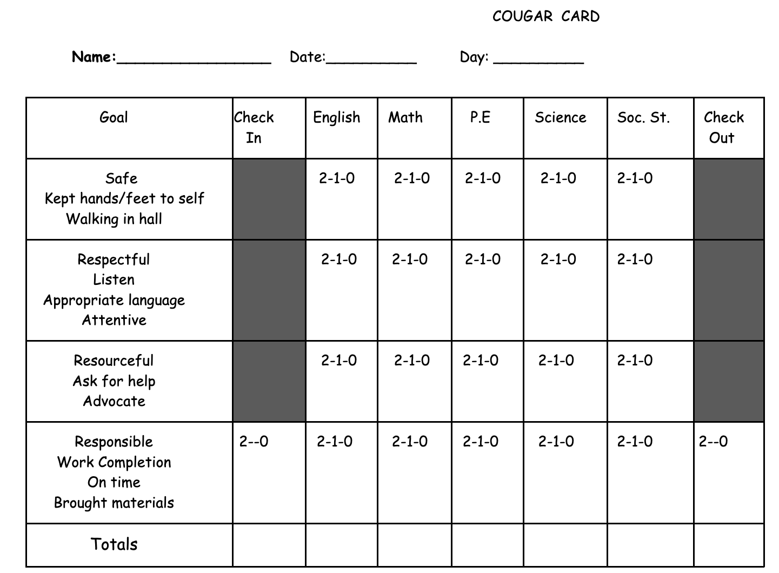
Progress Monitoring Tools: Examples
CICO Daily Progress Report
Targeted Social Skills: Daily or Weekly Progress Report (see examples)
Self-Management: Student Self-Ratings
Check and Connect: Student Monitoring Sheet
Direct Behavior Ratings (DBRs) (can use for a # of interventions)

Slide 45
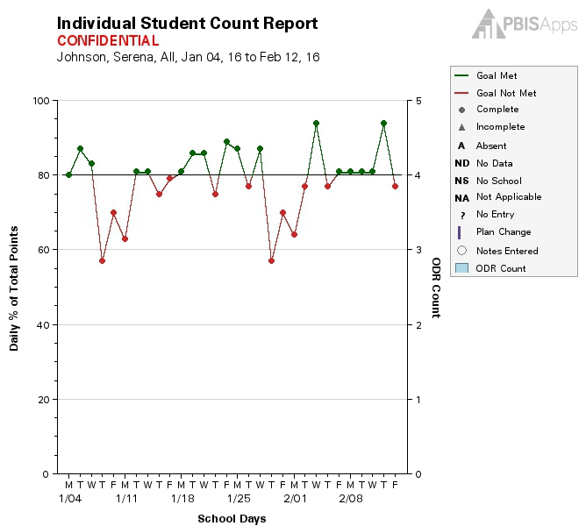
EXAMPLE: CICO SWIS MONITORING INDIVIDUAL STUDENT PROGRESS

Slide 46
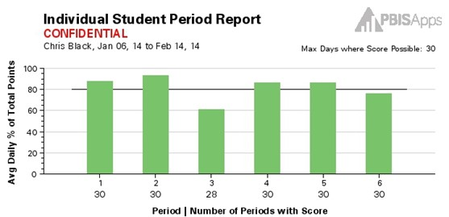
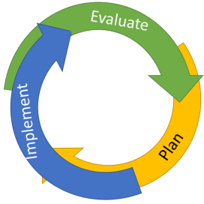
EXAMPLE: CICO SWIS INDIVIDUAL STUDENT PERIOD REPORT
The Student Period Report helps evaluate:
What does one student’s average day look like?

Slide 47
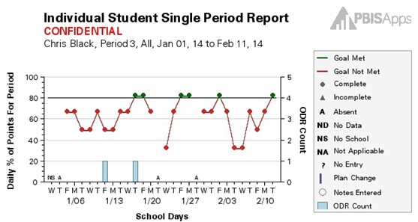
EXAMPLE: CICO SWIS INDIVIDUAL STUDENT SINGLE PERIOD REPORT
The Student Period Report helps evaluate:
What is one student’s pattern over time in a single period?

Slide 48
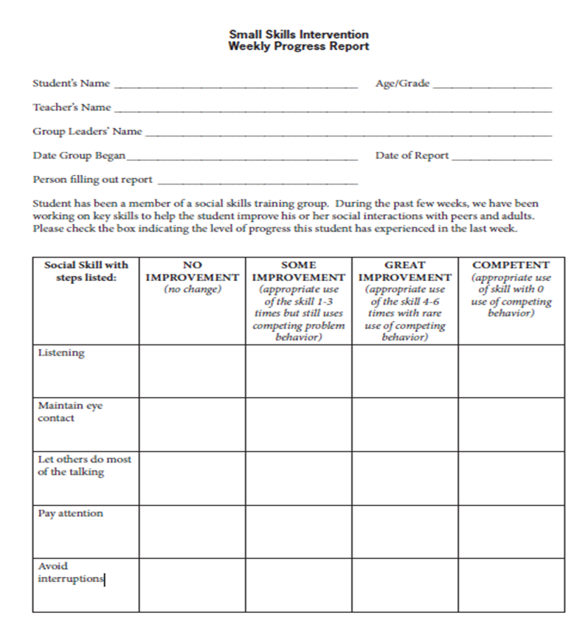
EXAMPLE: WEEKLY PROGRESS REPORT FOR SOCIAL SKILLS
Missouri PBIS

Slide 49
EXAMPLE: DBR PROGRESS REPORT
Notes:
Templates of forms available at https://dbr.education.uconn.edu/library/information-for-parents-and-professionals/
System to track progress? – would need an excel tracking form or could look at I-SWIS

Slide 50
Intro DISCUSSION: Progress Monitoring Tools
1. Do you have any tools in place to monitor student progress for your T2 interventions? Are there tools you need to add/develop?
2. How will you guide your team in planning for who will collect and summarize that data?
3. How might your team use that data for decision making?
2 minutes
5 minutes
Independent Jot
Whole Group

Slide 51
COLLECTING BASELINE DATA
Represents a student’s current level of functioning
Is the measuring stick by which intervention data are compared to determine the extent to which a change in behavior occurred
Aids in goal setting
Baseline data:
Notes:
What’s different about data at tier 2? Ask about how this differs w/regard to academic systems…at specific school
Highlight 2nd 2; data collection and review is more intense at t2

Slide 52
Response to Intervention:
OUTLINE A PROCESS to examine RTI
• Positive response
• Questionable response
• Poor response

Slide 53
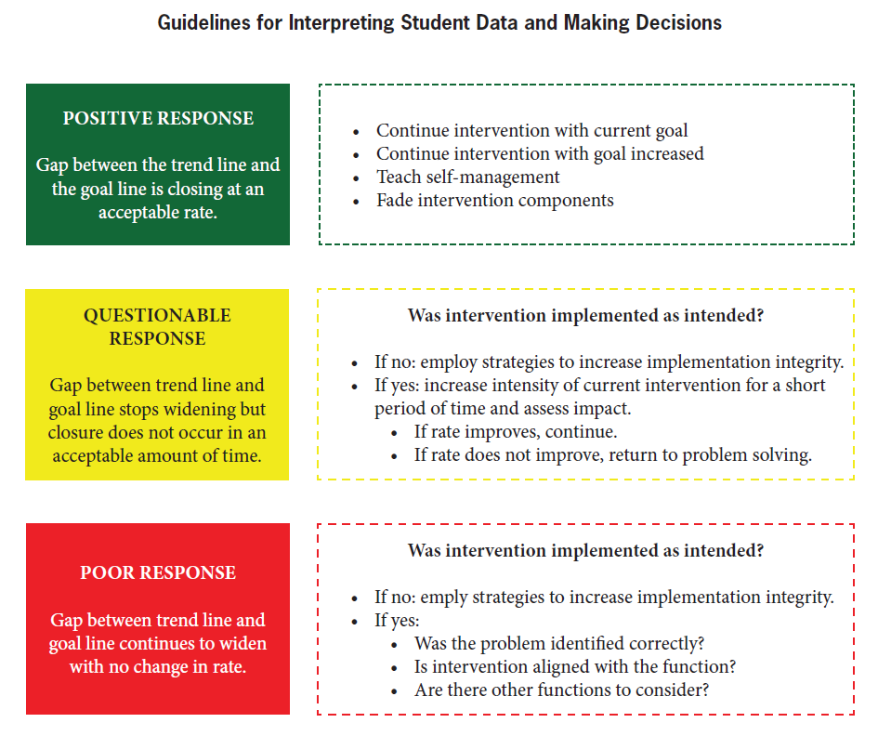
Source: MO PBIS

Slide 55
Were data collected?
YES
NO
Problem solve data collection—determine how to get data
Collect data for 2 weeks and reconvene
Are goals being met?
YES
NO
Celebrate and continue
Have plan for fading
Is plan being implemented as designed?
YES
NO
Modify intervention
Intensify
Problem solve barriers to implementation
Collect data and reconvene

Slide 56
Data Decision Rules—Considerations
• Length of intervention before reviewing data
- e.g., At least X weeks
• Minimum number of data points to collect before reviewing data
- e.g., At least X number of data points
• Decision rules…
– Positive response to intervention
– Questionable response to intervention
– Poor response to intervention
– When to fade an intervention
e.g., 4 of 5 data points above 80% per week, for 4 or more consecutive weeks

Slide 57
DISCUSSION: Using Progress Monitoring Tools for Decision Making
1.
1. How might you use your baseline data to set individual student goals?
2. How might you use PM data to make intervention decisions? What support do you need to develop decision rules?
3. How can this data help you make decisions school-wide?
3 minutes
10 minutes
Independent Jot
Whole Group

Slide 58
AGENDA & FOLLOW-UP
Training Overview
Develop a process for matching student need to practices
Coaching Tasks
Targeted Intervention Organizer – Part 1 complete and review your “decision rules” or guidelines for matching student need to practices
Preview Part 2 of the Targeted Intervention Organizer
Preview progress monitoring
Prepare for April team training (TIO Part 2)
Complete this doc for to schedule your TFI spring assessment
What questions do you have on today’s content?
What questions do you have on the follow-up team tasks?

Slide 59
Look ahead to April Team training day…
1
Establish a representative T2 leadership team
6
Develop an equitable process for matching student need to practices
2
Develop a collaborative process for identifying students
Develop a process for progress monitoring, data-based decision rules
7
3
Evaluate, select and adopt culturally appropriate tier 2 practices
Develop procedures for modifying/ adjusting implementation
8
4
Develop a process to install selected practices
Develop evaluation routines for fidelity and outcome data
9
5
Develop procedures to train staff and students; partner with families and community
Document and share routines, practices, and policies
10
Notes:
COACHES:
Seeing all of these steps can be uncomfortable or overwhelming – the goal is to walk away with an understanding of the elements and strategies to prioritize time and resources to get the steps achieved over a period of time.
TEAM MEMBERS
How will you participation in aspects of these steps support the process?

Slide 60
Coaches’ Reminders
Coaches’ Tasks February:
Working docs for review in your PBIS Academy Tier 2 folder shared with us ☺
Agenda
Develop a process for staff, student (and family) training
Critical features self-check for installing your T2 practices
Identify barriers/concerns
Navigating resources
Use a self-checklist or action plan to install primary T2 practices
Notes:
IF YOU HAVE NOT PARTICIPATED IN TA yet, please make a point to schedule this 1:1.
Reminder:
Fall, Winter (Dec, Jan, Feb), and Spring TA (in addition to team TFI if time allows)
Special note: if schools want to complete the BL TFI that did not in Nov, we can re-open those surveys
March: Targeted Intervention Organizer, Part 2 preview
End of April/May will be TFI assessments with trainers
If you need to access these materials through google, find the link at https://sebacademy.edc.org/tier-2-year-1-february-coach-meeting
CICO Rollout Checklist (comprehensive checklist for installing CICO)
CICO Self-Assessment (simpler checklist with space for the team to action plan)
T2 Intervention Checklist (assessing T2 features across multiple interventions)

Slide 61
EVALUATION
CONTACT INFORMATION:
Marcie Handler
mwhandler@gmail.com
Katie Meyer
Katherine.meyer@uconn.edu
Please remember to complete the evaluation to receive your Certificate of Attendance!
Notes:
Evaluation Link
https://edc.co1.qualtrics.com/jfe/form/SV_cBF9GI7gVEBsfSC

Slide 62
Additional CICO Resources
Check In Check Out tracking forms from RESA.net (all located under Tier-2):
Daily Check In Check Out Data Summary.xls (Excel doc)
Weekly Check In Check Out Data Summary.xls (Excel doc)
Example of Weekly CICO Data Summary filled out.xls
Check In Check Out Point Sheet.doc

