Slide 1
Welcome to
Tier 2 TEAM TRAINING!
GETTING STARTED:
Complete the ATTENDANCE
DURING / WHILE YOU WAIT:
Complete the TEAM SHARE
AT THE END:
Complete the EVALUATION
BE PREPARED:
Find training resources at : SEB PBIS Tier 2 Academy
(January team training)
Google docs at
Open or establish a Tier 2 shared folder
Open your team ongoing ACTION PLAN
~15%
Notes:
LINKS for today:
Attendance
https://edc.co1.qualtrics.com/jfe/form/SV_5BiXqi4bxzOCMS2
New team member communications survey - https://edc.co1.qualtrics.com/jfe/form/SV_db8zhNj6NJ3eXga
EDC Website for SEB Academy
https://sebacademy.edc.org/
Event Evaluation (at the end)
https://edc.co1.qualtrics.com/jfe/form/SV_cBF9GI7gVEBsfSC

Slide 2


PBIS Tier 2 Team Training
Year 1
January 2023
Marcie Handler & Katie Meyer
with support from NEPBIS Network, May Institute & Broad Reach Consulting

Slide 3

ACKNOWLEDGEMENTS
02
03
04
Northeast PBIS Network (nepbis.org)
01
Michigan Integrated Behavior & Learning Support Initiative
Dr. Heather George & FLPBIS
Missouri PBIS
Drs. Leanne Hawken, Deanne Crone, & Rob Horner
05
06
Midwest PBIS Network

Slide 4

EXPECTATIONS
Self
Others
Environment
Self-monitor
Mute when listening, unmute to talk​
Have electronics ready to use
Obtain help from peers and trainers
Work as a team:
Keep necessary materials at hand
Are you participating?
Engaged as a learner?
Stretch, break, stand as needed​
Room for every voice
Reinforce participation
action plan
relevant docs
water/snacks
Minimize distractions if possible​
Complete tasks efficiently
Notes:
Taking CARE of…

Slide 5









LEGEND
Timing
Example
Activity
Non-example
Guidelines
Preview
Big Idea
Review
Organization

Slide 6
Coaches’ (and TEAM) Reminders
Coaches’ Tasks (Sept-Dec):
Shared your PBIS Academy Tier 2 folder with us ☺
Questions?
TEAMING: Team Profiles and meeting schedules
SCREENING: RFA and DATA DECISION RULES:
TARGETED INTERVENTION ORGANIZER (Part 1)
Zoom link or email for Jan or Feb team meeting date
Notes:
IF YOU HAVE NOT PARTICIPATED IN TA yet, please make a point to schedule this for January.
Reminder:
Fall, Winter (Dec, Jan, Feb), and Spring TA (in addition to team TFI if time allows)
Special note: if schools want to complete the BL TFI that did not in Nov, we can re-open those surveys

Slide 7
Overview for today’s training
We are:
Reviewing as a team what critical features for T2 development we need to continue to work on
Adjusting / adding timelines to meet those goals
Sharing successes and concerns / barriers to developing or implementing
Enhancing existing T2 interventions
Notes:
Setting some expectations for today to align with our agenda:

Slide 8
GETTING STARTED WITH Tier 2
Develop an equitable process for matching student need to practices
1
Establish a representative T2 leadership team
6
2
Develop a collaborative process for identifying students
Develop a process for progress monitoring, data-based decision rules
7
3
Evaluate, select and adopt culturally appropriate tier 2 practices
Develop procedures for modifying/ adjusting implementation
8
4
Develop a process to install selected practices
Develop evaluation routines for fidelity and outcome data
9
5
Develop procedures to train staff and students; partner with families and community
Document and share routines, practices, and policies
10
Notes:
COACHES:
Seeing all of these steps can be uncomfortable or overwhelming – the goal is to walk away with an understanding of the elements and need to prioritize time and resources to get the steps achieved over a period of time.

Slide 9
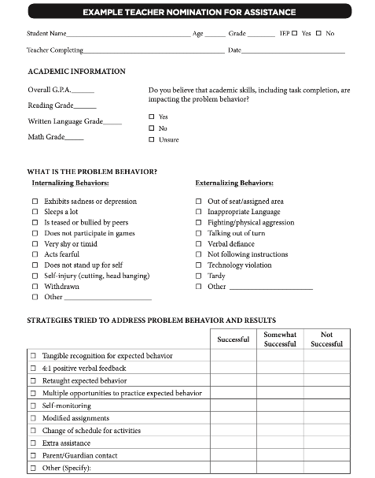
Methods for Identification
What did you decide to focus on first?
Nomination
Data Decision Rules
Screening
Do we have something simple?
What are some of our data sources?
Is the school using a universal screener?

Slide 10
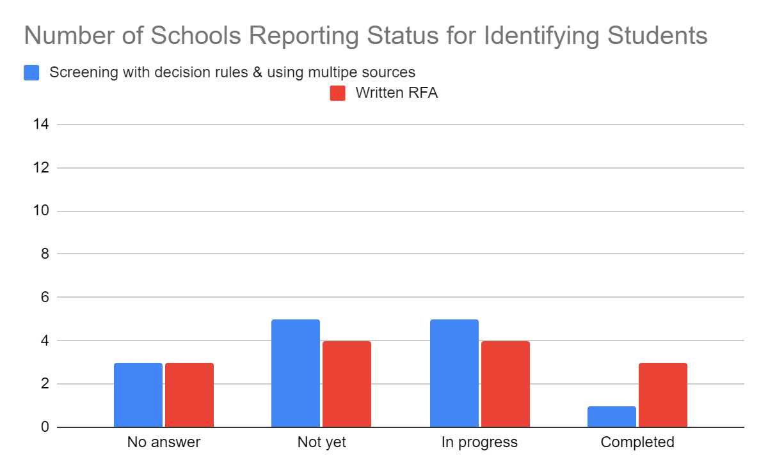
Where were most teams?
Screening: Tier 2 team uses decision rules and multiple sources of data (e.g., ODRs, academic progress, screening tools, attendance, teacher/family/student nomination process) to identify students who require Tier 2 supports.
Request for Assistance: Tier 2 planning team uses written request for assistance form and process that are timely and available to all staff, families, and students.

Slide 11
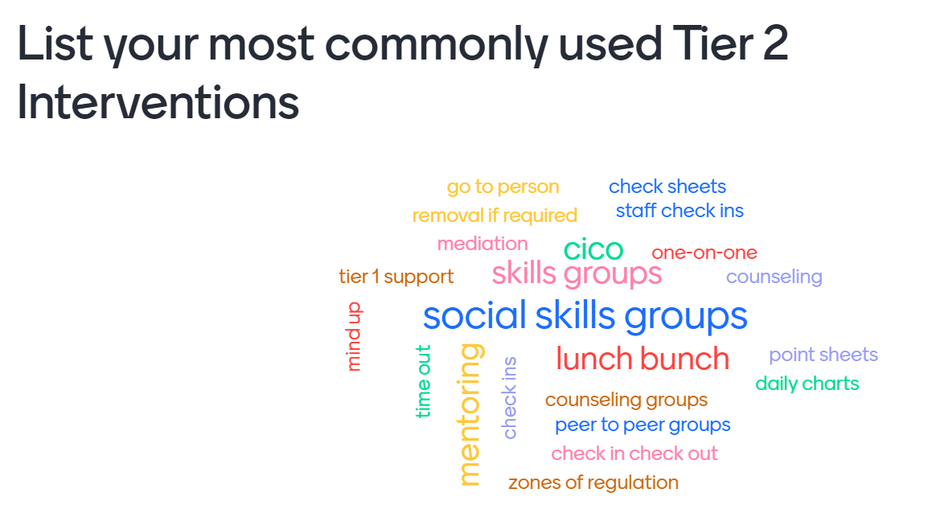

Slide 12
TEAM SHARE: Where are you now?
Celebrate (GLOW) & working on (GROW) related to:
Step 1: Are your team meetings and routines established?
Step 2. Developing a collaborative process for identifying students
Did you develop a request for assistance (RFA) form?
Did you establish decision rules based on existing data?
Did you address “gaps” in the data to more efficiently identify students?
Step 3. Evaluating and selecting Tier 2 interventions
Have you completed your inventory (part 1)?
Which interventions need adjustments?
Discuss with your team and add to TEAM SHARE
10 minutes

Slide 13

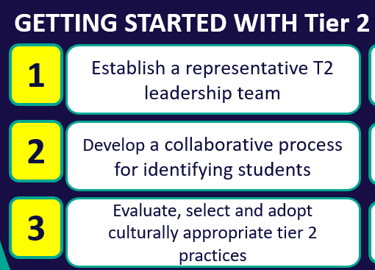
ACTION PLANNING for TEAM TIME
Evaluating and Selecting
Screening
Teaming
Regular meeting schedule
Request for Assistance (RFA)
Decision Rules (table)
Targeted Intervention Organizer (part 1)
Description of our targeted interventions
Add items to your team action plan
3 minutes
Notes:
BUILDING TEAM ROUTINES:
As a team, take 2-5 minutes to briefly discuss what the team has completed or need to continue working on this afternoon

Slide 14
Agenda & Team Tasks
Training Overview
Step 3: Selecting Targeted Interventions – Explore intervention resources
Step 5: Develop procedures to train staff and students; partner with families
Team Tasks
Identify Intervention Coordinator(s)
Draft orientation materials for students and communication with families
Draft Staff Training
Draft Daily Progress Report / monitoring form
Step 4: Develop a Process to Install T2 Practices - e.g., Check-In, Check-Out (CICO)
Notes:
We will be using CICO as an exemplar but coaches should consider throughout the training how to apply the process/systems to develop other Tier 2 interventions.

Slide 15
GETTING STARTED WITH Tier 2
Develop an equitable process for matching student need to practices
1
Establish a representative T2 leadership team
6
2
Develop a collaborative process for identifying students
Develop a process for progress monitoring, data-based decision rules
7
3
Evaluate, select and adopt culturally appropriate tier 2 practices
Develop procedures for modifying/ adjusting implementation
8
4
Develop a process to install selected practices
Develop evaluation routines for fidelity and outcome data
9
5
Develop procedures to train staff and students; partner with families and community
Document and share routines, practices, and policies
10
Notes:
COACHES:
Seeing all of these steps can be uncomfortable or overwhelming – the goal is to walk away with an understanding of the elements and strategies to prioritize time and resources to get the steps achieved over a period of time.
TEAM MEMBERS
How will you participation in aspects of these steps support the process?

Slide 16
Common Tier 2 Interventions
Social / Emotional skills (e.g., self-regulation)
Coping skills (anxiety, depression)
Academic / organizational skills
CBT
Check In/ Mentoring
Skills Groups
Counseling Groups
Classroom Interventions
Check in (with an adult)
Check in Check Out (CICO-BEP)
Check and Connect (Mentoring + Monitoring)
Enhance social skills instruction in the classroom (CW-FIT)
SEB curriculums, lessons on classroom ‘survival’ skills)
Therapeutic focus
Topic specific (e.g., grief, trauma, gender identity)
Diversion programs
Notes:
CW-FIT:
The CW-FIT program is a multilevel group contingency intervention that broadly addresses common functions of problem behavior. The CW-FIT is considered a classroom-level primary intervention because it is used with all students in a class. For students not responding to the primary-level intervention-group contingency, secondary-level or targeted interventions of self-management and help-card procedures are implemented. Students that do not respond to either primary or secondary intervention are candidates for a functional behavior assessment (tertiary level).
https://www.youtube.com/watch?v=PR_D291by4E
https://charts.intensiveintervention.org/intervention/toolSGL/3539f6442db882bf
https://www.ncbi.nlm.nih.gov/pmc/articles/PMC4532396/

Slide 17

Empirically-Supported Tier 2 Interventions
1. Check-in Check-out (CICO)
2. Check and Connect (Mentoring with Monitoring and goal setting)
3. SAIG – Social Academic Instructional Groups (“skills”) groups
  Classroom skills
  Organizational skills
  Social / Emotional skills
4. Mentoring
5. Class-wide Function-Based Intervention (CW-FIT)
6. REP – Resilience Education Program (CBT+CICO)
7. Freshman Success (HS)
EXAMPLES
Notes:
These are Tier 2 practices that schools often implement and we are using these as examples to help demonstrate the various system, data, and practices features.
What do these interventions have in common? What are some critical features?
https://checkandconnect.umn.edu/
Overview video - https://www.youtube.com/watch?v=3_-AFbDLn9c
https://smhcollaborative.org/rep/
Milwaukee PBIS Social Academic Intervention Groups (SAIG) – go to the website for a list of lessons

Slide 18
DISCUSSION: EXPLORE INTERVENTIONS
We will be providing instruction on CICO.
Determine if you want time this afternoon DURING INDIVIDUAL TEAM TIME to explore one or more of these interventions.
Team
2 minutes

Slide 19
Develop a Process to Install Selected Practices
Practices
Exemplar: CICO

Slide 20
Installing Tier 2 Practices
CRITICAL FEATURES
Formal process for teaching students skills /expected behaviors
Increased structure and predictability for students
Regular opportunities for students to perform and get feedback on appropriate behaviors and skills
Establish the Tier 2 strategy within the school so that it does not need unique development for each participating student
Notes:
Trainer notes: will use CICO as an example to illustrate all of these features!
But… consider it for other interventions you are enhancing/establishing as well

Slide 21
Installing Tier 2 Practices
CRITICAL FEATURES
Documentation describing the process and procedures including all supporting materials (e.g., consents, progress forms)
Staff and families are informed about the practice details and provided feedback on progress
Orientation materials provide information for all responsible staff who have students using the practice (e.g., teacher, substitutes, related services, lunch monitors)
Fidelity of implementation measure is established and used
Notes:
Trainer notes: will use CICO as an example to illustrate all of these features!
But… consider it for other interventions you are enhancing/establishing as well

Slide 22
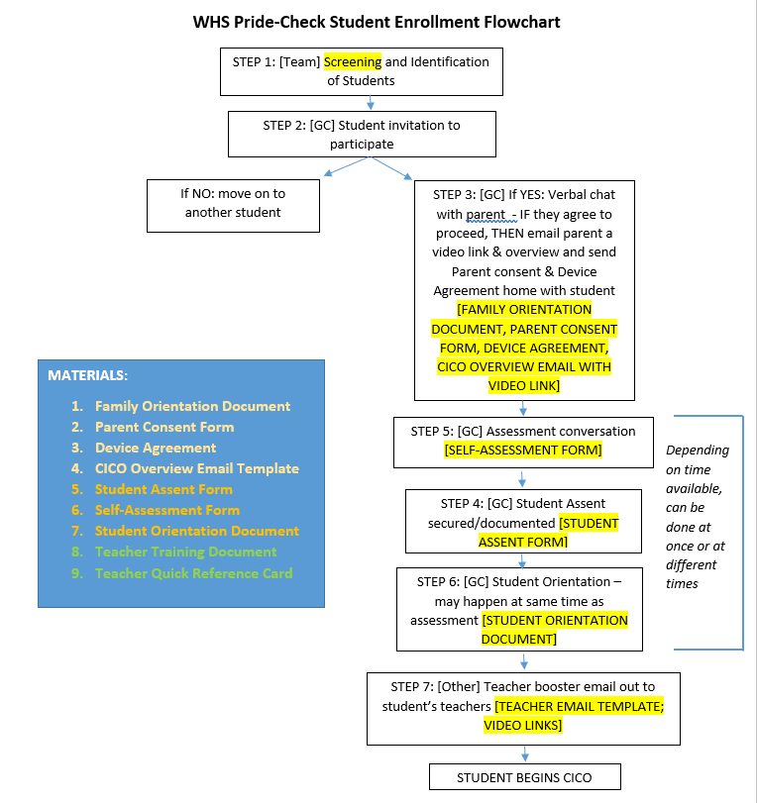
Sample Process for CICO

Slide 23
Exemplar:
Developing Interventions
CICO Critical Features

Slide 24
Check-In, Check-Out
Does your school currently implement CICO?
A. Nope, nothing like this.
B. We call it CICO but it’s not this structured.
C. We do something like this but only with a few kids.
D. Yes, and we implement it with fidelity.
Designed for students whose problem behaviors
are unresponsive to Tier I,
do not require individualized interventions, and
are observed across multiple settings or contexts.
CICO Practice Features:
  Increased positive adult contact and structure
  Embedded social skills training
  Direct link to school-wide behavioral goals and expectations
  Frequent feedback
  Daily home-school communication
  Positive reinforcement contingent on meeting behavioral goals
  Can be slightly modified based on student need or response

Slide 25
CICO Additional Features
Efficient and Effective
Group-based, Standardized intervention
Built-in Data System for...
monitoring students’ progress in the program
Can accommodate 7-12% student population
Student entry within a few days of referral
evaluating the fidelity of implementation, and
transitioning to a self-managed program.
Notes:
OTR: what is 7-12% #s in your school?

Slide 26
Why should 7-12% of students receive CICO supports?
If CICO is implemented with 7-12% of the students in your building,
how many students would you be supporting?
Students in the past who would not have gotten any support “until things got worse” will now get a positive boost of support
All teachers will expect that every day they will have students cross their threshold who need higher rates of positive contact
Re-allocation of resources to support students who need Tier III
Notes:
Research on CICO SWIS—median (?check) # of students supported is only 3!
Preview matching to student need
Within the 5-15%, 7-12% of students will benefit and research indicates will need an additional low lever Tier II support. If your numbers for CICO are low (5-6% or less), CICO will struggle to take hold and take off because not enough staff will be exposed to the intervention. All staff should know about and probably have a student who is identified to need the support of CICO. CICO is an extension of Tier I so quick and easy to deliver and gives students a boost of support from an adult.

Slide 27
CICO Works!
Research conducted on CICO and similar programs has consistently demonstrated associated decreases in…
Problem Behaviors
Office Discipline Referrals
Referrals for Special Education Services
Increases in Academic Engagement
Most importantly, research also has demonstrated that this intervention is most effective if Tier 1, SWPBIS systems and practices are well-established.
Notes:
Filter, K. J., McKenna, M. K., Benedict, E. A., Horner, R. H., Todd, A. W., & Watson, J. (2007). Checkin/check out: A post-hoc evaluation of an efficient, secondary-level targeted intervention for reducing problem behaviors in schools. Education and Treatment of Children, 30(1), 69-84.
Campbell, A., & Anderson, C. M. (2011). CHECK‐IN/CHECK‐OUT: A SYSTEMATIC EVALUATION AND COMPONENT ANALYSIS. Journal of applied behavior analysis, 44(2), 315-326.
Simonsen, B., Myers, D., & Briere, D. E. (2011). Comparing a behavioral check-in/check-out (CICO) intervention to standard practice in an urban middle school setting using an experimental group design. Journal of Positive Behavior Interventions, 13(1), 31-48.
Drevon, D. D., Hixson, M. D., Wyse, R. D., & Rigney, A. M. (2019). A meta-analytic review of the evidence for check-in checkout. Psychology in the Schools, 56, 393-412. https://doi.org/10.1002/pits.22195

Slide 28
RESEARCH SUPPORT
Pre-Schools
Chafouleas et al. 2007
Elementary Schools
Middle Schools
Meta-Analysis
Todd et al. ,2008
Fairbanks et al., 2007
Kauffman-Campbell, dissertation
Cheney et al., 2006; 2007
Hawken et al., 2007
Filter et al., 2007
Miller et al., 2015
Mong, Johnson, & Mong, 2011
Hawken et al., 2003
March et al., 2002
Simonsen, Myers, & Briere, 2011
Swoszowski et al., 2012
High Schools
Swain-Bradway, 2009
Drevon et al., 2019
CICO is an Evidence-Based Practice
At least 5 peer reviewed studies
At least 3 different researchers/settings
At least 20 different participants
(see national center on intensive interventions; intensiveintervention.org)
Notes:
CICO is an Evidence-Based Practice
At least 5 peer reviewed studies
At least 3 different researchers/settings
At least 20 different participants
(see national center on intensive interventions; intensiveintervention.org)

Slide 29
RESEARCH SUPPORT
Pre-Schools
Chafouleas et al. 2007
Elementary Schools
Middle Schools
Meta-Analysis
Todd et al. ,2008
Fairbanks et al., 2007
Kauffman-Campbell, dissertation
Cheney et al., 2006; 2007
Hawken et al., 2007
Filter et al., 2007
Miller et al., 2015
Mong, Johnson, & Mong, 2011
Hawken et al., 2003
March et al., 2002
Simonsen, Myers, & Briere, 2011
Swoszowski et al., 2012
High Schools
Swain-Bradway, 2009
Drevon et al., 2019

Slide 30
CICO Example
CLICK HERE for video
Notes:
Link to video: https://www.youtube.com/watch?v=vP7GJ72UxsA
Link to Google Drive for all CICO Materials linked to this video: https://drive.google.com/folderview?i...

Slide 31
CICO: Referral & Procedure
Request for Assistance
Office Discipline Referral
Parent recommendation
Administrator recommendation
Student Recommended for CICO
Buy-in meeting (coordinator, parent, student)
CICO is implemented
Notes:
Trainer Notes: Following the video, you can go through these slides quickly!
Student recommended for CICO by Teacher, parent, other school personnel?
Prior to CICO implementation- meeting with Counselor, parent and student
Go over expectations for each party (parent, school, and student)
Set goal
Sometimes contract is signed (I don’t know if you this was ever used Kelly)
3) CICO Implemented
4) Morning check-in
What did you check for? Pencil, binder, agenda, CICO form from day before
Gave students supplies if they did not have them to help them be successful
CICO Daily progress report given (can flip to next slide to show)
Teacher Feedback
Student carries card to teachers
Teachers have been trained to provide some sort of positive interaction upon receiving the card
-Teachers have also been trained not to use the system as punishment- no nagging
Afternoon check-out
CICO coordinator checks for goal
Reinforcement for checking out (High 5)
Bigger reinforcement for checking out and meeting goal (snack)
Parent Feedback
Send home- student gets feedback from parent
Student brings back form signed the next day
CICO Coordinator Summarizes Data for Decision Making
Using Quattro pro Spread sheet program- graphs data
Weekly CICO Meeting
½ hour to assess progress
who attends meeting
decisions made in meeting

Slide 32
CICO:
Referral & Procedure
How will you ensure parents receive and understand the DPR and provide constructive feedback?
Morning Check-In
Regular Teacher Feedback
Afternoon Check-Out
Parent Feedback
Afternoon Check Out
1. Student comes to coordinator
2. Coordinator reviews DPR
  Provides feedback/acknowledgments
  Prepares to send the DPR home
  Records points for the day
Morning Check In
1. Student comes to coordinator
2. Coordinator
  Reviews DPR
  Gives point card
  Reviews expectations
  Sets positive tone
  Provides missing materials if needed
Teacher Feedback
1. Set schedule for feedback
2. Student gives DPR to teacher at the start of class
3. At the end of class,
  Teacher provides points on behavioral expectations
  Provides verbal, positive feedback
Parent Feedback
  1. DPR goes home
  2. Parents provide positive/neutral feedback
  3. Parents sign report and send back to school
What questions do you have about the CICO process?
Notes:
Student recommended for CICO by Teacher, parent, other school personnel?
Prior to CICO implementation- meeting with Counselor, parent and student
Go over expectations for each party (parent, school, and student)
Set goal
Sometimes contract is signed (I don’t know if you this was ever used Kelly)
3) CICO Implemented
4) Morning check-in
What did you check for? Pencil, binder, agenda, CICO form from day before
Gave students supplies if they did not have them to help them be successful
CICO Daily progress report given (can flip to next slide to show)
Teacher Feedback
Student carries card to teachers
Teachers have been trained to provide some sort of positive interaction upon receiving the card
-Teachers have also been trained not to use the system as punishment- no nagging
Afternoon check-out
CICO coordinator checks for goal
Reinforcement for checking out (High 5)
Bigger reinforcement for checking out and meeting goal (snack)
Parent Feedback
Send home- student gets feedback from parent
Student brings back form signed the next day
CICO Coordinator Summarizes Data for Decision Making
Using Quattro pro Spread sheet program- graphs data
Weekly CICO Meeting
½ hour to assess progress
who attends meeting
decisions made in meeting

Slide 33
CICO:
Review of Procedure
CICO Coordinator
summarizes data
for decision making
Bi-weekly coordination
meeting to assess student
progress
Exit Program
Revise Program
Long Term Features:
Weekly or bi-weekly principal recognition
Data shared with all staff at least quarterly
Quarterly graph sent to parents
Notes:
Question: now that we have reviewed critical features, do you have any questions? Would you rate your implementation the same as above?
Yes we implement CICO with all the features reviewed (2), Yes, but with most of the features reviewed, (3) yes, with a few of the features, and 4 No we do not implement CICO at this time.
https://www.youtube.com/watch?v=GMo5aAm2rVw (coordinator video)
Student recommended for CICO by Teacher, parent, other school personnel?
Prior to CICO implementation- meeting with Counselor, parent and student
Go over expectations for each party (parent, school, and student)
Set goal
Sometimes contract is signed (I don’t know if you this was ever used Kelly)
3) CICO Implemented
4) Morning check-in
What did you check for? Pencil, binder, agenda, CICO form from day before
Gave students supplies if they did not have them to help them be successful
CICO Daily progress report given (can flip to next slide to show)
Teacher Feedback
Student carries card to teachers
Teachers have been trained to provide some sort of positive interaction upon receiving the card
-Teachers have also been trained not to use the system as punishment- no nagging
Afternoon check-out
CICO coordinator checks for goal
Reinforcement for checking out (High 5)
Bigger reinforcement for checking out and meeting goal (snack)
Parent Feedback
Send home- student gets feedback from parent
Student brings back form signed the next day
CICO Coordinator Summarizes Data for Decision Making
Using Quattro pro Spread sheet program- graphs data
Weekly CICO Meeting
½ hour to assess progress
who attends meeting
decisions made in meeting

Slide 34
Installing Tier 2 Practices: Critical Features
Formal process for teaching student skills and appropriate behaviors
Increased structure and predictability for students
Regular opportunities for students to perform and get feedback on appropriate behaviors and skills
Establish the Tier 2 strategy within the school so that it does not need unique development for each participating student
Documentation describing the support process and procedures for each selected practice including all supporting materials
Staff informed on support details and provide feedback
Orientation materials provide information for staff/substitutes who have students using the practice
Fidelity of implementation measure is established and used
How does CICO fit with these features?

Slide 35
DISCUSSION:
How might CICO supplement your existing Tier 2 supports?
What concerns/questions do you have?
Team discussion / report out
5 minutes
Notes:
Would your team consider creating a plan to develop CICO

Slide 36
Installing Tier 2 Practices
Identify personnel to coordinate and deliver Tier 2 strategy
Ensure Tier 2 strategy is consistent with school-wide expectations
Ensure strategy includes regular opportunities for students to perform and get feedback on appropriate behaviors and skills
Ensure Tier 2 strategy does not need unique development for each participating student

Slide 37
Identify Personnel to Coordinate & Deliver
Tier 2 Strategy
How will the coordinator be trained?
Does the coordinator have behavioral expertise?
Does the coordinator have time and resources to run the process?
Is the coordinator prepared to collect and maintain data systems?

Slide 38
COORDINATORS ARE KEY!
A coordinator must be in school daily and have a flexible schedule at the beginning and end of the day. “The coordinator must be someone who the students respect, enjoy, and trust. This person should be enthusiastic, positive, and friendly” (Crone, Hawken, & Horner, 2010)

Slide 39
CICO Coordinator
Role is central to the effective and efficient implementation.
Responsible for direct coordination and implementation of the intervention.
Focus on functions and activities rather than person or position
Variations: multiple coordinators across the school, students choose their coordinator, coordinators for each “house” or grade level
Notes:
CICO coordination is usually the responsibility of one trained staff member, but specific functions and responsibilities can be shared and duplicated across staff members. The advantages of this shared approach include (a) coverage in the case of absences, (b) support for multiple students across settings and contexts, and (c) long term implementation sustainability. As such, coordination has been shared, for example, by school psychologists, counselors, administrators, paraprofessionals, and educational assistants.

Slide 40
Sample Coordinator Functions & Responsibilities
Introduce & train students entering CICO intervention (see sample training steps & lesson plans, Appendix F)
Check students in & out on daily basis
  Positive “set up” (e.g., reminders, practice) for the beginning of day
  Positive reinforcement, reminders, & practice at end of day
Reinforce students for meeting behavioral goals, turning in progress reports, and obtaining parent/guardian signatures
Recognize staff for engaging in student check-ins positively & constructively
Communicate with teachers and families regarding progress and needs of individual students
Collect daily progress reports
Enter data daily into system
Summarize data and prioritize students to review with Behavior Support Team, students, their parents, and participating staff members

Slide 41
ACTIVITY:
Coordinator Roles and Functions
As a team review the Tier 2 Coordinator Checklist
2. Identify Coordinator(s), plan for allocation of resources, back up plans
3. Add items to your action plan
Team
15 minutes

Slide 42
DISCUSSION: Intervention Coordinators
Who did you discuss and what role(s) do they have in your school? Do they have the flexibility to check students in and out?
Will you have one or multiple coordinators? How many students can each coordinator manage?
Whole group
5 minutes

Slide 43
Installing Tier 2 Practices
Identify personnel to coordinate and deliver Tier 2 strategy
Ensure Tier 2 strategy is consistent with school-wide expectations
Ensure strategy includes regular opportunities for students to perform and get feedback on appropriate behaviors and skills
Ensure Tier 2 strategy does not need unique development for each participating student

Slide 44
CONSISTENCY BETWEEN TIER 2 STRATEGY & SW EXPECTATIONS
Do Tier 2 interventions use the language of Tier 1 supports?
Can materials for Tier 2 interventions align with Tier 1 supports?
Can Tier 1 acknowledgment practices be included in Tier 2 interventions?

Slide 45
WORKSHEET EXAMPLE
Infraction | Failure to Comply | Inappropriate Language | Tardiness
Linked SW Expectation | Responsible | Respectful & Reflective | Responsible
What You Want The Student To Do | Cooperate with instructions & directions timely | Use appropriate words to express sentiment (e.g., considerate, polite, kind, professional, etc.) | Be in seat when bell rings
Social and Emotional Skill Options to Teach | Asking for help Active listening Paraphrasing understanding Managing frustration (e.g., positive self-statements, deep breaths) | Stop-think-act Managing disappointment Turning the conversation Making a complaint Reframing negative thoughts | Managing transition time Planning ahead Self monitoring Using conversation enders (e.g., “catch you later”)

Slide 46
DISCUSSION: Alignment!
How might you support alignment between Tier 1 and Tier 2 interventions and supports?
Do you anticipate any barriers to alignment? How might you pre-correct for those?
Whole group
5 minutes
Notes:
TRAINERS – Discussion prompts are below; allow 5 minutes.
What did you learn about Tier 2 readiness and connections to Tier 1?
What is one (or two!) item/action plan step that you will prioritize?
How will you communicate with the Tier 1 Leadership team?

Slide 47
Example CICO Names
CICO Program | Daily Progress Report
Behavior Education Program | Daily Progress Report
Students on a Road to Success (SOARS) Program | SOARS Card
Helping a Winning Kid (HAWK) Program | HAWK Report
Hello, Update, and Goodbye (HUG) Program | HUG Card
Reinforcement of Appropriate Response (ROAR) Program | Wild Card
Positive Action with Support (PAWS) Program | PAWS Card
Building Up Fantastic Futures (BUFF) Program | BUFF Card
Trying All I Can to Learn (TAIL) Program | Tiger Tail Card
Rams Achieve More (RAM) Program | RAM Card
Heading with Energy in the Right Direction (HERD) Program | Earn Your Stripes Card
Excel and Gain Life Educational Skills (EAGLES) Program | EAGLES Card
Safe, Honest, Accountable, Responsible and Kind (SHARK) Program | Shark Code

Slide 48
Installing Tier 2 Practices
Identify personnel to coordinate and deliver Tier 2 strategy
Ensure Tier 2 strategy is consistent with school-wide expectations
Ensure strategy includes regular opportunities for students to perform and get feedback on appropriate behaviors and skills
Ensure Tier 2 strategy does not need unique development for each participating student

Slide 49
Strategy Includes Opportunities for Students to Perform & Get Feedback on Behaviors & Skills
How will staff model appropriate behavior?
How will the environment be organized so that students get regular opportunities for skill practice and feedback?
How will staff be trained to do these activities?

Slide 50
Designing Daily Progress Reports
Use school-wide expectations
Expectations stated positively
Numeric Rating scale vs.
  Ratings should be age appropriate
  0-2 Scale for SWIS Compatibility
Teacher- & Student-Friendly
  Circling vs. writing & place for teacher initials
  Consistent expectations
Data easy to summarize & determine if goal is met
Consider collecting baseline data

Slide 51
DPR Rating System
Define points
2 = Met expectations with positive behavior with no more than one reminder during a period
1 = Needed 2-3 reminders/corrections during a period
0 = Needed 3 or more reminders or corrections during a period
-Example-

Slide 52
CICO Form (Daily Progress Report): Example 2 Review
CICO Form
Name: ________________ Date: ______________
2 = great 1= OK 0= hard time
 | Safe | Responsible | Respectful
Check In | 2 1 0 | 2 1 0 | 2 1 0
Before Recess | 2 1 0 | 2 1 0 | 2 1 0
Before Lunch | 2 1 0 | 2 1 0 | 2 1 0
After Recess | 2 1 0 | 2 1 0 | 2 1 0
Check Out | 2 1 0 | 2 1 0 | 2 1 0
Today’s goal: |  | Today’s total points:
Behaviors listed are linked to school-wide expectations!
Comments:
Notes:
DPR example range within CICO video:
https://www.youtube.com/watch?v=f8Jhy_LxWDk

Slide 53
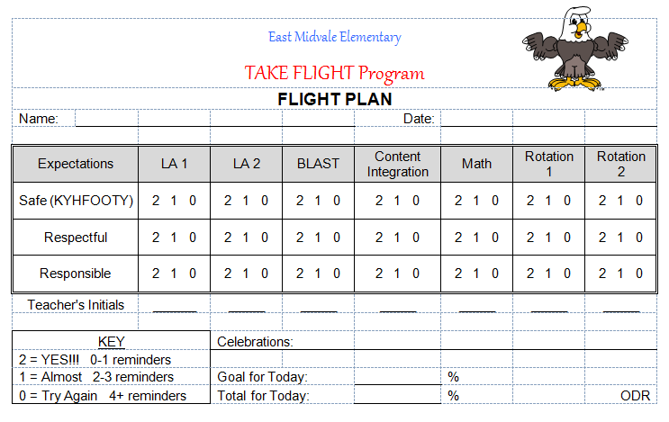
Notes:
MW slide
SWIS is set for a 0,1,2 rating scale. If the 0’s don’t fit with your school you can always change the out in the form with other language:
2-Got it
1=Getting there
0- Still trying
Whoever enters the data can translate the language to numbers in SWIS

Slide 54
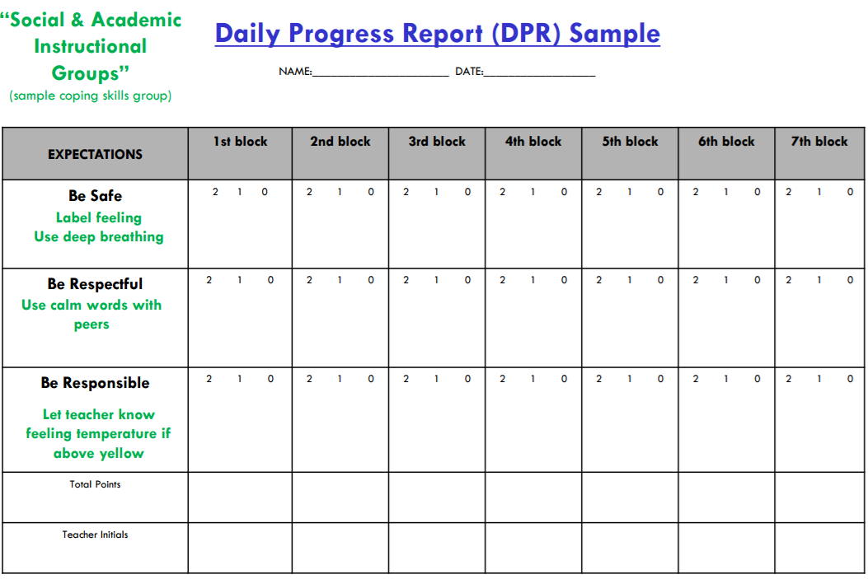
Integration with Additional Interventions
(Eber, 2016)
Notes:
Example—integration with coping skills group to support generalization of skills; THIS IS a slight modification to a standard card —will address more later in training

Slide 55
KENNEDY CARD
 |  |  | Name _____________________________________________________
Materials To Class | Worked and Let Others Work | Follow Directions the First Time |  | Teacher | Parent
2 1 No | 2 1 No | 2 1 No | Assignments:
 |  |  | Wow,
2 1 No | 2 1 No | 2 1 No | Assignments:
 |  |  | Wow,
2 1 No | 2 1 No | 2 1 No | Assignments:
 |  |  | Wow,
2 1 No | 2 1 No | 2 1 No | Assignments:
 |  |  | Wow,
2 1 No | 2 1 No | 2 1 No | Assignments:
 |  |  | Wow,
2 1 No | 2 1 No | 2 1 No | Assignments:
 |  |  | Wow,
 |  |  | = _____ Goal = 36
Notes:
High school/MS example

Slide 56
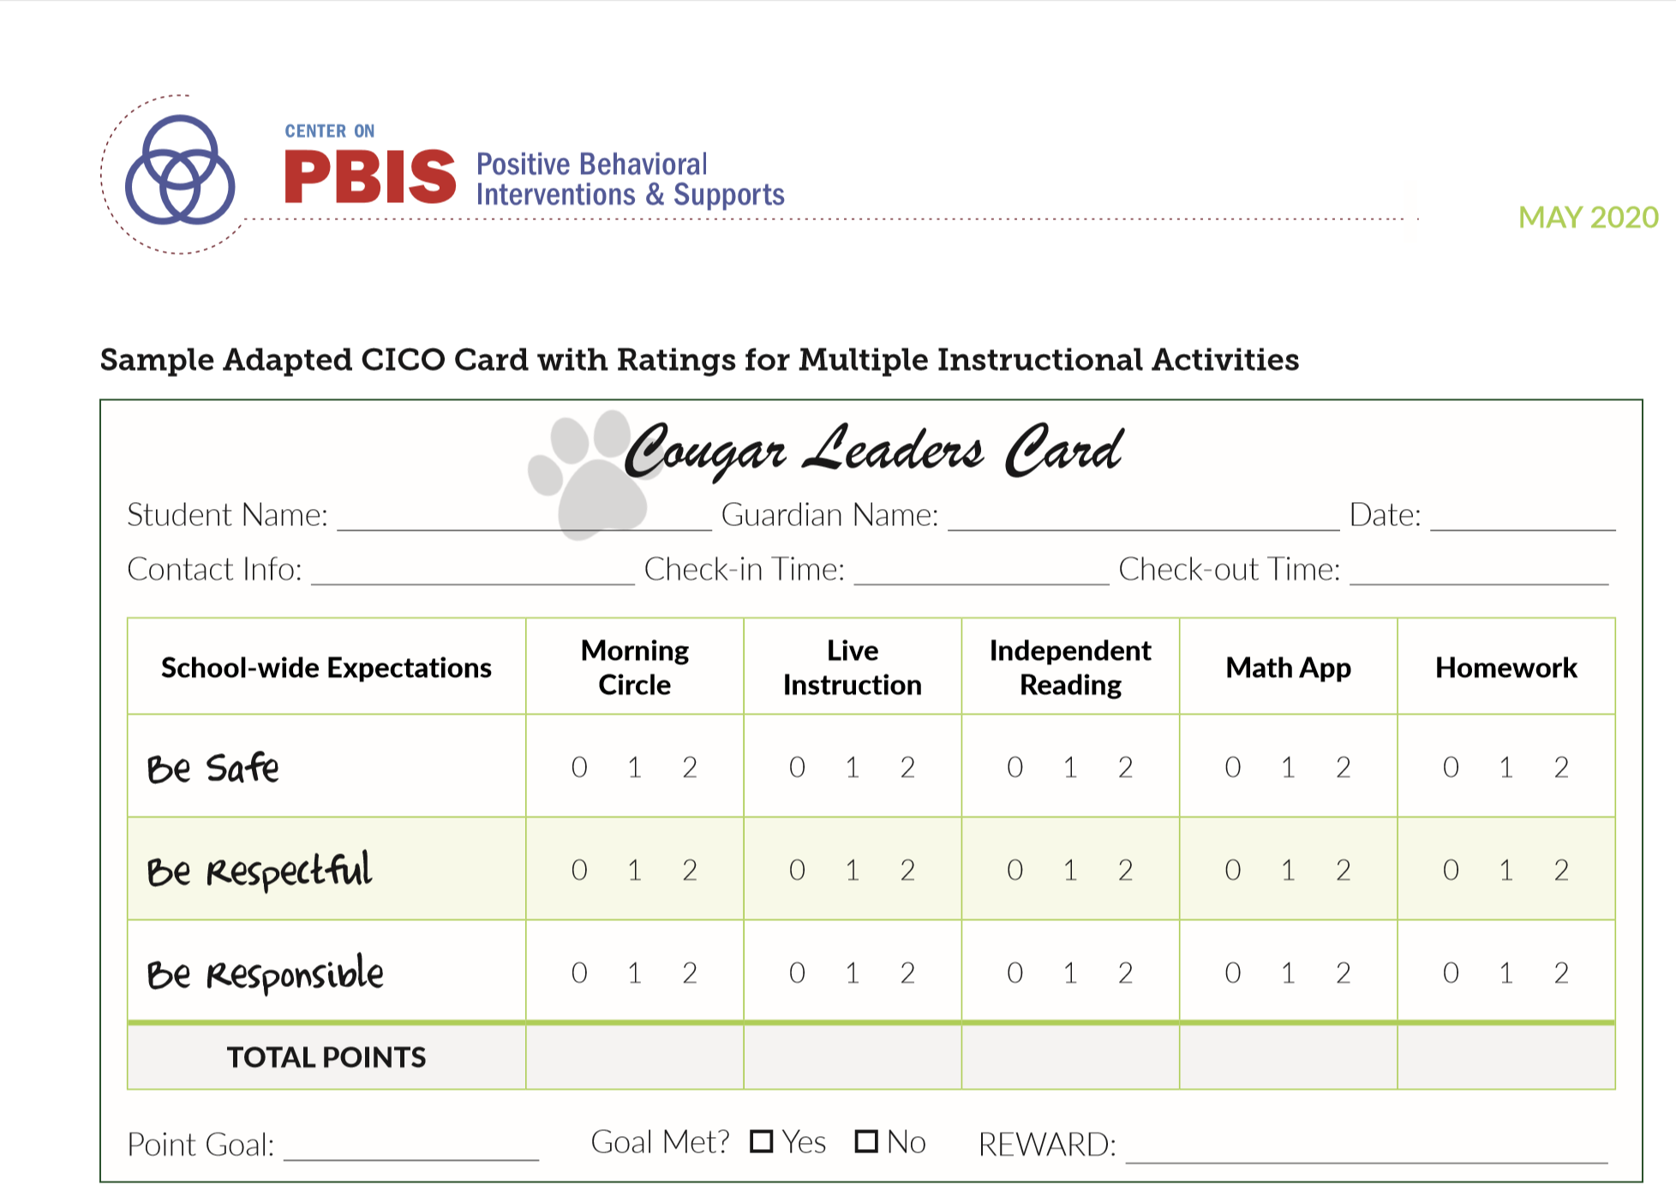
Notes:
From adapting CICO to remote instruction

Slide 57
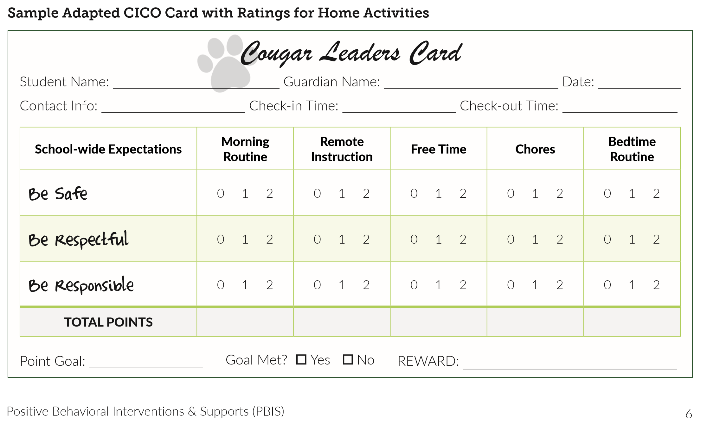
Notes:
Including home activities

Slide 58
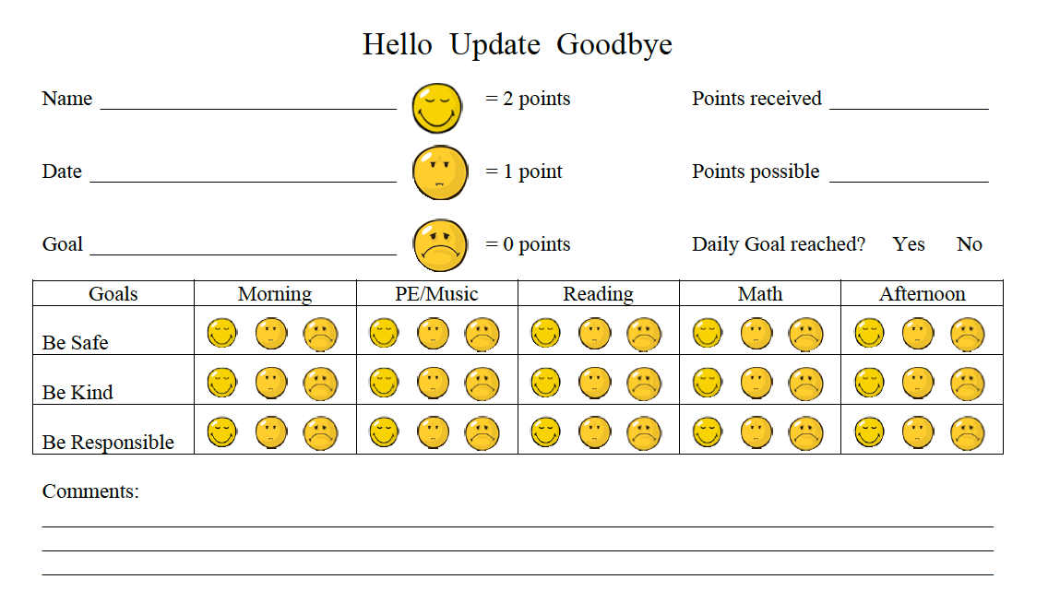
CAUTION!
Refer to next slides for precautions regarding comments on DPR cards.

Slide 59
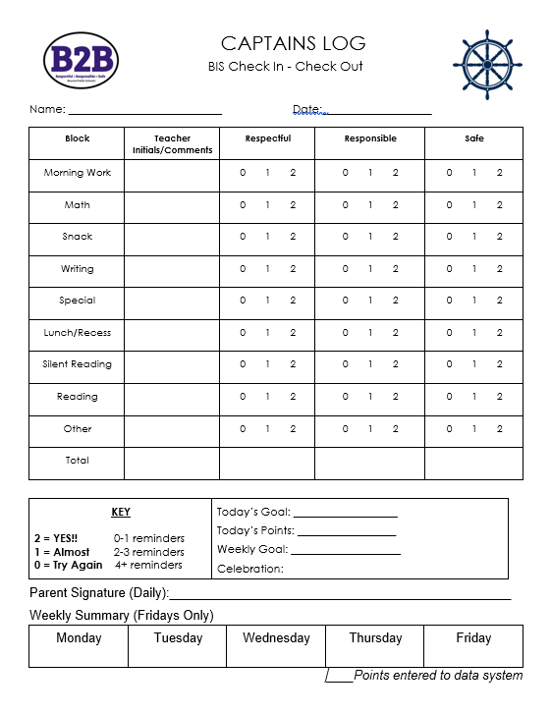

Slide 60
The card functions to provide:
visual prompts for appropriate behavior (expectations are written on the card)
points or other written feedback
*Positive adult interactions
*Constructive corrective feedback

Slide 61
CAUTION!
Consider the space you leave for open comments on the DPR.
Allowing lots of space for comments can:
  Prompt adults to write something positive!
  However, it can also discourage staff from having the verbal interaction with and re-teach the student (allows them to only write it)

Slide 62
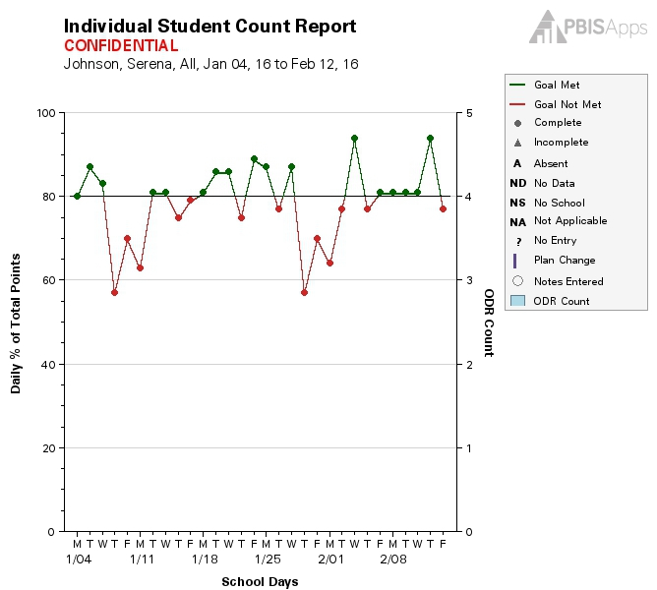
CICO SWIS: DPR Compatibility
Notes:
Make sure here we discuss 10 periods max, standardization, and some wiggle room for CICO-SWIS compatibility
Preview CICO-SWIS demo to show teams progress monitoring tool/system

Slide 63
Activity: Aligning CICO with Tier 1 and DPR design
Name your program and discuss alignment with Tier 1
Review sample DPRs
Design, or redesign/tweak your DPR
Discuss how you will get feedback from staff on the DPR
Add items to your action plan, as needed
Team
15 minutes
Notes:
If team is not developing CICO, apply these questions to other Tier 2 interventions
E.g., name the mentoring program, design the form to be used
How will you get staff feedback on the form?
Do the goals on the form align with SW Tier 1 behaviors?

Slide 64
DISCUSSION: CICO Logistics Debrief
What did you name your program?
How does it align with your Tier 1 practices?
Any questions about your DPR? How did you standardize it? Do you need to do any troubleshooting?
Whole group
5 minutes
Notes:
TRAINERS – Discussion prompts are below; allow 5 minutes.
What did you learn about Tier 2 readiness and connections to Tier 1?
What is one (or two!) item/action plan step that you will prioritize?
How will you communicate with the Tier 1 Leadership team?

Slide 65
CICO Process Decisions
Do students check in and out at different places? Or the same place?
Will students go to the coordinator or will the coordinator come to them?
Where will students check in in the morning and check out in the afternoon? (consider accessibility)
Do students need to come early and leave their last class early?
Where do we need feedback from staff?
Notes:
Trainer Note: these are some odds and ends that we didn’t get to in our last training

Slide 66
CICO Contingency Planning
Think proactively about the following possible scheduling scenarios…
Students arriving early or being dismissed early
Students who use the bus, walk/ bike, or get dropped off
Days during which a field trip or assembly occurs
Substitute staff

Slide 67
Student Acknowledgement Systems
Aligns with school-wide recognition system
Student included in identification of acknowledgment
Consider social acknowledgement to enhance student engagement & school connectedness
Age appropriate
Varied types that are valuable to diverse groups of students (tangible, social, privilege) (individual & group contingencies)
Predictable & dense schedule
  Allow for all students to be eligible to earn acknowledgements daily
Notes:
MW slide
Non-contingent examples: team develops a sense of community, opportunities for leadership among the CICO participants
Acknowledge student for checking in and out?

Slide 68
Student Acknowledgement System Considerations
How will students be acknowledged for displaying expected behavior?
When will acknowledgement occur? How often? Where?
How will you track/ monitor points, tokens, or other systems?
What will students receive when they trade in points or tokens?
How can acknowledgements be delivered efficiently?
Fit into daily activities (avoids interrupting instructional time)
Easy to teach, implement, etc.
Notes:
Still part of step 4c- let’s make that link explicit!! And again a couple of content slides followed by some examples

Slide 69
Points Required | Wants Attention | Wants Item/ Activity | Wants to Escape Attention | Wants to Avoid Something
100 pts | Take note to office/teacher Ask a peer to play/read/draw Be a leader Principals recess Teacher Helper | Choose HW Choose a 5 min. activity School wide sticker Principals recess | Computer time by self | Short break Alternative activity
250 pts | Computer with a friend Extra sharing time | More time for selected activity Free ticket to sporting event | Time alone Independent workspace | Alternative assignment
400 pts | Out to lunch with TBA Class recess, free time, or popcorn party | New school /art supplies |  | Get out of school early
Example
of a
Point System
CICO Point System: Focus on Building Relationships “School Connectedness”

Slide 70




Example
of Tokens

Slide 71
Reinforcement
Questions Prior to Implementation
What will students’ daily point goal be?
What reinforcers will students receive for meeting their daily point goal?
What reinforcers will students receive for checking in and out (e.g., praise and lottery ticket)?
How will you ensure students do not become satiated on the reinforcers?
Notes:
Is this too much on reinforcement?
More considerations. Have teams talk about these items

Slide 72
Activity: CICO Logistics
Discuss CICO process/logistics
Plan for acknowledgement, including alignment with Tier 1 systems
Add items to your action plan, as needed
Team
10 minutes

Slide 73
CHECK-IN: CICO Planning
What are your tentative roll-out plans? Have you considered piloting this spring?
How will supports be structured similarly across all students receiving the intervention?
Any questions regarding the daily progress report or CICO logistics? What have you considered to organize and summarize student data (e.g., CICO-SWIS, excel or google form)?
5 minutes
Notes:
Here are the questions if we go that route:
Did you discuss one or multiple coordinators? What role do they have in your school?
What are your tentative roll-out plans? Have you considered piloting this spring?
Any questions regarding the daily progress report? Are you considering using CICO-SWIS?
How will supports be structured similarly across all students receiving the intervention?

Slide 74
Next step LOGISTICS …
Develop Procedures to Train Staff & Students
Partnering with Families
Practices
Exemplar: CICO
Notes:
Trainer note: this is just a brief overview/introduction! I would not spend much time here, and assure your participants that we will come back to this content

Slide 75
Staff Training: Topics
General
For Each Tier 2 Practice
Referral/ request for assistance procedures
Progress Monitoring
Rationale
Critical features
Decision rules for entrance & exit
Consider opportunities to practice key components (e.g., giving error corrections and behavior specific praise)

Slide 76
Staff Training: Considerations
Ensure the strategy includes regular opportunities for students to perform & get feedback on appropriate behaviors & skills
Comprehensive CICO Support Training for ALL staff
How will CICO work in our school?
Introduce CICO DPR & include detailed explanation of how intervention will work
Video is a great resource, but it is not sufficient
Data used to identify students
Referral/request for assistance process
Progress monitoring
Opportunities to practice & provide performance feedback
Notes:
MW slide
Solid understanding of WHY CICO works
Clarify first bullet point, NOT the same training as today’s but within their building, their building’s specific decision rules etc. of how Tier IIT systems and Cico will work in THEIR building

Slide 77
Staff Training: Considerations
Pre-correct during staff professional development:
  This is not meant to be a response cost approach; we do not take points away
  What to do when student unhappy with score (corrective vs. negative feedback)
  Consequences for behavioral infractions are driven by the school-wide system
  If students are not in the classroom, then they do not have the opportunity to earn points for that time period
  Minors and majors are data sources that can be used to inform feedback from the facilitator and team decisions

Slide 78
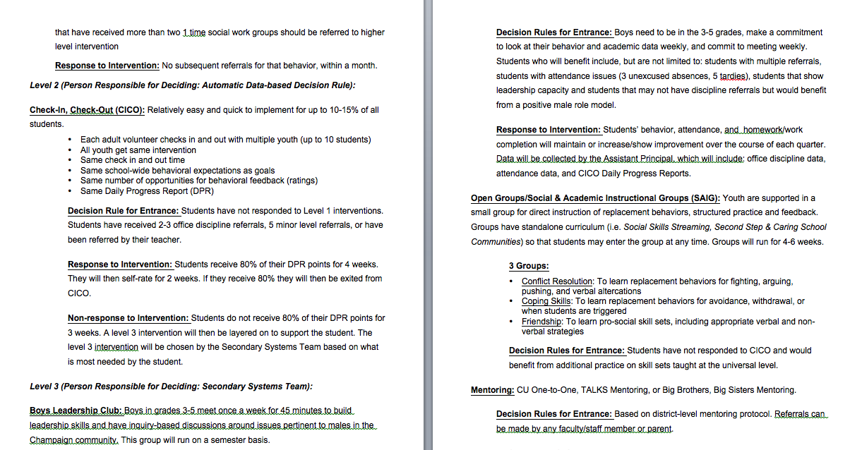
Staff Training for CICO: Information for Staff
Notes:
MW Example of providing information to all staff. Important to have written in staff handbook, student handbook, and parent handbook!

Slide 79
DISCUSSION: Staff Training
How will you plan for training all staff? What are some of the logistical barriers you’ll need to navigate?
How will you support staff in practicing behavior specific praise and corrective feedback? What are some of the established practice barriers you might need to navigate?
Whole group
5 minutes

Slide 80
Training Students & Partnering with Families: Critical Features
Training materials, including opportunities to practice routines
Review of student daily routine
Materials developed for providing information, permission, and ongoing communication
Information on families’ role relative to supporting positive behavior routines, including review of expectations, practice in home setting, and feedback
For Students
For Families

Slide 81
Student Training: CICO Example
Ensure the Tier 2 strategy includes a formal process for teaching student skills and appropriate behaviors
Features:
Involve students in development of CICO
Develop and deliver student training
  Role playing
  Discussion of routines
  Responding to redirection from teacher
Special considerations: training for students who need support accepting redirection
Notes:
MW
Students all need to be involved in the development.

Slide 82

Student Orientation
For students on intervention:
  Who, what, when, where
    What will orientation look like?
    Who will teach students what intervention looks like?
    Where do students go to check in and check out?
  Teach how students can engage their teachers
  Pre-correct: teach students what to do when they disagree with a score
Notes:
MW
Consider what the orientation for students will look like, who will teach students what the intervention look like, how they get card, who/where they go to Check in and Check out, what to do if they get a score that they don’t like, etc.

Slide 83
Orienting Students: Drake
Roosevelt Middle School’s (RMS) Tier 2 support team received a request for assistance form from Drake’s 7th grade team due to concerns about Drake’s attendance, academics, and frequent visits to the nurse for headaches. After reviewing prior interventions, the team agrees that Drake is a good candidate for additional supports.
The RMS Tier 2 team reviews the schools’ current Tier 2 interventions. Screening data identified Drake in the “at-risk” range for internalizing disorders, and his teachers note concerns that some of the recent changes in his behavior may function to avoid social situations and stressful tasks, like presentations and tests. The school psychologist on the team stated that she’s been planning on re-starting a Coping Cat group, a cognitive behavioral intervention targeting anxiety. The team agrees that this intervention seems like the best match for Drake. The psychologist will move timeline for starting the group up, call Drake's family to get their permission, and do a quick pre-group meeting with Drake this week to explain the structure and purpose of the group.
Notes:
Have folks read these two examples and discuss if this similar to some experiences they have had in pre referral teams. What different experiences have they had?
These are examples that will be followed the entire training day on day 3.

Slide 84
Orienting Students: Maria
At the same meeting, the RMS Tier 2 coordinator also reviews screening information regarding Maria, including 6 minor office referrals and 3 major referrals across most of her academic subjects this quarter for talk-outs during class, refusing to follow teacher directions, damaging a classroom bulletin board, and leaving class without permission. The Tier 2 team reviews prior interventions and match with current interventions.
Given Maria’s difficulties across subject areas, the team decides that the Eagles SOAR (CICO) intervention would provide increased adult attention, increased structure and predictability, and some regular feedback on skills. The Tier 2 coordinator agrees to call Maria’s family to explain the intervention and to do a quick meeting with Maria this week to orient her to the program. The AP will email Maria’s teachers and ask them to collect baseline data using the Eagles SOAR card for the rest of the week before Maria starts the intervention next week.
Notes:
Similar to prior slide, we will follow these examples throughout this training day content on day 3

Slide 85
Family Orientation
All Families:
What is Tier 2 support?
  Inform during registration process
  Address at open house, through newsletters, emails, etc.
Families of Students Receiving Tier 2 Support:
Process for Explaining/ Consent
  Best if phone call is made directly to family by the student’s teacher
  Followed by letter (see Appendix F-6)
  Consent: check with your district’s decision makers
  “Back-up Plan” in place if needed
Notes:
MW
NOTE SRE—parent feedback/participation is encouraged, but students should not be excluded from intervention if families do not participate (past consent)
How do we orient ALL families?
How do we specifically notify families of students who are nominated for CICO?
Are you going to get written permission, verbal, etc?

Slide 86
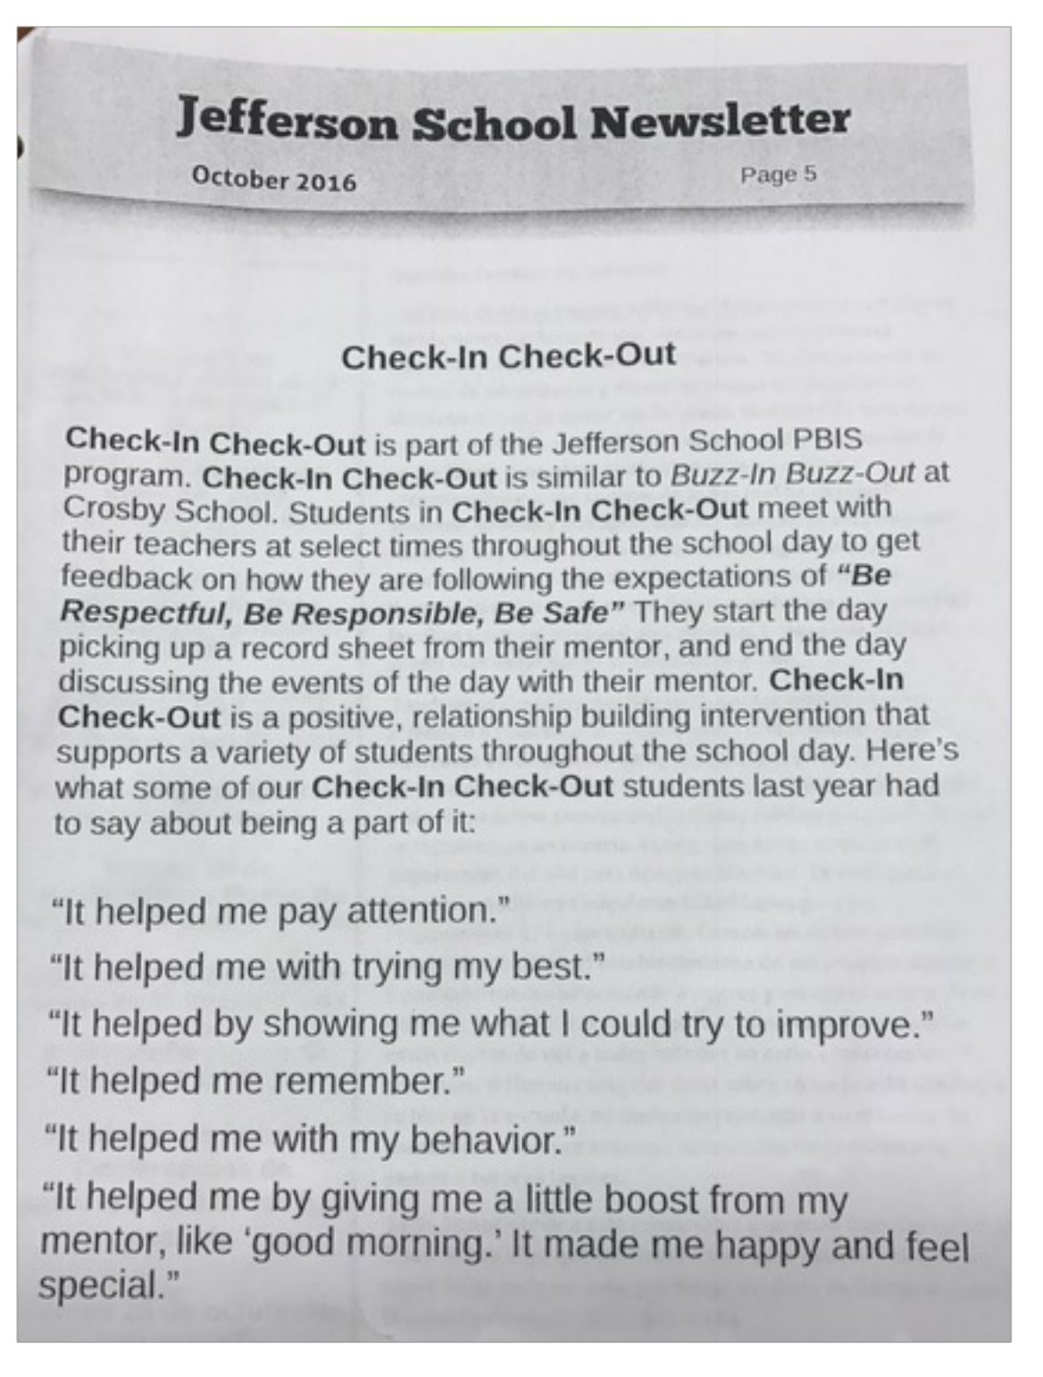
EXAMPLE

Slide 87
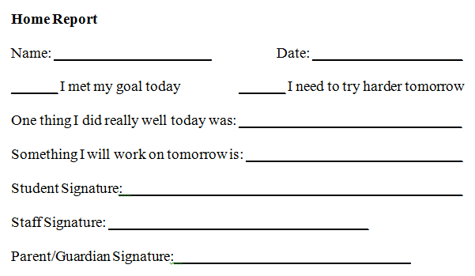
EXAMPLE:
Home Report/ Contact Form
Notes:
This can be used as an alternative to sending home the actual DPR.

Slide 88
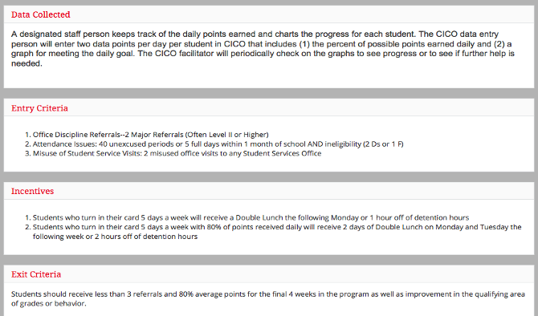
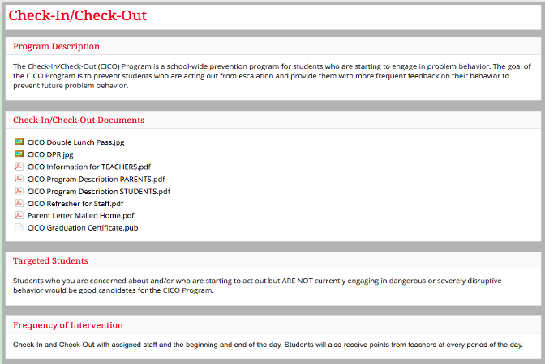
EXAMPLE: Partner Information
Notes:
MW include in appendix Information that could be shared with all staff, subs, others who are in the building working with students.

Slide 89
Guidelines:
Implementing Tier 2 Practices
Practices
Develop a written process for teaching and coaching all staff on Tier 2 interventions (including lesson plans)
Schedule initial and ongoing professional development
Develop procedures for training substitutes and new staff
Develop lesson plans for student orientation and practice
Design information for families, orientation materials, and procedures for ongoing communication

Slide 90
DISCUSSION:
Orientation & Communication
How will you orient students to the T2 intervention? How might you teach students strategies for what to do if they disagree with a score?
How will you orient families, and what do you think about ongoing communication? What program description materials will you need?
Whole group
5 minutes
Notes:
TRAINERS – Discussion prompts are below; allow 5 minutes.
What did you learn about Tier 2 readiness and connections to Tier 1?
What is one (or two!) item/action plan step that you will prioritize?
How will you communicate with the Tier 1 Leadership team?

Slide 91
Team Time

Slide 92
GETTING STARTED WITH Tier 2
What can your team complete today?
What do you begin?
Will you work in smaller groups or all together?
LEAVE TIME TO
ACTION PLAN
1
Establish a representative T2 leadership team
6
Develop an equitable process for matching student need to practices
2
Develop a collaborative process for identifying students
Develop a process for progress monitoring, data-based decision rules
7
3
Evaluate, select and adopt culturally appropriate tier 2 practices
Develop procedures for modifying/ adjusting implementation
8
4
Develop a process to install selected practices
Develop evaluation routines for fidelity and outcome data
9
5
Develop procedures to train staff and students; partner with families and community
Document and share routines, practices, and policies
10

Slide 93
Activity: Aligning CICO with Tier 1 and DPR design
Name your program and discuss alignment with Tier 1
Review sample DPRs
Design, or redesign/tweak your DPR
Discuss how you will get feedback from staff on the DPR
Add items to your action plan, as needed
Team
15 minutes
Notes:
If team is not developing CICO, apply these questions to other Tier 2 interventions
E.g., name the mentoring program, design the form to be used
How will you get staff feedback on the form?
Do the goals on the form align with SW Tier 1 behaviors?

Slide 94
Activity: Training Staff
Download the Midwest PBIS staff CICO ppt training template and staff script
Start to develop a plan for training ALL staff on your T2 Intervention
Add items to your action plan
Team
20 minutes

Slide 95
CHECK-IN: CICO Planning
What are your tentative roll-out plans? Have you considered piloting this spring?
How will supports be structured similarly across all students receiving the intervention?
Any questions regarding the daily progress report or CICO logistics? What have you considered to organize and summarize student data (e.g., CICO-SWIS, excel or google form)?
5 minutes
Notes:
Here are the questions if we go that route:
Did you discuss one or multiple coordinators? What role do they have in your school?
What are your tentative roll-out plans? Have you considered piloting this spring?
Any questions regarding the daily progress report? Are you considering using CICO-SWIS?
How will supports be structured similarly across all students receiving the intervention?

Slide 96
Activity: Orienting Students; Partnering with Families
Download the training scripts, sample program description, and letter home
Preview and plan student orientation
Preview and plan program description and family communication; decide on home-school communication
Add items to your action plan
Team
20 minutes
Notes:
TRAINERS – Discussion prompts are below; allow 5 minutes.
What did you learn about Tier 2 readiness and connections to Tier 1?
What is one (or two!) item/action plan step that you will prioritize?
How will you communicate with the Tier 1 Leadership team?

Slide 97
DISCUSSION: EXPLORE INTERVENTIONS
Team
15 minutes

Slide 98
AGENDA & FOLLOW-UP
What questions do you have on today’s content?
Training Overview
Step 3: Selecting Targeted Interventions – Explore intervention resources
Team Tasks
Identify Intervention Coordinators
Draft Daily Progress Report / monitoring form
Draft Staff Training
Draft orientation materials for students and communication with families
Step 4: Develop a Process to Install T2 Practices - e.g., CICO
Step 5: Develop procedures to train staff and students; partner with families
What questions do you have on the follow-up team tasks?

Slide 99
EVALUATION
CONTACT INFORMATION:
Marcie Handler
mwhandler@gmail.com
Katie Meyer
Katherine.meyer@uconn.edu
Please remember to complete the evaluation to receive your Certificate of Attendance!
Notes:
Evaluation Link
https://edc.co1.qualtrics.com/jfe/form/SV_cBF9GI7gVEBsfSC

