Slide 1
Welcome to Tier 2 Coaches meeting!
GETTING STARTED:
Complete the ATTENDANCE
WHILE YOU WAIT:
READ/ADD to the January TEAM SHARE
AT THE END:
Complete the EVALUATION
BE PREPARED:
Find training resources at : SEB PBIS Tier 2 Academy
Google docs at
Open or establish a Tier 2 shared folder
Open your team ongoing ACTION PLAN
~15%
Notes:
LINKS for today:
Attendance
https://edc.co1.qualtrics.com/jfe/form/SV_5BiXqi4bxzOCMS2
New team member communications survey - https://edc.co1.qualtrics.com/jfe/form/SV_db8zhNj6NJ3eXga
EDC Website for SEB Academy
https://sebacademy.edc.org/
Event Evaluation (at the end)
https://edc.co1.qualtrics.com/jfe/form/SV_cBF9GI7gVEBsfSC

Slide 2
PBIS Tier 2 Coaches Training Year 1 February 2023
Marcie Handler & Katie Meyer
with support from NEPBIS Network, May Institute & Broad Reach Consulting

Slide 3
ACKNOWLEDGEMENTS
02
03
04
Northeast PBIS Network (nepbis.org)
01
Michigan Integrated Behavior & Learning Support Initiative
Dr. Heather George & FLPBIS
Missouri PBIS
Drs. Leanne Hawken, Deanne Crone, & Rob Horner
05
06
Midwest PBIS Network

Slide 4
EXPECTATIONS
Self
Others
Environment
Self-monitor
Mute when listening, unmute to talk​
Have electronics ready to use
Obtain help from peers and trainers
Work as a team:
Keep necessary materials at hand
Are you participating?
Engaged as a learner?
Stretch, break, stand as needed​
Room for every voice
Reinforce participation
action plan
relevant docs
water/snacks
Minimize distractions if possible​
Complete tasks efficiently
Notes:
Taking CARE of…

Slide 5
LEGEND
Timing
Example
Activity
Non-example
Guidelines
Preview
Big Idea
Review
Organization

Slide 6
Coaches’ (and TEAM) Reminders
Coaches’ Tasks February:
Working docs for review in your PBIS Academy Tier 2 folder shared with us ☺
Agenda
Develop process for staff, student (and family) training
Critical features self-check for installing your T2 practices
Identify barriers/concerns
Navigating resources
Use a self-checklist or action plan to install primary T2 practices
Notes:
IF YOU HAVE NOT PARTICIPATED IN TA yet, please make a point to schedule this 1:1.
Reminder:
Fall, Winter (Dec, Jan, Feb), and Spring TA (in addition to team TFI if time allows)
Special note: if schools want to complete the BL TFI that did not in Nov, we can re-open those surveys
March: Targeted Intervention Organizer, Part 2 preview
End of April/May will be TFI assessments with trainers

Slide 7
TEAM SHARE: CELEBRATION!!
Celebrate (GLOW) & working on (GROW) related to:
Selecting and INSTALLING Tier 2 interventions
What do you notice about some other teams and their adoption of T2 practices?
Take a look at the TEAM SHARE
5 minutes

Slide 8
GETTING STARTED WITH Tier 2
Develop an equitable process for matching student need to practices
1
Establish a representative T2 leadership team
6
2
Develop a collaborative process for identifying students
Develop a process for progress monitoring, data-based decision rules
7
3
Evaluate, select and adopt culturally appropriate tier 2 practices
Develop procedures for modifying/ adjusting implementation
8
4
Develop a process to install selected practices
Develop evaluation routines for fidelity and outcome data
9
5
Develop procedures to train staff and students; partner with families and community
Document and share routines, practices, and policies
10
Notes:
COACHES:
Seeing all of these steps can be uncomfortable or overwhelming – the goal is to walk away with an understanding of the elements and strategies to prioritize time and resources to get the steps achieved over a period of time.
TEAM MEMBERS
How will you participation in aspects of these steps support the process?

Slide 9
Common Tier 2 Interventions
Social / Emotional skills (e.g., self-regulation)
Coping skills (anxiety, depression)
Academic / organizational skills
CBT
Check In/ Mentoring
Skills Groups
Counseling Groups
Classroom Interventions
Check in (with an adult)
Check in Check Out (CICO-BEP)
Check and Connect (Monitoring + Mentoring)
Enhance social skills instruction in the classroom (CW-FIT)
SEB curriculums, lessons on classroom ‘survival’ skills)
Therapeutic focus
Topic specific (e.g., grief, trauma, gender identity)
Diversion programs
Notes:
CW-FIT:
The CW-FIT program is a multilevel group contingency intervention that broadly addresses common functions of problem behavior. The CW-FIT is considered a classroom-level primary intervention because it is used with all students in a class. For students not responding to the primary-level intervention-group contingency, secondary-level or targeted interventions of self-management and help-card procedures are implemented. Students that do not respond to either primary or secondary intervention are candidates for tertiary level support.
https://www.youtube.com/watch?v=PR_D291by4E
https://charts.intensiveintervention.org/intervention/toolSGL/3539f6442db882bf
https://www.ncbi.nlm.nih.gov/pmc/articles/PMC4532396/

Slide 10
Empirically-Supported Tier 2 Interventions
1. Check-in Check-out (CICO)
2. Check and Connect (Mentoring with Monitoring and goal setting)
3. SAIG – Social Academic Instructional Groups (“skills”) groups
Classroom skills
Organizational skills
Social / Emotional skills
4. Mentoring
5. Class-wide Function-Based Intervention (CW-FIT)
6. REP – Resilience Education Program (CBT+CICO)
7. Freshman Success (HS)
What are some Common Features?
Notes:
These are Tier 2 practices that schools often implement and we are using these as examples to help demonstrate the various system, data, and practices features.
What do these interventions have in common? What are some critical features?
https://checkandconnect.umn.edu/
Overview video - https://www.youtube.com/watch?v=3_-AFbDLn9c
https://smhcollaborative.org/rep/
Milwaukee PBIS Social Academic Intervention Groups (SAIG) – go to the website for a list of lessons

Slide 11
DISCUSSION: PREVIEWING “MATCH TO NEED” Step
Did anyone choose to “explore” an additional T2 intervention and why?
What need did it “match” to for your students?
HINT: This reflection will help when we complete the Targeted Intervention Organizer Part 2)
Group
5 minutes
Notes:
Formal process for teaching student skills and appropriate behaviors – INSTRUCTION!
Increased structure and predictability for students
Regular opportunities for students to perform and get feedback on appropriate behaviors and skills

Slide 12
Develop a Process to Install Selected Practices What have you started? What challenges exist?
Practices

Slide 13
Installing Tier 2 Practices: Critical Features
Formal process for teaching student skills and appropriate behaviors
Increased structure and predictability for students
Regular opportunities for students to perform and get feedback on appropriate behaviors and skills
Establish the Tier 2 strategy within the school so that it does not need unique development for each participating student
Documentation describing the support process and procedures for each selected practice including all supporting materials
Staff informed on support details and provide feedback
Orientation materials provide information for staff/substitutes who have students using the practice
Fidelity of implementation measure is established and used
Self-check

Slide 14
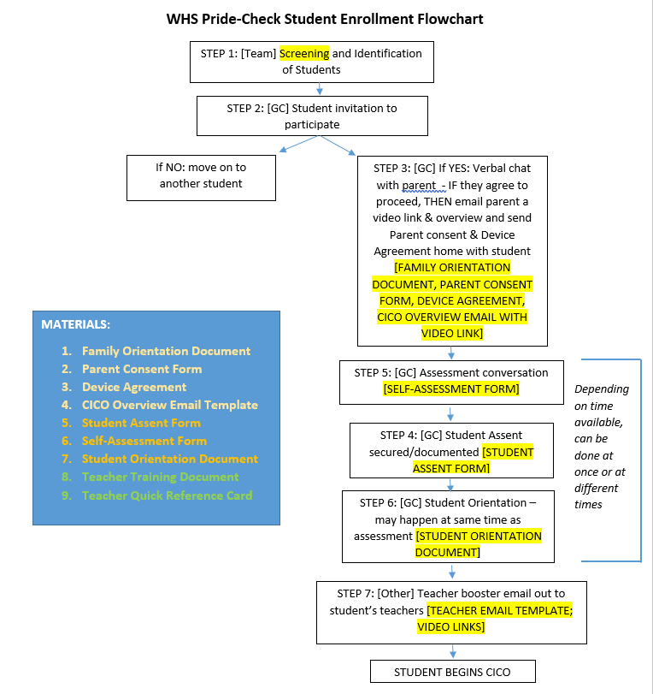
Sample Process for CICO

Slide 15
Installing Tier 2 Practices
Identify personnel to coordinate and deliver Tier 2 strategy
Ensure Tier 2 strategy is consistent with school-wide expectations
Ensure strategy includes regular opportunities for students to perform and get feedback on appropriate behaviors and skills
Ensure Tier 2 strategy does not need unique development for each participating student

Slide 16
Identify Personnel to Coordinate & Deliver Tier 2 Strategy
How will the coordinator be trained?
Does the coordinator have behavioral expertise?
Does the coordinator have time and resources to run the process?
Is the coordinator prepared to collect and maintain data systems?
Notes:
What other systems were established to support the intervention/ coordinator?
E.g., time of day, location for the intervention
Backup to the coordinator
Materials to support the intervention

Slide 17
ALIGNMENT EXAMPLE
Infraction | Failure to Comply | Inappropriate Language | Tardiness
Linked SW Expectation | Responsible | Respectful & Reflective | Responsible
What You Want The Student To Do | Cooperate with instructions & directions timely | Use appropriate words to express sentiment (e.g., considerate, polite, kind, professional, etc.) | Be in seat when bell rings
Social and Emotional Skill Options to Teach | Asking for help Active listening Paraphrasing understanding Managing frustration (e.g., positive self-statements, deep breaths) | Stop-think-act Managing disappointment Turning the conversation Making a complaint Reframing negative thoughts | Managing transition time Planning ahead Self monitoring Using conversation enders (e.g., “catch you later”)

Slide 18
Strategy Includes Opportunities for Students to Perform & Get Feedback on Behaviors & Skills
What did you create?
How will staff model appropriate behavior?
How will the environment be organized so that students get regular opportunities for skill practice and feedback?
How will staff be trained to do these activities?

Slide 19
COACHES SHARE:
Celebrate (GLOW) & working on (GROW) related to:
Consider one of the previous INSTALLATION STEPS:
1. What have you started to develop / put in place?
2. What are barriers to progress?
Discuss and Share
10 minutes

Slide 20
Develop Procedures to Train Staff & Students Partnering with Families
Practices
Notes:
Trainer note: this is just a brief overview/introduction! I would not spend much time here, and assure your participants that we will come back to this content

Slide 21
Installing Tier 2 Practices: Critical Features
Formal process for teaching student skills and appropriate behaviors
Increased structure and predictability for students
Regular opportunities for students to perform and get feedback on appropriate behaviors and skills
Establish the Tier 2 strategy within the school so that it does not need unique development for each participating student
Documentation describing the support process and procedures for each selected practice including all supporting materials
Staff informed on support details and provide feedback
Orientation materials provide information for staff/substitutes who have students using the practice
Fidelity of implementation measure is established and used
Self-check

Slide 22
Staff Training: Topics
General
For Each Tier 2 Practice
Referral/ request for assistance procedures
Progress Monitoring
Rationale
Critical features
Decision rules for entrance & exit
Consider opportunities to practice key components (e.g., giving error corrections and behavior specific praise)

Slide 23
Staff Training: Considerations
Ensure the strategy includes regular opportunities for students to perform & get feedback on appropriate behaviors & skills
Comprehensive CICO Support Training for ALL staff
How will CICO work in our school?
Introduce CICO DPR & include detailed explanation of how intervention will work
Video is a great resource, but it is not sufficient
Data used to identify students
Referral/request for assistance process
Progress monitoring
Opportunities to practice & provide performance feedback
Notes:
MW slide
Solid understanding of WHY CICO works
Clarify first bullet point, NOT the same training as today’s but within their building, their building’s specific decision rules etc. of how Tier IIT systems and Cico will work in THEIR building

Slide 24
Training Students & Partnering with Families: Critical Features
Training materials, including opportunities to practice routines
Review of student daily routine
Materials developed for providing information, permission, and ongoing communication
Information on families’ role relative to supporting positive behavior routines, including review of expectations, practice in home setting, and feedback
For Students
For Families

Slide 25
Coaches’ Reminders
Coaches’ Tasks February:
Working docs for review in your PBIS Academy Tier 2 folder shared with us ☺
Agenda
Develop a process for staff, student (and family) training
Critical features self-check for installing your T2 practices
Identify barriers/concerns
Navigating resources
Use a self-checklist or action plan to install primary T2 practices
Notes:
IF YOU HAVE NOT PARTICIPATED IN TA yet, please make a point to schedule this 1:1.
Reminder:
Fall, Winter (Dec, Jan, Feb), and Spring TA (in addition to team TFI if time allows)
Special note: if schools want to complete the BL TFI that did not in Nov, we can re-open those surveys
March: Targeted Intervention Organizer, Part 2 preview
End of April/May will be TFI assessments with trainers
If you need to access these materials through google, find the link at https://sebacademy.edc.org/tier-2-year-1-february-coach-meeting
CICO Rollout Checklist (comprehensive checklist for installing CICO)
CICO Self-Assessment (simpler checklist with space for the team to action plan)
T2 Intervention Checklist (assessing T2 features across multiple interventions)

Slide 26
EVALUATION
CONTACT INFORMATION:
Marcie Handler
mwhandler@gmail.com
Katie Meyer
Katherine.meyer@uconn.edu
Please remember to complete the evaluation to receive your Certificate of Attendance!
Notes:
Evaluation Link
https://edc.co1.qualtrics.com/jfe/form/SV_cBF9GI7gVEBsfSC

