Slide 1


PBIS School-Wide Coach Meeting
Year 3: February 2023
PBIS Track
[insert trainers name]
with support from NEPBIS Network, May Institute & Broad Reach Consulting
Notes:
Add trainer names for your event

Slide 2

EXPECTATIONS
Self
Others
Environment
Self-monitor
Mute when listening, unmute to talk​
Have your computer charged and ready to go​
If you have questions or comments:
Work as a team:
Keep necessary materials at hand
Are you participating?
Engaged as a learner?
Stretch, break, stand as needed​
unmute
use the chat box
Room for every voice
Reinforce participation
action plan
relevant docs
water/snacks
Minimize distractions if possible​

Slide 3
IN-PERSON TEAM TRAINING EVENT INCLEMENT WEATHER POLICY
In case of inclement weather, we will cancel our team training if the local school district where the training will be held is either delayed or cancelled due to inclement weather.
Please monitor school and district closings for the school district in which the training is being held. In any case that you feel it is not safe for you to travel to the cohort training, please make the decision that is most safe for you.
Your training site is [Trainers please fill in location] [Date of Next Training]

Slide 4
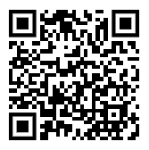
ACTIVITY: ATTENDANCE
Scan QR code on the left or follow the URL posted in the chat to access the online attendance survey
Follow prompts to enter attendance information
Notify trainers if you require assistance (e.g., identifying your cohort or cohort group)
Certificates of Attendance will be sent in January and June. Attendance records and Zoom log in will be use as verification
You are in Cohort 7
1 minute
Notes:
TRAINERS – QR Code is updated
Add your cohort number
Post a link to the attendance survey (below) in the chat for those who do not use the QR code on the slide:
ATTENDANCE: https://edc.co1.qualtrics.com/jfe/form/SV_5BiXqi4bxzOCMS2

Slide 5
Agenda & Coaches' Tasks
Presentation Content
Coaches Tasks
Glows & Grows: School-Family Partnerships
Resource Spotlight
Equity Review
Looking Ahead: March Poster session!
Review areas where your PBIS Framework can be more culturally responsive. Discuss with your team and action plan.
Discuss with your team what you may want to include on your poster during the March team training.

Slide 6

HELPFUL RESOURCES
RESOURCES:
Centering Equity within the PBIS Framework: Overview and Evidence of Effectiveness
Beginning to Address Equity in Tier 1 Systems
Discussing Race, Racism, and Important Events with Students
Tiered Fidelity Inventory
Family School Partnership Survey
Integrated TFI Companion Guide
Culturally Responsive Field Guide
Notes:
RESOURCES:
Centering Equity within the PBIS Framework: Overview and Evidence of Effectiveness: https://sebacademy.edc.org/centering-equity-within-pbis-framework-overview-and-evidence-effectiveness
Beginning to Address Equity in Tier 1 Systems: https://sebacademy.edc.org/beginning-address-equity-tier-1-systems
Discussing Race, Racism, and Important Events: https://sebacademy.edc.org/discussing-race-racism-and-important-current-events-students-guide-lesson-plans-and-resources
PBIS TFI Manual: https://sebacademy.edc.org/tiered-fidelity-inventory-tfi-manual
Family School Partnership Survey: https://uconn.co1.qualtrics.com/jfe/form/SV_4U9QPw9ASvLr83z
Integrated TFI Companion Guide -https://sebacademy.edc.org/integrated-tiered-fidelity-inventory-companion-guide
Culturally Responsive Field Guide -https://sebacademy.edc.org/pbis-cultural-responsiveness-field-guide

Slide 7
Glows & Grows:
Family School Partnerships
Notes:
12:30

Slide 8

What is family engagement?
Including families in PBIS implementation means families and school personnel work together and share in the responsibility making educational decisions and improving student outcomes.
(Center on PBIS, 2022)

Slide 9
What are the foundational elements of family engagement?
Two-Way Communication
Equity, Access, Representation
Meaningful Decision-Making
Intentionally obtain diverse and proportional input
Provide diverse range of opportunities for families to make shared decisions about PBIS systems and practices
Recognize family needs
Positive Relationships
Value cultural differences
Collect data on perceptions of home-school relationships
Engage in meaningful, two-way communication
Provide multiple avenues for families receive and provide information
Empower families with knowledge and skills to effectively support student learning
Cultivate social connections and networks among families
Effectively engage families in advanced student behavior supports
(Center on PBIS, 2022)

Slide 10

Family Engagement in PBIS
Reviews the reasons for family engagement in schools
Identifies practical strategies for promoting and supporting family engagement
Considers family engagement across diverse contexts and groups
(Center on PBIS, 2017)
Notes:
Aligning and Integrating Family Engagement in Positive Behavioral Interventions and Supports: https://sebacademy.edc.org/aligning-and-integrating-family-engagement-positive-behavioral-interventions-and-supports

Slide 11
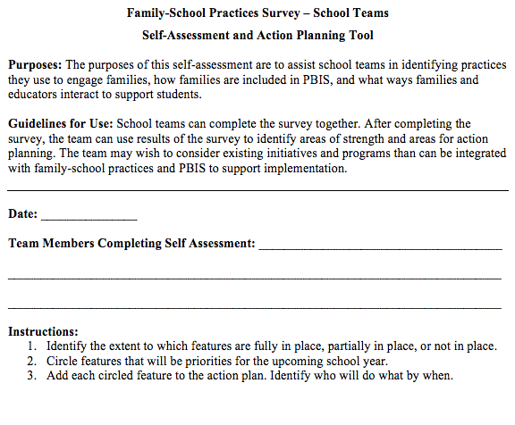
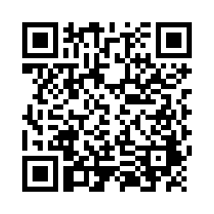
Examining School Approaches to Family Engagement in PBIS
The Family-School Practices Survey for school teams is a self-assessment and action planning tool.
Approaches to family engagement are assessed in several areas:
Communication
Family-School Activities
PBIS Practices at Home and School
Decision-Making/Shared-Ownership
Resources
(Garbacz, McIntosh, & Eagle, 2014)
Notes:
As this is review, you may remind folks that if they haven not yet, please complete the self-assessment, identify areas of strength and need, and complete the action plan at the end of the tool to target areas of need that build on strengths
Link to assessment: https://sebacademy.edc.org/family-school-practices-survey

Slide 12
DISCUSSION: FAMILY-SCHOOL PARTNERSHIPS
Did you complete the Family School Practices survey with your team?
How can we promote more shared decision making with our families?
What are your next action items that you discussed with your team?
Whole Group
10 minutes
Notes:
Family School Practices Survey: https://uconn.co1.qualtrics.com/jfe/form/SV_4U9QPw9ASvLr83z

Slide 13
PBIS
Resource Spotlight:
Discussing Race, Racism, and Current Events with Students
Notes:
https://sebacademy.edc.org/discussing-race-racism-and-important-current-events-students-guide-lesson-plans-and-resources

Slide 14

Discussing Race, and Racism...
This guide is intended to increase the frequency and quality of conversations about race, racism, and current events regarding race in K-12 classrooms to support students and provide voice and self-reflection.
Sections to take note...
Embed this work within existing systems
Build knowledge and expertise
Create an installation plan
Implement and monitor progress
Notes:
Resource Link: https://sebacademy.edc.org/discussing-race-racism-and-important-current-events-students-guide-lesson-plans-and-resources

Slide 15
DISCUSSION: Discussing Race, and Racism...
Independently Review the article and chat with your co-coaches (15 minutes)
Whole group discussion of common take aways (10 minutes)
How could this document be shared with your team and integrated into your current equity work.
Independ Review
Coach Review/Chat
Whole Group
5 Minutes
10 minutes
10 minutes
Notes:
https://sebacademy.edc.org/discussing-race-racism-and-important-current-events-students-guide-lesson-plans-and-resources

Slide 16
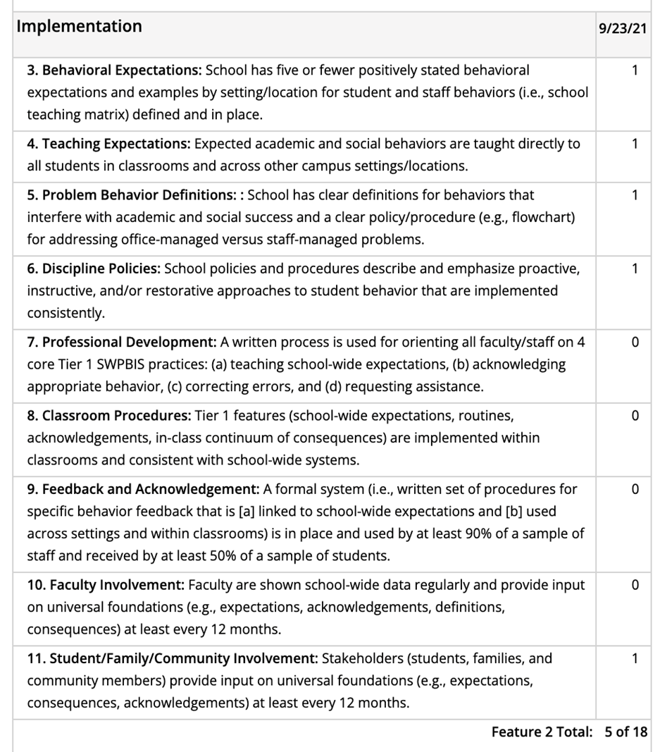

TFI Check-in Slide
Take a moment to go pull up your most recent TFI information for this equity review.
Go to PBISApps.org and log in.
Find your most recent TFI results and specifically the item report for this activity.

Slide 17
PBIS
Equity Check-in:
PBIS Culturally Responsive Field Guide
Notes:
Resource Link: https://sebacademy.edc.org/pbis-cultural-responsiveness-field-guide

Slide 18

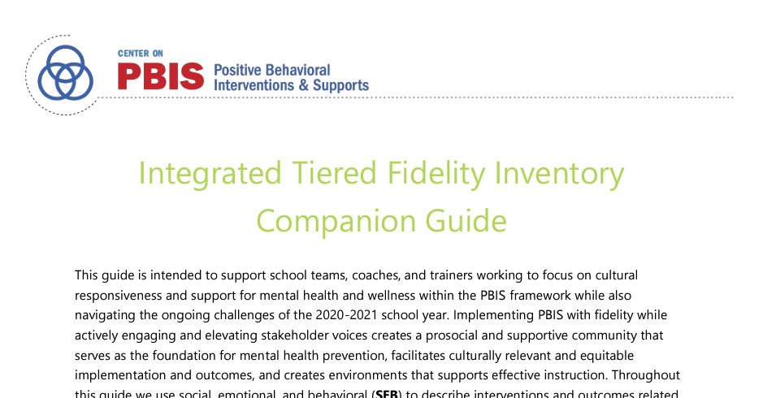
Culturally Responsive Field Guide
This guide is designed to assist trainers and coaches working with school SWPBIS teams (or other school leadership teams) seeking to implement culturally responsive practices systemically to enhance equity in school discipline
This guide as two important sections
Section 1: Identity Awareness
Section 2: TFI Cultural Responsiveness Field Guide
Integrated TFI Companion
Notes:
Resource Link: https://sebacademy.edc.org/pbis-cultural-responsiveness-field-guide
https://sebacademy.edc.org/integrated-tiered-fidelity-inventory-companion-guide

Slide 19
DISCUSSION: PBIS Cultural Responsive Field Guide
Independently Review the article independently (10 minutes)
Divide up into randomized discussion groups, and discuss your biggest takeaways (10 minutes)
Whole group discussion of common take aways (10 minutes)
What can be added to your team’s action plan?
20 minutes
10 minutes
Coach Review/Chat
Whole Group
Notes:
Resource Link: https://sebacademy.edc.org/pbis-cultural-responsiveness-field-guide

Slide 20

Preparing for March Training:
Poster Session!

Slide 21
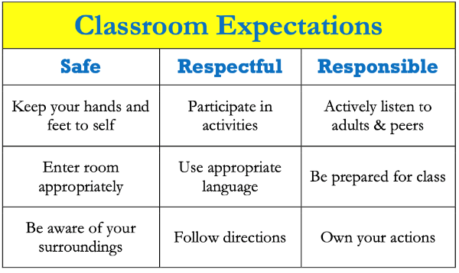
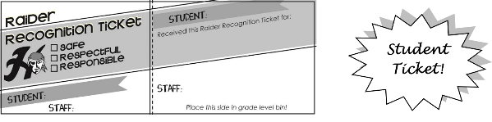
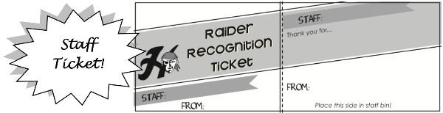
POSTER SESSION
Target Goal:
  Share examples of implementation of the PBIS Framework across districts and schools
Structure
  Show off! Each school will showcase aspects of your PBIS implementation with other teams
  Bring your poster! During March team training, we’ll have space with tables so you can show your posters with others.
  Get ideas! Bring ideas back to your
  school for follow up action planning
Notes:
This should be brief (5 minutes)

Slide 22
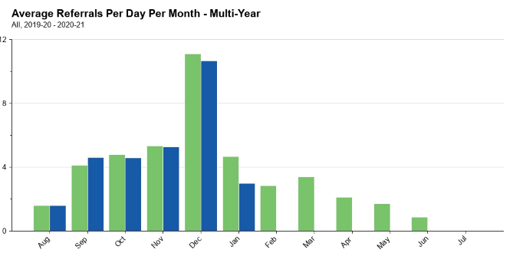
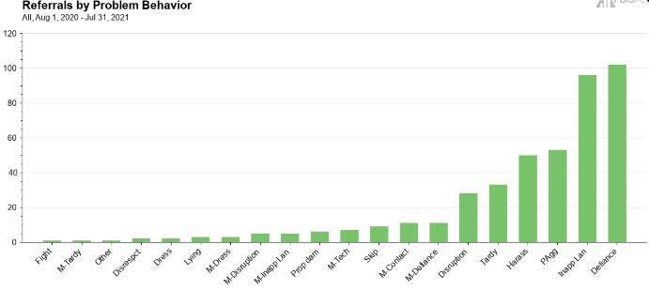
What to include on your poster
Examples of Systems, Data, and Practices!
Data Examples
  Fidelity Data (e.g., TFI or TIC)
  Outcome Data (e.g., ODR or attendance)
System Examples
  Team Action Plans
  Staff Survey
Practice Examples
  Lesson Plan
  Teaching Matrix
  Consequence Flow Chart
Please include data as part of your poster!
Notes:
This should be brief (5 minutes)

Slide 23
What to include on your poster
Consider including features that promote sustainability!
  PBIS Handbook image
  Newsletter sharing data with staff or families
  Picture of policy on school website
  Sample PD agenda to introduce new staff to PBIS
Notes:
This should be brief (5 minutes)

Slide 24
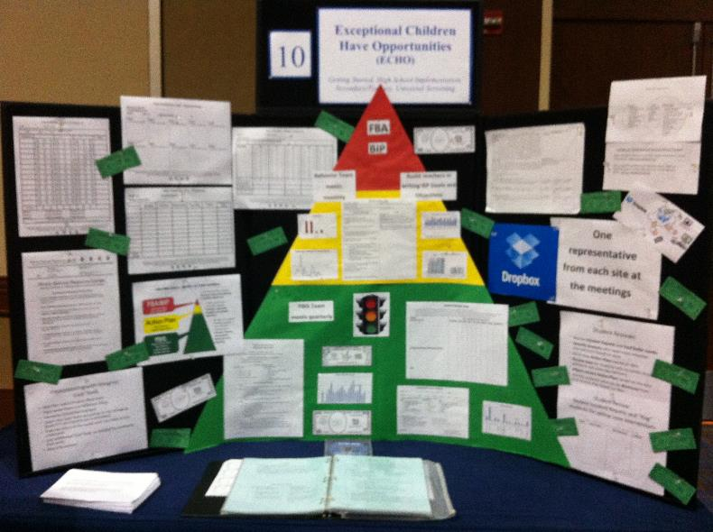
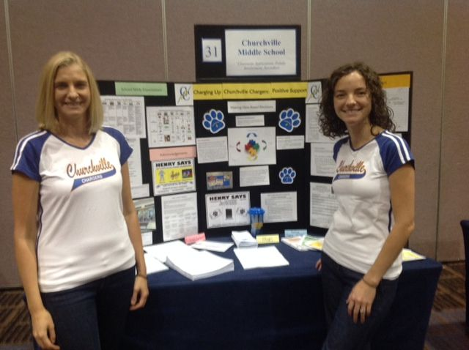
POSTER EXAMPLE
Notes:
TRAINER NOTE: Here is an example of a virtual poster from last year, created in google slides. You can click on the TV, fish, chalkboard, and computer screen to view various elements of PBIS, including the start of a PBIS Handbook. Feel free to get creative in your virtual poster design!

Slide 25
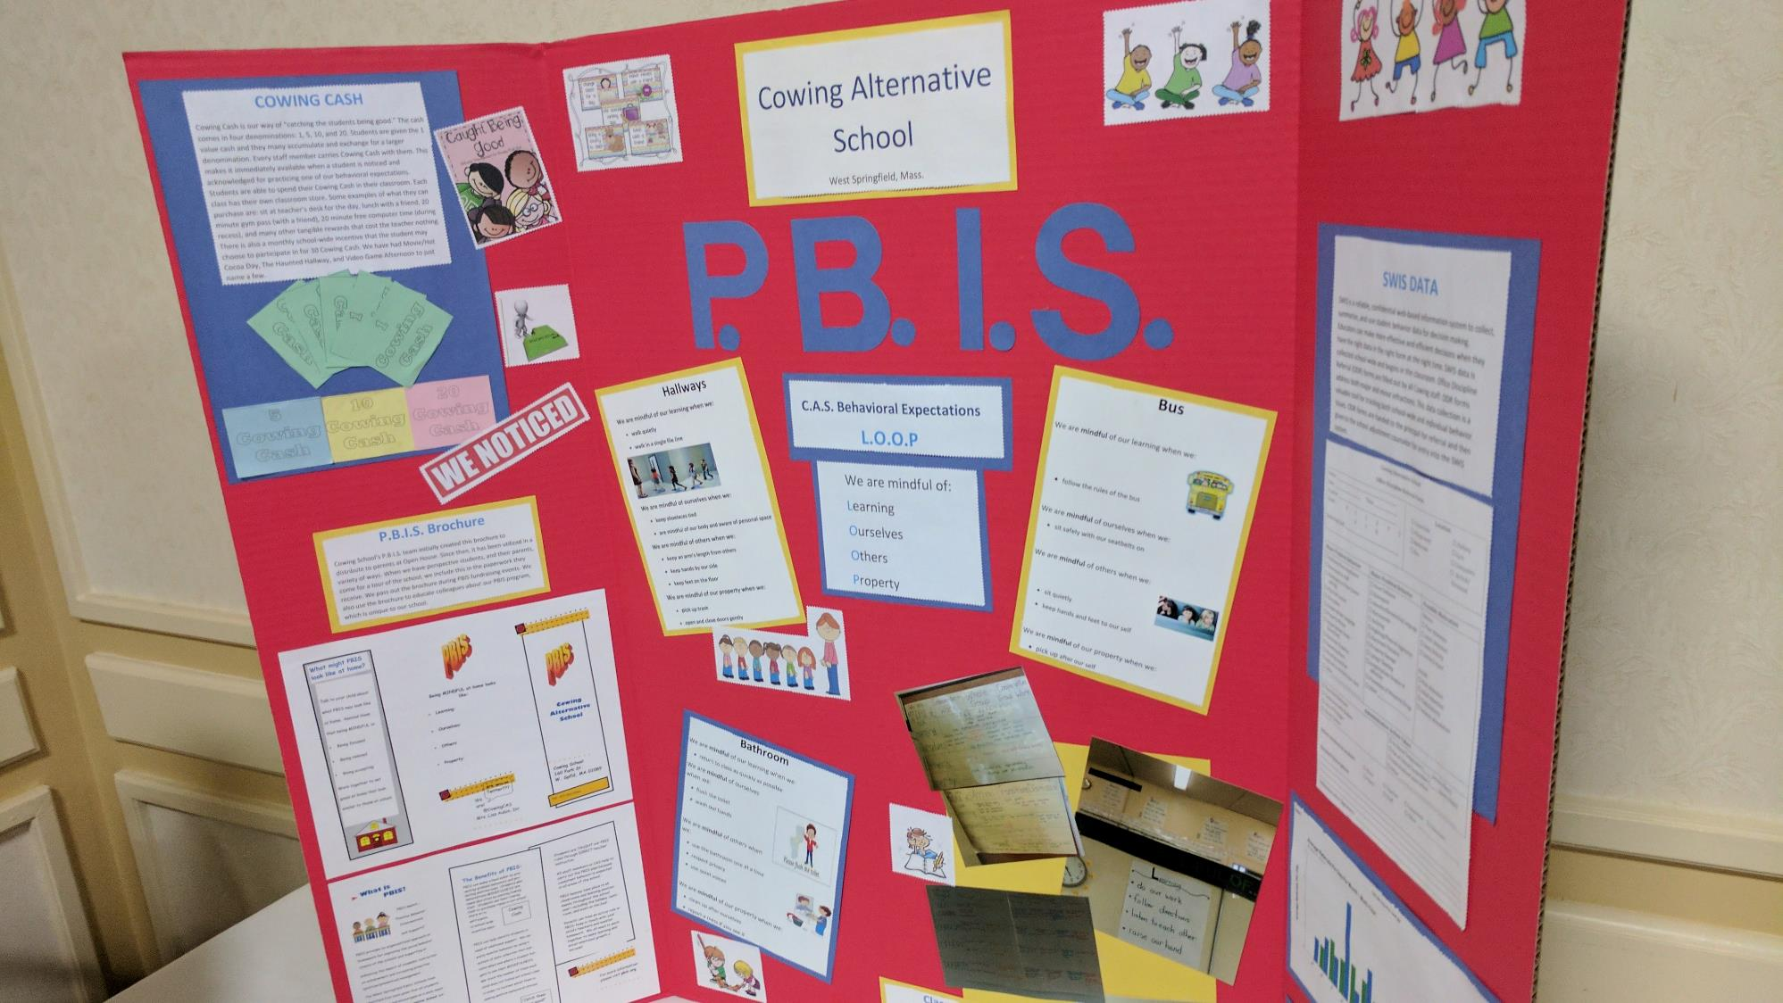

Slide 26


Slide 27
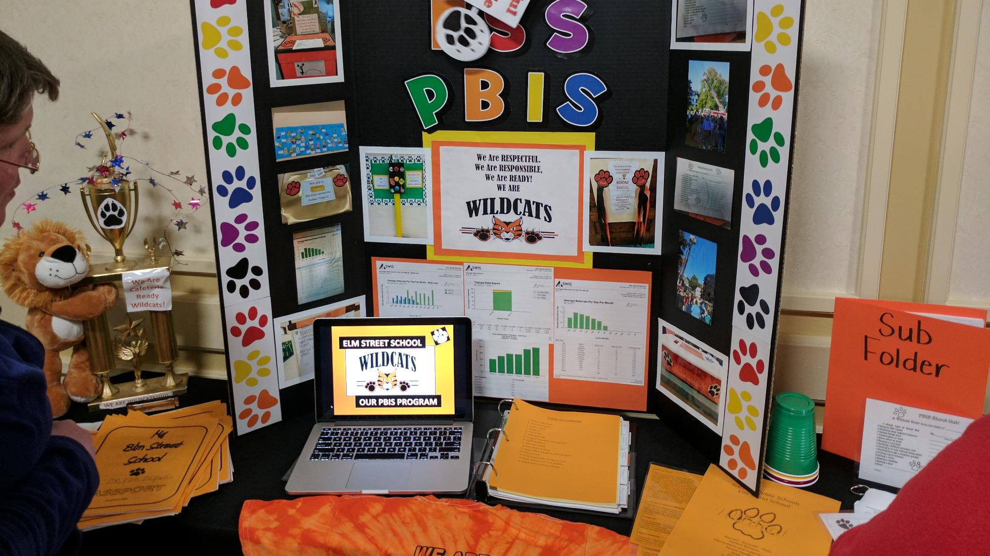

Slide 28
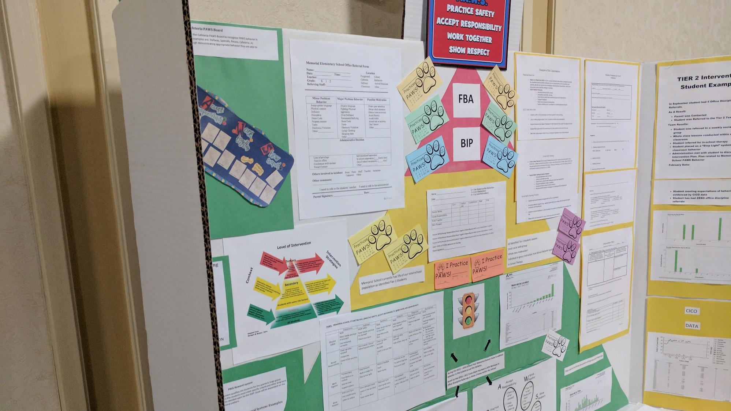

Slide 29
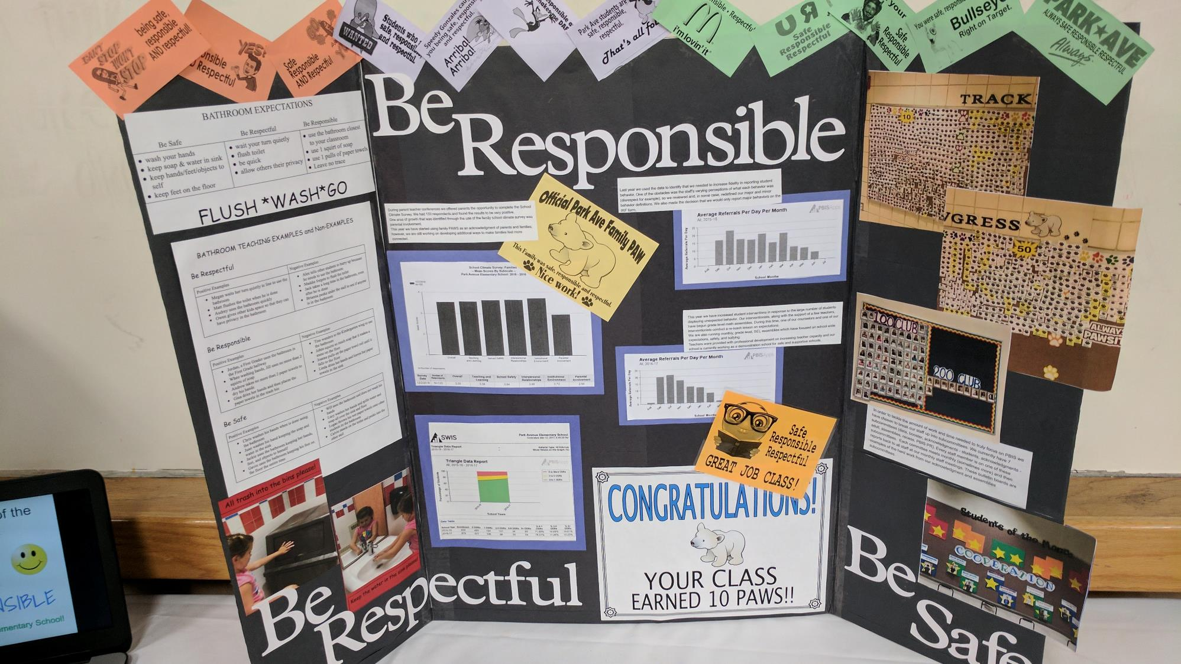

Slide 30
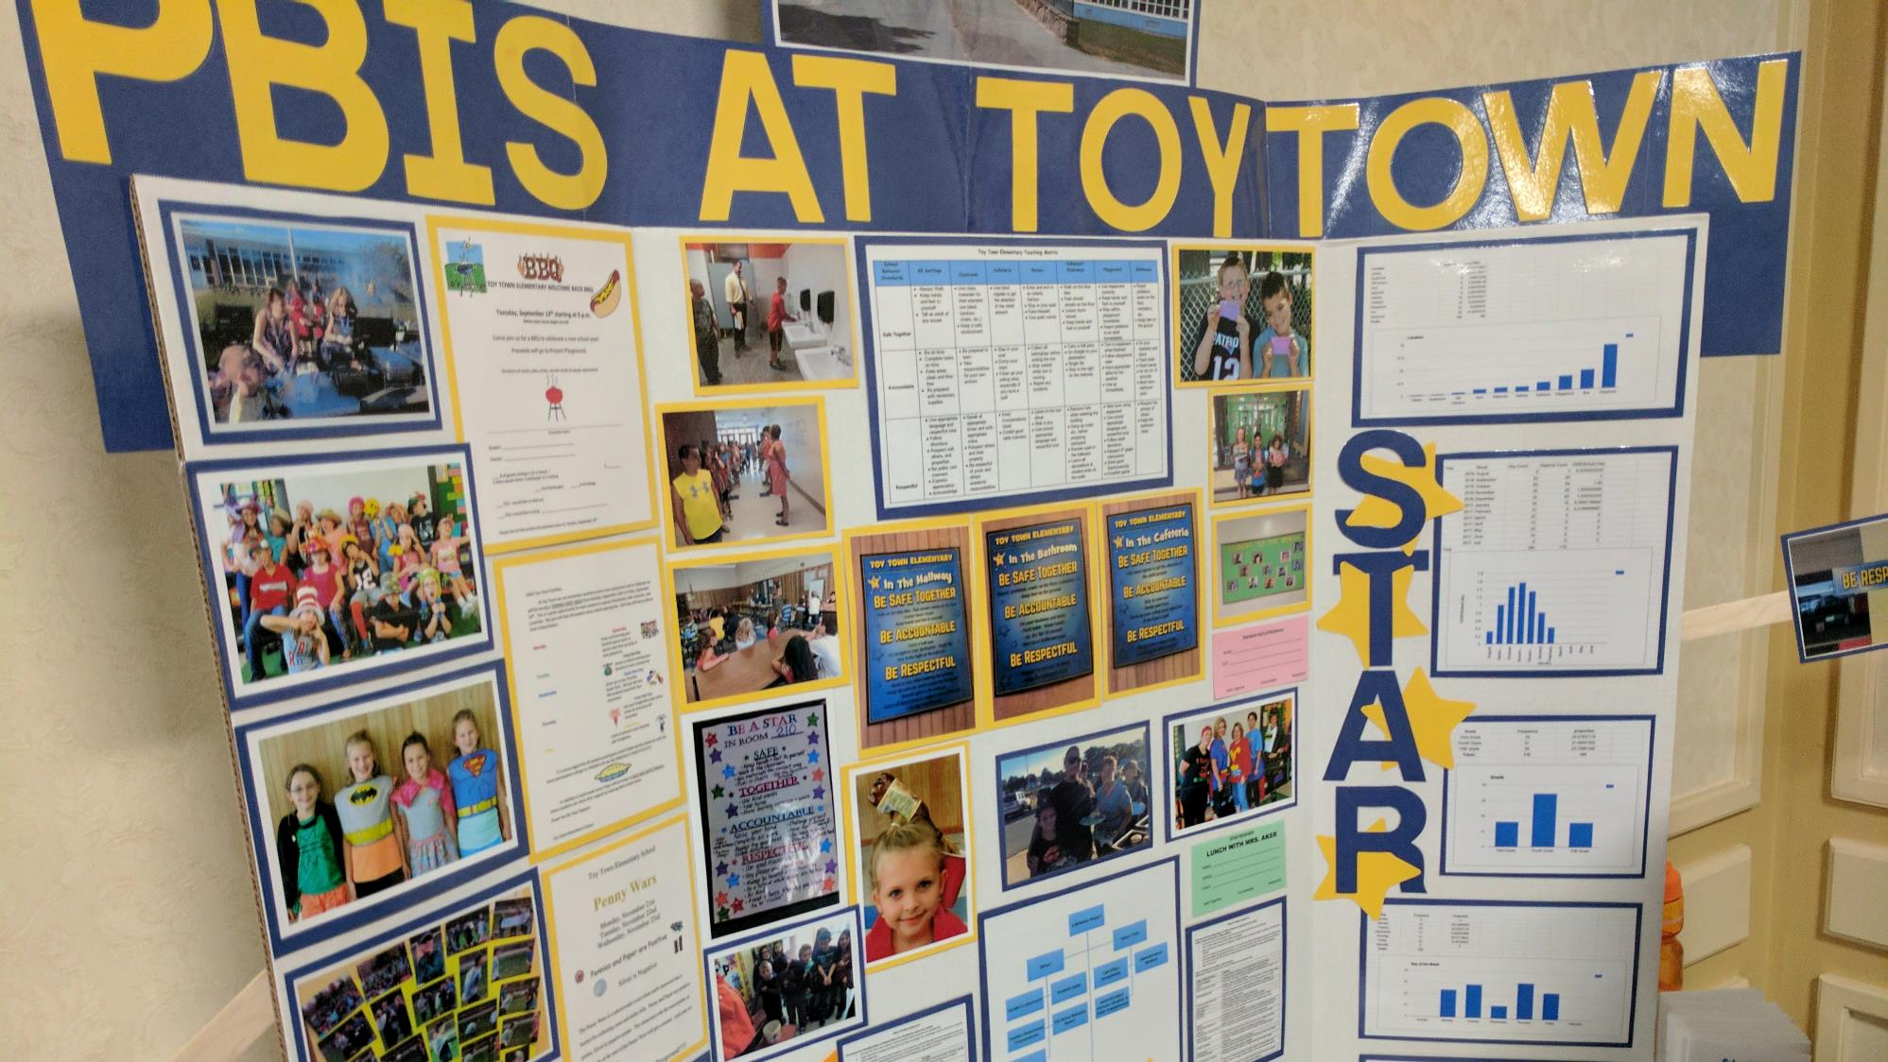

Slide 31
DISCUSSION: LOOKING AHEAD
Decide on a poster format and what you want to show off with your poster.
Discuss what next steps need to be completed between now and the March team training.
What further support do you need so you can support your team with this work?
5 minutes
5 minutes
With co-coach
Whole Group

Slide 32
Agenda & Coaches' Tasks
Presentation Content
Glows & Grows: School-Family Partnerships
Equity Review
Looking Ahead: March Poster session!
Coaches Tasks
Review areas where your PBIS Framework can be more culturally responsive. Discuss with your team and action plan.
Discuss with your team what you may want to include on your poster during the March team training.
Resource Spotlight
What questions do you have on today’s content?
What questions do you have on the follow-up tasks?

Slide 33
HELPFUL RESOURCES
RESOURCES:
Centering Equity within the PBIS Framework: Overview and Evidence of Effectiveness
Beginning to Address Equity in Tier 1 Systems
Discussing Race, Racism, and Important Events with Students
Tiered Fidelity Inventory
Family School Partnership Survey
Integrated TFI Companion Guide
Culturally Responsive Field Guide
Notes:
RESOURCES:
Centering Equity within the PBIS Framework: Overview and Evidence of Effectiveness: https://sebacademy.edc.org/centering-equity-within-pbis-framework-overview-and-evidence-effectiveness
Beginning to Address Equity in Tier 1 Systems: https://sebacademy.edc.org/beginning-address-equity-tier-1-systems
Discussing Race, Racism, and Important Events: https://sebacademy.edc.org/discussing-race-racism-and-important-current-events-students-guide-lesson-plans-and-resources
PBIS TFI Manual: https://sebacademy.edc.org/tiered-fidelity-inventory-tfi-manual
Family School Partnership Survey: https://uconn.co1.qualtrics.com/jfe/form/SV_4U9QPw9ASvLr83z
Integrated TFI Companion Guide -https://sebacademy.edc.org/integrated-tiered-fidelity-inventory-companion-guide
Culturally Responsive Field Guide -https://sebacademy.edc.org/pbis-cultural-responsiveness-field-guide

Slide 34
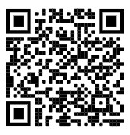
https://edc.co1.qualtrics.com/jfe/form/SV_cBF9GI7gVEBsfSC
EVALUATION
Please remember to complete the evaluation!
Scan the QR code to access.
Notes:
TRAINERS -
Put link to evaluation (below) in the chat for those who do not use the QR code:
https://edc.co1.qualtrics.com/jfe/form/SV_cBF9GI7gVEBsfSC

