Slide 1
Welcome tO THE
Tier 2 COACHES’ MEETing!
GETTING STARTED:
Update your display name in Zoom to read: [Your School], [Your Name] (e.g., Eastside HS, Joe Clark)
Complete the ATTENDANCE
Bookmark link to find training resources at : SEB PBIS Tier 2 Academy
In the chat, please share …
~15%
Notes:
LINKS for today:
Attendance
https://edc.co1.qualtrics.com/jfe/form/SV_5BiXqi4bxzOCMS2
New team member communications survey - https://edc.co1.qualtrics.com/jfe/form/SV_db8zhNj6NJ3eXga
EDC Website for SEB Academy
https://sebacademy.edc.org/
Event Evaluation (at the end)
https://edc.co1.qualtrics.com/jfe/form/SV_cBF9GI7gVEBsfSC

Slide 2


PBIS Coaching Meeting
TIER 2, Year 2
January 2023
Marcie Handler
with support from NEPBIS Network, May Institute & Broad Reach Consulting
Notes:
Add trainer names for your event

Slide 3

ACKNOWLEDGEMENTS
02
03
04
Northeast PBIS Network (nepbis.org)
01
Michigan Integrated Behavior & Learning Support Initiative
Dr. Heather George & FLPBIS
Missouri PBIS
Drs. Leanne Hawken, Deanne Crone, & Rob Horner
05
06
Midwest PBIS Network

Slide 4

EXPECTATIONS
Self
Others
Environment
Self-monitor
Mute when listening, unmute to talk​
Have electronics ready to use
Obtain help from peers and trainers
Work as a team:
Keep necessary materials at hand
Are you participating?
Engaged as a learner?
Stretch, break, stand as needed​
Room for every voice
Reinforce participation
action plan
relevant docs
water/snacks
Minimize distractions if possible​
Complete tasks efficiently
Notes:
Taking CARE of…

Slide 5
Agenda & Coaches' Tasks
Coaches’ Tasks:
1) Complete your TFI Tier 1 Self Assessment by Feb 17 (coach or team)
Presentation Content:
Resources: Tier 2 Academy Year 2 Structure; Building on Tier 1
BIG IDEAS: From Installing to Full Implementation
Nomination Form, Decision Rules, Universal Screening overview
Targeted Intervention Organizer
Glows and Grows: What routines are in place?
Team Profile and Meeting Schedule, 2022-2023 Action Plan
2) Share documents or folder with access to:

Slide 6










LEGEND
Timing
Example
Activity
Non-example
Guidelines
Preview
Big Idea
Review
Organization

Slide 7


ACTIVITY: ATTENDANCE
Use this link for ATTENDANCE
Follow prompts to enter attendance information
Notify trainers if you require assistance
Complete the evaluation at the end of the meeting to receive your Certificate of Attendance!
You are in Tier 2
Year 2
1 minute
Notes:
Zoom Link: https://us06web.zoom.us/j/86332996704?pwd=RnBIdTAxSm1VemJwV2RTUlFneEVPUT09
Meeting ID: 863 3299 6704; Passcode: 155276
Call-In Information: 1-929-205-6099 US or 1-309-205-3325 US
Attendance Link - https://edc.co1.qualtrics.com/jfe/form/SV_5BiXqi4bxzOCMS2
Evaluation Link - https://edc.co1.qualtrics.com/jfe/form/SV_cBF9GI7gVEBsfSC

Slide 8

Resources

Slide 9

FALL Technical Assistance (TA)
SECURE FEB/MARCH DATES
1:1 Coaching Support
or
Team Support
Establish
Routines
Work
smarter!
Review
Practices
Data-based Decisions
Evaluate
outcomes
Problem solve barriers
1 minute

Slide 10


ACTIVITY: SELF-ASSESS TIER 2 TFI (January/February)
Login to www.pbisapps.org
Click on PBIS assessments, then “open survey window.”
Click on SWPBIS TFI 2.1; “take survey”
Choose today’s date, team members w/o coach, and no walkthrough
Complete only Tier 2 items as a team
(2.1-2.13)
Add priority items to your action plan
PBIS TFI document
Plan for 20 minutes
Notes:
TRAINERS – Prompts for activity below; allow 30 minutes.
Login to www.pbisapps.org
Click on PBIS assessments, then “open survey window.”
Click on SWPBIS TFI 2.1; “take survey”
Choose today’s date, team members w/o external coach, and no walkthrough
Complete only Tier 2 items as a team (2.1-2.13)
Add items to your action plan; remember this is just a baseline!
For this administration, coaches can complete this or decide to conduct this after the meeting

Slide 11
Strengthening Classrooms across Tiers
Supporting and Responding to Students’ Social, Emotional, and Behavioral Needs: (Classrooms) (updated Jan 2022)
FACTS (Tier 2 or 3)
Class-wide Function-Based Intervention (CW-FIT)
MU Classroom Problem Solving Manual (Tier 2/3 in the classroom)
SEB Academy Classroom Resources
Notes:
"Supporting and Responding" summarizes evidence-based, positive, and proactive practices that support and respond to students’ social, emotional, and behavioral (SEB) needs in classrooms and similar teaching and learning environments (e.g., small-group activity). It walks through the critical components to effective classroom support and provides videos and examples.
It includes some suggestions for teachers when Tier 2 or 3 is needed, including a link to the FACTS – Functional Assessment Checklist for Teachers and Staff

Slide 12
Glows & Grows:
Tier 2 Foundations
Moving from
Tier 2 Initial Installation to
Full Implementation

Slide 13
Tier 2 FOUNDATION STEPS
Develop an equitable process for matching student need to practices
1
Establish a representative T2 leadership team
6
2
Develop a collaborative process for identifying students
Develop a process for progress monitoring, data-based decision rules
7
3
Evaluate, select and adopt culturally appropriate tier 2 practices
Develop procedures for modifying/ adjusting implementation
8
4
Develop a process to install selected practices
Develop evaluation routines for fidelity and outcome data
9
5
Develop procedures to train staff and students; partner with families and community
Document and share routines, practices, and policies
10

Slide 14
DISCUSSION: GLOWS & GROWS
What is something to celebrate & something you’re working on related to:
Tier 2 systems, practices, and data
Tier 2 roll out to staff, students, and families
Tier 2 DATA
Tier 2 fidelity tools
Tier 2 monitoring student progress and outcomes across intervention type
Add to our shared doc
3 minutes
10 minutes
Independent Jot
Whole Group
Notes:
As a follow up from the fall coaches meeting which focused on fidelity tools, progress monitoring tools, and how to track student progress across interventions…
https://docs.google.com/presentation/d/1vTArKNhe9ncl5wqXppNoj1__3PvErxEOx68Jx2HSO4E/edit?usp=sharing

Slide 15
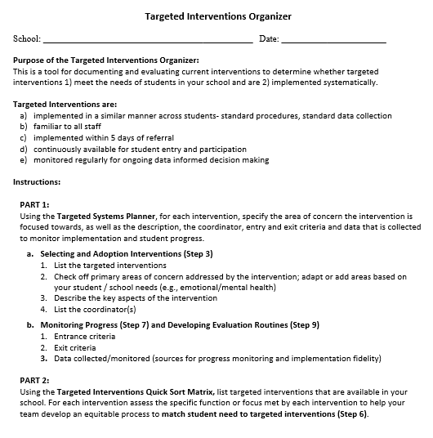
TARGETED INTERVENTIONS ORGANIZER
Systems
Purpose :
Document and evaluate current interventions
Determine whether targeted interventions
  1) meet the needs of students, and
  2) are implemented systematically
  + ENHANCED Communication
Notes:
The Targeted Interventions ORGANIZER gives teams some guidance to document and evaluate their current interventions.
During this process, we try to consider “fit” and “resources” in order to enhance, eliminate, or add interventions.
By establishing SYSTEMS, teams will be able to evaluate how meaningful and effective the interventions, if aspects need to be refined for them to work better, and what other interventions might be needed to address student needs.
Is your TIO complete???

Slide 16
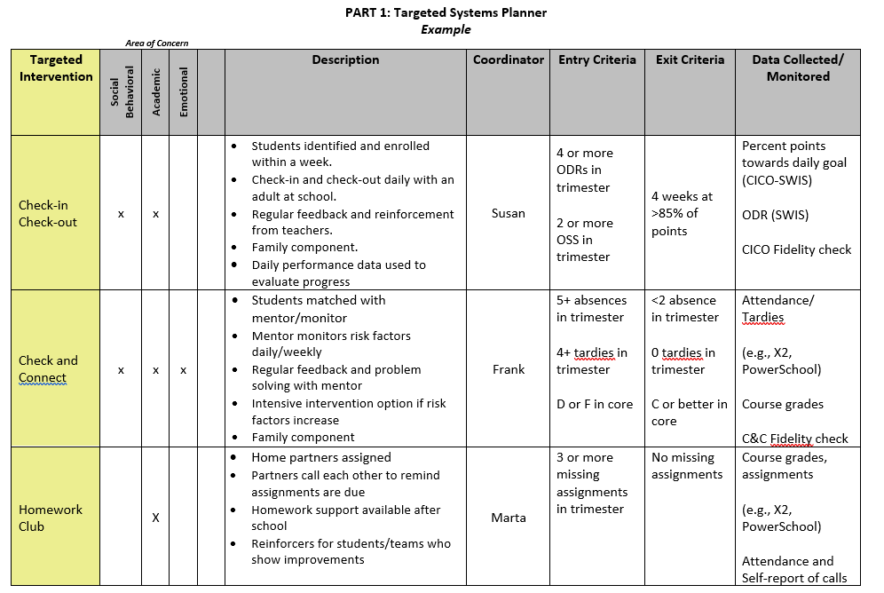
MEETING STUDENT NEEDS: PART 1
Notes:
Now we are ready for the TOOL
Part 1 is called the Targeted Systems Planner. This part provides teams with the chance to reflect on each intervention and how it may (or may not be) implemented systematically to provide meaningful outcomes.
On the left is the name of the intervention. Across the top some teams do a quick check off of whether they consider the intervention goals in area of concern (academic, social/behavioral, emotional or mental health focused).
This aligns well with Step 3 – select and adopt – first we need to see what we have and what global areas of concerns they address.
Then they describe the “essence” of the intervention – a few details and perhaps the purpose.
Teams might want to list the current year’s coordinator for each intervention to assist in planning and support for staff.
ADVANCED STEP: Sometimes teams expand the columns to show the frequency of the intervention (e.g., delivered daily, 1x per week, options of Monday or Wed). The name of the intervention, coordinator, and frequency of the intervention can also be something you put in a table at the end of the document if that seems easier.
The last three columns are areas you may not be quite ready for yet, but are critical for installing systems for data-based decisions.
Teams discuss what data will be considered to access or “enter” the intervention (e.g., ODRs, absences, missed assignments) and what data goal would indicate it’s time to “exit” or graduate from the intervention.
The last column reminds us of the data being collected to monitor implementation of the intervention (Fidelity) and student progress – what type of data, where can the team find the data that will be used to assess response to the intervention?
Reminders:
Don’t feel overwhelmed if your team doesn’t have each box filled in yet - that’s expected. Use this to identify those gaps and action plan as a team around a reasonable timeline to get aspects developed for ONE intervention.
Do that well and it will be easier to replicate for the next ones.

Slide 17
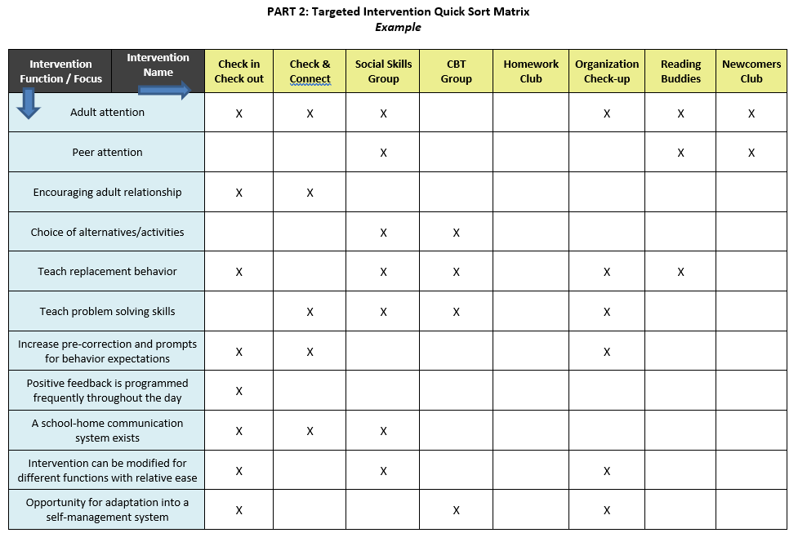
MEETING STUDENT NEEDS: PART 2
Did you update this?
Notes:
Part 2 is called the “Quick Sort Matrix”
So across the top we see the list of targeted interventions.
On the left side, we see the intervention focus and in some cases function. Essentially this is a quick way of seeing, in part 1, what interventions match to what need.
For example, Check in Check Out meets several student needs – it is well suited for students whose behavior is motivated by adult attention, and thus also serves to encourage adult relationships. CICO teaches students replacement behaviors such as how to gain attention appropriately. It’s structured to provide students with prompts and frequent feedback of behavioral expectations throughout the day by adults.
In this example, with an Organization Check-up, students will receive adult attention, but the primary purpose is to teach (weekly) problem solving strategies to help prepare academically and what we call replacement behaviors or other, more appropriate behaviors like scheduling meetings with teachers to access support instead of trying to avoid challenging tasks through missed assignments or disruptive behavior in class.
Some reminders as you complete this tool:
Typically, interventions will meet more than one of these needs or focus areas, but don’t expect it to meet all.
One size does NOT fits all – we need multiple interventions to meet multiple needs.
Schools do NOT begin with this many targeted social-emotional/behavioral interventions. It’s ok to only list a few to start the process.

Slide 18
GUIDING QUESTIONS when
Evaluating Targeted Interventions
Systems
Targeted Interventions are implemented:
in a similar manner across students - standard procedures, standard data collection
by relevant staff AND familiar to all staff
within 5 days of referral
continuously available for student entry and participation
monitored regularly for ongoing data informed decision making
Notes:
We will begin by doing an “INVENTORY” or list of our targeted interventions.
But before or as you list each intervention, the team should consider “does it meet the criteria as a targeted intervention,” meaning:
It can be implemented in a similar manner across multiple students – standard procedures and standard ways of collecting data on student progress builds efficiency in the delivery of interventions and improves access for students.
It also means that all staff are at least familiar with the ‘menu’ of interventions available, and what their role might be in implementing or assisting in the intervention.
Tier 2 interventions are implemented within 5 days of a ‘referral’ meaning either a request/nomination by staff or review of data patterns such as behavioral referrals to the office, attendance, nurses visits, guidance visits, mid-term progress reports, etc. The key here quick access - being pro-active reduce risk rather than a ‘wait and see’ approach
Continuously available for student entry and participation – this means that students can begin an intervention at any point in the year, rather than wait for the intervention to become available (e.g., a spot in a social skills group facilitated by the school counselor).
Intervention can be monitored regularly using standard data collection procedures and that data are used for decision making (more to come about that)
If it meets this criteria, keep it on the list.
If it doesn’t, what might be needed to ‘round’ out the intervention (e.g., a uniform checklist that all teachers use, a way of collecting data when students attend a skills group)?

Slide 19
GUIDING QUESTION:
GROUPING COMMON NEEDS
Systems
Do identified students have similar instructional needs?
  Skills to develop vs. Skills to practice/improve using (skill deficits) (performance deficits)
Do identified students have both academic and emotional/behavioral needs?
Are identified students’ academic needs similar?
Are the functions of behavior (assessed informally) similar across students?
Notes:
When we think about how students might be grouped for targeted interventions, remember that we are considering the similar manner in which the intervention is delivered across students because of their need – so staff gain efficiency in intervention design, standard procedures, and standard data collection and multiple students receiving a standard intervention. It does not necessarily mean the intervention is always received in a group format. That can sometimes be confusing to school teams.
So we ask as a guiding question when we consider the TYPES of targeted interventions if there are common needs.
Common needs = standard, quicker access interventions and more groups of students getting support
Do identified students have similar instructional needs?
Do identified students have both academic and emotional/behavioral needs?
Are identified students’ academic needs similar?
Are the functions of behavior (assessed informally) similar across students? (meaning can we make some informed assumptions about what the function is and deliver an intervention that meets the function?)

Slide 20
ACTIVITY: Targeted Intervention Organizer
Review the Targeted Intervention Organizer from last year and determine:
Is it complete for at least 1 intervention?
What methods did you add to monitor fidelity and progress?
What other interventions do you want to target for this year?
Have you complete Part 2, quick sort matrix?
15 minutes

Slide 21
How Matching to Need can lead to
Adaptations or
Expanding our Tier 2 Toolbox

Slide 22
Tier 2 FOUNDATION STEPS
1
Establish a representative T2 leadership team
6
Develop an equitable process for matching student need to practices
2
Develop a collaborative process for identifying students
7
Develop a process for progress monitoring, data-based decision rules
3
Evaluate, select and adopt culturally appropriate tier 2 practices
Develop procedures for modifying/ adjusting implementation
8
4
Develop a process to install selected practices
Develop evaluation routines for fidelity and outcome data
9
5
Develop procedures to train staff and students; partner with families and community
Document and share routines, practices, and policies
10

Slide 23
Common Tier 2 Interventions
Social / Emotional skills (e.g., self-regulation)
Coping skills (anxiety, depression)
Academic / organizational skills
CBT
Check In/ Mentoring
Skills Groups
Counseling Groups
Classroom Interventions
Check in (with an adult)
Check in Check Out (CICO-BEP)
Check and Connect (Mentoring + Monitoring)
Enhance social skills instruction in the classroom (CW-FIT)
SEB curriculums, lessons on classroom ‘survival’ skills)
Therapeutic focus
Topic specific (e.g., grief, trauma, gender identity)
Diversion programs
Notes:
CW-FIT (MO and KU):
The CW-FIT program is a multilevel group contingency intervention that broadly addresses common functions of problem behavior. The CW-FIT is considered a classroom-level primary intervention because it is used with all students in a class. For students not responding to the primary-level intervention-group contingency, secondary-level or targeted interventions of self-management and help-card procedures are implemented. Students that do not respond to either primary or secondary intervention are candidates for a functional behavior assessment (tertiary level).
https://www.youtube.com/watch?v=PR_D291by4E
https://charts.intensiveintervention.org/intervention/toolSGL/3539f6442db882bf
https://www.ncbi.nlm.nih.gov/pmc/articles/PMC4532396/

Slide 24

Empirically-Supported Tier 2 Interventions
1. Check-in Check-out (CICO)
2. Check and Connect (Mentoring/ Monitoring / Goal setting)
3. SAIG – Social Academic Instructional Groups (“skills”) groups
  Classroom skills
  Organizational skills
  Social / Emotional skills
SSIG - Social Skills Intervention Groups
4. Mentoring
5. REP – Resilience Education Program (CBT+CICO)
6. Class-wide Function-Based Intervention (CW-FIT)
7. MU Classroom Problem Solving Manual (Tier 2/3 in the classroom)
EXAMPLES
Notes:
These are Tier 2 practices that schools often implement and we are using these as examples to help demonstrate the various system, data, and practices features.
What do these interventions have in common? What are some critical features?
https://checkandconnect.umn.edu/
Overview video - https://www.youtube.com/watch?v=3_-AFbDLn9c
https://smhcollaborative.org/rep/
Milwaukee PBIS Social Academic Intervention Groups (SAIG) – go to the website for a list of lessons
Missouri SWPBS Social Skills Intervention Group (SSIG) – go to website for sample tools to install social skills groups

Slide 25
DISCUSSION: T2 Practices
Based on your inventory, where would you like to dive in?
CICO modifications;
Social Skills alignment;
REP
Check and Connect
10 minutes

Slide 26

CICO +
Adaptations to CICO

Slide 27
Checking in on CICO
Practices
And intervention modifications

Slide 28
CICO TIPS
Don’t enroll every student on CICO (but consider enrolling 5-10%!)
Enroll students who like attention from teachers
Don’t start every student with their own personalized card
Don’t leave students on it forever
Fade students of with self-management
Focus on fidelity of implementation

Slide 29
5 W’S OF TIER 2 MODIFICATIONS
1
2
3
4
WHO
Modify who is offering the intervention (e.g., preferred adult, peer)
WHAT
Modify what is being offered (e.g., intervention type)
WHERE
Modify where the intervention is occurring (e.g., classroom, SP office)
WHEN
Modify when it is being offered (e.g., frequency, intensity)
5
WHY
Modify WHY the intervention (e.g., consider FUNCTION, consult data)

Slide 30
CICO Modifications
Self-Management
Peer Attention
Integration with Social Skills
Escape-Maintained
With Academic Supports

Slide 31
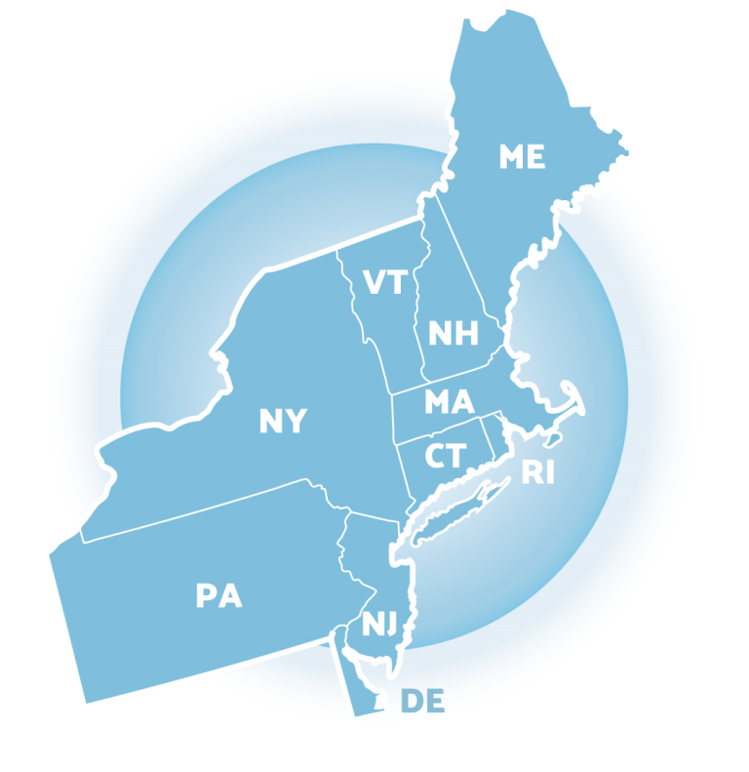
SELF-MONITORING

Slide 32
TEACH SELF-MANAGEMENT
Self-Management: the ability of an individual to make changes in her/his environment that result in changes to her/his behavior
→ Often implemented in conjunction with other interventions (e.g., CICO) with varied levels of teacher support or scaffolding
→ Can be used to:
  Maintain behavior change once interventions are faded
  Support the overall goal of CICO - to teach students to self-manage their behavior
Self-management can be used as a stand-alone intervention, or as part of the fading process for students who have responded positively to intervention
  (Cheney & Yong, 2014; Cooper, Heron, & Heward, 2007; Crone, Hawken, & Horner, 2010; Miller, Dugrene, Olmi, Tingstrom, & Filce, 2015; Skinner, 1953).

Slide 33
BENEFITS OF SELF-MANAGEMENT
Addresses problem behaviors privately
Reduces adults’ efforts
Promotes generalization and maintenance of behavior change
Efficient! A few self-management tactics can address many behaviors
Works for a wide-ranging population
As effective as other external strategies
Contributes to a more efficient and effective classroom environment
Students who are successful can be peer leaders or ambassadors for others
Self-management is an ultimate goal of education: an important skill to teach!

Slide 34
MOVING TOWARDS SELF-MANAGEMENT: CICO
Teach student to rate their behavior (self-evaluation)
Compare student & teacher behavior ratings → discuss discrepancies and reinforce for accuracy
Once accuracy is established, reinforce for behavior (rather than accuracy)
Continue self-evaluation; add self-reinforcement & fade check-in (1x/day)
Continue to fade CICO

Slide 35
CICO FORM (DAILY PROGRESS REPORT): REVIEW
CICO Form
Name: ________________ Date: ______________
2 = great 1= OK 0= hard time
 | Safe | Responsible | Respectful
Check In | 2 1 0 | 2 1 0 | 2 1 0
Before Recess | 2 1 0 | 2 1 0 | 2 1 0
Before Lunch | 2 1 0 | 2 1 0 | 2 1 0
After Recess | 2 1 0 | 2 1 0 | 2 1 0
Check Out | 2 1 0 | 2 1 0 | 2 1 0
Today’s goal: |  | Today’s total points:
Comments:
Notes:
Discuss student self-rating; matching with teacher…

Slide 36
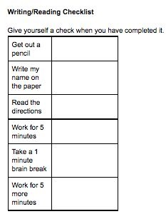
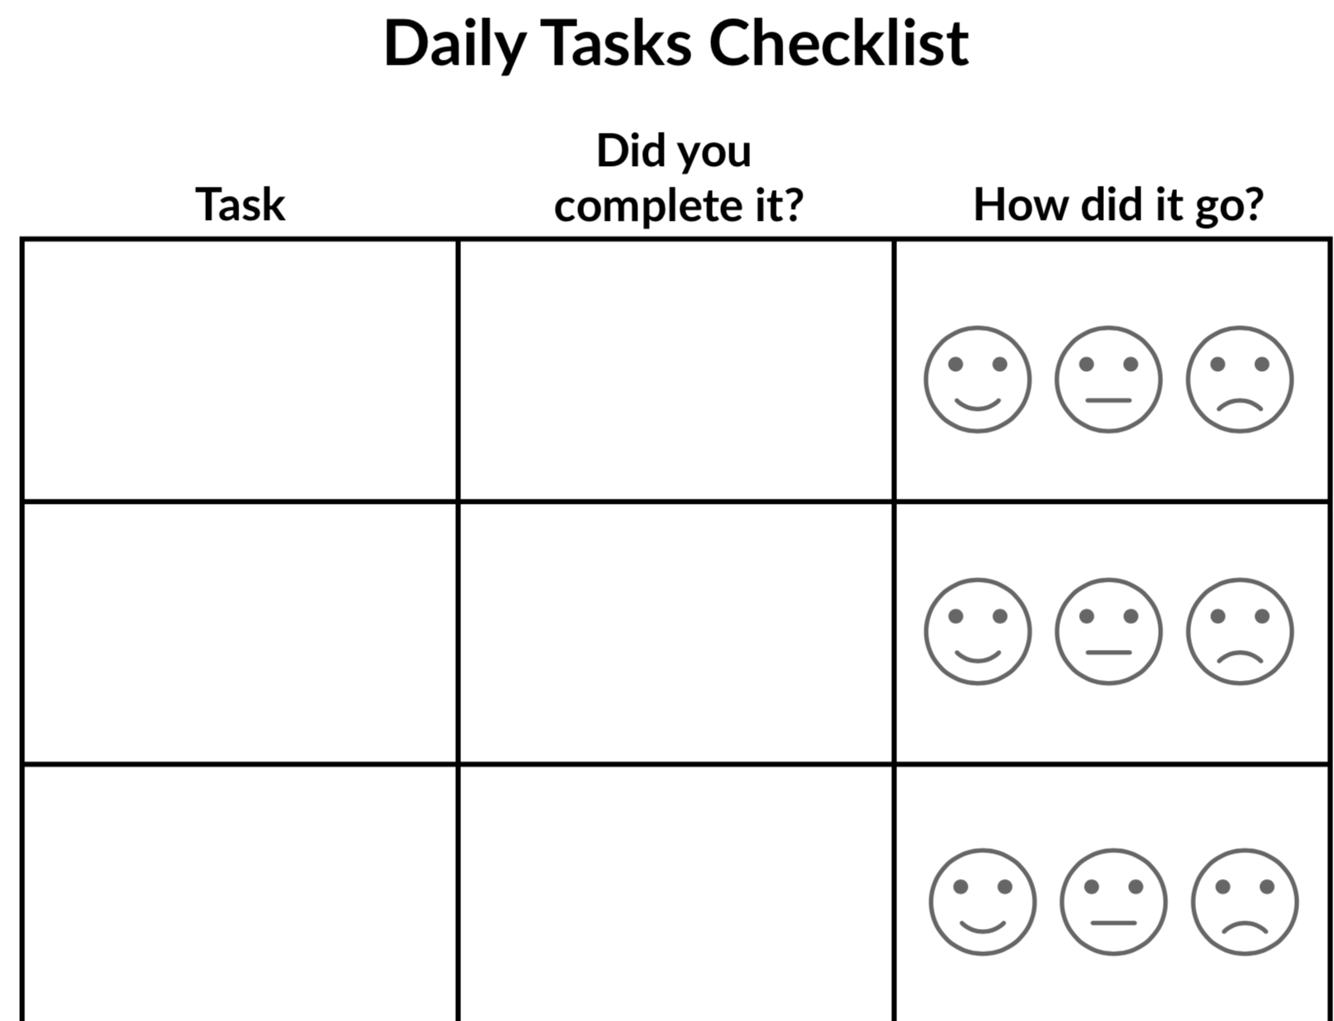
EXAMPLE: SELF-MONITORING, TRADITIONAL PAPER & PENCIL
Traditional Self-Monitoring
Technology-Based Self-Monitoring (TBSM)

Slide 37
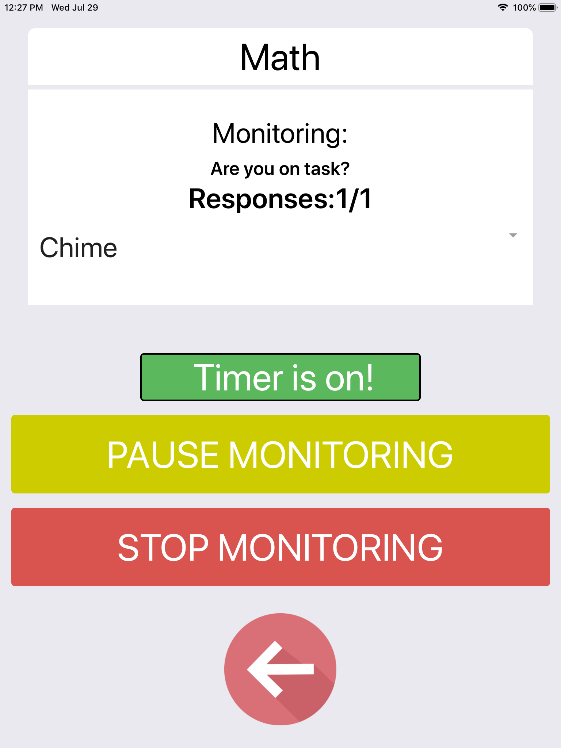
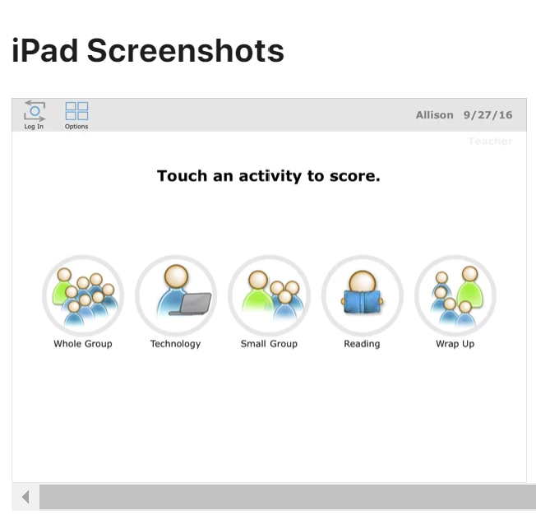
EXAMPLE: TECHNOLOGY-BASED SELF-MONITORING (TBSM)
Respond in the Chat:
What strategies have you used to SM your students? What students would respond to SM? How will you plan for this?
I-Connect
SCOREIT
CellF-Monitoring

Slide 38
Modifications: Consider Function!
Function | Intensified CICO | SAIG | Academic Seminar | Mentoring | FBA/BIP
Access to Adult Attention | ✔ | ✔ | ✔ | ✔ | ✔
Access to Peer Attention | ✔ | ✔ | ✔ | ✔ | ✔
Access to Tangible | ✔ |  |  |  | ✔
Avoiding Peer Attention | ✔ |  |  |  | ✔
Avoiding adult Attention | ✔ |  |  |  | ✔
Work Avoidance | ✔ | ✔ |  | ✔ | ✔

Slide 39
EXAMPLE: MODIFYING CICO FOR STUDENT WITH PEER ATTENTION-MAINTAINED BEHAVIOR
Have student check in with a peer
Consider an older student or a student that has completed self-management phase.
Modify reinforcement system so that they earn time with a peer / friend
Earn access to work or engage in free time

Slide 40
EXAMPLE: BREAKS ARE BETTER
Escape Motivated CICO
Similar CICO Routines
  Check in with coordinator to review expectations, ensure materials ready for the day
  Hand in DPR to teachers, feedback at the end of each class/subject
  Check out at the end of the day
Modifications
  Can request a predetermined # of brief (e.g., 2 minute) breaks throughout the day, recorded on DPR
  During breaks, students can engage in approved activity (e.g., drawing, books, alternative assignments)
  Break routines taught and reinforced

Slide 41
What students would respond to BrB? How will you plan for this?
Activity
Points Possible
How Points are Earned
Morning Check-in
2
Student attends Check-in (1) and has materials
Feedback
Up to 2 per Expectation
Meet behavioral and academic expectations
Break Tracker
1 per feedback session
Taking breaks appropriately when needed
Afternoon Check-out
2
Attended check-out and (1) and have teacher(s) ratings (1)

Slide 42
EXAMPLE: ACADEMIC MODIFICATIONS TO CICO
Modify goals to address academic organization needs
E.g., planner use & maintenance, notebook organization, goal setting for academic/ social behaviors, tracking progress, test taking, study strategies (Swain-Bradway & Horner, 2010)
If using CICO, have students have 3 to 5 minute academic skills practice at end of day during check-out
Modify plan to address academic needs
Refer to academic interventions team

Slide 43
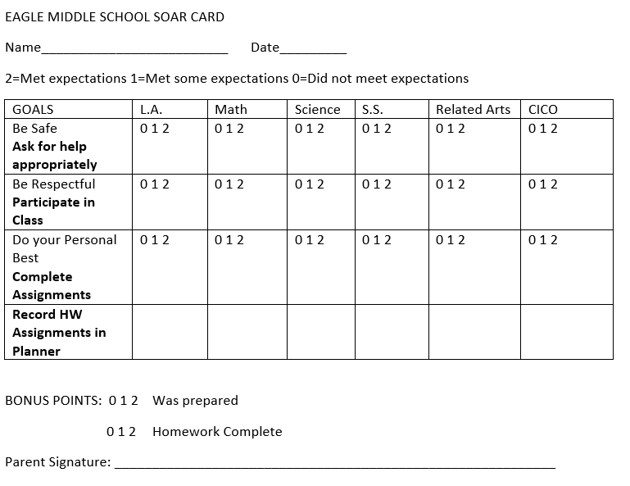
EXAMPLE: CICO PLUS ACADEMIC SUPPORTS
How could you modify your CICO DPR to add academic expectations and behaviors?

Slide 44
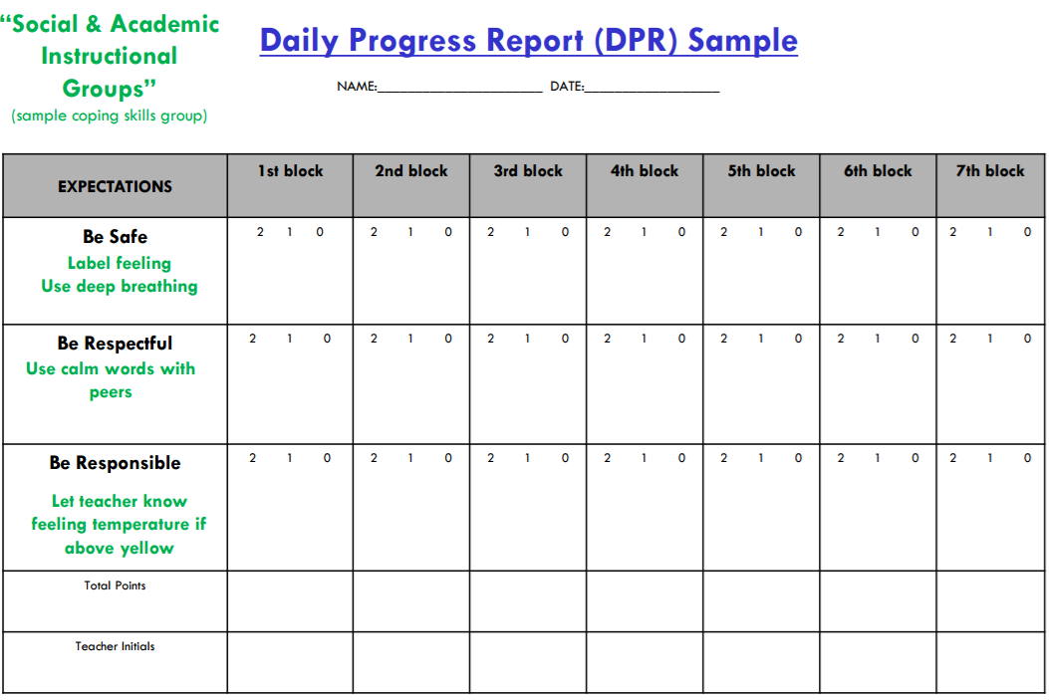
INTEGRATION WITH ADDITIONAL INTERVENTIONS
(Eber, 2016)

Slide 45
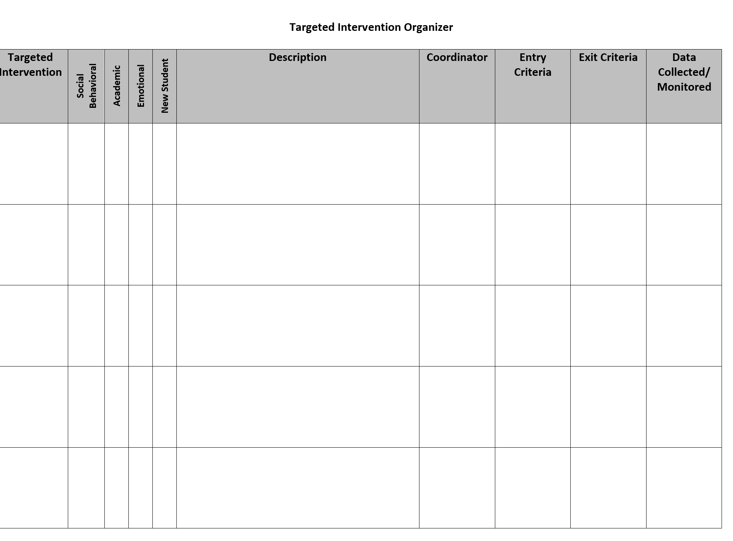
ACTIVITY: CICO Modifications
Discuss CICO modification options
Add those that you think you might want to incorporate to your inventory
Discuss how/when to implement

Slide 46
DISCUSSION: CICO Modifications
What modifications might you adopt?
What steps do you need to take to incorporate this modification for students and staff?
How can you standardize these modifications for efficiency?
5-10 minutes

Slide 47
Social Skills Groups
Aligning with Critical Features

Slide 48
SOCIAL SKILLS GROUPS
Social Skills Training includes direct instruction of appropriate social behavior. Instruction can be delivered to small targeted groups of students. Direct instruction includes modeling of appropriate behavior, feedback on behavior, and opportunities to practice appropriate behavior.
(Hawken et al., 2009)
Notes:
Intended to be a quick overview of social skills instruction; have participants evaluate how current practices match critical features and implementation guidelines for T2

Slide 49
SOCIAL SKILLS INSTRUCTION: FEATURES
Increased positive adult contact
Direct social skills training
Direct link to school-wide behavioral goals and expectations
Frequent feedback (daily or weekly)
Increased home-school communication
Plans for generalization and maintenance
Positive reinforcement contingent on meeting skill-based goal
Notes:
MW
Students all need to be involved in the development.

Slide 50
SOCIAL SKILLS INSTRUCTION WORKS!
Research conducted on social skills interventions demonstrates positive outcomes across ages, level of support needs, and types of skill deficits, especially when specific strategies are included to program for skill maintenance and generalization
(e.g., Gresham, Sugai, & Horner, 2001; Lane, Menzies, Barton-Arwood, Doukas, & Munton, 2005; Miller, Lane, & Wehby, 2005; Quinn, Kavale, Mathur, Rutherford, & Forness, 1999; Ray and Elliott, 2006)

Slide 51
SOCIAL SKILLS GROUP FEATURES
Few Students, High Rates of Adult Attention
Situated Learning
Systematic, Explicit Instruction
Modeling
Sequencing Positive & Negative Examples
Rehearsal & Problem Solving with Feedback
School-to-Home Communication
Self-Assessment & Recording

Slide 52
CONSISTENCY BETWEEN TIER 2 STRATEGY & SW EXPECTATIONS
Do Tier 2 interventions use the language of Tier 1 supports?
Can materials for Tier 2 interventions align with Tier 1 supports?
Can Tier 1 acknowledgment practices be included in Tier 2 interventions?

Slide 53
ALIGNMENT EXAMPLE
Infraction | Failure to Comply | Inappropriate Language | Tardiness
Linked SW Expectation | Responsible | Respectful & Reflective | Responsible
What You Want The Student To Do | Cooperate with instructions & directions timely | Use appropriate words to express sentiment (e.g., considerate, polite, kind, professional, etc.) | Be in seat when bell rings
Social and Emotional Skills to Teach | Asking for help Active listening Paraphrasing understanding Managing frustration (e.g., positive self-statements, deep breaths) | Stop-think-act Managing disappointment Turning the conversation Making a complaint Reframing negative thoughts | Managing transition time Planning ahead Self monitoring Using conversation enders (e.g., “catch you later”)
Notes:
Reminder: What’s the difference between a SKILL DEFICIT and a PERFORMANCE DEFICIT:
Skill deficit: “I don’t know what to do or how to do it”
Performance deficit: “I have been taught the skill, but don’t consistently use it or apply it across different situations.”
Link school-wide expectations to specific, observable behaviors that you want students to demonstrate (what you want the student to do).
Determine whether there needs to be adaptations / reinforcement / feedback delivered in the environment to support the USE of those behaviors, and/or if additional skill INSTRUCTION is needed to ACQUIRE and consistently use those skills.
Identify specific SEL skills to teach students so they can meet those expectations

Slide 54
STUDENT OPPORTUNITIES TO PERFORM & GET FEEDBACK
How will staff model appropriate behavior?
How will the environment be organized to provide regular opportunities for skill practice & feedback?
How will staff be trained to do these activities?
How does your school support student social skill practice across school settings?
Outside of planned lessons?

Slide 55
Daily Progress Report (DPR) Sample
Social Academic Instructional Groups
Individualized Student Card for Mark
(FBA/BIP)
EXPECTATIONS | 1st block | 2nd block | 3rd block | 4th block | 5th block | 6th block | 7th block
Be Safe | 2 1 0 | 2 1 0 | 2 1 0 | 2 1 0 | 2 1 0 | 2 1 0 | 2 1 0
Be Respectful | 2 1 0 | 2 1 0 | 2 1 0 | 2 1 0 | 2 1 0 | 2 1 0 | 2 1 0
Be Responsible | 2 1 0 | 2 1 0 | 2 1 0 | 2 1 0 | 2 1 0 | 2 1 0 | 2 1 0
Total Points
Teacher Initials
Mark will keep hands to self
Walk to class
Keep hands to self
Mark will hold up a yellow card to indicate needing a break
Use appropriate language
Raise hand to speak
Possible behaviors taught in previous SAIG groups
Replacement behavior
Mark will fill out assignment notebook
Bring materials
Fill out assignment notebook

Slide 56
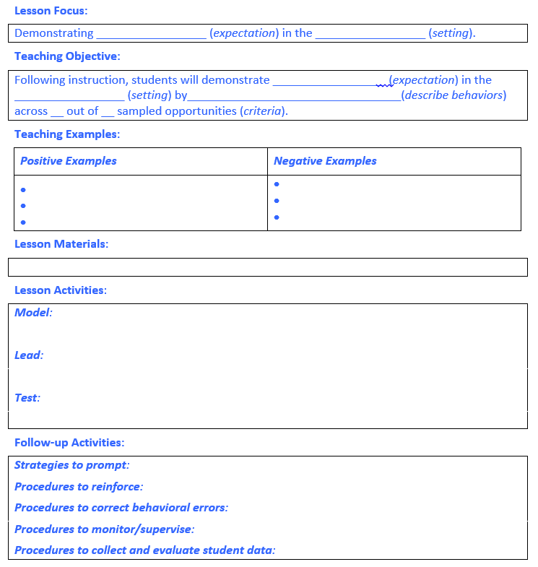
EXAMPLE BEHAVIOR LESSON PLAN
Notes:
Workbook page 57

Slide 57
PACKAGED CURRICULUM
Second Step
  (Grades PreK-8)
Thinking, Feeling, Behaving
  (Grades 1-12)
Tough Kids Social Skills
  (Grades 3-7)
Walker Social Skills Curriculum
  (Grades 6-12)
Skills Streaming
  (Grades Prek-12)
Stop & Think Social Skills
  (Grades Prek-8)
Passport
  (Grades 1-12)
I Can Problem Solve
  (Grades PreK-6)
Aggression Replacement Training
Academic Seminar
  (Grades 5-12)
All of the above examples can be used to develop universal behavior lesson plans.

Slide 58
MILWAUKEE SAIG (SOCIAL ACADEMIC INSTRUCTIONAL GROUP) CURRICULUM
Free access
Based on Skill Streaming & other evidence-based methods
Scripted Lessons:
  Emotional Management Skills
  Classroom Survival Skills
All levels: ES/MS/HS
Click Here to Access
Notes:
http://mps.milwaukee.k12.wi.us/en/Families/Family-Services/Intervention---PBIS/SAIG-Curriculum.htm

Slide 59
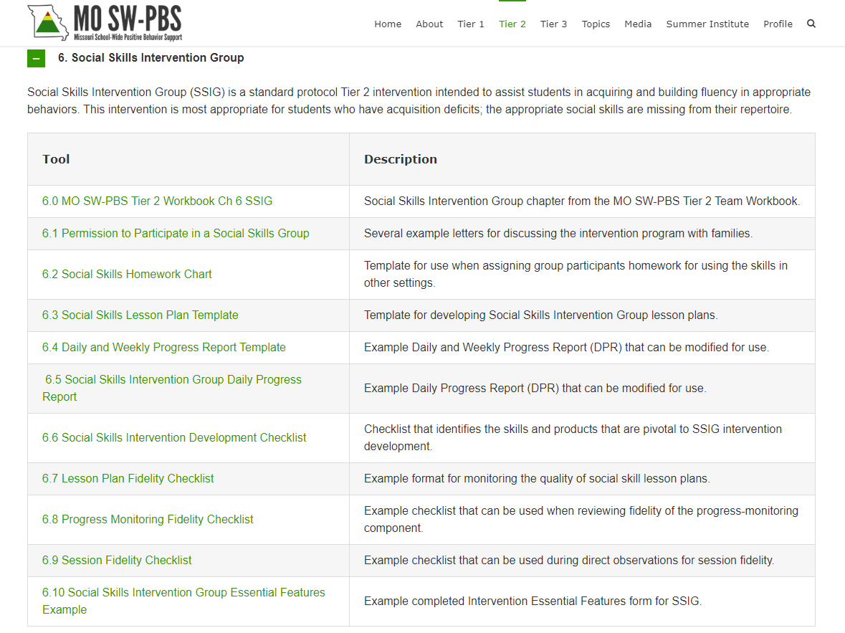
MISSOURI SOCIAL SKILLS INTERVENTION GROUPS (SSIG)
Click Here to Access
Resources to support installation of social skills groups
“Logistical” considerations
Notes:
Social Skills Intervention Group (SSIG)
Tier 2 Workbook & Resources - Learning System Missouri Schoolwide Positive Behavior Support (pbismissouri.org)
Take time

Slide 60
ACTIVITY: Social Skills Groups
To what extent do your skills groups align with T2 critical features?
Are there places for standardization?
How will/do you support Tier 1 social skills instruction?
1

Slide 61
DISCUSSION: Social Skills Groups
What do you have in place?
What steps do you need to take to standardize groups?
What steps do you need to take to complete the inventory for your skills groups (e.g., entry and exit criteria)
What logistics need to be considered to support installation of this practice?
5-10 minutes

Slide 62
Check & Connect

Slide 63
Check & Connect
Target population: students who show warning signs of disengagement from school, grades K-12
  Poor attendance, behavioral challenges, and/or low grades
Check & Connect features:
  Building a trusting relationship between the student and a trained mentor
  Students are followed for at least 2 years
  Focus on home-school relationship
  Check: mentors systematically monitor student performance data (e.g., absences, tardies, ODRs, grades)
  Connect: mentors provide individualized interventions to help students solve problems, build skills, and enhance competence
(http://checkandconnect.umn.edu/model/default.html)

Slide 64
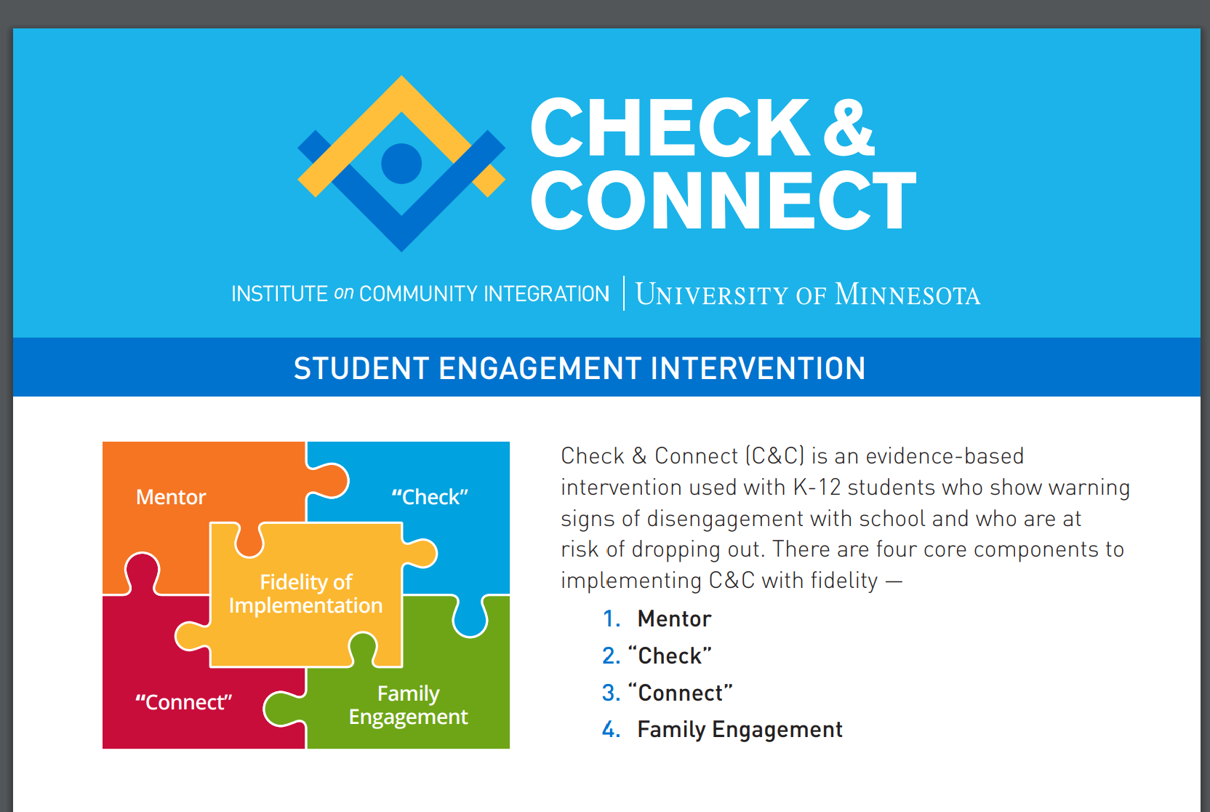

Slide 65
Research Outcomes
Of the dropout prevention interventions reviewed by the U.S. Department of Education’s What Works Clearinghouse, Check & Connect is the only program found to have strong evidence of positive effects on staying in school

Slide 66
Student Outcomes
Increase in:
Attendance
Persistence in school
Credit accrual
School completion rates
Decrease in:
Truancy
Tardies
Behavioral referrals
Dropout rates

Slide 67
Check & Connect Video
https://youtu.be/D93gwDLLUic

Slide 68
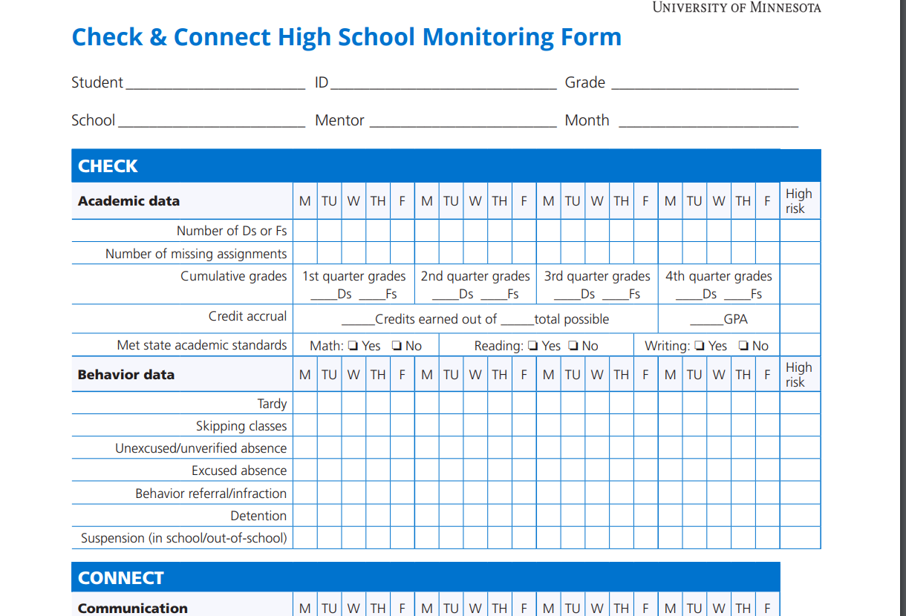

Slide 69
Check and Connect Mentors
Builds long-term relationships with students (2 years); support can be 2-3 students or one dedicated staff member supporting from 30-50 students
Supports student engagement and goal setting
Tracks progress weekly across indicators
Individualizes interventions based on data
Connects and collaborates with families
Collaborates with outside agencies

Slide 70
Check & Connect Resources
Check & Connect Manual
Training options to support implementation with fidelity
Asynchronous trainings available
Check & Connect App
Progress monitoring
Assess fidelity and impact
Manual and additional information, including implementation options and funding tips, on website

Slide 71
RESILIENCE EDUCATION PROGRAM

Slide 72

RESILIENCE EDUCATION PROGRAM (REP)
Tier 2 intervention for students with internalizing disorders (anxiety & depression)
Combination of CICO & Cognitive Behavioral Instruction
For elementary & middle school students (Grades 4-8)
Initial evidence to support (e.g., Allen, Kilgus, & Eklund, 2019)
Free materials!

Slide 73

REP: TWO COMPONENTS
REP
CBI
CICO
Cognitive Behavioral Instruction (CBI)
  Five lessons, taught across five weeks
  Small-group format (3-5 students)
  Focus on key skills
    Coping skills
    Cognitive restructuring
    Problem-solving skills
Modified Check In/Check Out (CICO)
  Check in and out with a mentor each day
  Teacher feedback throughout the day regarding skill use and other positive behaviors
  Connection with parents

Slide 74
REP: CORE CHARACTERISTICS
Efficiency
  Takes only a few weeks
  CICO: few minutes per day for teachers and mentors
  CBI: 30-45 two times per week
Relevance
  Includes intervention elements already being used in schools
General
  General CBI applicable to both depression and anxiety

Slide 75
REP: THEORY
CBI
  Student-oriented
  Instruct key social-emotional skills
CICO
  Ecologically-oriented
    Educators
    Parents and caregivers
  Prompt and reinforce student use of those skills
Home
School
CBI

Slide 76
OVERVIEW OF REP
Check-In/Check-Out
CICO occurs for 10 weeks; Students receive increased adult attention and performance feedback along with reinforcement of coping skills
Small group CBI Lessons
Small group lessons occur 2x/week for 5 weeks; students learn coping and problem-solving skills

Slide 77
MODIFIED CICO

Slide 78
CICO Procedures
Typical CICO
Morning check in with REP mentor
Teacher feedback and praise throughout the day
Daily Progress Report (DPR)
Afternoon check out with REP mentor
Home-based reinforcement
Progress monitoring via DPR
Self-monitoring (fading)
Modified Components
Modified DPR targets
  Skills aligned with CBI
  Other positive behaviors
Students self-rate their mood throughout the day
Notes:
lesson components corresponding to verbal instruction, modeled instruction, opportunities for practice with feedback, and homework assignments.
Appendix A

Slide 79
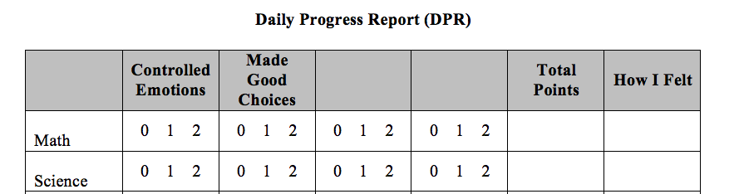
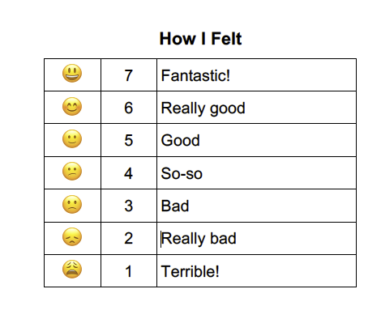
CICO PROCEDURES
Teacher Feedback & Praise
At the end of each activity…
  Teacher rates student behavior
    CBI-aligned behaviors
    Positive replacement behaviors (need to select)
  Delivers praise
  Minimizes attention to inappropriate behavior
  Student rates his or her mood
    Behavior <–> Mood
Notes:
Teachers rate student behavior on how well student controlled emotions, made good choices, and one additional specific replacement behavior on scale of 0 to 2 (Never to Often)
Students rate own feelings on 7-point Likert scale

Slide 80
COGNITIVE-BEHAVIORAL INSTRUCTION

Slide 81
REP INTERVENTION: CBI LESSONS
Team building and introduction
Identifying strong feelings
Using cognitive restructuring
Using problem-solving strategies
Using coping skills to manage emotions
Say-Show-Do Direct Instruction Model:
  Define key skill and explain importance
  Provide steps for using the skill
  Model steps for using the skill
  Role-play opportunities
  Goal-setting and homework
Notes:
lesson components corresponding to verbal instruction, modeled instruction, opportunities for practice with feedback, and homework assignments.
Appendix A

Slide 82
SETTING UP YOUR GROUP
Size of Group
Number of Weeks
Lesson Format
Two 30-minute lessons each week
One 45-50 minute lesson once a week
3 to 5 students ideal
2 or 6 students possible, but challenge
Can be done in 5 weeks
6 weeks better if content runs over
Notes:
Ideally 3-5 students – can do it with 2 or 6 but both pose challenges. What do you think those are?
Beauty of the group is it can be done in 5 weeks. Better to give yourself 6 weeks as sometimes content can run over!

Slide 83
REP LESSON FORMAT
General objectives
Concepts taught
Materials needed
SAY
  Provide direct instruction and definition of concepts covering
SHOW
  Provide examples through modeling and/or video demonstration
DO
  Provide opportunity for students sharing and acting out examples
Generalize
  Homework
Summary

Slide 84
These materials are freely available for download and available for use with students in Grades 4-8 who may be demonstrating early signs of internalizing concerns (e.g., anxiety, depression).
Curriculum includes manuals for delivering the 5-week Cognitive Behavioral Instruction (CBI), Student Handbooks to accompany the CBI, and a Resilient Families manual to engage parents/caretakers.
All free here!

Slide 85
WINTER Technical Assistance (TA)
FEB/MARCH DATES
1:1 Coaching Support
or
Team Support
Establish
Routines
Work
smarter!
Review
Practices
Data-based Decisions
Evaluate
outcomes
Problem solve barriers

Slide 86
TFI SELF-ASSESSMENT x 2
Jan/Feb: Self-assessment (coaches or with teams) (progress monitoring)
Complete by Feb 17
Pick 1 item to focus on
April-May: Assessment
Tier 2: With external coach (Marcie)
Tier 1: survey will be open for them to complete independently
* Determine team date for April/May
PBIS TFI document
Plan for 30 minutes

Slide 87
SPRING Coaches Meeting
Communicate Interest in Topic Areas
Tuesday April 4th, 9-11am
BIG IDEAS
EXPAND on: Evaluating and Selecting Tier 2 Practices using the Targeted Intervention Organizer
Possible Topics:
Data based decisions (drill down using the T2/T3 student monitoring tool)
Evaluation steps
Documenting Tier 2 features (“Tier 2 Toolbox” or “Guidebook”)
????

Slide 88
Agenda & Coaches' Tasks
Coaches’ Tasks:
1) Complete your TFI Tier 1 Self Assessment by Feb 17 (coach or team)
Presentation Content:
Resources: Tier 2 Academy Year 2 Structure; Building on Tier 1
BIG IDEAS: From Installing to Full Implementation
Glows and Grows: What routines are in place?
2) Share documents or folder for feedback
3) Schedule TA

Slide 89
EVALUATION
CONTACT INFORMATION:
Marcie Handler
mwhandler@gmail.com
Please remember to complete the evaluation to receive your Certificate of Attendance!
Notes:
Evaluation Link
https://edc.co1.qualtrics.com/jfe/form/SV_cBF9GI7gVEBsfSC

