Slide 1
PBIS School-Wide Coach Meeting Year 2: February 2023
PBIS Track
[insert trainers name]
with support from NEPBIS Network, May Institute & Broad Reach Consulting
Notes:
Add trainer names for your event

Slide 2
EXPECTATIONS
Self
Others
Environment
Self-monitor
Mute when listening, unmute to talk​
Have your computer charged and ready to go​
If you have questions or comments:
Work as a team:
Keep necessary materials at hand
Are you participating?
Engaged as a learner?
Stretch, break, stand as needed​
unmute
use the chat box
Room for every voice
Reinforce participation
action plan
relevant docs
water/snacks
Minimize distractions if possible​

Slide 3
IN-PERSON TEAM TRAINING EVENT INCLEMENT WEATHER POLICY
In case of inclement weather, we will cancel our team training if the local school district where the training will be held is either delayed or cancelled due to inclement weather. Please monitor school and district closings for the school district in which the training is being held. In any case that you feel it is not safe for you to travel to the cohort training, please make the decision that is most safe for you.
Your training site is [Trainers please fill in location]

Slide 4
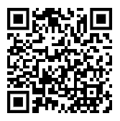
ACTIVITY: ATTENDANCE
Scan QR code on the left or follow the URL posted in the chat to access the online attendance survey
Follow prompts to enter attendance information
Notify trainers if you require assistance (e.g., identifying your cohort or cohort group)
Certificates of Attendance will be sent in January and June. Attendance records and Zoom log in will be use as verification
You are in Cohort 8
1 minute
Notes:
TRAINERS – QR Code is updated
Add your cohort number
Post a link to the attendance survey (below) in the chat for those who do not use the QR code on the slide:
ATTENDANCE: https://edc.co1.qualtrics.com/jfe/form/SV_5BiXqi4bxzOCMS2

Slide 5
Agenda & Coaches' Tasks
Coaches’ Tasks:
Presentation Content:
Glows & Grows: Implicit Bias
Support Team to develop Neutralizing Routines around vulnerable decision point (VDPs).
Disaggregating Data and decision making
Spring TFI planning
Work with your trainer to schedule your Spring TFI between April and June.

Slide 6
HELPFUL RESOURCES
RESOURCES:
Tiered Fidelity Inventory
A 5 Point Intervention Approach for Enhancing Equity in School Discipline
Examples of Engaging Instruction to Increase Equity in Education
Video: SWIS Equity Report: Risk Index
Notes:
RESOURCES:
PBIS TFI: Resource link: https://www.pbisapps.org/resource/tfi
https://sebacademy.edc.org/5-point-intervention-approach-enhancing-equity-school-discipline
https://sebacademy.edc.org/examples-engaging-instruction-increase-equity-education
https://www.pbisapps.org/resource/equity-graph-1-risk-index

Slide 7
Glows & Grows: Implicit Bias and supporting staff and student behavior
Notes:
12:30

Slide 8
What is Implicit Bias?
Unconscious, automatic
Based on stereotypes
We all have it (even those affected by it)
Generally not an indication of what we believe or would endorse
More likely to influence:
Snap decisions
Decisions that are ambiguous
Notes:
Let’s look further at implicit bias.

Slide 9
What is a VULNERABLE Decision Point?
What is an EQUITABLE Decision Point?
A specific decision in which school/district data shows LITTLE TO NO disproportionality
A specific decision that is more vulnerable to the effects of implicit bias
Two parts:
Elements of the SITUATION
The person’s DECISION STATE (internal state)

Slide 10
VDPs from National ODR Data
Subjective problem behavior
Defiance, Disrespect, Disruption
Major vs. minor
Non-classroom areas
Hallways
Classrooms
Afternoons
ambiguity
LACK OF contact
DEMANDS? Relevance?
fatigue

Slide 11
Two-Step Neutralizing Routine
When you see unwanted behavior or the
start of a power struggle, stop and ask yourself:
Is this a VDP?
What are the elements of the situation?
What is my internal decision state?
If so, use a pre-determined agreed-upon alternative response.

Slide 12
Elements of a Good Neutralizing Routine
If-Then Statement
Brief
Clear Steps
Doable
Interrupts the Chain of Events
Notes:
interruption

Slide 13
DISCUSSION: IMPLICIT BIAS
Has your team started to discuss developing an example Neutralizing Routine to share with staff?
How can this information be included in future professional development at your school?
Whole Group
10 minutes

Slide 14
PBIS Resource Spotlight: 5 Questions Every Team Should Ask about Racial Disproportionality
Notes:
RESOURCE LINK: https://www.pbis.org/resource/teaching-social-emotional-competencies-within-a-pbis-framework

Slide 15
5 QUESTIONS EVERY TEAM SHOULD ASK ABOUT RACIAL DISPROPORTIONALITY
Is there an inequity problem in our school?
What is it about our people, policies, and practices that contribute to this inequity?
Which equitable practices can address this discipline inequity?
Did the equity strategies decrease our discipline disparity?
Who is at the table when decisions are made about our school systems?
What is 1 question you feel is important to bring back to your team?
Notes:
This should be brief (5 minutes)
https://www.pbisapps.org/articles/5-questions-every-team-should-ask-about-racial-disproportionality

Slide 16
ACTIVITY: RESOURCE SPOTLIGHT
Review the shared resource independently.
With a partner discuss:
What was your key takeaway from this resource?
How might your team use this in the future?
Can this be used to provide professional development to staff? How?
Be ready to provide a 1- minute share-out of your discussion
Independent
Whole Group
5 minutes
15 minutes

Slide 17
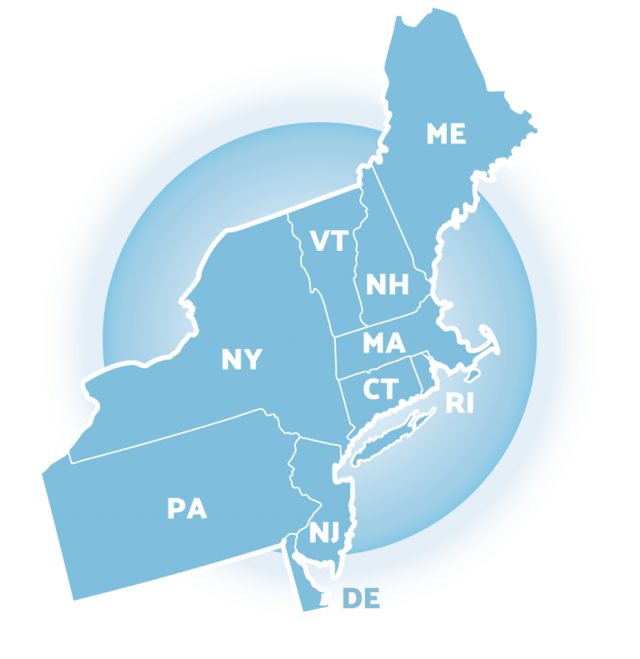
Big Idea Check-in: Disaggregating Data
Notes:
TRAINER NOTE: This information was provided to coaches and teams last month. As this is review, please go through the slides at a quicker pace unless coaches have questions. Focus on the discussions and please express to the coaches that the importance of reviewing this information as part of a coach community is to now learn from each other about how to support more disaggregation with our data together.
So in a sense, last month was within teams, this month will be cross school discussions with this important feature.

Slide 18
WHY DISAGGREGATE OUTCOME DATA?
Allows comparisons between groups (e.g., grade, gender, (dis)ability, race/ethnicity, etc.)
Facilitates development of precise problem statements
Supports equitable decision-making

Slide 19
Identify a question
Identify the data source
Disaggregate the data to answer the question
Are racial groups chronically absent at the same rate?
Attendance
Disaggregate by race
Are students with disabilities being referred at the same rate?
Office Discipline Referrals
Disaggregate by disability status
Do our LGBTQ+ students feel safe at school?
School Climate Survey
Disaggregate by gender identity
Notes:
TRAINERS: Please note the three examples when you put slide in slide show mode.

Slide 20
EXAMPLE 1: SURVEY DATA
Do students who are gay/lesbian feel safe at school?
“I feel safe…”
Average scores by sexual orientation
Does your school have survey data that can be disaggregated?

Slide 21
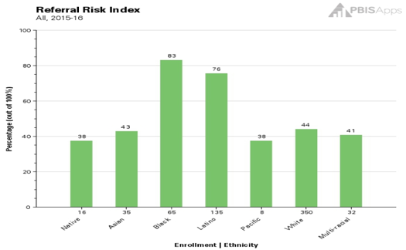
EXAMPLE 2: ATTENDANCE
Are racial groups chronically absent at the same rate?
Does your school have attendance data that can be disaggregated?
 | # of Enrolled Students | # of Students Identified as Chronically Absent | % of Students Within Ethnicity Identified as Chronically Absent | Risk Index
Native | 16 | 6 | 37.50% | 0.38
Asian | 35 | 15 | 42.86% | 0.43
Black | 65 | 54 | 83.08% | 0.83
Latino | 135 | 102 | 75.56% | 0.76
Pacific | 8 | 3 | 37.50% | 0.38
White | 350 | 154 | 44.00% | 0.44
Multi-racial | 32 | 13 | 40.63% | 0.41
Totals: | 641 | 347
Chronic Absenteeism Risk Index
54 of the 65 Black students are identified as chronically absent, so __?% of the Black students are missing significant instructional time.
102 of the __ Latino students are identified as chronically absent, so 76% of the Latino students are missing significant instructional time.

Slide 22
EXAMPLE 3: ODRS
Are students with disabilities being referred at the same rate?
Can your school’s ODR data that can be disaggregated?
 | # of Enrolled Students | # of Students with Referrals | % of Students within Disability with Referrals | Risk Index
IEP | 45 | 17 | 38% | 0.38
504 | 25 | 6 | 24% | 0.24
None | 300 | 63 | 21% | 0.21
17 of the 45 students with IEPs have a discipline referral, so __?% of students with IEPs have a referral.
63 of the __ students without a disability have a discipline referral, so 21% of the students without a disability have a referral.

Slide 23
DISAGGREGATING DATA
What questions does your team or school have about equitable outcomes or experiences for students?
Bring student data that you can or have disaggregated to answer those questions. Such as:
Survey data (school climate, etc.)
Attendance
ODRs
Referrals to Special Education
Suspension
How can you ensure that all students have access to equitable educational opportunities?

Slide 24
DISCUSSION: BIG IDEA CHECK-IN
What questions did your team or school have about equitable outcomes or experiences for students?
What data sources did you discuss disaggregating?
What are your next steps on your action plan?
What examples can you share?
3 minutes
12 minutes
Independent Jot
Whole Group

Slide 25
Reviewing Winter and Preparing for Spring TFI
Notes:
https://www.pbisapps.org/products/tfi

Slide 26
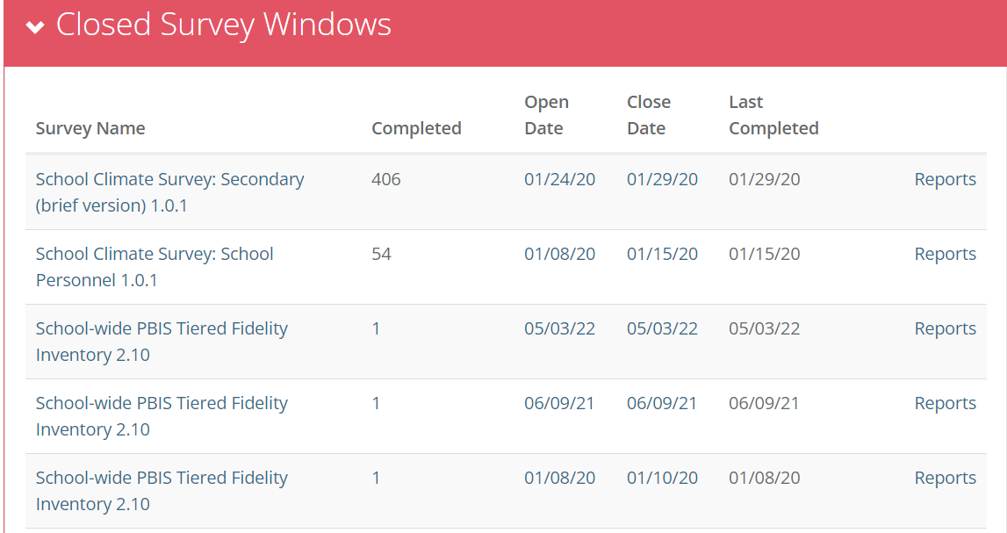
Have you updated your Action Plan based on your TFI results?
Log in at PBISApps.org
Click on reports to access TFI Results!

Slide 27
Have you updated your Action Plan based on your TFI results?
What was one or two things that you added to your action plan based on the TFI self-assessment last month?
Click on reports to access TFI Results!

Slide 28
TIERED FIDELITY INVENTORY (TFI) AND WALKTHROUGH PLANNING
Purpose: | Assess evidence of critical features of school-wide PBS implementation; Progress over time; Helps team make data-based decisions on intervention and program efficacy; Guides action-planning.
Format: | Survey ratings of features in place (self-assessment). About 30 mins per tier.
Completed by: | Team members with the coaches. Walkthrough tool completed by external coach.
When? | Self-Assessment Fall and/or Winter & Annually with external trainer (in spring)
What questions do you have regarding the Spring TFI process?
Have you scheduled your TFI date with your trainer?
Notes:
https://www.pbisapps.org/products/tfi

Slide 29
Agenda & Coaches' Tasks- Debrief
Presentation Content:
Glows & Grows: Implicit Bias
Disaggregating Data and decision making
Spring TFI planning
Coaches’ Tasks:
Support Team to develop Neutralizing Routines around vulnerable decision point (VDPs).
Work with your trainer to schedule your Spring TFI between April and June.
What questions do you have on today’s content?
What questions do you have on the follow-up tasks?

Slide 30
HELPFUL RESOURCES
RESOURCES:
Tiered Fidelity Inventory
A 5 Point Intervention Approach for Enhancing Equity in School Discipline
Examples of Engaging Instruction to Increase Equity in Education
Video: SWIS Equity Report: Risk Index
Notes:
RESOURCES:
PBIS TFI: Resource link: https://www.pbisapps.org/resource/tfi
https://sebacademy.edc.org/5-point-intervention-approach-enhancing-equity-school-discipline
https://sebacademy.edc.org/examples-engaging-instruction-increase-equity-education
https://www.pbisapps.org/resource/equity-graph-1-risk-index

Slide 31
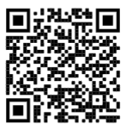
https://edc.co1.qualtrics.com/jfe/form/SV_cBF9GI7gVEBsfSC EVALUATION
Please remember to complete the evaluation!
Scan the QR code to access.
Notes:
TRAINERS -
Put link to evaluation (below) in the chat for those who do not use the QR code:
https://edc.co1.qualtrics.com/jfe/form/SV_cBF9GI7gVEBsfSC

