Slide 1
PBIS School-Wide Team Training Year 2: January 2023
PBIS Track
Insert trainer names here
with support from NEPBIS Network, May Institute & Broad Reach Consulting
Notes:
Add trainer names for your event

Slide 2
Agenda & Team Tasks
Team Tasks
Presentation Content
Identify how you can use data to drive effective PD supporting positive classroom practices.
REVIEW: Function of Behavior
Implicit Bias and Neutralizing Routines
Sharing: Acknowledgement Systems
Elements of effective professional development
LUNCH
Preview Disaggregating Data
Tiered Fidelity Inventory (TFI) Self-Assessment & Team time
Develop a Neutralizing Routine plan for your school.
Complete TFI Self-Assessment as a team and update your Action Plan (Share updated action plan with your trainer).
Discuss what you might need in order to disaggregate data to better tailor your school wide supports.
We’ve planned 90 mins of team time during this training event

Slide 3
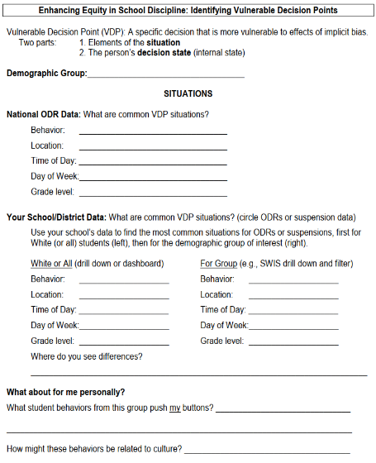
HELPFUL READINGS & RESOURCES
RESOURCES:
Supporting & Responding to Student Behavior
SWIS Drill Down Worksheet
Implicit Bias in Early Learning Video
Vulnerable Decision Points worksheet
Tiered Fidelity Inventory
TFI Tier 1 Quick Check Tip Sheet
TFI Action Plan
Notes:
Supporting & Responding to Student Behavior: https://sebacademy.edc.org/supporting-and-responding-students-social-emotional-and-behavioral-needs-classrooms
Nepbis.org Classroom PBIS website: https://nepbis.org/classroom-pbis/
SWIS Drill Down Worksheet: https://sebacademy.edc.org/swis-drill-down-worksheet
Implicit Bias in Early Education Video: https://www.youtube.com/watch?v=ucEAcIMkS0c
Vulnerable Decision Points Worksheet: https://sebacademy.edc.org/vulnerable-decision-points-vdp-worksheet
Tiered Fidelity Inventory: https://sebacademy.edc.org/tiered-fidelity-inventory-tfi-manual
TFI Tier 1 Quick Check Tip Sheet: https://sebacademy.edc.org/tfi-tier-1-quick-check-tip-sheet-scoring
TFI Action Plan: https://sebacademy.edc.org/tfi-action-plan-template

Slide 4
EXPECTATIONS
Self
Others
Environment
Self-monitor
Listen while others are speaking​
Have your computer charged and ready to go​
If you have questions or comments:
Work as a team:
Keep necessary materials at hand
Are you participating?
Engaged as a learner?
Stretch, break, stand as needed​
Raise hand
Room for every voice
Reinforce participation
action plan
relevant docs
water/snacks
Minimize distractions if possible​

Slide 5
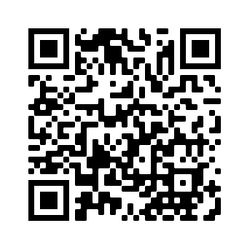
ACTIVITY: ATTENDANCE
Scan QR code on the left or follow the URL posted in the chat to access the online attendance survey
Follow prompts to enter attendance information
Notify trainers if you require assistance (e.g., identifying your cohort or cohort group)
Certificates of Attendance will be sent in January and June. Attendance records will be use as verification
You are in Cohort 8
1 minute
Notes:
Link to attendance form is here: https://edc.co1.qualtrics.com/jfe/form/SV_5BiXqi4bxzOCMS2
Add your cohort number
Post a link to the attendance survey (below) in the chat for those who do not use the QR code on the slide:
ATTENDANCE: https://edc.co1.qualtrics.com/jfe/form/SV_5BiXqi4bxzOCMS2

Slide 6
SEB Academy – PBIS Track Website
https://sebacademy.edc.org/

Slide 7
REVIEW: FUNCTION OF BEHAVIOR
Notes:
TRAINER NOTE: This is review content please be brief

Slide 8
A basic understanding of the science of behavior change:
Gives us tools to observe, measure, teach, and correct behaviors effectively and efficiently.
Moves us away from perceptions, opinions, and assumptions about motivations or intentions
Shares the following assumptions (see right)
Behavior is communication.
Behavior occurs in the context of an antecedent and consequence.
Behavior is learned (function).
Behavior is lawful (function).
Behavior is escalated through successive interactions (practice).
Behavior can be changed through an instructional approach.
(Colvin & Sugai, 1989)

Slide 9
BUILDING BLOCKS OF BEHAVIOR: Three Term Contingency
What typically precedes?
What do the behaviors look like?
What typically follows?
Antecedent
Behavior
Consequence
Based on observing patterns across time,
we can infer the probable function of behavior.

Slide 10
All behavior serves a function...
Get/Obtain
desired activities
tangible items
Avoid/Escape
aversive activities
tangible items
attention
sensory stimulation
attention
sensory stimulation
“Function” = outcome, result, purpose, consequence

Slide 11
By understanding function, we can intervene more effectively.
How can we prevent?
What should we teach the student to do instead?
How do we respond to make sure the new skill “works”?
Prevent
Teach
Respond
We can make simple tweaks to the antecedents, behaviors, and consequences, to prevent, teach, and respond, respectively.

Slide 12
DISCUSSION: FUNCTION OF BEHAVIOR
As a team: Briefly review how you previously discussed integrating function of behavior content within your school’s professional development.
What updates or follow up discussions are necessary?
Team Discussion
10 minutes

Slide 13
Implicit Bias, Vulnerable Decision Points, and Neutralizing Routines

Slide 14
What is Implicit Bias?
Unconscious, automatic
Based on stereotypes
We all have it (even those affected by it)
Generally not an indication of what we believe or would endorse
More likely to influence:
Snap decisions
Decisions that are ambiguous
Notes:
Let’s look further at implicit bias.

Slide 15
Implicit Bias in Early Learning (Gilliam et al., 2016)
Notes:
Youtube link: https://www.youtube.com/watch?v=ucEAcIMkS0c

Slide 16
A Multi-Dimensional View of Bias
Racial Bias
Disproportionate Discipline
SITUATION
What discipline decisions are influenced by implicit bias?
Notes:
TRAINER NOTE:
This simplified model of the research indicates that racial bias, even when it is implicit, has a direct and disproportionate impact on student discipline outcomes.
But this model has 2 problems:
1. it focuses solely on one variable that has been shown in many studies to be highly resistant to change (Racial bias)
2. fails to consider contextual variables that may be as critical to biased decision making but are much more malleable.
CLICK
However, when we recognize that the context or situation can influence someone’s response and that individuals may selectively show racial bias in different decision situations, we develop a multidimensional view of bias that can be altered with intervention. For example, a teacher may make more equitable discipline decisions at the start of the day but be more likely to send students of color to the office at the end of the day

Slide 17
What is a VULNERABLE Decision Point?
What is an EQUITABLE Decision Point?
A specific decision in which school/district data shows LITTLE TO NO disproportionality
A specific decision that is more vulnerable to the effects of implicit bias
Two parts:
Elements of the SITUATION
The person’s DECISION STATE (internal state)

Slide 18
Decision States: Resource Depletion
What are some of your vulnerable decision states?
Unmute or type in chat.
As we become fatigued, our filters for appropriate behavior can be affected
Effects of hunger (Gailliot et al., 2009)
Decreases in willpower later in day
“The Morning Morality Effect” (Kouchaki & Smith, 2014)
E.g., The best time to go before a judge is first thing in the morning or right after lunch
E.g., Handwashing compliance drops 8.7% over the course of a 12-hr shift
Notes:
MAIN IDEA: We’re all prone to vulnerable decision states, the key is recognizing them so we don’t act on impulse.

Slide 19
VDPs from National ODR Data
Subjective problem behavior
Defiance, Disrespect, Disruption
Major vs. minor
Non-classroom areas
Hallways
Classrooms
Afternoons
ambiguity
LACK OF contact
DEMANDS? Relevance?
fatigue

Slide 20
Two-Step Neutralizing Routine
When you see unwanted behavior or the
start of a power struggle, stop and ask yourself:
Is this a VDP?
What are the elements of the situation?
What is my internal decision state?
If so, use a pre-determined agreed-upon alternative response.

Slide 21
Neutralizing Routines
SELF-ASSESSMENT:
“Am I triggered or agitated?”
SETTING EVENT
ANTECEDENT
BEHAVIOR
CONSEQUENCE
Lack of positive interactions with student
Fatigue
Loud complaints about work (subjective behavior)
Send student to the office (ODR)
Student leaves class
(escape social interaction)
ALTERNATIVE RESPONSE:
Take a deep breath & model desired behavior.
Notes:
This is ME (my routine)
“You can’t punish skills into a child”

Slide 22
Elements of a Good Neutralizing Routine
If-Then Statement
Brief
Clear Steps
Doable
Interrupts the Chain of Events
Notes:
interruption

Slide 23
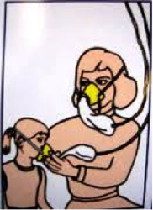
Neutralizing Routine Examples
If I am triggered or agitated, then I will...
Delay a decision until I can think clearly
“See me after class/at the next break”
Reframe the situation
“How do we do that at school?”
Take care of myself
Recognize my upset feelings and let them go

Slide 24
ACTIVITY: Explore Vulnerable Decision Points & Develop a Neutralizing Routine
Individually (5 minutes)
Use the VDP worksheet to:
Identify what you think might be possible VDPs (situations or states) for you?
Determine 1- 2 examples of neutralizing routines that you could use
Discuss with your team (10 minutes)
What are some common VDPs for adults in schools?
How could you introduce VDPs and neutralizing routines to your colleagues and promote the use of these practices in your school?
Whole group share (5 minutes)
20 minutes
Notes:
TRAINERS:
Encourage participants to jot down responses to the individual questions using the Identify Potential VDPs worksheet (link below and in syllabus) prior to sending people to team-based breakout rooms
https://sebacademy.edc.org/vulnerable-decision-points-vdp-worksheet

Slide 25
SHARING: ACKNOWLEDGEMENTS

Slide 26
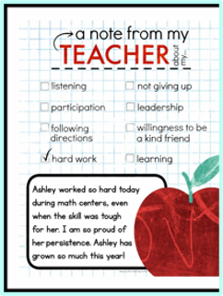
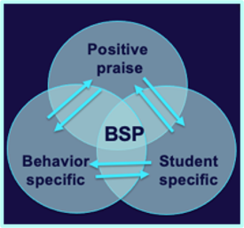
SHARING: How Do you Acknowledge students and staff for using school-wide expectations
Suggested items for sharing with others today.
How do you acknowledge your students/adults?
What are the different types of acknowledgements that you use for different types of motivation?
How were students involved in identifying acknowledgments?
What went well this year? And what would you like to change for next year?

Slide 27
ACTIVITY: CROSS-SCHOOL SHARING
1. Randomize participants into 4 or 5 groups.
2. In each group take turns sharing how your Acknowledge students and staff for demonstrating the school wide expectations.
3. Ask questions and take good notes.
4. Bring new examples back to your team for action planning!
20 minutes
Randomized Groups

Slide 28
10-minute break

Slide 29
Elements of Effective Sustainable Professional Development
Notes:
TRAINER NOTE: This is review content please be brief

Slide 30
Systems
Practices
Data
Continue to invest in systems to support high-fidelity implementation over time. Leverage existing leadership teams to guide planning and implementation and consider effective means to support educators’ professional learning and wellness given current resources, experience, and expertise.
Equity
Outcomes

Slide 31
What are SYSTEMS?
The way schools operate are their foundational systems.
In PBIS, these systems support:
accurate, durable implementation of practices
the effective use of data to achieve better outcomes
(pbis.org)
In other words…
systems are what we do to support the adults!

Slide 32
Systems SUPPORT implementation fidelity
Promoting and Sustaining Staff Engagement
Continuous Action Planning
Team-Based Implementation
Embedded and Ongoing Professional Development
Staff Recognition
Data Routines

Slide 33
Embedded and Ongoing Professional Development

Slide 34
Provide Universal Professional Development to ALL Staff instead of ”Training and Hoping”
Sound familiar?
We can do better!
REACT to problem behavior
Select and ADD Practice
Hire EXPERT to Train Practice
Expect, but HOPE for, Implementation
WAIT for New Problem

Slide 35
Continuum of Multi-tiered Professional Development Support
Tier 3
What do we do for the FEW staff needing intensive support?
Intensive Professional Development:
Data-driven Consultation
Performance Feedback:
Routine Walkthrough and Self-management Data Reviews
Tier 1
What do we do for
ALL Staff?
Universal Professional Development:
Training and Self-management
Universal Screening:
Walk-through and Student Data Review
~5%
~15%
Tier 2
What do we do for the SOME staff needing more support?
Targeted Professional Development:
Self-management with Peer or Coaching Support
Progress Monitoring:
Walkthrough, Student Data Review,
Teacher Collected Data
For now,
focus on providing ALL staff Tier 1 professional development
~80% of Staff

Slide 36
Embedded and Ongoing Professional Development
First, identify what staff need to know, then, provide…
Coaching/
Prompting
Explicit Training
Performance Feedback

Slide 37
CRITICAL TOPICS FOR STAFF PD
PBIS Core Features (i.e., lesson plans)
Function of Behavior
De escalation strategies
Positive Classroom Supports

Slide 38
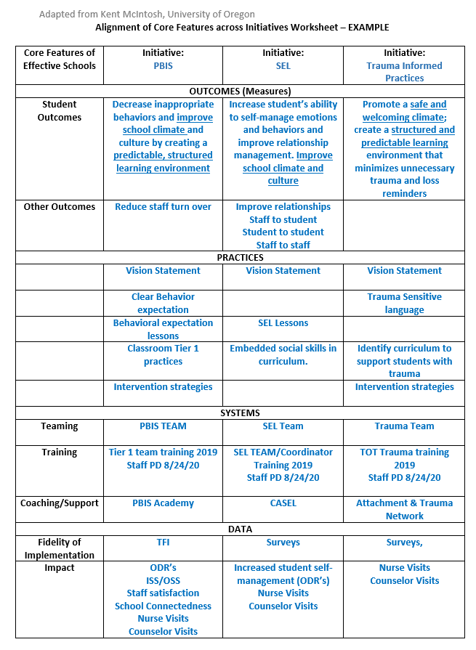
Integration of similar initiatives into PD

Slide 39
ADDITIONAL STAFF PD CONSIDERATIONS
Behavioral principles to understand and support student behavior
Mental health and trauma informed care foundations
Community culture, values, and historical perspectives (in partnership with families & local community supports)
Effectively applying core practices with cultural competence
If your data from staff, student, family surveys or outcomes indicate a need, these areas may also be beneficial PD topics
Integrated TFI Companion Guide, 2021

Slide 40
Embedded and Ongoing Professional Development
First, identify what staff need to know, then, provide…
Coaching/
Prompting
Explicit Training
Performance Feedback

Slide 41
Embedded and Ongoing Professional Development
First, identify what staff need to know, then, provide…
Coaching/
Prompting
Explicit Training
Performance Feedback
Model, lead, test format
Demonstrate desired skill (I do)
Provide effective examples/non-examples
Provide sufficient group practice (We do)
Provide opportunities to demonstrate and receive feedback (You do)
Connected to/embedded in typical practice/routines
Brief training/practice spaced out

Slide 42
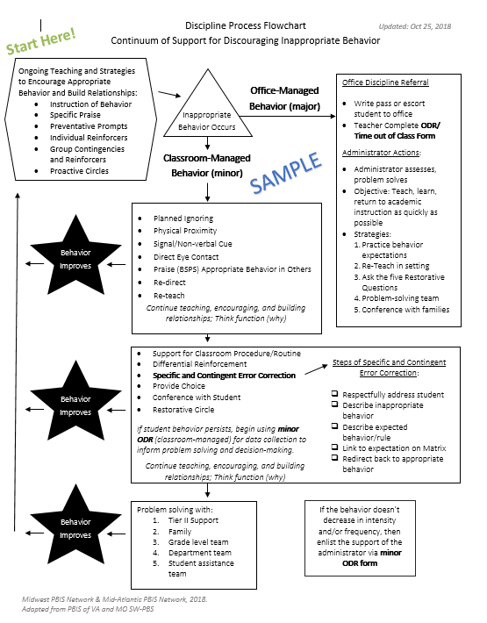
Train and Hope Method
Leadership Team shares the newly developed discipline flowchart with staff over email and asks everyone to start using it.

Slide 43
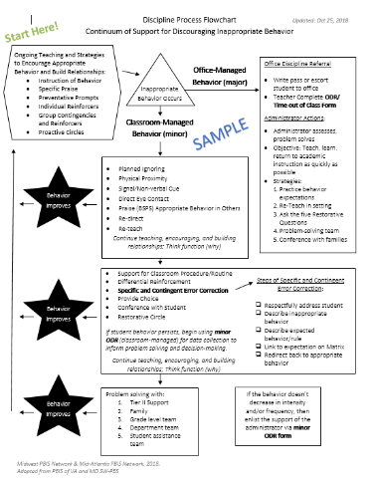
Explicit Training Example
Center School’s PBIS Leadership Team shares the finalized Discipline Flowchart (developed with staff input) to ALL staff.
A student scenario is provided and a team member performs a “think aloud” to model her interaction with a student. (I do)
Additional examples and non-examples of student-staff interactions are provided with opportunities for questions to be asked.
Another scenario is provided and small groups of staff discuss how to use the flowchart as a guide to their response. (We do)
One more scenario is provided. Each staff member writes down how they would respond and then shares the response with a colleague. (You do)
All staff are provided laminated copies of the Discipline Flowchart and are asked to focus on using it during dismissal time.
Next month…
each person writes an example of how they used the flowchart during dismissal and adds it to a Jamboard.
Staff are then asked to use the Discipline Flowchart throughout their daily routines.

Slide 44
Embedded and Ongoing Professional Development
First, identify what staff need to know, then, provide…
Coaching/
Prompting
Explicit Training
Performance Feedback
Prompt and remind educators of targeted practices implementation.
Provide supportive data-based feedback and suggestions for improving implementation.
Consider function not form: Supports may be delivered by internal or external coach, mentor, peer, or self).

Slide 45
Coaching Support
COACH
School/district coach conducts walkthrough observations and provides specific, supportive feedback
Mentors assigned to new educators provide feedback on use of PBIS practices
PEER
Educator pairs visit each other during instruction to gather data on specific practices and provide specific feedback/ support to one another
Communities of Practice are created to review critical features, share experiences, gather examples of core PBIS practices
SELF
Individuals commit to being a coach and providing support for 1 identified practice
Educators choose 1 practice to set goals for themselves, self-monitor (with a provided data collection tool) and self-reinforce when they meet their goal

Slide 46
Additional Coaching/Prompting Examples
For 8 weeks, a weekly email is sent out to staff reminding them to use the discipline flowchart when responding to student behavior incidents.
During grade level/ department meetings, teams discuss using the discipline flowchart and what works well and how to overcome barriers.
When staff follow the flowchart procedures for office-supported incidents, the administrator provides specific praise to the staff member.

Slide 47
Embedded and Ongoing Professional Development
First, identify what staff need to know, then, provide…
Coaching/
Prompting
Explicit Training
Performance Feedback
Data-based feedback (based on self-, peer-, or consultant collected data)
Summary of key observations
Delivered frequently (daily or weekly)
Specific suggestions for improvement or acknowledgements of good performance

Slide 48
Performance Feedback Example
After 3 months of a trial period, the Leadership Team shows staff ODR data and compares before and after PBIS implementation.
Staff receive specific, supportive feedback and targeted coaching support, as needed, to promote consistency with following procedures.

Slide 49
Align PBIS Practices to Evaluation Procedures
FIRST...
THEN...
Provide explicit training, coaching/prompting, and performance feedback
Consider adding PBIS practices in evaluation procedures
Gather positive-to-corrective educator/student interaction ratio data
Share amount of time spent actively supervising during cafeteria duty
Count number of specific praise statements provided during a lesson

Slide 50
NEPBIS.org
CLASSROOM PBIS
Provides links to more information about systems to support educators!
Educator Support
CLICK HERE
Notes:
TRAINER NOTE: Offer classroom as another area to develop effective PD.

Slide 51
Embedded and Ongoing Professional Development
First, identify what staff need to know, then, provide…
Coaching/
Prompting
Explicit Training
Performance Feedback
We need to provide staff with universal training and support for all components of the PBIS framework if we want them to implement!

Slide 52
Professional Development Planning
What content? | When will it be explicitly taught? | By who? | How will prompting and coaching occur? | How will staff be provided performance feedback?

Slide 53
Guidelines for Embedded and Ongoing Professional Development
Ensure PD includes explicit training, performance feedback and ongoing coaching
Develop a PBIS PD Calendar and routines (e.g. 15 minutes of every staff meeting, 1 hour of early release days)
Align staff evaluation procedures with expected practices where possible

Slide 54
ACTIVITY: Developing a System of Embedded and Ongoing Professional Development
Consider how you will provide embedded and ongoing professional development to staff that includes:
Explicit training
Coaching/prompting
Performance feedback
Add items to your Action Plan as necessary.
Be ready to present 2-3 “big ideas” from your discussion.
20 minutes

Slide 55
WHOLE GROUP DEBRIEF: Developing a System of Embedded and Ongoing Professional Development
What are some next steps your team will take to develop a system of embedded and ongoing professional development within your school?
What further support will you need to do this?
5 minutes

Slide 56
LUNCH

Slide 57
Disaggregating Data for Decision Making

Slide 58
WHY DISAGGREGATE OUTCOME DATA?
Allows comparisons between groups (e.g., grade, gender, (dis)ability, race/ethnicity, etc.)
Facilitates development of precise problem statements
Supports equitable decision-making

Slide 59
DISAGGREGATING DATA
What questions does your team or school have about equitable outcomes or experiences for students?
Bring student data that you can or have disaggregated to answer those questions. Such as:
Survey data (school climate, etc.)
Attendance
ODRs
Referrals to Special Education
Suspension
How can you ensure that all students have access to equitable educational opportunities?

Slide 60
Identify a question
Identify the data source
Disaggregate the data to answer the question
Are racial groups chronically absent at the same rate?
Attendance
Disaggregate by race
Are students with disabilities being referred at the same rate?
Office Discipline Referrals
Disaggregate by disability status
Do our LGBTQ+ students feel safe at school?
School Climate Survey
Disaggregate by gender identity
Notes:
TRAINERS: Please note the three examples when you put slide in slide show mode.

Slide 61
DATABASED DECISION MAKING -DRILL DOWN APPROACH
The Drill Down approach starts with the big picture and looks for potential “red flags” identifying a problem that might need to be addressed.
What is our current reality or big picture?
Is there a problem (red flag)?
What is the precise context & function of the problem?
What, where, when, who, how often, why?
Be efficient, don’t “drown” by getting too specific
Notes:
So we want to use a process call Drill Down where we take a close look at our data and drill down into it to see our Current Big Picture reality…then focus in on a specific problem we want to solve…and get the precise details about the who, what when where and whys of the problem.

Slide 62
EXAMPLE 1: SURVEY DATA
Do students who are gay/lesbian feel safe at school?
“I feel safe…”
Average scores by sexual orientation

Slide 63
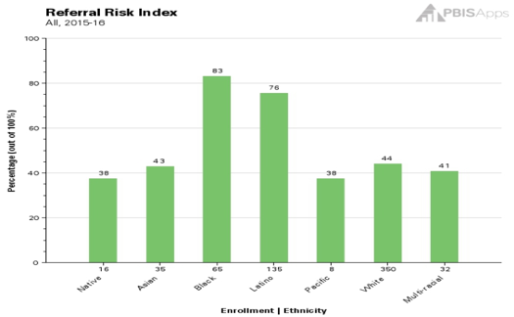
EXAMPLE 2: ATTENDANCE
Are racial groups chronically absent at the same rate?
 | # of Enrolled Students | # of Students Identified as Chronically Absent | % of Students Within Ethnicity Identified as Chronically Absent | Risk Index
Native | 16 | 6 | 37.50% | 0.38
Asian | 35 | 15 | 42.86% | 0.43
Black | 65 | 54 | 83.08% | 0.83
Latino | 135 | 102 | 75.56% | 0.76
Pacific | 8 | 3 | 37.50% | 0.38
White | 350 | 154 | 44.00% | 0.44
Multi-racial | 32 | 13 | 40.63% | 0.41
Totals: | 641 | 347
Chronic Absenteeism Risk Index
54 of the 65 Black students are identified as chronically absent, so 83% of Black students are missing significant instructional time.
102 of the 135 Latino students are identified as chronically absent, so 76% of Latino students are missing significant instructional time.

Slide 64
EXAMPLE 3: ODRS
Are students with disabilities being referred at the same rate?
 | # of Enrolled Students | # of Students with Referrals | % of Students within Disability with Referrals | Risk Index
IEP | 45 | 17 | 38% | 0.38
504 | 25 | 6 | 24% | 0.24
None | 300 | 63 | 21% | 0.21
17 of the 45 students with IEPs have a discipline referral, so __?% of students with IEPs have a referral.
63 of the __ students without a disability have a discipline referral, so 21% of the students without a disability have a referral.

Slide 65
CONTINUOUS QUALITY IMPROVEMENT
EVALUATE
PLAN
IMPLEMENT
Reassess & revise solution(s) as needed
Identify problems with precision
Monitor outcomes and compare to goal(s)
Establish goal(s)
Develop solution(s)
Implement solution(s) with integrity and fidelity
Systems
Data
Practices
Equity
DATA
Outcomes
Notes:
Now that you have Evaluated your school-wide data and identified a problem that needs addressing, You have created a plan to solve the problem and created a plan to implement the solution. Don’t forget to think about our S/D/P model to ensure you review or build systems for staff, You teach or reteach and practices to students, and you ensure there is equity and that you are not missing any subgroups of students. Then revisit your data to see if you have made progress.
Don’t for get that you will need to share your Precision Problem statement along with your data, your Solution Plan, and any new systems or practices with your staff. You’ll also want to share a simplified version with your students and families so that they can be an active part of the solution as well.

Slide 66
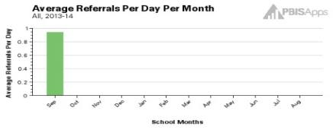
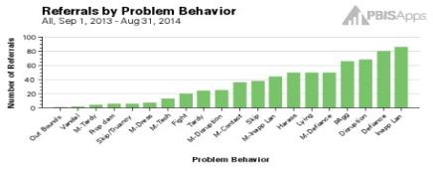
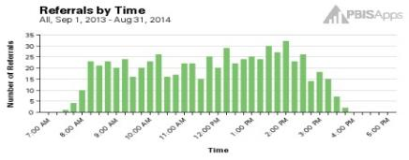
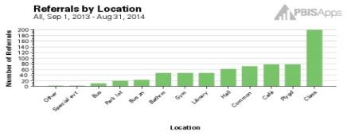
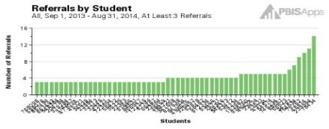
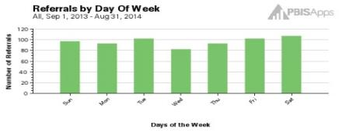
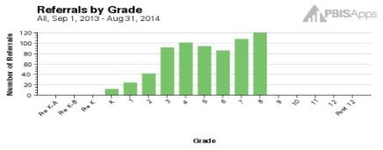
Example: SWIS & USING DATA DRILL DOWN
Core Reports
Helps check the current vital signs of the school
Helps identify areas for further inquiry
Notes:
Most School Data systems have some type of basic reports that you can review that will disaggregate school wide data by type of behavior, time, location, student, and grade. This information is necessary for developing precision problem statements. In SWIS these are called Core Reports allow teams to check the temperature and blood pressure, to see what problems or “red flags” may exist currently (e.g., since last meeting).

Slide 67
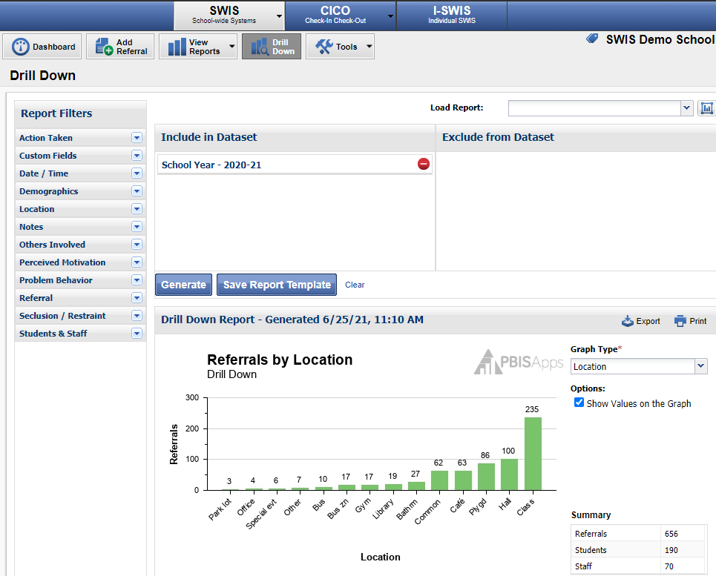
DRILL DOWN IN SWIS
SWIS video on how to use Drill Down https://screencast-o-matic.com/watch/cFit08FLSx

Slide 68
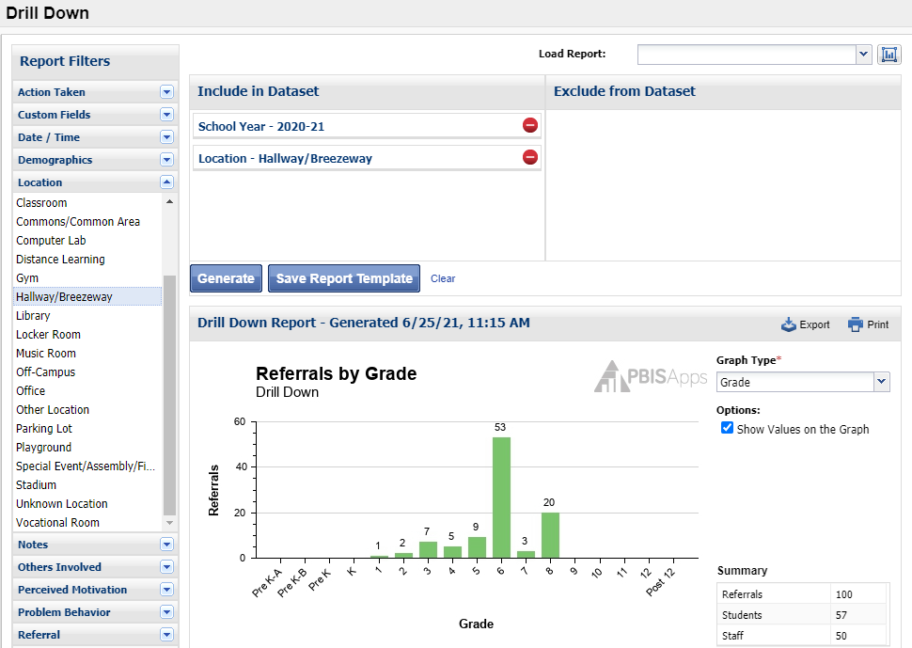
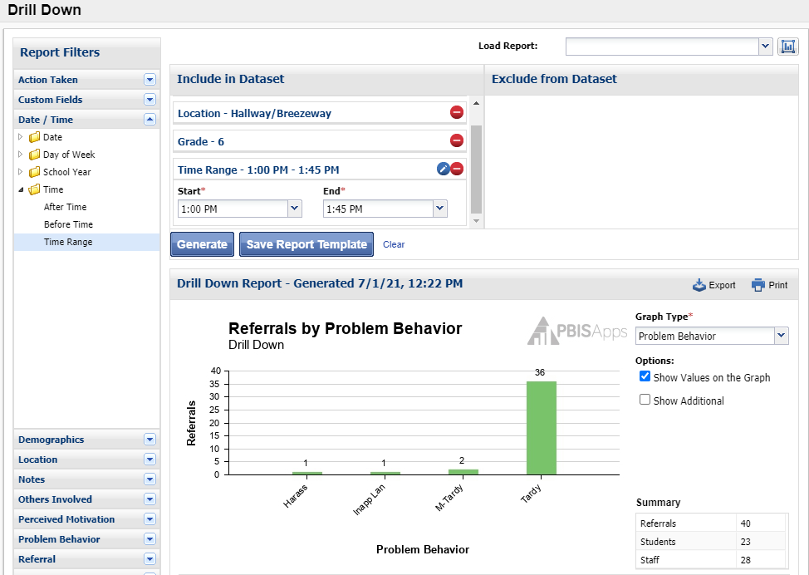
DRILL DOWN IN SWIS
Who
What
SWIS video on how to use Drill Down https://screencast-o-matic.com/watch/cFit08FLSx

Slide 69
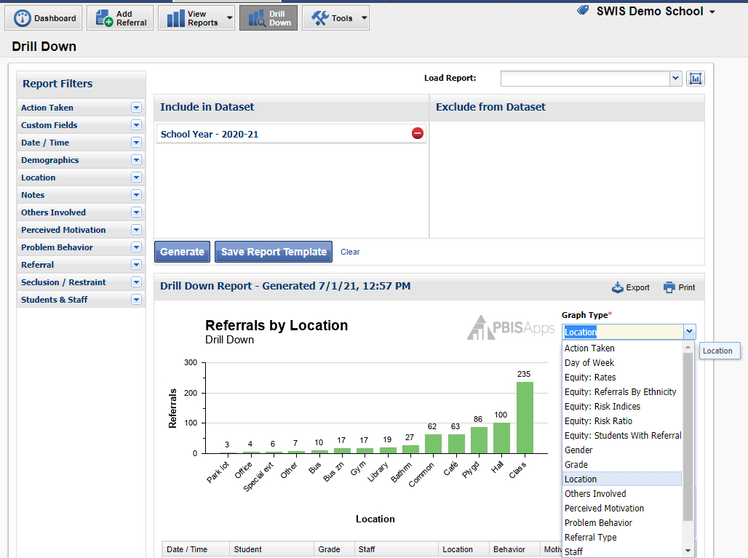
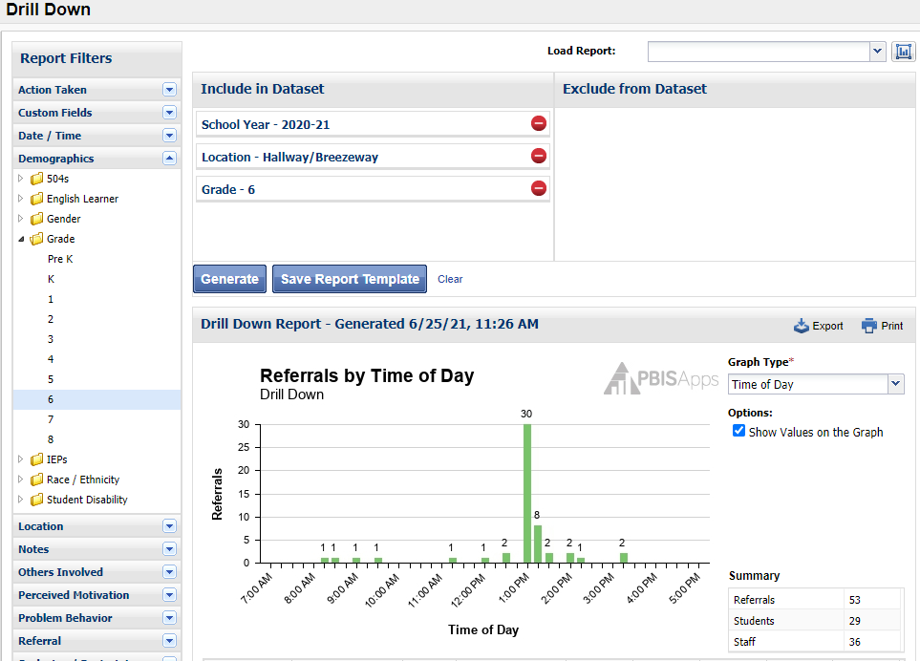
DRILL DOWN IN SWIS
Where
When
SWIS video on how to use Drill Down https://screencast-o-matic.com/watch/cFit08FLSx

Slide 70
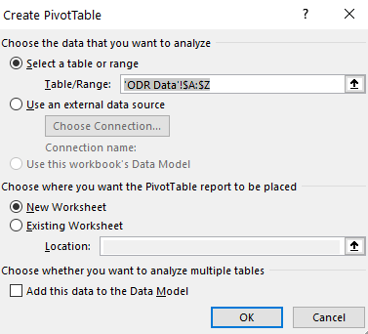
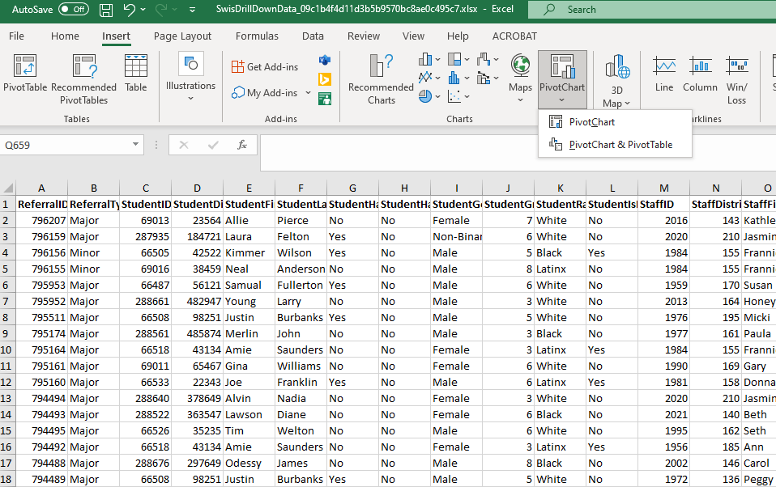
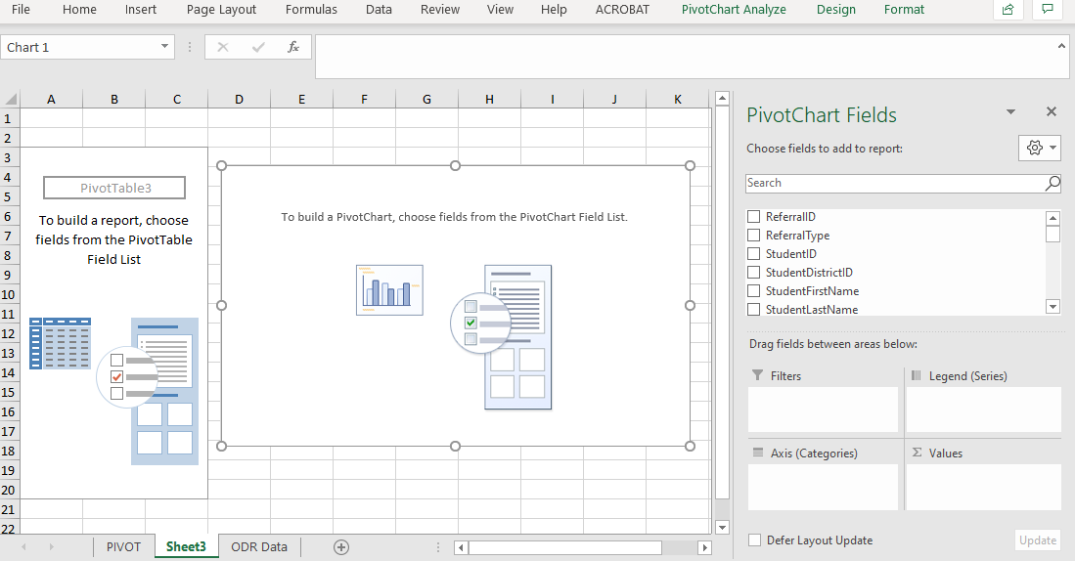
DRILL DOWN IN EXCEL USING A PIVOT CHART & TABLE
Creating a Pivot Chart in Excel https://support.microsoft.com/en-us/office/create-a-pivotchart-c1b1e057-6990-4c38-b52b-8255538e7b1c
Notes:
You can drill down into Excel sheets in a similar way to get the Who, what, where, and when data.

Slide 71
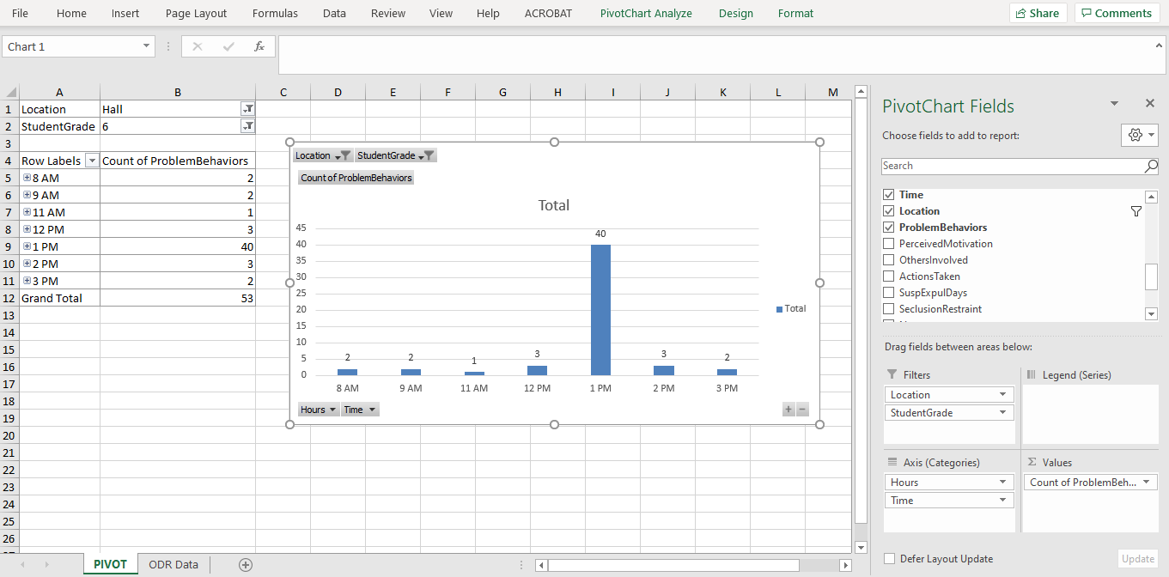
DRILL DOWN IN EXCEL USING A PIVOT CHART & TABLE

Slide 72
PRIMARY VS. PRECISION STATEMENTS
PRIMARY STATEMENTS
Too many referrals
September has more suspensions than last year.
Gang behavior is increasing.
The playground behavior is awful.
Student disrespect is out of control.
PRECISION STATEMENT
There are more ODRs for aggression on the playground than last year. These are most likely to occur during first recess, with a large number of students, and the aggression is related to getting access to the new playground equipment.
Notes:
Trainer Notes:
Here are examples of several primary statements and a precision statement.
What data are important to you? Are attendance data being entered into SWIS if students are “cutting” for specific times or subjects?

Slide 73
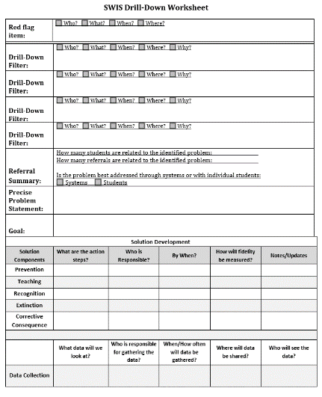
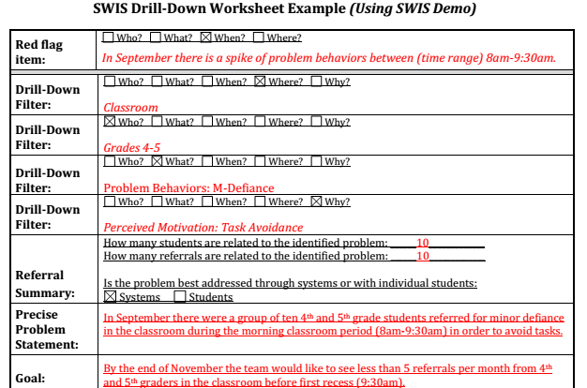
DRILL DOWN WORKSHEET Problem Identification & Goal
Notes:
https://sebacademy.edc.org/swis-drill-down-worksheet
We use a drill downs worksheet to help us pinpoint our issues so that we can begin to create solutions.
The top half of the worksheet tracks the various Who What When Where and Why questions.
The bottom half helps us create a plan for addressing the issues we discover.

Slide 74
DEFINING GOALS
Problem | Current Status | Goal
Many students are leaving garbage in the cafeteria resulting in conflict and ODRs. The behavior is maintained by task avoidance. | 22 ODRs per month from the cafeteria Heidi (cafeteria supervisor) rates cafeteria as “1” (low) on a 1-5 scale of cleanliness. | Less than 5 ODRs per month from the cafeteria. Heidi rates cafeteria cleanliness as 4 or greater for two weeks in a row.
Notes:
***This slide is designed to be an example and to be moved through quickly.***
I Do. Click to remove boxes that cover current status and goal.
Example Think Aloud:
“OK, I first define my problem with precision. I know that many students are leaving garbage in the cafeteria because it is easy to do and this results in conflict with adults and ODRs from the cafeteria supervisors.
(Click) I know that we have an average of 22 ODRs per month from the cafeteria, and the supervisors rate the cleanliness at a low (1 out of 5). That’s my level or current status .
(Click) With this information, I can design an appropriate goal. We need to decrease to less than 5 ODRs per month from the cafeteria, and we need cafeteria supervisors to rate the cleanliness at a 4 or higher for two consecutive weeks.”
First, define the problem with precision (Level/amount). Then, define what would be a reasonable goal to work towards. Once the goal is defined, use the goal to guide the solution development.

Slide 75
USING DATA TO BUILD SOLUTIONS
Prevention
Teaching
Recognition
Extinction
Corrective Consequences
Data Collection
Focus on prevention first. How could we reduce the situations that lead to these behaviors?
How do we ensure that students know what they SHOULD be doing when these situations arise?
How do we ensure that appropriate behavior is recognized?
How do we work to ensure that problem behavior is NOT being rewarded?
Are corrective consequences needed?
How will we know (a) if we are doing what we plan, and (b) if what we plan is working to benefit students?
Notes:
Trainer Note: We want to interrupt the traditional cycle of admiring the problem, by talking and talking about the problem before quickly launching into determining solutions.
We can do this by building a system for improved decision making.
Always methodically move through all the different ways to build a solution. Be sure to brainstorm lots of ideas.
Review Slide

Slide 76
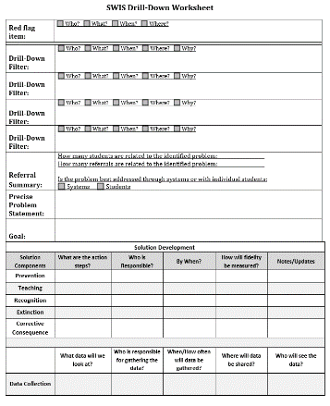
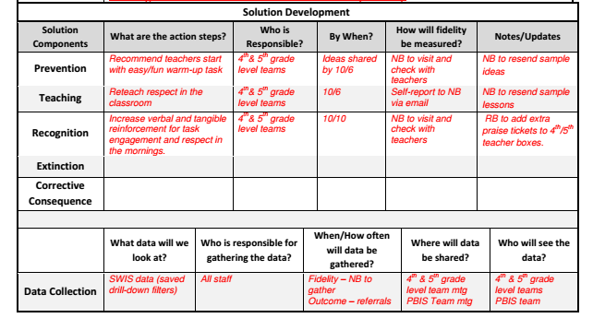
DRILL DOWN WORKSHEET Solution Development
Notes:
Here is what it looks like for this problem.

Slide 77
DRILLING DOWN INTO YOUR DATA
What student data can you drill into answer those questions. Such as:
Survey data (school climate, Feedback, survey etc.)
Attendance
ODRs
Referrals to Special Education
Suspension
Nurse Visits
Plan how you will incorporate Drill Down into your team’s data systems:
How often will Drill Down be completed?
Who will summarize and present drill down data at team meetings?
Which behaviors need reteaching?
Which students might need not feel welcome?
Which grades are seeing improvements?

Slide 78
TFI Self-Assessment

Slide 79
The purpose of the SWPBIS Tiered Fidelity Inventory (TFI) is to provide a valid, reliable, and efficient measure of the extent to which school personnel are applying the core features of school-wide positive behavioral interventions and supports.
Only Tier 1 will be required for this training.
Your team can choose to complete the additional tiers.
Tier 1 Subscales:
Teams
Implementation
Evaluation
Tier 2 Subscales:
Teams
Interventions
Evaluation
Tier 3 Subscales:
Teams
Resources
Support Plans
Evaluation

Slide 80
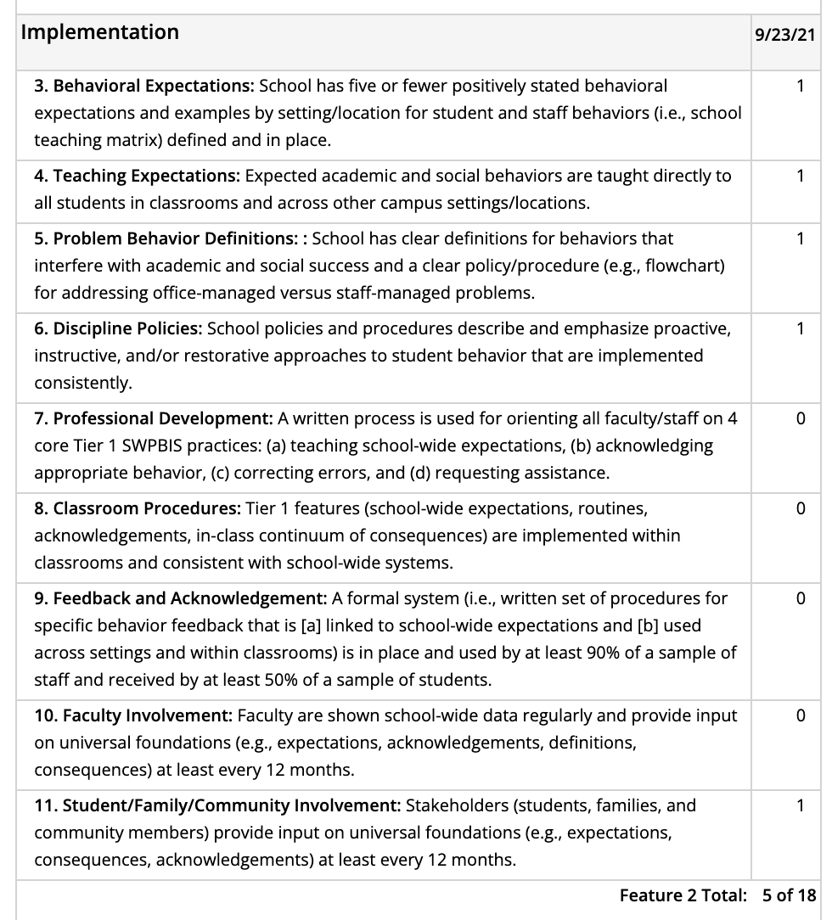
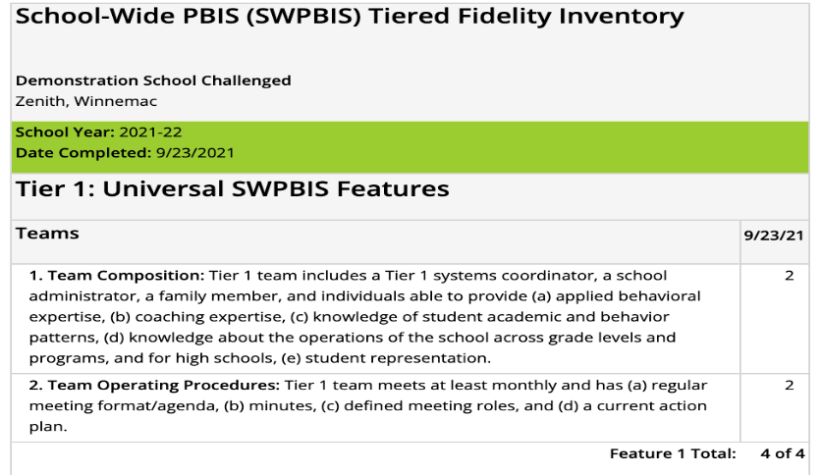
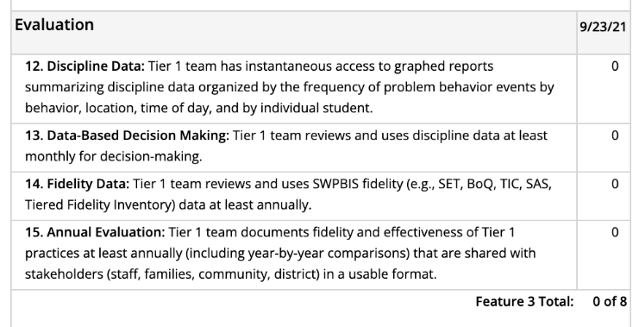
Individual items

Slide 81
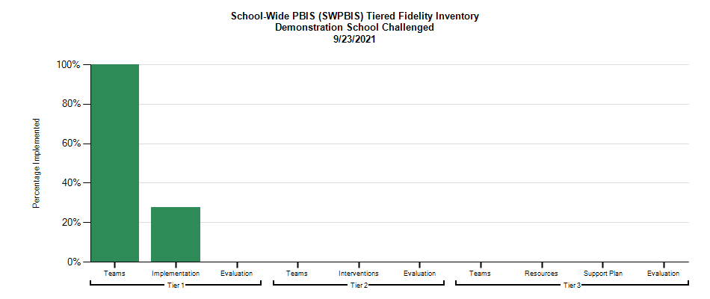
Select action steps based upon data from the TFI AND
your identified outcomes!
behavior incidents will decrease by __% relative to the same period as the prior year.
incidents of exclusionary discipline (suspension/expulsion) will decrease by __ % relative to the same period as the prior year

Slide 82
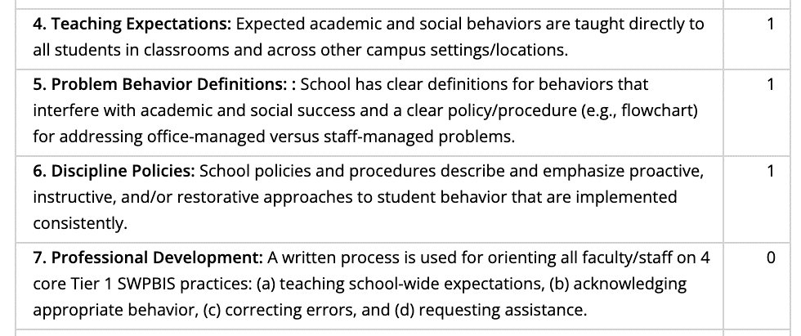
behavior incidents will decrease by __% relative to the same period as the prior year.
incidents of exclusionary discipline (suspension/expulsion) will decrease by __ % relative to the same period as the prior year
Implementing these features can support us to achieve our identified outcomes.
What do we need to do?
How? Who? By when?
1
4. Teaching Expectations
5. Problem Behavior Definitions
1
6. Discipline Policies
1
7. Professional Development
0

Slide 83
ACTIVITY: Using the TFI to Self-Assess and Action Plan
Coaches:
Go to www.pbisapps.org
Click on PBIS Assessment in the black navigation bar
Locate the TFI on your dashboard
Click on Take Survey
As a team:
Complete the Tier 1 section of the survey
Consider the following recommendations:
When in doubt, score lower rather than higher
If unable to come to consensus, vote and move on
Unless you have walkthrough/survey data, the maximum score on items requiring data (1.3, 1.4 and 1.9) is 1
Add items to your action plan as needed
This is a baseline self-assessment and will be completed throughout implementation to promote fidelity and action planning
20 minutes
Notes:
Tiered Fidelity Inventory: https://sebacademy.edc.org/tiered-fidelity-inventory-tfi-manual
TFI Tier 1 Quick Check Tip Sheet: https://sebacademy.edc.org/tfi-tier-1-quick-check-tip-sheet-scoring
TFI Action Plan: https://sebacademy.edc.org/tfi-action-plan-template

Slide 84
WHOLE GROUP DEBRIEF: Using the TFI to Self-Assess and Action Plan
What did your team identify as strengths as a result of completing this self-assessment?
What action steps will you take achieve your outcomes?
5 minutes
Notes:
TFI Action Plan: https://sebacademy.edc.org/tfi-action-plan-template

Slide 85
Team
Action Planning Time

Slide 86
TEAM TIME
Meet with your team and discuss action steps related to the following items reviewed today:
1. Review notes from our sharing activity today. What great ideas did you take away?
2. What are your next steps with assessment data or PD for supporting classroom practices?
3. Discuss how your team can identify a neutralizing routine for staff.
4. Discuss how your school can disaggregate data to better tailor schoolwide supports?
5. What are some major features that still need support after you completed your TFI Self-Assessment
Please update your action plans and share with your trainers.
Or use the TFI Action Plan Document
Teams
90 minutes
Prepare to share 1 new action item or goal from your discussion.
Notes:
https://sebacademy.edc.org/tfi-action-plan-template

Slide 87
SHARE OUT
What was one action item or goal your team identified?
5 minutes
Whole Group
Notes:
https://sebacademy.edc.org/tfi-action-plan-template

Slide 88
Agenda & Team Tasks
Team Tasks
Presentation Content
Identify how you can use data to drive effective PD supporting positive classroom practices.
REVIEW: Function of Behavior
Implicit Bias and Neutralizing Routines
Sharing: Acknowledgement Systems
Elements of effective professional development
LUNCH
Preview Disaggregating Data
Tiered Fidelity Inventory (TFI) Self-Assessment & Team time
Develop a Neutralizing Routine plan for your school.
Complete TFI Self-Assessment as a team and update your Action Plan (Share updated action plan with your trainer).
Discuss what you might need in order to disaggregate data to better tailor your school wide supports.
What questions do you have on today’s content?
What questions do you have on the follow-up tasks?

Slide 89
HELPFUL READINGS & RESOURCES
RESOURCES:
Supporting & Responding to Student Behavior
NEPBIS.org Classroom PBIS Website
SWIS Drill Down Worksheet
Implicit Bias in Early Learning Video
Vulnerable Decision Points worksheet
Tiered Fidelity Inventory
TFI Tier 1 Quick Check Tip Sheet
TFI Action Plan
Notes:
Supporting & Responding to Student Behavior: https://sebacademy.edc.org/supporting-and-responding-students-social-emotional-and-behavioral-needs-classrooms
Nepbis.org Classroom PBIS website: https://nepbis.org/classroom-pbis/
SWIS Drill Down Worksheet: https://sebacademy.edc.org/swis-drill-down-worksheet
Implicit Bias in Early Education Video: https://www.youtube.com/watch?v=ucEAcIMkS0c
Vulnerable Decision Points Worksheet: https://sebacademy.edc.org/vulnerable-decision-points-vdp-worksheet
Tiered Fidelity Inventory: https://sebacademy.edc.org/tiered-fidelity-inventory-tfi-manual
TFI Tier 1 Quick Check Tip Sheet: https://sebacademy.edc.org/tfi-tier-1-quick-check-tip-sheet-scoring
TFI Action Plan: https://sebacademy.edc.org/tfi-action-plan-template

Slide 90
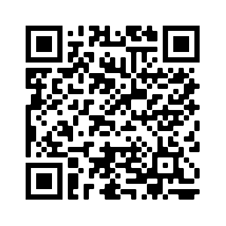
EVALUATION
Notes:
https://edc.co1.qualtrics.com/jfe/form/SV_cBF9GI7gVEBsfSC

