Slide 1
Welcome tO THE Tier 2 COACHES’ MEETing!
GETTING STARTED:
Update your display name in Zoom to read: [Your School], [Your Name] (e.g., Eastside HS, Joe Clark)
Complete the ATTENDANCE
Bookmark link to find training resources at : SEB PBIS Tier 2 Academy
In the chat, share a favorite holiday tradition.
~15%
Notes:
LINKS for today:
Attendance
https://edc.co1.qualtrics.com/jfe/form/SV_5BiXqi4bxzOCMS2
New team member communications survey - https://edc.co1.qualtrics.com/jfe/form/SV_db8zhNj6NJ3eXga
EDC Website for SEB Academy
https://sebacademy.edc.org/
Event Evaluation (at the end)
https://edc.co1.qualtrics.com/jfe/form/SV_cBF9GI7gVEBsfSC

Slide 2
PBIS Coaching Meeting TIER 2, Year 1 December 2022
Marcie Handler & Katie Meyer
with support from NEPBIS Network, May Institute & Broad Reach Consulting
Notes:
Add trainer names for your event

Slide 3
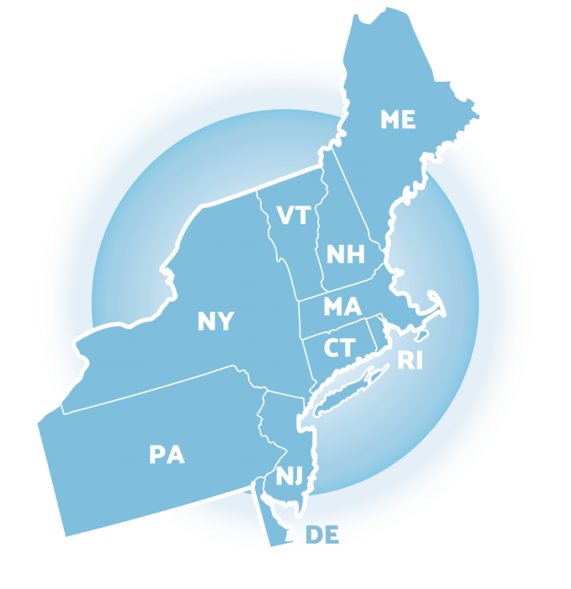
ACKNOWLEDGEMENTS
02
03
04
Northeast PBIS Network (nepbis.org)
01
Michigan Integrated Behavior & Learning Support Initiative
Dr. Heather George & FLPBIS
Missouri PBIS
Drs. Leanne Hawken, Deanne Crone, & Rob Horner
05
06
Midwest PBIS Network

Slide 4
EXPECTATIONS
Self
Others
Environment
Self-monitor
Mute when listening, unmute to talk​
Have electronics ready to use
Obtain help from peers and trainers
Work as a team:
Keep necessary materials at hand
Are you participating?
Engaged as a learner?
Stretch, break, stand as needed​
Room for every voice
Reinforce participation
action plan
relevant docs
water/snacks
Minimize distractions if possible​
Complete tasks efficiently
Notes:
Taking CARE of…

Slide 5
Coaches’ Reminders
Coaches’ Tasks (Sept-Nov):
Set up and share your PBIS Academy Tier 2 folder with us ☺
Content Questions?
Readiness checklist
Team Profiles and meeting schedules
Notes:
Shared Folders?
Welch
Bailey
Sullivan
Mulcahey
North Brookfield
STEM
Callahan

Slide 6
Agenda & Coaches' Tasks
Coaches’ Tasks (Nov/Dec):
Presentation Content:
TFI Baseline self-assessment by Nov 30th - DONE!
Glows and Grows: Step 2 (Process for identifying students)
Targeted Intervention Organizer (finalize Part 1) – shared?
Student identification process – complete one: RFA, data decision rules, guidelines for screening
Using the TFI to action plan
Preview T2 interventions for Jan team training

Slide 7
LEGEND
Timing
Example
Activity
Non-example
Guidelines
Preview
Big Idea
Review
Organization

Slide 8
Glows & Grows: Step 2 Process for Identifying Students

Slide 9
GETTING STARTED WITH Tier 2
Develop an equitable process for matching student need to practices
1
Establish a representative T2 leadership team
6
2
Develop a collaborative process for identifying students
Develop a process for progress monitoring, data-based decision rules
7
3
Evaluate, select and adopt culturally appropriate tier 2 practices
Develop procedures for modifying/ adjusting implementation
8
4
Develop a process to install selected practices
Develop evaluation routines for fidelity and outcome data
9
5
Develop procedures to train staff and students; partner with families and community
Document and share routines, practices, and policies
10
Notes:
COACHES:
Seeing all of these steps can be uncomfortable or overwhelming – the goal is to walk away with an understanding of the elements and need to prioritize time and resources to get the steps achieved over a period of time.

Slide 10
SHARE: GLOWS & GROWS
What is something to celebrate (GLOW) & something you’re working on (GROW) related to:
Step 2. Developing a collaborative process for identifying students
Did you develop a request for assistance (RFA) form?
Did you establish decision rules based on existing data?
Did you identify “gaps” in the data needed to efficiently identify students?
Step 3. Evaluating and selecting Tier 2 interventions
Have you completed your inventory?
Do some interventions need adjustments?
ADD LINKS / details in the SHARED google slides
5 minutes
Whole Group
Notes:
https://docs.google.com/presentation/d/1_sSdWYwBCBe7a7vOkx29j4YxdRJ3xWfUHic32Anwyhg/edit?usp=sharing

Slide 11
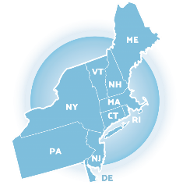
Interpreting the TFI and linking to Tier 2 Action Plan

Slide 12
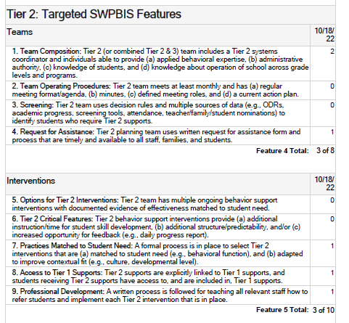
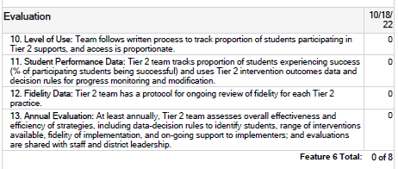
Baseline TFI Data
Generate a report
Understand the numbers
Put it into CONTEXT - “…IN THE BEGINNING” ☺
….Link to your action plan

Slide 13
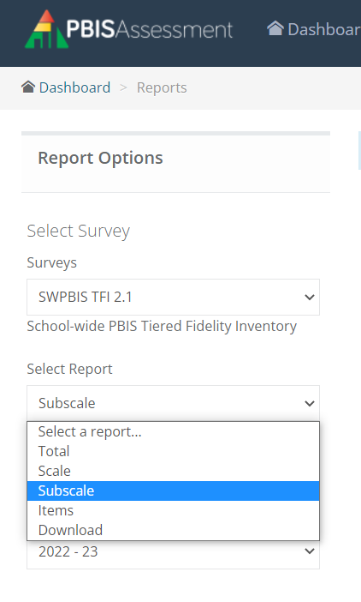
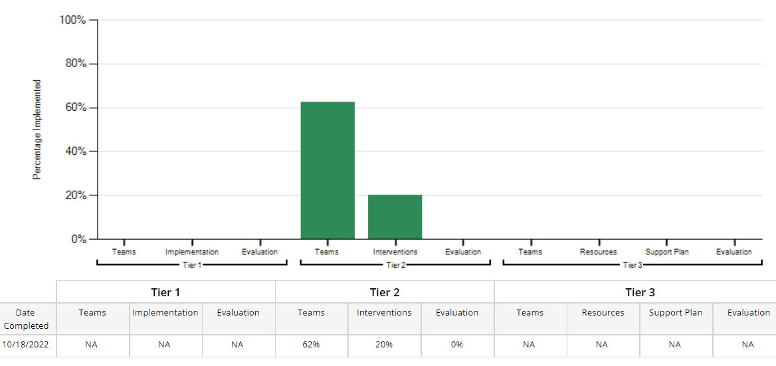
Where are we beginning?
“TOTAL” – not relevant
“SCALE” = Tier Score
“SUBSCALE” = percentage by scale for each Tier
ITEM ANALYSIS…. 0, 1, 2

Slide 14
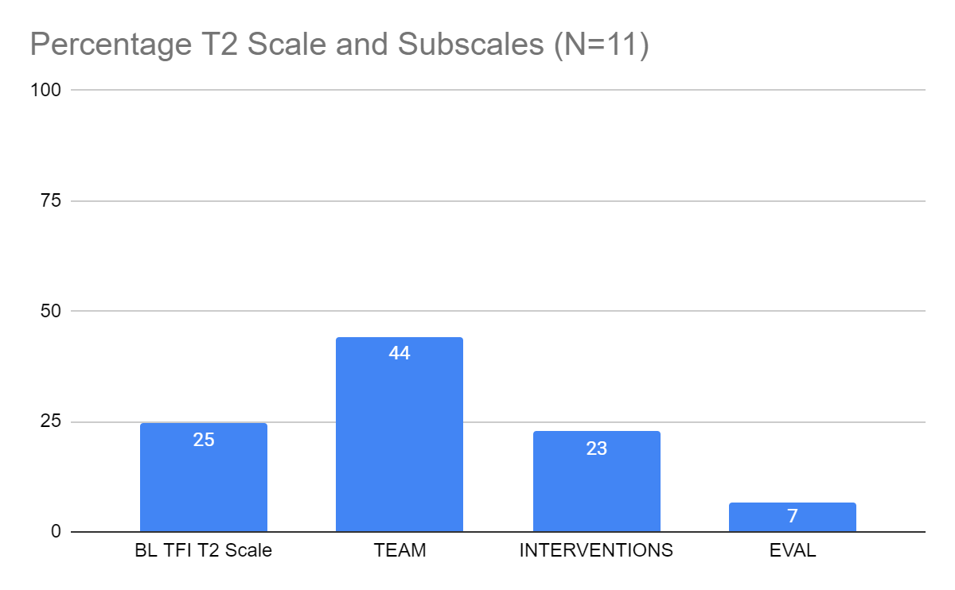
Where are we beginning?
SCALE SCORE – 25%
SUBSCALE -
TEAMS (SYSTEMS) = 44%!
INTERVENTIONS (PRACTICES)
EVALUATION (DATA)

Slide 15
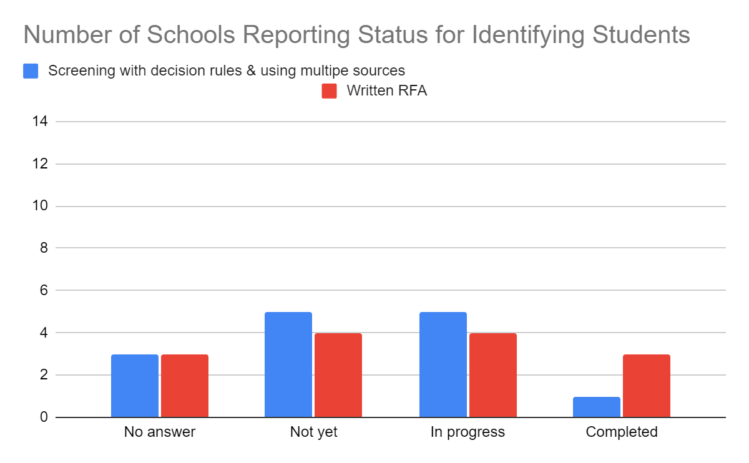
Where are we beginning?
3. Screening: Tier 2 team uses decision rules and multiple sources of data (e.g., ODRs, academic progress, screening tools, attendance, teacher/family/student nominations) to identify students who require Tier 2 supports.
4. Request for Assistance: Tier 2 planning team uses written request for assistance form and process that are timely and available to all staff, families, and students.

Slide 16
Step 2: Develop a collaborative process for identifying students (Part 2)

Slide 17
Student Identification Plan: Critical Features

Slide 18
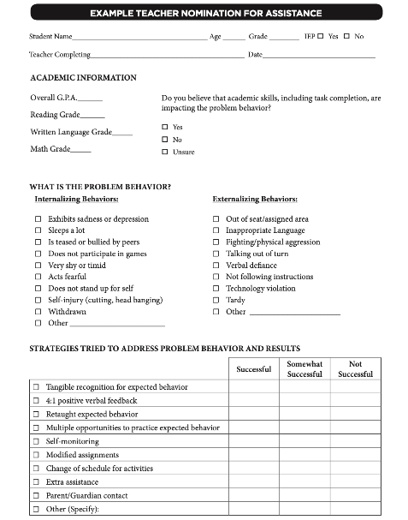
Methods for Identification
What did you decide to focus on first?
Nomination
Data Decision Rules
Screening
Do we have something simple?
What are some of our data sources?
Is the school using a universal screener?

Slide 19
Request for Assistance
Data
Available to staff, students, and families

Slide 20
Teacher Nomination Form

Slide 21
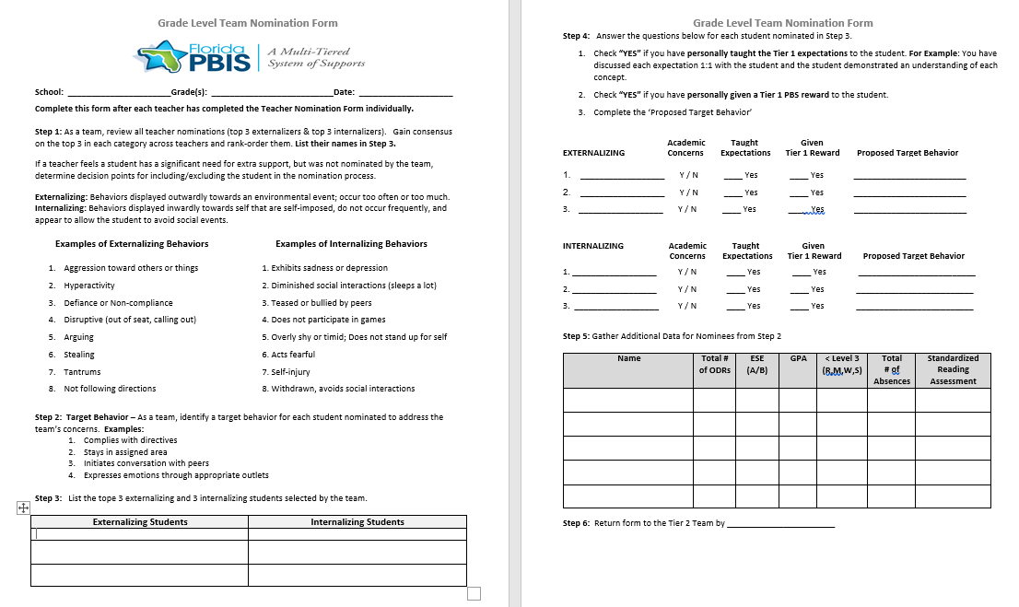
Grade Level Nomination Form

Slide 22
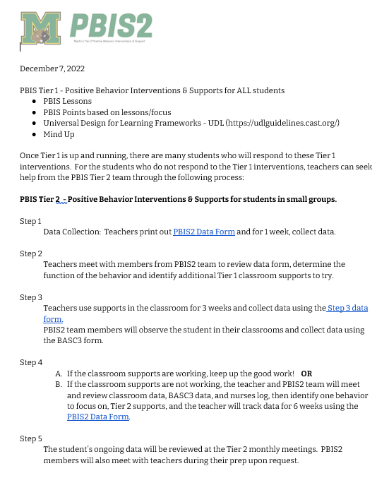
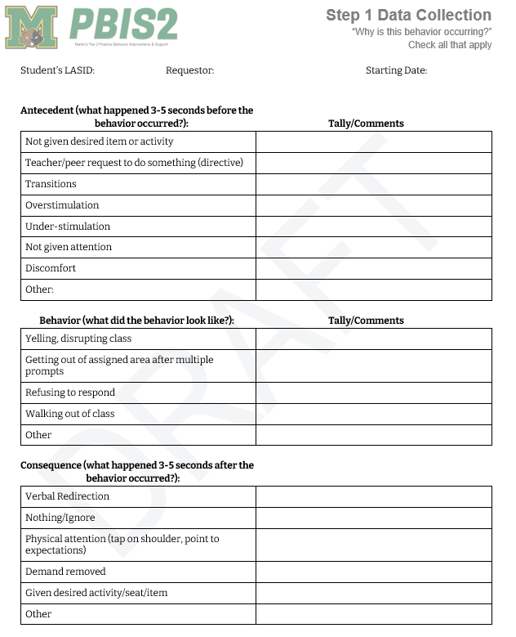
Adapted Nomination Form

Slide 23
ACTIVITY: Request for Assistance Form
Where are we?
0. Form not yet developed
Form developed, but not yet rolled out with staff training
Form developed, staff have been trained, and there is a process in place to respond to referrals
2 minutes
Poll / discussion

Slide 24
Request for Assistance Process
Timelines Determined
Nomination decisions
~10 days
Providing supports to students
~30 days
Family notification if child is nominated (who, what, how)
What is Needed?
Staff training
Decision rules
Procedures if teacher requests for support exceed resources
Staff notification of students receiving support
What systems are in place?
Notes:
Rationale:
All staff need to be trained on the purpose, how to participate in the process, and how to complete the nomination form.
Trainer’s Notes:
Ask the audience:
What are going to be the decision rules for determining the how and what the student needs?
How are staff going to be notified of students receiving supports? How will they support those supports? (communication / feedback loop)
Does the district have a policy for family notification? (e.g., notification vs opting in or out)

Slide 25
DISCUSSION: Request for Assistance Process
What procedures need to be standardized for reviewing requests, notifying staff and families?
How will you share/revise this with your team, and then get feedback from staff?
5 minutes
Action Plan

Slide 26
Using Existing Data Sources to Identify Students
Data
Starting to develop decision rules across data sources

Slide 27
Data Decision Rules
Must be contextually & culturally appropriate
What works in one school may not work in another!
Should be established to guide both entry to and exit from Tier 2 supports
Consider:
Current needs of students in the school
Available resources
Existing programs
Feasibility of starting new programs
Capacity to implement interventions

Slide 28
Sample Decision Rules
Measure | Proficient Score | At-Risk | High Risk
1. Classroom Minors | 0-4 | 5 or more | 15 or more
2. Major/ODR | 0-1 | 2 – 5 | 6 or more
3. Absences | <5/trimester | 5+/trimester | 10/trimester
4. Tardy | <4/trimester | 4+/trimester | 10/trimester
5. ISS | 0-1 | 2 | 4 or more
6. OSS | 0 | 1 | 2
7. Course Grades | 2.5 or higher | D or F in any course | Ds or Fs in multiple courses
8. Reading Inventory | 800+ | 799 or lower | 599 or lower
9. Writing Assessment | 3 or 4 | 2 | NS; 1
10. Nurse (non-medication) | 0-1 (no pattern) | 2 – 5 (patterns of regular visits) | 6 or more (pattern of regular visits)
EXAMPLE
Notes:
Sample decision rules across academic and behavioral sources of data; needs to fit context
Office discipline referrals, with teacher referral backed by absences or SAEBRS. We talked about using nurse/counselor visits we aren't there yet. Our academics are monitored for our WIN blocks, kids are put into 6 to 8 week intervention groups that happen T-F for 45 minutes daily. They are strictly academic groups at this point but our academic data is being monitored there.

Slide 29
GUIDING QUESTIONS: DATA SOURCES
Systems
What data sources do we already use and review?
Do we need to add any additional sources?
What about for this year?
Who will be responsible for collecting and summarizing these data?
How often (once a month, once a quarter) will we review school-wide extant data?
Are there clear routines for timely response to requests for assistance?

Slide 30
ACTIVITY: Using Existing Data Sources to Identify Students in Need of Support
What data sources do you plan to review?
Have you established data decision rules with team members and discussed with administration?
What help do you need?
3 minutes
Whole Group

Slide 31
Screening
Data
When are we ready to discuss this process?

Slide 32
RESOURCES
BRIEFS:
Guidance for Systematic Screening: Lessons Learned from Practitioners
Selecting a Universal Screening Tool
COMPREHENSIVE GUIDES
Best practices for Universal SEB Screening
SEB and MH Screening
Notes:
RESOURCES all linked at :
https://sebacademy.edc.org/student-identification-process-resources
Center on PBIS | Resource: Guidance for Systematic Screening: Lessons Learned from Practitioners
https://sebacademy.edc.org/sites/default/files/2022-12/Best%20Practices%20for%20universal%20SEB%20screening.pdf

Slide 33
PRACTICE (checking in)
Practice
Top Interventions

Slide 34
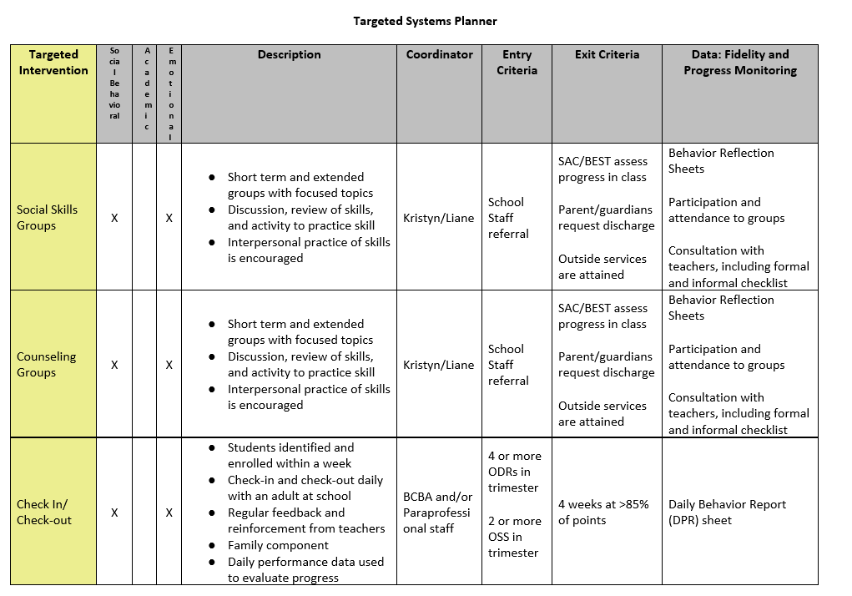
ACTIVITY: Targeted Systems Planner (Part 1)
Where are we?
0. Form not yet started
Form started, but additional time or suggestions needed
Form drafted and ready for feedback ☺
2 minutes
Poll / discussion

Slide 35
Looking Ahead: January Team Training

Slide 36
IN PERSON TEAM TRAINING
Questions?
Concerns?
Coverage?
January 19th 9-3pm (Courtyard Boston Marlborough)
(75 Felton Street, Marlborough)
INSTALLING TIER 2 PRACTICES - Understanding the Critical Features:
Check in Check Out (CICO)
Check and Connect (Mentoring with Monitoring)
SAIG – Social Academic Instructional Groups
Social / Emotional Skills
REP – Resilience Education Program (CBT+CICO)
Part 2 of Targeted Intervention Organizer – Matching Intervention to Need
Notes:
TEAM TRAINING LOCATION:
Courtyard Boston Marlborough 75 Felton Street Marlborough, MA 01752
CRITICAL FEATURES:
Tier 2 behavior support interventions provide (a) additional instruction/time for student skill development, (b) additional structure/predictability, and/or (c) increased opportunity for feedback (e.g., daily progress report).

Slide 37
Check-In, Check-Out: T2 Exemplar
CICO Video
CICO Practice Features:
Increased positive adult contact and structure
Embedded social skills training
Direct link to school-wide behavioral goals and expectations
Frequent feedback
Daily home-school communication
Positive reinforcement contingent on meeting behavioral goals
Match to function = access to ATTENTION
Can be slightly modified based on student need or response

Slide 38
Technical Assistance (TA) time
Coaches’ Tasks (before Dec break):
Options:
Send zoom link for Jan or Feb meeting date
Pair with a team meeting
Individual meeting with coach or coaches
Review of products team is working on
Send an email re specific items for review
Notes:
IF YOU HAVE NOT PARTICIPATED IN TA yet, please make a point to schedule this for January.
Reminder:
Fall, Winter (Dec, Jan, Feb), and Spring TA (in addition to team TFI if time allows)

Slide 39
Agenda & Coaches' Tasks
Coaches’ Tasks (Dec):
Presentation Content:
Targeted Intervention Organizer (finalize Part 1) – shared?
Glows and Grows: Step 2 (Process for identifying students)
Student identification process – complete one: RFA, data decision rules, guidelines for screening
Using the TFI to action plan
Preview T2 interventions for Jan team training

Slide 40
EVALUATION
CONTACT INFORMATION:
Marcie Handler
mwhandler@gmail.com
Katie Meyer
Katherine.meyer@uconn.edu
Please remember to complete the evaluation to receive your Certificate of Attendance!
Notes:
Evaluation Link
https://edc.co1.qualtrics.com/jfe/form/SV_cBF9GI7gVEBsfSC

