Slide 1


PBIS School-Wide Coach Meeting
Year 3: December 2022
PBIS Track
[insert trainers name]
with support from NEPBIS Network, May Institute & Broad Reach Consulting
Notes:
Add trainer names for your event

Slide 2

EXPECTATIONS
Self
Others
Environment
Self-monitor
Mute when listening, unmute to talk​
Have your computer charged and ready to go​
If you have questions or comments:
Work as a team:
Keep necessary materials at hand
Are you participating?
Engaged as a learner?
Stretch, break, stand as needed​
unmute
use the chat box
Room for every voice
Reinforce participation
action plan
relevant docs
water/snacks
Minimize distractions if possible​

Slide 3
IN-PERSON TEAM TRAINING EVENT INCLEMENT WEATHER POLICY
In case of inclement weather, we will cancel our team training if the local school district where the training will be held is either delayed or cancelled due to inclement weather.
Please monitor school and district closings for the school district in which the training is being held. In any case that you feel it is not safe for you to travel to the cohort training, please make the decision that is most safe for you.
Your training site is [Trainers please fill in location] [Date of Next Training]

Slide 4
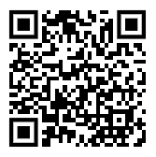
ACTIVITY: ATTENDANCE
Scan QR code on the left or follow the URL posted in the chat to access the online attendance survey
Follow prompts to enter attendance information
Notify trainers if you require assistance (e.g., identifying your cohort or cohort group)
Certificates of Attendance will be sent in January and June. Attendance records and Zoom log in will be use as verification
You are in Cohort 7
1 minute
Notes:
TRAINERS – QR Code is updated
Add your cohort number
Post a link to the attendance survey (below) in the chat for those who do not use the QR code on the slide:
ATTENDANCE: https://edc.co1.qualtrics.com/jfe/form/SV_5BiXqi4bxzOCMS2

Slide 5
Agenda & Coaches' Tasks
Coaches’ Tasks:
Presentation Content:
Glows & Grows: Classroom Assessment Plan
Discuss with team integration & alignment content. What other practice models should be integrated with PBIS supports? – Complete alignment activity and add to Canvas.
Fidelity Assessment: Walkthrough Planning
Work with team to plan and complete the TFI walkthrough prior to January Team training.
PBIS Assessment Coordinator Practice
Set up your TFI in PBIS Assessment for January
Integration & Alignment

Slide 6
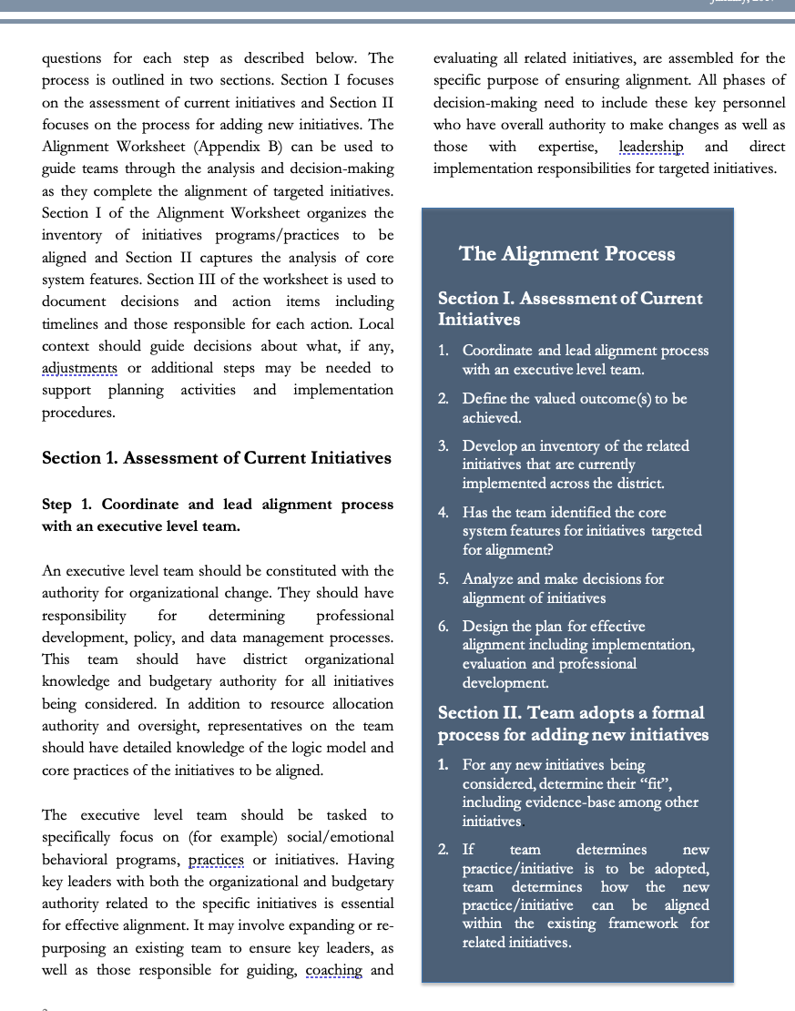
HELPFUL RESOURCES
RESOURCES:
Tiered Fidelity Inventory
  TFI Tier 1 Quick Check Tip Sheet for Scoring
  PBIS TFI Walkthrough Tip Sheet
  Integrated TFI Companion Guide
Alignment Activity
  Technical Guide for Alignment of Initiatives
  Integrating Trauma Informed Approach into a PBIS Framework
Classroom Assessment Plan (Template for upload)
  Classroom Management Observation Tool [CMOT]
  Classroom Support Doc with Class Self Assessment
  PBIS Apps Self Assessment Survey w/ Classroom
PBIS Assessment Manual
PBIS Assessment Videos [TFI, Open Surveys, Climate Survey etc.)
Notes:
RESOURCES:
PBIS TFI: Resource link: https://www.pbisapps.org/resource/tfi
TFI Tier 1 Quick Check Tip Sheet for Scoring https://sebacademy.edc.org/tfi-tier-1-quick-check-tip-sheet-scoring
PBIS TFI Walkthrough Tip Sheet: https://www.pbisapps.org/resource/tfi-walkthrough-tip-sheet
Integrated TFI Companion Guide: https://www.pbis.org/resource/integrated-tiered-fidelity-inventory-companion-guide
Classroom Assessment Plan (Template for upload) https://sebacademy.edc.org/classroom-assessmet-planning-template
Supportive Environments create Classroom Community - https://sebacademy.edc.org/supportive-environments-create-classroom-community
Self Assessment Surveys - https://www.pbisapps.org/resource/self-assessment-survey
Technical Guide for Alignment of Initiatives: https://www.pbis.org/resource/technical-guide-for-alignment-of-initiatives-programs-and-practices-in-school-districts
Integrating Trauma Informed Approach into a PBIS Framework https://sebacademy.edc.org/integrating-trauma-informed-approach-pbis-framework
Alignment Activity: https://sebacademy.edc.org/alignment-activity
PBIS Assessment Manual https://sebacademy.edc.org/pbis-assessment-user-manual-0
PBIS Assessment Videos – TFI, Opening Surveys, climate Surveys etc https://www.pbisapps.org/resources/videos#pbis-assessment

Slide 7
Glows & Grows:
Assessment
of Classroom Practices and Evaluation Planning
Notes:
12:30

Slide 8
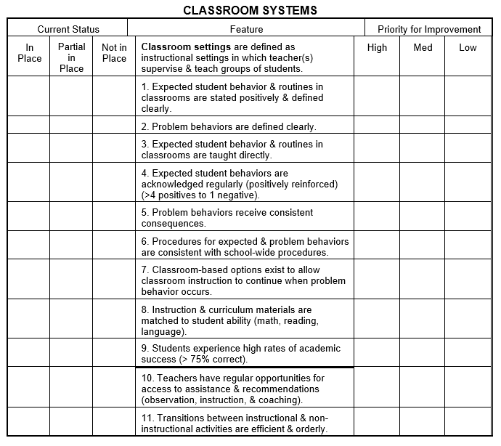
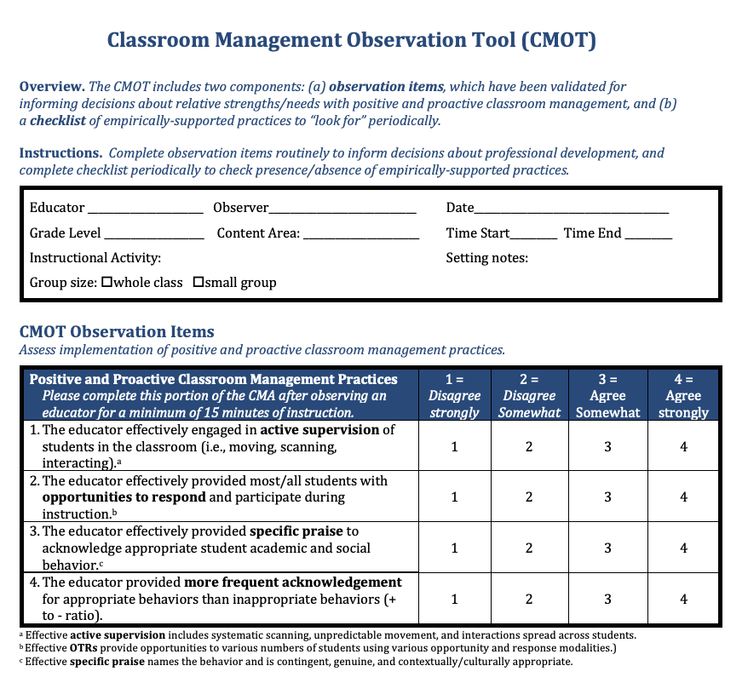
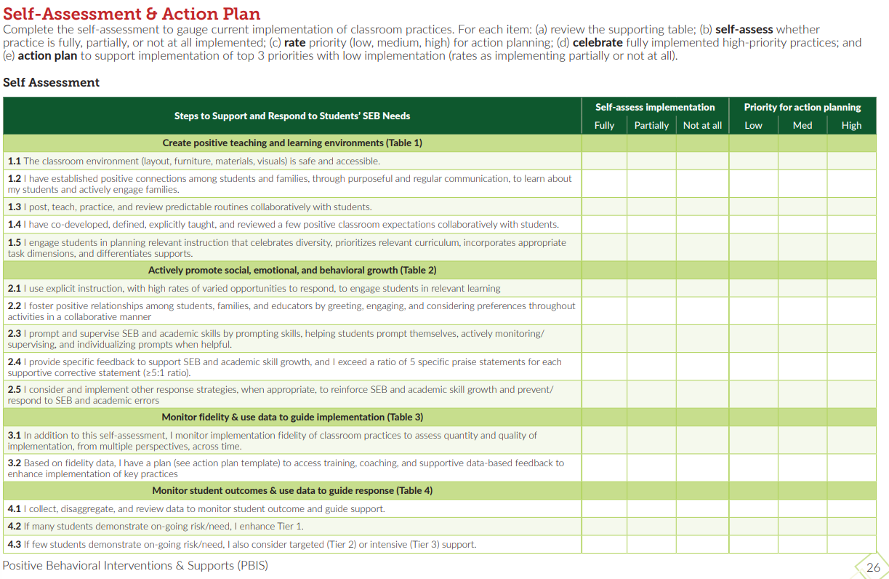
Classroom Self-Assessment?
CMOT
CLASSROOM
Self-Assessment
SAS: CLASSROOM SYSTEMS
Notes:
Resource: https://www.pbis.org/resource/supporting-and-responding-to-behavior-evidence-based-classroom-strategies-for-teachers
Cmot - https://sebacademy.edc.org/classroom-management-observation-tool-cmot

Slide 9
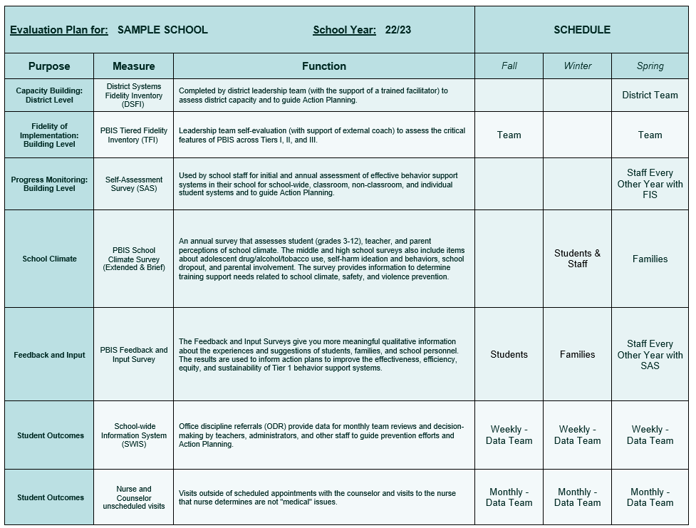
Do you have an EVALUATION PLAN?
At a minimum, it is strongly recommended that teams include the following in an evaluation plan:
School-wide student outcomes (weekly)
Student and staff perceptions (annually)
Fidelity (annually with the TFI)
A written plan will support the sustainability of PBIS.
Notes:
Data Decision Rules Activity - https://sebacademy.edc.org/developing-data-routines-activity
Evaluation Plan Template - https://sebacademy.edc.org/evaluation-schedule

Slide 10
DISCUSSION: CLASSROOM ASSESSMENT
How and when have you decided to assess classroom practices?
Do you have an Evaluation Plan for the year?
Independent Jot
Whole Group
2 minutes
13 minutes

Slide 11
PBIS
Resource Spotlight:
Aligning PBIS with Trauma Informed, SEL and other inititatives
Notes:
RESOURCE LINK: https://www.pbis.org/resource/teaching-social-emotional-competencies-within-a-pbis-framework

Slide 12

Trauma Informed within a PBIS Framework
The purpose of this Guide is to describe how district and school leaders can incorporate trauma-informed practices within a Positive Behavioral Interventions and Supports (PBIS) framework. This ensures that the investments in training school personnel about trauma can be integrated into a system that links these efforts to student outcomes. Recommendations are included for how to adjust the PBIS framework to support trauma informed practices.
Expand Teams to Ensure Trauma Expertise Guides and Informs Multi-tiered Systems.
Use Data Sources that Identify the Scope of Trauma
Ensure Early Access through Universal Screening
A Formal Process for Selecting Trauma informed Evidenced-based Practices
Decide How to Assess Fidelity and Impact Before Implementing
Notes:
Resource Link: https://www.pbis.org/resource/integrated-tiered-fidelity-inventory-companion-guide
CHANGE THIS to TRAUMA and pull description from Brief - https://sebacademy.edc.org/list-of-pbis-resources?keyword=trauma&pbis_resource_type=All&pbis_resource_topic=All&sort_by=field_date_value&sort_order=DESC

Slide 13
Carousel Activity: Teaching Social-Emotional Competencies within a PBIS Framework
Divide Coaches into 5 Breakout Room Groups to represent each of the 5 sections of the brief
Download & Review Integrating a Trauma Informed Approach into a PBIS Framework.
Read Introduction and your section (1-5)
Discuss the big takeaway. What from this brief/section resonates with you?
Be prepared to briefly share your section with the whole group
10 minutes
10 minutes
Coach Review/Chat
Whole Group
Notes:
https://sebacademy.edc.org/integrating-trauma-informed-approach-pbis-framework

Slide 14

INTEGRATION & ALIGNMENT WITH PBIS

Slide 15
BIG IDEAS: WHY ALIGN?
Systems
Data
Practices
Use one coherent implementation framework to align competing initiatives for the current context and avoid repeatedly shifting focus to new initiatives.
Articulate and simplify message so district, community/school leaders and staff see a coherent framework and can support an overall improvement strategy
Use the PBIS/MTSS core features as the guiding principles of the proactive/preventative approach.
Equity
Outcomes
Tier 3
Tier 2
Tier 1
Notes:
We know that every year schools are asked to add more onto their task list. It seems like just when schools are implementing near fidelity with one initiative or program another one gets thrown into the mix and we lose momentum with the last one. But they all seem so similar to each other…why can’t we just stick with one.
We’re not saying these aren’t important to the health of your school climate but how do you fully integrate everything together? We know PBIS has some explicit practices but mostly it’s an implementation framework that can be used to align initiatives and articulate a simplified message so that your stakeholders can support the overall improvement strategy rather then a series of disjointed practices that never get full attention. The PBIS/MTSS approach is proactive preventative and focuses on tiers of intervention. It’s within those systems and tiers that you can add new research and strategies to support your students.

Slide 16
ALIGNING INITIATIVES, PROGRAMS, & PRACTICES
1. Define the valued outcome(s).
2. List related initiatives.
3. Identify core system features.
4. Analyze and make decisions for alignment.
5. Design the plan for effective alignment.
View
Technical
Guide on pbis.org
National TA Center on PBIS. (2017). Technical guide for alignment of initiatives, programs, practices in school districts. Eugene, OR: Retrieved from www.pbis.org
Notes:
https://www.pbis.org/resource/technical-guide-for-alignment-of-initiatives-programs-and-practices-in-school-districts
There are 5 steps to take when thinking about Aligning initiatives.
Define your valued outcomes – Like a Positive School Culture
List your related initiatives – Like PBIS, SEL, mental health, Bully Prevention
Identify core system features – Such as Teaching Lessons or Acknowledging students
Analyze and make decisions - How to combine PD Events
And plan for effective alignment – like combining teams and outcomes.
If you're interested in learning more about integration and alignment, you can download and read the "Technical guide for Alignment" on PBIS.org
You can use section 5C in your getting started workbook for more information.

Slide 17
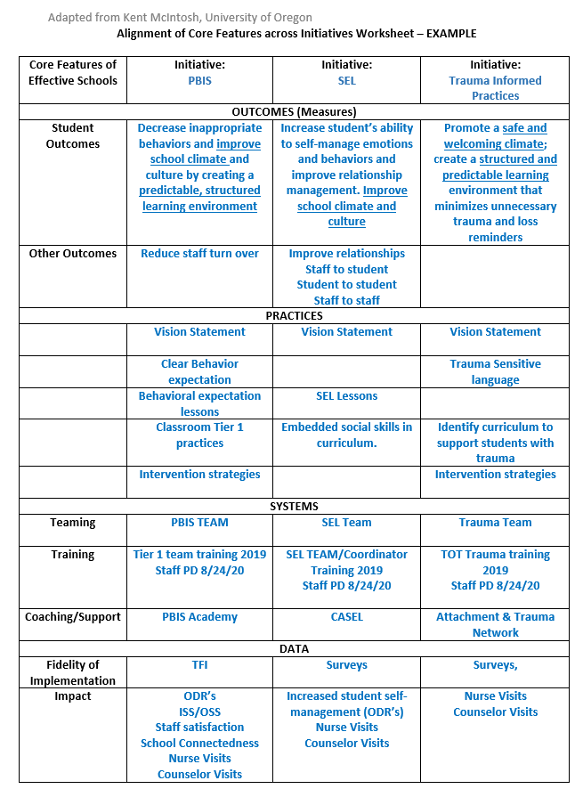
3. Identify core system features.
Notes:
Here is an example of The alignment activity you will work on this year. This one seeks to align PBIS with SEL and Trauma Informed Practices. This worksheet will help us align the Core System Features of each initiative. Let’s take a closer look.
Alignment Worksheet: https://nepbis.org/wp-content/uploads/2018/11/Alignment-Activity-1.docx

Slide 18
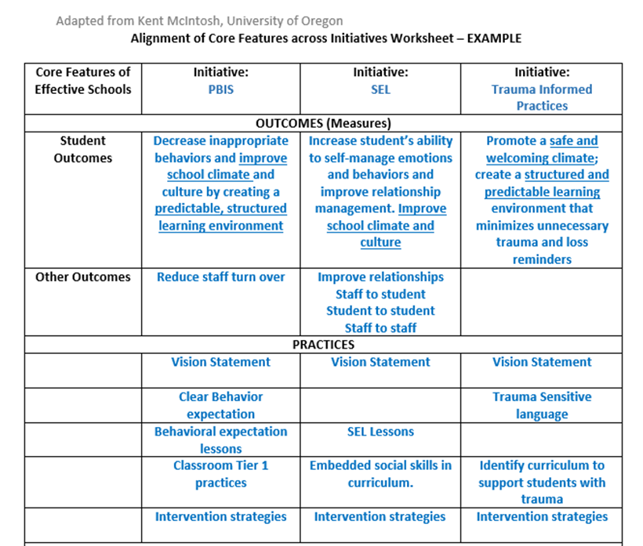
4. Analyze and make decisions for alignment.
5. Design the plan for effective alignment.
Notes:
We start by identifying our initiatives and then listing the desired Outcomes for each – CLICK
We see that overall our goal here is to improve the school climate and culture.
Next we list the various practice set align the practices so you can see where they overlap.
All 3 initiatives have a vision statement component. (we don’t need 3 separate statements but rather 1 that encompasses all 3 initiatives.)
We can also see other areas that overlap such as lessons and intervention strategies.

Slide 19
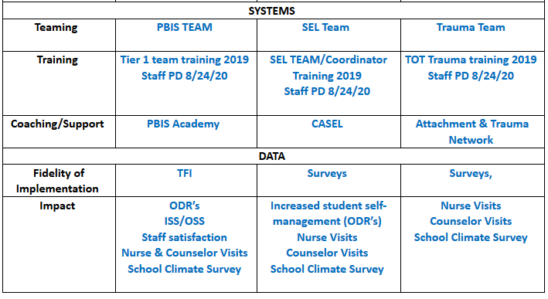
Notes:
The next ss to consider are Systems and Data –
You’ll want to list the team that was created to lead the initiative.
Can they be combined? Revisit your working smarter matrix and see if the same people are on multiple committees.
Next think of the training for staff -
Can we create staff PD that covers all 3 topics so that staff understand their interconnectedness?
Finally, consider what Fidelity and outcome data you will use to determine fidelity and effectiveness.
Here you can see that ODR’s, Nurse and counselor visits and the school climate survey will be outcome measures for all 3 initiatives

Slide 20
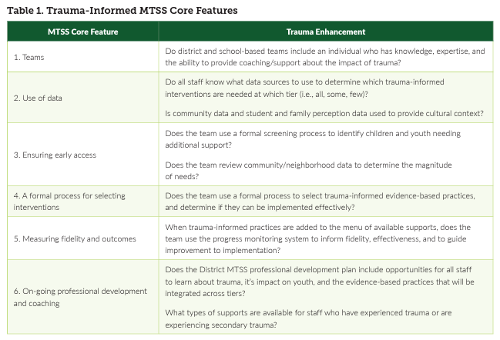
PBIS FRAMEWORK & Trauma Informed CROSSWALK
Notes:
Does your school have universal SEL practices (e.g., a curriculum such as Second Step, Zones of Regulation Restorative practices, Responsive Classroom)? If you said yes…how are you integrating them currently?
Specific behaviors are important and necessary, but we are also addressing social competency with all our students.

Slide 21
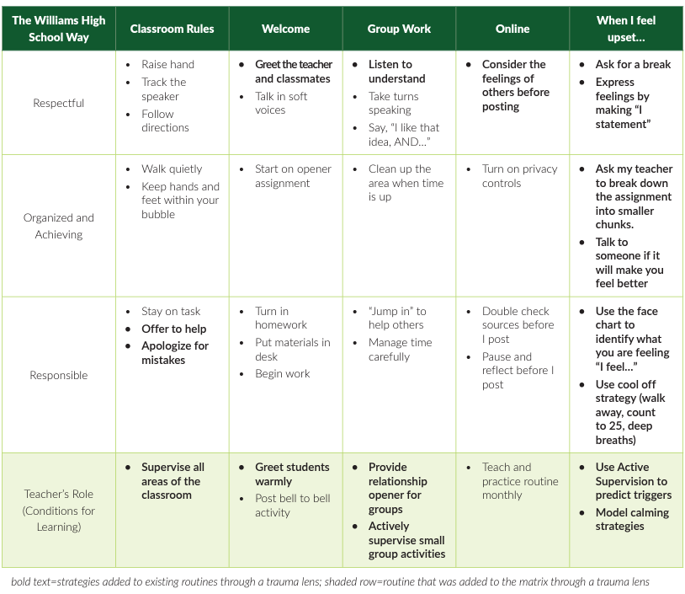

Slide 22
Teaching Matrix |  | INCORPORATE Coping Strategies for Managing Stress
 |  | All Settings | Hallways | Playgrounds | Lunch | Library/ Computer Lab | Assembly | Bus
Expectations | Respectful | Be on task. Give your best effort. Be prepared. | Walk. | Have a plan. | Invite those sitting alone to join in | Study, read, compute. | Sit in one spot. | Watch for your stop.
 | Achieving & Organized | Be kind. Hands/feet to self. Help/share with others. | Use normal voice volume. Walk to right. | Play safe. Include others. Share equipment. | Have a lunch plan and choose quiet or social lunch area | Whisper. Return books. | Listen/watch. Use appropriate applause. | Use a quiet voice. Stay in your seat.
 | Responsible | Recycle. Clean up after self. | Pick up litter. Maintain physical space. | Use equipment properly. Put litter in garbage can. | Use my breathing technique Listen to my signals | Push in chairs. Treat books carefully. | Pick up. Treat chairs appropriately. | Wipe your feet.
Notes:
For many schools who are returning to in person learning supporting students who have experienced high levels of stress and anxiety has become a priority. You can see how the team can develop strategies and skills and incorporate them into their social curriculum.
READ LUNCH Column - it would be a matter of teaching skills to students. – the matrix is the delivery mechanism to get skills out to EVERYONE!!! It’s the common language and script used to teach, acknowledge, pre-correct
This allows all staff to use the same approach for teaching and supporting across the school day and throughout the year.

Slide 23
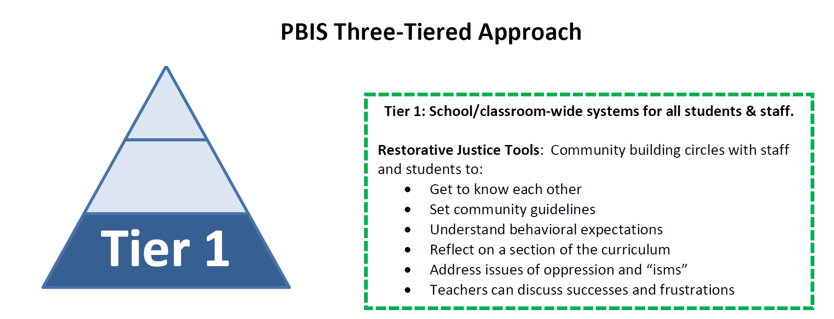
Restorative Justice Practices & PBIS
Notes:
As demonstrated in the sample, Trauma informed and restorative justice practices seamlessly integrated with PBIS and in fact have many of the same goals and outcomes.
So why do them all? Well, you don’t have to unless your data or climate indicate the need.
Each practice addresses a need or group of needs such as avoiding retraumatizing students or restoring relationships after conflict. You might have a gang prevention or bullying prevention program in your school that address those topics. But no matter the program you should use the MTSS/ PBIS framework to address it. Meaning you use your staff systems to inform and train staff, you use your teaching systems (advisory, SEL Block) to teach students, your communication systems to inform families and the broader community, and your data systems to analyzed your implementation and results.

Slide 24
GUIDELINES: EFFECTIVE ALIGNMENT
Organizational Level
Professional Development
Outcome Measures
Systems
Align multiple initiatives where common budget authority exists
Build aligned PD by comparing & combining core features of initiatives
Compare fundamental assumptions
Start with common “core features” & compare practices used to achieve these features
Determine how to incorporate additional core features efficiently
Build single PD curriculum that combines core features
Align multiple initiatives by using common measures to assess effectiveness
Logic Model
Resolve any logic model conflicts between initiatives
Notes:
Follow these guidelines to effectively align and integrate your initiatives.
Always start at the organizational level if possible – Can or does the same person have administrative and budget authority over the various initiatives? This can help to avoid redundancies in trainers, repetitive tasks, staffing and resources.
Use your Working Smarter matrix to align your common outcomes and outcome measures
Align and integrate the common core features into your practices and PD to be as efficient as possible with your time and resources.
Finally Resolve Logic Model Conflicts – Examine how everything flows together and resolve any issues where procedures might diverge. - such as one initiative might use Tangible reinforcers while another stresses only verbal feedback - work with your team to come up with a collaborative workable protocol or solution

Slide 25
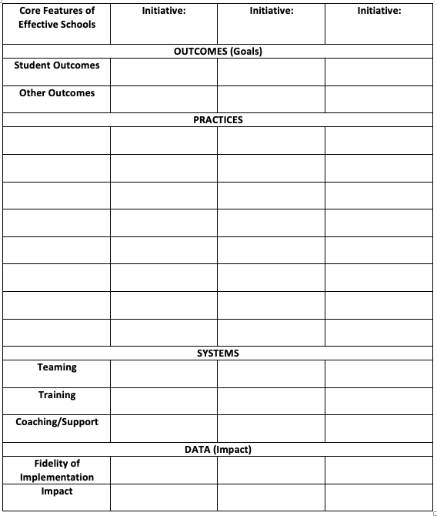
ACTIVITY: INTEGRATION & ALIGNMENT
Complete the Alignment Activity Worksheet
First consider what other practice models you want to align with your PBIS Framework
What action steps are necessary to begin this work?
Add relevant items to your action plan or adjust as needed.
Consider using your Working Smarter Matrix if necessary.
10 minutes
5 minutes
Coach Review/Chat
Whole Group
Notes:
Over this year work to complete the Integration and Alignment Activity that can be found on the platform.
Think about which initiatives you have in your building or district.
What resources might you need to help address the alignment
Do you need to review or recreate your Working Smarter Matrix?
Update your action plan.

Slide 26
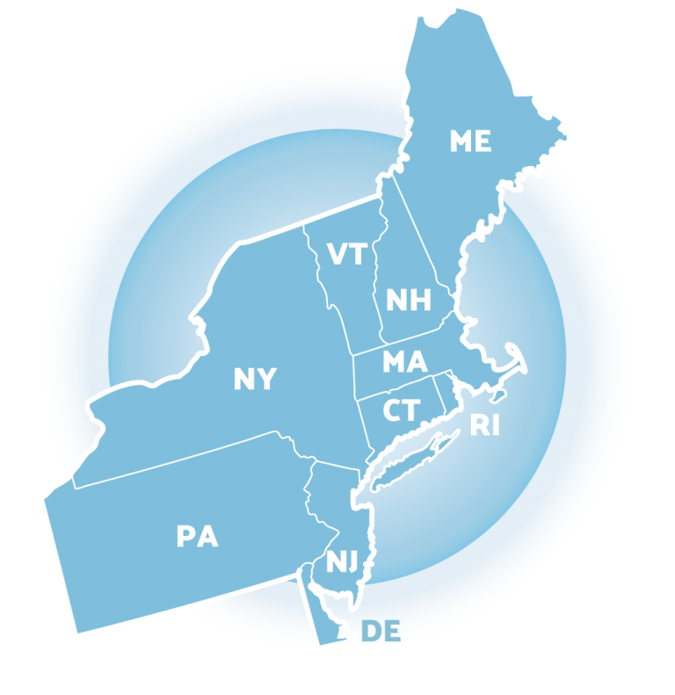
Preparing for Jan Training:
TFI Walkthrough Tool
Notes:
https://www.pbisapps.org/products/tfi

Slide 27
TIERED FIDELITY INVENTORY (TFI) AND WALKTHROUGH PLANNING
Purpose: | Assess evidence of critical features of school-wide PBS implementation; Progress over time; Helps team make data-based decisions on intervention and program efficacy; Guides action-planning.
Format: | Survey ratings of features in place (self-assessment). About 30 mins per tier.
Completed by: | Team members with the coaches. Walkthrough tool completed by external coach.
When? | Self-Assessment Fall and/or Winter & Annually with external trainer (in spring)
Walkthrough can be completed prior to Jan training
Notes:
https://www.pbisapps.org/products/tfi

Slide 28
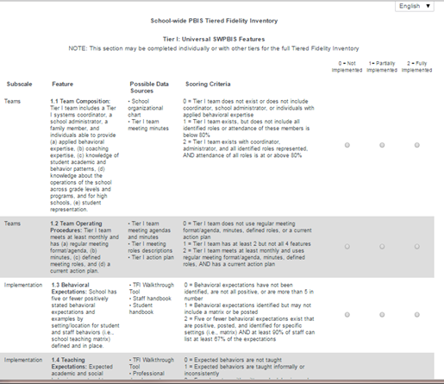
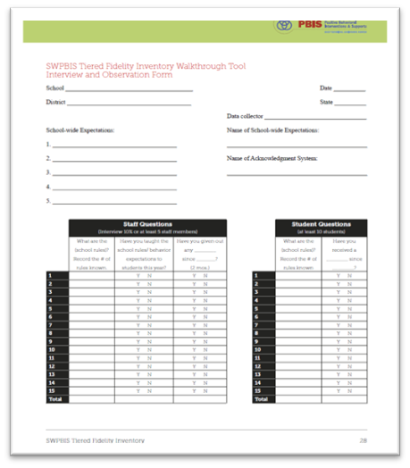
TIERED FIDELITY INVENTORY
PBIS Assessments - TFI
Walkthrough Tool
Notes:
The purpose of this content is to explicitly review the TFI Walkthrough tool to help coaches and teams collect this information independently.
Resource Link: https://www.pbisapps.org/resource/tfi

Slide 29
TFI WALKTHROUGH
Who should complete this tool? | Someone who is independent of the building.
 | Coach or team member who is internal for the purpose of a self-assessment.
 | District administrator
 | Coach or team member from another in-district building
Two Components | Staff Interviews (minimum of 10 people)
 | Student Interviews (minimum of 10 students)
Notes:
Resource link: https://www.pbisapps.org/resource/tfi
Appendix A, Page 27

Slide 30
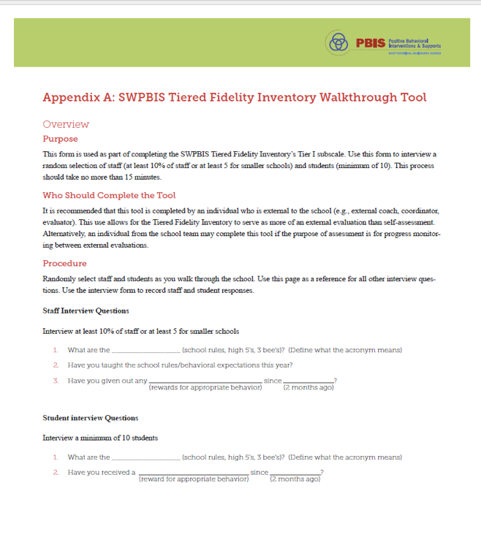
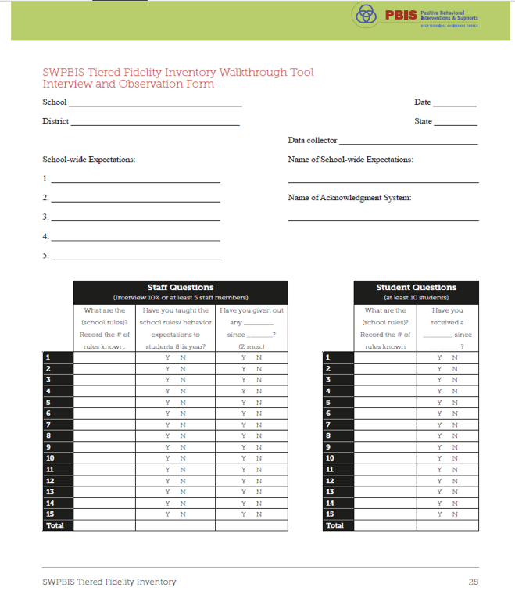
TFI Walkthrough: Appendix A
Notes:
The TFI Walkthrough Tool is Appendix A: pages 27-28 of the TFI. This is a tool that is used by a coach/external person to complete prior to the TFI. The first page provides an overview and the questions to ask staff and students. The second page is a place for recording the information. This provides an efficient way to calculate the percentages to assist with the TFI items.
https://www.pbisapps.org/resource/tfi

Slide 31
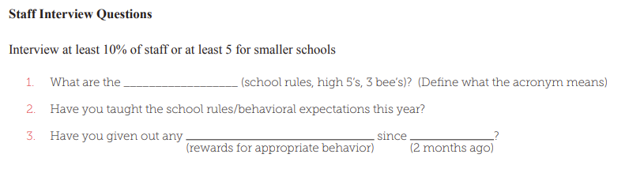
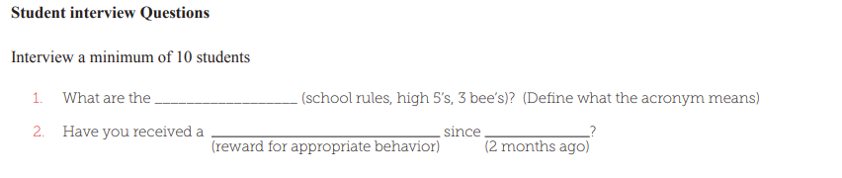
TFI WALKTHROUGH
Staff
interview Questions
Student interview Questions
Notes:
TRAINER NOTE: Remind evaluator to ask if they have "formally" taught the expectations to your students this year?
Resource link: https://www.pbisapps.org/resource/tfi
Appendix A, Page 27

Slide 32
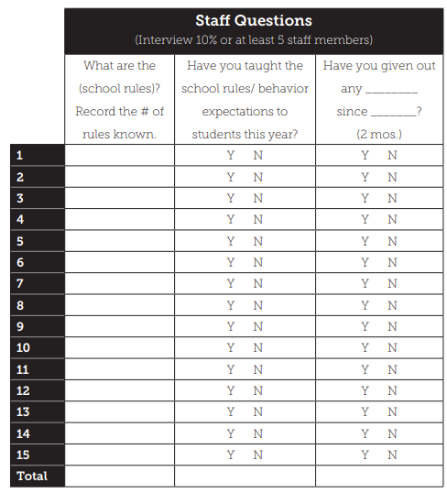
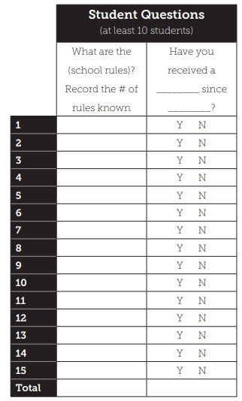
TFI WALKTHROUGH INTERVIEW FORM
Notes:
Resource link: https://www.pbisapps.org/resource/tfi
Appendix A, Page 27

Slide 33
ACTIVITY: TFI WALKTHROUGH PLANNING
Review the TFI Walkthrough Tool
Plan when you will conduct this walkthrough (try and collect this information in advance of our Jan training).
Plan who will conduct this walkthrough.
5 minutes
5 minutes
Coach Review/Chat
Whole Group
Notes:
Resource Link: https://www.pbisapps.org/resource/tfi-walkthrough-tip-sheet
Resource link: https://www.pbisapps.org/resource/tfi
Appendix A, Page 27

Slide 34
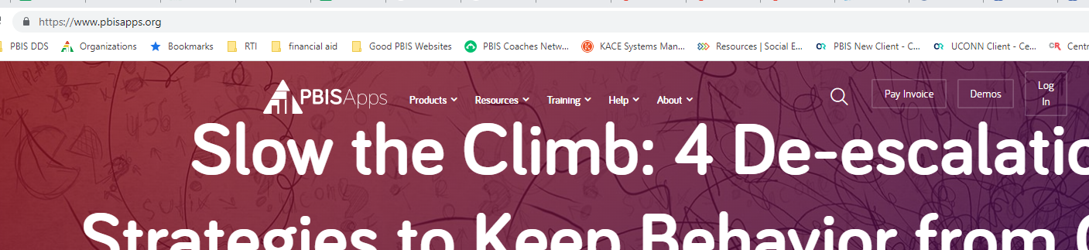
ACTIVITY: Log onto PBIS ASSESSMENTS
Review the TFI Walkthrough Tool
Plan when you will conduct this walkthrough (try and collect this information in advance of our Jan training).
Plan who will conduct this walkthrough.
5 minutes
5 minutes
Coach Review/Chat
Whole Group
Notes:
Resource Link: https://www.pbisapps.org/resource/tfi-walkthrough-tip-sheet
Resource link: https://www.pbisapps.org/resource/tfi
Appendix A, Page 27

Slide 35
Resource Spotlight 2:
Using PBIS Assessment for Evaluation Planning

Slide 36
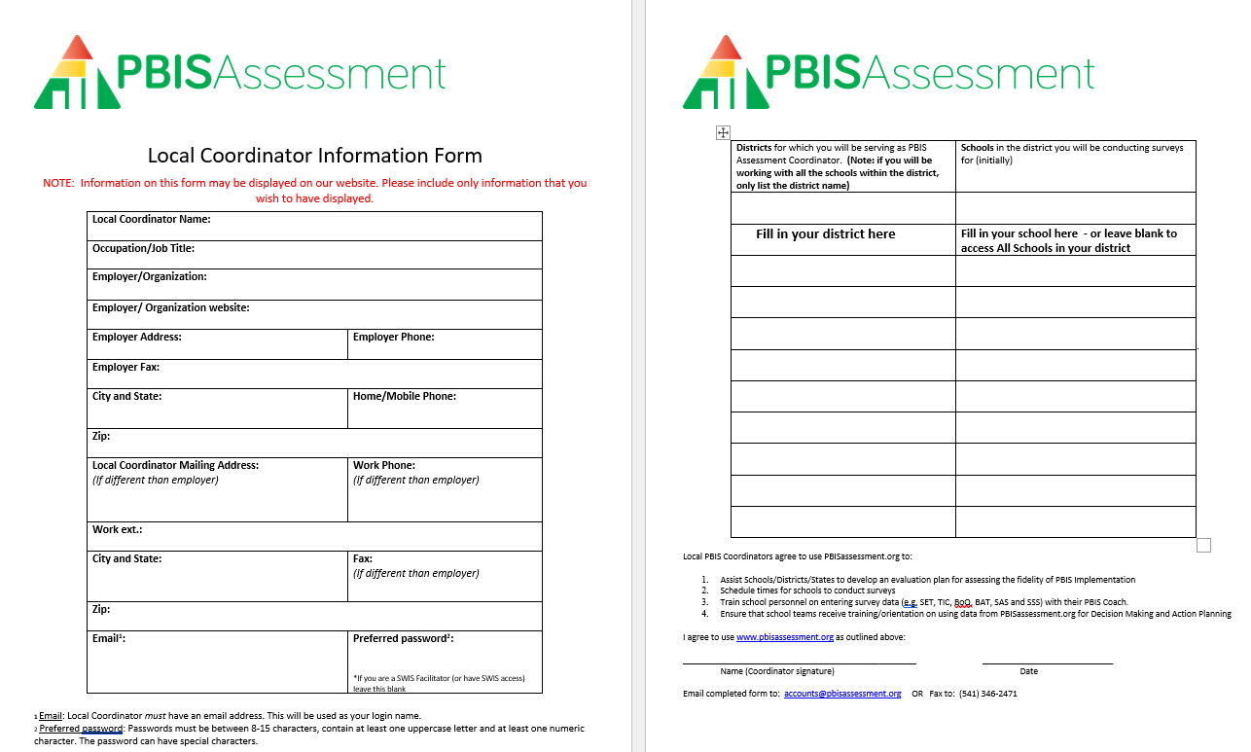
PBIS Assessments Coordinator
Did you complete form and send it in? If not, please download now and complete form and send to: accounts@pbisassessment.org
“Hello,
Please add me as a PBIS Assessment Coordinator. See attached form.
Thank you,”
Notes:
If they have not yet done so-----
Have coaches download this form from the EDC PBIS Resource page. https://sebacademy.edc.org/pbis-assessment-coordinator-form
Complete Form
Send it to accounts@pbisassessment.org with the script “Hello,
Please add me as a PBIS Assessment Coordinator. See attached form.
Thank you,”

Slide 37
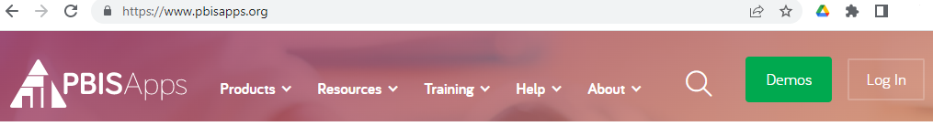
Let’s Log in to PBISApps
www.PBISApps.org
Notes:
TRAINER NOTE: Have coaches log onto PBIS Assessments and complete the tasks on the next page.
Walk them through logging on and demonstrate how to:
Review the open and closed surveys their dashboard.
How to VIEW REPORTS for one of their surveys.
How to OPEN a SURVEY drop down and choose a survey and set Open and Close Dates.
Delete Survey if it was a test or keep it to administer it.

Slide 38
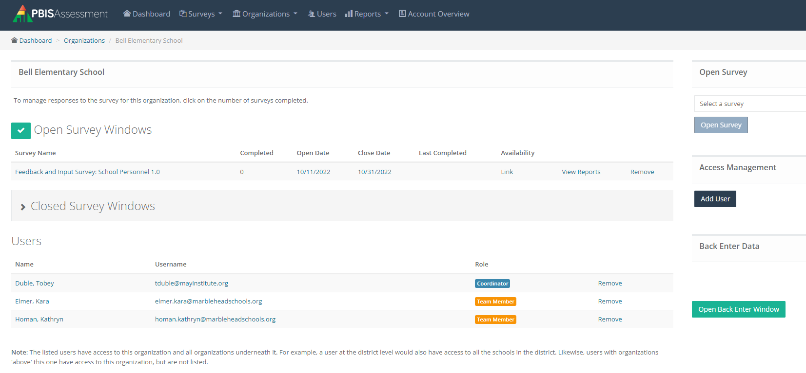
PBIS Assessment Dashboard
Open New Survey
Open and Closed Survey Windows
Add New
Users
Users
Notes:
Walk them through logging on and demonstrate how to:
Review the open and closed surveys their dashboard.
How to VIEW REPORTS for one of their surveys.
How to OPEN a SURVEY drop down and choose a survey and set Open and Close Dates.
Delete Survey if it was a test or keep it to administer it.

Slide 39
Practice: PBIS Assessment
Go to www.pbisapps.org and Log in.
Review the open and closed surveys for your school in your dashboard.
Click on VIEW REPORTS for one of your surveys.
Click on OPEN SURVEY drop down and choose a survey. Set Open and Close Dates Jan 1-Jan 31.
Delete Survey if it was a test or keep it to administer it.
Together as a Group
15 minutes
Notes:
PBIS Assessment Manual https://sebacademy.edc.org/pbis-assessment-user-manual-0
PBIS Assessment Videos – TFI, Opening Surveys, climate Surveys etc https://www.pbisapps.org/resources/videos#pbis-assessment

Slide 40
Agenda & Coaches' Tasks
Coaches’ Tasks:
Presentation Content:
Glows & Grows: Classroom Assessment Plan
Discuss with team integration & alignment content. What other practice models should be integrated with PBIS supports? – Complete alignment activity and add to Canvas.
Fidelity Assessment: Walkthrough Planning
Work with team to plan and complete the TFI walkthrough prior to January Team training.
PBIS Assessment Coordinator Practice
Set up your TFI in PBIS Assessment for January
Integration & Alignment
What questions do you have on today’s content?
What questions do you have on the follow-up tasks?

Slide 41
HELPFUL RESOURCES
RESOURCES:
Tiered Fidelity Inventory
  TFI Tier 1 Quick Check Tip Sheet for Scoring
  PBIS TFI Walkthrough Tip Sheet
  Integrated TFI Companion Guide
Alignment Activity
  Technical Guide for Alignment of Initiatives
  Integrating Trauma Informed Approach into a PBIS Framework
Classroom Assessment Plan (Template for upload)
  Classroom Management Observation Tool [CMOT]
  Classroom Support Doc with Class Self Assessment
  PBIS Apps Self Assessment Survey w/ Classroom
PBIS Assessment Manual
PBIS Assessment Videos [TFI, Open Surveys, Climate Survey etc.)
Notes:
RESOURCES:
PBIS TFI: Resource link: https://www.pbisapps.org/resource/tfi
TFI Tier 1 Quick Check Tip Sheet for Scoring https://sebacademy.edc.org/tfi-tier-1-quick-check-tip-sheet-scoring
PBIS TFI Walkthrough Tip Sheet: https://www.pbisapps.org/resource/tfi-walkthrough-tip-sheet
Integrated TFI Companion Guide: https://www.pbis.org/resource/integrated-tiered-fidelity-inventory-companion-guide
Classroom Assessment Plan (Template for upload) https://sebacademy.edc.org/classroom-assessmet-planning-template
Supportive Environments create Classroom Community - https://sebacademy.edc.org/supportive-environments-create-classroom-community
Self Assessment Surveys - https://www.pbisapps.org/resource/self-assessment-survey
Technical Guide for Alignment of Initiatives: https://www.pbis.org/resource/technical-guide-for-alignment-of-initiatives-programs-and-practices-in-school-districts
Integrating Trauma Informed Approach into a PBIS Framework https://sebacademy.edc.org/integrating-trauma-informed-approach-pbis-framework
Alignment Activity: https://sebacademy.edc.org/alignment-activity
PBIS Assessment Manual https://sebacademy.edc.org/pbis-assessment-user-manual-0
PBIS Assessment Videos – TFI, Opening Surveys, climate Surveys etc https://www.pbisapps.org/resources/videos#pbis-assessment

Slide 42
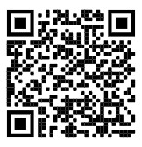
https://edc.co1.qualtrics.com/jfe/form/SV_cBF9GI7gVEBsfSC
EVALUATION
Please remember to complete the evaluation!
Scan the QR code to access.
Notes:
TRAINERS -
Put link to evaluation (below) in the chat for those who do not use the QR code:
https://edc.co1.qualtrics.com/jfe/form/SV_cBF9GI7gVEBsfSC

