Slide 1
Welcome tO THE Tier 2 COACHES’ MEETing!
GETTING STARTED:
Update your display name in Zoom to read: [Your School], [Your Name] (e.g., Eastside HS, Joe Clark)
Complete the ATTENDANCE
Bookmark link to find training resources at : SEB PBIS Tier 2 Academy
In the chat, share what Thanksgiving food(s) make you happy ☺
~15%
Notes:
LINKS for today:
Attendance
https://edc.co1.qualtrics.com/jfe/form/SV_5BiXqi4bxzOCMS2
New team member communications survey - https://edc.co1.qualtrics.com/jfe/form/SV_db8zhNj6NJ3eXga
EDC Website for SEB Academy
https://sebacademy.edc.org/
Event Evaluation (at the end)
https://edc.co1.qualtrics.com/jfe/form/SV_cBF9GI7gVEBsfSC

Slide 2
PBIS Coaching Meeting TIER 2, Year 1 November 2022
Marcie Handler & Katie Meyer
with support from NEPBIS Network, May Institute & Broad Reach Consulting
Notes:
Add trainer names for your event

Slide 3
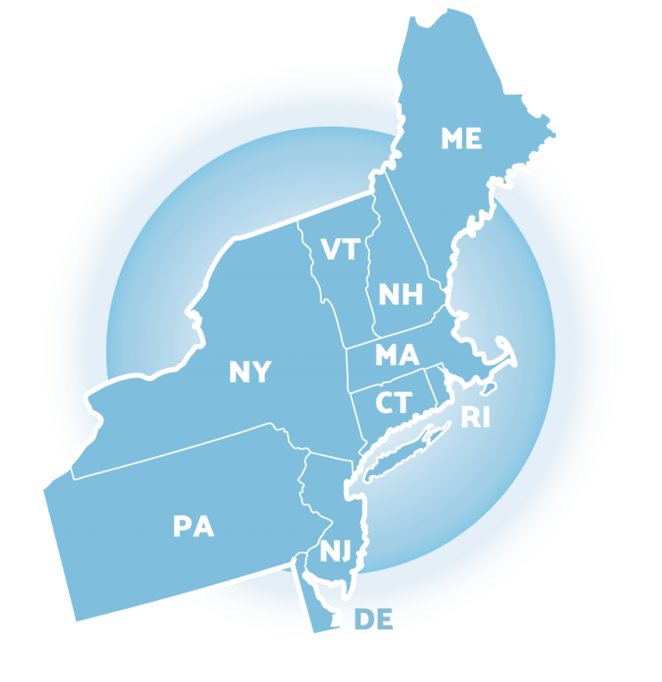
ACKNOWLEDGEMENTS
02
03
04
Northeast PBIS Network (nepbis.org)
01
Michigan Integrated Behavior & Learning Support Initiative
Dr. Heather George & FLPBIS
Missouri PBIS
Drs. Leanne Hawken, Deanne Crone, & Rob Horner
05
06
Midwest PBIS Network

Slide 4
EXPECTATIONS
Self
Others
Environment
Self-monitor
Mute when listening, unmute to talk​
Have electronics ready to use
Obtain help from peers and trainers
Work as a team:
Keep necessary materials at hand
Are you participating?
Engaged as a learner?
Stretch, break, stand as needed​
Room for every voice
Reinforce participation
action plan
relevant docs
water/snacks
Minimize distractions if possible​
Complete tasks efficiently
Notes:
Taking CARE of…

Slide 5
Agenda & Coaches' Tasks
Coaches’ Tasks (Nov/Dec):
Presentation Content:
TFI Baseline self-assessment by Nov 30th
Glows and Grows: Steps 1 and 3
Targeted Intervention Organizer (finalize Part 1)
Student identification process – pick at least 1 of the three areas to further develop (RFA, data decision rules, guidelines for screening)
Step 2: Develop a process for identifying students
Resources to support your coaching development

Slide 6
LEGEND
Timing
Example
Activity
Non-example
Guidelines
Preview
Big Idea
Review
Organization

Slide 7
Glows & Grows: Developing Systems to support Tier 2
Notes:
TRAINER NOTE:
Use this time to check in with coaches and gauge their existing knowledge base of PBIS and determine whether or not they already watched the PBIS Overview.
The following 2 slides provide an opportunity for a BRIEF review and chance to develop a basic common understanding. It is not intended to be a full explanation.

Slide 8
TIER 2 IS DESIGNED TO…
Use data to identify students who are at-risk for or currently experiencing emotional and/or behavioral difficulties
Prevent the development or decrease the frequency and/or intensity of students’ problem behaviors
Provide standardized interventions that effectively and efficiently support students yet do not require the time and resources needed to develop individualized plans

Slide 9
TIER 2 CRITICAL FEATURES
Consistent, standardized implementation across students
Easily accessible (e.g., within a few days of referral)
Continuous availability
Implemented by all school staff
Consistent with and extra doses of school-wide expectations and interventions

Slide 10
GETTING STARTED WITH Tier 2
Develop an equitable process for matching student need to practices
1
Establish a representative T2 leadership team
6
2
Develop a collaborative process for identifying students
Develop a process for progress monitoring, data-based decision rules
7
3
Evaluate, select and adopt culturally appropriate tier 2 practices
Develop procedures for modifying/ adjusting implementation
8
4
Develop a process to install selected practices
Develop evaluation routines for fidelity and outcome data
9
5
Develop procedures to train staff and students; partner with families and community
Document and share routines, practices, and policies
10
Notes:
COACHES:
Seeing all of these steps can be uncomfortable or overwhelming – the goal is to walk away with an understanding of the elements and need to prioritize time and resources to get the steps achieved over a period of time.

Slide 11
DISCUSSION: GLOWS & GROWS
What is something to celebrate (GLOW) & something you’re working on (GROW) related to:
Step 1. Team composition and structure/routines
Is your meeting schedule set?
Step 3. Evaluating and selecting Tier 2 interventions
Have you complete your inventory?
Do some interventions need adjustments?
10 minutes
Whole Group

Slide 12
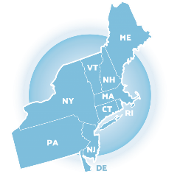
Step 2: Develop a collaborative process for identifying students

Slide 13
Student Identification Plan: Critical Features
Clearly defined, standardized process
All students considered
Promotes early identification
Identifies internalizing & externalizing concerns
Data should be selected from multiple sources
Should include academic and behavior data

Slide 14
Student Identification Plan: Critical Features

Slide 15
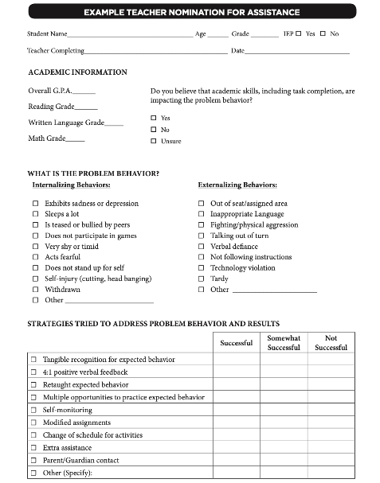
Methods for Identification
Nomination
Data Decision Rules
Screening
Notes:
The process for identifying students for Tier 2 supports typically
relies on existing data sources
provides information regarding function of behavior
Methods for identifying students include
nomination
teacher/staff
parent
self
data decision rules
extant data
NOTE: screening data is wonderful, but we don’t have time to cover in this training. If you are interested, there are more resources in the syllabus, you can talk to your trainers, and also there are districts in the state who do use universal screening with whom you could connect

Slide 16
Methods for Identification
Were you able to gather some information?
Nomination
Data Decision Rules
Screening
Do we have something simple?
What are some of our data sources?
Is the school using a universal screener?

Slide 17
Rationale: Multiple Sources of Data
Data
Varying Viewpoints
Lessens Bias
Motivation
Internalizing & externalizing concerns
Integrates academic & behavior interventions
What data sources do you plan to include in your student identification plan?
Unmute or type in the chat
Notes:
Rationale:
One set of data may not be comprehensive enough to accurately and appropriately identify students needing Tier 2 supports.
Trainer’s Notes:
By using multiple sources of data, it is more likely that teams will accurately identify students needing advanced supports and provide the intervention that best addresses the function of their behavior. It’s important that teams fully understand WHY data are needed and HOW the data can impact success.
Multiple data sources:
Identifies students with internalizing & externalizing concerns
Helps to integrate academic & behavior interventions
May inform motivation of students, leads to effective grouping/intervention
Helps mediate teacher bias
Provides varying viewpoints, information across multiple locations

Slide 18
Request for Assistance
Data
Available to staff, students, and families
Notes:
Poll: Which of the following request for assistance forms does your school currently use?
Staff
Student
Family

Slide 19
Request for Assistance Forms
Academic performance data
Student identifying information (gender, grade, IEP status)
Office discipline and/or minor referral information
Data
01
02
03
Information regarding problem behavior(s): including when, how often, and why (function)
Which of the features does your form currently include?
04
05
06
Strategies used to address the problem behaviors and student response
Teacher perceptions regarding acquisition or performance deficits

Slide 20
Request for Assistance Process
Timelines Determined
Nomination decisions
~10 days
Providing supports to students
~30 days
Family notification if child is nominated (who, what, how)
What is Needed?
Staff training
Decision rules
Procedures if teacher requests for support exceed resources
Staff notification of students receiving support
Notes:
Rationale:
All staff need to be trained on the purpose, how to participate in the process, and how to complete the nomination form.
Trainer’s Notes:
Ask the audience:
What are going to be the decision rules for determining the how and what the student needs?
How are staff going to be notified of students receiving supports? How will they support those supports? (communication / feedback loop)
Does the district have a policy for family notification? (e.g., notification vs opting in or out)

Slide 21
ACTIVITY: Request for Assistance Form
Review your current request for assistance form?
Review the sample forms.
Do you anticipate revising your current form or creating a new one?
5 minutes
School activity

Slide 22
DISCUSSION: Request for Assistance Process
What procedures need to be standardized for reviewing requests, notifying staff and families?
How will you share/revise this with your team, and then get feedback from staff?
10 minutes
Whole Group

Slide 23
Using Existing Data Sources to Identify Students
Data
Starting to develop decision rules across data sources

Slide 24
Possible Data Sources for Identifying Students
ATTENDANCE | BEHAVIOR | ACADEMICS
Absences Tardies (to school and/or to individual classes) Visits to nurse, guidance, office, restroom | Office discipline referrals Classroom managed behaviors Suspensions (in or out of school) Detentions | Course grades GPA Number of failures Academic screener scores Standardized test scores
Additional data to consider: teacher referrals, universal behavior screeners, parent/student requests

Slide 25
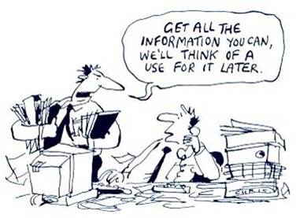
Lots of data do not always equal useful data!

Slide 26
Data Decision Rules
Must be contextually & culturally appropriate
What works in one school may not work in another!
Should be established to guide both entry to and exit from Tier 2 supports
Consider:
Current needs of students in the school
Available resources
Existing programs
Feasibility of starting new programs
Capacity to implement interventions

Slide 27
Sample Decision Rules
Measure | Proficient Score | At-Risk | High Risk
1. Classroom Minors | 0-4 | 5 or more | 15 or more
2. Major/ODR | 0-1 | 2 – 5 | 6 or more
3. Absences | <5/trimester | 5+/trimester | 10/trimester
4. Tardy | <4/trimester | 4+/trimester | 10/trimester
5. ISS | 0-1 | 2 | 4 or more
6. OSS | 0 | 1 | 2
7. Course Grades | 2.5 or higher | D or F in any course | Ds or Fs in multiple courses
8. Reading Inventory | 800+ | 799 or lower | 599 or lower
9. Writing Assessment | 3 or 4 | 2 | NS; 1
10. Nurse (non-medication) | 0-1 (no pattern) | 2 – 5 (patterns of regular visits) | 6 or more (pattern of regular visits)
EXAMPLE
Notes:
Sample decision rules across academic and behavioral sources of data; needs to fit context
Office discipline referrals, with teacher referral backed by absences or SAEBRS. We talked about using nurse/counselor visits we aren't there yet. Our academics are monitored for our WIN blocks, kids are put into 6 to 8 week intervention groups that happen T-F for 45 minutes daily. They are strictly academic groups at this point but our academic data is being monitored there.

Slide 28
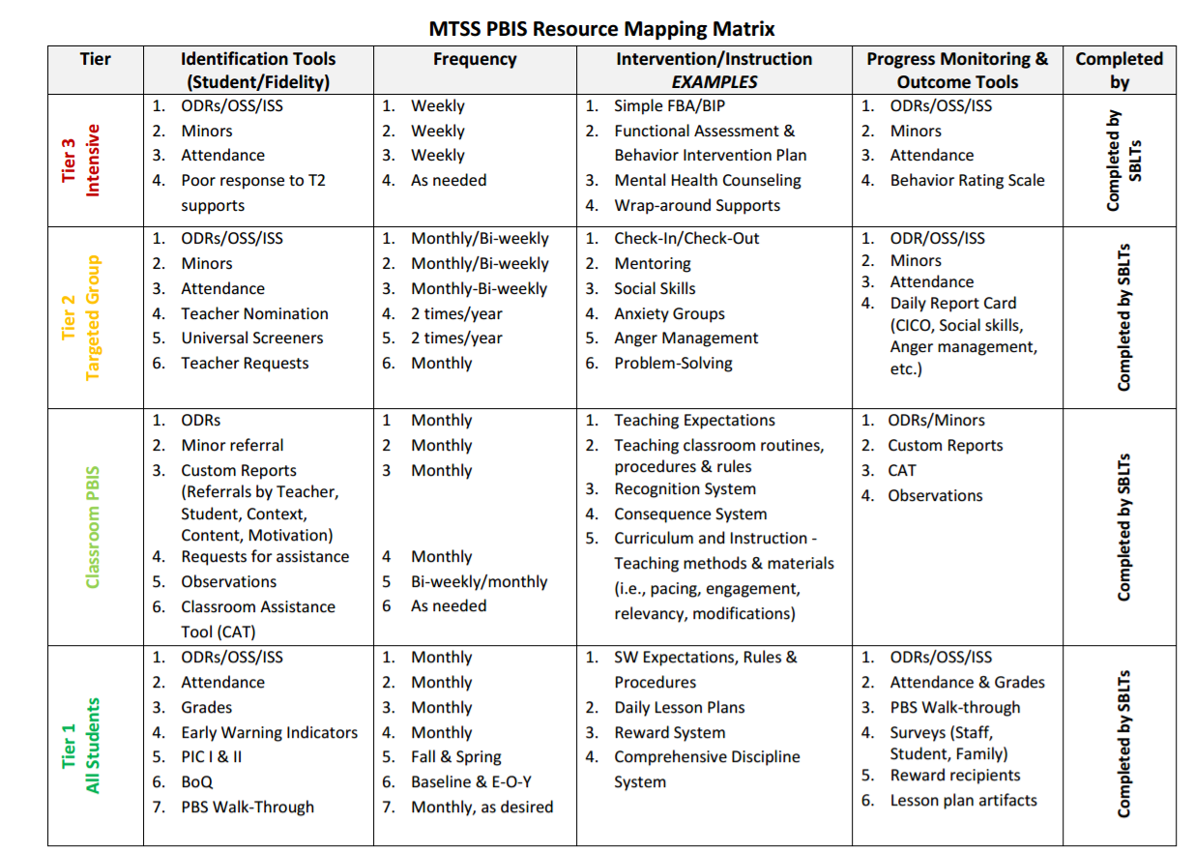
EXAMPLE
Notes:
Example:
SBLT = School-Based Leadership Teams (general term so that each school can “fill in” whatever team is responsible for the tiered activities)

Slide 29
GUIDING QUESTIONS: DATA SOURCES
Systems
What data sources do we already use and review?
Do we need to add any additional sources?
What about for this year?
Who will be responsible for collecting and summarizing these data?
How often (once a month, once a quarter) will we review school-wide extant data?
Are there clear routines for timely response to requests for assistance?

Slide 30
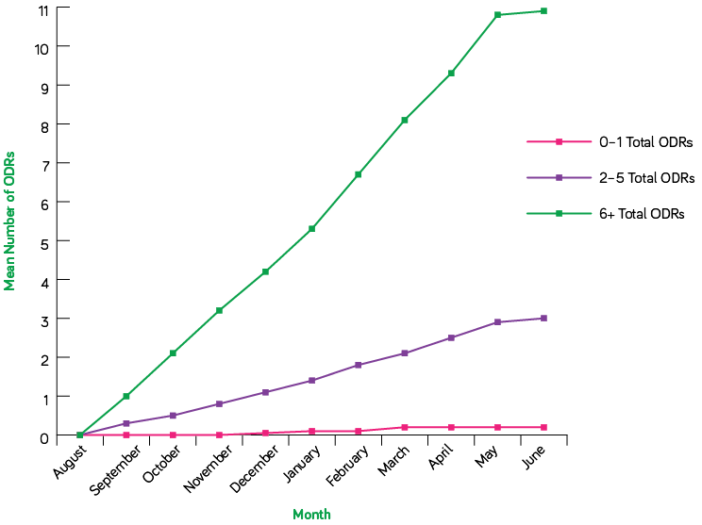
Researchers looked for how many referrals each student accumulated by the end of the year, and whether there is a time early on to intervene and change that trajectory.
In both studies, the answer is a resounding YES and that time is October.
Graph - Number of ODRs students accumulated on average every month.
These are the data from the middle school study; the elementary school data look nearly identical
For elementary schoolers with six or more referrals, 50% had two ODRs by the end of October[1].
For middle schoolers with six or more referrals, 71% had at least one ODR by the end of October[2].
Source: https://www.pbisapps.org/articles/the-future-is-now-for-students-who-need-more-support

Slide 31
DISCUSSION: Using Existing Data Sources to Identify Students in Need of Support
What data sources do you currently review? Would you consider adding any?
How often do you review data? Are there any decision rules in place?
How will you bring this conversation back to your team?
3 minutes
10 minutes
Independent Jot or partner
Whole Group

Slide 32
Screening
Data
When are we ready to discuss this process?

Slide 33
RESOURCES
Guidance for Systematic Screening: Lessons Learned from Practitioners
Selecting a Universal Screening Tool

Slide 34
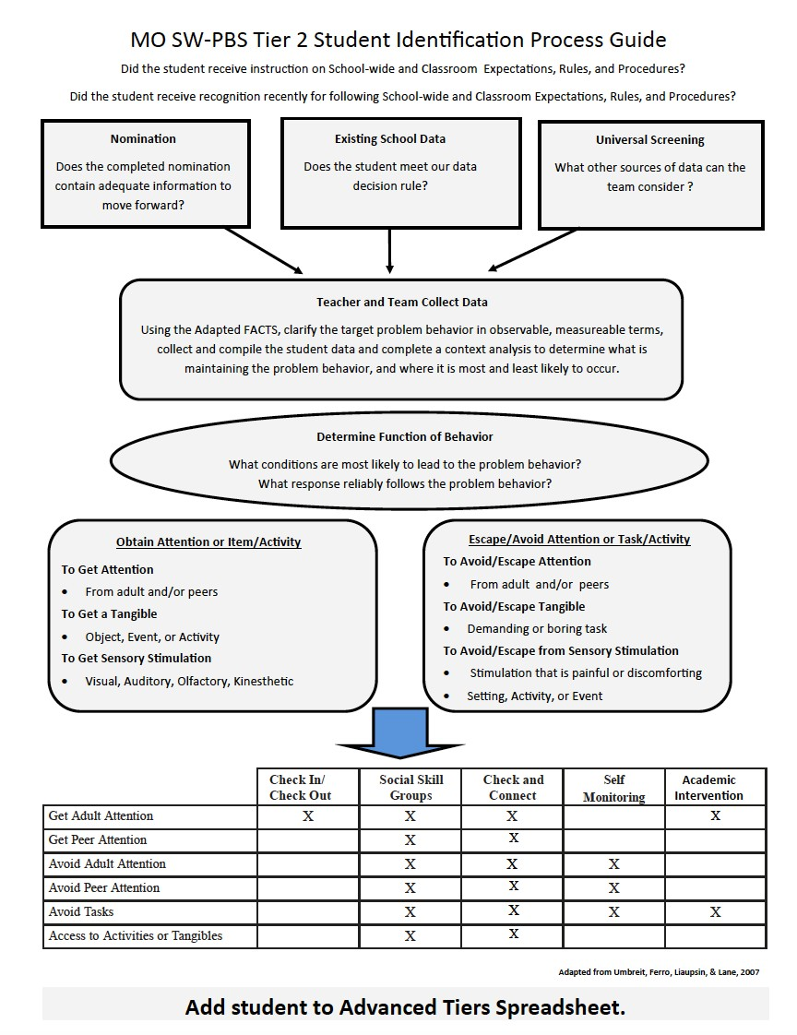
EXAMPLE:
Student Identification Process
Notes:
Student Identification Process Example
Year 2 or advanced step after building out each feature of step 3 (identifying students)
Nomination
Data decision rules
Universal screening
And step 6 (match to need)
Brief FBA / FACTS data to determine function
Select and enroll student in an intervention that matches skill need and function

Slide 35
Resources: Tier 2

Slide 36
HELPFUL RESOURCES
RESOURCES:
Expert Instruction Podcast: The Who Why How of Tier 2 Decision Making
The October Catch: The Future is Now for Students who Need More Support
https://sebacademy.edc.org/student-identification-process-resources
Notes:
More on screening in December

Slide 37
Advanced Resource : Supporting Child and Student Social, Emotional, Behavioral and Mental Health Needs

Slide 38
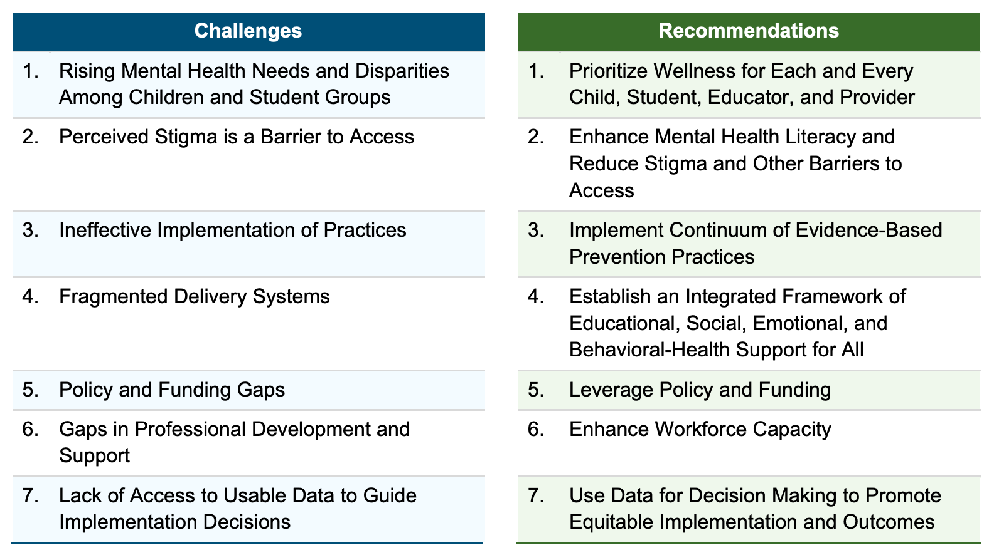
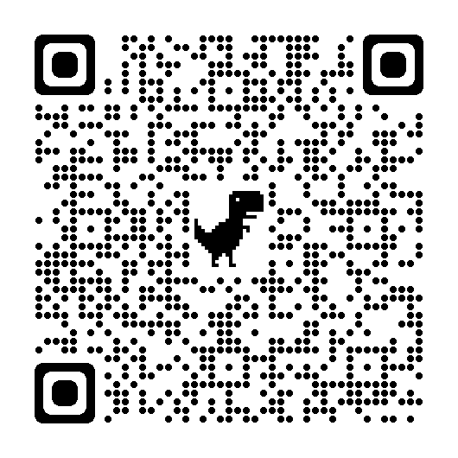
This is what you are training to do in your school!
Notes:
US DOE Guidance : https://www2.ed.gov/documents/students/supporting-child-student-social-emotional-behavioral-mental-health.pdf
TRAINER NOTE: Please highlight this new resource from US DOE and point out how the recommendations (specifically 3,4,6 & 7) align with the PBIS framework they are beginning to implement
In schools, we prioritize three critical and inter-related components of mental health: social (how we relate to others), emotional (how we feel), and behavioral (how we act) supports to promote overall well-being (Chafouleas, 2020).

Slide 39
Notes:
US DOE Guidance : https://www2.ed.gov/documents/students/supporting-child-student-social-emotional-behavioral-mental-health.pdf

Slide 40
Technical Assistance (TA) time
Coaches’ Tasks (Nov/Dec):
Options:
Set date (meetings) or deadline (products) for your Nov/Dec TA
Pair with a team meeting
Individual meeting with coach or coaches
Review of products team is working on

Slide 41
January TEAM TRAINING
January 19th 9-3pm (Marlboro)
In Person
Coaches and team members
BIG IDEAS
Check in-Check out in detail
Check and Connect
Evaluating and selecting Tier 2 Practices (continued)

Slide 42
Agenda & Coaches' Tasks
Coaches’ Tasks (Nov/Dec):
Presentation Content:
TFI Baseline self-assessment by Nov 30th
Glows and Grows: Steps 1 and 3
Targeted Intervention Organizer (finalize Part 1)
Student identification process – pick at least 1 of the three areas to further develop (RFA, data decision rules, guidelines for screening)
Step 2: Develop a process for identifying students
Resources to support your coaching development

Slide 43
EVALUATION
CONTACT INFORMATION:
Marcie Handler
mwhandler@gmail.com
Katie Meyer
Katherine.meyer@uconn.edu
Please remember to complete the evaluation to receive your Certificate of Attendance!
Notes:
Evaluation Link
https://edc.co1.qualtrics.com/jfe/form/SV_cBF9GI7gVEBsfSC

