Slide 1


PBIS School-Wide Coach Meeting
Year 2: November 2022
PBIS Track
Christine Downs
with support from NEPBIS Network, May Institute & Broad Reach Consulting
Notes:
Add trainer names for your event

Slide 2

EXPECTATIONS
Self
Others
Environment
Self-monitor
Mute when listening, unmute to talk​
Have your computer charged and ready to go​
If you have questions or comments:
Work as a team:
Keep necessary materials at hand
Are you participating?
Engaged as a learner?
Stretch, break, stand as needed​
unmute
use the chat box
Room for every voice
Reinforce participation
action plan
relevant docs
water/snacks
Minimize distractions if possible​

Slide 3
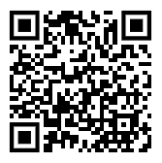
ACTIVITY: ATTENDANCE
Scan QR code on the left or follow the URL posted in the chat to access the online attendance survey
Follow prompts to enter attendance information
Notify trainers if you require assistance (e.g., identifying your cohort or cohort group)
Certificates of Attendance will be sent in January and June. Attendance records and Zoom log in will be use as verification
You are in Cohort 8
1 minute
Notes:
TRAINERS – QR Code is updated
Add your cohort number
Post a link to the attendance survey (below) in the chat for those who do not use the QR code on the slide:
ATTENDANCE: https://edc.co1.qualtrics.com/jfe/form/SV_5BiXqi4bxzOCMS2

Slide 4
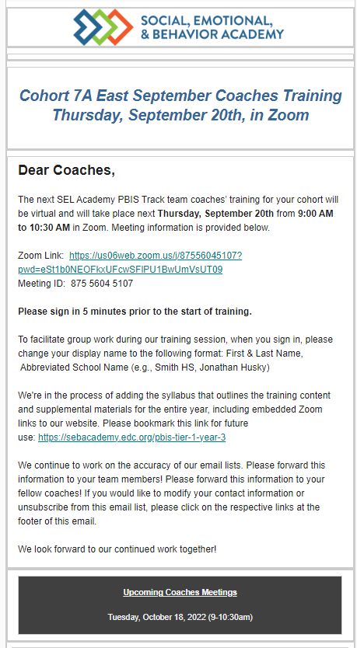
Event Reminders
Training or Coach Meeting Reminder
Are you receiving our Event Reminders?
Email Reminders will be sent to all coaches & administrators for Coach Meetings and to the full team for our Team Training Events.
The email will come from SEB Academy sebacademy@edc.org
If you are not receiving the email notifications please put your name and email in the chat
Next upcoming Training or Coach Meeting

Slide 5
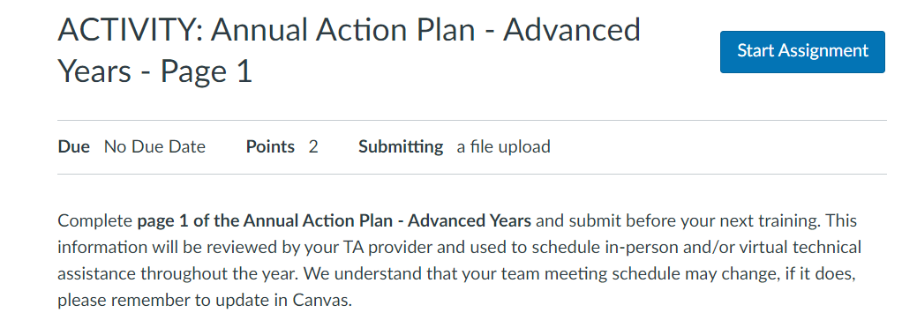
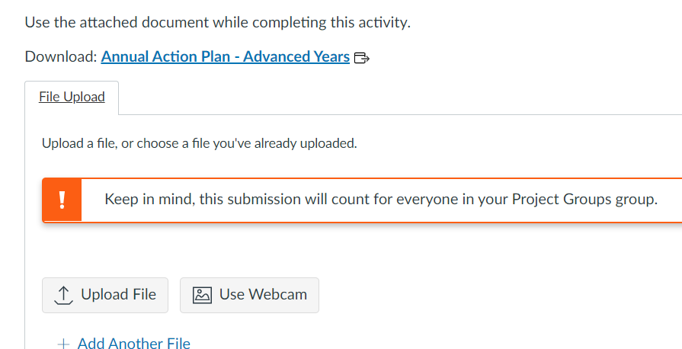
Canvas – For Coaches to Submit Documents
2.
Read Instructions for Assignment1234
Start Assignment
Download any documents still needed
Uploaded completed Document
1.
3.
If you have not received an invitation to join CANVAS please put your name and email in the chat
4.
Notes:
Review how to read directions and how to upload into canvas

Slide 6
Agenda & Coaches' Tasks
Coaches’ Tasks:
Presentation Content:
Glows & Grows: Use of Data
Decide how and when to solicit staff, student & family input: Focus Group, Feedback & Input Survey, School Created Survey – Add to Action Plan and upload to Canvas
Feedback and Input Surveys
Classroom Assessment Options
Complete the Classroom Assessment Plan document - upload to Canvas

Slide 7
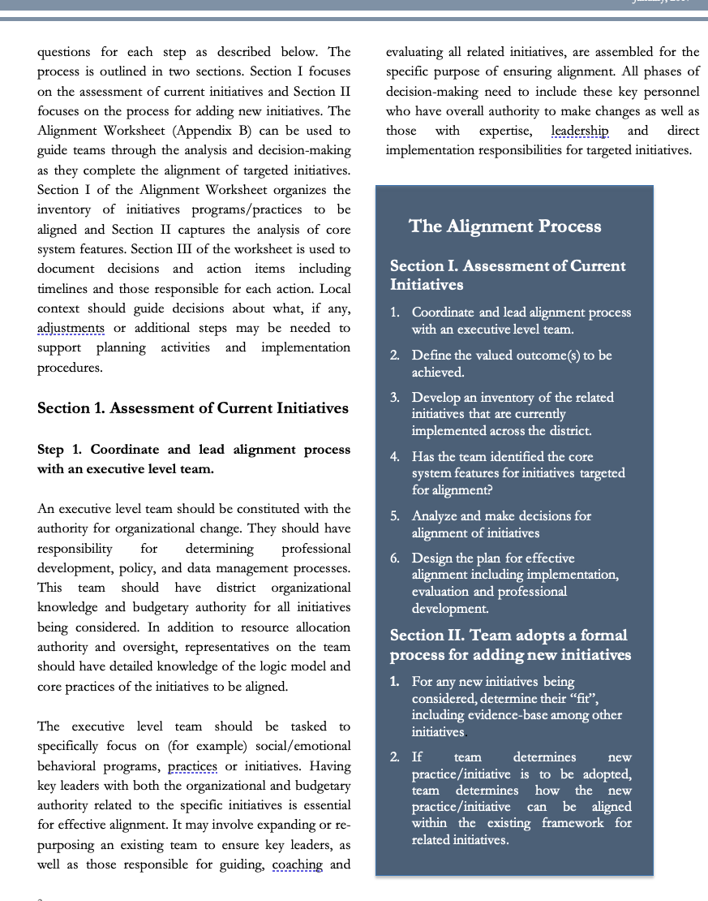
HELPFUL RESOURCES
RESOURCES:
Feedback & Input Survey Manual
Overview of the Feedback and Input Survey
Climate Survey Manual
The Classroom Management Observation Tool (CMOT)
Supporting & Responding to Student’s SEB Needs (classroom)
Self-Assessment Surveys
Supportive Environments Create Classroom Community
Classroom Support Systems Brief
Classroom Assessment Plan (Template for upload)
Notes:
RESOURCES:
Feedback & Input Survey Manual https://sebacademy.edc.org/pbis-feedback-input-survey-manual
Overview of the Feedback and Input Survey https://sebacademy.edc.org/overview-feedback-and-input-surveys
Climate Survey Manual - https://sebacademy.edc.org/pbis-climate-survey-manual
Cmot - https://sebacademy.edc.org/classroom-management-observation-tool-cmot
Supporting and responding to SEB Needs https://sebacademy.edc.org/supporting-and-responding-students-social-emotional-and-behavioral-needs-classrooms
Supportive Environments create Classroom Community - https://sebacademy.edc.org/supportive-environments-create-classroom-community
Classroom Support Systems Brief - https://sebacademy.edc.org/classroom-support-systems-brief
Classroom Assessment Plan (Template for upload) https://sebacademy.edc.org/classroom-assessmet-planning-template

Slide 8
Glows & Grows:
Feedback and Classrooms
Notes:
12:30

Slide 9
DISCUSSION: GLOWS & GROWS
What is something to celebrate & something you’re working on related to:
Use of Data – Assessment, Feedback, Discipline, etc.
Classrooms – Practices, Systems, Assessing, Providing PD
SHARE OUT: 1 Glow & 1 Grow
Independent Jot
Whole Group
5 minutes
10 minutes

Slide 10
PBIS
Resource Spotlight:
PBIS Assessment: Feedback and Input Surveys

Slide 11
MONITORING & EVALUATING PBIS PRACTICES
Use data to monitor the implementation & effectiveness of PBIS practices
Linked with meaningful outcome goals
Communicates purpose
Guides action planning
Used to measure and demonstrate progress
It is important to collect both Qualitative (feedback) and Quantitative (outcome) data

Slide 12
TFI 8A – Feedback and Input
TFI Questions 10 & 11: Teams typically report lower scores on these 2 questions
Staff Input (question 10)
3/7 Teams = 50%
4/7 Teams = 100%
Student/Family Input (question 11)
4/7 Teams = 0%
2/7 Teams = 50%
1/7 Teams = 100%

Slide 13
TFI 8B – Feedback and Input
TFI Questions 10 & 11: Teams typically report lower scores on these 2 questions
Staff Input (question 10)
2/13 Teams = 0%
9/8 Teams = 50%
2/13 Did not complete in 21/22
Student/Family Input (question 11)
5/13 Teams = 0%
6/13 Teams = 50%
2/13 Did not complete in 21/22

Slide 14

PBIS Assessment: Feedback & Input Surveys
The FIS is a set of four surveys to learn about how students, school personnel, and family members experience the school’s behavior support systems.
Surveys in the FIS include: (English & Spanish)
  Feedback and Input Survey: Elementary
  Feedback and Input Survey: Secondary
  Feedback and Input Survey: School Personnel
  Feedback and Input Survey: Family
Notes:
Feedback & Input Survey Manual https://www.pbisapps.org/resource/feedback-input-surveys-fis-manual

Slide 15
Climate Survey vs. Feedback & Input Survey
The School Climate Surveys are formal measures with strong evidence of reliability and validity for measuring quantitative perceptions of school climate.
The results are used to identify current status of school climate and to monitor progress over time. The School Climate Surveys are outcome measures.
The Feedback and Input Surveys give you more meaningful qualitative information about the experiences and suggestions of students, families, and school personnel. These surveys offer the entire school community a place to share their direct feedback with decision-makers.
The results are used to inform action plans to improve the effectiveness, efficiency, equity, and sustainability of Tier 1 behavior support systems. The Feedback and Input Surveys are feedback measures.

Slide 16
Quantitative vs Qualitative
Quantitative Research/Data
Use of statistics and “numbers” to measure variables, support hypothesis, make predictions, etc.
Uses directional verbs: effect, influence, cause, relate, etc..
Looks for “why”, ”to what extent”, etc.
Sample QT question:
What is the effect of PBIS in reducing ODRs in our school?
Qualitative Research/Data
Asks “what” or “how” questions in an open-ended design
Uses exploratory verbs: report, describe, discover, generate, explore
Looks for emergent themes from personal reports, focus groups, etc.
Sample of QL question (from Feedback Survey):
One thing teachers and staff could do better to improve behavior in my school is: ___________________

Slide 17
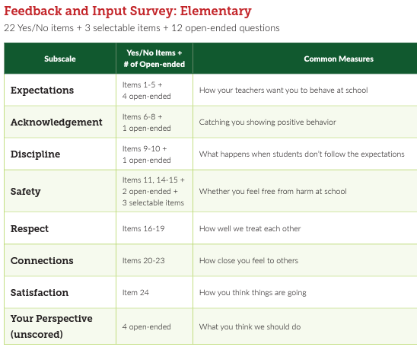
Student Surveys Elementary and Secondary
The student surveys are the same, but questions are phrased differently for the different age groups.
The secondary survey also has a few additional demographic categories
Elementary Grades: 3-6
Secondary Grades: 6-12

Slide 18
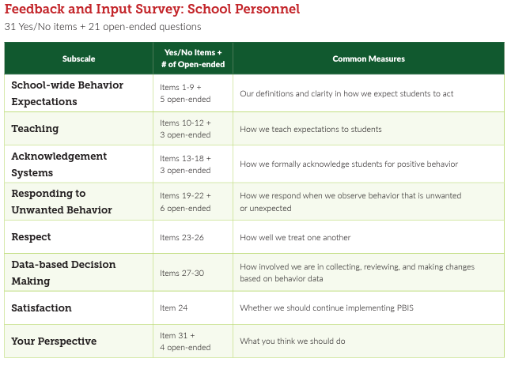
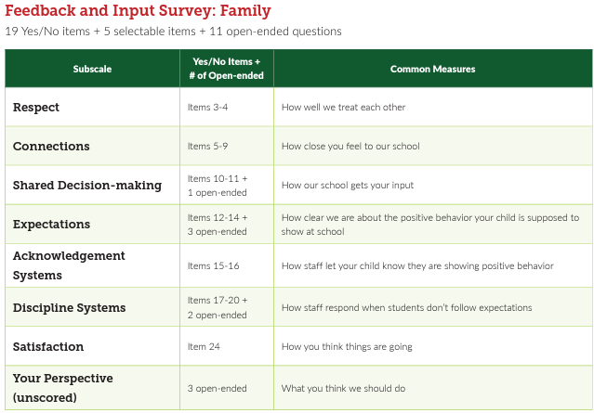
Staff and Family Input Surveys

Slide 19
DISCUSSION: Feedback & Input
Download & Review Feedback & Input Survey Manual.
Review Surveys (Appendix D – pgs. 20-48)
Would this information be valuable to your team?
Do you already collect this type of data? From all groups?
Which group would you most like to survey this year?
Consider if this survey or the Climate Survey is more valuable at this time.
10 minutes
10 minutes
Coach Review/Chat
Whole Group
Notes:
Climate Survey Manual - https://sebacademy.edc.org/pbis-climate-survey-manual
Feedback & Input Survey Manual https://sebacademy.edc.org/pbis-feedback-input-survey-manual

Slide 20

ASSESSING CLASSROOM BEHAVIOR SUPPORT PRACTICES & SYSTEMS

Slide 21

Supporting and Responding to Students’ SEB Needs
Center on PBIS. (2022). Supporting and responding to student’s social, emotional, and behavioral needs: Evidence-based practices for educators (Version 2.0). Center on PBIS, University of Oregon. www.pbis.org.
Notes:
https://www.pbis.org/resource/supporting-and-responding-to-behavior-evidence-based-classroom-strategies-for-teachers

Slide 22

Supporting and Responding to Students’ SEB Needs
1. Create Positive Teaching and Learning Environments
Design a Safe Environment
2. Actively Promote SEB Growth
Engage Students in Relevant Learning
3. Monitor Fidelity and Use Data to Guide Implementation
Monitor Educator Implementation
4. Monitor Student Outcomes and Use Data to Guide Response
Establish Positive Connections
Develop Predictable Routines
Define and Teach Positive Expectations
Plan Relevant Instruction
Foster Positive Relationships
Prompt and Supervise SEB and Academic Skills
Provide Specific Feedback (> 5 : 1 Ratio)
Consider Other Response Strategies
Provide Training, Coaching, and Feedback
If data indicate implementation challenges...
Monitor Student Outcomes
Enhance Tier 1
If many students make ongoing SEB errors...
Enhance Tier 1 and Consider Tiers 2 and 3
If few students make ongoing SEB errors...

Slide 23
Support Staff with Implementing Classroom PBIS
How can we support staff to use these practices?
Professional Development
What? Select 1 or 2 practices at a time, based on data
Coaching
Who? Identify staff with dedicated time to support classroom PBIS practices
How? Support classroom PBIS along with academic coaching support
Acknowledgement
Implementation and outcome data are shared & reviewed with staff and progress is recognized and celebrated
When? Set time aside at staff, grade level, or PLC meetings to discuss & problem solve
Notes:
This should be very brief (5 minutes)

Slide 24
HOW CAN WE ASSESS THE USE OF POSITIVE CLASSROOM PRACTICES?

Slide 25
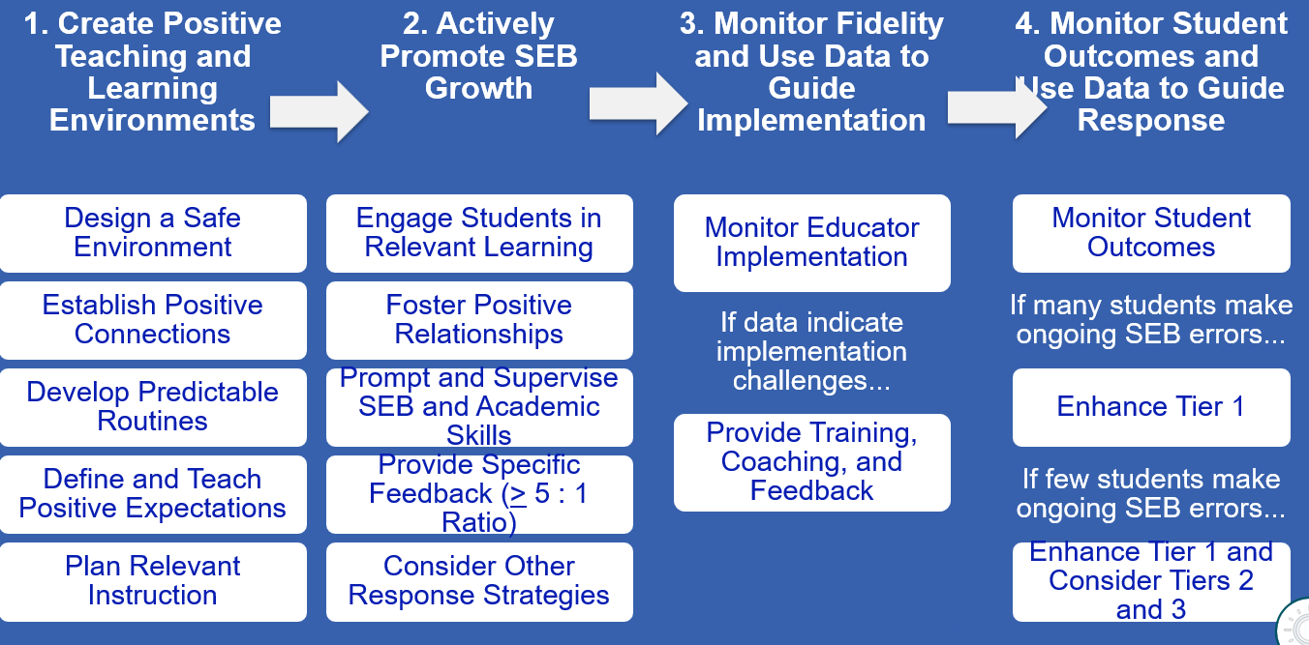
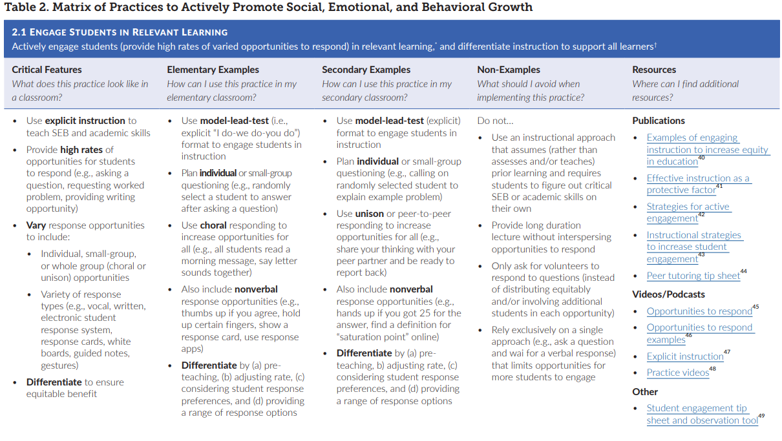
First, be familiar with our resources
Notes:
Incorporate familiar resources, such as the Supporting and Responding to behavior document, which can be found on PBIS.org and provides useful tools for organizing class-wide supports.
Please add this document to the chat: https://www.pbis.org/resource/supporting-and-responding-to-behavior-evidence-based-classroom-strategies-for-teachers

Slide 26
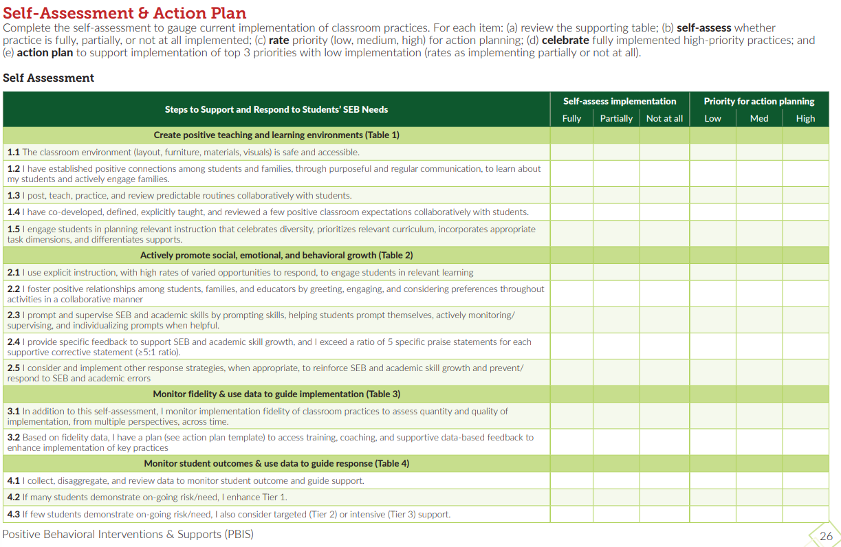
Self-Assessment?
Page 26 of the Supporting & Responding Brief
Notes:
Resource: https://www.pbis.org/resource/supporting-and-responding-to-behavior-evidence-based-classroom-strategies-for-teachers

Slide 27
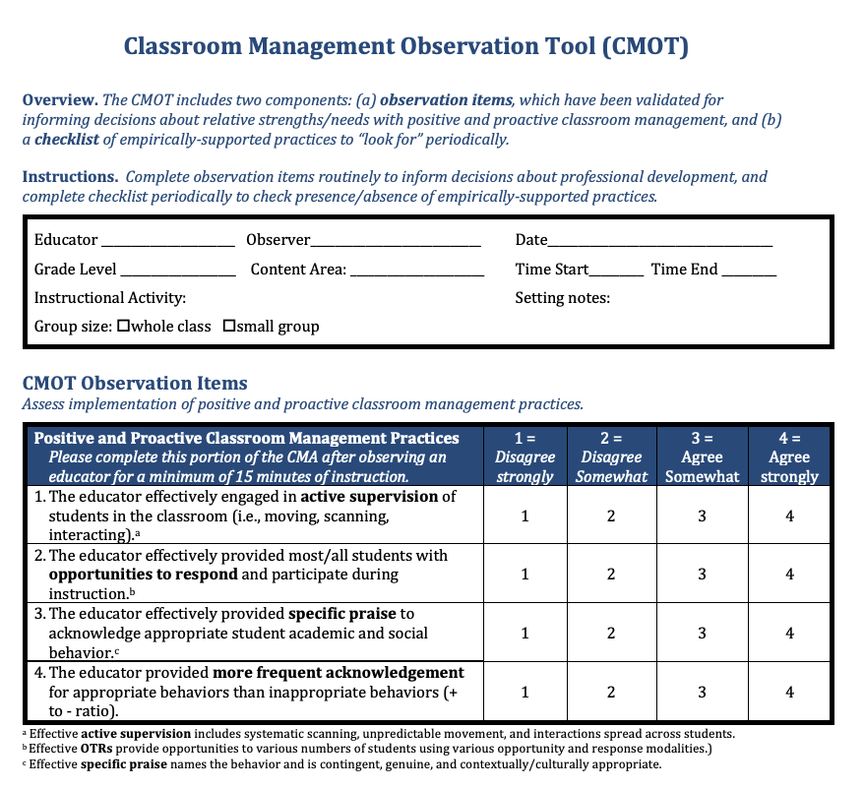
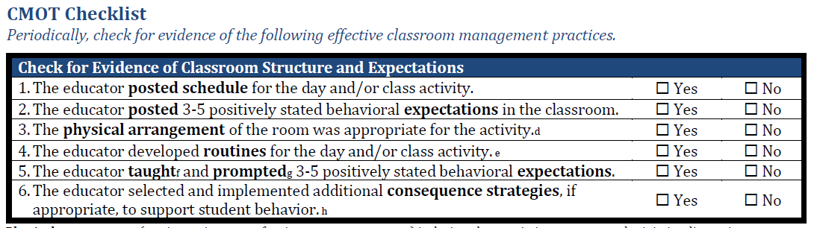
CMOT: Observation tool and Check List
2 Components:
Validated Observation Tool (min 15 mins)
Checklist of empirically supported practices
Notes:
The Classroom Management Observation Tool (CMOT) mentioned in
https://nepbis.org/wp-content/uploads/2020/06/CMOT-5.1.20.pdf

Slide 28
CMOT: Observation tool
Notes:
The Classroom Management Observation Tool (CMOT) mentioned in
https://nepbis.org/wp-content/uploads/2020/06/CMOT-5.1.20.pdf

Slide 29
CMOT: Check List of Practices
Notes:
The Classroom Management Observation Tool (CMOT) mentioned in
https://nepbis.org/wp-content/uploads/2020/06/CMOT-5.1.20.pdf

Slide 30
SELF ASSESSMENT SURVEY (SAS)
WWW.PBISAPPS.ORG
Purpose: | Progress monitoring survey. Staff perception of the implementation status and improvement priority for 4 systems: school-wide, non-classroom classroom, individual student
Format: | Paper or Email link to survey. 20-30 mins.
Completed by: | All school staff, with at least 80% response rate recommended for reliable results. In subsequent admins, all staff OR individuals from a representative group, i.e., teachers or paraprofessionals.
When? | Annually

Slide 31
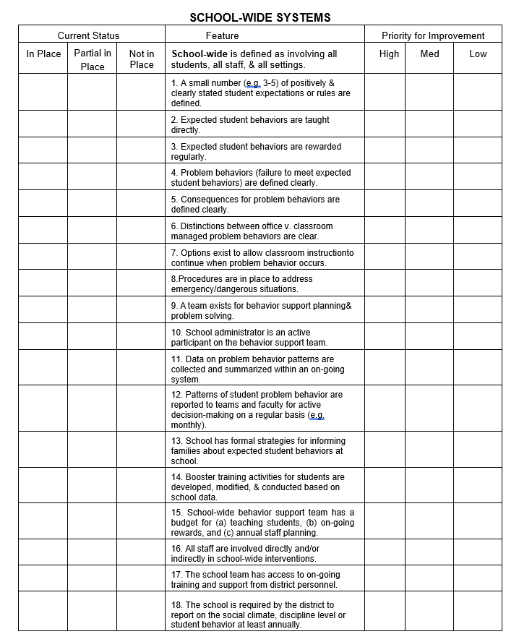
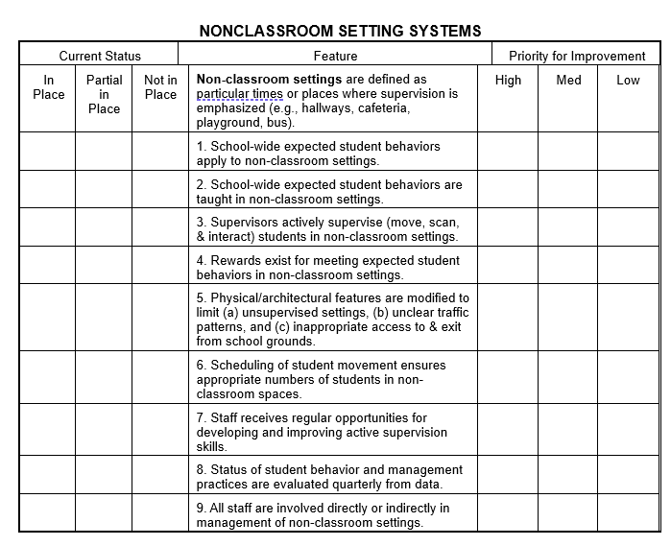
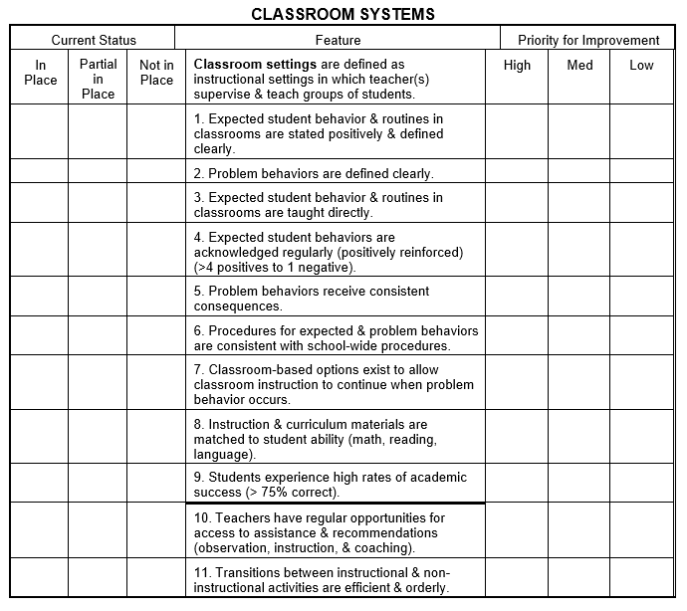
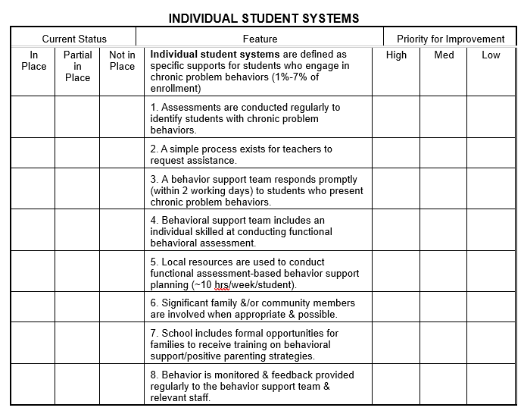
Self Assessment Survey (SAS)
School Wide – 18
Non-Classroom – 9
Classroom– 11
Individual Student – 8

Slide 32
SELF ASSESSMENT SURVEY
CLASSROOM SYSTEMS
Notes:
Review of question and how to complete survey.

Slide 33
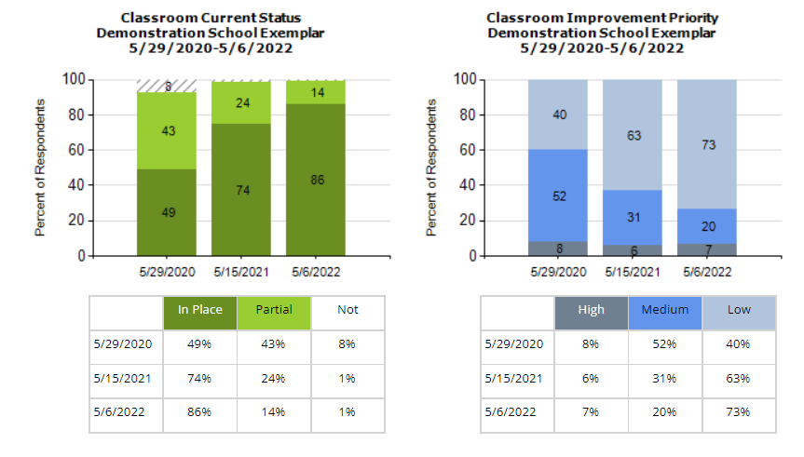
Classroom Score and Priority for Improvement
Notes:
Quick mention of What is fully in place, partial not and priority for improvement

Slide 34
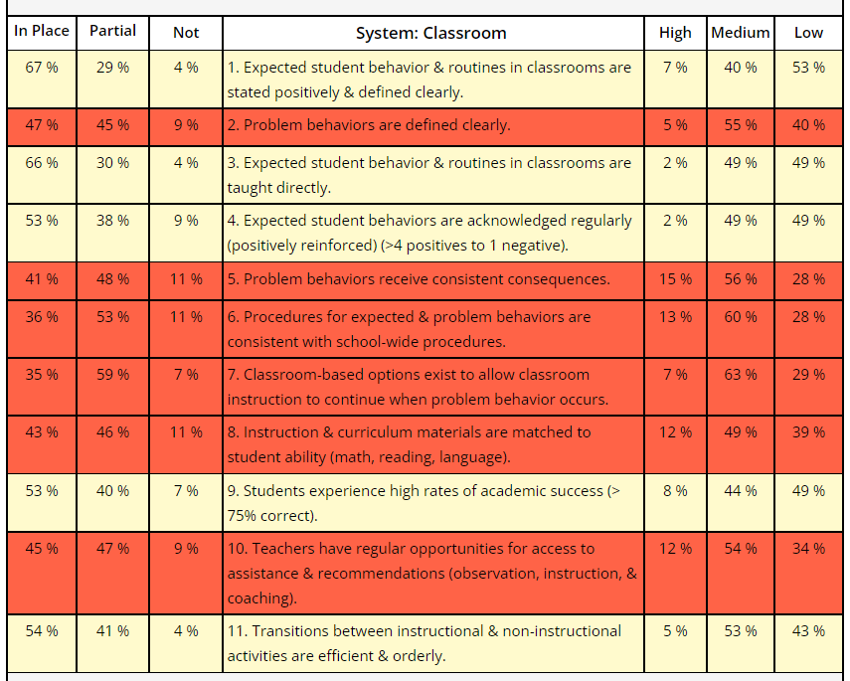
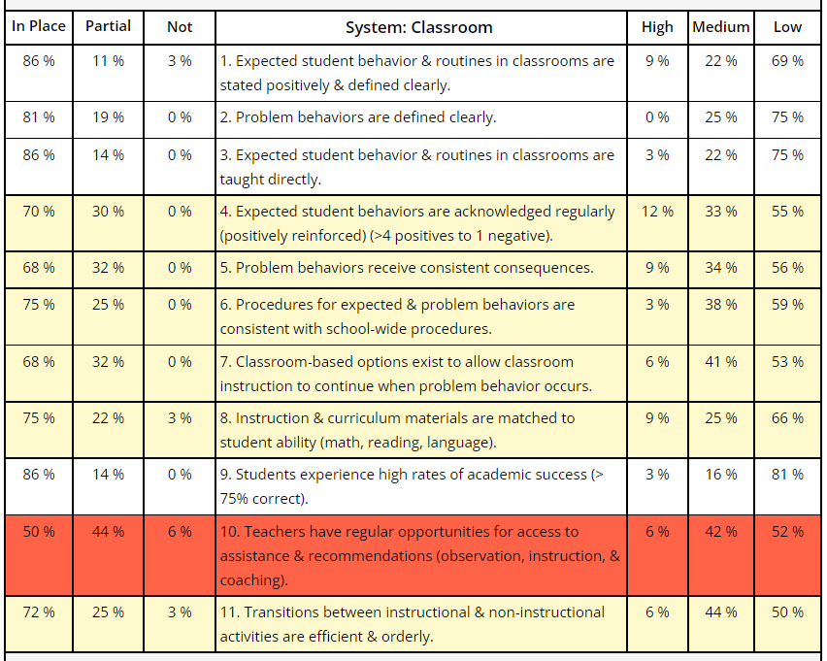
Classroom Items Report
From this → ------------------------ → To this
Notes:
Review of item graph as a quick action plan and tool for staff buy-in.
Red – less than 50% in place
Yellow – 50-79% in place
White – 80% in place or higher
If you want to take the SAS ask your training
Date Ranges for survey period
Recommend giving staff time to complete it during a staff meeting or PD.

Slide 35
DISCUSSION: ASSESSING CLASSROOM PRACTICES
Review the shared resources
With your co-coach discuss:
  How can you assess classroom practices?
  How might your team use one of these tools to assess Classroom Practices and Systems?
  Can these tools be used to provide professional development to staff? How?
Be ready to share-out of your discussion
Complete the
Coach Chat
Whole Group
10 minutes
5 minutes

Slide 36
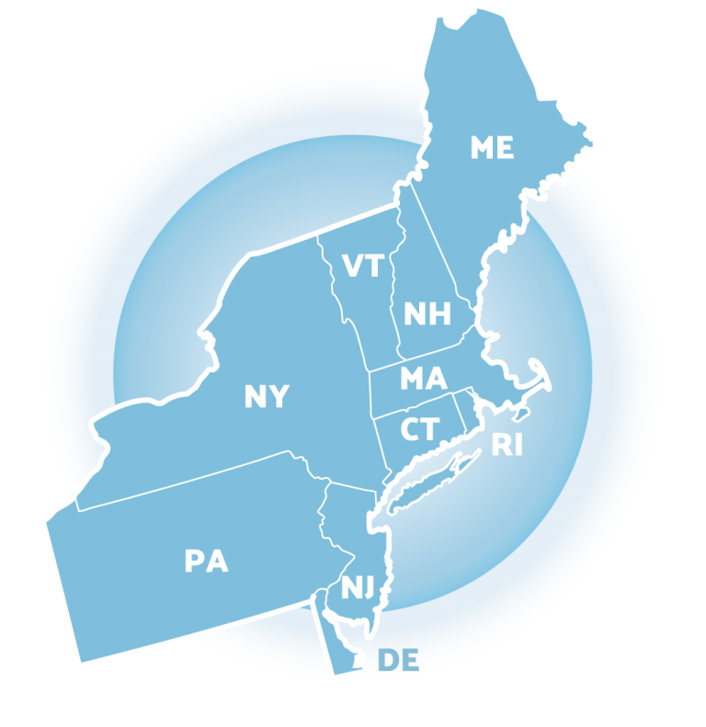
Looking Ahead

Slide 37
MONITORING & EVALUATING PBIS PRACTICES
Use data to monitor the implementation & effectiveness of PBIS practices
Linked with meaningful outcome goals
Communicates purpose
Guides action planning
Used to measure and demonstrate progress

Slide 38
TIERED FIDELITY INVENTORY (TFI)
Purpose: | Assess evidence of critical features of school-wide PBS implementation; Progress over time; Helps team make data-based decisions on intervention and program efficacy; Guides action-planning.
Format: | Survey ratings of features in place (self-assessment). About 30 mins per tier.
Completed by: | Team members with the coaches. Walkthrough tool completed by external coach.
When? | Annually (in spring)
Assessment & walkthrough can be conducted remotely

Slide 39
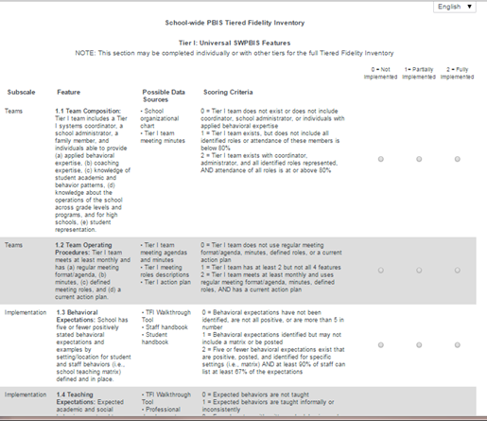
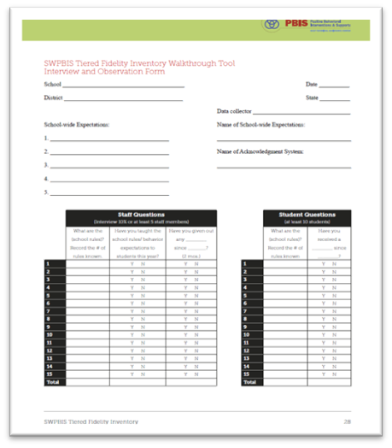
TIERED FIDELITY INVENTORY
PBIS Assessments
Walkthrough Tool

Slide 40
INTEGRATED TFI COMPANION GUIDE
The Integrated Companion Guide supports alignment of cultural responsiveness and mental health & wellness with the PBIS framework.
Notes:
TRAINERS: The Integrated TFI Companion Guide combines guidance from the Cultural Responsiveness Field Guide, the Interconnected Systems of Support Action Planning Field Guide, the Returning to School During and After Crisis Guide, and the Teaching Social Emotional Competencies within the PBIS Framework Brief. You may want to model pulling this tool up on the pbis.org website using the search feature.
Integrated TFI Companion Guide: https://www.pbis.org/resource/integrated-tiered-fidelity-inventory-companion-guide

Slide 41
Agenda & Coaches' Tasks- Debrief
Coaches’ Tasks:
Presentation Content:
Glows & Grows: Use of Data
Decide how and when to solicit staff, student & family input: Focus Group, Feedback & Input Survey, School Created Survey – Add to Action Plan and upload to Canvas
Complete the Classroom Assessment Plan document - upload to Canvas
Feedback and Input Surveys
Classroom Assessment Options
What questions do you have on today’s content?
What questions do you have on the follow-up tasks?

Slide 42
HELPFUL RESOURCES
RESOURCES:
Feedback & Input Survey Manual
Overview of the Feedback and Input Survey
Climate Survey Manual
The Classroom Management Observation Tool (CMOT)
Supporting & Responding to Student’s SEB Needs (classroom)
Self-Assessment Surveys
Supportive Environments Create Classroom Community
Classroom Support Systems Brief
Classroom Assessment Plan (Template for upload)
Notes:
RESOURCES:
Feedback & Input Survey Manual https://sebacademy.edc.org/pbis-feedback-input-survey-manual
Overview of the Feedback and Input Survey https://sebacademy.edc.org/overview-feedback-and-input-surveys
Climate Survey Manual - https://sebacademy.edc.org/pbis-climate-survey-manual
Cmot - https://sebacademy.edc.org/classroom-management-observation-tool-cmot
Supporting and responding to SEB Needs https://sebacademy.edc.org/supporting-and-responding-students-social-emotional-and-behavioral-needs-classrooms
Supportive Environments create Classroom Community - https://sebacademy.edc.org/supportive-environments-create-classroom-community
Classroom Support Systems Brief - https://sebacademy.edc.org/classroom-support-systems-brief
Classroom Assessment Plan (Template for upload) https://sebacademy.edc.org/classroom-assessmet-planning-template

Slide 43
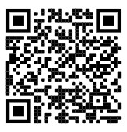
https://edc.co1.qualtrics.com/jfe/form/SV_cBF9GI7gVEBsfSC
EVALUATION
Please remember to complete the evaluation!
Scan the QR code to access.
Notes:
TRAINERS -
Put link to evaluation (below) in the chat for those who do not use the QR code:
https://edc.co1.qualtrics.com/jfe/form/SV_cBF9GI7gVEBsfSC

