Slide 1
PBIS School-Wide Coach Meeting Year 1: November 2022
PBIS Track
Christine Downs
Michelle Pratt
with support from NEPBIS Network, May Institute & Broad Reach Consulting
Notes:
Add trainer names for your event

Slide 2
EXPECTATIONS
Self
Others
Environment
Self-monitor
Mute when listening, unmute to talk​
Have your computer charged and ready to go​
If you have questions or comments:
Work as a team:
Keep necessary materials at hand
Are you participating?
Engaged as a learner?
Stretch, break, stand as needed​
unmute
use the chat box
Room for every voice
Reinforce participation
action plan
relevant docs
water/snacks
Minimize distractions if possible​

Slide 3
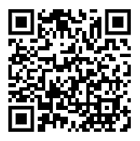
ACTIVITY: ATTENDANCE
Scan QR code on the left or follow the URL posted in the chat to access the online attendance survey
Follow prompts to enter attendance information
Notify trainers if you require assistance (e.g., identifying your cohort or cohort group)
Certificates of Attendance will be sent in January and June. Attendance records and Zoom log in will be use as verification
You are in Cohort 9
1 minute
Notes:
TRAINERS – QR Code is updated
Add your cohort letter – PLEASE review Certificates of Attendance process – They will automatically be sent in Jan and June based upon attendance and Zoom Log in info.
Post a link to the attendance survey (below) in the chat for those who do not use the QR code on the slide:
ATTENDANCE: https://edc.co1.qualtrics.com/jfe/form/SV_5BiXqi4bxzOCMS2

Slide 4
Agenda & Coaches' Tasks
Coaches’ Tasks:
Developing School-Wide Expectation Matrix
Presentation Content:
Grows and Glows
Creating Lesson Plans
School Wide Teaching Plans
Gaining Input for your Matrix
Obtaining Feedback on SW Expectations

Slide 5
HELPFUL RSOURCES
RESOURCES:
PBIS Cultural Responsiveness Field Guide
Lesson Plan Template
Lesson Plan Samples
7 Ways to Partner with Students and Level Up Your Implementation
Exemplar Resource Repository
Lesson Plan Activity
Activities for Canvas
Developing School-Wide Expectation Matrix
Obtaining Feedback on SW Expectations
Notes:
PBIS Cultural Responsiveness Field Guide https://sebacademy.edc.org/pbis-cultural-responsiveness-field-guide
Lesson Plan Template https://sebacademy.edc.org/lesson-plan-template
Lesson Plan Samples https://sebacademy.edc.org/list-of-pbis-resources?keyword=lesson+plan+sample&pbis_resource_type=113&pbis_resource_topic=All&sort_by=field_date_value&sort_order=DESC
7 Ways to Partner with Students and Level Up Your Implementation
https://sebacademy.edc.org/7-ways-partner-students-and-level-your-implementation
Lesson Plan Activity https://sebacademy.edc.org/behavioral-lesson-plan-activity

Slide 6
Canvas – For Coaches to Submit Documents
2.
Read Instructions for Assignment
Start Assignment
Download any documents still needed
Uploaded completed Document
1.
3.
If you have not received an invitation to join CANVAS please put your name and email in the chat
4.
Notes:
Review how to read directions and how to upload into canvas

Slide 7
DISCUSSION: GLOWS & GROWS
What is something to your school is excited about with PBIS or have accomplished thus far & something you’re planning on working on related to getting started with PBIS?
Use link to Grows and Glows slides
Whole Group
3 min Jot
8 min Share

Slide 8
Gaining input for your matrix from all interested parties: Staff, Students, & Families

Slide 9
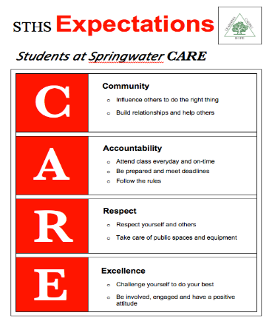
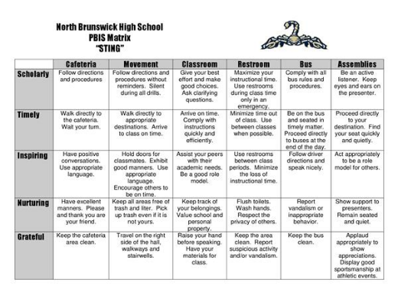
Your team and staff have identified school-wide expectations and developed a matrix...

Slide 10
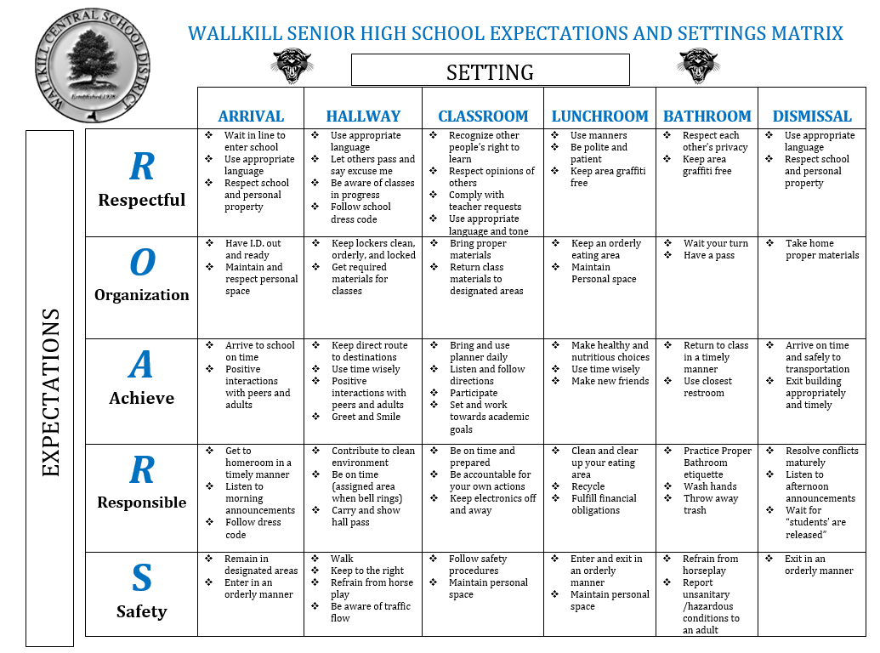
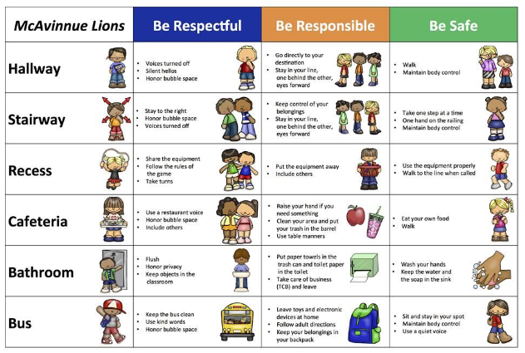
Getting Feedback on your Matrix
Notes:
Primary and Secondary examples

Slide 11
Determine if the expectations and matrix fit your school community!
Collecting input to guide our work helps with...
Staff buy-in
Ensuring our supports reflect each member of our school community (students, parents, community members).
Ensuring different perspectives and cultural values are considered.
Notes:
Please add link in the chat: https://sebacademy.edc.org/pbis-cultural-responsiveness-field-guide

Slide 12
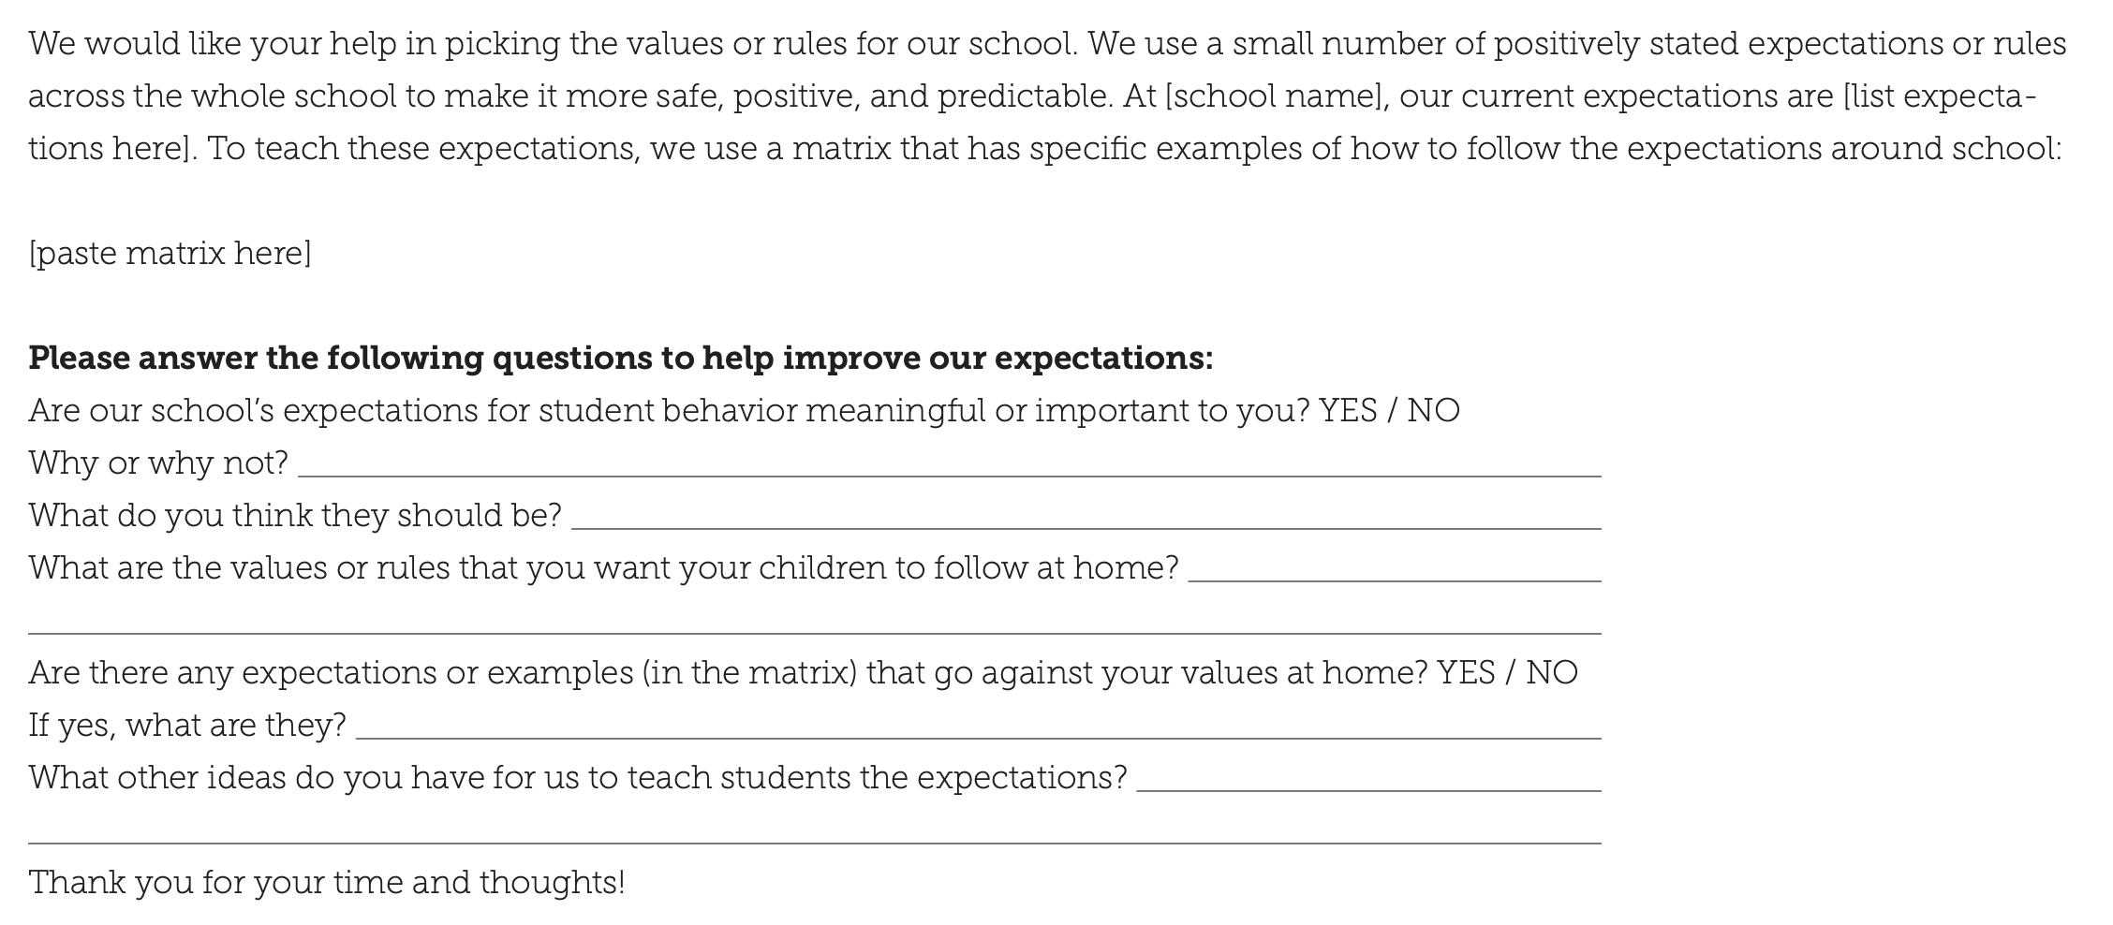
Assess existing expectations based on fit with values and needs of families and students
Sample survey
for
families/
community in Field Guide

Slide 13
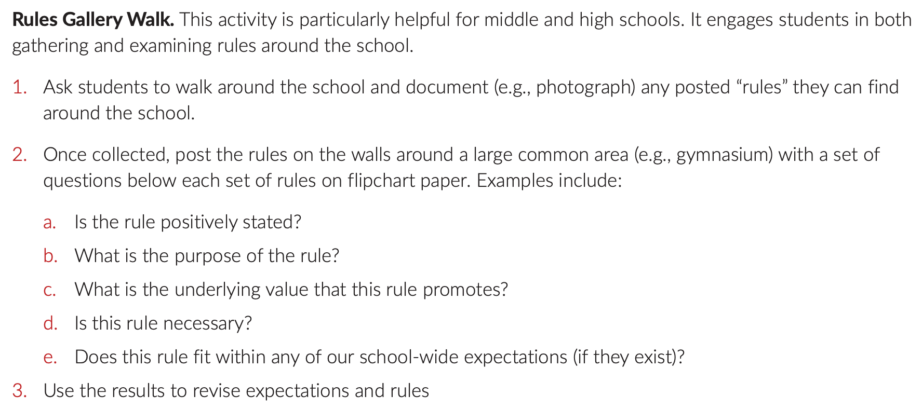
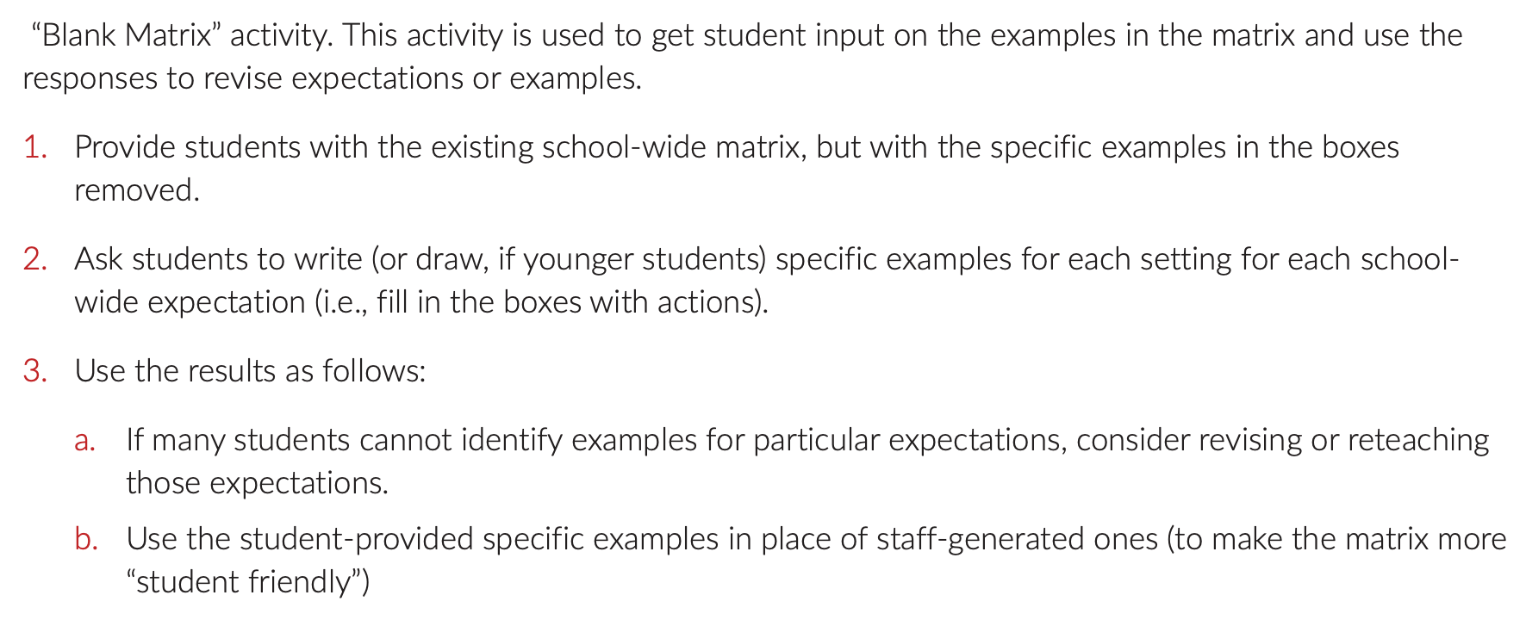
Gather student
input
Assess existing expectations based on fit with values and needs of staff, students, & families

Slide 14
Revise expectations and matrix based on feedback
Summarize the information you collected
Assess whether the existing expectations are valued by stakeholders.
If they are, move to creating lesson plans
If not, generate options for new expectations or specific examples for the matrix

Slide 15
Agree on revised expectations and matrix
Build consensus
Revised expectations and matrix
Consider using input from more marginalized groups
Move on to Creating Lesson Plan
Consider a student vote among a few possible options
Difficulty reaching consensus?
Consensus reached?

Slide 16
Assess new options for expectations and matrix based on critical features (guidelines)
Linked to social culture of school
Appropriate cultural & contextual fit
Considerate of social skills that already exist
3-5 in number
1-3 words per expectation
Positively Stated
Supportive of academic achievement
Comprehensive in scope
Mutually exclusive (minimal overlap)

Slide 17
DISCUSSION: Input from all parties
Is your Matrix ready for review? Have you followed the guidelines?
Have you reviewed and solicited input for your Expectations and Matrix with your:
Staff
Students
Families
Who do you still need to include? Have you included subgroups?
How will you share your final matrix?
Whole Group
5 minutes

Slide 18
Creating your Expectations Lesson Plans

Slide 19
Supporting Staff to Teach and Reteach Schoolwide Expectations
Expectations Created
Teaching Matrix Developed
Lesson Plans Written and Shared

Slide 20
GETTING STARTED WITH SWPBIS
Establish an effective leadership team
Develop a continuum to strengthen appropriate behaviors
Teach social behavior explicitly!
Develop a brief statement of purpose
Develop a continuum to discourage violations of expectations
Identify positive school-wide behavior expectations
Develop data-based procedures for monitoring
Develop procedures to teach school-wide expectations
Develop systems to support staff
Develop procedures to teach class-wide expectations
Build routines to ensure ongoing implementation

Slide 21
TEACHING ACADEMIC & SOCIAL BEHAVIORS
Define Simply
Model
Practice in Setting
Monitor & Acknowledge Continuously
Adjust for Efficiency

Slide 22
Teaching Matrix |  | Settings
 |  | All Settings | Hallways | Playgrounds | Cafeteria | Library/ Computer Lab | Assembly | Bus
Expectations | Respect Ourselves | Be on task. Give your best effort. Be prepared. | Walk. | Have a plan. | Eat all your food. Select healthy foods. | Study, read, compute. | Sit in one spot. | Watch for your stop.
 | Respect Others | Be kind. Hands/feet to self. Help/share with others. | Use normal voice volume. Walk to right. | Play safe. Include others. Share equipment. | Practice good table manners | Whisper. Return books. | Listen/watch. Use appropriate applause. | Use a quiet voice. Stay in your seat.
 | Respect Property | Recycle. Clean up after self. | Pick up litter. Maintain physical space. | Use equipment properly. Put litter in garbage can. | Replace trays & utensils. Clean up eating area. | Push in chairs. Treat books carefully. | Pick up. Treat chairs appropriately. | Wipe your feet. Sit appropriately.
2. NATURAL CONTEXT
1. SOCIAL SKILL
3. BEHAVIOR EXAMPLES

Slide 23
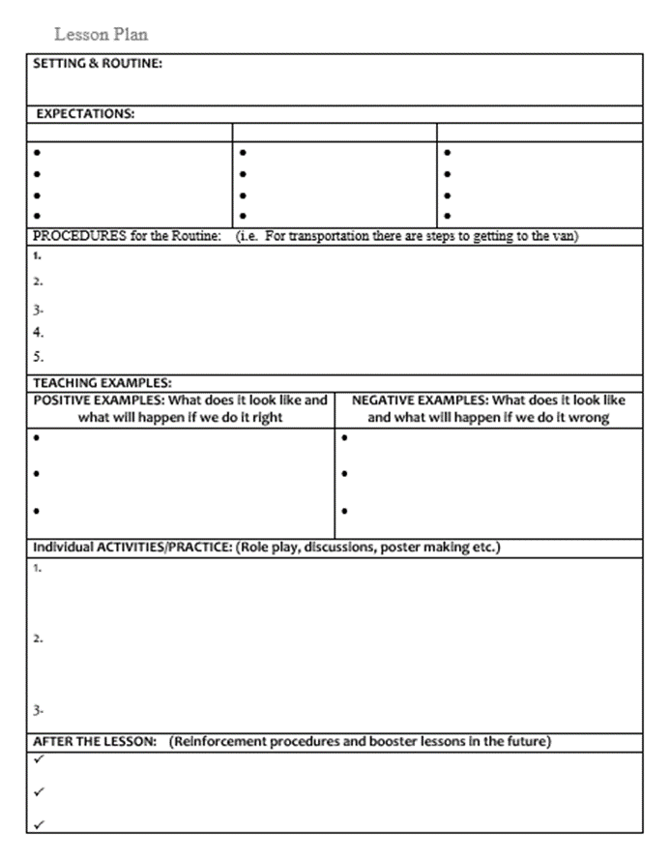
TEACH RULES IN CONTEXT OF ROUTINES
Teach expectations directly
Provide examples & non-examples
Actively involve students in lesson (game, role-play, etc.) to check for their understanding
Provide opportunities to practice rule following behavior in the natural setting.

Slide 24
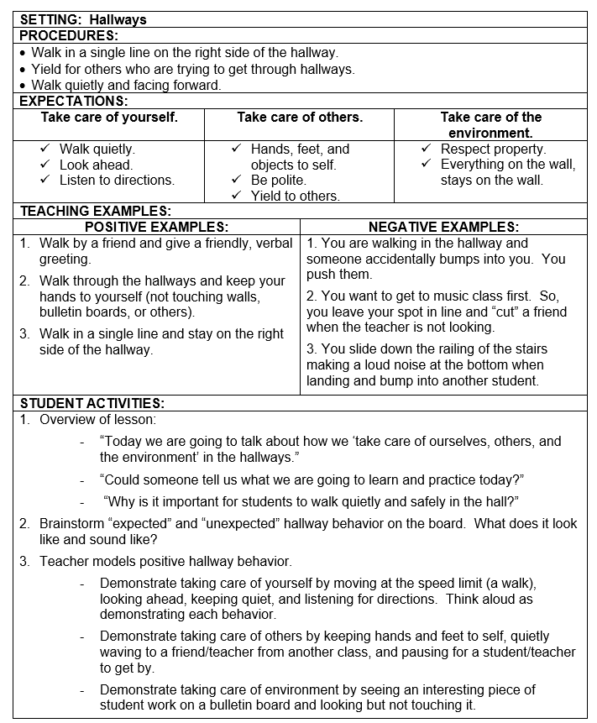
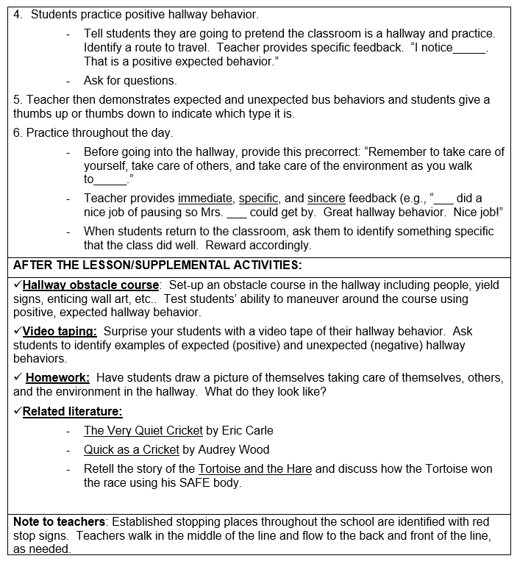

Slide 25
Expectations & behavioral skills are taught and recognized in context

Slide 26
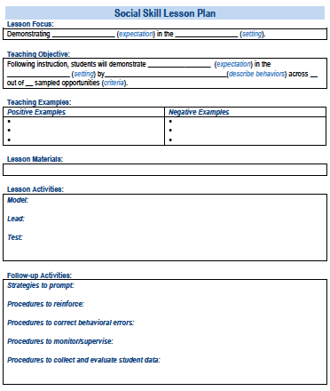
SOCIAL SKILL LESSON PLAN
A lesson plan more focused on social skill or routines. Beyond the expectations in the matrix – applicable across settings
Simonsen, Myers, Everett, Sugai, Spencer, & LaBreck (2012)
Notes:
More focused on social skill or routines. Beyond the expectations in the matrix – applicable across settings

Slide 27
Social Skill LESSON PLAN Sample
Skill Name
Getting Help: how to ask for assistance for difficulty tasks
Teaching Examples
1. When you’re working on a math problem that you can’t figure out, raise your hand and wait until the teacher can help you. 2. You and a friend are working together on a science experiment but you are missing a piece of lab equipment, ask the teacher for the missing equipment. 3. You are reading a story but you don’t know the meaning of most of the words, ask the teacher to read and explain the word.
Kid Activity
1. Ask 2-3 students to give an example of a situation in which they needed help to complete a task, activity, or direction. 2. Ask students to indicate or show how they could get help. 3. Encourage and support appropriate discussion/responses. Minimize attention for inappropriate responses.
After the Lesson (During the Day)
1. Just before giving students difficult or new task, direction, or activity, ask them to tell you how they could get help if they have difficulty (precorrection). 2. When you see students having difficulty with a task (e.g., off task, complaining), ask them to indicate that they need help (reminder). 3. Whenever a student gets help the correct way, provide specific praise to the student.
Notes:
TRAINER NOTE: Lesson plan template available on website and link in resources section at the end of presentation

Slide 28
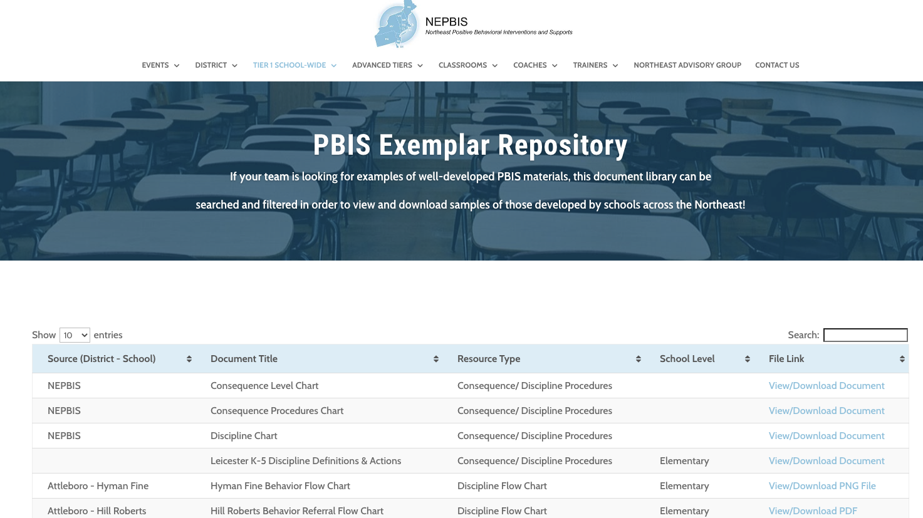
For more examples drawn from schools across the state, check out the Exemplar Repository
Notes:
https://sebacademy.edc.org/northeast-pbis-exemplar-resources

Slide 29
Example Teaching Videos
Notes:
Elementary example https://youtu.be/12jfEG1hHsA
Secondary Example https://youtu.be/Ddk0B_-LirY

Slide 30
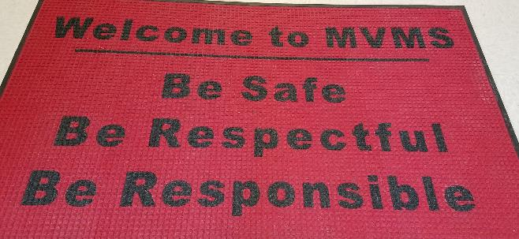
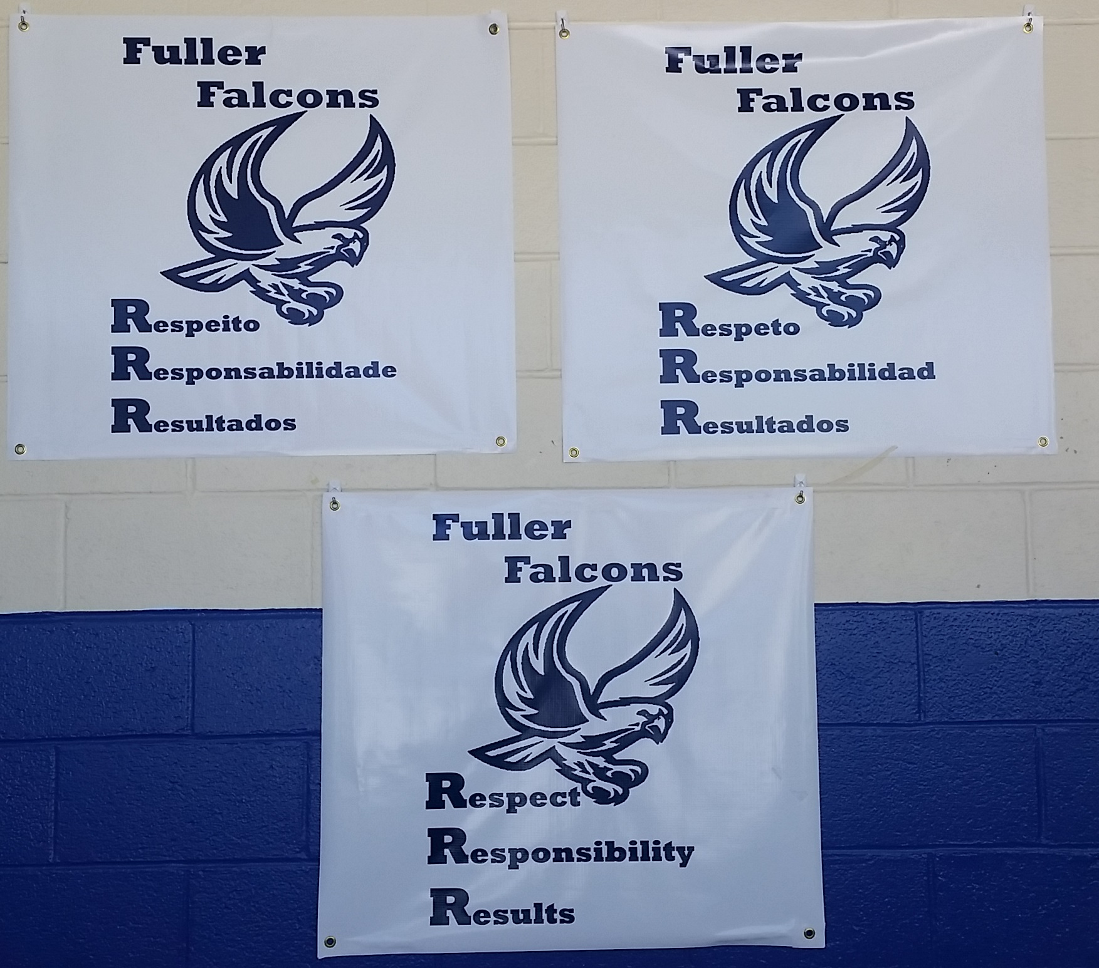
Remember to create signage

Slide 31
GUIDELINES FOR TEACHING EXPECTATIONS
Include main school settings/contexts
Consider lessons that already exist
Specify 2-3 observable, positive examples for each expectation within each setting
Teach social behavior like academic skills
Teach & provide opportunities for students to practice code-switching
Provide prompts, precorrections, & feedback in natural context
Schedule for introducing teaching plan to staff & getting feedback on lessons
Schedule for obtaining feedback from students, families, & community members
Schedule initial instruction in natural context
Schedule for regular review, practice, & follow-up

Slide 32
DISCUSSION: Lesson Plans
Is your Matrix reviewed and ready?
Decide how your team will create or review lesson plans?
What examples and non-examples might you use?
What activities might you include?
How will you review with teachers?
10 minutes
Coach Chat

Slide 33
Creating a Schoolwide Teaching Plan: How will you schedule and plan for teaching your PBIS lessons?

Slide 34
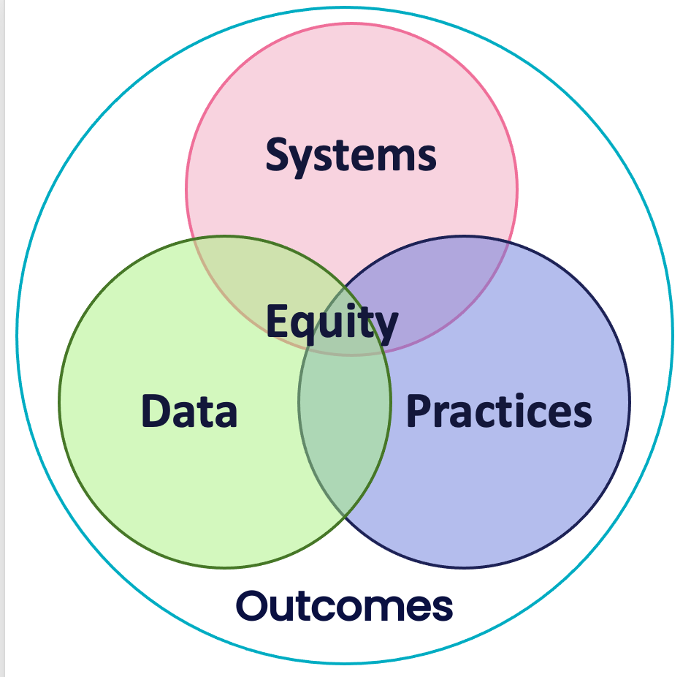
Consider HOW staff will teach the lessons.
Example: All staff will teach the lessons developed by the PBIS Team within their appropriate setting
(e.g. cafeteria monitors teach the cafeteria routine, classroom teachers teach the hallway routine, librarians teach the library routine, etc.)
Now Apply PBIS' Critical Features!
100% of students will receive direct instruction in our School-wide Expectations at the start of the school year and be retaught the expectations after each break.

Slide 35
Provide SYSTEMS to support staff to teach the lessons
Be sure lesson plans are readily available
Develop a calendar of expected teaching windows (e.g. All staff are expected to reteach SW expectations on the day after holiday break, during the month of November, reteach hallway behavior)
Plan whole school SW expectations teaching events
Send weekly/monthly email prompts to staff

Slide 36
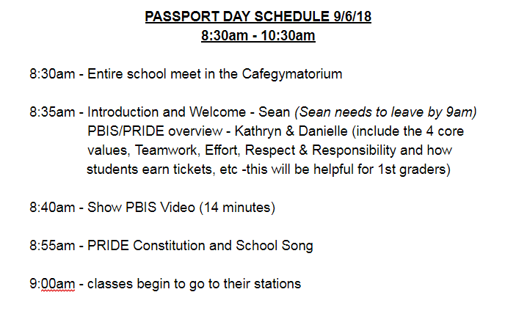
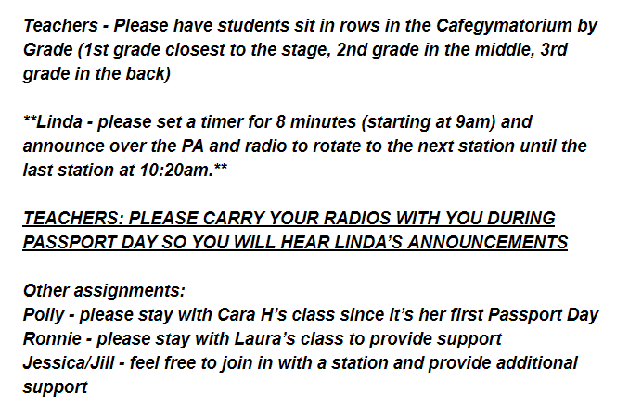
PASSPORT
Walkers/ Cars | Arrival/ Dismissal | Lunch | Assemblies
Recess | Stairways& Hallways | Bathrooms | Field Trips
Be sure to have your passport stamped
before leaving each location.
Name: _________________________
Grade: _________________________
Teacher: ________________________
Date: ___________________________

Slide 37
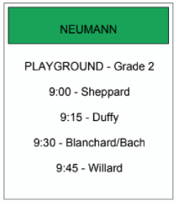
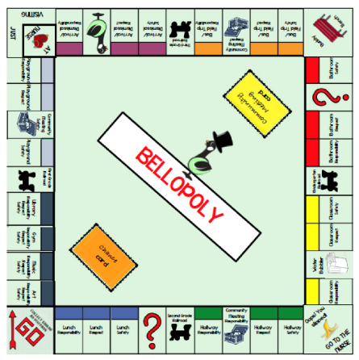
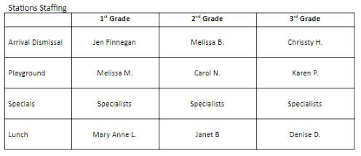
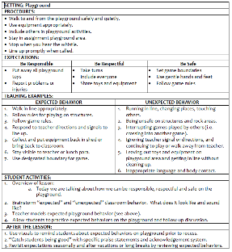
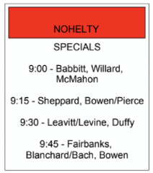
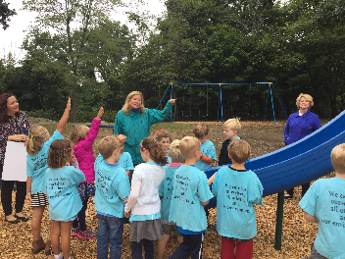
Bellopoly Stations
Support Staff
Rotation Schedule
Poster
Lesson plan
Stamp pad
Goldie Stamper
Notes:
Idea of Bellopoly
Each color on the board, is a different part of the matrix
Students would earn a stamp after learning the expectations in each location
Included nurse, water station, buddy bench

Slide 38
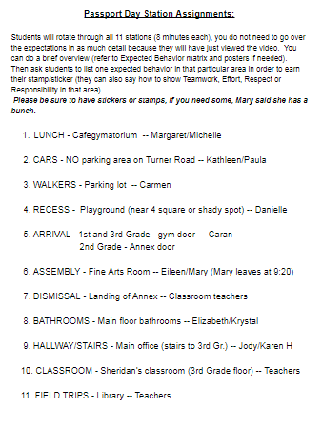
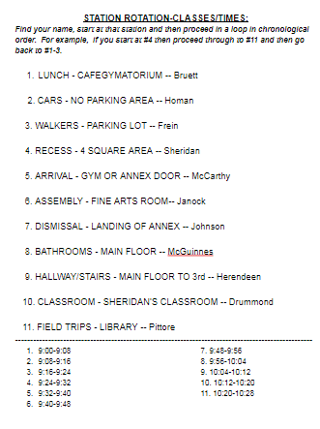

Slide 39
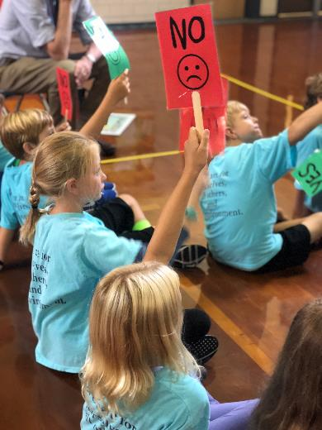
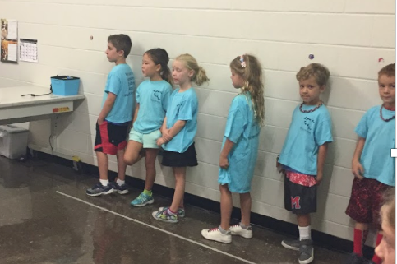
Engagement and Practice
EXAMPLES
My name is ____,
I order pizza for lunch. Thank you!
Notes:
Over the years, teachers have made taken their bellopoly lessons to the next level. Here are 2 examples of how teachers got creative

Slide 40
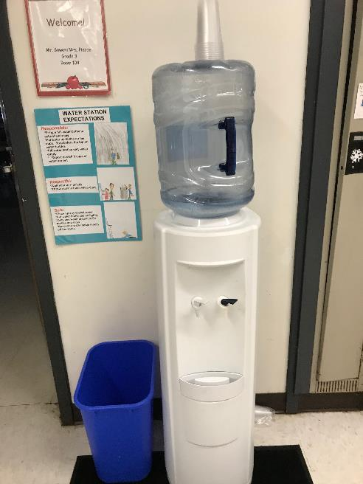
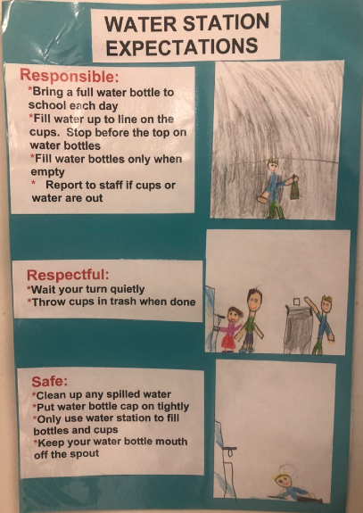
New Areas…New expectations
EXAMPLES
Science Fair
Field Day
Winter Musical Performance
Fine Arts Night
Field Trips
3rd Grade Moving On Event
Whole School Celebrations

Slide 41
EXAMPLES
Passport "Renewal" Week
We found that our students needed a “refresher” of expected behaviors in high traffic areas of our school. We dedicated a week in January to “Passport Renewal Week.” Each day of the week was dedicated to a different area of the school. These behaviors were taught by classroom teachers!
Monday – Arrival/Dismissal & Walkers/Cars
Tuesday – Lunch/Recess
Wednesday – Hallways/Stairwells & Bathrooms
Thursday – Assemblies
Friday – Field Trips/Buses & Classrooms
Please spend 10-15 minutes on the assigned day to review the “lesson” of the day.
Please travel with your students to the designated areas and re-teach the expectations for those areas and have the students practice the expected behaviors.
Please refer to the PBIS posters in those areas as a way to remind and reinforce the expected behaviors.

Slide 42
Review during the year - Jeopardy
EXAMPLES

Slide 43
DISCUSSION: School-wide Teaching Plan
How might your team teach your lessons to students?
How might you review with teachers, so they are set up to provide consistent lessons?
What further support do you need so you can support your team with this work?
Coach Chat
10 minutes

Slide 44
Agenda & Coaches' Tasks
Coaches’ Tasks:
Developing School-Wide Expectation Matrix
Presentation Content:
Grows and Glows
Creating Lesson Plans
School Wide Teaching Plans
Gaining Input for your Matrix
Obtaining Feedback on SW Expectations
What questions do you have on today’s content?
What questions do you have on the follow-up tasks?

Slide 45
HELPFUL RSOURCES
RESOURCES:
PBIS Cultural Responsiveness Field Guide
Lesson Plan Template
Lesson Plan Samples
7 Ways to Partner with Students and Level Up Your Implementation
Exemplar Resource Repository
Lesson Plan Activity
Activities for Canvas
Developing School-Wide Expectation Matrix
Obtaining Feedback on SW Expectations
Notes:
PBIS Cultural Responsiveness Field Guide https://sebacademy.edc.org/pbis-cultural-responsiveness-field-guide
Lesson Plan Template https://sebacademy.edc.org/lesson-plan-template
Lesson Plan Samples https://sebacademy.edc.org/list-of-pbis-resources?keyword=lesson+plan+sample&pbis_resource_type=113&pbis_resource_topic=All&sort_by=field_date_value&sort_order=DESC
7 Ways to Partner with Students and Level Up Your Implementation
https://sebacademy.edc.org/7-ways-partner-students-and-level-your-implementation
Lesson Plan Activity https://sebacademy.edc.org/behavioral-lesson-plan-activity

Slide 46
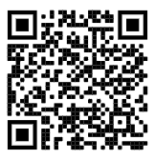
https://edc.co1.qualtrics.com/jfe/form/SV_cBF9GI7gVEBsfSC EVALUATION
Please remember to complete the evaluation!
Scan the QR code to access.
Notes:
TRAINERS -
Put link to evaluation (below) in the chat for those who do not use the QR code:
https://edc.co1.qualtrics.com/jfe/form/SV_cBF9GI7gVEBsfSC

